Slide 1
NIST Big Data Public Working Group NBD-PWG
Geoffrey Fox
Based on September 30, 2013 Presentations at one day workshop at NIST
Leaders of activity
Wo Chang, NIST
Robert Marcus, ET-Strategies
Chaitanya Baru, UC San Diego
Note web site http://bigdatawg.nist.gov/ is shut down

Slide 2
NBD-PWG Charter
Launch Date: June 26, 2013; Public Meeting with interim deliverables: September, 30, 2013; Edit and send out for comment Nov-Dec 2013
The focus of the (NBD-PWG) is to form a community of interest from industry, academia, and government, with the goal of developing a consensus definitions, taxonomies, secure reference architectures, and technology roadmap. The aim is to create vendor-neutral, technology and infrastructure agnostic deliverables to enable big data stakeholders to pick-and-choose best analytics tools for their processing and visualization requirements on the most suitable computing platforms and clusters while allowing value-added from big data service providers and flow of data between the stakeholders in a cohesive and secure manner.
Note identify common/best practice; includes but not limited to discussing standards (S in NIST)

Slide 3
NBD-PWG Subgroups & Co-Chairs
Requirements and Use Cases SG
Geoffrey Fox, Indiana U.; Joe Paiva, VA; Tsegereda Beyene, Cisco
Definitions and Taxonomies SG
Nancy Grady, SAIC; Natasha Balac, SDSC; Eugene Luster, R2AD
Reference Architecture SG
Orit Levin, Microsoft; James Ketner, AT&T; Don Krapohl, Augmented Intelligence
Security and Privacy SG
Arnab Roy, CSA/Fujitsu Nancy Landreville, U. MD Akhil Manchanda, GE
Technology Roadmap SG
Carl Buffington, Vistronix; Dan McClary, Oracle; David Boyd, Data Tactic

Slide 4
Requirements and Use Case Subgroup
The focus is to form a community of interest from industry, academia, and government, with the goal of developing a consensus list of Big Data requirements across all stakeholders. This includes gathering and understanding various use cases from diversified application domains.
Tasks
Gather use case input from all stakeholders
Derive Big Data requirements from each use case.
Analyze/prioritize a list of challenging general requirements that may delay or prevent adoption of Big Data deployment
Work with Reference Architecture to validate requirements and reference architecture
Develop a set of general patterns capturing the “essence” of use cases (to do)

Slide 5
Use Case Template
26 fields completed for 51 areas
Government Operation: 4
Commercial: 8
Defense: 3
Healthcare and Life Sciences: 10
Deep Learning and Social Media: 6
The Ecosystem for Research: 4
Astronomy and Physics: 5
Earth, Environmental and Polar Science: 10
Energy: 1

Slide 6
51 Detailed Use Cases: Many TB’s to Many PB’s
Government Operation: National Archives and Records Administration, Census Bureau
Commercial: Finance in Cloud, Cloud Backup, Mendeley (Citations), Netflix, Web Search, Digital Materials, Cargo shipping (as in UPS)
Defense: Sensors, Image surveillance, Situation Assessment
Healthcare and Life Sciences: Medical records, Graph and Probabilistic analysis, Pathology, Bioimaging, Genomics, Epidemiology, People Activity models, Biodiversity
Deep Learning and Social Media: Driving Car, Geolocate images/cameras, Twitter, Crowd Sourcing, Network Science, NIST benchmark datasets
The Ecosystem for Research: Metadata, Collaboration, Language Translation, Light source experiments
Astronomy and Physics: Sky Surveys compared to simulation, Large Hadron Collider at CERN, Belle Accelerator II in Japan
Earth, Environmental and Polar Science: Radar Scattering in Atmosphere, Earthquake, Ocean, Earth Observation, Ice sheet Radar scattering, Earth radar mapping, Climate simulation datasets, Atmospheric turbulence identification, Subsurface Biogeochemistry (microbes to watersheds), AmeriFlux and FLUXNET gas sensors
Energy: Smart grid
Next step involves matching extracted requirements and reference architecture
Alternatively develop a set of general patterns capturing the “essence” of use cases

Slide 7
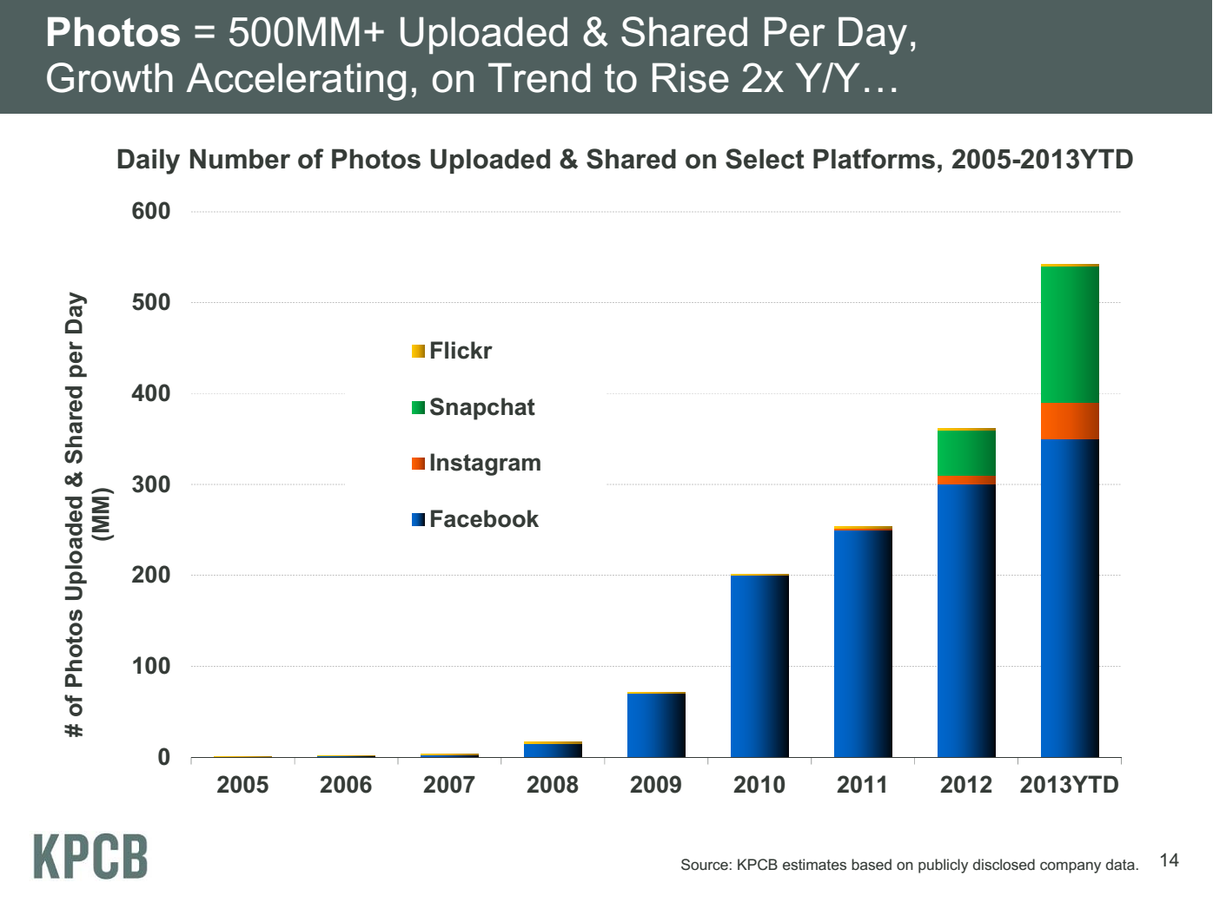
Some Trends
Also from IEEE Big Data conference in Santa Clara
Practitioners consider themselves Data Scientists
Images are a major source of Big Data
Radar
Light Synchrotrons
Phones
Bioimaging
Hadoop and HDFS dominant
Business – main emphasis at NIST – interested in analytics and assume HDFS
Academia also extremely interested in data management
Clouds v. Grids

Slide 8
Example Use Case I: Summary of Genomics
Application: NIST/Genome in a Bottle Consortium integrates data from multiple sequencing technologies and methods to develop highly confident characterization of whole human genomes as reference materials, and develop methods to use these Reference Materials to assess performance of any genome sequencing run.
Current Approach: The storage of ~40TB NFS at NIST is full; there are also PBs of genomics data at NIH/NCBI. Use Open-source sequencing bioinformatics software from academic groups (UNIX-based) on a 72 core cluster at NIST supplemented by larger systems at collaborators.
Futures: DNA sequencers can generate ~300GB compressed data/day which volume has increased much faster than Moore’s Law. Future data could include other ‘omics’ measurements, which will be even larger than DNA sequencing. Clouds have been explored.

Slide 9
Example Use Case II: Census Bureau Statistical Survey Response Improvement (Adaptive Design)
Application: Survey costs are increasing as survey response declines. The goal of this work is to use advanced “recommendation system techniques” that are open and scientifically objective, using data mashed up from several sources and historical survey para-data (administrative data about the survey) to drive operational processes in an effort to increase quality and reduce the cost of field surveys.
Current Approach: About a petabyte of data coming from surveys and other government administrative sources. Data can be streamed with approximately 150 million records transmitted as field data streamed continuously, during the decennial census. All data must be both confidential and secure. All processes must be auditable for security and confidentiality as required by various legal statutes. Data quality should be high and statistically checked for accuracy and reliability throughout the collection process. Use Hadoop, Spark, Hive, R, SAS, Mahout, Allegrograph, MySQL, Oracle, Storm, BigMemory, Cassandra, Pig software.
Futures: Analytics needs to be developed which give statistical estimations that provide more detail, on a more near real time basis for less cost. The reliability of estimated statistics from such “mashed up” sources still must be evaluated.

Slide 10
Example Use Case III: Large-scale Deep Learning
Application: Large models (e.g., neural networks with more neurons and connections) combined with large datasets are increasingly the top performers in benchmark tasks for vision, speech, and Natural Language Processing. One needs to train a deep neural network from a large (>>1TB) corpus of data (typically imagery, video, audio, or text). Such training procedures often require customization of the neural network architecture, learning criteria, and dataset pre-processing. In addition to the computational expense demanded by the learning algorithms, the need for rapid prototyping and ease of development is extremely high.
Current Approach: The largest applications so far are to image recognition and scientific studies of unsupervised learning with 10 million images and up to 11 billion parameters on a 64 GPU HPC Infiniband cluster. Both supervised (using existing classified images) and unsupervised applications investigated.
Futures: Large datasets of 100TB or more may be necessary in order to exploit the representational power of the larger models. Training a self-driving car could take 100 million images at megapixel resolution. Deep Learning shares many characteristics with the broader field of machine learning. The paramount requirements are high computational throughput for mostly dense linear algebra operations, and extremely high productivity for researcher exploration. One needs integration of high performance libraries with high level (python) prototyping environments.

Slide 11
Example Use Case IV: EISCAT 3D incoherent scatter radar system
Application: EISCAT, the European Incoherent Scatter Scientific Association, conducts research on the lower, middle and upper atmosphere and ionosphere using the incoherent scatter radar technique. This technique is the most powerful ground-based tool for these research applications. EISCAT studies instabilities in the ionosphere, as well as investigating the structure and dynamics of the middle atmosphere. It is also a diagnostic instrument in ionospheric modification experiments with addition of a separate Heating facility. Currently EISCAT operates 3 of the 10 major incoherent radar scattering instruments worldwide with its facilities in in the Scandinavian sector, north of the Arctic Circle.
Current Approach: The current running old EISCAT radar generates terabytes per year rates and does not present special challenges.
Futures: The design of the next generation radar, EISCAT_3D, will consist of a core site with a transmitting and receiving radar arrays and four sites with receiving antenna arrays at some 100 km from the core. The fully operational 5-site system will generate several thousand times data of current EISCAT system with 40 PB/year in 2022 and is expected to operate for 30 years. EISCAT 3D data e-Infrastructure plans to use the high performance computers for central site data processing and high throughput computers for mirror sites data processing. Downloading the full data is not time critical, but operations require real-time information about certain pre-defined events to be sent from the sites to the operation center and a real-time link from the operation center to the sites to set the mode of radar operation on with immediate action.

Slide 12
Example Use Case V: Consumption forecasting in Smart Grids
Application: Predict energy consumption for customers, transformers, sub-stations and the electrical grid service area using smart meters providing measurements every 15-mins at the granularity of individual consumers within the service area of smart power utilities. Combine Head-end of smart meters (distributed), Utility databases (Customer Information, Network topology; centralized), US Census data (distributed), NOAA weather data (distributed), Micro-grid building information system (centralized), Micro-grid sensor network (distributed). This generalizes to real-time data-driven analytics for time series from cyber physical systems
Current Approach: GIS based visualization. Data is around 4 TB a year for a city with 1.4M sensors in Los Angeles. Uses R/Matlab, Weka, Hadoop software. Significant privacy issues requiring anonymization by aggregation. Combine real time and historic data with machine learning for predicting consumption.
Futures: Wide spread deployment of Smart Grids with new analytics integrating diverse data and supporting curtailment requests. Mobile applications for client interactions.

Slide 13
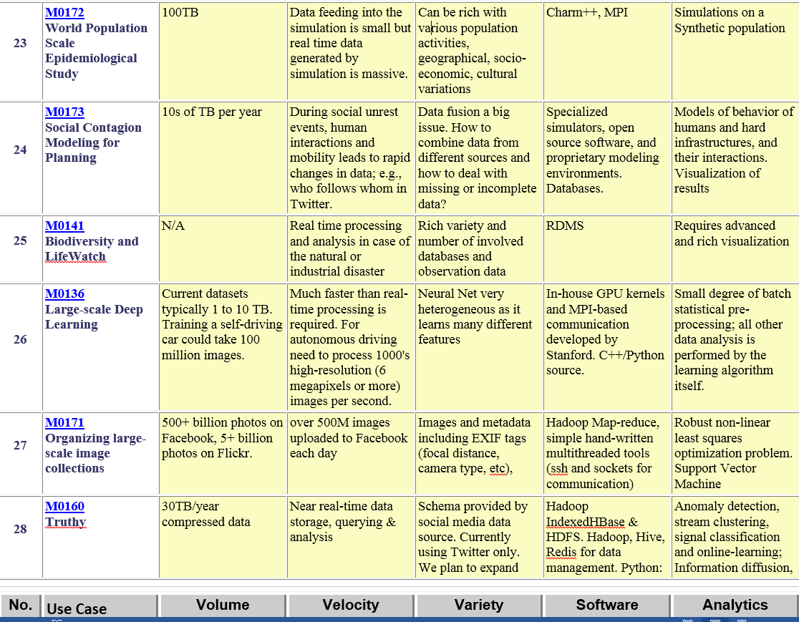
Part of Property Summary Table

Slide 14
Definitions and Taxonomies Subgroup
The focus is to gain a better understanding of the principles of Big Data. It is important to develop a consensus-based common language and vocabulary terms used in Big Data across stakeholders from industry, academia, and government. In addition, it is also critical to identify essential actors with roles and responsibility, and subdivide them into components and sub-components on how they interact/ relate with each other according to their similarities and differences.
Tasks
For Definitions: Compile terms used from all stakeholders regarding the meaning of Big Data from various standard bodies, domain applications, and diversified operational environments.
For Taxonomies: Identify key actors with their roles and responsibilities from all stakeholders, categorize them into components and subcomponents based on their similarities and differences

Slide 15
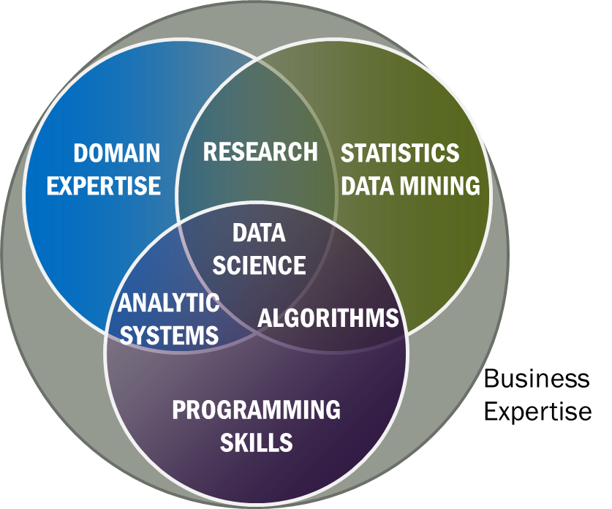
Data Science Definition (Big Data less consensus)
Data Science is the extraction of actionable knowledge directly from data through a process of discovery, hypothesis, and analytical hypothesis analysis.
A Data Scientist is a practitioner who has sufficient knowledge of the overlapping regimes of expertise in business needs, domain knowledge, analytical skills and programming expertise to manage the end-to-end scientific method process through each stage in the big data lifecycle.
Big Data refers to digital data volume, velocity and/or variety whose management requires scalability across coupled horizontal resources
Notes:
Big Data refers to digital data volume, velocity and/or variety whose management requires scalability across coupled horizontal resources
Data Science is the extraction of actionable knowledge directly from data through a process of discovery, hypothesis, and analytical hypothesis analysis.
A Data Scientist is a practitioner who has sufficient knowledge of the overlapping regimes of expertise in business needs, domain knowledge, analytical skills and programming expertise to manage the end-to-end scientific method process through each stage in the big data lifecycle.

Slide 16
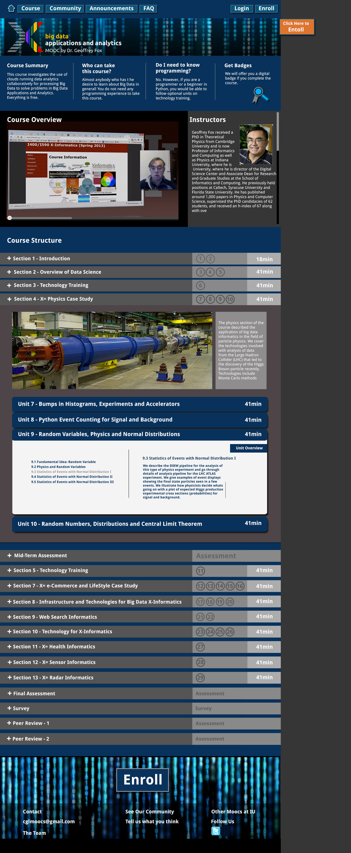
Data Science (MOOC) Degree at IU
Program in Data Science hosted by School of Informatics and Computing (37 faculty)
Initial activity is online Masters offered as MOOC
Still on approval cycle
First 4 courses (Certificate) which hopefully will be available next Semester
Big Data Applications and Analytics (~complete trial at https://x-informatics.appspot.com/preview)
Clouds
Information Visualization
Life Sciences Informatics

Slide 17
Reference Architecture Subgroup
The focus is to form a community of interest from industry, academia, and government, with the goal of developing a consensus-based approach to orchestrate vendor-neutral, technology and infrastructure agnostic for analytics tools and computing environments. The goal is to enable Big Data stakeholders to pick-and-choose technology-agnostic analytics tools for processing and visualization in any computing platform and cluster while allowing value-added from Big Data service providers and the flow of the data between the stakeholders in a cohesive and secure manner.
Tasks
Gather and study available Big Data architectures representing various stakeholders, different data types,’ use cases, and document the architectures using the Big Data taxonomies model based upon the identified actors with their roles and responsibilities.
Ensure that the developed Big Data reference architecture and the Security and Privacy Reference Architecture correspond and complement each other.

Slide 18
List Of Surveyed Architectures
Vendor-neutral and technology-agnostic proposals
Bob Marcus ET-Strategies
Orit Levin Microsoft
Gary Mazzaferro AlloyCloud
Yuri Demchenko University of Amsterdam
Vendors’ Architectures
IBM
Oracle
Booz Allen Hamilton
EMC
SAP
9sight
LexusNexis

Slide 19
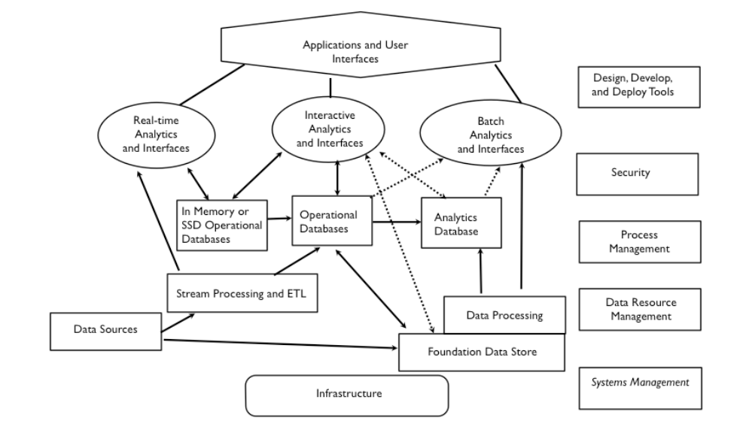
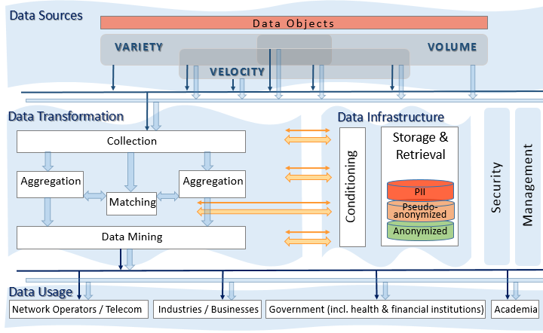
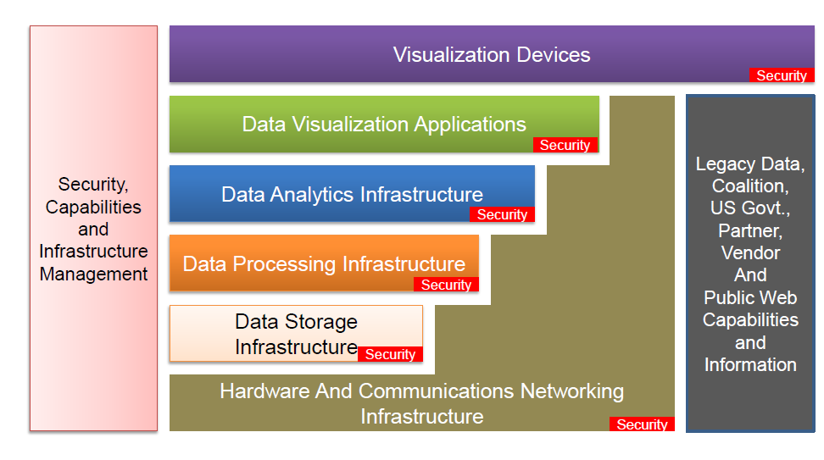
Vendor-neutral and Technology-agnostic Proposals
Data Processing Flow
M0039
Data Transformation Flow
M0017
IT Stack
M0047

Slide 20
Vendor-neutral and Technology-agnostic Proposals
Data Processing Flow
M0039
Data Transformation Flow
M0017
IT Stack
M0047

Slide 21
Vendor-neutral and Technology-agnostic Proposals
Data Processing Flow
M0039
Data Transformation Flow
M0017
IT Stack
M0047

Slide 22
Vendor-neutral and Technology-agnostic Proposals
Data Processing Flow
M0039
Data Transformation Flow
M0017
IT Stack
M0047

Slide 23
Draft Agreement / Rough Consensus
Transformation includes
Processing functions
Analytic functions
Visualization functions
Data Infrastructure includes
Data stores
In-memory DBs
Analytic DBs
Sources
Transformation
Data Infrastructure
Security
Cloud Computing
Management
Network
Usage

Slide 24
Main Functional Blocks
Application Specific
Identity Management & Authorization
Etc.
System Orchestrator
Big Data Application Provider
Data Provider
Data Consumer
Discovery of data
Description of data
Access to data
Code execution on data
Etc.
Discovery of services
Description of data
Visualization of data
Rendering of data
Reporting of data
Code execution on data
Etc.
Big Data Framework Provider
Analytic processing of data
Machine learning
Code execution on data et situ
Storage, retrieval, search, etc. of data
Providing computing infrastructure
Providing networking infrastructure
Etc.

Slide 25
INFORMATION VALUE CHAIN
System Orchestrator
Big Data Application Provider
Analytics
Data Provider
Curation
Visualization
Data Consumer
DATA
DATA
SW
Collection
Access
SW
DATA
SW
K E Y :
Big Data Framework Provider
Processing Frameworks (analytic tools, etc.)
IT VALUE CHAIN
Horizontally Scalable
Service Use
Vertically Scalable
Security & Privacy
DATA
Platforms (databases, etc.)
Management
Horizontally Scalable
Big Data Information Flow
Vertically Scalable
Infrastructures
SW
Horizontally Scalable (VM clusters)
SW Tools and Algorithms Transfer
Vertically Scalable
Physical and Virtual Resources (networking, computing, etc.)

Slide 26
Security and Privacy Subgroup
The focus is to form a community of interest from industry, academia, and government, with the goal of developing a consensus secure reference architecture to handle security and privacy issues across all stakeholders. This includes gaining an understanding of what standards are available or under development, as well as identifies which key organizations are working on these standards.
Tasks
Gather input from all stakeholders regarding security and privacy concerns in Big Data processing, storage, and services.
Analyze/prioritize a list of challenging security and privacy requirements from ~10 special use cases that may delay or prevent adoption of Big Data deployment
Develop a Security and Privacy Reference Architecture that supplements the general Big Data Reference Architecture

Slide 27
CSA (Cloud Security Alliance) BDWG: Top Ten Big Data Security and Privacy Challenges
Secure computations in distributed programming frameworks
Security best practices for non-relational datastores
Secure data storage and transactions logs
End-point input validation/filtering
Real time security monitoring
Scalable and composable privacy-preserving data mining and analytics
Cryptographically enforced access control and secure communication
Granular access control
Granular audits
Data provenance

Slide 28
Top 10 S&P Challenges: Classification
Infrastructure security
Secure Computations in Distributed Programming Frameworks
Security Best Practices for Non-Relational Data Stores
Data Privacy
Privacy Preserving Data Mining and Analytics
Cryptographically Enforced Data Centric Security
Granular Access Control
Data Management
Secure Data Storage and Transaction Logs
Granular Audits
Data Provenance
Integrity and Reactive Security
End-point validation and filtering
Real time Security Monitoring

Slide 29
Use Cases
Retail/Marketing
Modern Day Consumerism
Nielsen Homescan
Web Traffic Analysis
Healthcare
Health Information Exchange
Genetic Privacy
Pharma Clinical Trial Data Sharing
Cyber-security
Government
Military
Education

Slide 30
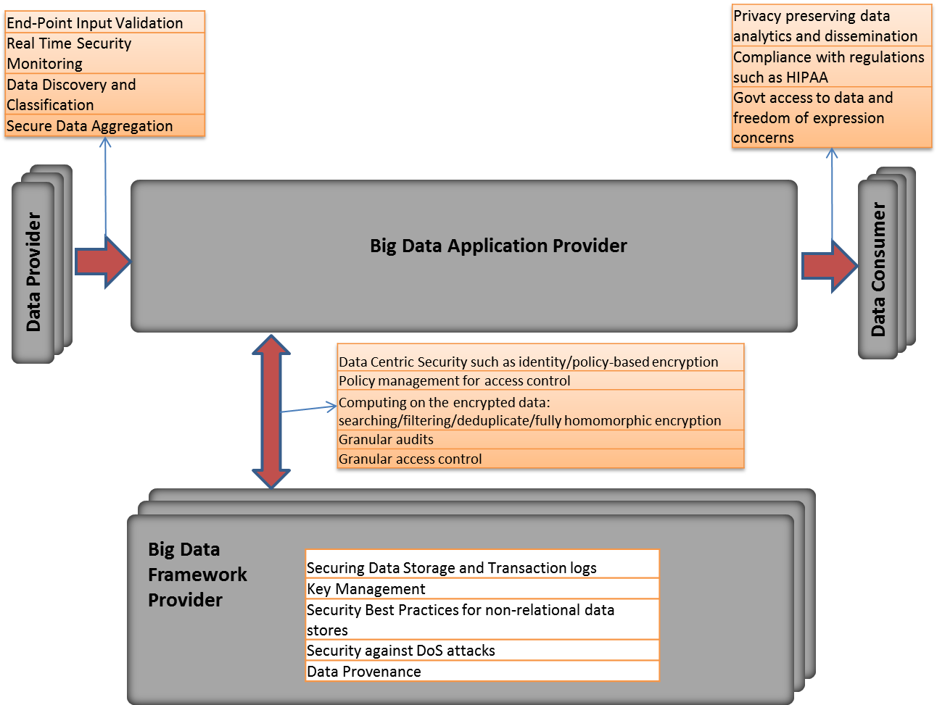
Big Data Security Reference Architecture

Slide 31
Technology Roadmap Subgroup
The focus is to form a community of interest from industry, academia, and government, with the goal of developing a consensus vision with recommendations on how Big Data should move forward by performing a good gap analysis through the materials gathered from all other NBD subgroups. This includes setting standardization and adoption priorities through an understanding of what standards are available or under development as part of the recommendations.
Tasks
Gather input from NBD subgroups and study the taxonomies for the actors’ roles and responsibility, use cases and requirements, and secure reference architecture.
Gain understanding of what standards are available or under development for Big Data
Perform a thorough gap analysis and document the findings
Identify what possible barriers may delay or prevent adoption of Big Data
Document vision and recommendations

Slide 32
Some Identified Features
Feature | Roles | Readiness | Ref Architecture Mapping
Storage Framework | TBD | TBD | Capabilities
Processing Framework | TBD | TBD | Capabilities
Resource Managers Framework | TBD | TBD | Capabilities
Infrastructure Framework | TBD | TBD | Capabilities
Information Framework | TBD | TBD | Data Services
Standards Integration Framework | TBD | TBD | Data Services
Applications Framework | TBD | TBD | Capabilities
Business Operations | TBD | TBD | Vertical Orchestrator
09.30.2013
Technology Roadmap

Slide 33
Interaction Between Subgroups
Requirements & Use Cases
❶
Reference Architecture
Technology Roadmap
❸
❷
Security & Privacy
❶
❷
❷
Definitions & Taxonomies
Due to time constraints, activities were carried out in parallel.

