Slide 1
AI First
High Performance Big Data Computing for Industry 4.0
International Workshop on Industrial Data Intelligence Technology
Jiangsu Industrial Technology Research Institute (JITRI), Southeast University and ACM Nanjing Chapter
Nanjing
Geoffrey Fox, June 6, 2018
Department of Intelligent Systems Engineering
gcf@indiana.edu, http://www.dsc.soic.indiana.edu/, http://spidal.org/
`,
Work with Judy Qiu, Supun Kamburugamuva, Shantenu Jha, Kannan Govindarajan, Pulasthi Wickramasinghe, Gurhan Gunduz, Ahmet Uyar

Slide 2



Industry 4.0 on the edge linked to an
AI First HPC Cloud
Cloud
HPC
Cloud
HPC
Fog
Cloud
HPC
Centralized AI First HPC Cloud + IoT Devices
Centralized AI First HPC Cloud + Edge
= Fog + IoT Devices

Slide 3
Predictions/Assumptions
Artificial Intelligence First requires High Performance Big Data Computing i.e. mammoth computing resources such as clouds, supercomputers, hyperscale systems (see Gartner) and their distributed integration
HPC Clouds or Next-Generation Commodity Systems will be a dominant force
  Merge Cloud HPC and (support of) Edge and AI First computing
  Federated Clouds running in multiple giant datacenters offering all types of computing
  Distributed data sources associated with device and Fog processing resources
  Server-hidden computing and AI First Function as a Service FaaS for user pleasure supporting scalable Machine Learning Functions
  Support a distributed event-driven serverless dataflow AI First computing model covering batch and streaming data as HPC-FaaS
  Needing parallel and distributed (Grid) computing ideas
  Span Pleasingly Parallel to Data management to Global Machine Learning
Although Supercomputers will be essential for large simulations, they will also be components of AI First high performance big data computing systems

Slide 4
Requirements for AI First Computing Systems
On general principles parallel and distributed computing have different requirements even if sometimes similar functionalities
  Apache stack ABDS typically uses distributed computing concepts
  For example, Reduce operation is different in MPI (Harp) and Spark
Large scale simulation requirements are well understood BUT
AI First Big Data requirements are not agreed but there are a few key use types
  Pleasingly parallel processing (including local machine learning LML) as of different tweets from different users with perhaps MapReduce style of statistics and visualizations; possibly Streaming
  Database model with queries again supported by MapReduce for horizontal scaling
  Global Machine Learning GML with single job using multiple nodes as classic parallel computing
  Deep Learning certainly needs HPC – possibly only multiple small systems
Current workloads stress 1) and 2) and are suited to current clouds and to Apache Big Data Software (with no HPC)
  This explains why Spark with poor GML performance can be so successful

Slide 5
Distinctive Features of All Applications including
AI First Applications
Ratio of data to model sizes: vertical axis on next slide
Importance of Synchronization – ratio of inter-node communication to node computing: horizontal axis on next slide
Sparsity of Data or Model; impacts value of GPU’s or vector computing
Irregularity of Data or Model
Geographic distribution of Data as in edge computing; use of streaming (dynamic data) versus batch paradigms
Dynamic model structure as in some iterative algorithms

Slide 6
Difficulty in Parallelism
Size of Synchronization constraints
Need a toolkit covering all applications with same API but different implementations
Loosely Coupled
Tightly Coupled
HPC Clouds
High Performance Interconnect
HPC Clouds/Supercomputers
Memory access also critical
Commodity Clouds
Size of Disk I/O
MapReduce as in scalable databases
Global Machine Learning
e.g. parallel clustering
Deep Learning
Unstructured Adaptive Sparsity
Medium size Jobs
Pleasingly Parallel
Often independent events
Train Industry 4.0 Systems
LDA
Graph Analytics e.g. subgraph mining
Individual Industry 4.0 Devices
Linear Algebra at core (typically not sparse)
Large scale simulations
Current major Big Data category
Structured Adaptive Sparsity
Huge Jobs
Parameter sweep simulations
Spectrum of Applications and Algorithms
There is also distribution seen in grid/edge computing
Exascale Supercomputers

Slide 7
Five Major Application Structures
Individual Industry 4.0 Devices
Train Industry 4.0 Systems
Global Machine Learning
Classic Cloud Workload

Slide 8
AI First interactive analysis of observational scientific data
AI enhanced Science Analysis Code, Mahout, R, Harp, Scikit-Learn, Tensorflow
Grid or Many Task Software, Hadoop, Spark, Giraph, Twister2 …
Data Storage: HDFS, Hbase, File Collection
Transport batch of data to primary analysis data system
Direct Transfer
Streaming Twitter data for Social Networking
Streaming Twitter data for Social Networking
Streaming Twitter data for Social Networking
Streaming Twitter data for Social Networking
Local Accumulate and initial computing
Local Accumulate and initial computing
Local Accumulate and initial computing
Local Accumulate and initial computing
Examples include LHC, Remote Sensing, Astronomy and Bioinformatics
Record Scientific Data in “field”
Record Scientific Data in “field”
Record Scientific Data in “field”
Record Scientific Data in “field”

Slide 9
Orchestrate multiple sequential and parallel data transformations and/or AI First analytics processing using a workflow manager
Nearly all workloads need to link multiple stages together. That is what workflow or orchestration does.
Technology like Hadoop is mainly aimed at individual stages
Specify AI First Analytics Pipeline
Orchestration Layer (Workflow)
AI Analytic-1
AI Analytic-2
Analytic-3
(Visualize)
Hadoop, Spark, Giraph, Twister2 …
Data Storage: HDFS, Hbase ….

Slide 10
Features of AI First Big Data Processing Systems
Application Requirements: The structure of application clearly impacts needed hardware and software
  Pleasingly parallel
  Workflow
  Global Machine Learning
Data model: SQL, NoSQL; File Systems, Object store; Lustre, HDFS
Distributed data from distributed sensors and instruments (Internet of Things) requires Edge computing model
  Device – Fog – Cloud model and streaming data software and algorithms
Hardware: node (accelerators such as GPU or KNL for deep learning) and multi-node architecture configured as AI First HPC Cloud;
  Disks speed and location
This implies software requirements: Use HPC-ABDS High Performance Computing Enhanced Apache Big Data Software Stack
Analytics
Data management
Streaming or Repository access or both

Slide 11
Ways of adding AI First High Performance
Fix performance issues in Spark, Heron, Hadoop, Flink etc.
  Messy as some features of these big data systems intrinsically slow in some (not all) cases
  All these systems are “monolithic” and difficult to deal with individual components
Execute AI First HPBDC from classic big data system (Spark) with custom communication environment – approach of Harp for the relatively simple Hadoop environment
Provide a native Mesos/Yarn/Kubernetes/HDFS high performance execution environment – goal of Twister2
Execute with MPI in classic (Slurm, Lustre) HPC environment
Add modules to existing frameworks like scikit-learn or Tensorflow either as new capability or as a higher performance version of existing module.

Slide 12
Integrating HPC and Apache Programming Environments
Harp-DAAL with a kernel Machine Learning library exploiting the Intel node library DAAL and HPC communication collectives within the Hadoop ecosystem.
  Harp-DAAL supports all 5 classes of data-intensive AI first computation, from pleasingly parallel to machine learning and simulations.
Twister2 is a toolkit of components that can be packaged in different ways
  Integrated batch or streaming data capabilities familiar from Apache Hadoop, Spark, Heron and Flink but with high performance.
  Separate bulk synchronous and data flow communication;
  Task management as in Mesos, Yarn and Kubernetes
  Dataflow graph execution models
  Launching of the Harp-DAAL library with native Mesos/Kubernetes/HDFS environment
  Streaming and repository data access interfaces,
  In-memory databases and fault tolerance at dataflow nodes. (use RDD to do classic checkpoint-restart)

Slide 13
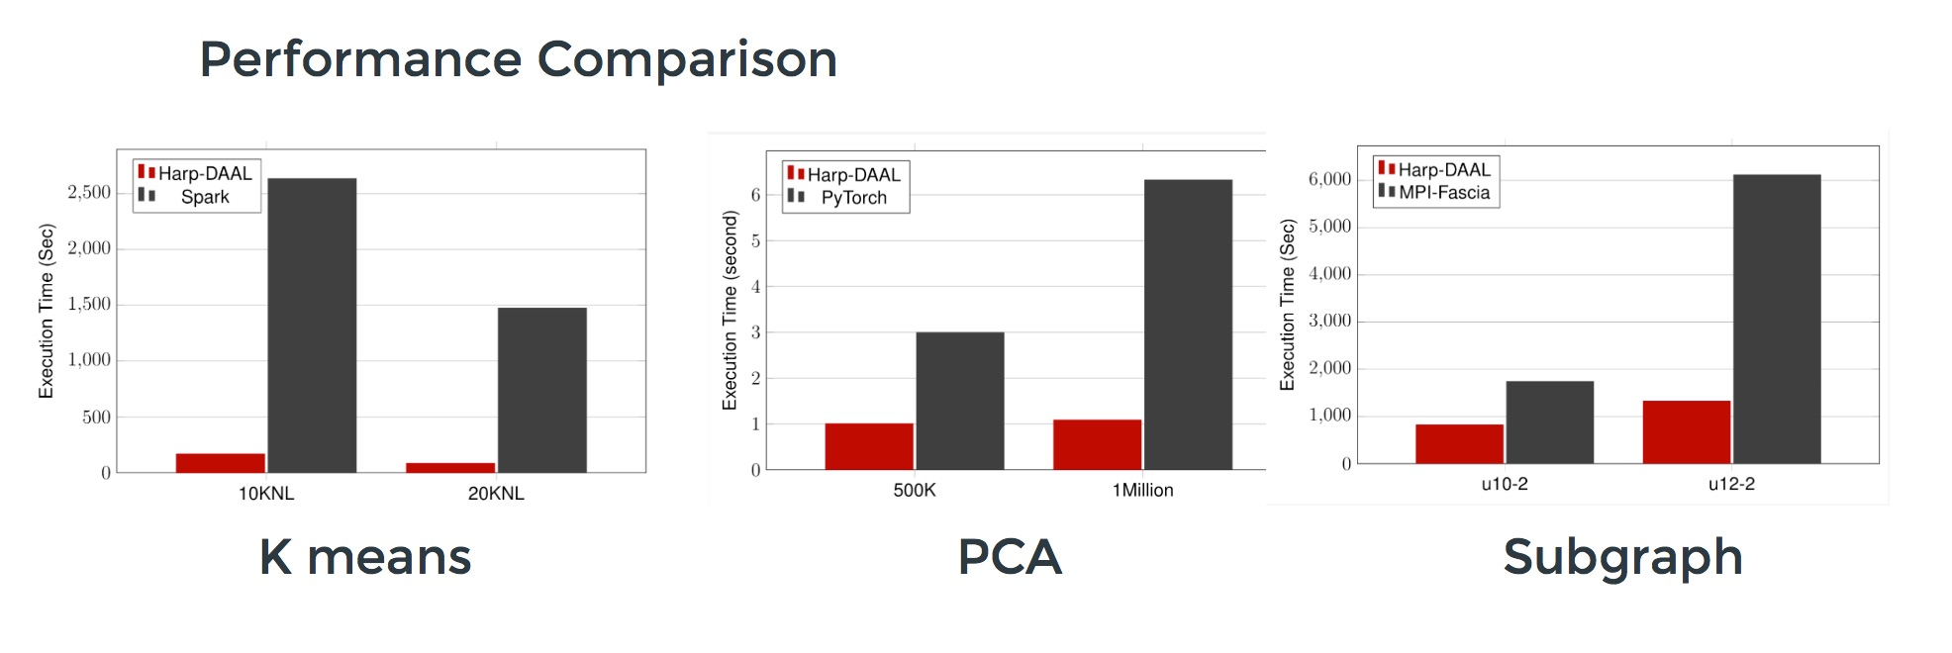
Harp v. Spark Harp v. Torch Harp v. MPI
Datasets: 5 million points, 10 thousand centroids, 10 feature dimensions
10 to 20 nodes of Intel KNL7250 processors
Harp-DAAL has 15x speedups over Spark MLlib
Datasets: 500K or 1 million data points of feature dimension 300
Running on single KNL 7250 (Harp-DAAL) vs. single K80 GPU (PyTorch)
Harp-DAAL achieves 3x to 6x speedups
Datasets: Twitter with 44 million vertices, 2 billion edges, subgraph templates of 10 to 12 vertices
25 nodes of Intel Xeon E5 2670
Harp-DAAL has 2x to 5x speedups over state-of-the-art MPI-Fascia solution

Slide 14
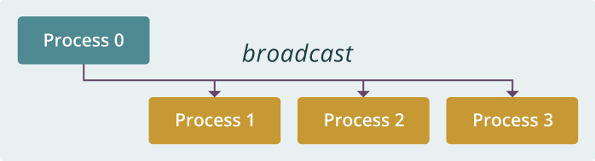
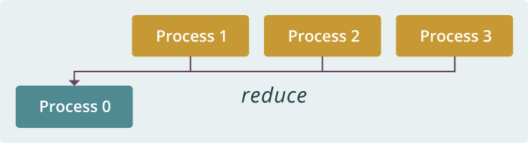
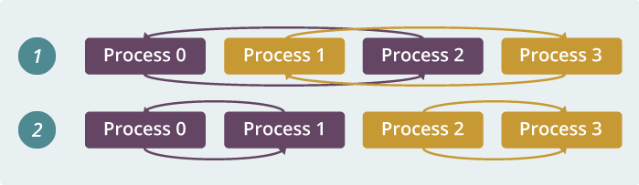
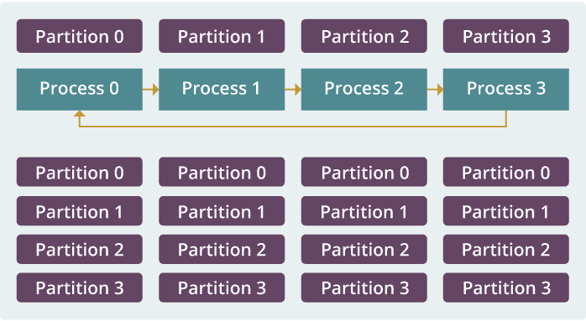
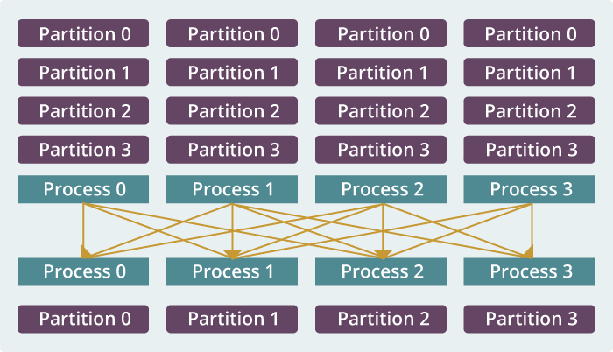
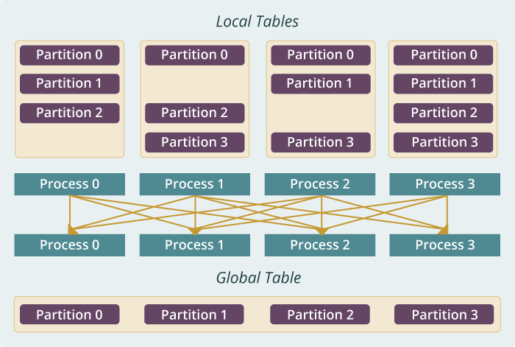
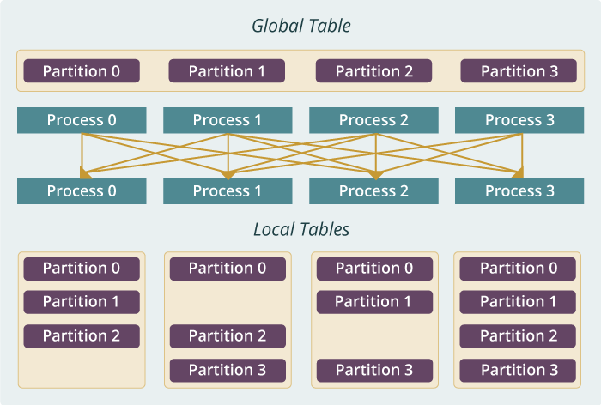
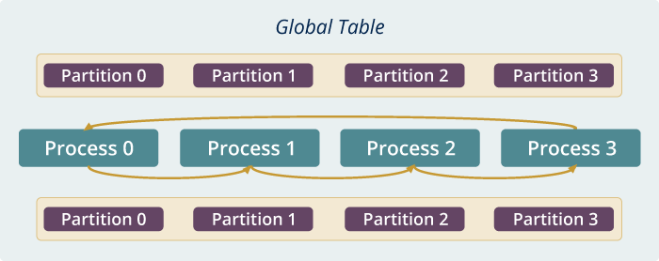
Run time software for Harp
broadcast
reduce
allreduce
allgather
regroup
push & pull
rotate
Map Collective Run time merges MapReduce and HPC

Slide 15
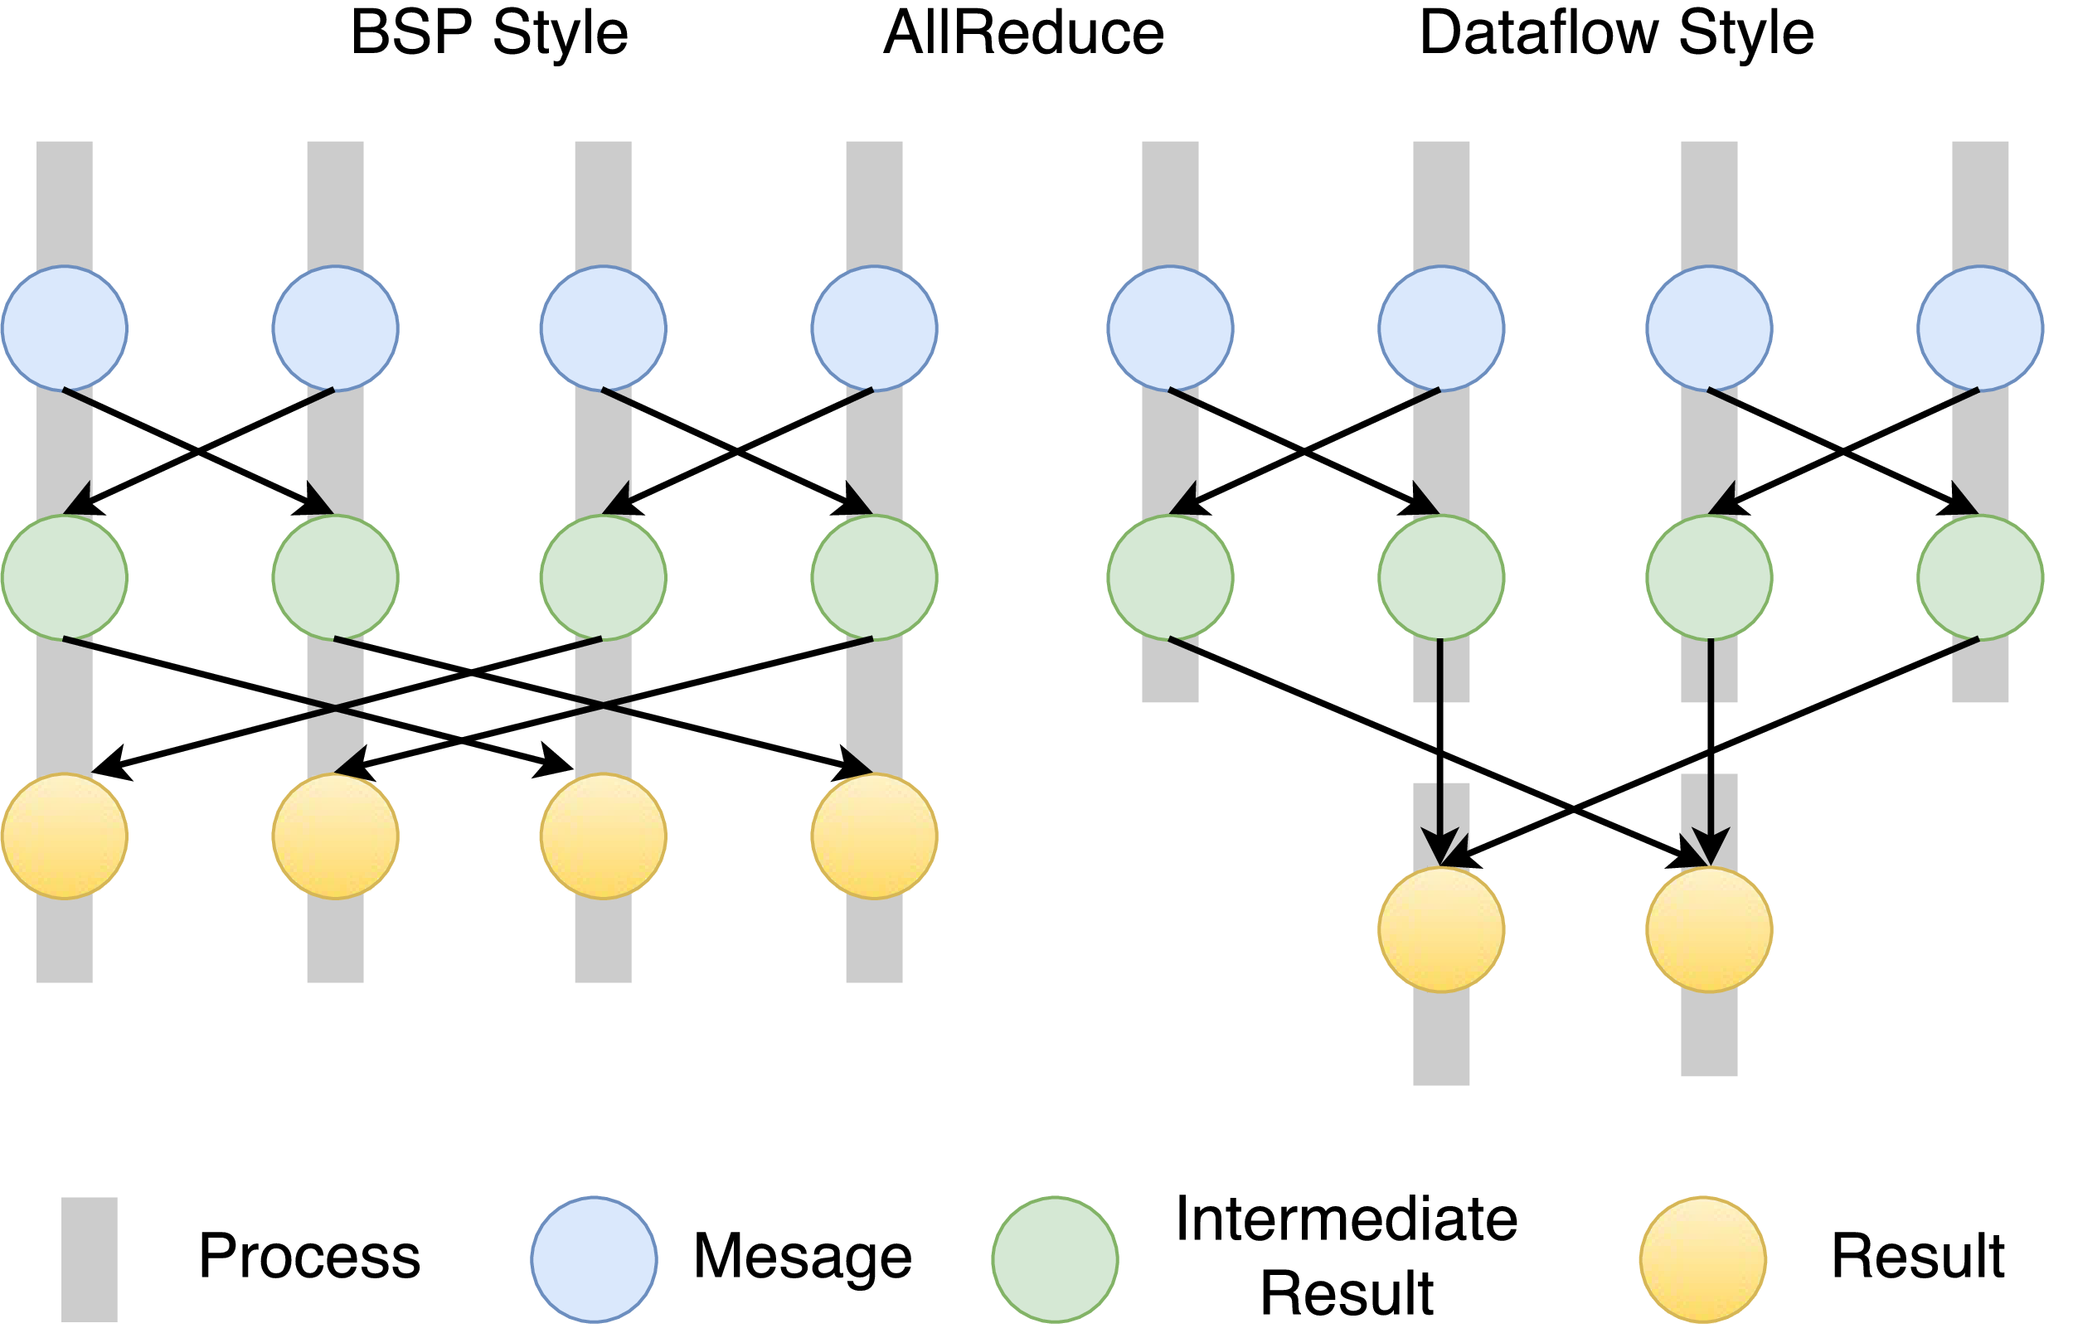
Twister2 Dataflow Communications
Twister:Net offers two communication models
  BSP (Bulk Synchronous Processing) communication using TC or MPI separated from its task management plus extra Harp collectives
plus a new Dataflow library DFW built using MPI software but at data movement not message level
  Non-blocking
  Dynamic data sizes
  Streaming model
    Batch case is modeled as a finite stream
  The communications are between a set of
  tasks in an arbitrary task graph
  Key based communications
  Communications spilling to disks
  Target tasks can be different from source tasks

Slide 16
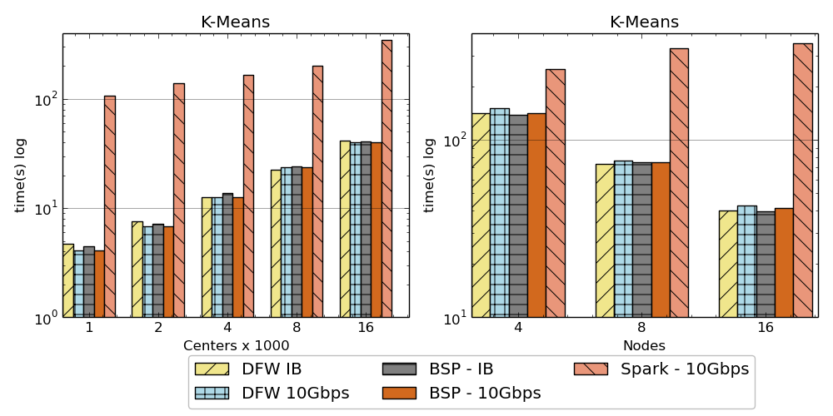

K-Means algorithm performance
Spark, DFW, BSP for Twister2
IB (Infiniband) and 10Gbps Ethernet
AllReduce Communication
Left: K-means job execution time on 16 nodes with varying centers, 2 million points with 320-way parallelism. Right: K-Means with 4,8 and 16 nodes where each node having 20 tasks. 2 million points with 16000 centers used.

Slide 17
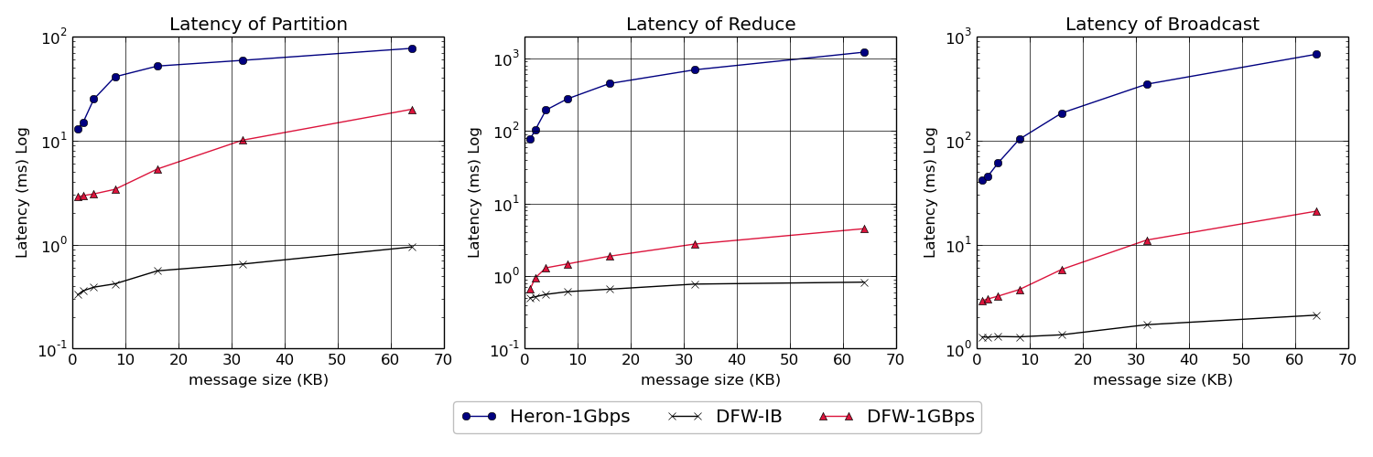
Twister:Net and Apache Heron for Streaming
Latency of Apache Heron and Twister:Net DFW (Dataflow) for Reduce, Broadcast and Partition operations in 16 nodes with 256-way parallelism

Slide 18
Twister2 Timeline: End of August 2018
Twister:Net Dataflow Communication API
  Dataflow communications with MPI or TCP
Harp for Machine Learning (Custom BSP Communications)
  Rich collectives
  Around 30 ML algorithms
  Other ML libraries – image processing from SPIDAL
  Study link with Tensorflow Scikit-Learn etc.
HDFS Integration
Task Graph
  Streaming - Storm model
  Batch analytics - Hadoop
Deployments on Docker, Kubernetes, Mesos (Aurora), Nomad, Slurm

Slide 19
Twister2 Timeline: End of December 2018
Native MPI integration to Mesos, Yarn
Naiad timely dataflow model based Task system for Machine Learning
Link to HPC user targeted Pilot Jobs from Rutgers
Fault tolerance
  Streaming
  Batch
Hierarchical dataflows with Streaming, Machine Learning and Batch integrated seamlessly
Data abstractions for streaming and batch (Streamlets, RDD)
Workflow graphs (Kepler, Spark) with linkage defined by Data Abstractions (RDD)
End to end applications

Slide 20
Twister2 Timeline: After December 2018
Dynamic task migrations
RDMA and other communication enhancements
Integrate parts of Twister2 components into existing big data systems
(i.e. run current Big Data software invoking Twister2 components)
  Heron (easiest), Spark, Flink, Hadoop (like Harp today)
Support different APIs (i.e. run Twister2 looking like current Big Data Software)
  Hadoop
  Spark (Flink)
  Storm
Refinements like Marathon with Mesos etc.
Function as a Service FaaS and Serverless Computing
Support higher level abstractions
  Twister:SQL

Slide 21
AI First High Performance Big Data Computing
Requires integration of current (Apache) Big Data ABDS and HPC technologies
  Integration of Big Data and Big Simulation
  Integration of edge to cloud or streaming to batch technologies
Detailed analysis of applications identifies five distinctive computation models
We have integrated HPC into many Apache systems as HPC-ABDS with a rich set of collectives: Harp enhances Hadoop
We have analyzed runtimes of Hadoop, Spark, Flink, Storm, Heron and identified key components and proposed a toolkit Twister2 allowing them to be assembled efficiently in different ways for different applications
  AI First can be delivered for all application classes
Apache systems use dataflow communication which is natural for distributed systems but slow for classic parallel computing
  We propose a new dataflow library Twister:Net
HPC could adopt some of tools of Big Data as in Coordination Points (dataflow nodes), State management (fault tolerance) with RDD (datasets)

