Slide 1
Next Generation Grid: Integrating Parallel and Distributed Computing Runtimes for an HPC Enhanced Cloud and Fog Spanning IoT Big Data and Big Simulations
Geoffrey Fox, Supun Kamburugamuve, Judy Qiu, Shantenu Jha
June 28, 2017
IEEE Cloud 2017 Honolulu Hawaii
gcf@indiana.edu
http://www.dsc.soic.indiana.edu/, http://spidal.org/
Department of Intelligent Systems Engineering
School of Informatics and Computing, Digital Science Center
Indiana University Bloomington
`

Slide 2
“Next Generation Grid – HPC Cloud” Problem Statement
Design a dataflow event-driven FaaS (microservice) framework running across application and geographic domains.
Build on Cloud best practice but use HPC wherever possible and useful to get high performance
Smoothly support current paradigms Hadoop, Spark, Flink, Heron, MPI, DARMA …
Use interoperable common abstractions but multiple polymorphic implementations.
  i.e. do not require a single runtime
Focus on Runtime but this implicitly suggests programming and execution model
This next generation Grid based on data and edge devices – not computing as in old Grid

Slide 3
Important Trends I
Data gaining in importance compared to simulations
  Data analysis techniques changing with old and new applications
All forms of IT increasing in importance; both data and simulations increasing
Internet of Things and Edge Computing growing in importance
Exascale initiative driving large supercomputers
Use of public clouds increasing rapidly
  Clouds becoming diverse with subsystems containing GPU’s, FPGA’s, high performance networks, storage, memory …
  They have economies of scale; hard to compete with
Serverless computing attractive to user:
“No server is easier to manage than no server”

Slide 4
Important Trends II
Rich software stacks:
  HPC for Parallel Computing
  Apache for Big Data including some edge computing (streaming data)
On general principles parallel and distributed computing has different requirements even if sometimes similar functionalities
  Apache stack typically uses distributed computing concepts
  For example, Reduce operation is different in MPI (Harp) and Spark
Important to put grain size into analysis
  Its easier to make dataflow efficient if grain size large
Streaming Data ubiquitous including data from edge
Edge computing has some time-sensitive applications
  Choosing a good restaurant can wait seconds
  Avoiding collisions must be finished in milliseconds

Slide 5
Important Trends III
HPC needed for some Big Data processing
  Deep Learning needs small HPC systems
Big Data requirements are not clear but current workloads have substantial pleasingly parallel or modestly synchronized applications that are well suited to current clouds
  Maybe will change as users get more sophisticated
  Such as change happened in simulation as increased computer power led to ability to do much larger and different problems (2D in 1980 became fully realistic 3D)
Data should not be moved unless essential
  Supported by Fog computing
Fog is a well establish idea but no agreement on architecture
Need Security and Fault Tolerance!!

Slide 6
Academic (Research) Big Data Applications
Applications ought to drive new-generation big data software stacks but (at many universities) academic applications lag commercial use in big data area and needs are quite modest
  This will change and we can expect big data software stacks to become more important and broadly used in academia
  Note importance of plethora of small (pleasingly parallel) jobs
Note University compute systems historically offer HPC and not Big Data Expertise.
  We could anticipate users moving to public clouds (away from university systems) but
  Users will still want support
Need a Requirements Analysis that builds in application changes that might occur as users get more sophisticated
Need to help (train) users to explore big data opportunities

Slide 7
Motivation Summary
Explosion of Internet of Things and Cloud Computing
  Clouds will continue to grow and will include more use cases
Edge Computing is adding an additional dimension to Cloud Computing
  Device --- Fog ---Cloud
Event driven computing is becoming dominant
  Signal generated by a Sensor is an edge event
  Accessing a HPC linear algebra function could be event driven and replace traditional libraries by FaaS (as NetSolve GridSolve Neos did in old Grid)
Services will be packaged as a powerful Function as a Service FaaS
Serverless must be important: users not interested in low level details of IaaS or even PaaS?
Applications will span from Edge to Multiple Clouds

Slide 8
Predictions/Assumptions
Supercomputers will continue for large simulations and may run other applications but these codes will be developed on HPC Clouds or
Next-Generation Commodity Systems which are dominant force
  Merge Cloud HPC and Edge computing
  Clouds running in multiple giant datacenters offering all types of computing
  Distributed data sources associated with device and Fog processing resources
  Server-hidden computing for user pleasure
  Support a distributed event driven dataflow computing model covering batch and streaming data
  Needing parallel and distributed (Grid) computing ideas

Slide 9

Implementing these ideas at a high level

Slide 10
What is the challenge?
Integrate systems that offer full capabilities
  Scheduling
  Storage
  “Database”
  Programming Model (dataflow and/or “in-place” control-flow) and corresponding runtime
  Analytics
  Workflow
  Function as a Service and Event-based Programming
With a broad scope
  For both Batch and Streaming
  Distributed and Centralized (Grid versus Cluster)
  Pleasingly parallel (Local machine learning) and Global machine learning (large scale parallel codes)
How do we do this?

Slide 11
Proposed Approach I
Unit of Processing is an Event driven Function (a service)
  Can have state that may need to be preserved in place (Iterative MapReduce)
  Can be hierarchical as in invoking a parallel job
  Functions can be single or 1 of 100,000 maps in large parallel code
Processing units run in clouds, fogs or devices but these all have similar architecture
  Fog (e.g. car) looks like a cloud to a device (radar sensor) while public cloud looks like a cloud to the fog (car)
Use polymorphic runtime that uses different implementations depending on environment e.g. on fault-tolerance – latency (performance) tradeoffs
Data locality (minimize explicit dataflow) properly supported as in HPF alignment commands (specify which data and computing needs to be kept together)
Support the federation of the heterogeneous (in function – not just interface that characterized old Grid) resources that form the new Grid

Slide 12
Proposed Approach II
Analyze the runtime of existing systems
  Hadoop, Spark, Flink, Naiad Big Data Processing
  Storm, Heron Streaming Dataflow
  Kepler, Pegasus, NiFi workflow systems
  Harp Map-Collective, MPI and HPC AMT runtime like DARMA
  And approaches such as GridFTP and CORBA/HLA (!) for wide area data links
Propose polymorphic unification (given function can have different implementations)
Choose powerful scheduler (Mesos?)
Support processing locality/alignment including MPI’s never move model with grain size consideration
This should integrate HPC and Clouds

Slide 13
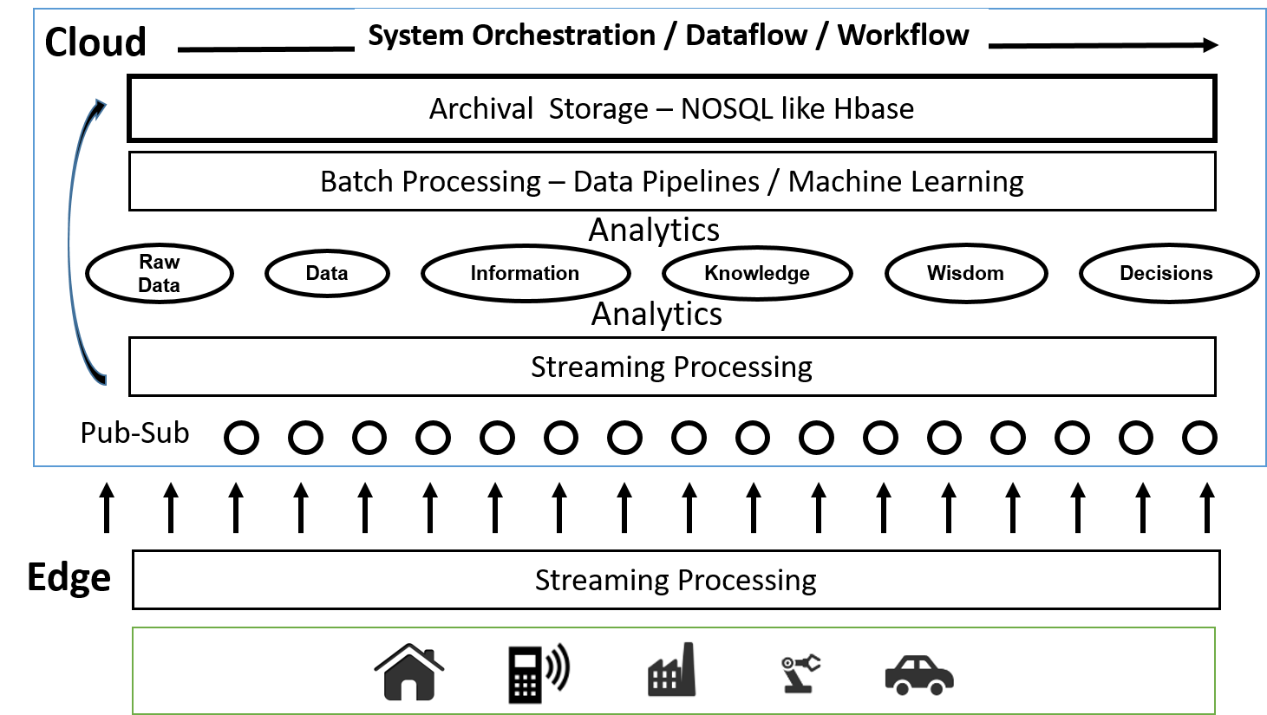
Cloud Architecture

Slide 14
Implementing these ideas in detail

Slide 15
Components of Big Data Stack
Google likes to show a timeline; we can build on (Apache version of) this
2002 Google File System GFS ~HDFS
2004 MapReduce Apache Hadoop
2006 Big Table Apache Hbase
2008 Dremel Apache Drill
2009 Pregel Apache Giraph
2010 FlumeJava Apache Crunch
2010 Colossus better GFS
2012 Spanner horizontally scalable NewSQL database ~CockroachDB
2013 F1 horizontally scalable SQL database
2013 MillWheel ~Apache Storm, Twitter Heron (Google not first!)
2015 Cloud Dataflow Apache Beam with Spark or Flink (dataflow) engine
Functionalities not identified: Security, Data Transfer, Scheduling, DevOps, serverless computing (assume OpenWhisk will improve to handle robustly lots of large functions)

Slide 16
HPC-ABDS
Integrated wide range of HPC and Big Data technologies.
I gave up updating!

Slide 17
Why use Spark Hadoop Flink rather than HPC?
Yes if you value ease of programming over performance.
  This could be the case for most companies where they can find people who can program in Spark/Hadoop much more easily than people who can program in MPI.
  Most of the complications including data, communications are abstracted away to hide the parallelism so that average programmer can use Spark/Flink easily and doesn't need to manage state, deal with file systems etc.
  RDD data support very helpful
For large data problems involving heterogeneous data sources such as HDFS with unstructured data, databases such as HBase etc
Yes if one needs fault tolerance for our programs.
  Our 13-node Moe “big data” (Hadoop twitter analysis) cluster at IU faces such problems around once per month. One can always restart the job, but automatic fault tolerance is convenient.

Slide 18
Why use HPC and not Spark, Flink, Hadoop?
The performance of Spark, Flink, Hadoop on classic parallel data analytics is poor/dreadful whereas HPC (MPI) is good
One way to understand this is to note most Apache systems deliberately support a dataflow programming model
e.g. for Reduce, Apache will launch a bunch of tasks and eventually bring results back
  MPI runs a clever AllReduce interleaved “in-place” tree
Maybe can preserve Spark, Flink programming model but change implementation “under the hood” where optimization important.
Note explicit dataflow is efficient and preferred at coarse scale as used in workflow systems
  Need to change implementations for different problems

Slide 19
Big Data Applications I
Big Data
  Large data
  Heterogeneous sources
    Unstructured data in raw storage
    Semi-structured data in NoSQL databases
    Raw streaming data
Important characteristics affecting processing requirements
  Data can be too big to load into even a large cluster
  Data may not be load balanced
  Streaming data needs to be analyzed before storing to disk

Slide 20
Big Data Applications II
Streaming applications
  High rate of data
  Low latency processing requirements
  Simple queries to complex online analytics
Data pipelines
  Raw data or semi structured data in in NoSQL databases
  Extract, transform and load (ETL) operations
Machine learning
  Mostly deal with curated data
  Complex algebraic operations
  Iterative computations with tight synchronizations

Slide 21
What do we need in runtime for distributed HPC FaaS
Finish examination of all the current tools
Handle Events
Handle State
Handle Scheduling and Invocation of Function
Define data-flow graph that needs to be analyzed
Handle data flow execution graph with internal event-driven model
Handle geographic distribution of Functions and Events
Design dataflow collective and P2P communication model
Decide which streaming approach to adopt and integrate
Design in-memory dataset model for backup and exchange of data in data flow (fault tolerance)
Support DevOps and server-hidden cloud models
Support elasticity for FaaS (connected to server-hidden)

Slide 22
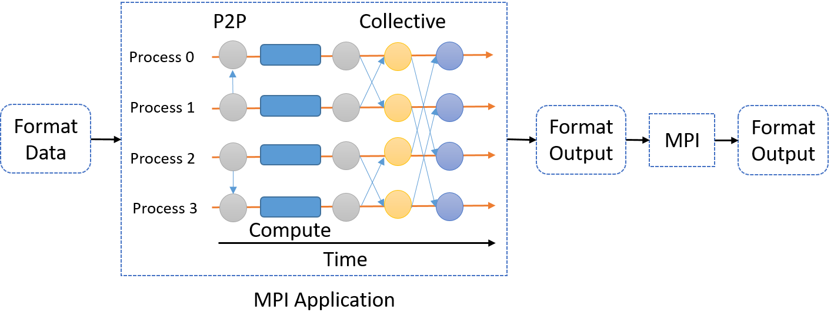
MPI Applications
Tightly synchronized applications
Efficient communications (µs latency)
  Use of advanced hardware
In place communications and computations
  Process scope state
HPC applications are orchestrated by workflow engines
Can expect curated, balanced data
User is required to manage threads, caches, NUMA boundaries
HPC application with components written in MPI and orchestrated by a workflow engine

Slide 23
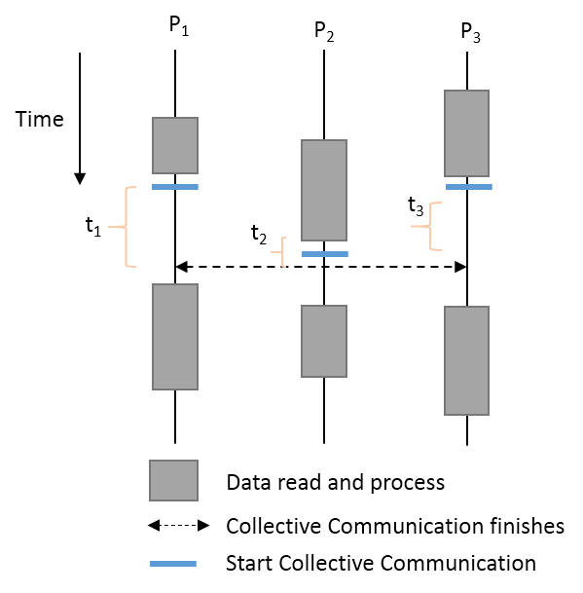
Load Imbalance & Velocity
Data in raw form are not load balanced
  HDFS, NoSQL, Streaming data
MPI style tightly synchronized operations need sophisticated load balancing?
Asynchronous Many Task Runtime such as DARMA suitable?

Slide 24
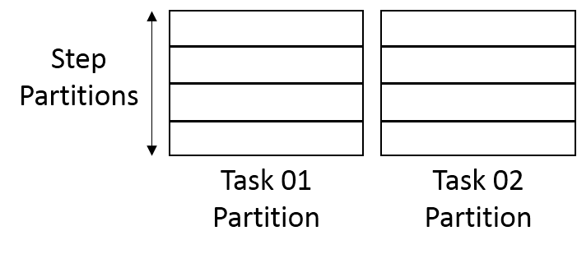
Data Partitioning
Cannot process the complete data set in memory
Data partitioned across the tasks
  Each task partitions the data further
Need to program specifically to handle such partitioning
Sometimes need to align partitions of different datasets
  Supported in past by HPF but not now?

Slide 25
Dataflow Applications
Model a computation as a graph
  Nodes does computations - Task
  Edges communications
A computation is activated when its input data dependencies are satisfied
  Data driven
Asynchronous execution of tasks
Tasks can only communicate through their input and output edges
  To preserve asynchronous nature of computation
  Otherwise becomes MPI
S
W
G
W
S
W
G
S
W

Slide 26
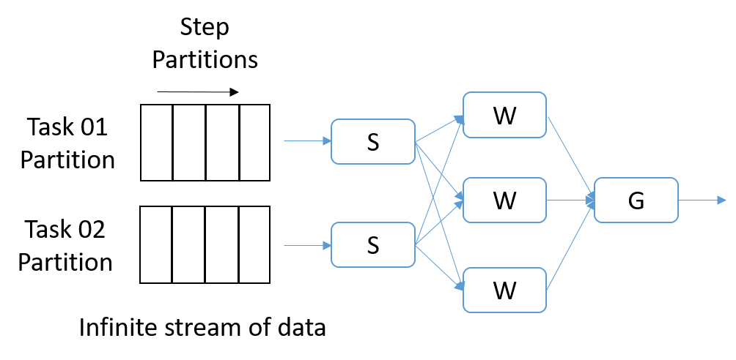
Streaming - Dataflow Applications
Streaming is a natural fit for dataflow
Partitions of the data are called Streams
Streams are unbounded, ordered data tuples
Order of events important
Group data into windows
  Count based
  Time based
Types of windows
  Sliding Windows
  Tumbling Windows
Continuously Executing Graph

Slide 27
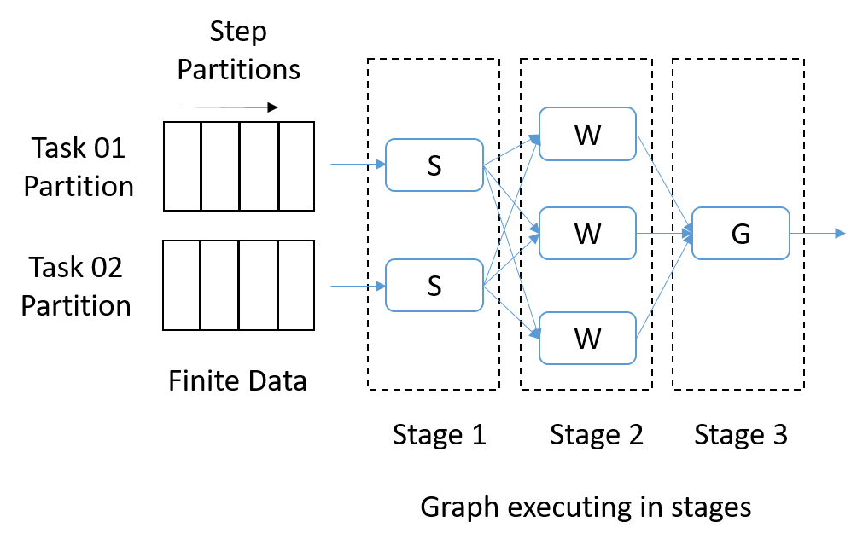
Data Pipelines – Dataflow Applications
Similar to streaming applications
Finite amount of data
  Partitioned hierarchically similar to streaming
Mostly pleasingly parallel, but some form of communications can be required
  Reduce, Join

Slide 28
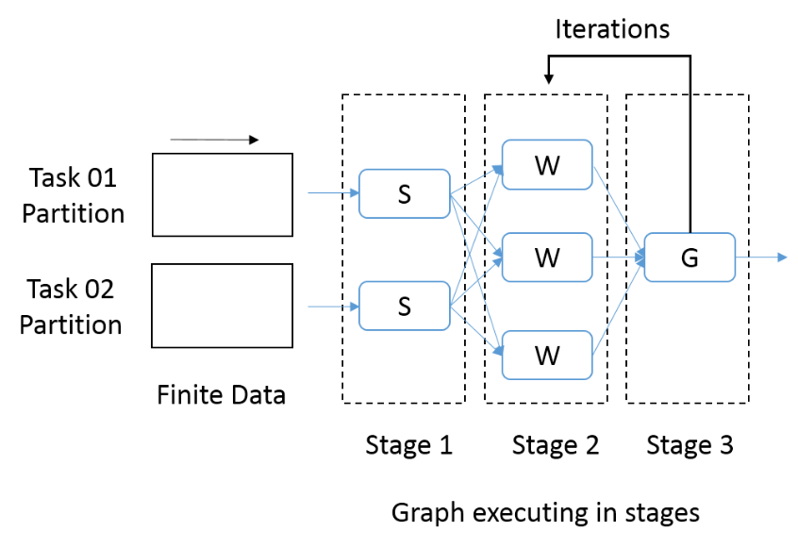
Machine Learning – Dataflow Applications
Need fine grain control of the graph to express complex operations
Iterative computations
There are both Model and Data, but only communicate model
Complex communication operations such as AllReduce

Slide 29
Data Transformation API
The operators in API define the computation as well how nodes are connected
  For example lets take map and reduce operators and our initial data set is A
  Map function produces a distributed dataset B by applying the user defined operator on each partition of A. If A had N partitions, B can contain N elements.
  The Reduce function is applied on B, producing a data set with a single partition.
A
Map
B
Reduce
C
Logical graph
a_1
B = A.map() {
User defined code to execute on a partition of A
};
C = B.reduce() {
User defined code to reduce two elements in B
}
Map 1
b_1
Reduce
C
a_n
Map n
b_n
Execution graph

Slide 30
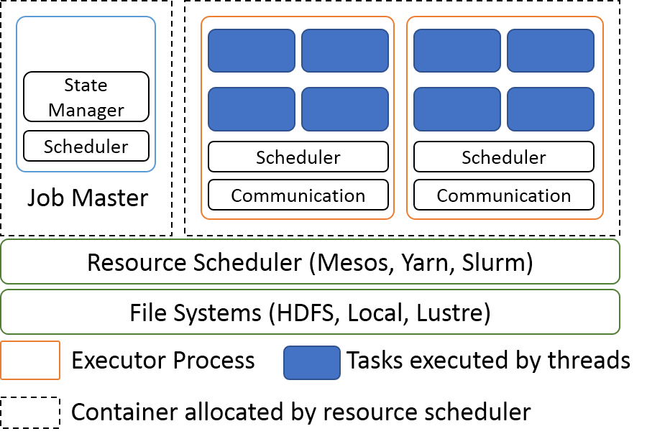
Dataflow Runtime General Architecture
Resource scheduler allocates resources
A Master program controls the deployment and monitoring of the application
A centralized scheduler or distributed scheduler schedules the tasks of the dataflow graph
An executor process runs the tasks using threads
A communication layer manages the inter-process and inter-node communications

Slide 31
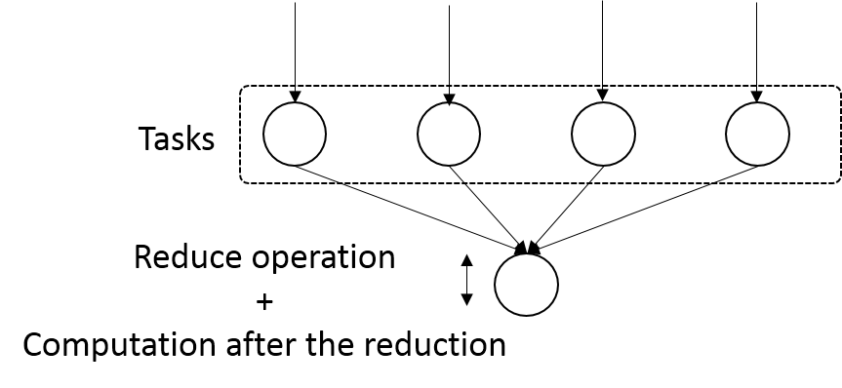
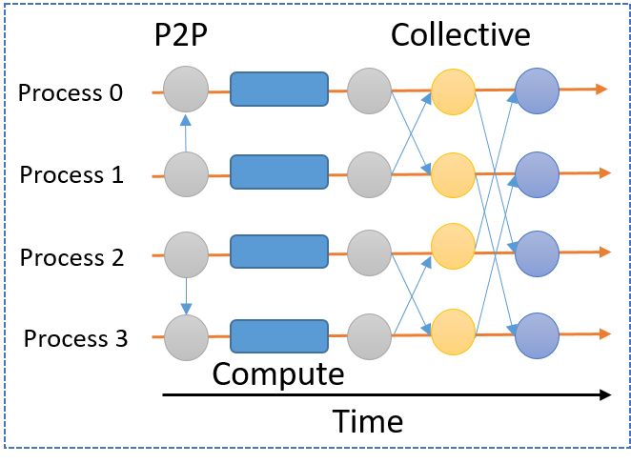
Communications
P2P Communications
Collective Communications
  Can involve more than 2 parties
  Can be optimized with algorithms for latency and throughput
MPI Communications
  In place communications
  Asynchronous and Synchronous
  One sided communications
Dataflow
  Only after a task finishes computation
Dataflow Communications
MPI Communications

Slide 32
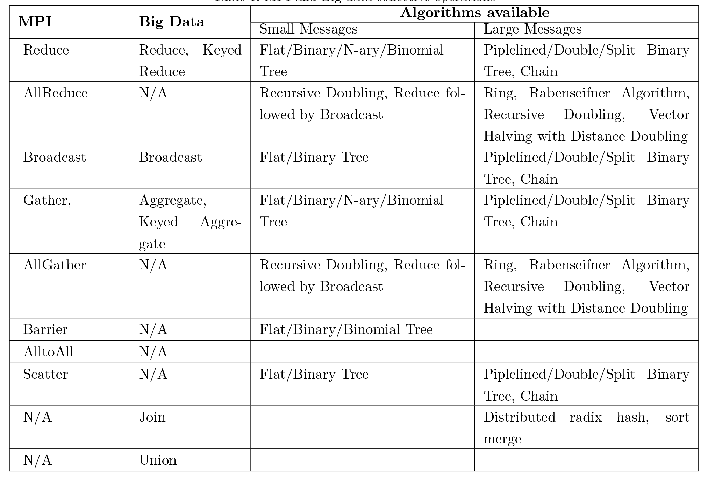
Communication Primitives
Big data systems do not implement optimized communications
It is interesting to see no AllReduce implementations
  AllReduce has to be done with Reduce + Broadcast
No consideration of RDMA except as add-on

Slide 33
High Performance Interconnects
MPI excels in RDMA (Remote direct memory access) communications and with optimized algorithms for collectives
  µs latency for communications involving large number of nodes
Big data systems have not taken RDMA seriously
  There are some implementations as plugins to existing systems
Open source High Performance Libraries such as Libfabric and Photon should make the integration easy

Slide 34
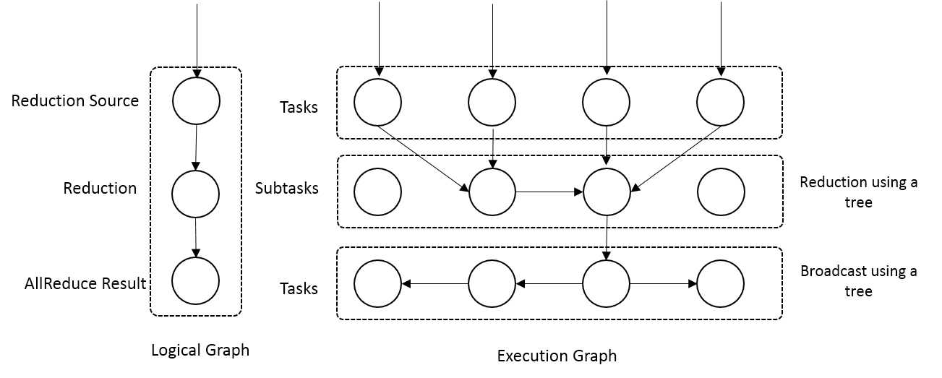
Optimized Dataflow Communications I
Novel feature of our approach
Optimize the dataflow graph to facilitate different algorithms
Example - Reduce
  Add subtasks and arrange them according to an optimized algorithm
  Trees, Pipelines
Preserves the asynchronous nature of dataflow computation
Reduce communication as a dataflow graph modification

Slide 35
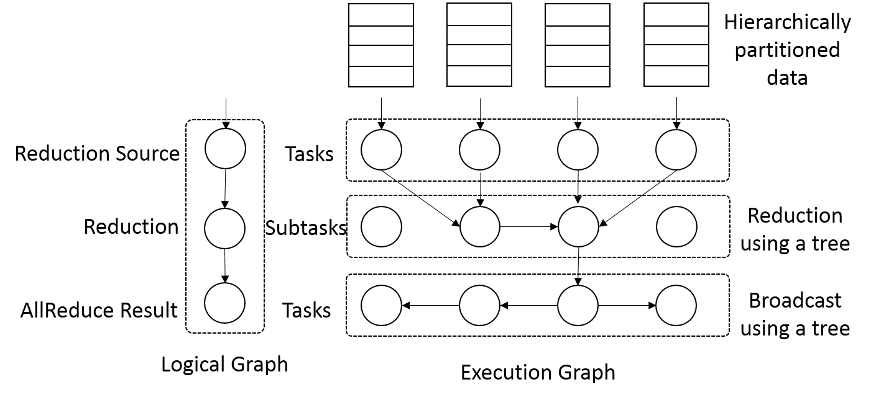
Optimized Communications II
AllReduce Communication
  As a Reduce + Broadcast
  More algorithms available
AllReduce Communication

Slide 36
Requirements of Dataflow Collectives
The communication and the underlying algorithm should be driven by data
The algorithm should be able to use disks when the amount of data is larger than the available memory
The collective communication should handle partitions of data
  In batch case the communication should finish after the partitions are handled

Slide 37
Dataflow Graph State and Scheduling
State is a key issue and handled differently in systems
  CORBA, AMT, MPI and Storm/Heron have long running tasks that preserve state
  Spark and Flink preserve datasets across dataflow node
  All systems agree on coarse grain dataflow; only keep state in exchanged data.
Scheduling is one key area where dataflow systems differ
  Dynamic Scheduling
    Fine grain control of dataflow graph
    Graph cannot be optimized
  Static Scheduling
    Less control of the dataflow graph
    Graph can be optimized

Slide 38
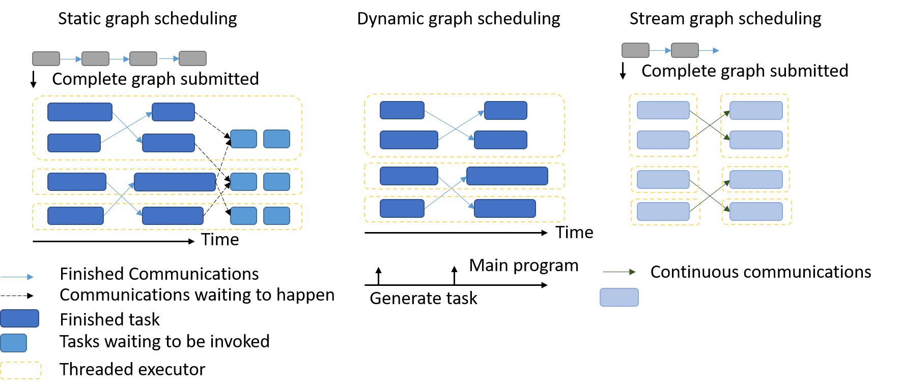
Dataflow Graph Task Scheduling

Slide 39
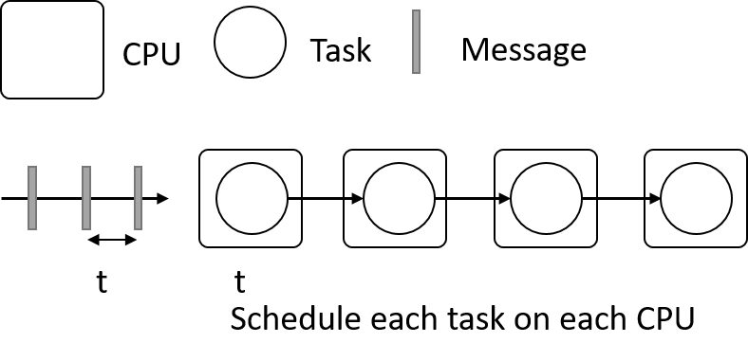
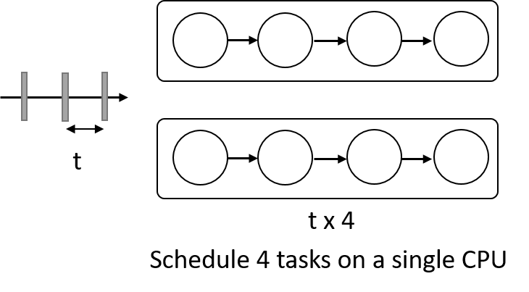
Difference between Stream & Batch Analytics
Stream analytics
  Latency vs Throughput
  Often latency is more important
Example
  Assume message rate of 1 msg per t Units of CPU time
  Assume we have 4 tasks to be executed on an incoming message each consuming t units of CPU time
  Now lets say we have a machine with 4 CPUs.
  There are two possible schedules of the tasks
    Schedule each task on each CPU
    For each message run the 4 tasks one after other on a CPU and load balance between CPUsC
  Can process the stream with 4 CPUs, preserve task locality
  Cannot run the stream on single CPU, need to load balance between the 4 CPUs, preserve data locality, but out of order processing of stream

Slide 40
Fault Tolerance
Similar form of check-pointing mechanism is used in HPC and Big Data
  MPI, Flink, Spark
  Flink and Spark do better than MPI due to use of database technologies; MPI is a bit harder due to richer state
Checkpoint after each stage of the dataflow graph
  Natural synchronization point
  Generally allows user to choose when to checkpoint (not every stage)
Executors (processes) don’t have external state, so can be considered as coarse grained operations

Slide 41
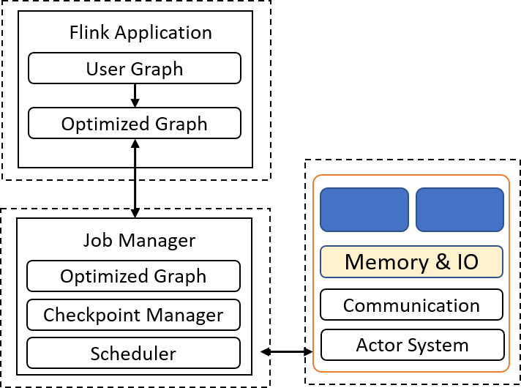
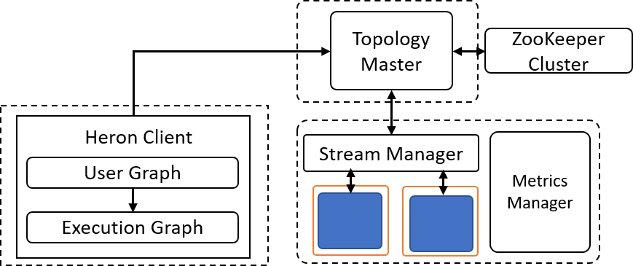
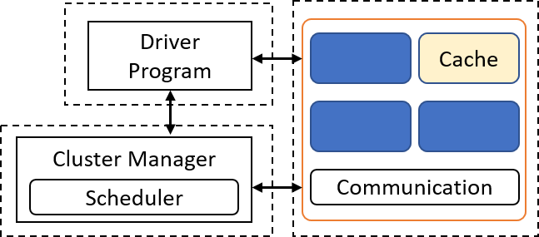
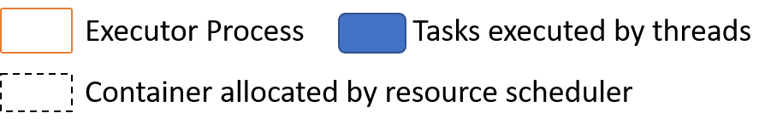
Runtime Architectures
Spark
Flink
Heron

Slide 42
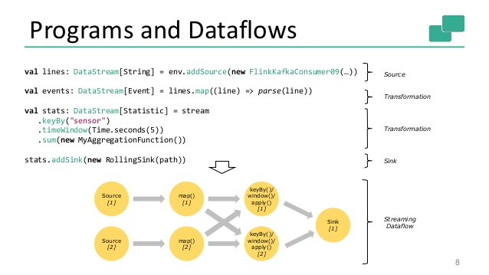
Spark Kmeans Flink Streaming Dataflow
P = loadPoints()
C = loadInitCenters()
for (int i = 0; i < 10; i++) {
T = P.map().withBroadcast(C)
C = T.reduce() }

Slide 43
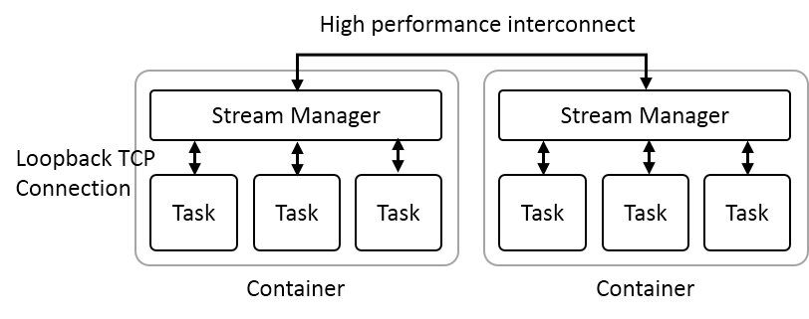
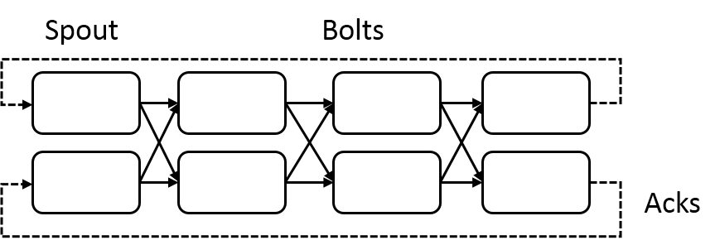
Heron Streaming Architecture
System Management
Add HPC
Infiniband
Omnipath
Inter node
Intranode
Typical Dataflow Processing Topology
User Specified Dataflow
All Tasks Long running
No context shared apart from dataflow
Parallelism 2; 4 stages

Slide 44
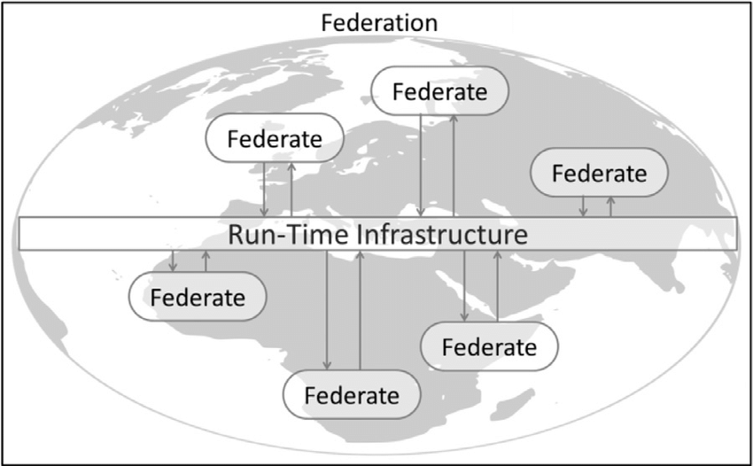
Naiad Timely Dataflow HLA Distributed Simulation

Slide 45
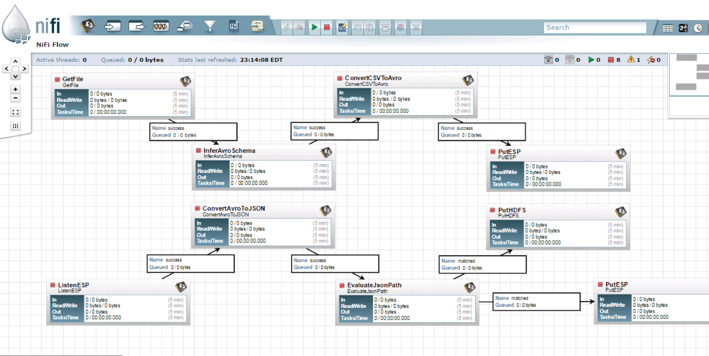
NiFi Workflow

Slide 46
Dataflow for a linear algebra kernel
Typical target of HPC AMT System
Danalis 2016

Slide 47
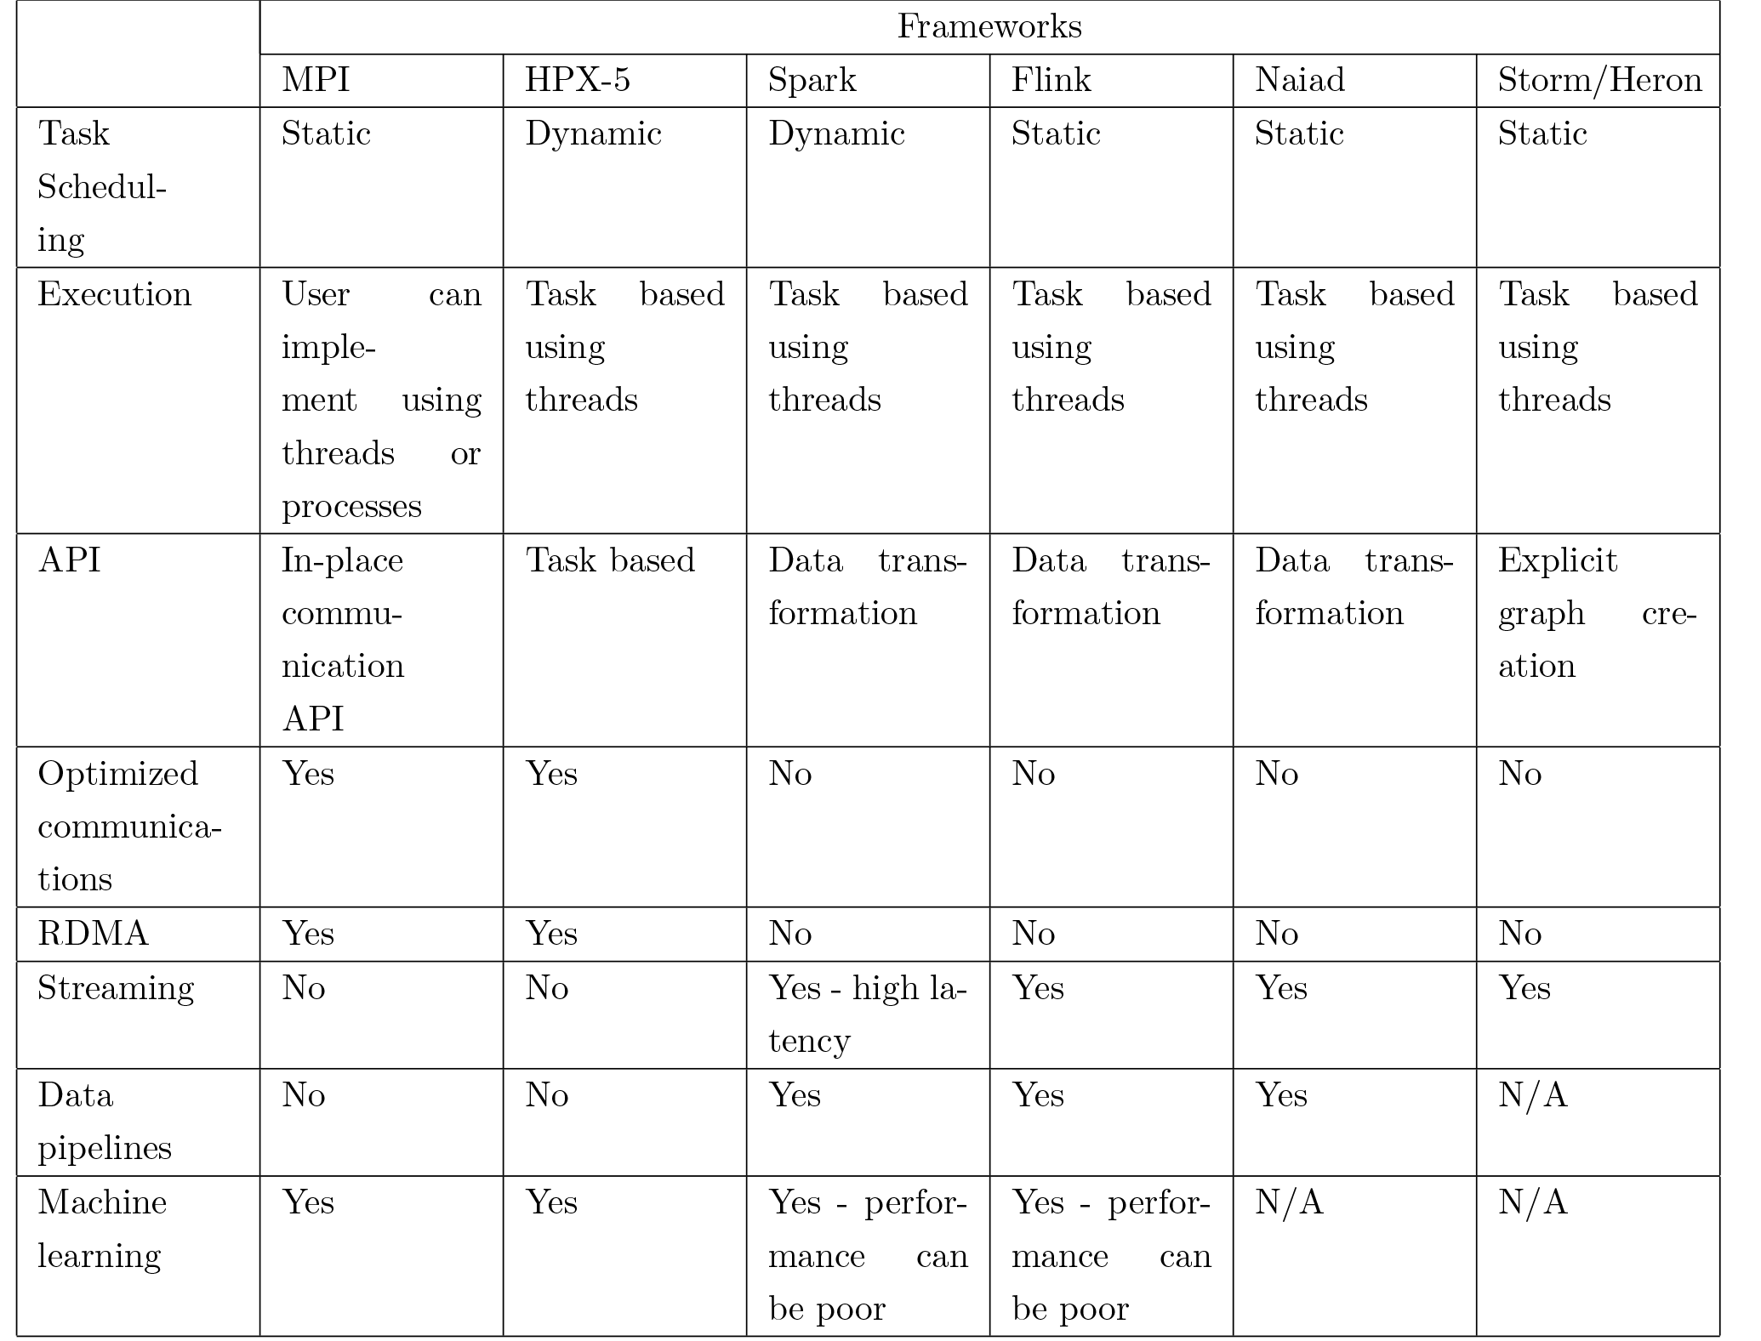
Dataflow Frameworks
Every major big data framework is designed according to dataflow model
Batch Systems
  Hadoop, Spark, Flink, Apex
Streaming Systems
  Storm, Heron, Samza, Flink, Apex
HPC AMT Systems
  Legion, Charm++, HPX-5, Dague, COMPs
Design choices in dataflow
  Efficient in different application areas

Slide 48
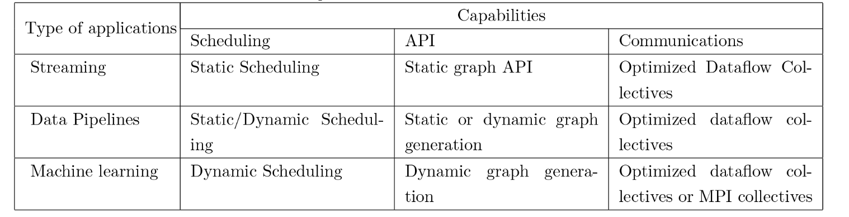
Polymorphic Dataflow Runtimes
Three different design choices
Three different application areas
Polymorphic runtime
  Each choice is pluggable

Slide 49
Machine Learning with MPI, Spark and Flink
Three algorithms implemented in three runtimes
  Multidimensional Scaling (MDS)
  Terasort
  K-Means
Implementation in Java
MDS is the most complex algorithm - three nested parallel loops
K-Means - one parallel loop
Terasort - no iterations

Slide 50

HPC Runtime versus ABDS distributed Computing Model on Data Analytics
Hadoop writes to disk and is slowest; Spark and Flink spawn many processes and do not support AllReduce directly;
MPI does in-place combined reduce/broadcast and is fastest
Need Polymorphic Reduction capability choosing best implementation
Use HPC architecture with
  Mutable model
  Immutable data

Slide 51
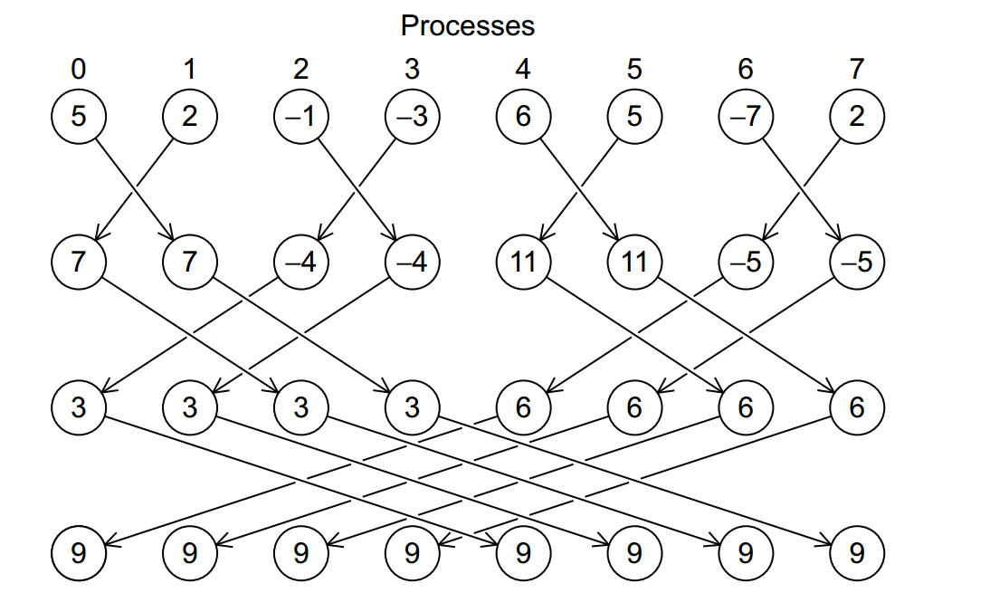
Illustration of In-Place AllReduce in MPI

Slide 52



Multidimensional Scaling
MDS execution time on 16 nodes with 20 processes in each node with varying number of points
MDS execution time with 32000 points on varying number of nodes. Each node runs 20 parallel tasks

Slide 53

Flink MDS Dataflow Graph

Slide 54
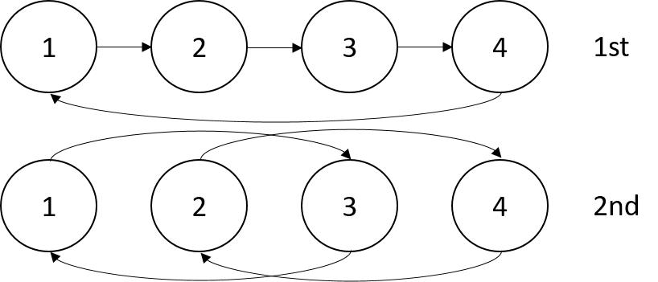


Terasort
Transfer data using MPI
Sorting 1TB of data records
Terasort execution time in 64 and 32 nodes. Only MPI shows the sorting time and communication time as other two frameworks doesn't provide a viable method to accurately measure them. Sorting time includes data save time. MPI-IB - MPI with Infiniband
Partition the data using a sample and regroup

Slide 55
K-Means
Point data set is partitioned and loaded to multiple map tasks
  Custom input format for loading the data as block of points
Full centroid data set is loaded at each map task
Iterate over the centroids
  Calculate the local point average at each map task
  Reduce (sum) the centroid averages to get a global centroids
  Broadcast the new centroids back to the map tasks
Data Set <Points>
Data Set <Initial Centroids>
Map (nearest centroid calculation)
Reduce (update centroids)
Data Set <Updated Centroids>
Broadcast

Slide 56
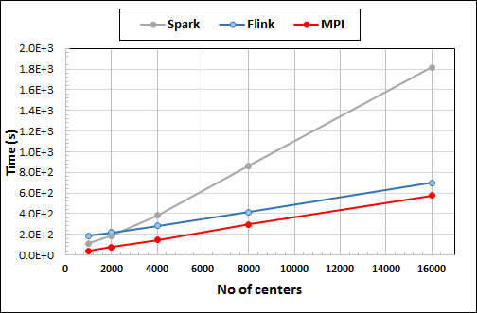
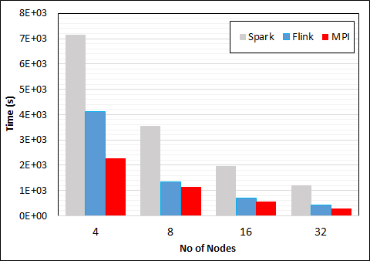
K-Means Clustering in Spark, Flink, MPI
Data Set <Points>
Dataflow for K-means
Data Set <Initial Centroids>
Map (nearest centroid calculation)
Reduce (update centroids)
Data Set <Updated Centroids>
Broadcast
K-Means execution time on 16 nodes with 20 parallel tasks in each node with 10 million points and varying number of centroids. Each point has 100 attributes.
K-Means execution time on varying number of nodes with 20 processes in each node with 10 million points and 16000 centroids. Each point has 100 attributes.
Notes:
Note the differences in communication architectures
Note times are in log scale
Bars indicate compute only times, which is similar across these frameworks
Overhead is dominated by communications in Flink and Spark

Slide 57
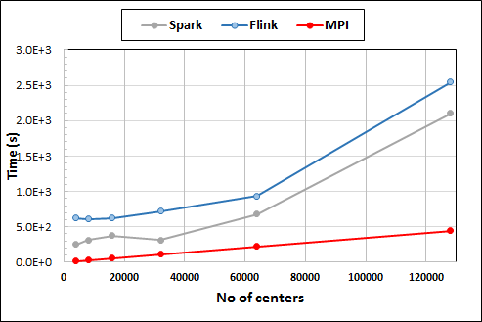
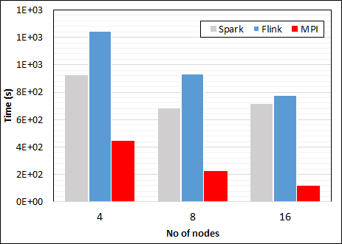
K-Means Clustering in Spark, Flink, MPI
K-Means execution time on 8 nodes with 20 processes in each node with 1 million points and varying number of centroids. Each point has 2 attributes.
K-Means execution time on varying number of nodes with 20 processes in each node with 1 million points and 64000 centroids. Each point has 2 attributes.
K-Means performed well on all three platforms when the computation time is high and communication time is low as illustrated in 10 million points and 10 iterations case. After lowering the computation and increasing the communication by setting the points to1 million and iterations to 100, the performance gap between MPI and the other two platforms increased.
Notes:
Note the differences in communication architectures
Note times are in log scale
Bars indicate compute only times, which is similar across these frameworks
Overhead is dominated by communications in Flink and Spark

Slide 58
Heron Architecture
Each topology runs as a single standalone Job
Topology Master handles the Job
Can run on any resource scheduler (Mesos, Yarn, Slurm)
Each task run as a separate Java Process (Instance)
Stream manager acts as a network router/bridge between tasks in different containers
Every task in a container connects to a stream manager running in that container

Slide 59
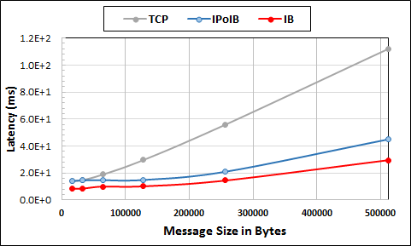
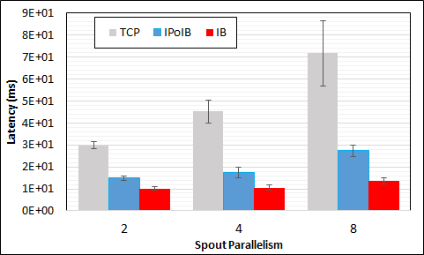
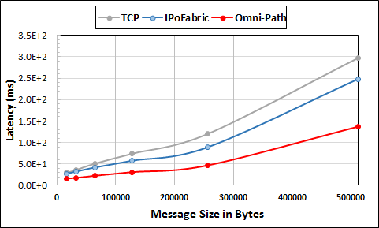
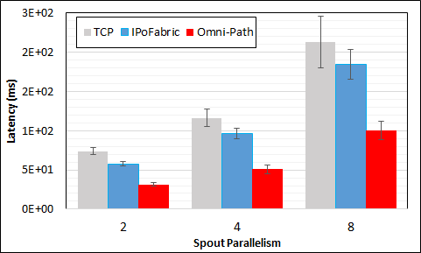
Heron High Performance Interconnects
Infiniband & Intel Omni-Path integrations
Using Libfabric as a library
Natively integrated to Heron through Stream Manager without needing to go through JNI

Slide 60
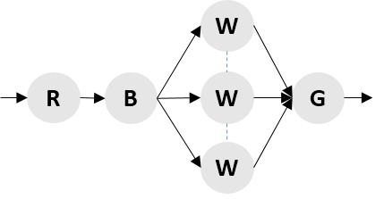
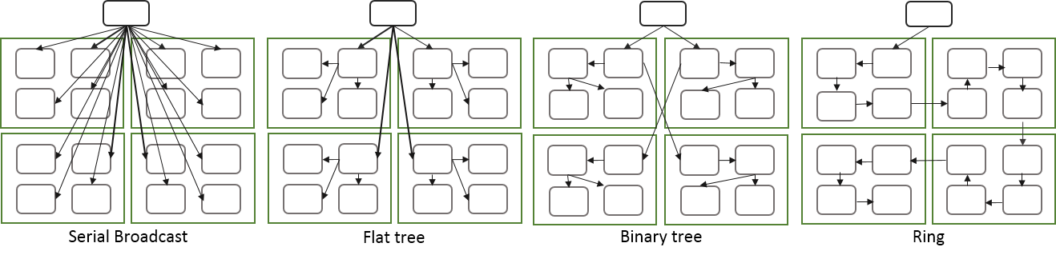
Apache Storm Broadcast
Three algorithms implemented as an optimization of dataflow graph
  Flat tree
  Binary tree
  Ring
Measure performance for latency and throughput

Slide 61
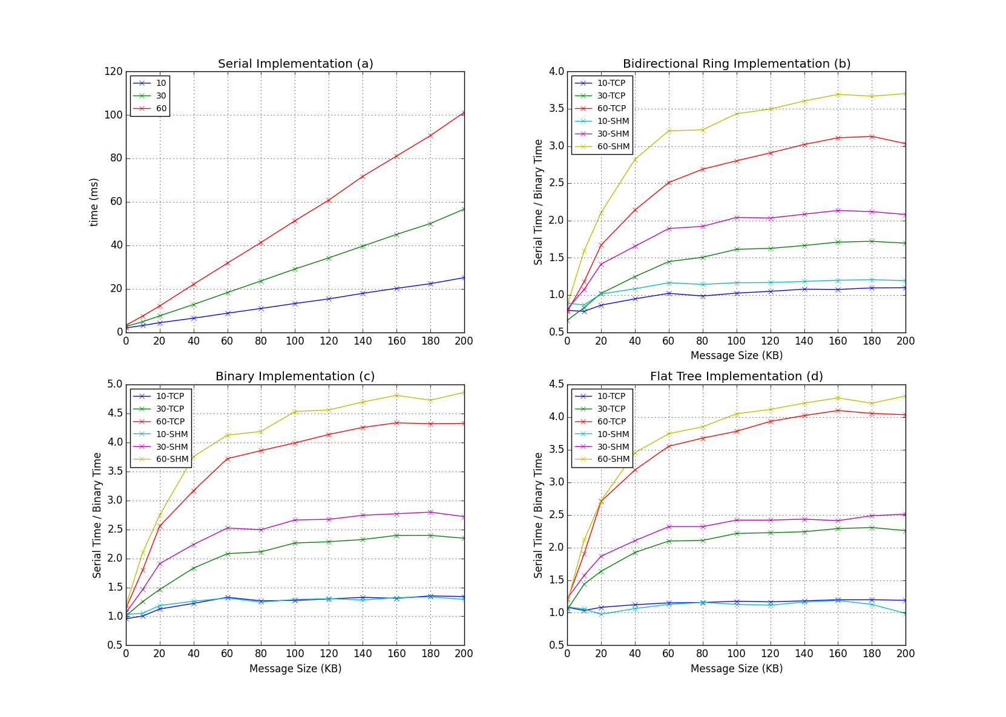
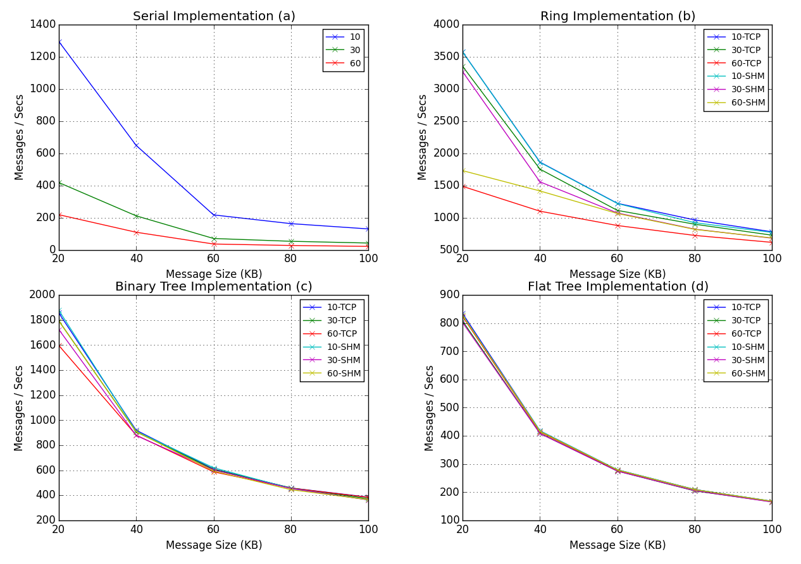
Latency & Throughput of the System
Latency
Throughput

Slide 62
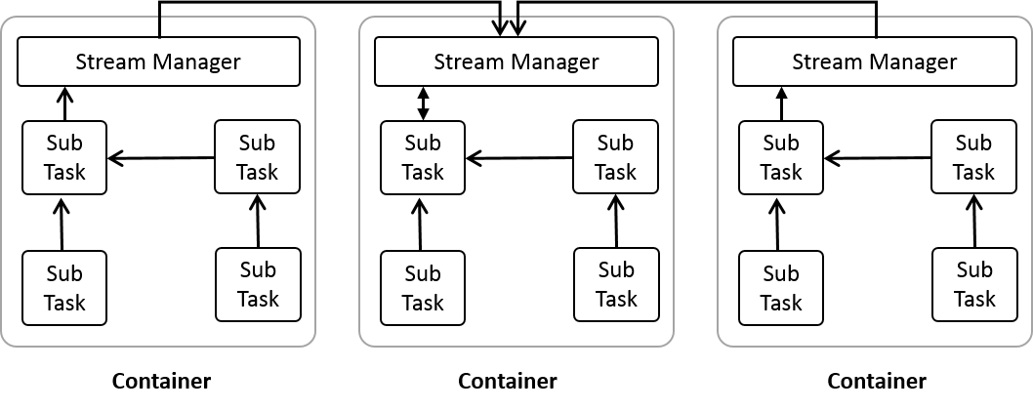
Heron Optimized Collective Implementation
Initial stages
Reduce implementation

Slide 63
Summary of HPC Cloud – Next Generation Grid
We suggest an event driven computing model built around Cloud and HPC and spanning batch, streaming, batch and edge applications
Expand current technology of FaaS (Function as a Service) and server-hidden computing
We have integrated HPC into many Apache systems with HPC-ABDS
We have analyzed the different runtimes of Hadoop, Spark, Flink, Storm, Heron, Naiad, DARMA (HPC Asynchronous Many Task)
  There are different technologies for different circumstances but can be unified by high level abstractions such as communication collectives
  Need to be careful about treatment of state – more research needed

