Slide 1
Using HPC-ABDS for Streaming Data
BIG DATA http://www.locationpowers.net/#agenda
Orlando, FL
Geoffrey Fox September 20, 2016
gcf@indiana.edu
http://www.dsc.soic.indiana.edu/, http://spidal.org/ http://hpc-abds.org/kaleidoscope/
Department of Intelligent Systems Engineering
School of Informatics and Computing, Digital Science Center
Indiana University Bloomington

Slide 2
Abstract
We review results from two recent workshops on streaming applications and their technology.
We introduce HPC-ABDS -- the High Performance Computing Enhanced Apache Big Data Stack and explain how it allows one to achieve performance of HPC and the richness and usability of Apache stack.
We give some examples from robotics and data analytics.
We give an initial discussion of geospatial problems from Polar science and other areas.

Slide 3
Inputs to a Geospatial Big Data Architecture
Two Streaming workshops at http://streamingsystems.org/
  Many important streaming geospatial use cases
NIST Public Big Data Working Group with 5 working groups: Requirements and Use Cases, Definitions and Taxonomies, Reference Architecture, Security and Privacy and Technology Roadmap
  Seem relevant to geospatial
  30% of uses cases were geospatial
  80% of use cases were streaming
  Follow up activities extending work and building exemplar use cases defined with DevOps so can be used on multiple infrastructures: HPC, Docker, OpenStack, AWS
NSF SPIDAL (Scalable Parallel Interoperable Data Analytics Library) project developing HPC-ABDS High Performance Computing enhanced Apache Big Data Stack

Slide 4
Summary of Streaming Workshops
NSF DoE and AFOSR funding
  October 27-28 2015 Indianapolis STREAM2015
  March 22-23, 2016 Washington DC, STREAM2016
http://streamingsystems.org/ has background material plus both workshops
STREAM2015 was to identify the gaps, requirements and challenges of future production cyberinfrastructure beyond traditional HPC with broad application coverage (NSF)
  43 attendees,17 white papers, 29 Presentations (23 with videos)
  Final Report http://streamingsystems.org/stream2015finalreport.html
STREAM2016 had a DoE focus – especially in applications which were mainly instrument based (light sources, astronomy)
  49 attendees, 27 white papers and 31 Presentations
  Final report in draft form

Slide 5
Streaming State of the Art
Classification of Application
  Initial investigation of application characteristics to define/develop classification
    Event size, synchronicity, time & length scales..
    Need to enhance with industry/research use case comparison – industry many small events; research often large (as are self driving cars)
Current software solutions
  Impressive commercial solutions for commercial applications: applicability to science and Government(e.g. DoE) unclear.
  Plethora of “local point” solutions (see report for detailed listing) but few end-to-end general streaming infrastructures outside open sourced big data systems (Apache Spark, Flink, Storm, Samza).
  Opens up issues in distributed computing, e.g., performance, fault-tolerance, dynamic resource management.

Slide 6
Streaming/Steering Application Class |  | Details and Examples | Features
1 | DDDAS, (Industrial) Internet of Things, Control, Cyberphysical Systems, | Software Defined Machines, Smart buildings, transportation, Electrical Grid, Environmental and seismic sensors, Robotics, Autonomous vehicles, Drones | Real-time response often needed; data varies from large to small events, heterogeneity in data sizes and timescales
2 | Internet of People: including wearables | Smart watches, bands, health, glasses, telemedicine | Small independent events
3 | Social media, Twitter, cell phones, blogs, e-commerce and financial transactions | Study of information flow, online algorithms, outliers, graph analytics | Sophisticated analytics across many events; text and numerical data
4 | Satellite and airborne monitors, National Security: Justice, Military | Surveillance, remote sensing, Missile defense, Mission planning, Anti-submarine, Naval tactical cloud | Often large volumes of heterogeneous data and sophisticated image analysis
5 | Astronomy, Light and Neutron Sources, TEM, Instruments like LHC, Sequencers | Scientific Data Analysis in real time or batch from “large” sources. LSST, DES, SKA in astronomy | Real-time or sometimes batch, or even both. large complex events
6 | Data Assimilation | Integrate typically distributed data into simulations to enhance quality. | Link large scale parallel simulations with time dependent data. Sensitivity to latency.
7 | Analysis of Simulation Results | Climate, Fusion, Molecular Dynamics, Materials. Typically local or in-situ data. HPC Big Data Convergence | Increasing bottleneck as simulations scale in size.
8 | Steering and Control | Aerial platforms. Control of simulations or Experiments. Network monitoring. Data could be local or distributed | Variety of scenarios with similarities to robotics. Fault tolerance often critical

Slide 7
Future Research Directions I
Algorithms including existing and new online (touch each data point once) and sampling methods
  Needed even for batch jobs to reduce O(N²) algorithms to O(NlogN) or reduce volume by sampling
  Some research but little robust “production” algorithms
Programming Models and runtime
  Note commercial solutions are better than existing Apache solutions (4 year old commercial systems!)
    e.g. Twitter announces Heron to replace Storm; Amazon Kinesis built to improve Storm performance; Google MillWheel
  Links to HPC runtime, orchestration, dataflow and publish-subscribe technologies

Slide 8
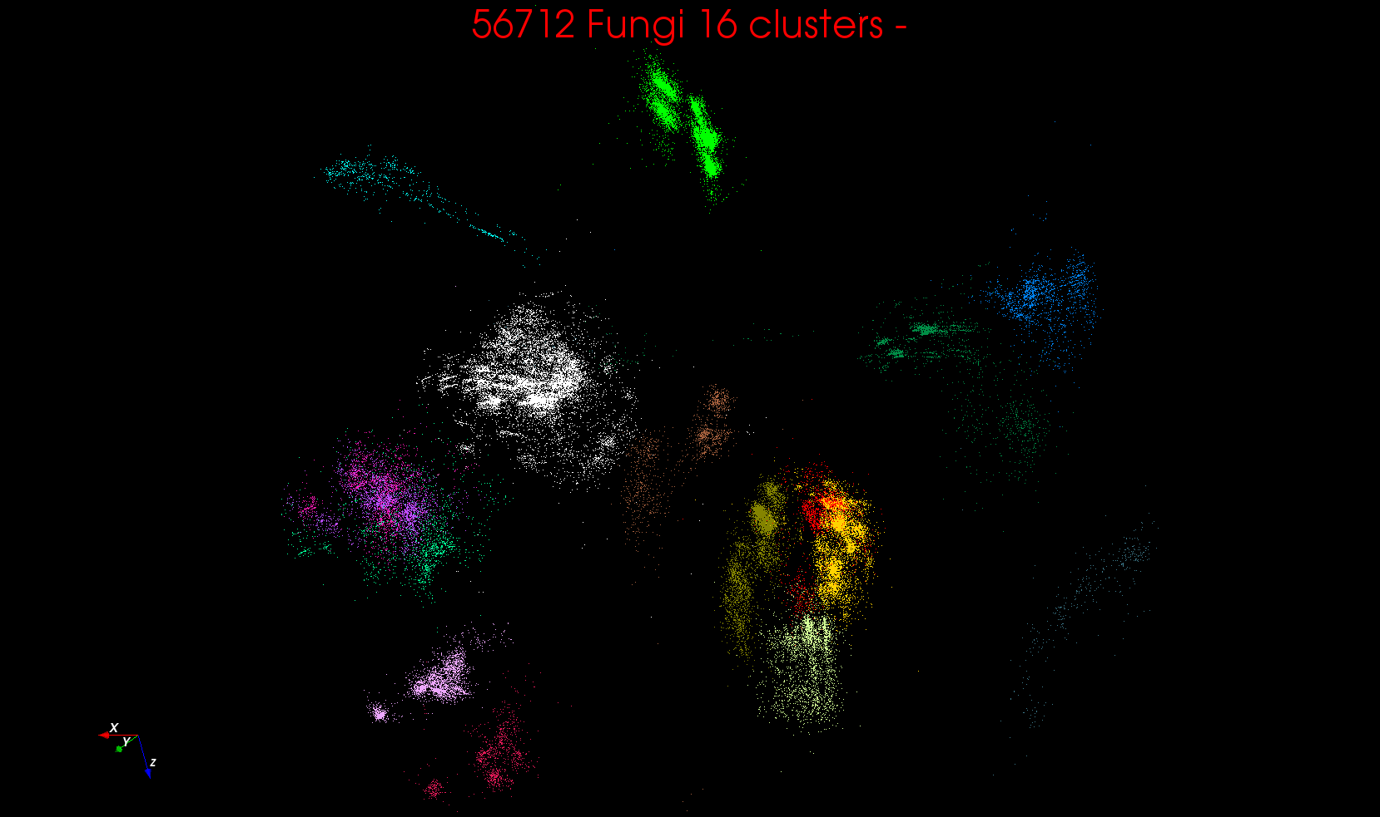
“clean” sample of 446K
O(N²) green-green and purple-purple interactions have value but green-purple are “wasted”
O(N²) reduced to O(N) times cluster size
O(N²) interactions between green and purple clusters should be able to represent by centroids as in Barnes-Hut.
Hard as no Gauss theorem; no multipole expansion and points really in 1000 dimension space as clustered before 3D projection

Slide 9
Future Research Directions II
Benchmarks and Application Collections and Scenarios
  Note huge amount of big data benchmarks (BigDataBench) but no streaming focus
  Participant talks/white papers suggested a few
Collect a streaming Software System and Algorithm Library
  Note paucity of existing streaming algorithms
Streaming System infrastructure
  Need some facilities that support streaming! Prototype possible approaches; I/O needed?
Steering and Human in the Loop
Streaming data produced by simulations increasing
Workshop brought together an interesting interdisciplinary community – need to build and sustain streaming community

Slide 10
NIST Big Data Study

Slide 11
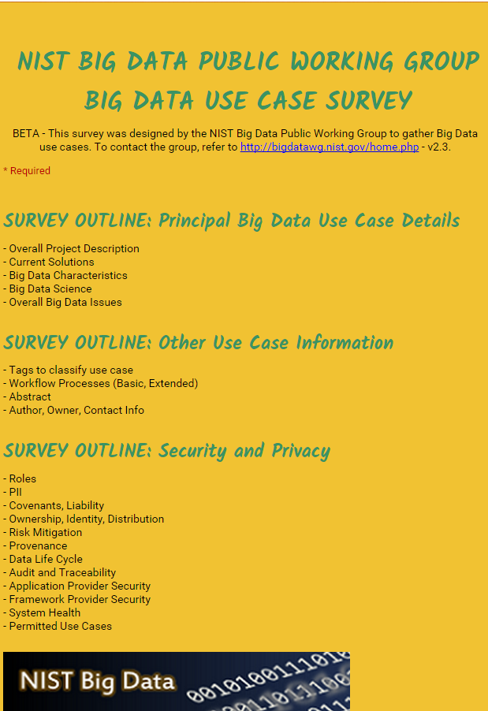
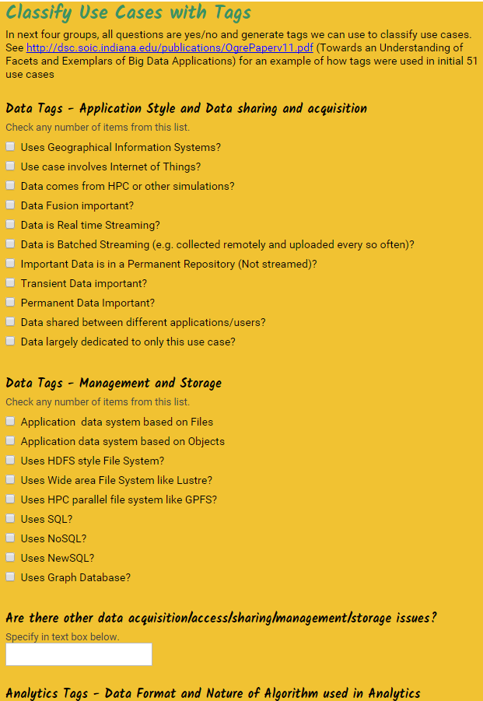
http://hpc-abds.org/kaleidoscope/survey/
Online Use Case Form

Slide 12
NBD-PWG (NIST Big Data Public Working Group) Subgroups & Co-Chairs
There were 5 Subgroups
  Note mainly industry
Requirements and Use Cases Sub Group
  Geoffrey Fox, Indiana U.; Joe Paiva, VA; Tsegereda Beyene, Cisco
Definitions and Taxonomies SG
  Nancy Grady, SAIC; Natasha Balac, SDSC; Eugene Luster, R2AD
Reference Architecture Sub Group
  Orit Levin, Microsoft; James Ketner, AT&T; Don Krapohl, Augmented Intelligence
Security and Privacy Sub Group
  Arnab Roy, CSA/Fujitsu Nancy Landreville, U. MD Akhil Manchanda, GE
Technology Roadmap Sub Group
  Carl Buffington, Vistronix; Dan McClary, Oracle; David Boyd, Data Tactics
http://nvlpubs.nist.gov/nistpubs/SpecialPublications/NIST.SP.1500-3.pdf

Slide 13
NIST Big Data Reference Architecture NBDRA

Slide 14
2. Perform real time analytics on data source streams and notify users when specified events occur
Specify filter
Filter Identifying Events
Fetch streamed Data
Post Selected Events
Streaming Data
Posted Data
Identified Events
Streaming Data
Streaming Data
Archive
Repository
Storm, Kafka, Hbase, Zookeeper

Slide 15



5. Perform interactive analytics on data in analytics-optimized database
Mahout, R
Hadoop, Spark, Giraph, Pig …
Data Storage: HDFS, Hbase
Data, Streaming, Batch …..

Slide 16
5A. Perform interactive analytics on observational scientific data
Science Analysis Code, Mahout, R
Grid or Many Task Software, Hadoop, Spark, Giraph, Pig …
Data Storage: HDFS, Hbase, File Collection
Direct Transfer
Transport batch of data to primary analysis data system
Streaming Twitter data for Social Networking
Local Accumulate and initial computing
NIST examples include LHC, Remote Sensing, Astronomy and Bioinformatics
Record Scientific Data in “field”

Slide 17
Sample Features of 51 Use Cases I
PP (26) “All” Pleasingly Parallel or Map Only
MR (18) Classic MapReduce MR (add MRStat below for full count)
MRStat (7) Simple version of MR where key computations are simple reduction as found in statistical averages such as histograms and averages
MRIter (23) Iterative MapReduce or MPI (Flink, Spark, Twister)
Graph (9) Complex graph data structure needed in analysis
Fusion (11) Integrate diverse data to aid discovery/decision making; could involve sophisticated algorithms or could just be a portal
Streaming (41) Some data comes in incrementally and is processed this way
Classify (30) Classification: divide data into categories
S/Q (12) Index, Search and Query

Slide 18
Sample Features of 51 Use Cases II
CF (4) Collaborative Filtering for recommender engines
LML (36) Local Machine Learning (Independent for each parallel entity) – application could have GML as well
GML (23) Global Machine Learning: Deep Learning, Clustering, LDA, PLSI, MDS,
  Large Scale Optimizations as in Variational Bayes, MCMC, Lifted Belief Propagation, Stochastic Gradient Descent, L-BFGS, Levenberg-Marquardt . Can call EGO or Exascale Global Optimization with scalable parallel algorithm
Workflow (51) Universal
GIS (16) Geotagged data and often displayed in ESRI, Microsoft Virtual Earth, Google Earth, GeoServer etc.
HPC (5) Classic large-scale simulation of cosmos, materials, etc. generating (visualization) data
Agent (2) Simulations of models of data-defined macroscopic entities represented as agents

Slide 20
6 Forms of MapReduce
Describes Architecture of
- Problem (Model reflecting data)
- Machine
- Software
2 important variants (software) of Iterative MapReduce and Map-Streaming a) “In-place” HPC b) Flow for model and data

Slide 21
SPIDAL Project

Slide 22
SPIDAL Project
Datanet: CIF21 DIBBs: Middleware and High Performance Analytics Libraries for Scalable Data Science
NSF14-43054 started October 1, 2014
Indiana University (Fox, Qiu, Crandall, von Laszewski)
Rutgers (Jha)
Virginia Tech (Marathe)
Kansas (Paden)
Stony Brook (Wang)
Arizona State (Beckstein)
Utah (Cheatham)
A co-design project: Software, algorithms, applications

Slide 23





Co-designing Building Blocks Collaboratively
Software: MIDAS
HPC-ABDS
OGC and GeoSpatial Use cases

Slide 24
Main Components of SPIDAL Project
Design and Build Scalable High Performance Data Analytics Library
SPIDAL (Scalable Parallel Interoperable Data Analytics Library): Scalable Analytics for:
  Domain specific data analytics libraries – mainly from project.
  Add Core Machine learning libraries – mainly from community.
  Performance of Java and MIDAS Inter- and Intra-node.
NIST Big Data Application Analysis – features of data intensive Applications deriving 50 Ogres and 64 Convergence Diamonds. Application Nexus.
HPC-ABDS: Cloud-HPC interoperable software performance of HPC (High Performance Computing) and the rich functionality of the commodity Apache Big Data Stack. Software Nexus
MIDAS: Integrating Middleware – from project.
Applications: Biomolecular Simulations, Network and Computational Social Science, Epidemiology, Computer Vision, Geographical Information Systems, Remote Sensing for Polar Science and Pathology Informatics, Streaming for robotics, streaming stock analytics
Implementations: HPC as well as clouds (OpenStack, Docker) Convergence with common DevOps tool Hardware Nexus

Slide 25
Why Connect (“Converge”) Big Data and HPC
Two major trends in computing systems are
  Growth in high performance computing (HPC) with an international exascale initiative (China in the lead)
  Big data phenomenon with an accompanying cloud infrastructure of well publicized dramatic and increasing size and sophistication.
Note “Big Data” largely an industry initiative although software used is often open source
  HPC labels overlaps with “research”: USA HPC community largely responsible for Astronomy & Accelerator (LHC, Belle, Light Source ....) data analysis
Merge HPC and Big Data to get
  More efficient sharing of large scale resources running simulations and data analytics
  Higher performance Big Data algorithms
  Richer software environment for research community building on many big data tools
  Easier sustainability model for HPC – HPC does not have resources to build and maintain a full software stack

Slide 26
Software Nexus
Application Layer On
Big Data Software Components for Programming and Data Processing On
HPC for runtime On
IaaS and DevOps Hardware and Systems
HPC-ABDS
MIDAS
Java Grande

Slide 27
HPC-ABDS

Slide 28
Functionality of 21 HPC-ABDS Layers
Message Protocols:
Distributed Coordination:
Security & Privacy:
Monitoring:
IaaS Management from HPC to hypervisors:
DevOps:
Interoperability:
File systems:
Cluster Resource Management:
Data Transport:
A) File management
B) NoSQL
C) SQL
In-memory databases & caches / Object-relational mapping / Extraction Tools
Inter process communication Collectives, point-to-point, publish-subscribe, MPI:
A) Basic Programming model and runtime, SPMD, MapReduce:
B) Streaming:
A) High level Programming:
B) Frameworks
Application and Analytics:
Workflow-Orchestration:
Lesson of large number (350). This is a rich software environment that HPC cannot “compete” with. Need to use and not regenerate
Note level 13 Inter process communication added

Slide 29
HPC-ABDS SPIDAL Project Activities
Green is MIDAS
Black is SPIDAL
Level 17: Orchestration: Apache Beam (Google Cloud Dataflow) integrated with Heron/Flink and Cloudmesh on HPC cluster
Level 16: Applications: Datamining for molecular dynamics, Image processing for remote sensing and pathology, graphs, streaming, bioinformatics, social media, financial informatics, text mining
Level 16: Algorithms: Generic and custom for applications SPIDAL
Level 14: Programming: Storm, Heron (Twitter replaces Storm), Hadoop, Spark, Flink. Improve Inter- and Intra-node performance; science data structures
Level 13: Runtime Communication: Enhanced Storm and Hadoop (Spark, Flink, Giraph) using HPC runtime technologies, Harp
Level 12: In-memory Database: Redis + Spark used in Pilot-Data Memory
Level 11: Data management: Hbase and MongoDB integrated via use of Beam and other Apache tools; enhance Hbase
Level 9: Cluster Management: Integrate Pilot Jobs with Yarn, Mesos, Spark, Hadoop; integrate Storm and Heron with Slurm
Level 6: DevOps: Python Cloudmesh virtual Cluster Interoperability

Slide 30
Java Grande
Revisited on 3 data analytics codes
Clustering
Multidimensional Scaling
Latent Dirichlet Allocation all sophisticated algorithms

Slide 31
Java versus C Performance
C and Java Comparable with Java doing better on larger problem sizes
All data from one million point dataset with varying number of centers on 16 nodes 24 core Haswell

Slide 32

Java Parallel Performance
128 24 core Haswell nodes on SPIDAL 200K DA-MDS Code
Speedup compared to 1 process per node on 48 nodes
Best MPI; inter and intra node
MPI; inter/intra node; Java not optimized
Best FJ Threads intra node; MPI inter node

Slide 33
Harp (Hadoop Plugin) brings HPC to ABDS
Basic Harp: Iterative HPC communication; scientific data abstractions
Careful support of distributed data AND distributed model
Avoids parameter server approach but distributes model over worker nodes and supports collective communication to bring global model to each node
Applied first to Latent Dirichlet Allocation LDA with large model and data
MapReduce Model
MapCollective Model
MapReduce Applications
MapCollective Applications
M
M
M
M
M
M
M
M
MapReduce V2
Harp
Shuffle
Collective Communication
R
R
YARN

Slide 34
Streaming Applications and Technology

Slide 35
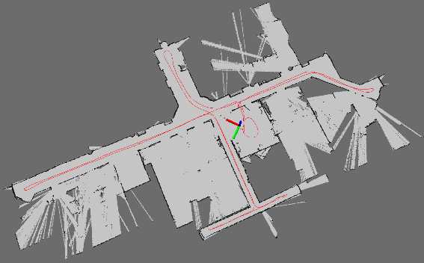
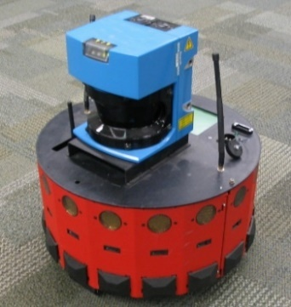
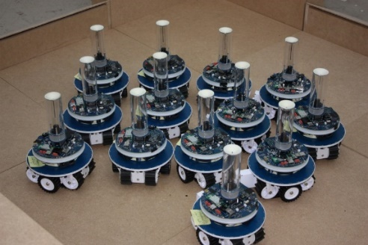
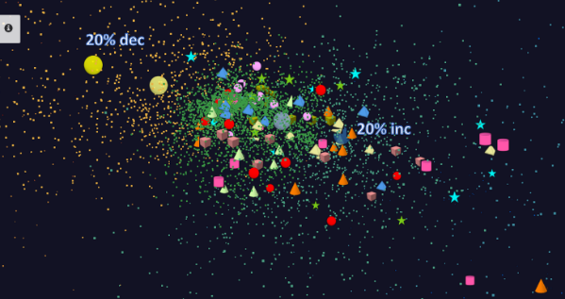
Adding HPC to Storm & Heron for Streaming
Robotics Applications
Time series data visualization in real time
Simultaneous Localization and Mapping
N-Body Collision
Avoidance
Map Built from
Robot data
Robot with a Laser Range Finder
Robots need to avoid collisions when they move
Map High dimensional data to 3D visualizer
Apply to Stock market data tracking 6000 stocks
Cloud Controlled Robotics
Streaming (stock market) data

Slide 36
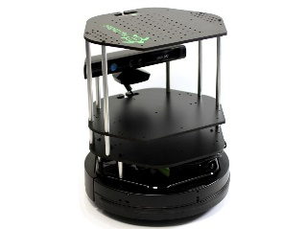
Data Pipeline
Sending to
pub-sub
Sending to
Persisting
storage
Multiple
streaming
workflows
Streaming
workflow
A stream application with some tasks running in parallel
Gateway
Message Brokers
RabbitMQ, Kafka
Streaming Workflows
Apache Heron and Storm
End to end delays without any processing is less than 10ms
Storm does not support “real parallel processing” within bolts – add optimized inter-bolt communication
Hosted on HPC and OpenStack cloud

Slide 37
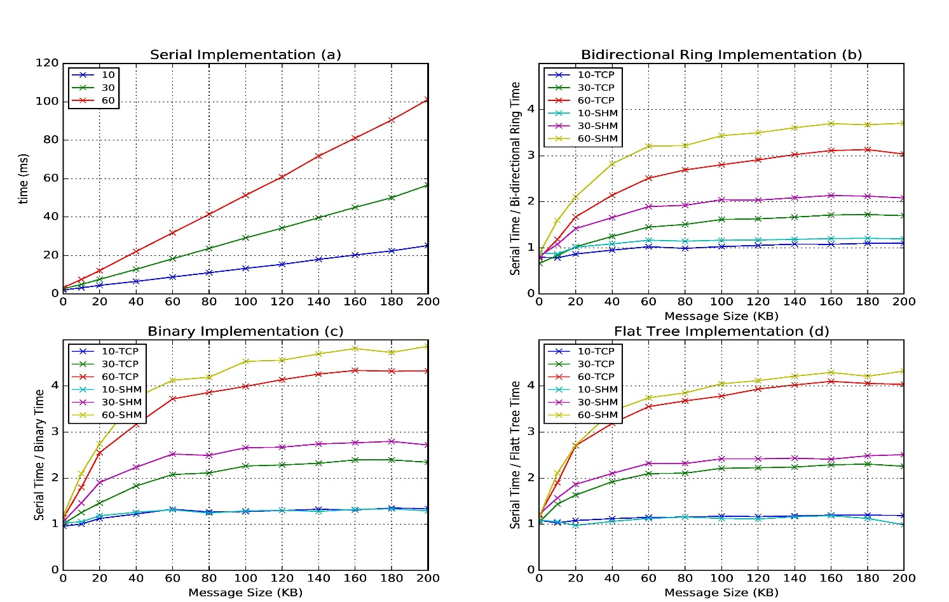
Improvement of Storm (Heron) using HPC communication algorithms
Latency of binary tree, flat tree and bi-directional ring implementations compared to serial implementation. Different lines show varying # of parallel tasks with either TCP communications and shared memory communications(SHM).
Original Time
Speedup Ring
Speedup Binary
Speedup Tree

Slide 38
SPIDAL Applications
Network Science: graph algorithms
General Discussion of Images
Remote Sensing in Polar regions: image processing
Pathology: image processing
Spatial search and GIS for Public Health
Biomolecular simulations
  Path Similarity Analysis
  Detect continuous lipid membrane leaflets in a MD simulation

Slide 39
Imaging Applications: Remote Sensing, Pathology, Spatial Systems
Both Pathology/Remote sensing working on 2D moving to 3D images
Each pathology image could have 10 billion pixels, and we may extract a million spatial objects per image and 100 million features (dozens to 100 features per object) per image. We often tile the image into 4K x 4K tiles for processing. We develop buffering-based tiling to handle boundary-crossing objects. For each typical study, we may have hundreds to thousands of images
Remote sensing aimed at radar images of ice and snow sheets; as data from aircraft flying in a line, we can stack radar 2D images to get 3D
2D problems need modest parallelism “intra-image” but often need parallelism over images
3D problems need parallelism for an individual image
Use many different Optimization algorithms to support applications (e.g. Markov Chain, Integer Programming, Bayesian Maximum a posteriori, variational level set, Euler-Lagrange Equation)
Classification (deep learning convolution neural network, SVM, random forest, etc.) will be important

Slide 40
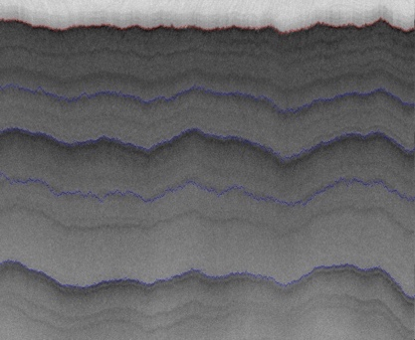
2D Radar Polar Remote Sensing
Need to estimate structure of earth (ice, snow, rock) from radar signals from plane in 2 or 3 dimensions.
Original 2D analysis (called [11]) used Hidden Markov Methods; better results using MCMC (our solution)
Extending to snow radar layers

Slide 41
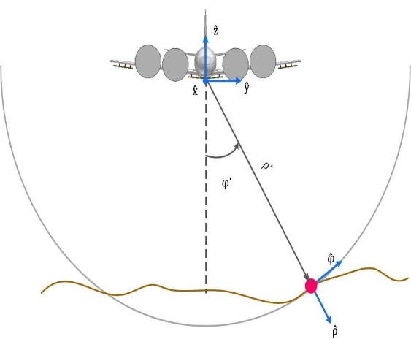
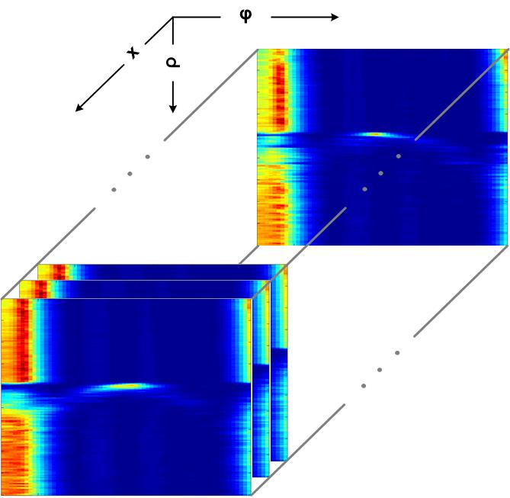
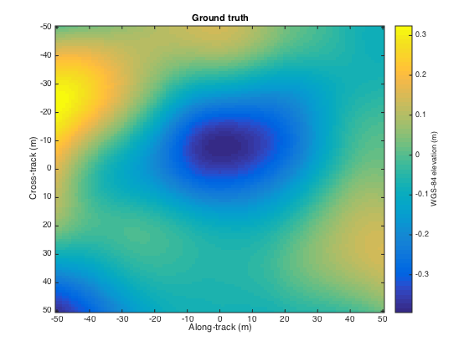
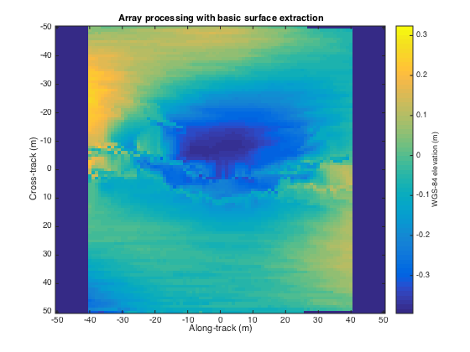
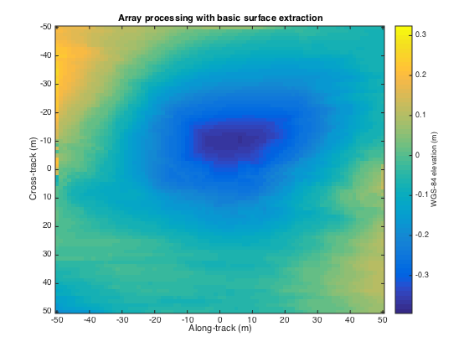
3D Radar Polar Remote Sensing
Uses Loopy belief propagation LBP to analyze 3D radar images
Radar gives a cross-section view, parameterized by angle and range, of the ice structure, which yields a set of 2-d tomographic slices (right) along the flight path.
Each image represents a 3d depth map, with along track and cross track dimensions on the x-axis and y-axis respectively, and depth coded as colors.
Reconstructing bedrock in 3D, for (left) ground truth, (center) existing algorithm based on maximum likelihood estimators, and (right) our technique based on a Markov Random Field formulation.

Slide 42
Returning to Geospatial issues

Slide 43
** Open Approaches to Big Geo Data **
Loose-coupling while enabling competition
  Identify open strategies at the interfaces
  Geospatial Services that keep processing close to data
Portability of data across clouds
  Information models, semantics, encodings
Algorithm and workflow abstractions
  Processing and workflow control from web clients
  Metadata for describing algorithms.
Proliferation of proprietary APIs
  Reverse the degradation of interoperability
Use HPC-ABDS and collaborate on Geospatial algorithms for SPIDAL

Slide 44
HTML5 web viewer WebPlotViz
Supports visualization of 3D point sets (typically derived by mapping from abstract spaces) for streaming and non-streaming case
  Simple data management layer
  3D web visualizer with various capabilities such as defining color schemes, point sizes, glyphs, labels
Core Technologies
  MongoDB management
  Play Server side framework
  Three.js
  WebGL
  JSON data objects
  Bootstrap Javascript web pages
Open Source
http://spidal-gw.dsc.soic.indiana.edu/
~10,000 lines of extra code
Front end view (Browser)
Plot visualization & time series animation (Three.js)
Upload
Request Plots
JSON Format Plots
Web Request Controllers (Play Framework)
Server
Upload format to JSON Converter
Data Layer
(MongoDB)
MongoDB

Slide 45
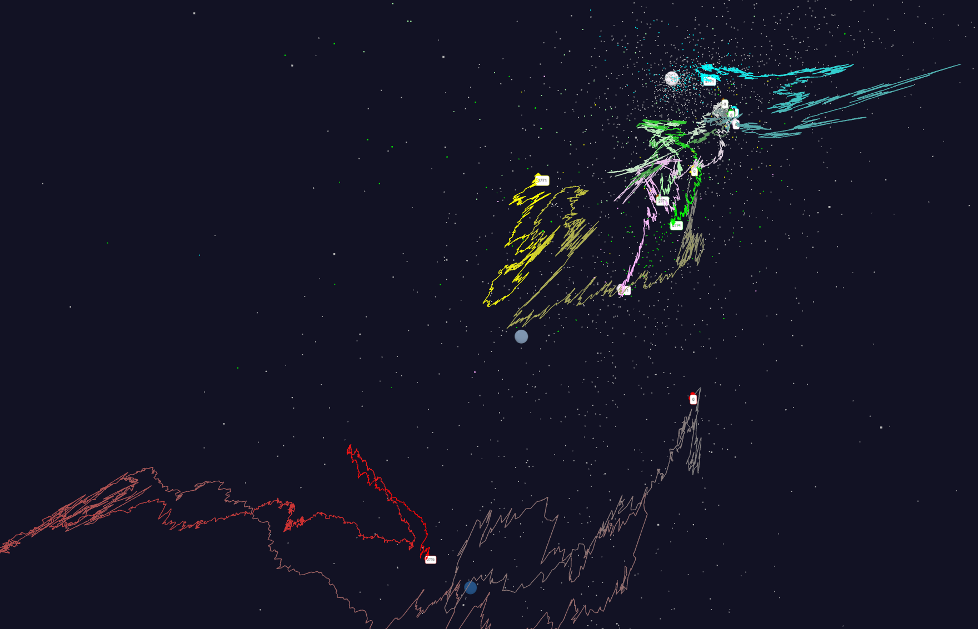
Relative Changes in Stock Values using one day values measured from January 2004 and starting after one year January 2005
Filled circles are final values
Origin
0% change
Finance
Energy
Dow Jones
S&P
Mid Cap
+10%
Apple
+20%

Slide 46
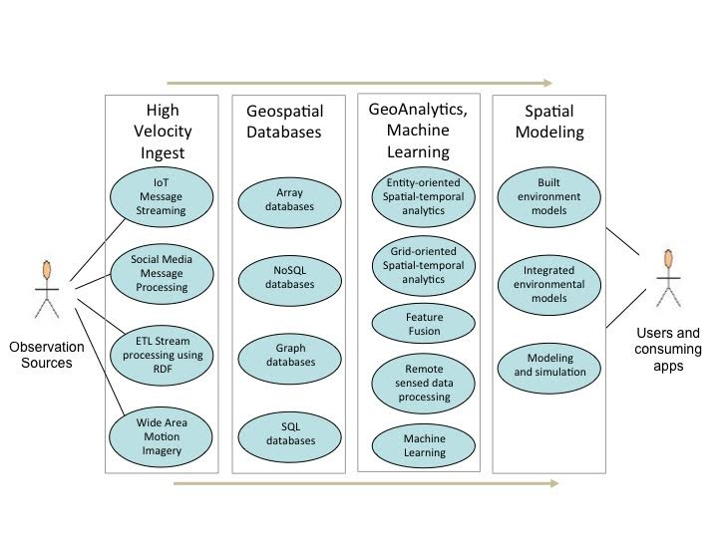
OGC Graphic

Slide 47
Possible HPC-ABDS Geospatial Activities
Level 17: Orchestration: Apache Beam (Google Cloud Dataflow) integrated with Heron/Flink and Cloudmesh on HPC cluster
Level 16: Applications: As in OGC white paper
Level 16: Algorithms: Generic (SPIDAL) and custom for OGC use cases. Requirements analysis; Design interfaces
Level 14: Programming: Storm, Heron, Hadoop, Spark, Flink. Improve Inter- and Intra-node performance; research and geospatial data structures
Level 13: Runtime Communication: Use MPI, OpenMP technologies when parallel computing needed. Take Apache for distributed & Pub-sub
Level 11: Data management: Use best SQL and NOSQL supporting spatial data structures and hence query and analytics
Level 9: Cluster Management: Yarn, Mesos, Slurm as research identies as best
Level 6: DevOps: Python Cloudmesh virtual Cluster Interoperability on OpenStack, AWS, Docker, HPC
Convergence: Use same tools with parallel computing run-time for simulations. Integrate with Apache Beam

