Slide 1
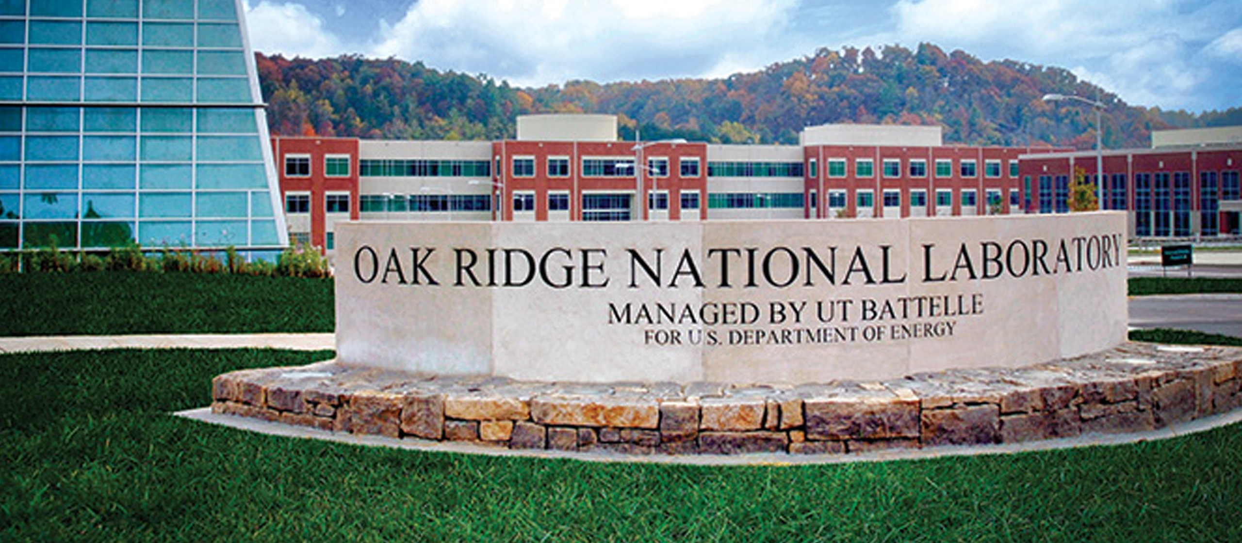
HPC, Big Data, and Machine Learning Convergence
Oak Ridge National Laboratory
Geoffrey Fox, Judy Qiu, Shantenu Jha January 2020
Digital Science Center, Indiana University
gcf@indiana.edu, http://www.dsc.soic.indiana.edu/, http://spidal.org/

Slide 2
HPC, Clouds, Big Data, Machine Learning and IoT Convergence
Abstract: We discuss the linkage and integration between High Performance Computing (HPC), Clouds, Big Data, Machine Learning (and AI) and Edge(IoT) computing
We discuss these separately as both sets of technologies/artifacts and as communities and their status in both academic, government (National Laboratory) and industry activities.
Their importance in transforming major industries: such as media, transportation/mobility, commerce, banking and health – implies industry involvement has become dominant.
These technologies will also transform science and research and here we must take the lead.
HPC can be used to enhance Big Data systems (HPC for ML) but also ML can be used to enhance system execution (ML for HPC) by large factors.
  Zettascale and probably Yottascale effective performance seems possible
We discuss details of classic HPC and Big Data Software Systems

Slide 3
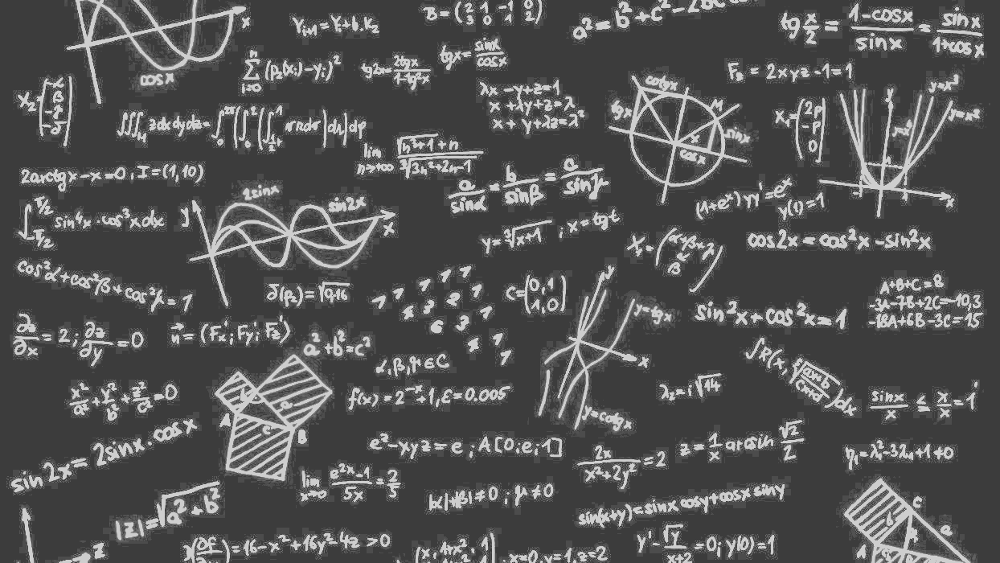
Communities
HPC Cloud Edge IoT and Big Data
Trends

Slide 4
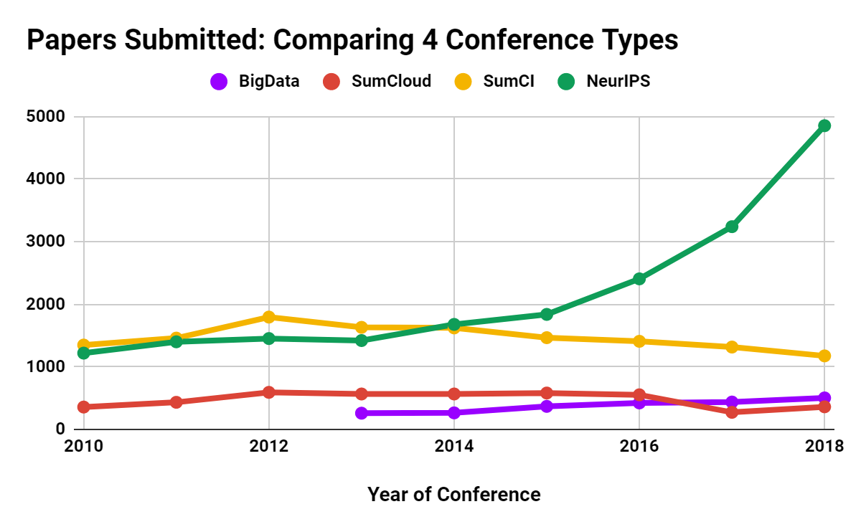
Papers Submitted: Comparing 4 Conference Types
SumCI: SC, eScience, CCGrid, IPDPS
SumCloud: IEEE Cloud, Cloudcom
Notes:
Summary

Slide 5
Trends in AI, Big Data, Clouds, Edge, HPC over last 5 years
Artificial Intelligence
Amazon Web Services (Proxy for cloud computing)
Internet of Things
Big Data
High Performance Computing (1%)

Slide 6
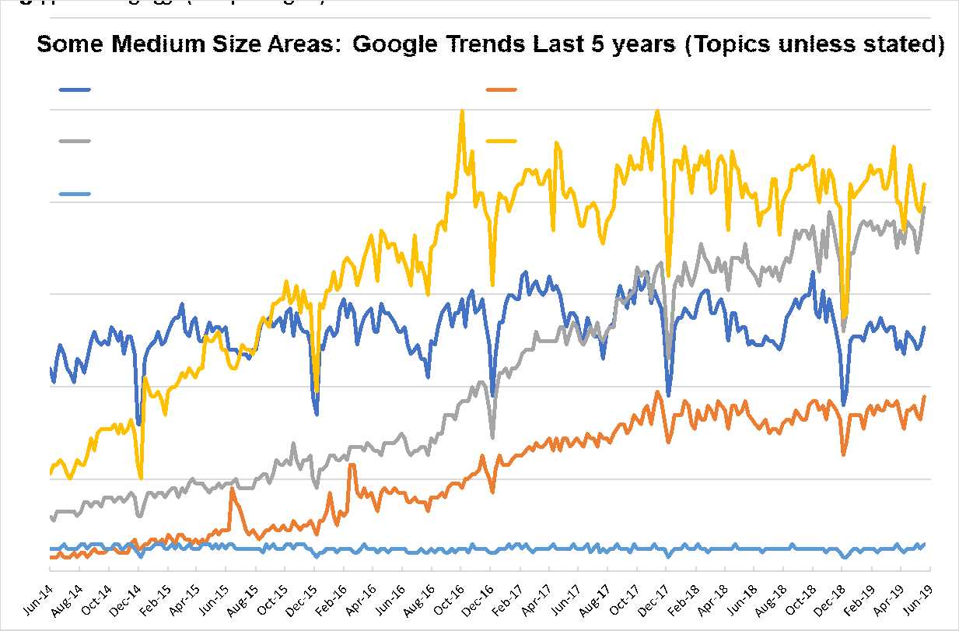
Some medium size areas: Google Trends last 5 years (Topics unless otherwise stated)
AI IS 10X BIG DATA, CYBERINFRASTRUCTURE, EXASCALE SMALL
Internet of Things
Machine Learning
(Search Term)
Big Data
Deep Learning
High Performance Computing (HPC)
Notes:
●IoT ML DL growing
●Big Data HPC flattish with HPC < Big Data

Slide 7
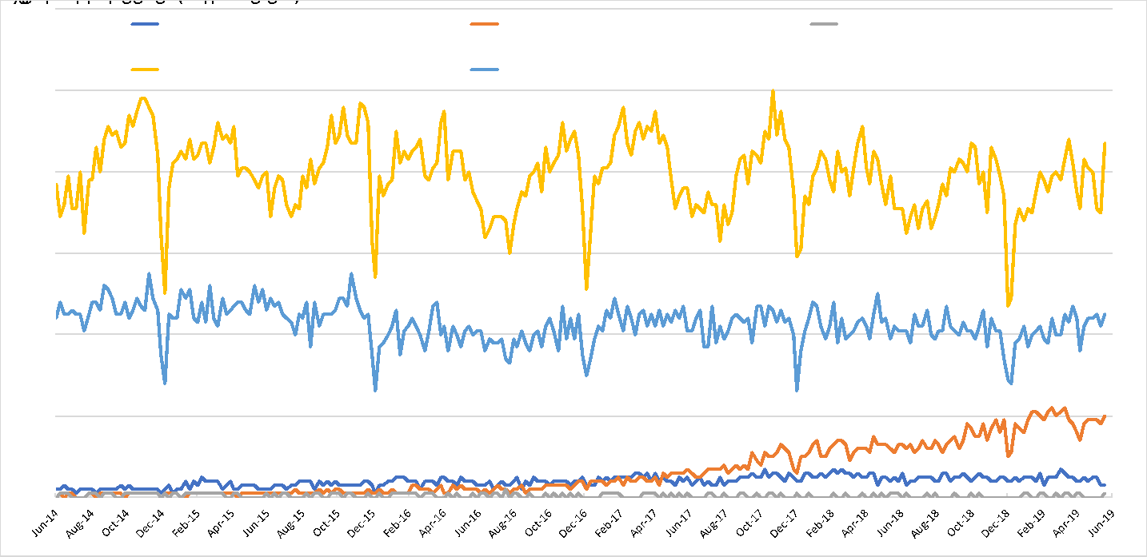
Some smaller areas: Google Trends last 5 years (Topics unless otherwise stated)
Parallel Computing (Programming Paradigm)
HPC
Edge Computing
Fog Computing
Cyberinfrastructure
Notes:
●Some small fields. Edge growing but pretty small

Slide 8
H5-index Conferences: AI, Big Data, Cloud, Systems, Other 2018 (2019 Brown)
H5 is h index for papers over 5 years for conferences and journals
158 (188) CVPR: Conference on Computer Vision and Pattern Recognition
101 (134) NeurIPS: Neural Information Processing Systems
98 (104) ECCV: European Conference on Computer Vision
91 (113) ICML: International Conference on Machine Learning
89 (124) ICCV: International Conference on Computer Vision
85 (86) CHI: Computer Human Interaction
80 (76) INFOCOM: Joint Conference of the Computer and Communications Societies
77 (76) WWW: International World Wide Web Conferences
73 (74) VLDB: International Conference on Very Large Databases
73 (77) SIGKDD: International Conference on Knowledge discovery and data mining
71 (75) ICRA: International Conference on Robotics and Automation
56 (69) AAAI: Assoc. Adv. AI Conference on Artificial Intelligence
54 (58) ISCA: International Symposium on Computer Architecture
50 (54) IROS: International Conference on Intelligent Robots and Systems
50 (51) ASPLOS: International Conference on Architectural Support for Programming Languages and Operating Systems
47 (42) SC: International Conference on High Performance Computing, Networking, Storage and Analysis
46 (51) HPCA: International Symposium on High Performance Computer Architecture
45 (61) IJCAI: International Joint Conference on Artificial Intelligence
43 (42) BMVC: British Machine Vision Conference
43 (46) IPDPS: International Symposium on Parallel & Distributed Processing
41 (41) MICRO: International Symposium on Microarchitecture
39 (31) CLOUD: International Conference on Cloud Computing
39 (?) OSDI: Symposium on Operating Systems Design and Implementation
37 (33) OOPSLA: SIGPLAN International Conference on Object-Oriented Programming, Systems, Languages, and Applications
37 (32) PPOPP: SIGPLAN Symposium on Principles & Practice of Parallel Programming
37 (33) CCGrid: International Symposium on Cluster Computing and the Grid
34 (41) ICIP: International Conference on Image Processing
34 (28) ICPR: International Conference on Pattern Recognition
30 (35) SoCC: Symposium on Cloud Computing
29 (22) ECAI: European Conference on Artificial Intelligence
29 (28) HPDC: International Symposium on High Performance Distributed Computing
28 (25) CloudCom: International Conference on Cloud Computing Technology and Science
26 (25) ICS: International Conference on Supercomputing
25 (33) Big Data: International Conference on Big Data
21 (20) CLUSTER: International Conference on Cluster Computing
21 (22) SPAA: Symposium on Parallelism in Algorithms and Architectures
20 (20) ICPP: International Conference on Parallel Processing
18 (20) ICCSA: International Conference on Computational Science and Its Applications
15 (12) SBAC-PAD: International Symposium on Computer Architecture and High Performance Computing
14 (11) DS-RT: International Symposium on Distributed Simulation and Real-Time Applications
2019 Averages and change from 2018
AI 15 Conferences <h5> = 80.4 up 15%
Systems 17 Conferences <h5> = 32.1 down 2%
Cloud 3 Conferences <h5> = 30.3 down 6%
Big Data 1 Conference h5=33 up 32%
Some didn’t make h5-index cut of >=12
Notes:
Escience below cut
H5 shows dominance of AI

Slide 9
Strength of Communities, Academia and Industry
HPC Community not growing in terms of obvious metrics such as new faculty advertisements, student interest, papers published
  Its importance as a technology – rather than a research area – is clear
Level of important innovation in deep learning dominates that in other areas
Cloud Community quite strong in Industry; relatively small academically as Industry has some advantages (infrastructure and data)
Big Data and Edge communities strong in Academia and Industry
  Big Data definition unclear but it is growing although still quite small in terms of dedicated activities
Cloud Edge IoT and Big Data conferences activities significant overlap – not surprising as most IoT/Edge systems connect to Cloud and ~all commercial Big Data work uses cloud.
All these academic fields need to align with mainstream (Industry) systems
In terms of sizes of effort Industry > DoE > Universities and more commonality in interest than in past
Planning research today considers if Google or Facebook will wipe us out

Slide 10
Convergence
Big Data
Deep Learning
Simulation
HPC

Slide 11
Next Generation of Cyberinfrastructure:
Application Requirements
Four clear classes of applications are
  Classic simulations which are addressed excellently by DoE exascale program and although our focus is Big Data, one should consider this application area as we need to integrate simulations with data analytics and ML (Machine Learning) -- item d) below
  Classic Big Data Analytics as in the analysis of LHC data, SKA, Light sources, health, and environmental data. HPCforML
  Cloud-Edge applications which certainly overlap with b) as data in many fields comes from the edge
    Note original compute Grid is now a data Grid and called Edge computing
  Integration of ML and Data analytics with simulations. “learning everywhere” MLforHPC

Slide 12
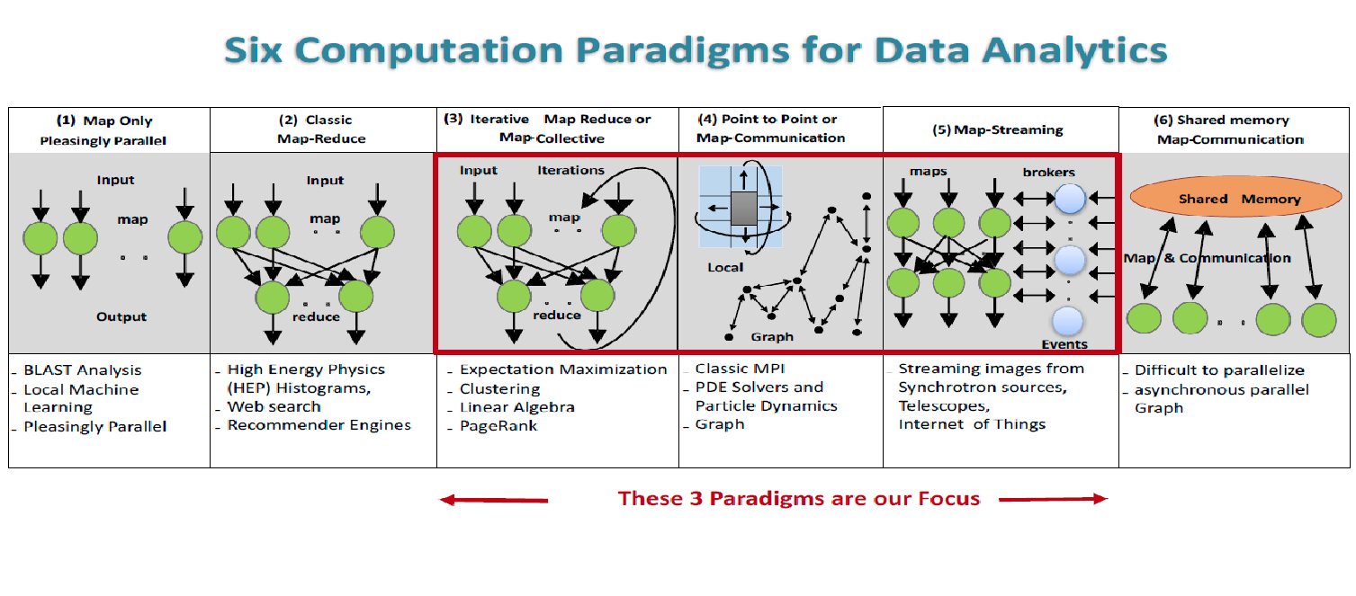
Five Major Application Structures
Global Machine Learning
Classic Cloud Workload
High Performance Big Data Workload
5 Application Classes cover both Applications and Simulations

Slide 13
Big Data and Simulation Similar Challenges in Parallelism
Complexity of Synchronization and Parallellization
Loosely Coupled
Regular Coupling
Complex Coupling
Big
Data
HPC Clouds: Accelerators
High Performance Interconnect
HPC Clouds/Supercomputers
Memory access also critical
Commodity Clouds
MapReduce as in scalable databases
Global Machine Learning
e.g. parallel clustering
Graph Analytics e.g. subgraph mining
Deep Learning
LDA
Pleasingly Parallel
Often independent events
Regular simulations
Unstructured Adaptive Sparse
Parameter sweep simulations
Structured Adaptive Sparse
Current major Big Data category
Linear Algebra at core
(often not sparse)
Straightforward Parallelism
User Performed Parallelism
Simulations

Slide 14
Remarks on Convergence Big Data, Simulation, HPC
HPC integration with both Big Data and (Big) Simulation has one clear aspect as both areas need high performance reached by HPC technology
  Clear in exascale initiative and success of computational science
  Part of Systems for ML in Dean’s talk at NeurIPS 2017 for Big Data
  We term HPCforML and reasonably clear how to support in hardware and software as seen in DoE systems
  Details uncertain partly due to uncertainties of Industry directions, HPC Clouds v. supercomputers etc.
We can also integrate Big Data technology (from Apache Software Stack to Containers) with simulations
Dean also discussed use of machine learning to enhance Systems which becomes MLforHPC when system built on HPC technology
  Actually involves applications and not just the system
Even broad principles for MLforHPC software and hardware support unclear at this early stage

Slide 15
MLforHPC
Categories
Examples

Slide 16
MLforHPC in detail
MLforHPC can be further subdivided into several categories:
  MLautotuning: Using ML to configure (autotune) ML or HPC simulations.
  MLafterHPC: ML analyzing results of HPC as in trajectory analysis and structure identification in biomolecular simulations
  MLaroundHPC: Using ML to learn from simulations and produce learned surrogates for the simulations or parts of simulations. The same ML wrapper can also learn configurations as well as results. Most Important
  MLControl: Using simulations (with HPC) in control of experiments and in objective driven computational campaigns. Here the simulation surrogates are very valuable to allow real-time predictions.

Slide 17
MLaroundHPC and MLAutotuningHPC
Use Computation to represent Simulation or Big Data
We identified 8 styles of MLforHPC
Improving Computations with Configurations and Integration of Data
  Autotuning of initial and running configuration; data assimilation
Learn Structure, Theory and Model for Computations
  Learn potentials, support cross-scale integration; learn microscale structure; derive fundamental theories
  Generate smart ensembles and collective coordinates
Learn Surrogates for Simulations
  Can be input specifications mapped into output features
    Can be combined with experimental observation over same input specifications
  Or input field values mapped to output field values
ML gives speedup factors from 2 (static Autotuning) to 10^{N} (N=5-8 in examples) from surrogates and smart ensembles with strong speedup (fixed problem speedup)

Slide 18
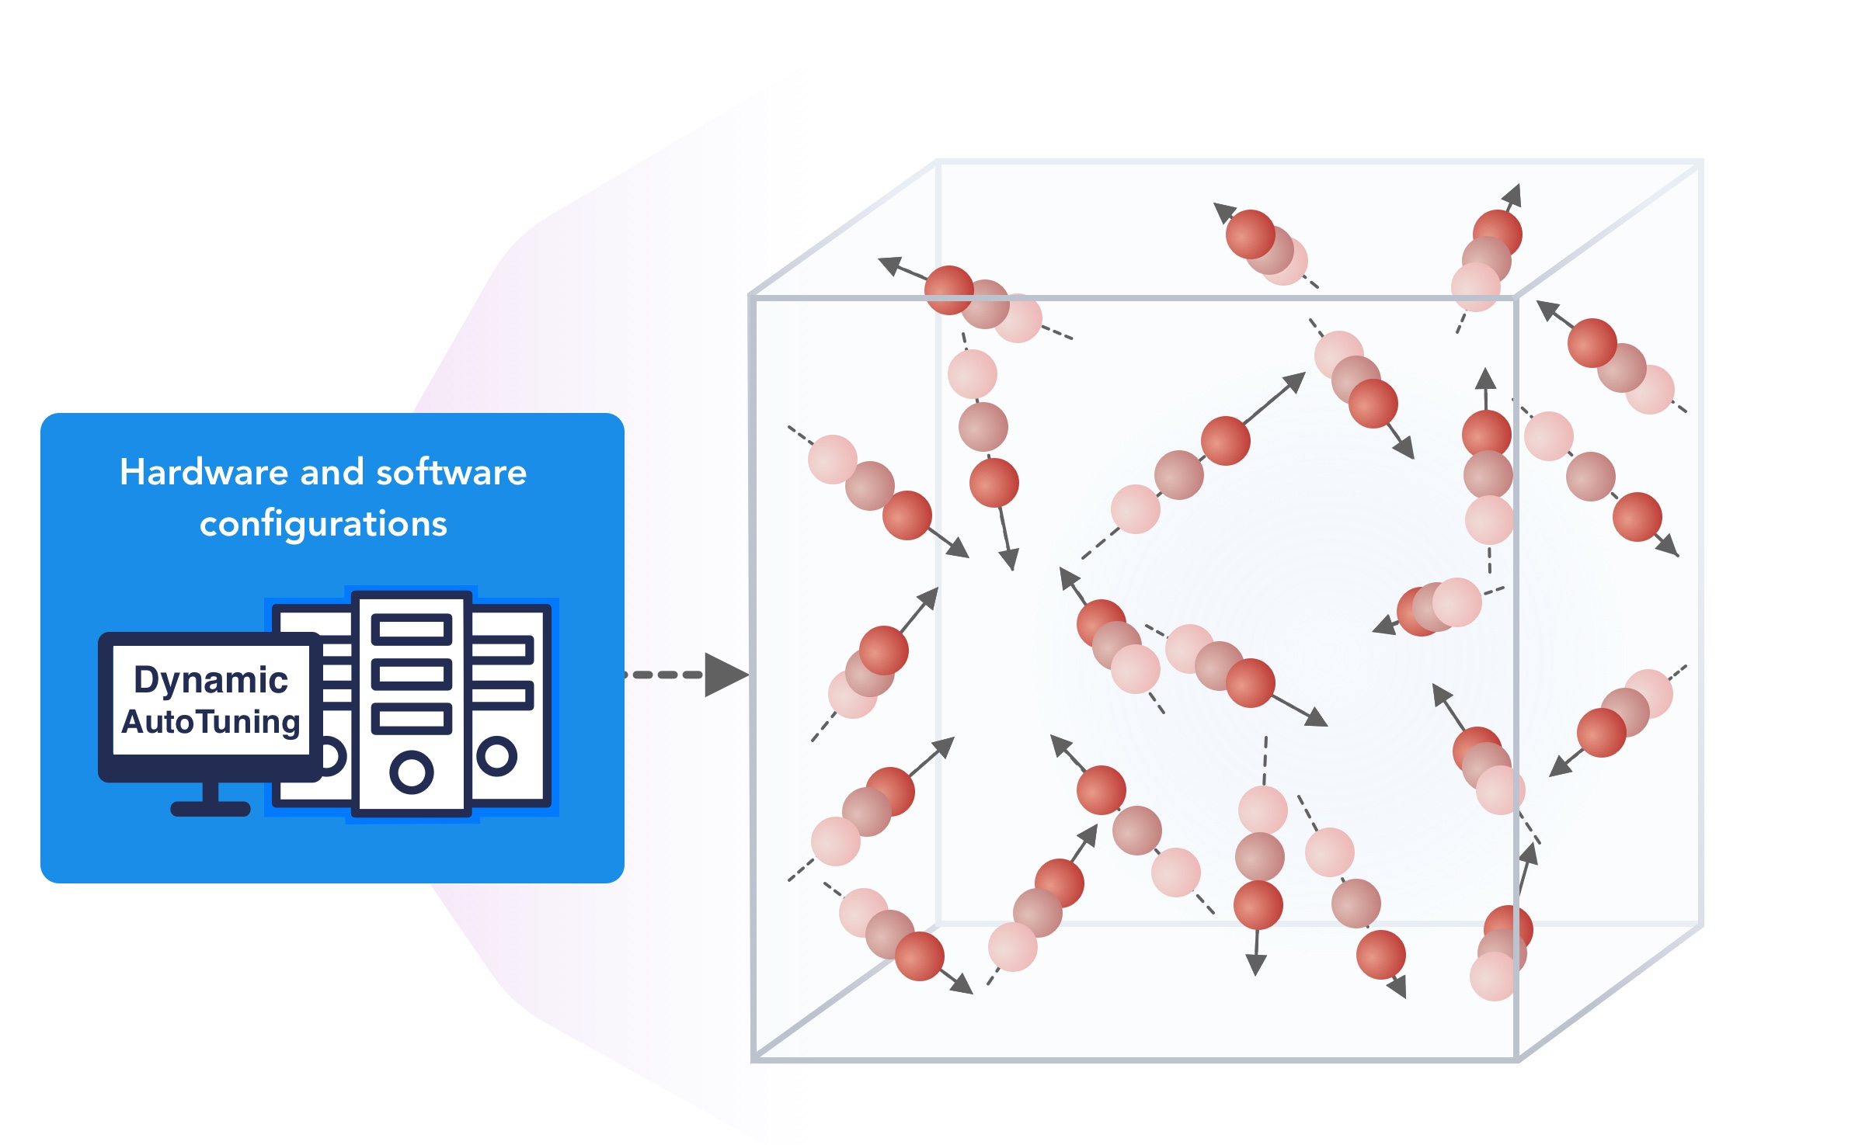
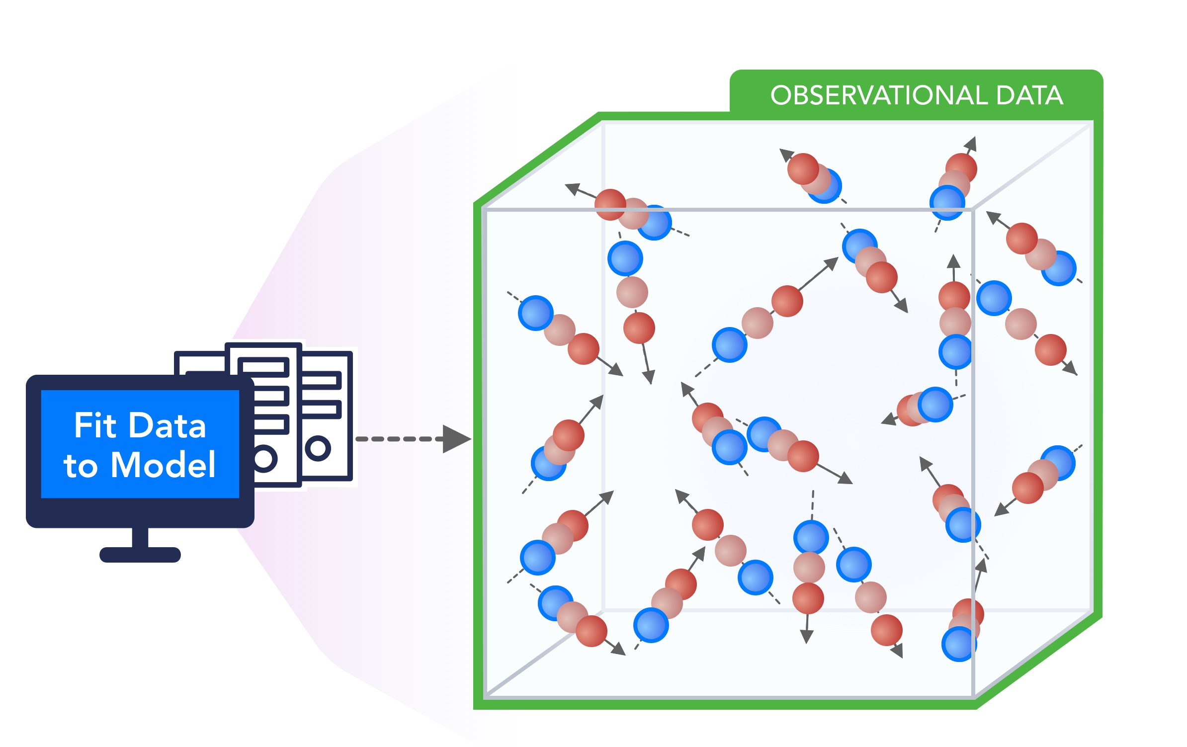
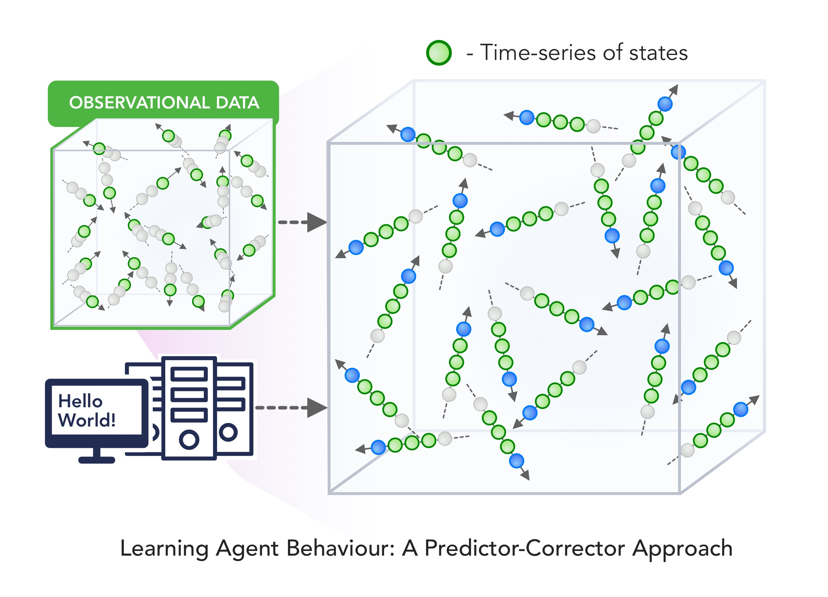
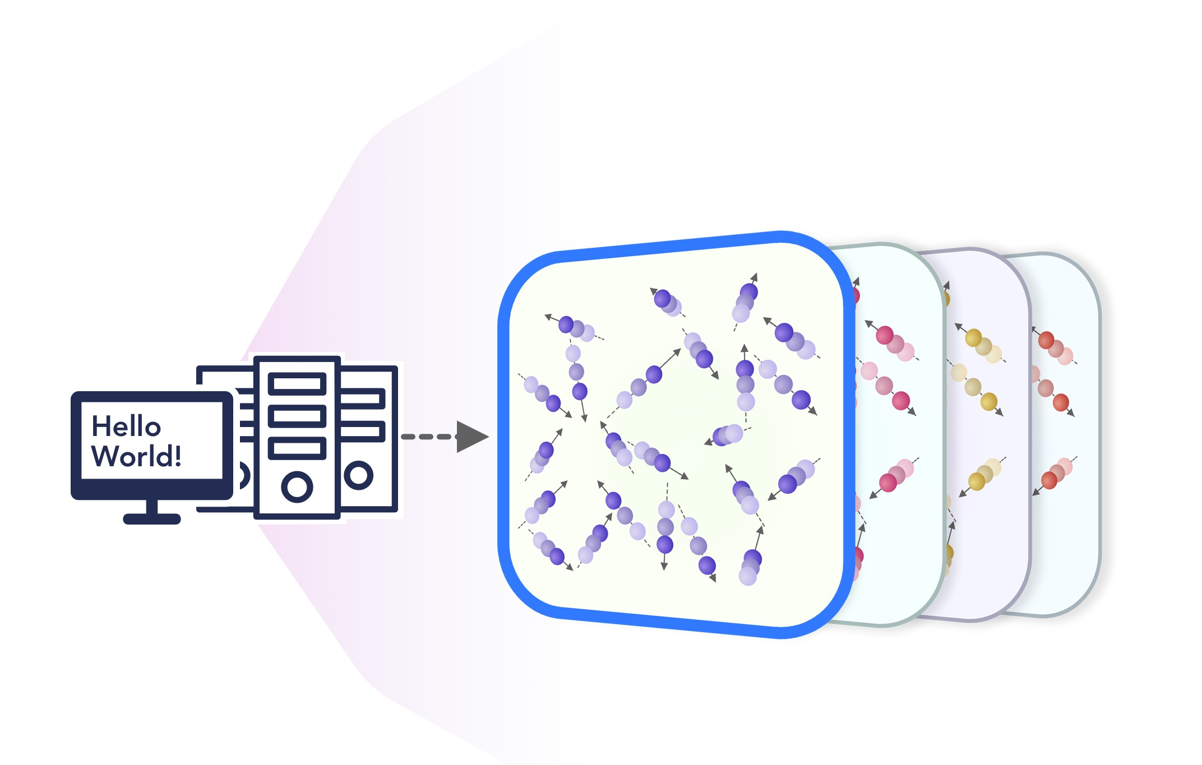
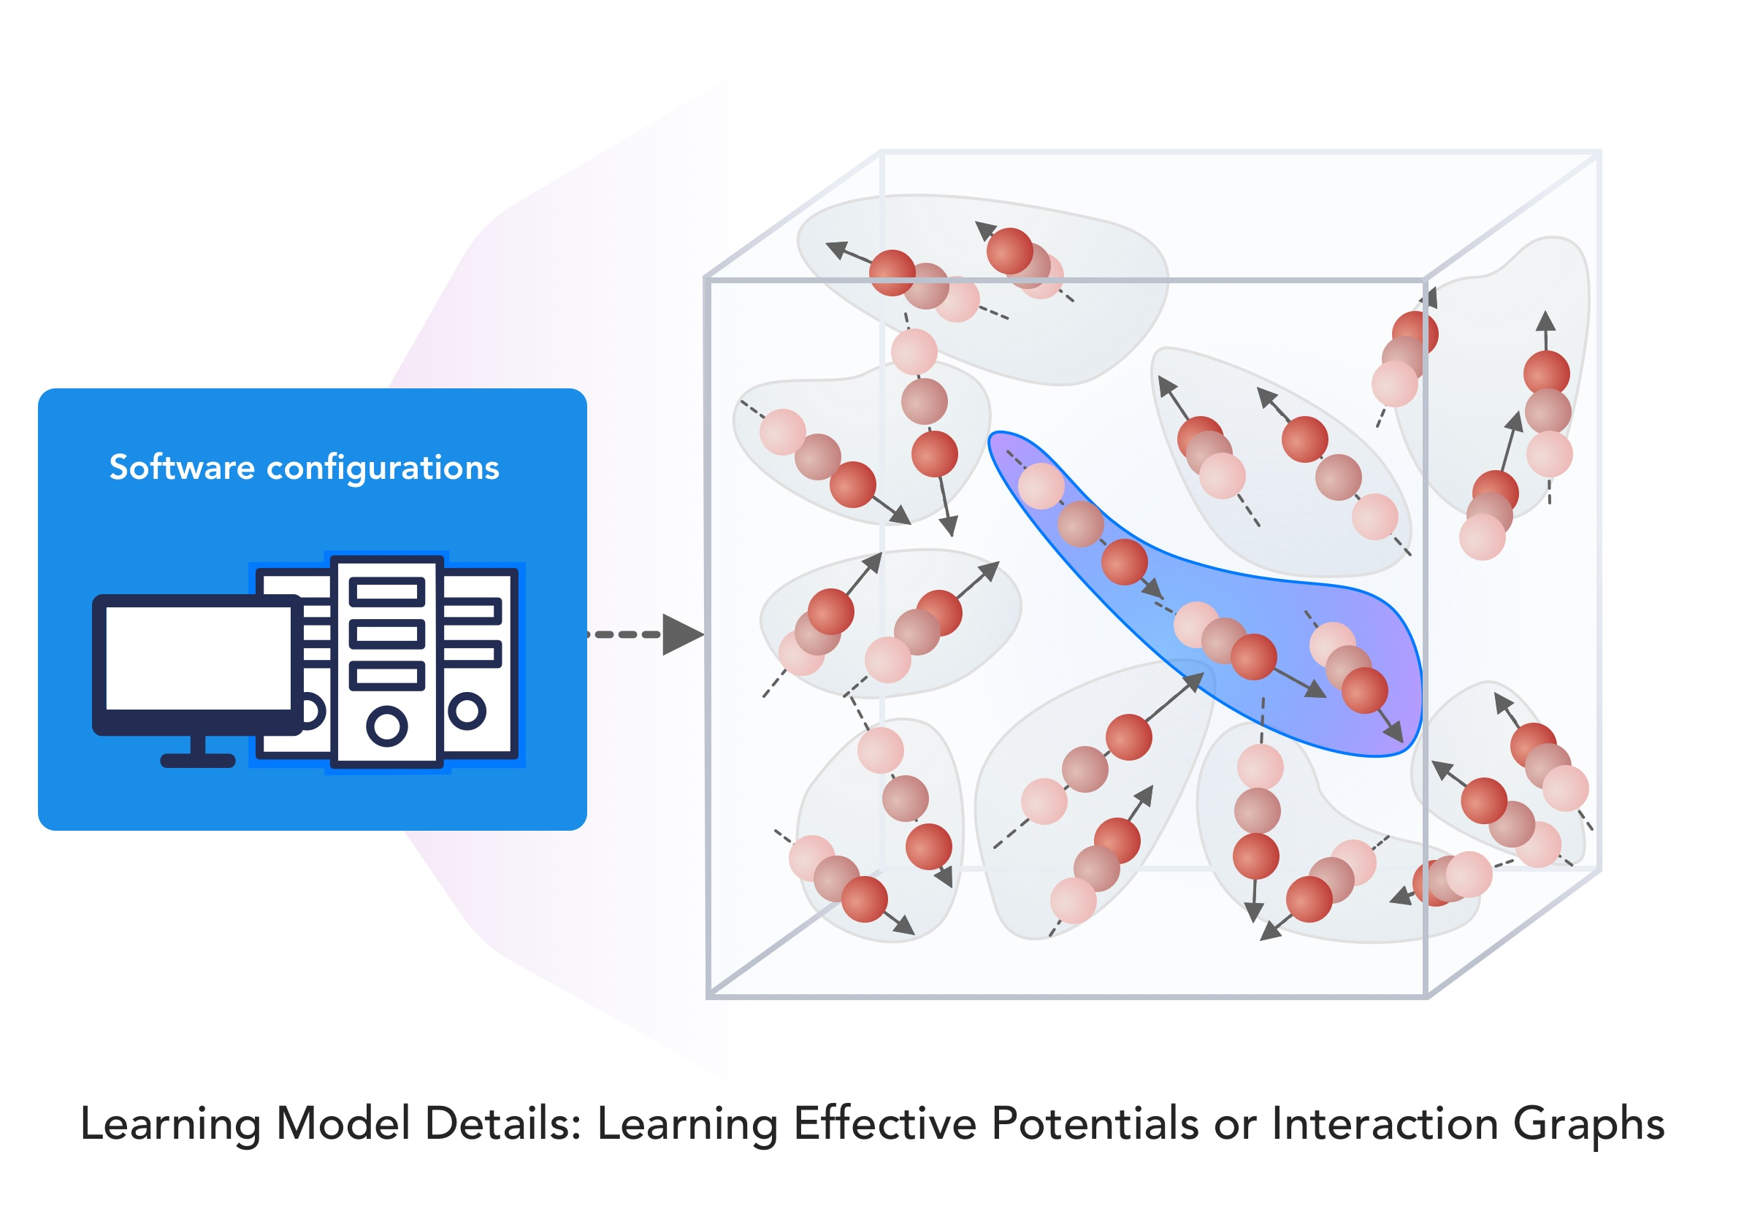
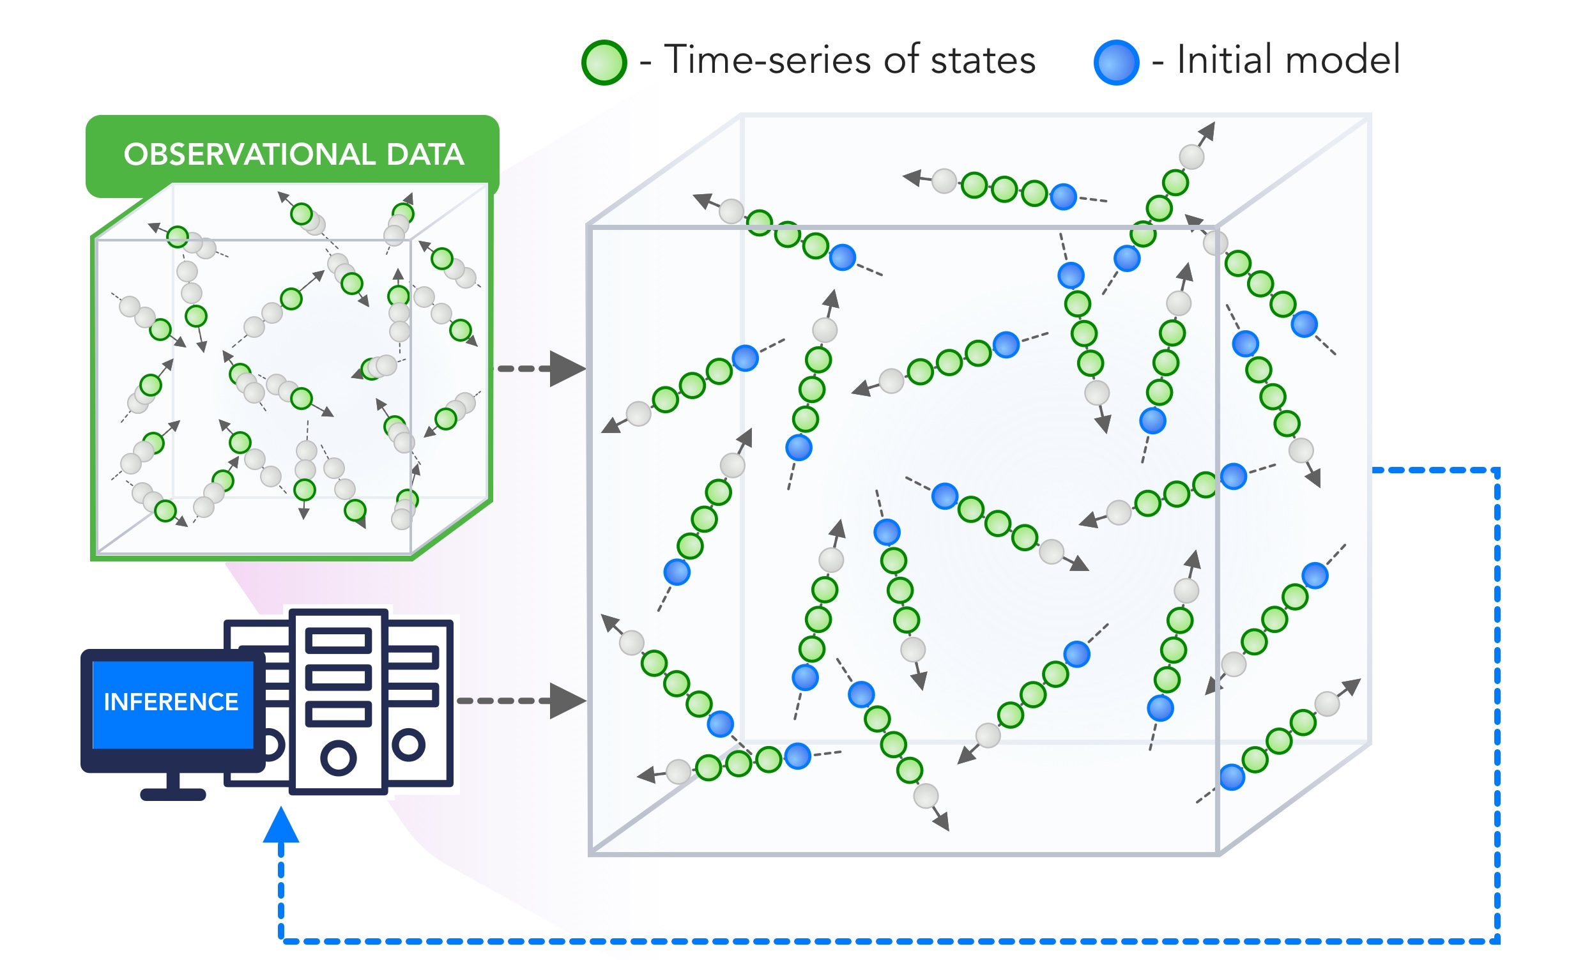
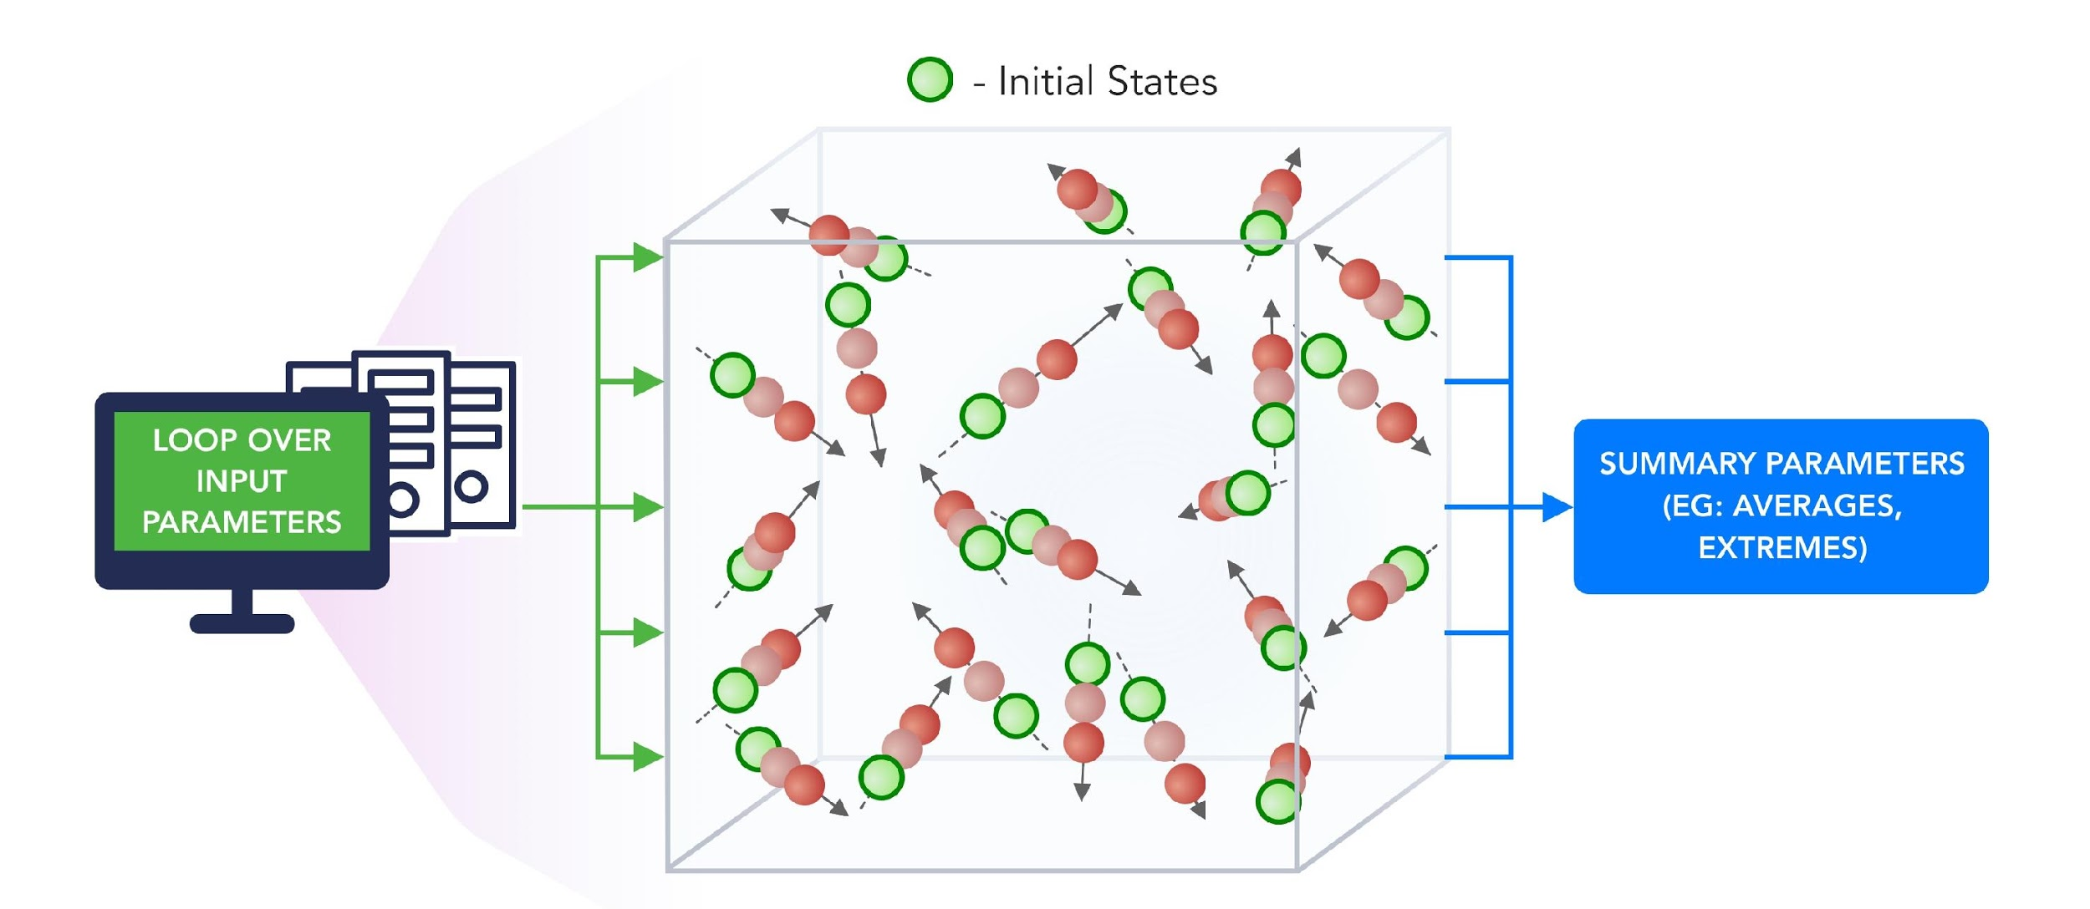
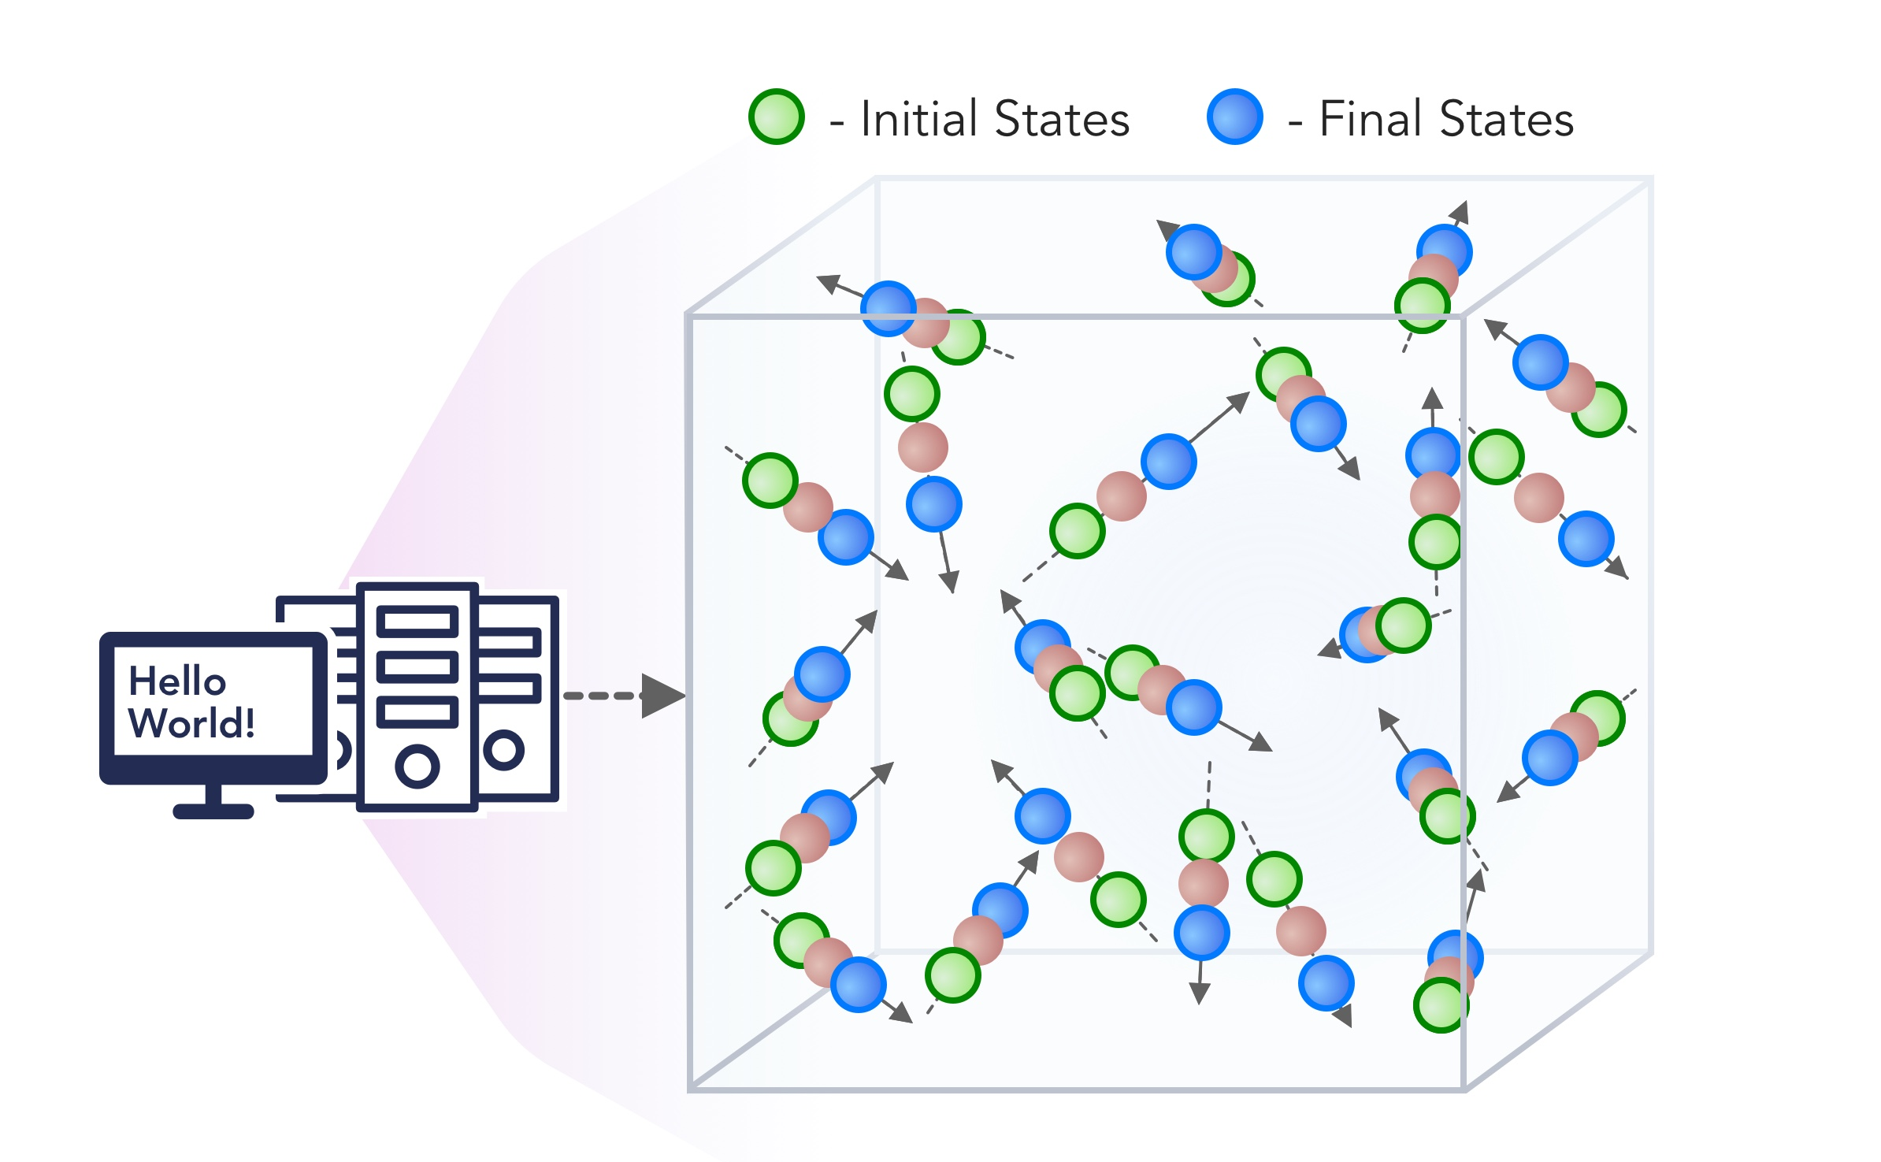
1. Improving Simulation with Configurations and Integration of Data
1.1 MLAutotuningHPC – Learn configurations
1.2 MLAutotuningHPC – Learn models from data
1.3 MLaroundHPC: Learning Model Details (ML based data assimilation)
2. Learn Structure, Theory and Model for Simulation
2.1 MLAutotuningHPC – Smart ensembles
2.2 MLaroundHPC: Learning Model Details (coarse graining, effective potentials)
2.3 MLaroundHPC: Improve Model or Theory
3. Learn Surrogates for Simulation
3.1 MLaroundHPC: Learning Outputs from Inputs (parameters)
3.2 MLaroundHPC: Learning Outputs from Inputs (fields)
https://arxiv.org/abs/1909.13340
https://arxiv.org/abs/1909.02363
INPUT
OUTPUT
100 refs classified in 8 classifications

Slide 19
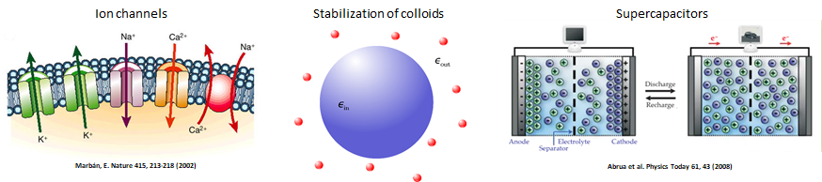
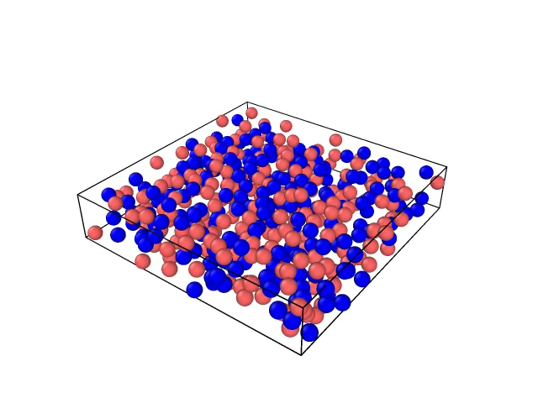
MLaroundHPC: Learning Outputs from Inputs (parameters)
High Performance Surrogates of nanosimulations
JCS Kadupitiya,
Geoffrey Fox,
Vikram Jadhao
An example of Learning Outputs from Inputs: Computation Results from Computation defining Parameters
Employed to extract the ionic structure in electrolyte solutions confined by planar and spherical surfaces.
Written with C++ and accelerated with hybrid MPI-OpenMP.
MLaroundHPC successfully learns desired features associated with the output ionic density that are in excellent agreement with the results from explicit molecular dynamics simulations.
Deployed on nanoHUB for education
(an attractive use of surrogates so students get answers fast)

Slide 20
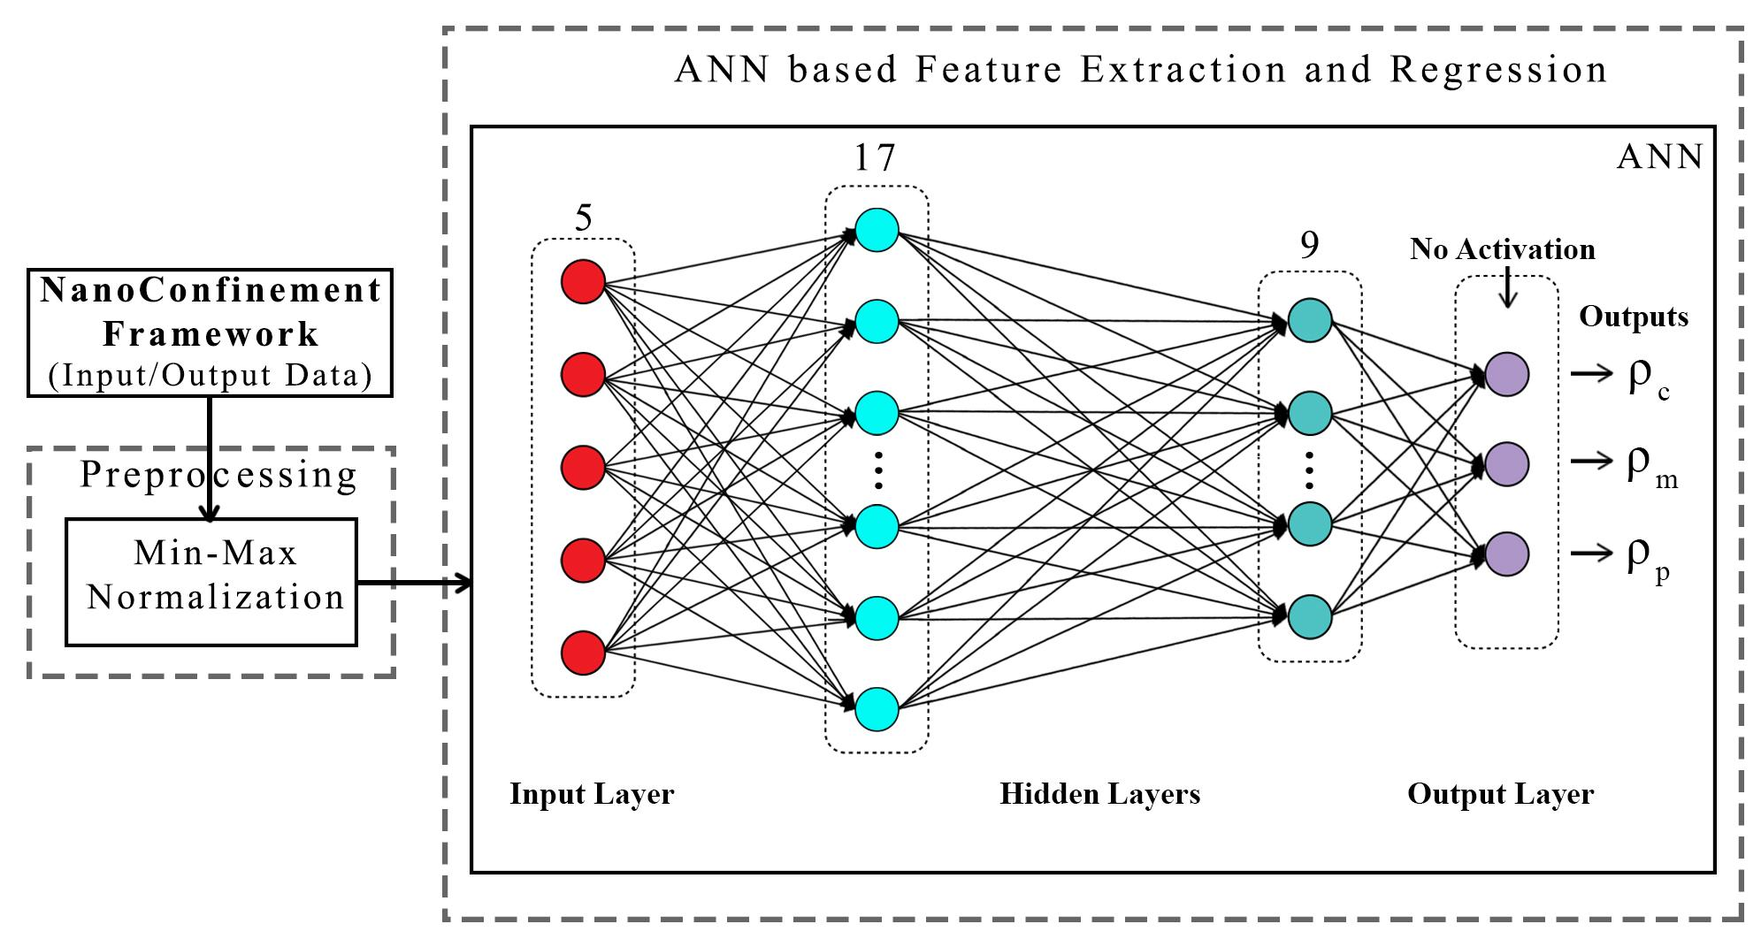
ANN for Regression
Dataset having 6,864 simulation configurations was created for training and testing (0.7:0.3) the ML model.
Note learning network quite small
ANN was trained to predict three continuous variables; Contact density ρ_{c} , mid-point (center of the slit) density ρ_{m} , and peak density ρ_{p}
TensorFlow, Keras and Sklearn libraries were used in the implementation
Adam optimizer, xavier normal distribution, mean square loss function, dropout regularization.
JCS Kadupitiya,
Geoffrey Fox,
Vikram Jadhao

Slide 21
HPCforML Parameter Prediction in Nanosimulation
ANN based regression model predicted Contact density ρ_{c} , mid-point (center of the slit) density ρ_{m} , and peak density ρ_{p} accurately with a success rate of 95.52% (MSE ~ 0:000072), 92.07% (MSE ~ 0:00023), and 94.78% (MSE ~ 0:00023) respectively, easily outperforming other non-linear regression models
Success means within error bars (2 sigma) of Molecular Dynamics Simulations
 | Contact Density |  | Midpoint Density |  | Peak Density
Model | Success % | MSE | Success % | MSE | Success % | MSE
Polynomial | 61.04 | 0.013 | 60.84 | 0.019 | 61.87 | 0.010
Decision Tree | 68.44 | 0.0085 | 64.54 | 0.0095 | 62.47 | 0.011
Random Forest | 74.15 | 0.0046 | 70.85 | 0.0079 | 75.09 | 0.0041
Kernel-Ridge | 78.86 | 0.0031 | 76.57 | 0.0041 | 75.93 | 0.0050
SVM | 80.11 | 0.0013 | 79.55 | 0.0025 | 81.98 | 0.0011
HPCforML-ANN | 95.52 | 0.000072 | 92.07 | 0.00023 | 94.78 | 0.00023

Slide 22
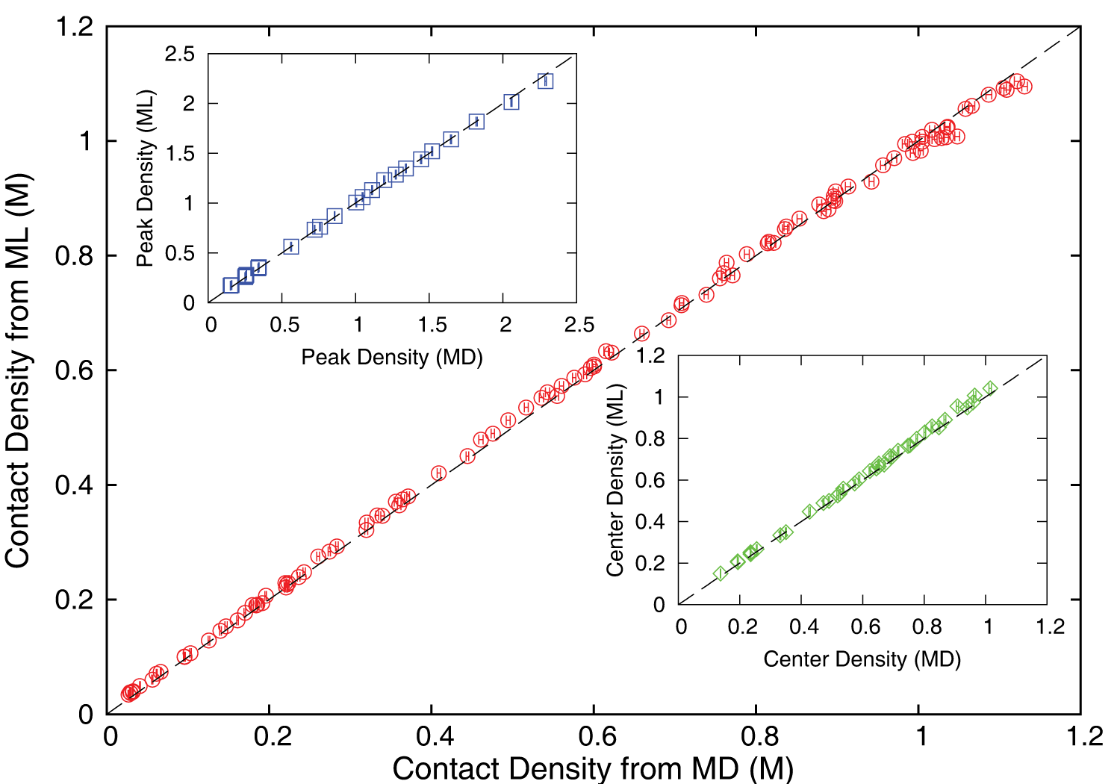
Accuracy comparison between ML predictions and MD simulation results
JCS Kadupitiya,
Geoffrey Fox,
Vikram Jadhao
ρ_{c ,} ρ_{m} and ρ_{p} predicted by the ML model were found to be in excellent agreement with those calculated using the MD method; correlated data from both approaches fall on the dashed lines which indicate perfect correlation.

Slide 23
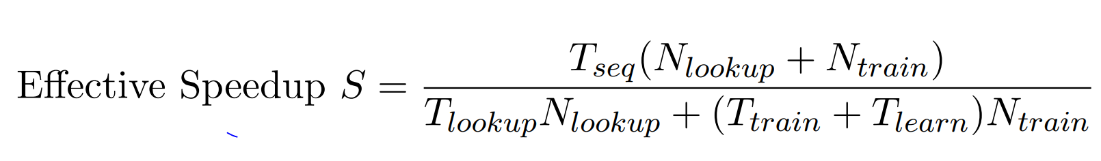
Speedup of MLaroundHPC
T_{seq} is sequential time
T_{train} time for a (parallel) simulation used in training ML
T_{learn} is time per point to run machine learning
T_{lookup} is time to run inference per instance
N_{train} number of training samples
N_{lookup} number of results looked up
Becomes T_{seq}/T_{train} if ML not used
Becomes T_{seq}/T_{lookup} (10⁵ in our case) if inference dominates (will overcome end of Moore’s law and win the race to zettascale)
Another factor as inferences uses one core; parallel simulation 128 cores
Speedup is strong (not weak with problem size increasing to improve performance) scaling as size fixed
N_{train} is 7K to 16K in our work

Slide 24
INSILICO MEDICINE USED CREATIVE AI TO DESIGN POTENTIAL DRUGS IN JUST 21 DAYS
September 4 2019 News Item
Map Drug (Material) Structure to Drug (Material) Properties
Hong Kong-based Insilico Medicine sent shockwaves through the pharma industry after publishing research in Nature Biotechnology that proves its AI-powered drug discovery system was capable of producing at least one potential treatment for fibrosis in less than a month's time.
The system uses a Deep Reinforcement Learning algorithm that can imagine potential protein structures based on existing research and certain preprogrammed design criteria.
Insilico's system initially produced 30,000 possible designs, which the research team whittled down to six that were synthesized in the lab, with one design eventually tested on mice to promising results.
Insilico's AI-powered research process could offer a massive push forward for the pharmaceutical industry, which faces increasingly high drug development costs. In just a handful of weeks and for approximately $150,000, Insilico delivered what typically takes pharmaceutical companies $2.6 billion over seven years.

Slide 25
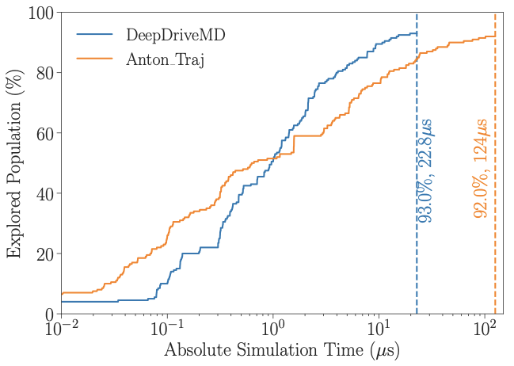
DeepDriveMD Smart Ensemble
O(10) improvement in sampling efficiency with DL model
O(1000) concurrent simulations on Summit supercomputer
Jha (BNL/Rutgers) and Ramanathan (ANL)
Notes:
Not a lucky

Slide 26
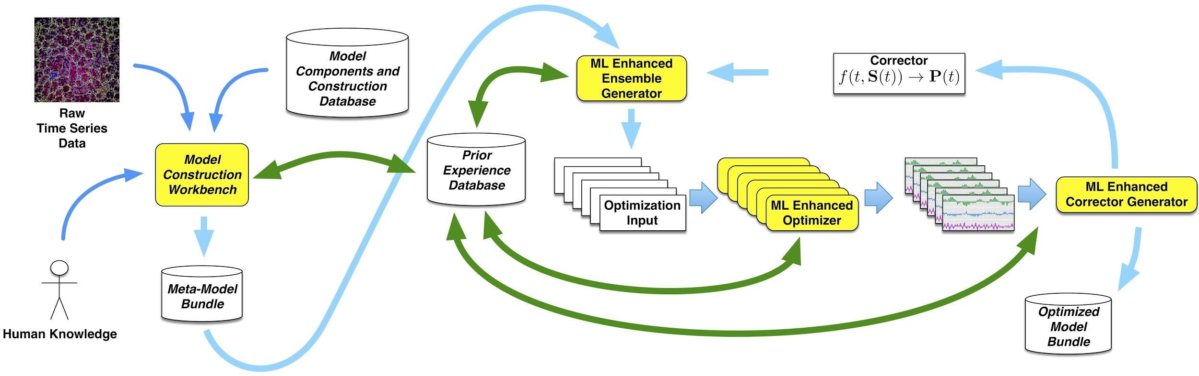
Putting it all Together
Simulating Biological Organisms (with James Glazier @IU)
Learning Model (Agent) Behavior
Replace components by learned surrogates
(Reaction Kinetics Coupled ODE’s)
All steps use MLAutotuning
Smart Ensembles
Dynamic Data Assimilation

Slide 27
Operator Formulation of Deep Learning Inference
Suppose we are solving PDE’s or sets of coupled ODE’s
Typically we solve iteratively New Values = (Differential Operator) Previous Values
Classic applied math tells you nifty difference equations and spectral methods to represent Operator numerically
Deep Learning learns the operator from classic numerics or observational data or their combination
Inference is New Values = (DL Operator) Previous Values
This new nonlinear trained DL operator can allow much larger time steps, incorporate variations in parameters, learn potentials etc.
DL Operator is the new theory (Newton’s laws) of science
High order approximations are traditionally very sensitive to noise and one was taught to avoid but ANN are the opposite – both verbose and robust
  See DL operator for one in two LSTM layers with 100-100,000 parameters
  Newton’s laws for this have 2-4 parameters

Slide 28

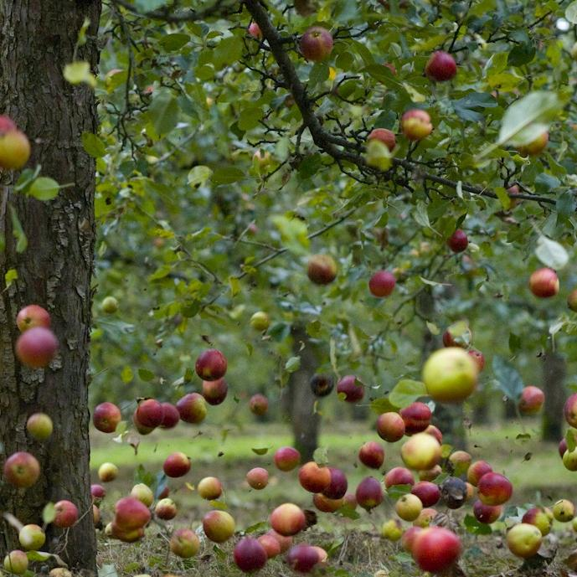
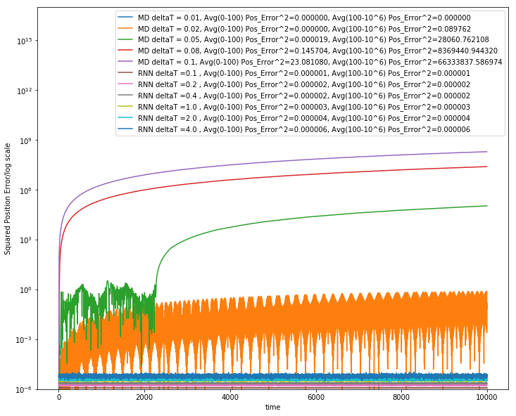
Learning how Apples Fall ?
Work with JCS Kadupitiya and Vikram Jadhao
We could use F=ma with 1D ODE solved by Verlet
Or use Recurrent Neural Network (LSTM) and Tensorflow/PyTorch (the new Newton) for particle in Lennard-Jones potential
MD and RNN Err² up to t=10,000
Error Squared
MD ∆t = 0.01 Err² = 0.018
MD ∆t = 0.02 Err² = 0.122
MD ∆t = 0.05 Err² = 2.8 10⁵
MD ∆t = 0.08 Err² = 8.4 10⁶
MD ∆t = 0.1 Err² = 6.6 10⁷
RNN ∆t = 0.1 Err² = 10⁻⁶
RNN ∆t = 0.2 Err² = 2.10⁻⁶
RNN ∆t = 0.4 Err² = 2.10⁻⁶
RNN ∆t = 1.0 Err² = 3.10⁻⁶
RNN ∆t = 2.0 Err² = 4.10⁻⁶
RNN ∆t = 4.0 Err² = 6.10⁻⁶
MD dt > 0.01
MD dt = 0.01 and lower is RNN
12705 Trained Parameters

Slide 29
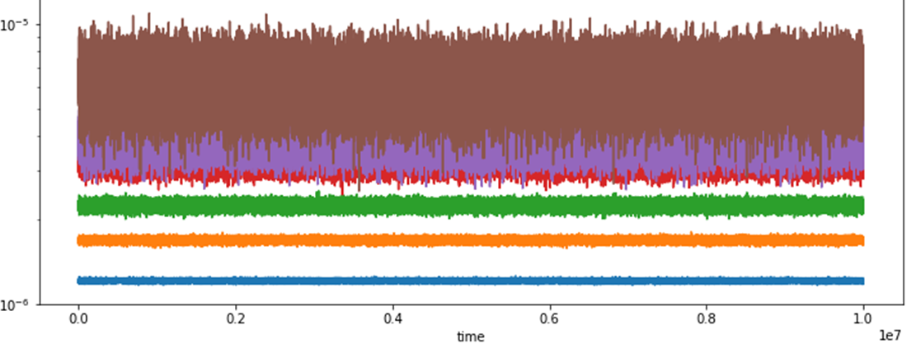
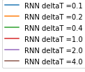
Extending Simple Harmonic Oscillator to longer times
System trained up to t=100 with dt = 0.001; LSTM surrogate used up to t=10,000,000
Plots show error for RNN(LSTM) for different time steps. LSTM step size upto ∆t=4
LSTM allows reliable large time steps; learns potential and differential operator
Compared to classic numerics has LOTS of parameters, statistical averaging (e.g. 32 initial LSTM’s only differing in randomized initial conditions) and nonlinear activation node
MD Err² for ∆t=0.01 is 0.017 averaged up to t =10⁴ larger than
RNN Err² up to t= 10⁷
Error Squared
∆t = 0.1 Err² = 10⁻⁶
∆t = 0.2 Err² = 2.10⁻⁶
∆t = 0.4 Err² = 2.10⁻⁶
∆t = 1.0 Err² = 3.10⁻⁶
∆t = 2.0 Err² = 4.10⁻⁶
∆t = 4.0 Err² = 6.10⁻⁶
873 Trained Parameters

Slide 30
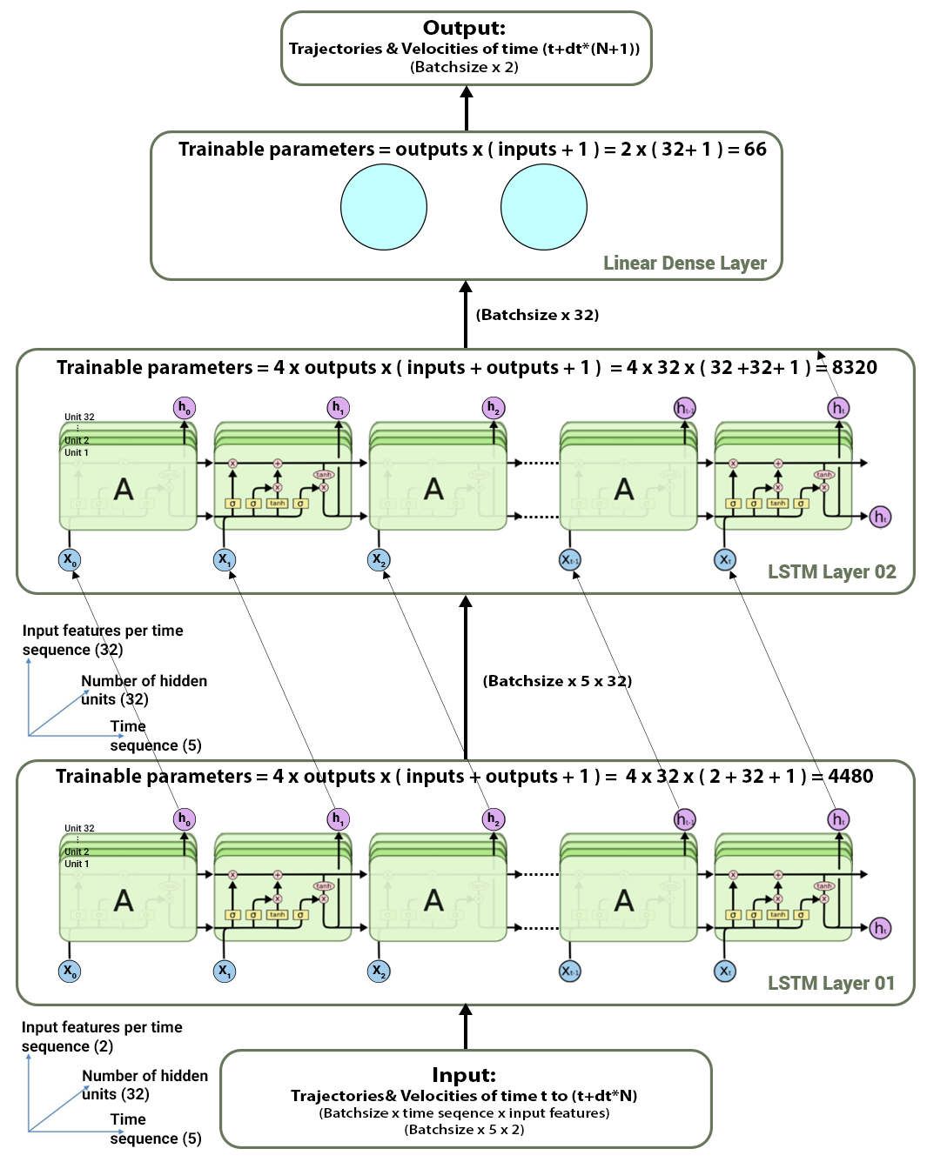
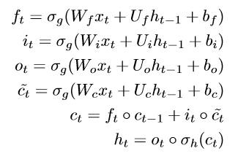
RNN (LSTM) model used for single particle ordinary verlet.
In the following example:
W: 32*2(matrix)
X: 2*1(batch_size)
U: 32*32(matrix)
b: 32*1(batch_size)
Input dimensions:
(Batch_Size * #_of_time_samples * input_features)
Input_features = #_of_particles * #_of_ spatial_dimensions * [positions, velocities, forces, etc]
Output dimensions:
(Batch_Size * output_features)
output_features= #_of_particles * #_of_ spatial_dimensions * [positions, velocities, forces, etc]
Notes:
There are several architectures of LSTM units. A common
architecture is composed of a cell (the memory part of the
LSTM unit) and three ”regulators”, usually called gates, of
the flow of information inside the LSTM unit:
an input gate (decides to add new stuff from the present input to our present
cell state scaled by how much we wish to add them),
an output gate(decide what to output from our cell state) and
a forget gate(helps us to take decisions about what must be removed
from the previous h(t-1) state and thus keeping only relevant
stuff).
Some variations of the LSTM unit do not have one or
more of these gates or maybe have other gates. (For example,
gated recurrent units (GRUs) do not have an output gate.)

Slide 31
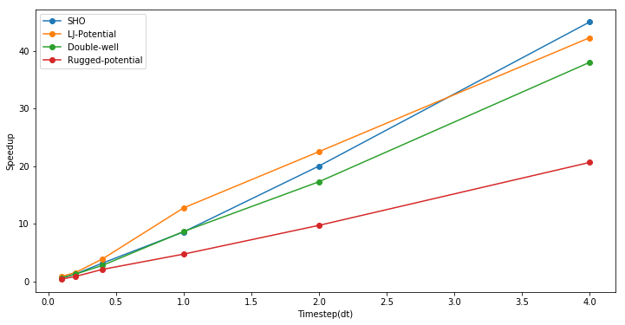
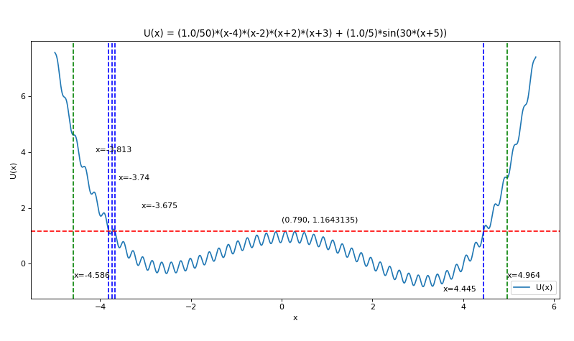
Speedup from use of LSTM compared to Velocity Verlet
Timings are integration from t=0 to 100 and MD velocity verlet used dt of 0.001 to get a accurate result
Speedup = (Time to do MD Simulation with dt=0.001) / (Time to do RNN (LSTM)-based simulation)
Unit of length 0.34nm; unit of time 2.1 picoseconds
Rugged Potential
198,273 Trainable Parameters as 128 units in each of 2 LSTM banks

Slide 32
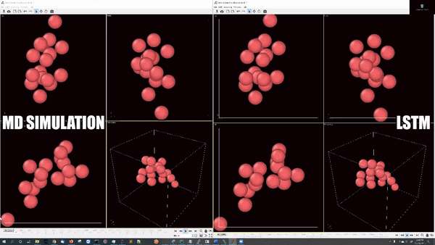
Multiparticle LJ Potential Periodic Boundary Conditions I
Train with 6000 different initial conditions and 16 particles with box (cube size 6.8³) or periodic boundary conditions
Train up to t=200 and errors up to t = 200,000 similar to the one particle case
LSTM Time: 2.96sec to advance to t=2000;
Speedup (Compared to sequential MD) is 67000 – much more than parallelism gives!
Animation shows 4 views of the same MD simulation on the left compared to 4 LSTM surrogates on the right

Slide 33
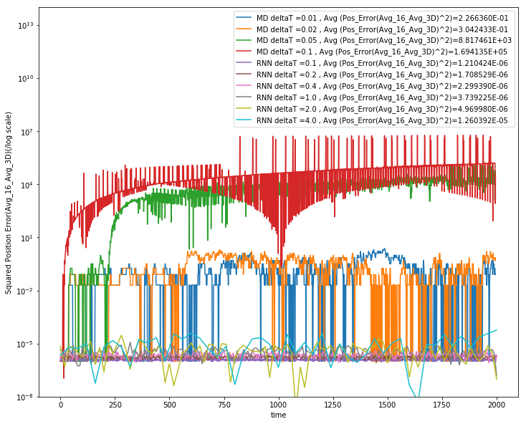
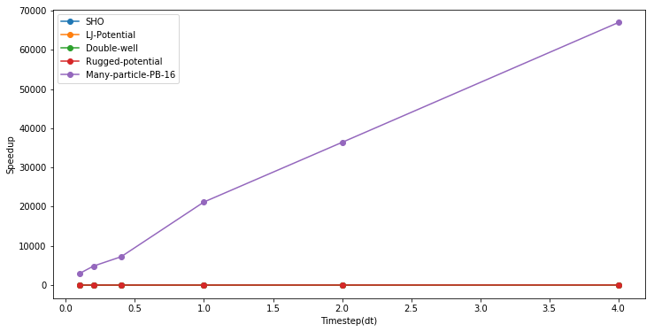
Multiparticle LJ Potential Periodic Boundary Conditions II
Errors in 16 particle periodic boundary LSTM and MD time evolution
Error values are averaged over 3D and 16 particles.
Total trainable params in (2 layer-64 units per layer) LSTM network: 65,072
Error Squared
MD ∆t = 0.01 Err² = 0.23
MD ∆t = 0.02 Err² = 0.30
MD ∆t = 0.05 Err² = 8.8 10³
MD ∆t = 0.1 Err² = 1.7 10⁵
RNN ∆t = 0.1 Err² = 1.2 10⁻⁶
RNN ∆t = 0.2 Err² = 1.7 10⁻⁶
RNN ∆t = 0.4 Err² = 2.3 10⁻⁶
RNN ∆t = 1.0 Err² = 3.710⁻⁶
RNN ∆t = 2.0 Err² = 5.010⁻⁶
RNN ∆t = 4.0 Err² = 1.310⁻⁵

Slide 34
Status of MLaroundHPC
MLaroundHPC broadly applicable but current use is nonuniform across domains
  we need to improve Cyberinfrastructure support to make MLforHPC more effective for more users
Use of modest DL network to map material/potential drug structure to properties (generalized QSAR) with simulation and observation: Advanced Progress
Learn surrogates for large scale simulations: initial small scale results
Use of MLforHPC in agent-based systems (learn agents): Very promising but few results
Macroscopic Structure as in learn complex multi-particle potentials scaling to N⁷: many great successes
Learn Collective coordinates and guide ensemble computations: dramatic progress with speedups up to 10⁸
Microscale; learn dynamics of small scale such as clouds, turbulence: Interesting results but much more to do
Use of Recurrent NN’s to represent dynamics (learn numerical differential operators): Promising but only studied in small problems

Slide 35
Remarks on Deep Learning for Time Series
The Deep Learning MD surrogates illustrate potential value of Recurrent Neural Nets (LSTM) and I am exploring other examples
Audio to Speech conversion and Road traffic prediction areas have huge Industry investment from Industry – Internet giants plus Uber/Didi and need to build on this
Good MLPerf working group on DL for Time series that is identifying available datasets and benchmarks.
Look at different recurrent networks such as GRU, RNN-T and Transformers (non-recurrent approach to sequence-sequence maps)
Uber/Didi etc. work highlights importance of geospatial time series where approach include graph (e.g. represent road network) deep learning nets and Convolutional-LSTM’s to process time series of images (2D space)

Slide 36
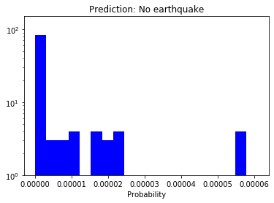
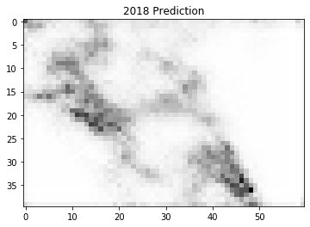
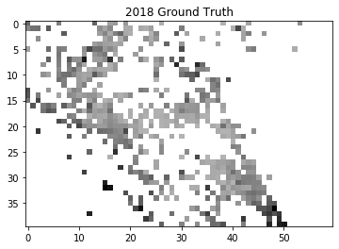
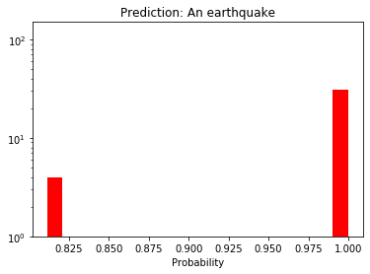
Initial Earthquake Forecasting with LSTM
Work with John Rundle, UC-Davis and IU student Bo Feng
LSTM learns hidden physics underlying simulated earthquakes; too easy – need a more complex model and more randomness
Representing time binned earthquakes as an image; convolutional LSTM has some success (R² > 0.9 for magnitudes > 3) in predicting one year from previous annual accumulated results for southern California
Simulated Earthquakes
Predicted probability when there is NOT an earthquake
Simulated Earthquakes
Predicted probability when there is an earthquake

Slide 37
Details on Systems for Convergence
Requirements
HPF Style Parallelism
AI as a Service

Slide 38
Next Generation of Cyberinfrastructure: Compute and Data patterns
The application classes a) to d) will all have needs in the four capabilities
  Parallel simulations;
  Data Management;
  Data analytics;
  Streaming
but the proportion of these will differ in the four classes and d) is particularly hard as it intermixes all of them in a dynamic heterogeneous fashion.
  A system for class d) will be able to run the other classes as it will have “everything” but a “d” system may not be the most cost-effective for a pure class a) or b) application.
  The growing complexity of work implies that dynamic heterogeneity will characterize all major problems of each class.
  In the absence of consensus application requirements and software systems to support ML driven HPC, it is unclear whether scaled up machines should be the same design but larger or have a radically different design and performance point.
Classic Simulations
Classic Big Data
Cloud-Edge
MLforHPC

Slide 39
Implications of Specialized AI Hardware
Currently GPU’s (and TPU’s) can be used to speedup both Deep Learning and Simulations
However we are likely to see specialized AI hardware which is
  Only useful for machine learning
  In fact perhaps only useful for deep learning and particular variants thereof
That impacts use and design of a machine used for both DL and other computing including simulations and data management and edge computing support
Edge v. Central mixed up with Training versus Inference
And will be very important when you need to run ML as an integrated part of a job which is doing simulations or other significant computing
  i.e. intra-job ML-simulation links shown in MLforHPC
  As well mixtures of ML/DL and simulation jobs

Slide 40
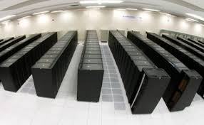

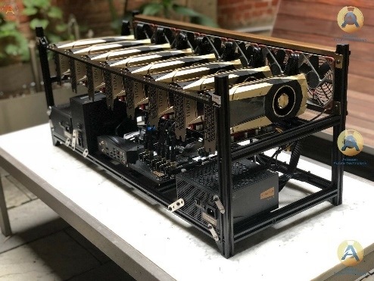

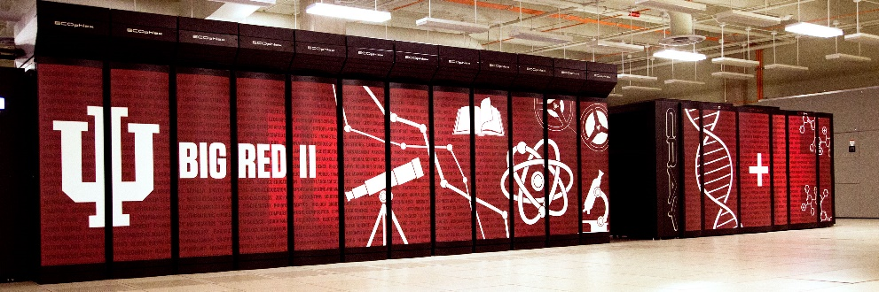

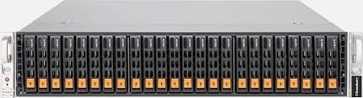
AI as a Service
Need to shield computer architectures and users from changes in AI implementations
One approach is to offer AI as a service; perhaps implemented as Function as a Service
  Event-based FaaS offers attractive computing model and low latency
  Mix of NVMe and fast communication channels to minimize data transfer and other overheads in accessing AI Service
Can change to new hardware/software/algorithm transparently
AI as a service
Broker
Simulation as a service
NVMe as a service

Slide 41
Value of HPF Style Parallel Support I
HPF model was roughly
  Decompose tensors across parallel tasks
  Owner Computes Rule
  Invoke MPI kernel libraries
  OpenMP for the threads
This solved parallel programming for applications as they stood at start of CRPC (1989) Center for Research in Parallel Computation
  However large scale simulations became extremely complex in many “Grand Challenges” of the 1990’s and one needs dynamic runtime not just compile time support
  So HPF did no take off although production compilers were made
It takes a huge effort and a long time to develop parallel compilers
  And they need to track rapid architectural change
  Users need to trust that paradigm will have long term support
  Another Handicap to HPF style compilers

Slide 42
Value of HPF Style Parallel Support II
Big Data problems and Machine Learning don’t have nearest neighbor connections and are
  Either pleasingly parallel or fit HPF style?
In particular Deep Learning training fits HPF style today
  Will it be like simulation become more sophisticated?
  We are in a 1989 moment for Big Data — just started
  Google tensorflow/mesh project seems to be HPF style deep learning
  Unclear to me if Industry will correctly do parallel deep learning
HPF style model for Java, C++, Go, Python, Julia, Fortran would address most Big Data and modest simulation problems
  not the most sophisticated simulations but those are naturally developed by dedicated teams
  ML surrogates and Big Data could change problem in favor of HPF style

Slide 43
Overall Architecture
Global AI and Modeling Supercomputer GAIMSC

Slide 44
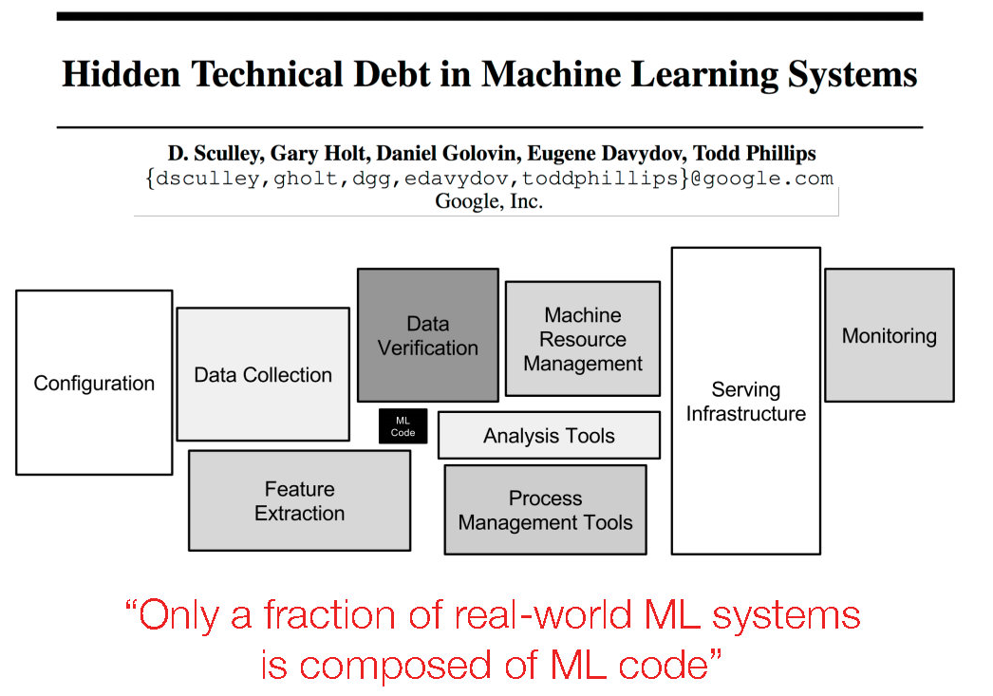
There is more to life (jobs) than Machine Learning and perhaps more jobs for data engineers than data scientists.
How do we implement the part that is not ML?
ML Code
NIPS 2015 http://papers.nips.cc/paper/5656-hidden-technical-debt-in-machine-learning-systems.pdf

Slide 45
Ways of adding High Performance to Big Data Systems
Fix performance issues in Spark, Heron, Hadoop, Flink etc.
  Messy as some features of these big data systems intrinsically slow in some (not all) cases
  All these systems are “monolithic” and difficult to deal with individual components
Execute HPBDC High Performance Big Data Computing from classic big data system with custom communication environment – approach of Harp for the relatively simple Hadoop environment
Provide a native Mesos/Yarn/Kubernetes/HDFS high performance execution environment with all capabilities of Spark, Hadoop and Heron – goal of Twister2
Execute with MPI in classic (Slurm, Lustre) HPC environment
In all cases, assume deep learning obtained from Tensorflow, PyTorch and/or MXNET
Also need to integrate orchestration (workflow) from Big Data and HPC environments

Slide 46
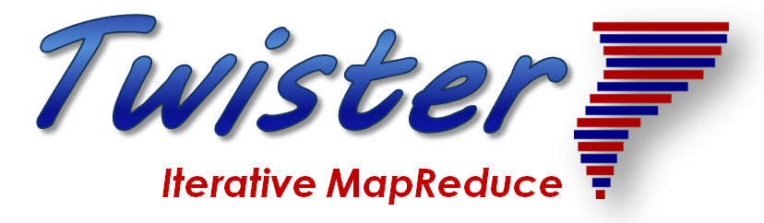

Programming Environment for HPC Cloud
2
Uses HPCforML(HPC for Big Data) and supports MLforHPC

Slide 47
Big Data Programming Environment Components I
Area | Component | Implementation | Comments: User API
Architecture Specification | Coordination Points | State and Configuration Management; Program, Data and Message Level | Change execution mode; save and reset state at dataflow nodes
 | Execution Semantics | Mapping of Resources to Bolts/Maps in Containers, Processes, Threads | Inherit Kubernetes support
 |  | Batch versus Streaming | Support both well; edge to cloud
 |  | High Throughput Computing | Important (dominant) style of use
 | Parallel Computing | Spark Flink Hadoop Pregel MPI modes | Owner Computes Rule, Support Iteration
Job Submission | (Dynamic/Static) Resource Allocation | Plugins for Slurm, Yarn, Nomad, (Mesos), Kubernetes | Client API (e.g. Python) for Job Management
Task System | Task migration | Monitoring of tasks and migrating tasks for better resource utilization | Task-based programming with Dynamic or Static Graph API done FaaS API to be done Support accelerators (CUDA,FPGA, AI nodes) to be enhanced
 | Elasticity | OpenWhisk
 | Streaming and FaaS | Heron, OpenWhisk, Kafka/RabbitMQ
 | Task Execution | Process, Threads, Queues
 | Task Scheduling | Dynamic Scheduling, Static Scheduling, Pluggable Scheduling Algorithms
 | Task Graph | Static Graph, Dynamic Graph Generation

Slide 48
Big Data Programming Environment Components II
Area | Component | Implementation | Comments
Communication API | Messages | Heron | This is user level and could map to multiple communication systems
 | Dataflow Communication | Fine-Grain Twister2 Dataflow communications: MPI,TCP and RMA Coarse grain Dataflow from NiFi, Kepler? | Streaming, ETL data pipelines; Twister2:Net standalone dataflow DFW library
 | BSP Communication Map-Collective | Conventional MPI, Harp | MPI Point to Point and Collective API. Add MapReduce primitives and keyed operations
Data Access | Static (Batch) Data | File Systems, NoSQL, SQL | Data API
 | Streaming Data | Message Brokers, Spouts
Data Management | Distributed Dataset | Persistent Distributed Data. In-memory databases. Owner computes rule | Tset has similar capabilities to Spark RDD, Heron Streamlet
Fault Tolerance | Check Pointing | Upstream (streaming) backup; Lightweight; Coordination Points; Spark/Flink, MPI and Heron models | Streaming and batch cases distinct; Crosses all components
Security | Storage, Execution, Messaging, | Research needed | Crosses all Components
Software Engineering |  | Modular Toolkit | Reuses other capabilities

Slide 49
Runtime Components
Atomic Job Submission
Connected or External DataFlow
Orchestration API
Streaming, Batch and ML Applications
Python API
SQL API
Java APIs
Scala APIs
Language APIs
Runtime
TSet
Tset Dataset API
Task Graph System
Task API
BSP Operations
Internal (fine grain) DataFlow Operations
Operator API
Resource API
Mesos Deprecated
Mesos
Kubernetes
Standalone
Slurm
HDFS
NoSQL
Message Brokers
Local
Data Access APIs
Future Features

Slide 50
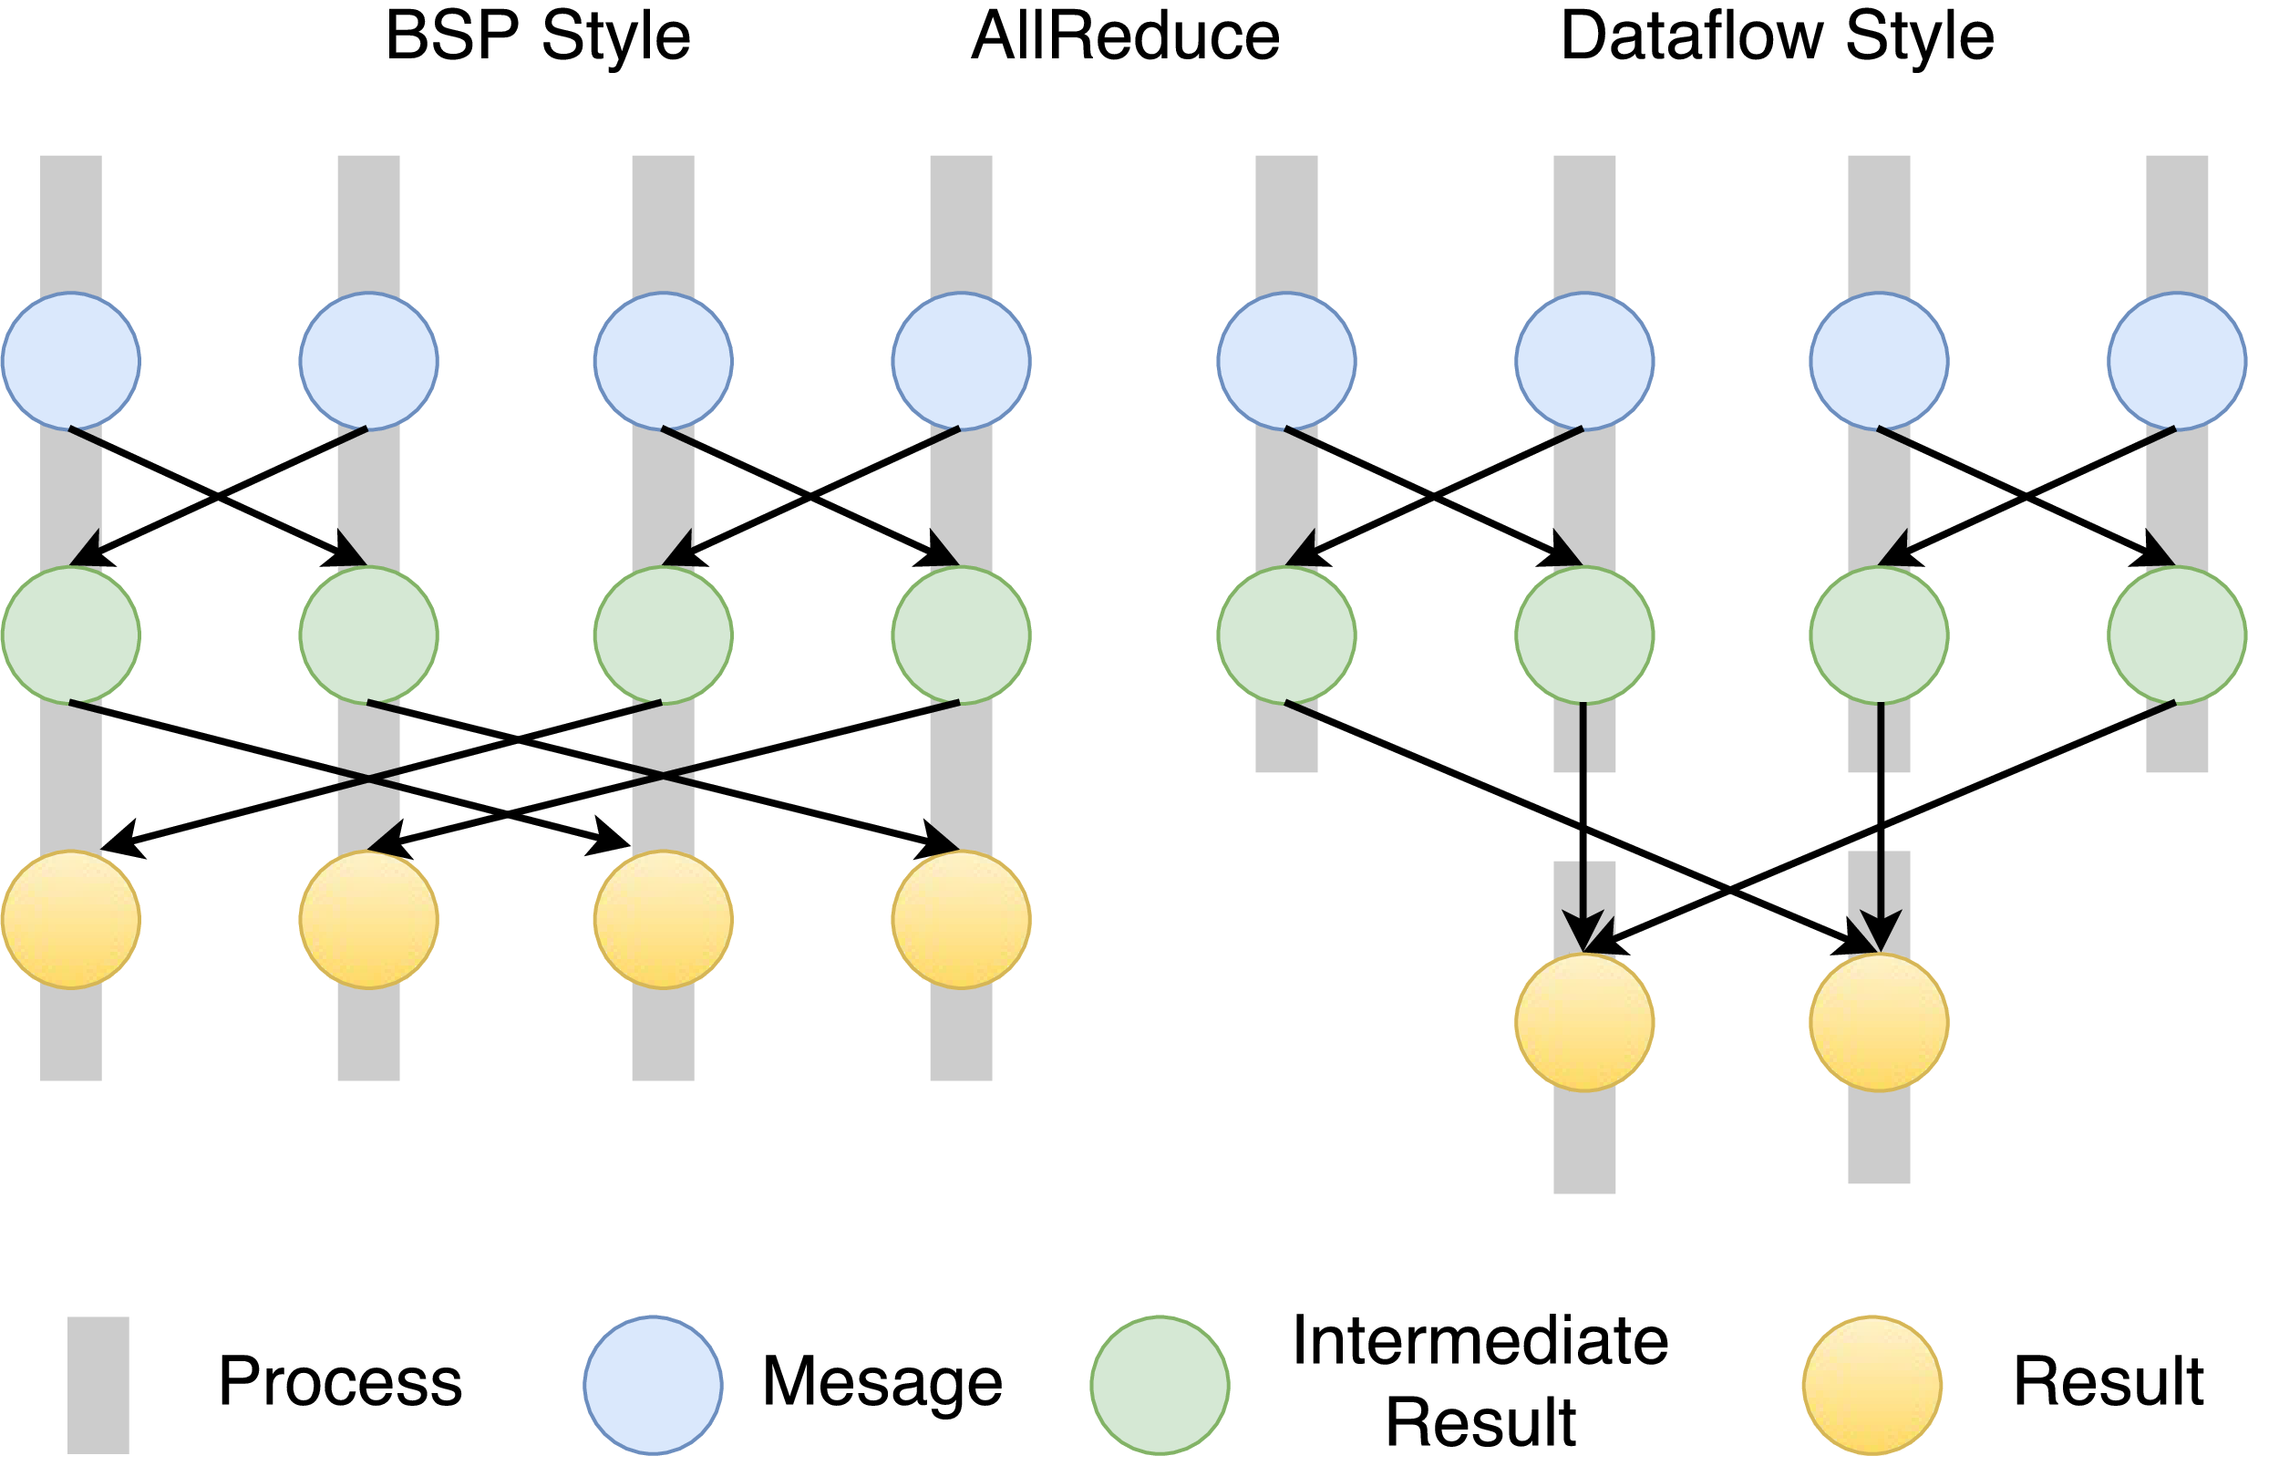
Twister2 Dataflow Communications
Twister:Net offers two communication models
BSP (Bulk Synchronous Processing) message-level communication using TCP or MPI separated from its task management plus extra Harp collectives
DFW a Dataflow library built using MPI software but at data movement not message level
  Non-blocking
  Dynamic data sizes
  Streaming model
    Batch case is represented as a finite stream
  The communications are between a set of
  tasks in an arbitrary task graph
  Key based communications: all the MapReduce
  movement functions
  Data-level Communications spilling to disks
  Target tasks can be different from source tasks
BSP and DFW
for Reduce Operation

Slide 51
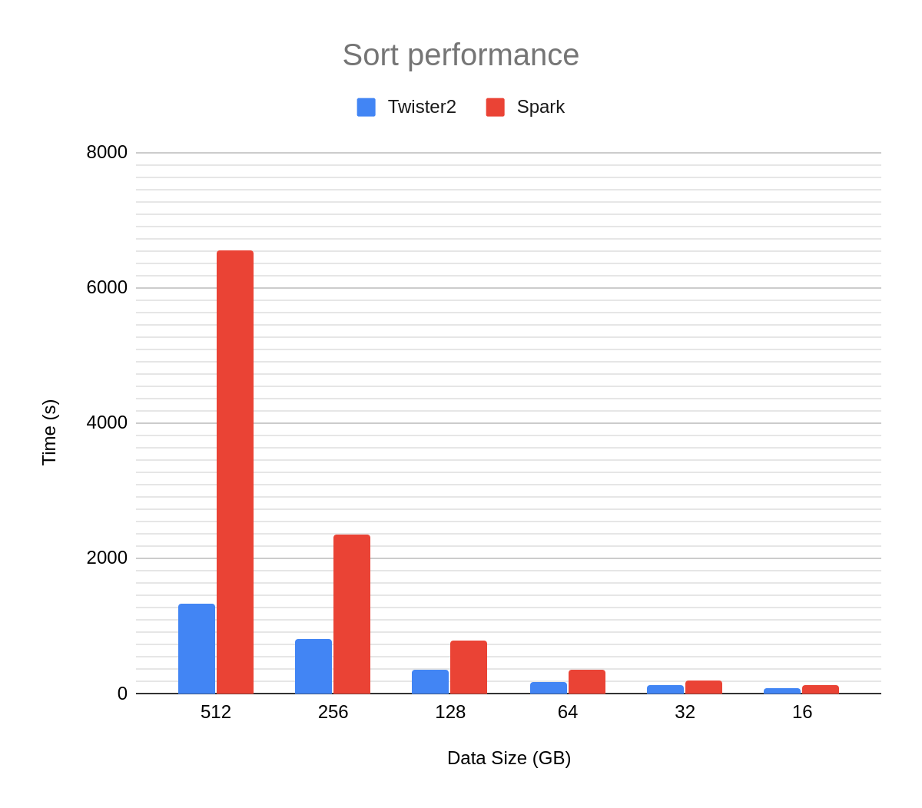
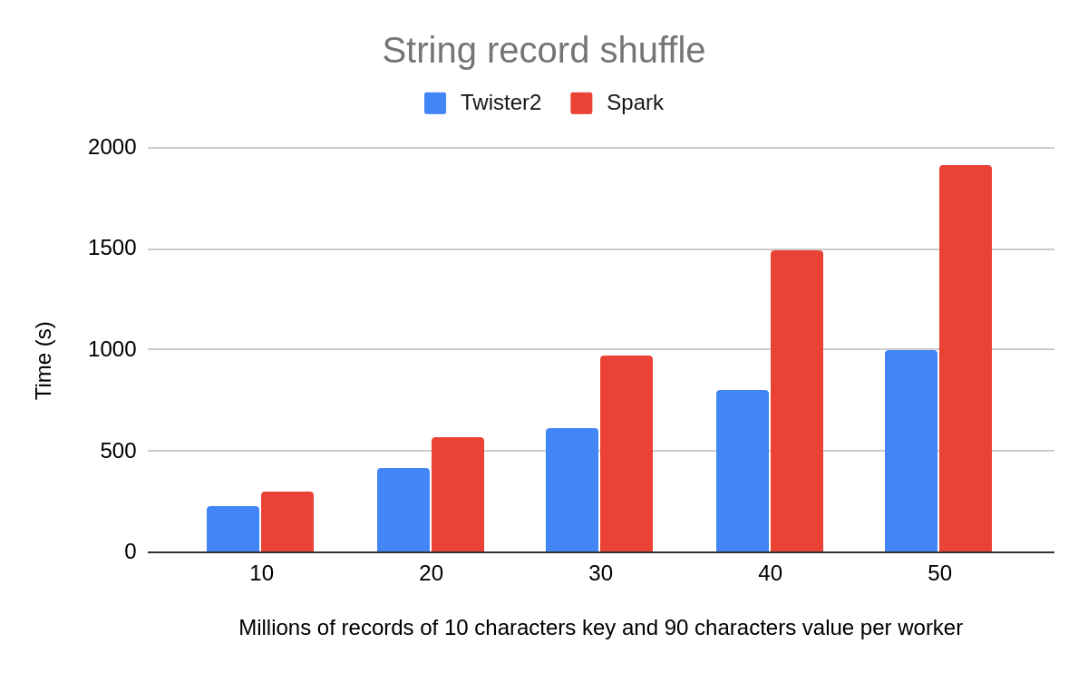
Results on Terasort and MapReduce Shuffle
Twister2 performance against Apache Spark running on 10 nodes and 100/80-way parallelism for sort/shuffle

Slide 52
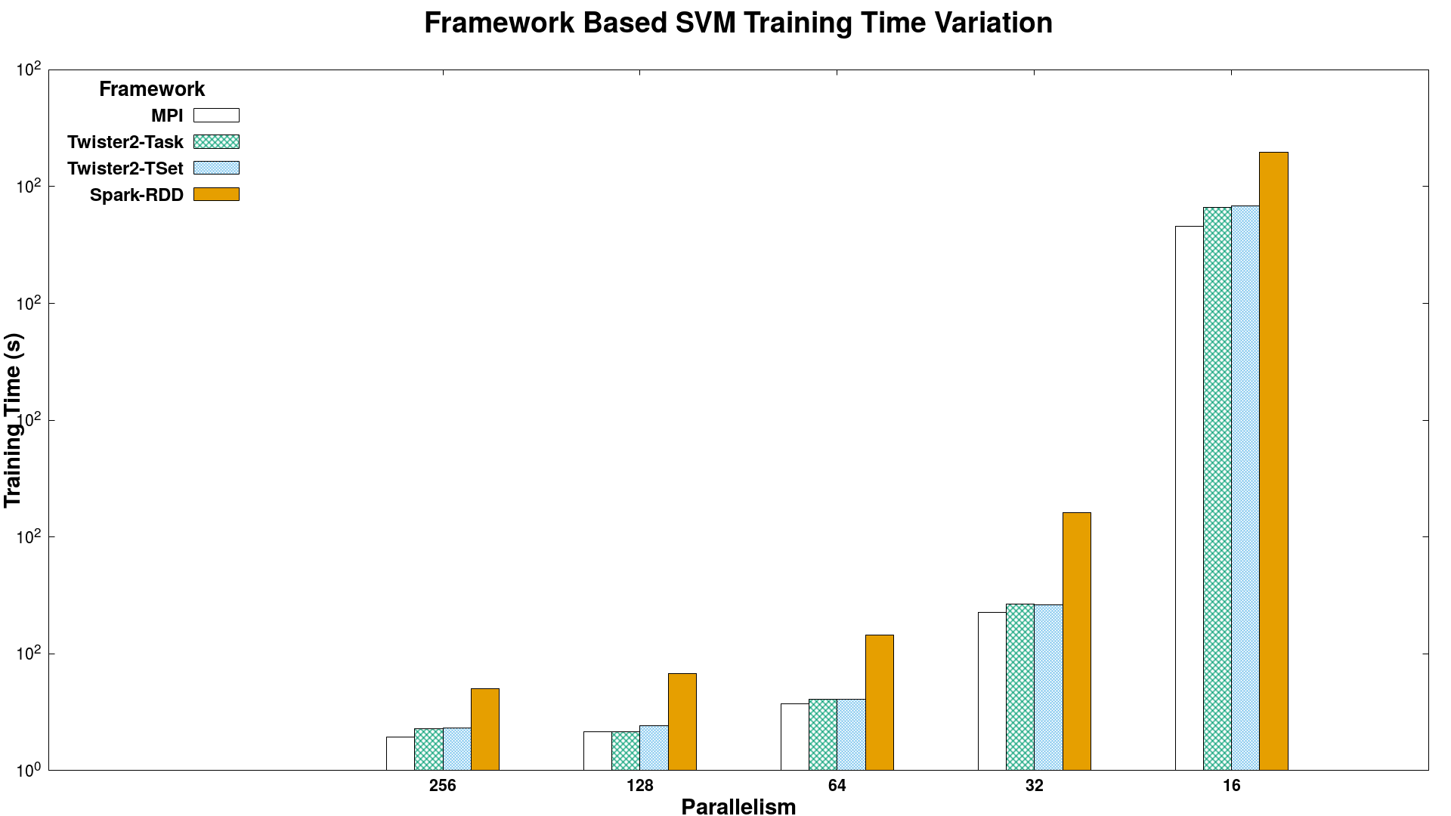
Batch Benchmark - SVM
Times (smaller better)
Spark RDD > Twister2 Tset > Twister2 Task > MPI
SVM job execution time for 320K data points with 2000 features and 500 iterations, on 16 nodes with varying parallelism

Slide 53
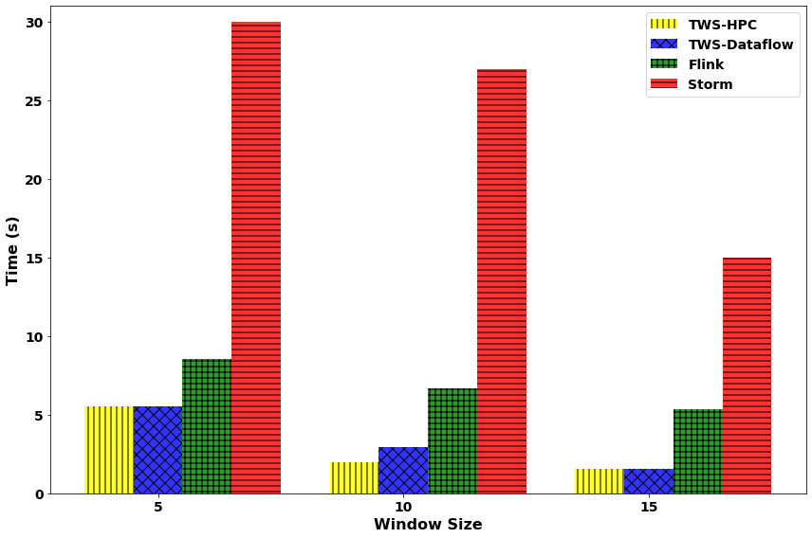
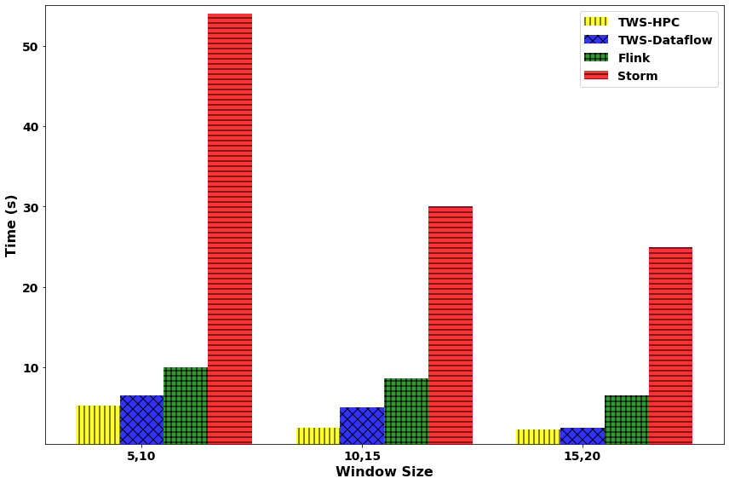
Streaming Machine Learning with Sliding Window
Streaming KMeans
Streaming SVM
KMeans: 49,000 data points with 23 features streamed. Model accuracy tested once a windowed computation is done. Testing data set size is 91,000 samples (1000 clusters). (non iterative)
SVM: 49,000 data points with 22 features streamed. Model accuracy tested once a windowed computation is done. Testing data set size is 91,000 samples. 5 Iterations per window.

Slide 54
Data Engineering/Organization System Topics
Topics | Spark tested | Twister2 tested | Functionality & Performance comparison
Iterative batch | Yes | Yes | Twister2 supports parallel iterations oppose to driver based iterations in Spark. Task creation happens at workers. This leads to 10x or more performance for some iterative machine learning applications.
Streaming latency | Yes | Yes | Twister2 supports native streaming while spark does mini batch. Twister2 observes microsecond latencies even for highly parallel synchronization operations
Streaming throughput | No | No | Twister2 supports high bandwidth networks.
Fault tolerance | No | No | We haven’t tested FT performance
Operator Level Programming | No | Yes | Twister2 allows programmers to access low level operations. It supports both BSP (Harp & MPI) and data flow operators. Spark has SQL
Streaming & Batch together |  | Yes | Twister2 allows applications with parts working as batch and parts working as streaming.
Dataflow graph | Yes | Yes | Because of distributed dataflow graph creation, the overhead is very small in Twister2 and can be made 4X faster. Spark compiles away redundant nodes
Shuffle | Yes | Yes | Better shuffle performance in Twister2 compared to Spark. Observed 5X performance compared to Spark for larger data sets.
Joins | No | No | Pending our experiments.

Slide 55
Conclusions
Twister2 ready to go
Big Data Systems
Parallel Computing
MLforHPC

Slide 56
Parallel Computing and MLforHPC Summary
Parallel Computing has a renaissance with Big Data
HPF Style could be well suited to Big Data and MLforHPC
MLforHPC will lead to many remarkable discoveries in both computational and data science
What computations can be assisted by what ML in which of different scenarios
  Not known how large training sets need to be.
What is performance and capability of different DL (ML) choices
Little or no study of either predicting errors or in fact of getting floating point numbers from deep learning.
What can we do with Yottascale computing? (10⁶ above Exascale)
Redesign all algorithms so they can be DL-assisted
Interesting load balancing issues if in parallel case some points learnt using surrogates and some points calculated from scratch

Slide 57
Summary of Big Data Systems
Everything should be Services/Microservices with good API
HPC/Computation and Machine Learning Link becoming clearer
HPCforML focus being extended to MLforHPC
Deep Learning becoming centered on PyTorch and Tensorflow
  But scikit-learn MXNet etc. can still be important
Also need combination of Data Engineering and Workflow support as in Apache Spark and Beam; HPC Workflow systems
  Implement Data ingestion from archives (SQL) and streaming; data preprocessing; organization of multiple fine and coarse grain dataflow tasks
  Interest in these areas has declined but Harp and Twister2 from IU address
What is an HPC Cloud?
What will industry not do?
  We can certainly apply technologies from anywhere to research problems as in ride hailing methods to earthquakes!

Slide 58
Twister2 Status: Ready to go
100,000 lines of new open source Code: mainly Java but significant Python
Github https://github.com/DSC-SPIDAL/twister2
Documentation https://twister2.org/
Operational with documentation and examples
December 2019 release 0.4.0: Fault tolerance, UCX unified communication (0.5.0 next week), Apache BEAM Linkage, Python API https://github.com/DSC-SPIDAL/twister2/releases
Near term: TensorFlow/PyTorch Integration, SQL interface using Apache Calcite, Certify Apache Beam compliance (Jan 5: ValidateRunner: 157 tests, 3 failing; NeedsRunner: 364 tests, 14 failing)
Medium term: Apache Arrow (cross language) Integration, MPI Fault tolerance integration (OpenMPI ULFT) for Slurm
Ongoing: C++ version of modules to improve performance

