Slide 1
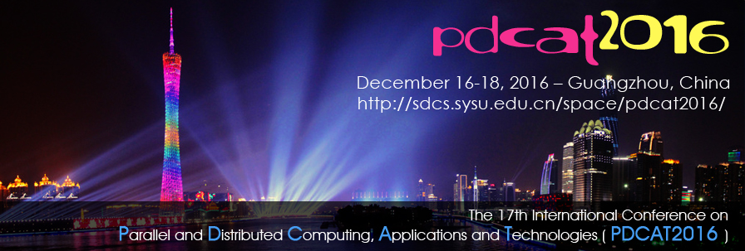
Big Data on Clouds and HPC
The 17th International Conference on Parallel and Distributed Computing, Applications and Technologies (PDCAT-16), December 16-18, 2016, Guangzhou, China, Sponsored by Sun Yat-Sen University
Geoffrey Fox December 17, 2016
gcf@indiana.edu
http://www.dsc.soic.indiana.edu/, http://spidal.org/ http://hpc-abds.org/kaleidoscope/
Department of Intelligent Systems Engineering
School of Informatics and Computing, Digital Science Center
Indiana University Bloomington

Slide 2
Indiana – Sun Yat-Sen Collaboration?
In 2014, we set up Masters in Data Science at Indiana University
  From 0 to 549 students in 2 years
  A cross department (Statistics, Computer Science, Information Science, Library Science, Informatics, ISE) program. There is no department of Data Science
In 2016, we set up Department of Intelligent Systems Engineering ISE
  Intelligent Systems includes Deep learning, Big data, Clouds etc.
  Computer Engineering includes HPC, datacenters, embedded systems
  Cyberphysical Systems: Robotics, Internet of Things, Smart-X
  Bioengineering and Neuroengineering
  Nanoengineering
ISE has curricula in Systems Engineering, Modeling & Simulation, Big Data
ISE research includes Intel MIC chips as used in Tianhe-2
ISE well aligned with School of Data and Computer Science at Guangzhou

Slide 3
Why Connect (“Converge”) Big Data and HPC
Two major trends in computing systems are
  Growth in high performance computing (HPC) with an international exascale initiative (China in the lead)
  Big data phenomenon with an accompanying cloud infrastructure of well publicized dramatic and increasing size and sophistication.
Note “Big Data” largely an industry initiative although software used is often open source
  So HPC labels overlaps with “research” e.g. HPC community largely responsible for Astronomy and Accelerator (LHC, Belle, BEPC ..) data analysis
Merge HPC and Big Data to get
  More efficient sharing of large scale resources running simulations and data analytics
  Higher performance Big Data algorithms
  Richer software environment for research community building on many big data tools
  Easier sustainability model for HPC – HPC does not have resources to build and maintain a full software stack

Slide 4
Convergence Points (Nexus) for
HPC-Cloud-Big Data-Simulation
Nexus 1: Applications – Divide use cases into Data and Model and compare characteristics separately in these two components with 64 Convergence Diamonds (features)
Nexus 2: Software – High Performance Computing (HPC) Enhanced Big Data Stack HPC-ABDS. 21 Layers adding high performance runtime to Apache systems (Hadoop is fast!). Establish principles to get good performance from Java or C programming languages
Nexus 3: Hardware – Use Infrastructure as a Service IaaS and DevOps to automate deployment of software defined systems on hardware designed for functionality and performance e.g. appropriate disks, interconnect, memory (HPC Cloud 3.0?)

Slide 5
SPIDAL Project
Datanet: CIF21 DIBBs: Middleware and High Performance Analytics Libraries for Scalable Data Science
NSF14-43054 started October 1, 2014
Indiana University (Fox, Qiu, Crandall, von Laszewski)
Rutgers (Jha)
Virginia Tech (Marathe)
Kansas (Paden)
Stony Brook (Wang)
Arizona State (Beckstein)
Utah (Cheatham)
A co-design project: Software, algorithms, applications

Slide 6





Co-designing Building Blocks Collaboratively
Software: MIDAS
HPC-ABDS

Slide 7
Main Components of SPIDAL Project
Design and Build Scalable High Performance Data Analytics Library
SPIDAL (Scalable Parallel Interoperable Data Analytics Library): Scalable Analytics for:
  Domain specific data analytics libraries – mainly from project.
  Add Core Machine learning libraries – mainly from community.
  Performance of Java and MIDAS Inter- and Intra-node.
NIST Big Data Application Analysis – features of data intensive Applications deriving 64 Convergence Diamonds. Application Nexus.
HPC-ABDS: Cloud-HPC interoperable software performance of HPC (High Performance Computing) and the rich functionality of the commodity Apache Big Data Stack. Software Nexus
MIDAS: Integrating Middleware – from project.
Applications: Biomolecular Simulations, Network and Computational Social Science, Epidemiology, Computer Vision, Geographical Information Systems, Remote Sensing for Polar Science and Pathology Informatics, Streaming for robotics, streaming stock analytics
Implementations: HPC as well as clouds (OpenStack, Docker) Convergence with common DevOps tool Hardware Nexus

Slide 8
Application Nexus
Use-case Data and Model
NIST Collection
Big Data Ogres
Convergence Diamonds

Slide 9
Data and Model in Big Data and Simulations I
Need to discuss Data and Model as problems have both intermingled, but we can get insight by separating which allows better understanding of Big Data - Big Simulation “convergence” (or differences!)
The Model is a user construction and it has a “concept”, parameters and gives results determined by the computation. We use term “model” in a general fashion to cover all of these.
Big Data problems can be broken up into Data and Model
  For clustering, the model parameters are cluster centers while the data is set of points to be clustered
  For queries, the model is structure of database and results of this query while the data is whole database queried and SQL query
  For deep learning with ImageNet, the model is chosen network with model parameters as the network link weights. The data is set of images used for training or classification

Slide 10
Data and Model in Big Data and Simulations II
Simulations can also be considered as Data plus Model
  Model can be formulation with particle dynamics or partial differential equations defined by parameters such as particle positions and discretized velocity, pressure, density values
  Data could be small when just boundary conditions
  Data large with data assimilation (weather forecasting) or when data visualizations are produced by simulation
Big Data implies Data is large but Model varies in size
  e.g. LDA with many topics or deep learning has a large model
  Clustering or Dimension reduction can be quite small in model size
Data often static between iterations (unless streaming); Model parameters vary between iterations
Data and Model Parameters are often confused in papers as term data used to describe the parameters of models.

Slide 11
51 Detailed Use Cases: Contributed July-September 2013
Covers goals, data features such as 3 V’s, software, hardware
Government Operation(4): National Archives and Records Administration, Census Bureau
Commercial(8): Finance in Cloud, Cloud Backup, Mendeley (Citations), Netflix, Web Search, Digital Materials, Cargo shipping (as in UPS)
Defense(3): Sensors, Image surveillance, Situation Assessment
Healthcare and Life Sciences(10): Medical records, Graph and Probabilistic analysis, Pathology, Bioimaging, Genomics, Epidemiology, People Activity models, Biodiversity
Deep Learning and Social Media(6): Driving Car, Geolocate images/cameras, Twitter, Crowd Sourcing, Network Science, NIST benchmark datasets
The Ecosystem for Research(4): Metadata, Collaboration, Language Translation, Light source experiments
Astronomy and Physics(5): Sky Surveys including comparison to simulation, Large Hadron Collider at CERN, Belle Accelerator II in Japan
Earth, Environmental and Polar Science(10): Radar Scattering in Atmosphere, Earthquake, Ocean, Earth Observation, Ice sheet Radar scattering, Earth radar mapping, Climate simulation datasets, Atmospheric turbulence identification, Subsurface Biogeochemistry (microbes to watersheds), AmeriFlux and FLUXNET gas sensors
Energy(1): Smart grid
Published by NIST as http://nvlpubs.nist.gov/nistpubs/SpecialPublications/NIST.SP.1500-3.pdf with common set of 26 features recorded for each use-case; “Version 2” being prepared
26 Features for each use case Biased to science

Slide 12
Sample Features of 51 Use Cases I
PP (26) “All” Pleasingly Parallel or Map Only
MR (18) Classic MapReduce MR (add MRStat below for full count)
MRStat (7) Simple version of MR where key computations are simple reduction as found in statistical averages such as histograms and averages
MRIter (23) Iterative MapReduce or MPI (Flink, Spark, Twister)
Graph (9) Complex graph data structure needed in analysis
Fusion (11) Integrate diverse data to aid discovery/decision making; could involve sophisticated algorithms or could just be a portal
Streaming (41) Some data comes in incrementally and is processed this way
Classify (30) Classification: divide data into categories
S/Q (12) Index, Search and Query

Slide 13
Sample Features of 51 Use Cases II
CF (4) Collaborative Filtering for recommender engines
LML (36) Local Machine Learning (Independent for each parallel entity) – application could have GML as well
GML (23) Global Machine Learning: Deep Learning, Clustering, LDA, PLSI, MDS,
  Large Scale Optimizations as in Variational Bayes, MCMC, Lifted Belief Propagation, Stochastic Gradient Descent, L-BFGS, Levenberg-Marquardt . Can call EGO or Exascale Global Optimization with scalable parallel algorithm
Workflow (51) Universal
GIS (16) Geotagged data and often displayed in ESRI, Microsoft Virtual Earth, Google Earth, GeoServer etc.
HPC (5) Classic large-scale simulation of cosmos, materials, etc. generating (visualization) data
Agent (2) Simulations of models of data-defined macroscopic entities represented as agents

Slide 14
7 Computational Giants of
NRC Massive Data Analysis Report
http://www.nap.edu/catalog.php?record_id=18374 Big Data Models?
G1: Basic Statistics e.g. MRStat
G2: Generalized N-Body Problems
G3: Graph-Theoretic Computations
G4: Linear Algebraic Computations
G5: Optimizations e.g. Linear Programming
G6: Integration e.g. LDA and other GML
G7: Alignment Problems e.g. BLAST

Slide 15
HPC (Simulation) Benchmark Classics
Linpack or HPL: Parallel LU factorization
for solution of linear equations; HPCG
NPB version 1: Mainly classic HPC solver kernels
  MG: Multigrid
  CG: Conjugate Gradient
  FT: Fast Fourier Transform
  IS: Integer sort
  EP: Embarrassingly Parallel
  BT: Block Tridiagonal
  SP: Scalar Pentadiagonal
  LU: Lower-Upper symmetric Gauss Seidel
Simulation Models

Slide 16
13 Berkeley Dwarfs
Dense Linear Algebra
Sparse Linear Algebra
Spectral Methods
N-Body Methods
Structured Grids
Unstructured Grids
MapReduce
Combinational Logic
Graph Traversal
Dynamic Programming
Backtrack and
Branch-and-Bound
Graphical Models
Finite State Machines
Largely Models for Data or Simulation
First 6 of these correspond to Colella’s original. (Classic simulations)
Monte Carlo dropped.
N-body methods are a subset of Particle in Colella.
Note a little inconsistent in that MapReduce is a programming model and spectral method is a numerical method.
Need multiple facets to classify use cases!

Slide 17
Classifying Use cases

Slide 18
Classifying Use Cases
The Big Data Ogres built on a collection of 51 big data uses gathered by the NIST Public Working Group where 26 properties were gathered for each application.
This information was combined with other studies including the Berkeley dwarfs, the NAS parallel benchmarks and the Computational Giants of the NRC Massive Data Analysis Report.
The Ogre analysis led to a set of 50 features divided into four views that could be used to categorize and distinguish between applications.
The four views are Problem Architecture (Macro pattern); Execution Features (Micro patterns); Data Source and Style; and finally the Processing View or runtime and algorithm features.
We generalized this approach to integrate Big Data and Simulation applications into a single classification looking separately at Data and Model with the total facets growing to 64 in number, called convergence diamonds, and split between the same 4 views.
A mapping of facets into work of the SPIDAL project has been given.

Slide 20
64 Features in 4 views for Unified Classification of Big Data and Simulation Applications
Both
Simulations
Analytics
(Model for Big Data)
(Nearly all Data)
(All Model)
(Mix of Data and Model)
(Nearly all Data+Model)

Slide 21
Examples in Problem Architecture View PA
The facets in the Problem architecture view include 5 very common ones describing synchronization structure of a parallel job:
  MapOnly or Pleasingly Parallel (PA1): the processing of a collection of independent events;
  MapReduce (PA2): independent calculations (maps) followed by a final consolidation via MapReduce;
  MapCollective (PA3): parallel machine learning dominated by scatter, gather, reduce and broadcast;
  MapPoint-to-Point (PA4): simulations or graph processing with many local linkages in points (nodes) of studied system.
  MapStreaming (PA5): The fifth important problem architecture is seen in recent approaches to processing real-time data.
  We do not focus on pure shared memory architectures PA6 but look at hybrid architectures with clusters of multicore nodes and find important performances issues dependent on the node programming model.
Most of our codes are SPMD (PA-7) and BSP (PA-8).

Slide 22
6 Forms of MapReduce
Describes Architecture of
- Problem (Model reflecting data)
- Machine
- Software
2 important variants (software) of Iterative MapReduce and Map-Streaming a) “In-place” HPC b) Flow for model and data

Slide 23
Clouds, HPC Clouds
Simulations, Big Data

Slide 24
Considerations on Big Data v. Clouds/HPC
“High Performance” seems natural for Big Data as this needs a lot of processing and HPC could do it faster?
Cons: But much big data processing involves I/O of distributed data and this dominates over computing accelerated by HPC
  Other problems (such as LHC data processing) are compute dominated but this is pleasingly parallel and so parallel computing and nifty HPC algorithms irrelevant
  Other problems (like basic databases) are essentially MapReduce and also do not have tight synchronization constraints addressed by HPC
Pros: Andrew Ng notes that a leading machine learning group must have both deep learning and HPC excellence.
  Some machine learning like topic modelling (LDA), clustering, deep learning, dimension reduction, graph algorithms involve Map-Collective or Map-Point to Point iterative structure and benefit from HPC
  HPC (MPI) often large factors (10-100) faster than Hadoop, Spark, Flink, Storm

Slide 25
Why HPC Cloud architectures?
Exascale simulations needed as have differential equation based models that need small space and time steps and this leads to numerical formulations that need the memory and compute power of an exascale machine to solve individual problems (capability computing)
Big data problems do not have differential operators and it is not obvious that you need a full exascale system to address a single Big Data problem
Rather you will be running lots of jobs that are sometimes pleasingly parallel/MapReduce (Cloud) and sometimes small to medium size HPC jobs which in aggregate are exascale (HPC Cloud) (capacity computing)
  Deep learning doesn’t exhibit massive parallelism due to stochastic gradient descent using small mini-batches of training data
  But deep learning does use small accelerator enhanced HPC clusters.
Note modest size clusters need all the software, hardware and algorithm expertise of HPC.
Systems designed for exascale HPC simulations, should be well suited for HPC cloud if I/O handled correctly (as in traditional clouds)

Slide 26
Comparison of Data Analytics with Simulation I
Simulations (models) produce big data as visualization of results – they are data source
  Or consume often smallish data to define a simulation problem
  HPC simulation in (weather) data assimilation is data + model
Pleasingly parallel often important in both
Both are often SPMD and BSP
  Classic Non-iterative MapReduce is major big data paradigm
  not a common simulation paradigm except where “Reduce” summarizes pleasingly parallel execution as in some Monte Carlos
Big Data often has large collective communication
  Classic simulation has a lot of smallish point-to-point messages
  Motivates MapCollective model
Simulations characterized often by difference or differential operators leading to nearest neighbor sparsity
Some important data analytics can be sparse as in PageRank and “Bag of words” algorithms but many involve full matrix algorithms

Slide 27
Comparison of Data Analytics with Simulation II
There are similarities between some graph problems and particle simulations with a particular cutoff force.
  Both are MapPoint-to-Point problem architecture
Note many big data problems are “long range force” (as in gravitational simulations) as all points are linked.
  Easiest to parallelize. Often full matrix algorithms
  e.g. in DNA sequence studies, distance δ(i, j) defined by BLAST, Smith-Waterman, etc., between all sequences i, j.
  Opportunity for “fast multipole” ideas in big data. See NRC report
Current Ogres/Diamonds do not have facets to designate underlying hardware: GPU v. Many-core (Xeon Phi) v. Multi-core as these define how maps processed; they keep map-X structure fixed; maybe should change as ability to exploit vector or SIMD parallelism could be a model facet.

Slide 28
Comparison of Data Analytics with Simulation III
In image-based deep learning, neural network weights are block sparse (corresponding to links to pixel blocks) but can be formulated as full matrix operations on GPUs and MPI in blocks.
In HPC benchmarking, Linpack being challenged by a new sparse conjugate gradient benchmark HPCG, while I am diligently using non- sparse conjugate gradient solvers in clustering and Multi-dimensional scaling.
Simulations tend to need high precision and very accurate results – partly because of differential operators
Big Data problems often don’t need high accuracy as seen in trend to low precision (16 or 32 bit) deep learning networks
  There are no derivatives and the data has inevitable errors
Note parallel machine learning (GML not LML) can benefit from HPC style interconnects and architectures as seen in GPU-based deep learning
  So commodity clouds not necessarily best. Need HPC Cloud

Slide 29
Example of Analytics needing HPC Cloud

Slide 30
Clustering and Visualization
The SPIDAL Library includes several clustering algorithms with sophisticated features
  Deterministic Annealing
  Radius cutoff in cluster membership
  Elkans algorithm using triangle inequality
They also cover two important cases
  Points are vectors – algorithm O(N) for N points
  Points not vectors – all we know is distance δ(i, j) between each pair of points i and j. algorithm O(N²) for N points
We find visualization important to judge quality of clustering
As data typically not 2D or 3D, we use dimension reduction to project data so we can then view it
Have a browser viewer WebPlotViz that replaces an older Windows system
Clustering and Dimension Reduction are modest HPC applications
Calculating distance δ(i, j) is similar compute load but pleasingly parallel

Slide 31
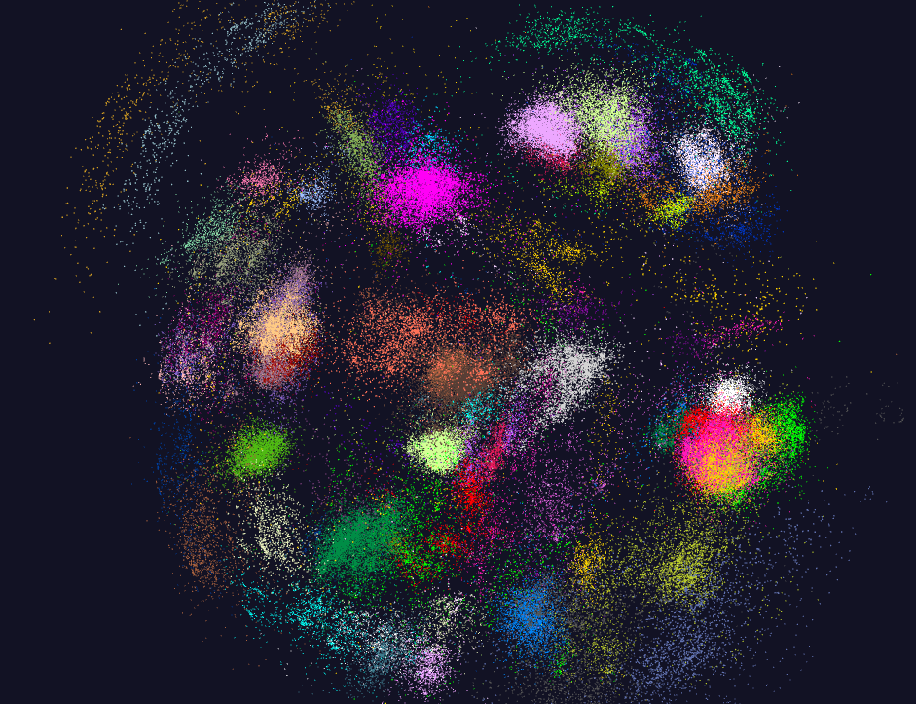
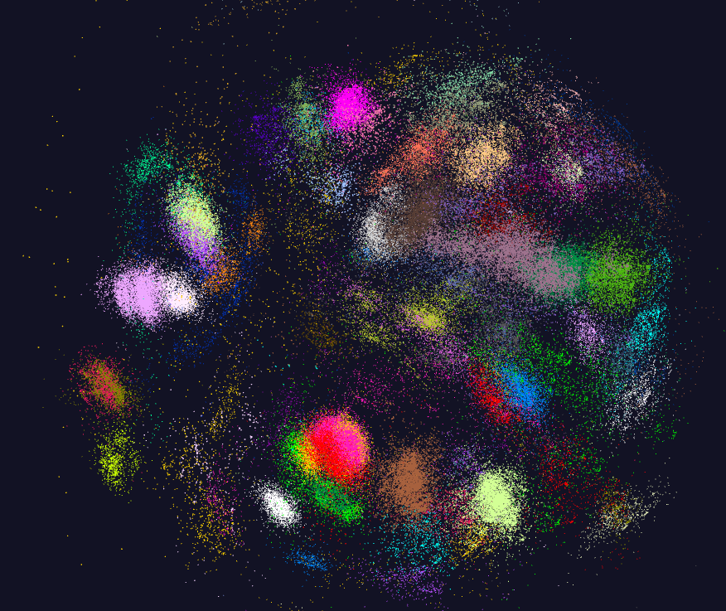
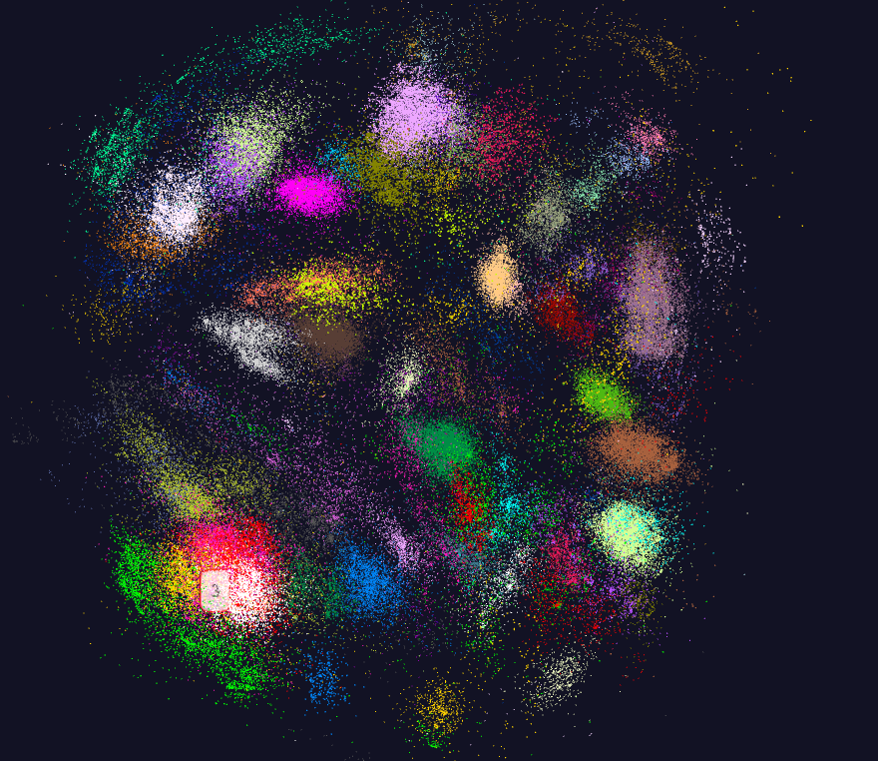
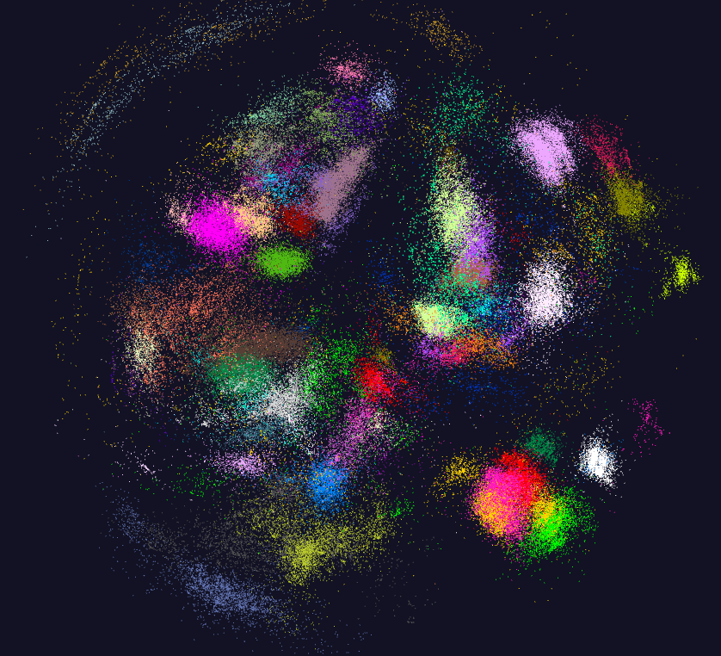
170K Fungi sequences

Slide 32
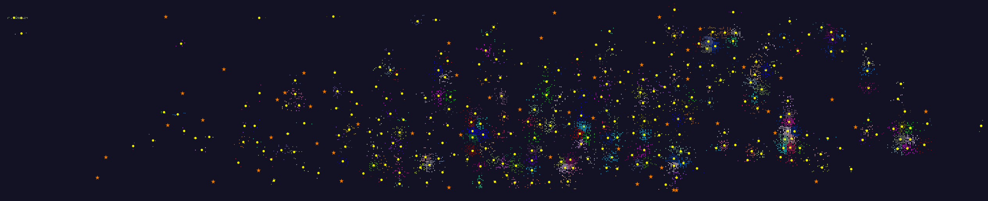
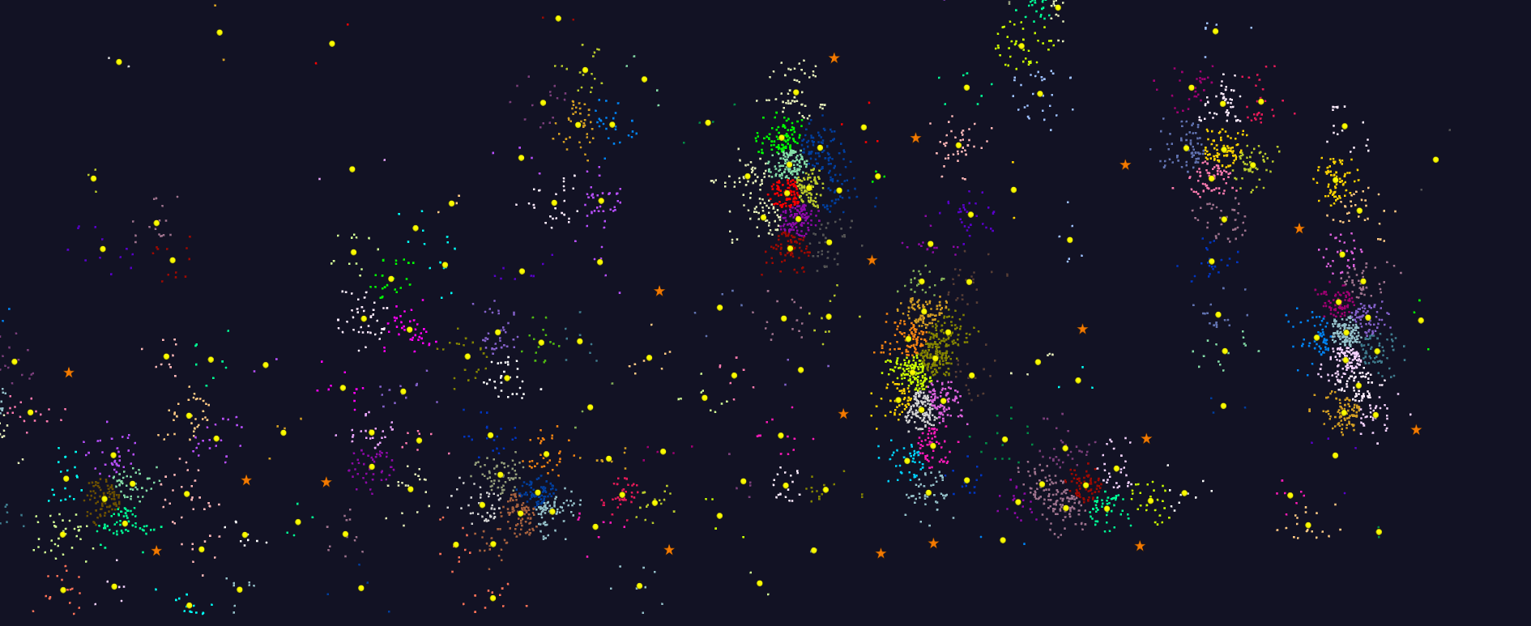
2D Vector Clustering with cutoff at 3 σ
Orange Star – outside all clusters; yellow circle cluster centers
LCMS Mass Spectrometer Peak Clustering. Charge 2 Sample with 10.9 million points and 420,000 clusters visualized in WebPlotViz

Slide 33
Software Nexus
Application Layer On
Big Data Software Components for Programming and Data Processing On
HPC for runtime On
IaaS and DevOps Hardware and Systems
HPC-ABDS
MIDAS
Java Grande

Slide 34
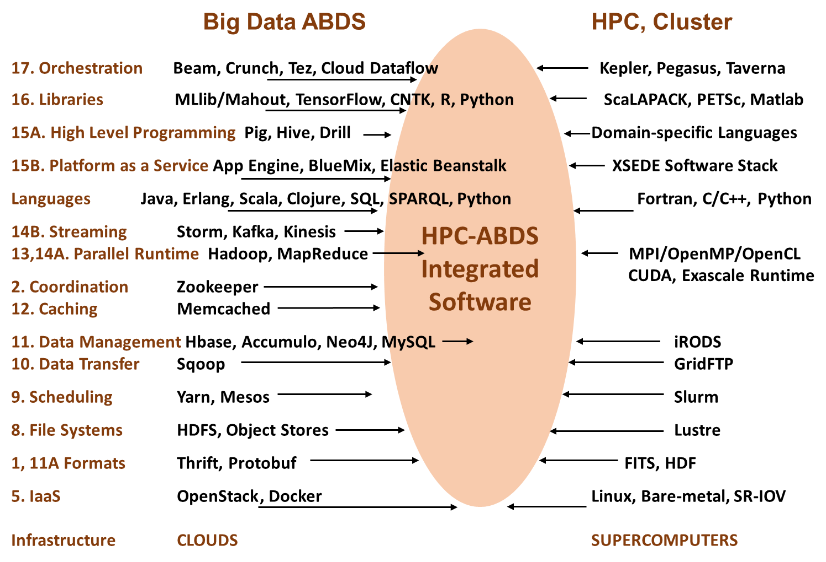

Slide 35
HPC-ABDS

Slide 36
Functionality of 21 HPC-ABDS Layers
Message Protocols:
Distributed Coordination:
Security & Privacy:
Monitoring:
IaaS Management from HPC to hypervisors:
DevOps:
Interoperability:
File systems:
Cluster Resource Management:
Data Transport:
A) File management
B) NoSQL
C) SQL
In-memory databases & caches / Object-relational mapping / Extraction Tools
Inter process communication Collectives, point-to-point, publish-subscribe, MPI:
A) Basic Programming model and runtime, SPMD, MapReduce:
B) Streaming:
A) High level Programming:
B) Frameworks
Application and Analytics:
Workflow-Orchestration:
Lesson of large number (350). This is a rich software environment that HPC cannot “compete” with. Need to use and not regenerate
Note level 13 Inter process communication added

Slide 37
Using “Apache” (Commercial Big Data) Data Systems for Science/Simulation
Pro: Use rich functionality and usability of ABDS (Apache Big Data Stack)
Pro: Sustainability model of community open source
Con (Pro for many commercial users): Optimized for fault-tolerance and usability and not performance
Feature: Naturally run on clouds and not HPC platforms
Feature: Cloud is logically centralized, physically distributed but science data typically distributed.
Question: how do science data analysis requirements differ from those commercially e.g. recommender systems heavily used commercially
Approach: HPC-ABDS using HPC runtime and tools to enhance commercial data systems (ABDS on top of HPC)
  Upper level software: ABDS
  Lower level runtime: HPC
  HPCCloud Hardware: HPC or classic cloud dependent on application requirements

Slide 38
Java Grande
Revisited on 3 data analytics codes
Clustering
Multidimensional Scaling
Latent Dirichlet Allocation all sophisticated algorithms

Slide 39

Java MPI performs better than FJ Threads
128 24 core Haswell nodes on SPIDAL 200K DA-MDS Code
Speedup compared to 1 process per node on 48 nodes
Best MPI; inter and intra node
MPI; inter/intra node; Java not optimized
Best FJ Threads intra node; MPI inter node

Slide 40
Investigating Process and Thread Models
FJ Fork Join Threads lower performance than Long Running Threads LRT
Results
  Large effects for Java
  Best affinity is process and thread binding to cores - CE
  At best LRT mimics performance of “all processes”
6 Thread/Process Affinity Models

Slide 41
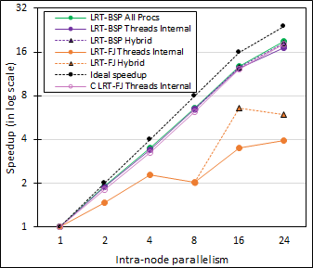
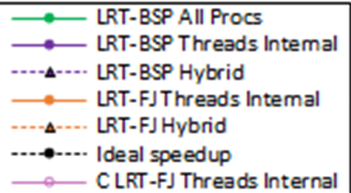
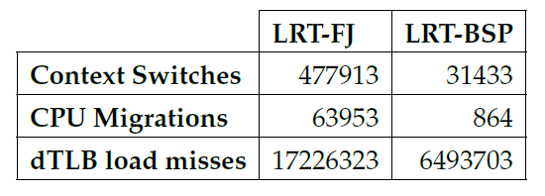
Performance Dependence on Number of Cores inside 24-core node (16 nodes total)
Long-Running Theads LRT Java
  All Processes
  All Threads internal to node
  Hybrid – Use one process per chip
Fork Join Java
  All Threads
  Hybrid – Use one process per chip
Fork Join C
  All Threads
All MPI internode
15x
74x
2.6x

Slide 42
Java versus C Performance
C and Java Comparable (if you use best Java approach) with Java doing better on larger problem sizes
All data from one million point dataset with varying number of centers on 16 nodes 24 core Haswell

Slide 43
HPC-ABDS
DataFlow and In-place Runtime

Slide 44
HPC-ABDS Parallel Computing
Both simulations and data analytics use similar parallel computing ideas
Both do decomposition of both model and data
Both tend use SPMD and often use BSP Bulk Synchronous Processing
One has computing (called maps in big data terminology) and communication/reduction (more generally collective) phases
Big data thinks of problems as multiple linked queries even when queries are small and uses dataflow model
Simulation uses dataflow for multiple linked applications but small steps such as iterations are done in place
Reduction in HPC (MPIReduce) done as optimized tree or pipelined communication between same processes that did computing
Reduction in Hadoop or Flink done as separate map and reduce processes using dataflow
  This leads to 2 forms (In-Place and Flow) of Map-X mentioned earlier
Interesting Fault Tolerance issues highlighted by Hadoop-MPI comparisons – not discussed here!

Slide 45
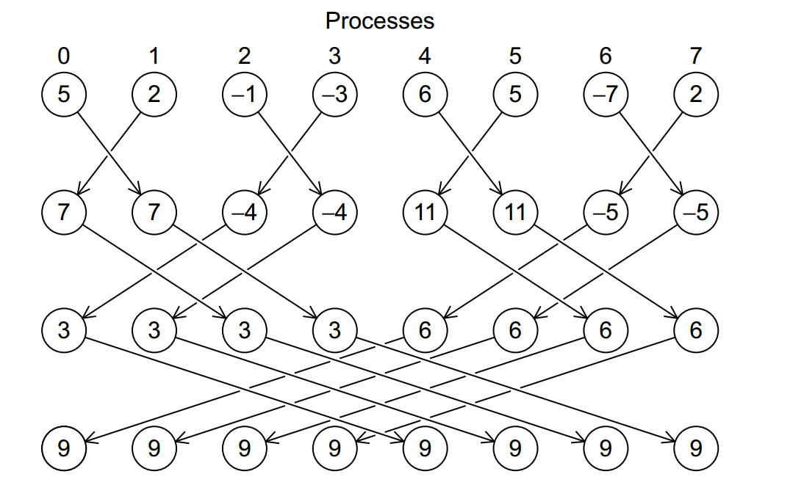
Illustration of In-Place AllReduce in MPI

Slide 46

Breaking Programs into Parts
Fine Grain Parallel Computing Data/model parameter decomposition
Coarse Grain Dataflow
HPC or ABDS

Slide 47
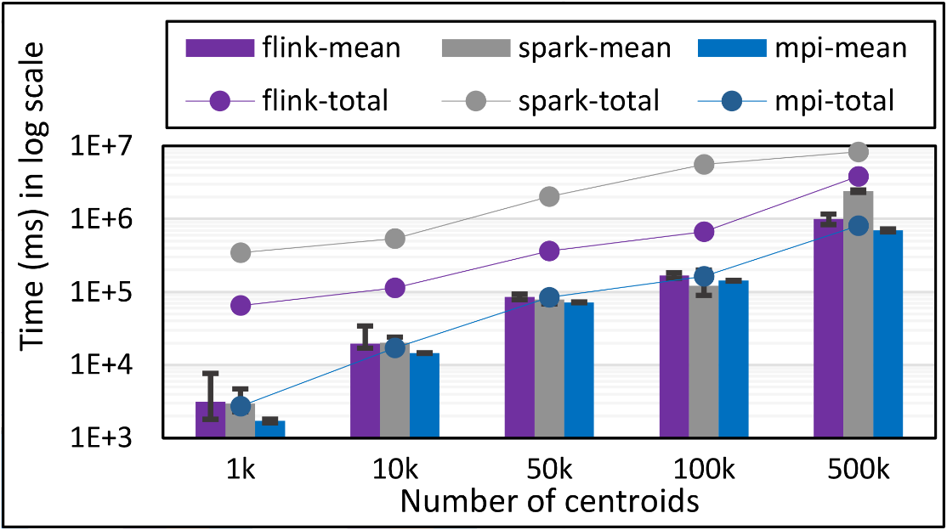
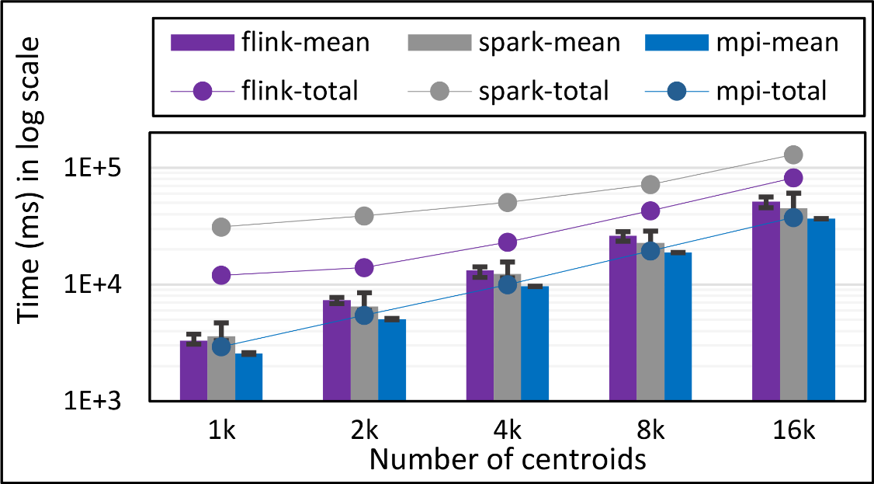
K-Means Clustering in Spark, Flink, MPI
Data Set <Points>
Dataflow for K-means
Map (nearest centroid calculation)
Reduce (update centroids)
Data Set <Initial Centroids>
Data Set <Updated Centroids>
Broadcast
K-Means total and compute times for 1 million 2D points and 1k,10,50k,100k, and 500k centroids for Spark, Flink, and MPI Java LRT-BSP CE. Run on 16 nodes as 24x1.
K-Means total and compute times for 1 million 2D points and 1k,10,50k,100k, and 500k centroids for Spark, Flink, and MPI Java LRT-BSP CE. Run on 16 nodes as 24x1.
K-Means total and compute times for 100k 2D points and1k,2k,4k,8k, and 16k centroids for Spark, Flink, and MPI Java LRT-BSP CE. Run on 1 node as 24x1.
Notes:
Note the differences in communication architectures
Note times are in log scale
Bars indicate compute only times, which is similar across these frameworks
Overhead is dominated by communications in Flink and Spark

Slide 48
Flink vs MPI DA-MDS Performance
Total time of MPI Java and Flink MDS implementations for 96 and 192 parallel tasks with no of points ranging from 1000 to 32000. The graph also show the computation time.

Slide 49

Flink MDS Dataflow Graph

Slide 50
HPC-ABDS Parallel Computing
MPI designed for fine grain case and typical of parallel computing used in large scale simulations
  Only change in model parameters are transmitted
  In-place implementation
  Synchronization important as parallel computing
Dataflow typical of distributed or Grid computing workflow paradigms
  Data sometimes and model parameters certainly transmitted
  If used in workflow, large amount of computing and no synchronization constraints
  Caching in iterative MapReduce avoids data communication and in fact systems like TensorFlow, Spark or Flink are called dataflow but usually implement “model-parameter” flow
HPC-ABDS Plan: Add in-place implementations when best to ABDS keeping ABDS Interface as in next slide

Slide 51
Harp (Hadoop Plugin) brings HPC to ABDS
Judy Qiu: Iterative HPC communication; scientific data abstractions
Careful support of distributed data AND distributed model
Avoids parameter server approach but distributes model over worker nodes and supports collective communication to bring global model to each node
Have also added HPC to Apache Storm and Heron; working on adding Parallel Computing Runtime to Distributed computing model built into Apache Spark, Flink, Beam
MapReduce Model
MapCollective Model
MapReduce Applications
MapCollective Applications
M
M
M
M
M
M
M
M
MapReduce V2
Harp
Shuffle
Collective Communication
R
R
YARN

Slide 52
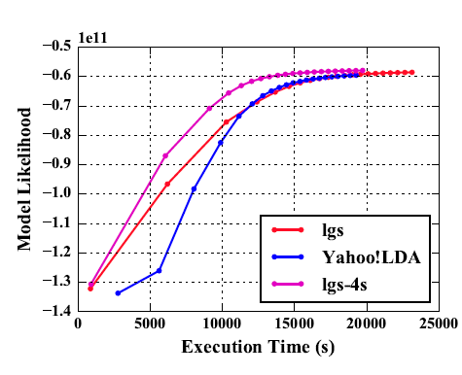
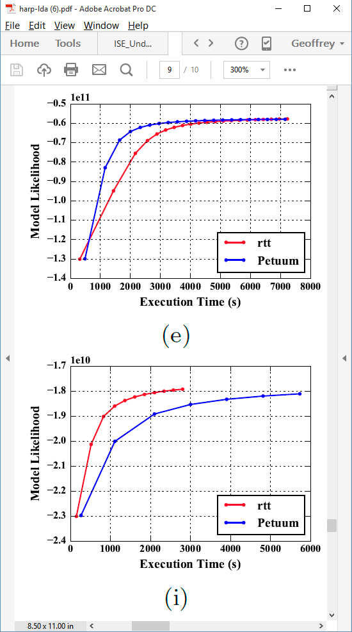
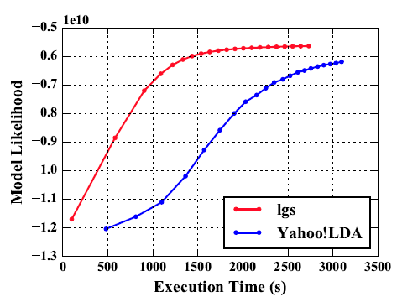
Latent Dirichlet Allocation on 100 Haswell nodes: red is Harp (lgs and rtt)
Clueweb
Clueweb
enwiki
Bi-gram

Slide 53
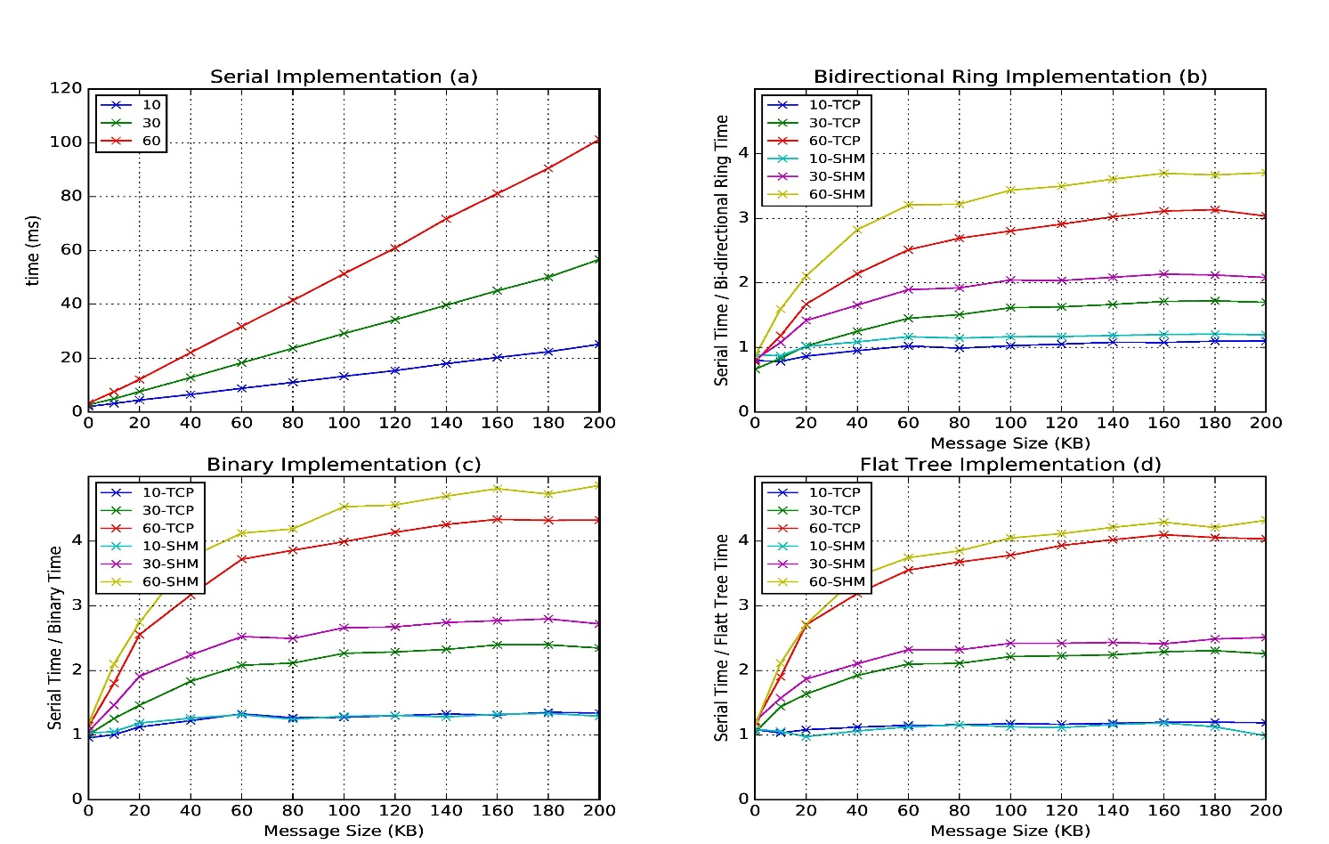
Improvement of Storm (Heron) using HPC communication algorithms
Latency of binary tree, flat tree and bi-directional ring implementations compared to serial implementation. Different lines show varying # of parallel tasks with either TCP communications and shared memory communications(SHM).
Original Time
Speedup Ring
Speedup Binary
Speedup Tree

Slide 54
Infrastructure Nexus
IaaS
DevOps
Cloudmesh

Slide 55
HPCCloud 2.0 Software Defined Systems
Significant advantages in specifying job software with scripts such as Chef, Puppet, Ansible – “Software Defined Systems” (SDS)
  Choose Ansible as Python based
Less voluminous than machine images; easier to ensure latest version; easy to recreate image on demand after crashes
In work with NIST, we looked at 87 applications from two of our “big data on cloud” classes and from NIST itself (6)
The 6 NIST use cases need 27 Ansible roles (distinct software subsystems) and full set of 87 needed 62 separate roles (average 4.75 roles per use case)
https://docs.google.com/spreadsheets/d/1e8-pzWn-7lz47-gIAra0VzCX6IkAypa8Cu5YG5MES_4
With NIST Public Big Data group, looking at mapping SDS to system architecture
Preparing Ansible specifications of many subsystems and use cases
Note many public Ansible roles (Andible Galaxy collection) do NOT expose full functionality of software and/or have errors
Microservices, HPCCloud 3.0 and serverless computing build on SDS https://youtu.be/iNN9KAsQ3G8?t=8m Amin Vahdat (Google)
  Amazon Lambda, Google Cloud Functions, Microsoft Azure Functions,
  IBM OpenWhisk; WOSC2017 workshop June 2017

Slide 56
Ansible Roles and Re-use in 6 NIST use cases
ID | 6 NIST Use Cass | Hadoop | Mesos | Spark | Storm | Pig | Hive | Drill | HDFS | HBase | Mysql | MongoDB | RethinkDB | Mahout | D3, Tableau | nltk | MLlib | Lucene/Solr | OpenCV | Python | Java | maven | Ganglia | Nagios | spark supervisord | zookeeper | AlchemyAPI | R
1 | NIST Fingerprint Matching | x |  | x |  |  | x | x |  | x | x |  |  |  |  |  |  |  |  |  | x | x | x | x | x | x
2 | Human and Face Detection |  | x | x |  |  |  |  |  |  |  |  |  |  |  |  |  |  | x | x |  |  |  |  |  | x
3 | Twitter Analysis |  |  |  | x |  |  |  |  | x |  | x |  |  | x | x |  |  |  | x | x |  |  |  |  | x | x | x
4 | Analytics for Healthcare Data/Health Informatics | x |  | x |  |  |  |  |  | x |  |  |  | x | x |  | x | x |  |  | x |  |  |  |  | x
5 | Spatial Big Data/Spatial Statistics/Geographic Information Systems | x |  | x |  |  |  |  |  |  |  |  |  | x | x |  | x |  |  |  | x | x
6 | Data Warehousing and Data Mining | x |  | x |  | x | x |  |  | x |  | x |  | x | x |  | x | x |  |  | x |  |  |  |  | x
count |  | 4 | 1 | 5 | 1 | 1 | 2 | 1 | 0 | 4 | 1 | 2 | 0 | 3 | 4 | 1 | 3 | 2 | 1 | 2 | 5 | 2 | 3 | 1 | 1 | 5 | 1 | 1

Slide 57
Cloudmesh HPCCloud 2.0 DevOps Tool
Model: Define software configuration with tools like Ansible (Chef, Puppet); instantiate on a virtual cluster
Save scripts not virtual machines and let script build applications
Cloudmesh is an easy-to-use command line program/shell and portal to interface with heterogeneous infrastructures taking script as input
  It first defines virtual cluster and then instantiates script on it
  It has several common Ansible defined software built in
Supports OpenStack, AWS, Azure, SDSC Comet, virtualbox, libcloud supported clouds as well as classic HPC and Docker infrastructures
  Has an abstraction layer that makes it possible to integrate other IaaS frameworks
Managing VMs across different IaaS providers is easier
Demonstrated interaction with various cloud providers:
  FutureSystems, Chameleon Cloud, Jetstream, CloudLab, Cybera, AWS, Azure, virtualbox
Status: AWS, and Azure, VirtualBox, Docker need improvements; we focus currently on SDSC Comet and NSF resources that use OpenStack
Interoperability Layer to build HPCCloud 2.0

Slide 58
Cloudmesh Architecture
Software Engineering Process
We define a basic virtual cluster which is a set of instances with a common security context
We then add basic tools including languages Python Java etc.
Then add management tools such as Yarn, Mesos, Storm, Slurm etc …..
Then add roles for different HPC-ABDS PaaS subsystems such as Hbase, Spark
  There will be dependencies e.g. Storm role uses Zookeeper
Any one project picks some of HPC-ABDS PaaS Ansible roles and adds >=1 SaaS that are specific to their project and for example read project data and perform project analytics
E.g. there will be an OpenCV role used in Image processing applications

Slide 59
Summary of Big Data - Big Simulation
Convergence?
HPC-Clouds convergence? (easier than converging higher levels in stack)
Can HPC continue to do it alone?
Convergence Diamonds
HPC-ABDS Software on differently optimized hardware infrastructure

Slide 60
HPCCloud Convergence Architecture
Running same HPC-ABDS software across all platforms but data management machine has different balance in I/O, Network and Compute from “model” machine
  Note data storage approach: HDFS v. Object Store v. Lustre style file systems is still rather unclear
The Model behaves similarly whether from Big Data or Big Simulation.
Data Management Model for Big Data
and Big Simulation
HPCCloud Capacity-style Operational Model matches hardware features with application requirements

Slide 61
Summary of Big Data HPC Convergence I
Applications, Benchmarks and Libraries
  51 NIST Big Data Use Cases, 7 Computational Giants of the NRC Massive Data Analysis, 13 Berkeley dwarfs, 7 NAS parallel benchmarks
  Unified discussion by separately discussing data & model for each application;
  64 facets– Convergence Diamonds -- characterize applications
  Characterization identifies hardware and software features for each application across big data, simulation; “complete” set of benchmarks (NIST)
Exemplar Ogre and Convergence Diamond Features
  Overall application structure e.g. pleasingly parallel
  Data Features e.g. from IoT, stored in HDFS ….
  Processing Features e.g. uses neural nets or conjugate gradient
  Execution Structure e.g. data or model volume
Need to distinguish data management from data analytics
Management and Search I/O intensive and suitable for classic clouds
  Science data has fewer users than commercial but requirements poorly understood
Analytics has many features in common with large scale simulations
  Data analytics often SPMD, BSP and benefits from high performance networking and communication libraries.
  Decompose Model (as in simulation) and Data (bit different and confusing) across nodes of cluster

Slide 62
Summary of Big Data HPC Convergence II
Software Architecture and its implementation
  HPC-ABDS: Cloud-HPC interoperable software: performance of HPC (High Performance Computing) and the rich functionality of the Apache Big Data Stack.
  Added HPC to Hadoop, Storm, Heron, Spark; could add to Beam and Flink
  Could work in Apache model contributing code in different ways
  One approach is an HPC project in Apache Foundation
HPCCloud runs same HPC-ABDS software across all platforms but “data management” nodes have different balance in I/O, Network and Compute from “model” nodes
  Optimize to data and model functions as specified by convergence diamonds rather than optimizing for simulation and big data
Convergence Language: Make C++, Java, Scala, Python (R) … perform well
Training: Students prefer to learn machine learning and clouds and need to be taught importance of HPC to Big Data
Sustainability: research/HPC communities cannot afford to develop everything (hardware and software) from scratch
HPCCloud 2.0 uses DevOps to deploy HPC-ABDS on clouds or HPC
HPCCloud 3.0 delivers Solutions as a Service

Slide 63
Abstract I
We review several questions at the intersection of Big Data, Clouds and HPC (high performance computing) with the large scale simulations usually run on supercomputers and the target of the exascale initiative
We base this on an analysis of many big data and simulation problems and a set of properties -- the Big Data Ogres -- characterizing them where we distinguish data and model properties.
We consider broad topics:
What are the application and user requirements?
  e.g. is the data streaming, how similar are commercial and scientific requirements?
What is execution structure of problems?
  e.g. is it dataflow or more like MPI?
  Should we use threads or processes?
  Is execution pleasingly parallel?

Slide 64
Abstract II
What about the many choices for infrastructure and middleware?
  Should we use classic HPC cluster, Docker or OpenStack?
  Where are Big Data (Apache) approaches superior/inferior to those familiar from Grid and HPC work?
  The choice of language -- C++, Java, Scala, Python, R highlights performance v. productivity trade-offs.
What is actual performance of Big Data implementations and what are good benchmarks?
Is software sustainability important and is the Apache model a good approach to this? The difference between capability and capacity computing on HPC clusters.
We introduce HPC-ABDS High Performance Computing enhanced Apache Big Data Stack and HPCCloud 3.0
We discuss how this HPC-ABDS concept allows one to discuss convergence of Big Data, Big Simulation, Cloud and HPC Systems. See http://hpc-abds.org/kaleidoscope/

