Slide 1
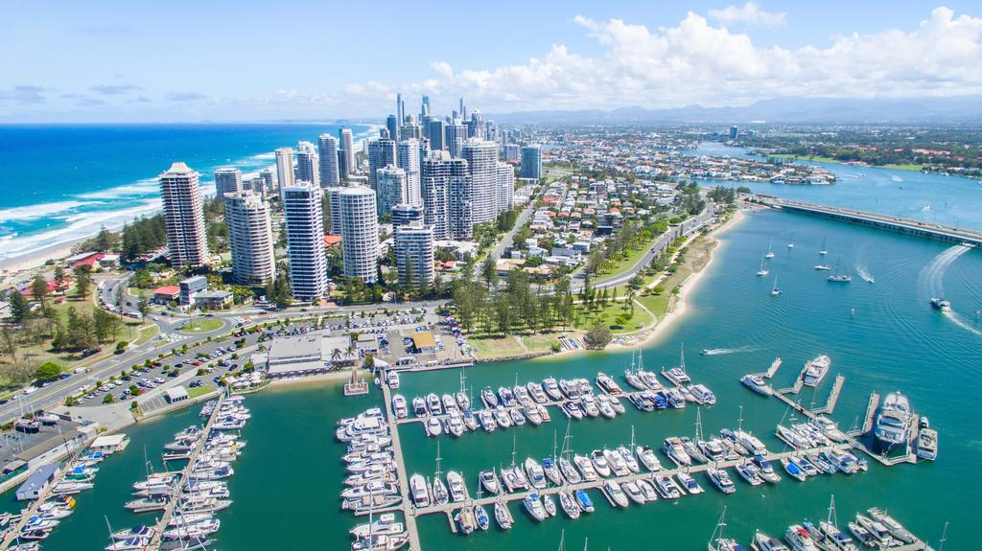

HPC, Big Data, and Machine Learning Convergence
PDCAT Conference Gold Coast, Australia
Geoffrey Fox, Judy Qiu, Shantenu Jha December 7, 2019
Digital Science Center, Indiana University
gcf@indiana.edu, http://www.dsc.soic.indiana.edu/, http://spidal.org/

Slide 2
HPC, Big Data, and Machine Learning Convergence
Abstract: We describe how High Performance Computing (HPC) can be used to enhance Big Data and Machine Learning (ML) systems (HPC for ML) but also how machine learning can be used to enhance system execution (ML for HPC).
We discuss how these communities as well cloud and IoT make up today's academic and industry activities. We note the differences between HPC software architectures and Big Data Systems such as Hadoop, Spark, and TensorFlow, which makes it not easy to integrate HPC and Big Data.
Further, we identify eight distinct ways MLforHPC can be used and give examples and describe compute science challenges in implementing these different ways that HPC and ML interact.
We describe our big data framework Twister2 and explain where it can offer improved capabilities over current systems in both MLforHPC and HPCforML.

Slide 3
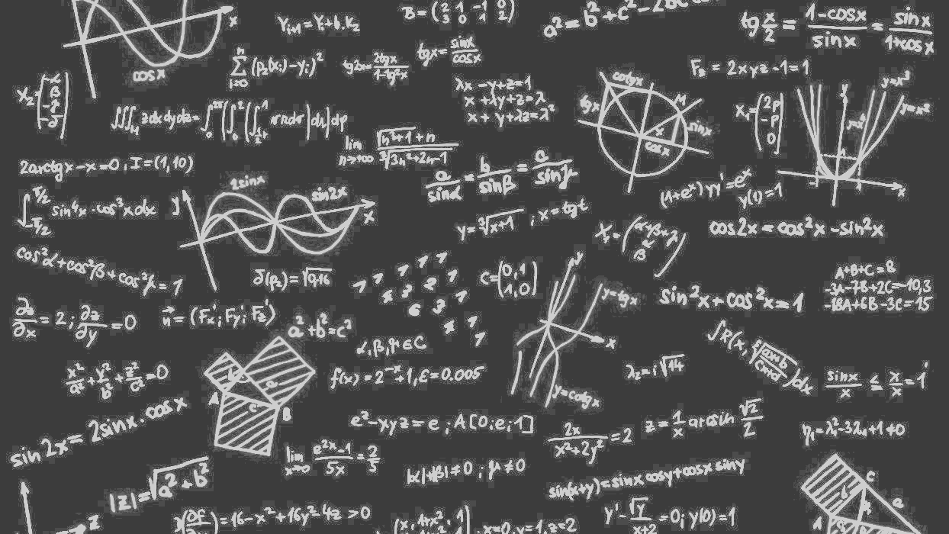
Communities
HPC Cloud Edge IoT and Big Data
Trends

Slide 4
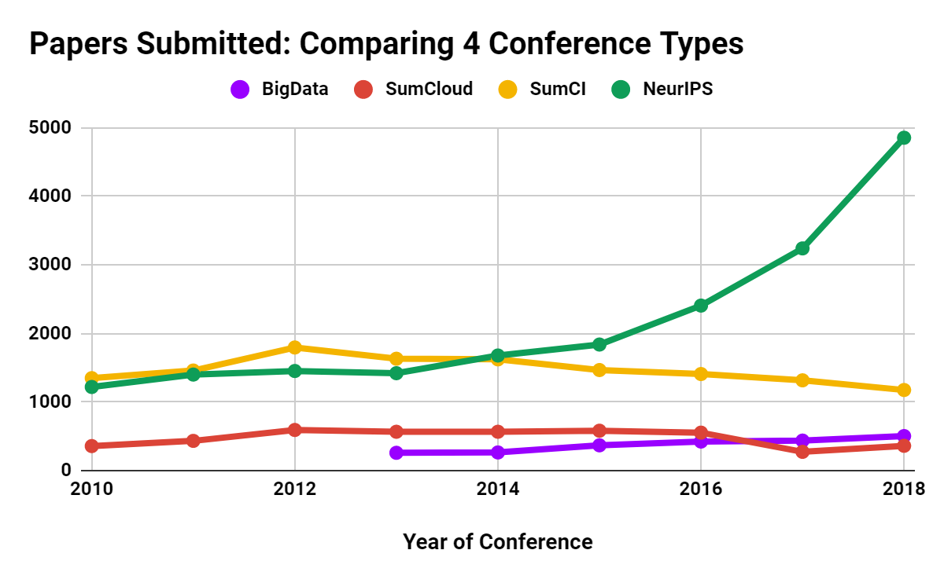
Papers Submitted: Comparing 4 Conference Types
SumCI: SC, eScience, CCGrid, IPDPS
SumCloud: IEEE Cloud, Cloudcom
Notes:
Summary

Slide 5
Trends in AI, Big Data, Clouds, Edge, HPC over last 5 years
Artificial Intelligence
Amazon Web Services (Proxy for cloud computing)
Internet of Things
Big Data
High Performance Computing (1%)

Slide 6
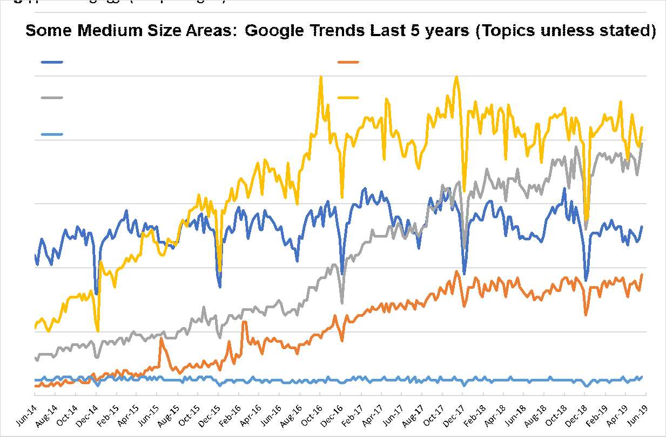
Some medium size areas: Google Trends last 5 years (Topics unless otherwise stated)
AI IS 10X BIG DATA, CYBERINFRASTRUCTURE, EXASCALE SMALL
Internet of Things
Machine Learning
(Search Term)
Big Data
Deep Learning
High Performance Computing (HPC)
Notes:
●IoT ML DL growing
●Big Data HPC flattish with HPC < Big Data

Slide 7
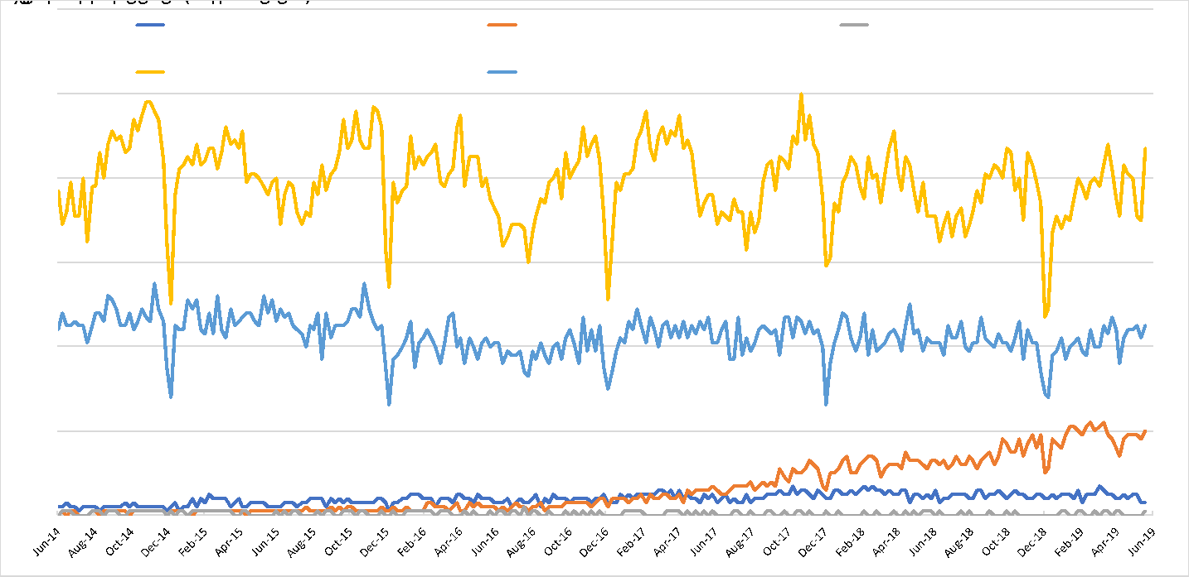
Some smaller areas: Google Trends last 5 years (Topics unless otherwise stated)
Parallel Computing (Programming Paradigm)
HPC
Edge Computing
Fog Computing
Cyberinfrastructure
Notes:
●Some small fields. Edge growing but pretty small

Slide 8
H5-index Conferences: AI, Big Data, Cloud, Systems, Other 2018 (2019 Brown)
H5 is h index for papers over 5 years for conferences and journals
158 (188) CVPR: Conference on Computer Vision and Pattern Recognition
101 (134) NeurIPS: Neural Information Processing Systems
98 (104) ECCV: European Conference on Computer Vision
91 (113) ICML: International Conference on Machine Learning
89 (124) ICCV: International Conference on Computer Vision
85 (86) CHI: Computer Human Interaction
80 (76) INFOCOM: Joint Conference of the Computer and Communications Societies
77 (76) WWW: International World Wide Web Conferences
73 (74) VLDB: International Conference on Very Large Databases
73 (77) SIGKDD: International Conference on Knowledge discovery and data mining
71 (75) ICRA: International Conference on Robotics and Automation
56 (69) AAAI: Assoc. Adv. AI Conference on Artificial Intelligence
54 (58) ISCA: International Symposium on Computer Architecture
50 (54) IROS: International Conference on Intelligent Robots and Systems
50 (51) ASPLOS: International Conference on Architectural Support for Programming Languages and Operating Systems
47 (42) SC: International Conference on High Performance Computing, Networking, Storage and Analysis
46 (51) HPCA: International Symposium on High Performance Computer Architecture
45 (61) IJCAI: International Joint Conference on Artificial Intelligence
43 (42) BMVC: British Machine Vision Conference
43 (46) IPDPS: International Symposium on Parallel & Distributed Processing
41 (41) MICRO: International Symposium on Microarchitecture
39 (31) CLOUD: International Conference on Cloud Computing
39 (?) OSDI: Symposium on Operating Systems Design and Implementation
37 (33) OOPSLA: SIGPLAN International Conference on Object-Oriented Programming, Systems, Languages, and Applications
37 (32) PPOPP: SIGPLAN Symposium on Principles & Practice of Parallel Programming
37 (33) CCGrid: International Symposium on Cluster Computing and the Grid
34 (41) ICIP: International Conference on Image Processing
34 (28) ICPR: International Conference on Pattern Recognition
30 (35) SoCC: Symposium on Cloud Computing
29 (22) ECAI: European Conference on Artificial Intelligence
29 (28) HPDC: International Symposium on High Performance Distributed Computing
28 (25) CloudCom: International Conference on Cloud Computing Technology and Science
26 (25) ICS: International Conference on Supercomputing
25 (33) Big Data: International Conference on Big Data
21 (20) CLUSTER: International Conference on Cluster Computing
21 (22) SPAA: Symposium on Parallelism in Algorithms and Architectures
20 (20) ICPP: International Conference on Parallel Processing
18 (20) ICCSA: International Conference on Computational Science and Its Applications
15 (12) SBAC-PAD: International Symposium on Computer Architecture and High Performance Computing
14 (11) DS-RT: International Symposium on Distributed Simulation and Real-Time Applications
Some didn’t make h5-index cut of >=12
Notes:
Escience below cut
H5 shows dominance of AI

Slide 9
Importance of HPC, Cloud, Edge and Big Data Community
HPC Community not growing in terms of obvious metrics such as new faculty advertisements, student interest, papers published
Cloud Community quite strong in Industry; relatively small academically as Industry has some advantages (infrastructure and data)
Big data and Edge communities strong in Academia and Industry
  Big Data definition unclear but it is growing although still quite small in terms of dedicated activities
At IEEE services federation in Milan in July 2019; Cloud Edge IoT and Big Data conferences had significant overlap – not surprising as most IoT/Edge systems connect to Cloud and essentially all Big Data computing uses cloud.
All these academic fields need to align with mainstream (Industry) systems
Microsoft described the AI Supercomputer linking Intelligent Cloud to Intelligent Edge

Slide 10
Convergence
Big Data
Deep Learning
Simulation
HPC

Slide 11
Remarks on Convergence Big Data, Simulation, HPC
HPC integration with both Big Data and (Big) Simulation has one clear aspect as both areas need high performance reached by HPC technology
  Clear in exascale initiative and success of computational science
  Part of Systems for ML in Dean’s talk at NeurIPS 2017 for Big Data
  We term HPCforML and directly supported by Twister2
We can also integrate Big Data technology (from Apache Software Stack to Containers) with simulations
Dean also discussed ML for Systems which becomes MLforHPC when system built on HPC technology
Twister2 supports MLforHPC with dynamic dataflow to integrate ML and computation.
  However needed support unclear at this early stage

Slide 12
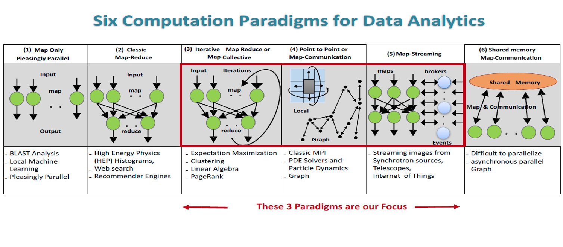
Five Major Application Structures
Global Machine Learning
Classic Cloud Workload
High Performance Big Data Workload
5 Application Classes cover both Applications and Simulations

Slide 13
Big Data and Simulation Similar Challenges in Parallelism
Complexity of Synchronization and Parallellization
Loosely Coupled
Regular Coupling
Complex Coupling
Big
Data
HPC Clouds: Accelerators
High Performance Interconnect
HPC Clouds/Supercomputers
Memory access also critical
Commodity Clouds
MapReduce as in scalable databases
Global Machine Learning
e.g. parallel clustering
Graph Analytics e.g. subgraph mining
Deep Learning
LDA
Pleasingly Parallel
Often independent events
Regular simulations
Unstructured Adaptive Sparse
Parameter sweep simulations
Structured Adaptive Sparse
Current major Big Data category
Linear Algebra at core
(often not sparse)
Straightforward Parallelism
User Performed Parallelism
Simulations

Slide 14
Next Generation of Cyberinfrastructure:
Application Requirements
Four clear classes of applications are
  Classic simulations which are addressed excellently by DoE exascale program and although our focus is Big Data, one should consider this application area as we need to integrate simulations with data analytics and ML (Machine Learning) -- item d) below
  Classic Big Data Analytics as in the analysis of LHC data, SKA, Light sources, health, and environmental data. HPCforML
  Cloud-Edge applications which certainly overlap with b) as data in many fields comes from the edge
    Note original compute Grid is now a data Grid and called Edge computing
  Integration of ML and Data analytics with simulations. “learning everywhere” MLforHPC

Slide 15
MLforHPC
Categories
Examples

Slide 16
MLforHPC in detail
MLforHPC can be further subdivided into several categories:
  MLautotuning: Using ML to configure (autotune) ML or HPC simulations.
  MLafterHPC: ML analyzing results of HPC as in trajectory analysis and structure identification in biomolecular simulations
  MLaroundHPC: Using ML to learn from simulations and produce learned surrogates for the simulations or parts of simulations. The same ML wrapper can also learn configurations as well as results. Most Important
  MLControl: Using simulations (with HPC) in control of experiments and in objective driven computational campaigns. Here the simulation surrogates are very valuable to allow real-time predictions.
Twister2 supports MLforHPC by allowing nodes of HPC dataflow representation to be wrapped with ML

Slide 17
MLaroundHPC and MLAutotuningHPC
Use Computation to represent Simulation or Big Data
We identified 8 styles of MLforHPC
Improving Computations with Configurations and Integration of Data
  Autotuning of initial and running configuration; data assimilation
Learn Structure, Theory and Model for Computations
  Learn potentials, support cross-scale integration; learn microscale structure; derive fundamental theories
  Generate smart ensembles and collective coordinates
Learn Surrogates for Simulations
  Can be input specifications mapped into output features
    Can be combined with experimental observation over same input specifications
  Or input field values mapped to output field values
ML gives speedup factors from 2 (static Autotuning) to 10^{N} (N=5-8 in examples) from surrogates and smart ensembles with strong speedup (fixed problem speedup)

Slide 18
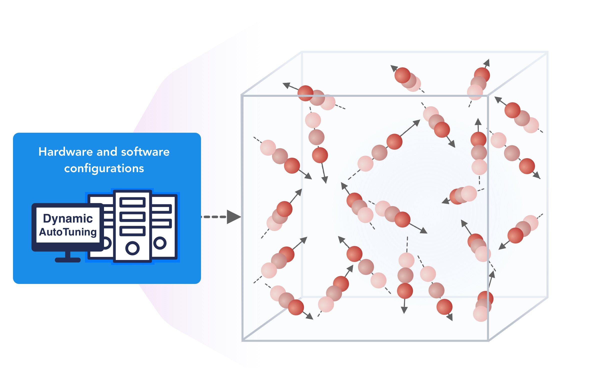
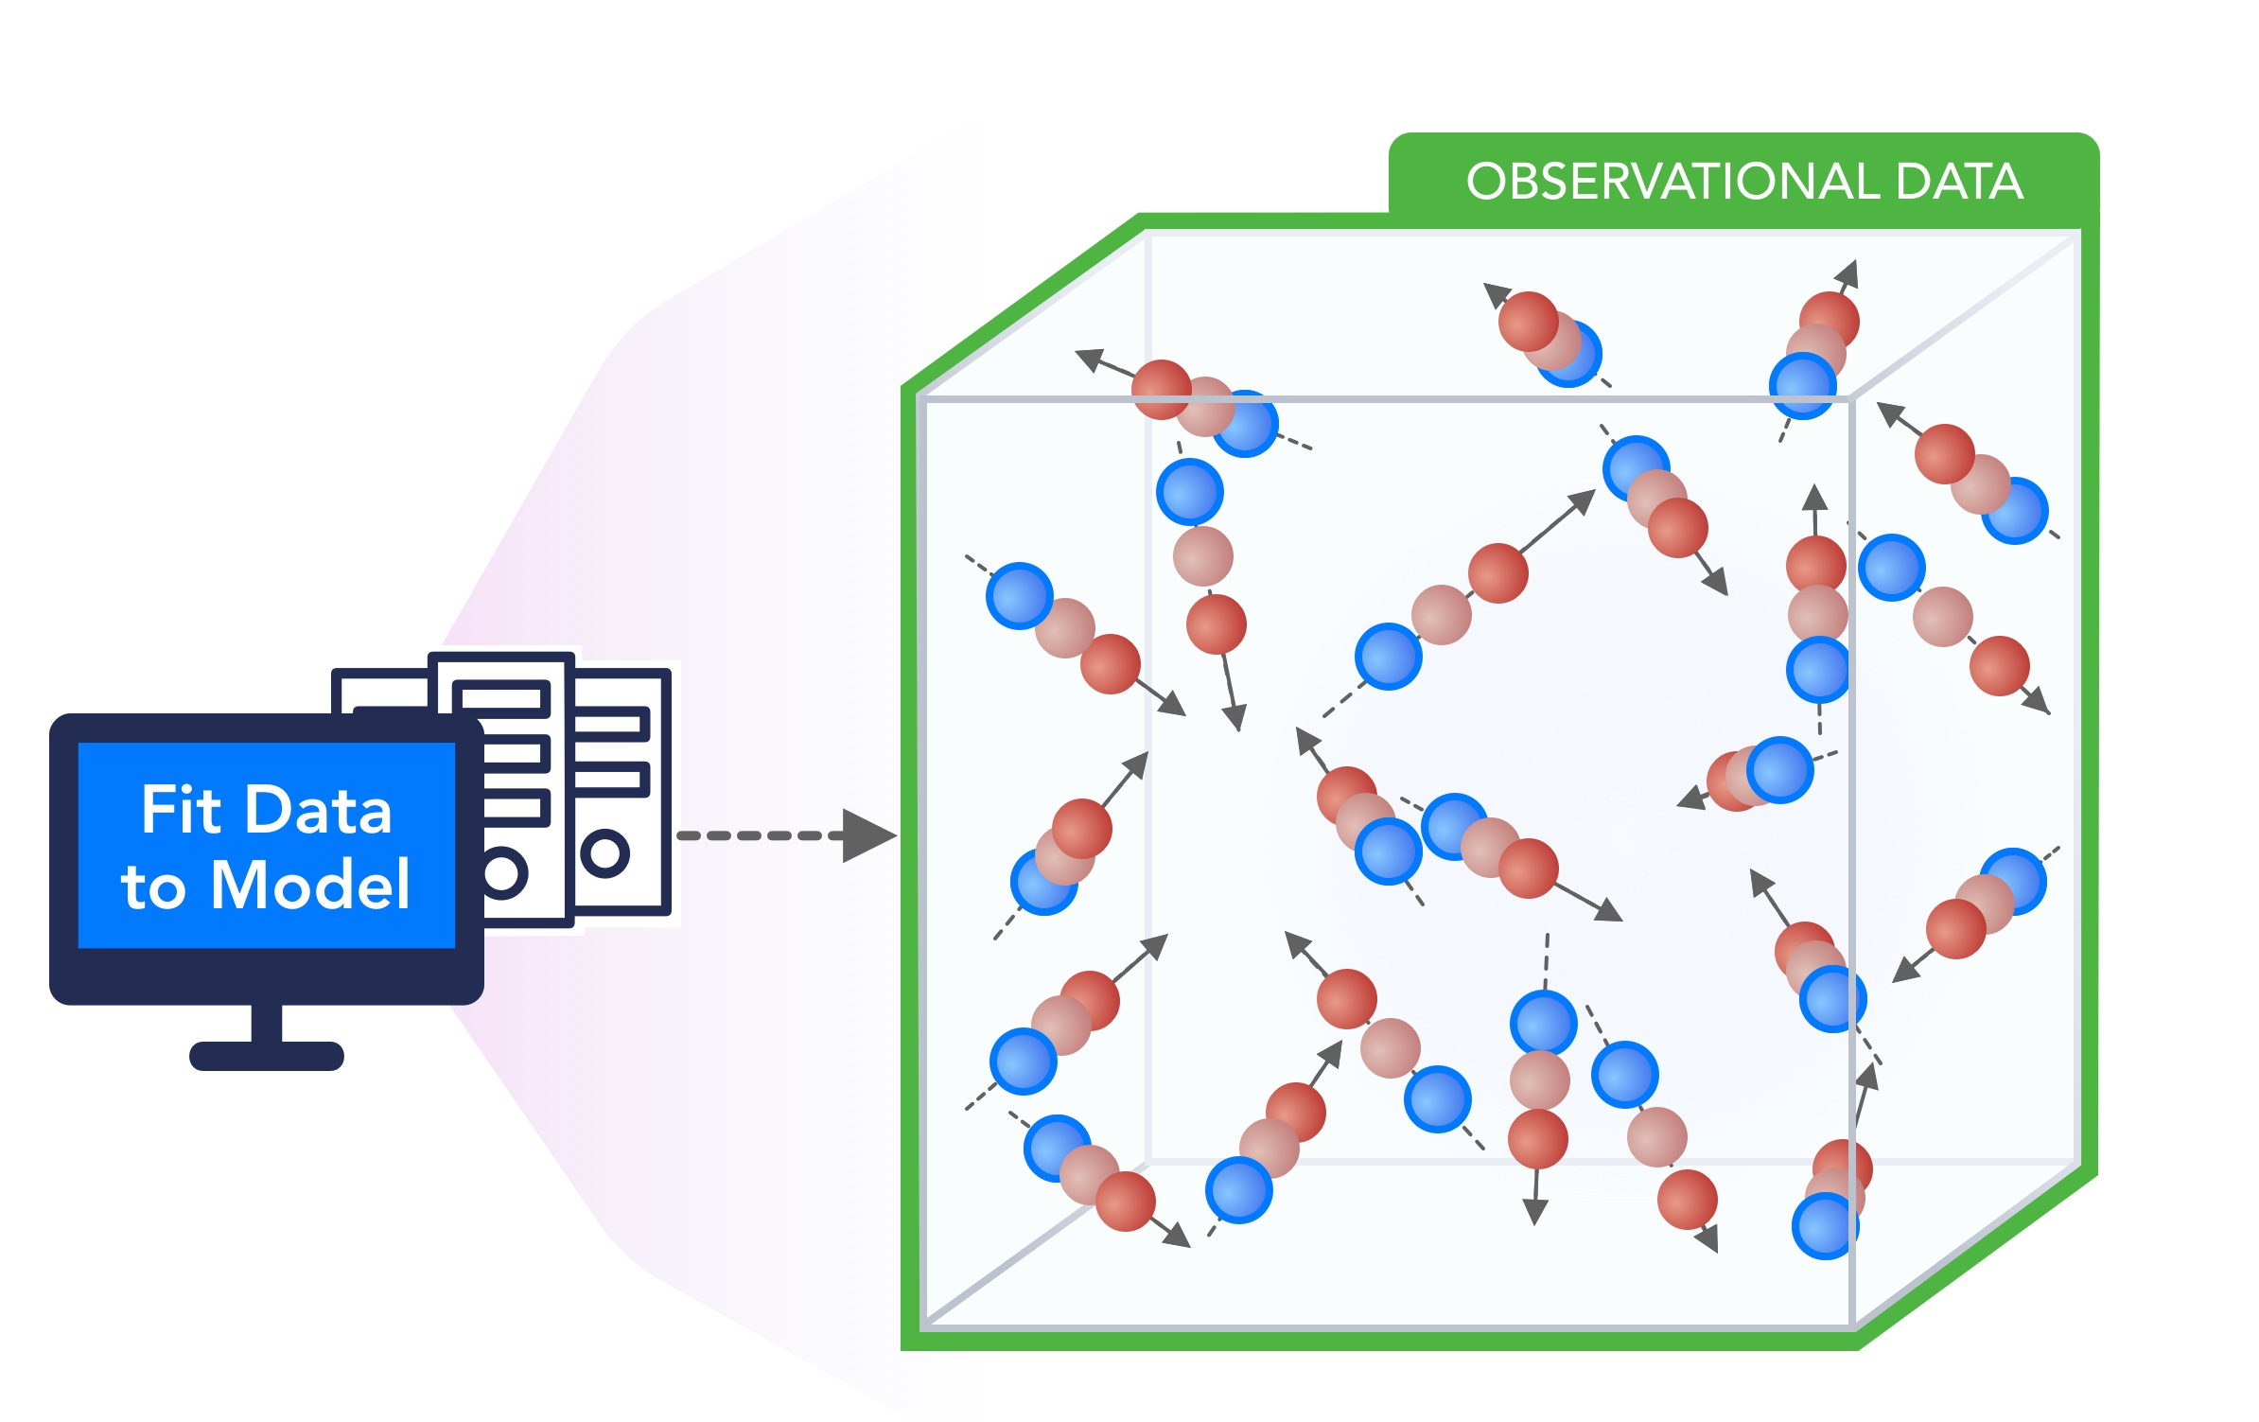
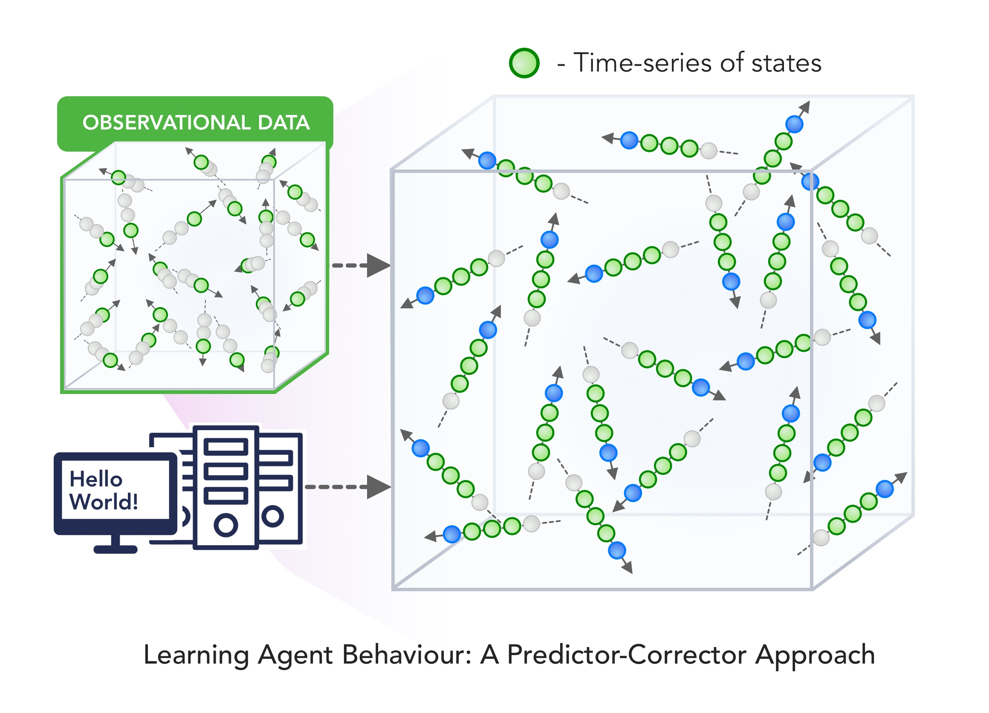
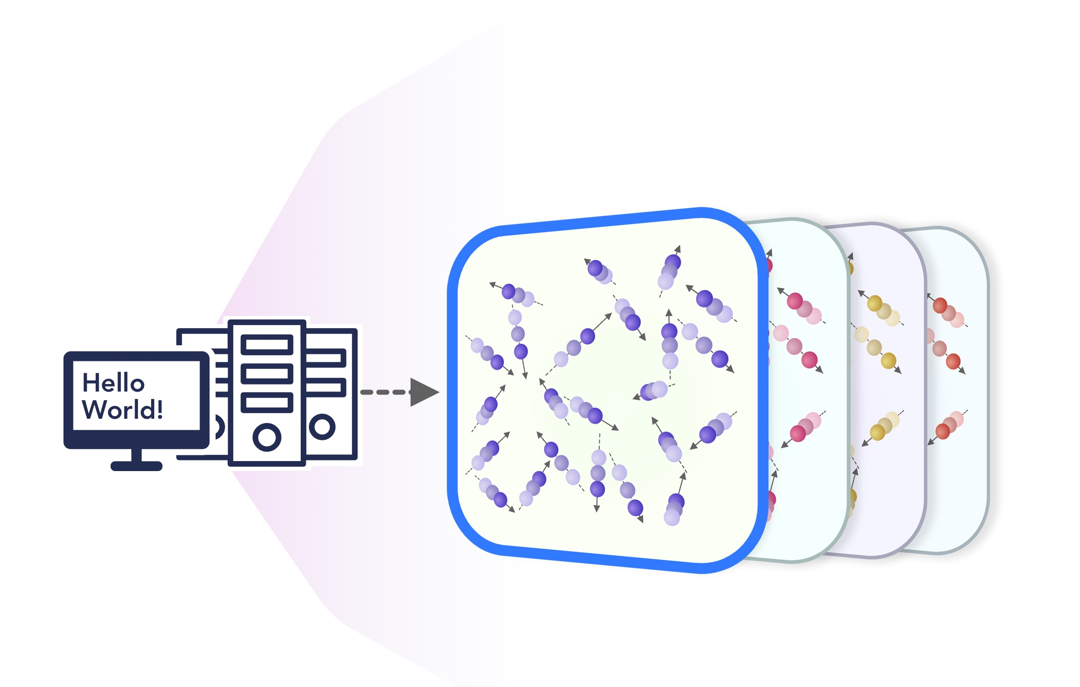
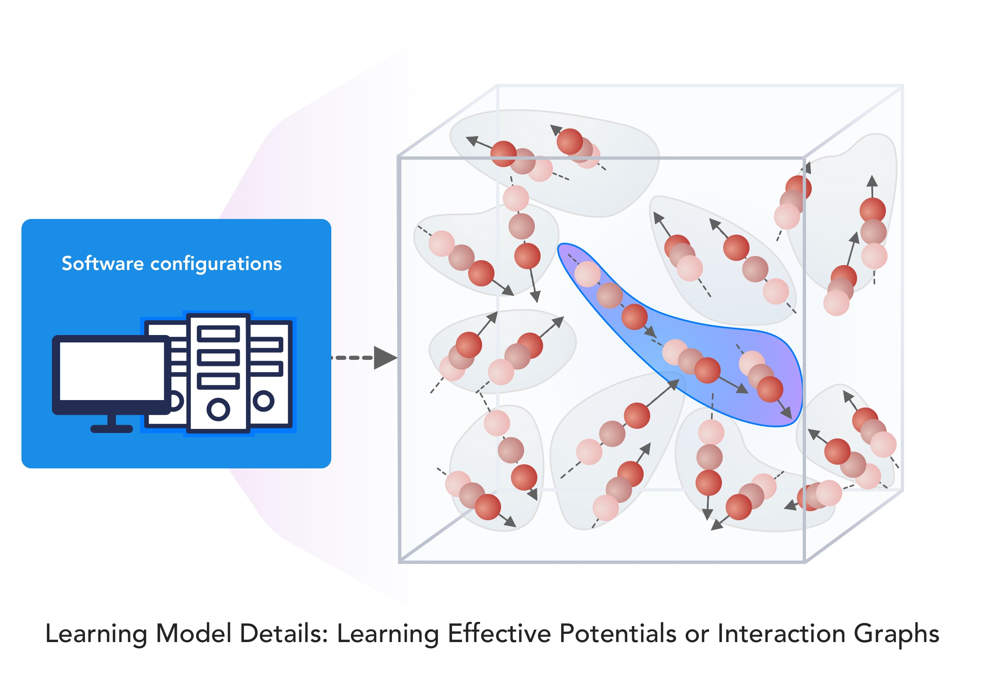
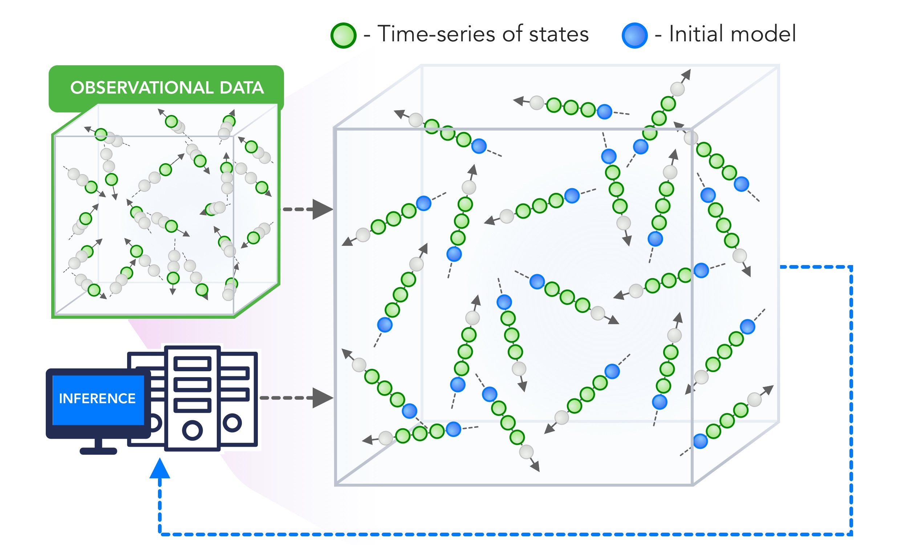
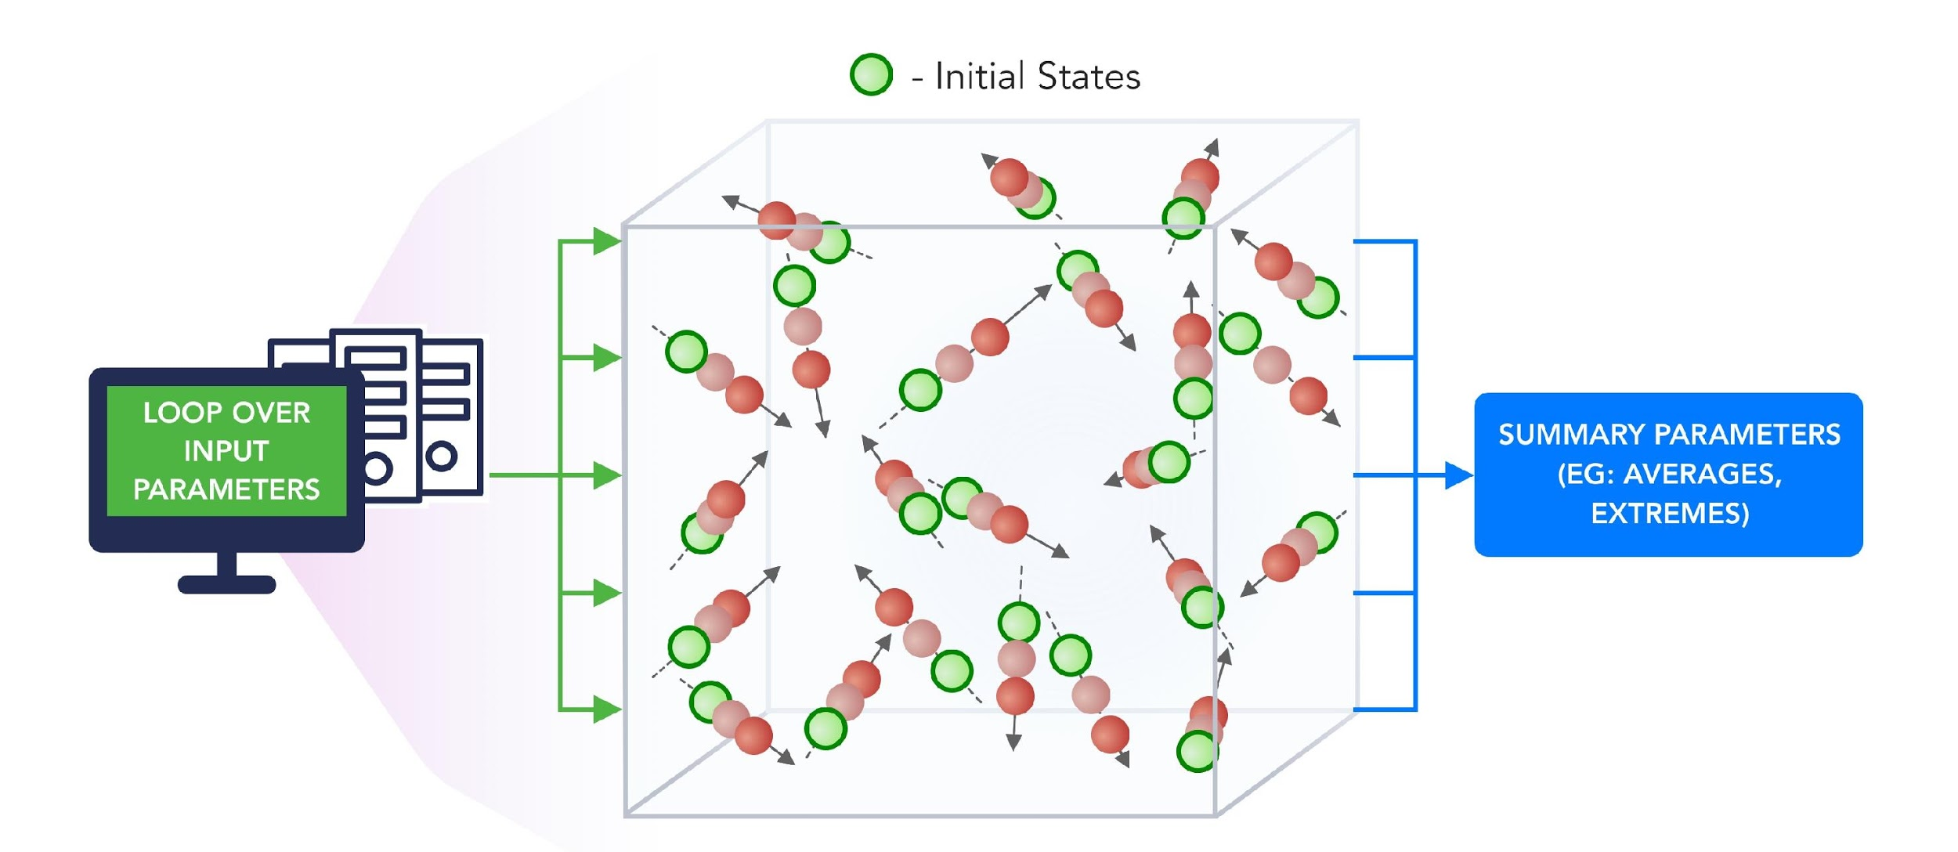
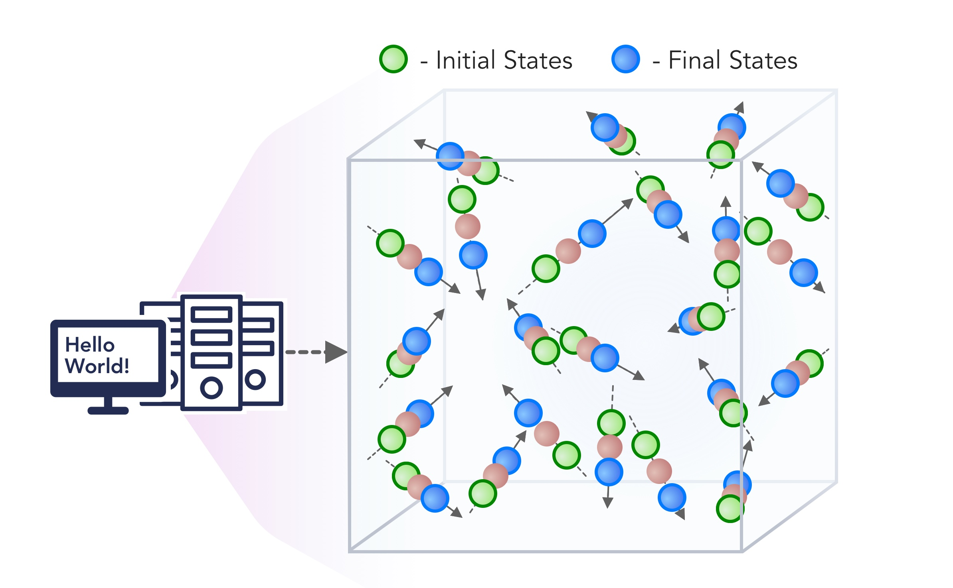
1. Improving Simulation with Configurations and Integration of Data
1.1 MLAutotuningHPC – Learn configurations
1.2 MLAutotuningHPC – Learn models from data
1.3 MLaroundHPC: Learning Model Details (ML based data assimilation)
2. Learn Structure, Theory and Model for Simulation
2.1 MLAutotuningHPC – Smart ensembles
2.2 MLaroundHPC: Learning Model Details (coarse graining, effective potentials)
2.3 MLaroundHPC: Improve Model or Theory
3. Learn Surrogates for Simulation
3.1 MLaroundHPC: Learning Outputs from Inputs (parameters)
3.2 MLaroundHPC: Learning Outputs from Inputs (fields)
https://arxiv.org/abs/1909.13340
https://arxiv.org/abs/1909.02363
INPUT
OUTPUT
100 refs classified in 8 classifications

Slide 19
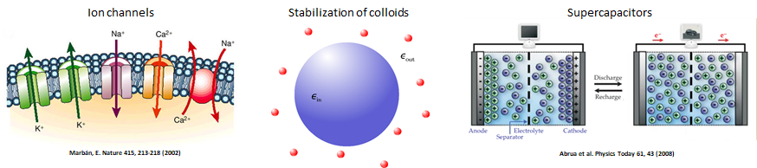
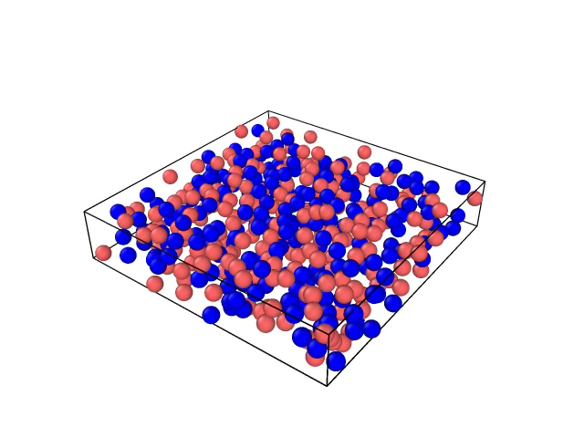
MLaroundHPC: Learning Outputs from Inputs (parameters)
High Performance Surrogates of nanosimulations
JCS Kadupitiya,
Geoffrey Fox,
Vikram Jadhao
An example of Learning Outputs from Inputs: Computation Results from Computation defining Parameters
Employed to extract the ionic structure in electrolyte solutions confined by planar and spherical surfaces.
Written with C++ and accelerated with hybrid MPI-OpenMP.
MLaroundHPC successfully learns desired features associated with the output ionic density that are in excellent agreement with the results from explicit molecular dynamics simulations.
Deployed on nanoHUB for education
(an attractive use of surrogates)

Slide 20
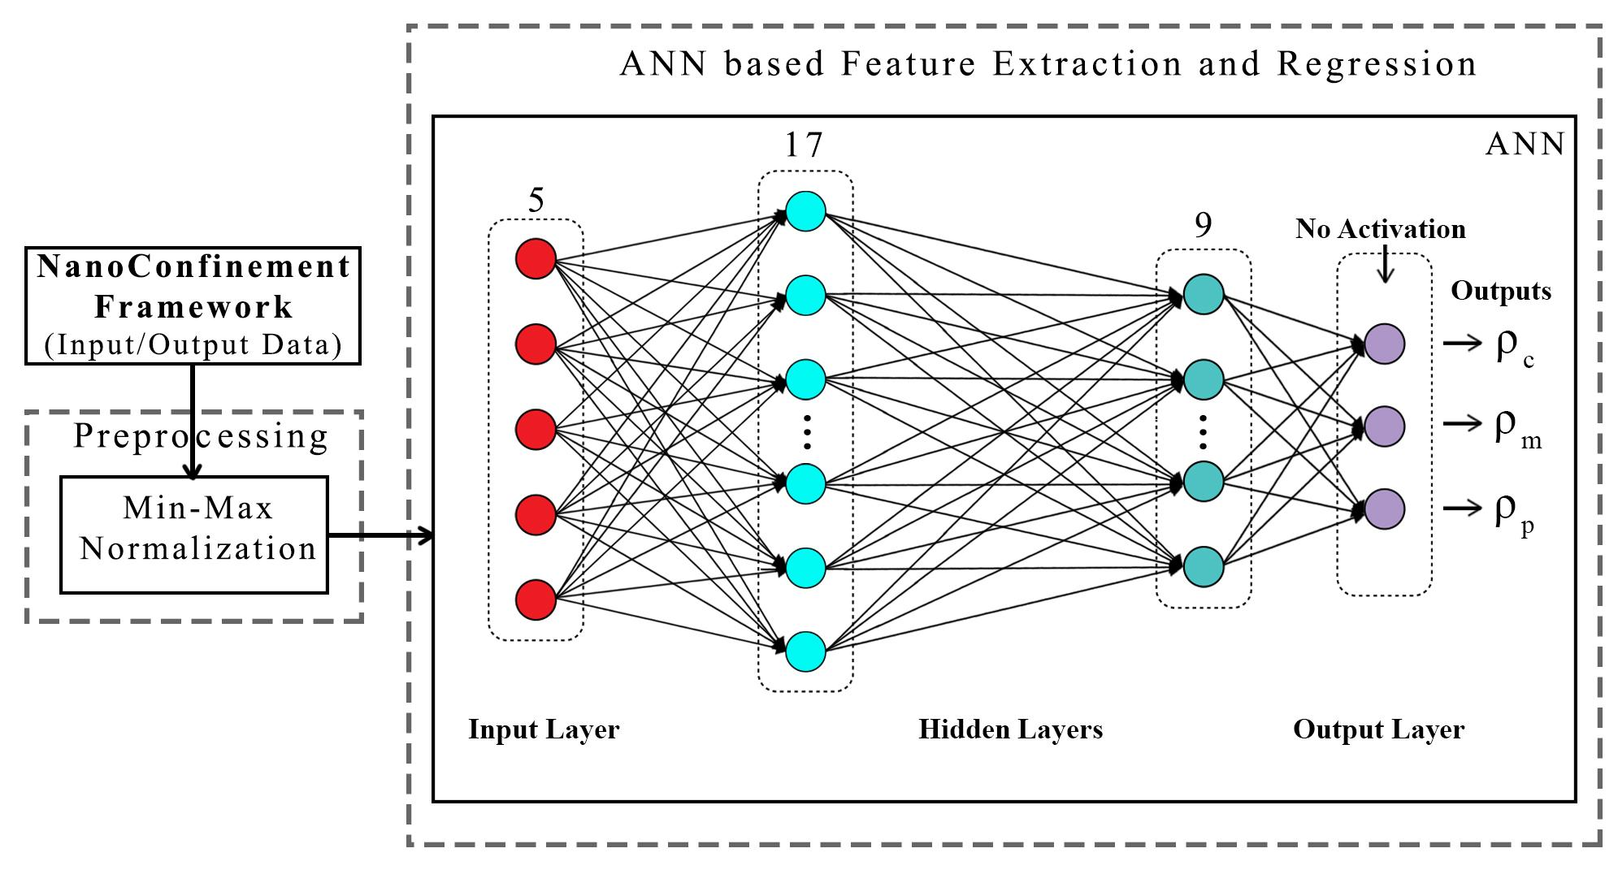
ANN for Regression
Dataset having 6,864 simulation configurations was created for training and testing (0.7:0.3) the ML model.
Note learning network quite small
ANN was trained to predict three continuous variables; Contact density ρ_{c} , mid-point (center of the slit) density ρ_{m} , and peak density ρ_{p}
TensorFlow, Keras and Sklearn libraries were used in the implementation
Adam optimizer, xavier normal distribution, mean square loss function, dropout regularization.
JCS Kadupitiya,
Geoffrey Fox,
Vikram Jadhao

Slide 21
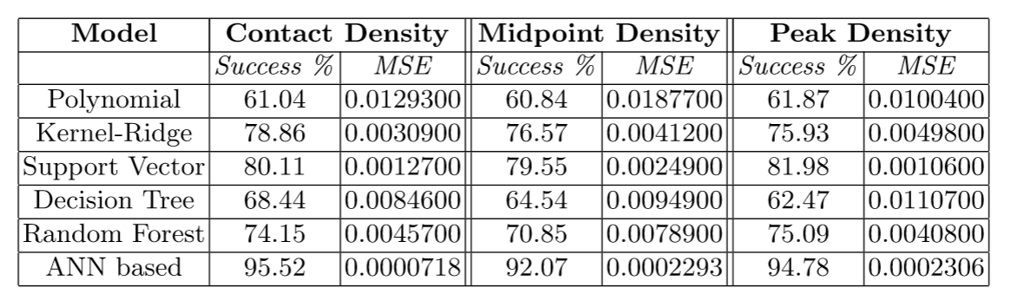
Parameter Prediction in Nanosimulation
ANN based regression model predicted Contact density ρ_{c} , mid-point (center of the slit) density ρ_{m} , and peak density ρ_{p} accurately with a success rate of 95:52% (MSE ~ 0:0000718), 92:07% (MSE ~ 0:0002293), and 94:78% (MSE ~ 0:0002306) respectively, easily outperforming other non-linear regression models
Success means within error bars (2 sigma) of Molecular Dynamics Simulations

Slide 22
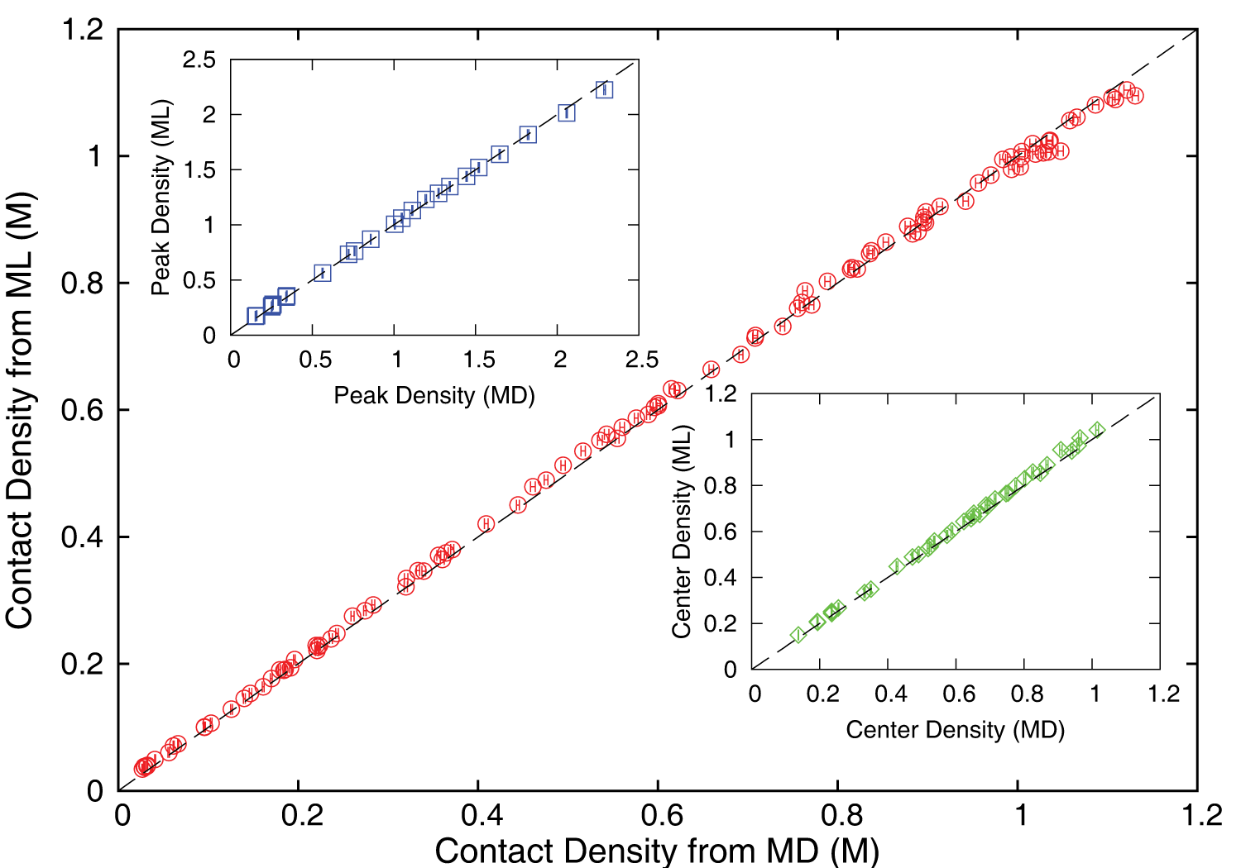
Accuracy comparison between ML predictions and MD simulation results
JCS Kadupitiya,
Geoffrey Fox,
Vikram Jadhao
ρ_{c ,} ρ_{m} and ρ_{p} predicted by the ML model were found to be in excellent agreement with those calculated using the MD method; correlated data from both approaches fall on the dashed lines which indicate perfect correlation.

Slide 23
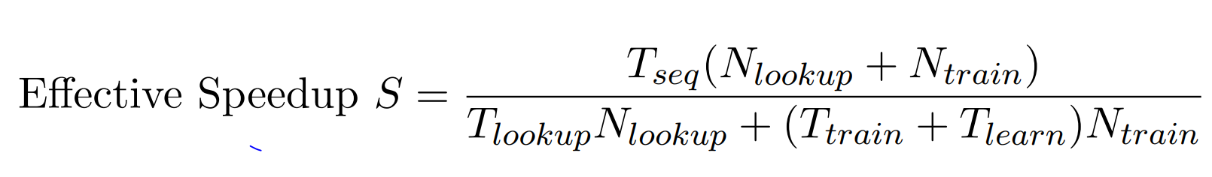
Speedup of MLaroundHPC
T_{seq} is sequential time
T_{train} time for a (parallel) simulation used in training ML
T_{learn} is time per point to run machine learning
T_{lookup} is time to run inference per instance
N_{train} number of training samples
N_{lookup} number of results looked up
Becomes T_{seq}/T_{train} if ML not used
Becomes T_{seq}/T_{lookup} (10⁵ in our case) if inference dominates (will overcome end of Moore’s law and win the race to zettascale)
Another factor as inferences uses one core; parallel simulation 128 cores
Speedup is strong (not weak with problem size increasing to improve performance) scaling as size fixed
N_{train} is 7K to 16K in our work

Slide 24
INSILICO MEDICINE USED CREATIVE AI TO DESIGN POTENTIAL DRUGS IN JUST 21 DAYS
September 4 2019 News Item
Map Drug (Material) Structure to Drug (Material) Properties
Hong Kong-based Insilico Medicine sent shockwaves through the pharma industry after publishing research in Nature Biotechnology that proves its AI-powered drug discovery system was capable of producing at least one potential treatment for fibrosis in less than a month's time.
The system uses a Deep Reinforcement Learning algorithm that can imagine potential protein structures based on existing research and certain preprogrammed design criteria.
Insilico's system initially produced 30,000 possible designs, which the research team whittled down to six that were synthesized in the lab, with one design eventually tested on mice to promising results.
Insilico's AI-powered research process could offer a massive push forward for the pharmaceutical industry, which faces increasingly high drug development costs. In just a handful of weeks and for approximately $150,000, Insilico delivered what typically takes pharmaceutical companies $2.6 billion over seven years.

Slide 25
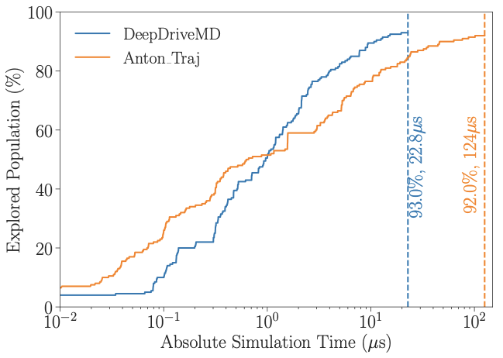
DeepDriveMD Smart Ensemble
O(10) improvement in sampling efficiency with DL model
O(1000) concurrent simulations on Summit supercomputer
Jha (BNL/Rutgers) and Ramanathan (ANL)
Notes:
Not a lucky

Slide 26
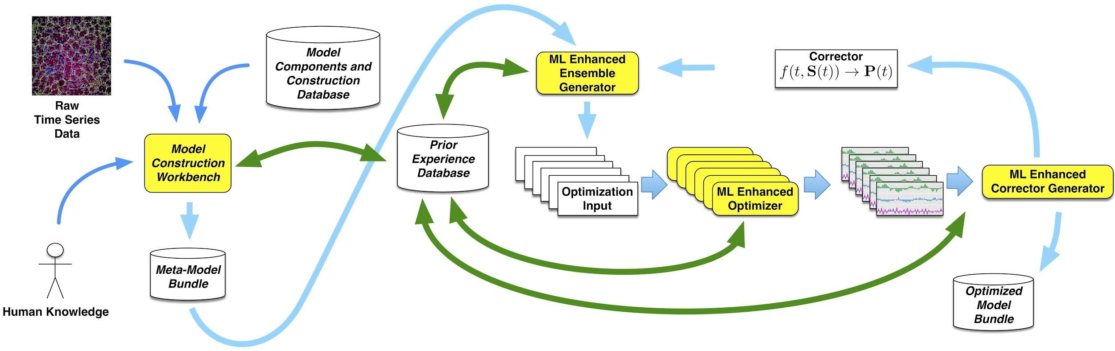
Putting it all Together
Simulating Biological Organisms (with James Glazier @IU)
Learning Model (Agent) Behavior
Replace components by learned surrogates
(Reaction Kinetics Coupled ODE’s)
All steps use MLAutotuning
Smart Ensembles
Dynamic Data Assimilation

Slide 27
Operator Formulation of Deep Learning Inference
Suppose we are solving PDE’s or sets of coupled ODE’s
Typically we solve iteratively New Values = (Differential Operator) Previous Values
Classic applied math tells you nifty difference equations and spectral methods to represent Operator numerically
Deep Learning learns the operator from classic numerics or observational data or their combination
Inference is New Values = (DL Operator) Previous Values
This new nonlinear trained DL operator can allow much larger time steps, incorporate variations in parameters etc.
DL Operator is the new theory (Newton’s laws) of science
High order approximations are traditionally very sensitive to noise and one was taught to avoid but ANN are the opposite – both verbose and robust
  See DL operator for Lennard Jones Potential in two LSTM layers with 100-100,000 parameters
  Newton’s laws for this have 2-4 parameters

Slide 28

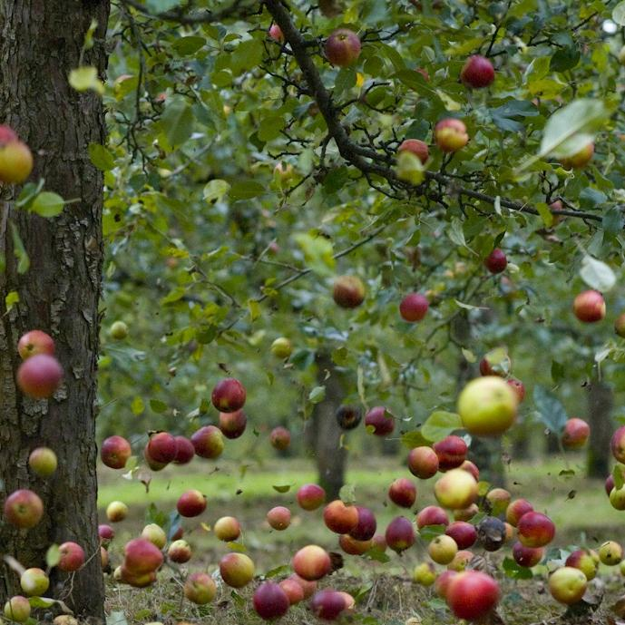
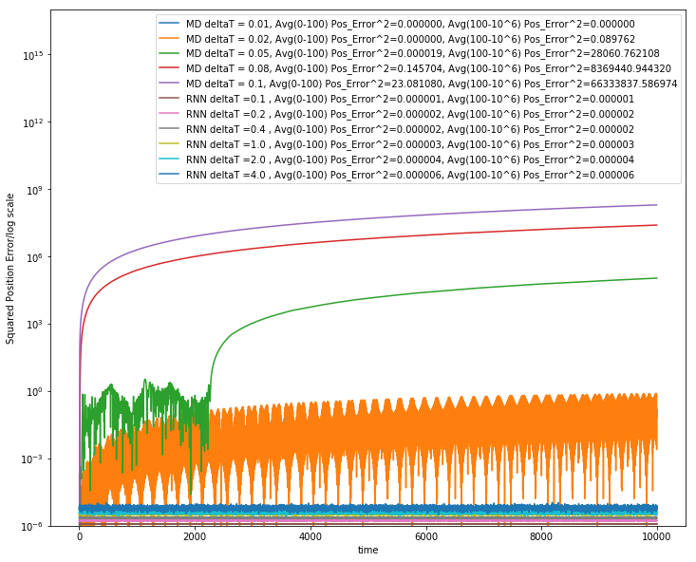
Learning how Apples Fall ?
Work with JCS Kadupitiya and Vikram Jadhao
We could use F=ma with 1D ODE solved by Verlet
Or use Recurrent Neural Network (LSTM) and Tensorflow (the new Newton) for particle in Lennard-Jones potential
Error Squared
MD dt > 0.01
12833 Trained Parameters
MD dt = 0.01, LSTM

Slide 29
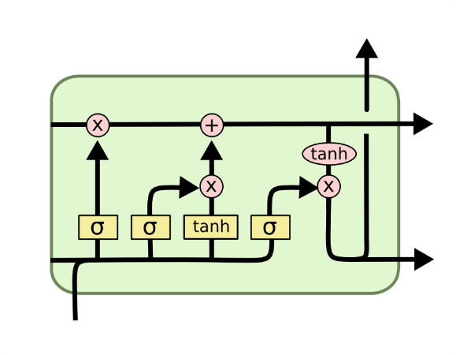
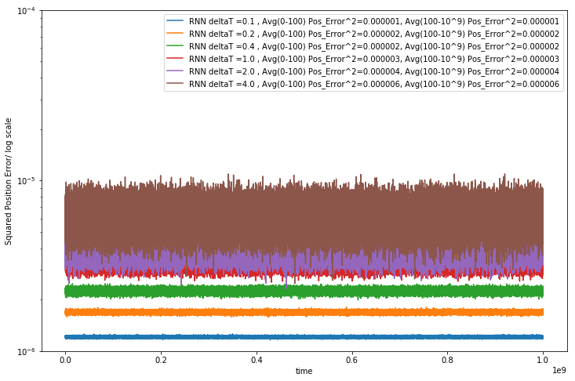
Extending to longer times
LSTM Cell
System trained up to t=100; network used up to t=10,000 or 10,000,000
Plots show error for MD and LSTM for different time steps. LSTM upto t=4
LSTM allows reliable large time steps; learns potential and differential operator
Compared to classic numerics has LOTS of parameters, statistical averaging (e.g. 32 initial LSTM’s only differing in randomized initial conditions) and nonlinear activation nodes
Looking at multiparticle systems learning O(N^2) potential
Simple Harmonic Oscillator used upto 10⁹ dt
Error Squared
905 Trained Parameters
Timesteps

Slide 30
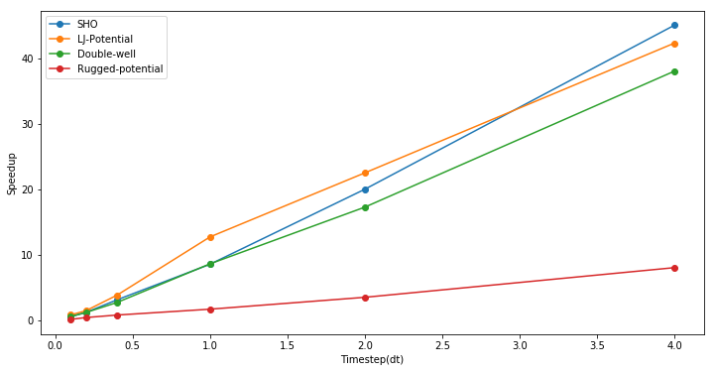
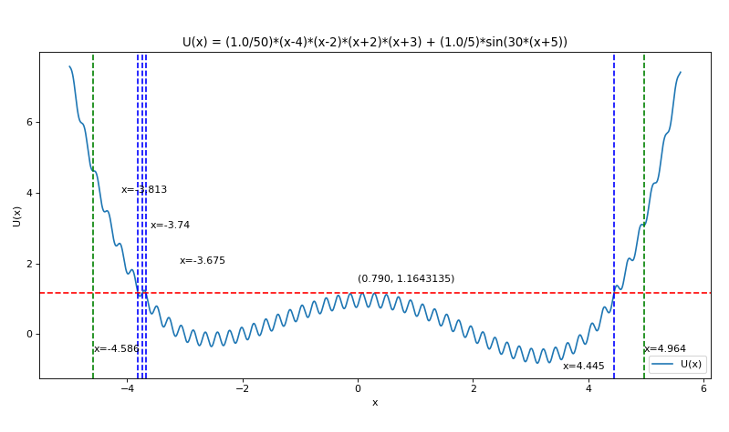
Speedup from use of LSTM compared to Velocity Verlet
Timings are integration from t=0 to 100 and MD velocity verlet used dt of 0.001 to get a accurate result
Speedup = (Time to do MD Simulation with dt=0.001) / (Time to do RNN (LSTM)-based simulation)
Rugged Potential
789,761 Trainable Parameters as 256 units in each of 2 LSTM banks
Can increase dt=4 and increase speedup

Slide 31
Status of MLaroundHPC
MLaroundHPC broadly applicable but current use is nonuniform across domains
  we need to improve Cyberinfrastructure support to make MLforHPC more effective for more users
Use of modest DL network to map material/potential drug structure to properties (generalized QSAR) with simulation and observation: Advanced Progress
Learn surrogates for large scale simulations: initial small scale results
Use of MLforHPC in agent-based systems (learn agents): Very promising but few results
Macroscopic Structure as in learn complex multi-particle potentials scaling to N⁷: many great successes
Learn Collective coordinates and guide ensemble computations: dramatic progress with speedups up to 10⁸
Microscale; learn dynamics of small scale such as clouds, turbulence: Interesting results but much more to do
Use of Recurrent NN’s to represent dynamics (learn numerical differential operators): Promising but only studied in small problems

Slide 32
Overall Architecture
Global AI and Modeling Supercomputer GAIMSC

Slide 33
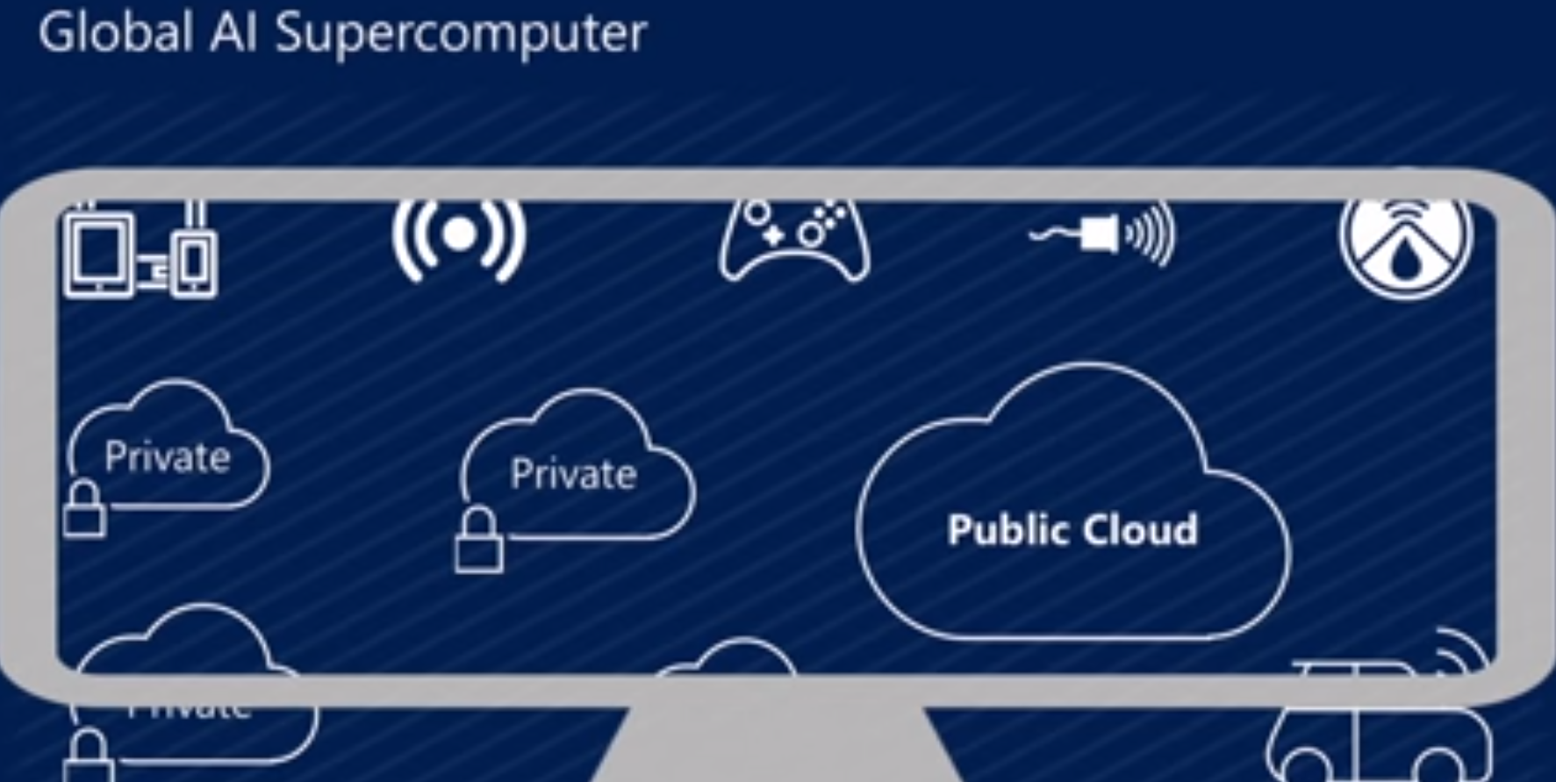
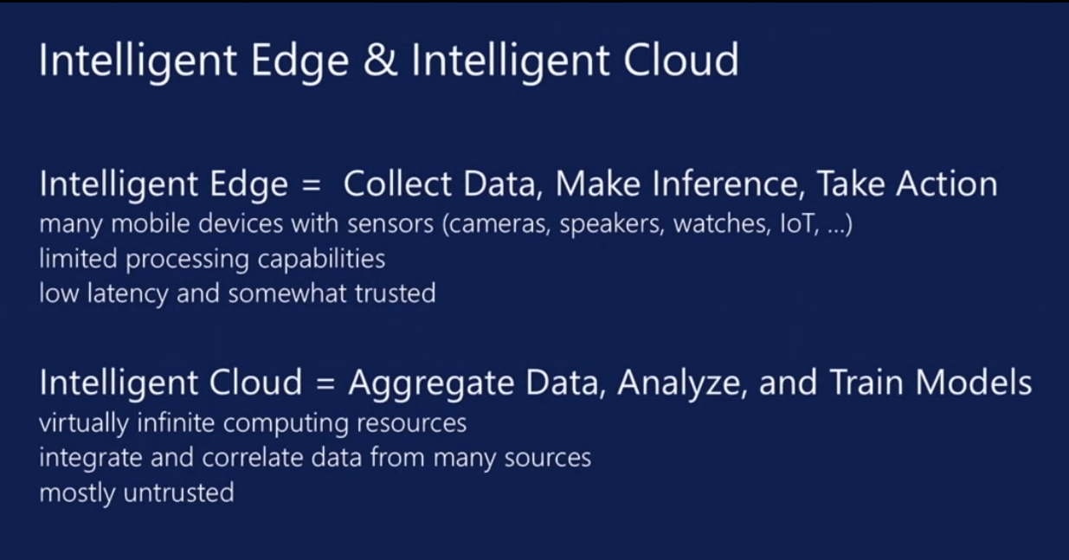
Microsoft Summer 2018: Global AI Supercomputer
By Donald Kossmann

Slide 34
Overall Global AI and Modeling Supercomputer GAIMSC Architecture
Global says we are all involved –
I added “Modeling” to get the Global AI and Modeling Supercomputer GAIMSC
There is only a cloud at the logical center but it’s physically distributed and domated by a few major players
Modeling includes classic simulation oriented supercomputers
Even in Big Data, one needs to build a model for the machine learning to use
GAIMSC will use classic HPC for data analytics which has similarities to big simulations (HPCforML)
GAIMSC must also support I/O centric data management with Hadoop, Spark, Flink etc.
  Twister2 supports GAIMSC
Nature of I/O subsystem controversial for such HPC clouds
  Lustre v. HDFS; importance of SSD and NVMe;
HPC Clouds would suggest that MPI runs well on Mesos and Kubernetes and with Java and Python

Slide 35
HPCforML in detail
HPCforML can be further subdivided
HPCrunsML: Using HPC to execute ML with high performance
SimulationTrainedML: Using HPC simulations to train ML algorithms, which are then used to understand experimental data or simulations.
Twister2 supports HPCrunsML by using high performance technology everywhere and this has been my major emphasis over last 5 years
HPC is a well understood technology to improve performance
ML develops many new innovative algorithms

Slide 36
Motivating Twister2
Initial Spark Flink MPI studies
HPCrunsML

Slide 37
Machine Learning with MPI, Spark and Flink
Three algorithms implemented in three runtimes
  Multidimensional Scaling (MDS)
  Terasort
  K-Means (drop as no time and looked at later)
Implementation in Java
  MDS is the most complex algorithm - three nested parallel loops
  K-Means - one parallel loop
  Terasort - no iterations (see later)
With care, Java performance ~ C performance
Without care, Java performance << C performance (details omitted)

Slide 38



Multidimensional Scaling: 3 Nested Parallel Sections
Flink
Spark
MPI
MPI Factor of 20-200 Faster than Spark/Flink
MDS execution time with 32000 points on varying number of nodes. Each node runs 20 parallel tasks
Spark, Flink No Speedup
MDS execution time on 16 nodes with 20 processes in each node with varying number of points
Flink especially loses touch with relationship of computing and data location

Slide 39
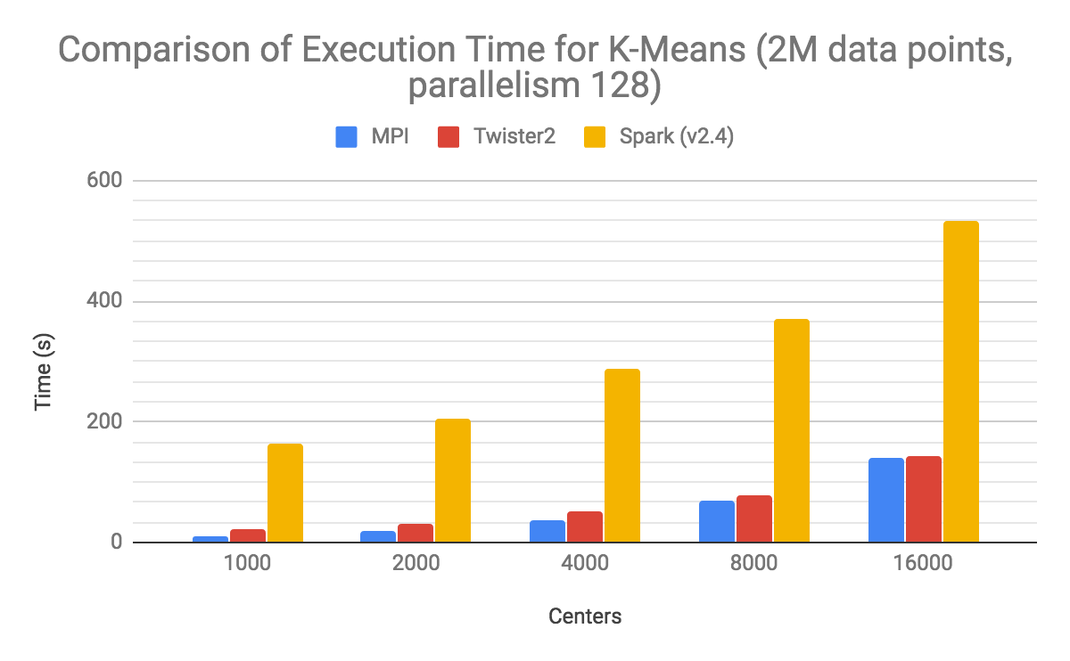

Slide 40
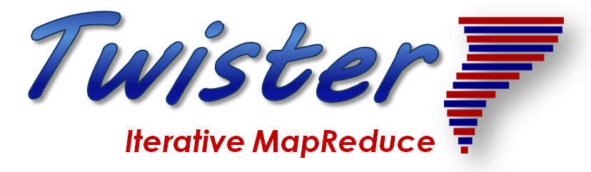

Programming Environment for Global AI and Modeling Supercomputer GAIMSC
2
Uses HPCforML(HPC for Big Data) and supports MLforHPC

Slide 41
Ways of adding High Performance to
Global AI (and Modeling) Supercomputer
Fix performance issues in Spark, Heron, Hadoop, Flink etc.
  Messy as some features of these big data systems intrinsically slow in some (not all) cases
  All these systems are “monolithic” and difficult to deal with individual components
Execute HPBDC High Performance Big Data Computing from classic big data system with custom communication environment – approach of Harp for the relatively simple Hadoop environment
Provide a native Mesos/Yarn/Kubernetes/HDFS high performance execution environment with all capabilities of Spark, Hadoop and Heron – goal of Twister2
Execute with MPI in classic (Slurm, Lustre) HPC environment
In all cases, assume deep learning obtained from Tensorflow, PyTorch and/or MXNET

Slide 42
Twister2 Highlights I
“Big Data Programming Environment” such as Hadoop, Spark, Flink, Storm, Heron but uses HPC wherever appropriate and outperforms Apache systems – often by large factors
Runs preferably under Kubernetes (Mesos) Nomad but Slurm supported
Highlight is high performance dataflow supporting iteration, fine-grain, coarse grain, dynamic, synchronized, asynchronous, batch and streaming
Three distinct communication environments
  DFW Dataflow with distinct source and target tasks; data not message level; Data-level Communications spilling to disks as needed
  BSP for parallel programming; MPI is default. Inappropriate for dataflow
  Storm API for streaming events with pub-sub such as Kafka
Rich state model (API) for objects supporting in-place, distributed, cached, RDD (Spark) style persistence with Tsets (see Pcollections in Beam, Datasets in Flink, Streamlets in Storm, Heron)

Slide 43
Twister2 Highlights II
Can be a pure batch engine
  Not built on top of a streaming engine
Can be a pure streaming engine supporting Storm/Heron API
  Not built on on top of a batch engine
Fault tolerance as in Spark or MPI today; dataflow nodes define natural synchronization points
Many API’s: Data, Communication, Task
  High level hiding communication and decomposition (as in Spark) and low level (as in MPI)
DFW supports MPI and MapReduce primitives: (All)Reduce, Broadcast, (All)Gather, Partition, Join with and without keys
Component based architecture -- it is a toolkit
  Defines the important layers of a distributed processing engine
  Implements these layers cleanly aiming at high performance data analytics

Slide 44
Twister2 Highlights III
Key features of Twister2 are associated with its dataflow model
  Fast and functional inter-node linkage; distributed from edge to cloud or in-place between identical source and target tasks
  Streaming or Batch nodes (Storm persisent or Spark emphemeral model)
  Supports both Orchestration (as in Pegasus, Kepler, NiFi) or high performance streaming flow (as in Naiad) model
  Tset Twister2 datasets like RDD define a full object state model supported across links of dataflow

Slide 45
Runtime Components
Atomic Job Submission
Connected or External DataFlow
Orchestration API
Streaming, Batch and ML Applications
Python API
SQL API
Java APIs
Scala APIs
Language APIs
Runtime
TSet
Tset API
Task Graph System
Task API
BSP Operations
Internal (fine grain) DataFlow Operations
Resource API
Mesos
Kubernetes
Standalone
Slurm
HDFS
NoSQL
Message Brokers
Local
Data Access APIs
Future Features

Slide 46
Comparison of Twister2 Task System Vs Big Data Systems
Big Data Platforms | Task Graph |  | Scheduling Types |  | Scheduling Job Types |  |  |  | Dataflow Programming Model | Task Executor
 | Static | Dynamic | Static | Dynamic | Batch | Streaming | MPI | FaaS/ Microservices |  | Streaming | Batch
Spark | Yes | Yes |  | Yes | Yes | Yes | Add-on |  | Yes | Yes | Yes
Flink | Yes |  | Yes |  | Yes | Yes |  |  | Yes | Yes | Yes
Heron | Yes |  | Yes |  |  | Yes |  |  | Yes | Yes
Storm | Yes |  | Yes |  |  | Yes |  |  | Yes | Yes
Hadoop MapReduce |  |  | Yes |  | Yes |  |  |  |  |  | Yes
Twister2 | Yes | Yes | Yes | Yes | Yes | Yes | Yes | No (Future Work) | Yes | Yes | Yes

Slide 47
TSets, RDDs and Streamlets
Similar abstractions with small differences
Twister2 Tset | Spark RDD | Heron Streamlet
Higher Level API | Lowest Level API | Heron has a Task Abstraction. So not the lowest.
Clear separation of data and operations | Data and operation separation not clear | Data and operations are not clearly separated
Streaming and Batch natively | Batch and Mini-Batch streaming | Only Streaming
More basic operations such as AllReduce and AllGather | More user focused operations
Clearly defined component of Twister2 | Capability intertwined with complete system. Hard to disentangle

Slide 48
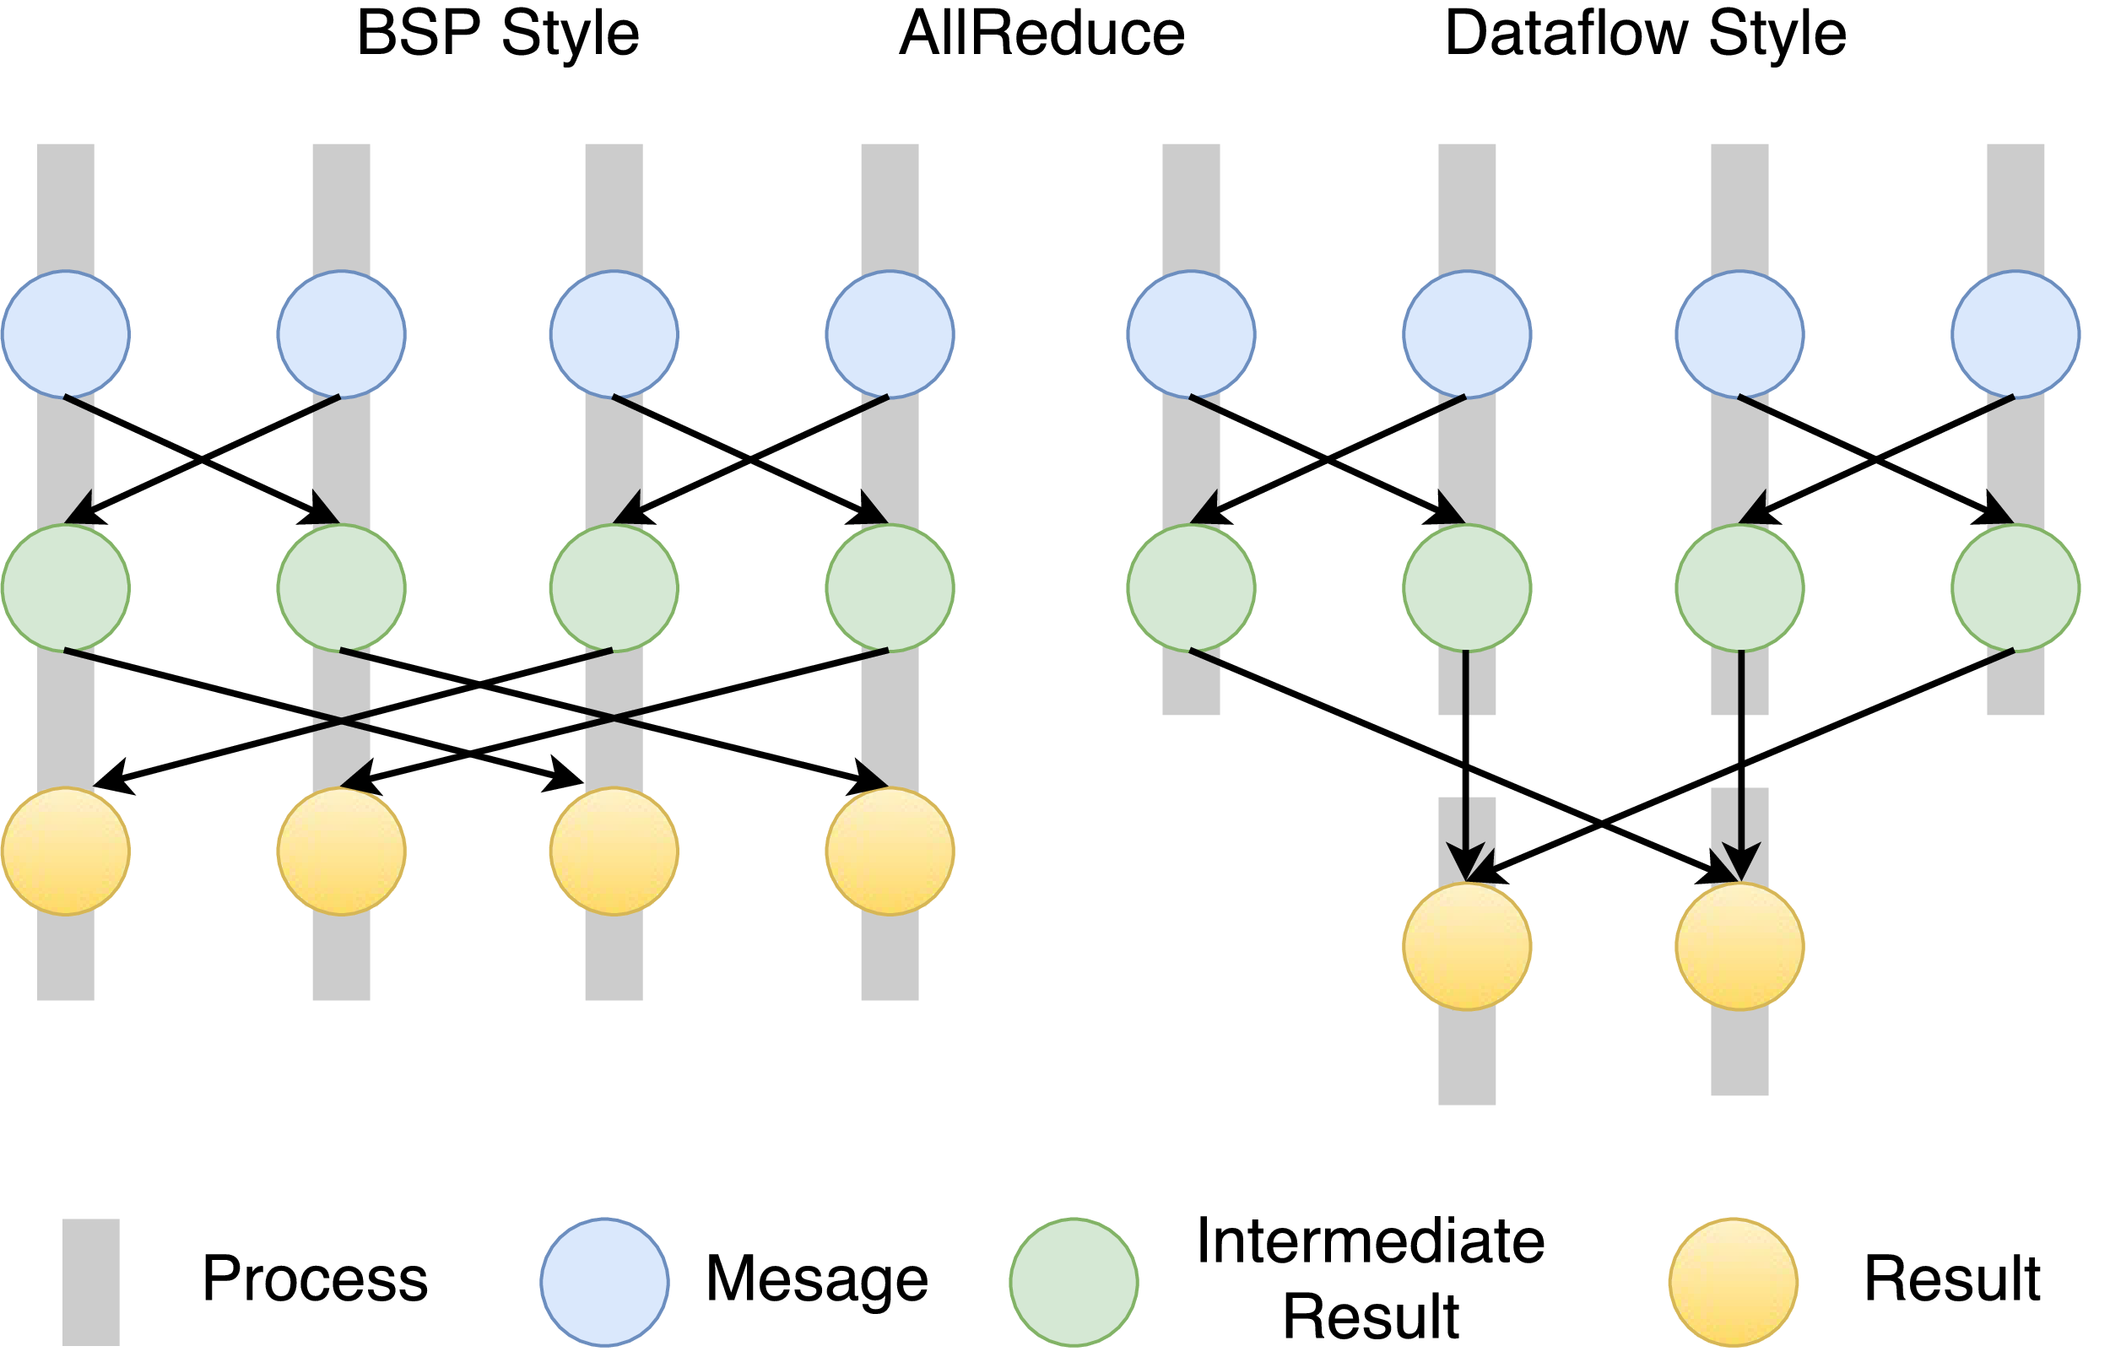
Twister2 Dataflow Communications
Twister:Net offers two communication models
BSP (Bulk Synchronous Processing) message-level communication using TCP or MPI separated from its task management plus extra Harp collectives
DFW a new Dataflow library built using MPI software but at data movement not message level
  Non-blocking
  Dynamic data sizes
  Streaming model
    Batch case is represented as a finite stream
  The communications are between a set of
  tasks in an arbitrary task graph
  Key based communications: all the MapReduce
  movement functions
  Data-level Communications spilling to disks
  Target tasks can be different from source tasks
BSP and DFW
for Reduce Operation

Slide 49
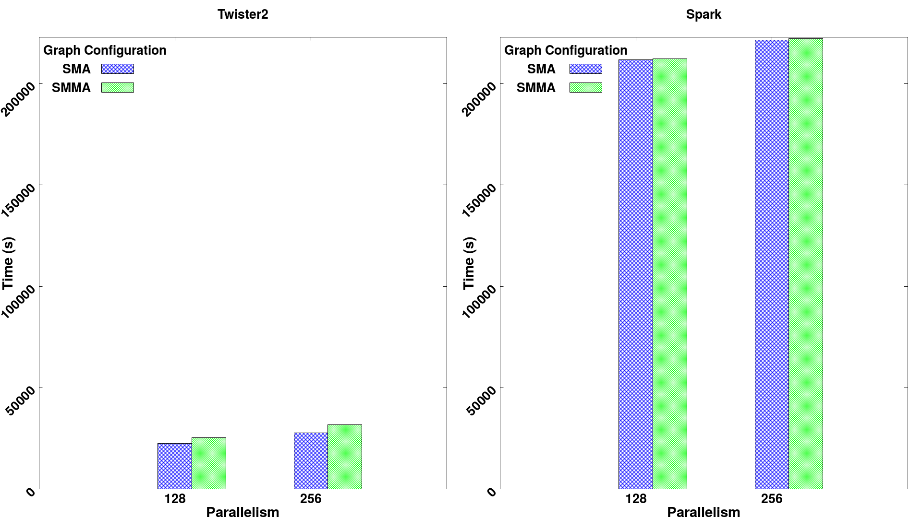
Effect of processing an extra dataflow node
Twister2 spawns a new context by “direct” dataflow node1 to node 2 which could be edge to cloud
Spark always compiles 2 nodes into one. Twister2 doesn’t do this but Twister2’s transfer communication is very fast

Slide 50
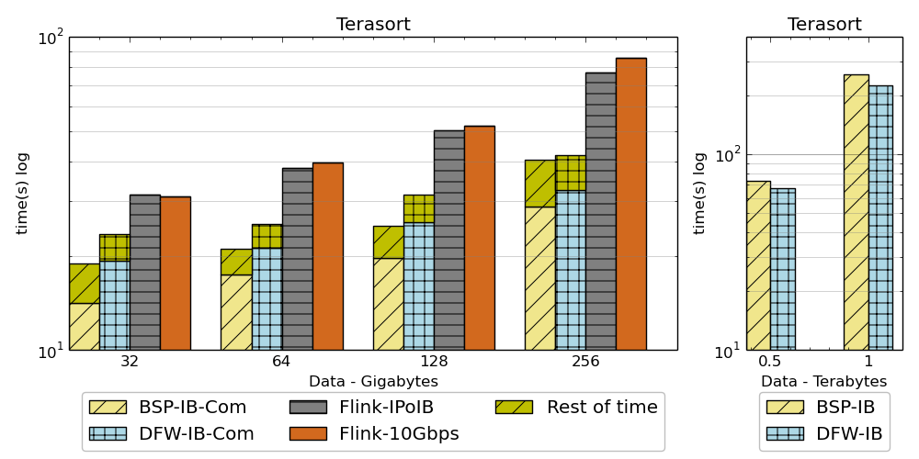
Results on Terasort
Twister2 performance against Apache Flink and MPI for Terasort.
As size increases, DFW improves wrt MPI
Notation :
DFW refers to Twister2
BSP refers to MPI (OpenMPI)

Slide 51
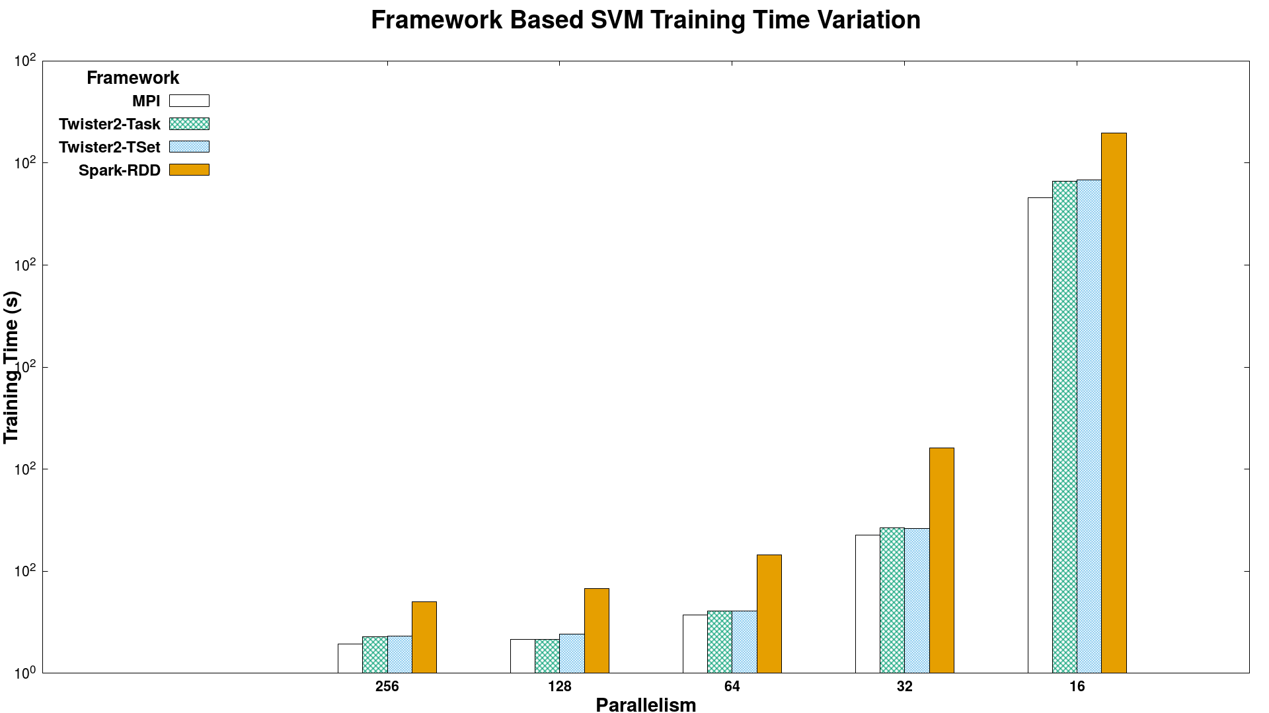
Batch Benchmark - SVM
Times (smaller better)
Spark RDD > Twister2 Tset > Twister2 Task > MPI
SVM job execution time for 320K data points with 2000 features and 500 iterations, on 16 nodes with varying parallelism

Slide 52
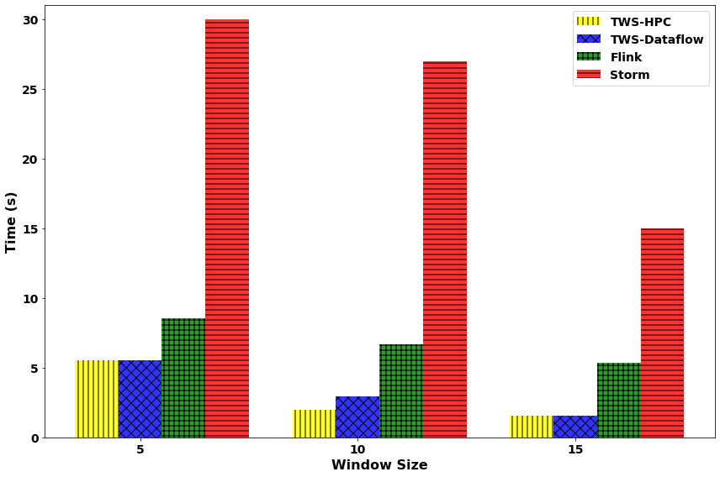
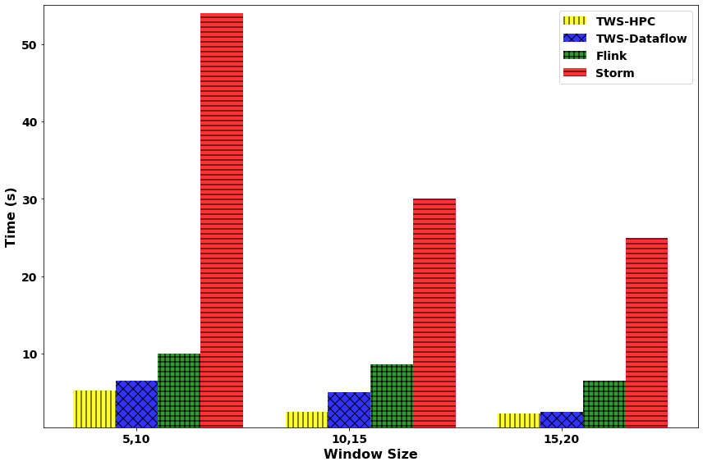
Streaming Machine Learning with Sliding Window
Streaming KMeans
Streaming SVM
KMeans: 49,000 data points with 23 features streamed. Model accuracy tested once a windowed computation is done. Testing data set size is 91,000 samples (1000 clusters). (non iterative)
SVM: 49,000 data points with 22 features streamed. Model accuracy tested once a windowed computation is done. Testing data set size is 91,000 samples. 5 Iterations per window.

Slide 53
Conclusions
Twister2 ready to go
Big Data Systems
Parallel Computing
MLforHPC

Slide 54
Twister2 Status
100,000 lines of new open source Code: mainly Java but significant Python
Github https://github.com/DSC-SPIDAL/twister2
Documentation https://twister2.org/
Operational with documentation and examples
November 2019 release 0.4.0: Fault tolerance, Apache BEAM Linkage, Python API https://github.com/DSC-SPIDAL/twister2/releases
Near term: TensorFlow Integration, Certify Beam compliance, SQL interface using Apache Calcite
Medium term: Apache Arrow (cross language) Integration, UCX unified communication, MPI Fault tolerance integration (OpenMPI ULFT) for Slurm
Ongoing: C++ version of modules to improve performance and Python integration

Slide 55
Summary of Big Data Systems
HPC/Computation and Machine Learning Link becoming clearer
HPCforML focus being extended to MLforHPC
Designing, building and using the Global AI and Modeling Supercomputer
  Cloudmesh build interoperable Cloud systems (von Laszewski)
  Harp is parallel high performance machine learning (Qiu)
  Twister2 can offer the major Spark Hadoop Heron capabilities with clean high performance
  Implements dataflow model for MLforHPC
  Tset high performance RDD
  DFW is distributed (dataflow) communication with data not message interface
  Apache Beam Integration and Python API

Slide 56
Parallel Computing and MLforHPC Summary
Parallel Computing has a renaissance with Big Data
HPF Style could be well suited to Big Data and MLforHPC
MLforHPC will lead to many remarkable discoveries in both computational and data science
What computations can be assisted by what ML in which of different scenarios
  Not known how large training sets need to be.
What is performance of different DL (ML) choices in compute time and capability
Little or no study of either predicting errors or in fact of getting floating point numbers from deep learning.
What can we do with Yottascale computing? (10⁶ above Exascale)
Redesign all algorithms so they can be DL-assisted
Interesting load balancing issues if in parallel case some points learnt using surrogates and some points calculated from scratch

Slide 57
Details on Systems for Convergence
Requirements
HPF Style Parallelism
AI as a Service

Slide 58
Next Generation of Cyberinfrastructure: Remarks on Deep Learning
We expect growing use of deep learning (DL) replacing older machine learning methods and DL will appear in many different forms such as Perceptrons, Convolutional NN's, Recurrent NN's, Graph Representational NN's, Autoencoders, Variational Autoencoder, Transformers, Generative Adversarial Networks, and Deep Reinforcement Learning.
For industry, growth in reinforcement learning is increasing the computational requirements of systems. However, it is hard to predict the computational complexity, parallelizability, and algorithm structure for DL even just 3 years out.
Note we always have the training and inference phases for DL and these have very different system needs.
  Training will give large often parallel jobs; Inference will need a lot of small tasks.
GPU’s and perhaps TPU’s are both AI and simulation accelerators; new generation of AI accelerators may be useless for simulations?
Note in parallel DL, one MUST change both batch size and # training epochs as one scales to larger systems (in fixed problem size case) and this is implicit in MLPerf results; this may change with more model parallelism
Parallel Computing Essential in DL

Slide 59
Next Generation of Cyberinfrastructure: Compute and Data patterns
The application classes a) to d) will all have needs in the four capabilities
  Parallel simulations;
  Data Management;
  Data analytics;
  Streaming
but the proportion of these will differ in the four classes and d) is particularly hard as it intermixes all of them in a dynamic heterogeneous fashion.
  A system for class d) will be able to run the other classes as it will have “everything” but a “d” system may not be the most cost-effective for a pure class a) or b) application.
  The growing complexity of work implies that dynamic heterogeneity will characterize all major problems of each class.
  In the absence of consensus application requirements and software systems to support ML driven HPC, it is unclear whether scaled up machines should be the same design but larger or have a radically different design and performance point.
Classic Simulations
Classic Big Data
Cloud-Edge
MLforHPC

Slide 60
Value of HPF Style Parallel Support I
HPF model was roughly
  Decompose tensors across parallel tasks
  Owner Computes Rule
  Invoke MPI kernel libraries
  OpenMP for the threads
This solved parallel programming for applications as they stood at start of CRPC (1989) Center for Research in Parallel Computation
  However large scale simulations became extremely complex in many “Grand Challenges” of the 1990’s and one needs dynamic runtime not just compile time support
  So HPF did no take off although production compilers were made
It takes a huge effort and a long time to develop parallel compilers
  And they need to track rapid architectural change
  Users need to trust that paradigm will have long term support
  Another Handicap to HPF style compilers

Slide 61
Value of HPF Style Parallel Support II
Big Data problems and Machine Learning don’t have nearest neighbor connections and are
  Either pleasingly parallel or fit HPF style?
In particular Deep Learning training fits HPF style today
  Will it be like simulation become more sophisticated?
  We are in a 1989 moment for Big Data — just started
  Google tensorflow/mesh project seems to be HPF style deep learning
HPF style model for Java, C++, Go, Python, Julia, Fortran would address most Big Data and modest simulation problems
  not the most sophisticated simulations but those are naturally developed by dedicated teams
  ML surrogates and Big Data could change problem in favor of HPF style

Slide 62
Implications of Specialized AI Hardware
Currently GPU’s (and TPU’s) can be used to speedup both Deep Learning and Simulations
However we are likely to see specialized AI hardware which is
  Only useful for machine learning
  In fact perhaps only useful for deep learning and particular variants thereof
That impacts use and design of a machine used for both DL and other computing including simulations and data management and edge computing support
And will be very important when you need to run ML as an integrated part of a job which is doing simulations or other significant computing
  i.e. intra-job ML-simulation links shown in MLforHPC
  As well mixtures of ML/DL and simulation jobs

Slide 63
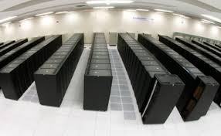

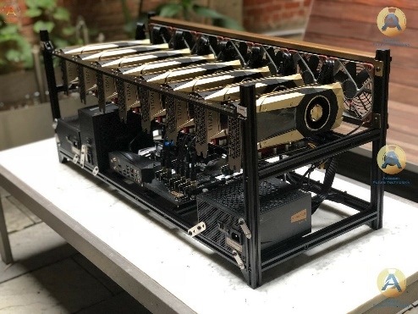

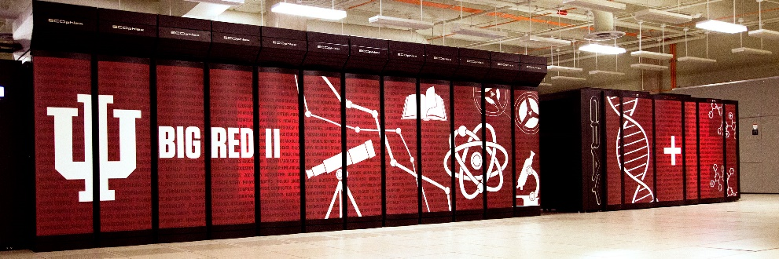

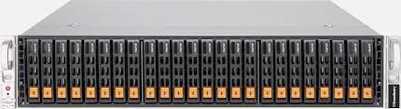
AI as a Service
Need to shield computer architectures and users from changes in AI implementations
One approach is to offer AI as a service implemented as Function as a Service
  Event-based FaaS offers attractive computing model and low latency
  Mix of NVMe and fast communication channels to minimize data transfer and other overheads in accessing AI Service
Can change to new hardware/software/algorithm transparently
AI as a service
Broker
Simulation as a service
NVMe as a service

