Slide 1
Digital Science Center Research in
High Performance Computing, Distributed Computing and Big Data
PHI
Geoffrey Fox October 28, 2016
gcf@indiana.edu
http://www.dsc.soic.indiana.edu/, http://spidal.org/ http://hpc-abds.org/kaleidoscope/ http://dsc.soic.indiana.edu/publications/SPIDAL-DIBBSreport_July2016.pdf
Department of Intelligent Systems Engineering
School of Informatics and Computing, Digital Science Center
Indiana University Bloomington

Slide 2
SPIDAL Project
Datanet: CIF21 DIBBs: Middleware and High Performance Analytics Libraries for Scalable Data Science
NSF14-43054 started October 1, 2014
Indiana University (Fox, Qiu, Crandall, von Laszewski)
Rutgers (Jha)
Virginia Tech (Marathe)
Kansas (Paden)
Stony Brook (Wang)
Arizona State (Beckstein)
Utah (Cheatham)
A co-design project: Software, algorithms, applications

Slide 3
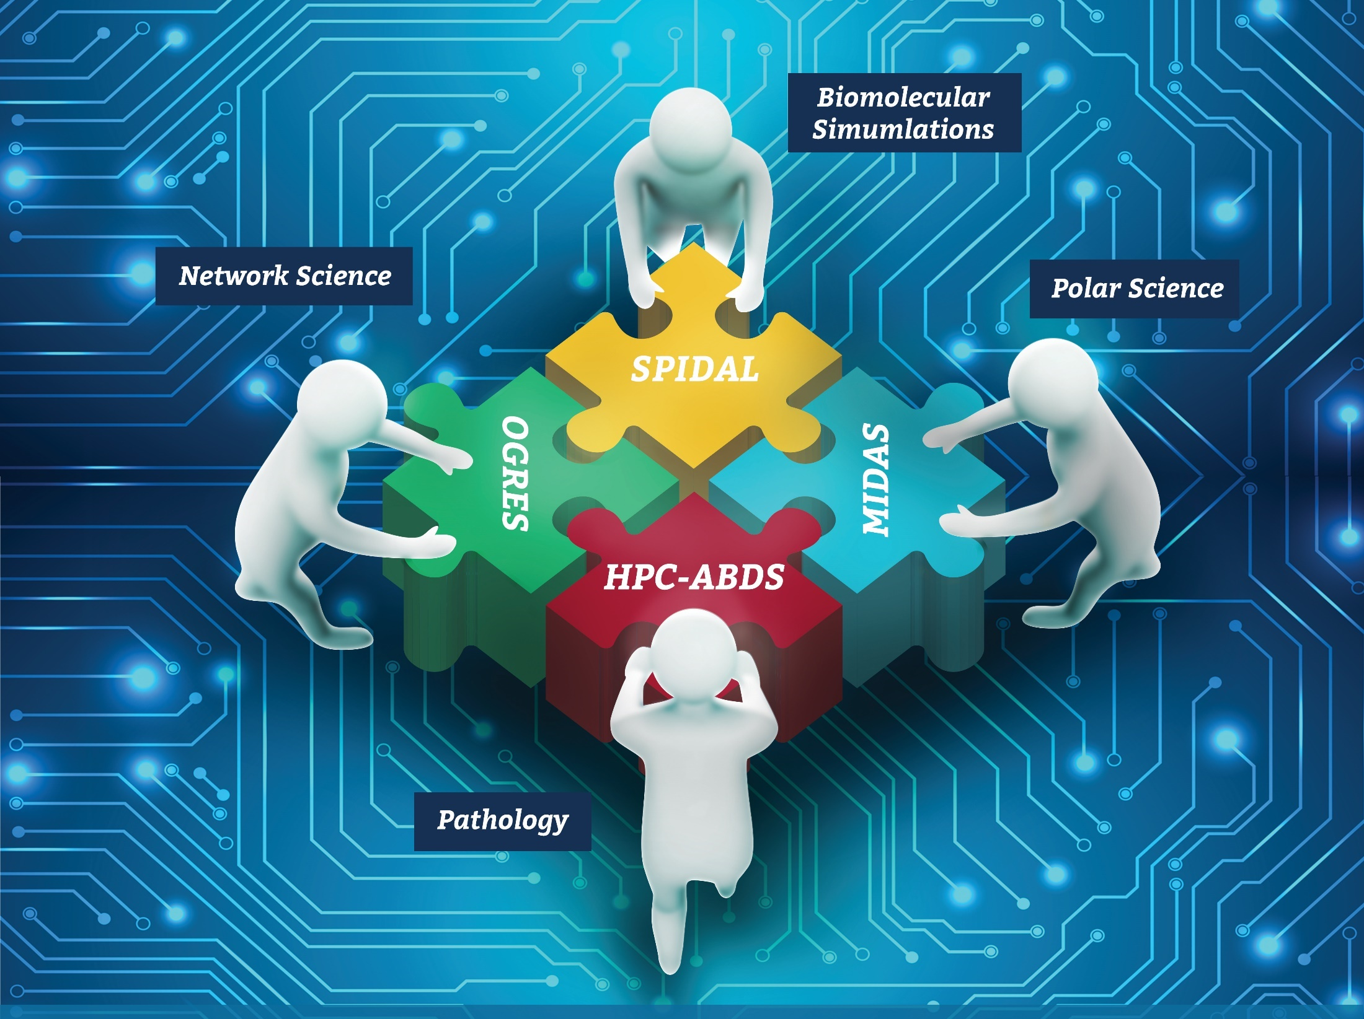




Co-designing Building Blocks Collaboratively
Software: MIDAS
HPC-ABDS

Slide 4
Main Components of SPIDAL Project
Design and Build Scalable High Performance Data Analytics Library
SPIDAL (Scalable Parallel Interoperable Data Analytics Library): Scalable Analytics for:
  Domain specific data analytics libraries – mainly from project.
  Add Core Machine learning libraries – mainly from community.
  Performance of Java and MIDAS Inter- and Intra-node.
NIST Big Data Application Analysis – features of data intensive Applications deriving 64 Convergence Diamonds. Application Nexus.
HPC-ABDS: Cloud-HPC interoperable software performance of HPC (High Performance Computing) and the rich functionality of the commodity Apache Big Data Stack. Software Nexus
MIDAS: Integrating Middleware – from project.
Applications: Biomolecular Simulations, Network and Computational Social Science, Epidemiology, Computer Vision, Geographical Information Systems, Remote Sensing for Polar Science and Pathology Informatics, Streaming for robotics, streaming stock analytics
Implementations: HPC as well as clouds (OpenStack, Docker) Convergence with common DevOps tool Hardware Nexus

Slide 5
Hardware
Clouds and HPC
Prototype DSC
128 node Haswell Cluster
4 node 16GPU Cluster
64 node Knights Landing Cluster
UITS

Slide 6
HPC-ABDS

Slide 7
HPC-ABDS SPIDAL Project Activities
Green is MIDAS
Black is SPIDAL
Level 17: Orchestration: Apache Beam (Google Cloud Dataflow) integrated with Heron/Flink and Cloudmesh on HPC cluster
Level 16: Applications: Datamining for molecular dynamics, Image processing for remote sensing and pathology, graphs, streaming, bioinformatics, social media, financial informatics, text mining
Level 16: Algorithms: Generic and custom for applications SPIDAL
Level 14: Programming: Storm, Heron (Twitter replaces Storm), Hadoop, Spark, Flink. Improve Inter- and Intra-node performance; science data structures
Level 13: Runtime Communication: Enhanced Storm and Hadoop (Spark, Flink, Giraph) using HPC runtime technologies, Harp
Level 12: In-memory Database: Redis + Spark used in Pilot-Data Memory
Level 11: Data management: Hbase and MongoDB integrated via use of Beam and other Apache tools; enhance Hbase
Level 9: Cluster Management: Integrate Pilot Jobs with Yarn, Mesos, Spark, Hadoop; integrate Storm and Heron with Slurm
Level 6: DevOps: Python Cloudmesh virtual Cluster Interoperability

Slide 8

Java MPI performs better than FJ Threads
128 24 core Haswell nodes on SPIDAL 200K DA-MDS Code
Speedup compared to 1 process per node on 48 nodes
Best MPI; inter and intra node
MPI; inter/intra node; Java not optimized
Best FJ Threads intra node; MPI inter node

Slide 9
HTML5 web viewer WebPlotViz
Supports visualization of 3D point sets (typically derived by mapping from abstract spaces) for streaming and non-streaming case
  Simple data management layer
  3D web visualizer with various capabilities such as defining color schemes, point sizes, glyphs, labels
Core Technologies
  MongoDB management
  Play Server side framework
  Three.js
  WebGL
  JSON data objects
  Bootstrap Javascript web pages
Open Source
http://spidal-gw.dsc.soic.indiana.edu/
~10,000 lines of extra code
Front end view (Browser)
Plot visualization & time series animation (Three.js)
Upload
Request Plots
JSON Format Plots
Web Request Controllers (Play Framework)
Server
Upload format to JSON Converter
Data Layer
(MongoDB)
MongoDB

Slide 10
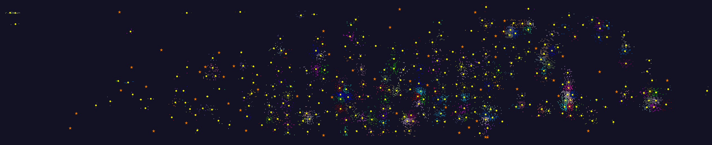
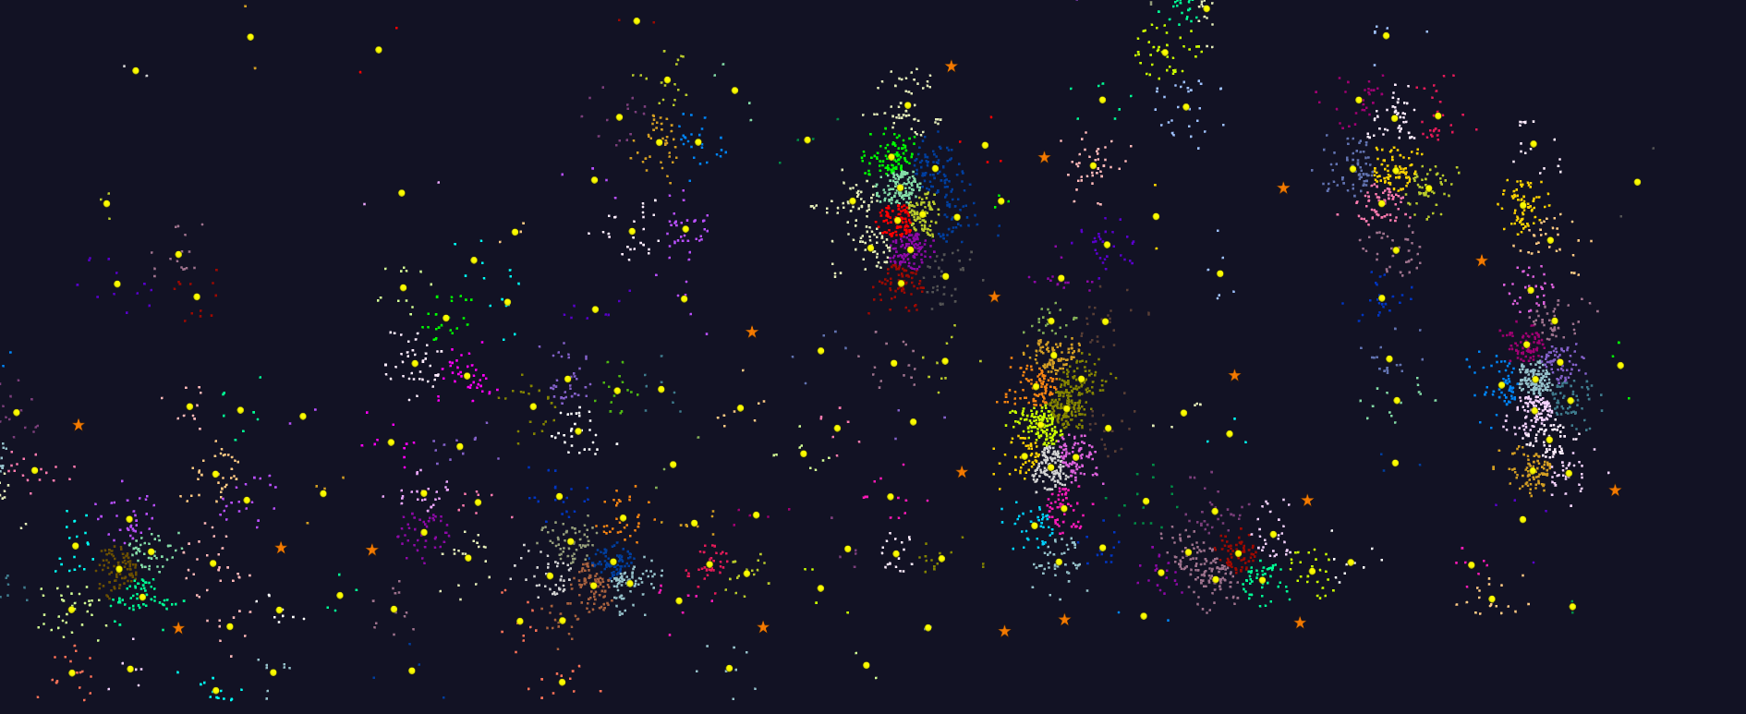
2D Vector Clustering with cutoff at 3 σ
Orange Star – outside all clusters; yellow circle cluster centers
Mass Spectrometer Peak Clustering. Charge 2 Sample with 10.9 million points and 420,000 clusters visualized in WebPlotViz

Slide 11
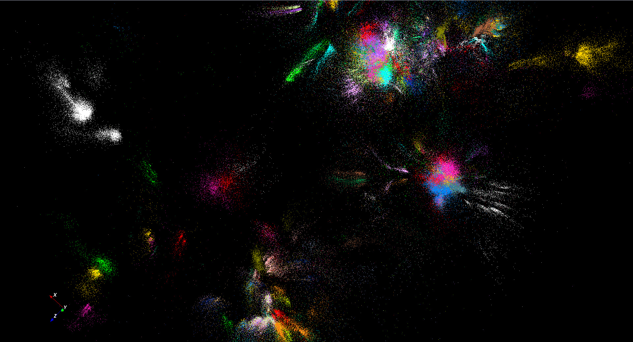
446K sequences
~100 clusters
Note distorted shapes probably due to imperfect distance measures e.g. position correlated with sequence length

Slide 12
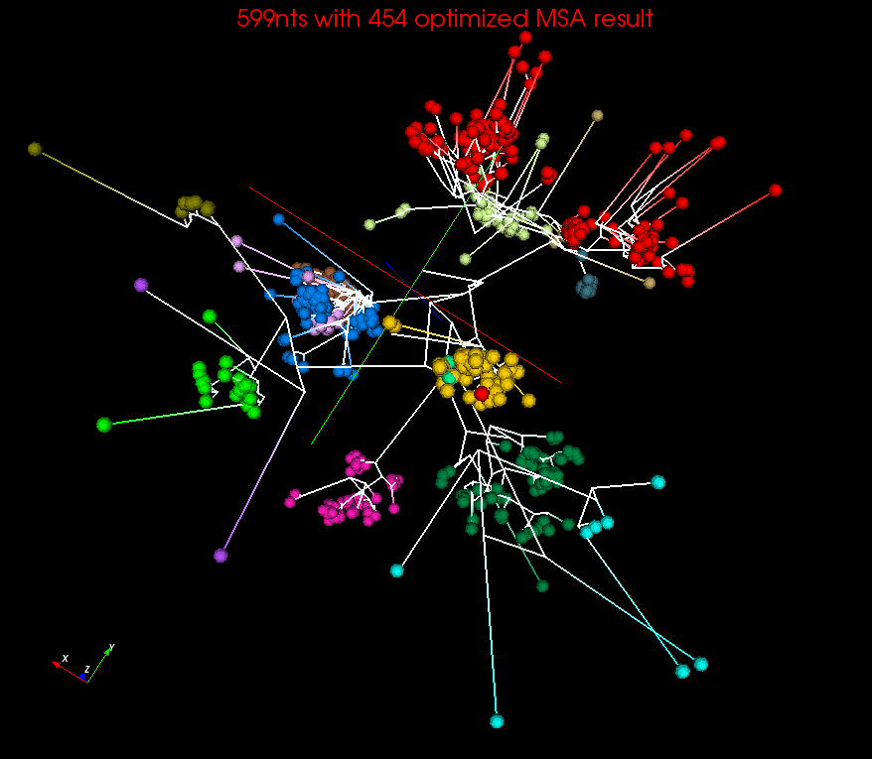
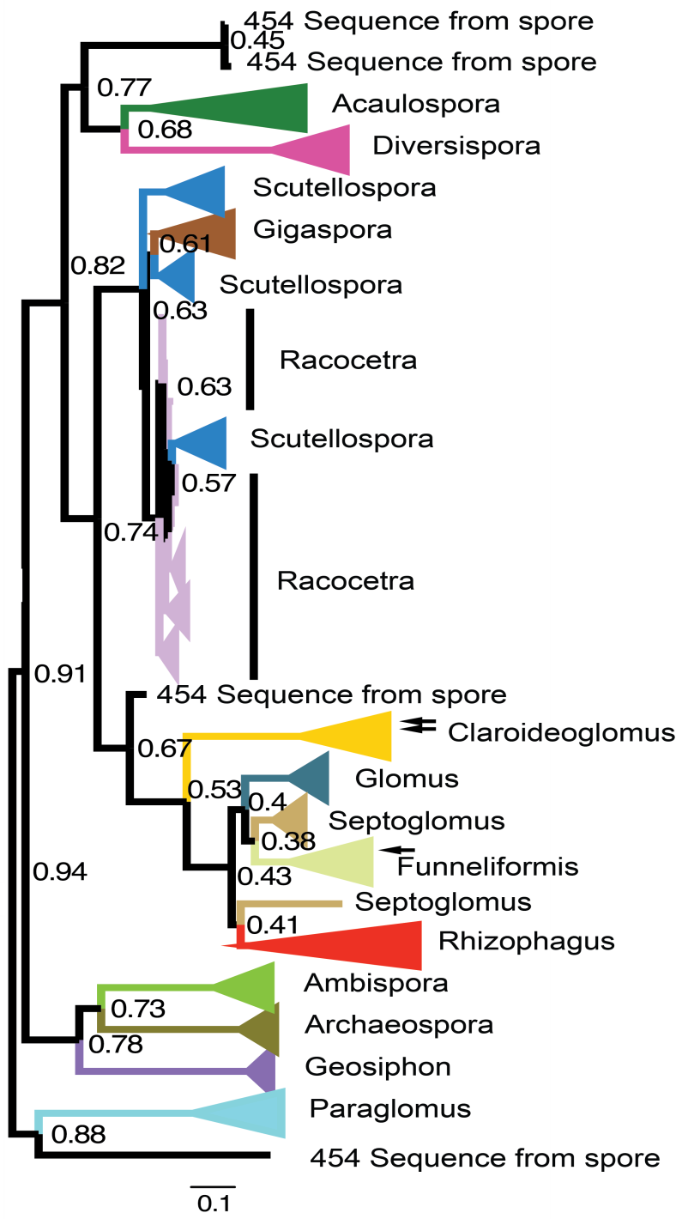
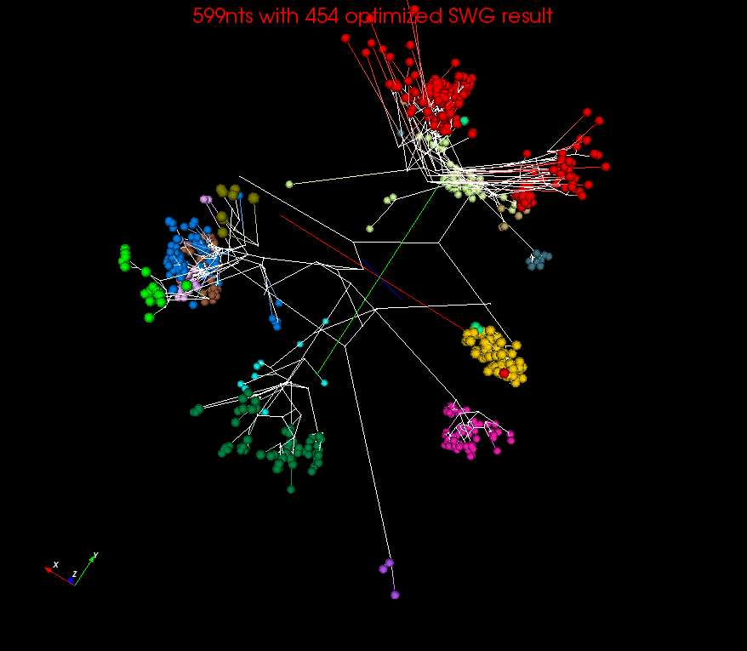
Spherical Phylograms
MSA or SWG distances
MSA
RAxML result visualized in FigTree.
SWG

Slide 13
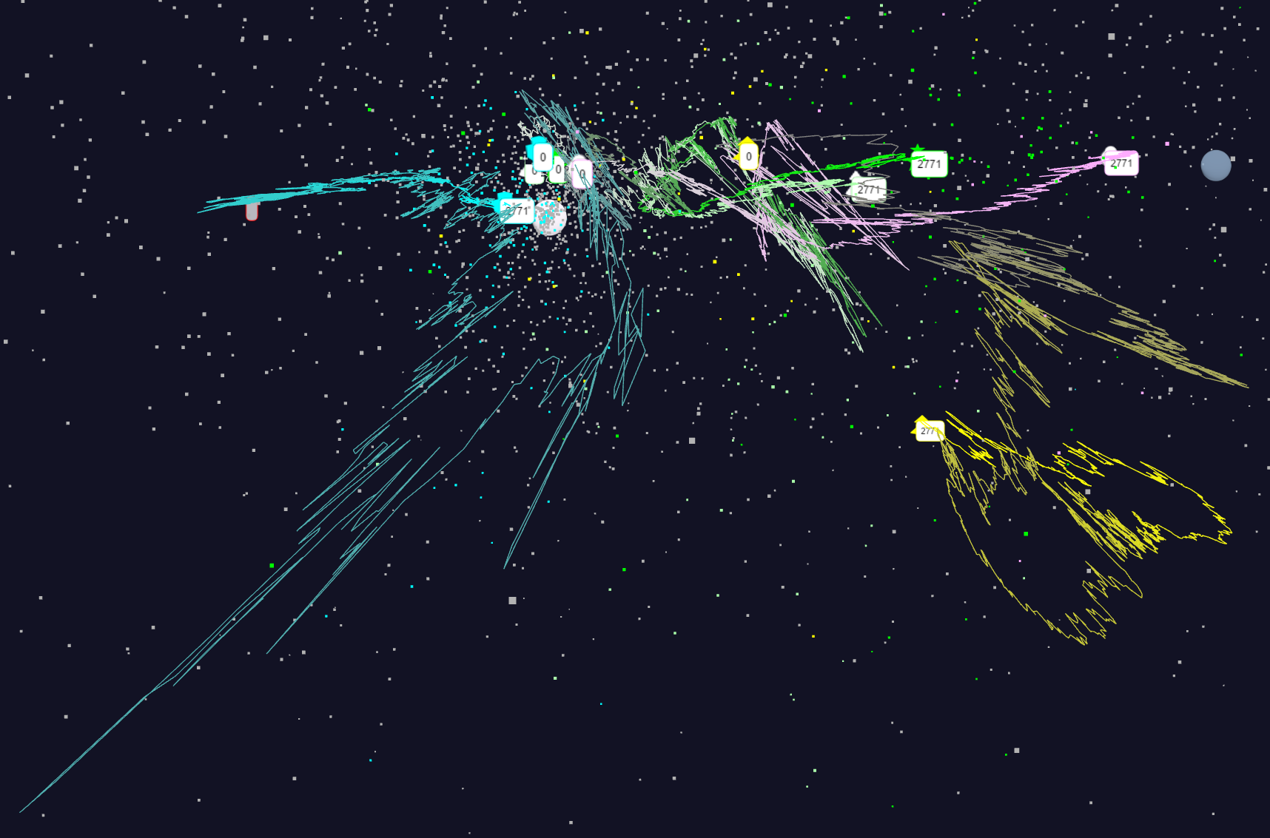
Relative Changes in Stock Values using one day values
Expansion of previous data
S&P
Mid Cap
S&P
Mid Cap
Dow Jones
Dow Jones
+10%
Finance
Finance
Origin
0% change
Energy
Energy
10/28/2016
13

Slide 14
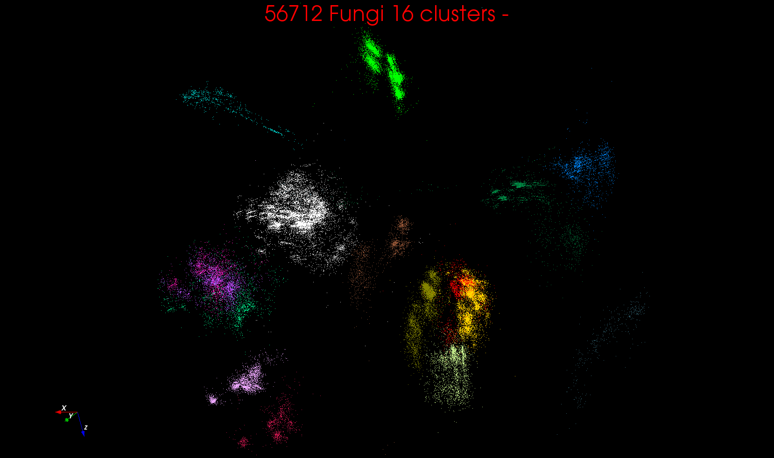
“clean” sample of 446K
O(N²) green-green and purple-purple interactions have value but green-purple are “wasted”
O(N²) reduced to O(N) times cluster size
O(N²) interactions between green and purple clusters should be able to represent by centroids as in Barnes-Hut.
Hard as no Gauss theorem; no multipole expansion and points really in 1000 dimension space as clustered before 3D projection

