Slide 1
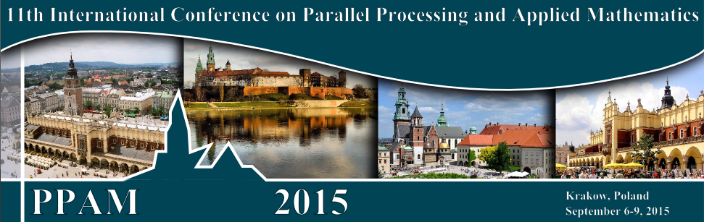
Data Analytics with HPC and DevOps
PPAM 2015, 11th International Conference On Parallel Processing And Applied Mathematics
Krakow, Poland, September 6-9, 2015
Geoffrey Fox, Judy Qiu, Gregor von Laszewski, Saliya Ekanayake, Bingjing Zhang, Hyungro Lee, Fugang Wang, Abdul-Wahid Badi
Sept 8 2015
gcf@indiana.edu
http://www.infomall.org, http://spidal.org/ http://hpc-abds.org/kaleidoscope/
Department of Intelligent Systems Engineering
School of Informatics and Computing, Digital Science Center
Indiana University Bloomington

Slide 2
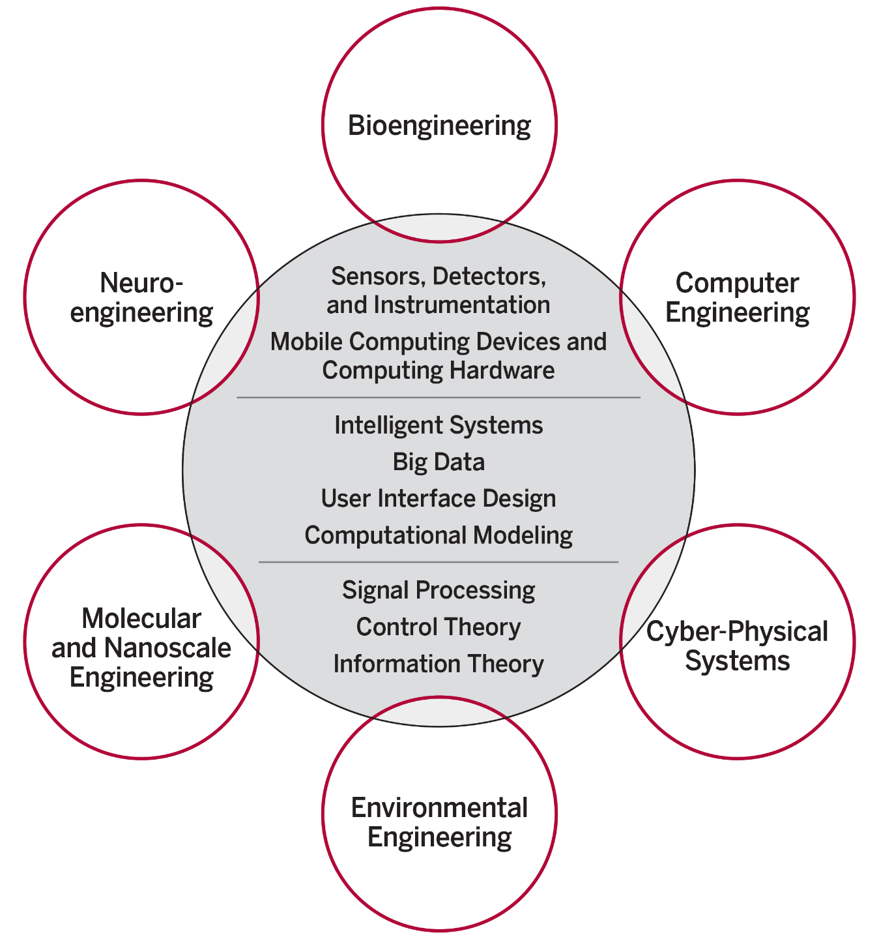
ISE Structure
The focus is on engineering of systems of small scale, often mobile devices that draw upon modern information technology techniques including intelligent systems, big data and user interface design. The foundation of these devices include sensor and detector technologies, signal processing, and information and control theory.
End to end Engineering
New faculty/Students Fall 2016
IU Bloomington is the only university among AAU’s 62 member institutions that does not have any type of engineering program.

Slide 3
Abstract
There is a huge amount of big data software that we want to use and integrate with HPC systems
Use Java and Python but face same challenges as large scale simulations to get good performance
We propose adoption of DevOps motivated scripts to support hosting of applications on the many different infrastructures like OpenStack, Docker, OpenNebula, Commercial clouds and HPC supercomputers.
Virtual Clusters can be used in clouds and Supercomputers and seem a useful concept on which base approach
Can also be thought of more generally as software defined distributed systems

Slide 4
Big Data Software

Slide 5
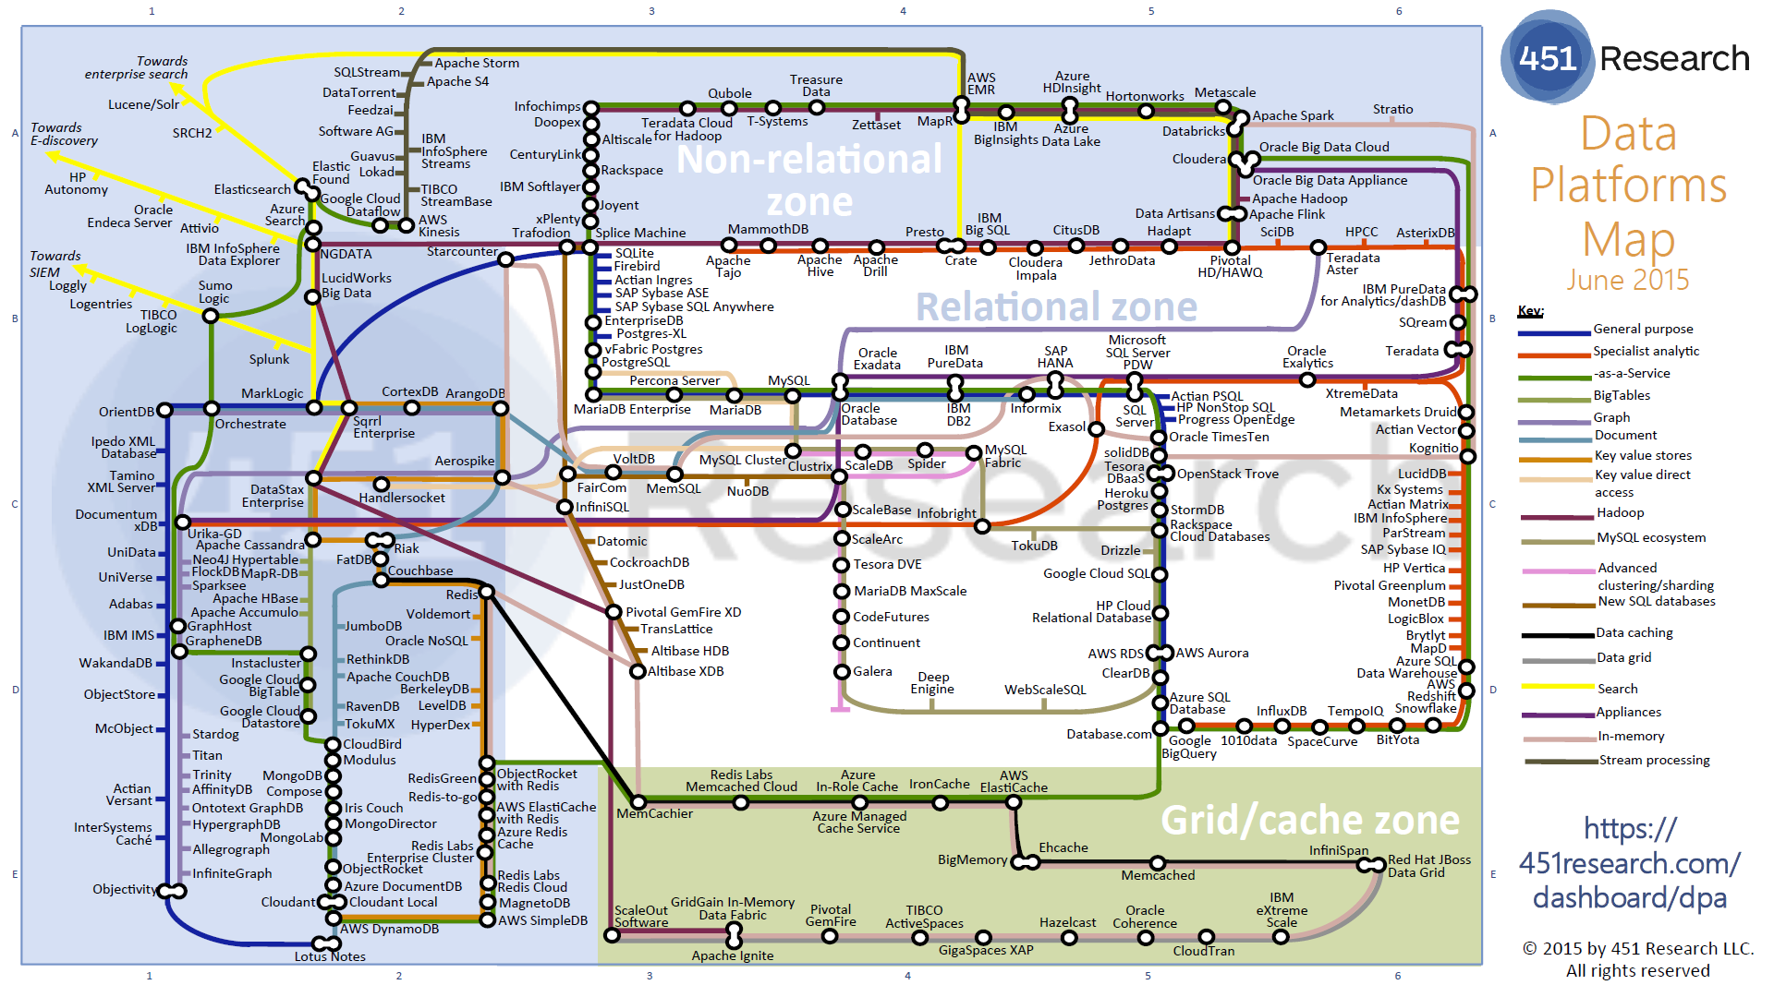
Data Platforms

Slide 6
Green implies HPC
Integration

Slide 7
Functionality of 21 HPC-ABDS Layers
Message Protocols:
Distributed Coordination:
Security & Privacy:
Monitoring:
IaaS Management from HPC to hypervisors:
DevOps:
Interoperability:
File systems:
Cluster Resource Management:
Data Transport:
A) File management
B) NoSQL
C) SQL
In-memory databases&caches / Object-relational mapping / Extraction Tools
Inter process communication Collectives, point-to-point, publish-subscribe, MPI:
A) Basic Programming model and runtime, SPMD, MapReduce:
B) Streaming:
A) High level Programming:
B) Frameworks
Application and Analytics:
Workflow-Orchestration:
Here are 21 functionalities. (including 11, 14, 15 subparts)
4 Cross cutting at top
17 in order of layered diagram starting at bottom

Slide 9
Java Grande
Revisited on 3 data analytics codes
Clustering
Multidimensional Scaling
Latent Dirichlet Allocation all sophisticated algorithms

Slide 10
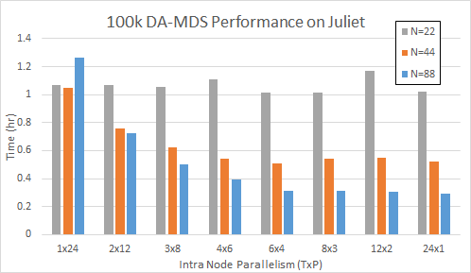
DA-MDS Scaling MPI + Habanero Java (22-88 nodes)
TxP is # Threads x # MPI Processes on each Node
As number of nodes increases, using threads not MPI becomes better
DA-MDS is “best general purpose” dimension reduction algorithm
Juliet is a 96 24-core node Haswell + 32 36-core Haswell Infiniband Cluster
Use JNI +OpenMPI gives similar MPI performance for Java and C
All MPI
on Node
All Threads
on Node

Slide 11
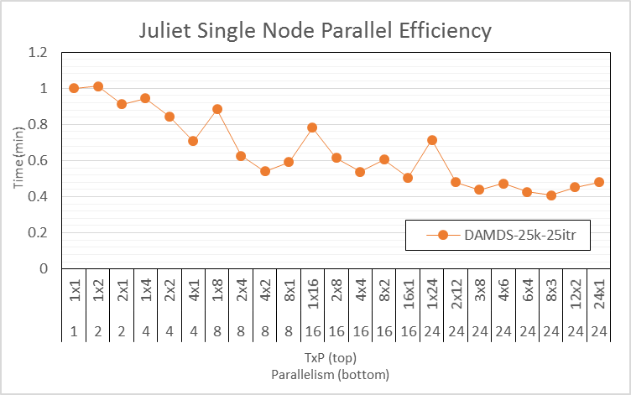
DA-MDS Scaling MPI + Habanero Java (1 node)
TxP is # Threads x # MPI Processes on each Node
On one node MPI better than threads
DA-MDS is “best known” dimension reduction algorithm
Juliet is a 96 24-core node Haswell + 32 36-core Haswell Infiniband Cluster
Use JNI +OpenMPI usually gives similar MPI performance for Java and C
24 way parallel
Efficiency
All MPI

Slide 12
FastMPJ (Pure Java) v.
Java on C OpenMPI v.
C OpenMPI

Slide 13
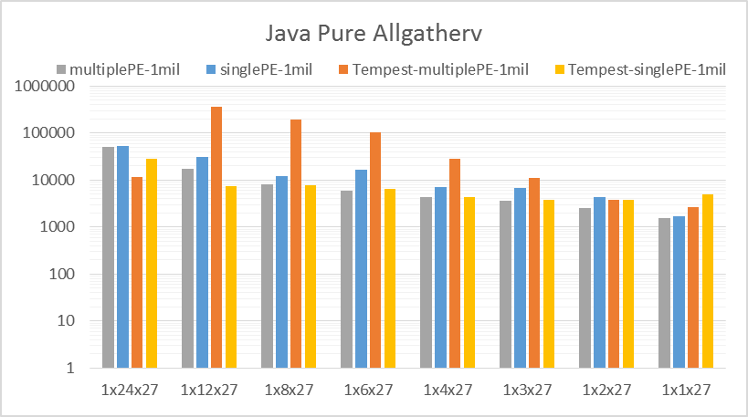
Sometimes Java Allgather MPI performs poorly
TxPxN where T=1 is threads per node and P is MPI processes per node and N is number of nodes
Tempest is old Intel Cluster
Bind processes to 1 or multiple cores
100K Data
Juliet

Slide 14
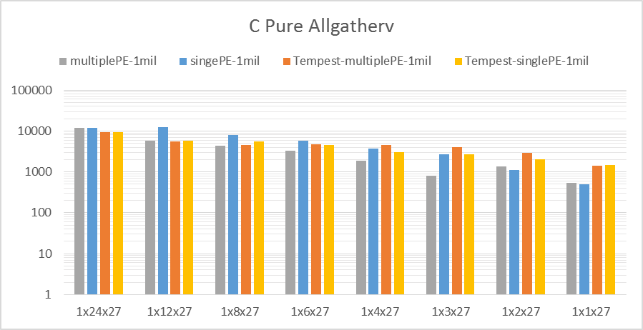
Compared to C Allgather MPI performing consistently
Juliet
100K Data

Slide 15
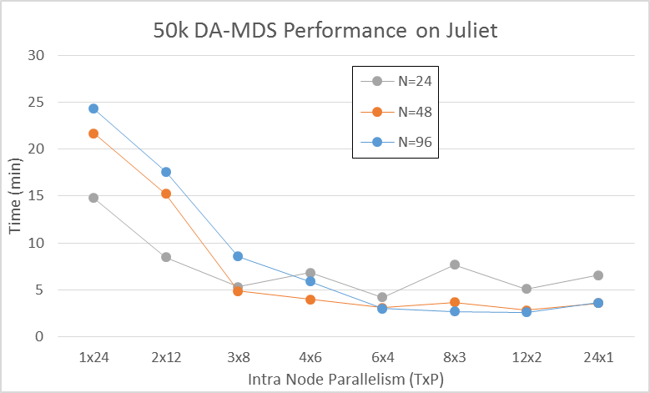
No classic nearest neighbor communication
All MPI collectives
All MPI on Node
All Threads
on Node

Slide 16
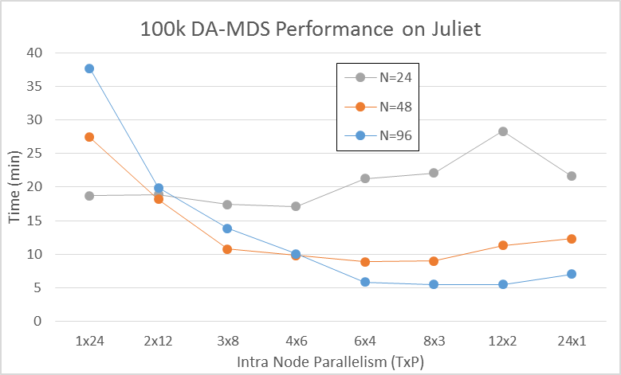
No classic nearest neighbor communication
All MPI collectives (allgather/scatter)
All Threads
on Node
All MPI
on Node

Slide 17
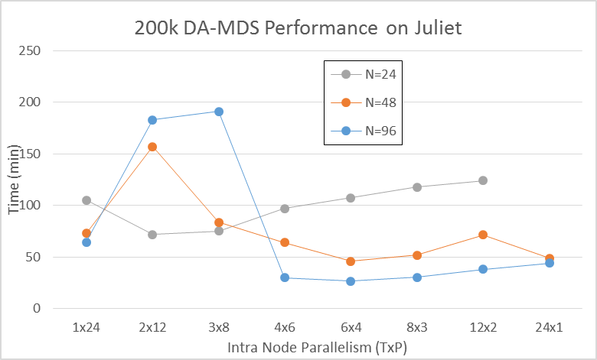
No classic nearest neighbor communication
All MPI collectives (allgather/scatter)
MPI crazy!
All Threads
on Node
All MPI
on Node

Slide 18
DA-PWC Clustering on old Infiniband cluster (FutureGrid India)
Results averaged over TxP choices with full 8 way parallelism per node
Dominated by broadcast implemented as pipeline

Slide 19
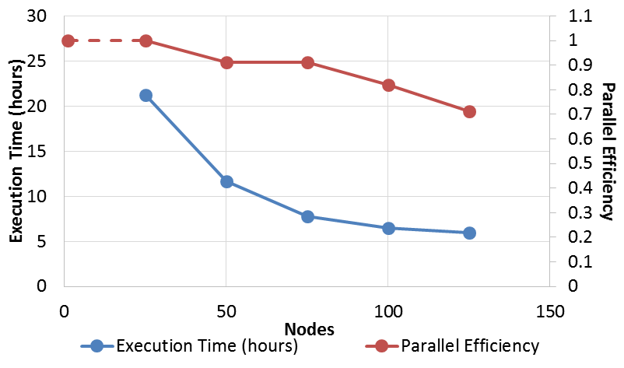
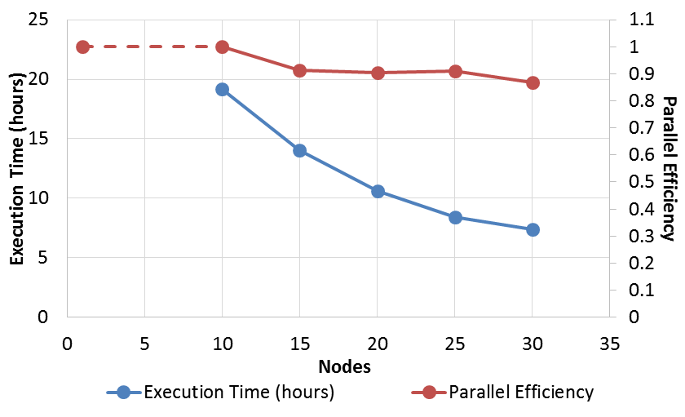
Parallel LDA Latent Dirichlet Allocation
Harp LDA on BR II (32 core old AMD nodes)
Java code running under Harp – Hadoop plus HPC plugin
Corpus: 3,775,554 Wikipedia documents, Vocabulary: 1 million words; Topics: 10k topics;
BR II is Big Red II supercomputer with Cray Gemini interconnect
Juliet is Haswell Cluster with Intel (switch) and Mellanox (node) infiniband
  Will get 128 node Juliet results
Harp LDA on Juliet (36 core Haswell nodes)

Slide 20
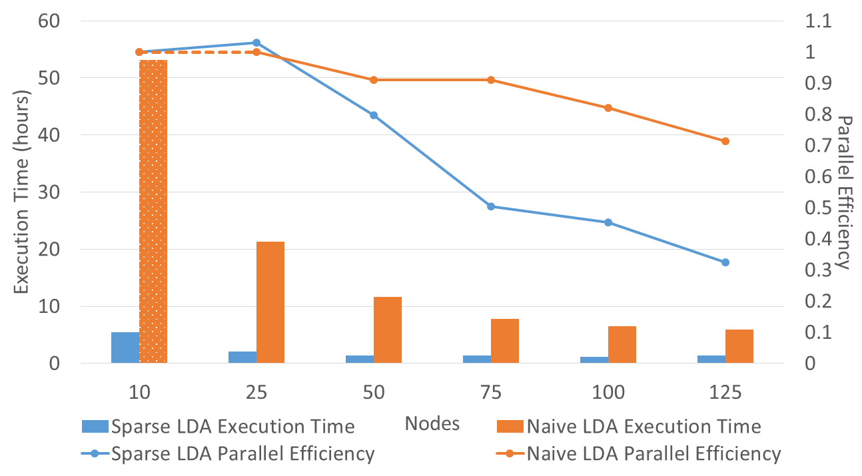
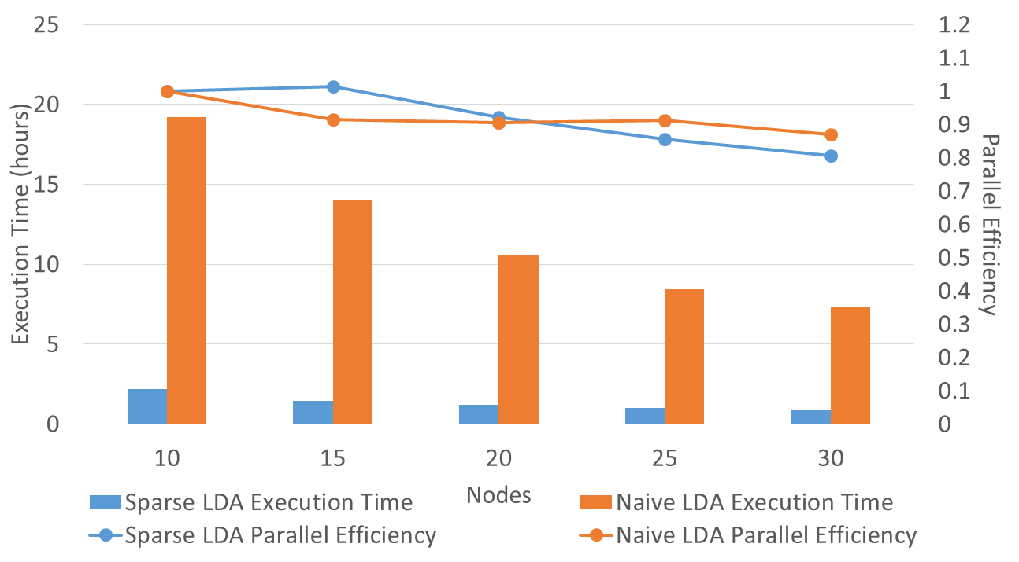
Parallel Sparse LDA
Harp LDA on BR II (32 core old AMD nodes)
Original LDA (orange) compared to LDA exploiting sparseness (blue)
Note data analytics making full use of Infiniband (i.e. limited by communication!)
Java code running under Harp – Hadoop plus HPC plugin
Corpus: 3,775,554 Wikipedia documents, Vocabulary: 1 million words; Topics: 10k topics;
BR II is Big Red II supercomputer with Cray Gemini interconnect
Juliet is Haswell Cluster with Intel (switch) and Mellanox (node) infiniband
Harp LDA on Juliet (36 core Haswell nodes)

Slide 21
Classification of Big Data Applications

Slide 22
Breadth of Big Data Problems
Analysis of 51 Big Data use cases and current benchmark sets led to 50 features (facets) that described important features
  Generalize Berkeley Dwarves to Big Data
Online survey http://hpc-abds.org/kaleidoscope/survey for next set of use cases
Catalog 6 different architectures
Note streaming data very important (80% use cases) as are Map-Collective (50%) and Pleasingly Parallel (50%)
Identify “complete set” of benchmarks
Submitted to ISO Big Data standards process

Slide 23
51 Detailed Use Cases: Contributed July-September 2013
Covers goals, data features such as 3 V’s, software, hardware
26 Features for each use case
Biased to science
http://bigdatawg.nist.gov/usecases.php
https://bigdatacoursespring2014.appspot.com/course (Section 5)
Government Operation(4): National Archives and Records Administration, Census Bureau
Commercial(8): Finance in Cloud, Cloud Backup, Mendeley (Citations), Netflix, Web Search, Digital Materials, Cargo shipping (as in UPS)
Defense(3): Sensors, Image surveillance, Situation Assessment
Healthcare and Life Sciences(10): Medical records, Graph and Probabilistic analysis, Pathology, Bioimaging, Genomics, Epidemiology, People Activity models, Biodiversity
Deep Learning and Social Media(6): Driving Car, Geolocate images/cameras, Twitter, Crowd Sourcing, Network Science, NIST benchmark datasets
The Ecosystem for Research(4): Metadata, Collaboration, Language Translation, Light source experiments
Astronomy and Physics(5): Sky Surveys including comparison to simulation, Large Hadron Collider at CERN, Belle Accelerator II in Japan
Earth, Environmental and Polar Science(10): Radar Scattering in Atmosphere, Earthquake, Ocean, Earth Observation, Ice sheet Radar scattering, Earth radar mapping, Climate simulation datasets, Atmospheric turbulence identification, Subsurface Biogeochemistry (microbes to watersheds), AmeriFlux and FLUXNET gas sensors
Energy(1): Smart grid

Slide 24

Geospatial Information System
Shared / Dedicated / Transient / Permanent
HPC Simulations
Internet of Things
Metadata/Provenance
Archived/Batched/Streaming
Data Source and Style View
10
9
8
HDFS/Lustre/GPFS
7
6
Enterprise Data Model
5
Files/Objects
SQL/NoSQL/NewSQL
4
Search / Query / Index
Local Analytics
Graph Algorithms
Micro-benchmarks
Alignment
Optimization Methodology
Learning
Classification
Streaming
Global Analytics
Linear Algebra Kernels
Recommendations
Visualization
Base Statistics
3
2
1
4 Ogre Views and 50 Facets
Execution View
Pleasingly Parallel
1
2
3
4
5
6
7
8
9
10
11
12
13
14
14
13
12
11
10
9
8
7
6
Classic MapReduce
Map-Collective
5
4
3
2
1
Map Point-to-Point
Single Program Multiple Data
Map Streaming
1
Processing View
Shared Memory
Bulk Synchronous Parallel
2
3
Performance Metrics
4
Volume
Dynamic = D / Static = S
$O\left(N^{2}\right)$ = NN / $O(N)$ = N
Velocity
Variety
Veracity
Communication Structure
Regular = R / Irregular = I
Data Abstraction
Iterative / Simple
5
Metric = M / Non-Metric = N
Flops per Byte; Memory I/O
Execution Environment; Core libraries
6
7
Fusion
Dataflow
8
Problem
Architecture
View
9
Agents
10
Workflow
11
12

Slide 25
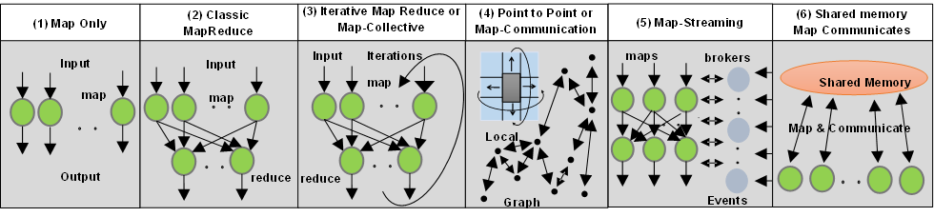
6 Forms of MapReduce cover “all” circumstances
Also an interesting software (architecture) discussion

Slide 26
Benchmarks/Mini-apps spanning Facets
Look at NSF SPIDAL Project, NIST 51 use cases, Baru-Rabl review
Catalog facets of benchmarks and choose entries to cover “all facets”
Micro Benchmarks: SPEC, EnhancedDFSIO (HDFS), Terasort, Wordcount, Grep, MPI, Basic Pub-Sub ….
SQL and NoSQL Data systems, Search, Recommenders: TPC (-C to x–HS for Hadoop), BigBench, Yahoo Cloud Serving, Berkeley Big Data, HiBench, BigDataBench, Cloudsuite, Linkbench
  includes MapReduce cases Search, Bayes, Random Forests, Collaborative Filtering
Spatial Query: select from image or earth data
Alignment: Biology as in BLAST
Streaming: Online classifiers, Cluster tweets, Robotics, Industrial Internet of Things, Astronomy; BGBenchmark.
Pleasingly parallel (Local Analytics): as in initial steps of LHC, Pathology, Bioimaging (differ in type of data analysis)
Global Analytics: Outlier, Clustering, LDA, SVM, Deep Learning, MDS, PageRank, Levenberg-Marquardt, Graph 500 entries
Workflow and Composite (analytics on xSQL) linking above

Slide 27
SDDSaaS
Software Defined Distributed Systems as a Service and Virtual Clusters

Slide 28
Supporting Evolving High Functionality ABDS
Many software packages in HPC-ABDS.
Many possible infrastructures
Would like to support and compare easily many software systems on different infrastructures
Would like to reduce system admin costs
  e.g. OpenStack very expensive to deploy properly
Need to use Python and Java
  All we teach our students
  Dominant (together with R) in data science
Formally characterize Big Data Ogres – extension of Berkeley dwarves – and benchmarks
Should support convergence of HPC and Big Data
  Compare Spark, Hadoop, Giraph, Reef, Flink, Hama, MPI ….
Use Automation (DevOps) but tools here are changing at least as fast as operational software

Slide 29
SDDSaaS Stack for HPC-ABDS
Just examples from 350 components
IPython, Pegasus, Kepler, FlumeJava, Tez, Cascading
Orchestration
HPC-ABDS at 4 levels
Mahout, MLlib, R
SaaS
PaaS
Hadoop, Giraph, Storm
IaaS
Docker, OpenStack,
Bare metal
NaaS
OpenFlow
BMaaS
Cobbler
Abstract Interfaces removes tool dependency

Slide 30
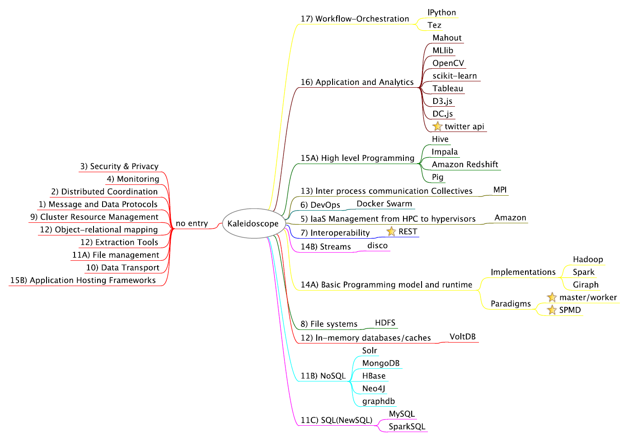
Mindmap of core Benchmarks
http://cloudmesh.github.io/introduction_to_cloud_computing/class/lesson/projects.html
Libraries
Visualization

Slide 31
Software for a Big Data Initiative
Functionality of ABDS and Performance of HPC
Workflow: Apache Crunch, Python or Kepler
Data Analytics: Mahout, R, ImageJ, Scalapack
High level Programming: Hive, Pig
Programming model:
  Batch Parallel: Hadoop, Spark, Giraph, Harp, MPI;
  Streaming: Storm, Kafka or RabbitMQ
In-memory: Memcached
Data Management: Hbase, MongoDB, MySQL
Distributed Coordination: Zookeeper
Cluster Management: Yarn, Mesos, Slurm
File Systems: HDFS, Object store (Swift),Lustre
DevOps: Cloudmesh, Chef, Ansible, Docker, Cobbler
IaaS: Amazon, Azure, OpenStack, Docker, SR-IOV
Monitoring: Inca, Ganglia, Nagios
Red implies layers of most interest to user

Slide 32
Automation or
“Software Defined Distributed Systems”
This means we specify Software (Application, Platform) in configuration file and/or scripts
Specify Hardware Infrastructure in a similar way
  Could be very specific or just ask for N nodes
  Could be dynamic as in elastic clouds
  Could be distributed
Specify Operating Environment (Linux HPC, OpenStack, Docker)
Virtual Cluster is Hardware + Operating environment
Grid is perhaps a distributed SDDS but only ask tools to deliver “possible grids” where specification consistent with actual hardware and administrative rules
  Allowing O/S level reprovisioning makes it easier than yesterday’s grids
Have tools that realize the deployment of application
  This capability is a subset of “system management” and includes DevOps
Have a set of needed functionalities and a set of tools from various commuinies

Slide 33
“Communities” partially satisfying SDDS management requirements
IaaS: OpenStack
DevOps Tools: Docker and tools (Swarm, Kubernetes, Centurion, Shutit), Chef, Ansible, Cobbler, OpenStack Ironic, Heat, Sahara; AWS OpsWorks,
DevOps Standards: OpenTOSCA; Winery
Monitoring: Hashicorp Consul, (Ganglia, Nagios)
Cluster Control: Rocks, Marathon/Mesos, Docker Shipyard/citadel, CoreOS Fleet
Orchestration/Workflow Standards: BPEL
Orchestration Tools: Pegasus, Kepler, Crunch, Docker Compose, Spotify Helios
Data Integration and Management: Jitterbit, Talend
Platform As A Service: Heroku, Jelastic, Stackato, AWS Elastic Beanstalk, Dokku, dotCloud, OpenShift (Origin)

Slide 34
Functionalities needed in SDDS Management/Configuration Systems
Planning job -- identifying nodes/cores to use
Preparing image
Booting machines
Deploying images on cores
Supporting parallel and distributed deployment
Execution including Scheduling inside and across nodes
Monitoring
Data Management
Replication/failover/Elasticity/Bursting/Shifting
Orchestration/Workflow
Discovery
Security
Language to express systems of computers and software
Available Ontologies
Available Scripts (thousands?)

Slide 35
Virtual Cluster Overview

Slide 36
Virtual Cluster
Definition: A set of (virtual) resources that constitute a cluster over which the user has full control. This includes virtual compute, network and storage resources.
Variations:
  Bare metal cluster: A set of bare metal resources that can be used to build a cluster
  Virtual Platform Cluster: In addition to a virtual cluster with network, compute and disk resources a platform is deployed over them to provide the platform to the user

Slide 37
Virtual Cluster Examples
Early examples:
  FutureGrid bare metal provisioned compute resources
Platform Examples:
  Hadoop virtual cluster (OpenStack Sahara)
  Slurm virtual cluster
  HPC-ABDS (e.g. Machine Learning) virtual cluster
Future examples:
  SDSC Comet virtual cluster; NSF resource that will offer virtual clusters based on KVM+Rocks+SR-IOV in next 6 months

Slide 38
Virtual Cluster Ecosystem

Slide 39
Virtual Cluster Components
Access Interfaces
  Provides easy access by users and programmers: GUI, command line/shell, REST, API
Integration Services
  Provides integration of new services, platforms and complex workflows while exposing them in simple fashion to the user
Access and Cluster Services
  Simple access services allowing easy use by the users (monitoring, security, scheduling, management)
Platforms
  Integration of useful platforms as defined by user interest
Resources
  Virtual clusters need to be instantiated on real resources
    Includes: IaaS, Baremetal, Containers
    Concrete resources: SDSC Comet, FutureSystems, …

Slide 40
Virtual Platform Workflow
Successful
Reservation
Select
Platform
Prepare
Deployment Framework
Workflow
(Devops)
Deploy
Return
Successful Platform
Deployment
Terminate reservation
Execute Experiment
Gregor von Laszewski

Slide 41
Virtual Platform Workflow
Successful
Reservation
Select
Platform
Prepare
Deployment Framework
Workflow
(Devops)
Deploy
Return
Successful Platform
Deployment
Terminate reservation
Execute Experiment
Gregor von Laszewski

Slide 42
Tools To Create Virtual Clusters

Slide 43
Phases needed for Virtual Cluster Management
Baremetal
  Manage bare metal servers
Provisioning
  Provision an image on bare metal
Software
  Package management, software installation
Configuration
  Configure packages and software
State
  Report on the state of the install and services
Service Orchestration
  Coordinate multiple services
Application Workflow
  Coordinate the execution of an application including state and application experiment management

Slide 44
From Bare metal Provisioning ⬅➔ to Application Workflow
Baremetal | Provisioning | Software | Configuration | State | Service Orchestration | Application Workflow
Ironic
Nova
Heat
disk-mage-bulder
OS config
OS state
MaaS
Juju
Packages
Chef, Puppet, ansible, salt, …
SLURM
Pegasus
Kepler
TripleO : deploys OpenStack

Slide 45
Some Comparison of DevOps Tools
Score | Framework | Open Stack | Language | Effort | Highlighted features
+++ | Ansible | x | python | low | Low entry barrier, push model, agentless via ssh, deployment, configuration, orchestration, can deploy onto windows but does not run on windows.
+ | Chef | x | Ruby | High | Cookbooks, Client server based, roles
++ | Puppet | x | Puppet DSL / Ruby | medium | Declarative language, client-server based,
(---) | Crowbar | x | Ruby |  | Cent OS only, bare metal, focus on openstack, moved from Dell to SUSE
+++ | Cobbler |  | Python | Medium - high | Networked installations of clusters, provisioning, DNS, DHCP, package updates, power management, orchestration
+++ | Docker |  | Go | very low | Low entry barrier, Container management, Dockerfile
(--) | Juju | x | Go | low | Manages services and applications
++ | xcat |  | Perl | medium | Diskless clusters, manage servers, setup of HPC stack, cloning of images
+++ | Heat | x | Python | medium | Templates, relationship between resources, focuses on infrastructure
+ | TripleO | x | Python | high | OpenStack focused, Install, upgrade OpenStack using OpenStack functionality
(+++) | Foreman | x | Ruby, puppet | low | REST, very nice documentation of REST apis
 | Puppet Razor |  | Ruby, puppet |  | Inventory, dynamic image selection, policy based provisioning
+++ | Salt | x | Python | low | Salt Cloud, dynamic bus for orchestration, remote execution and configuration management, faster than ansible via zeroMQ, ansible is in some aspects easier to use

Slide 46
PaaS as seen by Developers
Platform | Languages | Application staging | Highlighted features | Focus
Heroku | Ruby, PHP, Node.js, Python, Java, Go, Closure, Scala | Source code syncronization via git, addons | build, deliver, monitor and scale apps, data services, marketplace | Application development
Jelastic | Java, PHP, Python, Node.js, Ruby and .NET | Source code syncrhronization: git, svn, bitbucket | PaaS and container based IaaS, Heterogeneous cloud support, plugin support for IDEs and builders such as maven, ant | Web server and database development. Small number of available stacks
AWS Elastic Beanstalk | Java, .NET, PHP, Node.js, Python, Ruby, Go, and Docker | Selection from Webpage/REST API, CLI | deploying and scaling web applications | Apache, Nginx, Passenger, and IIS and self developed services
Dokku | See heroku | Source code synchronisation via git | Mini Heroku powered by docker, docker | Your own single-host local Heroku,
dotCloud | Java, Node.js PHP, Python, Ruby, (Go) |  | Sold by Docker. Small number of examples | managed service for web developers
Redhat Openshift |  | Via git | automates the provisioning, management and scaling of applications | Aplication hosting in public cloud
Pivotal Cloud Foundry | Java, Node.js ,Ruby, PHP, Python, Go | Command line |  | Integrates multiple clouds, develop and manage applications
Cloudify | Java, Python, REST | Command line, GUI, REST | open source TOSCA-based cloud orchestration software platform, can be installed locally | open source, TOSCA, integrates with many cloud platforms
Google App Engine | Python, Java, PHP, Go |  | Many useful services from OAUTH to MapReduce | run applications on Google’s infrastructure

Slide 47
Virtual Clusters Powered By Containers

Slide 48
Hypervisor Models
Type 1 - Baremetal
Type 2 – on OS
Hardware
Hypervisor
OS
OS
Hardware
Hypervisor
OS
OS
OS
KVM, FreeBSD bhyve make appear as type 1
but run on OS
Oracle VM Server for SPARC and x86,
Citrix XenServer, VMware ESX/ESXi ,
Microsoft Hyper-V 2008/2012.
VMware Workstation,
VMware Player, VirtualBox

Slide 49
Hypervisor vs. Container
Hypervisor (Type 2)
Container
Server
Operating System
Guest OS
Guest OS
Libraries
Libraries
App
App
App
App
Aop
App
Hypervisor
Server
Operating System
Container Engine
Libraries
Libraries
App
App
App
App
App
App

Slide 50
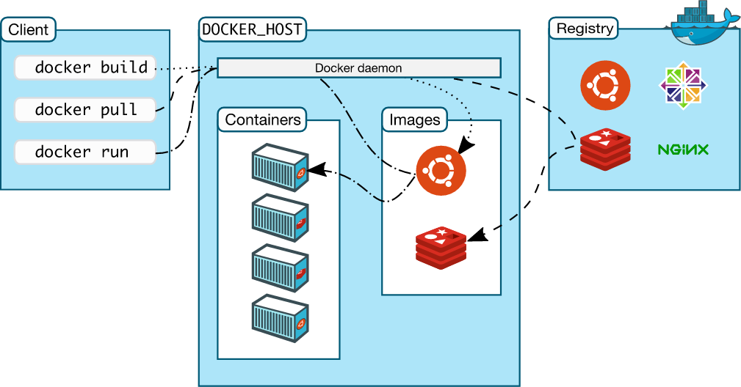
Docker Components
Docker Machine
  creates Docker hosts on computer, cloud providers, data center. Automatically creates hosts, installs Docker, configures docker client to talk to them. A “machine” is the combination of a Docker host and a configured client
Docker Client
  Builds, pulls, and runs docker images and containers while using the docker daemon and the registry
Docker Engine
  Builds and runs Containers with downloaded Images
Docker Registry
  Provides storage and distribution of Docker images e.g. Ubuntu, CentOS, nginx
Docker Compose
  Connects multi containers
Docker Swarm
  Manages containers on multiple hosts
Docker Hub
  Public image repository
Kitematic (GUI)
  OSX

Slide 51
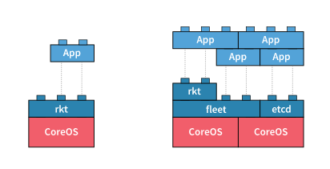
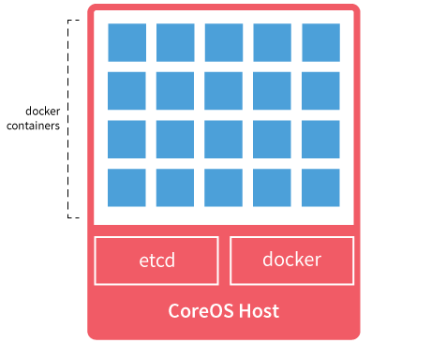
CoreOS Components
preconfigured OS with popular tools for running container
Operating System
  CoreOS
Container runtime
  rkt
Discovery
  etcd
Distributed System
  fleet
Network
  flannel
Source: https://coreos.com/

Slide 52
Provisioning Comparison
Containers do not carry the OS
  Provisioning is much faster
  Security may be an issue
    By employing server server isolation we do not have this issue
    Security will improve, may come at cost of runtime
tens of
minutes
Trend
minutes
seconds –
<seconds

Slide 53
Cluster Scaling from Single entity -> Multiple -> Distributed
Service/ Tool | Highlighted features | Provisioning | Single Entity | Multiple Entities | Distributed Entities | Distributed Scheduling
Rocks | HPC, Hadoop
Docker Tools | Uses Docker | Docker machine | Docker client | Docker-engine | Docker swarm
Helios | Uses Docker
Centurion | Uses Docker
Docker Shipyard | Composability
CoreOS Fleet | CoreOS
Mesos | Master-worker
Myriad | Mesos framework for scaling YARN
YARN | Next gen map reduce scheduler |  |  |  |  | Global, per application
Kubernetes | Manage cluster as single container system
Borg | Multiple cluster
Marathon | Manage cluster
Omega | Scheduler only

Slide 54
Container-powered Virtual Clusters (Tools)
Application Containers
  Docker, Rocket (rkt), runc (previously lmctfy) by OCI* (Open Container Initiative), Kurma, Jetpack
Operating Systems and support for Containers
  CoreOS, docker-machine
  requirements: kernel support (3.10+) and Application Containers installed i.e. Docker
Cluster management for containers
  Mesos, Kubernetes, Docker Swarm, Marathon/Mesos, Centurion, OpenShift, Shipyard, OpenShift Geard, Smartstack, Joyent sdf-docker, OpenStack Magnum
  requirements: job execution & scheduling, resource allocation, service discovery
Containers on IaaS
  Amazon ECS (EC2 Container Service supporting Docker), Joyent Triton
Service Discovery
  Zookeeper, etcd, consul, Doozer
  coordination service - registering master/workers
PaaS
  AWS OpsWorks, Elastic Beanstalk, Flynn, EngineYard, Heroku, Jelastic, Stackato (moved to HP Cloud from ActiveState)
Configuration Management
  Ansible, Chef, Puppet, Salt
* OCI - standard container format of the Open Container Project (OCP) from www.opencontainers.org

Slide 55
Container-based Virtual Cluster Ecosystem

Slide 56
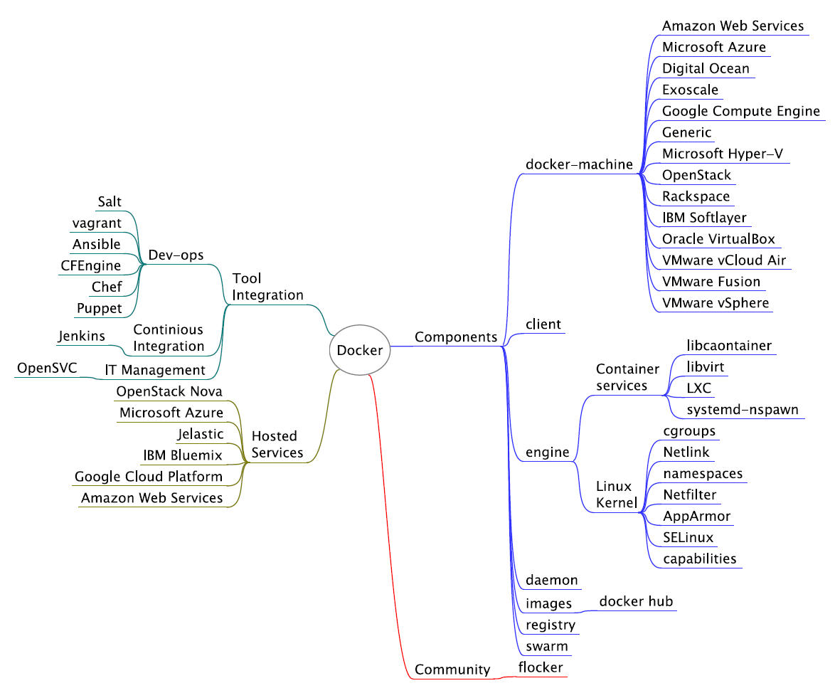
Docker Ecosystem

Slide 57
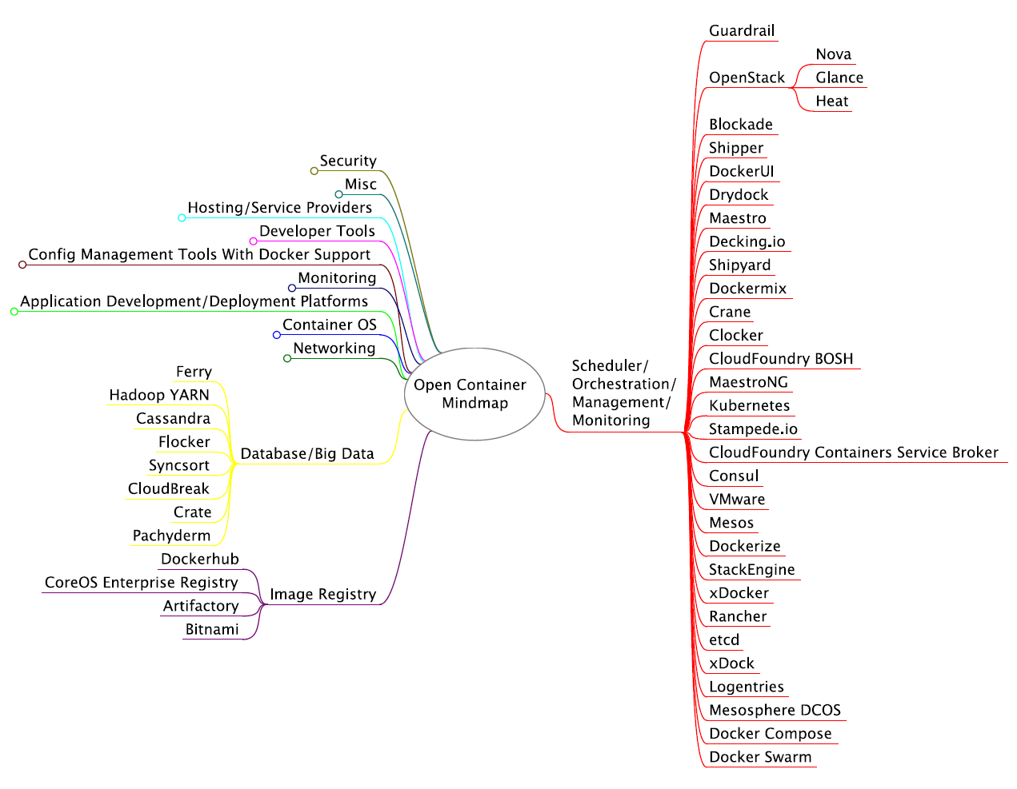
Open Container Mindmap 1
https://www.mindmeister.com/389671722/open-container-ecosystem-formerly-docker-ecosystem

Slide 58
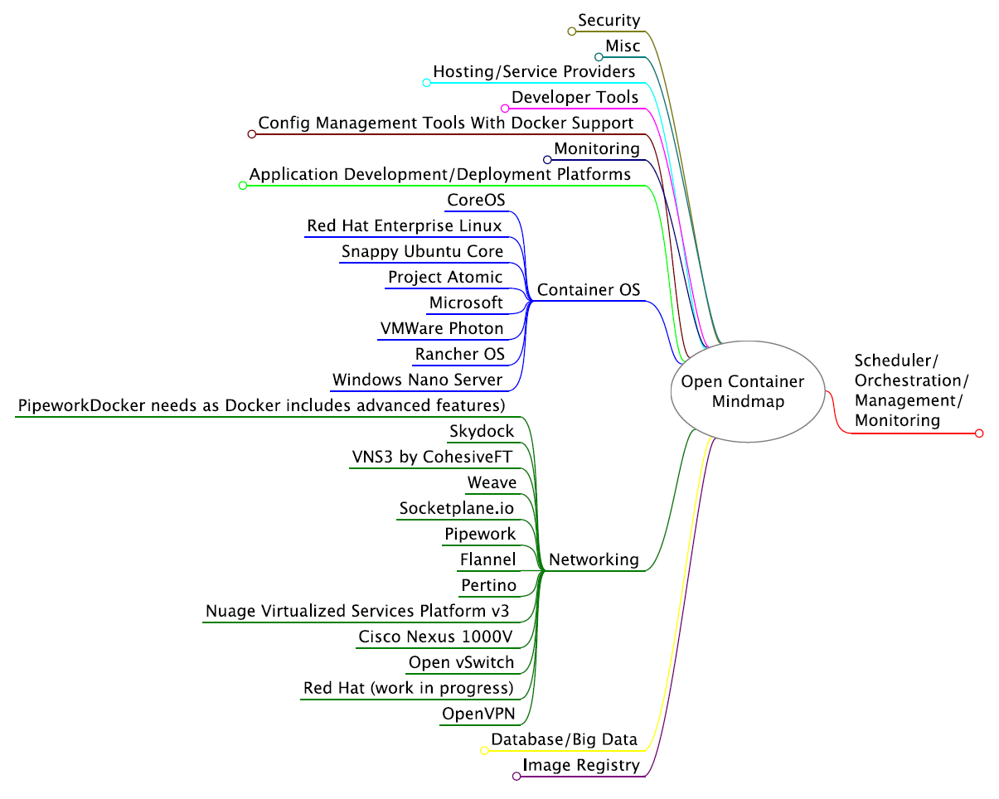
Open Container Mindmap 2
https://www.mindmeister.com/389671722/open-container-ecosystem-formerly-docker-ecosystem

Slide 59
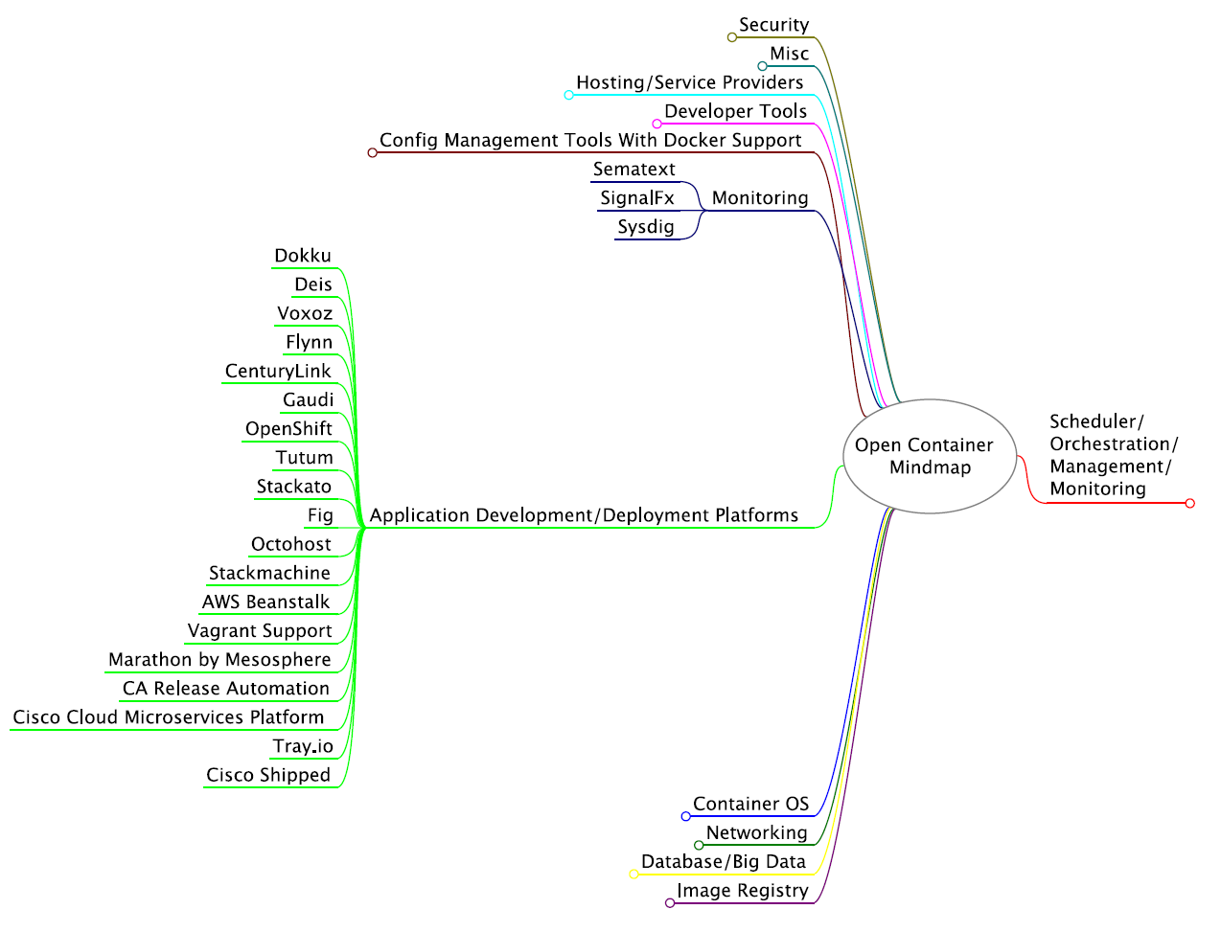
Open Container Mindmap 3
https://www.mindmeister.com/389671722/open-container-ecosystem-formerly-docker-ecosystem

Slide 60
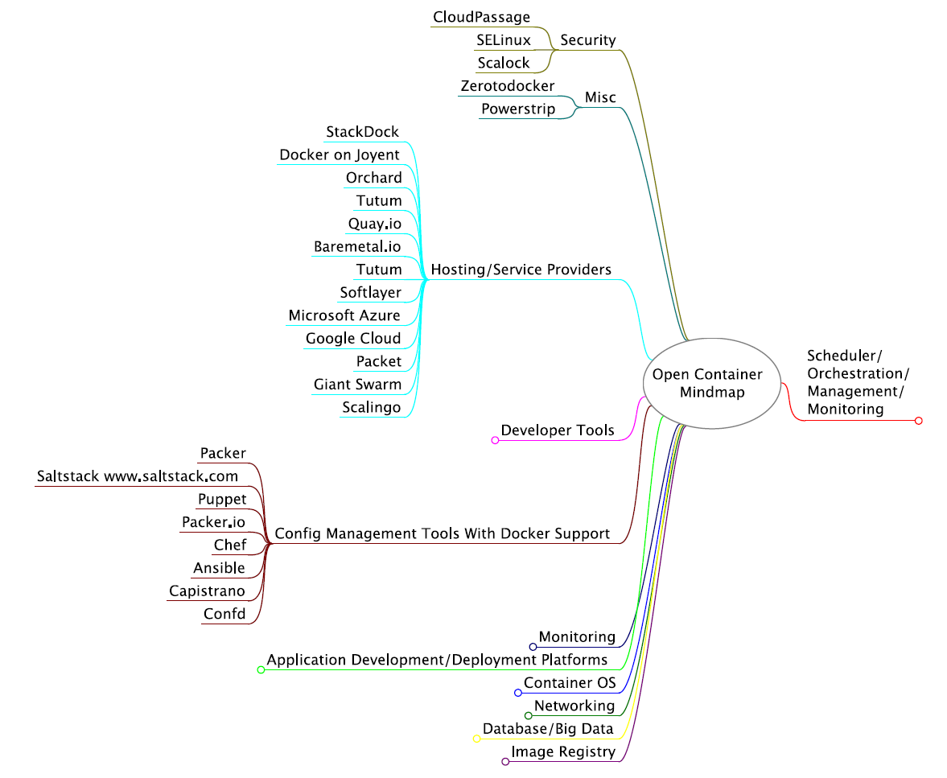
Open Container Mindmap 4
https://www.mindmeister.com/389671722/open-container-ecosystem-formerly-docker-ecosystem

Slide 61
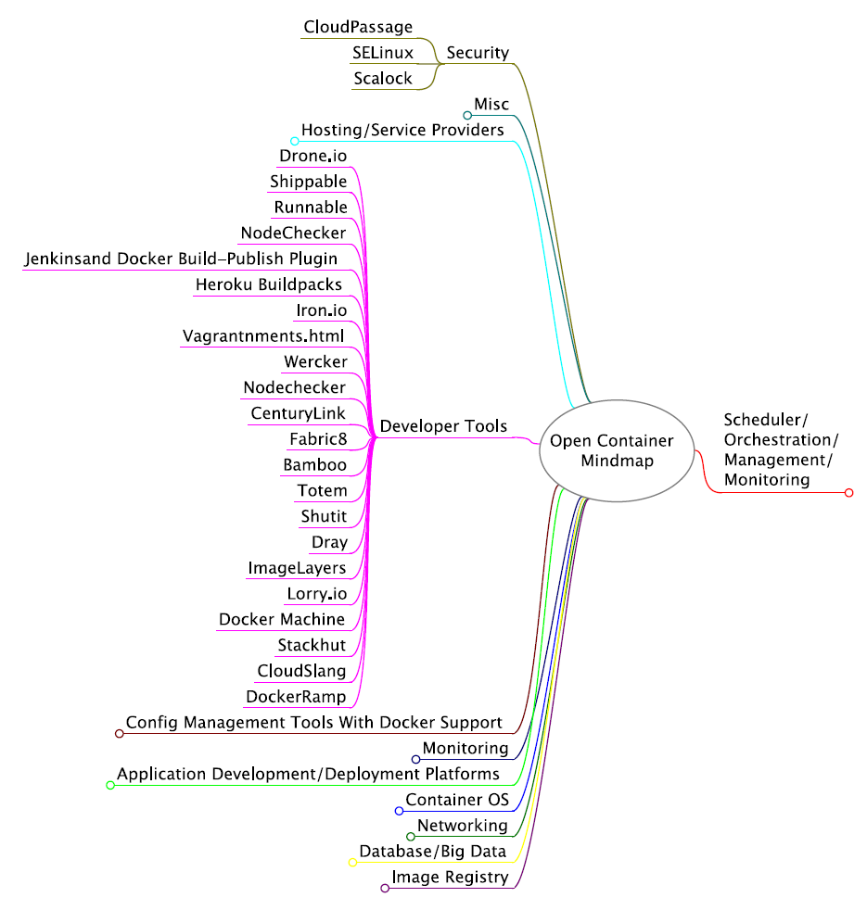
Open Container Mindmap 5
https://www.mindmeister.com/389671722/open-container-ecosystem-formerly-docker-ecosystem

Slide 62
Roles in Container-powered VC
Application Containers
  Provides isolation of the host environment for the running container process by cgroups and namespaces from linux kernel, No hypervisor.
  Tools: Docker, Rocket (rkt), runc (lmctfy)
  Use Case: Starting/running container images
Operating Systems
  Supports latest kernel version with minimal package extensions. Docker has small footprint and can be deployed easily on OS
Cluster Management
  Running container-based applications on complex cluster architectures needs additional supports for cluster management. Service Discovery, security, job execution and resource allocation are discussed.
Containers on IaaS
  During the transition between process and OS virtualization, running container tools on current IaaS platforms provides practices of running applications without dependencies.
Service Discovery
  Each container application communicates with others to exchange data, configuration information, etc via overlay network. In a cluster environment, access information and membership information need to be gathered and managed in a quorum. Zookeeper, etcd, consul, and doozer offer cluster coordination services.
Configuration Management (CM)
  Uses configuration scripts (i.e. recipes, playbooks) to maintain and construct VC software packages on target machines
  Tools: Ansible, Chef, Puppet, Salt
  Use case: Installing/configuring Mesos on cluster nodes

Slide 63
Issues for Container-powered Virtual Clusters
Latest OS required (e.g. CentOS 7 and RHEL 7)
  Docker runs on Linux Kernel 3.10+
  CentOS 6 and RHEL 6 are still most popular which have old kernels i.e. 2.6+
Linux is only supported
  Currently no containers for Windows or other OS
  Microsoft Windows Server and Hyper-V Containers will be available
    Preview of Windows Server Containers
Container Image
  Size Issue: Delay on large images in starting apps (> 1GB), Increased network traffic while downloading and registering, Scientific application containers are typically big
  Purging old images: completed container images stay in host machines which consumes storage. Unused images need to be cleaned up. One example is Docker Garbage Collection by Spotify
Security
  Insecure Image: image checksum flaws, docker 1.8 supports Docker Content Trust
  Vulnerable hosts can affect data and applications on containers
Lack of available Application Images
  Still lots of application images need to be created, especially for scientific applications
File Systems
  Lots of Confusing issues (Lustre v. HDFS etc.) but not special to Containers

Slide 64
Cluster Management with Containers
Name | Job Management (execution/ scheduling) | Image management (planning /preparing/ booting) | Configuration Service (Discovery, membership, quorum) | Replication/Failover (Elasticity/Bursting/Shifting) | Lang. | What can be specified (extent of ontologies)
Apache Mesos | Chronos, two-level scheduling | SchedulerDriver with ContainerInfo | Zookeeper | Zookeeper, Slave Recovery | C++ | Hadoop, spark, Kafka, elastic search
Google Kubernetes | kube-scheduler : Scheduling units (pods) with location affinity | Image Policy with Docker | SkyDNS | Controller manager | Go | Web applications
Apache Myriad (Mesos + YARN) | Marathon, Chronos, Myriad Executor | SchedulerDriver with ContainerInfo, dcos | Zookeeper | Zookeeper | Java | Spark, Cassandra, Storm, Hive, Pig, Impala, Drill [8]
Apache YARN | Resource Manager | Docker Container Executor | YARN Service Registry, Zookeeper | Resource Manager | Java | Hadoop, MapReduce, Tez, Impala, Broadly used
Docker Swarm | Swarm Filters and Strategies | Node agent | Etcd, consul, zookeeper | Etcd, consul, zookeeper | Go | Dokku, Docker Compose, Krane, Jenkins
Engine Yard Deis (PaaS) | Fleet | Docker | etcd | etcd | Python, Go | Applications from Heroku Buildpacks, Dockerfiles, Docker Images

Slide 65
Cluster Management with Containers
Legend | Description
Job Execution and Scheduling | Managing workload with priority, availability and dependency
Image management (planning/preparing/booting) | Downloading, powering up, and allocating images (VM image and container image) for applications
Configuration Service (discovery, membership, quorum) | Storing cluster membership with key-value stores. service discovery, leader election
Replication/Failover (elasticity/bursting/shifting) | High Availability (HA), recovery against service failures
Lang. | development programming language
What can be specified (extent of ontologies) | Supported applications available in scripts

Slide 66
Container powered Virtual Clusters for Big Data Analytics
Better for reproducible research
Issues on dealing with large amounts of data compatible with important for Data Software Stacks.
  Requires external file system integration such as HDFS, NFS for Big Data Software Stacks, or OpenStack Manila [10] (formerly cinder) to provide a distributed, shared file system
Examples: bioboxes, biodocker

Slide 67
Comparison of Different Infrastructures
HPC is well understood for limited application scope; robust core services like security and scheduling
  Need to add DevOps to get good scripting coverage
Hypervisors with management (OpenStack) are now well understood but high system overhead as changes every 6 months and complex to deploy optimally.
  Management models for networking non trivial to scale
  Performance overheads
  Won’t necessarily support custom networks
  Scripting good with Nova, Cloudinit, Heat, DevOps
Containers (Docker) still maturing but fast in execution and installation. Security challenges especially at core level (better to assign nodes)
  Preferred choice if have full access to hardware and can chose
  Scripting good with machine, Dockerfile, compose, swarm

Slide 68
Comparison in detail
HPC
  Pro
    Well understood model
    Hardened deployments
    Established services
      Queuing, AAA
    Managed in research environments
  Con
    Adding software is complex
    Requires devops to do it right
    Build “master” OS
    OS build for large community
Hypervisor
  Pro
    By now well understood
    Looks similar to bare metal
      E.g. lots of software the same
    Customized Images
    Relative good security in shared mode
  Con
    Needs Openstack or similar, which is difficult to use
    Not suited for MPI
    Performance loss when switching between VMs by OS

Slide 69
Comparison
Container
  Pro
    Super easy to install
    Fast
    Services can be containerized
    Application-based Customized containers
  Con
    Evolving technology
    Security challenges
    One may run lots of containers
    Evolving technologies for distributed container management
What to chose:
  Container
    If there is no pre installed system and you can start from scratch
    Have control over the hardware
  HPC
    If you need MPI
    Performance
  Hypervisor
    If you have access to cloud
    Have many users
    Do not totally saturate your machines with HPC code

Slide 70
Scripting the environment
Container (Docker)
  Docker-machine
    provisioning
  Dockerfile
    Software install
  Docker compose
    Orchestration
  Swarm
    Multiple containers
Relatively easy
Hypervisor (Openstack)
  Nova
    Provisioning
  Cloudinit & DevOps framework
    Software install
  Heat & DevOps
    Orchestration & multiple vms
Is more complex, but Container could also use DevOps

Slide 71
Scripting environment
HPC
  Shell & scripting languages
  Build in workflow
    Many users do not exploit this
  Restricted to installed software, and software that can be put in user space
  Application focus

Slide 72
Cloudmesh

Slide 73
CloudMesh SDDSaaS Architecture
Cloudmesh is a open source http://cloudmesh.github.io toolkit:
  A software-defined distributed system encompassing virtualized and bare-metal infrastructure, networks, application, systems and platform software with a unifying goal of providing Computing as a Service.
  The creation of a tightly integrated mesh of services targeting multiple IaaS frameworks
  The ability to federate a number of resources from academia and industry. This includes existing FutureSystems infrastructure, Amazon Web Services, Azure, HP Cloud, Karlsruhe using several IaaS frameworks
  The creation of an environment in which it becomes easier to experiment with platforms and software services while assisting with their deployment and execution.
  The exposure of information to guide the efficient utilization of resources. (Monitoring)
  Support reproducible computing environments
  IPython-based workflow as an interoperable onramp
Cloudmesh exposes both hypervisor-based and bare-metal provisioning to users and administrators
Access through command line, API, and Web interfaces.

Slide 74
Cloudmesh: from IaaS(NaaS) to Workflow (Orchestration)
(IaaS Orchestration)
Virtual Cluster
Heat
Python
Components
Chef or Ansible
(Recipes/Playbooks)
Infrastructure
VMs, Docker, Networks, Baremetal
(SaaS Orchestration)
Workflow
IPython
Pegasus etc.
Data
Images
HPC-ABDS Software components defined in Ansible. Python (Cloudmesh) controls deployment (virtual cluster) and execution (workflow)

Slide 75
Cloudmesh Functionality
Virtual Machine
Management
  IaaS Abstraction
Provisioning Management
  Rain
  Cloud Shifting
  Cloud Bursting
Experiment
Management
  Shell
  IPython
Information Services
  CloudMetrics
Cloudmesh
Accounting
  Internal
  External
User On-Ramp
Amazon, Azure, FutureSystems, Comet, XSEDE, ExoGeni, Other Science Clouds
Notes:
Due to its integrated services Cloudmesh provides the ability to be an onramp for other clouds.
It provides information services to various system level sensors to give access to sensor and utilization data. Internally, it can be used to optimize the system usage.
The provisioning experience from FutureGrid has taught us that we need to provide
the creation of new clouds (rain)
the repartitioning of resources between services (cloud shifting)
and the integration of external cloud resources in case of over provisioning (cloud bursting)
As we deal with many IaaS frameworks, we need an abstraction layer on top of the IaaS framework.
Experiment management is conducted with workflows controlled in shells, Python/iPython, as well as systems such as OpenStack's Heat.
Accounting is supported through additional services such as user management and charge rate management.
Not all features are yet implemented. Figure shows the main functionality that we target at this time to implement.

Slide 76
Cloudmesh Components I
Cobbler: Python based provisioning of bare-metal or hypervisor-based systems
Apache Libcloud: Python library for interacting with many of the popular cloud service providers using a unified API. (One Interface To Rule Them All)
Celery is an asynchronous task queue/job queue environment based on RabbitMQ or equivalent and written in Python
OpenStack Heat is a Python orchestration engine for common cloud environments managing the entire lifecycle of infrastructure and applications.
Docker (written in Go) is a tool to package an application and its dependencies in a virtual Linux container
OCCI is an Open Grid Forum cloud instance standard
Slurm is an open source C based job scheduler from HPC community with similar functionalities to OpenPBS

Slide 77
Cloudmesh Components II
Chef Ansible Puppet Salt are system configuration managers. Scripts are used to define system
Razor cloud bare metal provisioning from EMC/puppet
Juju from Ubuntu orchestrates services and their provisioning defined by charms across multiple clouds
Xcat (Originally we used this) is a rather specialized (IBM) dynamic provisioning system
Foreman written in Ruby/Javascript is an open source project that helps system administrators manage servers throughout their lifecycle, from provisioning and configuration to orchestration and monitoring. Builds on Puppet or Chef

Slide 78
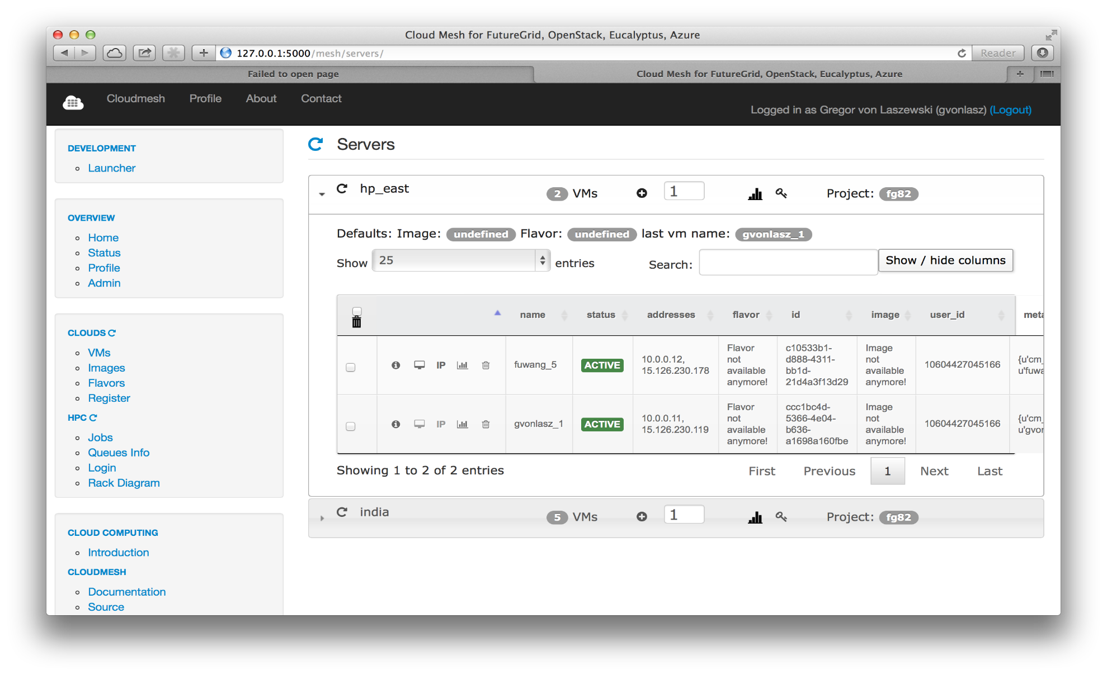
… Working with VMs in Cloudmesh
Search
VMs
Panel with VM Table (HP)

Slide 79
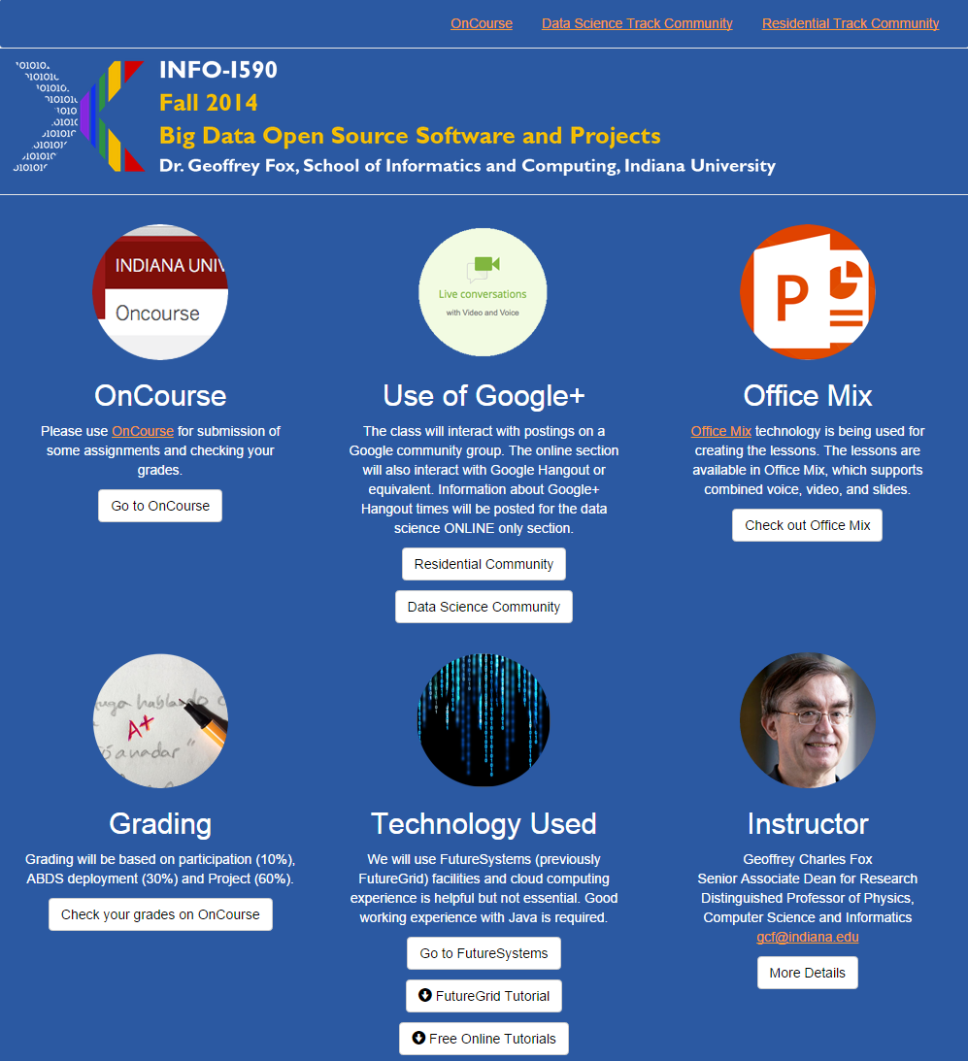
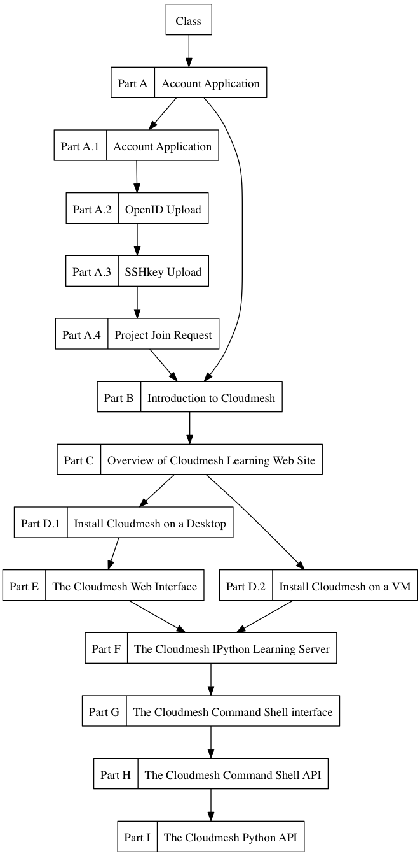
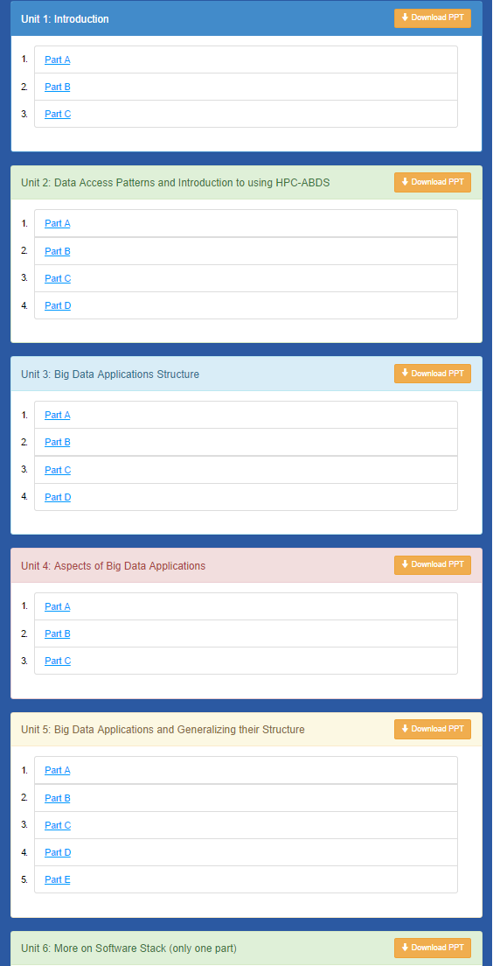
Cloudmesh MOOC Videos

Slide 80
Virtual Clusters On Comet
(Planned)

Slide 81
Comet
Two operational modes
  Traditional batch queuing system
  Virtual cluster based on time sliced reservations
    Virtual compute resources
    Virtual disks
    Virtual network

Slide 82
Layered Extensible Architecture
Allows various access modes
  GUI
  REST
  API
  Has API to also allow 2-tier execution on target host
  Reservation backends and resources can be added
GUI
Command Line & shell
REST
API
API
Reservation Backend
Resource
…
Resource

Slide 83
Usage Example OSG on Comet
  Traditional HPC Workflow:
    Reserve number of nodes on batch queue
    Install condor glidein
    Integrate batch resources into condor
    Use resources facilitated with glidins in condor scheduler
    Adv: can utilize standard resources in HPC queues
  Virtualized Resource Workflow:
    Reserve virtual compute nodes on cluster
    Install regular condor software in the nodes
    Register the nodes with condor
    Use resources in condor scheduler
    Adv:
      does not require glidein
      Possibly reduced effort as no glidein support needs to be considered, the virtual resources behave just like standard condor resources.

Slide 84
Comet High Level Interface (Planned)
Command line
Command shell
  Contains history of previous commands and actions
REST
GUI via JavaScript (so it could be hosted on Web server)

Slide 85
Comet VC commands
(shell and commands)
Based on simplified version of cloudmesh
  Allows one program that delivers a shell and executes commands also in a terminal
  Easy extension of new commands and features into the shell
  Integrated documentation through IEEE docopt standard

Slide 86
Command Shell
  cm comet
  cm> cluster --start=…
  --end=..
  --type=virtual
  --name=myvirtualcluster
  cm> status --name=myvirtualcluster
  cm> delete --name=myvirtualcluster
  cm> history
  cm> quit

Slide 87
Conclusions
Collected 51 use cases; useful although certainly incomplete and biased (to research and against energy for example)
Improved (especially in security and privacy) and available as online form
Identified 50 features called facets divided into 4 sets (views) used to classify applications
Used to derive set of hardware architectures
  Could discuss software (se papers)
Surveyed some benchmarks
Could be used to identify missing benchmarks
  Noted streaming a dominant feature of use cases but not common in benchmarks
Suggested integration of DevOps, Cluster Control, PaaS and workflow to generate software defined systems

