Slide 1
Future Grid User Portal
Marlon Pierce
Indiana University

Slide 2
Future Grid
Portal development team
Marlon Pierce (IU)
Maytal Dahan (TACC)
Sidd Maini (IU)
Patrick Hurley (TACC)
Joshua Rosen (IU)
IU and TACC have collaborated on the NSF funded OGCE project since 2003.
TACC leads the TeraGrid User Portal Development
IU has developed or supported a number of Science Gateways through OGCE and TeraGrid GIG funds.

Slide 3
Established Collaborations Through Components and Services
Component | Description
GPIR Portlets, Gadgets, and Web Services | Information service aggregators.
QBETS Prediction Portlets | Access to batch queue prediction services
Java COG | Programming abstractions for the Grid
File Manager Applet | Interactive interface to GridFTP servers.
Resource Discovery Service, REST Information services | Information services for gateways
XBaya and GFAC | Tools for wrapping applications as services and composing workflows
Proxy management | Cross-portlet Grid proxy support

Slide 4
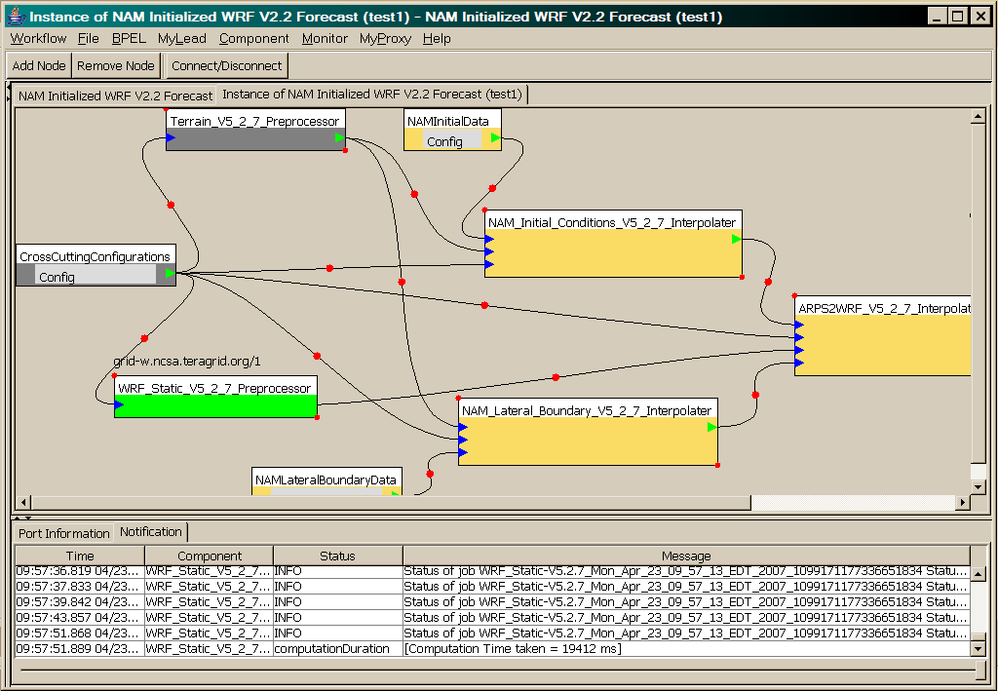
OGCE Workflow Tools Wrap and Execute Codes on the TeraGrid
WRF-Static running on Tungsten

Slide 5
Future Grid Portal Architecture
We will build upon OGCE current activities.
Improved Interactivity
JavaScript COG
Flash/Flex
Improved Portability
Adopt Google Gadgets
Will work with iGoogle, Liferay, Drupal, Mambo, Moodle, Sakai3, etc.
Improved Collaboration
Open Social extensions to gadgets allow us to build social networking applications that leverage existing networks.
Improved Access
Deliver capabilities to wireless devices, phones, etc.

Slide 7
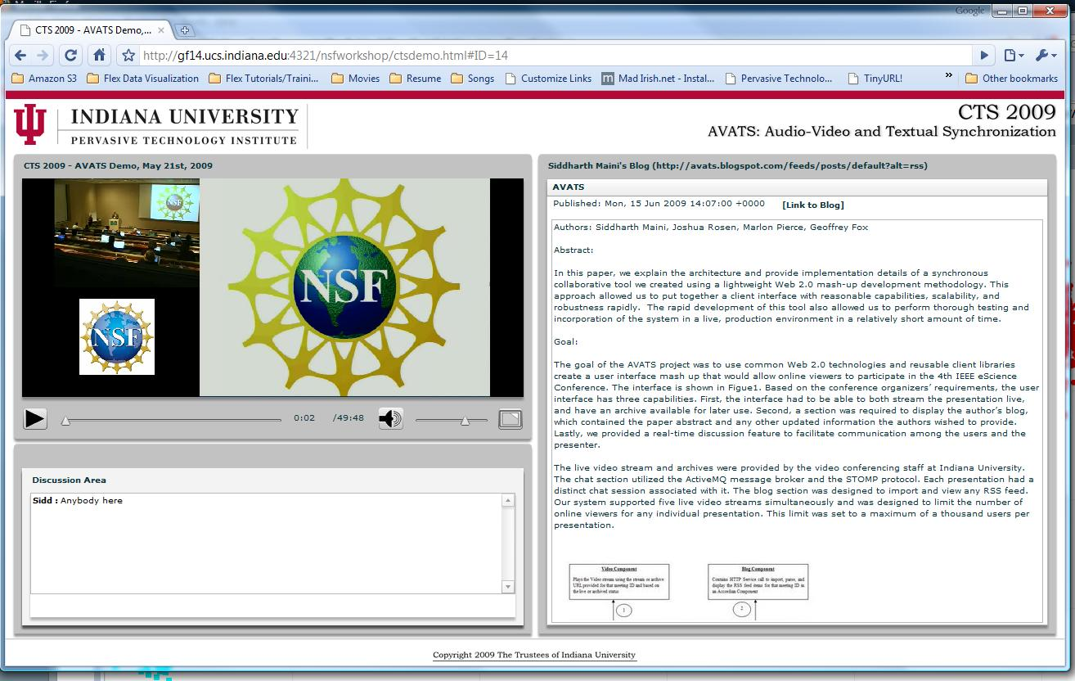
Some Recent Work

Slide 8
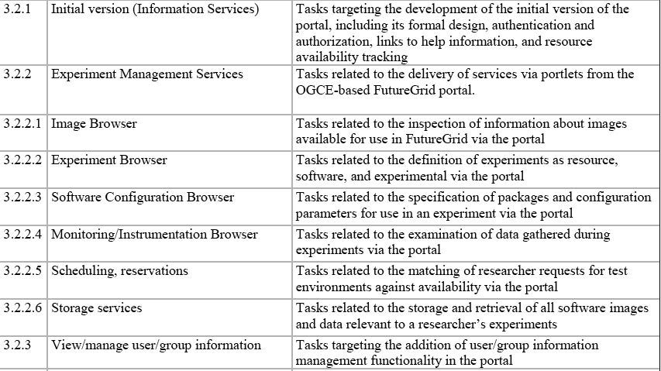
Future Grid Milestones (PEP)

Slide 9
Sample Portal Capabilities
Provide administrative, user, and public views.
Access monitoring and information services.
Access to ticketing and knowledge base systems.
User interfaces to virtual machines, data, and networks
Access to virtual experiment repositories
Manage social networks and virtual organizations of collaborators.

Slide 10
Admin Portal Components

Slide 11
Challenges
Must stay coordinated with infrastructure service providers.
Need to ramp up the user community with immediately useful services.
Need a deliberate pace for adding new features.
Focus on stability and reliability of a few compelling features.
Explore advanced features in synergistic work.

