Slide 1


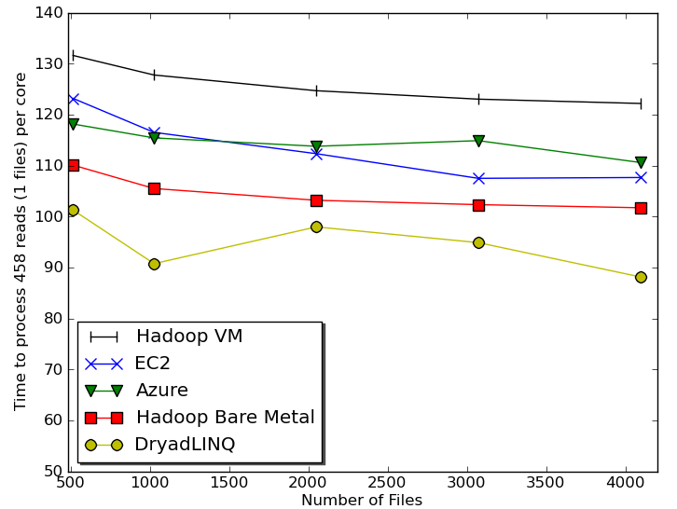
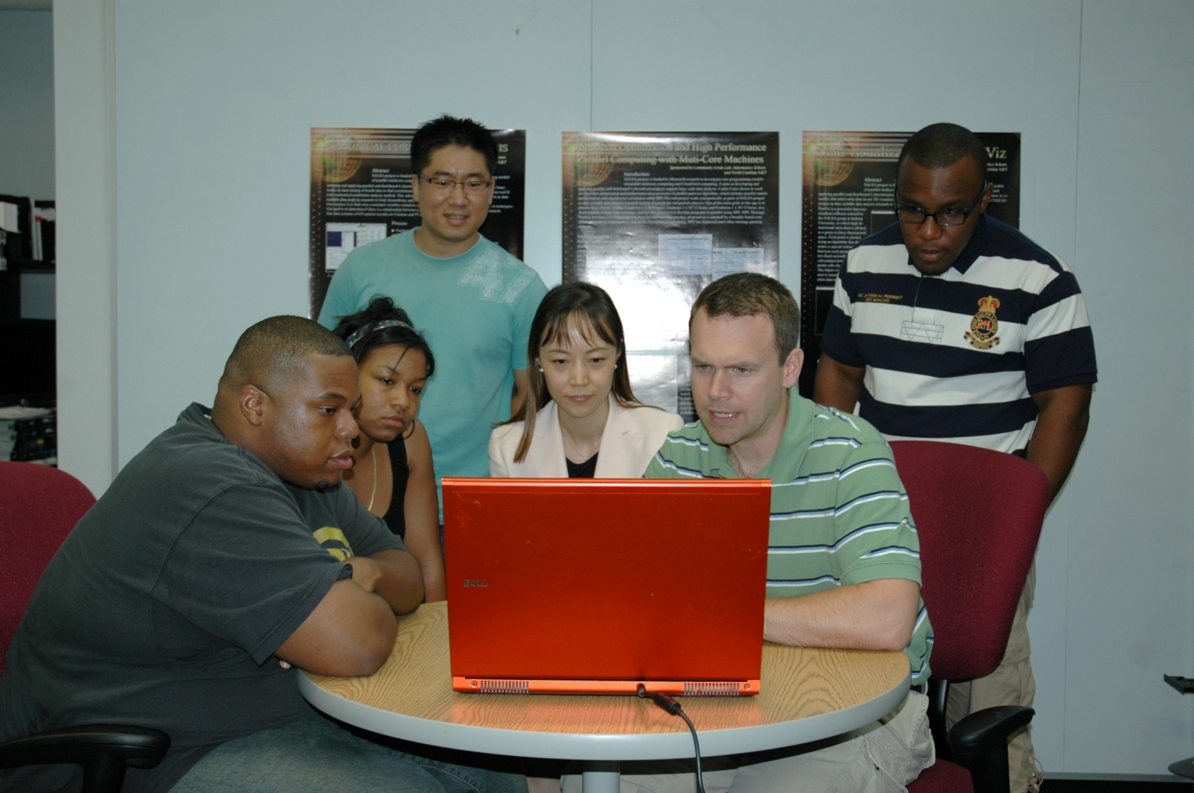


MapReduce and Clouds for Science
http://salsahpc.indiana.edu/
Indiana University Bloomington
Geoffrey Fox, Judy Qiu, SALSA Group
SALSA project (salsahpc.indiana.edu) investigates new programming models of parallel multicore computing and Cloud/Grid computing. It aims at developing and applying parallel and distributed Cyberinfrastructure to support large scale data analysis. We illustrate this with a project for life sciences: clustering for biology Alu and Metagenomics sequences; a study of usability and performance of different Cloud approaches; an iterative MapReduce runtime, Twister, to support complex data analysis algorithms for scientific applications; engagement of undergraduate students in new programming models using Dryad and TPL through class, REU, and Minority outreach programs.
Processing/Visualizing DNA Sequencing Pipeline
Biology MDS and Clustering Results
There is a data deluge throughout science and all areas need analysis pipelines or workflows to propel the data from instruments through various stages to scientific discovery often aided by visualization. It is well known that these pipelines typically offer natural data parallelism that can be implemented within many different frameworks. We chose to look at the MapReduce frameworks as these stem from the commercial information retrieval field which is perhaps currently the world’s most demanding data analysis problem. Exploiting commercial approaches offers a good chance that one can achieve high-quality, robust environments and MapReduce has a mixture of commercial and open source implementations. This figure illustrates results from our research of a pipeline mode to provide services on demand (Software as a Service SaaS) for genomics.
Alu Families
This visualizes results of Alu repeats from Chimpanzee and Human Genomes. Young families (green, yellow) are tight clusters
Metagenomics
This visualizes results of clustering and dimension reduction to 3D of 30000 gene sequences from an environmental sample.
Usability and Performance of Different Cloud/MapReduce Models
We have demonstrated that clouds offer attractive computing paradigms for loosely coupled scientific applications. Higher level models include Dryad and Hadoop which we find are easier to use than EC2 and Azure (less setup and fewer lines of code). The cost effectiveness of cloud data centers combined with the comparable performance reported here suggests that loosely coupled science applications will increasingly be implemented on clouds and that using MapReduce will offer convenient user interfaces with little overhead. Earlier studies have shown that MPI is similar in performance to Hadoop and Dryad.
Undergraduate Research Experiences
Twister(MapReduce++)
supports iterative MapReduce Computations and allows MapReduce to achieve higher performance, perform faster data transfers, and reduce the time it takes to process vast sets of data for data mining and machine learning applications. Open source code supports streaming communication and long running processes
The IU HBCU STEM Summer Scholar Institute is an eight-week program that provides opportunities for minority students to engage in continuous, substantive research and work with researchers of our group on active projects. Funded by NSF, a team of STEM summer scholars from North Carolina A&T has joined Community Grids Lab and involved in research activities with the SALSA project that is funded by Microsoft research.
http://www.iterativemapreduce.org/

