Slide 1


parallel data mining
on multicore clusters
Research Technologies Round Table, Indiana University, December 3 2008
Judy Qiu
xqiu@indiana.edu, http://www.infomall.org/salsa
Research Technologies UITS, Indiana University Bloomington IN
Geoffrey Fox, Seung-Hee Bae, Jong Youl Choi, Jaliya Ekanayake, Yang Ruan
Community Grids Laboratory, Indiana University Bloomington IN
George Chrysanthakopoulos, Henrik Nielsen
Microsoft Research, Redmond WA

Slide 2
Why Data-mining?
What applications can use the 128 cores expected in 2013?
Over same time period real-time and archival data will increase as fast as or faster than computing
  Internet data fetched to local PC or stored in “cloud”
  Surveillance
  Environmental monitors, Instruments such as LHC at CERN, High throughput screening in bio- , chemo-, medical informatics
  Results of Simulations
Intel RMS analysis suggests Gaming and Generalized decision support (data mining) are ways of using these cycles
SALSA is developing a suite of parallel data-mining capabilities: currently
  Clustering with deterministic annealing (DA)
  Mixture Models (Expectation Maximization) with DA
  Metric Space Mapping for visualization and analysis
  Matrix algebra as needed

Slide 3
Intel’s Application Stack

Slide 4
Multicore SALSA Project
Service Aggregated Linked Sequential Activities
We generalize the well known CSP (Communicating Sequential Processes) of Hoare to describe the low level approaches to fine grain parallelism as “Linked Sequential Activities” in SALSA.
We use term “activities” in SALSA to allow one to build services from either threads, processes (usual MPI choice) or even just other services.
We choose term “linkage” in SALSA to denote the different ways of synchronizing the parallel activities that may involve shared memory rather than some form of messaging or communication.
There are several engineering and research issues for SALSA
  There is the critical communication optimization problem area for communication inside chips, clusters and Grids.
  We need to discuss what we mean by services
  The requirements of multi-language support
Further it seems useful to re-examine MPI and define a simpler model that naturally supports threads or processes and the full set of communication patterns needed in SALSA (including dynamic threads).

Slide 5
Considering a Collection of computers
We can have various hardware
  Multicore – Shared memory, low latency
  High quality Cluster – Distributed Memory, Low latency
  Standard distributed system – Distributed Memory, High latency
We can program the coordination of these units by
  Threads on cores
  MPI on cores and/or between nodes
  MapReduce/Hadoop/Dryad../AVS for dataflow
  Workflow linking services
  These can all be considered as some sort of execution unit exchanging messages with some other unit
And there are higher level programming models such as OpenMP, PGAS, HPCS Languages

Slide 6
Data Parallel Run Time Architectures
CCR Ports
Trackers
CCR Ports
Pipes
MPI
Disk HTTP
CCR Ports
Trackers
CCR Ports
Pipes
MPI
Disk HTTP
CCR Ports
Trackers
CCR Ports
Pipes
MPI
Disk HTTP
CCR Ports
Trackers
CCR Ports
Pipes
MPI
Disk HTTP
CGL MapReduce is long running processing with asynchronous distributed
Rendezvous
synchronization
CCR (Multi Threading) uses short or long
running threads communicating via shared memory and
Ports (messages)
Microsoft DRYAD
uses short running processes communicating via pipes, disk or shared memory between cores
MPI is long running processes with Rendezvous for message exchange/
synchronization
CCR (Multi Threading) uses short or long
running threads communicating via shared memory and
Ports (messages)
Yahoo Hadoop uses short running processes communicating via disk and tracking processes

Slide 7
Status of SALSA Project
Status: is developing a suite of parallel data-mining capabilities: currently
  Clustering with deterministic annealing (DA)
  Mixture Models (Expectation Maximization) with DA
  Metric Space Mapping for visualization and analysis
  Matrix algebra as needed
Results: currently
  On a multicore machine (mainly thread-level parallelism)
    Microsoft CCR supports “MPI-style “ dynamic threading and via .Net provides a DSS a service model of computing;
    Detailed performance measurements with Speedups of 7.5 or above on 8-core systems for “large problems” using deterministic annealed (avoid local minima) algorithms for clustering, Gaussian Mixtures, GTM (dimensional reduction) etc.
  Extension to multicore clusters (process-level parallelism)
    MPI.Net provides C# interface to MS-MPI on windows cluster
    Initial performance results show linear speedup on up to 8 nodes dual core clusters
  Collaboration:
SALSA Team
Geoffrey Fox
Xiaohong Qiu
Seung-Hee Bae
Hong Youl Choi
Jaliya Ekanayake,
Yang Ruan
Indiana University
Application Collaboration
Cheminformatics
Rajarshi Guha, David Wild
Bioinformatics
Haiku Tang, Mina Rho
IU Medical School
Gilbert Liu, Shawn Hoch
Demographics (GIS)
Neil Devadasan
Technology Collaboration
George Chrysanthakopoulos
Henrik Frystyk Nielsen
Microsoft Research

Slide 8
MPI-CCR model
Distributed memory systems have shared memory nodes
(today multicore) linked by a messaging network
CCR
CCR
CCR
CCR
Core
Core
Core
Core
Core
Core
Core
Core
Cache
Cache
Cache
Cache
L2 Cache
Dataflow
L2 Cache
L2 Cache
L2 Cache
L3 Cache
L3 Cache
L3 Cache
L3 Cache
Main
Memory
Main
Memory
Main
Memory
Main
Memory
Cluster 1
MPI
Cluster 2
MPI
Cluster 3
Cluster 4
Interconnection Network
“Dataflow” or Events
DSS/Mash up/Workflow

Slide 9
Services vs. Micro-parallelism
Micro-parallelism uses low latency CCR threads or MPI processes
Services can be used where loose coupling natural
  Input data
  Algorithms
    PCA
    DAC GTM GM DAGM DAGTM – both for complete algorithm and for each iteration
    Linear Algebra used inside or outside above
    Metric embedding MDS, Bourgain, Quadratic Programming ….
    HMM, SVM ….
  User interface: GIS (Web map Service) or equivalent

Slide 10
Parallel Programming Strategy
“Main Thread” and Memory M
MPI/CCR/DSS
From other nodes
MPI/CCR/DSS
From other nodes
0
m₀
1
m₁
2
m₂
3
m₃
4
m₄
5
m₅
6
m₆
7
m₇
Subsidiary threads t with memory m_{t}
Use Data Decomposition as in classic distributed memory but use shared memory for read variables. Each thread uses a “local” array for written variables to get good cache performance
Multicore and Cluster use same parallel algorithms but different runtime implementations; algorithms are
        Accumulate matrix and vector elements in each process/thread
        At iteration barrier, combine contributions (MPI_Reduce)
        Linear Algebra (multiplication, equation solving, SVD)

Slide 11
Runtime System Used
micro-parallelism
  Microsoft CCR (Concurrency and Coordination Runtime)
    supports both MPI rendezvous and dynamic (spawned) threading style of parallelism
    has fewer primitives than MPI but can implement MPI collectives with low latency threads
    http://msdn.microsoft.com/robotics/
  MPI.Net
    a C# wrapper around MS-MPI implementation (msmpi.dll)
    supports MPI processes
    parallel C# programs can run on windows clusters
    http://www.osl.iu.edu/research/mpi.net/
macro-paralelism (inter-service communication)
  Microsoft DSS (Decentralized System Services) built in terms of CCR for service model
  Mash up
  Workflow (Grid)

Slide 12
General Formula DAC GM GTM DAGTM DAGM
N data points E(x) in D dimensions space and minimize F by EM
  Deterministic Annealing Clustering (DAC)
F is Free Energy
EM is well known expectation maximization method
p(x) with Σ p(x) =1
T is annealing temperature varied down from ∞ with final value of 1
Determine cluster center Y(k) by EM method
K (number of clusters) starts at 1 and is incremented by algorithm

Slide 13
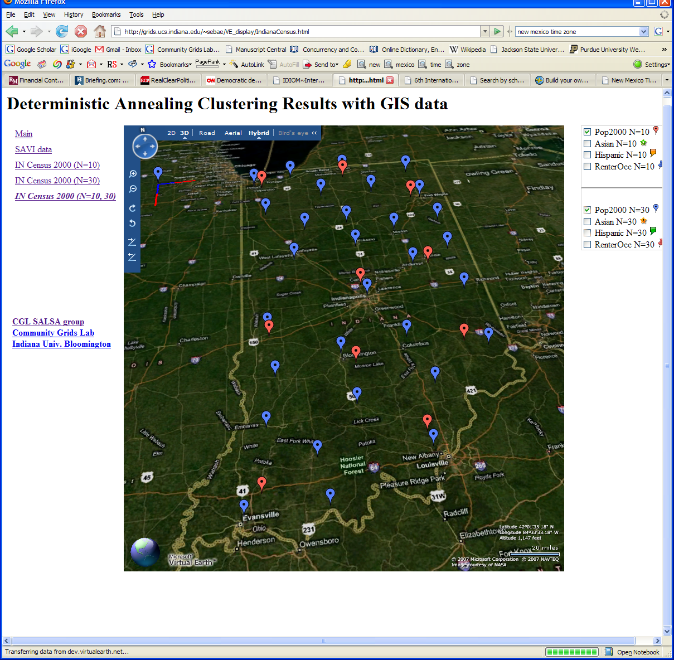
Deterministic Annealing Clustering of Indiana Census Data
Decrease temperature (distance scale) to discover more clusters

Slide 14
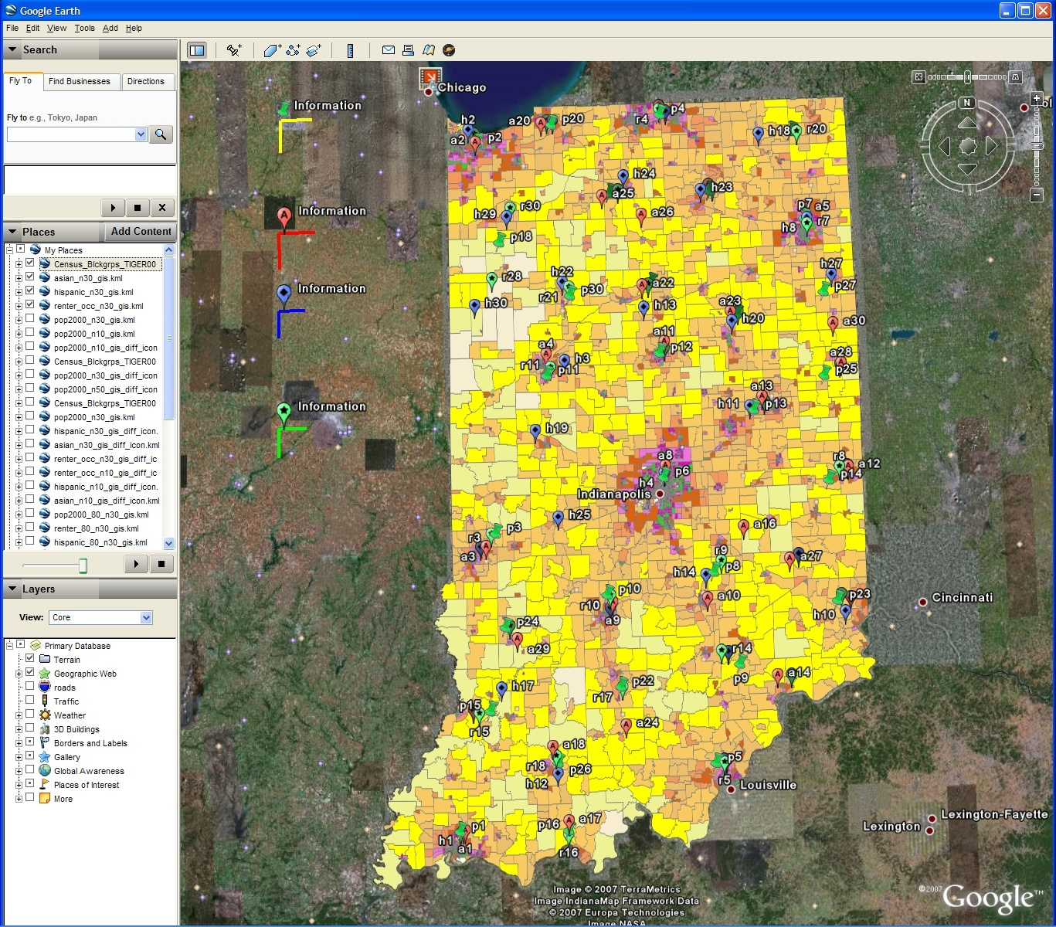
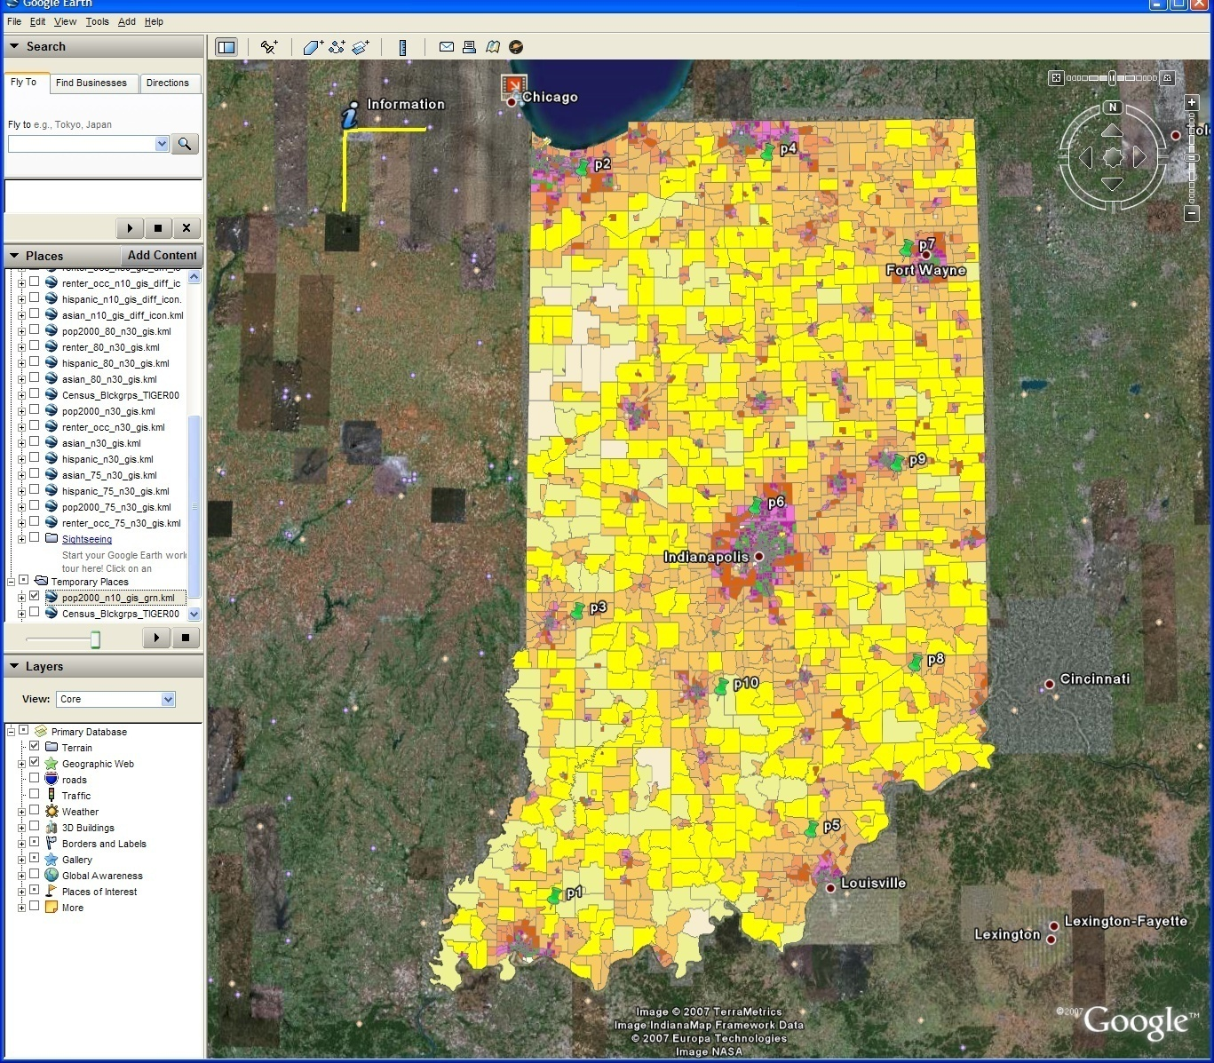
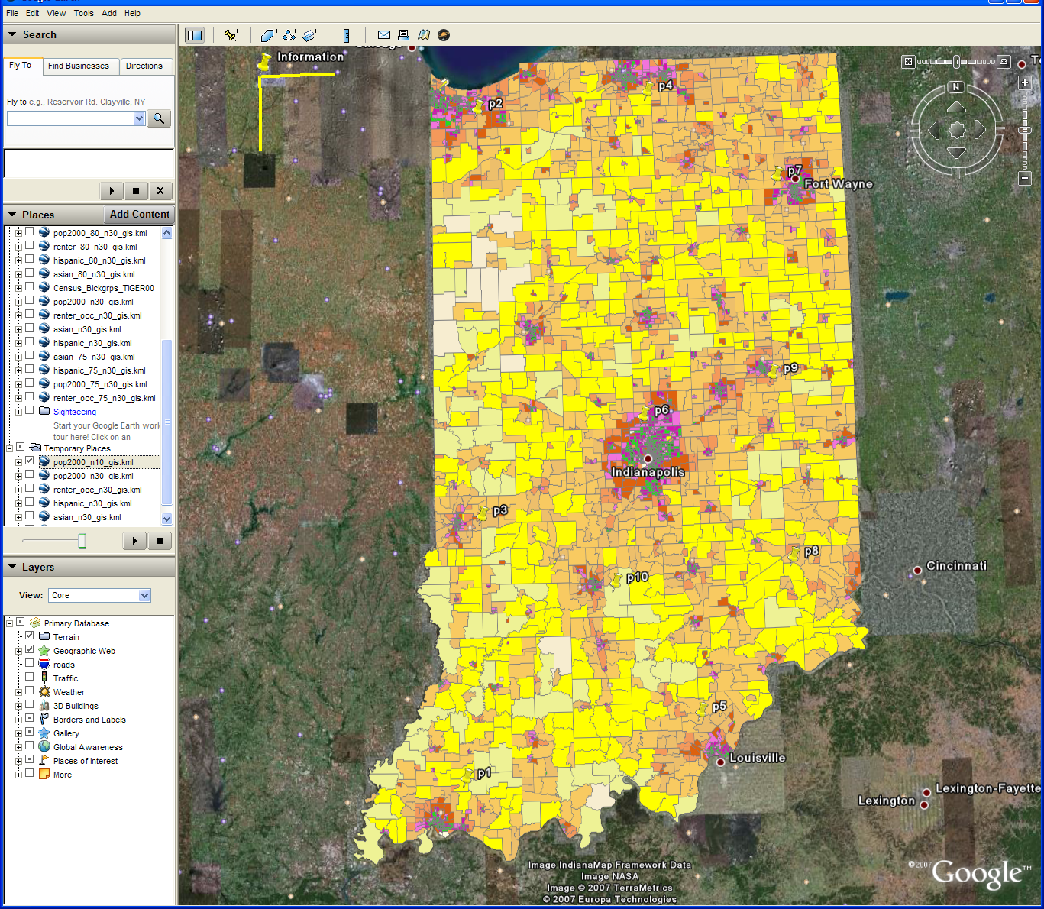
Changing resolution of GIS Clutering
Total
Asian
Hispanic
Renters
GIS Clustering
30 Clusters
30 Clusters
10 Clusters

Slide 15
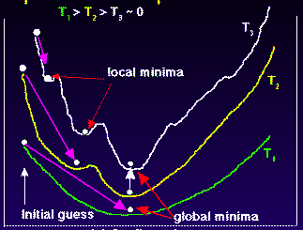
Deterministic
Annealing
F({Y}, T)
Solve Linear Equations for each temperature
Nonlinearity removed by approximating with solution at previous higher temperature
Configuration {Y}
Minimum evolving as temperature decreases
Movement at fixed temperature going to local minima if not initialized “correctly”

Slide 16

N data points E(x) in D dim. space and Minimize F by EM
  Deterministic Annealing Clustering (DAC)
  Generative Topographic Mapping (GTM)
  Deterministic Annealing Gaussian
  Mixture models (DAGM)
  Traditional Gaussian
  mixture models GM
a(x) = 1/N or generally p(x) with Σ p(x) =1
g(k)=1 and s(k)=0.5
T is annealing temperature varied down from ∞ with final value of 1
Vary cluster center Y(k) but can calculate weight P_{k} and correlation matrix s(k) = σ(k)² (even for matrix σ(k)²) using IDENTICAL formulae for Gaussian mixtures
K starts at 1 and is incremented by algorithm
a(x) = 1 and g(k) = (1/K)(β/2π)^{D/2}
s(k) = 1/ β and T = 1
Y(k) = Σ_{m=1}^{M} W_{m}φ_{m}(X(k))
Choose fixed φ_{m}(X) = exp( - 0.5 (X-μ_{m})²/σ² )
Vary W_{m} and β but fix values of M and K a priori
Y(k) E(x) W_{m} are vectors in original high D dimension space
X(k) and μ_{m} are vectors in 2 dimensional mapped space
As DAGM but set T=1 and fix K
a(x) = 1
g(k)={P_{k}/(2πσ(k)²)^{D/2}}^{1/T}
s(k)= σ(k)² (taking case of spherical Gaussian)
T is annealing temperature varied down from ∞ with final value of 1
Vary Y(k) P_{k} and σ(k)
K starts at 1 and is incremented by algorithm
  DAGTM: Deterministic Annealed
  Generative Topographic Mapping
GTM has several natural annealing versions based on either DAC or DAGM: under investigation
SALSA
Notes:
16

Slide 17
Parallel Multicore
Deterministic Annealing Clustering
Parallel Overhead
on 8 Threads Intel 8b
Speedup = 8/(1+Overhead)
10 Clusters
Overhead = Constant1 + Constant2/n
Constant1 = 0.05 to 0.1 (Client Windows) due to
thread runtime fluctuations
20 Clusters
10000/(Grain Size n = points per core)

Slide 18
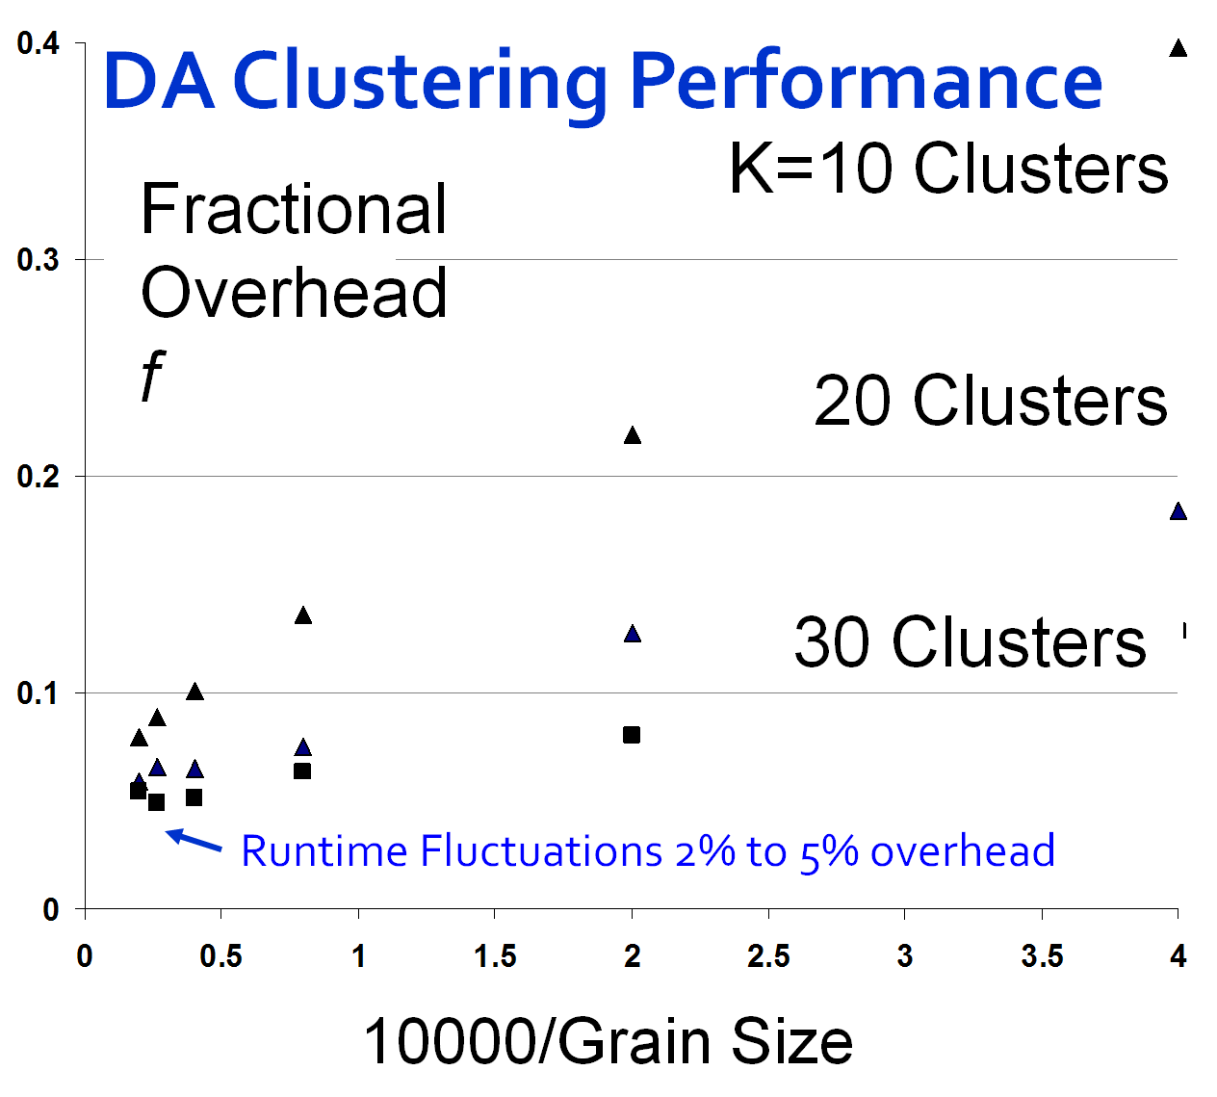
Speedup = Number of cores/(1+f)
f = (Sum of Overheads)/(Computation per core)
Computation ∝ Grain Size n . # Clusters K
Overheads are
Synchronization: small with CCR
Load Balance: good
Memory Bandwidth Limit: → 0 as K → ∞
Cache Use/Interference: Important
Runtime Fluctuations: Dominant large n, K
All our “real” problems have f ≤ 0.05 and
speedups on 8 core systems greater than 7.6
SALSA
Notes:
18

Slide 19

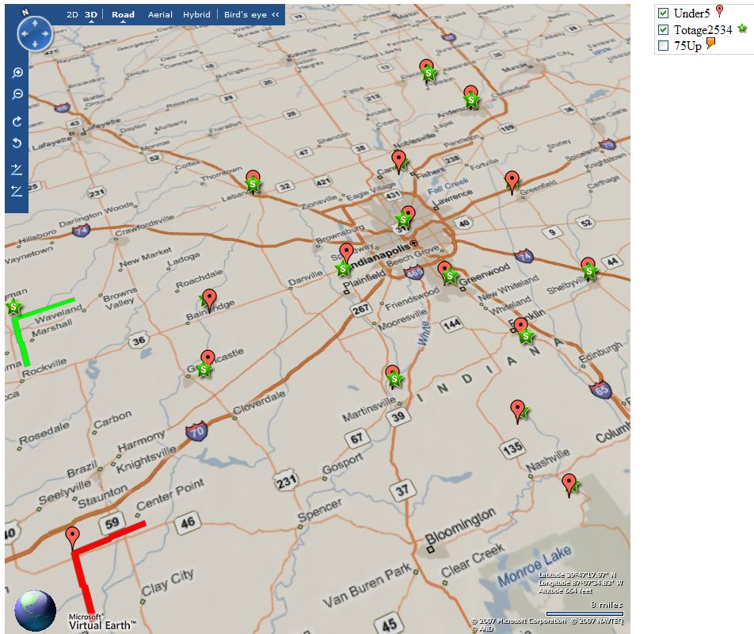

Slide 20
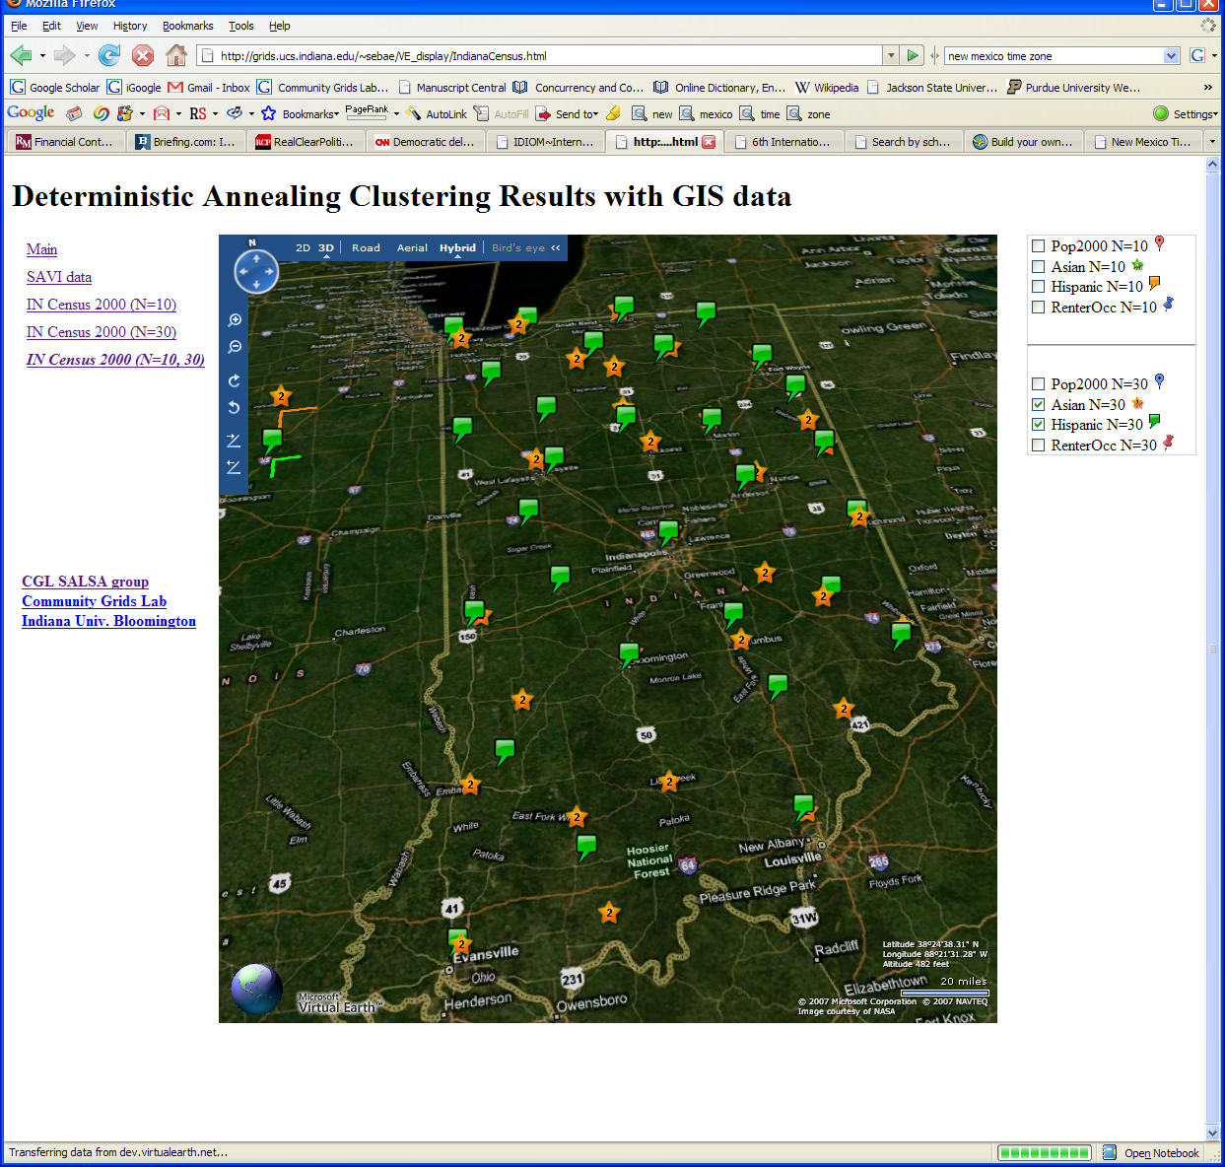

Slide 21
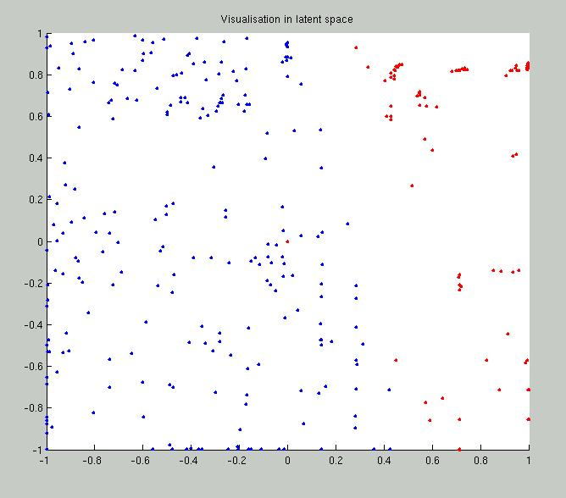
2 Clusters of Chemical Compounds in 155 Dimensions Projected into 2D
Deterministic Annealing for Clustering of 335 compounds
Method works on much larger sets but choose this as answer known
GTM (Generative Topographic Mapping) used for mapping 155D to 2D latent space
Much better than PCA (Principal Component Analysis) or SOM (Self Organizing Maps)

Slide 22
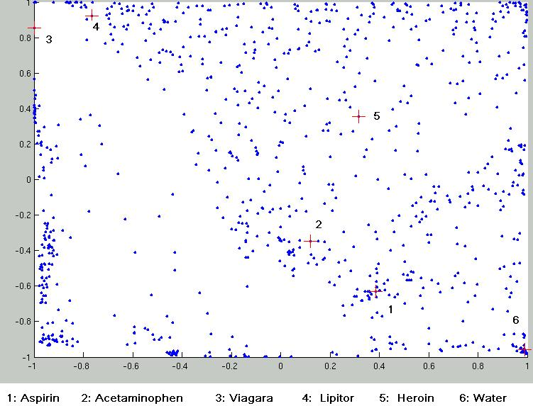
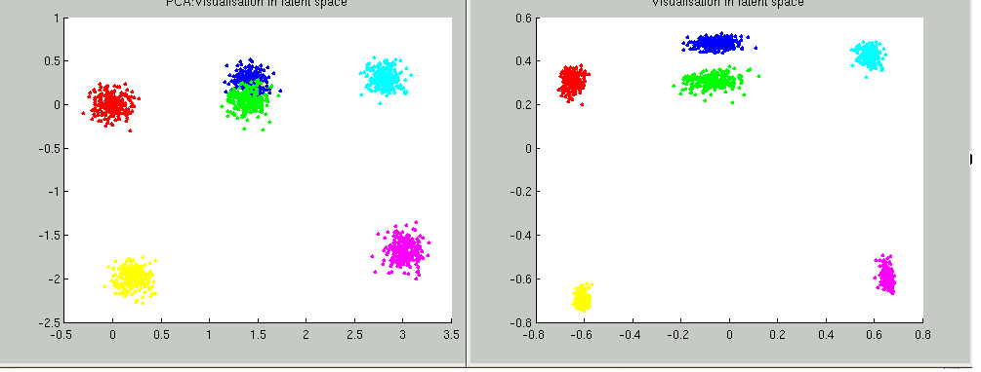
Parallel Generative Topographic Mapping GTM
Reduce dimensionality preserving topology and perhaps distances
Here project to 2D
GTM Projection of PubChem: 10,926,94 0compounds in 166 dimension binary property space takes 4 days on 8 cores. 64X64 mesh of GTM clusters interpolates PubChem. Could usefully use 1024 cores! David Wild will use for GIS style 2D browsing interface to chemistry
PCA
GTM
Linear PCA v. nonlinear GTM on 6 Gaussians in 3D
PCA is Principal Component Analysis
GTM Projection of 2 clusters
of 335 compounds in 155
dimensions
SALSA

Slide 23
Deterministic Annealing Clustering
Scaled Speedup Tests on 4 8-core Systems
1,600,000 points per C# thread
1, 2, 4. 8, 16, 32-way parallelism
On Windows
Parallel
Overhead
≈ 1-efficiency
= (PT(P)/T(1)-1)
On P processors
= (1/efficiency)-1
32-way
16-way
2-way
8-way
4-way
Nodes
1 2 1 1 4 2 1 2 1 1 4 2 1 4 2 1 2 1 1 4 2 4 2 4 2 2 4 4 4 4
MPI Processes per Node
1 1 2 1 1 2 4 1 2 1 2 4 8 1 2 4 1 2 1 4 8 2 4 1 2 1 8 4 2 1
CCR Threads per Process
1 1 1 2 1 1 1 2 2 4 1 1 1 2 2 2 4 4 8 1 1 2 2 4 4 8 1 2 4 8

Slide 24
Deterministic Annealing for Pairwise Clustering
Clustering is a well known data mining algorithm with K-means best known approach
Two ideas that lead to new supercomputer data mining algorithms
Use deterministic annealing to avoid local minima
Do not use vectors that are often not known – use distances δ(i,j) between points i, j in collection – N=millions of points are available in Biology; algorithms go like N² . Number of clusters
Developed (partially) by Hofmann and Buhmann in 1997 but little or no application
Minimize H_{PC} = 0.5 ∑_{i=1}^{N} ∑_{j=1}^{N} δ(i, j) ∑_{k=1}^{K} M_{i}(k) M_{j}(k) / C(k)
M_{i}(k) is probability that point i belongs to cluster k
C(k) = ∑_{i=1}^{N} M_{i}(k) is number of points in k’th cluster
M_{i}(k) ∝ exp( -ε_{i}(k)/T ) with Hamiltonian ∑_{i=1}^{N} ∑_{k=1}^{K} M_{i}(k) ε_{i}(k)
Reduce T from large to small values to anneal

Slide 25
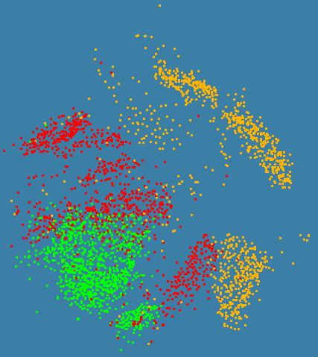
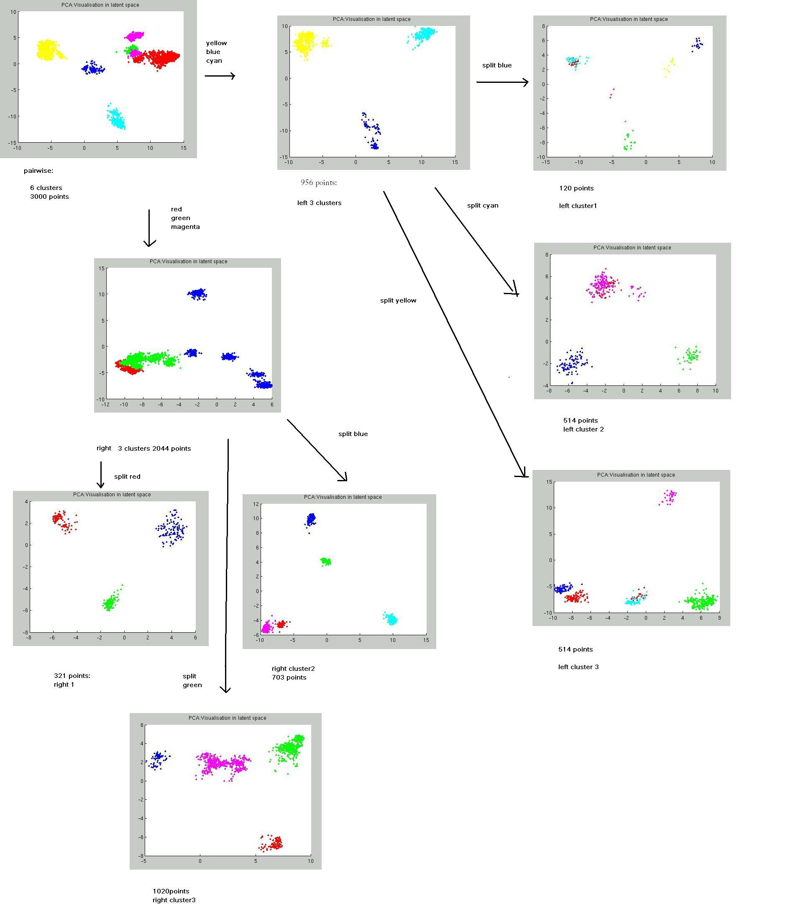
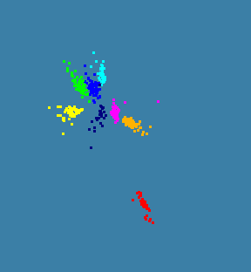
N=3000 sequences each length ~1000 features
Only use pairwise distances will repeat with 0.1 to 0.5 million sequences with a larger machine
C# with CCR and MPI
CLUSTAL W (1.83) multiple sequence alignment
chr3_4579922_4580207_+_AluJb ------------GGT---GTCA-------CACCT------GTAA--TCC-
chr3_7089087_7089393_+_AluJb GGCCAGGTGTTGTGG---CTCA-------TGCCT------GTTA--TCC-
chr3_4526196_4526492_+_AluJb --CCAGGTGT--GGT-GGCTCA-------TGCCT------GTAA--TTC-
chr3_4798388_4798673_+_AluJb ---CAGGTGC--AGT-GGCTCA-------CACCT------GTAA--TTG-
chr3_12851657_12851916_+_AluJb ---------------------A-------TGCCT------GTAA--TCC-
chr3_13105802_13106091_+_AluJb ----GGGAGC--ACT-AGCCCA-------TGCCT------GTAA--TAT-
chr3_4875875_4876179_+_AluJb ---CAGGTGC--AGT-GGTTCA-------TGCCG------ACAA--TCC-
chr3_4899657_4899970_+_AluJb GACCAGGTGT--GGT-GGC-------TCATACCT------ATAA--TCC-

Slide 26
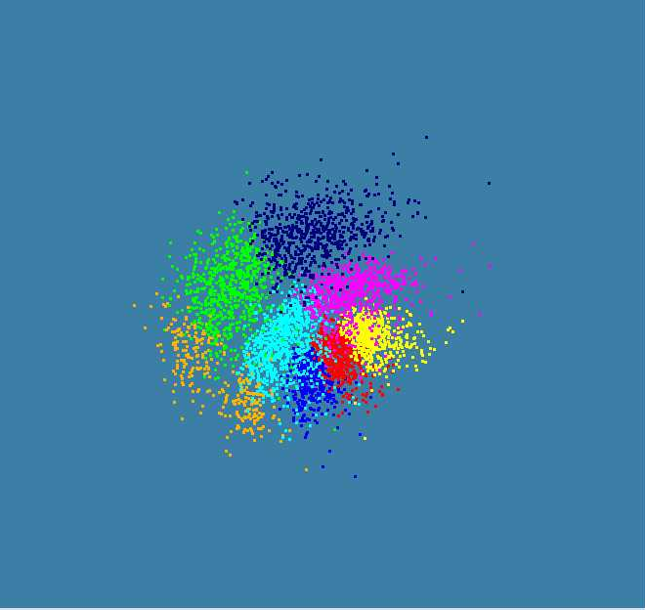
4500 Points Pairwise Annealing with distances determined pairwise

Slide 27
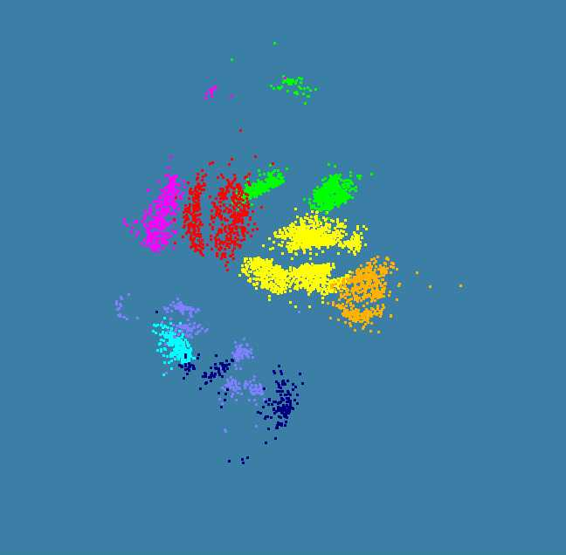
Same ALU Sequences with all sequences aligned with Clustal W (Multiple Alignment)

Slide 28
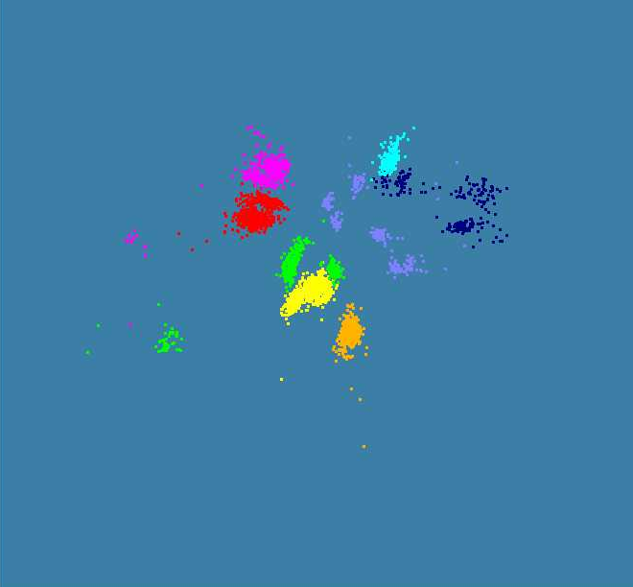
Same ALU Sequences with all sequences aligned with Clustal W (Multiple Alignment)
Distances scaled before visualization to correspond to
effective dimension of 4
Original effective dimension 20

Slide 29
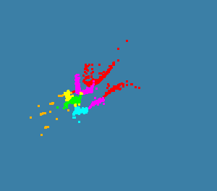
Childhood Obesity Patient Database
2000 records
6 Clusters
Will use our 8 node system to run 36,000 records
Working with IU Medical School to map patient clusters to environmental factors

Slide 30

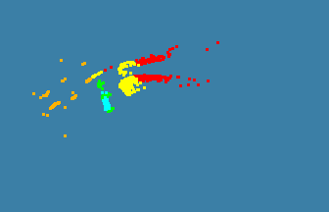
Childhood Obesity Patient Database
4000 records
8 Clusters
Will use our 8 node system to run 36,000 records
Working with IU Medical School to map patient clusters to environmental factors
Refinement of 3 clusters above into 5

Slide 31
MPI outside the mainstream
Multicore best practice and large scale distributed processing not scientific computing will drive best concurrent/parallel computing environments
Party Line Parallel Programming Model: Workflow (parallel--distributed) controlling optimized library calls
  Core parallel implementations no easier than before; deployment is easier
MPI is wonderful but it will be ignored in real world unless simplified; competition from thread and distributed system technology
CCR from Microsoft – only ~7 primitives – is one possible commodity multicore driver
  It is roughly active messages
  Runs MPI style codes fine on multicore

Slide 32
Deterministic Annealing for Pairwise Clustering
Clustering is a well known data mining algorithm with K-means best known approach
Two ideas that lead to new supercomputer data mining algorithms
Use deterministic annealing to avoid local minima
Do not use vectors that are often not known – use distances δ(i,j) between points i, j in collection – N=millions of points are available in Biology; algorithms go like N² . Number of clusters
Developed (partially) by Hofmann and Buhmann in 1997 but little or no application
Minimize H_{PC} = 0.5 ∑_{i=1}^{N} ∑_{j=1}^{N} δ(i, j) ∑_{k=1}^{K} M_{i}(k) M_{j}(k) / C(k)
M_{i}(k) is probability that point i belongs to cluster k
C(k) = ∑_{i=1}^{N} M_{i}(k) is number of points in k’th cluster
M_{i}(k) ∝ exp( -ε_{i}(k)/T ) with Hamiltonian ∑_{i=1}^{N} ∑_{k=1}^{K} M_{i}(k) ε_{i}(k)
Reduce T from large to small values to anneal

Slide 33
MPI Exchange Latency in μs
(20-30 computation between messaging)
Machine | OS | Runtime | Grains | Parallelism | MPI Exchange Latency (µs)
Intel8c:gf12 (8 core 2.33 Ghz) (in 2 chips) | Redhat | MPJE (Java) | Process | 8 | 181
 |  | MPICH2 (C) | Process | 8 | 40.0
 |  | MPICH2: Fast | Process | 8 | 39.3
 |  | Nemesis | Process | 8 | 4.21
Intel8c:gf20 (8 core 2.33 Ghz) | Fedora | MPJE | Process | 8 | 157
 |  | mpiJava | Process | 8 | 111
 |  | MPICH2 | Process | 8 | 64.2
Intel8b (8 core 2.66 Ghz) | Vista | MPJE | Process | 8 | 170
 | Fedora | MPJE | Process | 8 | 142
 | Fedora | mpiJava | Process | 8 | 100
 | Vista | CCR (C#) | Thread | 8 | 20.2
AMD4 (4 core 2.19 Ghz) | XP | MPJE | Process | 4 | 185
 | Redhat | MPJE | Process | 4 | 152
 |  | mpiJava | Process | 4 | 99.4
 |  | MPICH2 | Process | 4 | 39.3
 | XP | CCR | Thread | 4 | 16.3
Intel4 (4 core 2.8 Ghz) | XP | CCR | Thread | 4 | 25.8

Slide 34
CCR Overhead for a computation of 23.76 µs between messaging
Intel8b: 8 Core |  | Number of Parallel Computations
(μs) |  | 1 | 2 | 3 | 4 | 7 | 8
Spawned | Pipeline | 1.58 | 2.44 | 3 | 2.94 | 4.5 | 5.06
 | Shift |  | 2.42 | 3.2 | 3.38 | 5.26 | 5.14
 | Two Shifts |  | 4.94 | 5.9 | 6.84 | 14.32 | 19.44
 | Pipeline | 2.48 | 3.96 | 4.52 | 5.78 | 6.82 | 7.18
 | Shift |  | 4.46 | 6.42 | 5.86 | 10.86 | 11.74
 | Exchange As Two Shifts |  | 7.4 | 11.64 | 14.16 | 31.86 | 35.62
 | Exchange |  | 6.94 | 11.22 | 13.3 | 18.78 | 20.16
Rendezvous
MPI

Slide 35
Time Microseconds
Stages (millions)
Overhead (latency) of AMD4 PC with 4 execution threads on MPI style Rendezvous Messaging for Shift and Exchange implemented either as two shifts or as custom CCR pattern

Slide 36
Time Microseconds
Stages (millions)
Overhead (latency) of Intel8b PC with 8 execution threads on MPI style Rendezvous Messaging for Shift and Exchange implemented either as two shifts or as custom CCR pattern

Slide 37
Cache Line Interference
Implementations of our clustering algorithm showed large fluctuations due to the cache line interference effect (false sharing)
We have one thread on each core each calculating a sum of same complexity storing result in a common array A with different cores using different array locations
Thread i stores sum in A(i) is separation 1 – no memory access interference but cache line interference
Thread i stores sum in A(X*i) is separation X
Serious degradation if X < 8 (64 bytes) with Windows
  Note A is a double (8 bytes)
  Less interference effect with Linux – especially Red Hat

Slide 38
Cache Line Interface
Note measurements at a separation X of 8 and X=1024 (and values between 8 and 1024 not shown) are essentially identical
Measurements at 7 (not shown) are higher than that at 8 (except for Red Hat which shows essentially no enhancement at X<8)
As effects due to co-location of thread variables in a 64 byte cache line, align the array
with cache boundaries

Slide 39
8 Node 2-core Windows Cluster: CCR & MPI.NET
Execution Time ms
Label | ||ism | MPI | CCR | Nodes
1 | 16 | 8 | 2 | 8
2 | 8 | 4 | 2 | 4
3 | 4 | 2 | 2 | 2
4 | 2 | 1 | 2 | 1
5 | 8 | 8 | 1 | 8
6 | 4 | 4 | 1 | 4
7 | 2 | 2 | 1 | 2
8 | 1 | 1 | 1 | 1
9 | 16 | 16 | 1 | 8
10 | 8 | 8 | 1 | 4
11 | 4 | 4 | 1 | 2
12 | 2 | 2 | 1 | 1
Run label
2 CCR Threads 1 Thread 2 MPI Processes per node
8 4 2 1 8 4 2 1 8 4 2 1 nodes
Parallel Overhead f
Scaled Speed up: Constant data points per parallel unit (1.6 million points)
Speed-up = ||ism P/(1+f)
f = PT(P)/T(1) - 1
≈ 1- efficiency
Cluster of Intel Xeon CPU (2 cores) 3050@2.13GHz 2.00 GB of RAM
Run label

Slide 40
1 Node 4-core Windows Opteron: CCR & MPI.NET
Execution Time ms
Label | ||ism | MPI | CCR | Nodes
1 | 4 | 1 | 4 | 1
2 | 2 | 1 | 2 | 1
3 | 1 | 1 | 1 | 1
4 | 4 | 2 | 2 | 1
5 | 2 | 2 | 1 | 1
6 | 4 | 4 | 1 | 1
Run label
Scaled Speed up: Constant data points per parallel unit (0.4 million points)
Speed-up = ||ism P/(1+f)
f = PT(P)/T(1) - 1
≈ 1- efficiency
MPI uses REDUCE, ALLREDUCE (most used) and BROADCAST
AMD Opteron (4 cores) Processor 275 @ 2.19GHz 4 .00 GB of RAM
Parallel Overhead f
Run label

Slide 41
Overhead versus Grain Size
Speed-up = (||ism P)/(1+f) Parallelism P = 16 on experiments here
f = PT(P)/T(1) - 1 ≈ 1- efficiency
Fluctuations serious on Windows
We have not investigated fluctuations directly on clusters where synchronization between nodes will make more serious
MPI somewhat better performance than CCR; probably because multi threaded implementation has more fluctuations
Need to improve initial results with averaging over more runs
8 MPI Processes
2 CCR threads per process
Parallel Overhead f
16 MPI Processes
100000/Grain Size(data points per parallel unit)

Slide 42
Why is Speed up not = # cores/threads?
Synchronization Overhead
Load imbalance
  Or there is no good parallel algorithm
Cache impacted by multiple threads
Memory bandwidth needs increase proportionally to number of threads
Scheduling and Interference with O/S threads
  Including MPI/CCR processing threads
  Note current MPI’s not well designed for multi-threaded problems

Slide 43
Issues and Futures
This class of data mining does/will parallelize well on current/future multicore nodes
The MPI-CCR model is an important extension that take s CCR in multicore node to cluster
  brings computing power to a new level (nodes * cores)
  bridges the gap between commodity and high performance computing systems
Several engineering issues for use in large applications
  Need access to a 32~ 128 node Windows cluster
  MPI or cross-cluster CCR?
  Service model to integrate modules
  Need high performance linear algebra for C# (PLASMA from UTenn)
    Access linear algebra services in a different language?
  Need equivalent of Intel C Math Libraries for C# (vector arithmetic – level 1 BLAS)
Current work is more applications; refine current algorithms such as DAGTM
  Clustering with pairwise distances but no vector spaces
  MDS Dimensional Scaling with EM-like SMACOF and deterministic annealing
Future work is new parallel algorithms
  Support use of Newton’s Method (Marquardt’s method) as EM alternative
  Later HMM and SVM
  Bourgain Random Projection for metric embedding

Slide 44
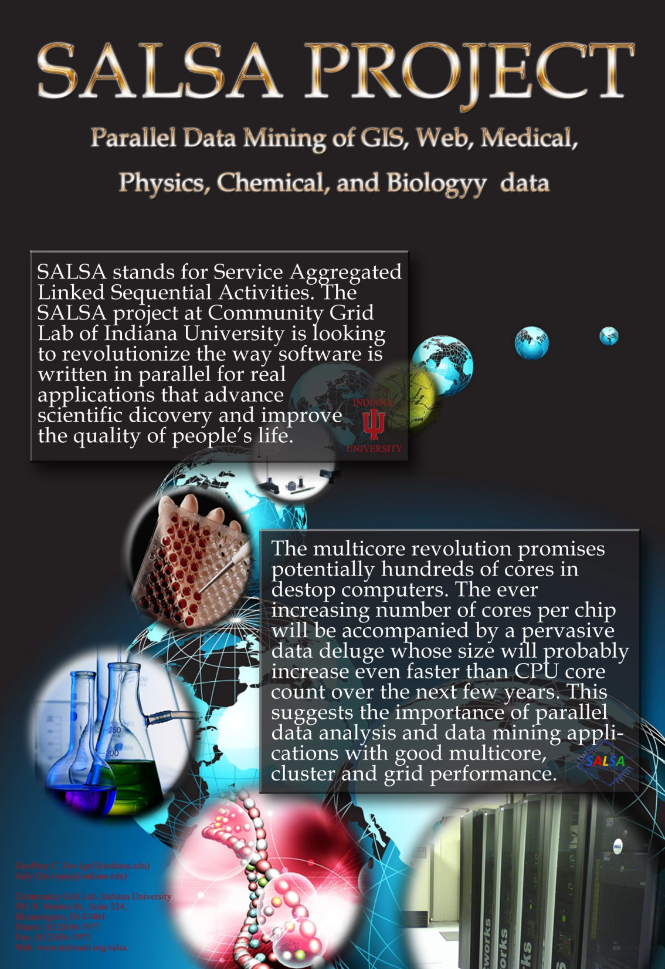
www.infomall.org/SALSA

