Slide 1


parallel data mining
on multicore clusters
International Conference on Computational Science June 23-25 2008 Kraków, Poland
Judy Qiu
xqiu@indiana.edu, http://www.infomall.org/salsa
Research Computing UITS, Indiana University Bloomington IN
Geoffrey Fox, Huapeng Yuan, Seung-Hee Bae
Community Grids Laboratory, Indiana University Bloomington IN
George Chrysanthakopoulos, Henrik Nielsen
Microsoft Research, Redmond WA

Slide 2
Why Data-mining?
What applications can use the 128 cores expected in 2013?
Over same time period real-time and archival data will increase as fast as or faster than computing
  Internet data fetched to local PC or stored in “cloud”
  Surveillance
  Environmental monitors, Instruments such as LHC at CERN, High throughput screening in bio- and chemo-informatics
  Results of Simulations
Intel RMS analysis suggests Gaming and Generalized decision support (data mining) are ways of using these cycles
SALSA is developing a suite of parallel data-mining capabilities: currently
  Clustering with deterministic annealing (DA)
  Mixture Models (Expectation Maximization) with DA
  Metric Space Mapping for visualization and analysis
  Matrix algebra as needed

Slide 3
Multicore SALSA Project
Service Aggregated Linked Sequential Activities
We generalize the well known CSP (Communicating Sequential Processes) of Hoare to describe the low level approaches to fine grain parallelism as “Linked Sequential Activities” in SALSA.
We use term “activities” in SALSA to allow one to build services from either threads, processes (usual MPI choice) or even just other services.
We choose term “linkage” in SALSA to denote the different ways of synchronizing the parallel activities that may involve shared memory rather than some form of messaging or communication.
There are several engineering and research issues for SALSA
  There is the critical communication optimization problem area for communication inside chips, clusters and Grids.
  We need to discuss what we mean by services
  The requirements of multi-language support
Further it seems useful to re-examine MPI and define a simpler model that naturally supports threads or processes and the full set of communication patterns needed in SALSA (including dynamic threads).

Slide 4
MPI-CCR model
Distributed memory systems have shared memory nodes
(today multicore) linked by a messaging network
CCR
CCR
CCR
CCR
Core
Core
Core
Core
Core
Core
Core
Core
Cache
Cache
Cache
Cache
L2 Cache
Dataflow
L2 Cache
L2 Cache
L2 Cache
L3 Cache
L3 Cache
L3 Cache
L3 Cache
Main
Memory
Main
Memory
Main
Memory
Main
Memory
Cluster 1
MPI
Cluster 2
MPI
Cluster 3
Cluster 4
Interconnection Network
“Dataflow” or Events
DSS/Mash up/Workflow

Slide 5
Services vs. Micro-parallelism
Micro-parallelism uses low latency CCR threads or MPI processes
Services can be used where loose coupling natural
  Input data
  Algorithms
    PCA
    DAC GTM GM DAGM DAGTM – both for complete algorithm and for each iteration
    Linear Algebra used inside or outside above
    Metric embedding MDS, Bourgain, Quadratic Programming ….
    HMM, SVM ….
  User interface: GIS (Web map Service) or equivalent

Slide 6
Parallel Programming Strategy
“Main Thread” and Memory M
MPI/CCR/DSS
From other nodes
MPI/CCR/DSS
From other nodes
0
m₀
1
m₁
2
m₂
3
m₃
4
m₄
5
m₅
6
m₆
7
m₇
Subsidiary threads t with memory m_{t}
Use Data Decomposition as in classic distributed memory but use shared memory for read variables. Each thread uses a “local” array for written variables to get good cache performance
Multicore and Cluster use same parallel algorithms but different runtime implementations; algorithms are
        Accumulate matrix and vector elements in each process/thread
        At iteration barrier, combine contributions (MPI_Reduce)
        Linear Algebra (multiplication, equation solving, SVD)

Slide 7
Status of SALSA Project
Status: is developing a suite of parallel data-mining capabilities: currently
  Clustering with deterministic annealing (DA)
  Mixture Models (Expectation Maximization) with DA
  Metric Space Mapping for visualization and analysis
  Matrix algebra as needed
Results: currently
  On a multicore machine (mainly thread-level parallelism)
    Microsoft CCR supports “MPI-style “ dynamic threading and via .Net provides a DSS a service model of computing;
    Detailed performance measurements with Speedups of 7.5 or above on 8-core systems for “large problems” using deterministic annealed (avoid local minima) algorithms for clustering, Gaussian Mixtures, GTM (dimensional reduction) etc.
  Extension to multicore clusters (process-level parallelism)
    MPI.Net provides C# interface to MS-MPI on windows cluster
    Initial performance results show linear speedup on up to 8 nodes dual core clusters
  Collaboration:
SALSA Team
Geoffrey Fox
Xiaohong Qiu
Seung-Hee Bae
Huapeng Yuan
Indiana University
Technology Collaboration
George Chrysanthakopoulos
Henrik Frystyk Nielsen
Microsoft
Application Collaboration
Cheminformatics
Rajarshi Guha
David Wild
Bioinformatics
Haiku Tang
Demographics (GIS)
Neil Devadasan
IU Bloomington and IUPUI

Slide 8
Runtime System Used
micro-parallelism
  Microsoft CCR (Concurrency and Coordination Runtime)
    supports both MPI rendezvous and dynamic (spawned) threading style of parallelism
    has fewer primitives than MPI but can implement MPI collectives with low latency threads
    http://msdn.microsoft.com/robotics/
  MPI.Net
    a C# wrapper around MS-MPI implementation (msmpi.dll)
    supports MPI processes
    parallel C# programs can run on windows clusters
    http://www.osl.iu.edu/research/mpi.net/
macro-paralelism (inter-service communication)
  Microsoft DSS (Decentralized System Services) built in terms of CCR for service model
  Mash up
  Workflow (Grid)

Slide 9
General Formula DAC GM GTM DAGTM DAGM
N data points E(x) in D dimensions space and minimize F by EM
  Deterministic Annealing Clustering (DAC)
F is Free Energy
EM is well known expectation maximization method
p(x) with Σ p(x) =1
T is annealing temperature varied down from ∞ with final value of 1
Determine cluster center Y(k) by EM method
K (number of clusters) starts at 1 and is incremented by algorithm

Slide 10
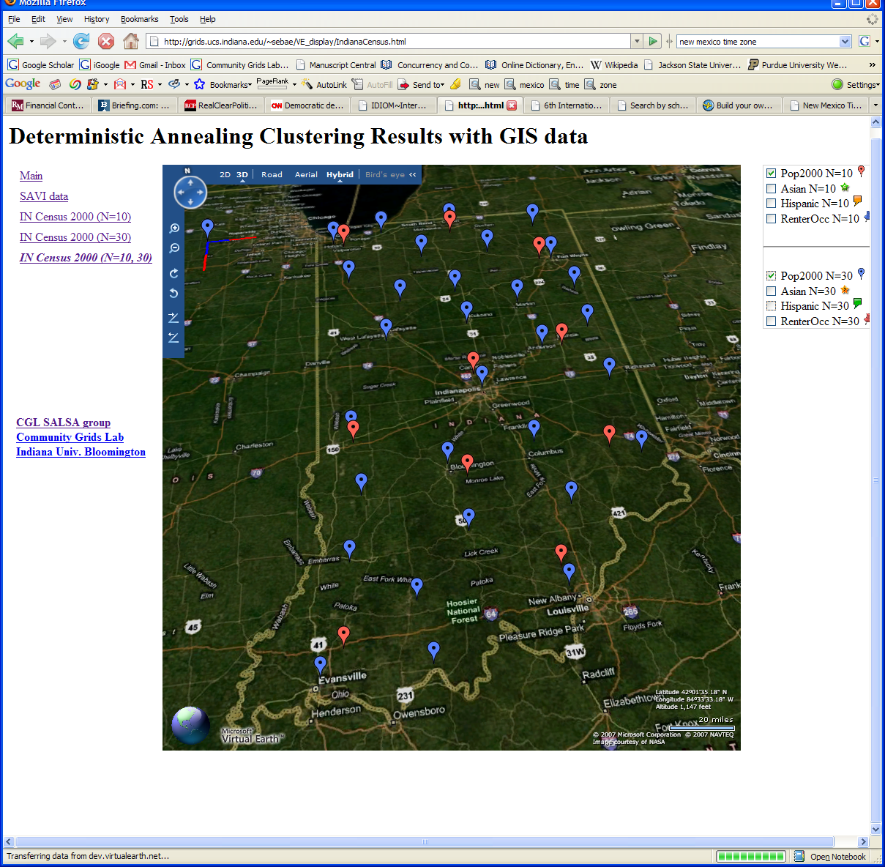
Deterministic Annealing Clustering of Indiana Census Data
Decrease temperature (distance scale) to discover more clusters

Slide 11
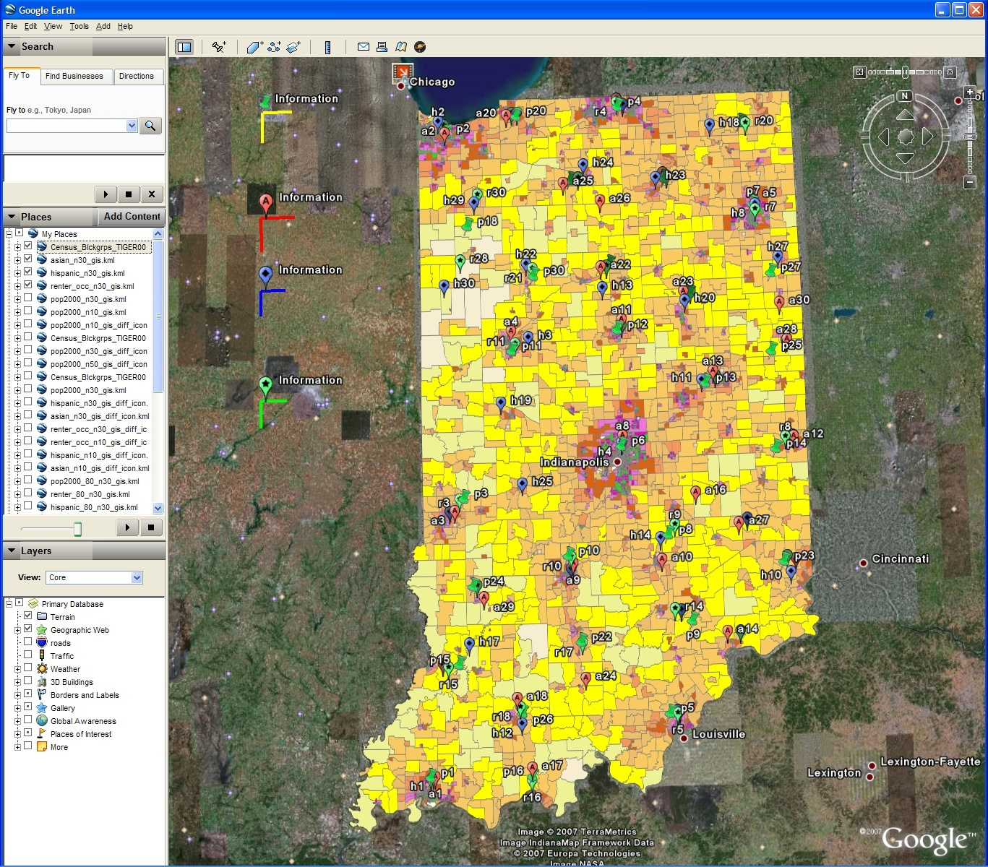
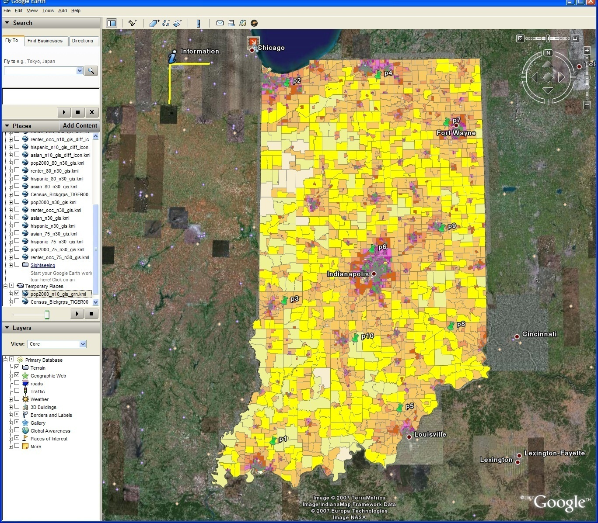
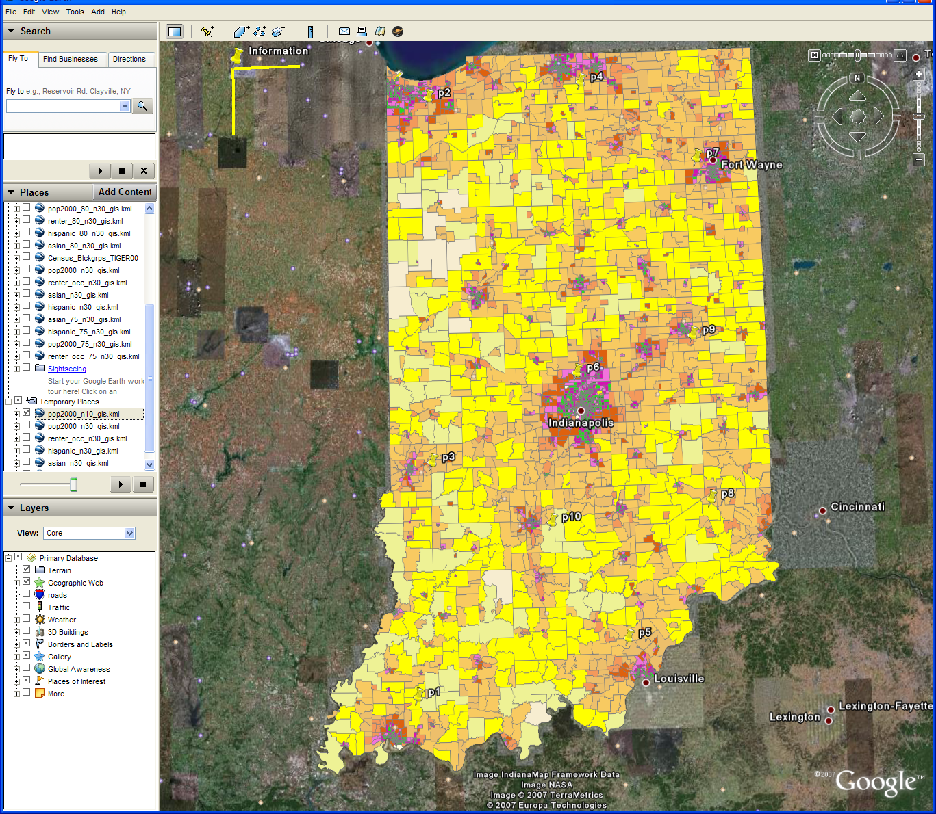
Changing resolution of GIS Clutering
Total
Asian
Hispanic
Renters
GIS Clustering
30 Clusters
30 Clusters
10 Clusters

Slide 12
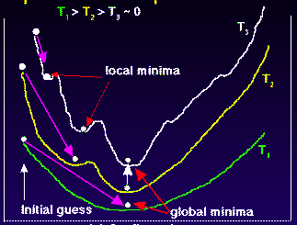
Deterministic
Annealing
F({Y}, T)
Solve Linear Equations for each temperature
Nonlinearity removed by approximating with solution at previous higher temperature
Configuration {Y}
Minimum evolving as temperature decreases
Movement at fixed temperature going to local minima if not initialized “correctly”

Slide 13

N data points E(x) in D dim. space and Minimize F by EM
  Deterministic Annealing Clustering (DAC)
  Generative Topographic Mapping (GTM)
  Deterministic Annealing Gaussian
  Mixture models (DAGM)
  Traditional Gaussian
  mixture models GM
a(x) = 1/N or generally p(x) with Σ p(x) =1
g(k)=1 and s(k)=0.5
T is annealing temperature varied down from ∞ with final value of 1
Vary cluster center Y(k) but can calculate weight P_{k} and correlation matrix s(k) = σ(k)² (even for matrix σ(k)²) using IDENTICAL formulae for Gaussian mixtures
K starts at 1 and is incremented by algorithm
a(x) = 1 and g(k) = (1/K)(β/2π)^{D/2}
s(k) = 1/ β and T = 1
Y(k) = Σ_{m=1}^{M} W_{m}φ_{m}(X(k))
Choose fixed φ_{m}(X) = exp( - 0.5 (X-μ_{m})²/σ² )
Vary W_{m} and β but fix values of M and K a priori
Y(k) E(x) W_{m} are vectors in original high D dimension space
X(k) and μ_{m} are vectors in 2 dimensional mapped space
As DAGM but set T=1 and fix K
a(x) = 1
g(k)={P_{k}/(2πσ(k)²)^{D/2}}^{1/T}
s(k)= σ(k)² (taking case of spherical Gaussian)
T is annealing temperature varied down from ∞ with final value of 1
Vary Y(k) P_{k} and σ(k)
K starts at 1 and is incremented by algorithm
  DAGTM: Deterministic Annealed
  Generative Topographic Mapping
GTM has several natural annealing versions based on either DAC or DAGM: under investigation
SALSA
Notes:
13

Slide 14
Parallel Multicore
Deterministic Annealing Clustering
Parallel Overhead
on 8 Threads Intel 8b
Speedup = 8/(1+Overhead)
10 Clusters
Overhead = Constant1 + Constant2/n
Constant1 = 0.05 to 0.1 (Client Windows) due to
thread runtime fluctuations
20 Clusters
10000/(Grain Size n = points per core)

Slide 15
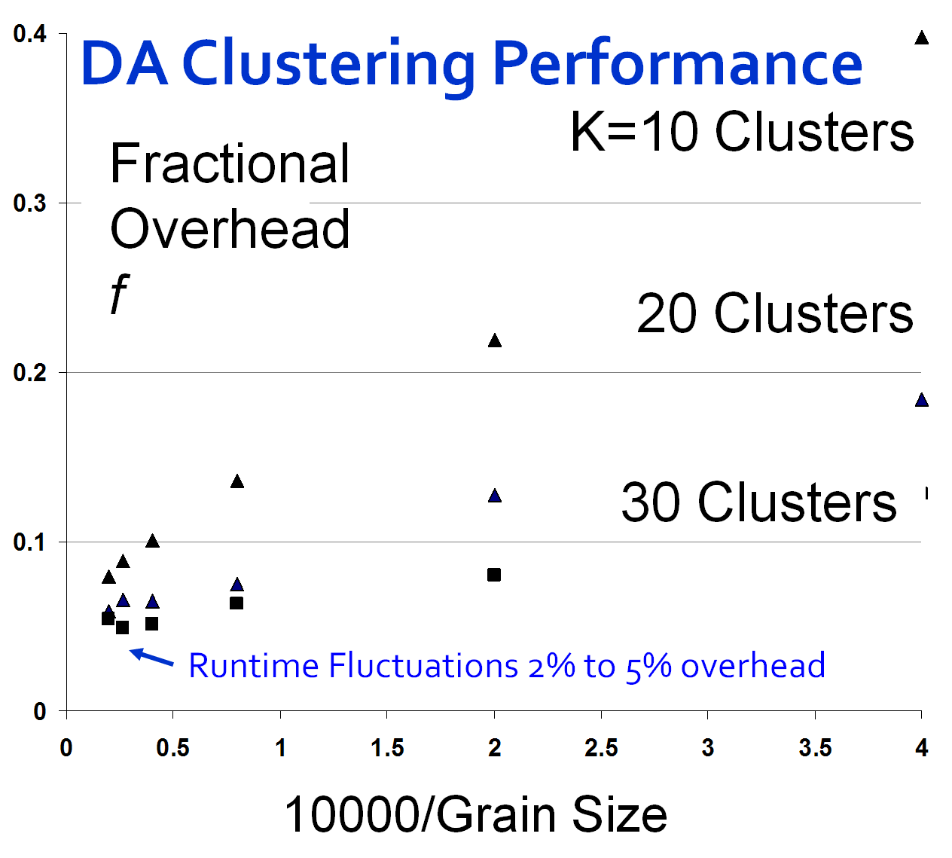
Speedup = Number of cores/(1+f)
f = (Sum of Overheads)/(Computation per core)
Computation ∝ Grain Size n . # Clusters K
Overheads are
Synchronization: small with CCR
Load Balance: good
Memory Bandwidth Limit: → 0 as K → ∞
Cache Use/Interference: Important
Runtime Fluctuations: Dominant large n, K
All our “real” problems have f ≤ 0.05 and
speedups on 8 core systems greater than 7.6
SALSA
Notes:
15

Slide 16


Notes:
This shows on Microsoft virtual Earth how one could use clustering to find locations of different population types. This corresponds to more extensive data than in census available for Indianapolis and the county (Brown) south of it
Here we compare under 5 population (red) with age bracket 25-34 (green). Note they are very similarly located as you might expect. The distance scales are shown on bottom left
In next animation we compare same under 5 population (red) with age bracket 75 and over (orange). Now we see more differences. The distance scales are shown on bottom left

Slide 17
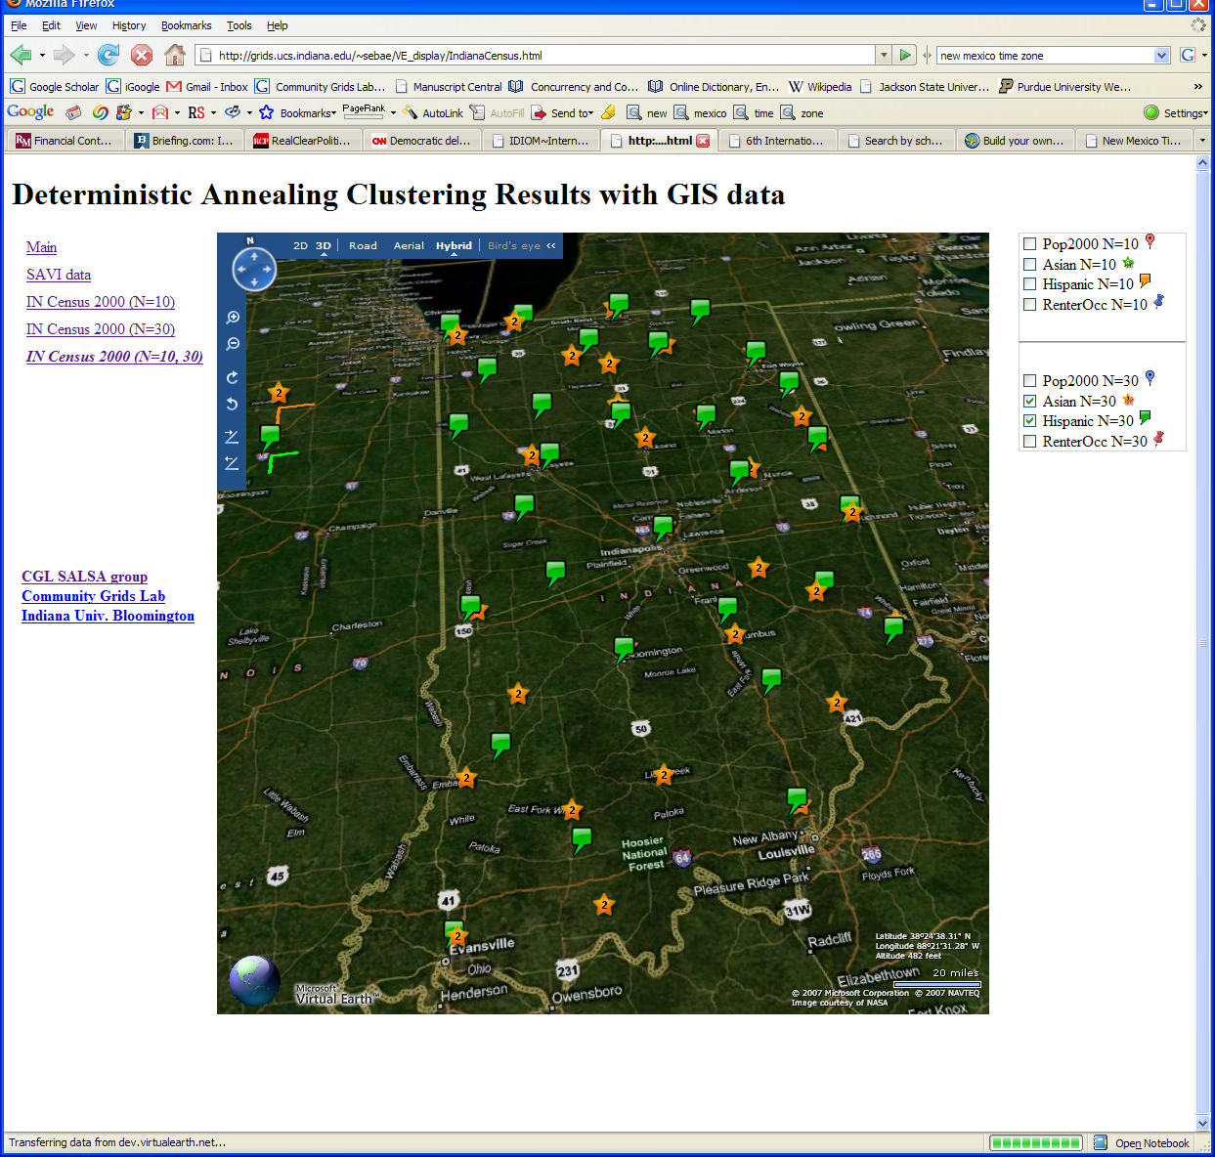

Slide 18
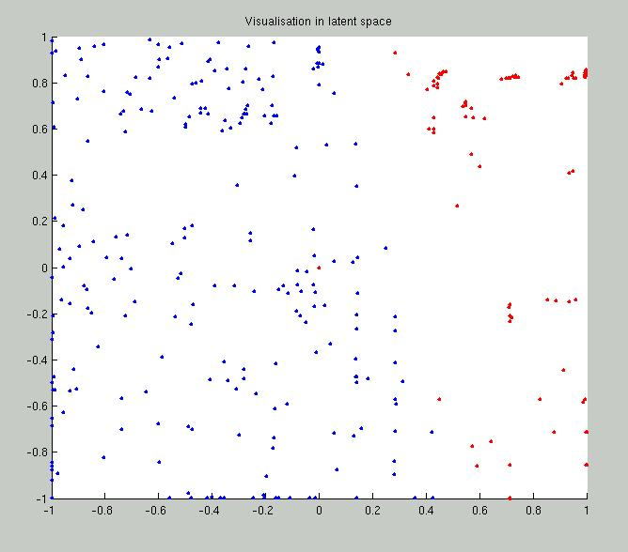
2 Clusters of Chemical Compounds in 155 Dimensions Projected into 2D
Deterministic Annealing for Clustering of 335 compounds
Method works on much larger sets but choose this as answer known
GTM (Generative Topographic Mapping) used for mapping 155D to 2D latent space
Much better than PCA (Principal Component Analysis) or SOM (Self Organizing Maps)

Slide 19
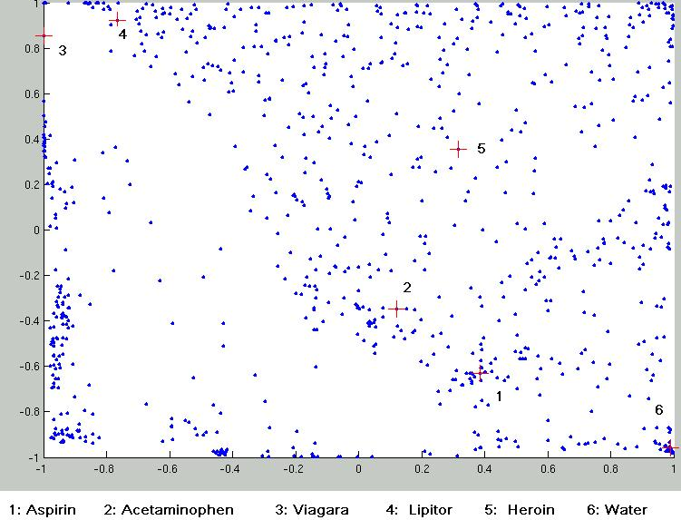
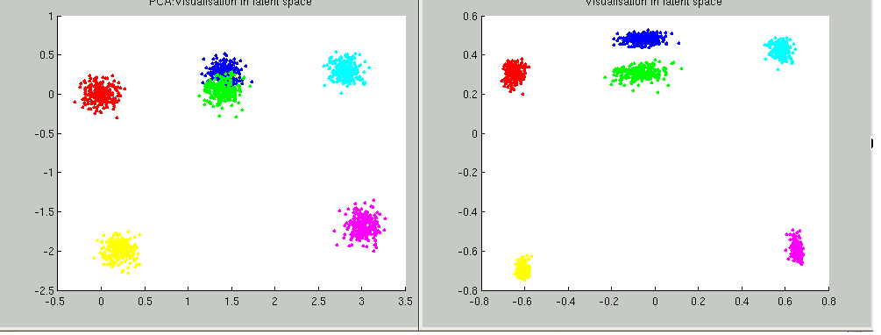
Parallel Generative Topographic Mapping GTM
Reduce dimensionality preserving topology and perhaps distances
Here project to 2D
GTM Projection of PubChem: 10,926,94 0compounds in 166 dimension binary property space takes 4 days on 8 cores. 64X64 mesh of GTM clusters interpolates PubChem. Could usefully use 1024 cores! David Wild will use for GIS style 2D browsing interface to chemistry
PCA
GTM
Linear PCA v. nonlinear GTM on 6 Gaussians in 3D
PCA is Principal Component Analysis
GTM Projection of 2 clusters
of 335 compounds in 155
dimensions
SALSA

Slide 20
MPI Exchange Latency in μs
(20-30 computation between messaging)
Machine | OS | Runtime | Grains | Parallelism | MPI Exchange Latency (µs)
Intel8c:gf12 (8 core 2.33 Ghz) (in 2 chips) | Redhat | MPJE (Java) | Process | 8 | 181
 |  | MPICH2 (C) | Process | 8 | 40.0
 |  | MPICH2: Fast | Process | 8 | 39.3
 |  | Nemesis | Process | 8 | 4.21
Intel8c:gf20 (8 core 2.33 Ghz) | Fedora | MPJE | Process | 8 | 157
 |  | mpiJava | Process | 8 | 111
 |  | MPICH2 | Process | 8 | 64.2
Intel8b (8 core 2.66 Ghz) | Vista | MPJE | Process | 8 | 170
 | Fedora | MPJE | Process | 8 | 142
 | Fedora | mpiJava | Process | 8 | 100
 | Vista | CCR (C#) | Thread | 8 | 20.2
AMD4 (4 core 2.19 Ghz) | XP | MPJE | Process | 4 | 185
 | Redhat | MPJE | Process | 4 | 152
 |  | mpiJava | Process | 4 | 99.4
 |  | MPICH2 | Process | 4 | 39.3
 | XP | CCR | Thread | 4 | 16.3
Intel4 (4 core 2.8 Ghz) | XP | CCR | Thread | 4 | 25.8

Slide 21
CCR Overhead for a computation of 23.76 µs between messaging
Intel8b: 8 Core |  | Number of Parallel Computations
(μs) |  | 1 | 2 | 3 | 4 | 7 | 8
Spawned | Pipeline | 1.58 | 2.44 | 3 | 2.94 | 4.5 | 5.06
 | Shift |  | 2.42 | 3.2 | 3.38 | 5.26 | 5.14
 | Two Shifts |  | 4.94 | 5.9 | 6.84 | 14.32 | 19.44
 | Pipeline | 2.48 | 3.96 | 4.52 | 5.78 | 6.82 | 7.18
 | Shift |  | 4.46 | 6.42 | 5.86 | 10.86 | 11.74
 | Exchange As Two Shifts |  | 7.4 | 11.64 | 14.16 | 31.86 | 35.62
 | Exchange |  | 6.94 | 11.22 | 13.3 | 18.78 | 20.16
Rendezvous
MPI

Slide 22
Time Microseconds
Stages (millions)
Overhead (latency) of AMD4 PC with 4 execution threads on MPI style Rendezvous Messaging for Shift and Exchange implemented either as two shifts or as custom CCR pattern

Slide 23
Time Microseconds
Stages (millions)
Overhead (latency) of Intel8b PC with 8 execution threads on MPI style Rendezvous Messaging for Shift and Exchange implemented either as two shifts or as custom CCR pattern

Slide 24
Cache Line Interference
Implementations of our clustering algorithm showed large fluctuations due to the cache line interference effect (false sharing)
We have one thread on each core each calculating a sum of same complexity storing result in a common array A with different cores using different array locations
Thread i stores sum in A(i) is separation 1 – no memory access interference but cache line interference
Thread i stores sum in A(X*i) is separation X
Serious degradation if X < 8 (64 bytes) with Windows
  Note A is a double (8 bytes)
  Less interference effect with Linux – especially Red Hat

Slide 25
Cache Line Interface
Note measurements at a separation X of 8 and X=1024 (and values between 8 and 1024 not shown) are essentially identical
Measurements at 7 (not shown) are higher than that at 8 (except for Red Hat which shows essentially no enhancement at X<8)
As effects due to co-location of thread variables in a 64 byte cache line, align the array
with cache boundaries

Slide 26
8 Node 2-core Windows Cluster: CCR & MPI.NET
Execution Time ms
Label | ||ism | MPI | CCR | Nodes
1 | 16 | 8 | 2 | 8
2 | 8 | 4 | 2 | 4
3 | 4 | 2 | 2 | 2
4 | 2 | 1 | 2 | 1
5 | 8 | 8 | 1 | 8
6 | 4 | 4 | 1 | 4
7 | 2 | 2 | 1 | 2
8 | 1 | 1 | 1 | 1
9 | 16 | 16 | 1 | 8
10 | 8 | 8 | 1 | 4
11 | 4 | 4 | 1 | 2
12 | 2 | 2 | 1 | 1
Run label
2 CCR Threads 1 Thread 2 MPI Processes per node
8 4 2 1 8 4 2 1 8 4 2 1 nodes
Parallel Overhead f
Scaled Speed up: Constant data points per parallel unit (1.6 million points)
Speed-up = ||ism P/(1+f)
f = PT(P)/T(1) - 1
≈ 1- efficiency
Cluster of Intel Xeon CPU (2 cores) 3050@2.13GHz 2.00 GB of RAM
Run label

Slide 27
1 Node 4-core Windows Opteron: CCR & MPI.NET
Execution Time ms
Label | ||ism | MPI | CCR | Nodes
1 | 4 | 1 | 4 | 1
2 | 2 | 1 | 2 | 1
3 | 1 | 1 | 1 | 1
4 | 4 | 2 | 2 | 1
5 | 2 | 2 | 1 | 1
6 | 4 | 4 | 1 | 1
Run label
Scaled Speed up: Constant data points per parallel unit (0.4 million points)
Speed-up = ||ism P/(1+f)
f = PT(P)/T(1) - 1
≈ 1- efficiency
MPI uses REDUCE, ALLREDUCE (most used) and BROADCAST
AMD Opteron (4 cores) Processor 275 @ 2.19GHz 4 .00 GB of RAM
Parallel Overhead f
Run label

Slide 28
Overhead versus Grain Size
Speed-up = (||ism P)/(1+f) Parallelism P = 16 on experiments here
f = PT(P)/T(1) - 1 ≈ 1- efficiency
Fluctuations serious on Windows
We have not investigated fluctuations directly on clusters where synchronization between nodes will make more serious
MPI somewhat better performance than CCR; probably because multi threaded implementation has more fluctuations
Need to improve initial results with averaging over more runs
8 MPI Processes
2 CCR threads per process
Parallel Overhead f
16 MPI Processes
100000/Grain Size(data points per parallel unit)

Slide 29
Why is Speed up not = # cores/threads?
Synchronization Overhead
Load imbalance
  Or there is no good parallel algorithm
Cache impacted by multiple threads
Memory bandwidth needs increase proportionally to number of threads
Scheduling and Interference with O/S threads
  Including MPI/CCR processing threads
  Note current MPI’s not well designed for multi-threaded problems

Slide 30
Issues and Futures
This class of data mining does/will parallelize well on current/future multicore nodes
The MPI-CCR model is an important extension that take s CCR in multicore node to cluster
  brings computing power to a new level (nodes * cores)
  bridges the gap between commodity and high performance computing systems
Several engineering issues for use in large applications
  Need access to a 32~ 128 node Windows cluster
  MPI or cross-cluster CCR?
  Service model to integrate modules
  Need high performance linear algebra for C# (PLASMA from UTenn)
    Access linear algebra services in a different language?
  Need equivalent of Intel C Math Libraries for C# (vector arithmetic – level 1 BLAS)
Future work is more applications; refine current algorithms such as DAGTM
New parallel algorithms
  Clustering with pairwise distances but no vector spaces
  Bourgain Random Projection for metric embedding
  MDS Dimensional Scaling with EM-like SMACOF and deterministic annealing
  Support use of Newton’s Method (Marquardt’s method) as EM alternative
  Later HMM and SVM

Slide 31
Thank You!
www.infomall.org/SALSA
http://escience2008.iu.edu

