Slide 1
Data-enabled Science and Engineering:
Scalable High Performance Data Analytics
Computer Science (CS) Colloquium Series
August 28, 2015
Judy Qiu

Slide 2



Outline
1. Introduction: Big Data (Batch and Streaming), interdisciplinary, HPC and Clouds
2. Clouds are important for Big Data Analysis
3. Clouds are important for Education and Training
4. Interdisciplinary Applications and Technologies
5. Enhancing Commodity systems (Apache Big Data Stack) to HPC-ABDS
6. Summary and Future

Slide 3
  Impacts preservation, access/use, programming model
  Data Analysis/Machine Learning
  Batch and Stream Processing
  In all fields of science and daily life
  Health, social, financial, policy, national security, environment
  Better understanding the world surrounding us
Inter-
disciplinary
Big Data
HPC
Cloud
  Parallel computing is important
  Performance from Multicore (Manycore or GPU)
  Commercially supported data center model
  IaaS, PaaS, SaaS

Slide 4
What is Big Data ?
Big Data is defined by IBM as “any data that cannot be captured, managed and/or processed using traditional data management components and techniques.”
Volume
Velocity
Variety
Veracity
Data at Scale
Terabytes to Petabytes of Data
Data in Motion
Streaming data
Real-time or near real-time to respond
Data in Many Forms
Structured and unstructured data
Text, numbers, and pixels
Data Uncertainty
Inconsistent, incomplete, ambiguous, and approximated data

Slide 5
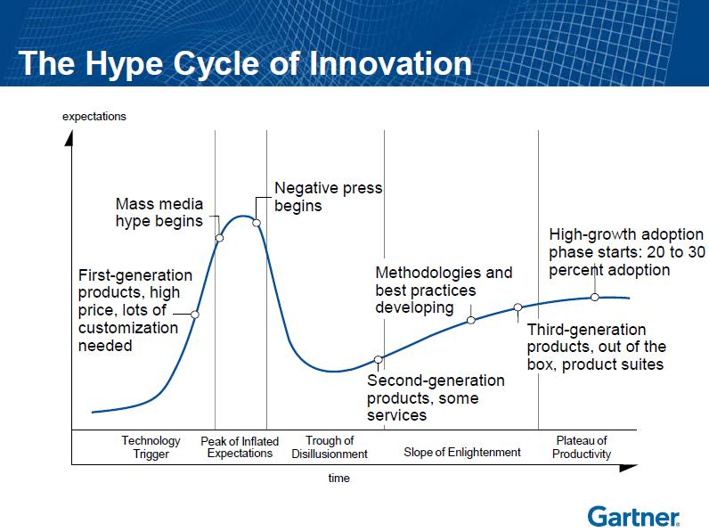

Natural Language Question Answering
2014
Internet of Things
Cloud Computing (2010)
Expectations
Cloud Computing (2009)
Wearable User Interface
Speech-to-Speech Translation
Consumer 3D Printing
Private Cloud Computing (2012)
Autonomous Vehicles
Smart Advisors
Cryptocurrencies
Cloud/Web Platforms (2010)
Big Data (2012)
Cloud Computing (2011)
Cloud Computing (2008)
1st generation
Data Science
Big Data
(2013)
Complex-Event Processing
Prescriptive Analysis
Big Data (2014)
Neurobusiness
In-Memory Database Management Systems
Cloud Computing
3rd generation
Biochips
Content Analytics
“Big Data” and Extreme Information
Processing and Management (2011)
Hybrid Cloud Computing (2014)
Affective Computing
Cloud Computing (2012)
Gamification
Augmented Reality
Smart Robots
Speech Recognition
3D Bioprinting Systems
Mobile Health
Monitoring
Cloud/Web Platforms(2011)
Volumetric and Holographic Displays
Machine-to-Machine
Communication Services
Consumer Telematics
Software-Defined Anything
3D Scanners
Quantum computing
Cloud Computing (2013)
Enterprise 3D Printing
Human Augmentation
Quantified Self
Brain-Computer Interface
Activity Streams
Connected Home
Cloud Computing (2014)
In-memory Analytics
Virtual Personal Assistants
NFC
Gesture Control
Digital Security
Smart Workspace
Cloud Computing
2nd generation
Bioacoustic Sensing
Virtual Reality
As of July 2014
Technology
Trigger
Peak of
Inflated
Expectations
Trough of
Disillusionment
Plateau of
Productivity
Slope of Enlightenment
Obsolete
Before plateau
Time
Plateau will be reached in:
Less than 2 years
2 to 5 years
5 to 10 years
More than 10 years

Slide 6
Challenges and Opportunities
Large-scale parallel simulations and data analysis drive scientific discovery across many disciplines
Research a holistic approach that will enable performance portability to any machine, while increasing developer productivity and accelerating the advance of science
Organize my research as Data-Enabled Discovery Environments for Science and Engineering (DEDESE)
― NSF Career: Map-Collective model for DEDESE and HPC-Cloud Integration
― DOE Workshop Report: Machine Learning and Understanding for Intelligent Extreme Scale Scientific Computing and Discovery, January 7-9, 2015

Slide 7



Outline
1. Introduction: Big Data (Batch and Streaming), interdisciplinary, HPC and Clouds
2. Clouds are important for Big Data Analysis
3. Clouds are important for Education and Training
4. Interdisciplinary Applications and Technologies
5. Enhancing Commodity systems (Apache Big Data Stack) to HPC-ABDS
6. Summary and Future

Slide 8
Motivation of Iterative MapReduce
MapReduce
Classic Parallel Runtimes (MPI)
Data Centered, QoS
Efficient and Proven techniques
Expand the Applicability of MapReduce to more classes of Applications
Sequential
Map-Only
MapReduce
Iterative MapReduce
MPI and Point-to-Point
Input
Input
Input
iterations
Input
map
map
map
map
Pij
Output
Output
reduce
reduce

Slide 9
MapReduce Programming Model & Architecture
Google MapReduce , Apache Hadoop,
Master Node
Worker Nodes
Input Data (Partitions)
Record readers
Read records from
data partitions
Map (Key , Value)
Distributed
File System
Intermediate <Key, Value> space partitioned using a key partition function
Inform
Master
Local disks
Sort input <key,value> pairs to groups
Sort
Download data
reduce(Key , List<Value>)
Schedule Reducers
Output
Distributed
File System
Map(), Reduce(), and the intermediate key partitioning strategy determine the algorithm
Input and Output => Distributed file system
Intermediate data => Disk -> Network -> Disk
Scheduling =>Dynamic
Fault tolerance (Assumption: Master failures are rare)
Notes:
How elaborate this should be?

Slide 10

Programming Model for Iterative MapReduce
Loop Invariant Data
Loaded only once
Intermediate data
Configure()
Cacheable map/reduce tasks
(in memory)
Main Program
Twister was our initial implementation with first paper having 585 Google Scholar citations
Map(Key, Value)
while(..)
{
runMapReduce(..)
}
Faster intermediate data transfer mechanism
Reduce (Key, List<Value>)
Combine(Map<Key,Value>)
Combiner operation to collect all reduce outputs
Iterative MapReduce is a programming model that applies a computation (e.g. Map task) or function repeatedly, using output from one iteration as the input of the next iteration. By using this pattern, it can solve complex computation problems by using apparently simple (user defined) functions.
Distinction on loop invariant (e.g. input) data and variable (e.g. intermediate) data
Cacheable map/reduce tasks (in-memory)
Combine operation

Slide 11




MapReduce Optimized for Iterative Computations
Twister: the speedy elephant
  Abstractions
  In-Memory
  Cacheable map/reduce tasks
  Data Flow
  Iterative
  Loop Invariant
  Variable data
  Thread
  Lightweight
  Local aggregation
  Map-Collective
  Communication patterns optimized for large intermediate data transfer
  Portability
  HPC (Java)
  Azure Cloud (C#)
  Supercomputer (C++, Java)

Slide 12


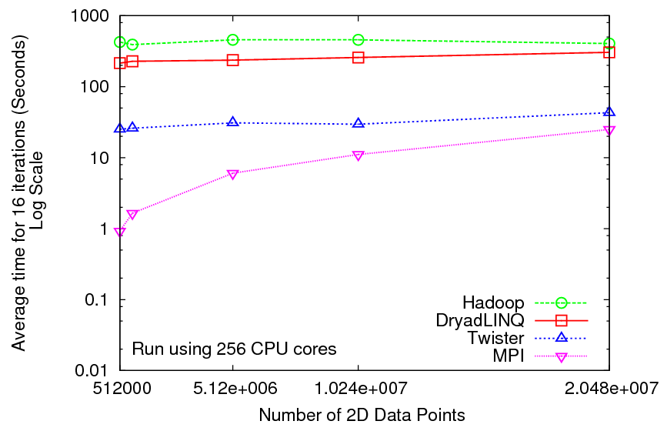
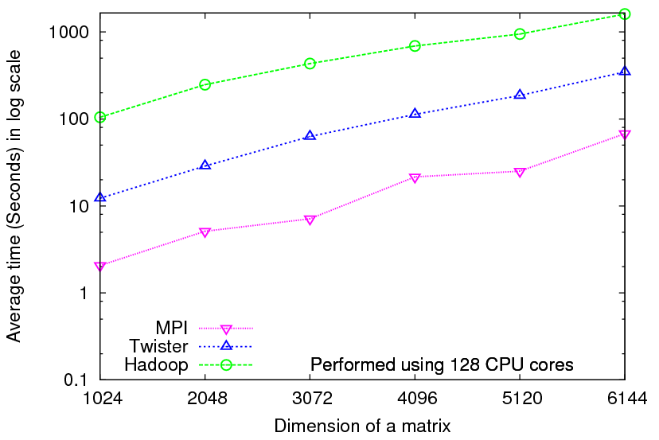
Iterative Computations
K-means
Matrix Multiplication
Performance of K-Means
Parallel Overhead Matrix Multiplication

Slide 13
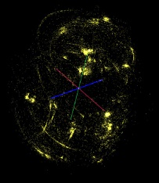
Demo of Multi-Dimensional Scaling using
Iterative MapReduce
II. Send intermediate results
Master Node
ActiveMQ
Broker
Twister
Driver
MDS Monitor
Twister-MDS
PlotViz
I. Send message to start the job
Client Node
  Input: 30K metagenomics data
  MDS reads pairwise distance matrix of all sequences
  Output: 3D coordinates visualized in PlotViz

Slide 14

Iterative MapReduce - MDS Demo

Slide 15
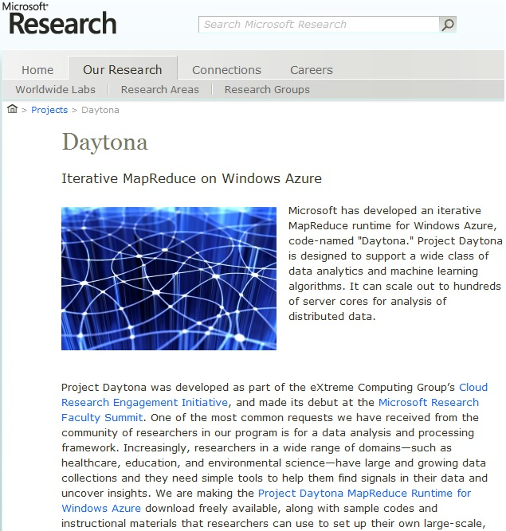

Slide 16
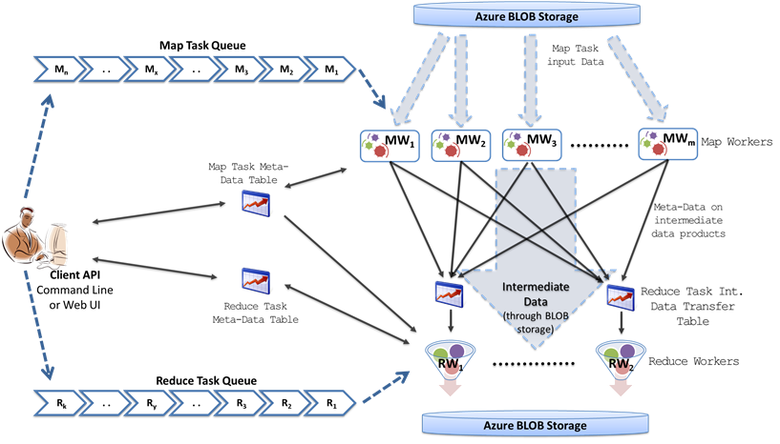
Twister4Azure
Demonstrate portability of Iterative MapReduce from HPC to PaaS Cloud (Azure))
Azure Queues for scheduling, Tables to store metadata and monitoring data, Blobs for input/output/intermediate data storage.

Slide 17
Outline
1. Introduction: Big Data (Batch and Streaming), interdisciplinary, HPC and Clouds
Cloud MOOC
2. Clouds are important for Big Data Analysis
3. Clouds are important for Education and Training: CloudMOOC
4. Interdisciplinary Applications and Technologies
5. Enhancing Commodity systems (Apache Big Data Stack) to HPC-ABDS
6. Summary and Future

Slide 18
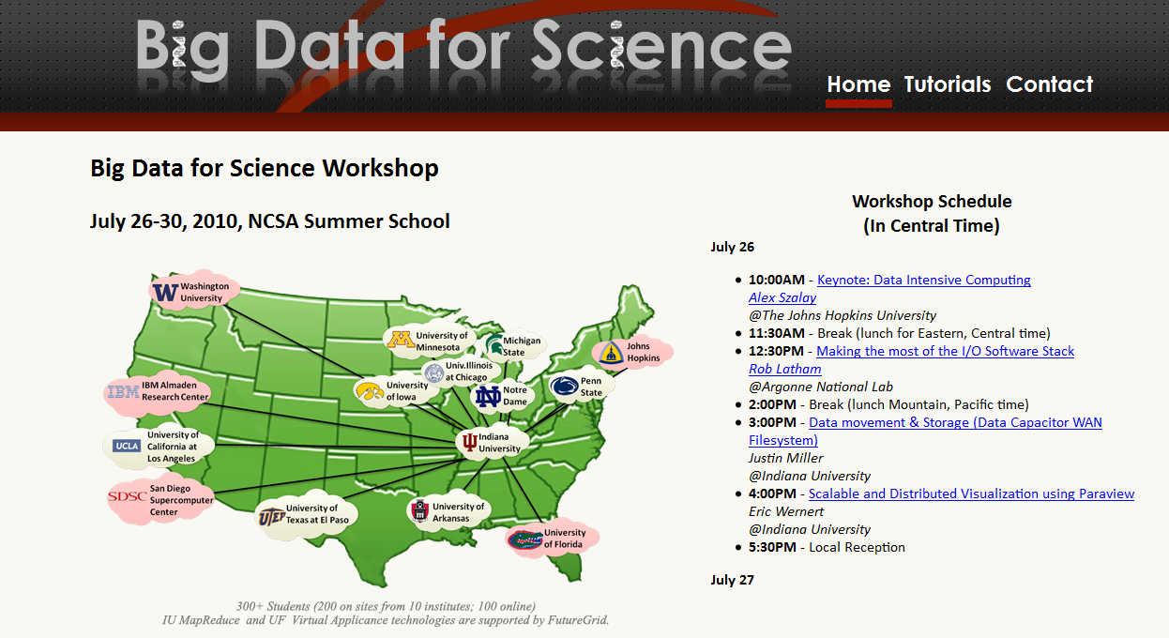

Slide 19
Education and Training using Cloud
Microsoft says there are 14 million cloud jobs around the world today while Forbes (December 2014) cites 18.2 million worldwide and 3.9 million in USA
McKinsey says that there will be up to 190,000 nerds and 1.5 million extra managers needed in Data Science by 2018 in USA
Many more jobs than simulation (third paradigm) where Computational Science not very successful as curriculum
Need curricula to educate people to use (or design) Clouds running Data Analytics processing Big Data to solve problems (e.g. health, social, financial, policy, national security, scientific experiment, environment)

Slide 20
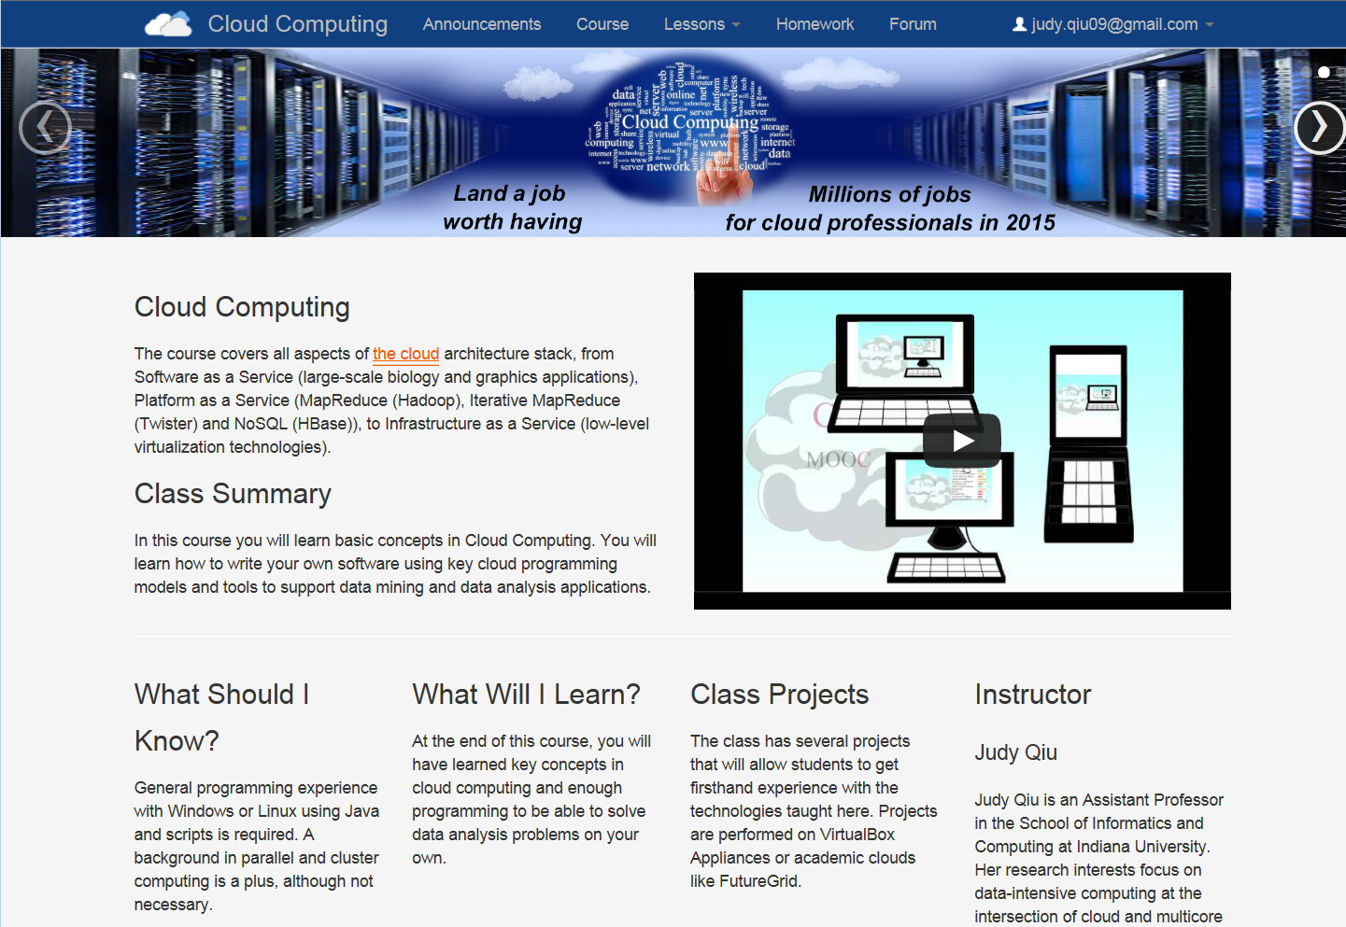

Slide 21
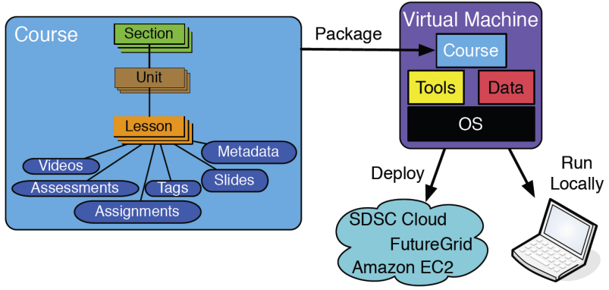
Biomedical Big Data Training Collaborative
An open online training framework
No single group or strategy that will be able to cover the full spectrum of educational needs required to comprehensively train biomedical big data researchers
Building a community repository, and creating lecture content and example courses with hands-on virtual machines for biomedical big data training

Slide 22
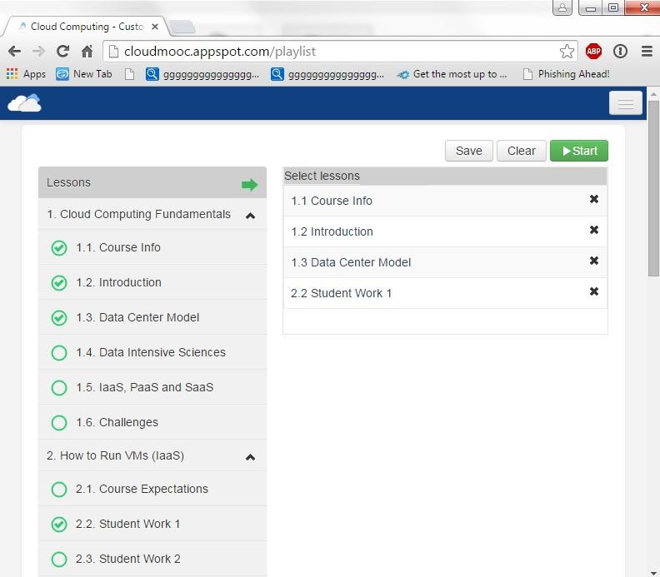
Customization using Playlist for Cloud Computing MOOC
The playlist feature is demonstrated in our CloudMOOC course, which teaches cloud computing and includes topics like Hadoop , OpenStack and NoSQL databases. This figure shows that a student can simply drag and drop course modules (left) to make a playlist of lessons (right).

Slide 23
Curriculum Development
Data-enabled Science covers Data curation and management, Analytics (Algorithms), Runtime (e.g. MapReduce, Workflow, NoSQL), Visualization for Applications
Some courses aimed at one aspect of this; our courses cover integration and link to applications
Look at Massive Open Online Courses (MOOCs) to support online modules that can be used by other universities; initially at ECSU and other HBCU
3 Funded collaborative curriculum developments using MOOCs
  Data Science - CloudMOOC (Google Course Builder)
  Biomedical training community repository - NIH/MOOC (NIH)
  HBCU-STEM curriculum development - HBCU (NSF) starts this Fall

Slide 24

Remote Sensing Curriculum Enhancement using Cloud Computing
ECSU-IU collaboration in environmental applications of Microwave Remote Sensing using Cloud Computing technology.
Demonstrate the concept that Data and Computational Science (remote sensing) curriculum can drive new workforce and research opportunities at Minority Serving Institutions (MSI) by exploiting enhancements using Cloud Computing technology.
We will explore multiple targeted courses built from this repository of shared customizable lessons.

Slide 25


Outline
1. Introduction: Big Data (Batch and Streaming), interdisciplinary, HPC and Clouds
Cloud MOOC
2. Clouds are important for Big Data Analysis
3. Clouds are important for education: CloudMOOC
4. Interdisciplinary Applications and Technologies
5. Enhancing Commodity systems (Apache Big Data Stack) to HPC-ABDS
6. Summary and Future

Slide 26
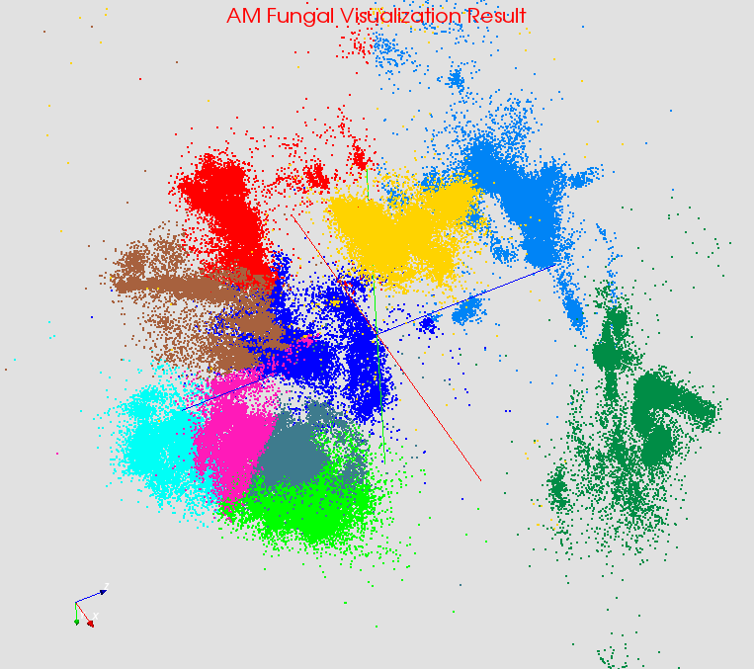

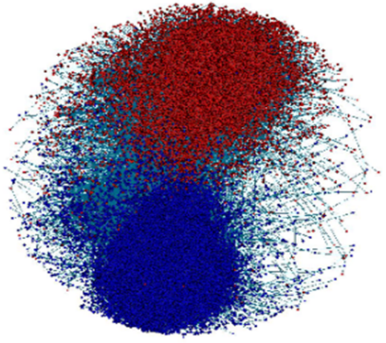
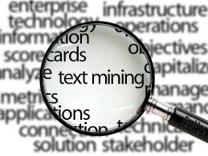
Large Scale Data Analysis Applications
Case Studies
  Bioinformatics: Multi-Dimensional Scaling (MDS) on gene sequence data
  Computer Vision: Kmeans Clustering on image data (high dimensional model data)
  Text Mining: LDA on wikipedia data (dynamic model data due to sampling)
  Complex Network: Online Kmeans (streaming data)
  Deep Learning: Convolutional Neural Networks on image data
Bioinformatics
Computer Vision
Complex Networks
Text Mining
Deep Learning

Slide 27
Case Study 1:
High Dimensional Image Data Clustering
4. Interdisciplinary Applications and Technologies
Map Collective Computing Paradigm

Slide 28
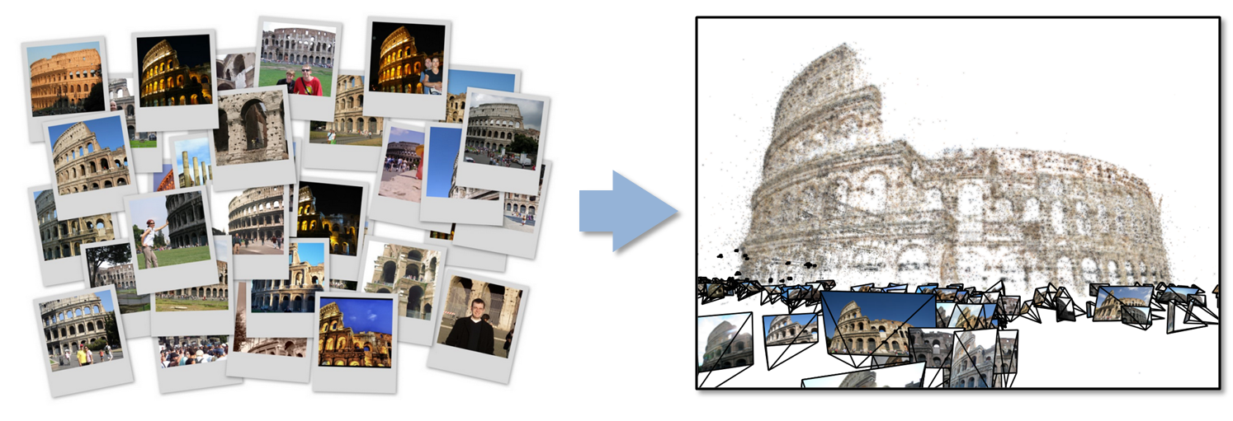
Data Intensive Batch Kmeans Clustering
  Image Classification: 7 million images; 512 features per image; 1 million clusters
  10K Map tasks; 64G broadcasting data (1GB data transfer per Map task node);
  20 TB intermediate data in shuffling.
Collaborative work with Prof. David Crandall

Slide 29
High Dimensional Image Data
K-means Clustering algorithm is used to cluster the images with similar features.
In image clustering application, each image is characterized as a data point (vector) with dimension in range 512 - 2048. Each value (feature) ranges from 0 to 255.
Around 180 million vectors in full problem
Currently, we are able to run K-means Clustering up to 1 million clusters and 7 million data points on 125 computer nodes.
  10K Map tasks; 64G broadcast data (1GB data transfer per Map task node);
  20 TB intermediate data in shuffling.

Slide 30
Twister Collective Communications
Broadcast
Broadcasting
  Data could be large
  Chain & MST
  Gather scatter
  Local global sync
  Roate
Map Collectives
  Local merge
Reduce Collectives
  Collect but no merge
Combine
  Direct download or Gather
Map Tasks
Map Tasks
Map Tasks
Map Collective
Map Collective
Map Collective
Reduce Tasks
Reduce Tasks
Reduce Tasks
Reduce Collective
Reduce Collective
Reduce Collective
Gather

Slide 31
Twister Broadcast Comparison
(Sequential vs. Parallel implementations)

Slide 32
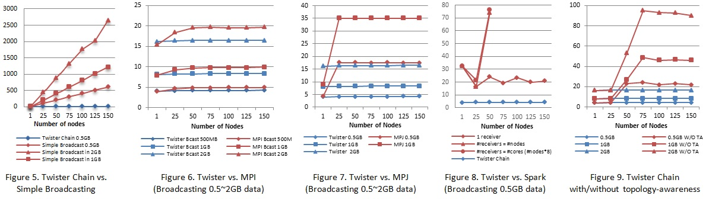
High Performance Data Movement
Tested on IU Polar Grid with 1 Gbps Ethernet connection
    At least a factor of 120 on 125 nodes, compared with the simple broadcast algorithm
    The new topology-aware chain broadcasting algorithm gives 20% better performance than best C/C++ MPI methods (four times faster than Java MPJ)
    A factor of 5 improvement over non-optimized (for topology) pipeline-based method over 150 nodes

Slide 33
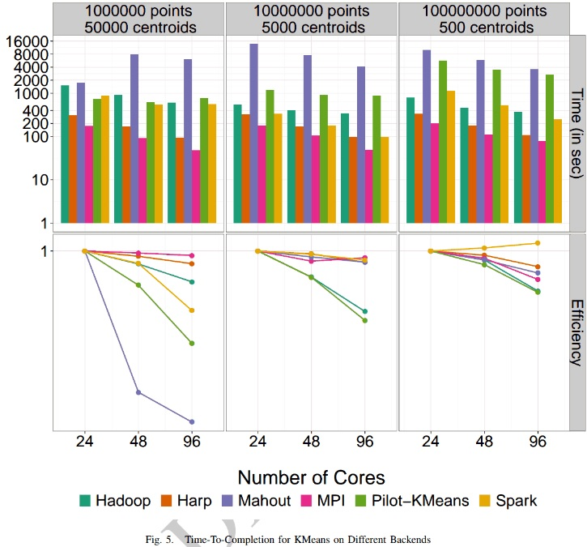
K-means Clustering Parallel Efficiency
Shantenu Jha et al. A Tale of Two Data-Intensive Paradigms: Applications, Abstractions, and Architectures. 2014.

Slide 34
Map Collective Computing Paradigm
Harp
Spark
Parameter Server
4. Interdisciplinary Applications and Technologies

Slide 35
  Why Collective Communications for Big Data Processing?
Collective Communication and Data Abstractions
  Our approach to optimize data movement
  Hierarchical data abstractions and operations defined on top of them
Map-Collective Programming Model
  Extended from MapReduce model to support collective communications
  Two Level of BSP parallelism
Harp Implementation
  A plug-in to Hadoop
  Component layers and the job flow

Slide 36
Harp Component Layers
Applications: K-Means, WDA-SMACOF, Graph-Drawing…
MapReduce Applications
MapCollective Applications
MapCollective Interface
Collective Communication APIs
Array, Key-Value, Graph Data Abstraction
Map-Collective Programming Model
MapReduce V2
Harp
Collective Communication Operators
Hierarchical Data Types
(Tables & Partitions)
Memory Resource Pool
Collective Communication Abstractions
YARN
Task Management
MapReduce

Slide 37
Comparison of Iterative Computation Tools
Spark
Harp
Parameter Server
Daemon
Worker
Server Group
Driver
Daemon
Worker
Worker
Worker Group
Worker Group
Daemon
Worker
Various Collective Communication Operations
Asynchronous Communication Operations
Implicit Data Distribution
Implicit Communication
Explicit Data Distribution
Explicit Communication
Explicit Data Distribution
Implicit Communication
M. Zaharia et al. “Spark: Cluster Computing with Working Sets”. HotCloud, 2010.
B. Zhang, Y. Ruan, J. Qiu. “Harp: Collective Communication on Hadoop”. IC2E, 2015.
M. Li, D. Anderson et al. “Scaling Distributed Machine Learning with the Parameter Server”. OSDI, 2014.

Slide 38
Spark
Input (Training) Data
1
Load
1
Load
1
Load
Driver
Broadcast
Current Model
2
Task
Task
Task
Current Model
Current Model
Current Model
3
Compute
3
Compute
3
Compute
5
Iteration
New Model
New Model
New Model
New Model
4
Reduce

Slide 39
Harp
Input (Training) Data
1
Load
1
Load
1
Load
Task
Task
Task
Current Model
Current Model
Current Model
2
Compute
2
Compute
2
Compute
4
Iteration
New Model
New Model
New Model
3
3
3
Collective Communication (e.g. Allreduce)

Slide 40
Parameter Server
Server
Global Model
4
Upload
2
Download
4
Upload
2
Download
4
Upload
2
Download
Task
Task
Task
Local Model
Local Model
Local Model
5
Iteration
3
Compute
3
Compute
3
Compute
1
Load
1
Load
1
Load
Training Data

Slide 41
Case Study 2:
Parallel Latent Dirichlet Allocation for Text Mining
4. Interdisciplinary Applications and Technologies
Map Collective Computing Paradigm

Slide 42
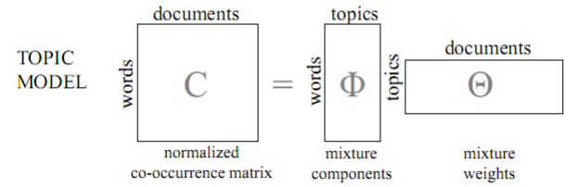
LDA and Topic Models
Topic Models is a modeling technique, modeling the data by probabilistic generative process.
Latent Dirichlet Allocation(LDA) is one widely used topic model.
Inference algorithm for LDA is an iterative algorithm using share global model data.
Document
Word
Topic: semantic unit inside the data
Topic Model
  documents are mixtures of topics, where a topic is a probability distribution over words
Word-Topic Matrix
Topic-Doc Matrix
1 million words
10k topics
3.7 million docs
Model Data
Notes:
global model data should be word-topic matrix or topic-document matrix,

Slide 43
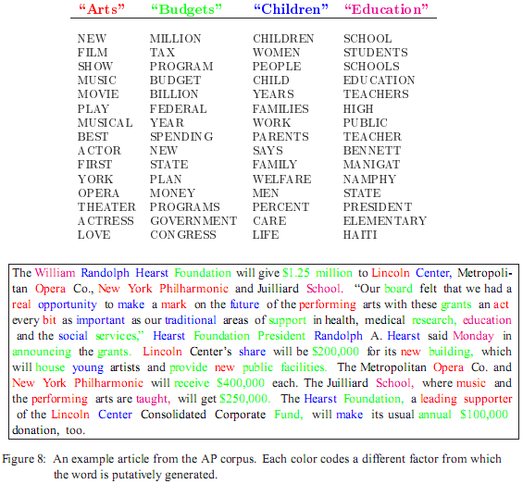
LDA: mining topics in text collection
Huge volume of Text Data
  information overloading
  what on earth is inside the TEXT Data?
Search
  find the documents relevant to my need (ad hoc query)
Filtering
  fixed info needs and dynamic text data
What's new inside?
  discover something I don't know
Blei, D. M., Ng, A. Y. & Jordan, M. I. Latent Dirichlet Allocation. J. Mach. Learn. Res. 3, 993–1022 (2003).

Slide 44
Harp-LDA Execution Flow
Challenges
Task
Task
Task
Load Documents
Load Documents
Load Documents
High memory consumption for model and input data
High number of iterations (~1000)
Computation intensive
Traditional “allreduce” operation in
MPI-LDA is not scalable.
Initial Sampling
Initial Sampling
Initial Sampling
Local Sampling Computation
Local Sampling Computation
Local Sampling Computation
Collective Communication
to generate the new global model
Harp-LDA uses AD-LDA (Approximate Distributed LDA) algorithm (based on Gibbs sampling algorithm)
Harp-LDA runs LDA in iterations of local computation and collective communication.

Slide 45
Harp LDA on Big Red II Supercomputer
Harp LDA Scaling Tests
Harp LDA on Juliet (SOIC Supercomputer)
Corpus: 3,775,554 Wikipedia documents, Vocabulary: 1 million words; Topics: 10k topics; alpha: 0.01; beta: 0.01; iteration: 200
Machine settings
  Big Red II: tested on 25, 50, 75, 100 and 125 nodes, each node uses 32 parallel threads; Gemini interconnect
  Juliet: tested on 10, 15, 20, 25, 30 nodes, each node uses 64 parallel threads on 36 core Intel Haswell node (each with 2 chips); infiniband interconnect

Slide 46
Case Study 3:
Parallel Tweet Online Clustering
4. Interdisciplinary Applications and Technologies
Map Streaming Computing Paradigm

Slide 47
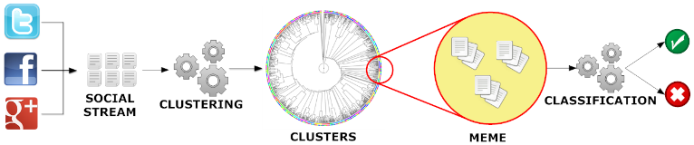
Parallel Tweet Online Clustering with Apache Storm
IU DESPIC analysis pipeline for meme clustering and classification : Detecting Early Signatures of Persuasion in Information Cascades
Implement with HBase + Hadoop (Batch) and HBase + Storm(Streaming) + ActiveMQ
2 million streaming tweets processed in 40 minutes; 35,000 clusters
Storm Bolts coordinated by ActiveMQ to synchronize parallel cluster center updates – add loops/iterations to Apache Storm
Xiaoming Gao, Emilio Ferrara, Judy Qiu, Parallel Clustering of High-Dimensional Social Media Data Streams Proceedings of CCGrid, May 4-7, 2015

Slide 48
Sequential Algorithm for Clustering Tweet Stream
Online (streaming) K-Means clustering algorithm with sliding time window and outlier detection
Group tweets in a time window as protomemes:
  Label protomemes (points in space to be clustered) by “markers”, which are Hashtags, User mentions, URLs, and phrases
  A phrase is defined as the textual content of a tweet that remains after removing the hashtags, mentions, URLs, and after stopping and stemming
    Number of tweets in a protomeme : Min: 1, Max :206, Average 1.33
Note a given tweet can be in more than one protomeme
  One tweet on average appears in 2.37 protomemes
  And number of protomemes is 1.8 times number of tweets

Slide 49
Online K-Means clustering
Slide time window by one time step
Delete old protomemes out of time window from their clusters
Generate protomemes for tweets in this step
For each new protomeme classify in old or new cluster (outlier)
#p2
#p2
If marker in common with a cluster member, assign to that cluster
Otherwise it is an outlier and a candidate new cluster
If near a cluster, assign to nearest cluster

Slide 50
Parallelization with Storm – Challenges
DAG organization of parallel workers: hard to synchronize cluster information
Worker Process
ActiveMQ
Broker
Clustering Bolt
…
Clustering Bolt
Synchronization Coordinator Bolt
Protomeme Generator Spout
…
tweet stream
Worker Process
Clustering Bolt
…
Clustering Bolt
Calculate Cluster Centers
Parallelize Similarity Calculation
Synchronization initiation methods:
Spout initiation by broadcasting INIT message
Clustering bolt initiation by local counting
Sync coordinator initiation by global counting (of #protomemes)
Suffer from variation of processing speed

Slide 51
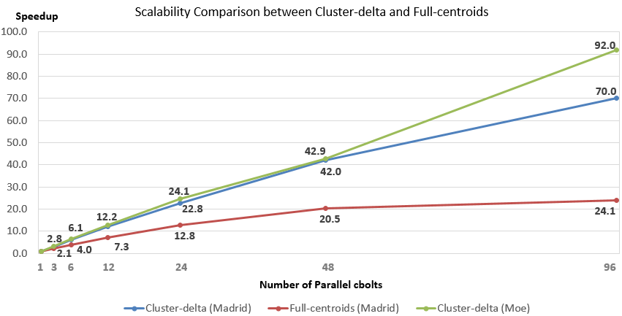
Parallel Tweet Clustering with Storm
Speedup on up to 96 bolts on two clusters, Moe and Madrid
Red curve is old online Kmeans algorithm; green and blue new algorithm
Full Twitter – 1000 way parallelism (expected)

Slide 52
Outline
1. Introduction: Big Data (Batch and Streaming), interdisciplinary, HPC and Clouds
Cloud Computing
2. Clouds are important for Big Data Analysis
3. Clouds are important for Education and Training
4. Interdisciplinary Applications and Technologies
5. Enhancing Commodity systems (Apache Big Data Stack) to HPC-ABDS
6. Summary and Future

Slide 53
Six Computation Paradigms for Data Analytics
(1)
Map Only
(2)
Classic
(3)
Iterative
Map Reduce or
(4) Point to Point or
(5)
Map
-
Streaming
(6) Shared memory
Map
Pleasingly Parallel
Map-Reduce
-
Collective
Map
-
Communication
Map-
Communication
Input
Input
Input
Iterations
maps
brokers
Shared
Memory
map
map
map
Local
Map & Communication
Output
reduce
reduce
Graph
Events
BLAST Analysis
Local Machine Learning
Pleasingly Parallel
High Energy Physics (HEP) Histograms,
Web search
Recommender Engines
Expectation Maximization
Clustering
Linear Algebra
PageRank
Classic MPI
PDE Solvers and Particle Dynamics
Graph
Streaming images from Synchrotron sources, Telescopes,
Internet of Things
Difficult to parallelize
asynchronous parallel
Graph
These 3 Paradigms are my Focus

Slide 54
Comparison of current Data Analytics stack from Cloud and HPC infrastructure
My Focus
J. Qiu, S. Jha, A. Luckow, G. Fox, TowardsHPC-ABDS: An Initial High-Performance Big Data Stack, proceedings of ACM 1st Big Data Interoperability Framework Workshop: Building Robust Big Data ecosystem, NIST special publication, March 13-21, 2014.

Slide 55
The Models of Contemporary Big Data Tools
DAG Model
MapReduce Model
Graph Model
BSP/Collective Model
Hadoop
For Iterations/
Learning
HaLoop
Giraph
Twister
Hama
Spark
GraphLab
GraphX
Dryad
Harp
Stratosphere / Flink
For Streaming
Many of them have fixed communication patterns!
S4
Samza
Storm
Spark Streaming
For Query
DryadLINQ
Pig
Hive
Tez
Spark SQL
MRQL

Slide 56
Data Analytics and Computing Ecosystem Compared
Mahout, R and Applications
Applications and Community Codes
Application Level
Hive
Pig
Sqoop
Flume
FORTRAN, C, C++, and IDEs
Map-Reduce
Storm
Domain-specific libraries
Middleware and Management
Zookeeper (coordination)
AVRO
Hbase BigTable (key-value store)
MPI/OpenMP + Accelerator Tools
Numerical Libraries
Performance and Debugging (such as PAPI)
Cloud Services (e.g., AWS)
HDFS (Hadoop File System)
Lustre (Parallel File System)
Batch Scheduler (such as SLURM)
System Monitoring Tools
Virtual machines and Cloud Services (optional)
System Software
Linux OS variant
Linux OS variant
Cluster Hardware
Ethernet Switches
Local Node Storage
Commodity X86 Racks
Infiniband + Ethernet Switches
SAN + Local Node Storage
X86 Racks + GPUs or Accelerators
Data Analysis Ecosystem
Computational Science Ecosystem
Daniel Reed and Jack Dongarra, Communications of the ACM, vol. 58, no. 7, p.58

Slide 57
Outline
1. Introduction: Big Data (Batch and Streaming), interdisciplinary, HPC and Clouds
Cloud Computing
2. Clouds are important for Big Data Analysis
3. Clouds are important for education: CloudMOOC
4. Interdisciplinary Applications and Technologies
5. Enhancing Commodity systems (Apache Big Data Stack) to HPC-ABDS
6. Summary and Future

Slide 58

Progress in HPC-ABDS Runtime
Standalone Twister: Iterative Execution (caching) and High performance communication extended to first Map-Collective runtime
HPC-ABDS Plugin Harp: adds HPC communication performance and rich data abstractions to Hadoop
Online Clustering with Storm integrates parallel and dataflow computing models
Development of library of Collectives to use at Reduce phase
  Broadcast and Gather needed by current applications
  Discover other important ones (e.g. Allgather)
  Implement efficiently on each platform (e.g. Amazon, Azure, Big Red II, Haswell Clusters)
Clearer application fault tolerance model based on implicit synchronizations points at iteration end points
Runtime for data parallel languages with initial work on Apache Pig enhanced with Harp
Later: Investigate GPU support

Slide 59
Summary and Future
Identification of Apache Big Data Software Stack and integration with High Performance Computing Stack to give HPC-ABDS
  ABDS/Many Big Data applications/algorithms need HPC for performance
  HPC needs ABDS for rich software model productivity/sustainability
Identification of Six Computation Models for Data Analytics
Identification and Study of Map-Collective and Map-Streaming Model
National Strategic Computing Initiative suggests HPC-Big Data Integration
Change approach from Twister/ Twister4Azure to Harp
  Apache Pig, Hadoop, Storm, and HBase enhancement in the form of plug-in

Slide 60
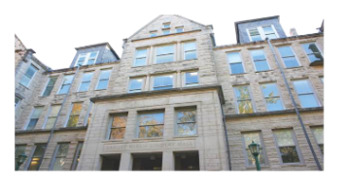

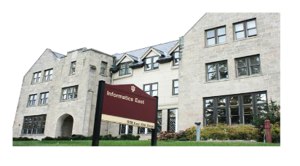





Acknowledgements
Bingjing Zhang
Xiaoming Gao
Stephen Wu
Jaliya Ekanayake
Thilina Gunarathne
Yuan Yang
Prof. Haixu Tang
Bioinformatics
Prof. David Wild
Cheminformatics
Prof. Raquel Hill
Security
Prof. David Crandall
Computer Vision
Prof. Filippo Menczer & CNETS
Complex Networks and Systems
SALSA HPC Group
School of Informatics and Computing
Indiana University

Slide 61

The Harp Library
Extra slides
Harp is an implementation designed in a pluggable way to bring high performance to the Apache Big Data Stack and bridge the differences between Hadoop ecosystem and HPC system through a clear communication abstraction, which did not exist before in the Hadoop ecosystem.
Hadoop Plugin that targets Hadoop 2.2.0
Provides implementation of the collective communication abstractions and MapCollective programming model
Project Link: http://salsaproj.indiana.edu/harp/index.html
Source Code Link: https://github.com/jessezbj/harp-project
We built Map-Collective as a unified model to improve the performance and expressiveness of Big Data tools. We ran Harp on K-means, Graph Layout, and Multidimensional Scaling algorithms with realistic application datasets over 4096 cores on the IU BigRed II Supercomputer (Cray/Gemini) where we have achieved linear speedup.

Slide 62
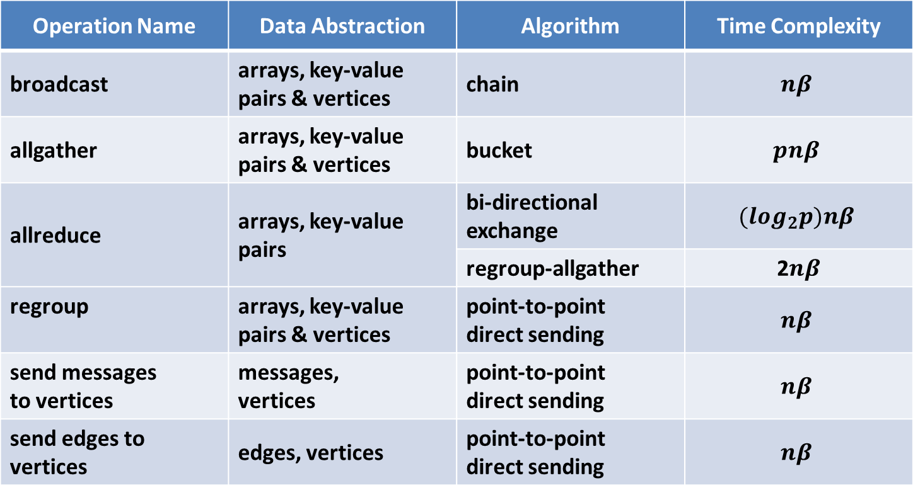
Collective Communication Operations
Operation Name | Data Abstraction | Algorithm | Time Complexity
broadcast | arrays, key-value pairs & vertices | chain | $$nβ$$
allgather | arrays, key-value pairs & vertices | bucket | $$pnβ$$
allreduce | arrays, key-value pairs | bi-directional exchange | $$(\log_{2}p)nβ$$
 |  | regroup-allgather | 2$nβ$
regroup | arrays, key-value pairs & vertices | point-to-point direct sending | $$nβ$$
send messages to vertices | messages, vertices | point-to-point direct sending | $$nβ$$
send edges to vertices | edges, vertices | point-to-point direct sending | $$nβ$$

Slide 63
K-means Clustering
M
M
M
M
allreduce centroids
On each node do
for t < iteration-num; t←t+1 do
for each p in points do
for each c in centroids do
Calculate the distance between p and c;
Add point p to the closest centroid c;
Allreduce the local point sum;
Compute the new centroids;
Test Environment: Big Red II http://kb.iu.edu/data/bcqt.html

Slide 64
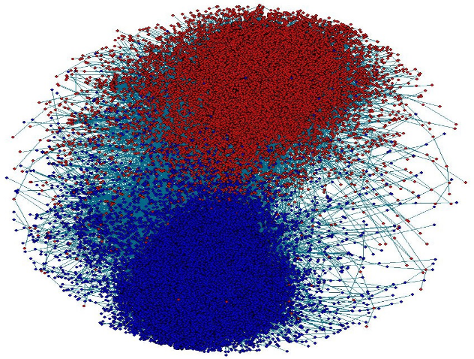
Force-directed Graph Drawing Algorithm
M
M
M
M
allgather positions of vertices
On each node do
for t < iteration-num; t←t+1 do
Calculate repulsive forces and displacements;
Calculate attractive forces and displacements;
Move the points with displacements limited by
temperature;
Allgather the new coordination values of the
points;
Near linear scalability Per-iteration on sequential R for 2012 network: 6035 seconds
T. Fruchterman, M. Reingold. “Graph Drawing by Force-Directed Placement”, Software Practice & Experience 21 (11), 1991.

Slide 65
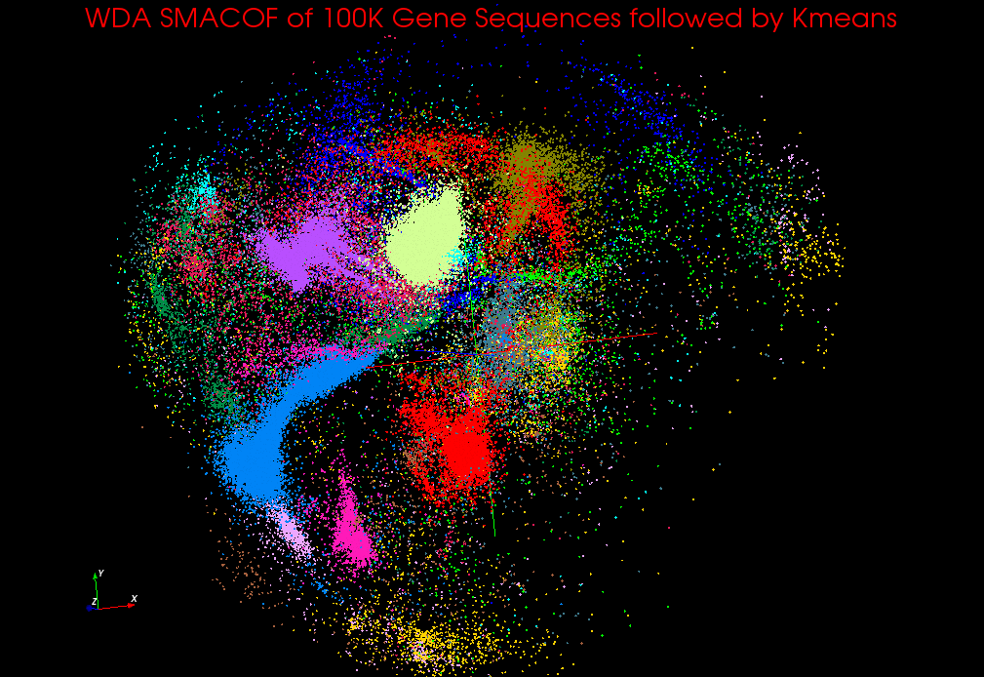
WDA-SMACOF
Scaling by Majorizing a Complicated Function (SMACOF) MDS algorithm
M
M
M
M
allgather and allreduce results in the conjugate gradient process
allreduce the stress value
On each node do
while current-temperature > min-temperature do
while stress-difference > threshold do
Calculate BC matrix;
Use conjugate gradient process to solve the
new coordination values;
(this is an iterative process which contains
allgather and allreduce operations)
Compute and allreduce the new stress value;
Calculate the difference of the stress
values;
Adjust the current temperature;
Y. Ruan et al. “A Robust and Scalable Solution for Interpolative Multidimensional Scaling With Weighting”. E-Science, 2013.

