Slide 1
Towards HPC-ABDS: An Initial Experience Optimizing Hadoop for Scalable High Performance Data Analytics
NDSSL, Virginia Tech
July 9, 2015
Judy Qiu

Slide 2
Important Trends
  In all fields of science and throughout life (e.g. web!)
  Data Analysis/Machine Learning
  Impacts preservation, access/use,
  programming model
    Mobile devices and Sensor network form the outskirts of the Internet
    50 billion devices by 2020
Big Data
Mobile
Clouds
HPC
  Implies parallel computing is important again
    Performance from extra cores in Manycore/GPU
    New commercially supported data center model building on compute grids
Notes:
Exponential data growth
Continuous analysis on streaming data
Multi/Manycore and GPU architectures
Thousand cores in clusters and millions in data centers
Cost and time tradeoff
Parallelism is a must to process data in a meaningful time

Slide 3
Challenges and Opportunities
Large-scale parallel simulations and data analysis drive scientific discovery across many disciplines
Research a holistic approach that will enable performance portability to any machine, while increasing developer productivity and accelerating the advance of science
― DOE Workshop Report: Machine Learning and Understanding for Intelligent Extreme Scale Scientific Computing and Discovery, January 7-9, 2015

Slide 4
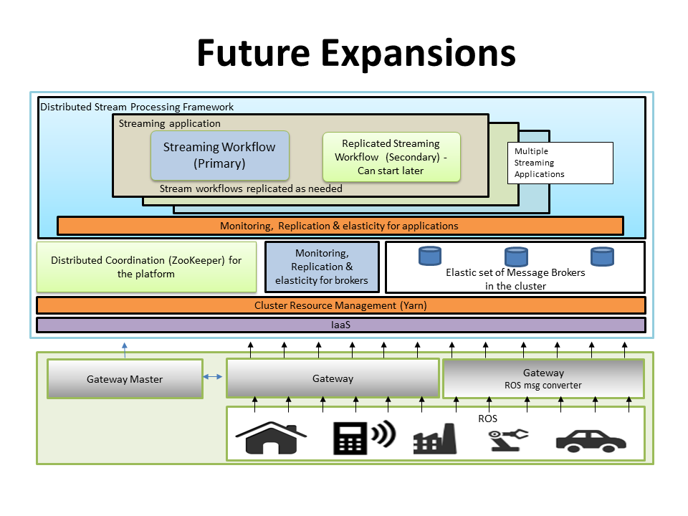
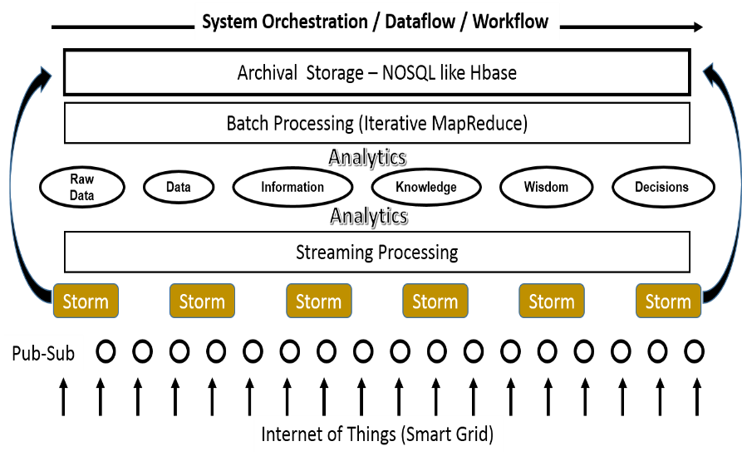
What Could Happen in 5 years?
The role of Analytics in Cloud, Big Data and Mobile
  Academia and Industry need advanced analytics on the data they have already collected.
  A distributed runtime environment needs to integrate with community infrastructure which supports interoperable, sustainable and high performance data analytics.
Data, Information, Knowledge and Wisdom

Slide 5
Software-Defined Distributed System (SDDS) as a Service includes:
Dynamic Orchestration and Dataflow
SDDS-aaS Tools
Provisioning
Image Management
IaaS Interoperability
NaaS, IaaS tools
Expt management
Dynamic IaaS NaaS
DevOps
Software
(Application
Or Usage) SaaS
Use HPC-ABDS
Class Usages e.g. run GPU & multicore
Applications
Control Robot
Cloud e.g. MapReduce
HPC e.g. PETSc, SAGA
Computer Science e.g. Compiler tools, Sensor nets, Monitors
Platform
PaaS
CloudMesh is a SDDSaaS tool that uses Dynamic Provisioning and Image Management to provide custom environments for general target systems
Involves (1) creating,
(2) deploying, and
(3) provisioning
of one or more images in a set of machines on demand http://mycloudmesh.org/
Software Defined Computing (virtual Clusters)
Hypervisor, Bare Metal
Operating System
Infrastructure
IaaS
Network
NaaS
Software Defined Networks
OpenFlow GENI

Slide 6
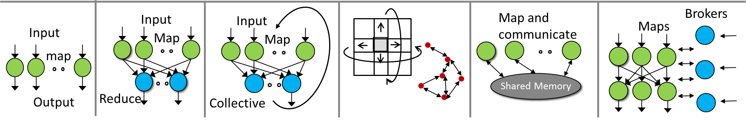
Applications and Computation Models
Pleasingly Parallel
  Parallelization over items
  E.g. BLAST, protein docking, and local analytics
Classic MapReduce
  E.g. search, index and query, and classification
Map Collective
  Iterative maps + collective communications
  E.g. PageRank, MDS, and clustering
Map Point-to-Point
  Iterative maps + point-to-point communications
  E.g. graph algorithms
Map Streaming
  Maps with streaming data
  E.g. Processing sensor data from robots
Shared Memory
  E.g. Applications in MineBench

Slide 7
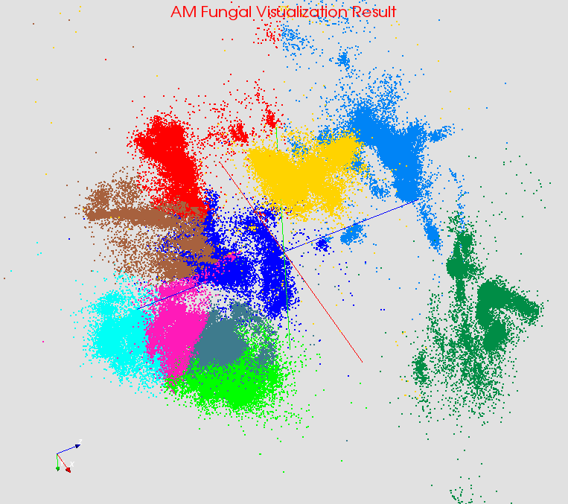

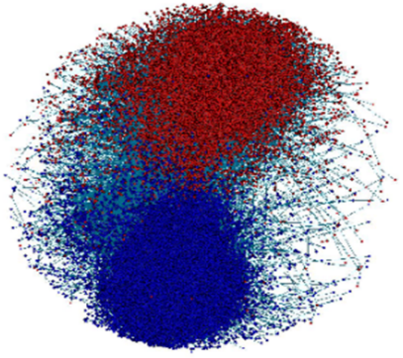
Large Scale Data Analysis Applications
Iterative Applications
  Cached and reused local data between iterations
  Complicated computation steps
  Large intermediate data in communications
  Various communication patterns
Bioinformatics
Computer Vision
Complex Networks
Deep Learning

Slide 8
Programming Model for Iterative MapReduce
Loop Invariant Data
Loaded only once
Configure()
Cacheable map/reduce tasks
(in memory)
Variable data
Main Program
while(..)
{
runMapReduce(..)
}
Map(Key, Value)
Faster intermediate data transfer mechanism
Reduce (Key, List<Value>)
Combine(Map<Key,Value>)
Combiner operation to collect all reduce outputs
Distinction on loop invariant data and variable data (data flow vs. δ flow)
Cacheable map/reduce tasks (in-memory)
Combine operation

Slide 9
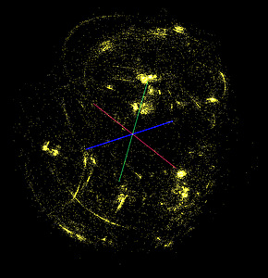
Demo of Multi-Dimensional Scaling using Iterative MapReduce
II. Send intermediate results
Master Node
ActiveMQ
Broker
Twister
Driver
MDS Monitor
Twister-MDS
PlotViz
I. Send message to start the job
Client Node
  Input: 30K metagenomics data
  MDS reads pairwise distance matrix of all sequences
  Output: 3D coordinates visualized in PlotViz

Slide 10

Iterative MapReduce -MDS Demo

Slide 11




MapReduce Optimized for Iterative Computations
Twister: the speedy elephant
  Abstractions
  In-Memory
  Cacheable map/reduce tasks
  Data Flow
  Iterative
  Loop Invariant
  Variable data
  Thread
  Lightweight
  Local aggregation
  Map-Collective
  Communication patterns optimized for large intermediate data transfer
  Portability
  HPC (Java)
  Azure Cloud (C#)
  Supercomputer (C++, Java)

Slide 12
  Why Collective Communications For Big Data Processing?
Motivations
Collective Communication Abstractions
  Our approach to optimize data movement
  Hierarchical data abstractions and operations defined on top of them
MapCollective Programming Model
  Extended from MapReduce model to support collective communications
  Two Level BSP parallelism
Harp Implementation
  A plugin on Hadoop
  Component layers and the job flow
Experiments

Slide 13
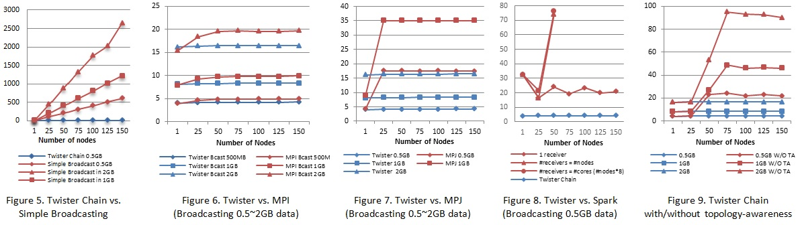
High Performance Data Movement
Tested on IU Polar Grid with 1 Gbps Ethernet connection
    At least a factor of 120 on 125 nodes, compared with the simple broadcast algorithm
    The new topology-aware chain broadcasting algorithm gives 20% better performance than best C/C++ MPI methods (four times faster than Java MPJ)
    A factor of 5 improvement over non-optimized (for topology) pipeline-based method over 150 nodes.

Slide 14
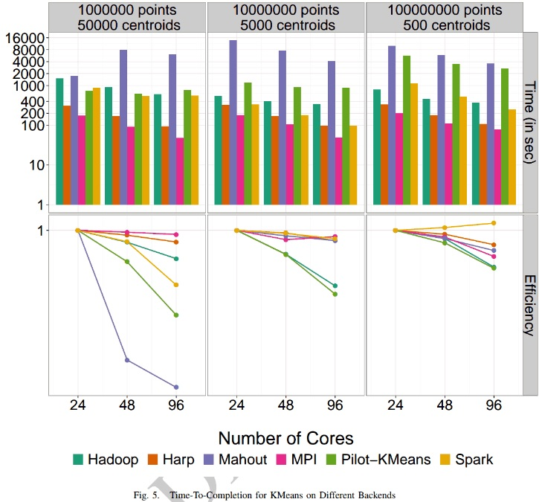
K-means Clustering Parallel Efficiency
Shantenu Jha et al. A Tale of Two Data-Intensive Paradigms: Applications, Abstractions, and Architectures. 2014.

Slide 15
Map-Collective
More efficient and much simpler!
K-means Clustering in
(Iterative) MapReduce
K-means Clustering in
Collective Communication
broadcast
M
M
M
M
M
M
M
M
shuffle
R
R
allreduce
gather
M: Compute local points sum
R: Compute global centroids
M: Control iterations and compute local points sum

Slide 16
Component Layers
Applications: K-Means, WDA-SMACOF, Graph-Drawing…
MapReduce Applications
MapCollective Applications
MapCollective Interface
Collective Communication APIs
Array, Key-Value, Graph Data Abstraction
MapCollective Programming Model
MapReduce V2
Harp
Collective Communication Operators
Hierarchical Data Types
(Tables & Partitions)
Memory Resource Pool
Collective Communication Abstractions
YARN
Task Management
MapReduce

Slide 17
Contributions
Parallelism Model
Architecture
MapReduce Model
MapCollective Model
MapReduce Applications
MapCollective Applications
Application
M
M
M
M
M
M
M
M
MapReduce V2
Harp
Shuffle
Framework
Collective Communication
R
R
Resource Manager
YARN

Slide 18

The Harp Library
Harp is an implementation designed in a pluggable way to bring high performance to the Apache Big Data Stack and bridge the differences between Hadoop ecosystem and HPC system through a clear communication abstraction, which did not exist before in the Hadoop ecosystem.
Hadoop Plugin that targets Hadoop 2.2.0
Provides implementation of the collective communication abstractions and MapCollective programming model
Project Link
  http://salsaproj.indiana.edu/harp/index.html
Source Code Link
  https://github.com/jessezbj/harp-project

Slide 19
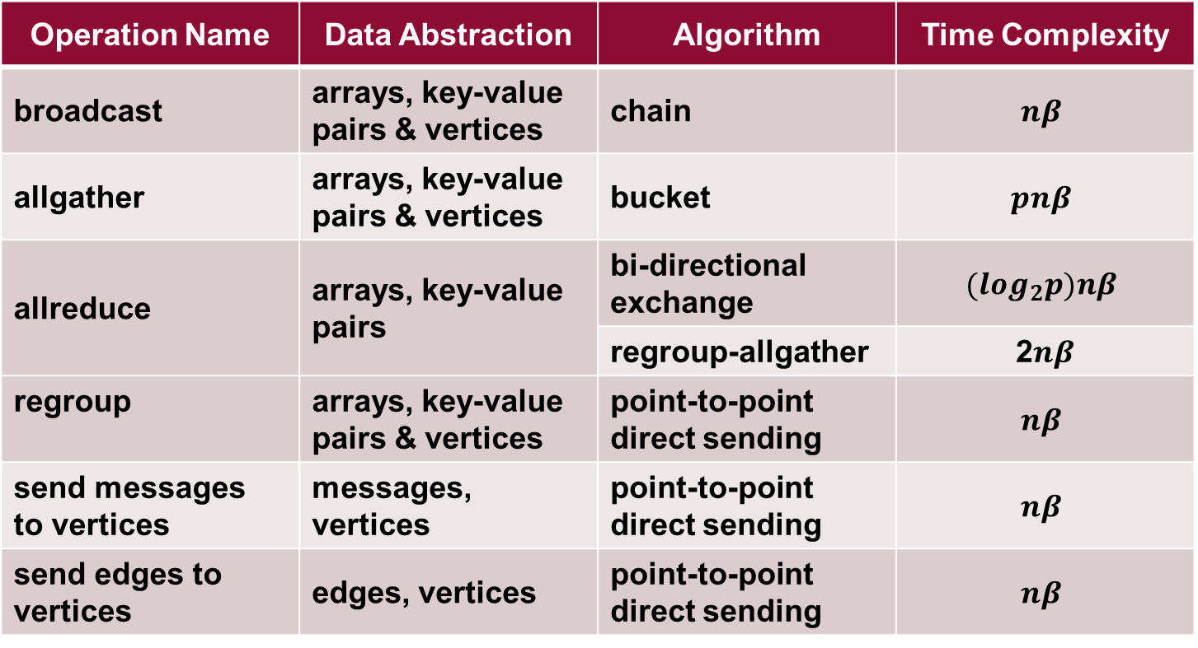
Collective Communication Operations
Operation Name | Data Abstraction | Algorithm | Time Complexity
broadcast | arrays, key-value pairs & vertices | chain | $$nβ$$
allgather | arrays, key-value pairs & vertices | bucket | $$pnβ$$
allreduce | arrays, key-value pairs | bi-directional exchange | $$(\log_{2}p)nβ$$
 |  | regroup-allgather | 2$nβ$
regroup | arrays, key-value pairs & vertices | point-to-point direct sending | $$nβ$$
send messages to vertices | messages, vertices | point-to-point direct sending | $$nβ$$
send edges to vertices | edges, vertices | point-to-point direct sending | $$nβ$$

Slide 20
MapCollective Programming Model
BSP parallelism Inter-node parallelism and inner node parallelism
Process Level
Thread Level
Process Level

Slide 21
A MapCollective Job
YARN Resource Manager
I. Launch AppMaster
II. Launch Tasks
Client
MapCollective
AppMaster
CollectiveMapper
2. Read key-value pairs
MapCollective
Container
Allocator
setup
MapCollective Runner
mapCollective
3. Invoke collective communication APIs
MapCollective
Container
Launcher
cleanup
4. Write output to HDFS
1. Record Map task locations from original MapReduce AppMaster

Slide 22
K-means Clustering
M
M
M
M
allreduce centroids
On each node do
for t < iteration-num; t←t+1 do
for each p in points do
for each c in centroids do
Calculate the distance between p and c;
Add point p to the closest centroid c;
Allreduce the local point sum;
Compute the new centroids;
Test Environment: Big Red II http://kb.iu.edu/data/bcqt.html

Slide 23
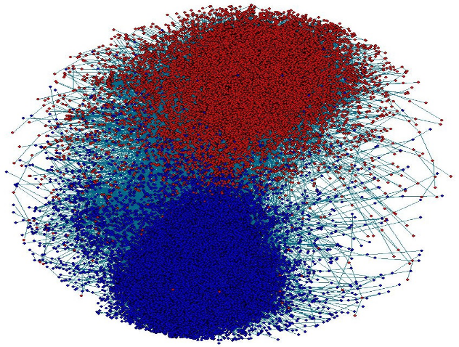
Force-directed Graph Drawing Algorithm
M
M
M
M
allgather positions of vertices
On each node do
for t < iteration-num; t←t+1 do
Calculate repulsive forces and displacements;
Calculate attractive forces and displacements;
Move the points with displacements limited by
temperature;
Allgather the new coordination values of the
points;
Near linear scalability Per-iteration on sequential R for 2012 network: 6035 seconds
T. Fruchterman, M. Reingold. “Graph Drawing by Force-Directed Placement”, Software Practice & Experience 21 (11), 1991.

Slide 24
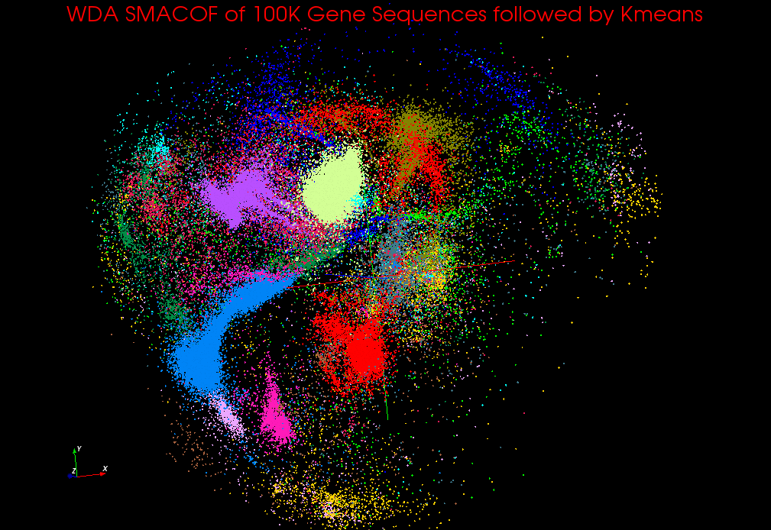
WDA SMACOF
The Scaling by Majorizing a Complicated Function (SMACOF) MDS algorithm is known to be fast and efficient. DA-SMACOF can reduce the time cost and find global optima by using deterministic annealing. The drawback is it assumes all weights are equal to one for all input distance matrices. To remedy this we added a weighting function to the SMACOF function, called WDA-SMACOF.
On each node do
while current-temperature > min-temperature do
while stress-difference > threshold do
Calculate BC matrix;
Use conjugate gradient process to solve the
new coordination values;
(this is an iterative process which contains
allgather and allreduce operations)
Compute and allreduce the new stress value;
Calculate the difference of the stress
values;
Adjust the current temperature;

Slide 25
WDA-SMACOF
M
M
M
M
allgather and allreduce results in the conjugate gradient process
We built Map-Collective as a unified model to improve the performance and expressiveness of Big Data tools. We run Harp on K-means, Graph Layout, and Multidimensional Scaling algorithms with realistic application datasets over 4096 cores on the IU BigRed II Supercomputer (Cray/Gemini) where we have achieved linear speedup.
allreduce the stress value
Y. Ruan et al. “A Robust and Scalable Solution for Interpolative Multidimensional Scaling With Weighting”. E-Science, 2013.

Slide 26
Collective Communication Abstractions
Hierarchical Data Abstractions
  Basic Types
    Arrays, key-values, vertices, edges and messages
  Partitions
    Array partitions, key-value partitions, vertex partitions, edge partitions and message partitions
  Tables
    Array tables, key-value tables, vertex tables, edge tables and message tables
Collective Communication Operations
  Broadcast, allgather, allreduce
  Regroup
  Send messages to vertices, send edges to vertices

Slide 27
Hierarchical Data Abstractions
broadcast, allgather, allreduce, regroup, message-to-vertex…
Table
Array Table <Array Type>
Edge
Table
Message Table
Vertex Table
Key-Value Table
Partition
Array Partition
<Array Type>
Edge Partition
Message Partition
Vertex Partition
Key-Value Partition
broadcast, send
Long Array
Int Array
Double Array
Byte Array
Vertices, Edges, Messages
Key-Values
Basic Types
Array
Object
broadcast, send
Transferable

Slide 28
The Models of Contemporary Big Data Tools
DAG Model
MapReduce Model
Graph Model
BSP/Collective Model
Hadoop
For Iterations/
Learning
HaLoop
Giraph
Twister
Hama
Spark
GraphLab
GraphX
Dryad
Harp
Stratosphere / Flink
For Streaming
S4
Samza
Many of them have fixed communication patterns!
Storm
Spark Streaming
For Query
DryadLINQ
Pig
Hive
Tez
Spark SQL
MRQL

Slide 29
http://hpc-abds.org/kaleidoscope/

Slide 30
Comparison of current Data Analytics stack from Cloud and HPC infrastructure
J. Qiu, S. Jha, A. Luckow, G. Fox, TowardsHPC-ABDS: An Initial High-Performance Big Data Stack, proceedings of ACM 1st Big Data Interoperability Framework Workshop: Building Robust Big Data ecosystem, NIST special publication, March 13-21, 2014.

Slide 31
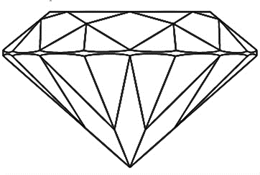
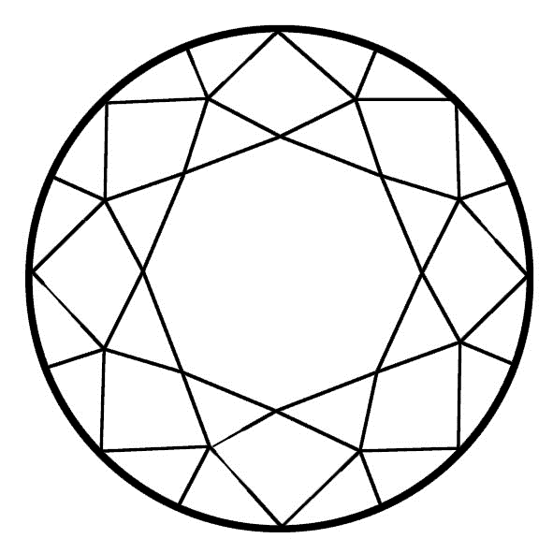

Big Data Ogres1
Systematic
  4 Dimensions – Problem architecture, Execution, Data source and style, and Processing
  50 facets
Classes of Problems
  Similar to Berkeley Dwarfs
Think of Diamonds ☺
Front View
Top View
Bottom View
¹Geoffrey C.Fox, S.J., Judy Qiu, Andre Luckow. Towards an Understanding of Facets and Exemplars of Big Data Applications. Available from: http://grids.ucs.indiana.edu/ptliupages/publications/OgrePaperv9.pdf
Notes:
If there were 8 more facets we could call it the brilliant cut Ogre :D

Slide 32

Ogre Views
14
$O\left(N^{2}\right)$ = NN / $O(N)$ = N
Shared / Dedicated / Transient / Permanent
13
Metric = M / Non-Metric = N
12
Data Abstraction
11
Iterative / Simple
Execution View
Data Source and Style View
10
Regular = R / Irregular = I
Geospatial Information System
Archived/Batched/Streaming
Benchmark
Dynamic = D / Static = S
9
8
Communication Structure
Metadata/Provenance
Enterprise Data Model
SQL/NoSQL/NewSQL
7
Veracity
HDFS/Lustre/GPFS
6
Variety
Velocity
HPC Simulations
Internet of Things
5
Data Source and Style View
  Data collection, storage, and access
  Many of the Big Data benchmarks
Files/Objects
4
Volume
Processing View
  Classes of processing steps
  Algorithms and kernels
3
Execution Environment; Core libraries
2
Flops/Byte
1
Performance Metrics
Ogre Views and Facets
Flops per Byte; Memory I/O
8
10
11
12
1
2
3
4
5
6
7
9
Ogre Views
10
9
8
7
6
5
4
3
2
1
Pleasingly Parallel
Classic MapReduce
Map-Collective
Map Point-to-Point
Map Streaming
Shared Memory
Single Program Multiple Data
Bulk Synchronous Parallel
Fusion
Dataflow
Agents
Workflow
Micro-benchmarks
1
Local Analytics
Problem Architecture View
  “Shape” of the application
  Relates to the machine architecture
2
Execution View
  Describes computational issues
  Traditional HPC benchmarks
  Impacts application performance
Global Analytics
3
Optimization Methodology
4
Visualization
5
Alignment
6
Streaming
7
Basic Statistics
Problem Architecture View
8
Search / Query / Index
9
Processing View
Recommender Engine
10
Classification
11
Deep Learning
12
Graph Algorithms
13
Linear Algebra Kernels
14

Slide 33
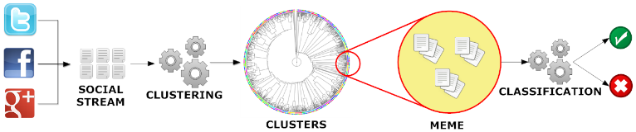
Parallel Tweet Clustering with Storm I
IU DESPIC analysis pipeline for meme clustering and classification : Detecting Early Signatures of Persuasion in Information Cascades
Implement with Hbase + Hadoop (Batch) and Hbase + Storm + ActiveMQ (Streaming)
2 million streaming tweets processed in 40 minutes; 35,000 clusters
Storm Bolts coordinated by ActiveMQ to synchronize parallel cluster center updates – add loops to Storm
Xiaoming Gao, Emilio Ferrara, Judy Qiu, Parallel Clustering of High-Dimensional Social Media Data Streams Proceedings of CCGrid, May 4-7, 2015

Slide 34
Social media data stream and it’s clustering
{
"text":"RT @sengineland: My Single Best... ",
"created_at":"Fri Apr 15 23:37:26 +0000 2011",
"retweet_count":0,
"id_str":"59037647649259521",
"entities":{
"user_mentions":[{
"screen_name":"sengineland",
"id_str":"1059801",
"name":"Search Engine Land"
}],
"hashtags":[],
"urls":[{
"url":"http:\/\/selnd.com\/e2QPS1",
"expanded_url":null
}]},
"user":{
"created_at":"Sat Jan 22 18:39:46 +0000 2011",
"friends_count":63,
"id_str":"241622902",
...},
"retweeted_status":{
"text":"My Single Best... ",
"created_at":"Fri Apr 15 21:40:10 +0000 2011",
"id_str":"59008136320786432",
...},
...
}
Group social messages sharing similar social meaning
  Text
  Hashtags
  URL’s
  Retweet
  Users
Useful in meme detection, event detection, social bots detection, etc.

Slide 35
Sequential algorithm for clustering tweet stream
Online (streaming) K-Means clustering algorithm with sliding time window and outlier detection
Group tweets in a time window as protomemes:
  Label protomemes (points in space to be clustered) by “markers”, which are Hashtags, User mentions, URLs, and phrases.
  A phrase is defined as the textual content of a tweet that remains after removing the hashtags, mentions, URLs, and after stopping and stemming
  In example, Number of tweets in a protomeme : Min: 1, Max :206, Average 1.33
Note a given tweet can be in more than one protomeme
  In example, one tweet on average appears in 2.37 protomemes
  And Number of protomemes is 1.8 times number of tweets

Slide 36
Defining Protomemes
Define protomemes as 4 high dimensional vectors or bags V_{T} V_{U} V_{C} V_{D}
A binary TID vector containing the IDs of all the tweets in this protomeme:
  V_{T} = [tid1 : 1, tid2 : 1, …, tidT : 1];
A binary UID vector containing the IDs of all the users who authored the tweets in this protomeme
  V_{U} = [uid1 : 1, uid2 : 1, …, uidU : 1];
A content vector containing the combined textual word frequencies (bag of words) for all the tweets in this protomeme
  V_{C} = [w1 : f1, w2 : f2, …, wC : fC];
A binary vector containing the IDs of all the users in the diffusion network of this protomeme. The diffusion network of a protomeme is defined as the union of the set of tweet authors, the set of users mentioned by the tweets, and the set of users who have retweeted the tweets.
  The diffusion vector is V_{D} = [uid1 : 1, uid2 : 1, …, uidD : 1].

Slide 37
Online K-Means clustering
Slide time window by one time step
Delete old protomemes out of time window from their clusters
Generate protomemes for tweets in this step
For each new protomeme classify in old or new cluster (outlier)
#p2
#p2
If marker in common with a cluster member, assign to that cluster
Otherwise it is an outlier and a candidate new cluster
If near a cluster, assign to nearest cluster

Slide 38
Parallelization with Storm – challenges I
DAG organization of parallel workers: hard to synchronize cluster information
Worker Process
ActiveMQ
Broker
Clustering Bolt
…
Clustering Bolt
Synchronization Coordinator Bolt
Protomeme Generator Spout
…
tweet stream
Worker Process
Clustering Bolt
…
Clustering Bolt
Calculate Cluster Centers
Parallelize Similarity Calculation
Synchronization initiation methods:
Spout initiation by broadcasting INIT message
Clustering bolt initiation by local counting
Sync coordinator initiation by global counting (of #protomemes)
Suffer from variation of processing speed

Slide 39
Parallelization with Storm – challenges II
Large size of high-dimensional vectors make traditional synchronization expensive
Data point 1:
Data point 2:
Content_Vector: [“step”:1, “time”:1, “nation”: 1,
“ram”:1]
Diffusion_Vector: …
…
Content_Vector: [“lovin”:1, “support”:1, “vcu”:1,
“ram”:1]
Diffusion_Vector: …
…
Centroid:
Content_Vector: [“step”:0.5, “time”:0.5, “nation”: 0.5, “ram”:1.0, “lovin”:0.5,
“support”:0.5, “vcu”:0.5]
Diffusion_Vector: …
…
Cluster
Cluster-delta synchronization strategy: transmit changes and not full vector

Slide 40
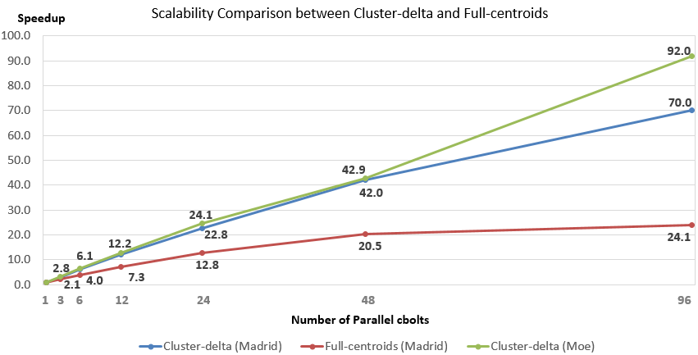
Parallel Tweet Clustering with Storm
Speedup on up to 96 bolts on two clusters Moe and Madrid
Red curve is old algorithm; green and blue new algorithm
Full Twitter – 1000 way parallelism
Full Everything – 10,000 way parallelism

Slide 41
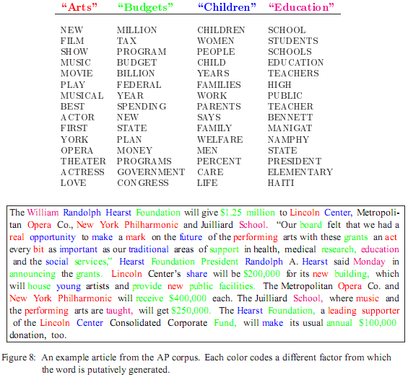
LDA: mining topics in text collection
Huge volumn of Text Data
  information overloading
  what on earth is inside the TEXT Data?
Search
  find the documents relevant to my need(ad hoc query)
Filtering
  fixed info needs and dynamic text data
What's new inside?
  discover something I don't know
Notes:
refer: 1.Blei, D. M., Ng, A. Y. & Jordan, M. I. Latent dirichlet allocation. J. Mach. Learn. Res. 3, 993–1022 (2003).

Slide 42
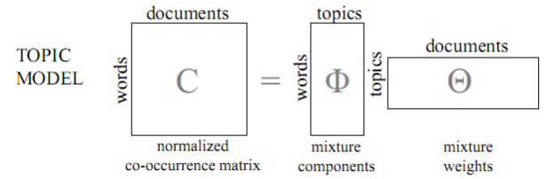
LDA and Topic Models
Topic Models is a modeling technique, modeling the data by probabilistic generative process.
Latent Dirichlet Allocation(LDA) is one widely used topic model.
Inference algorithm for LDA is an iterative algorithm using share global model data.
Document
Word
Topic: semantic unit inside the data
Topic Model:
  documents are mixtures of topics, where a topic is a probability distribution over words
Word-Topic Matrix
Topic-Doc Matrix
Model Data
Notes:
global model data should be word-topic matrix or topic-document matrix,

Slide 43
Inference Algorithm for LDA
Iterative:
  Calculate on every observed data point, then reassign its topic id
  Iteration until convergence
Global model data
  Calculation relies on random access of model data
  Model data: word-topic count matrix and topic-document count matrix

Slide 44
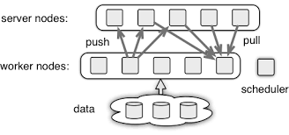
Challenges in large scale LDA
Model data can be too large to be held in one machine, how to do model data partition and synchronization efficiently?
How to exploit multi-cores and even GPUs to accelerate the local LDA training process?
“Big” LDA model with at least 10⁵ topics inferred from 10⁹ search queries
hierarchical distributed architecture
  sampling server: φ_{local}
  data server: Dmv , (m doc group, v word group )
  aggregation server: hierachical
asynchronous and delayed synchronization
a general parameter server architecture
Notes:
https://github.com/dmlc/parameter_server

Slide 45
Harp-LDA Execution Flow
Challenges
Task
Task
Task
Load Documents
Load Documents
Load Documents
High memory consumption
High number of iterations (~1000)
Computation intensive
Traditional “allreduce” operation in
MPI-LDA is unscalable.
Initial Sampling
Initial Sampling
Initial Sampling
Local Sampling Computation
Local Sampling Computation
Local Sampling Computation
Collective Communication
to generate the new global model
We use Harp-LDA to process 3775554 Wikipedia documents with a vocabulary of 1 million words and 200 topics on 6 machines, each of which has 16 processors and 40 GB memory.
Harp-LDA uses AD-LDA (Approximate Distributed LDA) algorithm (based on Gibbs sampling algorithm)
Harp-LDA runs LDA in iterations of local computation and collective communication.

Slide 46


Large-Scale Data Analysis and Applications
    Data analysis plays an important role in data-driven scientific discovery and commercial services. An interesting principle is that HPC ideas should integrate well with Apache (and other) open source big data technologies (ABDS). HPC-ABDS is a sustainable model that provides Cloud-HPC interoperable software building blocks with the performance of HPC (High Performance Computing) and the rich functionality of the commodity Apache Big Data Stack.
    SPIDAL (Scalable Parallel Interoperable Data Analytics Library) is an IU-led community infrastructure built upon the HPC-ABDS concept for Biomolecular Simulations, Network and Computational Social Science, Epidemiology, Computer Vision, Spatial Geographical Information Systems, Remote Sensing for Polar Science and Pathology Informatics.
    Illustrating HPC-ABDS, we have shown that previous standalone enhanced versions of MapReduce can be replaced by Harp (a Hadoop plug-in) that offers both data abstractions useful for high performance iteration and MPI-quality communication and can drive libraries like Mahout, MLlib, DAAL and Deep Learning on HPC and Cloud systems.
    Project: Optimize performance of SPIDAL data analytics both between and within nodes on leading edge Intel systems: initially Haswell and Knights Landing.
    Benefit: Data Analytics running on cloud and HPC Intel clusters with top performance
    Support Requested:
Classified OUT
Collaboration on Optimization
Funding of software engineer optimizing SPIDAL algorithm performance. $50K per year
IN
Bioinformatics
Computer Vision
Complex Networks
Deep Learning

Slide 47
Six Computation Models for Data Analytics
(1)
Map Only
(2)
Classic
(3)
Iterative
Map Reduce or
(4) Point to Point or
(5)
Map
-
Streaming
(6) Shared memory
Pleasingly Parallel
Map-Reduce
Map
-
Collective
Map
-
Communication
Map-
Communication
Input
Input
Input
Iterations
maps
brokers
Shared
Memory
map
map
map
Local
Map & Communication
Output
reduce
reduce
Graph
Events
BLAST Analysis
Local Machine Learning
Pleasingly Parallel
High Energy Physics (HEP) Histograms,
Web search
Recommender Engines
Expectation maximization
Clustering
Linear Algebra
PageRank
Classic MPI
PDE Solvers and Particle Dynamics
Graph
Streaming images from Synchrotron sources, Telescopes,
Internet of Things
Difficult to parallelize
asynchronous parallel
Graph

Slide 48
Machine Learning in Network Science, Imaging in Computer Vision
, Pathology, Polar Science, Biomolecular Simulations
Algorithm | Applications | Features | Status | Parallelism
Graph Analytics
Community detection | Social networks, webgraph | Graph . | P-DM | GML-GrC
Subgraph/motif finding | Webgraph, biological/social networks |  | P-DM | GML-GrB
Finding diameter | Social networks, webgraph |  | P-DM | GML-GrB
Clustering coefficient | Social networks |  | P-DM | GML-GrC
Page rank | Webgraph |  | P-DM | GML-GrC
Maximal cliques | Social networks, webgraph |  | P-DM | GML-GrB
Connected component | Social networks, webgraph |  | P-DM | GML-GrB
Betweenness centrality | Social networks | Graph, Non-metric, static | P-Shm | GML-GRA
Shortest path | Social networks, webgraph |  | P-Shm
Spatial Queries and Analytics
Spatial relationship based queries | GIS/social networks/pathology informatics | Geometric | P-DM | PP
Distance based queries |  |  | P-DM | PP
Spatial clustering |  |  | Seq | GML
Spatial modeling |  |  | Seq | PP
GML Global (parallel) ML
GrA Static
GrB Runtime partitioning

Slide 49
Some specialized data analytics in SPIDAL
Algorithm | Applications | Features | Status | Parallelism
Core Image Processing
Image preprocessing | Computer vision/pathology informatics | Metric Space Point Sets, Neighborhood sets & Image features | P-DM | PP
Object detection & segmentation |  |  | P-DM | PP
Image/object feature computation |  |  | P-DM | PP
3D image registration |  |  | Seq | PP
Object matching |  | Geometric | Todo | PP
3D feature extraction |  |  | Todo | PP
Deep Learning
Learning Network, Stochastic Gradient Descent | Image Understanding, Language Translation, Voice Recognition, Car driving | Connections in artificial neural net | P-DM | GML
aa
PP Pleasingly Parallel (Local ML)
Seq Sequential Available
GRA Good distributed algorithm needed
Todo No prototype Available
P-DM Distributed memory Available
P-Shm Shared memory Available

Slide 50
Some Core Machine Learning Building Blocks
Algorithm | Applications | Features | Status | //ism
DA Vector Clustering | Accurate Clusters | Vectors | P-DM | GML
DA Non metric Clustering | Accurate Clusters, Biology, Web | Non metric, O(N²) | P-DM | GML
Kmeans; Basic, Fuzzy and Elkan | Fast Clustering | Vectors | P-DM | GML
Levenberg-Marquardt Optimization | Non-linear Gauss-Newton, use in MDS | Least Squares | P-DM | GML
SMACOF Dimension Reduction | DA- MDS with general weights | Least Squares, O(N²) | P-DM | GML
Vector Dimension Reduction | DA-GTM and Others | Vectors | P-DM | GML
TFIDF Search | Find nearest neighbors in document corpus | Bag of “words” (image features) | P-DM | PP
All-pairs similarity search | Find pairs of documents with TFIDF distance below a threshold
 |  |  | Todo | GML
Support Vector Machine SVM | Learn and Classify | Vectors | Seq | GML
Random Forest | Learn and Classify | Vectors | P-DM | PP
Gibbs sampling (MCMC) | Solve global inference problems | Graph | Todo | GML
Latent Dirichlet Allocation LDA with Gibbs sampling or Var. Bayes | Topic models (Latent factors) | Bag of “words” | P-DM | GML
Singular Value Decomposition SVD | Dimension Reduction and PCA | Vectors | Seq | GML
Hidden Markov Models (HMM) | Global inference on sequence models | Vectors | Seq | PP & GML

Slide 51
Applications SPIDAL MIDAS ABDS
Govt. Operations | Commercial Defense |  | Healthcare, Life Science |  |  | Deep Learning, Social Media |  | Research Ecosystems | Astronomy, Physics |  | Earth, Env., Polar Science |  | Energy
(Inter)disciplinary Workflow
Analytics Libraries
Native ABDS SQL-engines, Storm, Impala, Hive, Shark |  | Native HPC MPI |  | HPC-ABDS MapReduce
 |  |  |  | Map Only, PP Many Task |  |  | Classic MapReduce |  |  | Map Collective |  | Map – Point to Point, Graph
MIddleware for Data-Intensive Analytics and Science (MIDAS) API
Communication (MPI, RDMA, Hadoop Shuffle/Reduce, HARP Collectives, Giraph point-to-point) |  |  |  |  |  |  | Data Systems and Abstractions (In-Memory; HBase, Object Stores, other NoSQL stores, Spatial, SQL, Files)
Higher-Level Workload Management (Tez, Llama) |  |  |  |  | Workload Management (Pilots, Condor) |  |  |  |  | Framework specific Scheduling (e.g. YARN)
External Data Access (Virtual Filesystem, GridFTP, SRM, SSH) |  |  |  |  |  |  | Cluster Resource Manager (YARN, Mesos, SLURM, Torque, SGE)
Compute, Storage and Data Resources (Nodes, Cores, Lustre, HDFS)
Community & Examples
SPIDAL
Programming & Runtime Models
MIDAS
Resource Fabric

Slide 52
Summary of Insights
Proposed classification of Big Data applications with features generalized as facets and kernels for analytics
Identification of Apache Big Data Software Stack and integration with High Performance Computing Stack to give HPC-ABDS
Integrate (don’t compete with) HPC and one’s research with ABDS
  i.e. improve Mahout and MLlib; don’t compete with them
  Use Hadoop plug-ins like Harp rather than replacing Hadoop and Spark
Identification of Six Computation Models for Data Analytics
Standalone Twister: Iterative Execution (caching) and High performance communication extended to first Map-Collective runtime
HPC-ABDS Plugin Harp: adds HPC communication performance and rich data abstractions to Hadoop
Online Clustering with Storm integrates parallel and dataflow computing models

