Slide 1
Scalable High Performance Data Analytics
Intel®PCC Showcase: Indiana University
May 22, 2017
Judy Qiu
Intelligent Systems Engineering Department, Indiana University
Email: xqiu@indiana.edu

Slide 2


Outline
1. Introduction: HPC-ABDS, Harp (Hadoop plug in), DAAL
2. Optimization Methodologies
3. Results (configuration, benchmark)
4. Code Optimization Highlights
5. Conclusions and Future Work

Slide 3
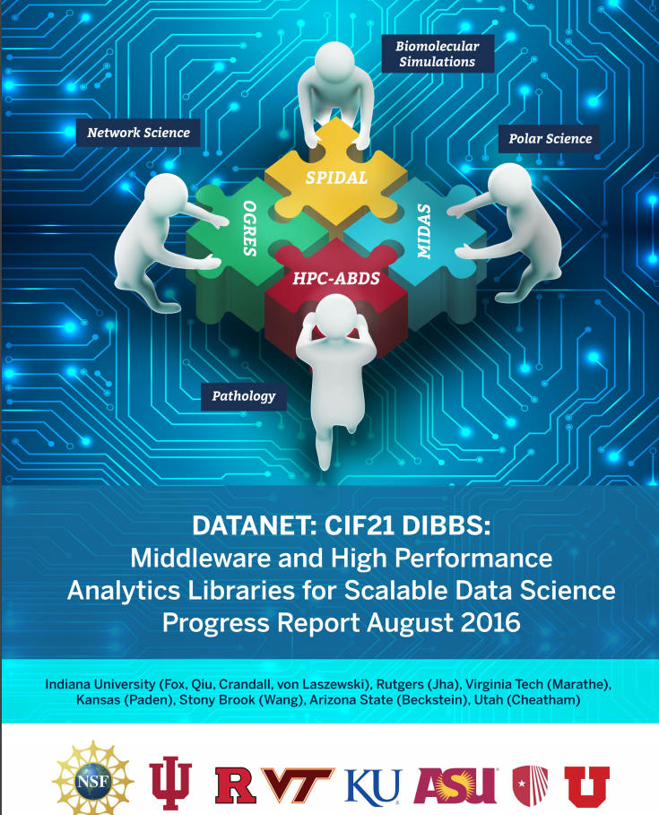

Slide 4
High Performance – Apache Big Data Stack
Big Data Application Analysis [1] [2] identifies features of data intensive applications that need to be supported in software and represented in benchmarks. This analysis has been extended to support HPC-Simulations-Big Data convergence.
The project is a collaboration between computer and domain scientists in application areas in Biomolecular Simulations, Network Science, Epidemiology, Computer Vision, Spatial Geographical Information Systems, Remote Sensing for Polar Science and Pathology Informatics.
HPC-ABDS [3] as Cloud-HPC interoperable software with performance of HPC (High Performance Computing) and the rich functionality of the commodity Apache Big Data Stack was a bold idea developed.
[1] Shantenu Jha, Judy Qiu, Andre Luckow, Pradeep Mantha, Geoffrey Fox, A Tale of Two Data-Intensive Paradigms: Applications, Abstractions, and Architectures, Proceedings of the 3rd International Congress on Big Data Conference (IEEE BigData 2014).
[2] Geoffrey Fox, Shantenu Jha, Judy Qiu, Andre Luckow, Towards an Understanding of Facets and Exemplars of Big Data Applications, accepted to the Twenty Years of Beowulf Workshop (Beowulf), 2014.
[3] Judy Qiu, Shantenu Jha, Andre Luckow, Geoffrey Fox, Towards HPC-ABDS: An Initial High-Performance Big Data Stack, accepted to the proceedings of ACM 1st Big Data Interoperability Framework Workshop: Building Robust Big Data ecosystem, NIST special publication, 2014.

Slide 5
Scalable Parallel Interoperable Data Analytics Library
MIDAS integrating middleware that links HPC and ABDS now has several components including an architecture for Big Data analytics, an integration of HPC in communication and scheduling on ABDS; it also has rules to get high performance Java scientific code.
SPIDAL (Scalable Parallel Interoperable Data Analytics Library) now has 20 members with domain specific and core algorithms.
Language: SPIDAL Java runs as fast as C++
Designed and Proposed HPCCloud as hardware-software infrastructure supporting
  Big Data Big Simulation Convergence
  Big Data Management via Apache Stack ABDS
  Big Data Analytics using SPIDAL and other libraries

Slide 6
Motivation for faster and bigger problems
Machine Learning Needs high performance
  Big data and Big model
  Iterative algorithms are fundamental in learning a non-trivial model
  Model training and Hyper-parameter tuning steps run the iterative algorithms many times
Architecture for Big Data analytics
  to understand the algorithms through a Model-Centric view
  to focus on the computation and communication patterns for optimizations
  Trade-offs of efficiency and productivity
    linear speedup with an increasing number of processors
    easier to be parallelized on multicore or manycore computers

Slide 7
Motivation of Iterative MapReduce
MapReduce
Classic Parallel Runtimes (MPI)
Data Centered, QoS
Efficient and Proven techniques
Expand the Applicability of MapReduce to more classes of Applications
Sequential
Map-Only
MapReduce
Iterative MapReduce
MPI and Point-to-Point
Input
Input
Input
iterations
Input
map
map
map
map
Pij
Output
Output
reduce
reduce

Slide 8

Programming Model for Iterative MapReduce
Loop Invariant Data
Loaded only once
Intermediate data
Configure()
Cacheable map/reduce tasks
(in memory)
Main Program
Twister was our initial implementation with first paper having 854 Google Scholar citations
Map(Key, Value)
while(..)
{
runMapReduce(..)
}
Faster intermediate data transfer mechanism
Reduce (Key, List<Value>)
Combine(Map<Key,Value>)
Combiner operation to collect all reduce outputs
Iterative MapReduce is a programming model that applies a computation (e.g. Map task) or function repeatedly, using output from one iteration as the input of the next iteration. By using this pattern, it can solve complex computation problems by using apparently simple (user defined) functions.
Distinction on loop invariant (e.g. input) data and variable (e.g. intermediate) data
Cacheable map/reduce tasks (in-memory)
Combine operation

Slide 9




MapReduce Optimized for Iterative Computations
The speedy elephant
  Abstractions
  In-Memory [3]
  Cacheable map/reduce tasks
  Data Flow [3]
  Iterative
  Loop Invariant
  Variable data
  Thread [3]
  Lightweight
  Local aggregation
  Map-Collective [5]
  Communication patterns optimized for large intermediate data transfer
  Portability [4][5]
  HPC (Java)
  Azure Cloud (C#)
  Supercomputer (C++, Java)
Three PhD thesis/publications:
[3] J. Ekanayake et. al, “Twister: A Runtime for Iterative MapReduce”, in Proceedings of the 1st International Workshop on MapReduce and its Applications of ACM HPDC 2010 conference.
[4] T. Gunarathne et. al, “Portable Parallel Programming on Cloud and HPC: Scientific Applications of Twister4Azure”, in Proceedings of 4th IEEE International Conference on Utility and Cloud Computing (UCC 2011).
[5] B. Zhang et. al, “Harp: Collective Communication on Hadoop,” in Proceedings of IEEE International Conference on Cloud Engineering (IC2E 2015).

Slide 10
The Concept of Harp Plug-in
Parallelism Model
Architecture
MapReduce Model
MapCollective Model
MapReduce Applications
MapCollective Applications
Application
M
M
M
M
M
M
M
M
MapReduce V2
Harp
Shuffle
Framework
Collective Communication
R
R
Resource Manager
YARN
Harp is an open-source project developed at Indiana University [6], it has:
MPI-like collective communication operations that are highly optimized for big data problems.
Harp has efficient and innovative computation models for different machine learning problems.
[6] Harp project. Available at https://dsc-spidal.github.io/harp

Slide 11
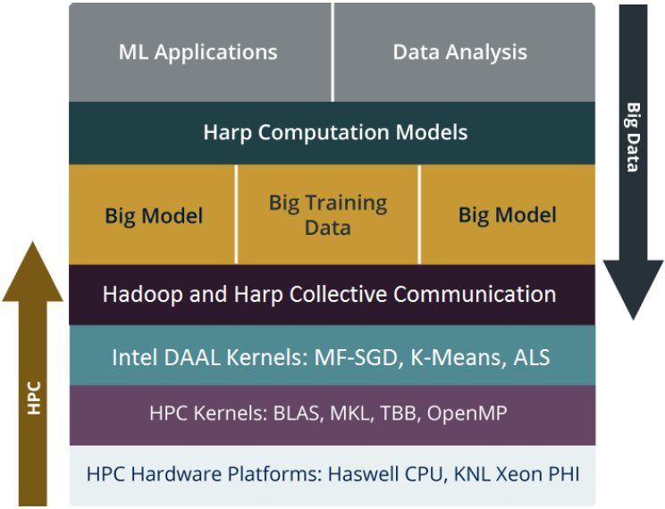
Harp-DAAL Framework for Multi-core and Many-core architectures
Bridge the gap between HPC hardware and Big data/Machine learning Software
Support Iterative Computation, Collective Communication, Intel DAAL and native kernels
Portable to new many-core architectures like Xeon Phi and run on Haswell and KNL clusters

Slide 12
Harp-DAAL: Machine Learning Algorithms
witin Hadoop Clusters on Multi/Many-core Hardware
Bridge the gap between HPC hardware and Big data/Machine learning Software
Iterative MapReduce + Collective Communication + Intel DAAL HPC native kernels
Good support to new many-core architecture like Intel Xeon Phi KNL

Slide 13
Outline
1. Introduction: HPC-ABDS, Harp (Hadoop plug in), DAAL
2. Optimization Methodologies
3. Results (configuration, benchmark)
4. Code Optimization Highlights
5. Conclusions and Future Work

Slide 14
General Reduction in Hadoop, Spark, Flink
Map Tasks
Comparison of Reductions:
Separate Map and Reduce Tasks
Switching tasks is expensive
MPI only has one sets of tasks for map and reduce
MPI achieves AllReduce by interleaving multiple binary trees
MPI gets efficiency by using shared memory intra-node (e.g. multi-/manycore, GPU)
Reduce Tasks
Follow by Broadcast for AllReduce which is a common approach to support iterative algorithms
For example, paper [7] 10 learning algorithms can be written in a certain “summation form,” which allows them to be easily parallelized on multicore computers.
Output partitioned with Key
[7] Cheng-Tao Chu, Sang Kyun Kim, Yi-An Lin, YuanYuan Yu, Gary Bradski, Andrew Y. Ng and Kunle Olukotun, Map-Reduce for Machine Learning on Multicore,
in NIPS 19 2007.

Slide 15

HPC Runtime versus ABDS distributed Computing Model on Data Analytics
Hadoop writes to disk and is slowest; Spark and Flink spawn many processes and do not support allreduce directly; MPI does in-place combined reduce/broadcast

Slide 16
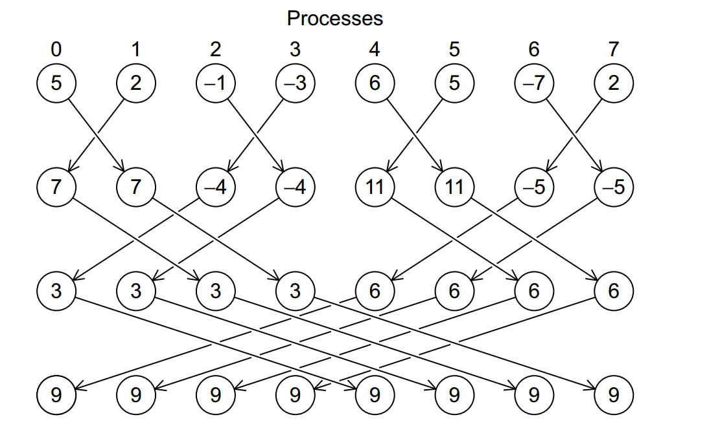
Illustration of In-Place AllReduce in MPI

Slide 17
  Why Collective Communications for Big Data Processing?
Collective Communication and Data Abstractions
  Optimization of global model synchronization
    ML algorithms: convergence vs. consistency
    Model updates can be out of order
  Hierarchical data abstractions and operations
Map-Collective Programming Model
  Extended from MapReduce model to support collective communications
  BSP parallelism at Inter-node vs. Intra-node levels
Harp Implementation
  A plug-in to Hadoop

Slide 18
Harp APIs
Scheduler
Collective
broadcast
Event Driven
reduce
allgather
allreduce
regroup
push
pull
rotate
getEvent
waitEvent
sendEvent
DynamicScheduler
StaticScheduler

Slide 19
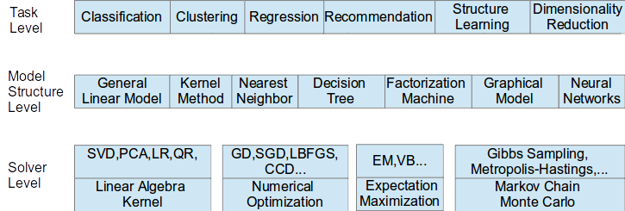
Taxonomy for Machine Learning Algorithms
Optimization and related issues
  Task level only can't capture the traits of computation
  Model is the key for iterative algorithms, it's structure, e.g., vectors, matrix, tree, matrices, and size are critical for performance
  Solver has specific computation and communication pattern
We investigate different computation and communication patterns of important ml algorithms

Slide 20
Parallel Machine Learning Application Implementation Guidelines
Computation Model
Collective Communication Operations
Algorithm
Load Balancing on Computation and Communication
System Optimization
Locking, Rotation, Allreduce, Asynchronous
Expectation-Maximization, Gradient Optimization, Markov Chain Monte Carlo…
Per-Thread Implementation
Latent Dirichlet Allocation, Matrix Factorization, Linear Regression…
Application

Slide 21
Computation Models

Slide 22
Harp Solution to Big Data Problems
Distributed Memory
Computation Models
Model-Centric Synchronization Paradigm
broadcast
regroup
sendEvent
reduce
push & pull
getEvent
Computation Models
allgather
rotate
waitEvent
allreduce
Communication Operations
Locking
Rotation
Shared Memory
Asynchronous
Schedulers
Harp-DAAL
High Performance Library
Allreduce
Dynamic Scheduler
Static Scheduler

Slide 23
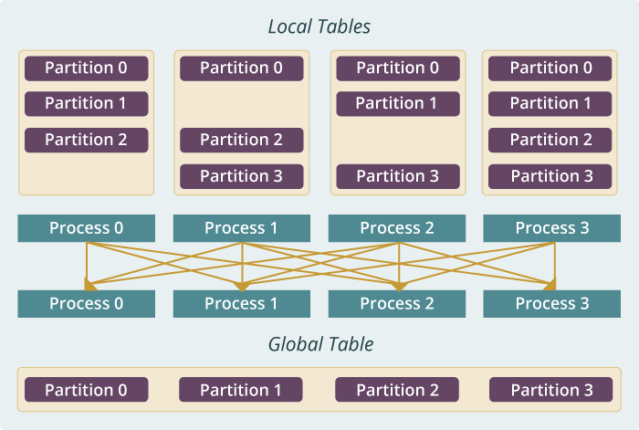
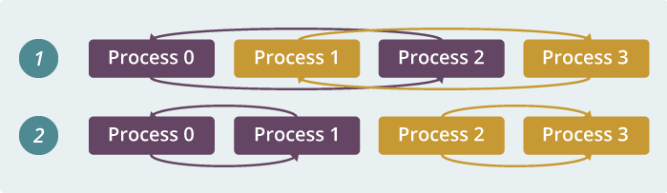
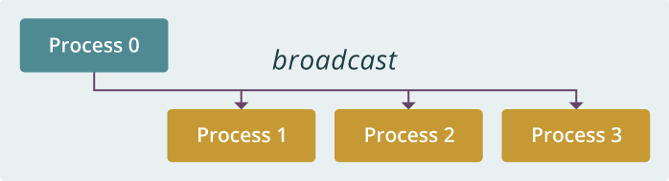
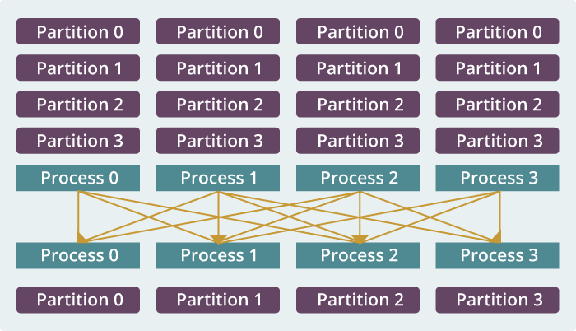
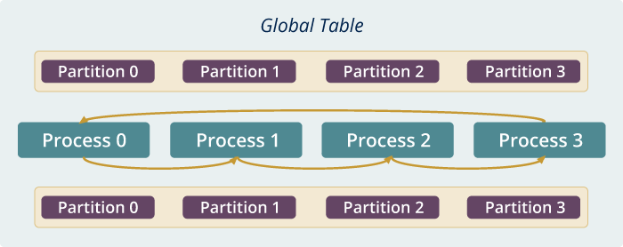
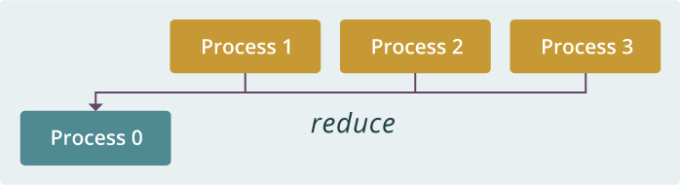
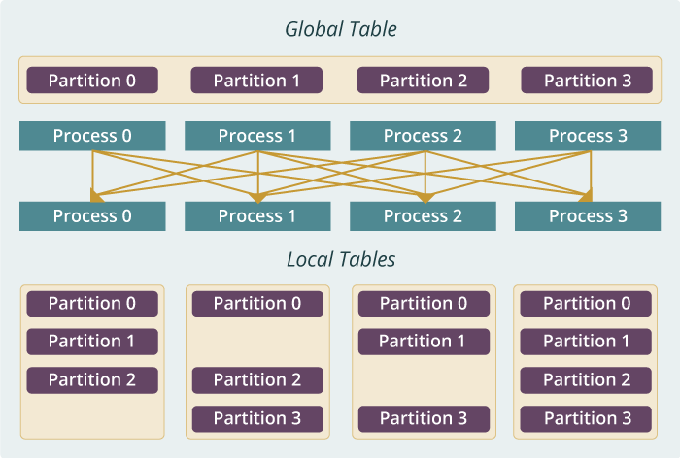
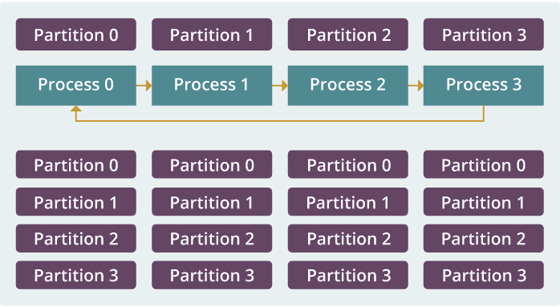
Example: K-means Clustering
The Allreduce Computation Model
Model
Worker
Worker
Worker
When the model size cannot be held in each machine’s memory
When the model size is small
When the model size is large but can still be held in each machine’s memory
broadcast
regroup
push & pull
allreduce
reduce
allgather
rotate

Slide 24
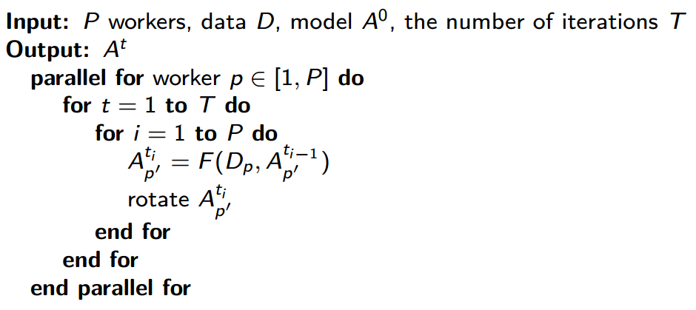
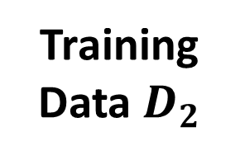
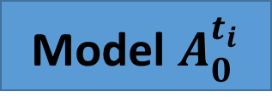
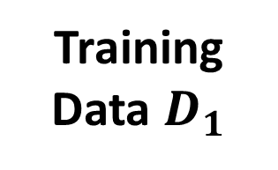
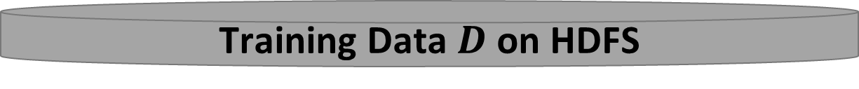
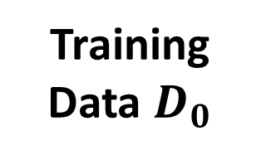

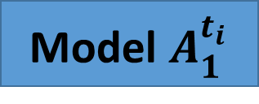
An Parallelization Solution Example
Model Rotation
3
Iteration Control
2
Rotate Model
Worker 0
Worker 1
Worker 2
Model $A_{0}^{t_{i}}$
Model $A_{1}^{t_{i}}$
Model $A_{2}^{t_{i}}$
Training Data $D_{0}$
Training Data $D_{1}$
Training Data${ D}_{2}$
Goals:
Maximizing the effectiveness of parallel model updates for algorithm convergence
Minimizing the overhead of communication for scaling
1
Local Compute
Load, Cache & Initialize
Training Data $D$ on HDFS

Slide 25
Outline
1. Introduction: HPC-ABDS, Harp (Hadoop plug in), DAAL
2. Optimization Methodologies
3. Results (configuration, benchmark)
4. Code Optimization Highlights
5. Conclusions and Future Work

Slide 26
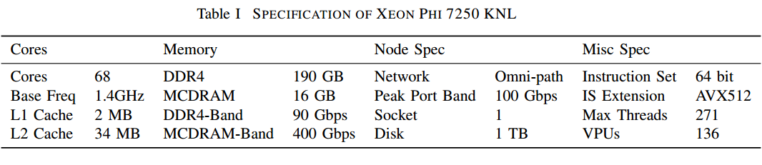
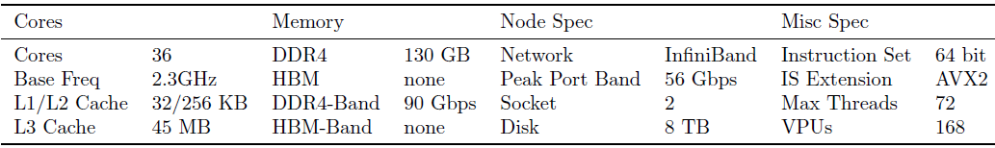
Hardware specifications

Slide 27
Harp-LDA Test Plan and Datasets
Dataset | Documents | Words | Tokens | LDA Parameters
clueweb | 76,163,963 | 999,933 | 29,911,407,874 | K = 10000 α = 0.01 β = 0.01
enwiki | 3,775,554 | 1,000,000 | 1,107,903,672
Test Harp LDA (Latent Dirichlet Allocation) and other state-of-the-art implementations
  Petuum Strads LDA
  Yahoo! LDA
Test with the same number of threads on Haswell and KNL
Throughput scalability test on Haswell and KNL

Slide 28
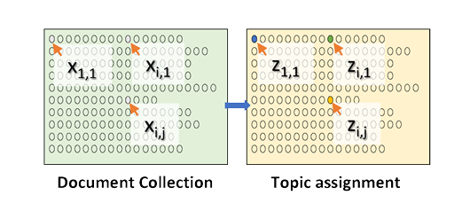
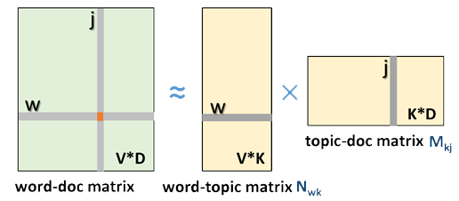
LDA and Topic model for Text Mining
Topic Models is a modeling technique, modeling the data by probabilistic generative process.
Latent Dirichlet Allocation (LDA) is one widely used topic model.
Inference algorithm for LDA is an iterative algorithm using share global model data.
Document
Word
Topic: semantic unit inside the data
Topic Model
  documents are mixtures of topics, where a topic is a probability distribution over words
Global Model Data
3.7 million docs
10k topics
1 million words
Blei, D. M., Ng, A. Y. & Jordan, M. I. Latent Dirichlet Allocation. J. Mach. Learn. Res. 3, 993–1022 (2003).
  Normalized co-occurrence matrix
  Mixture components
  Mixture weights

Slide 29
The Comparison of LDA CGS Model Convergence Speed
The parallelization strategy can highly affect the algorithm convergence and the system efficiency. This brings us four questions:
What part of the model needs to be synchronized?
The parallelization needs to decide which model parts needs synchronization.
When should the model synchronization happen?
In the parallel execution timeline, the parallelization should choose the time point to perform model synchronization.
Where should the model synchronization occur?
The parallelization needs to tell the distribution of the model among parallel components, what parallel components are involved in the model synchronization.
How is the model synchronization performed?
The parallelization needs to explain the abstraction and the mechanism of the model synchronization.
rtt & Petuum: rotate model parameters
lgs & lgs-4s: one or more rounds of model synchronization per iteration
Yahoo!LDA: asynchronously fetch model parameters

Slide 30
Code Optimization Highlights
Choose the proper computation model
Use optimized collective communication
Improve load balancing between parallel nodes
Optimize data structures and loop structures
Improve caching and avoid re-calculation

Slide 31
clueweb: 720 threads in total
Haswell 24x30
KNL 12x60
KNL is four times slower than Haswell when the number of threads is equal

Slide 32
enwiki: 300 threads in total
Haswell 10x30
KNL 5x60

Slide 33
Scalability Test on Haswell
2x30
4x30
8x30
16x30

Slide 34
Haswell Throughput Scalability on enwiki
Harp-LDA has the highest throughput, but the speedup is a little lower than the other implementations

Slide 35
Scalability Test on KNL (1)
2x60
4x60

Slide 36
Scalability Test on KNL (2)
8x60
16x60

Slide 37
KNL Throughput Scalability on enwiki
Harp-LDA has the highest throughput, but the speedup is a little lower than the other implementations

Slide 38
Code Optimization Highlights
Apply high-performance inter/intra-node parallel computation model
  Use model rotation in both inter-node and intra-node
Dynamic control on model synchronization
  Time controlled synchronization
Utilize efficient data structures
  Use arrays to store topic counts
  Combine arrays and maps for fast topic search and traversal during the sampling procedure
Loop optimization for token sampling
  Loop through words and then the documents
  Sort topic counts to let the topic with large count come first and reduce the time spent on looping
Caching intermediate results in the sampling process
  Avoid recalculating topic probabilities during the sampling procedure

Slide 39
Conclusion
Harp LDA is 2x~4x faster than Petuum Strads LDA and more than 10x faster than Yahoo! LDA
Harp LDA has higher throughput of token sampling than Petuum Strads LDA and Yahoo! LDA at all the scales
The performance gain comes from a collection of system optimizations through understanding the time complexity bounds in different stages of the SparseLDA algorithm.
When the total number of threads is equal, KNL machines are about four times slower than Haswell machines.
  It concludes that, for LDA, when the total number of processors is equal, KNL machines (each use 60 of 68 cores) has the similar performance compared with Haswell machines (each has two processors and each processor uses 15 of 18 cores)

Slide 40
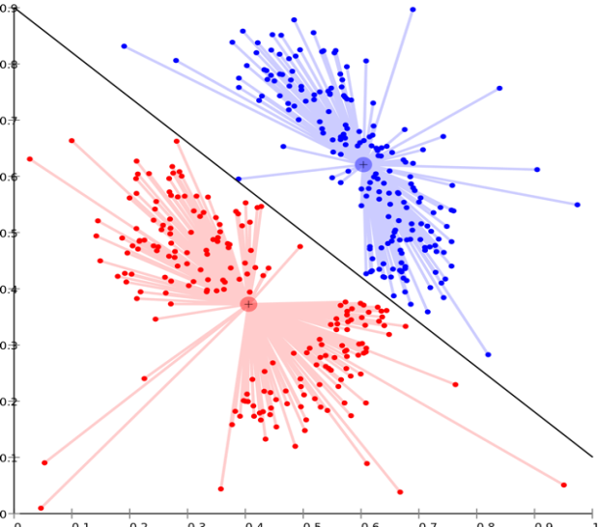
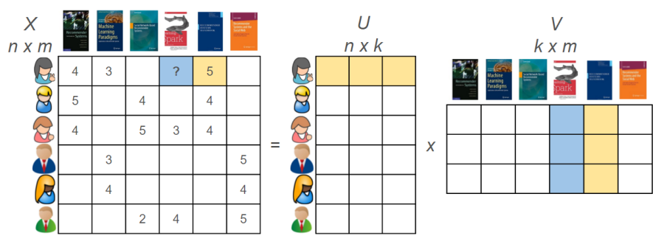
Harp-DAAL Applications
Harp-DAAL-Kmeans
Harp-DAAL-SGD
Harp-DAAL-ALS
Matrix Factorization
Huge model data
Random Memory Access
Easy to scale up
Hard to parallelize
Matrix Factorization
Huge model data
Regular Memory Access
Easy to parallelize
Hard to scale up
Clustering
Vectorized computation
Small model data
Regular Memory Access

Slide 41
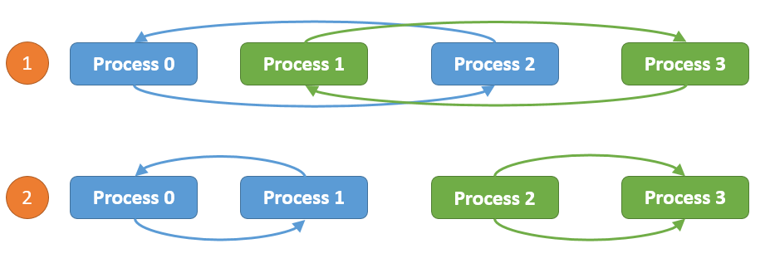
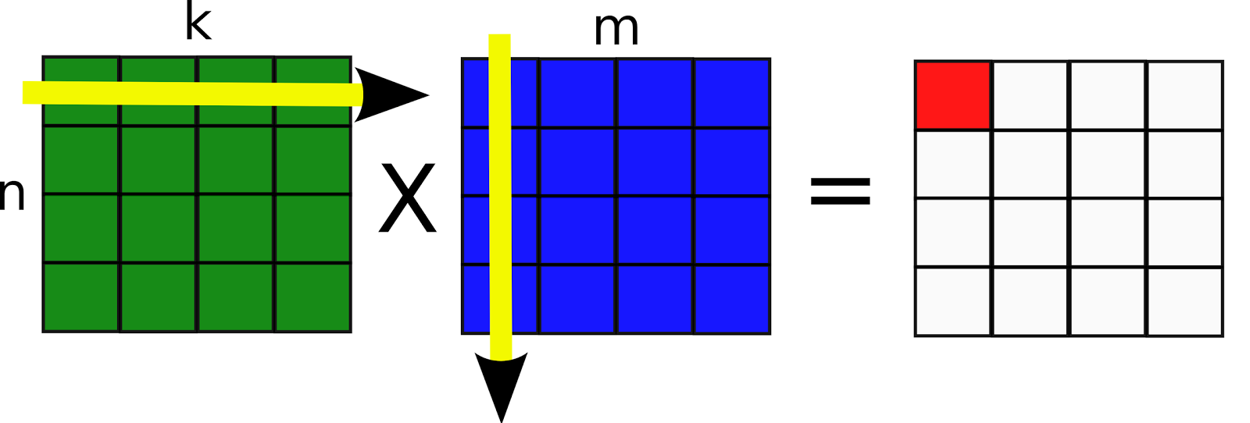
Computation models for K-means
Harp-DAAL-Kmeans
Inter-node: Allreduce, Easy to implement, efficient when model data is not large
Intra-node: Shared Memory, matrix-matrix operations, xGemm: aggregate vector-vector distance computation into matrix-matrix multiplication, higher computation intensity (BLAS-3)

Slide 42
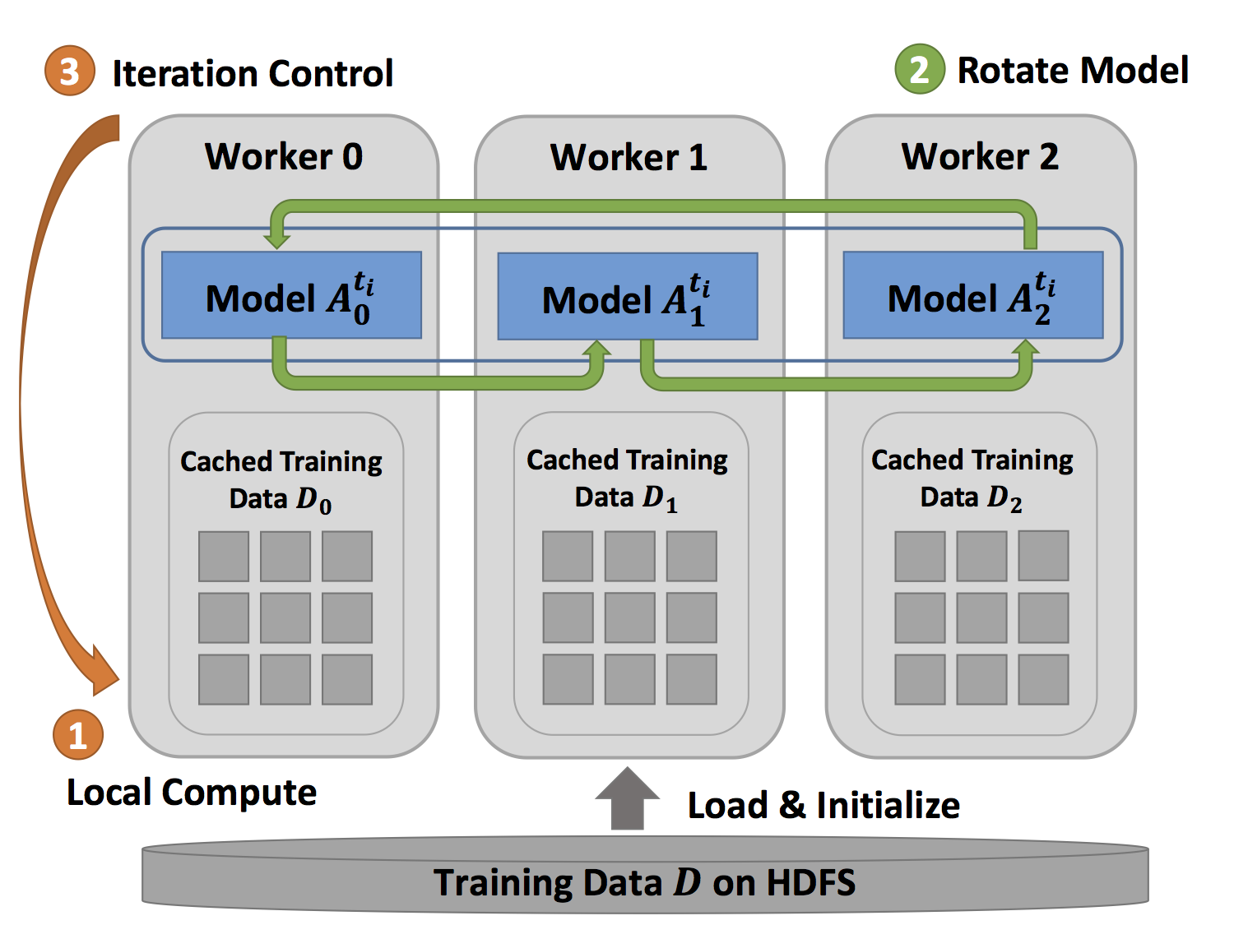
Computation models for MF-SGD
Inter-node: Rotation
Intra-node: Asynchronous
Rotation: Efficent when the mode data
Is large, good scalability
Asynchronous: Random access to model data, good
For thread-level workload balance

Slide 43


Computation Models for ALS
Inter-node: Allreduce
Intra-node: Shared Memory, Matrix operations
xSyrk: symmetric rank-k update

Slide 44
Performance on Single Node
Harp-DAAL-Kmeans vs. Spark-Kmeans:
~ 20x speedup
Harp-DAAL-Kmeans invokes MKL matrix operation kernels at low level
Matrix data stored in contiguous memory space, leading to regular access pattern and data locality
Harp-DAAL-SGD vs. NOMAD-SGD
Small dataset (MovieLens, Netflix): comparable perf
Large dataset (Yahoomusic, Enwiki): 1.1x to 2.5x, depending on data distribution of matrices
Harp-DAAL-ALS vs. Spark-ALS
20x to 50x speedup
Harp-DAAL-ALS invokes MKL at low level
Regular memory access, data locality in matrix operations
Harp-DAAL has much better single node performance than Java solution (Spark-Kmeans, Spark-ALS) and comparable performance to state-of-arts C++ solution (NOMAD-SGD)

Slide 45
Performance on Multi-Nodes
Harp-DAAL-Kmeans:
15x to 20x speedup over Spark-Kmeans
Fast single node performance
Near-linear strong scalability from 10 to 20 nodes
After 20 nodes, insufficient computation workload leads to some loss of scalability
Harp-DAAL-SGD:
2x to 2.5x speedup over NOMAD-SGD
Comparable or fast single node performance
Collective communication operations in Harp-DAAL outperform point-to-point MPI communication in NOMAD
Harp-DAAL-ALS:
25x to 40x speedup over Spark-ALS
Fast single node performance
ALS algorithm is not scalable (high communication ratio)
Harp-DAAL combines the benefits from local computation (DAAL kernels) and communication operations (Harp), which is much better than Spark solution and comparable to MPI solution.

Slide 46
Breakdown of Intra-node Performance
Thread scalability:
Harp-DAAL best threads number: 64 (K-means, ALS) and 128 (MF-SGD), more than 128 threads no performance gain
communications between cores intensify
cache capacity per thread also drops significantly
Spark best threads number 256, because Spark could not fully Utilize AVX-512 VPUs
NOMAD-SGD could use AVX VPU, thus has 64 its best thread as that of Harp-DAAL-SGD

Slide 47
Breakdown of Intra-node Performance
Spark-Kmeans and Spark-ALS dominated by Computation (retiring), no AVX-512 to reduce
retiring Instructions, Harp-DAAL improves L1 cache bandwidth utilization due to AVX-512

Slide 48
Data Conversion Challenge
Code Optimization Highlights
Harp Data
DAAL Java API
DAAL Native Kernel
Table<Obj>
Data on JVM Heap
NumericTable
Data on JVM heap
Data on Native Memory
MicroTable
Data on Native Memory
A single DirectByteBuffer
has a size limite of 2 GB
Store data at DAAL Java API in two ways
Keep Data on JVM heap (no contiguous memory access requirement )
  Small size DirectByteBuffer and parallel copy (OpenMP)
Keep Data on Native Memory ( contiguous memory access requirement )
  Large size DirectByteBuffer and bulk copy

Slide 49
Data Structures of Harp & Intel’s DAAL
Table<Obj> in Harp has a three-level data
Hierarchy
Table: consists of partitions
Partition: partition id, container
Data container: wrap up Java objs, primitive arrays
Data in different partitions, non-contiguous in
memory
Harp Table consists of Partitions
NumericTable in DAAL stores data either in
Contiguous memory space (native side)
or non-contiguous arrays (Java heap side)
Data in contiguous memory space favors matrix
operations with regular memory accesses.
DAAL Table has different types of Data storage

Slide 50
Two Types of Data Conversion
JavaBulkCopy:
Dataflow: Harp Table<Obj> -----
Java primitive array ---- DiretByteBuffer ----
NumericTable (DAAL)
Pros: Simplicity in implementation
Cons: high demand of DirectByteBuffer size
NativeDiscreteCopy:
Dataflow: Harp Table<Obj> ----
DAAL Java API (SOANumericTable)
---- DirectByteBuffer ---- DAAL native memory
Pros: Efficiency in parallel data copy
Cons: Hard to implement at low-level kernels

Slide 51
Outline
1. Introduction: HPC-ABDS, Harp (Hadoop plug in), DAAL
2. Optimization Methodologies
3. Results (configuration, benchmark)
4. Code Optimization Highlights
5. Conclusions and Future Work

Slide 52
Six Computation Paradigms for Data Analytics
(1)
Map Only
(2)
Classic
(3)
Iterative
Map Reduce or
(4) Point to Point or
(5)
Map
-
Streaming
(6) Shared memory
Map
Pleasingly Parallel
Map-Reduce
-
Collective
Map
-
Communication
Map-
Communication
Input
Input
Input
Iterations
maps
brokers
Shared
Memory
map
map
map
Local
Map & Communication
Output
reduce
reduce
Graph
Events
BLAST Analysis
Local Machine Learning
Pleasingly Parallel
High Energy Physics (HEP) Histograms,
Web search
Recommender Engines
Expectation Maximization
Clustering
Linear Algebra
PageRank
Classic MPI
PDE Solvers and Particle Dynamics
Graph
Streaming images from Synchrotron sources, Telescopes,
Internet of Things
Difficult to parallelize
asynchronous parallel
Graph
These 3 Paradigms are our Focus

Slide 53
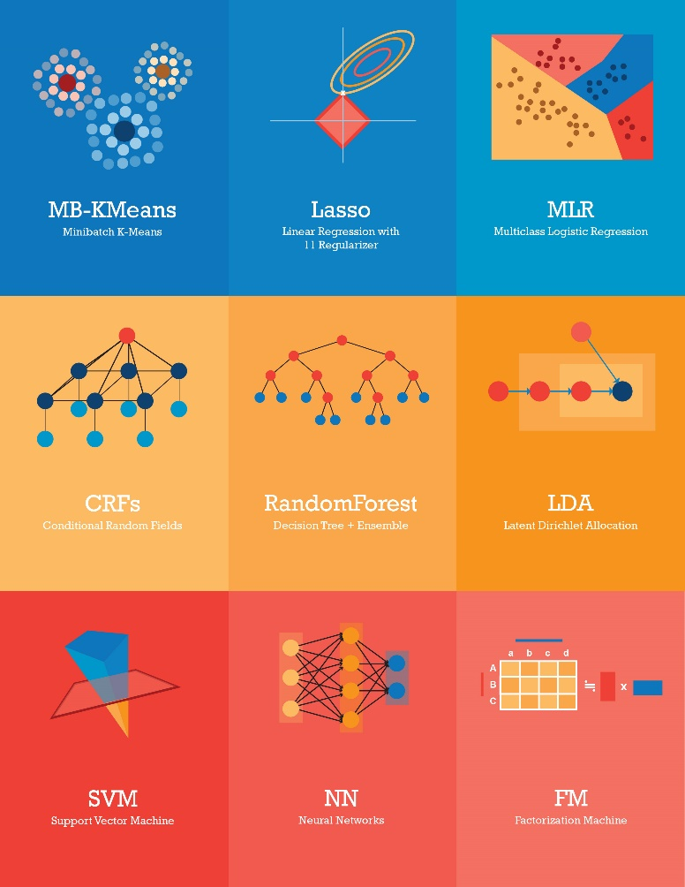
Core Machine Learning Algorithms
1. MB_KMeans: minibatch K-Means
2. LR: Logistic Regression
3. Lasso: linear regression with l1 regulizer
4. SVM: support vector machine
5. FM: Factorization Machine
6. CRFs: conditional random fields
7. NN: neural networks
8. ID3/C4.5: decision tree
9. LDA: latent dirichlet allocation
10. KNN: K-nearest neighbor
They have:
Iterative computation workload
High volume of training & model data

Slide 54
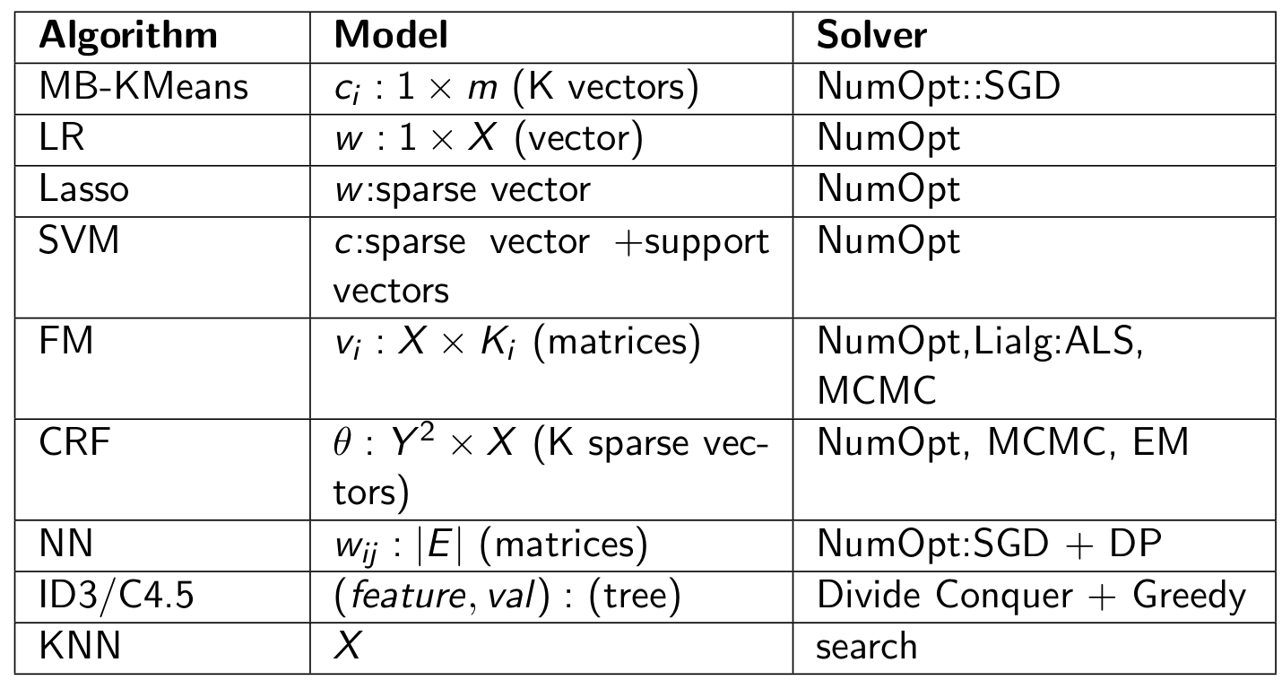
Summary of the Candidate Algorithms

Slide 55
Scalable Algorithms implemented using Harp
Algorithm | Category | Applications | Features | Computation Model | Collective Communication
K-means | Clustering | Most scientific domain | Vectors | AllReduce | allreduce, regroup+allgather, broadcast+reduce, push+pull
 |  |  |  | Rotation | rotate
Multi-class Logistic Regression | Classification | Most scientific domain | Vectors, words | Rotation | regroup, rotate, allgather
Random Forests | Classification | Most scientific domain | Vectors | AllReduce | allreduce
Support Vector Machine | Classification, Regression | Most scientific domain | Vectors | AllReduce | allgather
Neural Networks | Classification | Image processing, voice recognition | Vectors | AllReduce | allreduce
Latent Dirichlet Allocation | Structure learning (Latent topic model) | Text mining, Bioinformatics, Image Processing | Sparse vectors; Bag of words | Rotation | rotate, allreduce
Matrix Factorization | Structure learning (Matrix completion) | Recommender system | Irregular sparse Matrix; Dense model vectors | Rotation | rotate
Multi-Dimensional Scaling | Dimension reduction | Visualization and nonlinear identification of principal components | Vectors | AllReduce | allgarther, allreduce
Subgraph Mining | Graph | Social network analysis, data mining, fraud detection, chemical informatics, bioinformatics | Graph, subgraph | Rotation | rotate
Force-Directed Graph Drawing | Graph | Social media community detection and visualization | Graph | AllReduce | allgarther, allreduce

Slide 56



Conclusions
Identification of Apache Big Data Software Stack and integration with High Performance Computing Stack to give HPC-ABDS
    ABDS (Many Big Data applications/algorithms need HPC for performance)
    HPC (needs software model productivity/sustainability)
Identification of 4 computation models for machine learning applications
    Locking, Rotation, Allreduce, Asynchroneous
HPC-ABDS Plugin Harp: adds HPC communication performance and rich data abstractions to Hadoop by development of Harp library of Collectives to use at Reduce phase
    Broadcast and Gather needed by current applications
    Discover other important ones (e.g. Allgather, Global-local sync, Rotation pipeline)

Slide 57
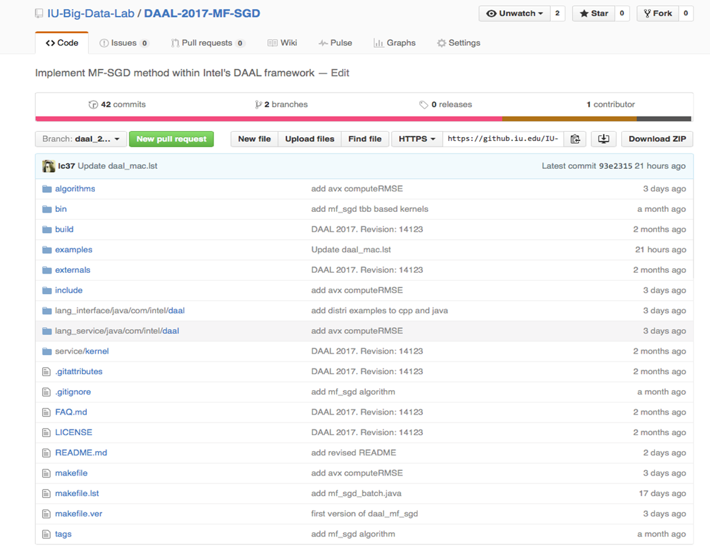
Hadoop/Harp-DAAL: Prototype and Production Code
Source codes available on Indiana University’s Github account
An example of MF-SGD is at
https://github.iu.edu/IU-Big-Data-Lab/DAAL-2017-MF-SGD
Harp-DAAL follows the same standard of DAAL’s original codes
improve DAAL’s existed algorithms for distributed usage
add new algorithms to DAAL’s codebase.
Harp-DAAL’s kernel is also compatible with other communication tools.

Slide 58

Future Work
High performance Harp-DAAL data analysis applications
Online Clustering with Harp or Storm integrates parallel and dataflow computing models
Start HPC incubator project in Apache to bring HPC-ABDS to community
Integration of Hadoop/Harp with Intel DAAL and other libraries
Implement efficiently on each platform (e.g. Amazon, Azure, Big Red II, Haswell/KNL Clusters)

Slide 59
Plan A
Development of Harp-DAAL applications. DAAL provides batch or distributed C/C++ codes and Java Interface for the following applications:
Plan B
A survey and benchmarking work for Machine learning algorithms. We download and run benchmark algorithms from state-of-arts machine learning libraries and evaluate their performance on different platforms (Xeon, Xeon Phi, and GPU)
Candidates with Distributed codes
Principal Component Analysis (PCA)
https://software.intel.com/en-us/node/564625
Singular Value Decomposition (SVD)
https://software.intel.com/en-us/node/564635
Neural Networks
https://software.intel.com/en-us/node/681960
Candidates with Batch codes
Cholesky Decomposition
https://software.intel.com/en-us/node/564631
QR Decomposition
https://software.intel.com/en-us/node/564640
Expectation-Maximization
https://software.intel.com/en-us/node/564649
Multivariate Outlier Detection
https://software.intel.com/en-us/node/564653
Univariate Outlier Detection
https://software.intel.com/en-us/node/564657
Association Rules
https://software.intel.com/en-us/node/564661
Support Vector Machine Classifier (SVM)
https://software.intel.com/en-us/node/564708

Slide 60
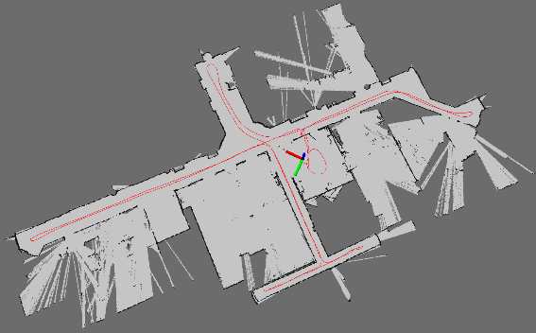
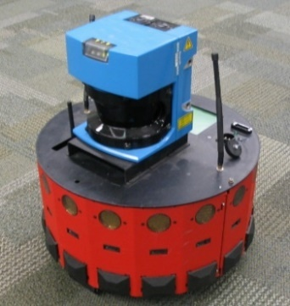
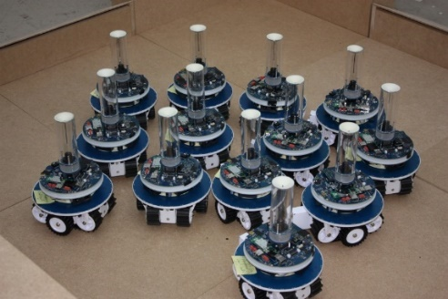
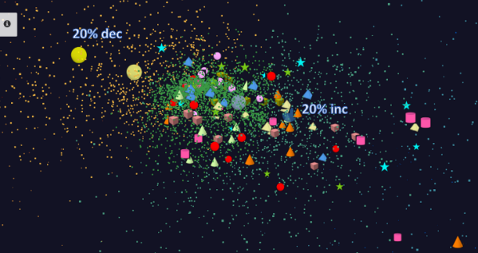
Adding HPC to Storm & Heron for Streaming
Simultaneous Localization and Mapping
Robotics Applications
N-Body Collision
Avoidance
Time series data visualization in real time
Map Built from
Robot data
Robot with a Laser Range Finder
Robots need to avoid collisions when they move
Map High dimensional data to 3D visualizer
Apply to Stock market data tracking 6000 stocks

Slide 61
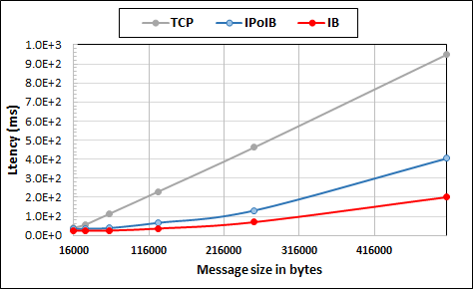
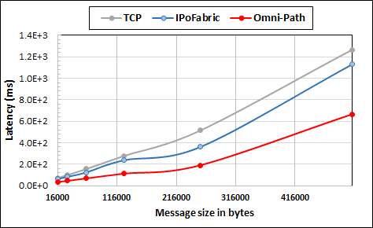
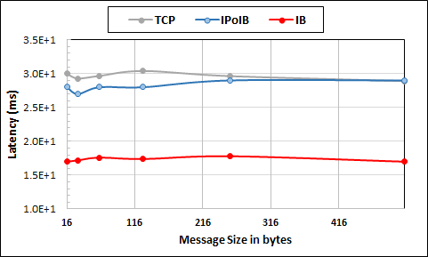
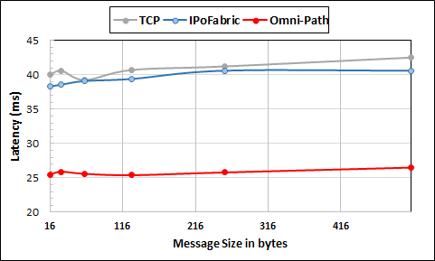
Plan C
Benchmark communication on Haswell vs. KNL clusters
Large messages
Small messages
Parallelism of 2 and using 8 Nodes
Parallelism of 2 and using 4 Nodes
Intel Haswell Cluster with 2.4GHz Processors and 56Gbps Infiniband and 1Gbps Ethernet
Intel KNL Cluster with 1.4GHz Processors and 100Gbps Omni-Path and 1Gbps Ethernet

Slide 62
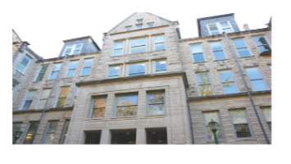

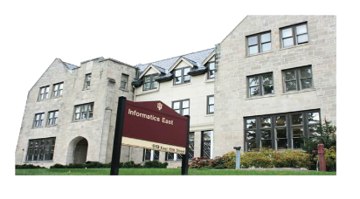


Acknowledgements
We gratefully acknowledge support from Intel Parallel Computing Center (IPCC) Grant.
Langshi Cheng Bo Peng Kannan Govindarajan
Bingjing Zhang Supun Kamburugamuve Yiming Zhou Ethan Li Mihai Avram Vibhatha Abeykoon
Yining Wang Prawal Gangwar Bingi Raviteja Anurag Sharma Manpreet Gulia Bingi Ravi Teja
SALSA HPC Group
School of Informatics and Computing
Indiana University

