Slide 1
Accelerating Machine Learning with Model-Centric Approach on Emerging Architectures
BeyondMR 2016 Workshop, San Francisco
July 1, 2016
Judy Qiu
Indiana University

Slide 2
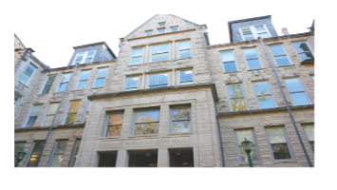

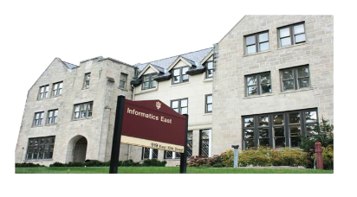





Acknowledgements
Bingjing Zhang
Thomas Wiggins
Langshi Chen
Meng Li
Bo Peng
Yiming Zou
Prof. Haixu Tang
Bioinformatics
Prof. David Wild
Cheminformatics
Prof. Raquel Hill
Security
Prof. David Crandall
Computer Vision
Prof. Filippo Menczer & CNETS
Complex Networks and Systems
SALSA HPC Group
School of Informatics and Computing
Indiana University

Slide 3


Outline
1. Introduction: Big Data Tools
2. Methodologies: Model-Centric Computation Abstractions for Iterative Computations
3. Results: Interdisciplinary Applications and Technologies
4. Summary and Future Work

Slide 4
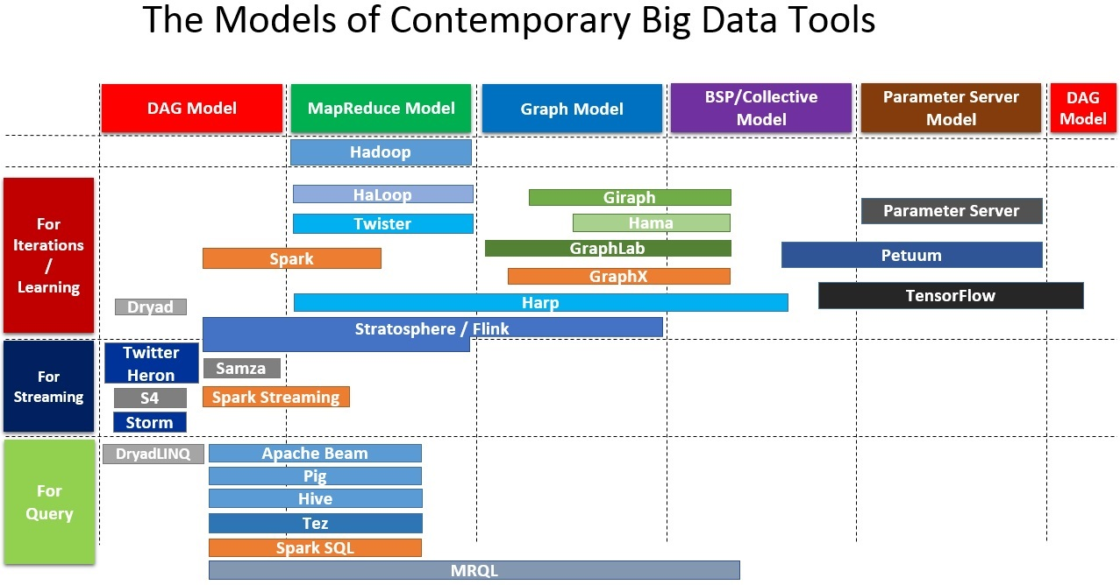

Slide 5
The Data Analytics System Hierarchy
Algorithm
  Choose the algorithm for the big data analysis
Computation Model
  High level description of the parallel algorithm, not associating with any execution environment.
Programing Model
  Middle level description of the parallelization, associating with a programming framework or runtime environment and including the data abstraction/distribution, processes/threads and the operations/APIs for performing the parallelization (e.g. network and manycore/GPU devices).
Implementation
  Low level details of implementation (e.g. language).

Slide 6
Types of Machine Learning Algorithms
Expectation-Maximization Type
K-Means Clustering
Collapsed Variational Bayesian for topic modeling (e.g. LDA)
Gradient Optimization Type
Stochastic Gradient Descent and Cyclic Coordinate Descent for classification (e.g. SVM and Logistic Regression), regression (e.g. LASSO), collaborative filtering (e.g. Matrix Factorization)
Markov Chain Monte Carlo Type
Collapsed Gibbs Sampling for topic modeling (e.g. LDA)

Slide 7
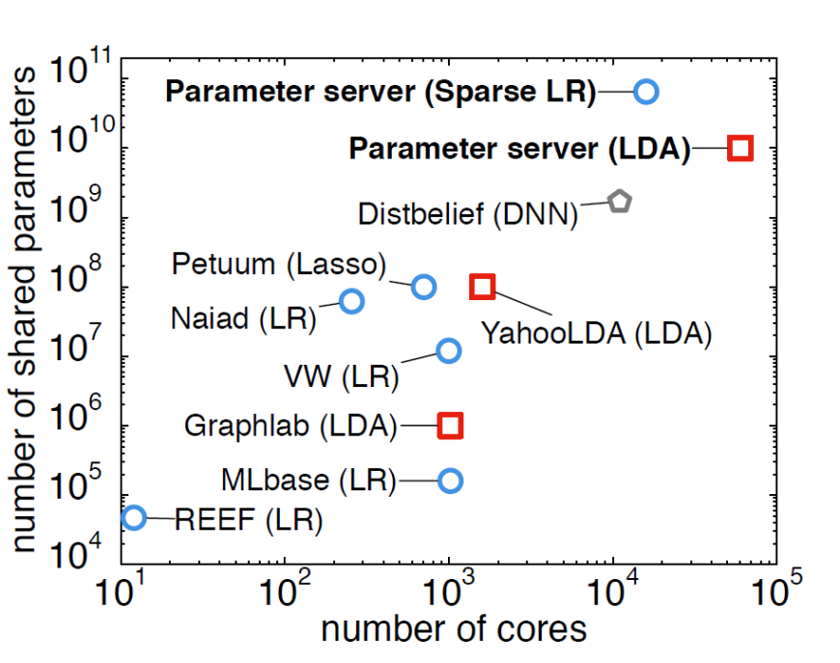
Comparison of public large machine learning experiments.
Problems are color-coded as follows: Blue circles — sparse logistic regression; red squares — latent variable graphical models; grey pentagons — deep networks.
Mu Li, David G. Andersen, Jun Woo Park, Alexander J. Smola, Amr Ahmed, Vanja Josifovski, James Long, Eugene J. Shekita, Bor-Yiing Su, Scaling Distributed Machine Learning with the Parameter Server, OSDI’14

Slide 8
Computation Models
Model-Centric Synchronization Paradigm

Slide 9
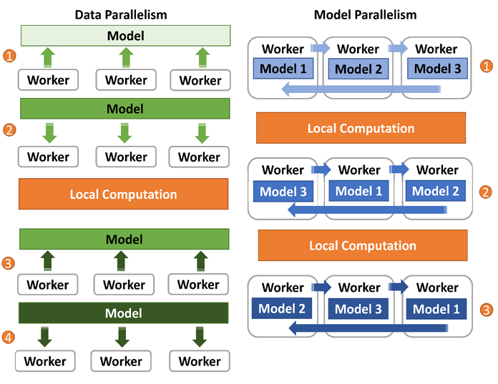
Data Parallelism & Model Parallelism
Data Parallelism
While the training data are split among parallel workers, the global model is distributed on a set of servers or existing workers. Each worker computes on a local model and updates it with the synchronization between local models and the global model.
Model Parallelism
In addition to splitting the training data over parallel workers, the global model data is split between workers and rotated between workers
Bingjing Zhang, Bo Peng and Judy Qiu, High Performance LDA through Collective Model Communication Optimization,
Proceedings of International Conference on Computational Science (ICCS), June 6-8, 2016.

Slide 10
Programming Models
Comparison of Iterative Computation Tools
Spark
Harp
Parameter Server
Daemon
Worker
Server Group
Driver
Daemon
Worker
Worker
Worker Group
Worker Group
Daemon
Worker
Various Collective Communication Operations
Asynchronous Communication Operations
Implicit Data Distribution
Implicit Communication
Explicit Data Distribution
Explicit Communication
Explicit Data Distribution
Implicit Communication
M. Zaharia et al. “Spark: Cluster Computing with Working Sets”. HotCloud, 2010.
B. Zhang, Y. Ruan, J. Qiu. “Harp: Collective Communication on Hadoop”. IC2E, 2015.
M. Li, D. Anderson et al. “Scaling Distributed Machine Learning with the Parameter Server”. OSDI, 2014.

Slide 11
The Concept of Harp Plug-in
Parallelism Model
Architecture
MapReduce Model
MapCollective Model
MapReduce Applications
MapCollective Applications
M
M
M
M
Application
M
M
M
M
MapReduce V2
Harp
Shuffle
Framework
Collective Communication
R
R
Resource Manager
YARN

Slide 12
Hierarchical Data Abstraction
Broadcast, AllGather, AllReduce,
Regroup-(Combine/Reduce), Message-to-Vertex…
Table
Array Table <Array Type>
Edge
Table
Message Table
Vertex Table
Key-Value Table
Partition
Array Partition
<Array Type>
Edge Partition
Message Partition
Vertex Partition
Key-Value Partition
Broadcast, Send
Long Array
Int Array
Double Array
Byte Array
Vertices, Edges, Messages
Key-Values
Basic Types
Array
Object
Broadcast, Send
Transferable

Slide 13
Harp Component Layers
Applications: K-Means, WDA-SMACOF, Graph-Drawing…
MapReduce Applications
MapCollective Applications
MapCollective Interface
Collective Communication APIs
Array, Key-Value, Graph Data Abstraction
Map-Collective Programming Model
MapReduce V2
Harp
Collective Communication Operators
Hierarchical Data Types
(Tables & Partitions)
Memory Resource Pool
Collective Communication Abstractions
YARN
Task Management
MapReduce

Slide 14
  Why Collective Communications for Big Data Processing?
Collective Communication and Data Abstractions
  Our approach to optimize data movement
  Hierarchical data abstractions and operations defined on top of them
Map-Collective Programming Model
  Extended from MapReduce model to support collective communications
  Two Level of BSP parallelism
Harp Implementation
  A plug-in to Hadoop
  Component layers and the dataflow

Slide 15
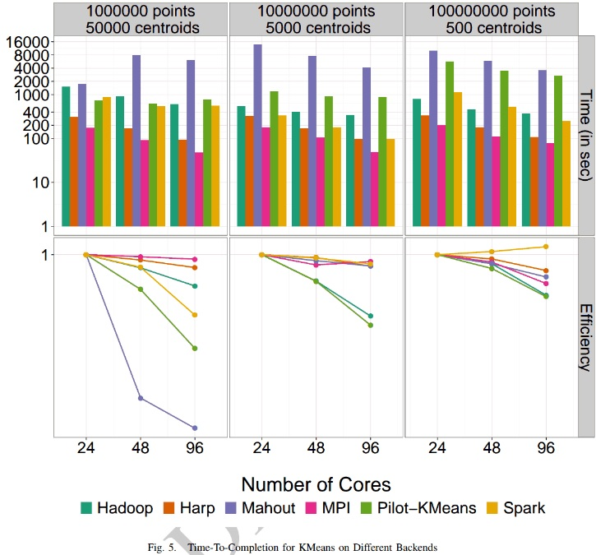
K-means Clustering Parallel Efficiency
Shantenu Jha et al. A Tale of Two Data-Intensive Paradigms: Applications, Abstractions, and Architectures. 2014.

Slide 16
Harp
Input (Training) Data
1
Load
1
Load
1
Load
Task
Task
Task
Current Model
Current Model
Current Model
2
Compute
2
Compute
2
Compute
4
Iteration
New Model
New Model
New Model
3
3
3
Collective Communication (e.g. Allreduce)

Slide 17
Four Questions
What part of the model needs to be synchronized?
  A machine learning algorithm may involve several model parts, the parallelization needs to decide which model parts needs synchronization.
When should the model synchronization happen?
  In the parallel execution timeline, the parallelization should choose the time point to perform model synchronization.
Where should the model synchronization occur?
  The parallelization needs to tell the distribution of the model among parallel components, what parallel components are involved in the model synchronization.
How is the model synchronization performed?
  The parallelization needs to explain the abstraction and the mechanism of the model synchronization.

Slide 18
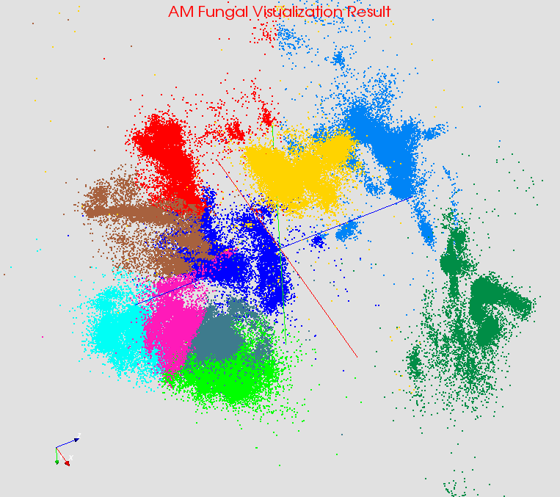

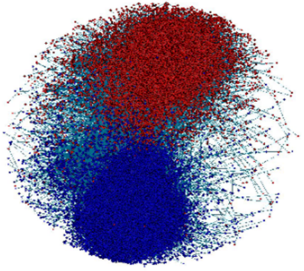

Large Scale Data Analysis Applications
Case Studies
  Bioinformatics: Multi-Dimensional Scaling (MDS) on gene sequence data
  Computer Vision: K-means Clustering on image data (high dimensional model data)
  Text Mining: LDA on wikipedia data (dynamic model data due to sampling)
  Complex Network: Sub-graph counting (graph data) and Online K-means (streaming data)
  Deep Learning: Convolutional Neural Networks on image data
Bioinformatics
Computer Vision
Complex Networks
Text Mining
Deep Learning

Slide 19
Case Study :
Parallel Latent Dirichlet Allocation for Text Mining
4. Interdisciplinary Applications and Technologies
Map Collective Computing Paradigm

Slide 20
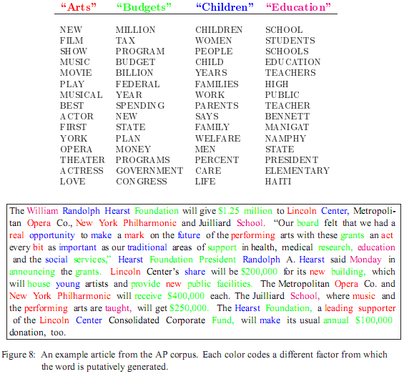
LDA: mining topics in text collection
Huge volume of Text Data
  Information overloading
  What on earth is inside the TEXT Data?
Search
  Find the documents relevant to my need (ad hoc query)
Filtering
  Fixed info needs and dynamic text data
What's new inside?
  Discover something I don't know
Blei, D. M., Ng, A. Y. & Jordan, M. I. Latent Dirichlet Allocation. J. Mach. Learn. Res. 3, 993–1022 (2003).

Slide 21
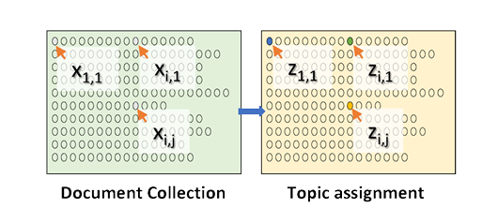
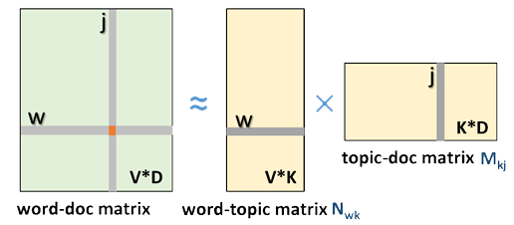
LDA and Topic Models
Topic Models is a modeling technique, modeling the data by probabilistic generative process.
Latent Dirichlet Allocation (LDA) is one widely used topic model.
Inference algorithm for LDA is an iterative algorithm using share global model data.
Document
Word
Topic: semantic unit inside the data
Topic Model
  documents are mixtures of topics, where a topic is a probability distribution over words
Global Model Data
3.7 million docs
10k topics
1 million words
  Normalized co-occurrence matrix
  Mixture components
  Mixture weights
Notes:
global model data should be word-topic matrix or topic-document matrix,

Slide 22
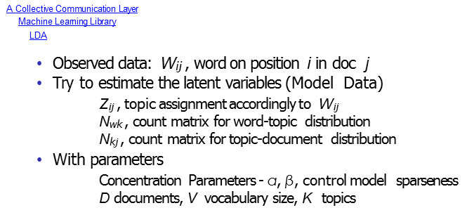
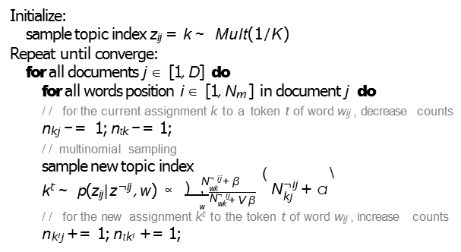
Gibbs Sampling in LDA
k‘ ~
∞
___
∑

Slide 23
Training Datasets used in LDA Experiments
The total number of model parameters is kept as 10 billion on all the datasets.
Dataset | enwiki | clueweb | bi-gram | gutenberg
Num. of Docs | 3.8M | 50.5M | 3.9M | 26.2K
Num. of Tokens | 1.1B | 12.4B | 1.7B | 836.8M
Vocabulary | 1M | 1M | 20M | 1M
Doc Len. Avg/STD | 293/523 | 224/352 | 434/776 | 31879/42147
Highest Word Freq. | 1714722 | 3989024 | 459631 | 1815049
Lowest Word Freq. | 7 | 285 | 6 | 2
Num. of Topics | 10K | 10K | 500 | 10K
Init. Model Size | 2.0GB | 14.7GB | 5.9GB | 1.7GB
Note: Both “enwiki” and “bi-gram” are English articles from Wikipedia. “clueweb is a 10% dataset from ClueWeb09, which is a collection of English web pages. “gutenberg” is comprised of English books from Project Gutenberg.

Slide 24
In LDA (CGS) with model rotation
What part of the model needs to be synchronized?
  Doc-topic matrix stays in local, only word-topic matrix is required to be synchronized.
When should the model synchronization happen?
  When all the workers finish performing the computation with the data and model partitions owned, the workers shifts the model partitions in a ring topology.
  One round of model rotation per iteration.
Where should the model synchronization occur?
  Model parameters are distributed among workers.
  Model rotation happens between workers.
  In real implementation, each worker is a process.
How is the model synchronization performed?
  Model rotation is performed through a collective operation with routing optimized.

Slide 25
What part of the model needs to be synchronized?
Requires model synchronization

Slide 26
When should the model synchronization happen?
Happens per iteration
Worker
Worker
Worker
3
Rotate
3
Rotate
3
Rotate
Model 1
Model 2
Model 3
2
2
2
Compute
Compute
Compute
Iteration
4
1
Load
Training Data

Slide 27
Where should the model synchronization occur?
Occurs between each worker,
a process in the implementation
Worker
Worker
Worker
3
Rotate
3
Rotate
3
Rotate
Model 1
Model 2
Model 3
2
2
2
Compute
Compute
Compute
Iteration
4
1
Load
Training Data

Slide 28
How is the model synchronization performed?
Worker
Worker
Worker
3
Rotate
3
Rotate
3
Rotate
Model 1
Model 2
Model 3
Performed as a collective communication operation
2
2
2
Compute
Compute
Compute
Iteration
4
1
Load
Training Data

Slide 29
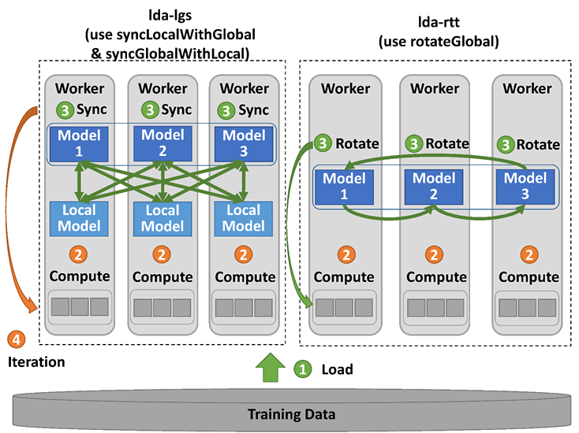
Harp-LDA Execution Flow
Challenges
High memory consumption for model and input data
High number of iterations (~1000)
Computation intensive
Traditional “allreduce” operation in
MPI-LDA is not scalable.
Harp-LDA uses AD-LDA (Approximate Distributed LDA) algorithm (based on Gibbs sampling algorithm)
Harp-LDA runs LDA in iterations of local computation and collective communication to generate new global model.

Slide 30
Data Parallelism: Comparison between Harp-lgs and Yahoo! LDA
Harp-LDA Performance Tests on Intel Haswell Cluster
clueweb
enwiki
50.5 million webpage documents, 12.4B tokens, 1 million vocabulary, 10K topics, 14.7 GB model size
3.8 million wikipedia documents, 1.1B tokens, 1M vocabulary,
10K topics, 2.0 GB model size

Slide 31
Model Parallelism: Comparison between Harp rtt and Petuum LDA
Harp-LDA Performance Tests on Intel Haswell Cluster
clueweb
bi-gram
50.5 million web page documents, 12.4 billion tokens, 1 million vocabulary, 10K topics, 14.7 GB model size
3.9Million wikipedia documents, 1.7 billion tokens, 20 million vocabulary, 500 topics, 5.9 GB model size

Slide 32
Harp LDA on Big Red II Supercomputer (Cray)
Harp LDA Scaling Tests
Harp LDA on Juliet (Intel Haswell)
Corpus: 3,775,554 Wikipedia documents, Vocabulary: 1 million words; Topics: 10k topics; alpha: 0.01; beta: 0.01; iteration: 200
Machine settings
  Big Red II: tested on 25, 50, 75, 100 and 125 nodes, each node uses 32 parallel threads; Gemini interconnect
  Juliet: tested on 10, 15, 20, 25, 30 nodes, each node uses 64 parallel threads on 36 core Intel Haswell node (each with 2 chips); infiniband interconnect

Slide 33
Harp-DAAL Integration
Harp
1. Java API
2. Local computation: Java threads
3. Communication: Harp
DAAL
1. Java & C++ API
2. Local computation: MKL, TBB
3. Invocation: MPI & Hadoop & Spark
Harp-DAAL
1. Java API
2. Local Computation: DAAL
3. Communication:
Harp
Use Hadoop/Harp as a distributed framework to invoke Intel’s Data Analytics Acceleration Library (DAAL)
and test on Intel’s multi/many-core architectures (e.g. Xeon/Xeon Phi)
We have shown that previous standalone enhanced versions of MapReduce can be replaced by Harp (a Hadoop plug-in) that offer both data abstractions useful for high performance iterative computation and MPI-quality communication.

Slide 34
Data Structure
Harp (Java)
DAAL (C++)
NumericTable
DataCollection
…
AOSNumericTable
SOANumericTable
…
Matrix
HomogenNumericTable
…
Int2ObjectOpenHashMap<V>
ArrTable<T>
ArrPartition<T>
Array<T>
Array<T>
ArrPartition<T>
Array<T>
Function needs to be defined
by user in the subclass of this class
Array<T> + Identifier
Interfaces to Package
com.intel.daal.algorithms
T + Start + Size
E.g. T = double[]
Harp: data storage is optimized for communication.
DAAL: Data could be stored in memory in HomogenNumericTable
Harp-DAAL: data type conversion serialization/deserialization of data

Slide 35
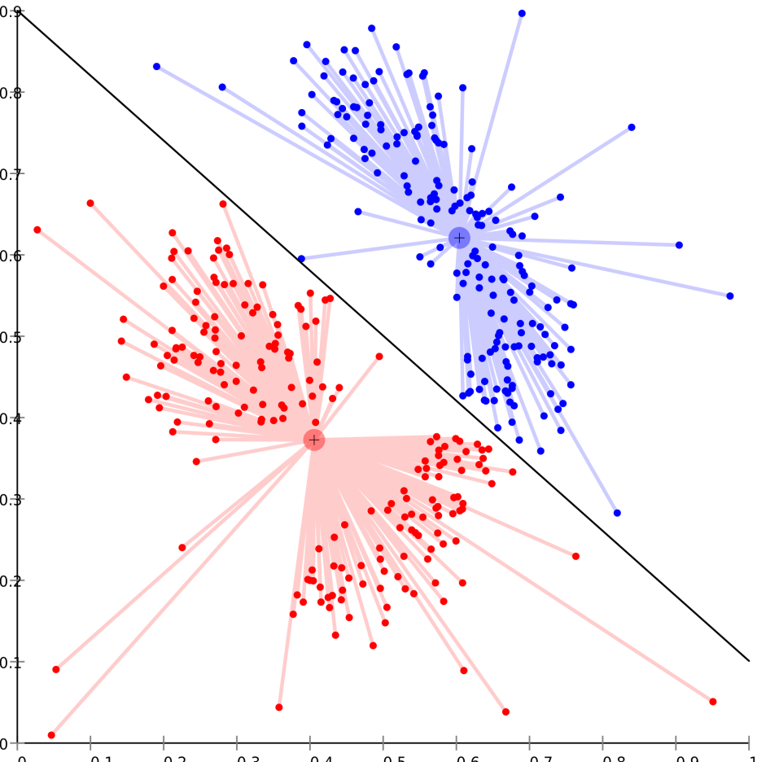
Harp-DAAL K-means
KMeansDaalCollectiveMapper.java
Step 1: Set up
Load data points
Create centroids
…
Step 2: Iterative MapReduce
DistributedStep1Local (Map: DAAL K-means)
HomogenNumericTable to ArrTable (Data type conversion)
allreduceLarge (shuffle-reduce: Harp AllreduceCollective)
ArrTable to HomogenNumericTable (Data type conversion)
Harp-DAAL-Kmeans: Hybrid implementation of Harp with DAAL-2017. The local computation is offloaded to DAAL while the communication layer is handled by Harp. There is a group of Java classes dedicated to the data type conversion between Harp and DAAL

Slide 36
Preliminary Results
Harp-DAAL K-means outperforms DAAL K-means when dataset is large and computation is intensive (up to 4X speedup)
Figure (top)
Input data: 5K, 50K, 500K points
Centroids: 100K
Figure (bottom)
Input data: 500K points
Centroids: 1K, 10K, 100K
Experiments on a single node of Juliet (Intel Haswell Cluster)
Node specification (J-023)
two Xeon E5-2670 processors
12 cores, 24 threads per socket
128 GB memory per node

Slide 37

Summary
Identification of Apache Big Data Software Stack and integration with High Performance Computing Stack to give HPC-ABDS
    ABDS (Many Big Data applications/algorithms need HPC for performance)
    HPC (needs software model productivity/sustainability)
Identification of 4 computation models for machine learning applications
HPC-ABDS Plugin Harp: adds HPC communication performance and rich data abstractions to Hadoop
Development of Harp library of Collectives to use at Reduce phase
    Broadcast and Gather needed by current applications
    Discover other important ones (e.g. Allgather, Global-local sync, Rotation pipeline)
    Implement efficiently on each platform (e.g. Amazon, Azure, Big Red II, aswell/KNL Clusters)
Integration of Harp with Intel DAAL and other libraries

