Slide 1
A High Performance Model-Centric Approach to Machine Learning Across Emerging Architectures
ORNL EE Cloud Computing Conference
October 2, 2017
Judy Qiu
Intelligent Systems Engineering Department, Indiana University
Email: xqiu@indiana.edu

Slide 2


Outline
1. Introduction: HPC-ABDS, Harp (Hadoop plug in), DAAL
2. Optimization Methodologies
3. Results (configuration, benchmark)
4. Code Optimization Highlights
5. Conclusions and Future Work

Slide 3
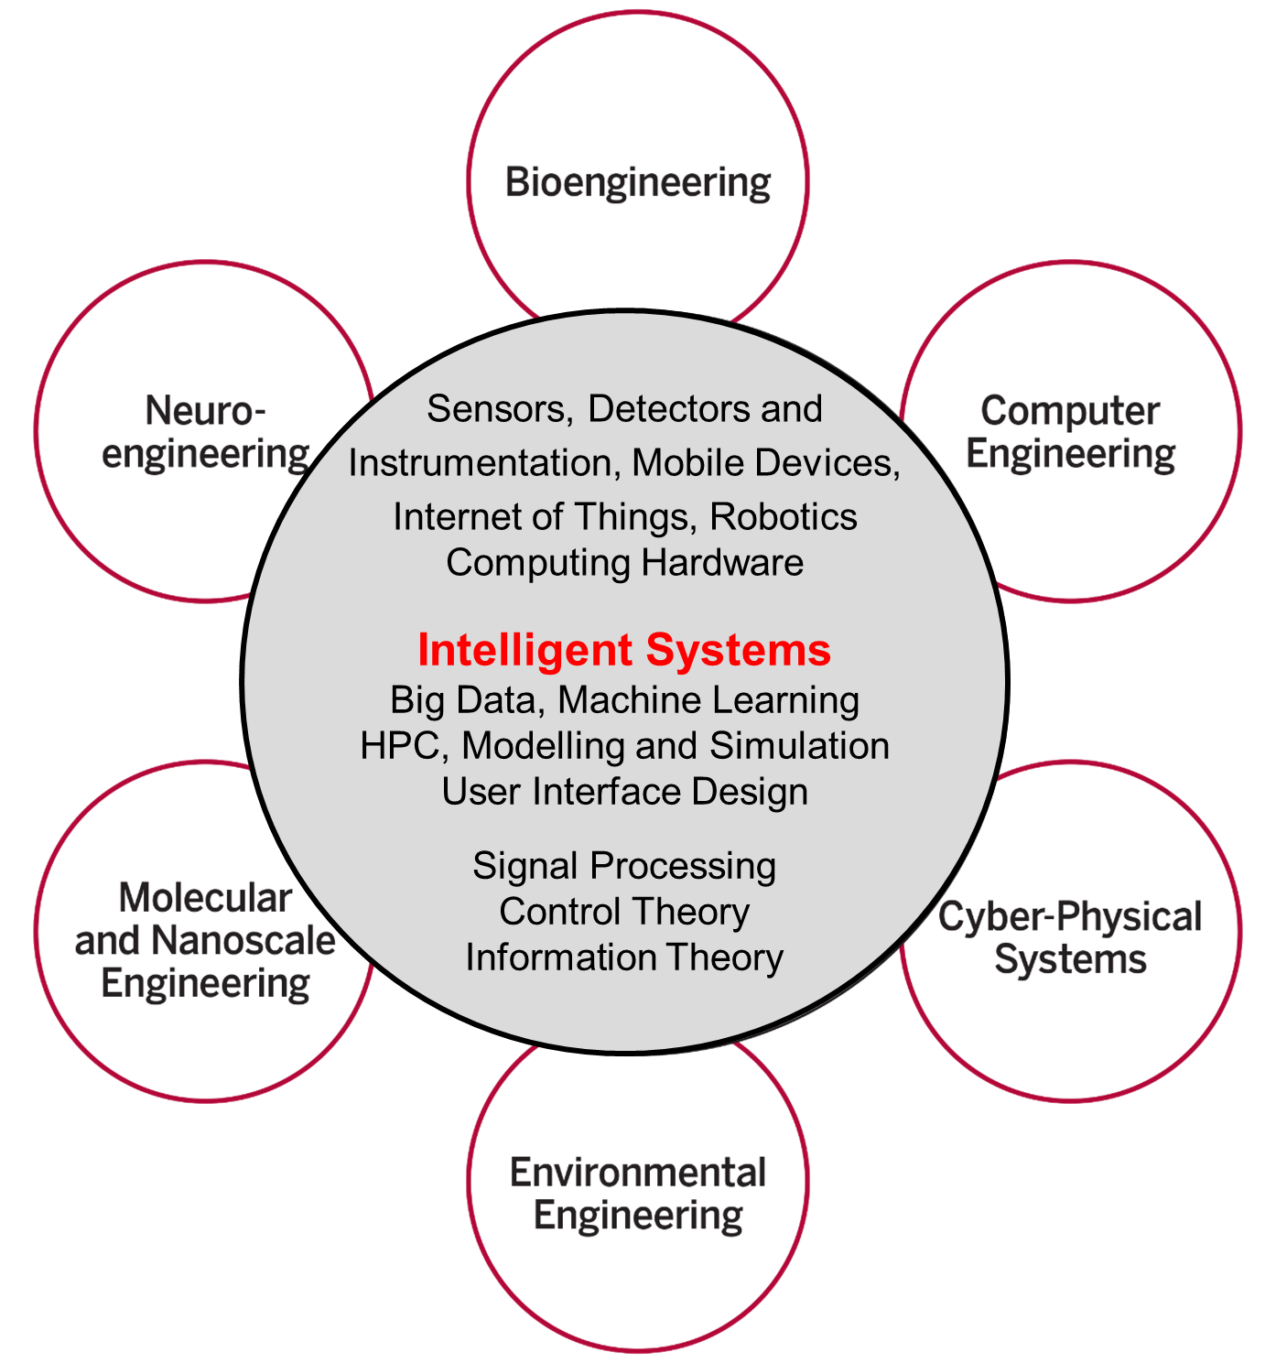
Intelligent Systems Engineering at Indiana University
All students do basic engineering plus machine learning (AI), Modelling& Simulation, Internet of Things
Also courses on HPC, cloud computing, edge computing, deep learning and physical optimization (this conference)
Fits recent headlines:
Google, Facebook, And Microsoft Are Remaking Themselves Around AI
How Google Is Remaking Itself As A “Machine Learning First” Company
If You Love Machine Learning, You Should Check Out General Electric

Slide 4
Important Trends II
Rich software stacks:
  HPC (High Performance Computing) for Parallel Computing
  Apache for Big Data Software Stack ABDS including some edge computing (streaming data)
On general principles parallel and distributed computing have different requirements even if sometimes similar functionalities
  Apache stack ABDS typically uses distributed computing concepts
  For example, Reduce operation is different in MPI (Harp) and Spark
Big Data requirements are not clear but there are a few key use types
  Pleasingly parallel processing (including local machine learning LML) as of different tweets from different users with perhaps MapReduce style of statistics and visualizations; possibly Streaming
  Database model with queries again supported by MapReduce for horizontal scaling
  Global Machine Learning GML with single job using multiple nodes as classic parallel computing
  Deep Learning certainly needs HPC – possibly only multiple small systems
Current workloads stress 1) and 2) and are suited to current clouds and to ABDS (with no HPC)

Slide 5
High Performance – Apache Big Data Stack
MapReduce
Classic Parallel Runtimes (MPI)
Data Centered, QoS
Efficient and Proven techniques
Expand the Applicability of MapReduce to more classes of Applications on HPC-Cloud Platforms
(Multicore, Manycore, GPU, …)
Sequential
Map-Only
MapReduce
Iterative MapReduce
MPI and Point-to-Point
Input
Input
Input
iterations
Input
map
map
map
map
Pij
Output
Output
reduce
reduce

Slide 6
The Concept of Harp Plug-in
Parallelism Model
Architecture
MapReduce Model
MapCollective Model
MapReduce Applications
MapCollective Applications
Application
M
M
M
M
M
M
M
M
MapReduce V2
Harp
Shuffle
Framework
Collective Communication
R
R
Resource Manager
YARN
Harp is an open-source project developed at Indiana University [1], it has:
MPI-like collective communication operations that are highly optimized for big data problems.
Harp has efficient and innovative computation models for different machine learning problems.
[1] Harp project. Available at https://dsc-spidal.github.io/harp

Slide 7
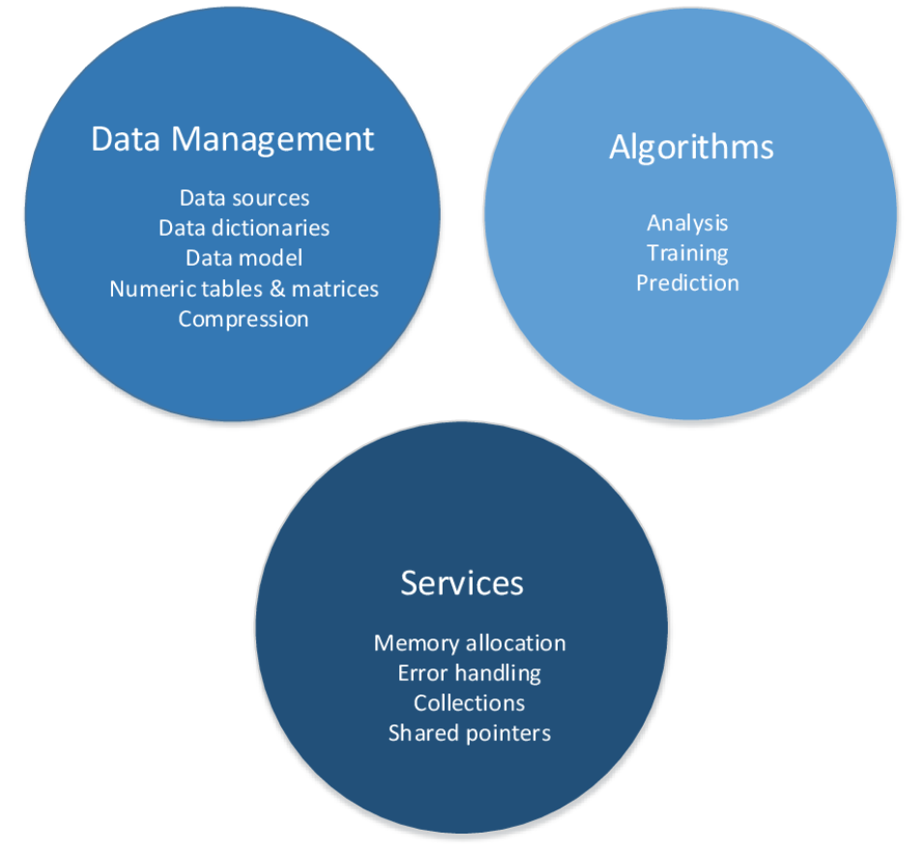
DAAL is an open-source project that provides:
Algorithms Kernels to Users
    Batch Mode (Single Node)
    Distributed Mode (multi nodes)
    Streaming Mode (single node)
Data Management & APIs to Developers
    Data structure, e.g., Table, Map, etc.
    HPC Kernels and Tools: MKL, TBB, etc.
    Hardware Support: Compiler

Slide 8
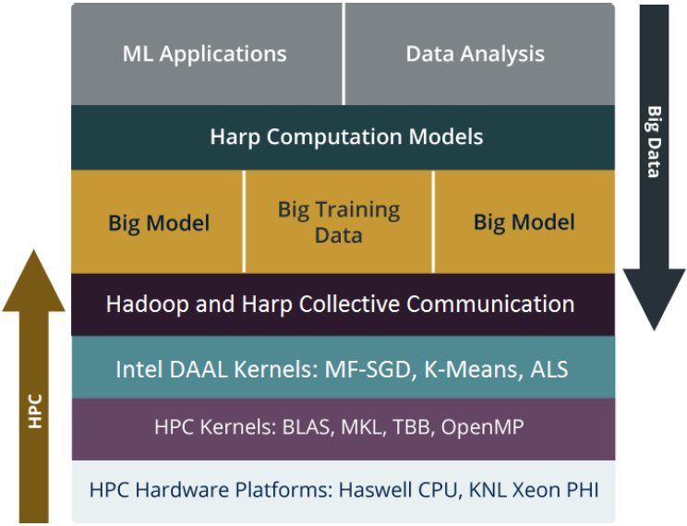
Harp-DAAL enable faster Machine Learning Algorithms
with Hadoop Clusters on Multi-core and Many-core architectures
Bridge the gap between HPC hardware and Big data/Machine learning Software
Support Iterative Computation, Collective Communication, Intel DAAL and native kernels
Portable to new many-core architectures like Xeon Phi and run on Haswell and KNL clusters

Slide 9

Performance of Harp-DAAL on KNL Single Node
Harp-DAAL vs. Spark vs. NOMAD
Harp-DAAL-Kmeans vs. Spark-Kmeans:
~ 20x speedup
Harp-DAAL-Kmeans invokes MKL matrix operation kernels at low level
Matrix data stored in contiguous memory space, leading to regular access pattern and data locality
Harp-DAAL-SGD vs. NOMAD-SGD
Small dataset (MovieLens, Netflix): comparable perf
Large dataset (Yahoomusic, Enwiki): 1.1x to 2.5x, depending on data distribution of matrices
Harp-DAAL-ALS vs. Spark-ALS
20x to 50x speedup
Harp-DAAL-ALS invokes MKL at low level
Regular memory access, data locality in matrix operations

Slide 10
Outline
1. Introduction: HPC-ABDS, Harp (Hadoop plug in), DAAL
2. Optimization Methodologies
3. Results (configuration, benchmark)
4. Code Optimization Highlights
5. Conclusions and Future Work

Slide 11
General Reduction in Hadoop, Spark, Flink
Map Tasks
Comparison of Reductions:
Separate Map and Reduce Tasks
Switching tasks is expensive
MPI only has one sets of tasks for map and reduce
MPI achieves AllReduce by interleaving multiple binary trees
MPI gets efficiency by using shared memory intra-node (e.g. multi-/manycore, GPU)
Reduce Tasks
Follow by Broadcast for AllReduce which is a common approach to support iterative algorithms
For example, paper [7] 10 learning algorithms can be written in a certain “summation form,” which allows them to be easily parallelized on multicore computers.
Output partitioned with Key
[7] Cheng-Tao Chu, Sang Kyun Kim, Yi-An Lin, YuanYuan Yu, Gary Bradski, Andrew Y. Ng and Kunle Olukotun, Map-Reduce for Machine Learning on Multicore,
in NIPS 19 2007.

Slide 12

HPC Runtime versus ABDS distributed Computing Model on Data Analytics
Hadoop writes to disk and is slowest; Spark and Flink spawn many processes and do not support allreduce directly; MPI does in-place combined reduce/broadcast

Slide 13
  Why Collective Communications for Big Data Processing?
Collective Communication and Data Abstractions
  Optimization of global model synchronization
    ML algorithms: convergence vs. consistency
    Model updates can be out of order
  Hierarchical data abstractions and operations
Map-Collective Programming Model
  Extended from MapReduce model to support collective communications
  BSP parallelism at Inter-node vs. Intra-node levels
Harp Implementation
  A plug-in to Hadoop

Slide 14
Harp APIs
Scheduler
Collective
broadcast
Event Driven
reduce
allgather
allreduce
regroup with combine
Graph & ML operations
rotate global model parameters between workers
getEvent
waitEvent
sendEvent
DynamicScheduler
StaticScheduler
MPI collective communication
MapReduce “shuffle-reduce”
“push” & “pull” model parameters

Slide 15
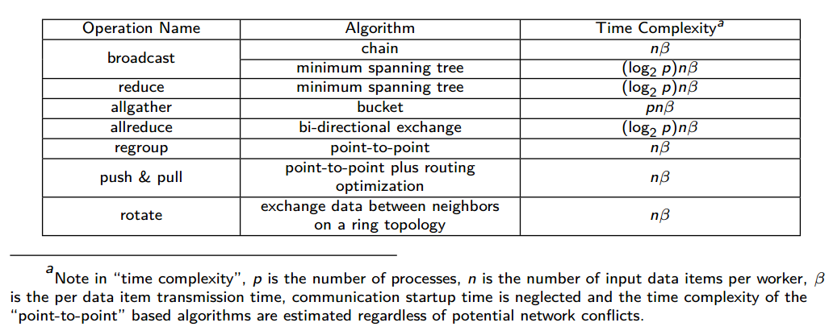
Collective Communication Operations

Slide 16
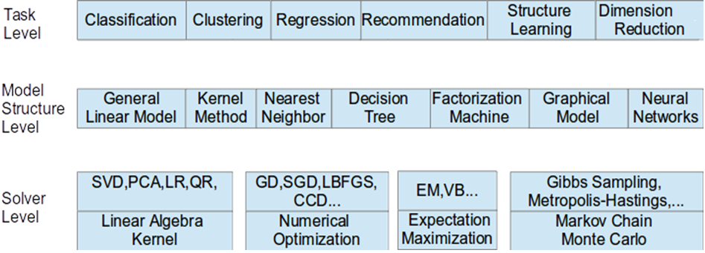
Taxonomy for Machine Learning Algorithms
Optimization and related issues
  Task level only can't capture the traits of computation
  Model is the key for iterative algorithms. The structure (e.g. vectors, matrix, tree, matrices) and size are critical for performance
  Solver has specific computation and communication pattern
We investigate different computation and communication patterns of important ml algorithms

Slide 17
Parallel Machine Learning Application Implementation Guidelines
Computation Model
Collective Communication Operations
Algorithm
Load Balancing on Computation and Communication
System Optimization
Locking, Rotation, Allreduce, Asynchronous
Expectation-Maximization, Gradient Optimization, Markov Chain Monte Carlo…
Per-Thread Implementation
Latent Dirichlet Allocation, Matrix Factorization, Linear Regression…
Application

Slide 18
Computation Models
B. Zhang, B. Peng, and J. Qiu, “Model-centric computation abstractions in machine learning applications,” in Proceedings of
the 3rd ACM SIGMOD Workshop on Algorithms and Systems for MapReduce and Beyond, BeyondMR@SIGMOD 2016

Slide 19
Harp Solution to Big Data Problems
Distributed Memory
Computation Models
Model-Centric Synchronization Paradigm
broadcast
regroup
sendEvent
reduce
push & pull
getEvent
Computation Models
allgather
rotate
waitEvent
allreduce
Communication Operations
Locking
Rotation
Shared Memory
Asynchronous
Schedulers
Harp-DAAL
High Performance Library
Allreduce
Dynamic Scheduler
Static Scheduler

Slide 20
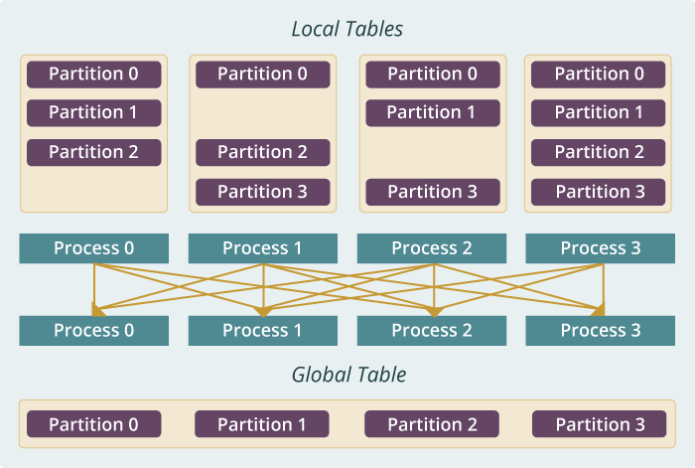
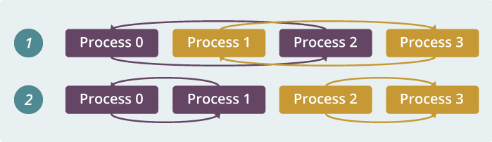
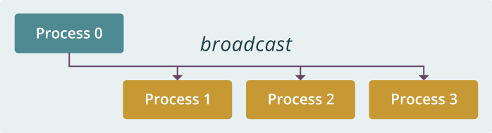
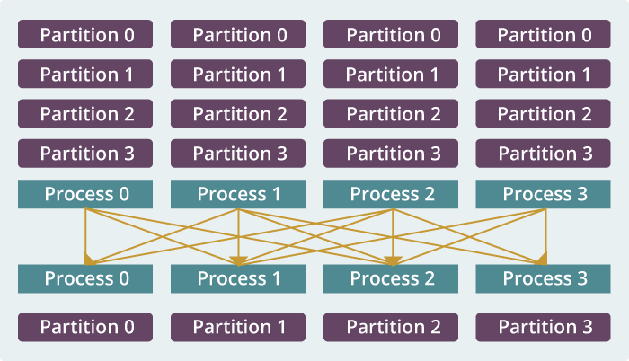
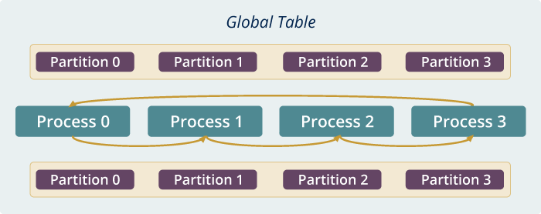
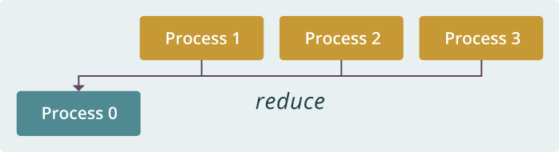
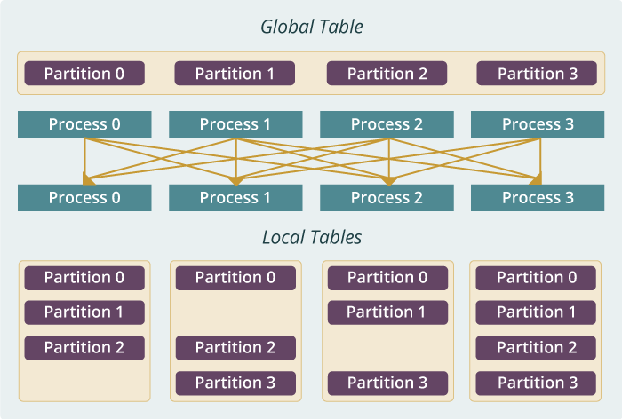
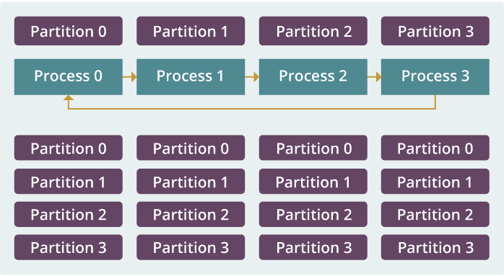
Example: K-means Clustering
The Allreduce Computation Model
Model
Worker
Worker
Worker
When the model size cannot be held in each machine’s memory
When the model size is small
When the model size is large but can still be held in each machine’s memory
broadcast
regroup
push & pull
allreduce
reduce
allgather
rotate

Slide 21
Outline
1. Introduction: HPC-ABDS, Harp (Hadoop plug in), DAAL
2. Optimization Methodologies
3. Results (configuration, benchmark)
4. Code Optimization Highlights
5. Conclusions and Future Work

Slide 22
Case Study :
Parallel Latent Dirichlet Allocation for Text Mining
Map Collective Computing Paradigm

Slide 23
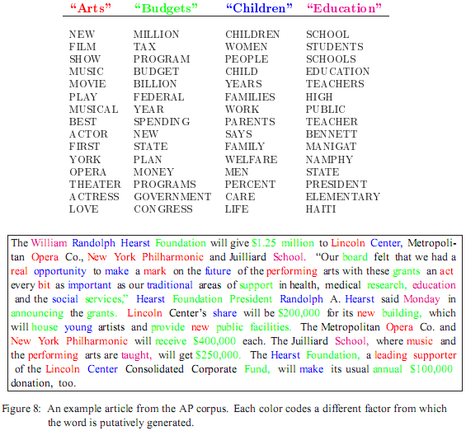
LDA: mining topics in text collection
Huge volume of Text Data
  Information overloading
  What on earth is inside the TEXT Data?
Search
  Find the documents relevant to my need (ad hoc query)
Filtering
  Fixed info needs and dynamic text data
What's new inside?
  Discover something I don't know
Blei, D. M., Ng, A. Y. & Jordan, M. I. Latent Dirichlet Allocation. J. Mach. Learn. Res. 3, 993–1022 (2003).

Slide 24
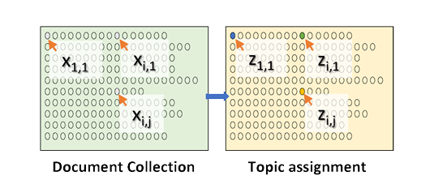
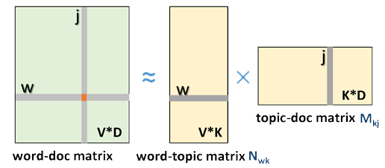
LDA and Topic Models
Topic Models is a modeling technique, modeling the data by probabilistic generative process.
Latent Dirichlet Allocation (LDA) is one widely used topic model.
Inference algorithm for LDA is an iterative algorithm using share global model data.
Document
Word
Topic: semantic unit inside the data
Topic Model
  documents are mixtures of topics, where a topic is a probability distribution over words
Global Model Data
3.7 million docs
10k topics
1 million words
  Normalized co-occurrence matrix
  Mixture components
  Mixture weights
Notes:
global model data should be word-topic matrix or topic-document matrix,

Slide 25
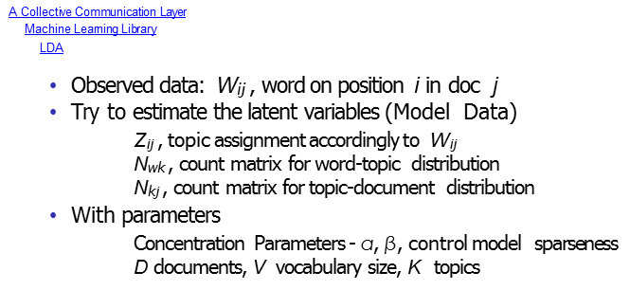
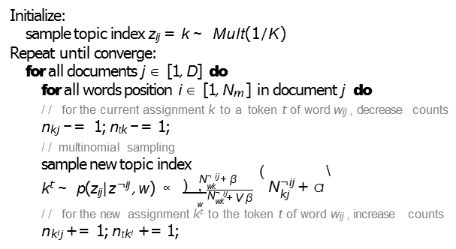
Gibbs Sampling in LDA
k‘ ~
∞
___
∑

Slide 26
Training Datasets used in LDA Experiments
The total number of model parameters is kept as 10 billion on all the datasets.
Dataset | enwiki | clueweb | bi-gram | gutenberg
Num. of Docs | 3.8M | 50.5M | 3.9M | 26.2K
Num. of Tokens | 1.1B | 12.4B | 1.7B | 836.8M
Vocabulary | 1M | 1M | 20M | 1M
Doc Len. Avg/STD | 293/523 | 224/352 | 434/776 | 31879/42147
Highest Word Freq. | 1714722 | 3989024 | 459631 | 1815049
Lowest Word Freq. | 7 | 285 | 6 | 2
Num. of Topics | 10K | 10K | 500 | 10K
Init. Model Size | 2.0GB | 14.7GB | 5.9GB | 1.7GB
Note: Both “enwiki” and “bi-gram” are English articles from Wikipedia. “clueweb is a 10% dataset from ClueWeb09, which is a collection of English web pages. “gutenberg” is comprised of English books from Project Gutenberg.

Slide 27
In LDA (CGS) with model rotation
What part of the model needs to be synchronized?
  Doc-topic matrix stays in local, only word-topic matrix is required to be synchronized.
When should the model synchronization happen?
  When all the workers finish performing the computation with the data and model partitions owned, the workers shifts the model partitions in a ring topology.
  One round of model rotation per iteration.
Where should the model synchronization occur?
  Model parameters are distributed among workers.
  Model rotation happens between workers.
  In real implementation, each worker is a process.
How is the model synchronization performed?
  Model rotation is performed through a collective operation with routing optimized.

Slide 28
What part of the model needs to be synchronized?
Requires model synchronization

Slide 29
When should the model synchronization happen?
Happens per iteration
Worker
Worker
Worker
3
Rotate
3
Rotate
3
Rotate
Model 1
Model 2
Model 3
2
2
2
Compute
Compute
Compute
Iteration
4
1
Load
Training Data

Slide 30
Where should the model synchronization occur?
Occurs between each worker,
a process in the implementation
Worker
Worker
Worker
3
Rotate
3
Rotate
3
Rotate
Model 1
Model 2
Model 3
2
2
2
Compute
Compute
Compute
Iteration
4
1
Load
Training Data

Slide 31
How is the model synchronization performed?
Worker
Worker
Worker
3
Rotate
3
Rotate
3
Rotate
Model 1
Model 2
Model 3
Performed as a collective communication operation
2
2
2
Compute
Compute
Compute
Iteration
4
1
Load
Training Data

Slide 32
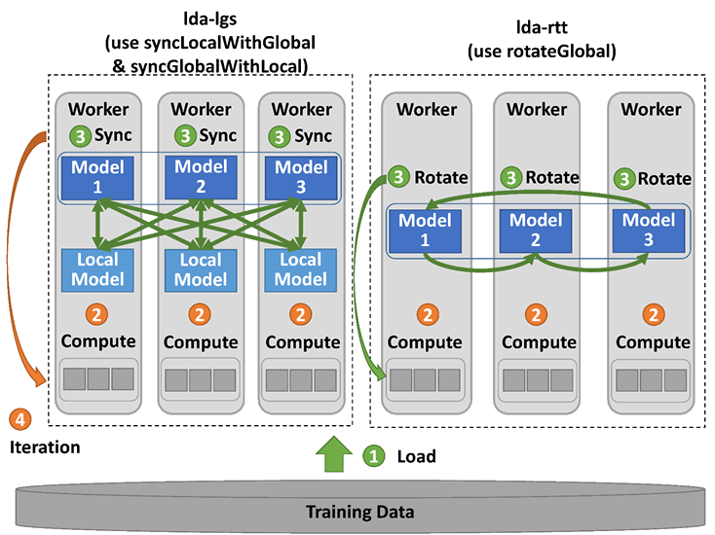
Harp-LDA Execution Flow
Challenges
High memory consumption for model and input data
High number of iterations (~1000)
Computation intensive
Traditional “allreduce” operation in
MPI-LDA is not scalable.
Harp-LDA uses AD-LDA (Approximate Distributed LDA) algorithm (based on Gibbs sampling algorithm)
Harp-LDA runs LDA in iterations of local computation and collective communication to generate new global model.

Slide 33
Data Parallelism: Comparison between Harp-lgs and Yahoo! LDA
Harp-LDA Performance Tests on Intel Haswell Cluster
clueweb
enwiki
50.5 million webpage documents, 12.4B tokens, 1 million vocabulary, 10K topics, 14.7 GB model size
3.8 million wikipedia documents, 1.1B tokens, 1M vocabulary,
10K topics, 2.0 GB model size

Slide 34
Model Parallelism: Comparison between Harp rtt and Petuum LDA
Harp-LDA Performance Tests on Intel Haswell Cluster
clueweb
bi-gram
50.5 million web page documents, 12.4 billion tokens, 1 million vocabulary, 10K topics, 14.7 GB model size
3.9Million wikipedia documents, 1.7 billion tokens, 20 million vocabulary, 500 topics, 5.9 GB model size

Slide 35
Harp LDA on Big Red II Supercomputer (Cray)
Harp LDA Scaling Tests
Harp LDA on Juliet (Intel Haswell)
Corpus: 3,775,554 Wikipedia documents, Vocabulary: 1 million words; Topics: 10k topics; alpha: 0.01; beta: 0.01; iteration: 200
Machine settings
  Big Red II: tested on 25, 50, 75, 100 and 125 nodes, each node uses 32 parallel threads; Gemini interconnect
  Juliet: tested on 10, 15, 20, 25, 30 nodes, each node uses 64 parallel threads on 36 core Intel Haswell node (each with 2 chips); infiniband interconnect

Slide 36
Harp LDA compared with LightLDA and Nomad
Time/HarpLDA+ Time
Parallel Speedup versus number of nodes
Harp has a very efficient parallel algorithm compared to Nomad and LightLDA. All use thread parallelism.
Row 1: enwiki dataset (3.7M docs, 5,000 LDA Topics). 8 nodes, each 16 Threads, Row 2: clueweb30b dataset (76M docs, 10,000 LDA Topics). 20 nodes, each 16 Threads.
All codes run on identical Intel Haswell Cluster

Slide 37
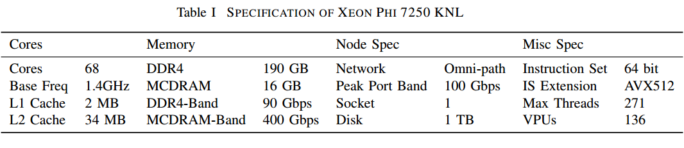
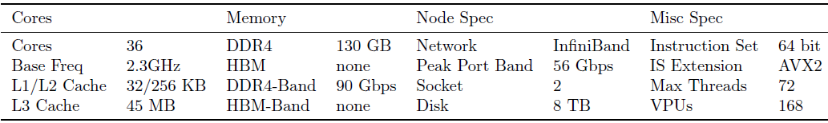
Hardware specifications
All scalability tests run on the above Haswell (128 node) and KNL (64 node) clusters.

Slide 38
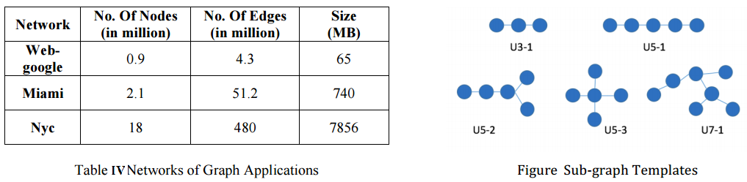
Harp-SAhad SubGraph Mining
VT and IU collaborative work
Relational sub-graph isomorphism problem: find sub-graphs in G which are isomorphic to the given template T.
SAhad is a challenging graph application that is both data intensive and communication intensive.
Harp-SAhad is an implementation for sub-graph counting problem based on SAHAD algorithm and Harp framework.
G
T
w₃
b
b
b
s
w₂
s
w₄
s
c
w₁
c
p
c
s
w₅
s
p’
c
b
b
w₆
[9] Zhao Z, Wang G, Butt A, Khan M, Kumar VS Anil, Marathe M. SAHad: Subgraph analysis in massive networks using hadoop. Shanghai, China: IEEE Computer Society; 2012:390–401. Proceedings of the 2012 IEEE 26th International Parallel and Distributed Processing Symposium.

Slide 39
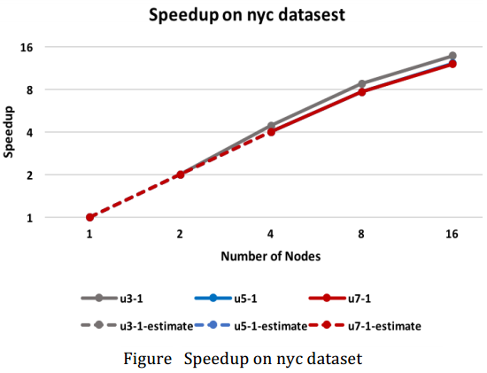
Harp-SAHad Performance Results
VT and IU collaborative work

Slide 40
Harp-DAAL using Twitter dataset with 44 million vertices, 2 billion edges
(on Juliet, a 16 node Intel’s Haswell many-core cluster)

Slide 41
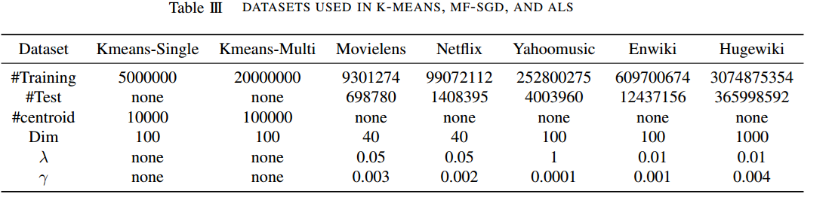
Test Plan and Datasets

Slide 42
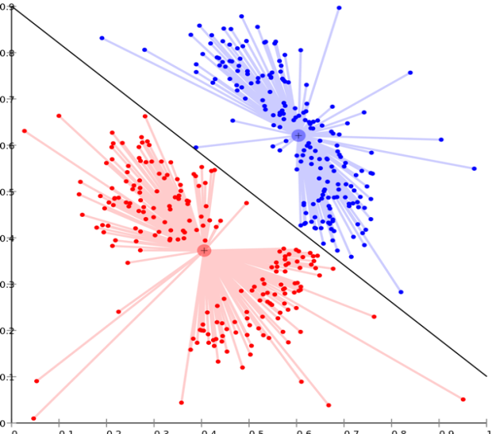
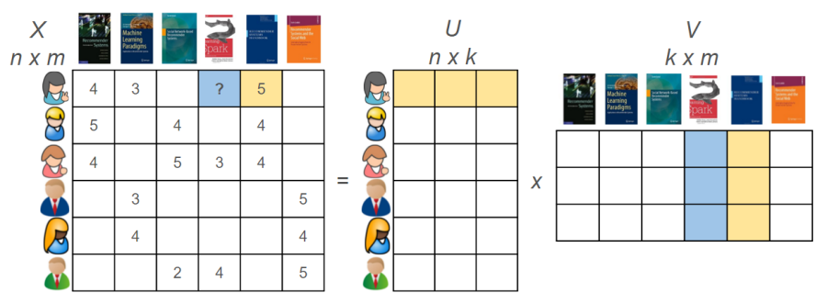
Harp-DAAL Applications
Harp-DAAL-Kmeans
Harp-DAAL-SGD
Harp-DAAL-ALS
Matrix Factorization
Huge model data
Random Memory Access
Matrix Factorization
Huge model data
Regular Memory Access
Clustering
Vectorized computation
Small model data
Regular Memory Access
[10] Langshi Chen, Bo Peng, Bingjing Zhang, Tony Liu, Yiming Zou, Lei Jiang, Robert Henschel, Craig Stewart, Zhang Zhang, Emily Mccallum, Zahniser Tom, Omer Jon, Judy Qiu, Benchmarking Harp-DAAL: High Performance Hadoop on KNL Clusters, in the Proceedings of the International Conference on Cloud Computing (CLOUD 2017), June 25-30, 2017.

Slide 43
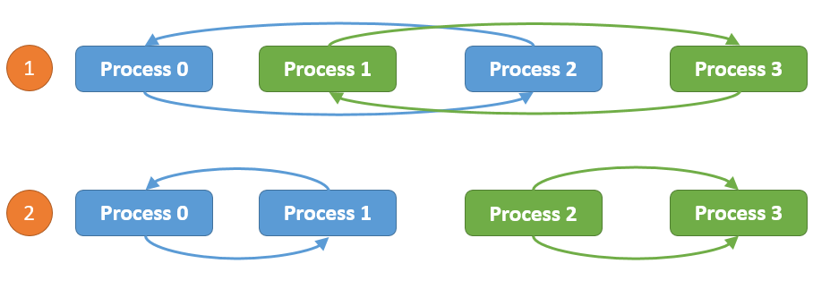
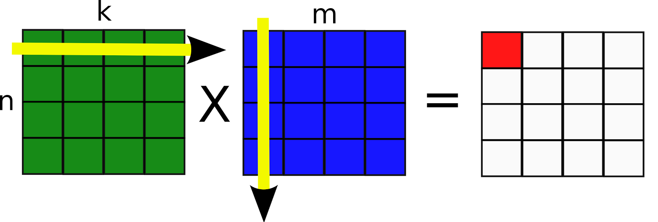
Computation models for K-means
Harp-DAAL-Kmeans
Inter-node: Allreduce, Easy to implement, efficient when model data is not large
Intra-node: Shared Memory, matrix-matrix operations, xGemm: aggregate vector-vector distance computation into matrix-matrix multiplication, higher computation intensity (BLAS-3)

Slide 44
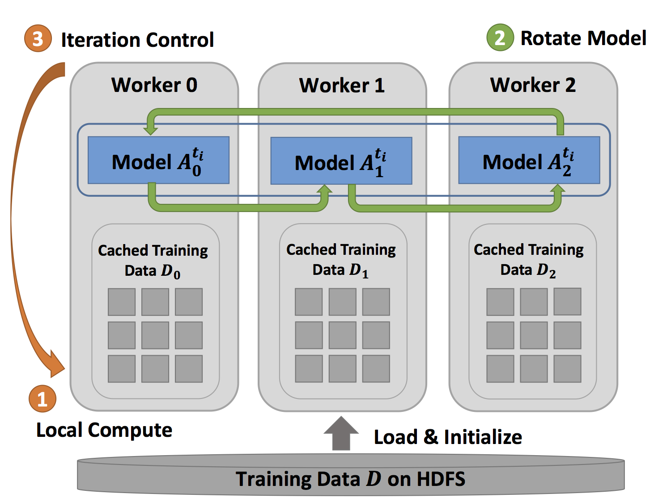
Computation models for MF-SGD
Inter-node: Rotation
Intra-node: Asynchronous
Rotation: Efficent when the mode data
Is large, good scalability
Asynchronous: Random access to model data
Good for thread-level workload balance.

Slide 45


Computation Models for ALS
Inter-node: Allreduce
Intra-node: Shared Memory, Matrix operations
xSyrk: symmetric rank-k update

Slide 46
Performance on KNL Multi-Nodes
Harp-DAAL-Kmeans:
15x to 20x speedup over Spark-Kmeans
Fast single node performance
Near-linear strong scalability from 10 to 20 nodes
After 20 nodes, insufficient computation workload leads to some loss of scalability
Harp-DAAL-SGD:
2x to 2.5x speedup over NOMAD-SGD
Comparable or fast single node performance
Collective communication operations in Harp-DAAL outperform point-to-point MPI communication in NOMAD
Harp-DAAL-ALS:
25x to 40x speedup over Spark-ALS
Fast single node performance
ALS algorithm is not scalable (high communication ratio)
Harp-DAAL combines the benefits from local computation (DAAL kernels) and communication operations (Harp), which is much better than Spark solution and comparable to MPI solution.

Slide 47
Breakdown of Intra-node Performance
Thread scalability:
Harp-DAAL best threads number: 64 (K-means, ALS) and 128 (MF-SGD), more than 128 threads no performance gain
communications between cores intensify
cache capacity per thread also drops significantly
Spark best threads number 256, because Spark could not fully Utilize AVX-512 VPUs
NOMAD-SGD could use AVX VPU, thus has 64 its best thread as that of Harp-DAAL-SGD

Slide 48
Breakdown of Intra-node Performance
Spark-Kmeans and Spark-ALS dominated by Computation (retiring), no AVX-512 to reduce
retiring Instructions, Harp-DAAL improves L1 cache bandwidth utilization due to AVX-512

Slide 49
Data Conversion
Code Optimization Highlights
Harp Data
DAAL Java API
DAAL Native Kernel
Table<Obj>
Data on JVM Heap
NumericTable
Data on JVM heap
Data on Native Memory
MicroTable
Data on Native Memory
A single DirectByteBuffer
has a size limits of 2 GB
Two ways to store data using DAAL Java API
Keep Data on JVM heap
  no contiguous memory access requirement
  Small size DirectByteBuffer and parallel copy (OpenMP)
Keep Data on Native Memory
  contiguous memory access requirement
  Large size DirectByteBuffer and bulk copy

Slide 50
Data Structures of Harp & Intel’s DAAL
Table<Obj> in Harp has a three-level data
Hierarchy
Table: consists of partitions
Partition: partition id, container
Data container: wrap up Java objs, primitive arrays
Data in different partitions, non-contiguous in
memory
Harp Table consists of Partitions
NumericTable in DAAL stores data either in
Contiguous memory space (native side)
or non-contiguous arrays (Java heap side)
Data in contiguous memory space favors matrix
operations with regular memory accesses.
DAAL Table has different types of Data storage

Slide 51
Two Types of Data Conversion
JavaBulkCopy:
Dataflow: Harp Table<Obj> -----
Java primitive array ---- DiretByteBuffer ----
NumericTable (DAAL)
Pros: Simplicity in implementation
Cons: high demand of DirectByteBuffer size
NativeDiscreteCopy:
Dataflow: Harp Table<Obj> ----
DAAL Java API (SOANumericTable)
---- DirectByteBuffer ---- DAAL native memory
Pros: Efficiency in parallel data copy
Cons: Hard to implement at low-level kernels

Slide 52
Outline
1. Introduction: HPC-ABDS, Harp and DAAL
2. Optimization Methodologies
3. Results (configuration, benchmark)
4. Code Optimization Highlights
5. Conclusions and Future Work

Slide 53

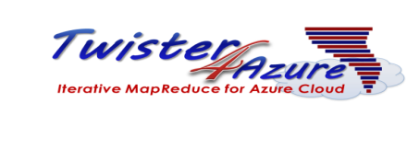

Conclusions
Identification of Apache Big Data Software Stack and integration with High Performance Computing Stack to give HPC-ABDS
    ABDS (Many Big Data applications/algorithms need HPC for performance)
    HPC (needs software model productivity/sustainability)
Identification of 4 computation models for machine learning applications
    Locking, Rotation, Allreduce, Asynchroneous
HPC-ABDS: High performance Hadoop (with Harp-DAAL) on KNL and Haswell clusters

Slide 54
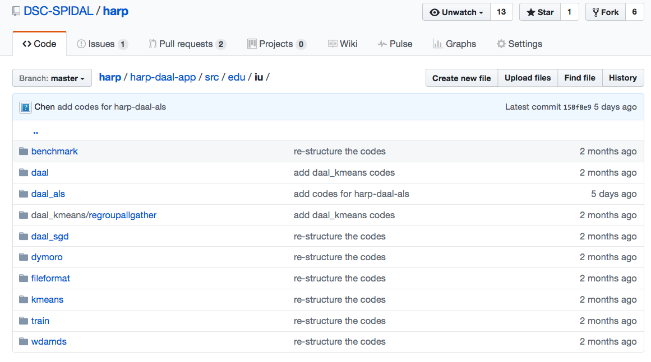
Harp-DAAL: Prototype and Production Code
Open Source Available at https://dsc-spidal.github.io/harp
Source codes became available on Github in February, 2017.
Harp-DAAL follows the same standard of DAAL’s original codes
Twelve Applications
  Harp-DAAL Kmeans
  Harp-DAAL MF-SGD
  Harp-DAAL MF-ALS
  Harp-DAAL SVD
  Harp-DAAL PCA
  Harp-DAAL Neural Networks

Slide 55
Scalable Algorithms implemented using Harp
Algorithm | Category | Applications | Features | Computation Model | Collective Communication
K-means | Clustering | Most scientific domain | Vectors | AllReduce | allreduce, regroup+allgather, broadcast+reduce, push+pull
 |  |  |  | Rotation | rotate
Multi-class Logistic Regression | Classification | Most scientific domain | Vectors, words | Rotation | regroup, rotate, allgather
Random Forests | Classification | Most scientific domain | Vectors | AllReduce | allreduce
Support Vector Machine | Classification, Regression | Most scientific domain | Vectors | AllReduce | allgather
Neural Networks | Classification | Image processing, voice recognition | Vectors | AllReduce | allreduce
Latent Dirichlet Allocation | Structure learning (Latent topic model) | Text mining, Bioinformatics, Image Processing | Sparse vectors; Bag of words | Rotation | rotate, allreduce
Matrix Factorization | Structure learning (Matrix completion) | Recommender system | Irregular sparse Matrix; Dense model vectors | Rotation | rotate
Multi-Dimensional Scaling | Dimension reduction | Visualization and nonlinear identification of principal components | Vectors | AllReduce | allgarther, allreduce
Subgraph Mining | Graph | Social network analysis, data mining, fraud detection, chemical informatics, bioinformatics | Graph, subgraph | Rotation | rotate
Force-Directed Graph Drawing | Graph | Social media community detection and visualization | Graph | AllReduce | allgarther, allreduce

Slide 56
Intelligent HPC Cloud
General Purpose Machine Intelligence requires both Cloud and HPC Technologies
HPC-Apache Big Data Stack supports AI and IoT
Illustration of Harp and Intel’s High Performance Data Analytics

Slide 57
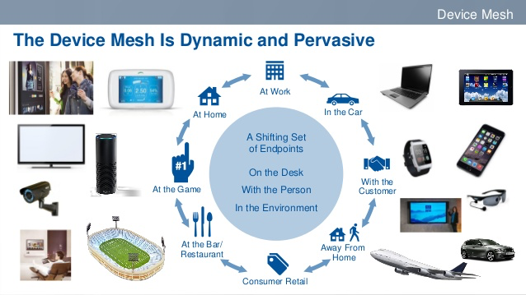
50 Billion Devices by 2020
World Popular will be 7.6 billion by 2020
HPC Cloud
(e.g. CPU, GPU, FPGA)
©Digital Transformation and Innovation

Slide 58
Predictions/Assumptions
Supercomputers will be essential for large simulations and will run other applications
HPC Clouds or Next-Generation Commodity Systems will be a dominant force
  Merge Cloud HPC and (support of) Edge computing
  Federated Clouds running in multiple giant datacenters offering all types of computing
  Distributed data sources associated with device and Fog processing resources
  Server-hidden computing and Function as a Service FaaS for user pleasure
  Support a distributed event-driven serverless dataflow computing model covering batch and streaming data as HPC-FaaS
  Needing parallel and distributed computing ideas
  Span Pleasingly Parallel to Data management to Global Machine Learning

Slide 59

Future Work
Harp-DAAL machine learning and data analysis applications with optimal performance.
Online Clustering with Harp or Storm integrates parallel and dataflow computing models
Start HPC Cloud incubator project in Apache to bring HPC-ABDS to community

Slide 60
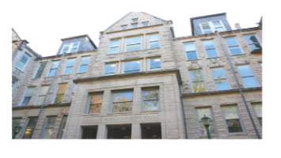

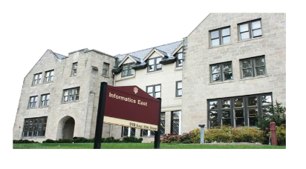


Acknowledgements
We gratefully acknowledge support from NSF, IU and Intel Parallel Computing Center (IPCC) Grant.
Langshi Cheng Bingjing Zhang Bo Peng Kannan Govindarajan
Supun Kamburugamuve Yiming Zhou Ethan Li Mihai Avram Vibhatha Abeykoon
Intelligent Systems Engineering
School of Informatics and Computing
Indiana University

