Slide 1
Harp-DAAL: A Next Generation Platform for
High Performance Machine Learning
SC’17, Denver Colorado
November 15, 2017
Judy Qiu
Intelligent Systems Engineering Department, Indiana University
Email: xqiu@indiana.edu

Slide 2
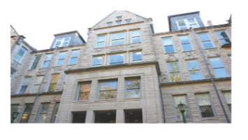

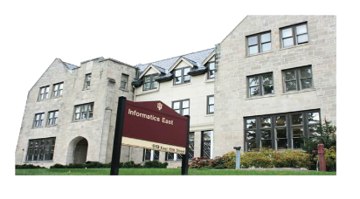


Acknowledgements
We gratefully acknowledge support from NSF, IU and Intel Parallel Computing Center (IPCC) Grant.
Langshi Cheng Bingjing Zhang Bo Peng Kannan Govindarajan, Supun Kamburugamuve, Mihai Avram, Sabra Ossen
Robert Henschel, Craig Stewart, Shaojuan Zhu, Emily Mccallum, Lisa Smith, Tom Zahniser, Jon Omer
Zhao Zhao, Saliya Ekanalyake, Anil Vullikanti, Madhav Marathe
Intelligent Systems Engineering
School of Informatics and Computing
Indiana University

Slide 3
HPC-ABDS: Big Data and HPC Convergence
Machine Learning Framework Harp-DAAL
Concept
Computation Model
Runtime
Use Cases
Conclusion and Future Directions
Big Data
Clouds
HPC
Outline

Slide 4

HPC-ABDS
• Big Data and HPC Convergence

Slide 5
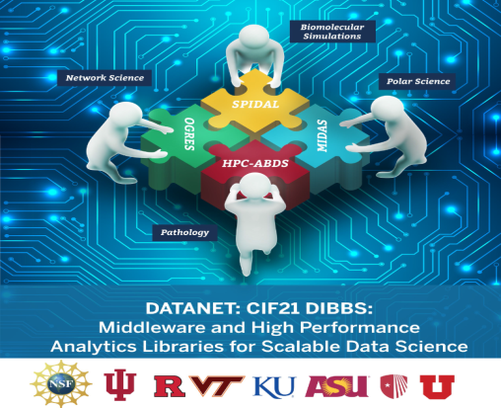

Slide 6
High Performance – Apache Big Data Stack
Big Data Application Analysis [1] [2] identifies features of data intensive applications that need to be supported in software and represented in benchmarks. This analysis has been extended to support HPC-Simulations-Big Data convergence.
The project is a collaboration between computer and domain scientists in application areas in Biomolecular Simulations, Network Science, Epidemiology, Computer Vision, Spatial Geographical Information Systems, Remote Sensing for Polar Science and Pathology Informatics.
HPC-ABDS [3] as Cloud-HPC interoperable software with performance of HPC (High Performance Computing) and the rich functionality of the commodity Apache Big Data Stack was a bold idea developed.
[1] Shantenu Jha, Judy Qiu, Andre Luckow, Pradeep Mantha, Geoffrey Fox, A Tale of Two Data-Intensive Paradigms: Applications, Abstractions, and Architectures, Proceedings of the 3rd International Congress on Big Data Conference (IEEE BigData 2014).
[2] Geoffrey Fox, Shantenu Jha, Judy Qiu, Andre Luckow, Towards an Understanding of Facets and Exemplars of Big Data Applications, accepted to the Twenty Years of Beowulf Workshop (Beowulf), 2014.
[3] Judy Qiu, Shantenu Jha, Andre Luckow, Geoffrey Fox, Towards HPC-ABDS: An Initial High-Performance Big Data Stack, accepted to the proceedings of ACM 1st Big Data Interoperability Framework Workshop: Building Robust Big Data ecosystem, NIST special publication, 2014.

Slide 7
Motivation of Iterative MapReduce
MapReduce
Classic Parallel Runtimes (MPI)
Data Centered, QoS
Efficient and Proven techniques
Expand the Applicability of MapReduce to more classes of Applications
Sequential
Map-Only
MapReduce
Iterative MapReduce
MPI and Point-to-Point
Input
Input
Input
iterations
Input
map
map
map
map
Pij
Output
Output
reduce
reduce

Slide 8
Harp-DAAL Machine Learning Framework
• Concept • Computation Model • Runtime

Slide 9
The Concept of Harp Plug-in
Parallelism Model
Architecture
MapReduce Model
MapCollective Model
MapReduce Applications
MapCollective Applications
Application
M
M
M
M
M
M
M
M
MapReduce V2
Harp
Shuffle
Framework
Collective Communication
R
R
Resource Manager
YARN
Harp is an open-source project developed at Indiana University, it has:
MPI-like collective communication operations that are highly optimized for big data problems.
Harp has efficient and innovative computation models for different machine learning problems.
[3] J. Ekanayake et. al, “Twister: A Runtime for Iterative MapReduce”, in Proceedings of the 1st International Workshop on MapReduce and its Applications of ACM HPDC 2010 conference.
[4] T. Gunarathne et. al, “Portable Parallel Programming on Cloud and HPC: Scientific Applications of Twister4Azure”, in Proceedings of 4th IEEE International Conference on Utility and Cloud Computing (UCC 2011).
[5] B. Zhang et. al, “Harp: Collective Communication on Hadoop,” in Proceedings of IEEE International Conference on Cloud Engineering (IC2E 2015).

Slide 10
Data management
Algorithms
Intel® DAAL is an open-source project that provides:
Algorithms Kernels to Users
    Batch Mode (Single Node)
    Distributed Mode (multi nodes)
    Streaming Mode (single node)
Data Management & APIs to Developers
    Data structure, e.g., Table, Map, etc.
    HPC Kernels and Tools: MKL, TBB, etc.
    Hardware Support: Compiler
Data sources
Data dictionaries
Data model
Numeric tables and matrices
Compression
Analysis
Training
Prediction
Services
Memory allocation
Error handling
Collections
Shared pointers

Slide 11
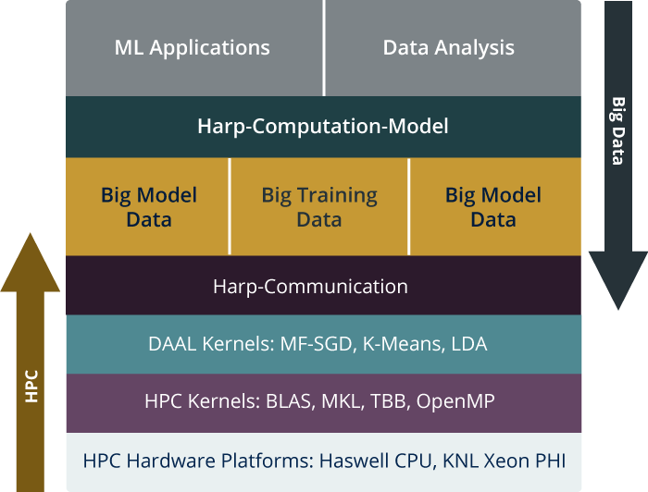
HPC-ABDS is Cloud-HPC interoperable software with the performance of HPC (High Performance Computing) and the rich functionality of the commodity Apache Big Data Stack. This concept is illustrated by Harp-DAAL.
High Level Usability: Python Interface, well documented and packaged modules
Middle Level Data-Centric Abstractions: Computation Model and optimized communication patterns
Low Level optimized for Performance: HPC kernels Intel® DAAL and advanced hardware platforms such as Xeon and Xeon Phi
Harp-DAAL

Slide 12
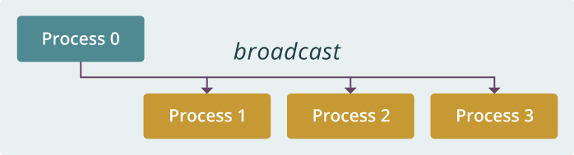
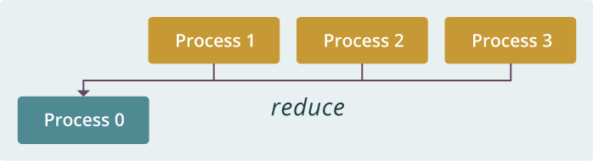
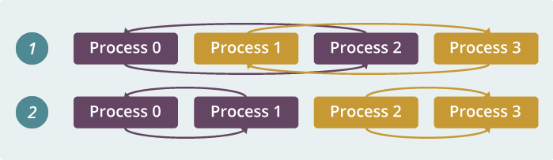
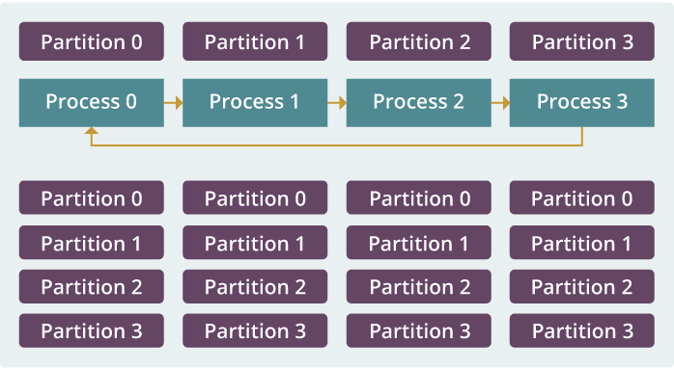
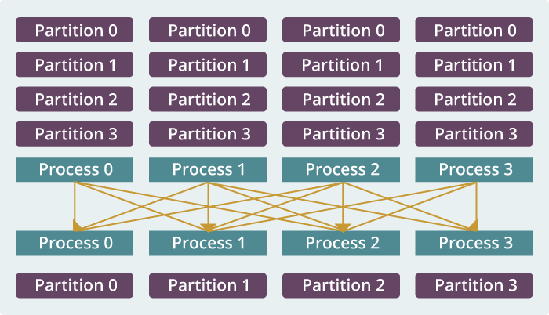
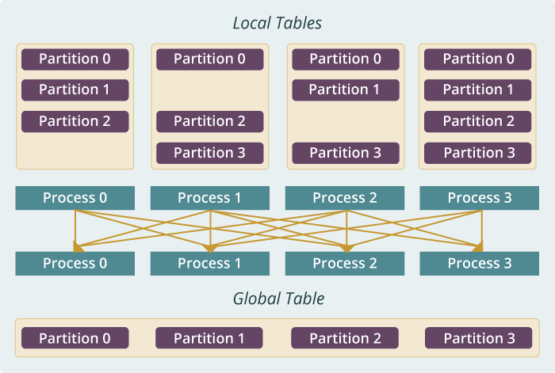
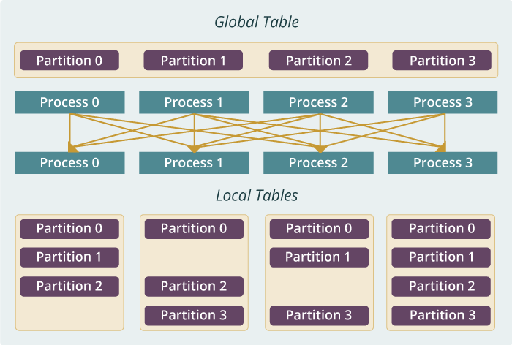
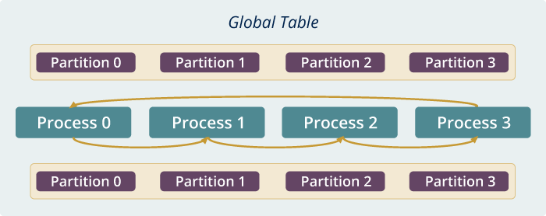
broadcast
reduce
allreduce
allgather
regroup
push & pull
rotate
Collective

Slide 13
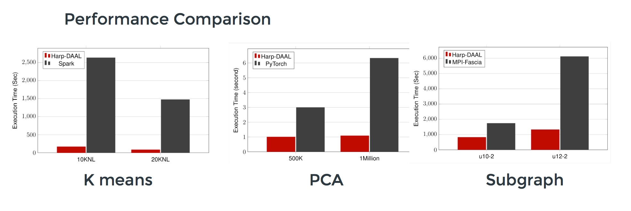
Datasets: 5 million points, 10 thousand centroids, 10 feature dimensions
10 to 20 nodes of Intel KNL7250 processors
Harp-DAAL has 15x speedups over Spark MLlib
Datasets: 500K or 1 million data points of feature dimension 300
Running on single KNL 7250 (Harp-DAAL) vs. single K80 GPU (PyTorch)
Harp-DAAL achieves 3x to 6x speedups
Datasets: Twitter with 44 million vertices, 2 billion edges, subgraph templates of 10 to 12 vertices
25 nodes of Intel Xeon E5 2670
Harp-DAAL has 2x to 5x speedups over state-of-the-art MPI-Fascia solution

Slide 14
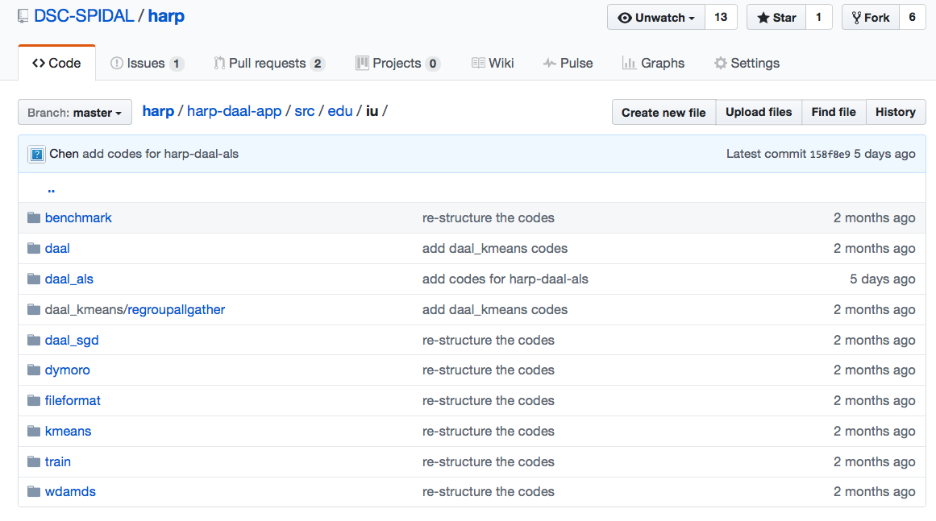
Harp-DAAL: Prototype and Production Code
Available at https://dsc-spidal.github.io/harp
Source codes became available on Github in February, 2017.
Harp-DAAL follows the same standard of DAAL’s original codes
Twelve Applications
  Harp-DAAL Kmeans
  Harp-DAAL MF-SGD
  Harp-DAAL MF-ALS
  Harp-DAAL SVD
  Harp-DAAL PCA
  Harp-DAAL Neural Networks
  Harp-DAAL Naïve Bayes
  Harp-DAAL Linear Regression
  Harp-DAAL Ridge Regression
  Harp-DAAL QR Decomposition
  Harp-DAAL Low Order Moments
  Harp-DAAL Covariance

Slide 15
Scalable Algorithms implemented using Harp
Algorithm | Category | Applications | Features | Computation Model | Collective Communication
K-means | Clustering | Most scientific domain | Vectors | AllReduce | allreduce, regroup+allgather, broadcast+reduce, push+pull
 |  |  |  | Rotation | rotate
Multi-class Logistic Regression | Classification | Most scientific domain | Vectors, words | Rotation | regroup, rotate, allgather
Random Forests | Classification | Most scientific domain | Vectors | AllReduce | allreduce
Support Vector Machine | Classification, Regression | Most scientific domain | Vectors | AllReduce | allgather
Neural Networks | Classification | Image processing, voice recognition | Vectors | AllReduce | allreduce
Latent Dirichlet Allocation | Structure learning (Latent topic model) | Text mining, Bioinformatics, Image Processing | Sparse vectors; Bag of words | Rotation | rotate, allreduce
Matrix Factorization | Structure learning (Matrix completion) | Recommender system | Irregular sparse Matrix; Dense model vectors | Rotation | rotate
Multi-Dimensional Scaling | Dimension reduction | Visualization and nonlinear identification of principal components | Vectors | AllReduce | allgarther, allreduce
Subgraph Mining | Graph | Social network analysis, data mining, fraud detection, chemical informatics, bioinformatics | Graph, subgraph | Rotation | rotate
Force-Directed Graph Drawing | Graph | Social media community detection and visualization | Graph | AllReduce | allgarther, allreduce

Slide 16
Harp-DAAL Machine Learning Framework
• Concept • Computation Model • Runtime

Slide 17
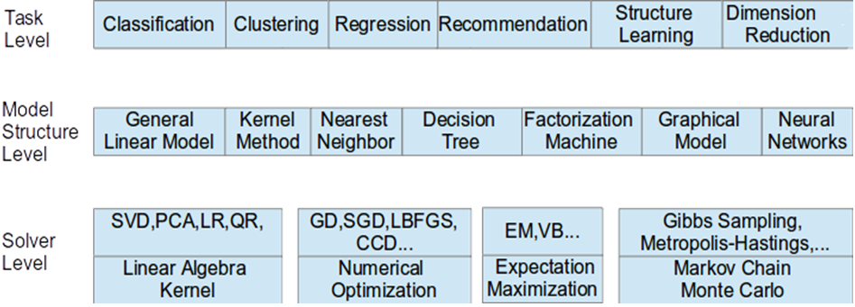
Taxonomy for Machine Learning Algorithms
Optimization and related issues
  Task level only can't capture the traits of computation
  Model is the key for iterative algorithms. The structure (e.g. vectors, matrix, tree, matrices) and size are critical for performance
  Solver has specific computation and communication pattern

Slide 18
Computation Models
B. Zhang, B. Peng, and J. Qiu, “Model-centric computation abstractions in machine learning applications,” in Proceedings of
the 3rd ACM SIGMOD Workshop on Algorithms and Systems for MapReduce and Beyond, BeyondMR@SIGMOD 2016
Notes:
For large scale problems:
X distributed; not only the input data, but also the intermediate data during the process of computation not pleasingly parallel, because of dependency determined by the iterative or recursive nature

Slide 19
Machine Learning Application
Machine Learning Algorithm
Programming Interface
Computation Model
Implementation
Parallelization of
Machine Learning Applications

Slide 20
Harp-DAAL Machine Learning Framework
• Concept • Data Computation Model • Runtime

Slide 21
Example: K-means Clustering
The Allreduce Computation Model
Model
Worker
Worker
Worker
When the model size cannot be held in each machine’s memory
When the model size is small
When the model size is large but can still be held in each machine’s memory
broadcast
regroup
push & pull
allreduce
reduce
allgather
rotate

Slide 22
  Why Collective Communications for Big Data Processing?
Collective Communication and Data Abstractions
  Optimization of global model synchronization
    ML algorithms: convergence vs. consistency
    Model updates can be out of order
  Hierarchical data abstractions and operations
Map-Collective Programming Model
  Extended from MapReduce model to support collective communications
  BSP parallelism at Inter-node vs. Intra-node levels
Harp Implementation
  A plug-in to Hadoop

Slide 23

HPC Runtime versus ABDS Distributed Computing Model on Data Analytics
Hadoop writes to disk and is slowest; Spark and Flink spawn many processes and do not support Allreduce directly; MPI does in-place combined reduce/broadcast

Slide 24
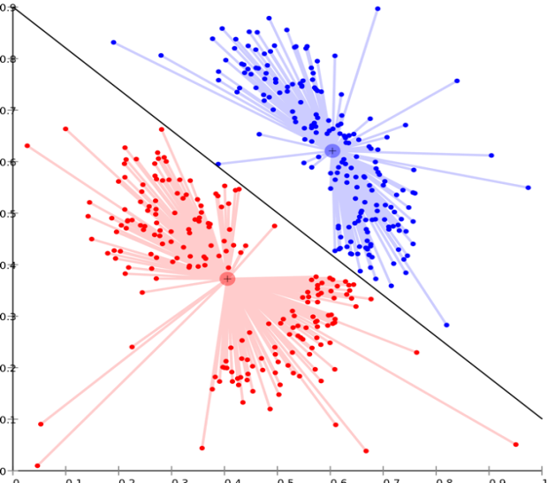
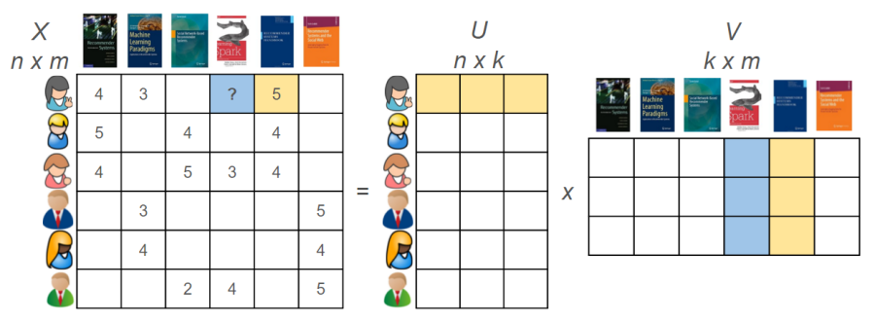
Harp-DAAL Applications
Harp-DAAL-Kmeans
Harp-DAAL-SGD
Harp-DAAL-ALS
Matrix Factorization
Huge model data
Random Memory Access
Matrix Factorization
Huge model data
Regular Memory Access
Clustering
Vectorized computation
Small model data
Regular Memory Access
Langshi Chen, Bo Peng, Bingjing Zhang, Tony Liu, Yiming Zou, Lei Jiang, Robert Henschel, Craig Stewart, Zhang Zhang, Emily Mccallum, Zahniser Tom, Omer Jon, Judy Qiu, Benchmarking Harp-DAAL: High Performance Hadoop on KNL Clusters, in the Proceedings of the International Conference on Cloud Computing (CLOUD 2017), June 25-30, 2017.

Slide 25
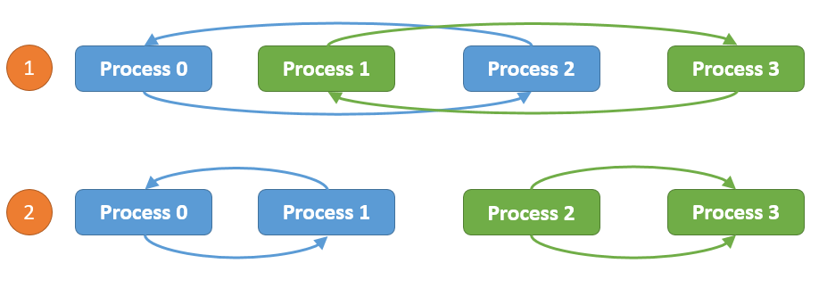
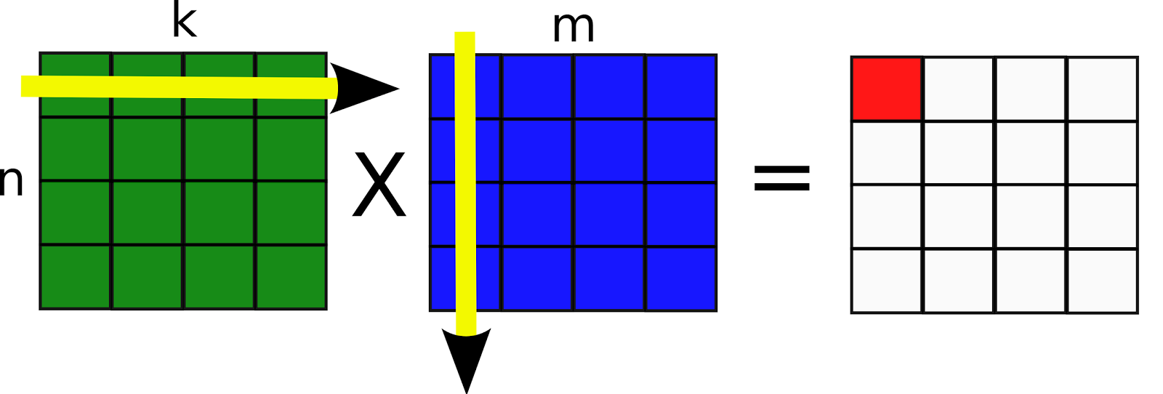
Computation models for K-means
Inter-node: Allreduce, Easy to implement, efficient when model data is not large
Intra-node: Shared Memory, matrix-matrix operations, xGemm: aggregate vector-vector distance computation into matrix-matrix multiplication, higher computation intensity (BLAS-3)
Harp-DAAL-Kmeans vs. Spark-Kmeans:
~ 20x speedup
Harp-DAAL-Kmeans invokes MKL matrix operation kernels at low level
Matrix data stored in contiguous memory space, leading to regular access pattern and data locality

Slide 26
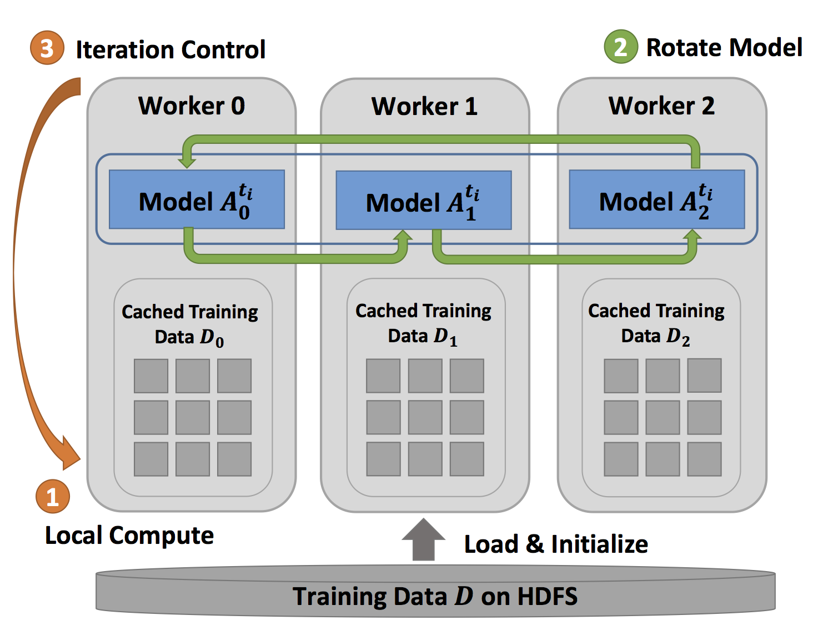
Computation models for MF-SGD
Inter-node: Rotation Efficient when the mode data
Is large, good scalability
Harp-DAAL-SGD vs. NOMAD-SGD
Small dataset (MovieLens, Netflix): comparable perf
Large dataset (Yahoomusic, Enwiki): 1.1x to 2.5x, depending on data distribution of matrices
Intra-node: Asynchronous
Random access to model data. Good for thread-level workload balance.

Slide 27


Computation Models for ALS
Inter-node: Allreduce
Intra-node: Shared Memory, Matrix operations xSyrk: symmetric rank-k update
Harp-DAAL-ALS vs. Spark-ALS
20x to 50x speedup
Harp-DAAL-ALS invokes MKL at low level
Regular memory access, data locality in matrix operations

Slide 28
Breakdown of Intra-node Performance
Spark-Kmeans and Spark-ALS dominated by Computation (retiring), no AVX-512 to reduce
retiring Instructions, Harp-DAAL improves L1 cache bandwidth utilization due to AVX-512

Slide 29
Breakdown of Intra-node Performance
Thread scalability:
Harp-DAAL best threads number: 64 (K-means, ALS) and 128 (MF-SGD), more than 128 threads no performance gain
communications between cores intensify
cache capacity per thread also drops significantly
Spark best threads number 256, because Spark could not fully Utilize AVX-512 VPUs
NOMAD-SGD could use AVX VPU, thus has 64 its best thread as that of Harp-DAAL-SGD

Slide 30
Case Studies
• LDA • Subgraph Counting

Slide 31
Case Study 1:
Parallel Latent Dirichlet Allocation for Text Mining and DNA Sequence Analysis

Slide 32
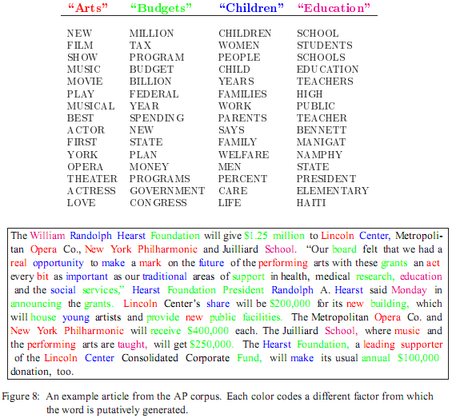
LDA: mining topics in text collection
Huge volume of Text Data
  Information overloading
  What on earth is inside the TEXT Data?
Search
  Find the documents relevant to my need (ad hoc query)
Filtering
  Fixed info needs and dynamic text data
What's new inside?
  Discover something I don't know
Blei, D. M., Ng, A. Y. & Jordan, M. I. Latent Dirichlet Allocation. J. Mach. Learn. Res. 3, 993–1022 (2003).

Slide 33
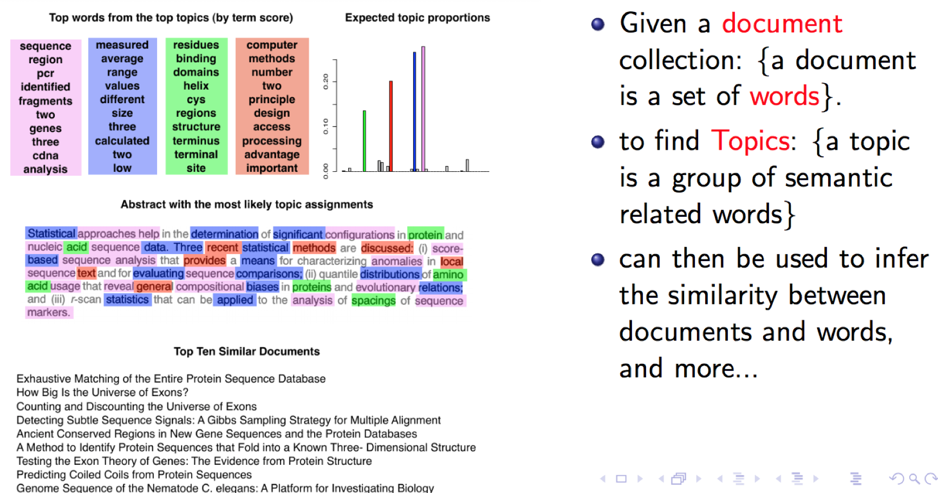
Chance and Statistic Significance in Protein and DNA Sequence Analysis
Samuel Karlin and Volker Brendel

Slide 34
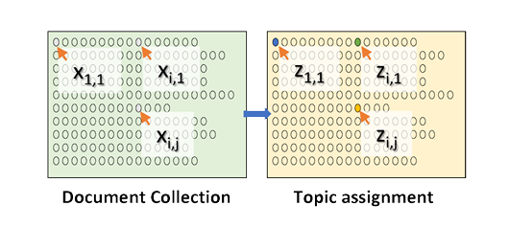
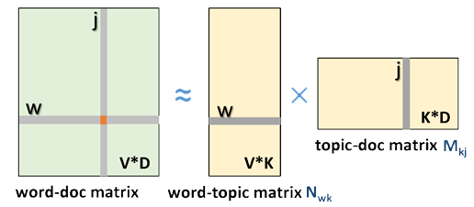
LDA and Topic Models
Topic Models is a modeling technique, modeling the data by probabilistic generative process.
Latent Dirichlet Allocation (LDA) is one widely used topic model.
Inference algorithm for LDA is an iterative algorithm using share global model data.
Document
Word
Topic: semantic unit inside the data
Topic Model
  documents are mixtures of topics, where a topic is a probability distribution over words
Global Model Data
3.7 million docs
10k topics
1 million words
Topic Discovery
  Normalized co-occurrence matrix
  Mixture components
  Mixture weights
Notes:
global model data should be word-topic matrix or topic-document matrix,

Slide 35
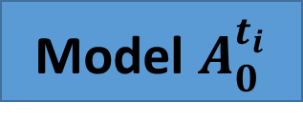
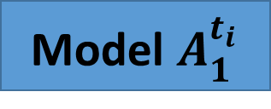
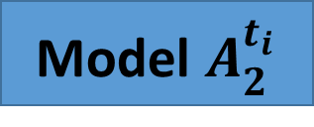
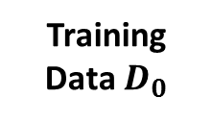
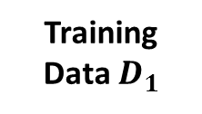
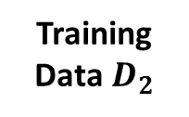
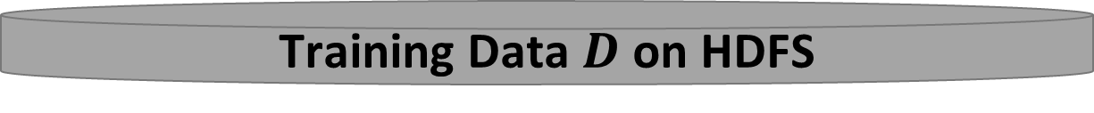
A Parallelization Solution using Model Rotation
3
Iteration Control
2
Rotate Model
Maximizing the effectiveness of parallel model updates for algorithm convergence
Worker 0
Worker 1
Worker 2
Model $A_{0}^{t_{i}}$
Model $A_{1}^{t_{i}}$
Model $A_{2}^{t_{i}}$
Minimizing the overhead of communication for scaling
Training Data $D_{0}$
Training Data $D_{1}$
Training Data${ D}_{2}$
1
Local Compute
Load, Cache & Initialize
Training Data $D$ on HDFS

Slide 36







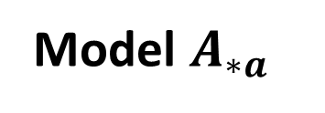
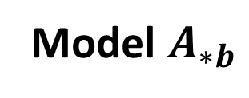


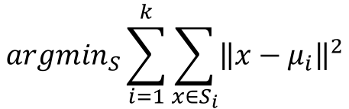



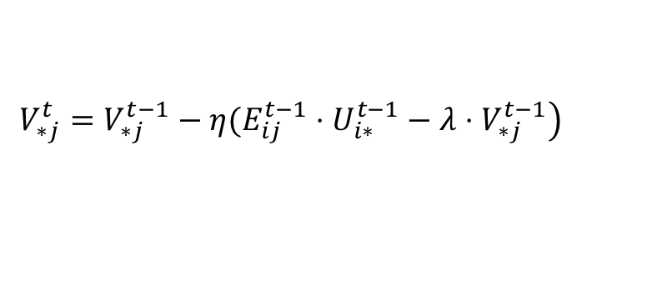










Pipeline Model Rotation
Model $A_{∗a}$
Model $A_{∗b}$
Worker 0
Worker 1
Worker 2
$$A_{0a}$$
$$A_{1a}$$
$$A_{2a}$$
Time
$$A_{0b}$$
$$A_{1b}$$
$$A_{2b}$$
$$A_{2a}$$
$$A_{0a}$$
$$A_{1a}$$
$$A_{2b}$$
$$A_{0b}$$
$$A_{1b}$$
$$A_{1a}$$
$$A_{2a}$$
$$A_{0a}$$
$$A_{1b}$$
$$A_{2b}$$
$$A_{0b}$$
$$A_{0a}$$
$$A_{1a}$$
$$A_{2a}$$
$$A_{0b}$$
$$A_{1b}$$
$$A_{2b}$$
Shift
Shift
Shift

Slide 37
Dynamic Rotation Control for LDA
Multi-Thread Execution
Model Parameters
From Rotation
Model Related Data
Computes until the time arrives, then starts model rotation
Other Model Parameters
From Caching

Slide 38
CGS Model Convergence Speed
LDA Dataset | Documents | Words | Tokens | CGS Parameters
clueweb1 | 76163963 | 999933 | 29911407874 | $$K=10000,α=0.01, β=0.01$$
60 nodes x 20 threads/node
30 nodes x 30 threads/node
K: number of features; 𝑎, 𝑏 hyperparameters;

Slide 39
Harp LDA on Big Red II Supercomputer (Cray)
Harp LDA Scaling Tests
Harp LDA on Juliet (Intel Haswell)
Corpus: 3,775,554 Wikipedia documents, Vocabulary: 1 million words; Topics: 10k topics; alpha: 0.01; beta: 0.01; iteration: 200
Machine settings
  Big Red II: tested on 25, 50, 75, 100 and 125 nodes, each node uses 32 parallel threads; Gemini interconnect
  Juliet: tested on 10, 15, 20, 25, 30 nodes, each node uses 64 parallel threads on 36 core Intel Haswell node (each with 2 chips); infiniband interconnect

Slide 40
Case Study 2:
Parallel Subgraph Counting

Slide 41
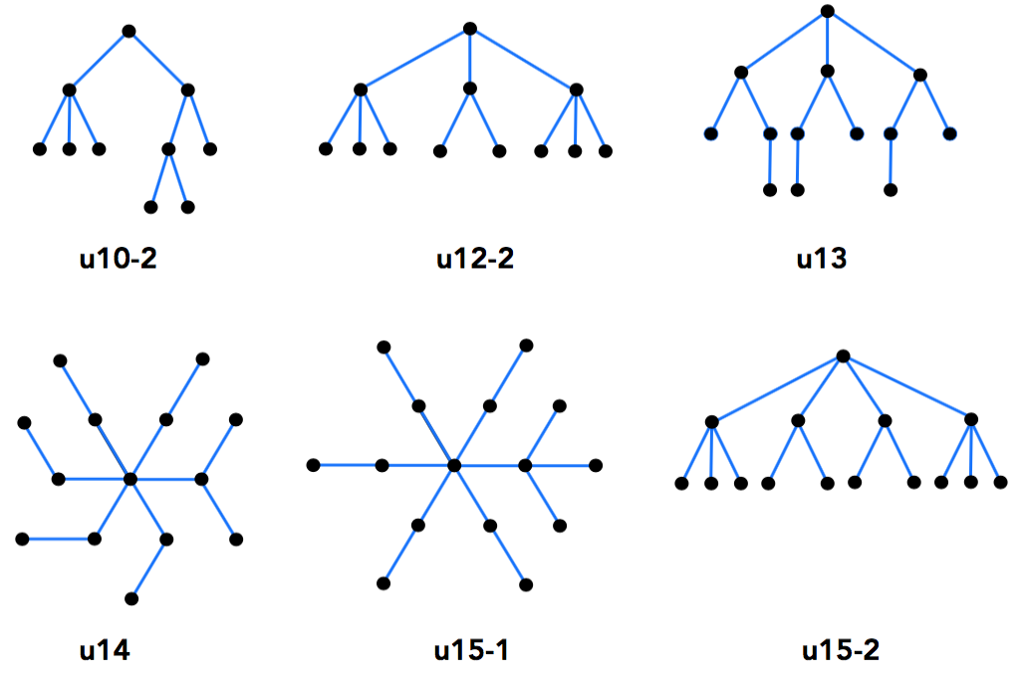
Subgraph Counting
Relational sub-graph isomorphism problem: find sub-graphs in G which are isomorphic to the given template T.
It’s NP-hard problem and both computation and communication intensive
Irregular communication data volume in computing each sub-template
Embedding of Sub-template
Tree Sub-template
Zhao Z, Wang G, Butt A, Khan M, Kumar VS Anil, Marathe M. SAHad: Subgraph analysis in massive networks using hadoop. Shanghai, China: IEEE Computer Society; 2012:390–401. Proceedings of the 2012 IEEE 26th International Parallel and Distributed Processing Symposium.

Slide 42
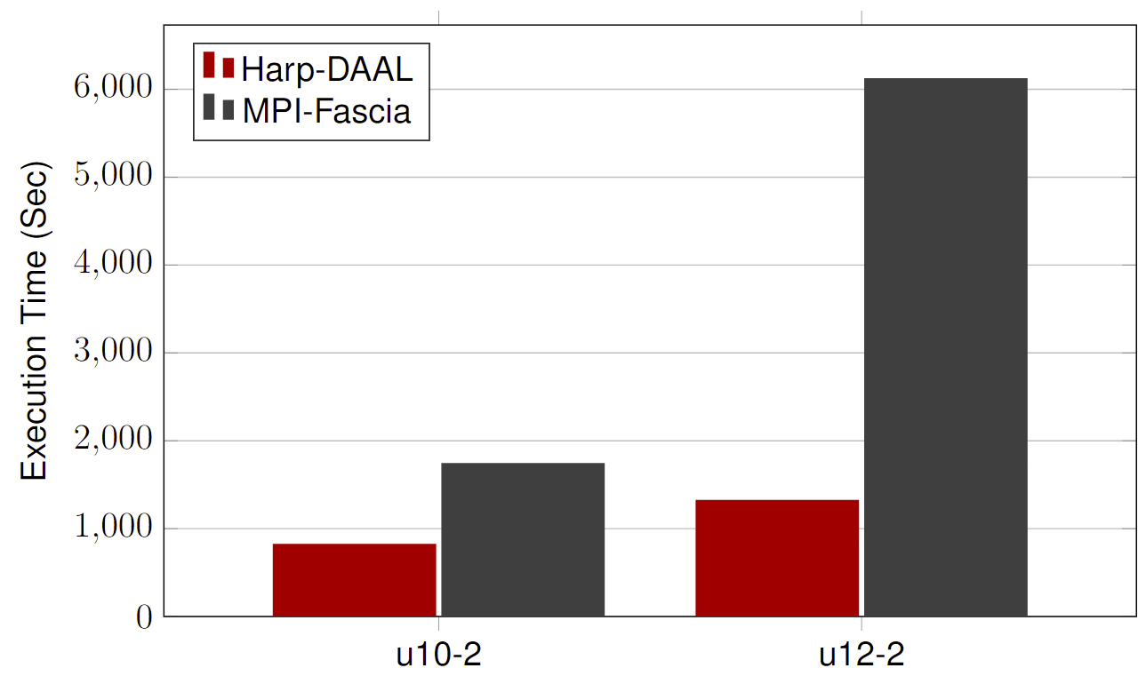
Datasets: Twitter with 44 million vertices, 2 billion edges, subgraph template size of 10 to 12 vertices
25 nodes of Intel® Xeon E5 2670
Large templates have longer sub-template chain causing communication variation
Harp-DAAL has 2x to 5x speedups over state-of-the-art MPI-Fascia solution
Performance

Slide 43
Adaptive-Group Communication
MPI collective operation (e.g., AlltoAll)
Harp Adaptive-Group Communication
Execution flow driven
Static communication type defined in codes (Sender ID, Send Size, DataType)
(Receiver ID, Send Size, DataType)
Data driven communication
Routing rules defined at runtime with data partition ID
On-demand decoupled steps and each step
P1
P2
P3
P4
P5
P1
P2
P3
P4
P5

Slide 44
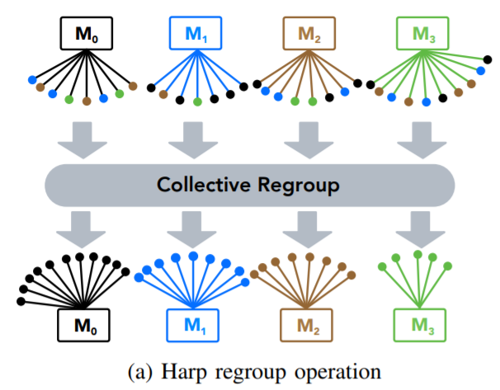
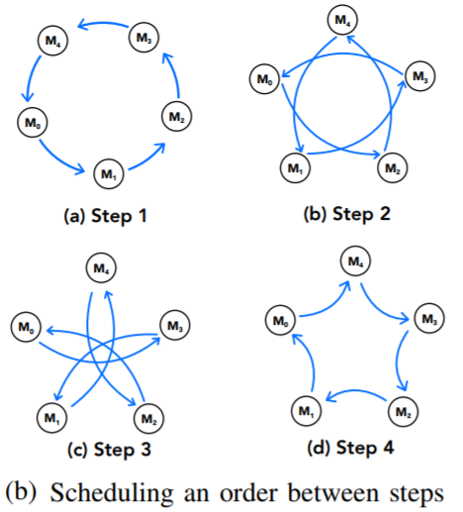

Computation models for Subgraph Counting
Com-Friendster
65 million nodes
5 billion edges
On-demand decoupled steps
Pipelined by computation
Each step partial collective communication within group
SNAP network repository
Count number of template u12-2
4.358118772743884$×{10}^{37}$
Count time of template u12-2
30 minutes

Slide 45
Conclusion and Future Directions

Slide 46

Conclusion and Future Directions
HPC-ABDS is a bold ideas developed with ­­Apache Big Data Software Stack integration with High Performance Computing Stack
    ABDS (Many Big Data applications or algorithms need HPC for performance)
    HPC (needs software model productivity and sustainability)
Harp-DAAL is an implementation of HPC-ABDS that gives fast solutions for machine learning and graph applications. This supports high performance Hadoop (with Harp collective communication and high performance Intel® DAAL kernel library enhancement) on Intel® Xeon™ and Xeon Phi ™ architectures.
Identification of 4 computation models for machine learning applications and development of Harp library of Collectives to use at Reduce phase.
There are 12 Harp-DAAL algorithms and a total of 34 algorithms in SPIDAL library
Start HPC Cloud incubator project in Apache to bring HPC-ABDS to community

Slide 47
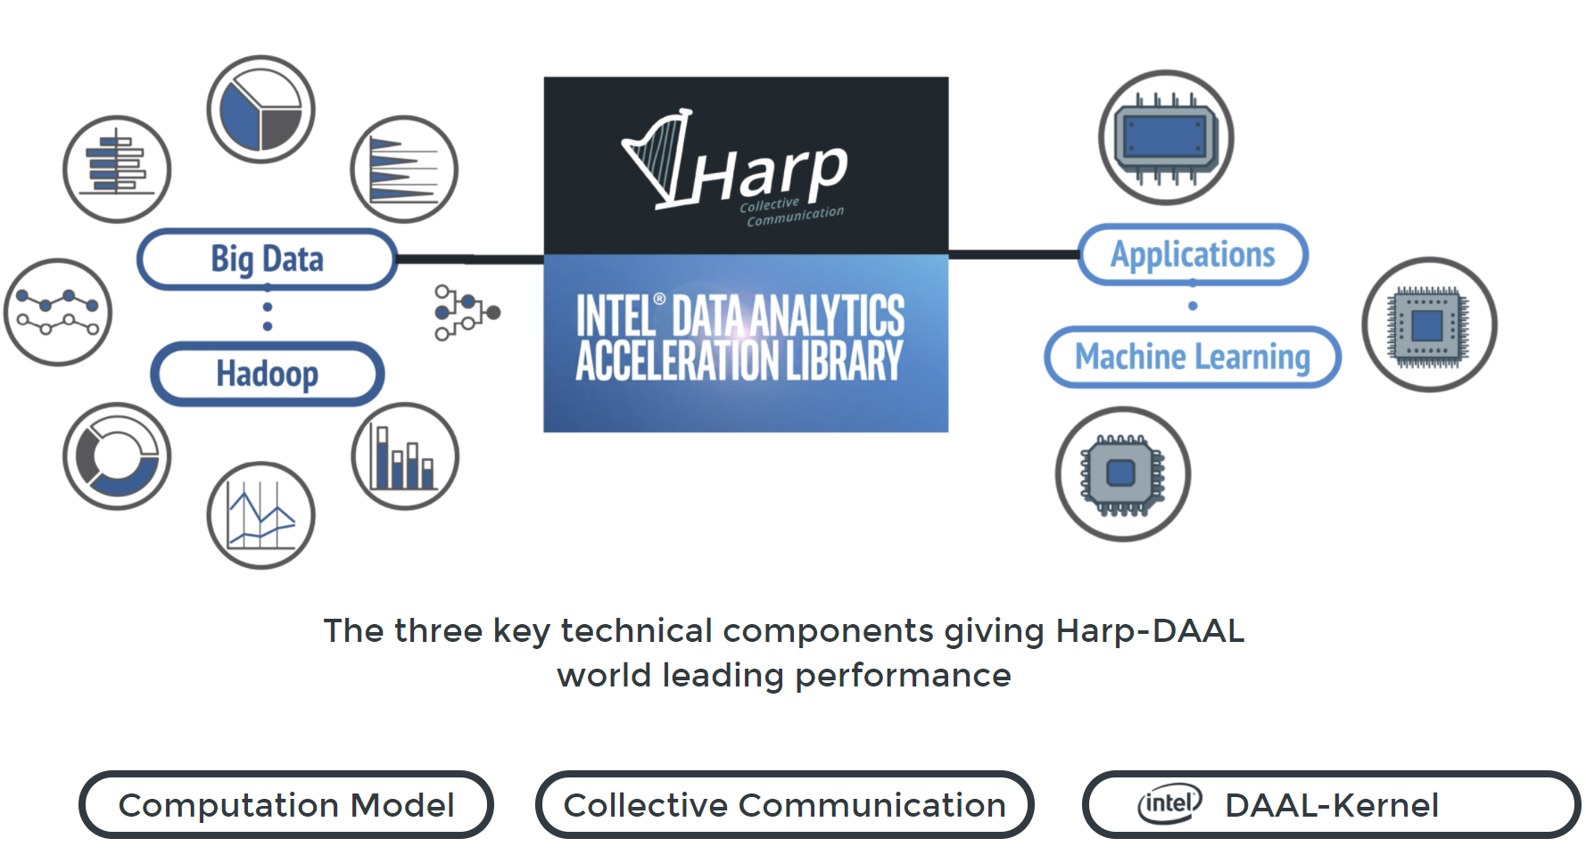

Slide 48
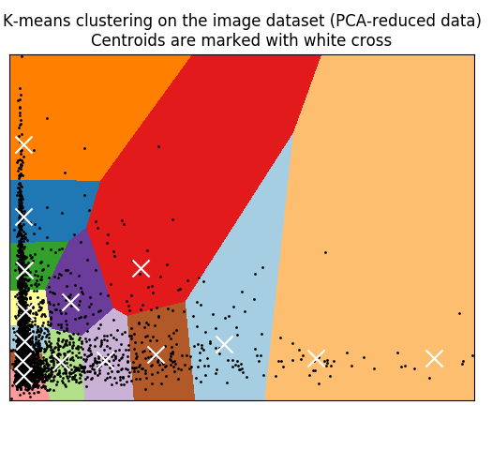
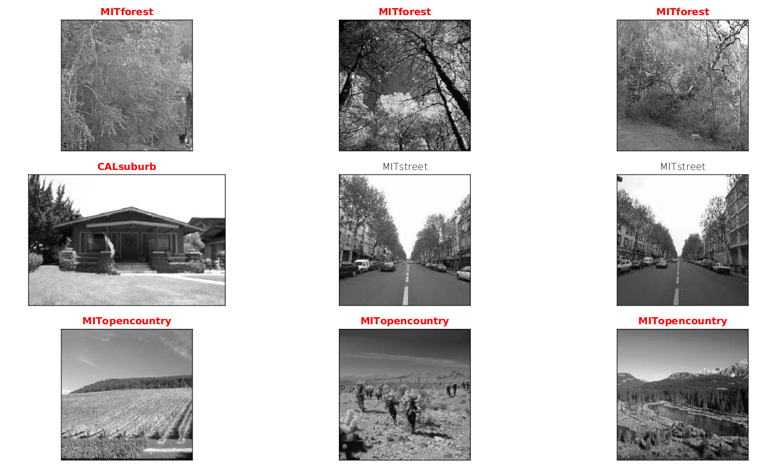
result: sample images of the result clusters,
one row for each cluster
Result

Slide 49
Image results from Scikit-learn
Image results from Harp-Daal

Slide 50

Demo: Harp-Daal KMeans for image clustering

Slide 51
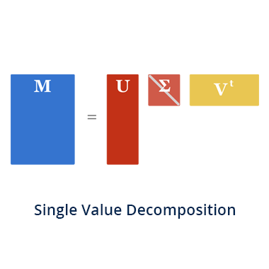
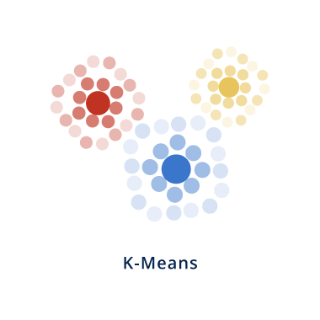
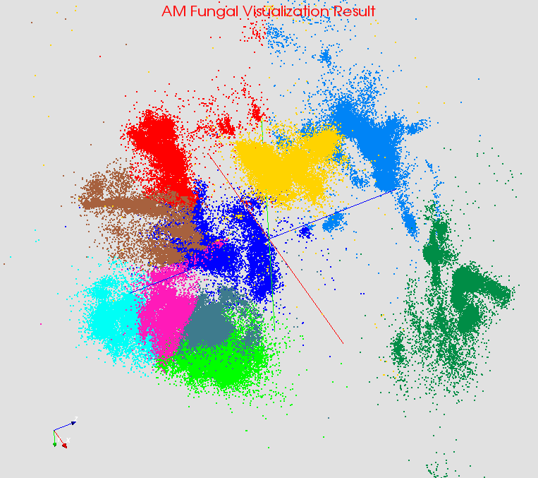

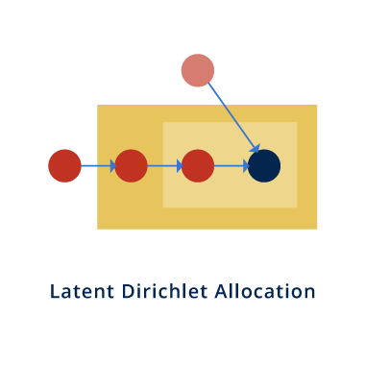
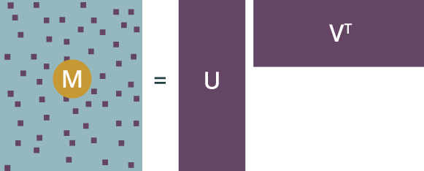
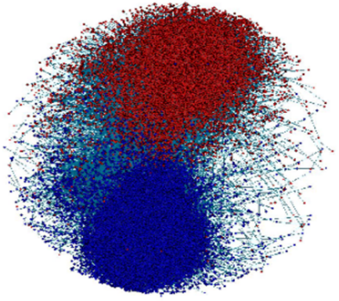

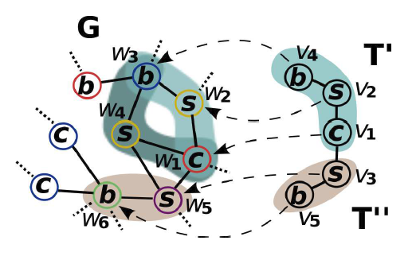
Explore Algorithms
PCA
Bioinformatics
Computer Vision
Alternating least squares (ALS)
Complex Networks
Text Mining
MatrixFactorization-SGD
SubGraph Counting

Slide 52

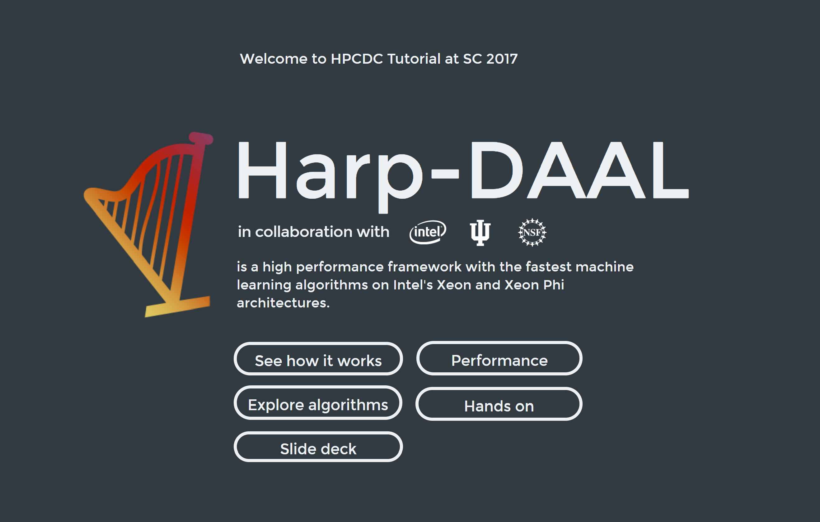
Interactive Website (https://dexterrules.github.io/SC-Demo-17/SC-Demo.html)

