Slide 1

Big Data and Simulations: HPC and Clouds
Data-Intensive Science and Technologies Workshop
http://www.stfc.ac.uk/news-events-and-publications/events/stfc-events/data-intensive-workshop/
RAL UK
Geoffrey Fox September 14, 2016
gcf@indiana.edu
http://www.dsc.soic.indiana.edu/, http://spidal.org/ http://hpc-abds.org/kaleidoscope/
Department of Intelligent Systems Engineering
School of Informatics and Computing, Digital Science Center
Indiana University Bloomington

Slide 2
Abstract I
We review several questions at the intersection of Big Data, Big Simulations, Clouds and HPC. We base analysis on an analysis of many big data and simulation problems and a set of properties -- the Big Data Ogres -- characterizing them. We consider broad topics:
  What are the application and user requirements?
  e.g. is the data streaming, how similar are commercial and scientific requirements?
  What is execution structure of problems?
  e.g. is it dataflow or more like MPI?
  Should we use threads or processes?
  Is execution pleasingly parallel?

Slide 3
Abstract II
What about the many choices for infrastructure and middleware?
  Should we use classic HPC cluster, Docker or OpenStack?
  Where are Big Data (Apache) approaches superior/inferior to those familiar from Grid and HPC work?
  The choice of language -- C++, Java, Scala, Python, R highlights performance v. productivity trade-offs.
  What is actual performance of Big Data implementations and what are good benchmarks?
  Is software sustainability important and is the Apache model a good approach to this?
  How does the exascale initiative fit in
See http://hpc-abds.org/kaleidoscope/ and
http://dsc.soic.indiana.edu/publications/HPCBigDataConvergence.pdf
https://www.researchgate.net/project/SPIDAL-CIF21-DIBBs-Middleware-and-High-Performance-Analytics-Libraries-for-Scalable-Data-Science

Slide 4
Why Connect (“Converge”) Big Data and HPC
Two major trends in computing systems are
  Growth in high performance computing (HPC) with an international exascale initiative (China in the lead)
  Big data phenomenon with an accompanying cloud infrastructure of well publicized dramatic and increasing size and sophistication.
Note “Big Data” largely an industry initiative although software used is often open source
  HPC labels overlaps with “research”: USA HPC community largely responsible for Astronomy & Accelerator (LHC, Belle, Light Source ....) data analysis
Merge HPC and Big Data to get
  More efficient sharing of large scale resources running simulations and data analytics
  Higher performance Big Data algorithms
  Richer software environment for research community building on many big data tools
  Easier sustainability model for HPC – HPC does not have resources to build and maintain a full software stack

Slide 5
Convergence Points (Nexus) for
HPC-Cloud-Big Data-Simulation
Nexus 1: Applications – Divide use cases into Data and Model and compare characteristics separately in these two components with 64 Convergence Diamonds (features)
Nexus 2: Software – High Performance Computing (HPC) Enhanced Big Data Stack HPC-ABDS. 21 Layers adding high performance runtime to Apache systems (Hadoop is fast!). Establish principles to get good performance from Java or C programming languages
Nexus 3: Hardware – Use Infrastructure as a Service IaaS and DevOps to automate deployment of software defined systems on hardware designed for functionality and performance e.g. appropriate disks, interconnect, memory. Don’t Cover this

Slide 6
Application Nexus
Use-case Data and Model
NIST Collection
Big Data Ogres
Convergence Diamonds

Slide 7
Data and Model in Big Data and Simulations I
Need to discuss Data and Model as problems have both intermingled, but we can get insight by separating which allows better understanding of Big Data - Big Simulation “convergence” (or differences!)
The Model is a user construction and it has a “concept”, parameters and gives results determined by the computation. We use term “model” in a general fashion to cover all of these.
Big Data problems can be broken up into Data and Model
  For clustering, the model parameters are cluster centers while the data is set of points to be clustered
  For queries, the model is structure of database and results of this query while the data is whole database queried and SQL query
  For deep learning with ImageNet, the model is chosen network with model parameters as the network link weights. The data is set of images used for training or classification

Slide 8
Data and Model in Big Data and Simulations II
Simulations can also be considered as Data plus Model
  Model can be formulation with particle dynamics or partial differential equations defined by parameters such as particle positions and discretized velocity, pressure, density values
  Data could be small when just boundary conditions
  Data large with data assimilation (weather forecasting) or when data visualizations are produced by simulation
Big Data implies Data is large but Model varies in size
  e.g. LDA with many topics or deep learning has a large model
  Clustering or Dimension reduction can be quite small in model size
Data often static between iterations (unless streaming); Model parameters vary between iterations

Slide 9
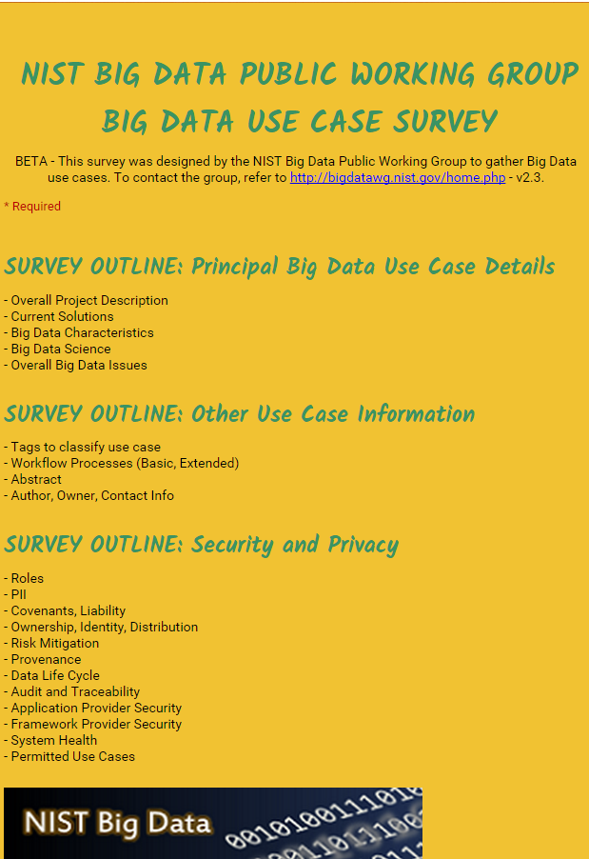
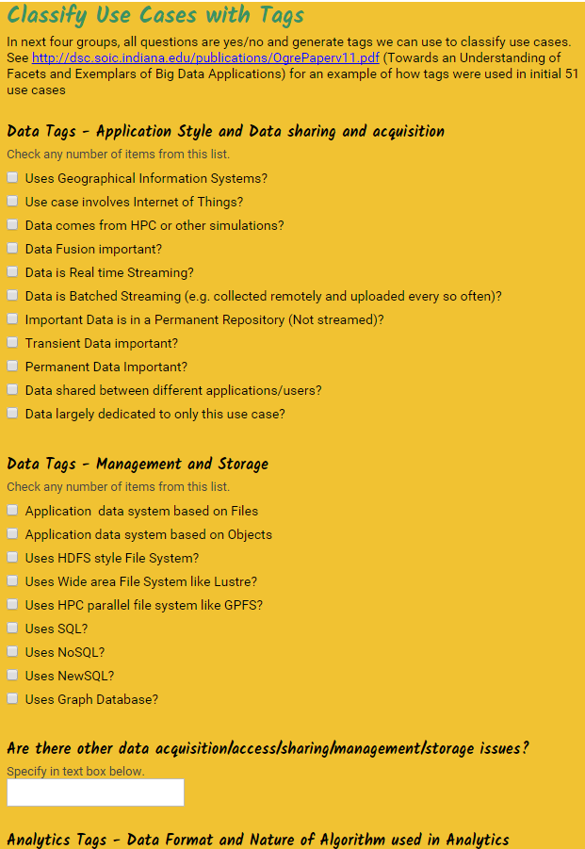
http://hpc-abds.org/kaleidoscope/survey/
Online Use Case Form

Slide 10
51 Detailed Use Cases: Contributed July-September 2013
Covers goals, data features such as 3 V’s, software, hardware
Government Operation(4): National Archives and Records Administration, Census Bureau
Commercial(8): Finance in Cloud, Cloud Backup, Mendeley (Citations), Netflix, Web Search, Digital Materials, Cargo shipping (as in UPS)
Defense(3): Sensors, Image surveillance, Situation Assessment
Healthcare and Life Sciences(10): Medical records, Graph and Probabilistic analysis, Pathology, Bioimaging, Genomics, Epidemiology, People Activity models, Biodiversity
Deep Learning and Social Media(6): Driving Car, Geolocate images/cameras, Twitter, Crowd Sourcing, Network Science, NIST benchmark datasets
The Ecosystem for Research(4): Metadata, Collaboration, Language Translation, Light source experiments
Astronomy and Physics(5): Sky Surveys including comparison to simulation, Large Hadron Collider at CERN, Belle Accelerator II in Japan
Earth, Environmental and Polar Science(10): Radar Scattering in Atmosphere, Earthquake, Ocean, Earth Observation, Ice sheet Radar scattering, Earth radar mapping, Climate simulation datasets, Atmospheric turbulence identification, Subsurface Biogeochemistry (microbes to watersheds), AmeriFlux and FLUXNET gas sensors
Energy(1): Smart grid
Published by NIST as http://nvlpubs.nist.gov/nistpubs/SpecialPublications/NIST.SP.1500-3.pdf with common set of 26 features recorded for each use-case; “Version 2” being prepared
26 Features for each use case Biased to science

Slide 11
Sample Features of 51 Use Cases I
PP (26) “All” Pleasingly Parallel or Map Only
MR (18) Classic MapReduce MR (add MRStat below for full count)
MRStat (7) Simple version of MR where key computations are simple reduction as found in statistical averages such as histograms and averages
MRIter (23) Iterative MapReduce or MPI (Flink, Spark, Twister)
Graph (9) Complex graph data structure needed in analysis
Fusion (11) Integrate diverse data to aid discovery/decision making; could involve sophisticated algorithms or could just be a portal
Streaming (41) Some data comes in incrementally and is processed this way
Classify (30) Classification: divide data into categories
S/Q (12) Index, Search and Query

Slide 12
Sample Features of 51 Use Cases II
CF (4) Collaborative Filtering for recommender engines
LML (36) Local Machine Learning (Independent for each parallel entity) – application could have GML as well
GML (23) Global Machine Learning: Deep Learning, Clustering, LDA, PLSI, MDS,
  Large Scale Optimizations as in Variational Bayes, MCMC, Lifted Belief Propagation, Stochastic Gradient Descent, L-BFGS, Levenberg-Marquardt . Can call EGO or Exascale Global Optimization with scalable parallel algorithm
Workflow (51) Universal
GIS (16) Geotagged data and often displayed in ESRI, Microsoft Virtual Earth, Google Earth, GeoServer etc.
HPC (5) Classic large-scale simulation of cosmos, materials, etc. generating (visualization) data
Agent (2) Simulations of models of data-defined macroscopic entities represented as agents

Slide 13
7 Computational Giants of
NRC Massive Data Analysis Report
http://www.nap.edu/catalog.php?record_id=18374 Big Data Models?
G1: Basic Statistics e.g. MRStat
G2: Generalized N-Body Problems
G3: Graph-Theoretic Computations
G4: Linear Algebraic Computations
G5: Optimizations e.g. Linear Programming
G6: Integration e.g. LDA and other GML
G7: Alignment Problems e.g. BLAST

Slide 14
HPC (Simulation) Benchmark Classics
Linpack or HPL: Parallel LU factorization
for solution of linear equations; HPCG
NPB version 1: Mainly classic HPC solver kernels
  MG: Multigrid
  CG: Conjugate Gradient
  FT: Fast Fourier Transform
  IS: Integer sort
  EP: Embarrassingly Parallel
  BT: Block Tridiagonal
  SP: Scalar Pentadiagonal
  LU: Lower-Upper symmetric Gauss Seidel
Simulation Models

Slide 15
13 Berkeley Dwarfs
Dense Linear Algebra
Sparse Linear Algebra
Spectral Methods
N-Body Methods
Structured Grids
Unstructured Grids
MapReduce
Combinational Logic
Graph Traversal
Dynamic Programming
Backtrack and
Branch-and-Bound
Graphical Models
Finite State Machines
Largely Models for Data or Simulation
First 6 of these correspond to Colella’s original. (Classic simulations)
Monte Carlo dropped.
N-body methods are a subset of Particle in Colella.
Note a little inconsistent in that MapReduce is a programming model and spectral method is a numerical method.
Need multiple facets to classify use cases!

Slide 16
Classifying Use cases

Slide 17
Classifying Use Cases
The Big Data Ogres built on a collection of 51 big data uses gathered by the NIST Public Working Group where 26 properties were gathered for each application.
This information was combined with other studies including the Berkeley dwarfs, the NAS parallel benchmarks and the Computational Giants of the NRC Massive Data Analysis Report.
The Ogre analysis led to a set of 50 features divided into four views that could be used to categorize and distinguish between applications.
The four views are Problem Architecture (Macro pattern); Execution Features (Micro patterns); Data Source and Style; and finally the Processing View or runtime features.
We generalized this approach to integrate Big Data and Simulation applications into a single classification looking separately at Data and Model with the total facets growing to 64 in number, called convergence diamonds, and split between the same 4 views.
A mapping of facets into work of the SPIDAL project has been given.

Slide 19
64 Features in 4 views for Unified Classification of Big Data and Simulation Applications
Both
Simulations
Analytics
(Model for Big Data)
(Nearly all Data)
(All Model)
(Mix of Data and Model)
(Nearly all Data+Model)

Slide 20
Examples in Problem Architecture View PA
The facets in the Problem architecture view include 5 very common ones describing synchronization structure of a parallel job:
  MapOnly or Pleasingly Parallel (PA1): the processing of a collection of independent events;
  MapReduce (PA2): independent calculations (maps) followed by a final consolidation via MapReduce;
  MapCollective (PA3): parallel machine learning dominated by scatter, gather, reduce and broadcast;
  MapPoint-to-Point (PA4): simulations or graph processing with many local linkages in points (nodes) of studied system.
  MapStreaming (PA5): The fifth important problem architecture is seen in recent approaches to processing real-time data.
  We do not focus on pure shared memory architectures PA6 but look at hybrid architectures with clusters of multicore nodes and find important performances issues dependent on the node programming model.
Most of our codes are SPMD (PA-7) and BSP (PA-8).

Slide 21
6 Forms of MapReduce
Describes Architecture of
- Problem (Model reflecting data)
- Machine
- Software
2 important variants (software) of Iterative MapReduce and Map-Streaming a) “In-place” HPC b) Flow for model and data

Slide 22
Examples in Execution View EV
The Execution view is a mix of facets describing either data or model; PA was largely the overall Data+Model
EV-M14 is Complexity of model (O(N²) for N points) seen in the non-metric space models EV-M13 such as one gets with DNA sequences.
EV-M11 describes iterative structure distinguishing Spark, Flink, and Harp from the original Hadoop.
The facet EV-M8 describes the communication structure which is a focus of our research as much data analytics relies on collective communication which is in principle understood but we find that significant new work is needed compared to basic HPC releases which tend to address point to point communication.
The model size EV-M4 and data volume EV-D4 are important in describing the algorithm performance as just like in simulation problems, the grain size (the number of model parameters held in the unit – thread or process – of parallel computing) is a critical measure of performance.

Slide 23
Examples in Data View DV
We can highlight DV-5 streaming where there is a lot of recent progress;
DV-9 categorizes our Biomolecular simulation application with data produced by an HPC simulation
DV-10 is Geospatial Information Systems covered by our spatial algorithms.
DV-7 provenance, is an example of an important feature that we are not covering.
The data storage and access DV-3 and D-4 is covered in our pilot data work.
The Internet of Things DV-8 is not a focus of our project although our recent streaming work relates to this and our addition of HPC to Apache Heron and Storm is an example of the value of HPC-ABDS to IoT.

Slide 24
Examples in Processing View PV
The Processing view PV characterizes algorithms and is only Model (no Data features) but covers both Big data and Simulation use cases.
Graph PV-M13 and Visualization PV-M14 covered in SPIDAL.
PV-M15 directly describes SPIDAL which is a library of core and other analytics.
This project covers many aspects of PV-M4 to PV-M11 as these characterize the SPIDAL algorithms (such as optimization, learning, classification).
  We are of course NOT addressing PV-M16 to PV-M22 which are simulation algorithm characteristics and not applicable to data analytics.
Our work largely addresses Global Machine Learning PV-M3 although some of our image analytics are local machine learning PV-M2 with parallelism over images and not over the analytics.
Many of our SPIDAL algorithms have linear algebra PV-M12 at their core; one nice example is multi-dimensional scaling MDS which is based on matrix-matrix multiplication and conjugate gradient.

Slide 25
Comparison of Data Analytics with Simulation I
Simulations (models) produce big data as visualization of results – they are data source
  Or consume often smallish data to define a simulation problem
  HPC simulation in (weather) data assimilation is data + model
Pleasingly parallel often important in both
Both are often SPMD and BSP
  Non-iterative MapReduce is major big data paradigm
  not a common simulation paradigm except where “Reduce” summarizes pleasingly parallel execution as in some Monte Carlos
Big Data often has large collective communication
  Classic simulation has a lot of smallish point-to-point messages
  Motivates MapCollective model
Simulations characterized often by difference or differential operators leading to nearest neighbor sparsity
Some important data analytics can be sparse as in PageRank and “Bag of words” algorithms but many involve full matrix algorithm

Slide 26


“Force Diagrams” for macromolecules and Facebook

Slide 27
Comparison of Data Analytics with Simulation II
There are similarities between some graph problems and particle simulations with a particular cutoff force.
  Both are MapPoint-to-Point problem architecture
Note many big data problems are “long range force” (as in gravitational simulations) as all points are linked.
  Easiest to parallelize. Often full matrix algorithms
  e.g. in DNA sequence studies, distance δ(i, j) defined by BLAST, Smith-Waterman, etc., between all sequences i, j.
  Opportunity for “fast multipole” ideas in big data. See NRC report
Current Ogres/Diamonds do not have facets to designate underlying hardware: GPU v. Many-core (Xeon Phi) v. Multi-core as these define how maps processed; they keep map-X structure fixed; maybe should change as ability to exploit vector or SIMD parallelism could be a model facet.

Slide 28
Comparison of Data Analytics with Simulation III
In image-based deep learning, neural network weights are block sparse (corresponding to links to pixel blocks) but can be formulated as full matrix operations on GPUs and MPI in blocks.
In HPC benchmarking, Linpack being challenged by a new sparse conjugate gradient benchmark HPCG, while I am diligently using non- sparse conjugate gradient solvers in clustering and Multi-dimensional scaling.
Simulations tend to need high precision and very accurate results – partly because of differential operators
Big Data problems often don’t need high accuracy as seen in trend to low precision (16 or 32 bit) deep learning networks
  There are no derivatives and the data has inevitable errors
Note parallel machine learning (GML not LML) can benefit from HPC style interconnects and architectures as seen in GPU-based deep learning
  So commodity clouds not necessarily best

Slide 29
Software Nexus
Application Layer On
Big Data Software Components for Programming and Data Processing On
HPC for runtime On
IaaS and DevOps Hardware and Systems
HPC-ABDS
Java Grande

Slide 30
HPC-ABDS

Slide 31
Functionality of 21 HPC-ABDS Layers
Message Protocols:
Distributed Coordination:
Security & Privacy:
Monitoring:
IaaS Management from HPC to hypervisors:
DevOps:
Interoperability:
File systems:
Cluster Resource Management:
Data Transport:
A) File management
B) NoSQL
C) SQL
In-memory databases & caches / Object-relational mapping / Extraction Tools
Inter process communication Collectives, point-to-point, publish-subscribe, MPI:
A) Basic Programming model and runtime, SPMD, MapReduce:
B) Streaming:
A) High level Programming:
B) Frameworks
Application and Analytics:
Workflow-Orchestration:
Lesson of large number (350). This is a rich software environment that HPC cannot “compete” with. Need to use and not regenerate
Note level 13 Inter process communication added

Slide 32
Some key ABDS Software
Workflow: Apache Beam (Google Cloud Dataflow) supporting streaming and batch
Analytics: TensorFlow, SPIDAL, R, Matlab
Programming: Apache Flink, Spark, Hadoop
Streaming: Apache Heron (supersedes Storm)
Low-level Runtime: Take from HPC such as MPI
Data Systems: Redis, Hbase, MongoDB, SQL
Cluster Management: Yarn, Mesos, Slurm
DevOps: Ansible, Cloudmesh mapping to HPC, Docker, Amazon, Azure, OpenStack
Language: Python, Java (with Grande principles), C, C++ …

Slide 33
Java Grande
Revisited on 3 data analytics codes
Clustering
Multidimensional Scaling
Latent Dirichlet Allocation all sophisticated algorithms

Slide 34
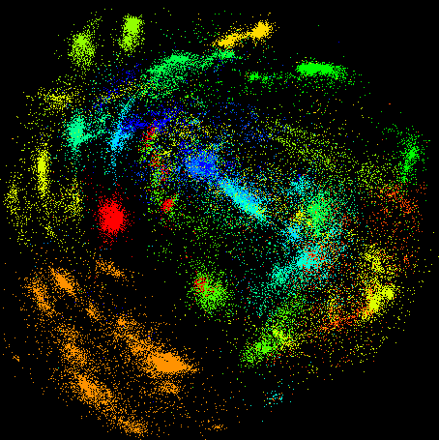
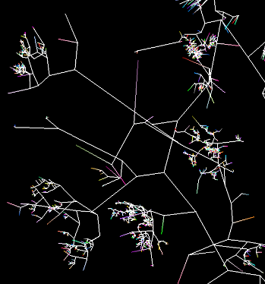
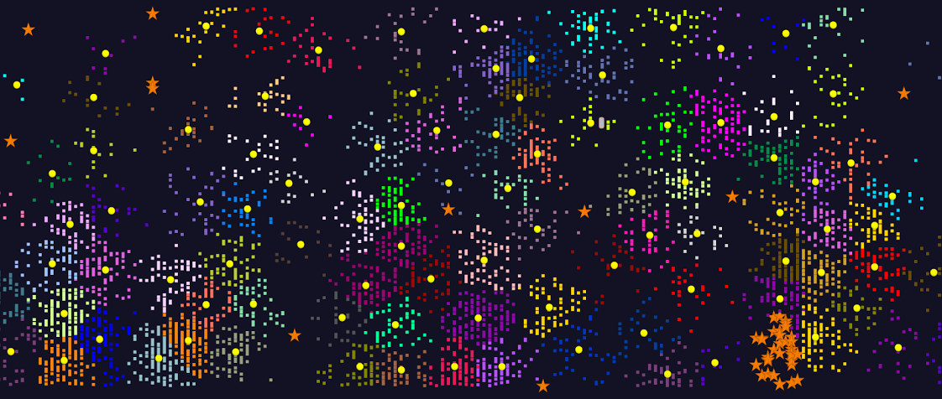
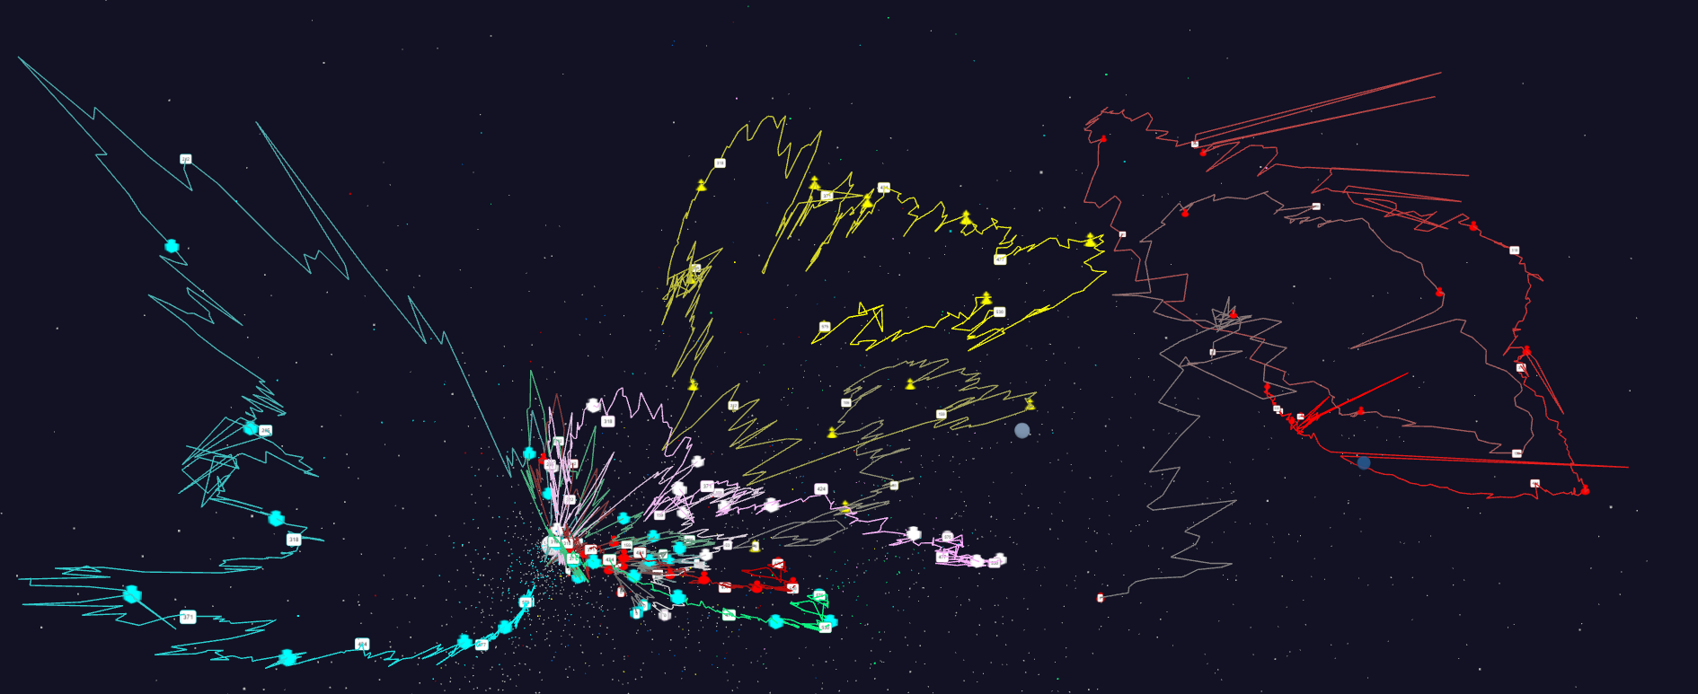
Some large scale analytics
100,000 fungi
Sequences
Eventually
120 clusters
3D phylogenetic tree
LCMS Mass Spectrometer Peak Clustering. Sample of 25 million points. 700 clusters
Jan 1 2004 → December 2015
Daily Stock Time Series in 3D

Slide 35

Java MPI performs better than FJ Threads
128 24 core Haswell nodes on SPIDAL 200K DA-MDS Code
Speedup compared to 1 process per node on 48 nodes
Best MPI; inter and intra node
MPI; inter/intra node; Java not optimized
Best FJ Threads intra node; MPI inter node

Slide 36
HPC-ABDS Parallel Computing
Both simulations and data analytics use similar parallel computing ideas
Both do decomposition of both model and data
Both tend use SPMD and often use BSP Bulk Synchronous Processing
One has computing (called maps in big data terminology) and communication/reduction (more generally collective) phases
Big data thinks of problems as multiple linked queries even when queries are small and uses dataflow model
Simulation uses dataflow for multiple linked applications but small steps such as iterations are done in place
Reduction in HPC (MPIReduce) done as optimized tree or pipelined communication between same processes that did computing
Reduction in Hadoop or Flink done as separate map and reduce processes using dataflow
  This leads to 2 forms (In-Place and Flow) of Map-X mentioned earlier
Interesting Fault Tolerance issues highlighted by Hadoop-MPI comparisons – not discussed here!

Slide 37
Kmeans Clustering Flink and MPI one million 2D points fixed; various # centers
24 cores on 16 nodes

Slide 38

Breaking Programs into Parts
Fine Grain Parallel Computing Data/model parameter decomposition
Coarse Grain Dataflow
HPC or ABDS

Slide 39
HPC-ABDS Parallel Computing
For a given application, need to understand:
  Ratio of amount of computing to amount of communication
  Hardware compute/communication ratio
Inefficient to use same runtime mechanism independent of characteristics
  Use In-Place implementations for parallel computing with high overhead and Flow for flexible low overhead cases
Classic Dataflow is approach of Spark and Flink so need to add parallel in-place computing as done by Harp for Hadoop
HPC-ABDS plan is to keep current user interfaces (say to Spark Flink Hadoop Storm Heron) and transparently use HPC to improve performance exploiting added level 13 in HPC-ABDS
We have done this to Hadoop (next Slide), Spark, Storm, Heron
  Working on further HPC integration with ABDS

Slide 40
Harp (Hadoop Plugin) brings HPC to ABDS
Basic Harp: Iterative HPC communication; scientific data abstractions
Careful support of distributed data AND distributed model
Avoids parameter server approach but distributes model over worker nodes and supports collective communication to bring global model to each node
Applied first to Latent Dirichlet Allocation LDA with large model and data
MapReduce Model
MapCollective Model
MapReduce Applications
MapCollective Applications
M
M
M
M
M
M
M
M
MapReduce V2
Harp
Shuffle
Collective Communication
R
R
YARN

Slide 41
Streaming Applications and Technology

Slide 42
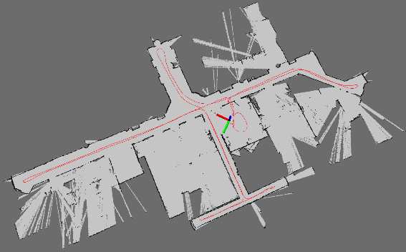
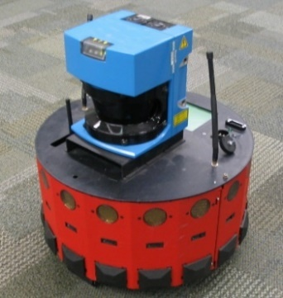
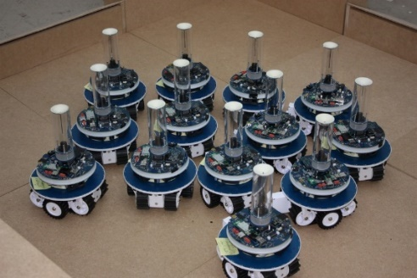
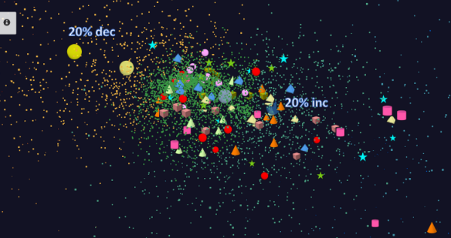
Adding HPC to Storm & Heron for Streaming
Robotics Applications
Time series data visualization in real time
Simultaneous Localization and Mapping
N-Body Collision
Avoidance
Map Built from
Robot data
Robot with a Laser Range Finder
Robots need to avoid collisions when they move
Map High dimensional data to 3D visualizer
Apply to Stock market data tracking 6000 stocks

Slide 43
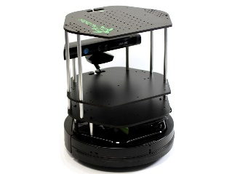
Data Pipeline
Sending to
pub-sub
Sending to
Persisting
storage
Multiple
streaming
workflows
Streaming
workflow
A stream application with some tasks running in parallel
Gateway
Message Brokers
RabbitMQ, Kafka
Streaming Workflows
Apache Heron and Storm
End to end delays without any processing is less than 10ms
Storm does not support “real parallel processing” within bolts – add optimized inter-bolt communication
Hosted on HPC and OpenStack cloud

Slide 44
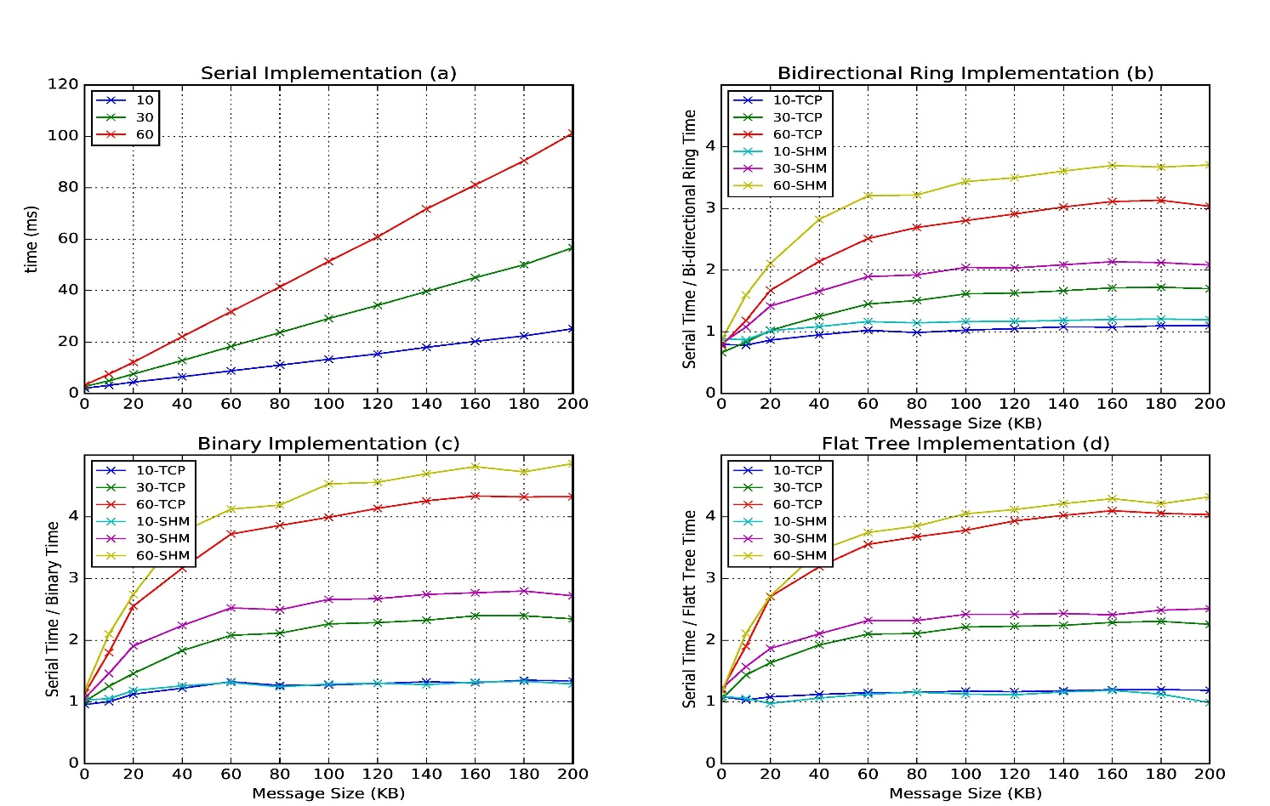
Improvement of Storm (Heron) using HPC communication algorithms
Latency of binary tree, flat tree and bi-directional ring implementations compared to serial implementation. Different lines show varying # of parallel tasks with either TCP communications and shared memory communications(SHM).
Original Time
Speedup Ring
Speedup Binary
Speedup Tree

Slide 45
Summary of Big Data - Big Simulation
Convergence?
HPC-Clouds convergence? (easier than converging higher levels in stack)
Can HPC continue to do it alone?
Convergence Diamonds
HPC-ABDS Software on differently optimized hardware infrastructure

Slide 46
General Aspects of Big Data HPC Convergence
Applications, Benchmarks and Libraries
  51 NIST Big Data Use Cases, 7 Computational Giants of the NRC Massive Data Analysis, 13 Berkeley dwarfs, 7 NAS parallel benchmarks
  Unified discussion by separately discussing data & model for each application;
  64 facets– Convergence Diamonds -- characterize applications
  Characterization identifies hardware and software features for each application across big data, simulation; “complete” set of benchmarks (NIST)
Software Architecture and its implementation
  HPC-ABDS: Cloud-HPC interoperable software: performance of HPC (High Performance Computing) and the rich functionality of the Apache Big Data Stack.
  Added HPC to Hadoop, Storm, Heron, Spark; could add to Beam and Flink
  Could work in Apache model contributing code
Run same HPC-ABDS across all platforms but “data management” nodes have different balance in I/O, Network and Compute from “model” nodes
  Optimize to data and model functions as specified by convergence diamonds
  Do not optimize for simulation and big data
Convergence Language: Make C++, Java, Scala, Python (R) … perform well
Training: Students prefer to learn Big Data rather than HPC
Sustainability: research/HPC communities cannot afford to develop everything (hardware and software) from scratch

