Slide 1
Geoffrey Fox
High-Performance Big Data Computing: International, National, and Local initiatives
COLLABORATORS
China and IU: Fudan University, SICE, OVPR
SPIDAL: NIST, Intel, Arizona State University, Rutgers University, Stony Brook University, Universities of Kansas and Utah, Virginia Tech
BDECng: Europe, China, Japan, DoE, NSF, Tennessee, Northwestern, Iowa, John Hopkins ……..
Local: Judy Qiu, Martin Swany, David Crandall, UITS, Precision Health

Slide 2
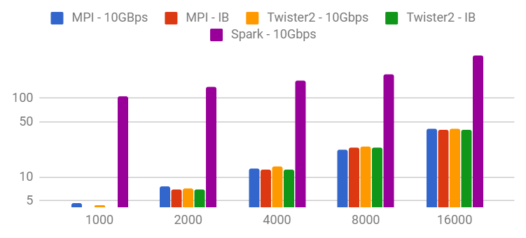
Middleware and High Performance Analytics Libraries for Scalable Data Science
7 Universities collaborating on an ecosystem for scalable applications with the performance of HPC (High Performance Computing) and the rich functionality of the commodity Apache Big Data Stack.
Cross-cutting high-performance data-analysis libraries; SPIDAL (Scalable Parallel Interoperable Data Analytics Library) will support new programming and execution models for data-intensive analysis in a wide range of science and engineering applications.
Technology driven by major application data challenges in seven different communities: Biomolecular Simulations, Network and Computational Social Science, Epidemiology, Computer Vision, Spatial Geographical Information Systems, Remote Sensing for Polar Science, and Pathology Informatics.
Indiana University:
David Crandall working with Kansas on Image Processing for Polar Science Remote Sensing;
Judy Qiu: Harp DAAL data analytics developed with INTEL;
Twister2: a set of middleware components to support batch or streaming data capabilities familiar from Apache Hadoop, Spark, Heron and Flink but with high performance. Twister2 covers bulk synchronous and data flow communication; task management as in Mesos, Yarn and Kubernetes; dataflow graph execution models; launching of the Harp-DAAL library; streaming and repository data access interfaces, in-memory databases and fault tolerance at dataflow nodes.
Execution Time
Kmeans: Number of Centers

Slide 3
BigData Exascale BDECng Vision: Data Center to Edge
The nature of scientific and engineering research is changing and is challenging the high-performance computing (HPC) community to adapt and connect to a broader community. It increasingly depends on an integrated ecosystem of sensors and instruments, big data analytics and machine learning, and computational science. Concurrently, rich commercial cloud computing and data analytic services have also emerged, creating new opportunities and organizational perspectives for scientific discovery.
Sensors and instruments now span an enormous range, from a small number of large-scale, scientific instruments to billions of edge/IoT devices and produce massive amounts of real-time, streaming data. HPC, parallel computing, and data analytics pervade all elements of this continuum, often requiring closed loop integration and computational adaptation.
The BDEC community is engaged in a shaping strategy and process that builds on the collective expertise of an expanded community: New application domains, Infrastructure providers, Technology community
First BDECng meeting: Indiana University Bloomington October 3-5 2018

Slide 4
Fudan University Kickoff Meeting Wednesday
April 11: HPSA18: High-Performance Systems and Analytics for Big Data Workshop: A path to future Artificial General Intelligence
Rick Van Kooten OVPR, Judy Qiu IU, and X. Sean Wang Fudan: Introduction
Linton Ward, IBM Building the cognitive platform to accelerate innovation (Keynote 1)
Nathan Greeneltch Intel, Learn Faster with Intel Data Analytics Acceleration Library (DAAL)
Takuya Araki NEC, SX-Aurora TSUBASA and its application to machine learning
Anthony Skjellum UTC Adding HPC to Apache Spark
Andrew Younge Sandia, Supporting High Performance Analysts with System Software for Virtualized Supercomputing
Anil Vullikanti Virginia Tech, Finding Trees and Anomalous Subgraphs in Parallel
Albert Jonathan Univ. of Minnesota, Geo-Distributed Clouds For Data Analytics
Tony Hey UK STFC Big Scientific Data and Data Science (Keynote2)
Piotr Luszczek Univ. of Tenessee, HPC Autotuning Techniques for Computational Kernels in Data Analytics
Scott Michael UITS, IU Big Data Infrastructure
Wo Chang NIST, NIST PWG Big Data Reference Architecture for HPC and Analytics
X. Sean Wang Fudan University, Overview including Astronomy (SKA) Data Analysis
Weihua Zhang Fudan, Eunomia: Scaling Concurrent Search Trees under Contention Using HTM
Martin Swany IU, Hardware-Accelerated Network Microservices for Big Data and Extreme Scale Computing
Geoffrey Fox IU, High Performance Big Data Computing in the Digital Science Center
Panel Session (Chair: Dennis Gannon) on 5 year challenges in HPSA

Slide 5
THANK YOU
PRESENTER CONTACT INFO
gcf@iu.edu
Digital Science Center https://www.dsc.soic.indiana.edu/,
Big Data Exascale http://www.exascale.org/bdec/,
SPIDAL Collaboration http://www.spidal.org/,
HPSA18: http://ipcc.soic.iu.edu/HPSA/

