Slide 1
RaPyDLI: Rapid Prototyping HPC Environment for Deep Learning NSF 1439007
NSF XPS PI Meeting
June 2, 2015
Indiana University, University of Tennessee Knoxville, Stanford University
Geoffrey Fox Indiana University Bloomington
Jack Dongarra UTK
Andrew Ng Stanford, Baidu
http://rapydli.org

Slide 2
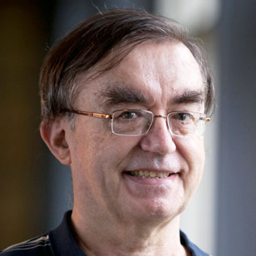
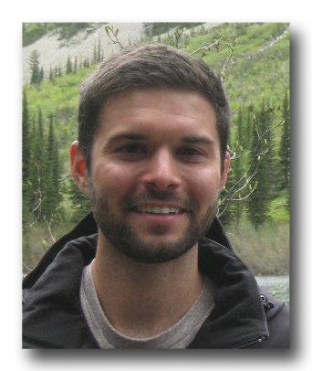
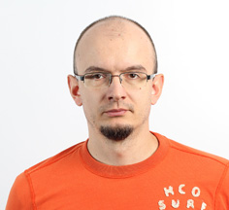
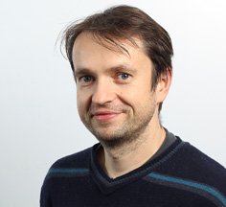
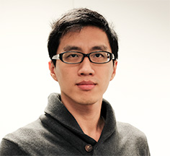
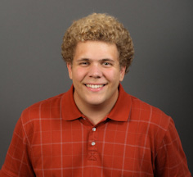
Introduction
Jack Dongarra, Andrew Ng, Geoffrey Fox
Adam Coates, Brody Huval
Gregor von Laszewski, JUDY QIU
Jakub Kurzak, Piotr Luszczek, Yaohung (Mike) Tsai, BLAKE Haugen

Slide 3
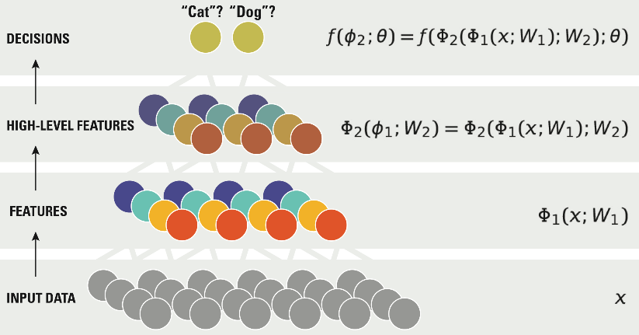
Deep Learning Network
Perhaps XPS DL (really virtual panel) is Highly Competitive, Competitive, Not Competitive
Performance
Deep Learning
Deep Learning Improves with Scale
Custom Feature Engineering
Data & Compute Size

Slide 4
Deep Learning
Learning Networks take input data, such as a set of pixels in images, and map them into decisions, such as labelling animals in an image, or deciding how best to drive given a video image from a car-mounted camera. The input and output are linked by multiple nodes in a layered network where each node is a function of weights and thresholds.
A deep learning (DL) network has multiple layers - say 10 or more. Introduced around 25 years ago. improved algorithms and drastic increases in compute power led to breakthroughs ~10 years ago.
DL networks have the advantage of being very general; you don’t need to make application-specific models, but rather you can use general structures, such as in convolutional neural networks that work well with images and generate translation and rotation invariant mappings.
DLs are used in all major commercial speech recognition systems and outperform Hidden Markov Models.
The quality of a DL depends on the number of layers and nature of nodes in network. These choices require extensive prototyping with rapid turnaround on trial networks.
RaPyDLI aims to enable this prototyping with an attractive Python interface and a high performance Autotuned DL network computation engine for the training stage.
Architecture: Environment supporting broad base of deep learning
Rapid Prototyping: Python Frontend and HPC Libraries
Interoperability/ portability with very good performance: Autotuning
High performance portable storage: NoSQL

Slide 5
ILSVRC Imagenet Large Scale Visual Recognition Challenge Winning Results
1.2 million images in 1000 categories.
2015 Baidu Deep Image gets 4.58% error – better than human 5.1%
% Error
30%
% Teams using GPUs
100%
% Teams using GPUs
75%
20%
50%
10%
25%
% Error
0%
0%
2010
2011
2012
2013
2014
AlexNet first use of deep learning

Slide 6
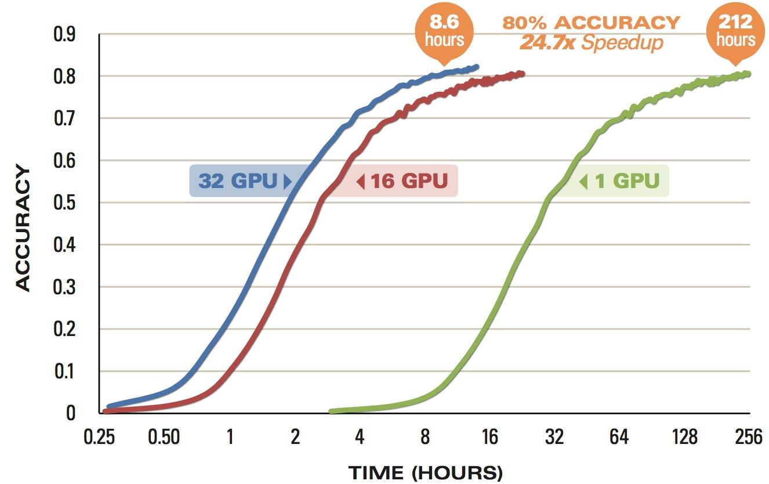
“Baidu Minwa supercomputer AI trumps Google, Microsoft and humans at image recognition”
May 15 Quote
Baidu’s Minwa (72 nodes, 2 GPU per node) Scaling
[Wu et al., arXiv:1501.02876, 2015]

Slide 7
Caveat From Baidu
Dear ILSVRC community,
Recently the ILSVRC organizers contacted the Heterogeneous Computing team to inform us that we exceeded the allowable number of weekly submissions to the ImageNet servers (~ 200 submissions during the lifespan of our project).
We apologize for this mistake and are continuing to review the results. We have added a note to our research paper, Deep Image: Scaling up Image Recognition, and will continue to provide relevant updates as we learn more.
We are staunch supporters of fairness and transparency in the ImageNet Challenge and are committed to the integrity of the scientific process.
Ren Wu – Baidu Heterogeneous Computing Team

Slide 8
RaPyDLI CompuTational Model

Slide 9
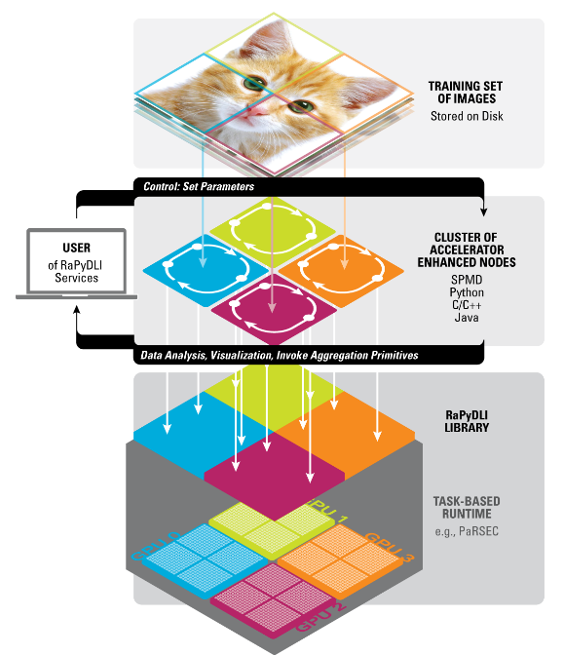
The RaPyDLI Computational Model
Model parallelism illustrated with
Image Data
User Interface invoking Library and task-based runtime
Data parallelism over images in spite of SGD

Slide 10
Python Frontend: Rapid Prototyping
Rapydli
On Ramp
API
REST
Shell
Web Service
3rd Party
Deploy
Monitor
Leverages Cloudmesh HPC-Cloud DevOps Environment
The RaPyDLI Python Prototyping environment will provide a comprehensive On Ramp to Big Data Research integrating infrastructure (Software-defined systems) and “experiment management”.
DevOps frameworks will be utilized to deploy RaPyDLI on other resources and increase reusability by the community
Experiments can be prototyped and deployment is integrated into the experiment.

Slide 11
Interoperability/ portability with very good performancE
Our convolution kernel, at the heart of deep learning neural networks for some of the network layers, achieves almost the same performance as the cuDNN library provided by NVIDIA.
Both of these implementations are competitive replacements of the most time consuming kernels of the Caffe project for deep neural networks from the University of California at Berkeley.
Almost the same percent of the peak performance is achieved by our kernels on both Kepler and the newly released Maxwell GPU cards.
The competing implementations are either closed source (NVIDIA’s cuDNN) and do not contribute to the broader impact that our optimization techniques have, or they are platform specific
maxDNN is a convolutional network implementation from Ebay based on a Maxwell-only assembler from Nervana.

Slide 12
Preliminary Results on NVIDIA Maxwell
DNN Type | Kernel 1 NCHW | Kernel 2 NHWC | Kernel 3 NHWC | CuDNN NCHW | CuDNN NHWC | Nervana eBay
Alex v2 L1 (Layer 1) | 1435.9 | 2642.0 | N/A | 1372.8 | 1316.1 | 3975.6
Alex v2 L2 | 1151.8 | 1974.1 | N/A | 1718.4 | 1748.0 | 4148.5
Alex v2 L3 | 977.2 | 1272.3 | 1542.1 | 2245.7 | 2125.6 | 4107.0
Alex v2 L4 | 1095.5 | 1202.9 | 1649.7 | 2247.4 | 2384.7 | 4065.0
Alex v2 L5 | 1018.4 | 1200.0 | 1543.7 | 2430.4 | 2352.1 | 4042.5
Overfeat L1 | 1479.0 | 2669.2 | N/A | 1516.8 | 1344.0 | 2986.7
Overfeat L2 | 1195.0 | 1278.1 | N/A | 2492.6 | 2316.0 | 4120.0
Overfeat L3 | 926.2 | 1350.0 | 2534.2 | 2668.2 | 2296.7 | 4144.9
Overfeat L4 | 961.7 | 1282.5 | 2517.3 | 2888.0 | 2346.3 | 4145.0
Overfeat L5 | 965.7 | 1295.8 | 2529.7 | 2592.7 | 2370.3 | 4137.7
From | RaPyDLI | RaPyDLI | RaPyDLI | NVIDIA | NVIDIA | eBay
RaPyDLI based on Stanford Code base Fastlab (DeepSail)
Maxwell and Kepler (no eBay) numbers complete
Next AMD, Xeon Phi, and Haswell
arxiv:1410.0759

Slide 13
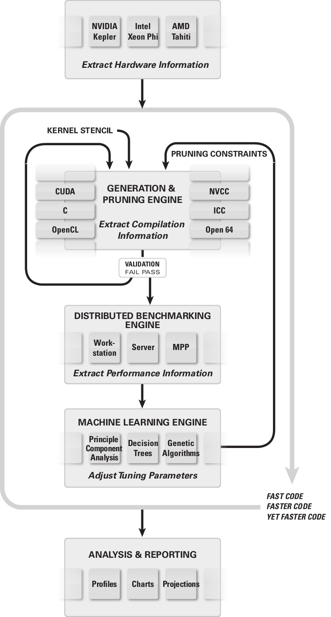
BEAST: Benchtuning Environment for Automated Software Tuning
BEAST Principles
device query
large space generation
powerful pruning
parallel benchmarking

Slide 14
I/O Interfaces
We define a generic high level interface for data load and save operations. They take a set of input data files, a subset extraction policy, a partition policy, a distribution policy, and a list of computation nodes as input parameters.
Our data storage and access interface is associated with multiple stages in the deep learning process such as input training data records composed of feature sets, metadata shared by parallel workers during the learning process, and output records describing the trained models. The primary computation performs on N-dimensional arrays of numerical data.
We support heterogeneous data storage backends from parallel or distributed file systems (e.g., Lustre, HDFS) and NoSQL databases (e.g., HBase) with uniform I/O interfaces.
Model Partitions
N-dimentional arrays
Model Parameters
I/O Interfaces (e.g. Load, Save)
Training Data
Lustre, HDFS, HBase

Slide 15
Comparison of Data Loading TIMES
Batch size | 8 | 16 | 32 | 64
LMDB | 1.05 | 1.61 | 2.31 | 5.23
LevelDB | 1.03 | 1.68 | 3.13 | 5.76
Image file | 8.1 | 15.6 | 31.4 | 62.4
The experiment runs Alexnet model on ImageNet data in Caffe.
Batch size is number of images loaded in each iteration, which changes from 8 to 64.
We run 100 iterations and compare the data loading time for LMDB (memory mapped key-value), LevelDB (new Bigtable), and image files.
LMDB and LevelDB outperform direct image file loading by caching nearby image data using table and block cache.
Data Loading Time (seconds)

