Slide 1
RaPyDLI: Rapid Prototyping HPC Environment for Deep Learning NSF 1439007
NSF XPS PI Meeting
June 2, 2015
Indiana University, University of Tennessee Knoxville, Stanford University
Geoffrey Fox Indiana University Bloomington
Jack Dongarra UTK
Andrew Ng Stanford, Baidu
http://rapydli.org

Slide 2
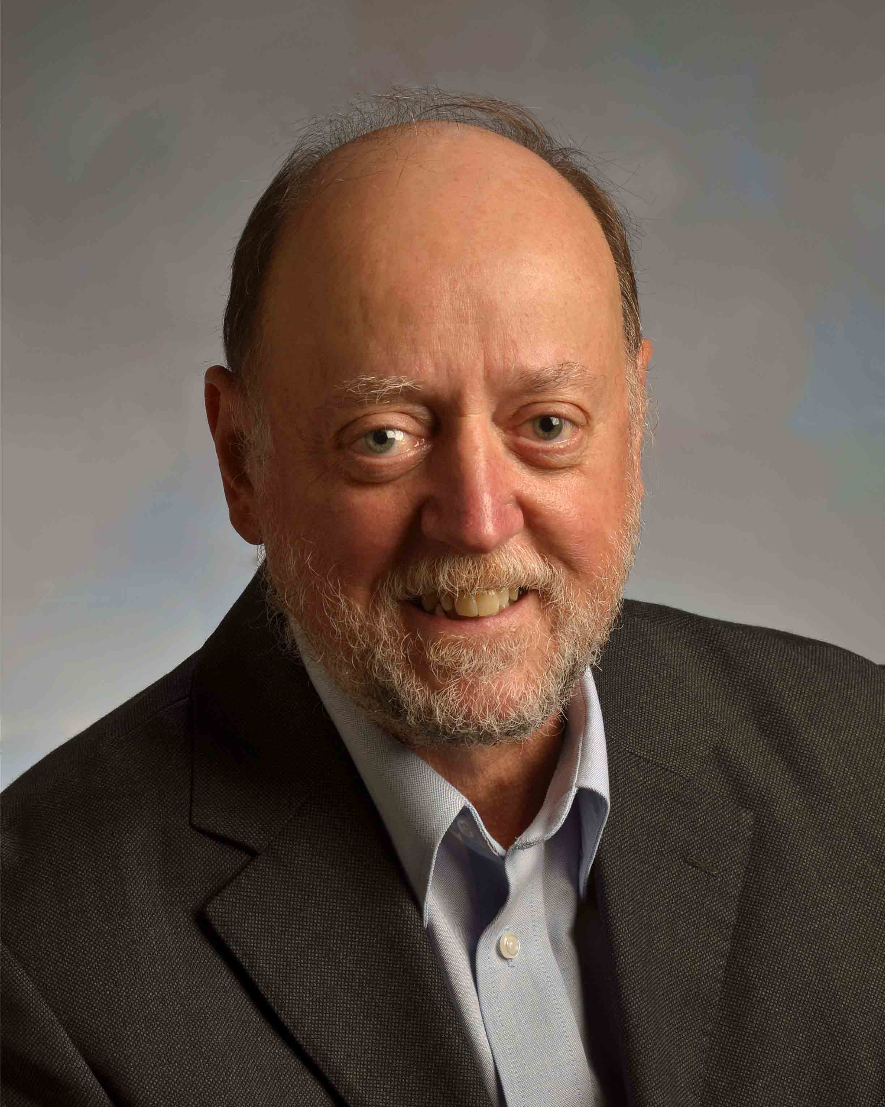
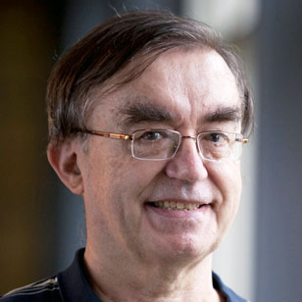
Introduction

Slide 3
Deep Learning
Learning Networks take input data, such as a set of pixels in images, and map them into decisions, such as labelling animals in an image, or deciding how best to drive given a video image from a car-mounted camera.
The input and output are linked by multiple nodes in a layered network where each node corresponds to a parameterized transformation–a function of weights and thresholds.
A (very) deep learning (DL) network has multiple layers (intermediate nodes)–perhaps 10 or more. Introduced around 25 years ago,
DL networks were originally unsuccessful, but improved algorithms and drastic increases in available compute power led to practical breakthroughs around 10 years ago.
DL networks have the advantage of being very general; you don’t need to make application-specific models, but rather you can use general structures, such as in convolutional neural networks that work well with images and generate translation and rotation invariant mappings.
DLs are now used in all major commercial speech recognition systems and outperform previous Hidden Markov Model based systems.
The quality of a DL depends on the number of layers and nature of nodes in network. These choices require extensive prototyping with rapid turnaround on trial networks. RaPyDLI aims to enable this prototyping with an attractive Python interface and a high performance DL network computation engine for the training stage.

Slide 4
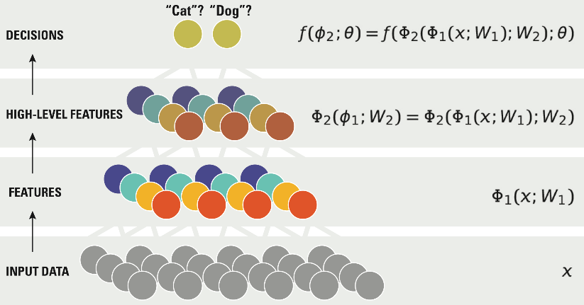
Deep Learning Network

Slide 5
RaPyDLI Components
Goals
Rapid Prototyping
Interoperability/ portability with very good performance (include GPU Intel)
Environment supporting broad base of deep learning
Data management
Approach
Python Frontend
Runtime
Autotuning
Hbase

Slide 6
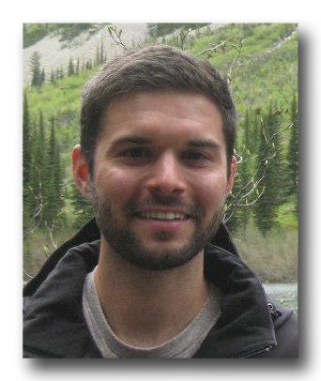
State of the Art
Andrew Ng, Adam Coates, Brody Huval

Slide 7
Rapidly CHANGING State of The art
The Image-net Large Scale Visual Recognition Challenge (ILSVRC) has become the most significant large scale benchmark for computer vision.
Since the success of AlexNet in 2012, Convolutional Neural Networks (CNNs) have been essential to obtaining state-of-the-art performance on ILSVRC.
The trend in CNNs since AlexNet has been to increase network size and data set size (through augmentation). Both of these require substantially more computational power which motivates a need for software that can utilize multiple GPUs while still allowing for rapid prototyping.
In the current state-of-the-art model for ILSVRC, Baidu showed how they were able to train their network using 32 GPUs in 8.6 hours to 80% accuracy, something that would’ve taken 212 hours on a single GPU (a speedup of 24.7x).

Slide 8
Deep learning improves with scale
Performance
Deep Learning
Custom Feature Engineering
Data & Compute Size

Slide 9
ILSVRC Imagenet Large Scale Visual Recognition Challenge Winning Results
1.2 million images in 1000 categories.
2015 Baidu Deep Image gets 4.58% error – better than human 5.1%
% Error
30%
% Teams using GPUs
100%
% Teams using GPUs
75%
20%
50%
10%
25%
% Error
0%
0%
2010
2011
2012
2013
2014
AlexNet first use of deep learning

Slide 10
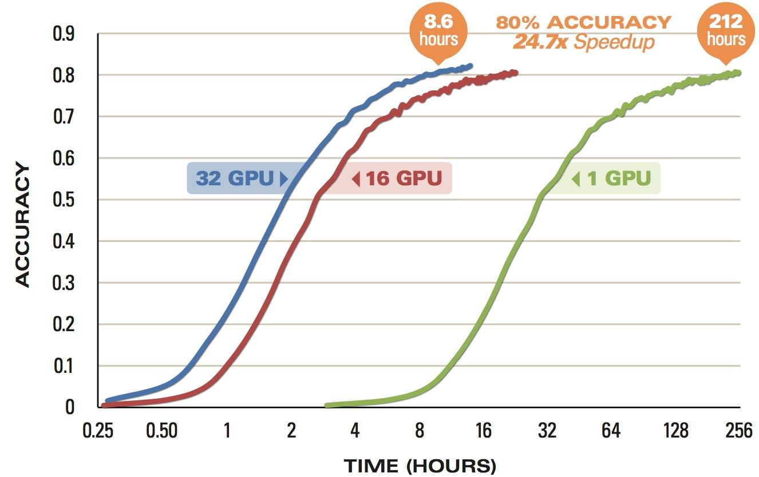
“Baidu Minwa supercomputer AI trumps Google, Microsoft and humans at image recognition”
Baidu’s Minwa Scaling
[Wu et al., arXiv:1501.02876, 2015]

Slide 11
Caveat From Baidu
Dear ILSVRC community,
Recently the ILSVRC organizers contacted the Heterogeneous Computing team to inform us that we exceeded the allowable number of weekly submissions to the ImageNet servers (~ 200 submissions during the lifespan of our project).
We apologize for this mistake and are continuing to review the results. We have added a note to our research paper, Deep Image: Scaling up Image Recognition, and will continue to provide relevant updates as we learn more.
We are staunch supporters of fairness and transparency in the ImageNet Challenge and are committed to the integrity of the scientific process.
Ren Wu – Baidu Heterogeneous Computing Team

Slide 12
RaPyDLI CompuTational Model

Slide 13
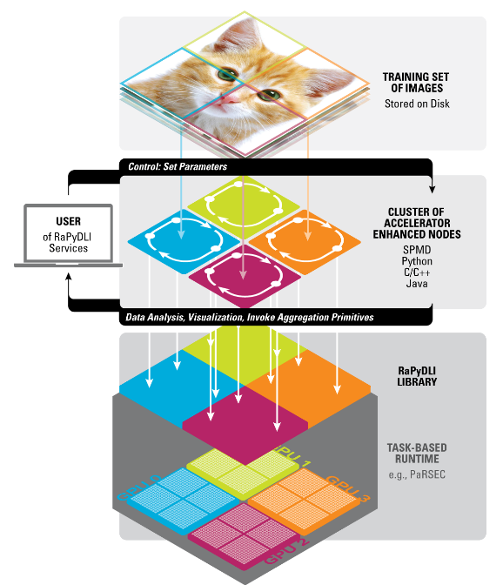
The RaPyDLI Computational Model
Model parallelism illustrated with
Image Data
User Interface invoking
Library and task-based runtime

Slide 14
RaPyDLI Front end
Gregor von Laszewski, Geoffrey Fox

Slide 15
Rapid Prototyping
RaPyDLI can be used as an on-ramp to deep learning.
It serves as an aggregator for modules related to deep learning while simplifying access via a service interface and hosted services that provide access to fast computing resources.
To achieve this we need to address a multitude of issues, including deployment, access, and integration of other frameworks.
We offer simple interfaces to the deployment framework but also the actual algorithmic functionality through a variety of interfaces.
This includes a Python API, REST, a command shell, and Web Services. In addition we will provide an experiment management framework that allows us to monitor the services and resources.

Slide 16
RaPyDLI FrontEnd
Multiple frontends are provided to make it possible to utilize RaPyDLI as a developer and user platform.
The RaPyDLI Frontend will therefore become an On Ramp to deep learning and the deployment of hosted RaPyDLI services.
A prototype hosted web service is used to demonstrate the capabilities of the RaPyDLI framework.
These services can then be choreographed to deploy and stage services users may need.
The RaPyDLI framework can leverage HPC, Clouds, or Grids through service orchestration.

Slide 17
Rapid Prototyping
Rapydli
On Ramp
API
REST
Shell
Web Service
3rd Party
Deploy
Monitor
The Rapydli Python Prototyping environment will provide a comprehensive On Ramp to Big Data Research integrating compute resources, and Big Data Services.
DevOps frameworks will be utilized to deploy Rapydli on other resources and increase reusability by the community
Experiments can be prototyped and deploymet can be made part of the experiment.

Slide 18
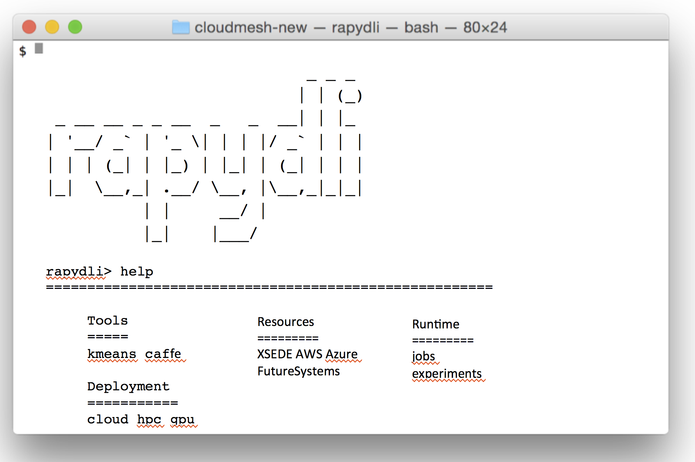
Python Frontend
Requirements
Interfaces
Access to Resources
Local machines
Institutional clusters
Prototyping machines
HPC: XSEDE, …
Clouds: AWS, Azure, NSF chameleon, …
Management of Experiments
Long running experiments
Prototyping
Easy manipulation of parameters
Repeatability of experiments
RaPyDLI Command Shell
Web browser access
Secure REST Interface
Python API

Slide 19
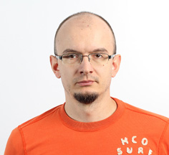
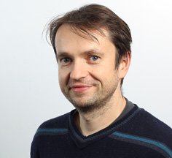
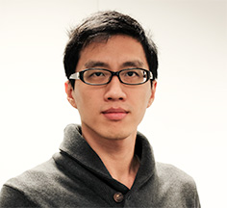
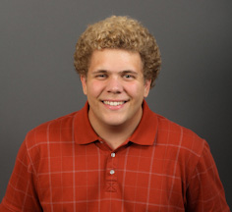
Tuning and Optimization Convolutional Deep Neural Networks
Jakub Kurzak, Piotr Luszczek, Yaohung (Mike) Tsai, BLAKE Haugen

Slide 20
Interoperability/ portability with very good performancE
Our convolution kernel, at the heart of deep learning neural networks for some of the network layers, achieves almost the same performance as the cuDNN library provided by NVIDIA.
Both of these implementations are competitive replacements of the most time consuming kernels of the Caffe project for deep neural networks from the University of California at Berkeley.
Almost the same percent of the peak performance is achieved by our kernels on both Kepler and the newly released Maxwell GPU cards.
The competing implementations are either closed source (NVIDIA’s cuDNN) and do not contribute to the broader impact that our optimization techniques have, or they are platform specific
maxDNN is a convolutional network implementation from Ebay based on a Maxwell-only assembler from Nervana.

Slide 21
Environment supporting broad base of deep learning
Our approach is based on a general framework that includes various dimensions of the deep network layers to allow us to provide a high performance kernels, not just for one particular network type or configuration, which might be of great interest at the moment, but we can also target broader application space that utilize a variety of neural network layers, dimensionality, and connectivity.
The goal is to first target the popular classifier networks of interest to the community and then broaden the scope further to accommodate for other uses, e.g., object detection, etc.

Slide 22
Runtime
We are investigating two parallelization potentials offered by the deep neural networks: data-parallel and model-parallel.
Model parallel allows Bulk Synchronous Parallel execution with great potential for locality-aware computing with sporadic data interchanges of the border neurons and synapses.
Data parallel gives rise to independent calculation with concurrent access to the global state.
Our work focuses on combining both and improving on Stanford’s FastLab code base for deep neural networks that exposes both types of parallelism. We are using our dataflow runtime systems that support both multicore and accelerators.

Slide 23
Autotuning
Our kernel work is based on an autotuning framework that allows generic expression of a computational stencil.
The simplest cases are templates and/or stencils based on multiple loop nests--a perfect case for deep neural network research.
Given a generic code and the parameter space, our framework discovers a subspace of the parametric space that is allowed by the hardware (hard constraint pruning) and has not been excluded by the user (soft constraint pruning).
After the extensive pruning, we enumerate all possible instantiations of the kernel with all parameters replaced by constants, which gives the compiler the opportunity to generate a very specific--and hence potentially superior--code when compared with variable-length loop nests.
The execution harness tests the produced binaries and selects the best performer, often with a surprising set of parameters due to complex interaction between the kernel template, the compiler toolchain, and the hardware configuration.

Slide 24
Deep Neural Networks (DNN) Implementation Landscape
In recent years, Deep Neural Networks have become a hotly contested technology by various commercial entities
Caffe from U. Cal. Berkeley has become the de facto standard (http://demo.caffe.berkeleyvision.org/)
Other projects have been obseleted: ConvNet, ConvNet2, …
Python-only Theano gets some traction due to its purely mathematical approach to defining machine learning algorithms
Stanford called FastLab (formerly DeepSail)
It includes multi-GPU, MPI support but lacks some features present in Caffe

Slide 25
Performance in DNN
Berkeley Caffe achieves performance by calling cuBlas
The matrix shapes passed to cuBlas are not the most favorable to good performance (they’re driven by the shape of DNN)
In RaPyDLI, we tried autotuning these oddly-shaped calls
Some improvement can be achieved
NVIDIA makes available a closed source library called cuDNN (CUDA-based DNN)
Much better performance is achieved (10% as advertised by NVIDIA) due to more DNN-like interface

Slide 26
Other DNN Libraries
Facebook’s approach is based on phase space computation and FFT through highly optimized fbfft
Ebay developed DNN library specifically for NVIDIA Maxwell: maxDNN
It is based on reverse engineered assembly for Maxwell provided by Nervana on GitHub
It achieves over 90% of the peak performance on single precision matrix-matrix multiply
The published code uses almost all available GPU optimization tricks
Instruction scheduling, constant cache to remove instructions…

Slide 27
Preliminary Results on Kepler
Layer | Kernel 1 NCHW | Kernel 2 NHWC | Kernel 3 NHWC | cuDNN NCHW | cuDNN NHWC
Alex v2 L1 | 770.5 | 877.5 | 0 | 1064.4 | 1137.5
Alex v2 L2 | 760.9 | 857.5 | 0 | 1240.6 | 1176.2
Alex v2 L3 | 661.7 | 859.1 | 1156.4 | 1525.9 | 1292.7
Alex v2 L4 | 692.2 | 855.8 | 781.6 | 1609.7 | 1512.0
Alex v2 L5 | 684.1 | 853.9 | 779.3 | 1585.9 | 1512.8
Overfeat L1 | 778.3 | 876.8 | 0 | 1065.4 | 1564.0
Overfeat L2 | 772.6 | 1266.8 | 0 | 1657.6 | 1564.0
Overfeat L3 | 607.0 | 864.0 | 739.3 | 1654.1 | 1551.6
Overfeat L4 | 614.6 | 823.1 | 746.4 | 1691.1 | 1473.9
Overfeat L5 | 617.8 | 825.0 | 747.8 | 1625.3 | 1369.7

Slide 28
Preliminary Results on Maxwell
DNN Kind | Kernel 1 NCHW | Kernel 2 NHWC | Kernel 3 NHWC | CuDNN NCHW | CuDNN NHWC | Nervana eBay
Alex v2 Layer 1 | 1435.9 | 2642.0 | N/A | 1372.8 | 1316.1 | 3975.6
Alex v2 L2 | 1151.8 | 1974.1 | N/A | 1718.4 | 1748.0 | 4148.5
Alex v2 L3 | 977.2 | 1272.3 | 1542.1 | 2245.7 | 2125.6 | 4107.0
Alex v2 L4 | 1095.5 | 1202.9 | 1649.7 | 2247.4 | 2384.7 | 4065.0
Alex v2 L5 | 1018.4 | 1200.0 | 1543.7 | 2430.4 | 2352.1 | 4042.5
Overfeat L1 | 1479.0 | 2669.2 | N/A | 1516.8 | 1344.0 | 2986.7
Overfeat L2 | 1195.0 | 1278.1 | N/A | 2492.6 | 2316.0 | 4120.0
Overfeat L3 | 926.2 | 1350.0 | 2534.2 | 2668.2 | 2296.7 | 4144.9
Overfeat L4 | 961.7 | 1282.5 | 2517.3 | 2888.0 | 2346.3 | 4145.0
Overfeat L5 | 965.7 | 1295.8 | 2529.7 | 2592.7 | 2370.3 | 4137.7
From | RaPyDLI | RaPyDLI | RaPyDLI | NVIDIA | NVIDIA | eBay
Next AMD Xeon Phi and Haswell 36 core

Slide 29
Going Beyond NVIDIA Hardware
Strategy: Go beyond NVIDIA hardware by replacing hand tuning in assembly with Autotuning
Looking into OpenCL version of our Kernels on AMD hardware
Peak hardware performance of AMD top-of-the-line cards comparable with NVIDIA’s
The use of lower level features (AMD IL) might be required
Looking into Intel Xeon Phi
Good double precision performance is not used by DNN
Peak single precision precision is inferior
Might be fixed by the next iteration of the hardware: KNL
Might require lower level programming (intrinsics)
Harness the Auto-tuning BEAST

Slide 30
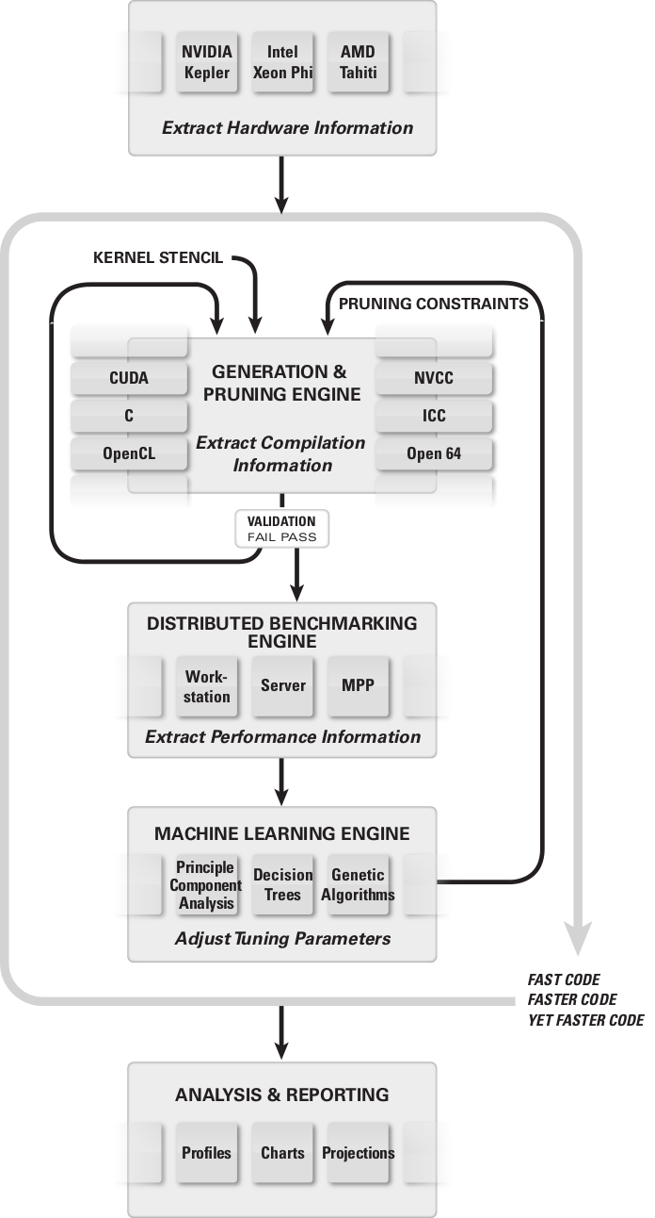
BEAST: Benchtuning Environment for Automated Software Tuning
BEAST Principles
device query
large space generation
powerful pruning
parallel benchmarking

Slide 31
device query
published specs
empirical probing
pruning constraints
hard hardware (max threads)
soft hardware (full warps)
hard software (divisible dimensions)
soft software (register pressure)
generation parameters
tuning parameters (e.g. tiling)
algorithmic variants (different big-O)
implementation variants (same big-O)
hardware switches
shmem vs L1
4 vs 8-byte shmem banks
multiple precisions (S, C, D, Z)
different data layouts
compiler output analysis
arithmetic saturation
memory saturation
branching saturation
validation
correctness-violating optimizations
user-defined validation
disposal of irrelevant corner cases
tune performance & extract Info
use multiple GPUs for tuning
use MPPs / clusters for tuning
apply brute force
explore large space
profile extensively
collect “Big Data”
data analysis
analyze the “Big Data”
principal components
decision trees
. . .
visualization

Slide 32
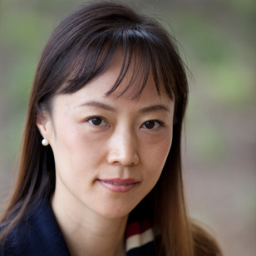
DATA Management
Judy Qiu

Slide 33
Data Management
Deep Learning researchers will benefit from the ease of use and highly productive RaPyDLI environment.
Data Storage
Data partitioning
Data movement
Data transformation
It will allow users rapid prototyping or interactive experimentation with new algorithms and apply to vast datasets with billions or trillions of parameters.

Slide 34
I/O Interfaces
We define a generic high level interface for data load and save operations. They take a set of input data files, a subset extraction policy, a partition policy, a distribution policy, and a list of computation nodes as input parameters.
Our data storage and access interface is associated with multiple stages in the deep learning process such as input training data records composed of feature sets, metadata shared by parallel workers during the learning process, and output records describing the trained models. The primary computation performs on N-dimensional arrays of numerical data.
We support heterogeneous data storage backends from parallel or distributed file systems (e.g., Lustre, HDFS) and NoSQL databases (e.g., HBase) with uniform I/O interfaces.
Model Partitions
N-dimentional arrays
Model Parameters
I/O Interfaces (e.g. Load, Save)
Training Data
Lustre, HDFS, HBase

Slide 35
HBase
To effectively support parallel computation of the RaPyDLI library, we investigate the storage I/O interface that provides operations in three stages: input data loading, snapshot of intermediate parameters, and the resulting collection.
For example, various optimizations will be applied for the partition and distribution steps. We’ve compared existing database approaches in Caffe using an AlexNet model on ImageNet Data.
Beyond the parallel file I/O operations, RaPyDLI will also provide fine-grained record-level I/O operations using HBase and further compose higher-level abstractions, including N-dimensional array-based indexing.

Slide 36
Comparison of Data Loading
Batch size | 8 | 16 | 32 | 64
LMDB | 1.05 | 1.61 | 2.31 | 5.23
LevelDB | 1.03 | 1.68 | 3.13 | 5.76
Image file | 8.1 | 15.6 | 31.4 | 62.4
The experiment runs Alexnet model on ImageNet data in Caffe.
Batch size is number of images loaded in each iteration, which changes from 8 to 64.
We run 100 iterations and compare the data loading time for LMDB (memory mapped key-value), LevelDB (new Bigtable), and image files.
LMDB and LevelDB outperform direct image file loading by caching nearby image data using table and block cache.
Data Loading Time (seconds)

