Slide 1
Big Data and Simulations:
HPC and Clouds
COMPUTER SCIENCE MEETS ENVIRONMENTAL SCIENCE
Reading UK
Geoffrey Fox September 15, 2016
gcf@indiana.edu
http://www.dsc.soic.indiana.edu/, http://spidal.org/ http://hpc-abds.org/kaleidoscope/
Department of Intelligent Systems Engineering
School of Informatics and Computing, Digital Science Center
Indiana University Bloomington

Slide 2
SPIDAL Project
Datanet: CIF21 DIBBs: Middleware and High Performance Analytics Libraries for Scalable Data Science
NSF14-43054 started October 1, 2014
Indiana University (Fox, Qiu, Crandall, von Laszewski)
Rutgers (Jha)
Virginia Tech (Marathe)
Kansas (Paden)
Stony Brook (Wang)
Arizona State (Beckstein)
Utah (Cheatham)
A co-design project: Software, algorithms, applications

Slide 3





Co-designing Building Blocks Collaboratively
Software: MIDAS
HPC-ABDS
Lovelace Centre
Environmental Science

Slide 4
Main Components of SPIDAL Project
Design and Build Scalable High Performance Data Analytics Library
SPIDAL (Scalable Parallel Interoperable Data Analytics Library): Scalable Analytics for:
  Domain specific data analytics libraries – mainly from project.
  Add Core Machine learning libraries – mainly from community.
  Performance of Java and MIDAS Inter- and Intra-node.
NIST Big Data Application Analysis – features of data intensive Applications deriving 50 Ogres and 64 Convergence Diamonds. Application Nexus.
HPC-ABDS: Cloud-HPC interoperable software performance of HPC (High Performance Computing) and the rich functionality of the commodity Apache Big Data Stack. Software Nexus
MIDAS: Integrating Middleware – from project.
Applications: Biomolecular Simulations, Network and Computational Social Science, Epidemiology, Computer Vision, Geographical Information Systems, Remote Sensing for Polar Science and Pathology Informatics, Streaming for robotics, streaming stock analytics
Implementations: HPC as well as clouds (OpenStack, Docker) Convergence with common DevOps tool Hardware Nexus

Slide 5
Why Connect (“Converge”) Big Data and HPC
Two major trends in computing systems are
  Growth in high performance computing (HPC) with an international exascale initiative (China in the lead)
  Big data phenomenon with an accompanying cloud infrastructure of well publicized dramatic and increasing size and sophistication.
Note “Big Data” largely an industry initiative although software used is often open source
  HPC labels overlaps with “research”: USA HPC community largely responsible for Astronomy & Accelerator (LHC, Belle, Light Source ....) data analysis
Merge HPC and Big Data to get
  More efficient sharing of large scale resources running simulations and data analytics
  Higher performance Big Data algorithms
  Richer software environment for research community building on many big data tools
  Easier sustainability model for HPC – HPC does not have resources to build and maintain a full software stack

Slide 6
Software Nexus
Application Layer On
Big Data Software Components for Programming and Data Processing On
HPC for runtime On
IaaS and DevOps Hardware and Systems
HPC-ABDS
MIDAS
Java Grande

Slide 7
HPC-ABDS

Slide 8
Functionality of 21 HPC-ABDS Layers
Message Protocols:
Distributed Coordination:
Security & Privacy:
Monitoring:
IaaS Management from HPC to hypervisors:
DevOps:
Interoperability:
File systems:
Cluster Resource Management:
Data Transport:
A) File management
B) NoSQL
C) SQL
In-memory databases & caches / Object-relational mapping / Extraction Tools
Inter process communication Collectives, point-to-point, publish-subscribe, MPI:
A) Basic Programming model and runtime, SPMD, MapReduce:
B) Streaming:
A) High level Programming:
B) Frameworks
Application and Analytics:
Workflow-Orchestration:
Lesson of large number (350). This is a rich software environment that HPC cannot “compete” with. Need to use and not regenerate
Note level 13 Inter process communication added

Slide 9
HPC-ABDS SPIDAL Project Activities
Green is MIDAS
Black is SPIDAL
Level 17: Orchestration: Apache Beam (Google Cloud Dataflow) integrated with Heron/Flink and Cloudmesh on HPC cluster
Level 16: Applications: Datamining for molecular dynamics, Image processing for remote sensing and pathology, graphs, streaming, bioinformatics, social media, financial informatics, text mining
Level 16: Algorithms: Generic and custom for applications SPIDAL
Level 14: Programming: Storm, Heron (Twitter replaces Storm), Hadoop, Spark, Flink. Improve Inter- and Intra-node performance; science data structures
Level 13: Runtime Communication: Enhanced Storm and Hadoop (Spark, Flink, Giraph) using HPC runtime technologies, Harp
Level 12: In-memory Database: Redis + Spark used in Pilot-Data Memory
Level 11: Data management: Hbase and MongoDB integrated via use of Beam and other Apache tools; enhance Hbase
Level 9: Cluster Management: Integrate Pilot Jobs with Yarn, Mesos, Spark, Hadoop; integrate Storm and Heron with Slurm
Level 6: DevOps: Python Cloudmesh virtual Cluster Interoperability

Slide 10
Java Grande
Revisited on 3 data analytics codes
Clustering
Multidimensional Scaling
Latent Dirichlet Allocation all sophisticated algorithms

Slide 11
Java versus C Performance
C and Java Comparable with Java doing better on larger problem sizes
All data from one million point dataset with varying number of centers on 16 nodes 24 core Haswell

Slide 12

Java Parallel Performance
128 24 core Haswell nodes on SPIDAL 200K DA-MDS Code
Speedup compared to 1 process per node on 48 nodes
Best MPI; inter and intra node
MPI; inter/intra node; Java not optimized
Best FJ Threads intra node; MPI inter node

Slide 13
Harp (Hadoop Plugin) brings HPC to ABDS
Basic Harp: Iterative HPC communication; scientific data abstractions
Careful support of distributed data AND distributed model
Avoids parameter server approach but distributes model over worker nodes and supports collective communication to bring global model to each node
Applied first to Latent Dirichlet Allocation LDA with large model and data
MapReduce Model
MapCollective Model
MapReduce Applications
MapCollective Applications
M
M
M
M
M
M
M
M
MapReduce V2
Harp
Shuffle
Collective Communication
R
R
YARN

Slide 14
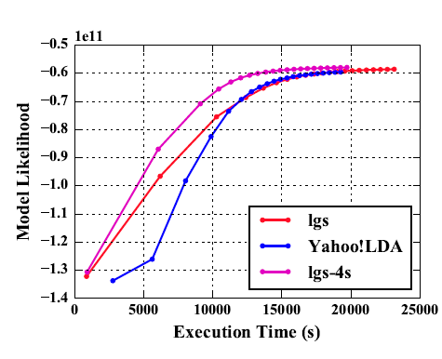
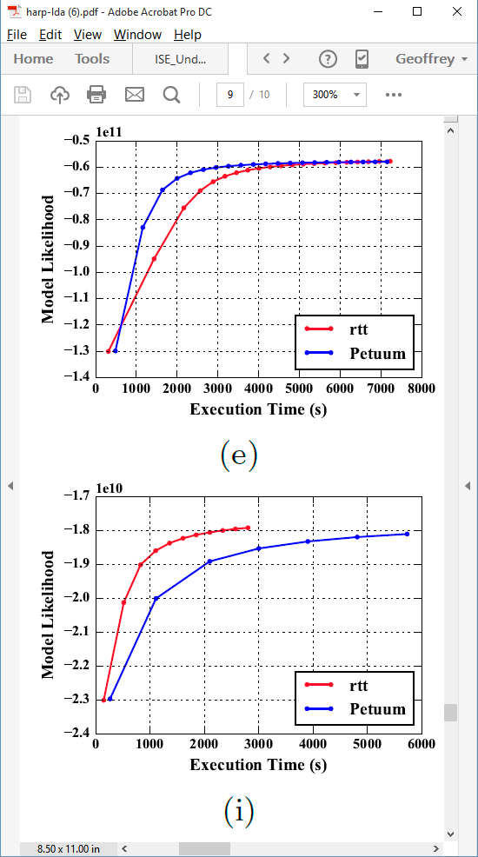
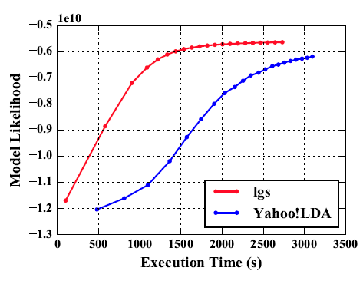
Latent Dirichlet Allocation on 100 Haswell nodes: red is Harp (lgs and rtt)
Clueweb
Clueweb
enwiki
Bi-gram

Slide 15
Streaming Applications and Technology

Slide 16
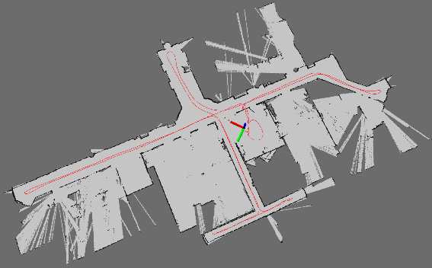
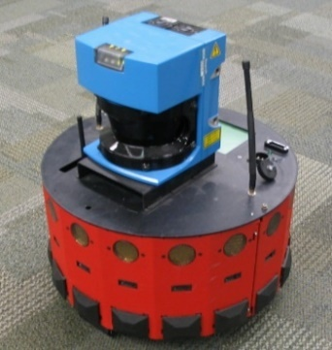
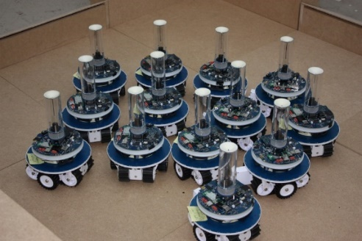
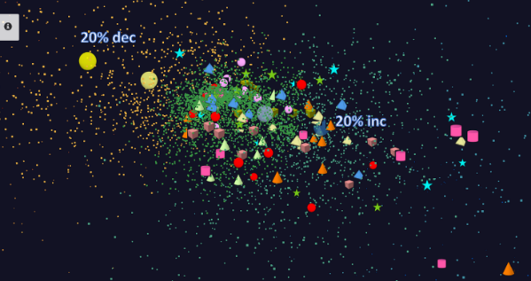
Adding HPC to Storm & Heron for Streaming
Robotics Applications
Time series data visualization in real time
Simultaneous Localization and Mapping
N-Body Collision
Avoidance
Map Built from
Robot data
Robot with a Laser Range Finder
Robots need to avoid collisions when they move
Map High dimensional data to 3D visualizer
Apply to Stock market data tracking 6000 stocks
Cloud Controlled Robotics
Streaming (stock market) data

Slide 17
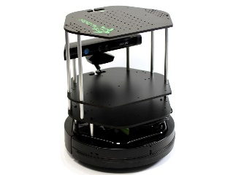
Data Pipeline
Sending to
pub-sub
Sending to
Persisting
storage
Multiple
streaming
workflows
Streaming
workflow
A stream application with some tasks running in parallel
Gateway
Message Brokers
RabbitMQ, Kafka
Streaming Workflows
Apache Heron and Storm
End to end delays without any processing is less than 10ms
Storm does not support “real parallel processing” within bolts – add optimized inter-bolt communication
Hosted on HPC and OpenStack cloud

Slide 18
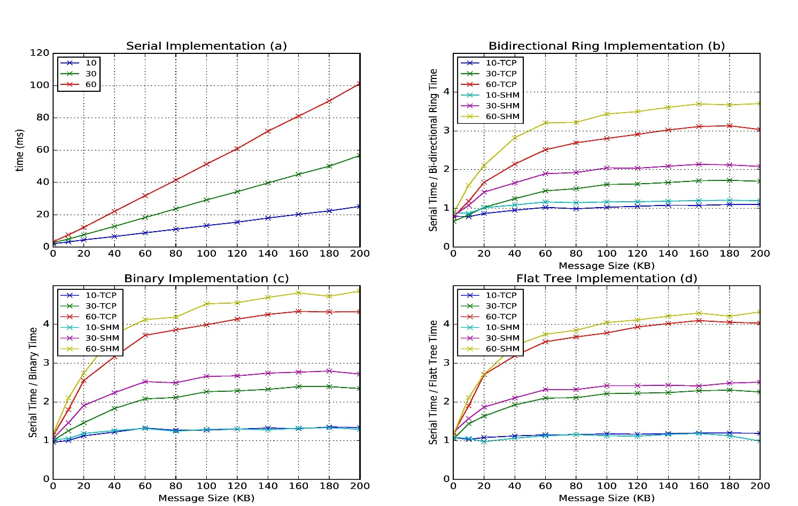
Improvement of Storm (Heron) using HPC communication algorithms
Latency of binary tree, flat tree and bi-directional ring implementations compared to serial implementation. Different lines show varying # of parallel tasks with either TCP communications and shared memory communications(SHM).
Original Time
Speedup Ring
Speedup Binary
Speedup Tree

Slide 19
SPIDAL Applications
Network Science: graph algorithms
General Discussion of Images
Remote Sensing in Polar regions: image processing
Pathology: image processing
Spatial search and GIS for Public Health
Biomolecular simulations
  Path Similarity Analysis
  Detect continuous lipid membrane leaflets in a MD simulation

Slide 20
Imaging Applications: Remote Sensing, Pathology, Spatial Systems
Both Pathology/Remote sensing working on 2D moving to 3D images
Each pathology image could have 10 billion pixels, and we may extract a million spatial objects per image and 100 million features (dozens to 100 features per object) per image. We often tile the image into 4K x 4K tiles for processing. We develop buffering-based tiling to handle boundary-crossing objects. For each typical study, we may have hundreds to thousands of images
Remote sensing aimed at radar images of ice and snow sheets; as data from aircraft flying in a line, we can stack radar 2D images to get 3D
2D problems need modest parallelism “intra-image” but often need parallelism over images
3D problems need parallelism for an individual image
Use many different Optimization algorithms to support applications (e.g. Markov Chain, Integer Programming, Bayesian Maximum a posteriori, variational level set, Euler-Lagrange Equation)
Classification (deep learning convolution neural network, SVM, random forest, etc.) will be important

Slide 21
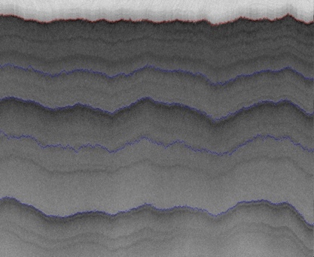
2D Radar Polar Remote Sensing
Need to estimate structure of earth (ice, snow, rock) from radar signals from plane in 2 or 3 dimensions.
Original 2D analysis (called [11]) used Hidden Markov Methods; better results using MCMC (our solution)
Extending to snow radar layers

Slide 22
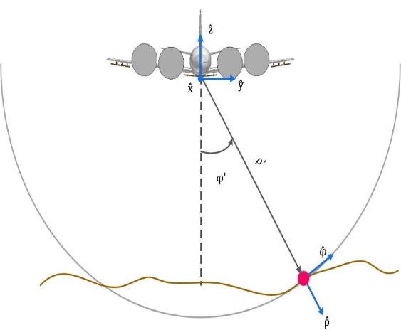
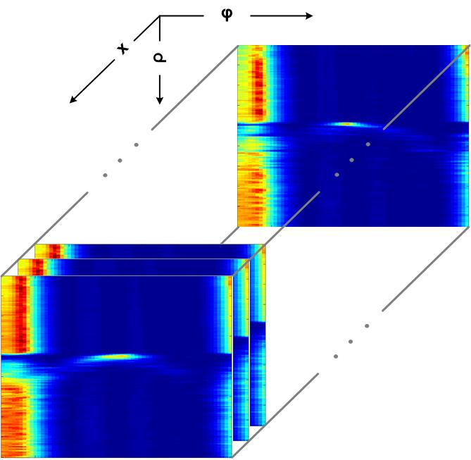
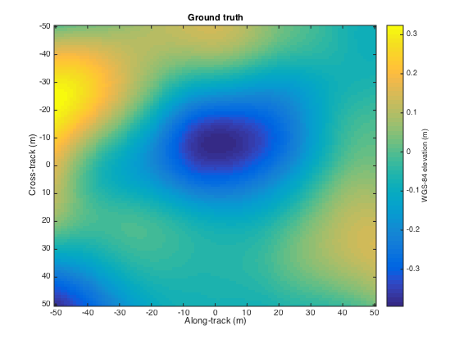
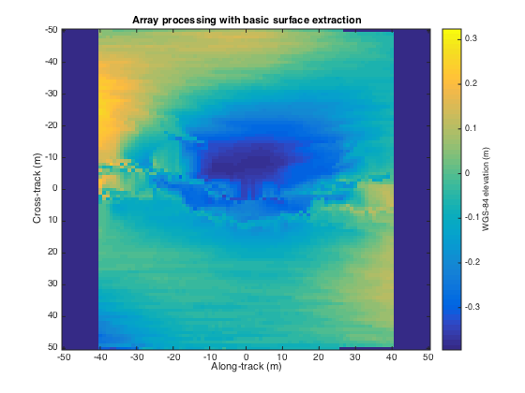
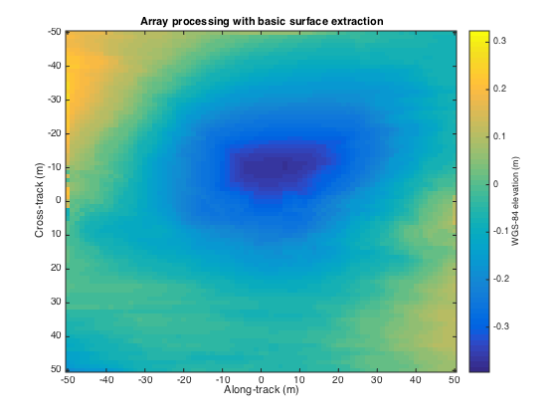
3D Radar Polar Remote Sensing
Uses Loopy belief propagation LBP to analyze 3D radar images
Radar gives a cross-section view, parameterized by angle and range, of the ice structure, which yields a set of 2-d tomographic slices (right) along the flight path.
Each image represents a 3d depth map, with along track and cross track dimensions on the x-axis and y-axis respectively, and depth coded as colors.
Reconstructing bedrock in 3D, for (left) ground truth, (center) existing algorithm based on maximum likelihood estimators, and (right) our technique based on a Markov Random Field formulation.

Slide 23
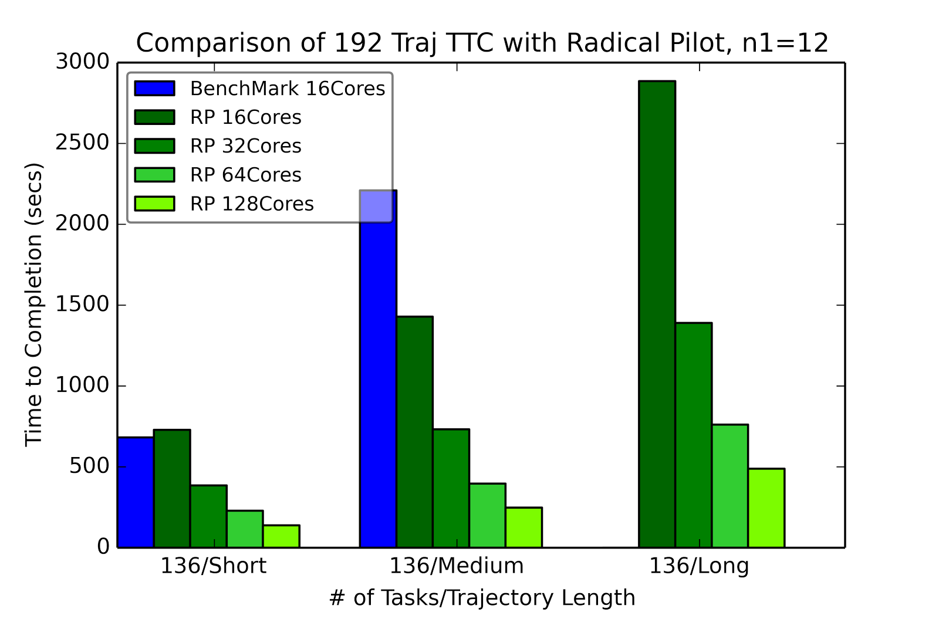
Biomolecular Simulations: Path Similarity Analysis all-pairs Distances between Trajectories
RADICAL Pilot benchmark run for three different test sets of trajectories, using 12x12 “blocks” per task.

Slide 24
SPIDAL Algorithms
Core
Optimization
Graph
Domain Specific

Slide 25
HTML5 web viewer WebPlotViz
Supports visualization of 3D point sets (typically derived by mapping from abstract spaces) for streaming and non-streaming case
  Simple data management layer
  3D web visualizer with various capabilities such as defining color schemes, point sizes, glyphs, labels
Core Technologies
  MongoDB management
  Play Server side framework
  Three.js
  WebGL
  JSON data objects
  Bootstrap Javascript web pages
Open Source
http://spidal-gw.dsc.soic.indiana.edu/
~10,000 lines of extra code
Front end view (Browser)
Plot visualization & time series animation (Three.js)
Upload
Request Plots
JSON Format Plots
Web Request Controllers (Play Framework)
Server
Upload format to JSON Converter
Data Layer
(MongoDB)
MongoDB

Slide 26
Stock Daily Data Streaming Example
Example is collection of around 7000 distinct stocks with daily values available at ~2750 distinct times
  Clustering as provided by Wall Street – Dow Jones set of 30 stocks, S&P 500, various ETF’s etc.
The Center for Research in Security Prices (CSRP) database through the Wharton Research Data Services (wrds) web interface
Available for free to the Indiana University students for research
2004 Jan 01 to 2015 Dec 31 have daily Stock prices in the form of a CSV file
We use the information
  ID, Date, Symbol, Factor to Adjust Volume, Factor to Adjust Price, Price, Outstanding Stocks

Slide 27

Relative Changes in Stock Values using one day values measured from January 2004 and starting after one year January 2005
Filled circles are final values
Origin
0% change
Finance
Energy
Dow Jones
S&P
Mid Cap
+10%
Apple
+20%

Slide 28
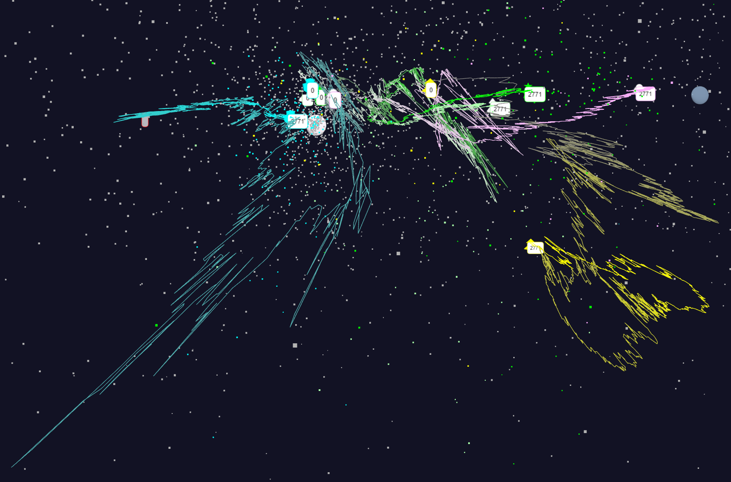
Relative Changes in Stock Values using one day values
Expansion of previous data
S&P
Mid Cap
S&P
Mid Cap
Dow Jones
Dow Jones
+10%
Finance
Finance
Origin
0% change
Energy
Energy
7/5/2018
28

Slide 29
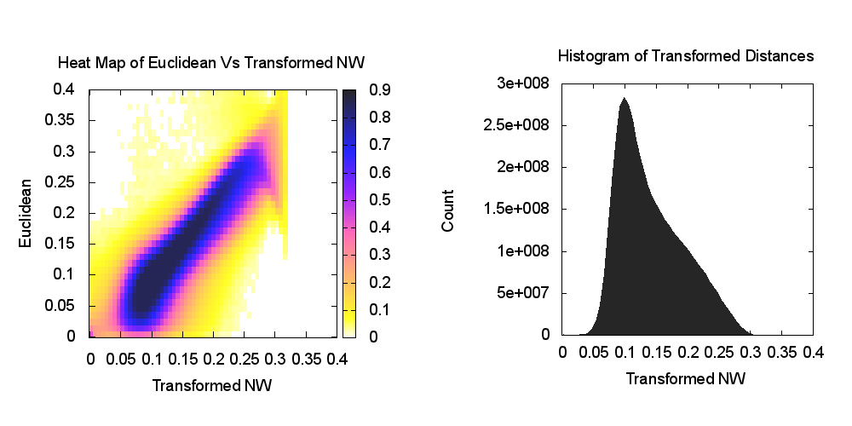
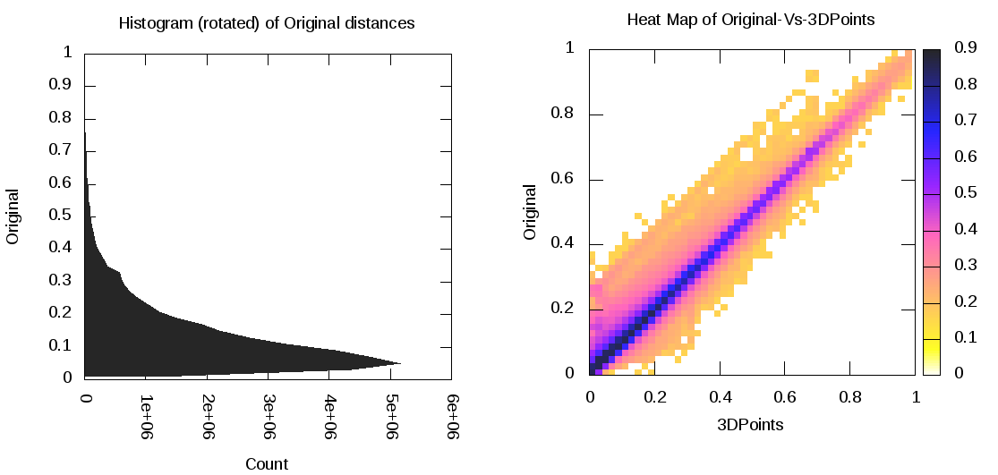
Heatmap of original distance vs 3D Euclidean Distances for Sequences and Stocks
One can visualize quality of dimension by comparing as a scatterplot or heatmap, the distances δ(i, j) before and after mapping to 3D.
Perfection is a diagonal straight line and results seem good in general
Proteomics Example
Stock Market Example

Slide 30
SPIDAL Algorithms – Core I
Several parallel core machine learning algorithms; need to add SPIDAL Java optimizations to complete parallel codes except MPI MDS
  https://www.gitbook.com/book/esaliya/global-machine-learning-with-dsc-spidal/details
O(N²) distance matrices calculation with Hadoop parallelism and various options (storage MongoDB vs. distributed files), normalization, packing to save memory usage, exploiting symmetry
WDA-SMACOF: Multidimensional scaling MDS is optimal nonlinear dimension reduction enhanced by SMACOF, deterministic annealing and Conjugate gradient for non-uniform weights. Used in many applications
  MPI (shared memory) and MIDAS (Harp) versions
MDS Alignment to optimally align related point sets, as in MDS time series
WebPlotViz data management (MongoDB) and browser visualization for 3D point sets including time series. Available as source or SaaS
MDS as χ² using Manxcat. Alternative more general but less reliable solution of MDS. Latest version of WDA-SMACOF usually preferable
Other Dimension Reduction: SVD, PCA, GTM to do

Slide 31
SPIDAL Algorithms – Core II
Latent Dirichlet Allocation LDA for topic finding in text collections; new algorithm with MIDAS runtime outperforming current best practice
DA-PWC Deterministic Annealing Pairwise Clustering for case where points aren’t in a vector space; used extensively to cluster DNA and proteomic sequences; improved algorithm over other published. Parallelism good but needs SPIDAL Java
DAVS Deterministic Annealing Clustering for vectors; includes specification of errors and limit on cluster sizes. Gives very accurate answers for cases where distinct clustering exists. Being upgraded for new LC-MS proteomics data with one million clusters in 27 million size data set
K-means basic vector clustering: fast and adequate where clusters aren’t needed accurately
Elkan’s improved K-means vector clustering: for high dimensional spaces; uses triangle inequality to avoid expensive distance calcs
Future work – Classification: logistic regression, Random Forest, SVM, (deep learning); Collaborative Filtering, TF-IDF search and Spark MLlib algorithms
Harp-DaaL extends Intel DAAL’s local batch mode to multi-node distributed modes
  Leveraging Harp’s benefits of communication for iterative compute models

Slide 32
SPIDAL Algorithms – Optimization I
Manxcat: Levenberg Marquardt Algorithm for non-linear χ² optimization with sophisticated version of Newton’s method calculating value and derivatives of objective function. Parallelism in calculation of objective function and in parameters to be determined. Complete – needs SPIDAL Java optimization
Viterbi algorithm, for finding the maximum a posteriori (MAP) solution for a Hidden Markov Model (HMM). The running time is O(n*s²) where n is the number of variables and s is the number of possible states each variable can take. We will provide an "embarrassingly parallel" version that processes multiple problems (e.g. many images) independently; parallelizing within the same problem not needed in our application space. Needs Packaging in SPIDAL
Forward-backward algorithm, for computing marginal distributions over HMM variables. Similar characteristics as Viterbi above. Needs Packaging in SPIDAL

Slide 33
SPIDAL Algorithms – Optimization II
Loopy belief propagation (LBP) for approximately finding the maximum a posteriori (MAP) solution for a Markov Random Field (MRF). Here the running time is O(n²*s²*i) in the worst case where n is number of variables, s is number of states per variable, and i is number of iterations required (which is usually a function of n, e.g. log(n) or sqrt(n)). Here there are various parallelization strategies depending on values of s and n for any given problem.
  We will provide two parallel versions: embarrassingly parallel version for when s and n are relatively modest, and parallelizing each iteration of the same problem for common situation when s and n are quite large so that each iteration takes a long time.
  Needs Packaging in SPIDAL
Markov Chain Monte Carlo (MCMC) for approximately computing marking distributions and sampling over MRF variables. Similar to LBP with the same two parallelization strategies. Needs Packaging in SPIDAL

Slide 34
SPIDAL Graph Algorithms
Subgraph Mining: Finding patterns specified by a template in graphs
  Reworking existing parallel VT algorithm Sahad with MIDAS middleware giving HarpSahad which runs 5 (Google) to 9 (Miami) times faster than original Hadoop version
Triangle Counting: PATRIC improved memory use (factor of 25 lower) and good MPI scaling
Random Graph Generation: with particular degree distribution and clustering coefficients. new DG method with low memory and high performance, almost optimal load balancing and excellent scaling.
  Algorithms are about 3-4 times faster than the previous ones.
Last 2 need to be packaged for SPIDAL using MIDAS (currently MPI)
Community Detection: current work
Old version
SPIDAL
Harp
Pure Hadoop
Old New
VT

