Slide 1
General Remarks on SOIC@ Indiana University Bloomington
(Followed by 4 detailed talks)
Geoffrey Fox
gcf@indiana.edu
http://www.soic.indiana.edu/
http://www.infomall.org https://portal.futuregrid.org/
Director, Digital Science Center, Pervasive Technology Institute
Associate Dean for Research and Graduate Studies, School of Informatics and Computing
Indiana University Bloomington

Slide 2

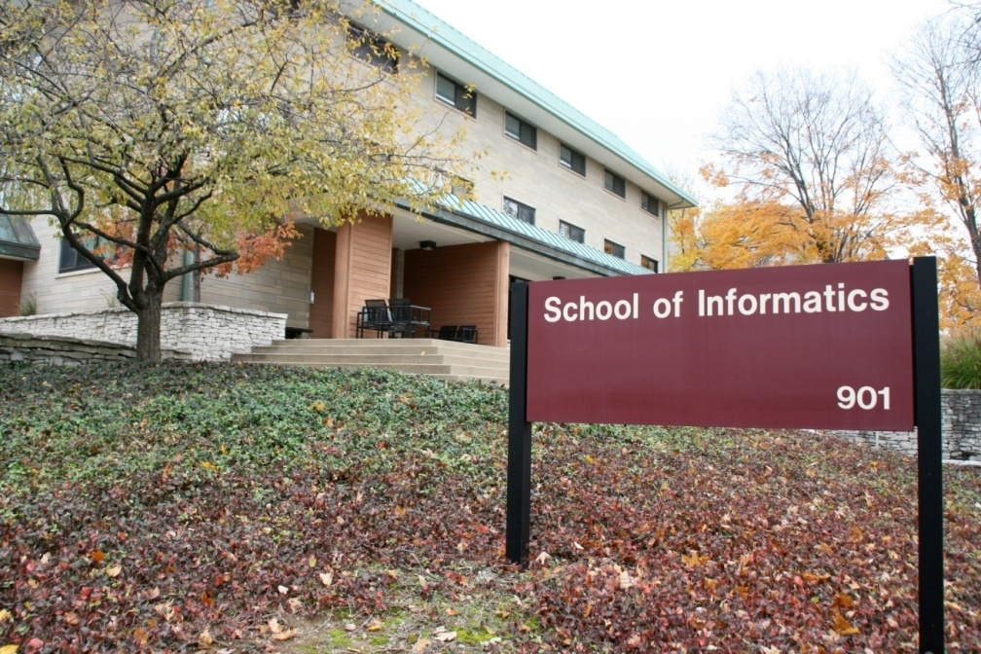
Research Areas
Largely Informatics
Security
Bioinformatics
Cheminformatics
Health Informatics
Music Informatics
Complex Networks and Systems
Human Computer Interaction Design
Social Informatics

Slide 3
Research Areas
Largely Applied Computer Science
Cyberinfrastructure and High Performance Computing
Data, Databases and Search
Image Processing/ Computer Vision
Ubiquitous Computing
Robotics
Visualization and Computer Graphics

Slide 4
Research Areas
Largely Core Computer Science
Computer Architecture
Computer Networking
Programming Languages and Compilers
Artificial Intelligence, Artificial Life and Cognitive Science
Computation Theory and Logic
Quantum Computing

Slide 5
Research Areas
Cyberinfrastructure
Several nationally well known researchers (Bramley, Chauhan, Fox, Lumsdaine, Plale, Qiu, Sterling, Swany)
UITS also very strong (RT, Networking)
Data Deluge: Personal Genomics in future 2000 petabytes of data each year and 1.5*10⁸ to 1.5*10¹⁰ cores to BLAST
  Diagnostic Radiology today 70 petabytes/year (LHC at CERN only 15 Petabytes per year)
Clouds give needed on demand cost effective performance with security/privacy challenges and novel data storage
  MapReduce disruptive data analytics technology
FutureGrid National testbed for experimentation: Clouds, large memory, large disk, GPUs, distributed

Slide 6
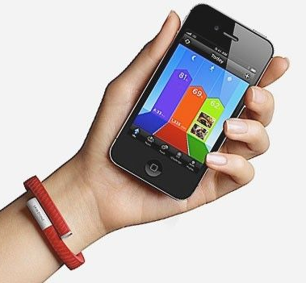

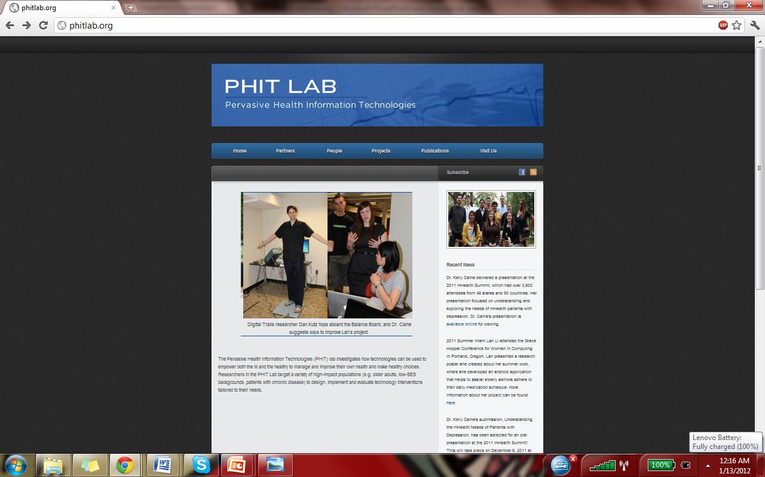
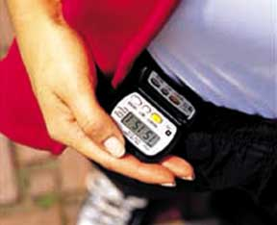
Patient-Centered
Health Informatics
Kay Connelly & Kelly Caine
Patient Domains
  Aging in Place
  Chronically Ill
  Low-SES
  Preventative/Healthy
Technologies
  Mobile/smartphone
  Sensors/home
  Privacy-Enhanced Technologies
Process
  Patient-Centered
  Iterative
  Human-factors

Slide 7
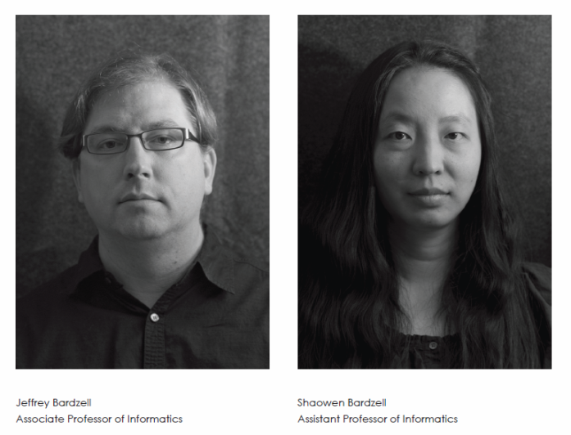
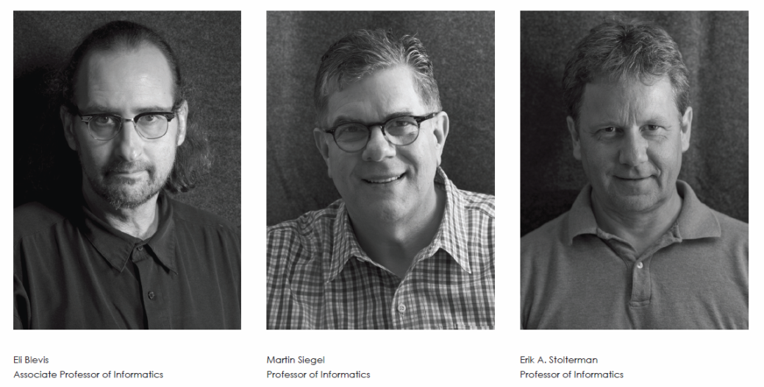

The HCI/d program comprises five faculty with varied research interests and a significant research profile in the HCI and design communities, with significant published output. These research interests include: Design Theory, Interaction Criticism, HCI, Design, and Studio Based Learning, Sustainability, including Food and Health, Collapse Informatics, Feminist HCI, Design Methods in HCI, Visual Thinking , and others. The program offers MS and PhD degrees, as well as undergraduate courses.

Slide 8
Details on SOIC@ Indiana University Bloomington
David Hakken Social Informatics
Luis Rocha, Yong-Yeol Ahn Complex Systems
XiaoFeng Wang, Haixu Tang, Raquel Hill Security Health Informatics
Predrag Radivojac Bioinformatics

Slide 9
In our view, the job of social informatics is to account for what happens when digital technologies are put into use
As such, want to focus on both how the technology influences the context and the context the technology—how they co-construct each other
Health informatics as the arena in which the term “informatics” is most recognized
Hence, we see accounting for health informatics dynamics as central to the general Informatics project
Social Informatics and Health Informatics

Slide 10
Therapeutic Social Robotics (Sabanovics)
Use of robots in therapeutic (e.g. nursing home) contexts
Cross cultural study of therapeutic social robotics
See recent EAGER Grant For US-Japan comparative work with the PARO robot
Assistive Technology for People with Disabilities (Hakken)
Several projects on development and use with advocacy groups and a state department of developmental disabilities
Organizational Informatics in the health sector (Hakken and Medina)
Knowledge Networking project to build cooperation between County Mental Health and local Not-for-Profits
Existing Health Informatics Competences
in the Bloomington SI Group

Slide 11
Some Heuristics for IUB SoIC Health Informatics
As getting the data generated by health informatics systems used is as hard as building the systems, learning how to get it used should be just as central to our program as generating it
This means that training students to be leaders, advocates, brokers, translators, and organizers is as important as training them to be builders
Understanding how people think about and act on health is important
As organizational dynamics may be the biggest hurdle to use, these also must be understood and anticipated
Activist groups and organizations can be an important ally in getting systems used

Slide 12
Human-robot Interaction & User-Oriented Health Informatics at IUB
Prof. Selma Sabanovic, Social Informatics
Designing and evaluating health technology prototypes in emerging areas: HRI, robotics
Prototyping and HRI Living lab at SOIC, HRI courses that offer prototyping experience
Work with local healthcare community: retirement homes, etc.
New funding and international collaboration possibilities: National Robotics Initiative, cross-cultural research on assistive robotics

Slide 13
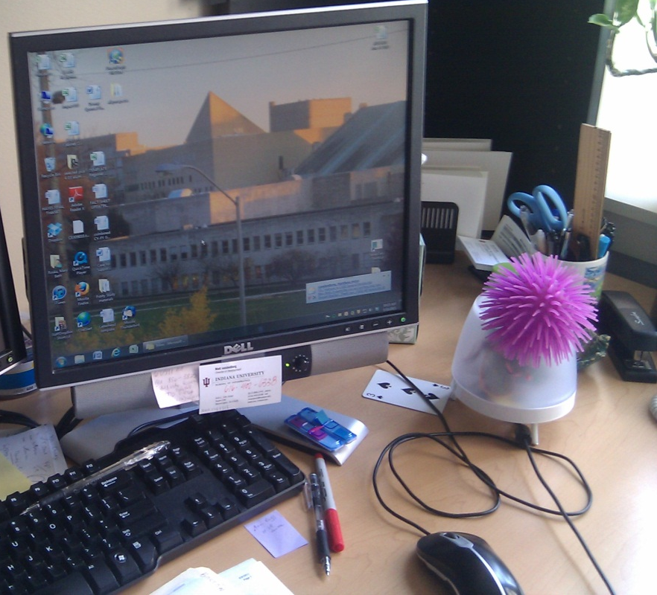
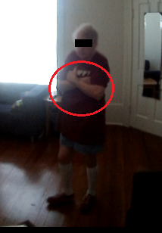
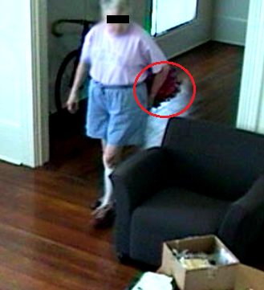
Prototyping and evaluating emerging robotic health technologies
A simple robot for helping office workers manage break-taking
Evaluating the effect of robotic technologies on older adult behavior and aging in place

Slide 14
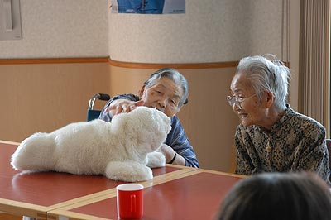
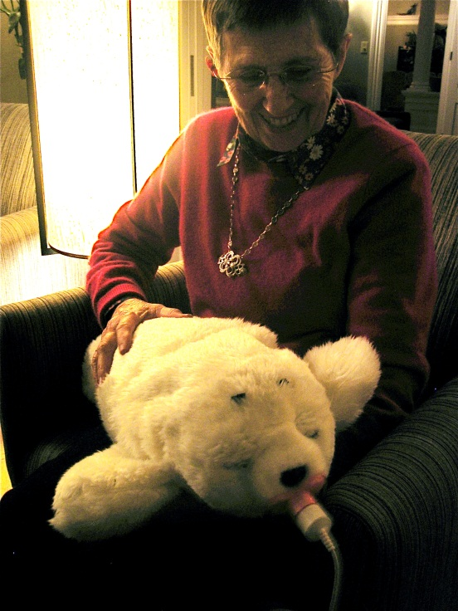
Cross-cultural research on socially assistive robots
NSF funded EAGER project in socially assistive robotics led by Selma Sabanovic
Evaluating how PARO, a therapeutic robot developed in Japan, is used in the US:
  How nursing home residents respond to the robot
  Guidelines for nursing home staff and therapists

Slide 15
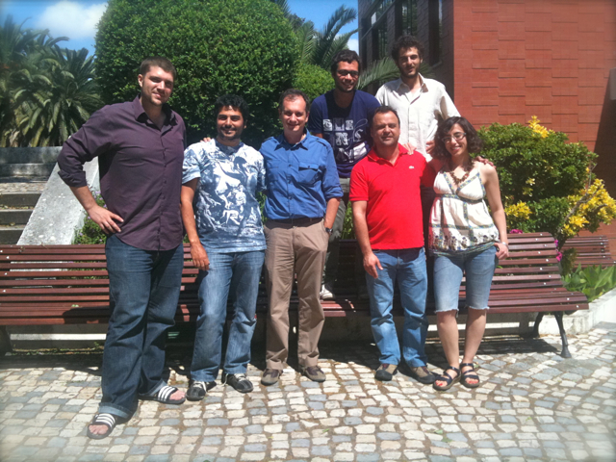
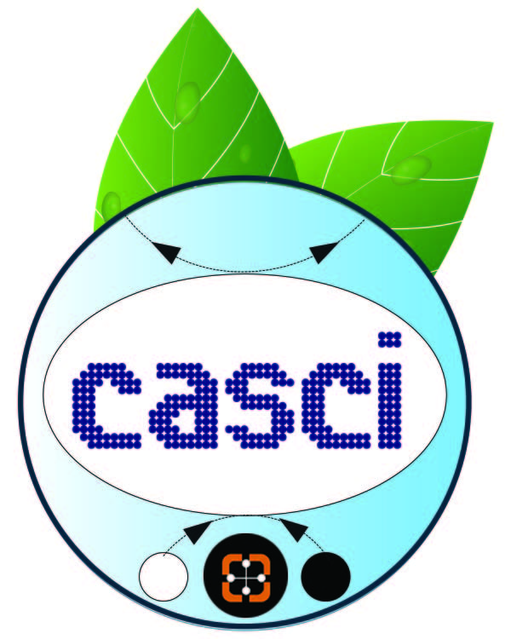
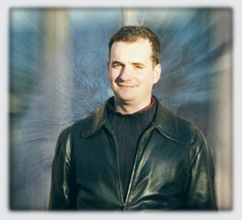
complex adaptive systems
CASCI Team
and computational intelligence @ indiana university, bloomington, usa
http://cnets.indiana.edu/groups/casci
luis m. rocha (PI)
and computational biology @ instituto gulbenkian de ciência, portugal
http://www.igc.gulbenkian.pt/research/unit/76
Informational properties of natural and artificial systems
  emergence of information and collective computation in evolving systems
  principles from natural systems for adaptive information technology
Research projects
  text and literature mining for biomedicine, computational biology, modeling dynamics in complex networks, automata dynamics, models of non-coding RNA, artificial life, evolutionary systems, adaptive search and recommendation, and biosemiotics.

Slide 16
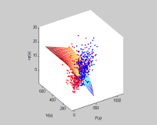
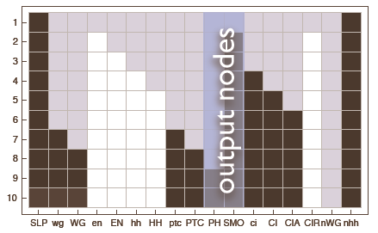
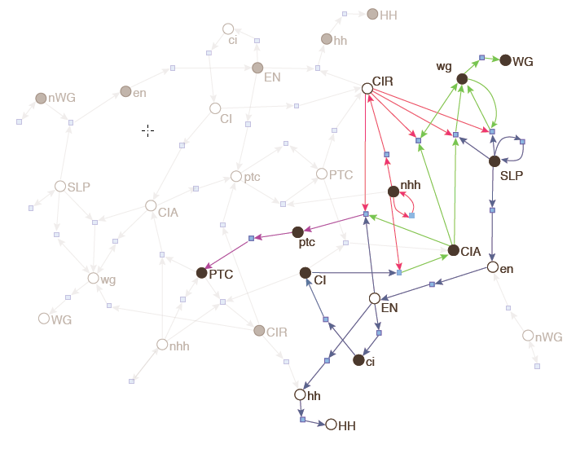
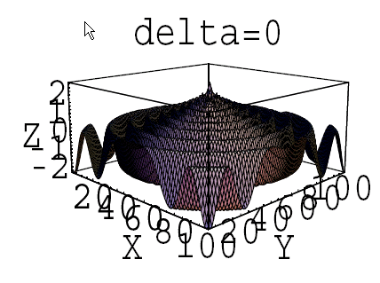
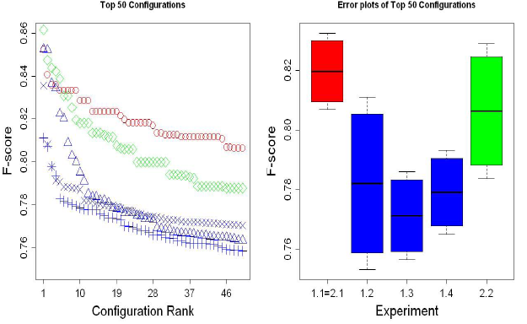
Complex adaptive systems and computational intelligence
Selected projects
Text-mining in computational Biology: Discovery of Protein-Protein Interaction, Drug Pharmacokinetics, etc. Among top performing teams in BioCreative PPI tasks
Abi Haidar, A et al. [2008] Genome Biology 9(Suppl 2):S11.
A. Kolchinsky, et al [2010]. Trans. Comp. Bio. Bioinf., 7(3):400-411
A. Lourenco, et al [2011]. BMC Bioinformatics. 2(Suppl 8):S12
Automata Networks: modeling biochemical signaling, regulation, modularity, robutsness and emergent computation in Boolean Networks and Cellular Automata
Marques-Pita , Mitchell & Rocha. [2008]. UC08. LNCS. 5204: 146-163
Agent-based models of evolutionary dynamics: RNA Editing and T-Cell Cross regulation dynamics.
Huang, C-F, et al [2007]. Evolutionary Computation. 15(3).
A. Abi-Haidar and L.M. Rocha [2011]. Evolutionary Intelligence. 4(2):69-80.

Slide 17
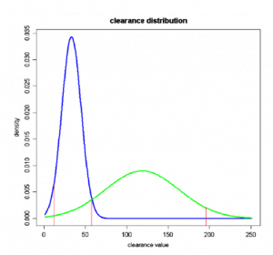
Drug-Drug Interaction Prediction from Literature and Patient Records
IUCRG project (2011-2012)
Lang Li (IUPUI School of Medicine): drug metabolism and drug interaction
Jon Duke (Regentrief Institute, IUPUI): medical informatics and electronic medical records
Luis M. Rocha (IU, SOIC, Bloomington): large-scale literature mining
1) Large-scale mining and analysis of drug interactions covering metabolism enzymes and their associated drugs
2) Assessing the clinical importance of the proposed interactions based on analysis of a large-scale patient repository
Z. Wang, et al[2009]. Journal of Biomedical Informatics. 42 (4): 726-735.
A. Lourenco, et al [2011]. BMC Bioinformatics. 2(Suppl 8):S12
S. Karnik, et ali [2011] Proc. 1st Challenge task on Drug-Drug Interaction Extraction, pp. 83-88.

Slide 18
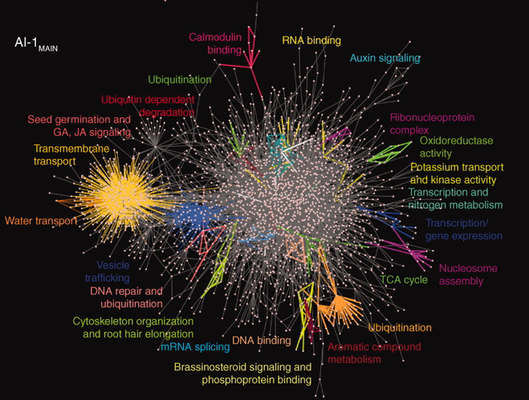
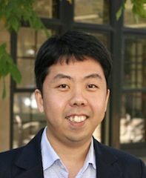
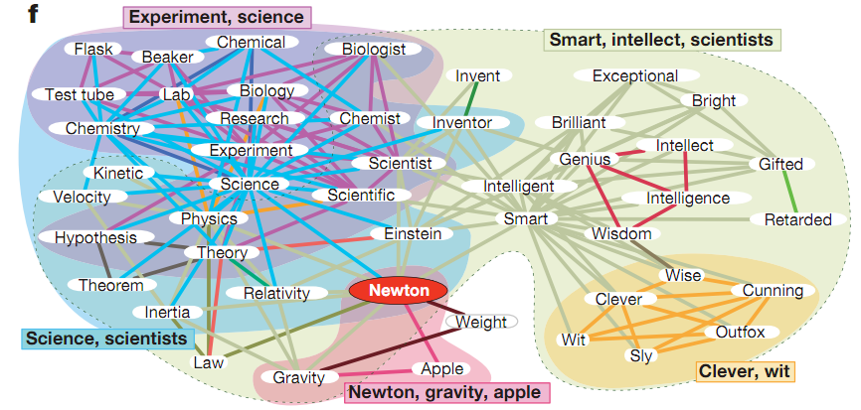
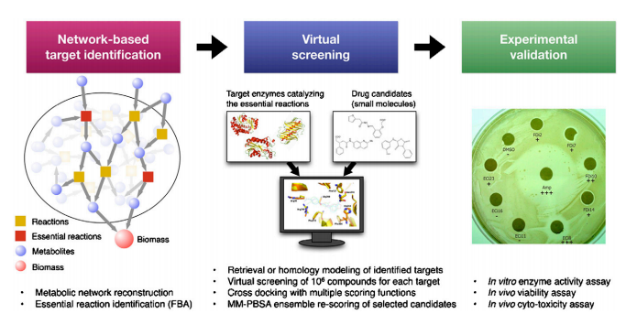
Yong-Yeol Ahn
Recent work: Network analysis
Discovering modules
From a PPI network.
Arabidopsis Interactome Mapping Consortium, Science 333, 601 (2011)
yyahn@indiana.edu
Network clustering
General overlapping module discovery method for all types of networks.
Y.-Y. Ahn et al., Nature 466, 701 (2010)
Metabolic network analysis
Y. Shen et al, PNAS 107, 1082 (2010)

Slide 19
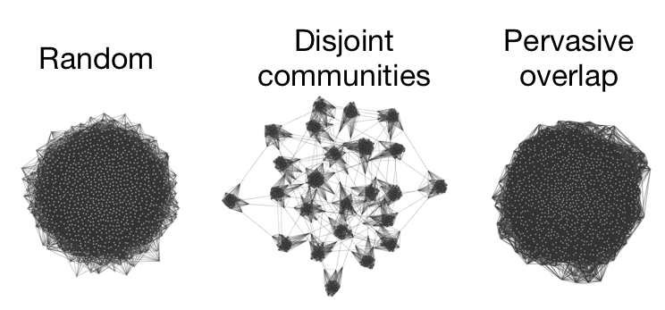
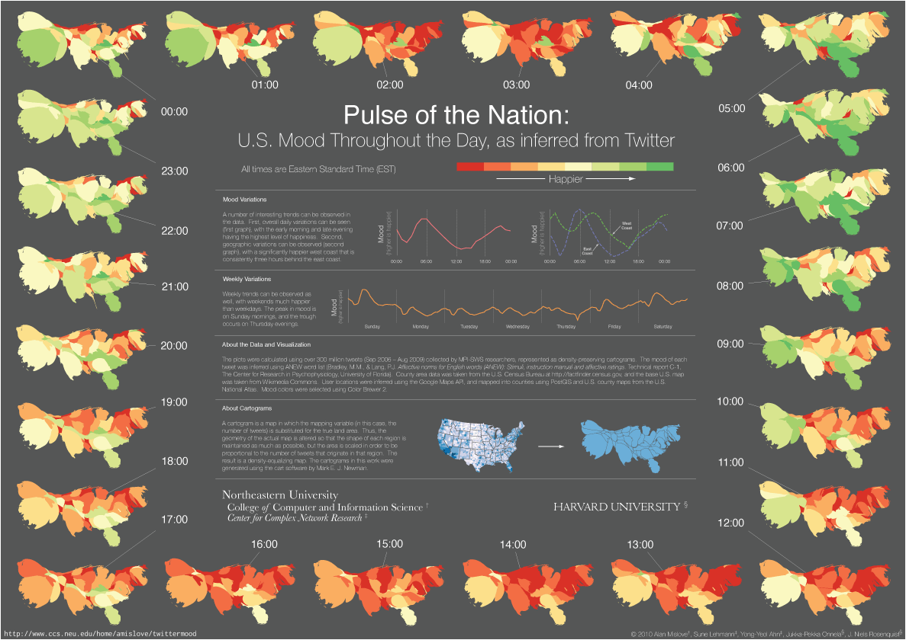
Yong-Yeol Ahn
Networks and social media
Community structure of social networks and the spreading of information and ideas.
Pulse of the Nation:
Measuring mood of people through social media.
Public health application: monitoring large-scale public behavior and mood.

Slide 20
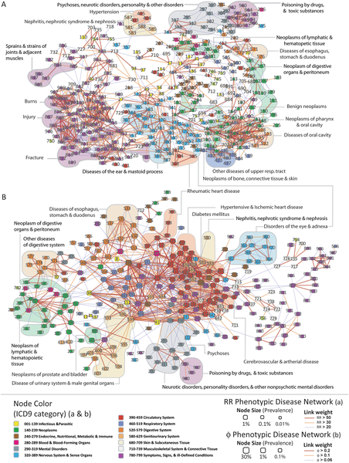
Yong-Yeol Ahn
Other future directions
Disease association discovery based on clinical data
C. Hidalgo et al., PLoS Comp. Biol. 5, e1000353 (2009)

Slide 21
Security Health Informatics
Dr. XiaoFeng Wang (http://www.informatics.indiana.edu/xw7)
Dr. Haixu Tang (http://www.informatics.indiana.edu/hatang/)
Dr. Raquel Hill (https://www.cs.indiana.edu/~ralhill/)

Slide 22
Security HI Research at SoIC
Human Genome Privacy
Privacy-preserving access control

Slide 23
Genome Privacy Research
Dr. XiaoFeng Wang and Dr. Haixu Tang
Associate Professors of SoIC

Slide 24
Genome Privacy
Human DNA are important to the genomic research,
biomedical research, etc., and becoming part of EHR
However, genomes are also sensitive
  Personally identifiable markers: skin, hair color…
  Disease markers
    What if your insurance company knows?

Slide 25
Challenges
Dissemination is important !
  Data sharing is key to Human Genome/biomedical Research
  But how to do it securely (i.e. to preserve human privacy)?
Computation: to outsource or not to?
  Demand >> supply: public clouds to save the day
  But wait! How about privacy?

Slide 26
What do we have now?
Informed consent and agreement of data use
Con: complicated
Con: liability
Con: limited effects
  Are the data safe with the researchers?
  Are participants indeed well informed?

Slide 27
Our Research on Genome Privacy
Privacy Risk and Protection in Genome Data Sharing
  Discovery of new re-identification threats in publishing GWAS papers [1]
    Winner of the 2011 PET AWARD for OUTSTANDING RESEARCH in PRIVACY ENHANCING TECHNOLOGIES
    Reported by BioSpace
  Preliminary study on when to release aggregated DNA data [2]
Privacy-Preserving Genome Computing
  Computation partition, specialization over hybrid clouds [3, 4]

Slide 28
New directions, great potentials
Genome privacy is important
  Personalized genomics is the future (for medicine and healthcare)!
  The public cares, the NIH cares, private companies care
Genome privacy is new
  Special data features, different computation requirements
  Existing crypto approach often fails
Genome privacy is highly interdisciplinary
  Privacy, bioinformatics, Cloud computing, ELSI

Slide 29
References
(papers posted at www.informatics.indiana.edu/xw7)
R. Wang, Y. Li, X. Wang, H. Tang and X. Zhou, 2009 "Learning Your Identity and Disease from Research Papers: Information Leaks in Genome Wide Association Study". In Proceedings of the 16th ACM Conference on Computer and Communications Security (CCS)
X. Zhou, B. Peng, Y. Li, Y. Chen, H. Tang and X. Wang, 2011 “To Release or Not to Release: Evaluating Information Leaks in Aggregate Human-Genome Data”. In Proceedings of European Symposium on Research in Computer Security (ESORICS).
R. Wang, X. Wang, Z. Li, H. Tang, M. Reiter and Z. Dong, 2009 "Privacy-Preserving Genomic Computation Through Program Specialization". In Proceedings of the 16th ACM Conference on Computer and Communications Security (CCS)
Y. Chen, B. Peng, X. Wang and H. Tang, 2012 “Large-Scale Privacy-Preserving Mappings of Human Genomic Sequences on Hybrid Clouds”. To appear in Proceedings of the 19th Annual Network and Distributed System Security Symposium (NDSS)

Slide 30
Privacy Preserving Access Control
Dr. Raquel Hill
Assistant Professor
SoIC

Slide 31
Problem: Privacy of Medical-Related Survey Data
Social Scientists often collect health and other medical-related data in their surveys
  Data includes information about disease, exams, prescription drugs, etc.
Data is often high-dimensional and sparse, having many attributes for which participants have provided unique responses
Uniqueness facilitates successful re-identification of records when traditional identifiers have been removed

Slide 32
Goals
Goals of this work is to provide practitioners with the tools to:
  Assess vulnerabilities in high-dimensional medical-related data
  Identify risk of re-identification
  Reduce risk of re-identification while preserving utility
  Define privacy preserving data sharing policies, while quantifying the privacy risk

Slide 33
References
A. C. Solomon, R. Hill, E. Janssen, S. Sanders, J. Heiman, Uniqueness and How it Impacts Privacy in Health-Related Social Science Datasets, To Appear in the Proceedings of the ACM International Health Informatics Symposium (IHI 2012), January 28-30, 2012, Miami Florida.
A. C. Solomon, R. Hill, E. Janssen, S. Sanders, Privacy and De-Identification in High Dimensional Social Science Data Sets, in the Proceedings of the 32nd Annual IEEE Symposium on Security and Privacy , Oakland, California, May 22-25, 2011.

Slide 34

Bioinformatics
Predrag Radivojac
Indiana University, Bloomington
January 13, 2012

Slide 35

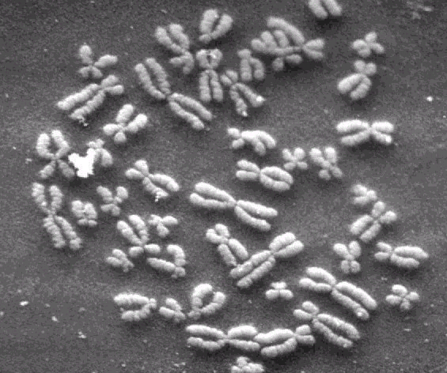


Human genome and its impact on phenotype
What is the molecular basis of it?
… AGTTTACCGA …
… AGCATACCGA …
… AGCATAGCGA …
Phenome
Genome

Slide 36
Base changes resulting in different proteins
>12 million known unique sites!
Gene
Another gene…
Exon
DNA
regulatory
non-synonymous
synonymous
genomic
intronic
G38D in 1tag
Adapted from: http://snp.ims.u-tokyo.ac.jp/samplesMethods.html#SNP
Yue et al. J Mol Biol, 2005, 353: 459

Slide 37
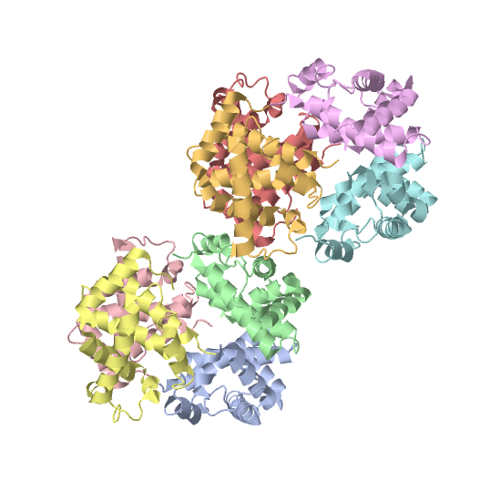
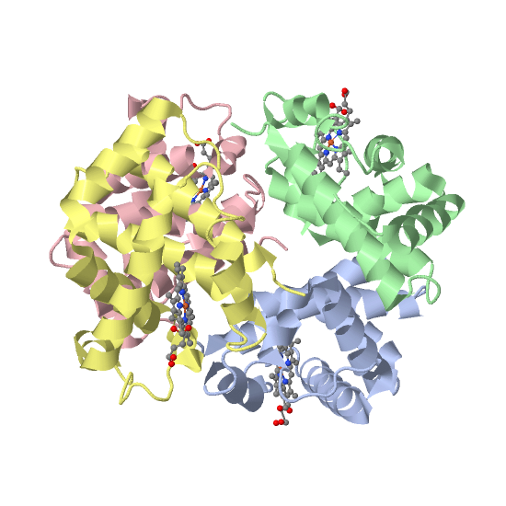
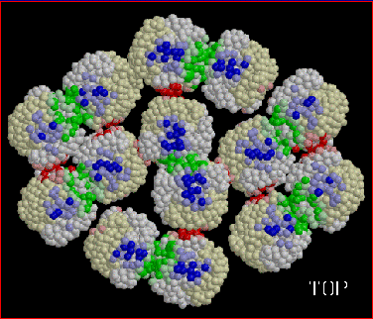
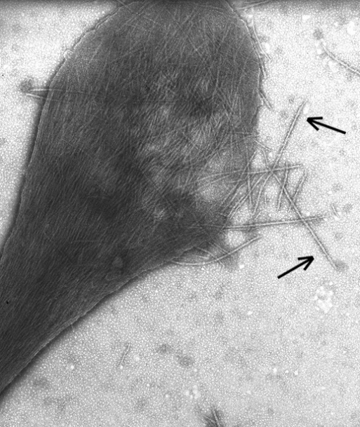
Loss/Gain of function and disease
E6V
4hhb
2hbs
Sickle Cell Disease:
Autosomal recessive disorder
E6V in HBB causes interaction w/ F85 and L88
Formation of amyloid fibrils
Abnormally shaped red blood cells, leads to sickle cell anemia
Manifestation of disease vastly different over patients
Pauling et al. Science 110: 543 (1949). Chui & Dover. Curr Opin Pediatr, 13: 22 (2001).
http://gingi.uchicago.edu/hbs2.html
Notes:
37
The clinical manifestations of Hb S homozygotes are extremely variable. Approximately 10% to 20% of SCD patients develop strokes that may result in serious disabilities. In a prospective study, most SCD patients had one or fewer painful episodes per year, and 5% to 10% of patients had three or more painful crises per year. This is particularly significant because more than three painful crises per year is a risk factor for early mortality in adults with SCD [3].

Slide 38
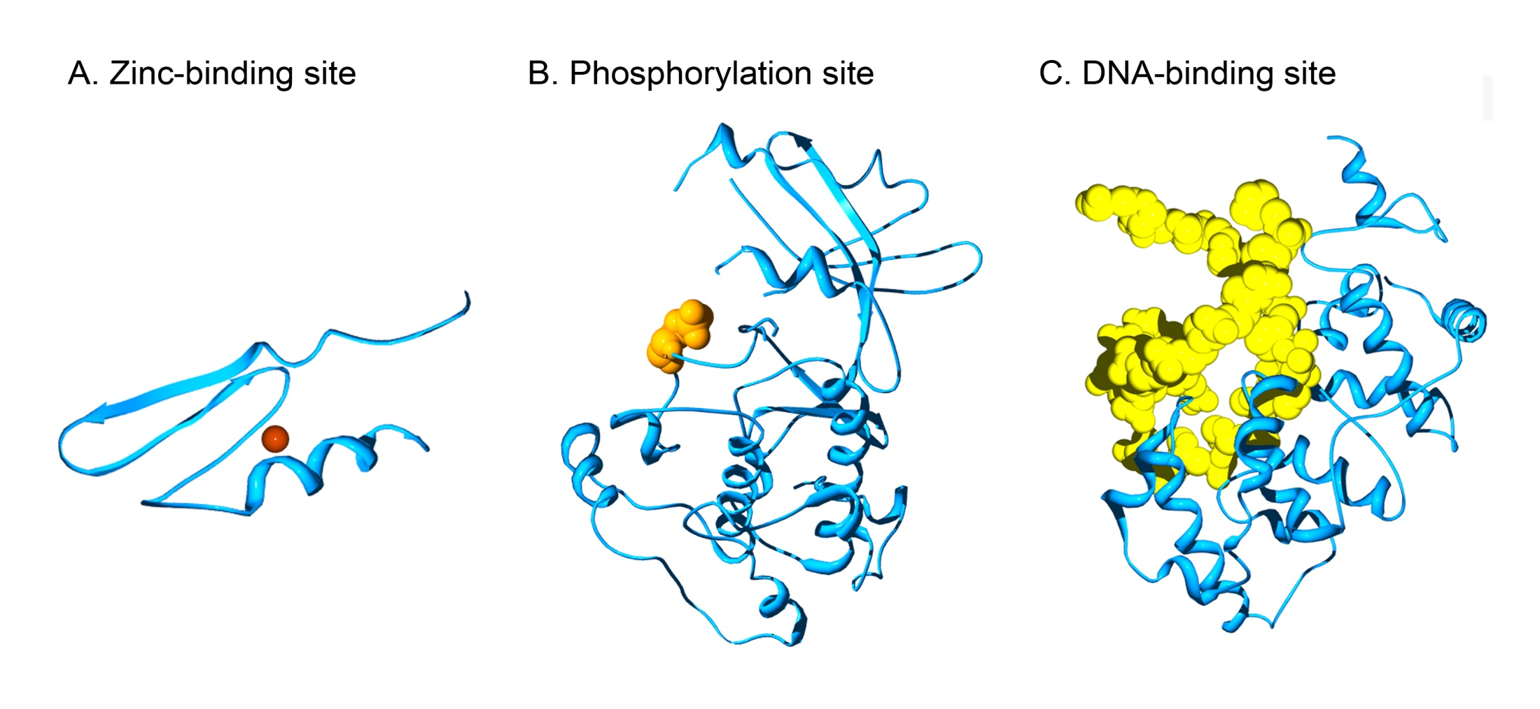
Examples of functional sites
Xin and Radivojac. Curr Prot Pept Sci 12: 456 (2011)

Slide 39
Gain of catalytic activity causes disease
Catalytic residues of PCSK9 (2qtw)
    a member of the proteinase K sub-family of subtilases that reduces the number of LDL receptors in liver through a posttranscriptional mechanism.
    D374Y leads to a 10-fold increase in catalytic activity that causes hypercholesterolemia.
Lagace, T. A. et al. (2006) J Clin Invest, 116 (11), 2995–3005.

Slide 40
Inherited vs. somatic disease
2174 11 13
1488 4 12
1801 49 73
Li et al. Bioinformatics 25:2744-50 (2009).

Slide 41
Where are disease genes?

Slide 42
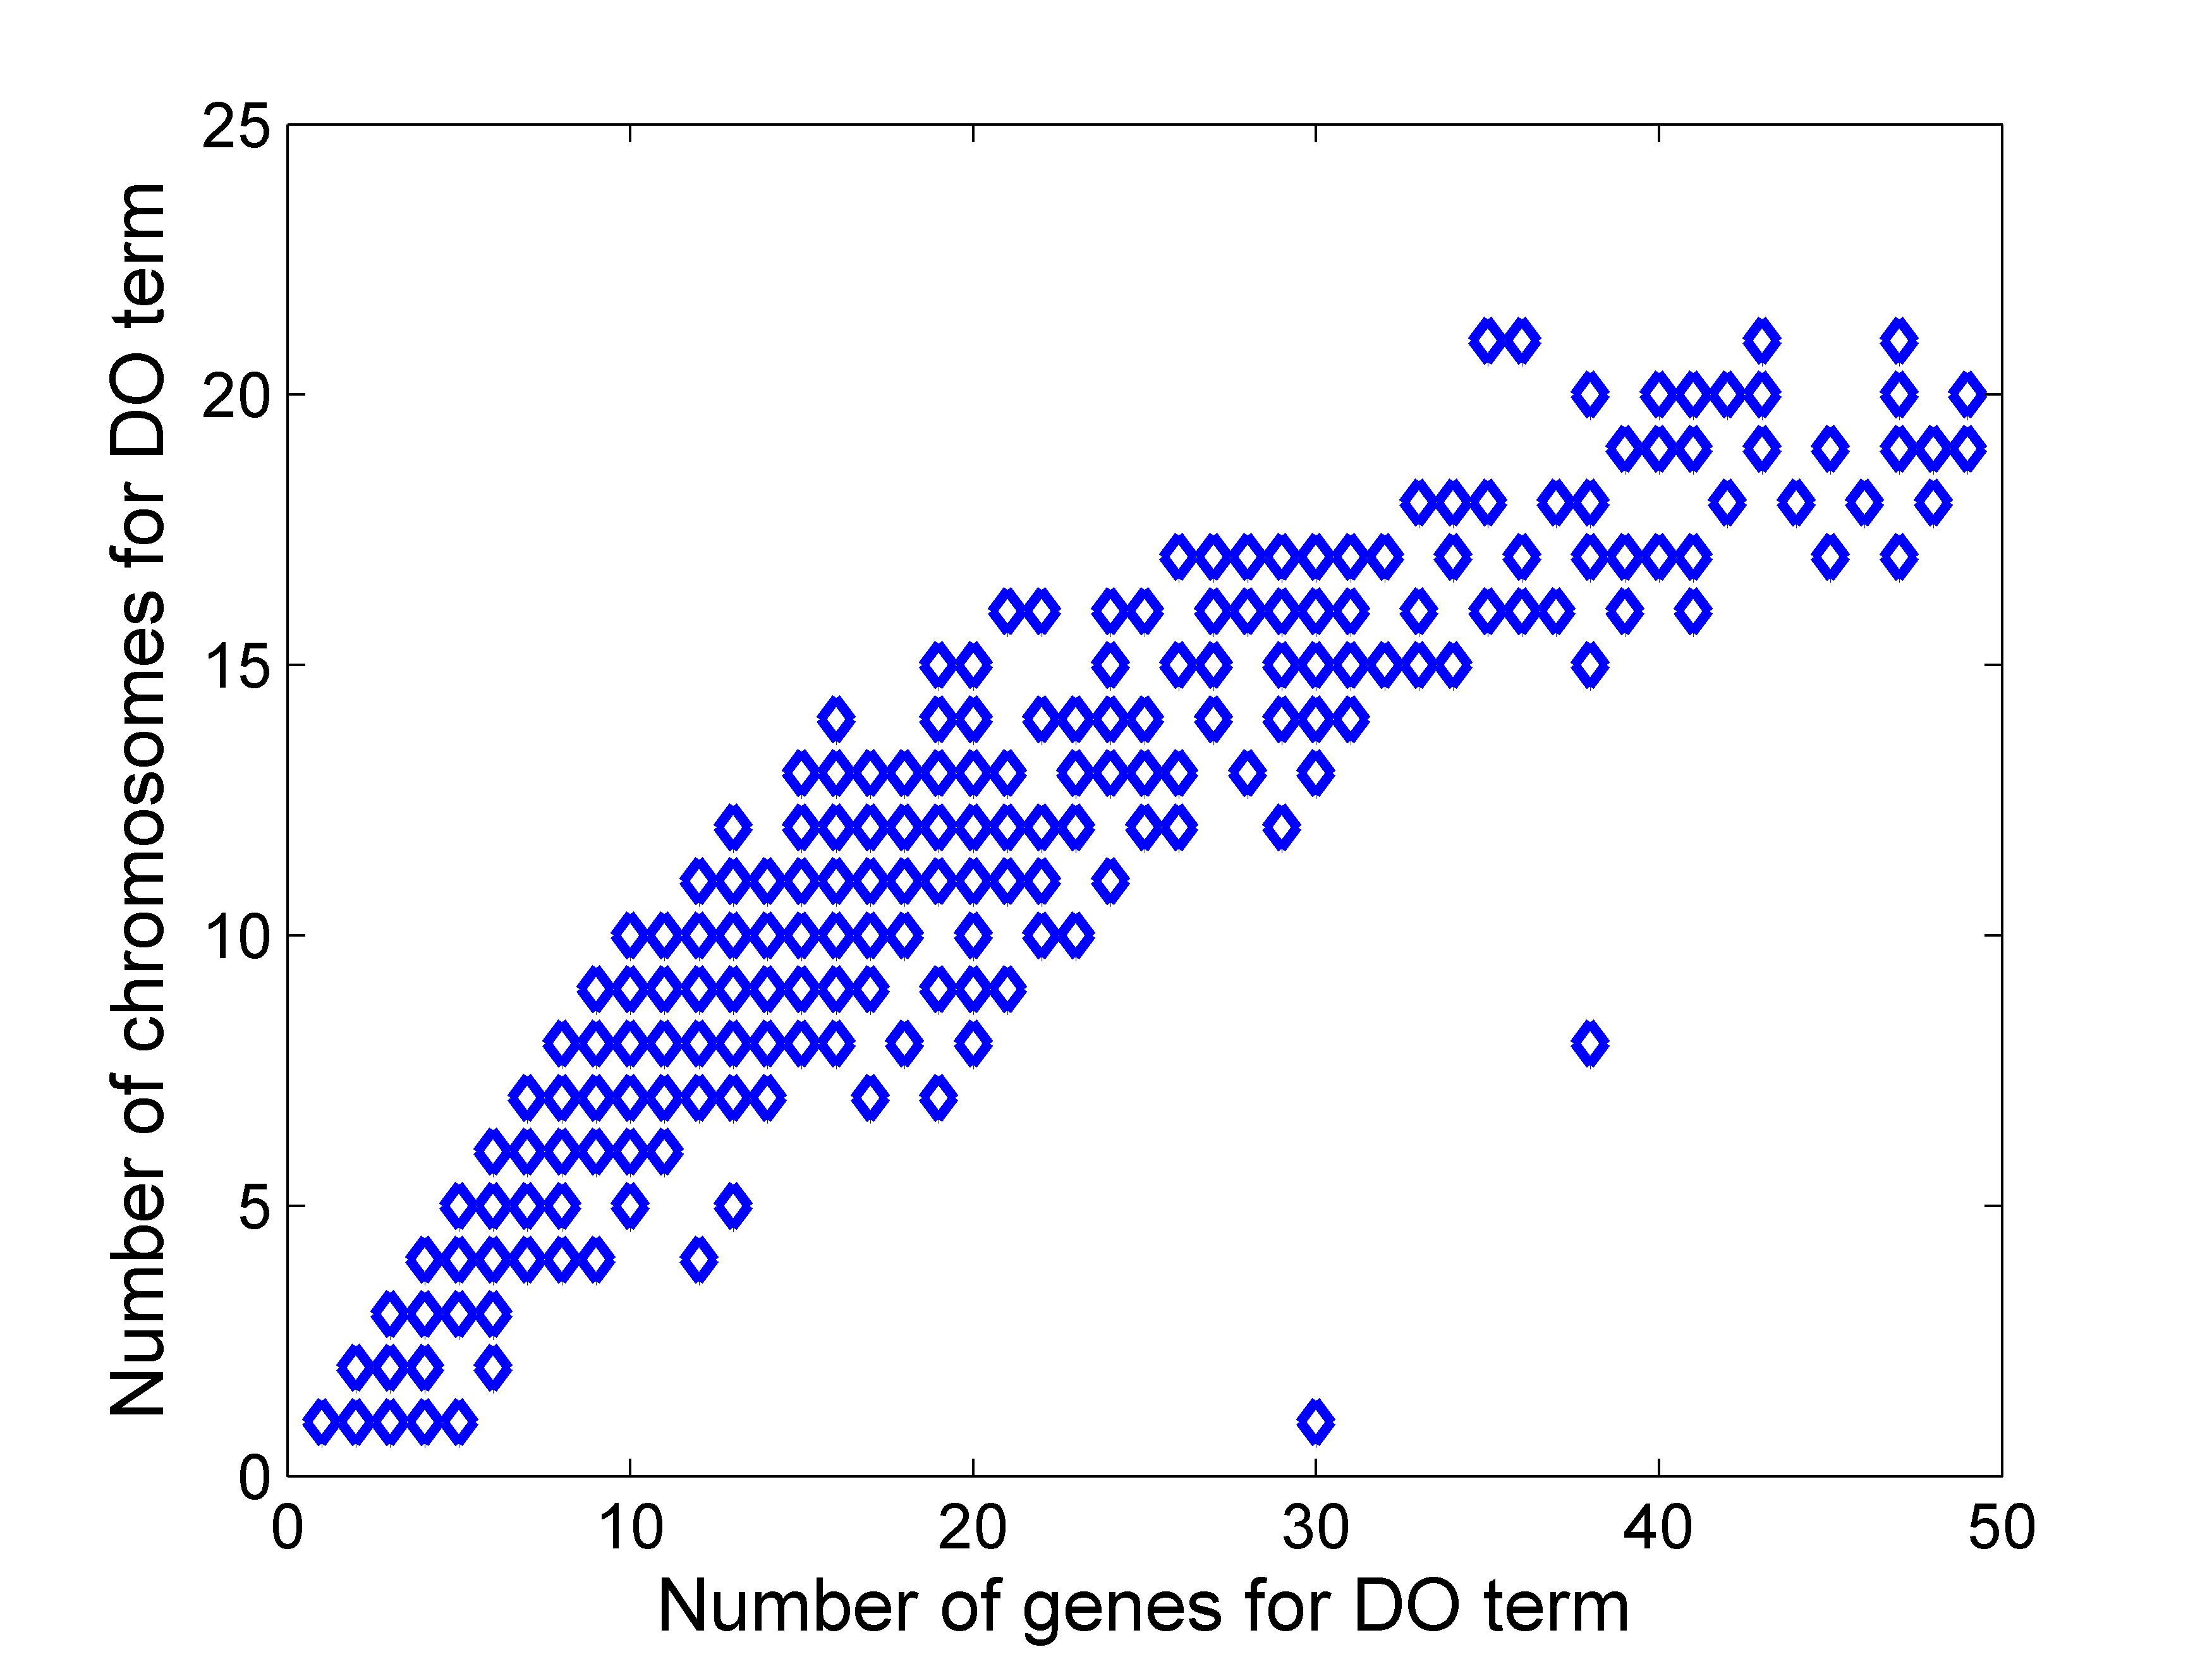
Disease genes are scattered around
Mental Retardation, X-Linked
67 DO terms where # chromosomes equals # genes (e.g. Hereditary Night Blindness) : # genes ≥ 5
Clark & Radivojac, unpublished data.

Slide 43
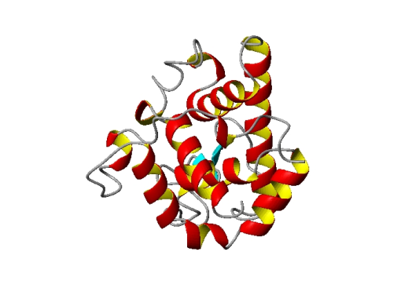
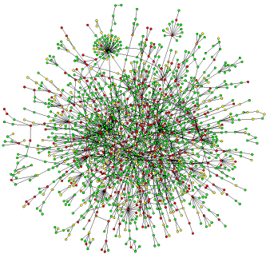

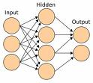
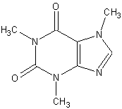
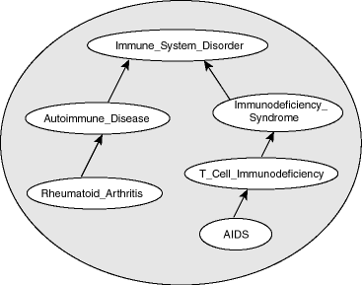
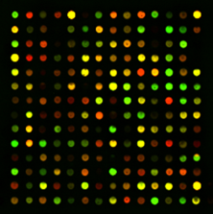
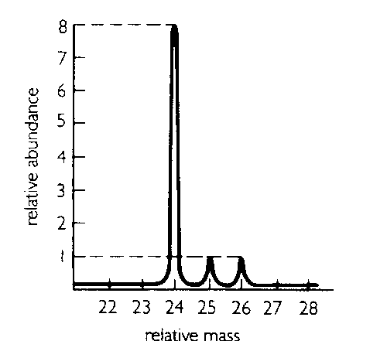

Everything comes together
human expertise
data and databases
mathematical models
technology
human reasoning
model organisms

Slide 44
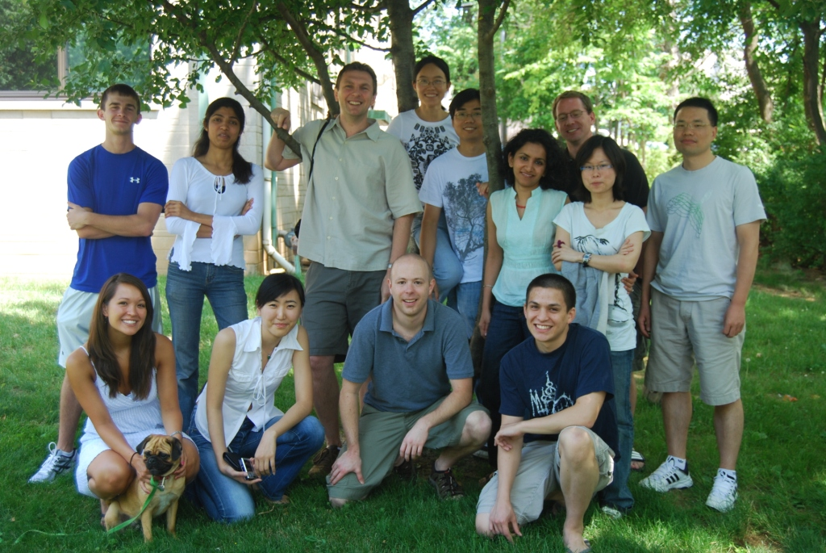


Acknowledgements
Indiana University
Biao Li
Fuxiao Xin
Buck Institute
Sean Mooney
Vidhya Krishnan
Kishore Kamati
Cardiff University
David Cooper
Matthew Mort

