Slide 1
SBIR Final Meeting
Collaboration Sensor Grid and Grids of Grids
Information Management
Anabas
July 9, 2008

Slide 2
Introduction I
Grids and Cyberinfrastructure have emerged as key technologies to support distributed activities that span scientific data gathering networks with commercial RFID or (GPS enabled) cell phone nets. This SBIR extends the Grid implementation of SaaS (Software as a Service) to SensaaS (Sensor as a service) with a scalable architecture consistent with commercial protocol standards and capabilities. The prototype demonstration supports layered sensor nets and an Earthquake science GPS analysis system with a Grid of Grids management environment that supports the inevitable system of systems that will be used in DoD’s GiG.

Slide 3
Introduction II
The final delivered software both demonstrates the concept and provides a framework with which to extend both the supported sensors and core technology
The SBIR team was led by Anabas which provided collaboration Grid and the expertise that developed SensaaS. Indiana University provided core technology and the Earthquake science application. Ball Aerospace integrated NetOps into the SensaaS framework and provided DoD relevant sensor application.
Extensions to support the growing sophistication of layered sensor nets and evolving core technologies are proposed

Slide 4
Objectives
ANABAS
Integrate Global Grid Technology with multi-layered sensor technology to provide a Collaboration Sensor Grid for Network-Centric Operations research to examine and derive warfighter requirements on the GIG.
Build Net Centric Core Enterprise Services compatible with GGF/OGF and Industry.
Add key additional services including advance collaboration services and those for sensors and GIS.
Support Systems of Systems by federating Grids of Grids supporting a heterogeneous software production model allowing greater sustainability and choice of vendors.
Build tool to allow easy construction of Grids of Grids.
Demonstrate the capabilities through sensor-centric applications with situational awareness.

Slide 5
Technology Evolution
During course of SBIR, there was substantial technology evolution in especially mainstream commercial Grid applications
These evolved from (Globus) Grids to clouds allowing enterprise data centers of 100x current scale
This would impact Grid components supporting background data processing and simulation as these need not be distributed
However Sensors and their real time interpretation are naturally distributed and need traditional Grid systems
Experience has simplified protocols and deprecated use of some complex Web Service technologies

Slide 6
Commercial Technology Backdrop
ANABAS
Build everything as Services
Grids are “just” Collections of Services
XaaS or X as a Service is dominant trend
X = S: Software (applications) as a Service
X = I: Infrastructure (data centers) as a Service
X = P: Platform (distributed O/S) as a Service
Grids are any collection of Services and manage distributed services or distributed collections of Services i.e. Grids to give Grids of Grids
We added
X = C: Collections (Grids) as a Service and
X = Sens(or Y): Sensors as a Service

Slide 7
Technologies
ANABAS
Anabas Impromptu Collaboration Framework
Indiana University NaradaBrokering Messaging System
Ball Aerospace & Technology’s NetOps (Network Operations) Situational Awareness technology
Sun Microsystems Java platform
Haskell Programming Language (Ball)
Low cost sensors including Wii Remote sensor, RFID reader and tags, GPS sensors, accelerometer, gyroscope, compass, ultrasonic,
temperature, audio/video recorders, etc.

Slide 8
ANABAS
Results of the SBIR
Key Software Systems and Modules are ready for use in demonstrating layered Sensor Grids and in adding new sensors and filter modules
An Enabling and Extensible Collaborative Sensor-Centric Grid Framework that supports UDOP/COP using SensaaS (Sensor as a Service).
An API for third-party legacy or new applications to easily acquire grid situational awareness.
An API for sensor developers to easily integrate sensors with collaboration sensor grid to enhancement situational awareness.
A Grid Builder Management System to build, deployment, management, monitor sensor and general grids.
Examples of integrating filter (compute) and collaboration grids with Sensor Grids in Grid of Grids scenario
A NetOps Situational Awareness Sensor-Grid Demo Client.
An Impromptu Sensor-Grid Demo Client with support for UDOP and Earthquake Science.

Slide 9
Typical Sensor Grid Interface

Slide 10

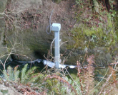






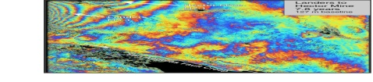
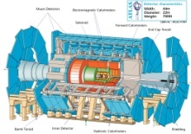
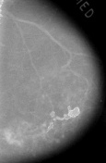



Information and Cyberinfrastructure
Raw Data → Data → Information → Knowledge → Wisdom → Decisions
Another
Grid
Another
Grid
SS
SS
SS
SS
SS
SS
fs
fs
Discovery
Cloud
Filter
Service
Portal
Filter
Cloud
fs
fs
SS
fs
fs
Filter
Cloud
Inter-Service Messages
Another
Service
fs
fs
SS
Filter
Cloud
fs
Filter
Service
fs
fs
fs
SS
fs
fs
fs
Filter
Service
fs
Discovery
Cloud
fs
fs
fs
fs
SS
Traditional Grid with exposed services
Filter
Cloud
fs
Filter
Service
fs
Filter
Cloud
Filter
Cloud
SS
fs
fs
Another
Grid
SS
SS
SS
SS
SS
SS
Sensor or Data
Interchange
Service
SS
SS
SS
SS
SS
SS
Compute
Cloud
Storage
Cloud
Database

Slide 11
Component Grids Integrated
ANABAS
Sensor display and control
  A sensor is a time-dependent stream of information with a geo-spatial location.
  A static electronic entity is a broken sensor with a broken GPS! i.e. a sensor architecture applies to everything
Filters for GPS and video analysis (Compute or Simulation Grids)
Earthquake forecasting
Collaboration Services
NetOps Situational Awareness Service

Slide 12
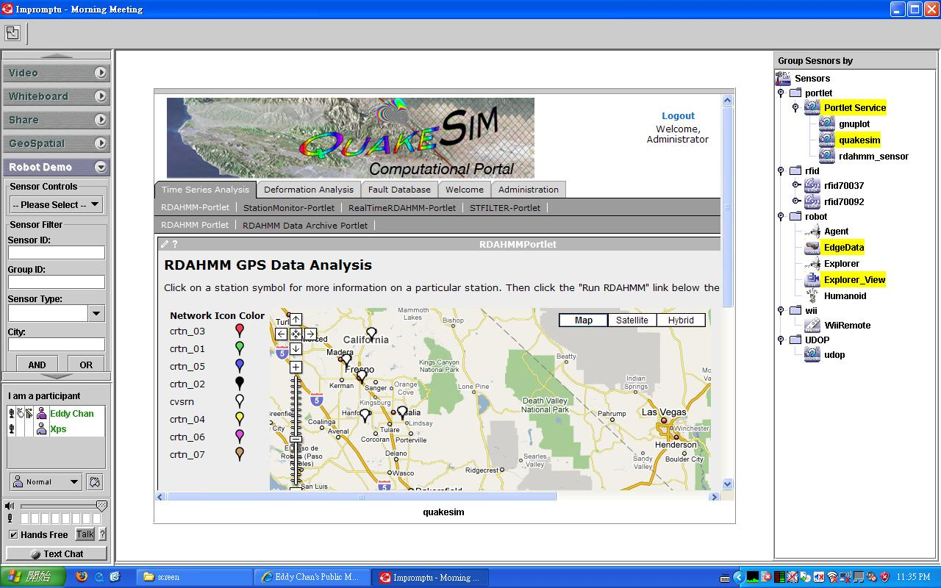
QuakeSim Grid of Grids with RDAHMM Filter (Compute) Grid

Slide 13
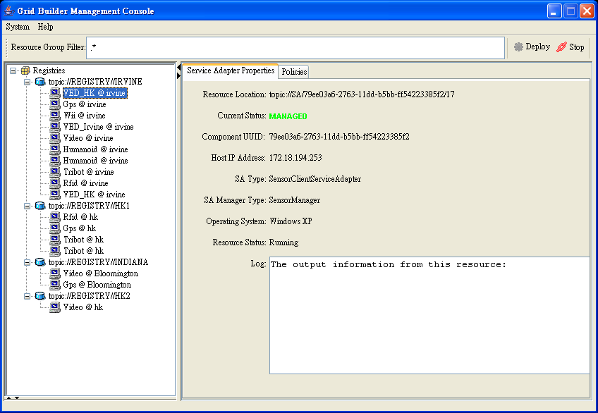
Grid Builder Service Management Interface

Slide 14
Multiple Sensors Scaling for NASA application
NB Server
RYO To ASCII Converter
Simple Filter
RYO Publisher 1
RYO Publisher 2
RYO Publisher n
Topic 2
Topic 1A
Topic n
Topic 1B
The results show that 1000 publishers (9000 GPS sensors) can be supported with no performance loss. This is an operating system limit that can be improved

Slide 15
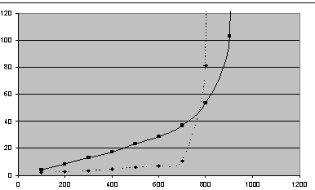
Average Video Delays
Scaling for video streams with one broker
Multiple
sessions
One session
Latency ms
30 frames/sec
# Receivers

Slide 16
Commercialization
ANABAS
Three-prong strategy:
Work with Ball and AFRL to get input for DoD application requirements for an integrable Grid situational awareness product.
Harden SBIR result prototype to seek In-Q-Tel type of funding to commericalize and customize the prototype for Home Land Security applications.
Commercial mobile solution applications for social networks with large number of sensors like the iPhone or Google phone.

Slide 17
Future Research
ANABAS
Trusted Sensing (at level of individual sensors)
Layered Sensor Grid (i.e. collections of sensors)
Grid of Grids

Slide 18
Analysis of DoD Net Centric Services in terms of Web and Grid services

Slide 19
The Grid and Web Service Institutional Hierarchy
4: Application or Community of Interest (CoI)
Specific Services such as “Map Services”, “Run BLAST” or “Simulate a Missile”
XBML
XTCE VOTABLE
CML
CellML
3: Generally Useful Services and Features
(OGSA and other GGF, W3C) Such as “Collaborate”, “Access a Database” or “Submit a Job”
OGSA GS-*
and some WS-*
GGF/W3C/….
XGSP (Collab)
2: System Services and Features
(WS-* from OASIS/W3C/Industry)
Handlers like WS-RM, Security, UDDI Registry
WS-* from
OASIS/W3C/
Industry
1: Container and Run Time (Hosting)
Environment (Apache Axis, .NET etc.)
Apache Axis
.NET etc.
Must set standards to get interoperability

Slide 20
The Ten areas covered by the 60 core WS-* Specifications
WS-* Specification Area | Examples
1: Core Service Model | XML, WSDL, SOAP
2: Service Internet | WS-Addressing, WS-MessageDelivery; Reliable Messaging WSRM; Efficient Messaging MOTM
3: Notification | WS-Notification, WS-Eventing (Publish-Subscribe)
4: Workflow and Transactions | BPEL, WS-Choreography, WS-Coordination
5: Security | WS-Security, WS-Trust, WS-Federation, SAML, WS-SecureConversation
6: Service Discovery | UDDI, WS-Discovery
7: System Metadata and State | WSRF, WS-MetadataExchange, WS-Context
8: Management | WSDM, WS-Management, WS-Transfer
9: Policy and Agreements | WS-Policy, WS-Agreement
10: Portals and User Interfaces | WSRP (Remote Portlets)

Slide 21
Activities in Global Grid Forum Working Groups
GGF Area | GS-* and OGSA Standards Activities
1: Architecture | High Level Resource/Service Naming (level 2 of slide 6), Integrated Grid Architecture
2: Applications | Software Interfaces to Grid, Grid Remote Procedure Call, Checkpointing and Recovery, Interoperability to Job Submittal services, Information Retrieval,
3: Compute | Job Submission, Basic Execution Services, Service Level Agreements for Resource use and reservation, Distributed Scheduling
4: Data | Database and File Grid access, Grid FTP, Storage Management, Data replication, Binary data specification and interface, High-level publish/subscribe, Transaction management
5: Infrastructure | Network measurements, Role of IPv6 and high performance networking, Data transport
6: Management | Resource/Service configuration, deployment and lifetime, Usage records and access, Grid economy model
7: Security | Authorization, P2P and Firewall Issues, Trusted Computing

Slide 22
Net-Centric Core Enterprise Services
Core Enterprise Services | Service Functionality
NCES1: Enterprise Services Management (ESM) | including life-cycle management
NCES2: Information Assurance (IA)/Security | Supports confidentiality, integrity and availability. Implies reliability and autonomic features
NCES3: Messaging | Synchronous or asynchronous cases
NCES4: Discovery | Searching data and services
NCES5: Mediation | Includes translation, aggregation, integration, correlation, fusion, brokering publication, and other transformations for services and data. Possibly agents
NCES6: Collaboration | Provision and control of sharing with emphasis on synchronous real-time services
NCES7: User Assistance | Includes automated and manual methods of optimizing the user GiG experience (user agent)
NCES8: Storage | Retention, organization and disposition of all forms of data
NCES9: Application | Provisioning, operations and maintenance of applications.

Slide 23
The Core Features/Service Areas I
Service or Feature | WS-* | GS-* | NCES (DoD) | Comments
A: Broad Principles
FS1: Use SOA: Service Oriented Arch. | WS1 |  |  | Core Service Architecture, Build Grids on Web Services. Industry best practice
FS2: Grid of Grids |  |  |  | Distinctive Strategy for legacy subsystems and modular architecture
B: Core Services
FS3: Service Internet, Messaging | WS2 |  | NCES3 | Streams/Sensors.
FS4: Notification | WS3 |  | NCES3 | JMS, MQSeries.
FS5 Workflow | WS4 |  | NCES5 | Grid Programming
FS6 : Security | WS5 | GS7 | NCES2 | Grid-Shib, Permis Liberty Alliance ...
FS7: Discovery | WS6 |  | NCES4 | UDDI
FS8: System Metadata & State | WS7 |  |  | Globus MDS Semantic Grid, WS-Context
FS9: Management | WS8 | GS6 | NCES1 | CIM
FS10: Policy | WS9 |  | ECS

Slide 24
The Core Feature/Service Areas II
Service or Feature | WS-* | GS-* | NCES | Comments
B: Core Services (Continued)
FS11: Portals and User assistance | WS10 |  | NCES7 | Portlets JSR168, NCES Capability Interfaces
FS12: Computing |  | GS3 |  | Clouds!
FS13: Data and Storage |  | GS4 | NCES8 | NCOW Data Strategy Clouds!
FS14: Information |  | GS4 |  | JBI for DoD, WFS for OGC
FS15: Applications and User Services |  | GS2 | NCES9 | Standalone Services Proxies for jobs
FS16: Resources and Infrastructure |  | GS5 |  | Ad-hoc networks
FS17: Collaboration and Virtual Organizations |  | GS7 | NCES6 | XGSP, Shared Web Service ports
FS18: Scheduling and matching of Services and Resources |  | GS3 |  | Current work only addresses scheduling “batch jobs”. Need networks and services

