Slide 1
High Performance Data Analytics and a Java Grande Run Time
Rice University
April 18 2014
Geoffrey Fox
gcf@indiana.edu
http://www.infomall.org
School of Informatics and Computing
Digital Science Center
Indiana University Bloomington

Slide 2
Abstract
There is perhaps a broad consensus as to important issues in practical parallel computing as applied to large scale simulations; this is reflected in supercomputer architectures, algorithms, libraries, languages, compilers and best practice for application development.
However the same is not so true for data intensive even though commercially clouds devote many more resources to data analytics than supercomputers devote to simulations.
Here we use a sample of over 50 big data applications to identify characteristics of data intensive applications and to deduce needed runtime and architectures.
We propose a big data version of the famous Berkeley dwarfs and NAS parallel benchmarks.
Our analysis builds on the Apache software stack that is well used in modern cloud computing.
We give some examples including clustering, deep-learning and multi-dimensional scaling.
One suggestion from this work is value of a high performance Java (Grande) runtime that supports simulations and big data

Slide 3
NIST Big Data Use Cases

Slide 4
NIST Requirements and Use Case Subgroup
Part of NIST Big Data Public Working Group (NBD-PWG) June-September 2013 http://bigdatawg.nist.gov/
Leaders of activity
  Wo Chang, NIST
  Robert Marcus, ET-Strategies
  Chaitanya Baru, UC San Diego
Also Reference Architecture, Taxonomy, Secuty&Privacx, Roadmap groups
The focus is to form a community of interest from industry, academia, and government, with the goal of developing a consensus list of Big Data requirements across all stakeholders. This includes gathering and understanding various use cases from diversified application domains.
Tasks
Gather use case input from all stakeholders
Derive Big Data requirements from each use case.
Analyze/prioritize a list of challenging general requirements that may delay or prevent adoption of Big Data deployment
Develop a set of general patterns capturing the “essence” of use cases (doing)
Work with Reference Architecture to validate requirements and explicitly implement some patterns based on use cases

Slide 5
Big Data Definition
More consensus on Data Science definition than that of Big Data
Big Data refers to digital data volume, velocity and/or variety that:
Enable novel approaches to frontier questions previously inaccessible or impractical using current or conventional methods; and/or
Exceed the storage capacity or analysis capability of current or conventional methods and systems; and
Differentiates by storing and analyzing population data and not sample sizes.
Needs management requiring scalability across coupled horizontal resources
Everybody says their data is big (!) Perhaps how it is used is most important

Slide 6
What is Data Science?
I was impressed by number of NIST working group members who were self declared data scientists
I was also impressed by universal adoption by participants of Apache technologies – see later
McKinsey says there are lots of jobs (1.65M by 2018 in USA) but that’s not enough! Is this a field – what is it and what is its core?
  The emergence of the 4th or data driven paradigm of science illustrates significance - http://research.microsoft.com/en-us/collaboration/fourthparadigm/
  Discovery is guided by data rather than by a model
  The End of (traditional) science http://www.wired.com/wired/issue/16-07 is famous here
Another example is recommender systems in Netflix, e-commerce etc. where pure data (user ratings of movies or products) allows an empirical prediction of what users like

Slide 7
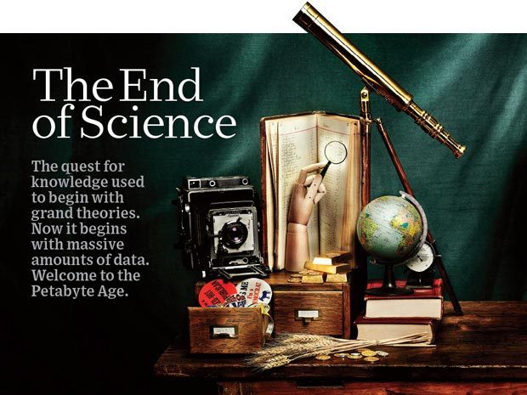
http://www.wired.com/wired/issue/16-07 September 2008

Slide 8
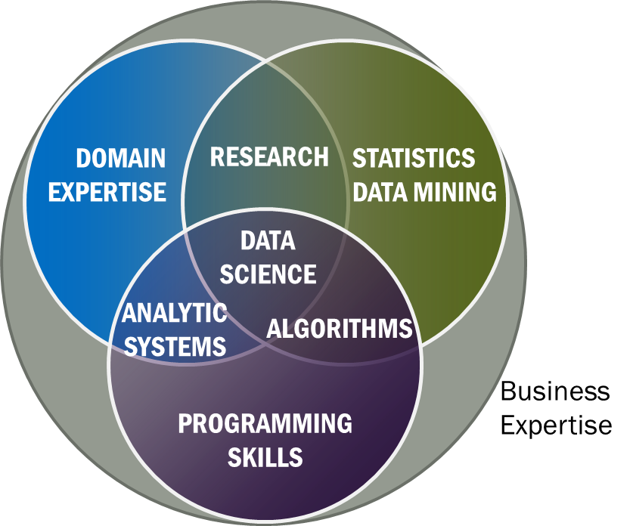
Data Science Definition
Data Science is the extraction of actionable knowledge directly from data through a process of discovery, hypothesis, and analytical hypothesis analysis.
A Data Scientist is a practitioner who has sufficient knowledge of the overlapping regimes of expertise in business needs, domain knowledge, analytical skills and programming expertise to manage the end-to-end scientific method process through each stage in the big data lifecycle.
Notes:
Big Data refers to digital data volume, velocity and/or variety whose management requires scalability across coupled horizontal resources
Data Science is the extraction of actionable knowledge directly from data through a process of discovery, hypothesis, and analytical hypothesis analysis.
A Data Scientist is a practitioner who has sufficient knowledge of the overlapping regimes of expertise in business needs, domain knowledge, analytical skills and programming expertise to manage the end-to-end scientific method process through each stage in the big data lifecycle.

Slide 9

Use Case Template
26 fields completed for 51 areas
Government Operation: 4
Commercial: 8
Defense: 3
Healthcare and Life Sciences: 10
Deep Learning and Social Media: 6
The Ecosystem for Research: 4
Astronomy and Physics: 5
Earth, Environmental and Polar Science: 10
Energy: 1

Slide 10
51 Detailed Use Cases: Contributed July-September 2013
Covers goals, data features such as 3 V’s, software, hardware
26 Features for each use case
Biased to science
http://bigdatawg.nist.gov/usecases.php
https://bigdatacoursespring2014.appspot.com/course (Section 5)
Government Operation(4): National Archives and Records Administration, Census Bureau
Commercial(8): Finance in Cloud, Cloud Backup, Mendeley (Citations), Netflix, Web Search, Digital Materials, Cargo shipping (as in UPS)
Defense(3): Sensors, Image surveillance, Situation Assessment
Healthcare and Life Sciences(10): Medical records, Graph and Probabilistic analysis, Pathology, Bioimaging, Genomics, Epidemiology, People Activity models, Biodiversity
Deep Learning and Social Media(6): Driving Car, Geolocate images/cameras, Twitter, Crowd Sourcing, Network Science, NIST benchmark datasets
The Ecosystem for Research(4): Metadata, Collaboration, Language Translation, Light source experiments
Astronomy and Physics(5): Sky Surveys including comparison to simulation, Large Hadron Collider at CERN, Belle Accelerator II in Japan
Earth, Environmental and Polar Science(10): Radar Scattering in Atmosphere, Earthquake, Ocean, Earth Observation, Ice sheet Radar scattering, Earth radar mapping, Climate simulation datasets, Atmospheric turbulence identification, Subsurface Biogeochemistry (microbes to watersheds), AmeriFlux and FLUXNET gas sensors
Energy(1): Smart grid

Slide 11

Part of Property Summary Table

Slide 12
3: Census Bureau Statistical Survey Response Improvement (Adaptive Design)
Government
Application: Survey costs are increasing as survey response declines. The goal of this work is to use advanced “recommendation system techniques” that are open and scientifically objective, using data mashed up from several sources and historical survey para-data (administrative data about the survey) to drive operational processes in an effort to increase quality and reduce the cost of field surveys.
Current Approach: About a petabyte of data coming from surveys and other government administrative sources. Data can be streamed with approximately 150 million records transmitted as field data streamed continuously, during the decennial census. All data must be both confidential and secure. All processes must be auditable for security and confidentiality as required by various legal statutes. Data quality should be high and statistically checked for accuracy and reliability throughout the collection process. Use Hadoop, Spark, Hive, R, SAS, Mahout, Allegrograph, MySQL, Oracle, Storm, BigMemory, Cassandra, Pig software.
Futures: Analytics needs to be developed which give statistical estimations that provide more detail, on a more near real time basis for less cost. The reliability of estimated statistics from such “mashed up” sources still must be evaluated.

Slide 13
26: Large-scale Deep Learning
Deep Learning
Social Networking
Application: Large models (e.g., neural networks with more neurons and connections) combined with large datasets are increasingly the top performers in benchmark tasks for vision, speech, and Natural Language Processing. One needs to train a deep neural network from a large (>>1TB) corpus of data (typically imagery, video, audio, or text). Such training procedures often require customization of the neural network architecture, learning criteria, and dataset pre-processing. In addition to the computational expense demanded by the learning algorithms, the need for rapid prototyping and ease of development is extremely high.
Current Approach: The largest applications so far are to image recognition and scientific studies of unsupervised learning with 10 million images and up to 11 billion parameters on a 64 GPU HPC Infiniband cluster. Both supervised (using existing classified images) and unsupervised applications
Futures: Large datasets of 100TB or more may be necessary in order to exploit the representational power of the larger models. Training a self-driving car could take 100 million images at megapixel resolution. Deep Learning shares many characteristics with the broader field of machine learning. The paramount requirements are high computational throughput for mostly dense linear algebra operations, and extremely high productivity for researcher exploration. One needs integration of high performance libraries with high level (python) prototyping environments
Classified OUT
IN

Slide 14
35: Light source beamlines
Research Ecosystem
Application: Samples are exposed to X-rays from light sources in a variety of configurations depending on the experiment. Detectors (essentially high-speed digital cameras) collect the data. The data are then analyzed to reconstruct a view of the sample or process being studied.
Current Approach: A variety of commercial and open source software is used for data analysis – examples including Octopus for Tomographic Reconstruction, Avizo (http://vsg3d.com) and FIJI (a distribution of ImageJ) for Visualization and Analysis. Data transfer is accomplished using physical transport of portable media (severely limits performance) or using high-performance GridFTP, managed by Globus Online or workflow systems such as SPADE.
Futures: Camera resolution is continually increasing. Data transfer to large-scale computing facilities is becoming necessary because of the computational power required to conduct the analysis on time scales useful to the experiment. Large number of beamlines (e.g. 39 at LBNL ALS) means that total data load is likely to increase significantly and require a generalized infrastructure for analyzing gigabytes per second of data from many beamline detectors at multiple facilities.

Slide 15
10 Suggested Generic Use Cases
Multiple users performing interactive queries and updates on a database with basic availability and eventual consistency (BASE)
Perform real time analytics on data source streams and notify users when specified events occur
Move data from external data sources into a highly horizontally scalable data store, transform it using highly horizontally scalable processing (e.g. Map-Reduce), and return it to the horizontally scalable data store (ELT)
Perform batch analytics on the data in a highly horizontally scalable data store using highly horizontally scalable processing (e.g MapReduce) with a user-friendly interface (e.g. SQL like)
Perform interactive analytics on data in analytics-optimized database
Visualize data extracted from horizontally scalable Big Data store
Move data from a highly horizontally scalable data store into a traditional Enterprise Data Warehouse
Extract, process, and move data from data stores to archives
Combine data from Cloud databases and on premise data stores for analytics, data mining, and/or machine learning
Orchestrate multiple sequential and parallel data transformations and/or analytic processing using a workflow manager

Slide 16
10 Security & Privacy Use Cases
Consumer Digital Media Usage
Nielsen Homescan
Web Traffic Analytics
Health Information Exchange
Personal Genetic Privacy
Pharma Clinic Trial Data Sharing
Cyber-security
Aviation Industry
Military - Unmanned Vehicle sensor data
Education - “Common Core” Student Performance Reporting
Need to integrate 10 “generic” and 10 “security & privacy” with 51 “full use cases”

Slide 17
Big Data Patterns – the Ogres

Slide 18
Would like to capture “essence of these use cases”
“small” kernels, mini-apps
Or Classify applications into patterns
Do it from HPC background not database view point
e.g. focus on cases with detailed analytics
Section 5 of my class https://bigdatacoursespring2014.appspot.com/preview classifies 51 use cases with ogre facets

Slide 19
What are “mini-Applications”
Use for benchmarks of computers and software (is my parallel compiler any good?)
In parallel computing, this is well established
  Linpack for measuring performance to rank machines in Top500 (changing?)
  NAS Parallel Benchmarks (originally a pencil and paper specification to allow optimal implementations; then MPI library)
  Other specialized Benchmark sets keep changing and used to guide procurements
    Last 2 NSF hardware solicitations had NO preset benchmarks – perhaps as no agreement on key applications for clouds and data intensive applications
  Berkeley dwarfs capture different structures that any approach to parallel computing must address
  Templates used to capture parallel computing patterns
Also database benchmarks like TPC

Slide 20
HPC Benchmark Classics
Linpack or HPL: Parallel LU factorization for solution of linear equations
NPB version 1: Mainly classic HPC solver kernels
  MG: Multigrid
  CG: Conjugate Gradient
  FT: Fast Fourier Transform
  IS: Integer sort
  EP: Embarrassingly Parallel
  BT: Block Tridiagonal
  SP: Scalar Pentadiagonal
  LU: Lower-Upper symmetric Gauss Seidel

Slide 21
13 Berkeley Dwarfs
Dense Linear Algebra
Sparse Linear Algebra
Spectral Methods
N-Body Methods
Structured Grids
Unstructured Grids
MapReduce
Combinational Logic
Graph Traversal
Dynamic Programming
Backtrack and Branch-and-Bound
Graphical Models
Finite State Machines
First 6 of these correspond to Colella’s original.
Monte Carlo dropped
N-body methods are a subset of Particle in Colella
Note a little inconsistent in that MapReduce is a programming model and spectral method is a numerical method
Need multiple facets!

Slide 22
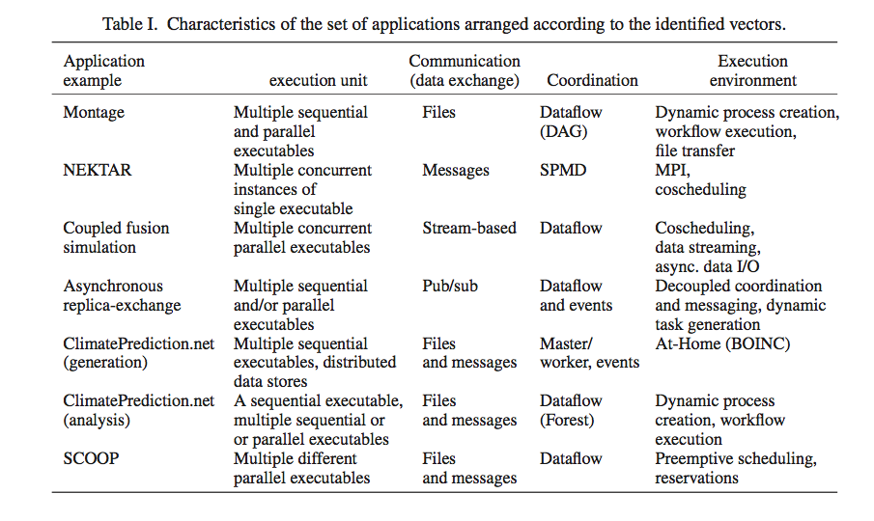
Distributed Computing MetaPatterns I
Jha, Cole, Katz, Parashar, Rana, Weissman

Slide 23
Core Analytics Facet of Ogres (microPattern)
Search/Query
Local Machine Learning – pleasingly parallel
Summarizing statistics
Recommender Systems (Collaborative Filtering)
Outlier Detection (iORCA)
Clustering (many methods),
LDA (Latent Dirichlet Allocation) or variants like PLSI (Probabilistic Latent Semantic Indexing),
SVM and Linear Classifiers (Bayes, Random Forests),
PageRank, (Find leading eigenvector of sparse matrix)
SVD (Singular Value Decomposition),
Learning Neural Networks (Deep Learning),
MDS (Multidimensional Scaling),
Graph Structure Algorithms (seen in search of RDF Triple stores),
Network Dynamics - Graph simulation Algorithms (epidemiology)
Global
Optimization
Matrix
Algebra

Slide 24
Problem Architecture Facet of Ogres (Meta or MacroPattern)
Pleasingly Parallel – as in Blast, Protein docking, some (bio-)imagery
Local Analytics or Machine Learning – ML or filtering pleasingly parallel as in bio-imagery, radar images (really just pleasingly parallel but sophisticated local analytics)
Global Analytics or Machine Learning seen in LDA, Clustering etc. with parallel ML over nodes of system
SPMD (Single Program Multiple Data)
Bulk Synchronous Processing: well defined compute-communication phases
Fusion: Knowledge discovery often involves fusion of multiple methods.
Workflow (often used in fusion)
Notes:
Big dwarfs are Ogres
Implement Ogres in ABDS+

Slide 25
18: Computational Bioimaging
Healthcare
Life Sciences
Application: Data delivered from bioimaging is increasingly automated, higher resolution, and multi-modal. This has created a data analysis bottleneck that, if resolved, can advance the biosciences discovery through Big Data techniques.
Current Approach: The current piecemeal analysis approach does not scale to situation where a single scan on emerging machines is 32TB and medical diagnostic imaging is annually around 70 PB even excluding cardiology. One needs a web-based one-stop-shop for high performance, high throughput image processing for producers and consumers of models built on bio-imaging data.
Futures: Goal is to solve that bottleneck with extreme scale computing with community-focused science gateways to support the application of massive data analysis toward massive imaging data sets. Workflow components include data acquisition, storage, enhancement, minimizing noise, segmentation of regions of interest, crowd-based selection and extraction of features, and object classification, and organization, and search. Use ImageJ, OMERO, VolRover, advanced segmentation and feature detection software.
Largely Local Machine Learning

Slide 26
27: Organizing large-scale, unstructured collections of consumer photos I
Deep Learning
Social Networking
Application: Produce 3D reconstructions of scenes using collections of millions to billions of consumer images, where neither the scene structure nor the camera positions are known a priori. Use resulting 3d models to allow efficient browsing of large-scale photo collections by geographic position. Geolocate new images by matching to 3d models. Perform object recognition on each image. 3d reconstruction posed as a robust non-linear least squares optimization problem where observed relations between images are constraints and unknowns are 6-d camera pose of each image and 3-d position of each point in the scene.
Current Approach: Hadoop cluster with 480 cores processing data of initial applications. Note over 500 billion images on Facebook and over 5 billion on Flickr with over 500 million images added to social media sites each day.
Global Machine Learning after Initial Local steps

Slide 27
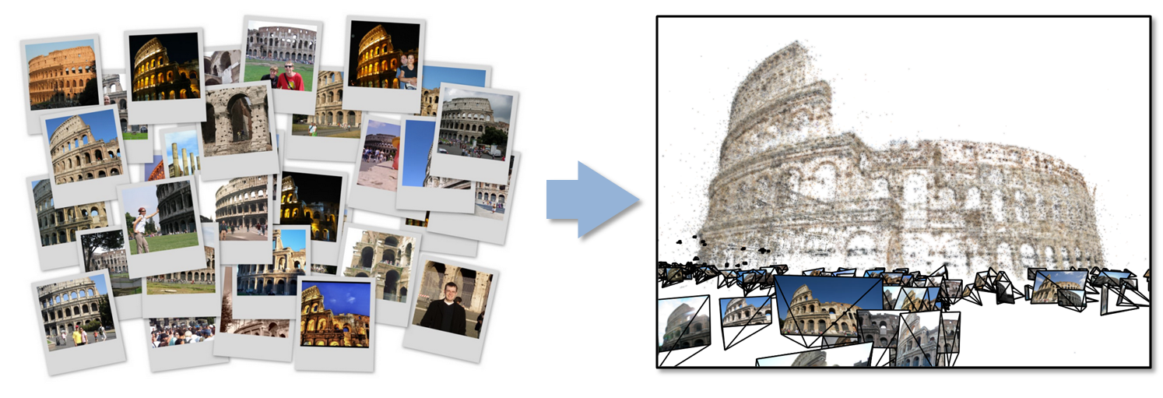
27: Organizing large-scale, unstructured collections of consumer photos II
Deep Learning
Social Networking
Futures: Need many analytics including feature extraction, feature matching, and large-scale probabilistic inference, which appear in many or most computer vision and image processing problems, including recognition, stereo resolution, and image denoising. Need to visualize large-scale 3-d reconstructions, and navigate large-scale collections of images that have been aligned to maps.
Global Machine Learning after Initial Local steps

Slide 28
This Facet of Ogres has Features
These core analytics/kernels can be classified by features like
(a) Flops per byte;
(b) Communication Interconnect requirements;
(c) Is application (graph) constant or dynamic
(d) Most applications consist of a set of interconnected entities; is this regular as a set of pixels or is it a complicated irregular graph
(d) Is communication BSP or Asynchronous; in latter case shared memory may be attractive
(e) Are algorithms Iterative or not?
(f) Are data points in metric or non-metric spaces

Slide 29
Application Class Facet of Ogres
(a) Search and query
(b) Maximum Likelihood,
(c) χ² minimizations,
(d) Expectation Maximization (often Steepest descent)
(e) Global Optimization (Variational Bayes)
(f) Agents, as in epidemiology (swarm approaches)
(g) GIS (Geographical Information Systems).
Not as essential

Slide 30
Data Source Facet of Ogres
(i) SQL,
(ii) NOSQL based,
(iii) Other Enterprise data systems (10 examples from Bob Marcus)
(iv) Set of Files (as managed in iRODS),
(v) Internet of Things,
(vi) Streaming and
(vii) HPC simulations.
Before data gets to compute system, there is often an initial data gathering phase which is characterized by a block size and timing. Block size varies from month (Remote Sensing, Seismic) to day (genomic) to seconds or lower (Real time control, streaming)
There are storage/compute system styles: Shared, Dedicated, Permanent, Transient
Other characteristics are need for permanent auxiliary/comparison datasets and these could be interdisciplinary implying nontrivial data movement/replication
Notes:
Big dwarfs are Ogres
Implement Ogres in ABDS+

Slide 31
Lessons / Insights
Ogres classify Big Data applications by multiple facets – each with several exemplars and features
  Guide to breadth and depth of Big Data
  Does your architecture/software support all the ogres?
Add database exemplars
In parallel computing, the simple analytic kernels dominate mindshare even though agreed limited

Slide 32
HPC-ABDS
Integrating High Performance Computing with Apache Big Data Stack

Slide 33
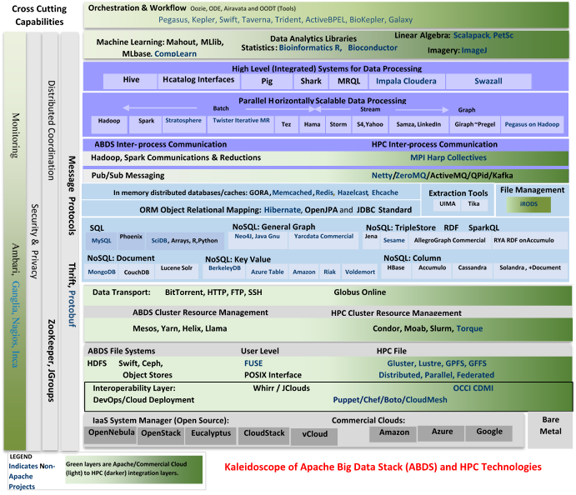

Slide 34
HPC-ABDS
~120 Capabilities
>40 Apache
Green layers have strong HPC Integration opportunities
Goal
Functionality of ABDS
Performance of HPC

Slide 35
Broad Layers in HPC-ABDS
Workflow-Orchestration
Application and Analytics
High level Programming
Basic Programming model and runtime
  SPMD, Streaming, MapReduce, MPI
Inter process communication
  Collectives, point to point, publish-subscribe
In memory databases/caches
Object-relational mapping
SQL and NoSQL, File management
Data Transport
Cluster Resource Management (Yarn, Slurm, SGE)
File systems(HDFS, Lustre …)
DevOps (Puppet, Chef …)
IaaS Management from HPC to hypervisors (OpenStack)
Cross Cutting
  Message Protocols
  Distributed Coordination
  Security & Privacy
  Monitoring

Slide 36
Getting High Performance on Data Analytics (e.g. Mahout, R …)
On the systems side, we have two principles
  The Apache Big Data Stack with ~120 projects has important broad functionality with a vital large support organization
  HPC including MPI has striking success in delivering high performance with however a fragile sustainability model
There are key systems abstractions which are levels in HPC-ABDS software stack where Apache approach needs careful integration with HPC
  Resource management
  Storage
  Programming model -- horizontal scaling parallelism
  Collective and Point to Point communication
  Support of iteration
  Data interface (not just key-value)
In application areas, we define application abstractions to support
  Graphs/network
  Geospatial
  Genes
  Images etc.

Slide 37
Iterative MapReduce

Slide 38
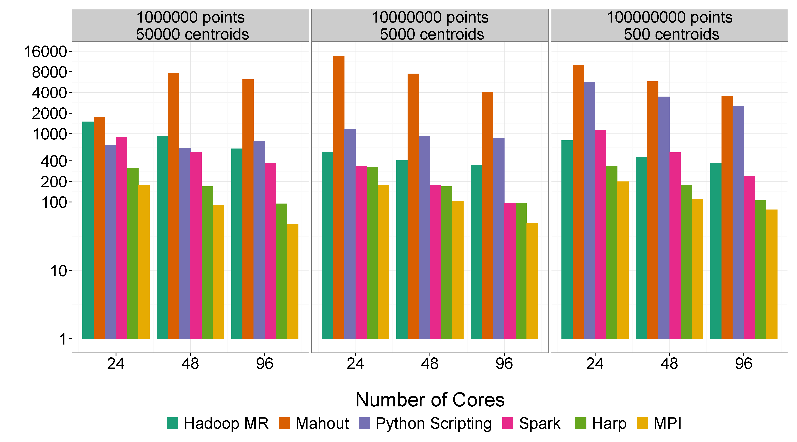
Mahout and Hadoop MR – Slow due to MapReduce
Python slow as Scripting
Spark Iterative MapReduce, non optimal communication
Harp Hadoop plug in with ~MPI collectives
MPI fastest as C not Java
Increasing Communication
Identical Computation

Slide 39
4 Forms of MapReduce
(a) Map Only
(b) Classic MapReduce
(c) Iterative MapReduce
(d) Loosely Synchronous
Input
Input
Iterations
Input
map
map
map
P_{ij}
reduce
reduce
Output
BLAST Analysis
Parametric sweep
Pleasingly Parallel
High Energy Physics (HEP) Histograms
Distributed search
Expectation maximization Clustering e.g. Kmeans
Linear Algebra, Page Rank
Classic MPI
PDE Solvers and particle dynamics
Domain of MapReduce and Iterative Extensions
Science Clouds
MPI
Giraph
MPI is Map followed by Point to Point or Collective Communication
– as in style c) plus d)

Slide 40
Map Collective Model (Judy Qiu)
Generalizes Iterative MapReduce
Combine MPI and MapReduce ideas
Implement collectives optimally on Infiniband, Azure, Amazon ……
Iterate
Input
map
Initial work on Twister (2008, 2010-2013) and Twister4Azure (2011-13) being moved to Harp with a explicit communication layer
Initial Collective Step
Generalized Reduce
Final Collective Step

Slide 41
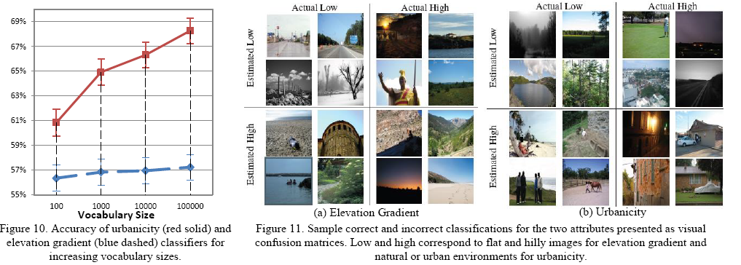
Pipelined Broadcasting with Topology-Awareness
Vocabulary from clustering 7 million features into a million clusters
Tested on IU Polar Grid with 1 Gbps Ethernet connection

Slide 42
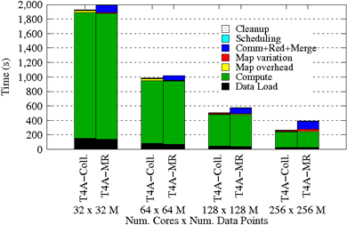
Using Optimal “Collective” Operations
Twister4Azure Iterative MapReduce with enhanced collectives
  Map-AllReduce primitive and MapReduce-MergeBroadcast.
Strong Scaling on Kmeans for up to 256 cores on Azure

Slide 43
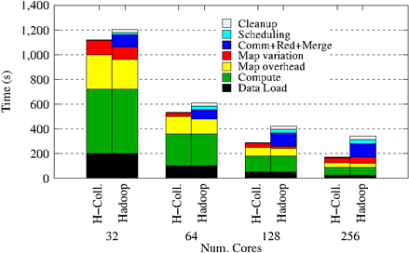
Collectives improve traditional MapReduce
This is Kmeans running within basic Hadoop but with optimal AllReduce collective operations
Running on Infiniband Linux Cluster

Slide 44
Kmeans and (Iterative) MapReduce
Shaded areas are computing only where Hadoop on HPC cluster fastest
Areas above shading are overheads where T4A smallest and T4A with AllReduce collective has lowest overhead
Note even on Azure Java (Orange) faster than T4A C# for compute

Slide 45
Implementing HPC-ABDS

Slide 46
Major Analytics Architectures in Use Cases
Pleasingly Parallel including local machine learning as in parallel over images and apply image processing to each image -- Hadoop
Search including collaborative filtering and motif finding implemented using classic MapReduce (Hadoop) or non iterative Giraph
Iterative MapReduce using Collective Communication (clustering) – Hadoop with Harp, Spark …..
Iterative Giraph (MapReduce) with point to point communication (most graph algorithms such as maximum clique, connected component, finding diameter, community detection)
  Vary in difficulty of finding partitioning (classic parallel load balancing)
Shared memory thread based (event driven) graph algorithms (shortest path, Betweenness centrality)

Slide 47

HPC-ABDS
Hourglass
HPC ABDS
System (Middleware)
120 Software Projects
System Abstractions/standards
Data format
Storage
HPC Yarn for Resource management
Horizontally scalable parallel programming model
Collective and Point to Point communication
Support of iteration (in memory databases)
Application Abstractions/standards
Graphs, Networks, Images, Geospatial ….
High performance
Applications
SPIDAL (Scalable Parallel Interoperable Data Analytics Library) or High performance Mahout, R, Matlab …..

Slide 48
Integrating Yarn with HPC

Slide 49
Harp Design
Parallelism Model
Architecture
MapReduce Model
Map-Collective Model
MapReduce Applications
Map-Collective Applications
M
M
M
M
Application
M
M
M
M
MapReduce V2
Harp
Shuffle
Framework
R
R
Collective Communication
Resource Manager
YARN

Slide 50
Features of Harp Hadoop Plug in
Hadoop Plugin (on Hadoop 1.2.1 and Hadoop 2.2.0)
Hierarchical data abstraction on arrays, key-values and graphs for easy programming expressiveness.
Collective communication model to support various communication operations on the data abstractions.
Caching with buffer management for memory allocation required from computation and communication
BSP style parallelism
Fault tolerance with check-pointing

Slide 51
Performance on Madrid Cluster (8 nodes)
Increasing
Communication
Identical Computation
Note compute same in each case as product of centers times points identical

Slide 52
3 Classes of Parallel Datamining Problems
The classic MapReduce problems
The Search in Information Retrieval
k nearest neighbor (Collaborative Filtering)
And optimize giant objective function by nifty Steepest Descent with iteration and expectation maximization
k means Clustering (often for classification)
Deterministic Annealing (DA) Clustering for metric spaces
DA Clustering for non metric spaces
Multi dimensional scaling for non metric spaces (with or without DA)
Generative Topographic Mapping with or without DA (metric space approach to dimension reduction)
Gaussian mixtures (with or without DA)
Topic/Latent factor determination using Latent Dirichlet Allocation by variational Bayes or PLSI (Probabilistic Latent Semantic Indexing)
Deep Learning by Stochastic Gradient Descent

Slide 53
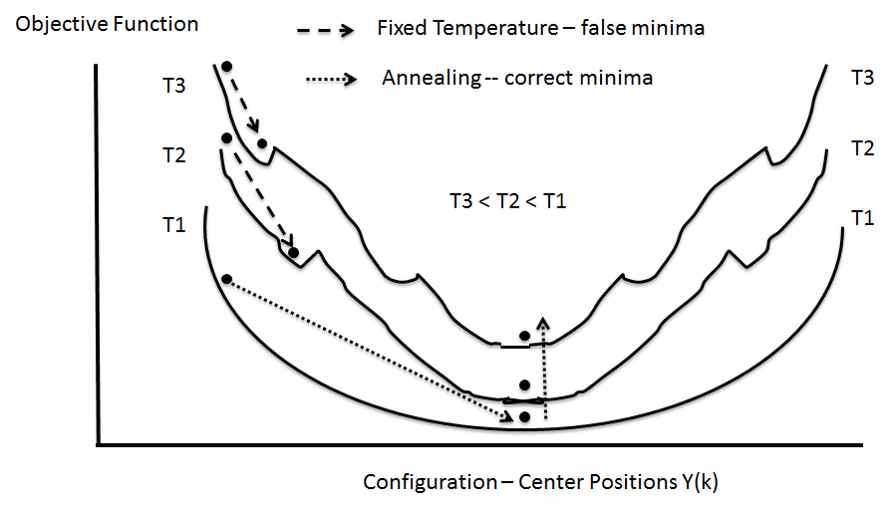
(Deterministic) Annealing
Find minimum at high temperature when trivial
Small change avoiding local minima as lower temperature
Typically gets better answers than standard libraries- R and Mahout
And can be parallelized and put on GPU’s etc.

Slide 54
Features of these parallel problems
Parallelism over items (documents, points, gene sequences) and/or parameters to be determined (clusters, network weights)
Nothing like sparseness as seen simulation problems
  Deep learning is local blocks but each block dominated by full matrix algorithms
Clustering sees dynamic locality/sparseness as good algorithms only look at points near a cluster center
  This needs dynamic load balancing familiar from geometrically heterogeneous simulation problems
  Such algorithms not studied much
  Graph algorithms need static load balancing

Slide 55
Features of these (blue/green) problems
(Non-metric) problems use O(N²) δ(i, j) the distance between points i and j for N points. This implies longer compute times and lots of storage (distributed over nodes)
  Often no sparsity here
Need to calculate gradients, new parameter values
  Matrix multiplication
  Broadcasts and (all)reductions
Some methods also look at second derivative matrix and need to solve linear equations and/or find eigenvectors
  I always use conjugate gradient to convert O(N³) to a # iterations O(N²)
Stochastic Gradient Descent not so easy to parallelize as only uses a few points at a time
  Deep learning parallel over pixels of images; not images

Slide 56
DA-PWC EM Steps (E is red, M Black) k runs over clusters; i,j points; <M_{i}(k)> is probability that point I in cluster k
A(k) = - 0.5 ∑_{i=1}^{N} ∑_{j=1}^{N} δ(i, j) <M_{i}(k)> <M_{j}(k)> / <C(k)>²
B_{i}(k) = ∑_{j=1}^{N} δ(i, j) <M_{j}(k)> / <C(k)>
ε_{i}(k) = (B_{i}(k) + A(k))
<M_{i}(k)> = exp( -ε_{i}(k)/T )/∑_{k=1}^{K} exp(-ε_{i}(k)/T)
C(k) = ∑_{i=1}^{N} <M_{i}(k)>
Iterate to converge variables at fixed T; iteratively decrease T from ∞
i points (distributed)
k clusters (replicated)
Parallelize by distributing points across processes
Steps 1 global sum (reduction)
Step 1, 2, 5 local sum if <M_{i}(k)> broadcast

Slide 57
Illustrations of Results and Performance

Slide 58
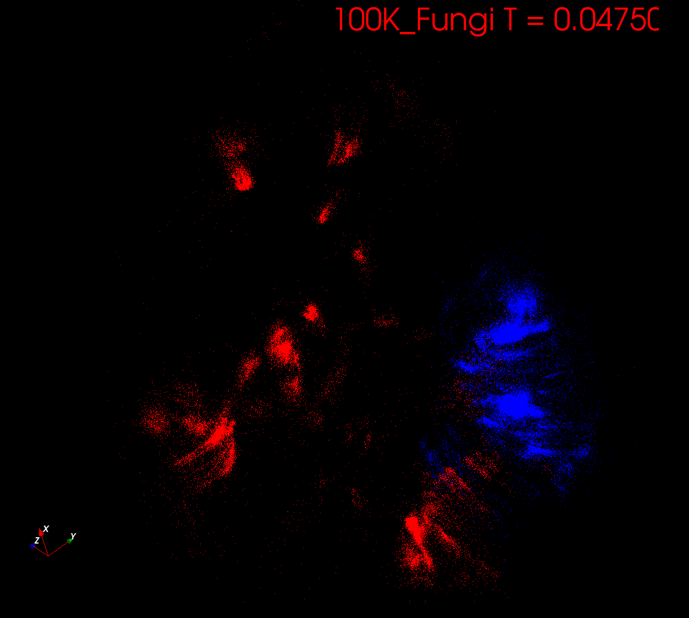
Start at T= “∞” with 1 Cluster
Decrease T, Clusters emerge at instabilities

Slide 59
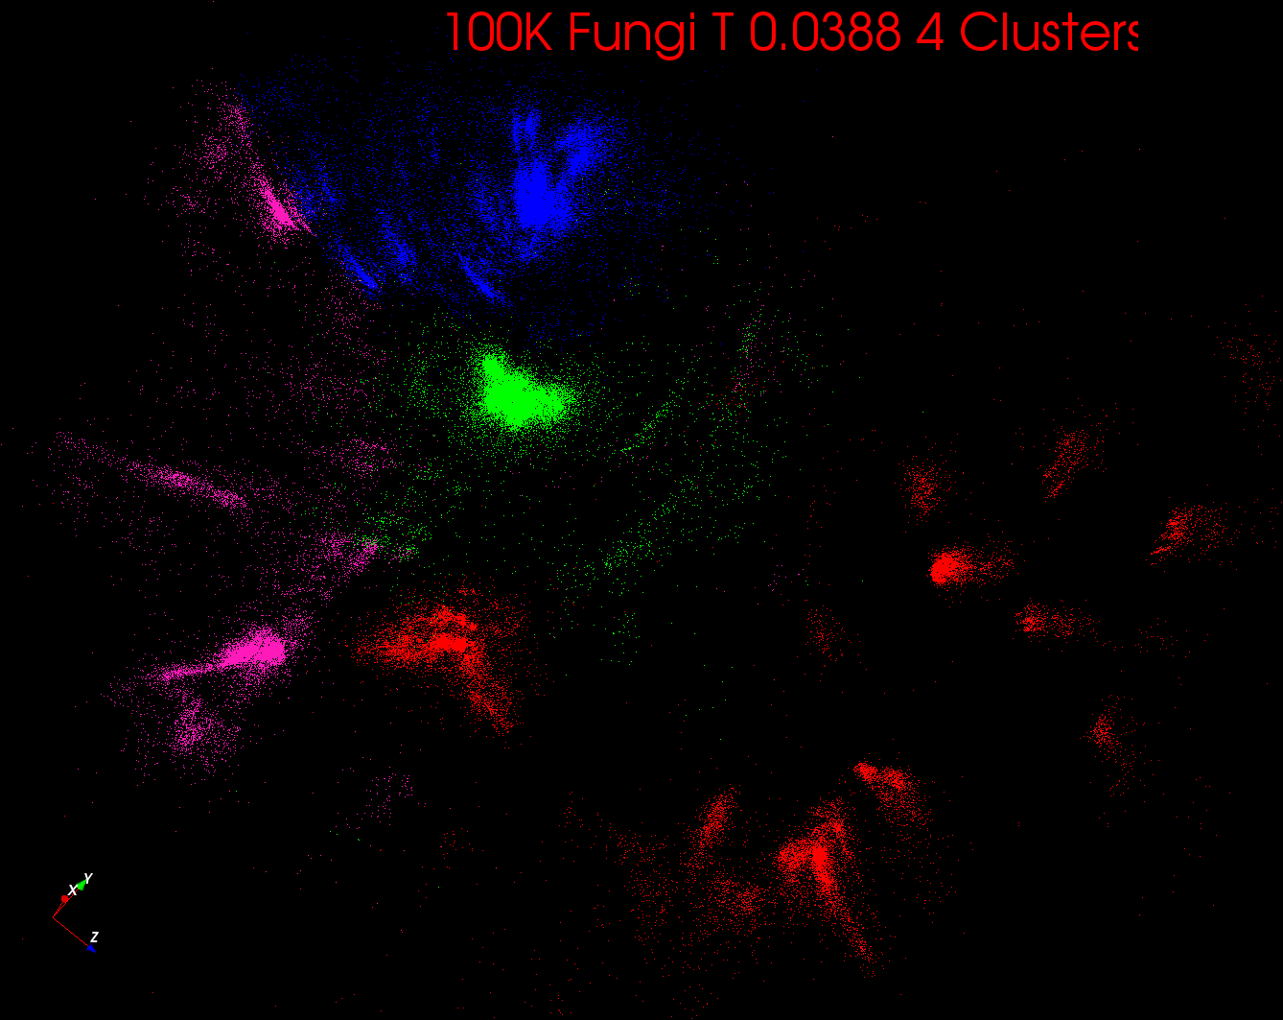

Slide 60
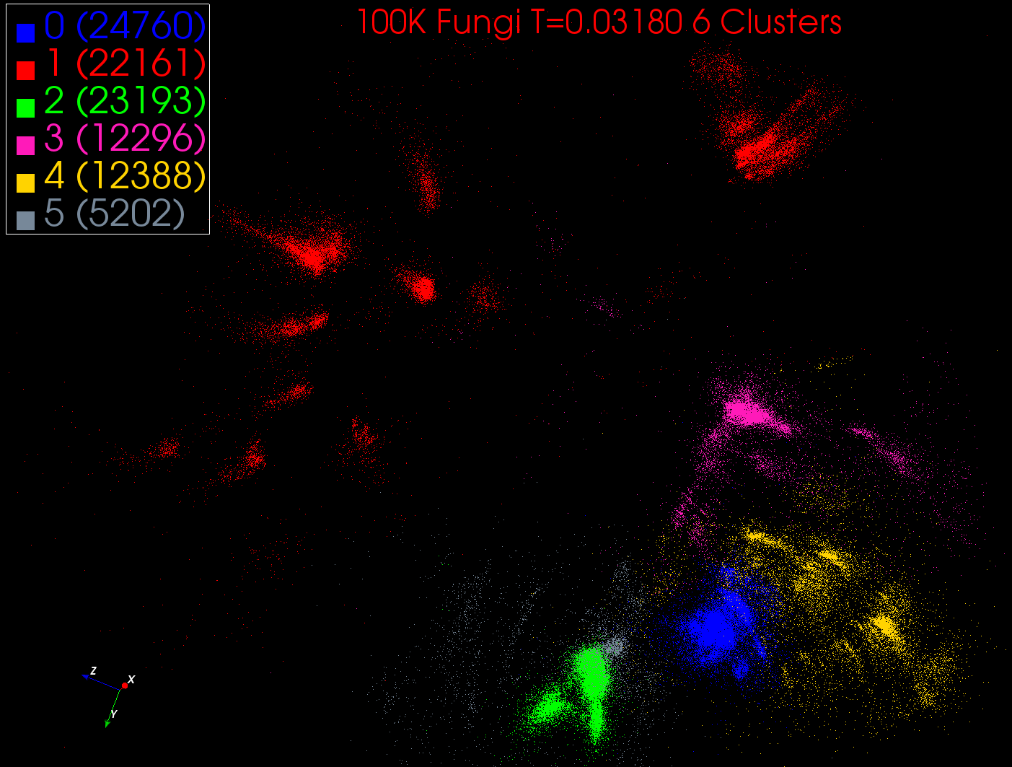

Slide 61
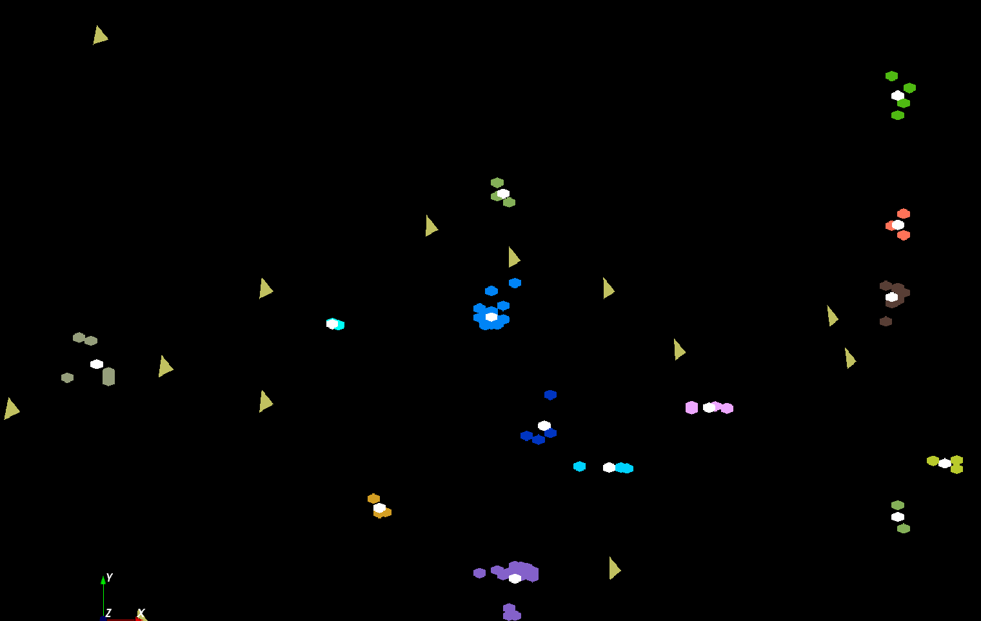
Analysis of Mass Spectrometry data to find peptides by clustering peaks in 2D
The brownish triangles are “sponge” peaks outside any cluster.
The colored hexagons are peaks inside clusters with the white hexagons being cluster center determined by algorithm
Fragment of 30,000 Clusters
241605 Points

Slide 62
Cluster Count v. Temperature for 2 Runs
All start with one cluster at far left
T=1 special as measurement errors divided out
DA2D counts clusters with 1 member as clusters. DAVS(2) does not

Slide 63
Speedups for several runs on Madrid using C# and MPI.NET from sequential through 128 way parallelism defined as product of number of threads per process and number of MPI processes. We look at different choices for MPI processes which are either inside nodes or on separate nodes. For example 16-way parallelism shows 3 choices with thread count 1:16 processes on one node (the fastest), 2 processes on 8 nodes and 8 processes on 2 nodes

Slide 64
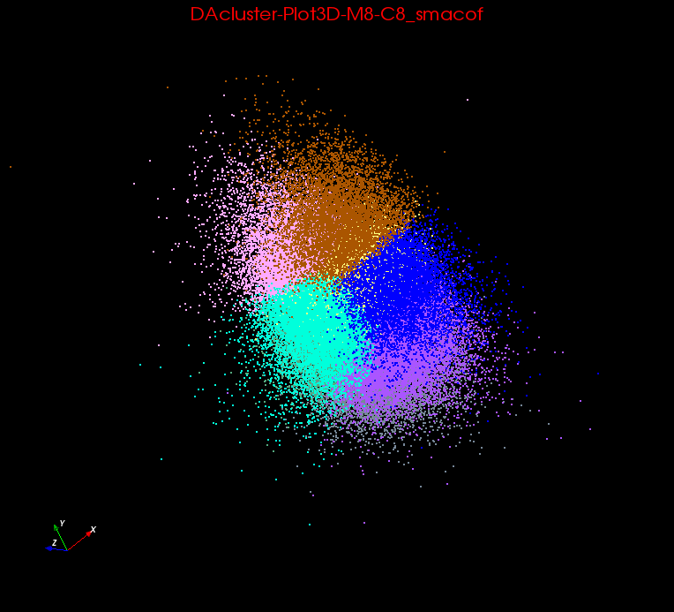
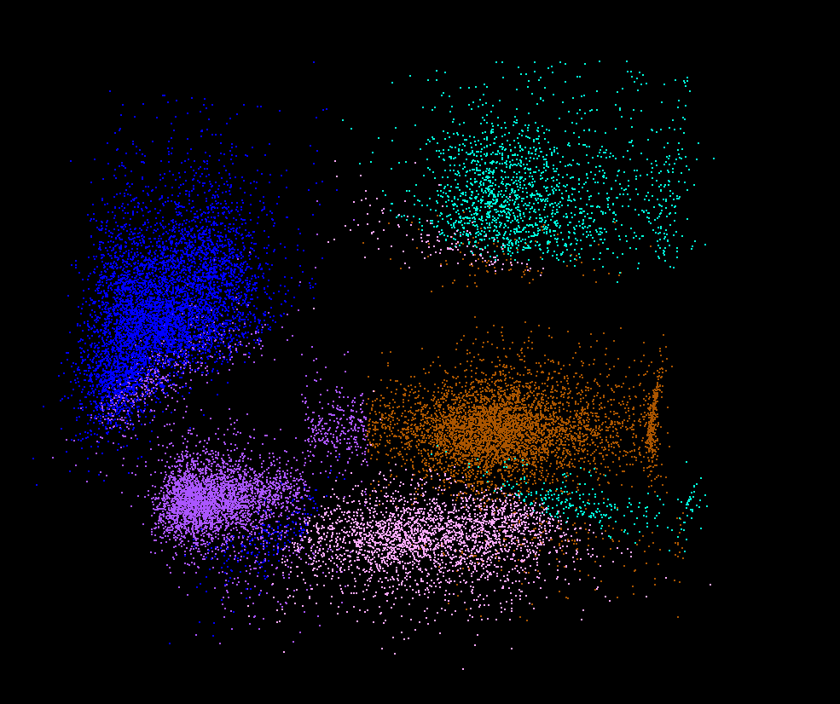
Clusters v. Regions
Lymphocytes 4D
Pathology 54D
In Lymphocytes clusters are distinct
In Pathology, clusters divide space into regions and sophisticated methods like deterministic annealing are probably unnecessary

Slide 65

Protein Universe Browser for COG Sequences with a few illustrative biologically identified clusters

Slide 66
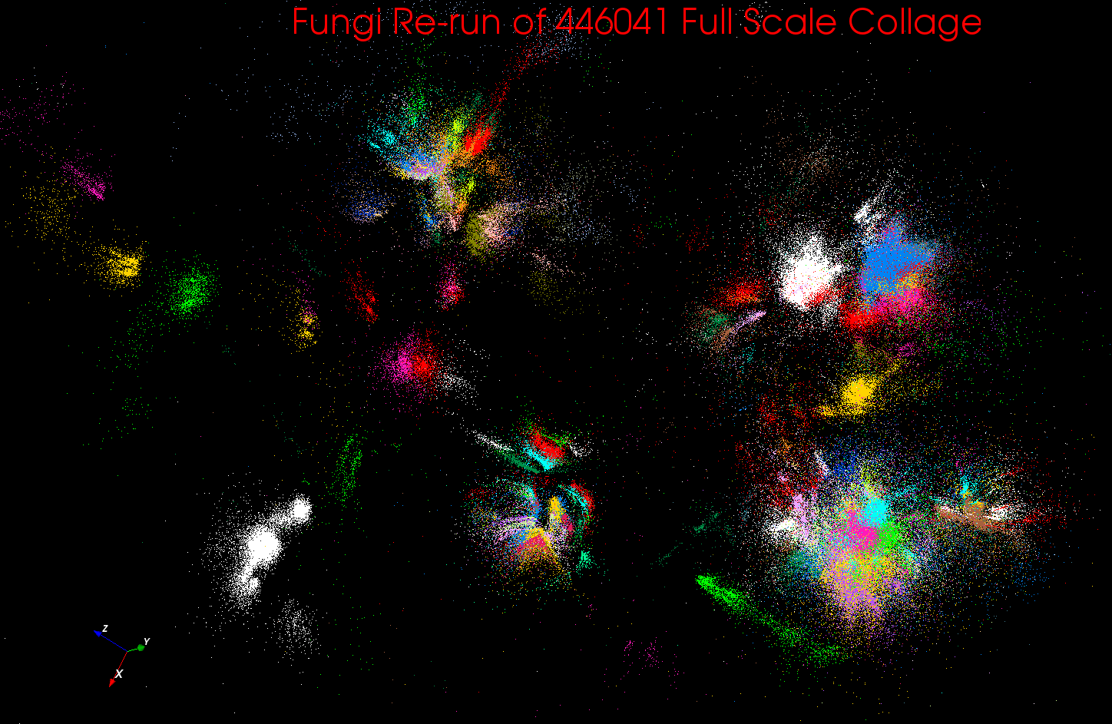
Full 446K Clustered

Slide 67
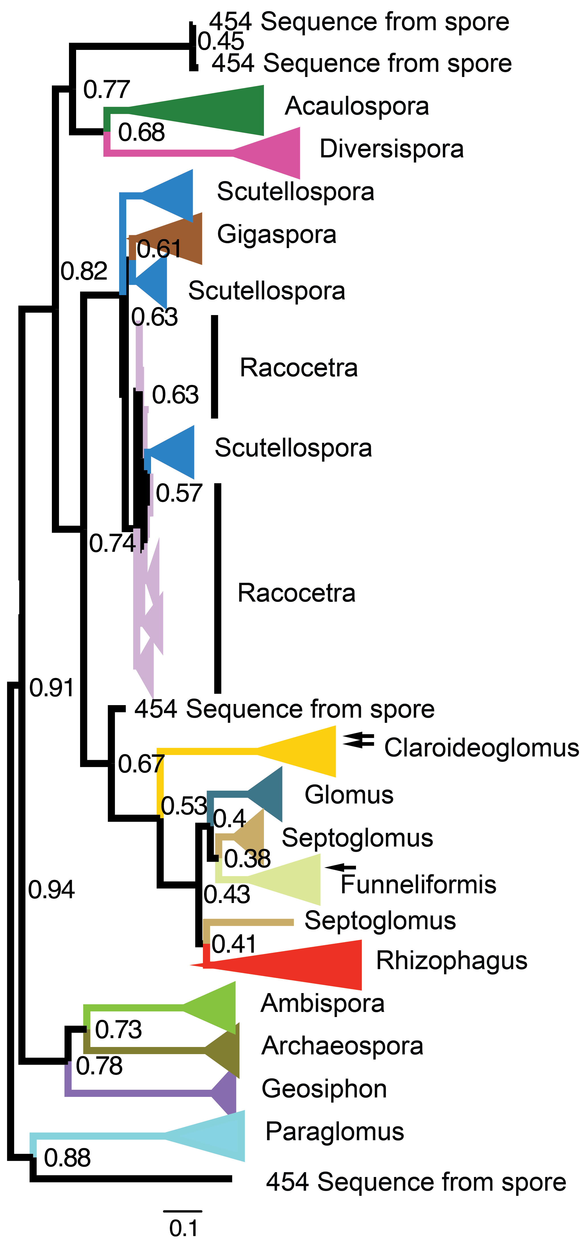
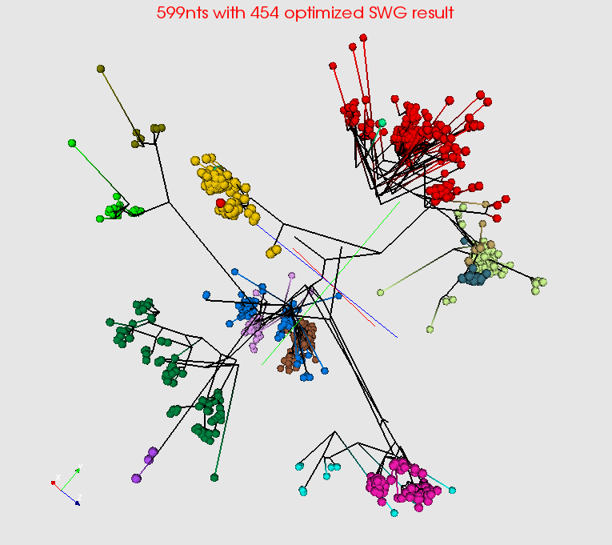
Summarize a million Fungi Sequences
Spherical Phylogram Visualization
Spherical Phylogram from new MDS method visualized in PlotViz
RAxML result visualized to right.

Slide 68
Features of these problems
55K lines of C# (becoming Java) running with MPI.Net and 20K lines of Java running on Twister
Convert all to Java with Harp+Hadoop or OpenMPI (?MPJ) plus Habanero Java
  Kmeans, Elkans method
  Vector DA Clustering
  Non metric (PW pairwise) DA clustering
  Levenberg Marquardt χ² or ML solver
  MDS as χ²
  MDS as Weighted DA SMACOF
  Lots of auxiliary routines such as Smith-Waterman and Needleman Wunsch gene alignment
Less well tested
  GTM, PLSI, SVM, LDA, PageRank, outlier detection

Slide 69
DAVS Performance
Charge2 Proteomics 241605 points
Pure MPI Times
MPI with Threads
Pure MPI Speedup

Slide 70
Performance of MPI Kernel Operations
Pure Java as in FastMPJ slower than Java interfacing to C version of MPI

Slide 71
DAPWC Performance
Parallelism ≥ 16

Slide 72
DAPWC Performance
Speedup on a relatively small problem
Performance with threads is better than DAVS, but (T=8)x1xN is peculiar as doesn’t use CPU’s on processor
FastMPJ failed as before
MPI.NET and OMPI-nightly runs are yet to be done

Slide 73
WDA SMACOF on Harp Big Red 2
Parallel Efficiency
Based On 8Nodes and 256 Cores

Slide 74
Lessons / Insights
Integrate (don’t compete) HPC with “Commodity Big data” (Google to Amazon to Enterprise Data Analytics)
  i.e. improve Mahout; don’t compete with it
  Use Hadoop plug-ins rather than replacing Hadoop
  Enhanced Apache Big Data Stack HPC-ABDS has 120 members – please improve list!
Data intensive algorithms do not have the well developed high performance libraries familiar from HPC
Not really any agreement on methodologies as typically use sequential low performance systems
Strong case for high performance Java (Grande) run time supporting all forms of parallelism
  Also need more suitable computers!

