Slide 1


AMSA TO 4 Sensor Grid
Technical Interchange Meeting
24 Mar 2011
Anabas Inc.
Indiana
University

Slide 2
Agenda
Core SCGMMS (Sensor Centric Grid Middleware Management System)
  Ryan Hartman (Indiana University)
Cloud and Grid Computing
  Geoffrey Fox (Indiana University)
  Alex Ho (Anabas Inc.)
Vulnerability analysis: Exposure and Defense
  XiaoFeng Wang (Indiana University)
  Apu Kapadia (Indiana University)
  Steven Meyer (Indiana University)
Sensor Grid Testbed Development Status
  Garry Whitted (Ball Aerospace)
  Dale Williams (Ball Aerospace)
  Stephen Halwes (Ball Aerospace)
CTS 2011 Presentation/Demonstration Support

Slide 3
Core SCGMMS (Sensor Centric Grid Middleware Management System)
The IU Middleware Team:
  Ryan Hartman
  Sankarbala Manoharan
  Vignesh Ravindran
  Vinod Periasamy
Project Website https://sites.google.com/site/sensorcloudproject
Continuing Sensor Grid work originating at Anabas, Inc.

Slide 4
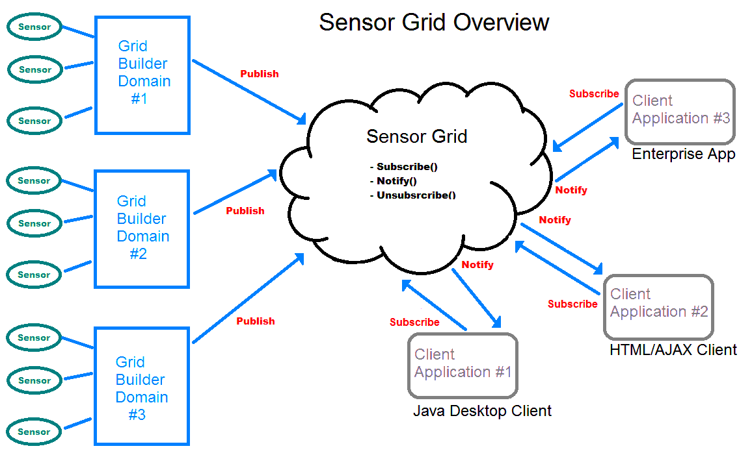
Review of the Sensor Grid Architecture

Slide 5
Current Research Activities
Infrastructure
  New Message Broker
  Web Based Interface
New Collaborative Sensors
  Improved Video
  Text Chat
  File Transfer
  Android Video

Slide 6
New Message Broker
Replace NaradaBrokering with ActiveMQ
Motivation
  NB is still an excellent choice for a message broker
  No longer being actively maintained so compatibility issues will eventually arise
Why ActiveMQ?
  Open Source Product from Apache
  Based on the JMS standard like NB
  Excellent client and protocol support
  ActiveBlaze a sub-project of ActiveMQ designed specifically to meet the needs of low latency high throughput collaborative real-time applications

Slide 7
Web Based Interface
Anabas Java Desktop Client
  Featured application for viewing/interacting/filtering sensor data published to the Sensor Grid
  Fully supported and is the recommended choice for desktop users
Web Based Clients
  Optimized for mobile browsers
  Based on HTML5 and Google Web Toolkit JavaScript
    WebSockets
    Canvas
    Built in video support
  Aiming for the next generation of mobile browsers

Slide 8
New Collaborative Sensors
Finished New Sensors
  Moderated Text Chat
  File Transfer
  These sensors are now also integrated into the Anabas Desktop Client
Proposed Collaborative Sensors
  White Board
  Shared Display
    Leveraging TightVNC or other open source product
  Video Chat
    Leveraging new generic video sensor

Slide 9
New Video Sensor
Using the Google WebM Project
  VP8 Video Codec
  Vorbis Audio Codec
  WebM Video Container
Goals
  Remove Windows specific code from:
    GridBuilder
    Desktop Client
  Support for higher video resolution
  Support for web clients

Slide 10
Example Applications of the Sensor Grid
Grid of Grids
First Responder
Self-Initializing Sensor Network
  An idea mentioned in conversation with Ball Aerospace

Slide 11
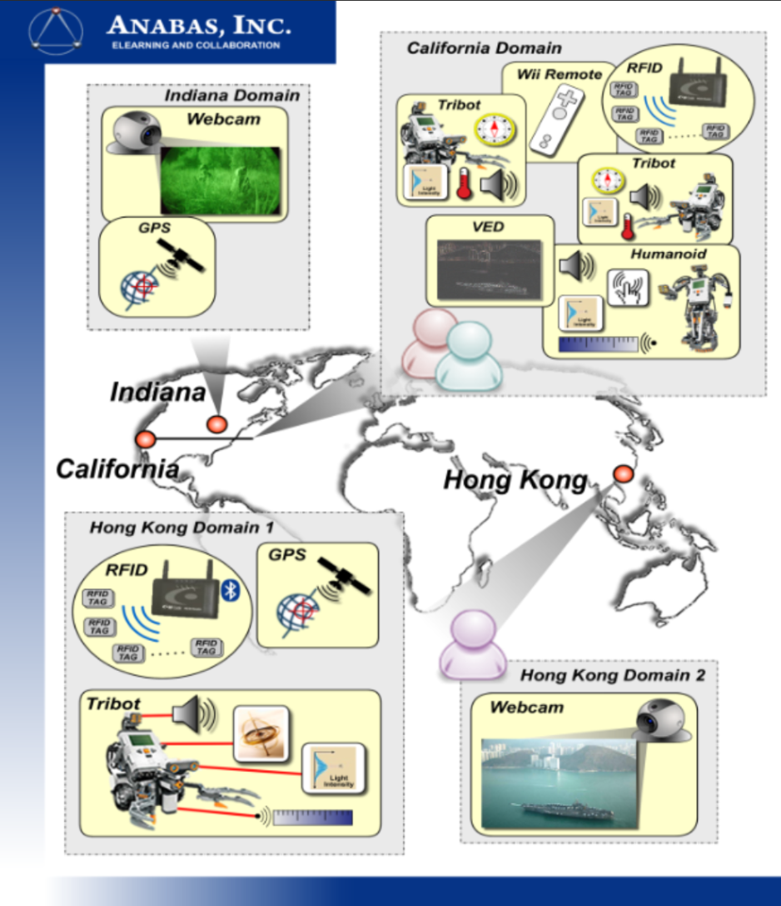
Grid of Grids
One of the initial project scenarios
Using a distributed messaging network to connect a collection of spatially separated sensor grids
The current SGX/Grid Builder framework has support for this arrangement
Is this still an interesting deployment scenario?

Slide 12
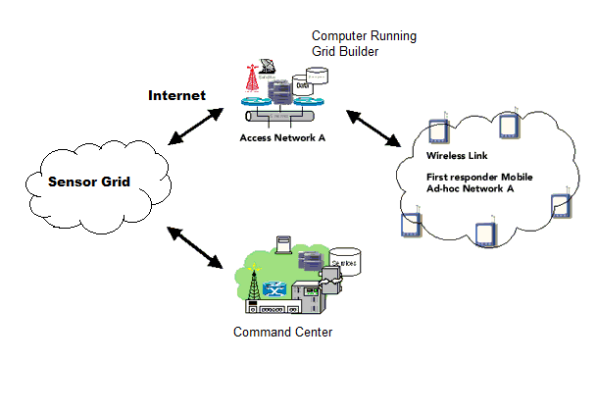
First Responder
Here we collect data from mobile sensors over an Ad-Hoc wireless network
This data is published to the Sensor Grid by an onsite laptop running the Grid Builder
Once ‘sensor’ programs are written for the physical sensors you wish to deploy this scenario is currently supported

Slide 13
Self-Initializing Sensor Network
This is a scenario that has been mentioned informally in conversations about the project
Arrive on Scene
Release Sensors
Initialization
Sensors Auto-Deploy
Connect to Grid
Publication
Publish Data

Slide 14
Questions?
Ryan Hartman
rdhartman@indiana.edu

Slide 15
Sensor Grid Testbed Development Status
H/W & S/W Status
H/W & S/W Status
  H/W
    New development hardware purchased and assembled
    Purchased 2 Motorola Xoom Android tablets
    Purchased National Instruments mobile sensor platform
  S/W
    In the process of setting up development environment on new development hardware
    Successfully ported current Android sensor grid software to Motorola Xoom
      Will need to rewrite GUI to accommodate the larger screen of the Xoom
    Beginning development for NI mobile sensor platform
    AXIS Network Camera blob tracker complete
    Gumstix platform with IR Laser Range finder, integration complete
    Laser Eye software with ports on Android 2.2 and 3, integration complete

Slide 16
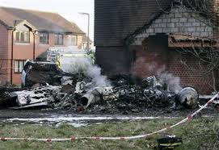
Sensor Grid Testbed Development Status
Application (Live, Virtual, and Constructive (LVC) Sensor Integration for Operations & Training (SIDFOT))
Planned LVC SIDFOT Scenario
  Small A/C (live NCMR prop) flown into chemical plant
    Visible from WPAFB (at Cville)
  Rescue team responds
    WIRTO TO 32 scenario variation
  Deploy of support personnel and equipment
  Incident expands in scope
    Determine cause (forensics)
    Provide security for scene and nearby area (sensor grid, live)
    Coordinate between mil/civil authorities (mobile C2)
    Others?
  End of Incident/After Action Review
Credit: aviaton-weblog.com

Slide 17




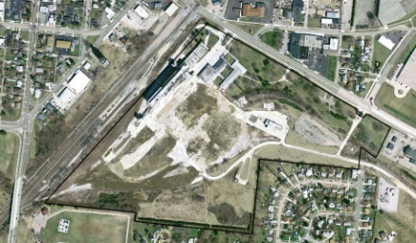




Sensor Grid Testbed Development Status
Application (Live, Virtual, and Constructive (LVC) Sensor Integration for Operations & Training (SIDFOT))
LVC CONCEPT (DRAFT)
Virtual/Constructive
C2
Site(s)
EOC/LSOC
Sensors (e.g., Camera)
Viewers
Fusion
C2
Live
Primary Training/Simulation Site(s)
Remote
Site(s)
Sensors (e..g., Camera)
Other Simulations
Rehearsal
Post Process
High Fidelity site
Training/Rehearsal Site
Virtual/Constructive
Simulation hub
Provide extensive
connectivity capabilities
Sensor Grid
(trust, trustworthiness)
Remote Sensing
\Sensors (TBD)
Sensors (e.g., Camera, cell, etc.)
Internet (2.0?)
Connectivity
Calamityville
Site
Flexible set of sites usually centered on C’ville site
Instrument locations/activity at site
(e.g., audio, video, human loc/status/activity)
Provide communication mechanisms/devices
Provide digital/Internet connectivity
Data collection and analysis
Virtual Distributed Environment
  “Second-Life”-Like

Slide 18
Sensor Grid Testbed Development Status
Application (Live, Virtual, and Constructive (LVC) Sensor Integration for Operations & Training (SIDFOT))
Objectives
  Ad Hoc connectivity of sensors to Sensor Grid
    Show connecting and un-connecting to Grid
  Number of various sensors
    1 AXIS 214 PTZ Camera
    1 to 2 AXIS 207MW Camera
    1 Trendnet TV-IP422W/A Camera
  Provide viewing mechanisms/devices
    Android software capable of viewing Blob tracking data from AXIS 207MW Camera
    Remote viewing of Sensors
    Host connectivity of sensors
Goals
  Provide Internet connectivity
  Web cam sensors
  Android sensors

Slide 19
Sensor Grid Demo
Sensor Grid Testbed Development Status
Application (Live, Virtual, and Constructive (LVC) Sensor Integration for Operations & Training (SIDFOT))
Ad Hoc Sensors (e.g., Camera)
Viewers Sensor data
Ad Hoc Sensors (e..g., Camera)
Viewers Sensor Data
Remote
Site(s)
Sensor Grid
Android Blob Tracking Viewer
Android Phone Sensors
Web Cam Sensor
Ad Hoc
Sensors (e.g., Camera, cell, etc.)

Slide 20
Sensor Grid Archival System Objective
  Sensor Grid Testbed Development Status
  SAFE (or alternate Sensor Data Storage) Integration
Develop an “SensorGrid Archival System” that will:
  Archive sensor data from the SensorGrid
  Handle any size/type of sensor data
  Accept new sensors on-the-fly
  Allow filtering of data requests
  Provide a Client to access stored data

Slide 21
Sensor Data Storage Systems
Under Consideration
  Sensor Grid Testbed Development Status
  SAFE (or alternate Sensor Data Storage) Integration
Situational Awareness Fusion Engine (SAFE)
  Developed by Woolpert for the DoD
  Provides a collection of web services for storing imagery and video sensor data
Sensor Observation Service (SOS)
  Developed by Open Geospatial Consortium (OGC) for web-connected sensors of all types
  Provides a web-based API for managing deployed sensors and retrieving sensor data

Slide 22
SAFE/SOS Feature Comparison
  Sensor Grid Testbed Development Status
  SAFE (or alternate Sensor Data Storage) Integration
Feature | SAFE | SOS
Web Services | Web Map Service (WMS), Web Feature Service (WFS), JAX-WS, Import | Sensor Observation Service (SOS)
Standardization | Custom collection of Standard and Non-standard services | Standardized, OGC defined
Development/Support | Inactive (Woolpert) | Active (OGC / 52 North)
Data Types | Imagery/Video | Imagery/String/Numeric
Client Available | Limited | Full featured
Database Backend | Oracle | PostgreSQL
Pyramiding/Tiling | Yes | No

Slide 23
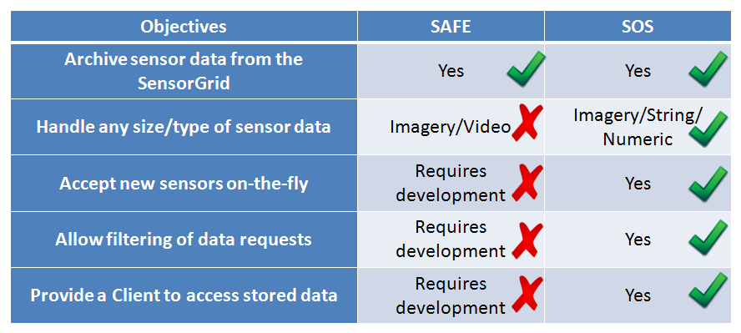
SensorGrid Archival System
  Sensor Grid Testbed Development Status
  SAFE (or alternate Sensor Data Storage) Integration

Slide 24
Conclusion
  Sensor Grid Testbed Development Status
  SAFE (or alternate Sensor Data Storage) Integration
Both SAFE and SOS have useful features
SOS features are more applicable and would require less development time for modifications
SAFE has many unnecessary features and would require more development time
SOS is more suitable than SAFE for SensorGrid
Recommendation: SOS

