Slide 1
Hybrid Consistency Framework for Distributed Annotation Records in a Collaborative Environment
Ahmet Fatih Mustacoglu
Geoffrey C. Fox
Indiana University
Computer Science Department
Community Grids Laboratory
amustaco@cs.indiana.edu
http://www.cs.indiana.edu/~amustaco
May 21, 2008
CTS-2008, Irvine, CA, U.S.A.

Slide 2
Outline
Introduction
Motivations
Architecture
Hybrid Consistency Framework
Conclusions
Contributions and Future Works

Slide 3
Online Collaboration
Rapid development of annotation tools and services
Aimed at fostering online collaboration and sharing between users and communities:
Bookmarking Tools supports annotation using keywords called tags and sharing
e.g. del.icio.us
Tools for annotation and sharing of scholarly publications
Connotea
Citeulike
Bibsonomy
Social Networking Tools(MySpace)
Video Sharing and annotation
e.g. YouTube
Notes:
YouTube integration in future and face book is different

Slide 4
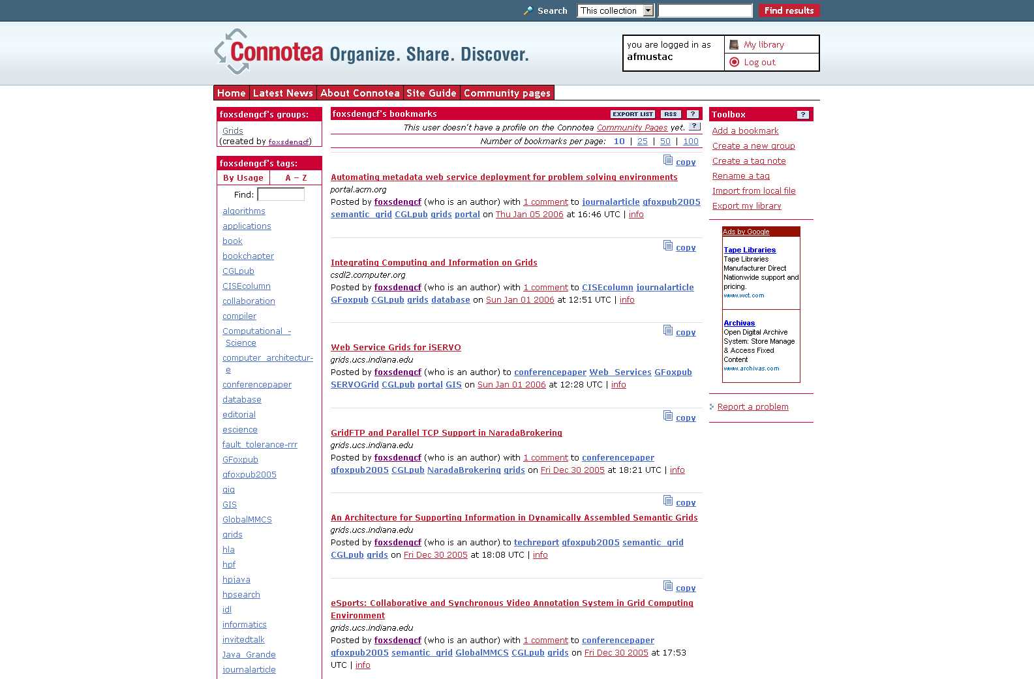
Typical User Library in Connotea

Slide 5
Motivations
Using existing annotation tools and their services with added capabilities for scientific research
Management of metadata coming from different sources
Annotation tools, different and limited metadata storage
Multiple instances of metadata about the same document
No time-stamp info for updated records
Causing inconsistencies
Lack of interoperability between annotation sites
Applying service-based architecture to annotation systems
Missing services
Upload and extract metadata from/to a repository

Slide 6
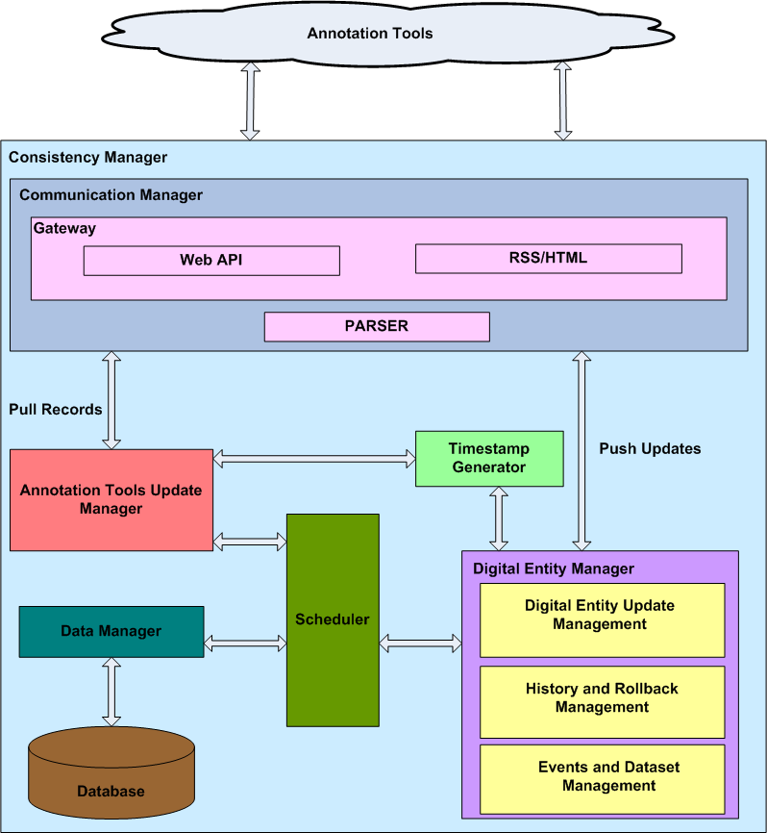
Big Picture: Hybrid Consistency Framework (HCF)

Slide 7
KEY CONCEPTS
Distributed Annotation Record (DAR): Collection of metadata stored at an annotation tool.
Digital Entity (DE): A digital collection of metadata for a citation stored in a system database forms a primary copy of a DAR.
Event: A time-stamped action on a digital entity
Major Events:
Insertion or deletion of a digital entity
Minor Events:
Modifications to an existing digital entity

Slide 8
Communication Manager-I
Responsible for providing communication between annotation tools and update manager and digital entity manager via gateways
e.g. Connotea gateway
Utilizes a gateway for each annotation tool, and a parser
Retrieve records in XML format
Parse and pass records to annotation tools update manager
Post updates coming from digital entity manager to annotation tools via unicast technology

Slide 9
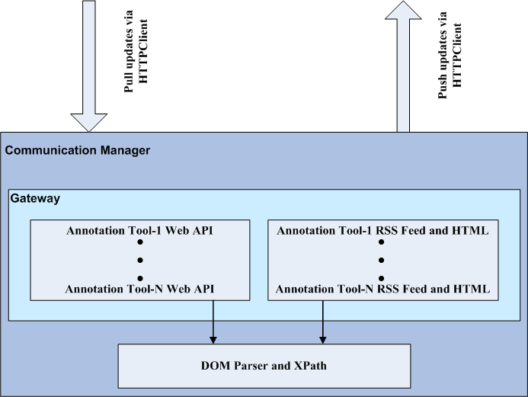
Communication Manager-II

Slide 10
Gateway
Interface to communicate with annotation tools
Provides extensibility
A gateway needs to be deployed for each annotation tool that need to be integrated into the system
Annotation Toolsotation Tools
HCF
Gateways
HCF Modules

Slide 11
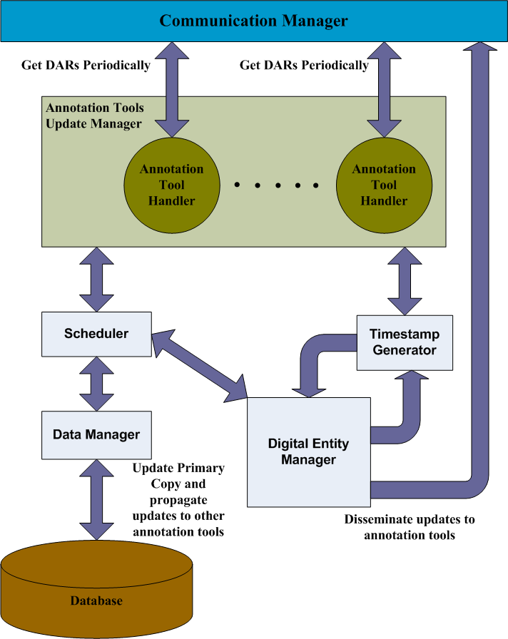
Annotation Tools Update Manager
Responsible for:
Retrieving the records from annotation tools periodically (Time-based consistency approach by pulling records)
Finding out the updates
Passing the updates to Digital Entity Manager so that they can be applied on the primary copy of each record
Notes:
Finding out the updates based on annotation tools priority

Slide 12
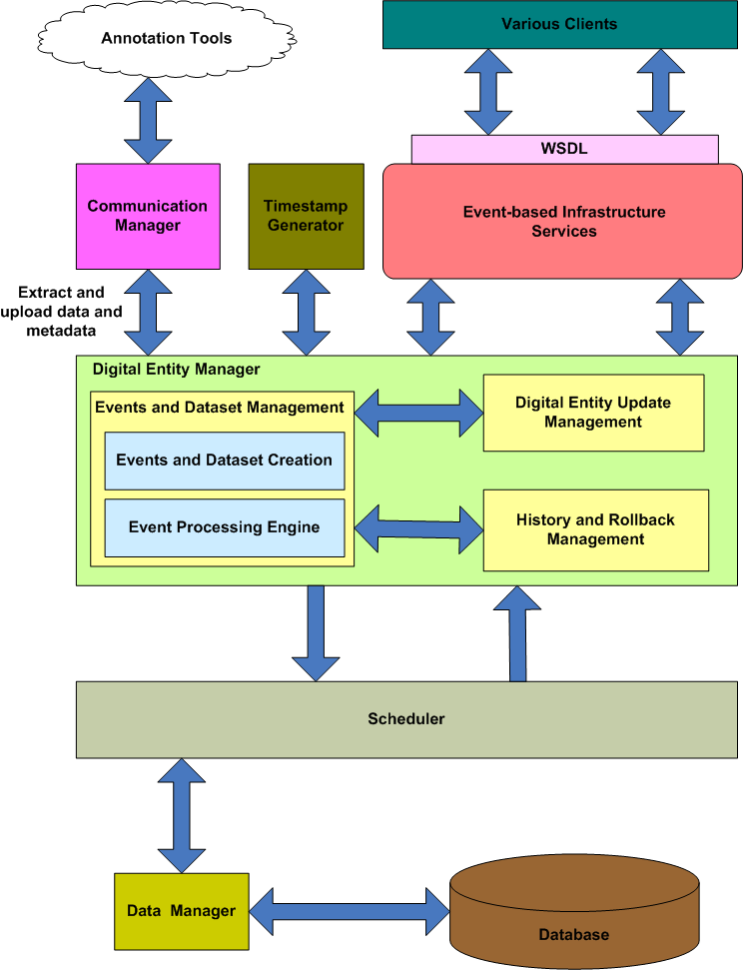
Digital Entity Manager
Responsible for:
Events and dataset creation
Event Processing
Manages updates made on the primary copy of a digital entity
Updates primary copy located on a system database
Pass updates to the Communication Manager (Strict consistency by pushing updates immediately)
Deals with history and rollback management of a digital entity

Slide 13
Summary of Hybrid Consistency Framework
Hybrid Consistency Framework maintains consistency by adopting
Time based consistency mechanism (pull approach)
Primary-copy based strict consistency mechanism (push approach)
Updates are propagated to annotation tools via unicast technology
Updates from annotation tools are collected by utilizing pull strategy
It has modular structure and supports the usage of annotation tools for scientific research with added capabilities

Slide 14
Future Works
Supporting video collaboration tools
YouTube
Integration of other academic collaboration and publication tools into the current system
e.g. Bibsonomy integration
Conducting various scalability tests of our proposed hybrid consistency framework

