Slide 1
Architecture and Measured Characteristics of a Cloud Based Internet of Things
May 22, 2012
The 2012 International Conference on Collaboration Technologies and Systems
(CTS 2012)
May 21-25, 2012
Denver, Colorado, USA
Ryan Hartman
rdhartma@indiana.edu
Indiana University Bloomington

Slide 2
Collaborators
Principal Investigator Geoffrey Fox
Graduate Student Team
  Supun Kamburugamuve
  Bitan Saha
  Abhyodaya Padiyar
https://sites.google.com/site/opensourceiotcloud/

Slide 3
Internet of Things and the Cloud
It is projected that there will soon be 50 billion devices on the Internet. Most will be small sensors that send streams of information into the cloud where it will be processed and integrated with other streams and turned into knowledge that will help our lives in a million small and big ways.
It is not unreasonable for us to believe that we will each have our own cloud-based personal agent that monitors all of the data about our life and anticipates our needs 24x7.
The cloud will become increasing important as a controller of and resource provider for the Internet of Things.
As well as today’s use for smart phone and gaming console support, “smart homes” and “ubiquitous cities” build on this vision and we could expect a growth in cloud supported/controlled robotics.
Natural parallelism over “things”

Slide 4
  Internet of Things: Sensor Grids
  A pleasingly parallel example on Clouds
A Sensor (“Thing”) is any source or sink of a time series
  In the thin client era, Smart phones, Kindles, Tablets, Kinects, Web-cams are sensors
  Robots, distributed instruments such as environmental measures are sensors
  Web pages, Googledocs, Office 365, WebEx are sensors
  Ubiquitous Cities/Homes are full of sensors
  Observational science growing use of sensors from satellites to “dust”
  Static web page is a broken sensor
  They have IP address on Internet
Sensors – being intrinsically distributed are Grids
However natural implementation uses clouds to consolidate and control and collaborate with sensors
Sensors are typically “small” and have pleasingly parallel cloud implementations

Slide 5
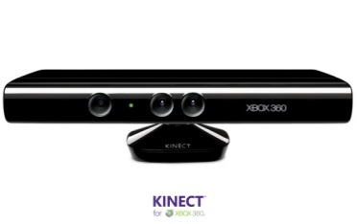








Sensors as a Service
Output Sensor
Sensors as a Service
Sensor Processing as a Service (could use
MapReduce)
A larger sensor ………

Slide 6
Sensor Grid supported by IoTCloud
Distributed Access to Sensors
and services driven
by sensor data
IoT Cloud
Controller and link
to Sensor Services
Sensor Grid
Sensor
Client Application Enterprise App
Notify
Publish
Publish
IoT Cloud
Control
Subscribe()
Notify()
Unsubscribe()
Sensor
Notify
Client Application Desktop Client
Sensor
Publish
Notify
Client Application Web Client
Pub-Sub Brokers are cloud interface for sensors
Filters subscribe to data from Sensors
Naturally Collaborative
Rebuilding software from scratch as Open Source – collaboration welcome

Slide 7
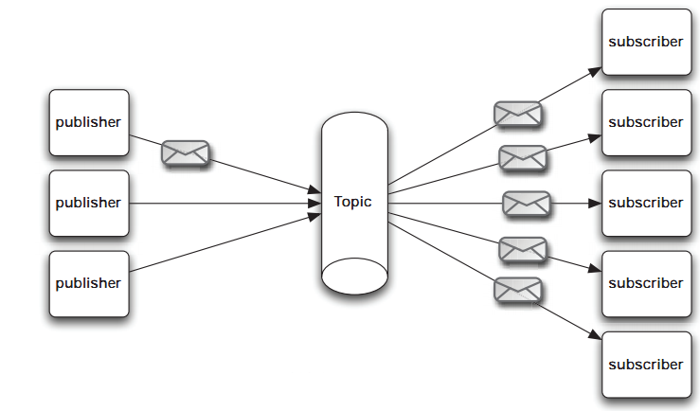
Pub/Sub Messaging
At the core Sensor Cloud is a pub/sub system
Publishers send data to topics with no information about potential subscribers
Subscribers subscribe to topics of interest and similarly have no knowledge of the publishers
URL: https://sites.google.com/site/opensourceiotcloud/
Notes:
The publish/subscribe (pub/sub) design pattern [5] describes a loosely-coupled architecture based message-oriented communication between distributed applications. In such an arrangement applications may fire-and-forget messages to a broker that manages the details of message delivery. This is an especially powerful benefit in heterogeneous environments, allowing clients to be written using different languages and even possibly different wire protocols. The pub/sub provider acts as the middle-man, allowing heterogeneous integration and interaction in an asynchronous (non-blocking) manner.
The pub/sub architecture uses destinations known as topics. Publishers address messages to a topic and subscribers register to receive messages from the topic. Publishers and subscribers are generally anonymous and may dynamically publish or subscribe to the content hierarchy. The system takes care of distributing the messages arriving from a topic's multiple publishers to its multiple subscribers. Topics retain messages only as long as it takes to distribute them to current subscribers. Figure 1 illustrates pub/sub messaging.
Message publication is inherently asynchronous in that no fundamental timing dependency exists between the production and the consumption of a message. Messages can be consumed in either of two ways:
Synchronously. A subscriber or a receiver explicitly fetches the message from the destination by calling the receive method. The receive method can block until a message arrives or can time out if a message does not arrive within a specified time limit.
Asynchronously. A client can register a message listener with a consumer. A message listener is similar to an event listener.

Slide 8
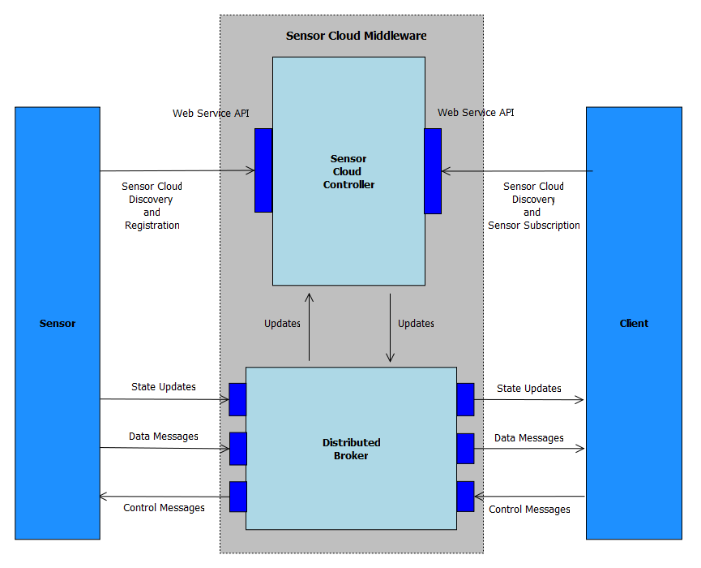
Sensor Cloud Architecture
Originally brokers were from NaradaBrokering
Replacing with ActiveMQ and Netty for streaming

Slide 9
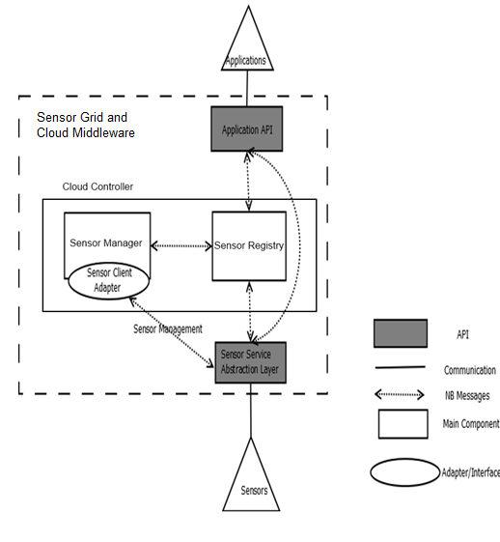
Sensor Cloud Middleware
Sensors are deployed in Grid Builder Domains
Sensors are discovered through the Sensor Cloud
Grid Builder and Sensor Grid are abstractions on top of the underlying Message Broker
Sensors Applications connect via simple Java API
Web interfaces for video (Google WebM), GPS and Twitter sensors

Slide 10
Grid Builder
GB is a sensor management module
1. Define the properties of sensors
2. Deploy sensors according to defined properties
3. Monitor deployment status of sensors
4. Remote Management - Allow management irrespective of the location of the sensors
5. Distributed Management – Allow management irrespective of the location of the manager / user
GB itself posses the following characteristics:
1. Extensible – the use of Service Oriented Architecture (SOA) to provide extensibility and interoperability
2. Scalable - management architecture should be able to scale as number of managed sensors increases
3. Fault tolerant - failure of transports OR management components should not cause management architecture to fail

Slide 11
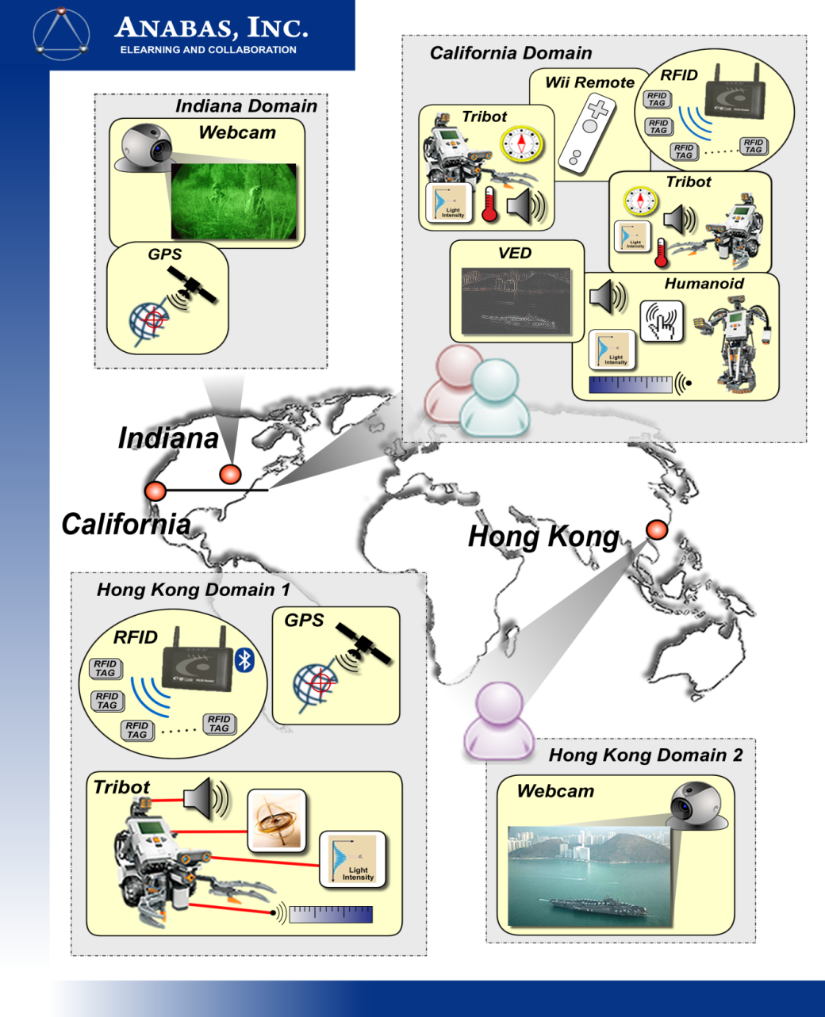
Early Sensor Grid Demonstration

Slide 12
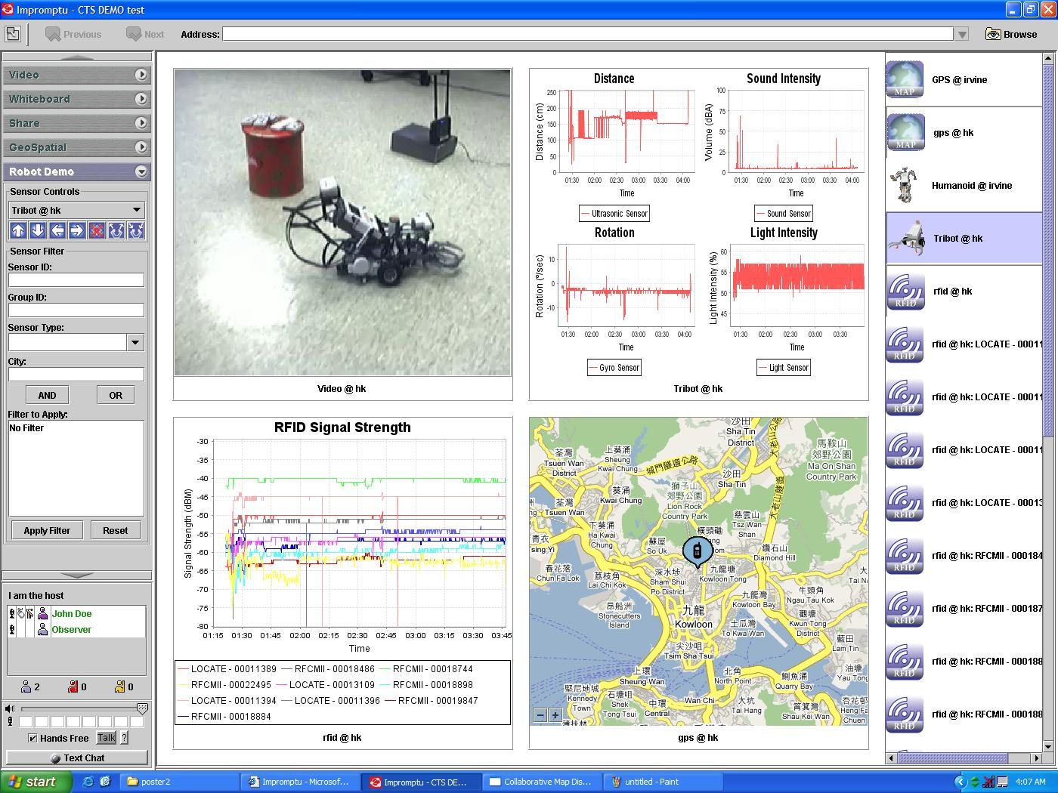

Slide 13
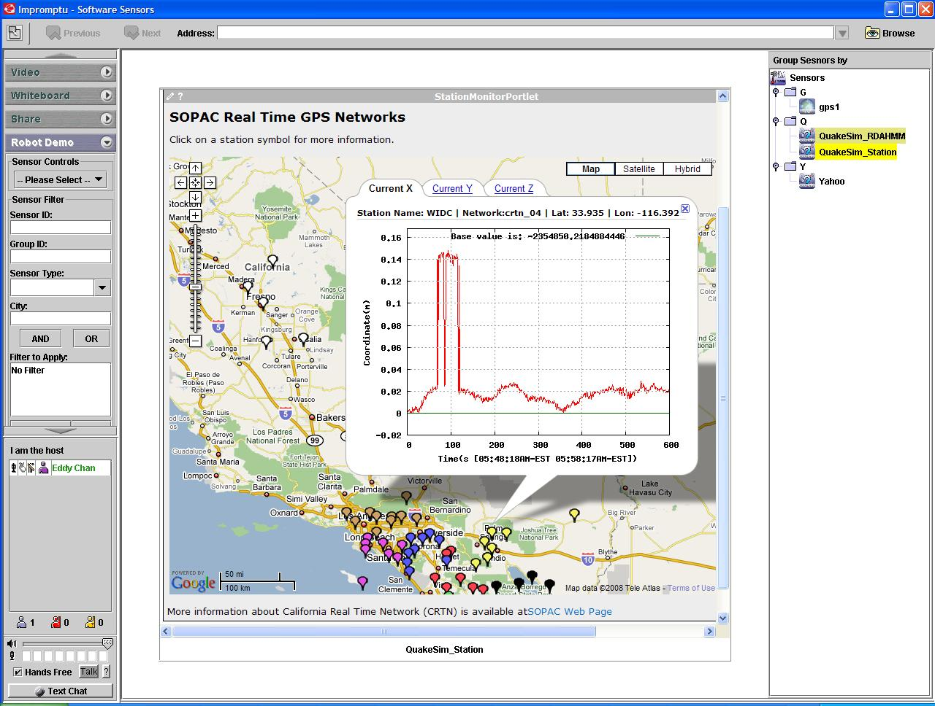

Slide 14
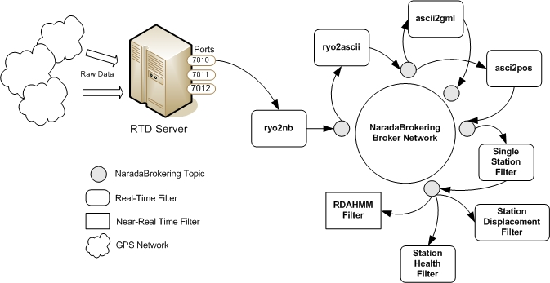
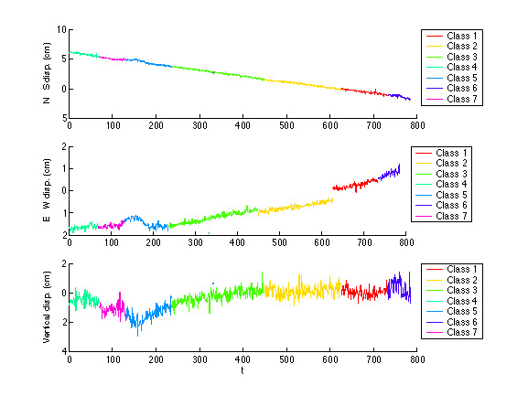
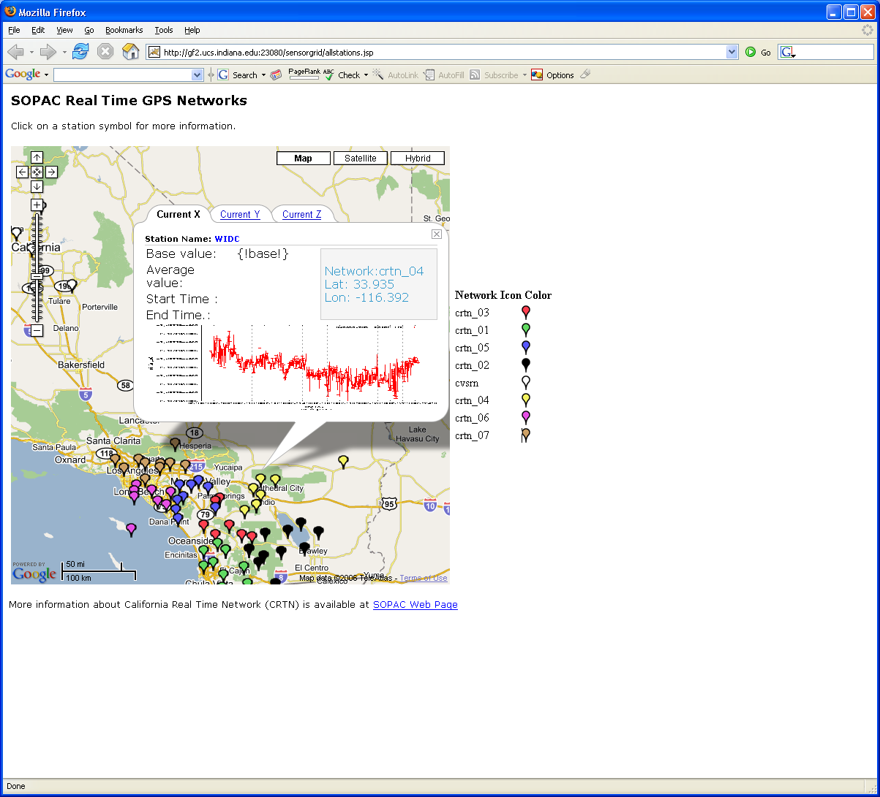
Real-Time GPS Sensor Data-Mining
Services process real time data from ~70 GPS Sensors in Southern California
Brokers and Services on Clouds – no major performance issues
CRTN GPS
Earthquake
Streaming Data
Support
Transformations
Data Checking
Archival
Hidden Markov
Datamining (JPL)
Display (GIS)
Real Time
14
Notes:
14

Slide 15
Lightweight Cyberinfrastructure to support mobile Data gathering expeditions plus classic central resources (as a cloud)
Sensors are airplanes here!

Slide 16
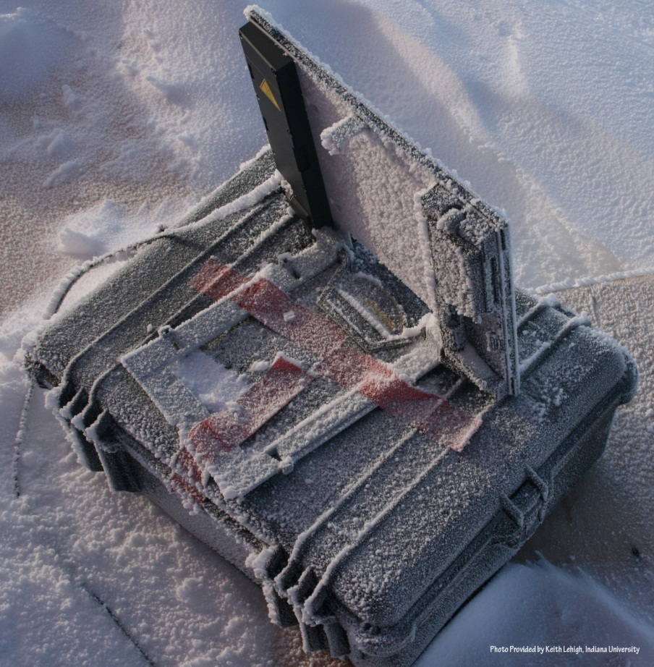
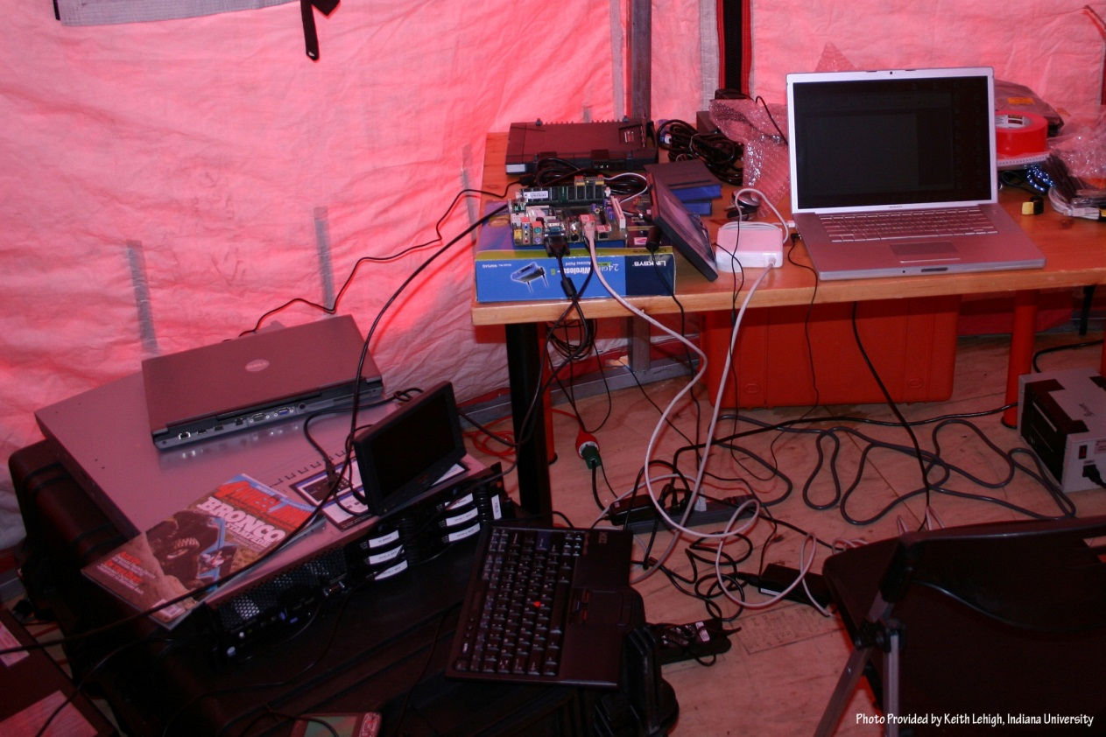
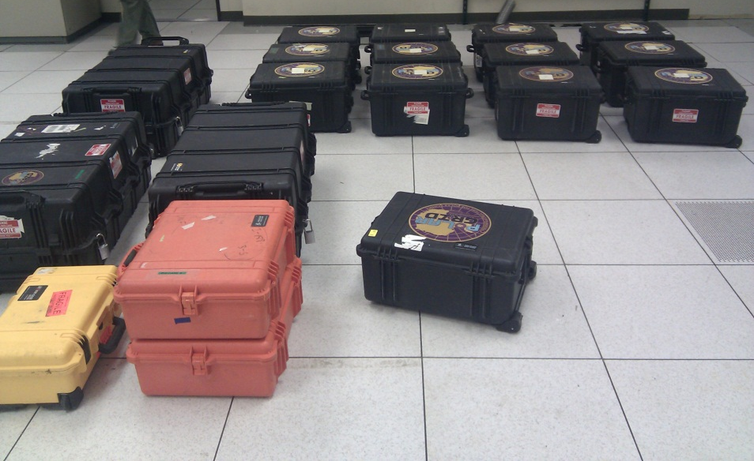
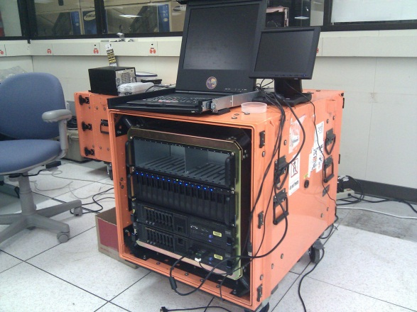

Slide 17
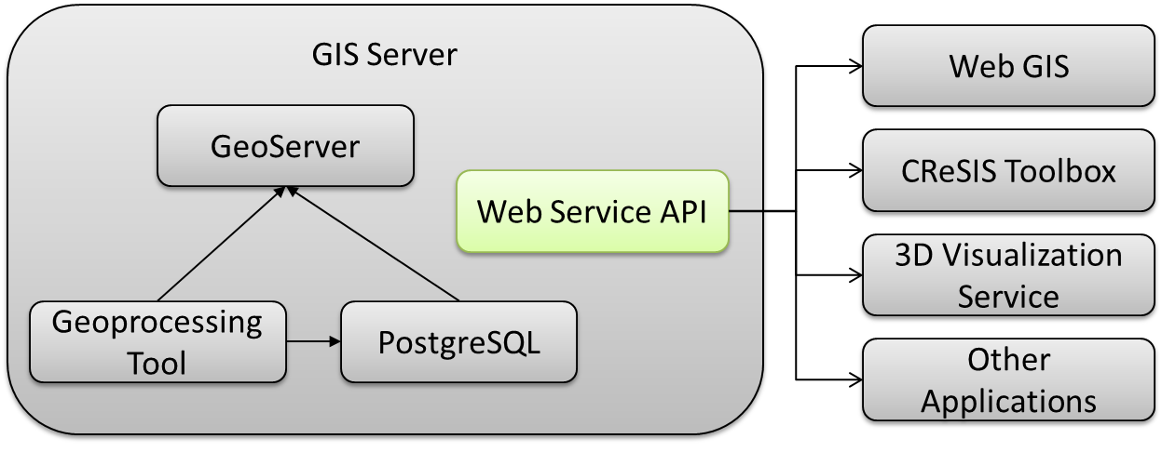
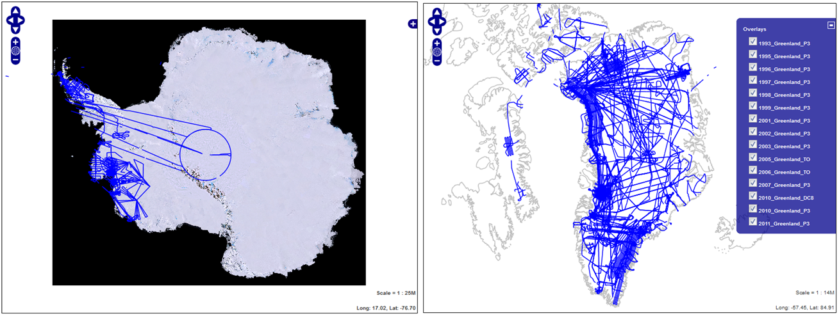
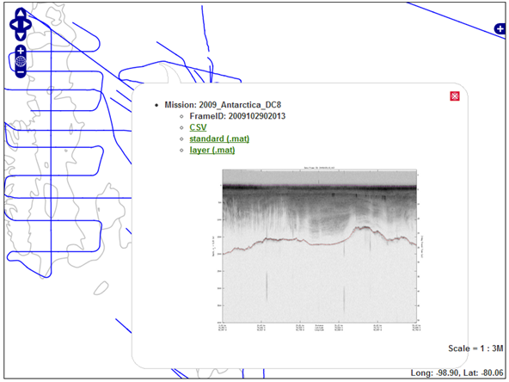
PolarGrid Data Browser

Slide 18
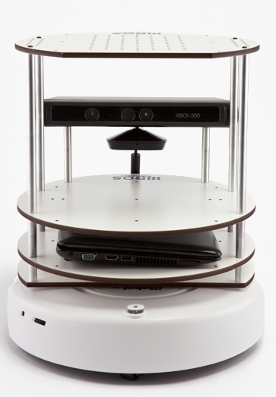

Sensor Grid Performance
Overheads of either pub-sub mechanism or virtualization are <~ one millisecond
Kinect mounted on Turtlebot using pub-sub ROS software gets latency of 70-100 ms and bandwidth of 5 Mbs whether connected to cloud (FutureGrid) or local workstation

Slide 19
What is FutureGrid?
The FutureGrid project mission is to enable experimental work that advances:
  Innovation and scientific understanding of distributed computing and parallel computing paradigms,
  The engineering science of middleware that enables these paradigms,
  The use and drivers of these paradigms by important applications, and,
  The education of a new generation of students and workforce on the use of these paradigms and their applications.
The implementation of mission includes
  Distributed flexible hardware with supported use
  Identified IaaS and PaaS “core” software with supported use
  Outreach
~4500 cores in 5 major sites

Slide 20
Distribution of FutureGrid Technologies and Areas
200 Projects

Slide 21
Some Typical Results
GPS Sensor (1 per second, 1460byte packet)
Low-end Video Sensor (10 per second, 1024byte packet)
High End Video Sensor (30 per second, 7680byte packet)
All with NaradaBrokering pub-sub system – no longer best

Slide 22
GPS Sensor: Multiple Brokers in Cloud

Slide 23
Low-end Video Sensors (surveillance or video conferencing)

Slide 24
High-end Video Sensor

Slide 25
Sensor Geometry

Slide 26
Network Level
Round-trip Latency Due to VM
Round-trip Latency Due to OpenStack VM
Number of iperf connections = 0 Ping RTT = 0.58 ms

Slide 27
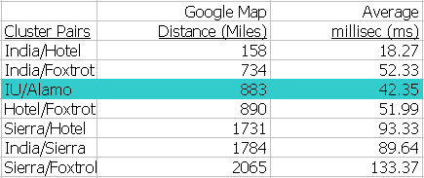
Network Level
– Round-trip Latency Due to Distance

Slide 28
Network Level – Ping RTT with 32 iperf connections
Lowest RTT measured between two FutureGrid clusters.

Slide 29
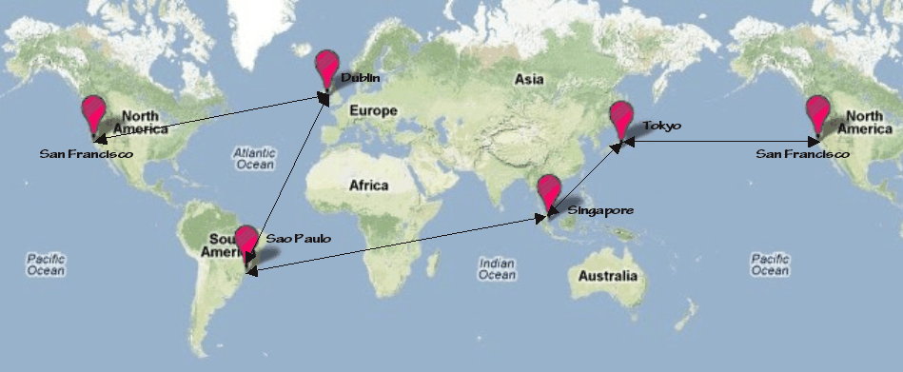
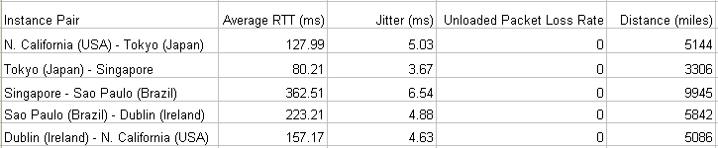
Measurement of Round-trip Latency, Data Loss Rate, Jitter
Five Amazon EC2 clouds selected: California, Tokyo, Singapore, Sao Paulo, Dublin
Web-scale inter-cloud network characteristics

Slide 30
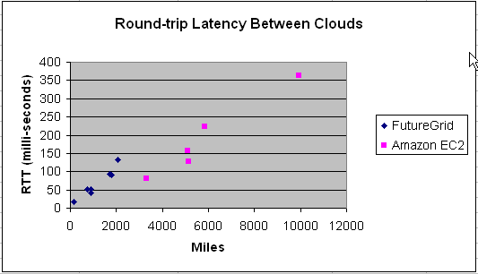
Measured Web-scale and National-scale Inter-Cloud Latency
Inter-cloud latency is proportional to distance between clouds.

Slide 31
Some Current Activities
IoTCloud https://sites.google.com/site/opensourceiotcloud/
FutureGrid https://portal.futuregrid.org/
Science Cloud Summer School July 30-August 3 offered virtually
  Aiming at computer science and application students
  Lab sessions on commercial clouds or FutureGrid
  http://www.vscse.org/summerschool/2012/scss.html

