Slide 1
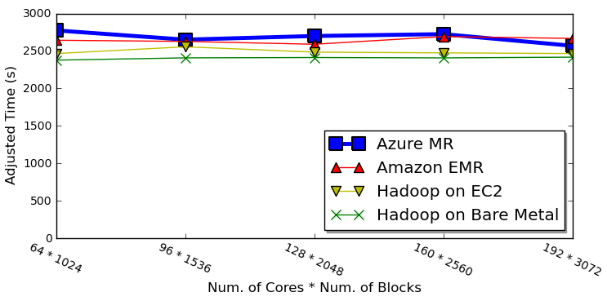
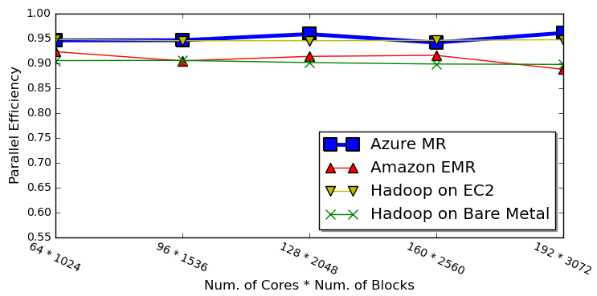
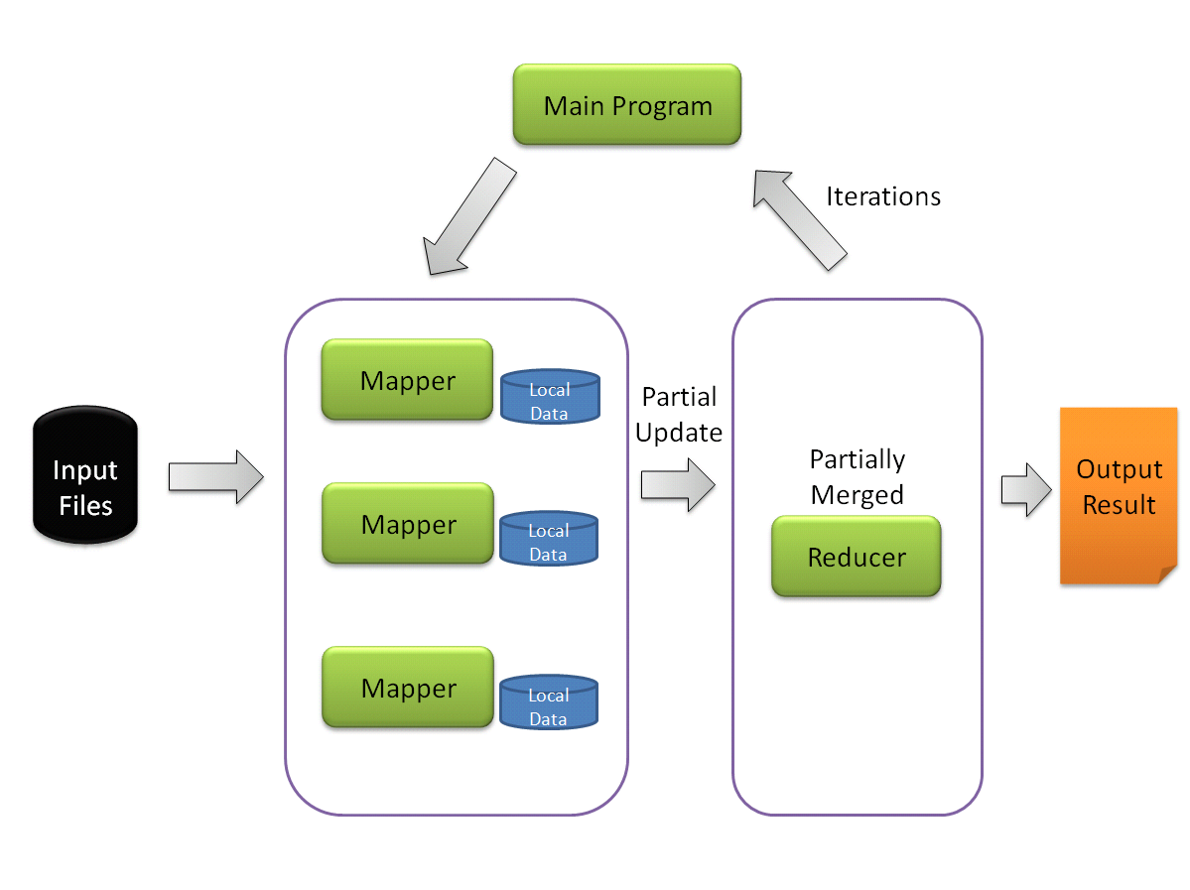
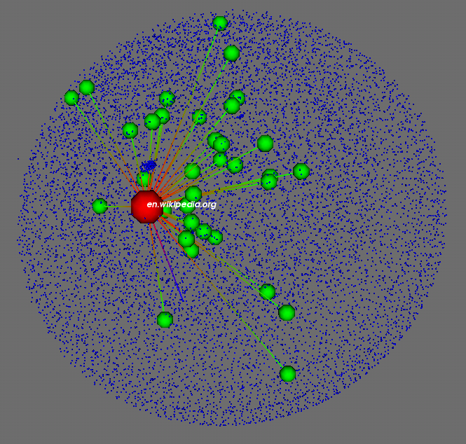
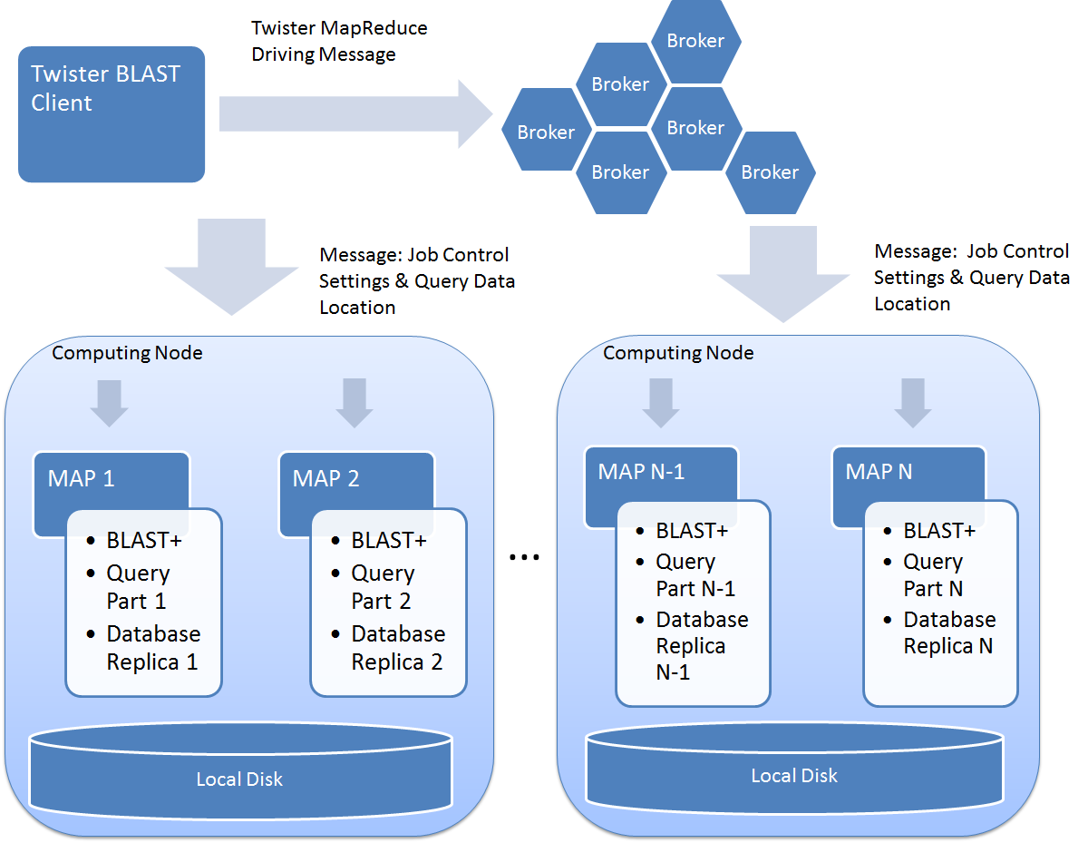
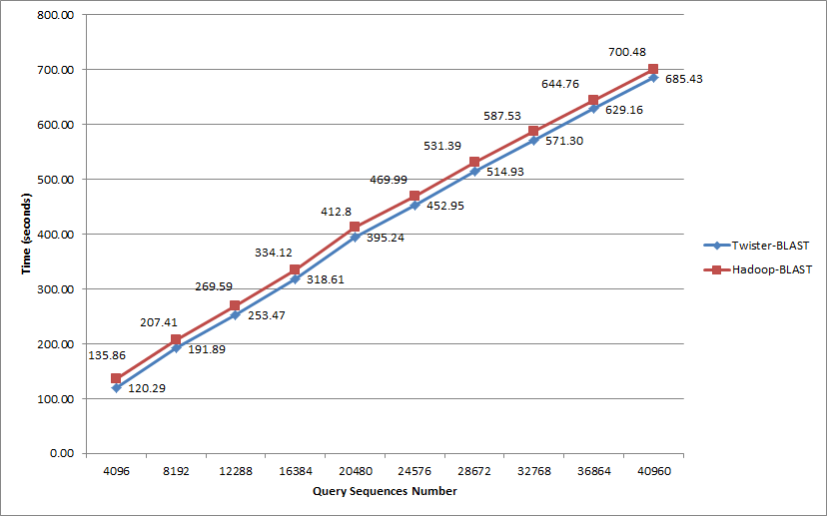
Parallel Applications And Tools
For Cloud Computing Environments
SALSA PROJECTS
http://salsahpc.indiana.edu/
Thilina Gunarathne, Stephen Tak-lon Wu, Hui Li, Yuduo Zhou, Bingjing Zhang,
Adam Lee Hughes, Saliya Ekanayake, Jong Youl Choi, Seung-Hee Bae, Yang Ruan
SALSA group, Pervasive Technology Institute, Indiana University, Bloomington, Indiana
Advisor : Professor Geoffrey Fox and Professor Judy Qiu
Azure MapReduce
A Decentralized MapReduce Framework Built On Top Of Windows Azure Cloud Services.
A solution to the void of parallel programming frameworks on Microsoft Azure
  Use distributed, highly scalable & available cloud services
  Supports dynamically scaling up/down
  No Single Point of Failure
  Comparable Performance
Smith Waterman Sequence Alignment All-Pairs Normalized Performance
CAP3 Sequence Assembly Absolute Parallel Efficiency
Fault Tolerance
Combiner step
Web based monitoring console
Easy testing and deployment
Co-exist with eventual consistency of cloud infrastructure services
Minimal management / maintenance overhead
Large-scale PageRank with Twister
Efficient processing of large scale PageRank challenges current MapReduce runtimes.
Difficulties: messaging > memory > computation
Implementations: Twister, DryadLINQ, Hadoop, MPI
Optimization strategies
  Load partition data in memory
  Fit partition size in memory
  Local merge in Reduce stage
Implement with Twister and Hadoop with 50 million web pages.
Twister caches the partitions of web graph in memory during multiple iteration, while Hadoop need reload partition from disk to memory for each iteration.
Implement with DryadLINQ with 50 million web pages on a 32 nodes Windows HPC cluster
Level of granularity
  Coarse granularity: split whole web graph into 256 files.
  Fine granularity: split whole web graph into 1280 files
Results Visualization with PlotViz3
10K 3D vertices processed with MDS
Twister BLAST
A simple parallel BLAST application based on Twister MapReduce framework
Runs on a single machine, a cluster, or Amazon EC2 cloud platform
Adaptable to the latest BLAST tool (BLAST+ 2.2.24)
Uses the state-of-the-art binary invoking parallelism, fully utilize highly optimized stand-alone BLAST software since it is
Brings scalability and simplicity to program and database maintenance.
Query is partitioned and transmitted to all nodes.
Database is replicated to all the nodes before execution
Database is compressed before replication and transported through Twister File Tool

Slide 2
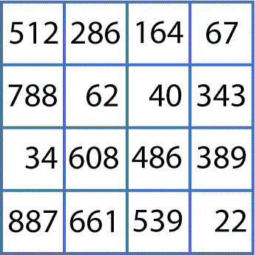



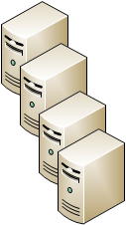
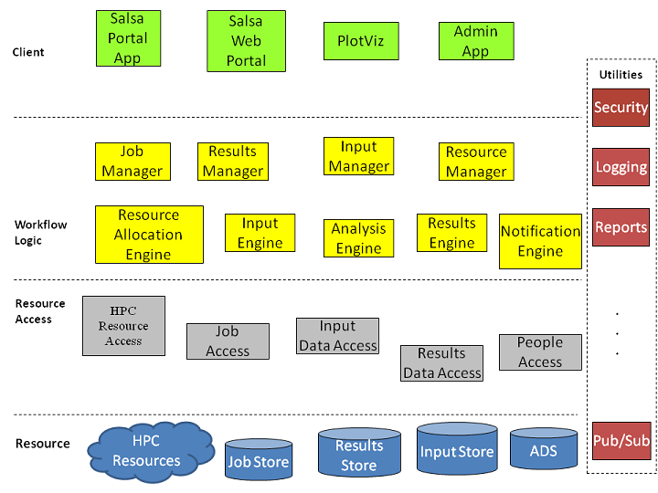
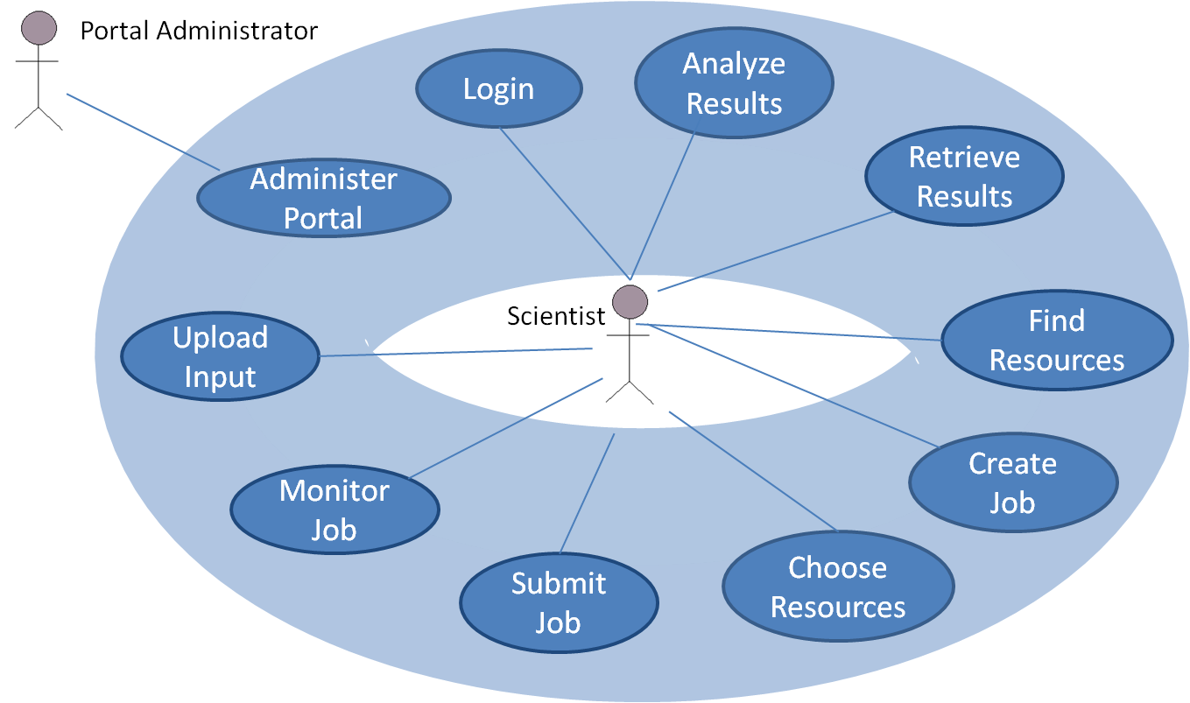
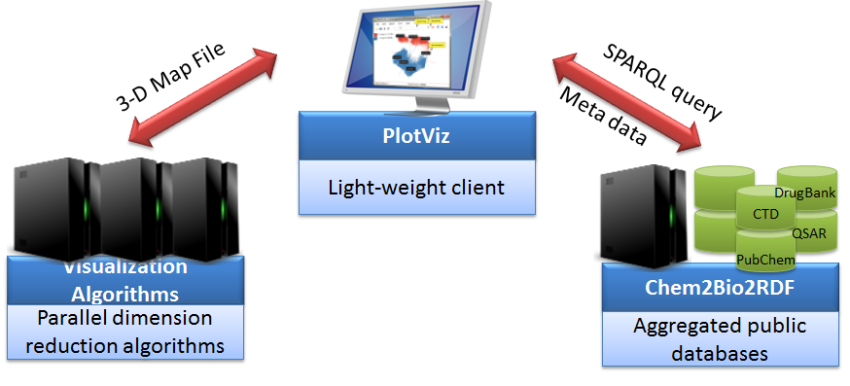
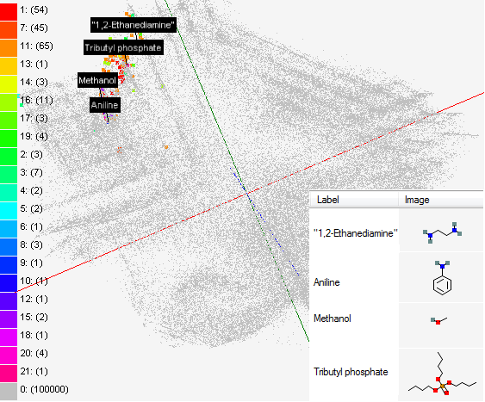
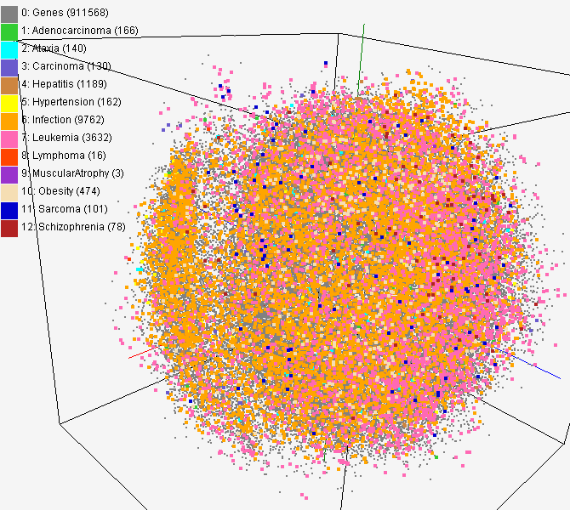
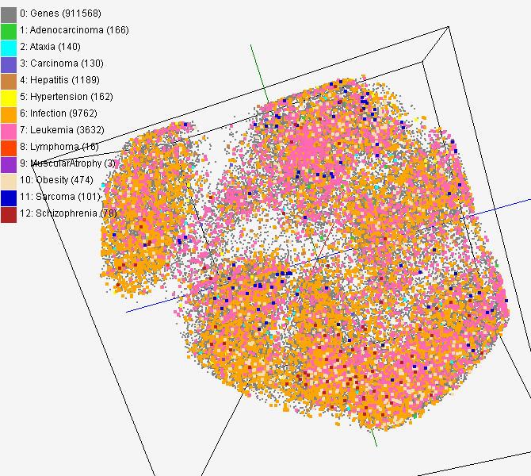
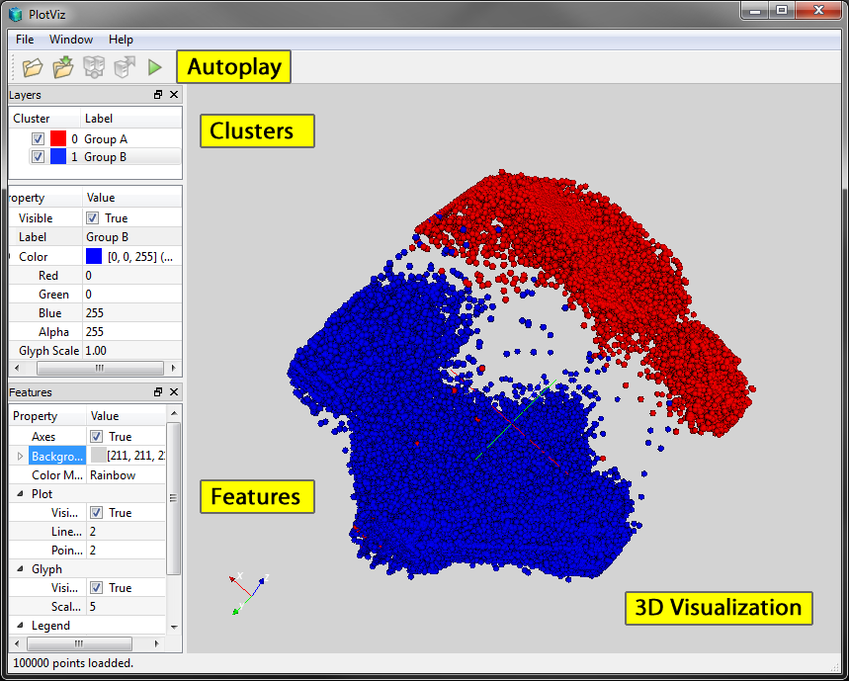
Parallel Applications And Tools
For Cloud Computing Environments
SALSA PROJECTS
http://salsahpc.indiana.edu/
Thilina Gunarathne, Stephen Tak-lon Wu, Hui Li, Yuduo Zhou, Bingjing Zhang,
Adam Lee Hughes, Saliya Ekanayake, Jong Youl Choi, Seung-Hee Bae, Yang Ruan
SALSA group, Pervasive Technology Institute, Indiana University, Bloomington, Indiana
Advisor : Professor Geoffrey Fox and Professor Judy Qiu
SALSA Portal and Biosequence Analysis Workflow
Pairwise Clustering
Cluster Indices
The SALSA biosequence workflow consists of a configuration builder and .NET versions of sequence alignment, pairwise clustering, and dimensional scaling software. The results are visualized using PlotViz.
Alu Sequences
Pairwise Alignment & Distance Calculation
Visualization
3D Plot
Distance Matrix
Multi-Dimensional Scaling
Coordinates
implements
The goal of a biosequence workflow is to automate the process by which scientists analyze large groups of sequences. In this case, sequences are clustered in some meaningful way, and the results are transformed into three-dimensional space for visualization.
Job Configuration and Submission Tool
Submit
Microsoft HPC Cluster
Cluster Head-node
Distribute Job
Compute Nodes
PlotViz - 3D Visualization Tool
Retrieve Results
Write Results
Sequence Aligning
Pairwise Clustering
Dimension Scaling
The SALSA Portal presents a set of web services for interacting with HPC resources. One of the Portal’s high-level use cases is an encapsulation of the complete biosequence workflow discussed here.
encapsulates
Create Biosequence Analysis Job
implements
<<extend>>
Implementation of the SALSA Portal use cases is accomplished through a set of tiered WCF services.
PlotViz Visualization with parallel MDS/GTM
Solvent-screening study
This visualizes a result of GTM dimension reduction for 215 solvents used in a pharmaceutical pre-screening process along with 100,000 chemical compounds . The result shows that our tool can clearly separate solvents from other chemicals based on the structural characteristics and users can navigate the large chemical space with visualization.
System Architecture of PlotViz
A tool for visualizing data points
  Dimension reduction
  by GTM and MDS
  Browse large and
  high-dimensional data
  Use many open
  (value-added) data
Parallel Visualization Algorithms
  GTM (Generative Topographic Mapping)
  MDS (Multi-dimensional Scaling)
  Interpolation extensions to GTM and MDS
CTD data visualization
Visualized about 930,000 gene and disease-related chemical compounds in PubChem database by using both MDS (left) and GTM (right) algorithms and labeled as different colors to discover cause-and-effect associations between genes and diseases based on Comparative Toxicogenomics Database (CTD) dataset.
Screenshot of PlotViz

