Slide 1
Parallel Applications And Tools For Cloud Computing Environments
SC 10
New Orleans, USA
Nov 17, 2010

Slide 2
Azure MapReduce

Slide 3
AzureMapReduce
A MapRedue runtime for Microsoft Azure using Azure cloud services
Azure Compute
Azure BLOB storage for in/out/intermediate data storage
Azure Queues for task scheduling
Azure Table for management/monitoring data storage
Advantages of the cloud services
Distributed, highly scalable & available
Backed by industrial strength data centers and technologies
Decentralized control
Dynamically scale up/down
No Single Point of Failure

Slide 4
AzureMapReduce Features
Familiar MapReduce programming model
Combiner step
Fault Tolerance
Rerunning of failed and straggling tasks
Web based monitoring console
Easy testing and deployment
Customizable
Custom Input & output formats
Custom Key and value implementations
Load balanced global queue based scheduling

Slide 5
Advantages
Fills the void of parallel programming frameworks on Microsoft Azure
Well known, easy to use programming model
Overcome the possible unreliability's of cloud compute nodes
Designed to co-exist with eventual consistency of cloud services
Allow the user to overcome the large latencies of cloud services by using coarser grained tasks
Minimal management/maintanance overhead

Slide 6
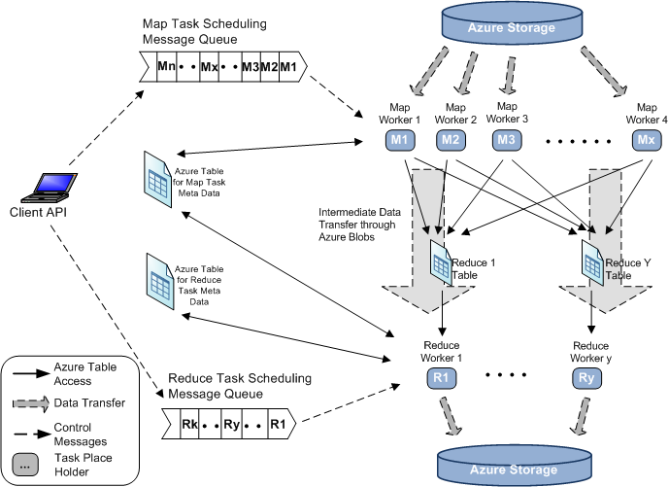
AzureMapReduce Architecture

Slide 7
Performance
Smith Watermann Pairwise Distance All-Pairs Normalized Performance
CAP3 Sequence Assembly Parallel Efficiency

Slide 8
Large-scale PageRank with Twister

Slide 9
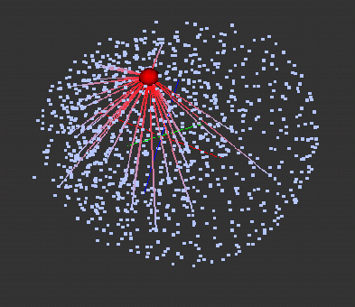
Pagerank with MapReduce
Efficient processing of large scale Pagerank challenges current MapReduce runtimes.
Implementations: Twister, DryadLINQ, Hadoop, MPI
Optimization strategies
Load static data in memory
Fit partition size to memory
Local merge in Reduce stage
Results Visualization with PlotViz3
1K 3D vertices processed with MDS
Red vertex represent “wikipedia.org”

Slide 10
Pagerank Optimization Strategies
Implement with DryadLINQ with 50 million web pages on a 32 nodes Windows HPC cluster
The coarse granularity strategy out performs fine granularity because it saves scheduling cost and network traffic
Implement with Twister and Hadoop with 50 million web pages.
Twister caches the partitions of web graph in memory during multiple iteration, while Hadoop needs to reload partition from disk to memory for each iteration.

Slide 11
Twister BLAST

Slide 12
Twister-BLAST
A simple parallel BLAST application based on Twister MapReduce framework
Runs on a single machine, a cluster, or Amazon EC2 cloud platform
Adaptable to the latest BLAST tool (BLAST+ 2.2.24)

Slide 13
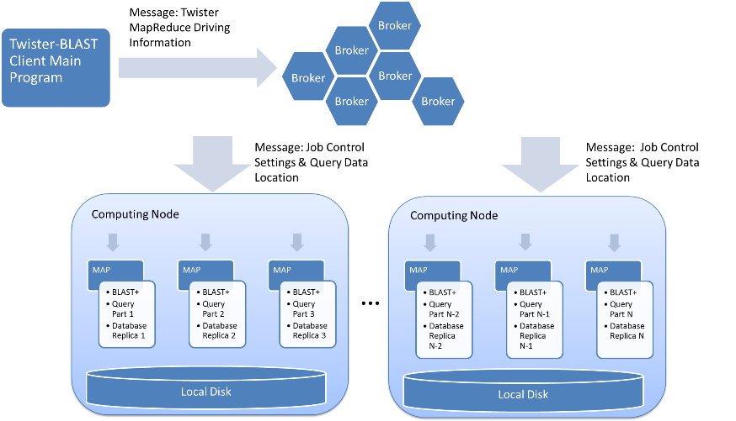
Twister-BLAST Architecture

Slide 14
Database Management
Replicated to all the nodes, in order to support BLAST binary execution
Compression before replication
Transported through file share script tool in Twister

Slide 15
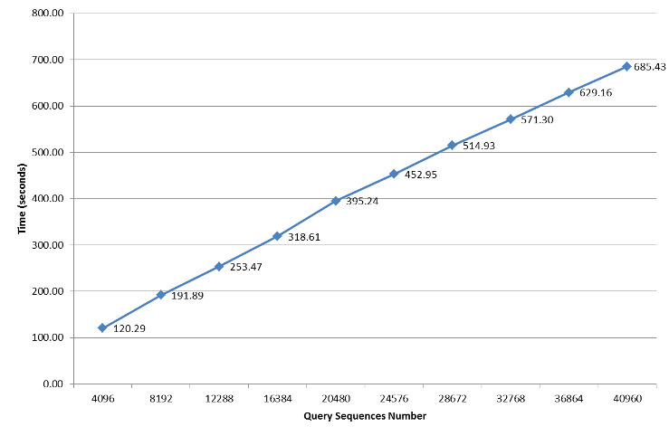
Twister-BLAST Performance Chart on IU PolarGrid

Slide 16
SALSA Portal and Biosequence Analysis Workflow

Slide 17
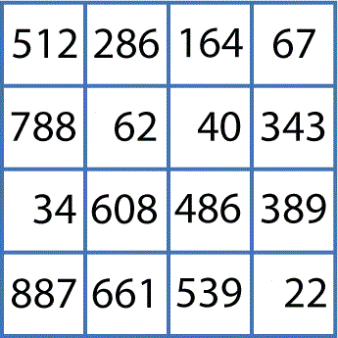
Biosequence Analysis
Conceptual Workflow
Pairwise Clustering
Cluster Indices
Pairwise Alignment & Distance Calculation
Alu Sequences
Visualization
3D Plot
Distance Matrix
Coordinates
Multi-Dimensional Scaling

Slide 18
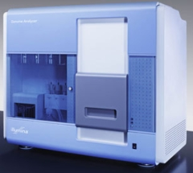
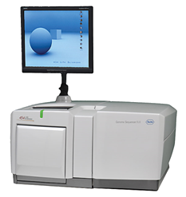
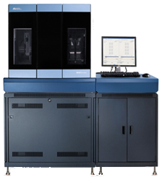
DNA Sequencing Pipeline
MapReduce
Pairwise
clustering
Sequence
alignment
Dissimilarity
Matrix
N(N-1)/2 values
Visualization
Plotviz
FASTA File N Sequences
Blocking
block
Pairings
MPI
MDS
Read Alignment
Illumina/Solexa Roche/454 Life Sciences Applied Biosystems/SOLiD
Internet
Modern Commercial Gene Sequencers
This chart illustrate our research of a pipeline mode to provide services on demand (Software as a Service SaaS)
User submit their jobs to the pipeline. The components are services and so is the whole pipeline.

Slide 19
Alu and Metagenomics Workflow
“All pairs” problem
Data is a collection of N sequences. Need to calculate N² dissimilarities (distances) between sequnces (all pairs).
These cannot be thought of as vectors because there are missing characters
“Multiple Sequence Alignment” (creating vectors of characters) doesn’t seem to work if N larger than O(100), where 100’s of characters long.
Step 1: Can calculate N² dissimilarities (distances) between sequences
Step 2: Find families by clustering (using much better methods than Kmeans). As no vectors, use vector free O(N²) methods
Step 3: Map to 3D for visualization using Multidimensional Scaling (MDS) – also O(N²)
Results:
N = 50,000 runs in 10 hours (the complete pipeline above) on 768 cores
Discussions:
Need to address millions of sequences …..
Currently using a mix of MapReduce and MPI
Twister will do all steps as MDS, Clustering just need MPI Broadcast/Reduce

Slide 20
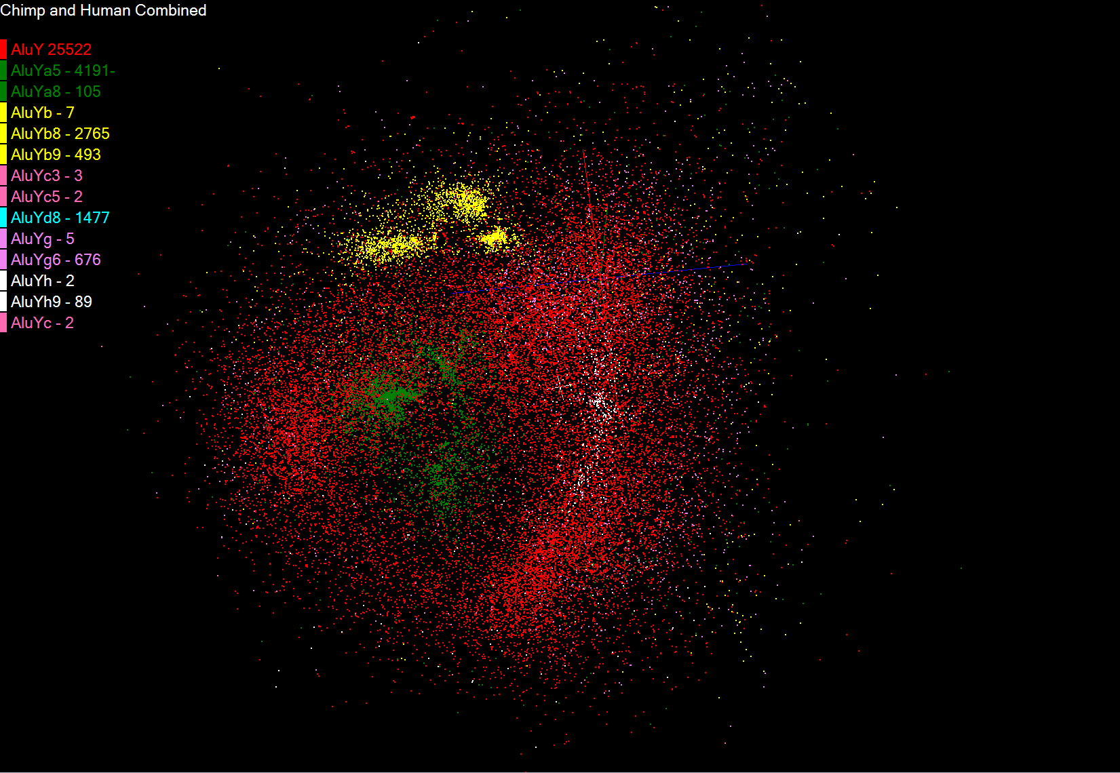
Alu Families
This visualizes results of Alu repeats from Chimpanzee and Human Genomes. Young families (green, yellow) are seen as tight clusters. This is projection of MDS dimension reduction to 3D of 35399 repeats – each with about 400 base pairs

Slide 21
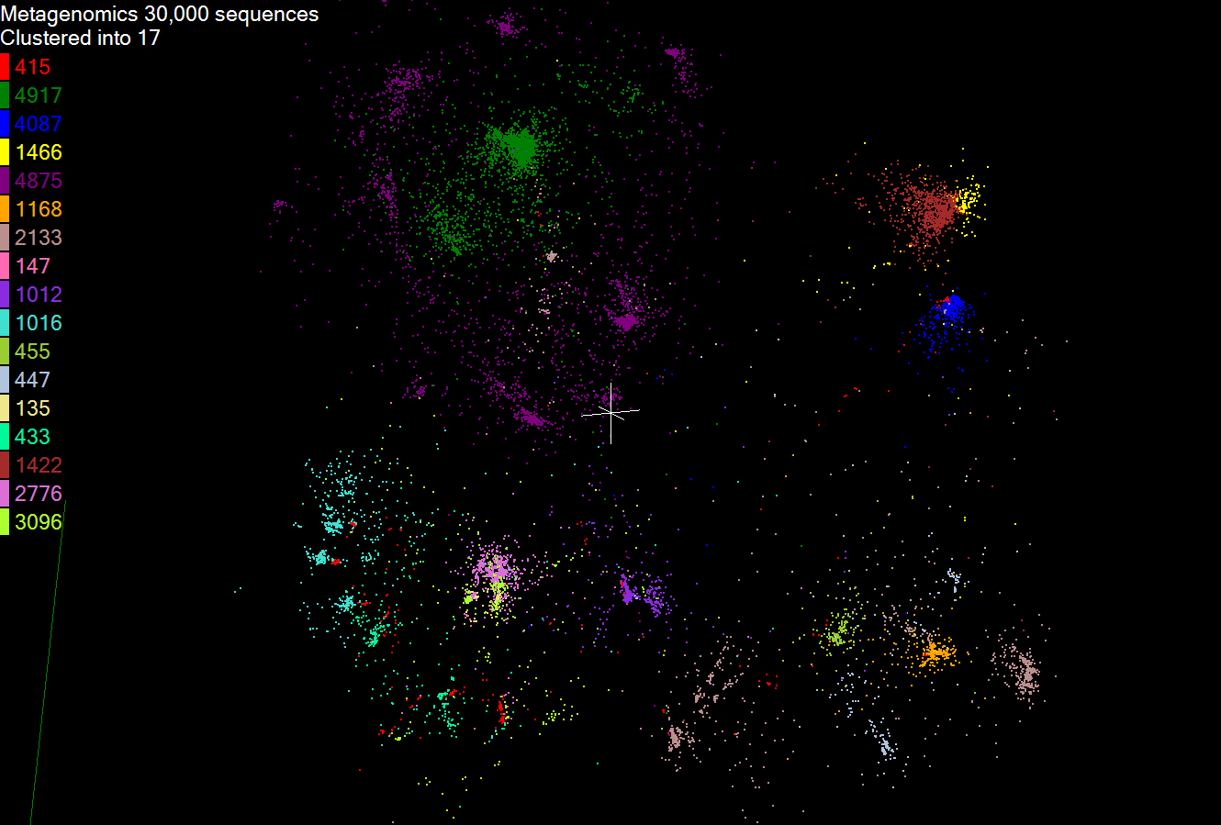
Metagenomics
This visualizes results of dimension reduction to 3D of 30000 gene sequences from an environmental sample. The many different genes are classified by clustering algorithm and visualized by MDS dimension reduction

Slide 22
Biosequence Analysis
Workflow Implementation
Job Configuration and Submission Tool
Microsoft HPC Cluster
Submit
Distribute Job
Compute Nodes
Cluster Head-node
Sequence Aligning
Pairwise Clustering
Dimension Scaling
PlotViz - 3D Visualization Tool
Retrieve Results
Write Results

Slide 23
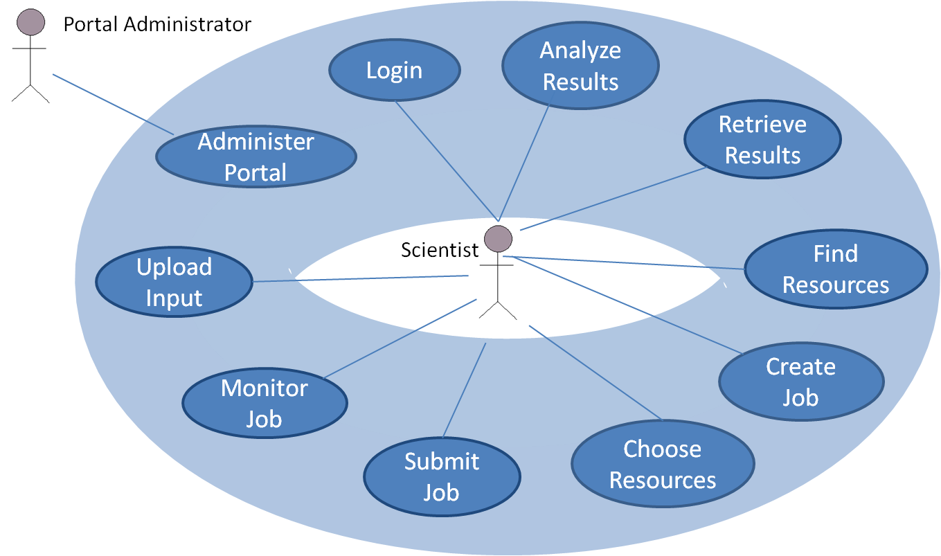
SALSA Portal
Use Cases
<<extend>>
Create Biosequence Analysis Job

Slide 24
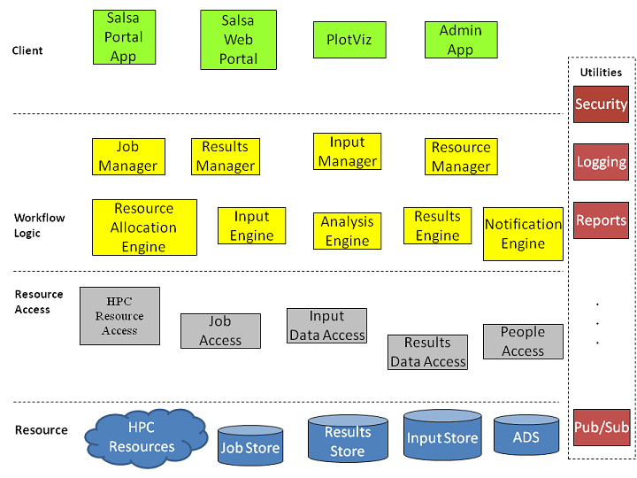
SALSA Portal
Architecture

Slide 25
PlotViz Visualization with parallel MDS/GTM

Slide 26
PlotViz and Dimension Reduction
http://salsahpc.org/plotviz
Currently available DirectX Windows binary
3-6 months open source VTK/OPENGL
A tool for visualizing data points
Dimension reduction by GTM and MDS
Browse large and high-dimensional data
Use many open (value-added) data
Parallel Dimension Reduction Algorithms
GTM (Generative Topographic Mapping)
MDS (Multi-dimensional Scaling)
Interpolation extensions to GTM and MDS

Slide 27
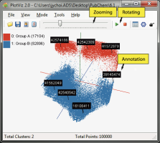
PlotViz System Overview
3-D Map File
SPARQL query
PlotViz
Meta data
Light-weight client
DrugBank
CTD
QSAR
Visualization Algorithms
PubChem
Chem2Bio2RDF
Parallel dimension reduction algorithms
Aggregated public databases

Slide 28
Parallel Data Analysis Algorithms on Multicore
Developing a suite of parallel data-analysis capabilities
Clustering for vectors and for points where only dissimilarities defined
Dimension Reduction for visualization and analysis (MDS, GTM)
Matrix algebra as needed
Matrix Multiplication
Equation Solving
Eigenvector/value Calculation
Extending to Global Optimization Algorithms such as Latent Dirichlet Allocation LDA
Use Deterministic Annealing for Clustering, MDS, GTM, LDA, Gaussian Mixtures ….
Extending O(N²) MDS/ dissimilarity clustering to O(NlogN)
Notes:
Results
Microsoft CCR supports MPI, dynamic threading
Detailed performance measurements with Speedups of 7.5 or above on 8-core systems for “large problems” using deterministic annealed (avoid local minima) algorithms for clustering, Gaussian Mixtures, GTM (dimensional reduction) etc.

Slide 29
General Deterministic Annealing Formula
N data points E(x) in D dimensions space and minimize F by EM
Deterministic Annealing Clustering (DAC)
F is Free Energy
EM is well known expectation maximization method
p(x) with Σ p(x) =1
T is annealing temperature varied down from ∞ with final value of 1
Determine cluster center Y(k) by EM method
K (number of clusters) starts at 1 and is incremented by algorithm

Slide 30
Deterministic Annealing I
Gibbs Distribution at Temperature T P(χ) = exp( - H(χ)/T) / ∫ dχ exp( - H(χ)/T)
Or P(χ) = exp( - H(χ)/T + F/T )
Minimize Free Energy F = < H - T S(P) > = ∫ dχ {P(χ)H + T P(χ) lnP(χ)}
Where χ are (a subset of) parameters to be minimized
Simulated annealing corresponds to doing these integrals by Monte Carlo
Deterministic annealing corresponds to doing integrals analytically and is naturally much faster
In each case temperature is lowered slowly – say by a factor 0.99 at each iteration

Slide 31
Deterministic Annealing
F({y}, T)
Solve Linear Equations for each temperature
Nonlinearity effects mitigated by initializing with solution at previous higher temperature
Configuration {y}
Minimum evolving as temperature decreases
Movement at fixed temperature going to local minima if not initialized “correctly

Slide 32
Deterministic Annealing II
For some cases such as vector clustering and Gaussian Mixture Models one can do integrals by hand but usually will be impossible
So introduce Hamiltonian H₀(χ, ε) which by choice of ε can be made similar to H(χ) and which has tractable integrals
P₀(χ) = exp( - H₀(χ)/T + F₀/T ) approximate Gibbs
F_{R} (P₀) = < H_{R} - T S₀(P₀) >|₀ = < H_{R} – H₀> |₀ + F₀(P₀)
Where <…>|₀ denotes ∫ dχ P_{o}(χ)
Easy to show that real Free Energy F_{A} (P_{A}) ≤ F_{R} (P₀)
In many problems, decreasing temperature is classic multiscale – finer resolution (T is “just” distance scale)
Same idea called variational (Bayes) inference used for Latent Dirichlet Allocation

Slide 33
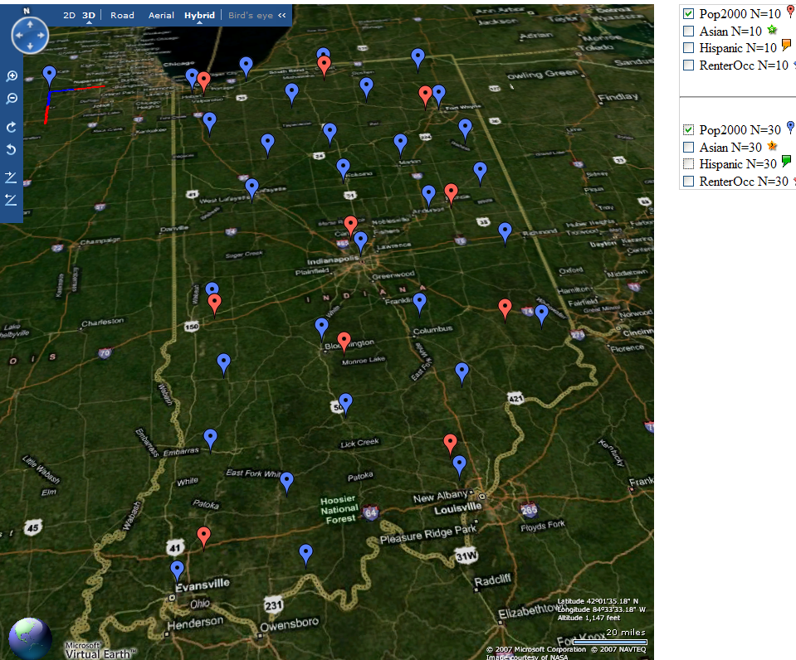
Deterministic Annealing Clustering of Indiana Census Data
Decrease temperature (distance scale) to discover more clusters
Distance Scale Temperature^{0.5}
Red is coarse resolution with 10 clusters
Blue is finer resolution with 30 clusters
Clusters find cities in Indiana
Distance Scale is √Temperature

Slide 34
Implementation of DA I
Expectation step E is find ε minimizing F_{R} (P₀) and
Follow with M step setting χ = <χ> |₀ = ∫ dχ χ P_{o}(χ) and if one does not anneal over all parameters and one follows with a traditional minimization of remaining parameters
In clustering, one then looks at second derivative matrix of F_{R} (P₀) wrt ε and as temperature is lowered this develops negative eigenvalue corresponding to instability
This is a phase transition and one splits cluster into two and continues EM iteration
One starts with just one cluster

Slide 35
Rose, K., Gurewitz, E., and Fox, G. C. ``Statistical mechanics and phase transitions in clustering,'' Physical Review Letters, 65(8):945-948, August 1990.
My #5 my most cited article (311)

Slide 36
High Performance Dimension Reduction and Visualization
Need is pervasive
Large and high dimensional data are everywhere: biology, physics, Internet, …
Visualization can help data analysis
Visualization of large datasets with high performance
Map high-dimensional data into low dimensions (2D or 3D).
Need Parallel programming for processing large data sets
Developing high performance dimension reduction algorithms:
MDS(Multi-dimensional Scaling), used earlier in DNA sequencing application
GTM(Generative Topographic Mapping)
DA-MDS(Deterministic Annealing MDS)
DA-GTM(Deterministic Annealing GTM)
Interactive visualization tool PlotViz
We are supporting drug discovery by browsing 60 million compounds in PubChem database with 166 features each
Notes:
With David Wild

Slide 37
Dimension Reduction Algorithms
Multidimensional Scaling (MDS) [1]
Given the proximity information among points.
Optimization problem to find mapping in target dimension of the given data based on pairwise proximity information while minimize the objective function.
Objective functions: STRESS (1) or SSTRESS (2)
Only needs pairwise distances δ_{ij} between original points (typically not Euclidean)
d_{ij}(X) is Euclidean distance between mapped (3D) points
Generative Topographic Mapping (GTM) [2]
Find optimal K-representations for the given data (in 3D), known as K-cluster problem (NP-hard)
Original algorithm use EM method for optimization
Deterministic Annealing algorithm can be used for finding a global solution
Objective functions is to maximize log-likelihood:
[1] I. Borg and P. J. Groenen. Modern Multidimensional Scaling: Theory and Applications. Springer, New York, NY, U.S.A., 2005.
[2] C. Bishop, M. Svens´en, and C. Williams. GTM: The generative topographic mapping. Neural computation, 10(1):215–234, 1998.
Notes:
MDS implemented in C#; GTM in R and C/C++

Slide 38
GTM vs. MDS
GTM
MDS (SMACOF)
Purpose
Non-linear dimension reduction
Find an optimal configuration in a lower-dimension
Iterative optimization method
Objective Function
Maximize Log-Likelihood
Minimize STRESS or SSTRESS
Complexity
O(KN) (K << N)
O(N²)
Optimization
Method
EM
Iterative Majorization (EM-like)
MDS also soluble by viewing as nonlinear χ² with iterative linear equation solver

Slide 39
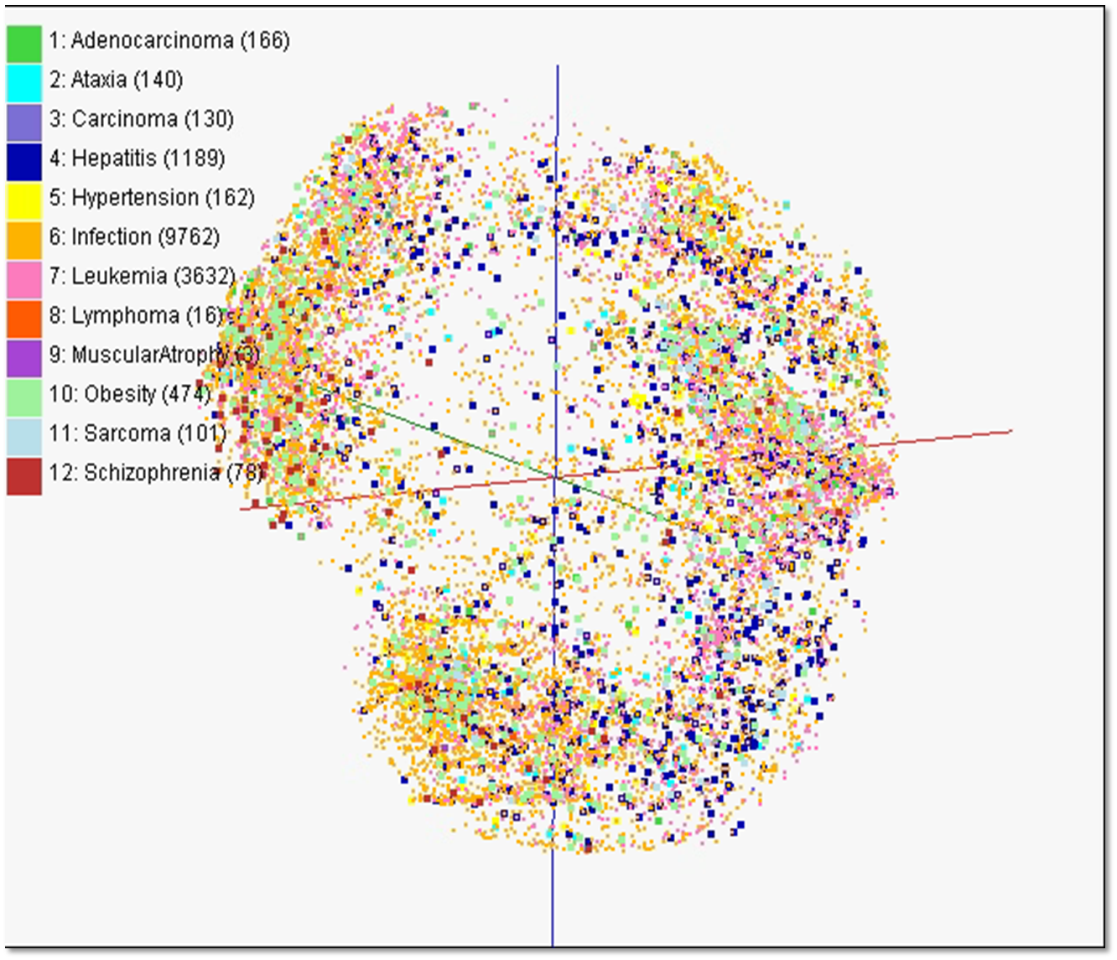
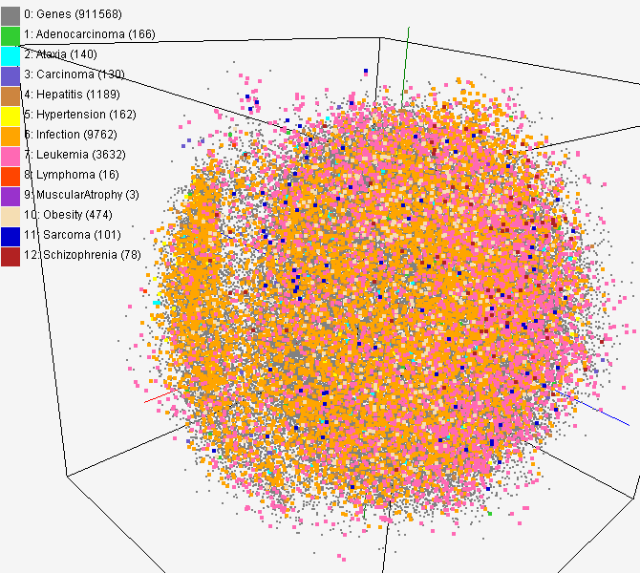
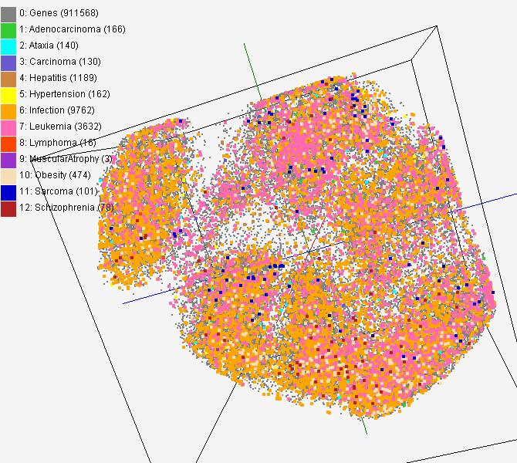
MDS and GTM Map (1)
PubChem data with CTD visualization by using MDS (left) and GTM (right)
About 930,000 chemical compounds are visualized as a point in 3D space, annotated by the related genes in Comparative Toxicogenomics Database (CTD)

Slide 40
CTD data for gene-disease
PubChem data with CTD visualization by using MDS (left) and GTM (right)
About 930,000 chemical compounds are visualized as a point in 3D space, annotated by the related genes in Comparative Toxicogenomics Database (CTD)

Slide 41
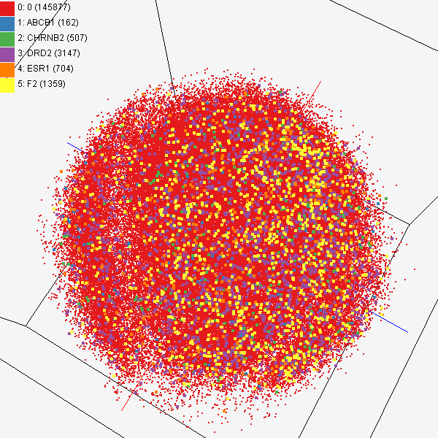
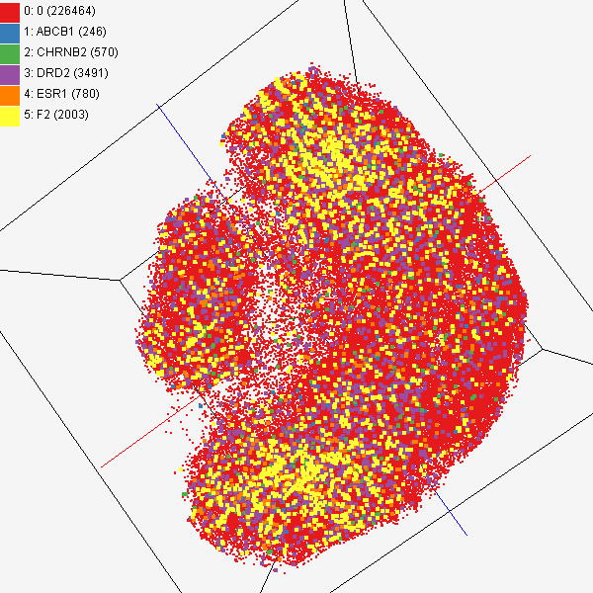
Chem2Bio2RDF
Chemical compounds shown in literatures, visualized by MDS (left) and GTM (right)
Visualized 234,000 chemical compounds which may be related with a set of 5 genes of interest (ABCB1, CHRNB2, DRD2, ESR1, and F2) based on the dataset collected from major journal literatures which is also stored in Chem2Bio2RDF system.

Slide 42
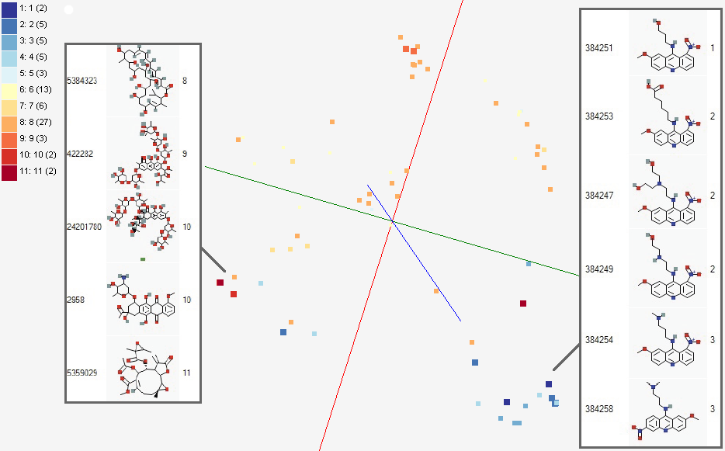
Activity Cliffs
GTM Visualization of bioassay activities

Slide 43
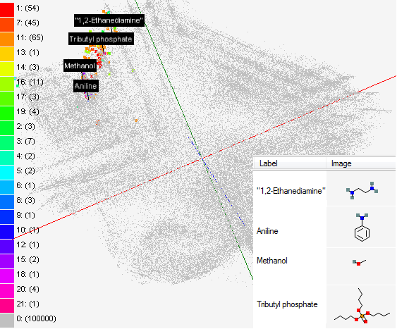
Solvent Screening
Visualizing 215 solvents
215 solvents (colored and labeled) are embedded with 100,000 chemical compounds (colored in grey) in PubChem database

Slide 44
Interpolation Method
MDS and GTM are highly memory and time consuming process for large dataset such as millions of data points
MDS requires O(N²) and GTM does O(KN) (N is the number of data points and K is the number of latent variables)
Training only for sampled data and interpolating for out-of-sample set can improve performance
Interpolation is a pleasingly parallel application suitable for MapReduce and Clouds
n in-sample
Training
Trained data
N-n
out-of-sample
Interpolated
MDS/GTM map
Interpolation
Total N data

Slide 45
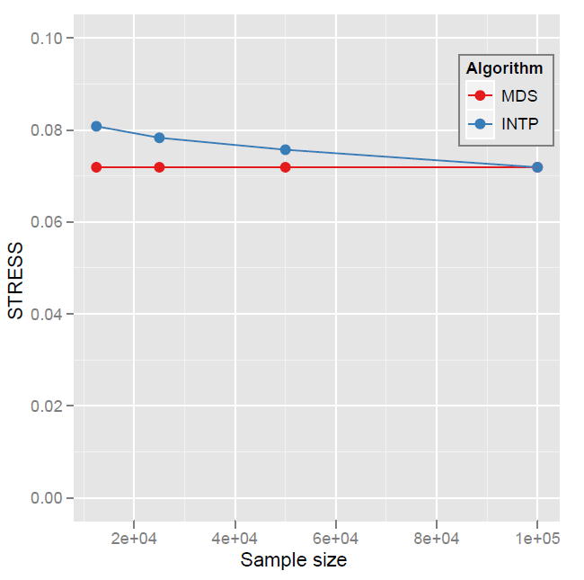
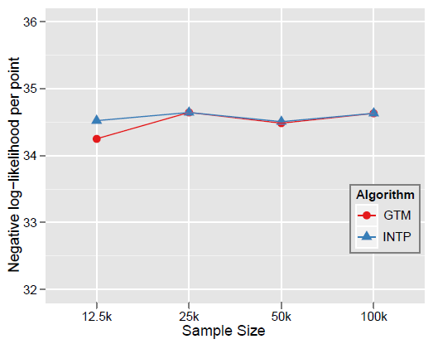
Quality Comparison (O(N²) Full vs. Interpolation)
MDS
GTM
Quality comparison between Interpolated result upto 100k based on the sample data (12.5k, 25k, and 50k) and original MDS result w/ 100k.
STRESS:
w_{ij} = 1 / ∑δ_{ij}²
16 nodes
Interpolation result (blue) is getting close to the original (red) result as sample size is increasing.
Time = C(250 n² + nN_{I}) where sample size n and N_{I} points interpolated
Notes:
12.5K 25K 50K 100K Run on 16 nodes of Tempest
Note that we gain performance of over a factor of 100 for this data size. It would be more for larger data set.

