Slide 1
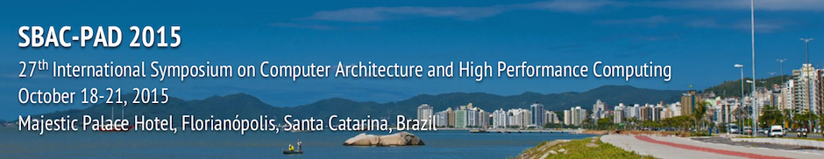
Big Data Applications, Software and System Architectures
SBAC-PAD 2015
Geoffrey Fox October 19 2015
gcf@indiana.edu
http://www.infomall.org, http://spidal.org/ http://hpc-abds.org/kaleidoscope/
Department of Intelligent Systems Engineering
School of Informatics and Computing, Digital Science Center
Indiana University Bloomington

Slide 2
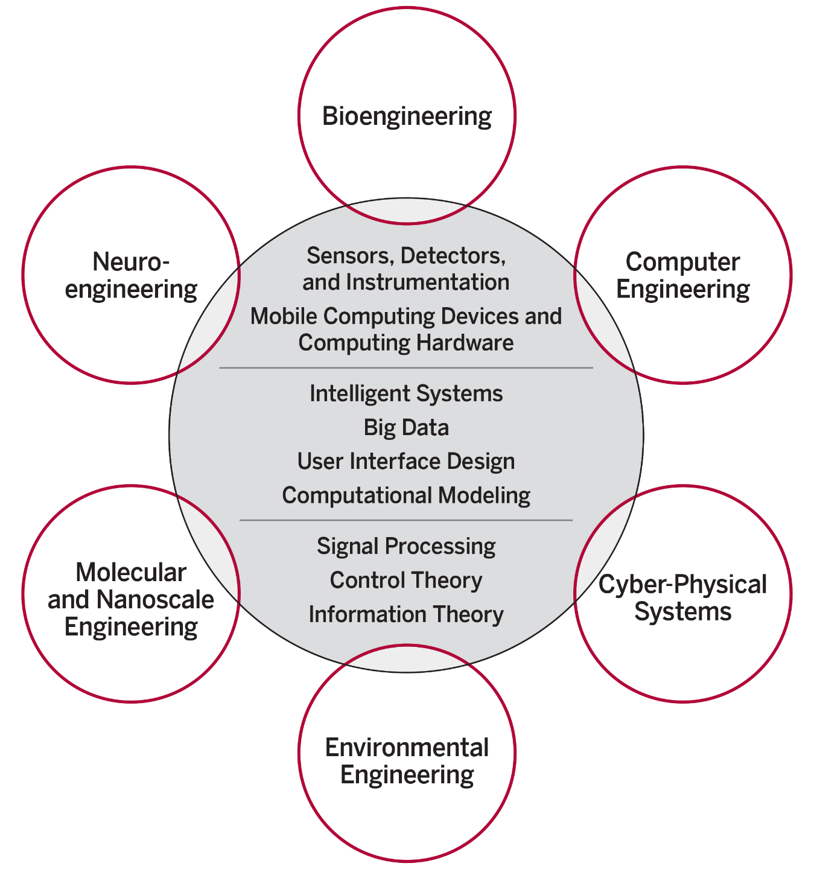
ISE Structure
The focus is on engineering of systems of small scale, often mobile devices that draw upon modern information technology techniques including intelligent systems, big data and user interface design. The foundation of these devices include sensor and detector technologies, signal processing, and information and control theory.
End to end Engineering in 6 areas
New faculty/Students Fall 2016
https://indiana.peopleadmin.com/postings/1900
IU Bloomington is the only university among AAU’s 62 member institutions that does not have any type of engineering program.

Slide 3
Abstract
We discuss the nexus of big data applications, software and infrastructure where we identify 6 overall machine architectures.
The big Data applications are drawn from a study from NIST and the layered software from a compendium of open-source, commercial and HPC systems.
We illustrate with typical "big data analytics" Machine learning with varied Parallel Programming Models (MPI, Hadoop, Spark, Storm) on both cloud and HPC platforms.
We discuss performance (of Java) and the use of DevOps scripts such as Chef/Ansible and OpenStack Heat to specify software stack. This leads to the interesting virtual cluster concept.

Slide 4
NIST Big Data Initiative
Led by Chaitin Baru, Bob Marcus, Wo Chang
And
Big Data Application Analysis

Slide 5
NBD-PWG (NIST Big Data Public Working Group) Subgroups & Co-Chairs
There were 5 Subgroups
  Note mainly industry
Requirements and Use Cases Sub Group
  Geoffrey Fox, Indiana U.; Joe Paiva, VA; Tsegereda Beyene, Cisco
Definitions and Taxonomies SG
  Nancy Grady, SAIC; Natasha Balac, SDSC; Eugene Luster, R2AD
Reference Architecture Sub Group
  Orit Levin, Microsoft; James Ketner, AT&T; Don Krapohl, Augmented Intelligence
Security and Privacy Sub Group
  Arnab Roy, CSA/Fujitsu Nancy Landreville, U. MD Akhil Manchanda, GE
Technology Roadmap Sub Group
  Carl Buffington, Vistronix; Dan McClary, Oracle; David Boyd, Data Tactics
See http://bigdatawg.nist.gov/usecases.php
and http://bigdatawg.nist.gov/V1_output_docs.php

Slide 6

Use Case Template
26 fields completed for 51 apps
Government Operation: 4
Commercial: 8
Defense: 3
Healthcare and Life Sciences: 10
Deep Learning and Social Media: 6
The Ecosystem for Research: 4
Astronomy and Physics: 5
Earth, Environmental and Polar Science: 10
Energy: 1
Now an online form

Slide 7
51 Detailed Use Cases: Contributed July-September 2013
Covers goals, data features such as 3 V’s, software, hardware
26 Features for each use case
Biased to science
http://bigdatawg.nist.gov/usecases.php
https://bigdatacoursespring2014.appspot.com/course (Section 5)
Government Operation(4): National Archives and Records Administration, Census Bureau
Commercial(8): Finance in Cloud, Cloud Backup, Mendeley (Citations), Netflix, Web Search, Digital Materials, Cargo shipping (as in UPS)
Defense(3): Sensors, Image surveillance, Situation Assessment
Healthcare and Life Sciences(10): Medical records, Graph and Probabilistic analysis, Pathology, Bioimaging, Genomics, Epidemiology, People Activity models, Biodiversity
Deep Learning and Social Media(6): Driving Car, Geolocate images/cameras, Twitter, Crowd Sourcing, Network Science, NIST benchmark datasets
The Ecosystem for Research(4): Metadata, Collaboration, Language Translation, Light source experiments
Astronomy and Physics(5): Sky Surveys including comparison to simulation, Large Hadron Collider at CERN, Belle Accelerator II in Japan
Earth, Environmental and Polar Science(10): Radar Scattering in Atmosphere, Earthquake, Ocean, Earth Observation, Ice sheet Radar scattering, Earth radar mapping, Climate simulation datasets, Atmospheric turbulence identification, Subsurface Biogeochemistry (microbes to watersheds), AmeriFlux and FLUXNET gas sensors
Energy(1): Smart grid

Slide 8
Features and Examples

Slide 9
51 Use Cases: What is Parallelism Over?
People: either the users (but see below) or subjects of application and often both
Decision makers like researchers or doctors (users of application)
Items such as Images, EMR, Sequences below; observations or contents of online store
  Images or “Electronic Information nuggets”
  EMR: Electronic Medical Records (often similar to people parallelism)
  Protein or Gene Sequences;
  Material properties, Manufactured Object specifications, etc., in custom dataset
  Modelled entities like vehicles and people
Sensors – Internet of Things
Events such as detected anomalies in telescope or credit card data or atmosphere
(Complex) Nodes in RDF Graph
Simple nodes as in a learning network
Tweets, Blogs, Documents, Web Pages, etc.
  And characters/words in them
Files or data to be backed up, moved or assigned metadata
Particles/cells/mesh points as in parallel simulations

Slide 10
Features of 51 Use Cases I
PP (26) “All” Pleasingly Parallel or Map Only
MR (18) Classic MapReduce MR (add MRStat below for full count)
MRStat (7) Simple version of MR where key computations are simple reduction as found in statistical averages such as histograms and averages
MRIter (23) Iterative MapReduce or MPI (Spark, Twister)
Graph (9) Complex graph data structure needed in analysis
Fusion (11) Integrate diverse data to aid discovery/decision making; could involve sophisticated algorithms or could just be a portal
Streaming (41) Some data comes in incrementally and is processed this way
Classify (30) Classification: divide data into categories
S/Q (12) Index, Search and Query

Slide 11
Features of 51 Use Cases II
CF (4) Collaborative Filtering for recommender engines
LML (36) Local Machine Learning (Independent for each parallel entity) – application could have GML as well
GML (23) Global Machine Learning: Deep Learning, Clustering, LDA, PLSI, MDS,
  Large Scale Optimizations as in Variational Bayes, MCMC, Lifted Belief Propagation, Stochastic Gradient Descent, L-BFGS, Levenberg-Marquardt . Can call EGO or Exascale Global Optimization with scalable parallel algorithm
Workflow (51) Universal
GIS (16) Geotagged data and often displayed in ESRI, Microsoft Virtual Earth, Google Earth, GeoServer etc.
HPC (5) Classic large-scale simulation of cosmos, materials, etc. generating (visualization) data
Agent (2) Simulations of models of data-defined macroscopic entities represented as agents

Slide 12
Local and Global Machine Learning
Many applications use LML or Local machine Learning where machine learning (often from R) is run separately on every data item such as on every image
But others are GML Global Machine Learning where machine learning is a single algorithm run over all data items (over all nodes in computer)
  maximum likelihood or χ² with a sum over the N data items – documents, sequences, items to be sold, images etc. and often links (point-pairs).
  Graph analytics is typically GML
Covering clustering/community detection, mixture models, topic determination, Multidimensional scaling, (Deep) Learning Networks
PageRank is “just” parallel linear algebra
Note many Mahout algorithms are sequential – partly as MapReduce limited; partly because parallelism unclear
  MLLib (Spark based) better
SVM and Hidden Markov Models do not use large scale parallelization in practice?

Slide 13
Big Data Patterns – the Ogres
Benchmarking

Slide 14
Classifying Applications and Benchmarks
“Benchmarks” “kernels” “algorithm” “mini-apps” can serve multiple purposes
Motivate hardware and software features
  e.g. collaborative filtering algorithm parallelizes well with MapReduce and suggests using Hadoop on a cloud
  e.g. deep learning on images dominated by matrix operations; needs CUDA&MPI and suggests HPC cluster
Benchmark sets designed cover key features of systems in terms of features and sizes of “important” applications
Take 51 uses cases → derive specific features; each use case has multiple features
Generalize and systematize as Ogres with features termed “facets”
50 Facets divided into 4 sets or views where each view has “similar” facets

Slide 15
7 Computational Giants of
NRC Massive Data Analysis Report
http://www.nap.edu/catalog.php?record_id=18374
G1: Basic Statistics e.g. MRStat
G2: Generalized N-Body Problems
G3: Graph-Theoretic Computations
G4: Linear Algebraic Computations
G5: Optimizations e.g. Linear Programming
G6: Integration e.g. LDA and other GML
G7: Alignment Problems e.g. BLAST

Slide 16
HPC Benchmark Classics
Linpack or HPL: Parallel LU factorization
for solution of linear equations
NPB version 1: Mainly classic HPC solver kernels
  MG: Multigrid
  CG: Conjugate Gradient
  FT: Fast Fourier Transform
  IS: Integer sort
  EP: Embarrassingly Parallel
  BT: Block Tridiagonal
  SP: Scalar Pentadiagonal
  LU: Lower-Upper symmetric Gauss Seidel

Slide 17
13 Berkeley Dwarfs
Dense Linear Algebra
Sparse Linear Algebra
Spectral Methods
N-Body Methods
Structured Grids
Unstructured Grids
MapReduce
Combinational Logic
Graph Traversal
Dynamic Programming
Backtrack and
Branch-and-Bound
Graphical Models
Finite State Machines
First 6 of these correspond to Colella’s original.
Monte Carlo dropped.
N-body methods are a subset of Particle in Colella.
Note a little inconsistent in that MapReduce is a programming model and spectral method is a numerical method.
Need multiple facets!

Slide 18

Geospatial Information System
Shared / Dedicated / Transient / Permanent
HPC Simulations
Internet of Things
Metadata/Provenance
Archived/Batched/Streaming
Data Source and Style View
10
9
8
HDFS/Lustre/GPFS
7
6
Enterprise Data Model
5
Files/Objects
SQL/NoSQL/NewSQL
4
Search / Query / Index
Local Analytics
Graph Algorithms
Micro-benchmarks
Alignment
Optimization Methodology
Learning
Classification
Streaming
Global Analytics
Linear Algebra Kernels
Recommendations
Visualization
Base Statistics
3
2
1
4 Ogre Views and 50 Facets
Execution View
Pleasingly Parallel
1
2
3
4
5
6
7
8
9
10
11
12
13
14
14
13
12
11
10
9
8
7
6
Classic MapReduce
Map-Collective
5
4
3
2
1
Map Point-to-Point
Single Program Multiple Data
Map Streaming
1
Processing View
Shared Memory
Bulk Synchronous Parallel
2
3
Performance Metrics
4
Volume
Dynamic = D / Static = S
$O\left(N^{2}\right)$ = NN / $O(N)$ = N
Velocity
Variety
Veracity
Communication Structure
Regular = R / Irregular = I
Data Abstraction
Iterative / Simple
5
Metric = M / Non-Metric = N
Flops per Byte; Memory I/O
Execution Environment; Core libraries
6
7
Fusion
Dataflow
8
Problem
Architecture
View
9
Agents
10
Workflow
11
12

Slide 19
Facets of the Ogres
Problem Architecture
Meta or Macro Aspects of Ogres

Slide 20
Problem Architecture View of Ogres (Meta or MacroPatterns)
Pleasingly Parallel – as in BLAST, Protein docking, some (bio-)imagery including Local Analytics or Machine Learning – ML or filtering pleasingly parallel, as in bio-imagery, radar images (pleasingly parallel but sophisticated local analytics)
Classic MapReduce: Search, Index and Query and Classification algorithms like collaborative filtering (G1 for MRStat in Features, G7)
Map-Collective: Iterative maps + communication dominated by “collective” operations as in reduction, broadcast, gather, scatter. Common datamining pattern
Map-Point to Point: Iterative maps + communication dominated by many small point to point messages as in graph algorithms
Map-Streaming: Describes streaming, steering and assimilation problems
Shared Memory: Some problems are asynchronous and are easier to parallelize on shared rather than distributed memory – see some graph algorithms
SPMD: Single Program Multiple Data, common parallel programming feature
BSP or Bulk Synchronous Processing: well-defined compute-communication phases
Fusion: Knowledge discovery often involves fusion of multiple methods.
Dataflow: Important application features often occurring in composite Ogres
Use Agents: as in epidemiology (swarm approaches)
Workflow: All applications often involve orchestration (workflow) of multiple components
Notes:
Big dwarfs are Ogres
Implement Ogres in ABDS+

Slide 21
Relation of Problem and Machine Architecture
In my old papers (especially book Parallel Computing Works!), I discussed computing as multiple complex systems mapped into each other
Problem → Numerical formulation → Software → Hardware
Each of these 4 systems has an architecture that can be described in similar language
One gets an easy programming model if architecture of problem matches that of Software
One gets good performance if architecture of hardware matches that of software and problem
So “MapReduce” can be used as architecture of software (programming model) or “Numerical formulation of problem”

Slide 22
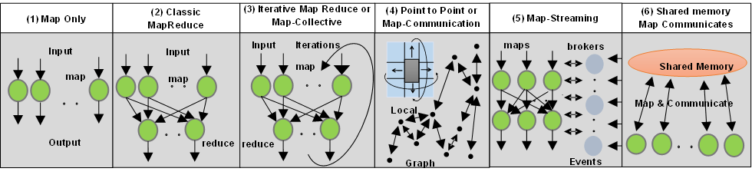
6 Forms of MapReduce cover “all” circumstances
Also an interesting software (architecture) discussion

Slide 23
Facets of the Ogres
Data Source and Style Aspects

Slide 24
Data Source and Style View of Ogres I
SQL NewSQL or NoSQL: NoSQL includes Document,
Column, Key-value, Graph, Triple store; NewSQL is SQL redone to exploit NoSQL performance
Other Enterprise data systems: 10 examples from NIST integrate SQL/NoSQL
Set of Files or Objects: as managed in iRODS and extremely common in scientific research
File systems, Object, Blob and Data-parallel (HDFS) raw storage: Separated from computing or colocated? HDFS v Lustre v. Openstack Swift v. GPFS
Archive/Batched/Streaming: Streaming is incremental update of datasets with new algorithms to achieve real-time response (G7); Before data gets to compute system, there is often an initial data gathering phase which is characterized by a block size and timing. Block size varies from month (Remote Sensing, Seismic) to day (genomic) to seconds or lower (Real time control, streaming)
Notes:
Big dwarfs are Ogres
Implement Ogres in ABDS+

Slide 25
Data Source and Style View of Ogres II
Shared/Dedicated/Transient/Permanent: qualitative property of data; Other characteristics are needed for permanent auxiliary/comparison datasets and these could be interdisciplinary, implying nontrivial data movement/replication
Metadata/Provenance: Clear qualitative property but not for kernels as important aspect of data collection process
Internet of Things: 24 to 50 Billion devices on Internet by 2020
HPC simulations: generate major (visualization) output that often needs to be mined
Using GIS: Geographical Information Systems provide attractive access to geospatial data
Note 10 Bob Marcus (led NIST effort) Use cases
Notes:
Big dwarfs are Ogres
Implement Ogres in ABDS+

Slide 26
2. Perform real time analytics on data source streams and notify users when specified events occur
Specify filter
Filter Identifying Events
Fetch streamed Data
Post Selected Events
Streaming Data
Posted Data
Identified Events
Streaming Data
Streaming Data
Archive
Repository
Storm, Kafka, Hbase, Zookeeper

Slide 27



5. Perform interactive analytics on data in analytics-optimized database
Mahout, R
Hadoop, Spark, Giraph, Pig …
Data Storage: HDFS, Hbase
Data, Streaming, Batch …..

Slide 28
5A. Perform interactive analytics on observational scientific data
Science Analysis Code, Mahout, R
Grid or Many Task Software, Hadoop, Spark, Giraph, Pig …
Data Storage: HDFS, Hbase, File Collection
Direct Transfer
Transport batch of data to primary analysis data system
Streaming Twitter data for Social Networking
Local Accumulate and initial computing
NIST examples include LHC, Remote Sensing, Astronomy and Bioinformatics
Record Scientific Data in “field”

Slide 29
Benchmarks and Ogres

Slide 30
Benchmarks/Mini-apps spanning Facets
Look at NSF SPIDAL Project, NIST 51 use cases, Baru-Rabl review
Catalog facets of benchmarks and choose entries to cover “all facets”
Micro Benchmarks: SPEC, EnhancedDFSIO (HDFS), Terasort, Wordcount, Grep, MPI, Basic Pub-Sub ….
SQL and NoSQL Data systems, Search, Recommenders: TPC (-C to x–HS for Hadoop), BigBench, Yahoo Cloud Serving, Berkeley Big Data, HiBench, BigDataBench, Cloudsuite, Linkbench
  includes MapReduce cases Search, Bayes, Random Forests, Collaborative Filtering
Spatial Query: select from image or earth data
Alignment: Biology as in BLAST
Streaming: Online classifiers, Cluster tweets, Robotics, Industrial Internet of Things, Astronomy; BGBenchmark.
Pleasingly parallel (Local Analytics): as in initial steps of LHC, Pathology, Bioimaging (differ in type of data analysis)
Global Analytics: Outlier, Clustering, LDA, SVM, Deep Learning, MDS, PageRank, Levenberg-Marquardt, Graph 500 entries
Workflow and Composite (analytics on xSQL) linking above

Slide 31
Summary
Classification of Big Data Applications

Slide 32
Breadth of Big Data Problems
Analysis of 51 Big Data use cases and current benchmark sets led to 50 features (facets) that described important features
  Generalize Berkeley Dwarfs to Big Data
Online survey http://hpc-abds.org/kaleidoscope/survey for next set of use cases
Catalog 6 different architectures
Note streaming data very important (80% use cases) as are Map-Collective (50%) and Pleasingly Parallel (50%)
Identify “complete set” of benchmarks
Submitted to ISO Big Data standards process

Slide 33
Big Data Software

Slide 34
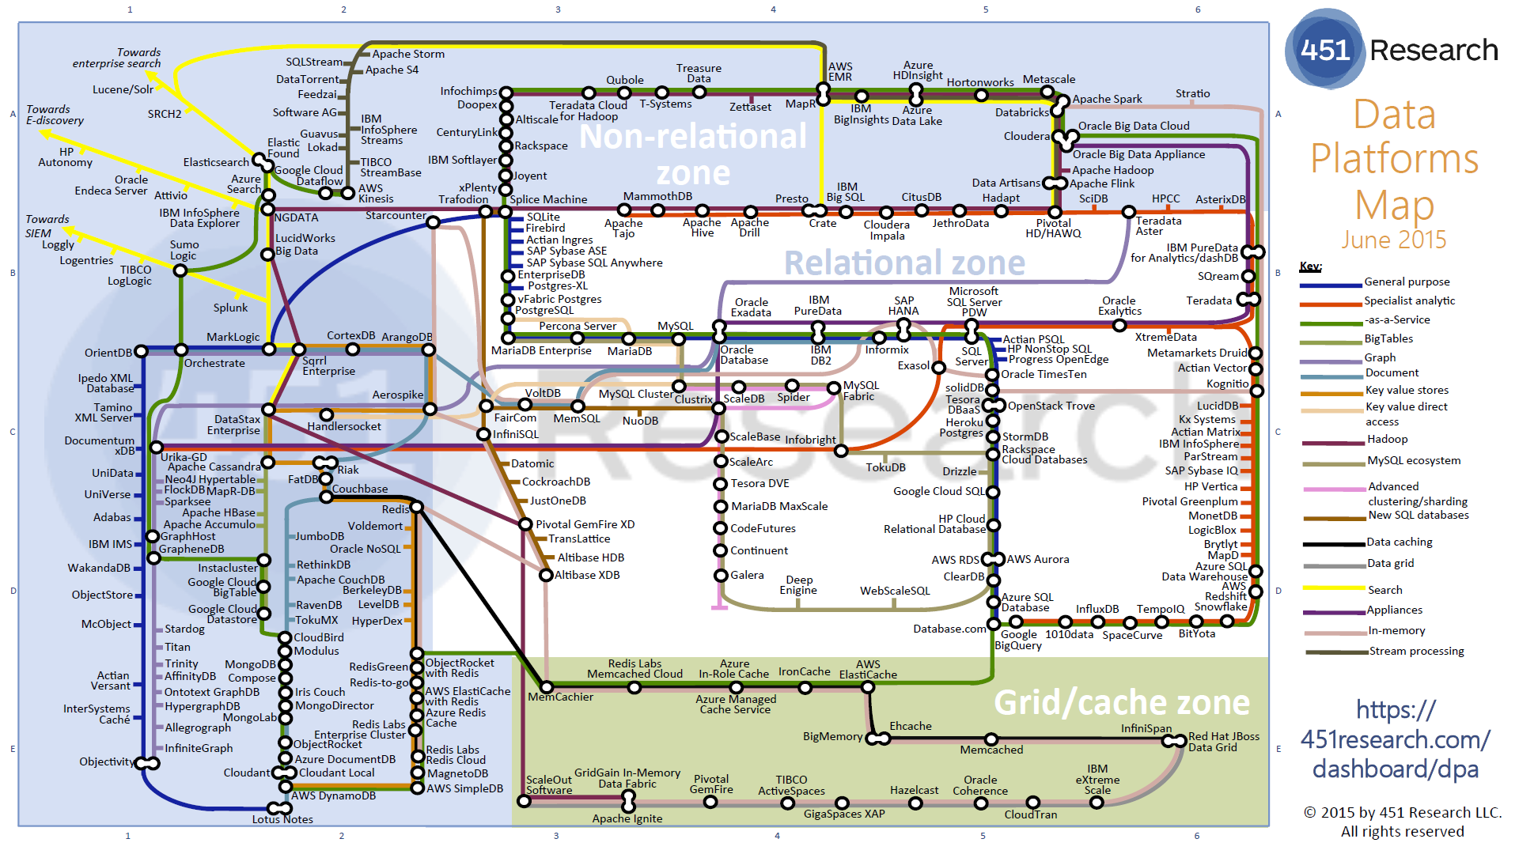
Data Platforms

Slide 35
Green implies HPC
Integration

Slide 36
Functionality of 21 HPC-ABDS Layers
Message Protocols:
Distributed Coordination:
Security & Privacy:
Monitoring:
IaaS Management from HPC to hypervisors:
DevOps:
Interoperability:
File systems:
Cluster Resource Management:
Data Transport:
A) File management
B) NoSQL
C) SQL
In-memory databases&caches / Object-relational mapping / Extraction Tools
Inter process communication Collectives, point-to-point, publish-subscribe, MPI:
A) Basic Programming model and runtime, SPMD, MapReduce:
B) Streaming:
A) High level Programming:
B) Frameworks
Application and Analytics:
Workflow-Orchestration:
Here are 21 functionalities. (including 11, 14, 15 subparts)
4 Cross cutting at top
17 in order of layered diagram starting at bottom

Slide 38
Java Grande
Revisited on 3 data analytics codes
Clustering
Multidimensional Scaling
Latent Dirichlet Allocation all sophisticated algorithms

Slide 39
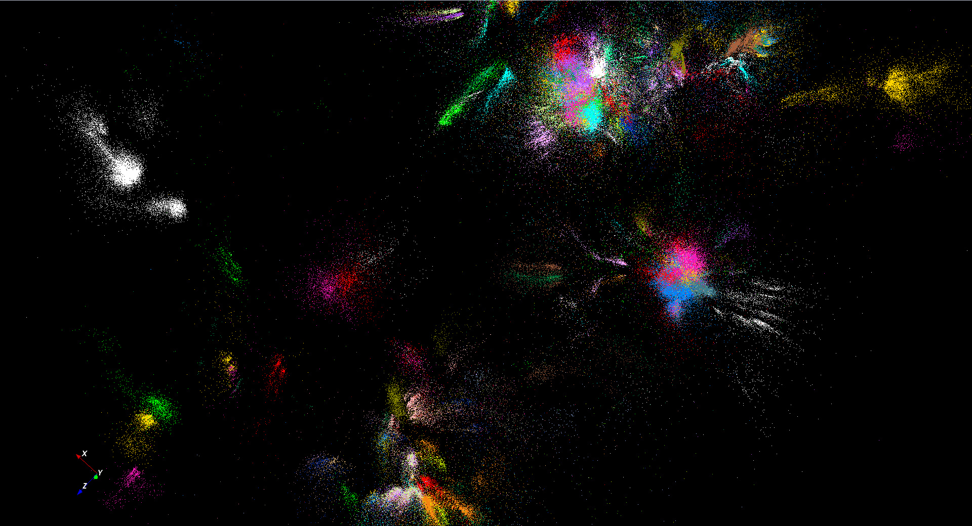
446K sequences
~100 clusters

Slide 40

Protein Universe Browser for COG Sequences with a few illustrative biologically identified clusters

Slide 41
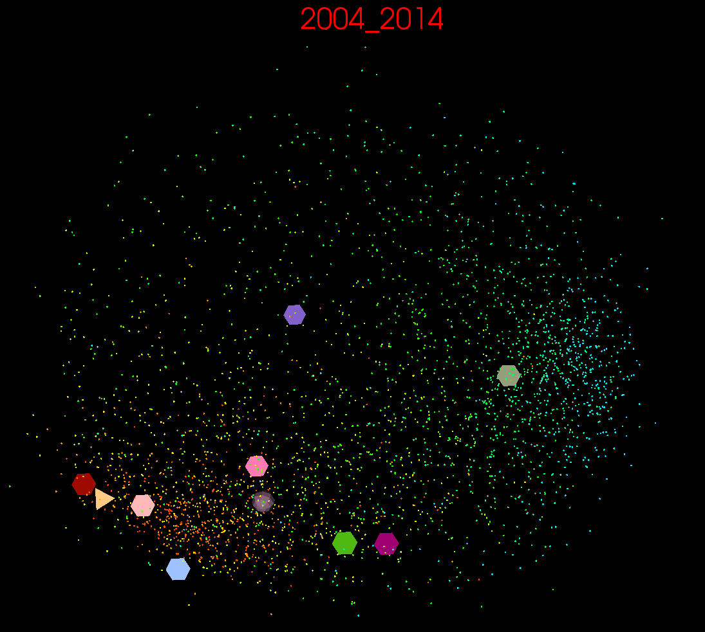
10 year US Stock daily price time series mapped to 3D (work in progress)
3400 stocks
10 large ones shown
down
up

Slide 42
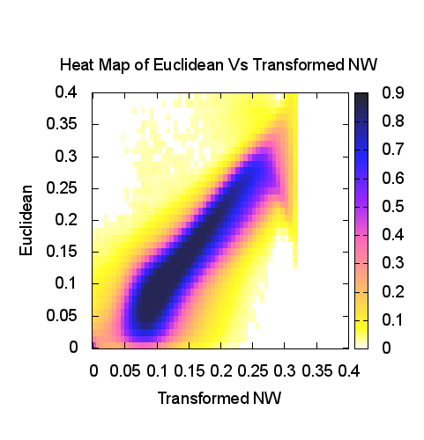
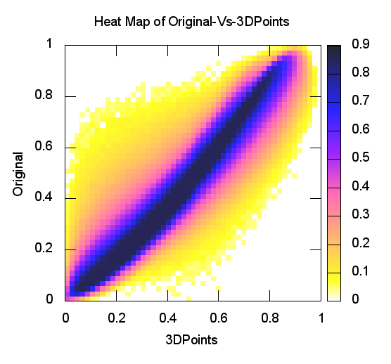
Heatmap of Original distances vs 3D Euclidean Distances
Stock market: Annual Change 2004
Proteomics (Needleman-Wunsch)
y=x is perfection

Slide 43
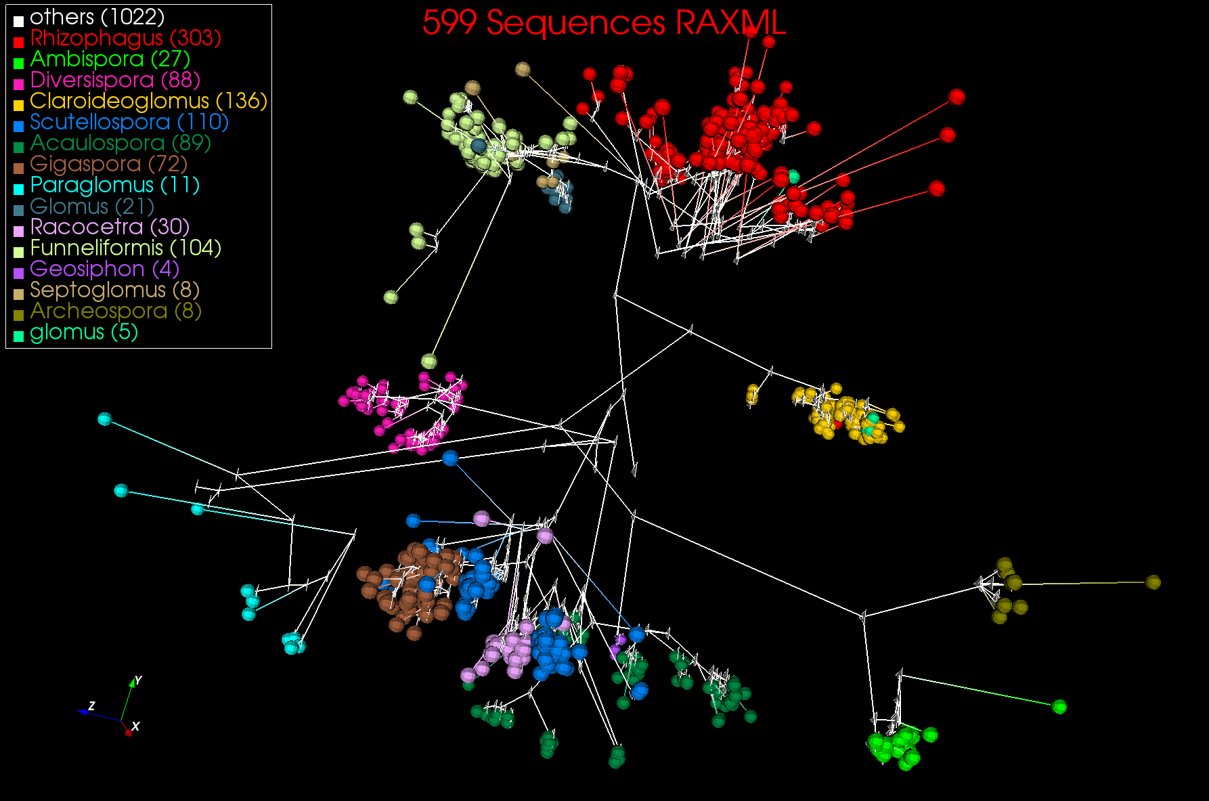
3D Phylogenetic Tree from WDA SMACOF

Slide 44
FastMPJ (Pure Java) v.
Java on C OpenMPI v.
C OpenMPI

Slide 45
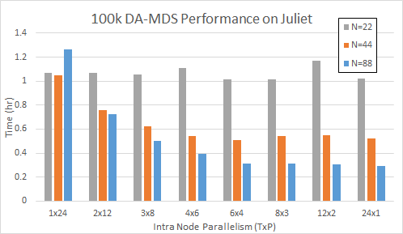
DA-MDS Scaling MPI + Habanero Java (22-88 nodes)
TxP is # Threads x # MPI Processes on each Node
As number of nodes increases, using threads not MPI becomes better
DA-MDS is “best general purpose” dimension reduction algorithm
Juliet is a 96 24-core node Haswell + 32 36-core Haswell Infiniband Cluster
Use JNI +OpenMPI gives similar MPI performance for Java and C
All MPI
on Node
All Threads
on Node

Slide 46
Memory Mapping with MPI – How it works
Memory mapping exploits shared memory to do inter-process communication for processes within a node and avoid any network overhead
We map part of a file as an off-heap (i.e. no garbage collection) buffer. Once mapped operations on the buffer takes only memory access time << network I/O
  Note 1. File doesn’t need to be in disk – e.g. /dev/shm in Linux is a mount for RAM, which is what we use and that avoids OS having to do any disk I/O in the background.
  Note 2. Default Java memory mapping doesn’t guarantee writes from one process to the memory map will be immediately visible to another process with the same mapping. We use a library (OpenHFT JavaLang) built on sun.misc.Unsafe to guarantee this.
Processes within a node maps the same file, but at different offsets for their data.
Once all processes (within a node) have written content to buffer a preselected leader process participates in the collective communication through network I/O with other leaders on other nodes.
  Non leaders wait for their leaders to finish communication.
Once leaders complete communication, data is IMMEDIATELY available to all the processes within that node as we are using memory maps.

Slide 47
Memory Mapping with MPI – Why it is fast?
Reduced network I/O
  1x24x48 with all MPI will have 1152 processes sending M bytes to all 1152 processes through network
  With memory mapping this will be 48 processes sending 24M bytes to 48 processes
  Note. All threads (24x1x48) will have the same communication as memory mapped 1x24x48, so in that is MPI faster than threads not because of communication but because computations with processes is faster than with threads in our applications.
    A possible reason is cache getting invalidated as threads access shared data, but at different offsets
Reduced GC
  As communication buffers are off-heap GC will not get involved. Also, they are allocated (mapped) once, so minimal memory usage

Slide 48
48 Nodes 100k DA-MDS Performance on Juliet
All nodes 24 way parallel: threads v. MPI
Three approaches to MPI

Slide 49
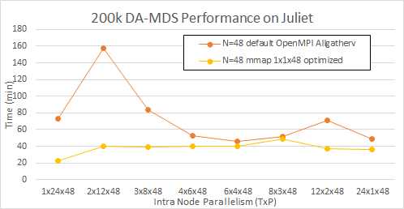
48 Nodes 200k DA-MDS Performance on Juliet
All nodes 24 way parallel: threads v. MPI
Two approaches to MPI

Slide 50
100k DAMDS Speedup as a function of parallelism inside node on 48 nodes
Two approaches to MPI

Slide 51
200k DAMDS Speedup as a function of parallelism inside node on 48 nodes
Two approaches to MPI

Slide 52
DA-MDS Scaling MPI + Habanero Java (1 node)
TxP is # Threads x # MPI Processes on each Node
On one node MPI better than threads
DA-MDS is “best known” dimension reduction algorithm
Juliet is a 96 24-core node Haswell + 32 36-core Haswell Infiniband Cluster
Use JNI +OpenMPI usually gives similar MPI performance for Java and C
MPI Only
All MPI

Slide 53
DA-PWC Clustering on old Infiniband cluster (FutureGrid India)
Results averaged over TxP choices with full 8 way parallelism per node
Dominated by broadcast implemented as pipeline

Slide 54
Parallel Sparse LDA
Harp LDA on BR II (32 core old AMD nodes)
Original LDA (orange) compared to LDA exploiting sparseness (blue)
Note data analytics making use of Infiniband (i.e. limited by communication!)
Java code running under Harp – Hadoop plus HPC plugin
Corpus: 3,775,554 Wikipedia documents, Vocabulary: 1 million words; Topics: 10k topics;
BR II is Big Red II supercomputer with Cray Gemini interconnect
Juliet is Haswell Cluster with Intel (switch) and Mellanox (node) infiniband (not optimized)
Harp LDA on Juliet (36 core Haswell nodes)

Slide 55
IoT Activities at Indiana University
Parallel Clustering for Tweets: Judy Qiu, Emilio Ferrara, Xiaoming Gao
Parallel Cloud Control for Robots: Supun Kamburugamuve, Hengjing He, David Crandall

Slide 56
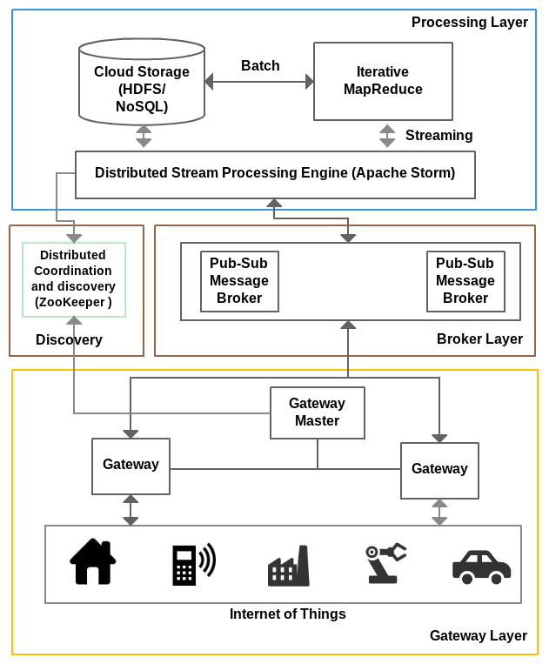
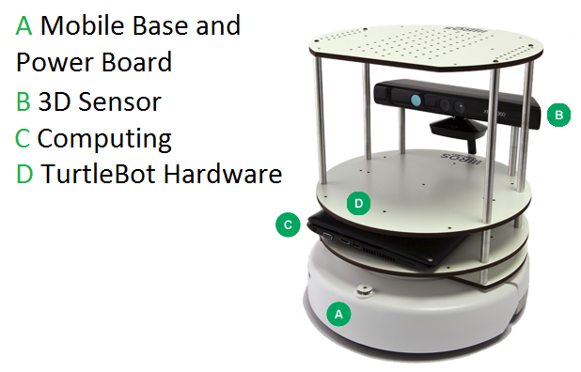
IOTCloud
Device → Pub-Sub→Storm → Datastore → Data Analysis
Apache Storm provides scalable distributed system for processing data streams coming from devices in real time.
For example Storm layer can decide to store the data in cloud storage for further analysis or to send control data back to the devices
Evaluating Pub-Sub Systems ActiveMQ, RabbitMQ, Kafka, Kestrel
Turtlebot and Kinect

Slide 57
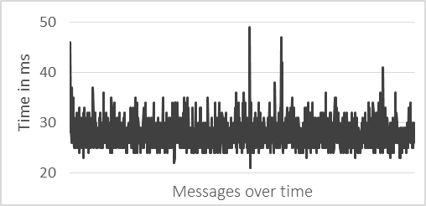
Robot Latency Kafka & RabbitMQ
RabbitMQ versus Kafka
Kinect with
Turtlebot and RabbitMQ

Slide 58
Parallel SLAM Simultaneous Localization and Mapping by Particle Filtering
Speedup

Slide 59
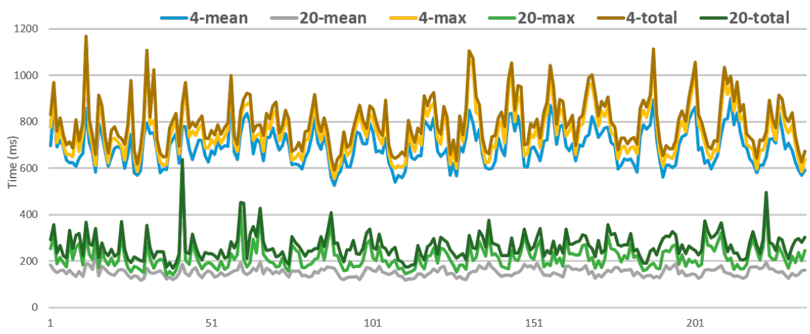
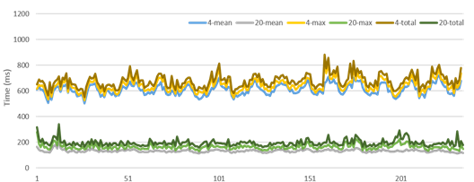
SLAM for 4 or 20 way parallelism
No Cut
Fluctuations decrease after Cut on #iterations per swarm member

Slide 60
Bringing Optimal Communication to Apache Storm
Original
50 Tasks
Original
20 Tasks
Optimized
20 or 50 tasks

Slide 61
Virtual Cluster Comments

Slide 62
Automation or
“Software Defined Distributed Systems”
This means we specify Software (Application, Platform) in configuration file and/or scripts
Specify Hardware Infrastructure in a similar way
  Could be very specific or just ask for N nodes
  Could be dynamic as in elastic clouds
  Could be distributed
Specify Operating Environment (Linux HPC, OpenStack, Docker)
Virtual Cluster is Hardware + Operating environment
Grid is perhaps a distributed SDDS but only ask tools to deliver “possible grids” where specification consistent with actual hardware and administrative rules
  Allowing O/S level reprovisioning makes it easier than yesterday’s grids
Have tools that realize the deployment of application
  This capability is a subset of “system management” and includes DevOps
Have a set of needed functionalities and a set of tools from various commuinies

Slide 63
Functionalities needed in SDDS Management/Configuration Systems
Planning job -- identifying nodes/cores to use
Preparing image
Booting machines
Deploying images on cores
Supporting parallel and distributed deployment
Execution including Scheduling inside and across nodes
Monitoring
Data Management
Replication/failover/Elasticity/Bursting/Shifting
Orchestration/Workflow
Discovery
Security
Language to express systems of computers and software
Available Ontologies
Available Scripts (thousands?)

Slide 64
“Communities” partially satisfying SDDS management requirements
IaaS: OpenStack
DevOps Tools: Docker and tools (Swarm, Kubernetes, Centurion, Shutit), Chef, Ansible, Cobbler, OpenStack Ironic, Heat, Sahara; AWS OpsWorks,
DevOps Standards: OpenTOSCA; Winery
Monitoring: Hashicorp Consul, (Ganglia, Nagios)
Cluster Control: Rocks, Marathon/Mesos, Docker Shipyard/citadel, CoreOS Fleet
Orchestration/Workflow Standards: BPEL
Orchestration Tools: Pegasus, Kepler, Crunch, Docker Compose, Spotify Helios
Data Integration and Management: Jitterbit, Talend
Platform As A Service: Heroku, Jelastic, Stackato, AWS Elastic Beanstalk, Dokku, dotCloud, OpenShift (Origin)

Slide 65
Virtual Cluster
Definition: A set of (virtual) resources that constitute a cluster over which the user has full control. This includes virtual compute, network and storage resources.
Variations:
  Bare metal cluster: A set of bare metal resources that can be used to build a cluster
  Virtual Platform Cluster: In addition to a virtual cluster with network, compute and disk resources a software environment is deployed over them to provide a platform (as a service) to the user
  Hypervisor based or Container based or both
    Containers at node level; OpenStack at core level

Slide 66
Cloudmesh Functionality
Virtual Machine
Management
  IaaS Abstraction
Python based
Hides low level differences
Provisioning Management
  Rain
  Cloud Shifting
  Cloud Bursting
Experiment
Management
  Shell
  IPython
Information Services
  CloudMetrics
Cloudmesh
Accounting
  Internal
  External
User On-Ramp
Amazon, Azure, FutureSystems, Comet, XSEDE, ExoGeni, Other Science Clouds
Notes:
Due to its integrated services Cloudmesh provides the ability to be an onramp for other clouds.
It provides information services to various system level sensors to give access to sensor and utilization data. Internally, it can be used to optimize the system usage.
The provisioning experience from FutureGrid has taught us that we need to provide
the creation of new clouds (rain)
the repartitioning of resources between services (cloud shifting)
and the integration of external cloud resources in case of over provisioning (cloud bursting)
As we deal with many IaaS frameworks, we need an abstraction layer on top of the IaaS framework.
Experiment management is conducted with workflows controlled in shells, Python/iPython, as well as systems such as OpenStack's Heat.
Accounting is supported through additional services such as user management and charge rate management.
Not all features are yet implemented. Figure shows the main functionality that we target at this time to implement.

Slide 67
Container-powered Virtual Clusters (Tools)
Application Containers
  Docker, Rocket (rkt), runc (previously lmctfy) by OCI (Open Container Initiative), Kurma, Jetpack
Operating Systems and support for Containers
  CoreOS, docker-machine
  requirements: kernel support (3.10+) and Application Containers installed i.e. Docker
Cluster management for containers
  Kubernetes, Docker Swarm, Marathon/Mesos, Centurion, OpenShift, Shipyard, OpenShift Geard, Smartstack, Joyent sdf-docker, OpenStack Magnum
  requirements: job execution & scheduling, resource allocation, service discovery
Containers on IaaS
  Amazon ECS (EC2 Container Service supporting Docker), Joyent Triton
Service Utilities
  etcd, consul, ha/ doozer, doozerd, Zookeeper
  Requirements: Coordination, Discovery, Registration
Platform as a Service
  AWS OpsWorks, Elastic Beanstalk, EngineYard, Heroku, Jelastic, Stackato (moved to HP)
Configuration Management
  Ansible, Chef, Puppet, Salt

Slide 68
Conclusions

Slide 69
Conclusions
Surveyed and categorized 350 software systems
Explored “Java Grande”, finding it surprisingly hard to get good performance with Java data analytics
Collected 51 use cases; useful although certainly incomplete and biased (to research and against energy for example)
Identified 50 features called facets divided into 4 sets (views) used to classify applications
Used to derive set of hardware architectures
Surveyed some benchmarks
Suggested integration of DevOps, Cluster Control, PaaS and workflow to generate software defined systems (not discussed)

