Slide 1
Earthquake Polar and Sensor Grids
Community Grids Laboratory
November 20 2008
Geoffrey Fox
Community Grids Laboratory, School of informatics
Indiana University
gcf@indiana.edu, http://www.infomall.org
1
Notes:
1

Slide 2
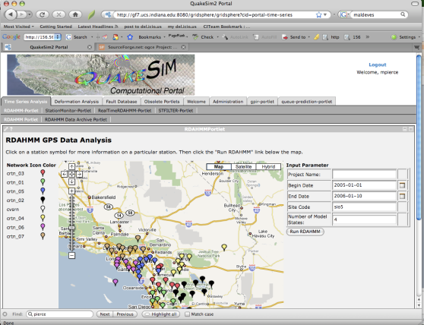
HTTP(S)
Portlets + Client Stubs
SOAP/HTTP
WSDL
WSDL
WSDL
WSDL
WSDL
WSDL
WSDL
WSDL
DB Service
Job Sub/Mon
And File
Services
Visualization
Or Map
Service
JDBC
DB
Operating and
Queuing
Systems
DB,
etc
Host 1 (QT or GRWS)
Host 2 (Comp Grid)
Host 3 (GIS)

Slide 3
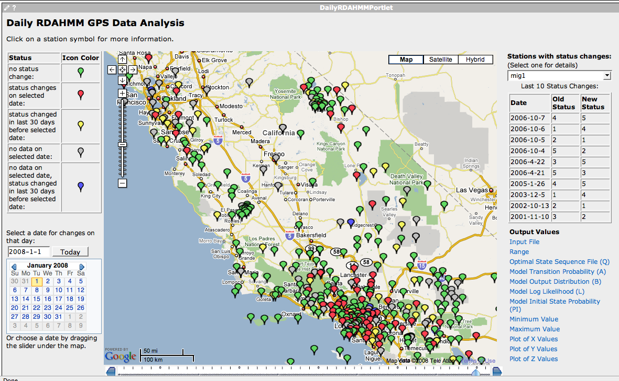
Daily RDAHMM Updates
Daily analysis and
event classification
of GPS data from
REASoN’s GRWS.

Slide 4
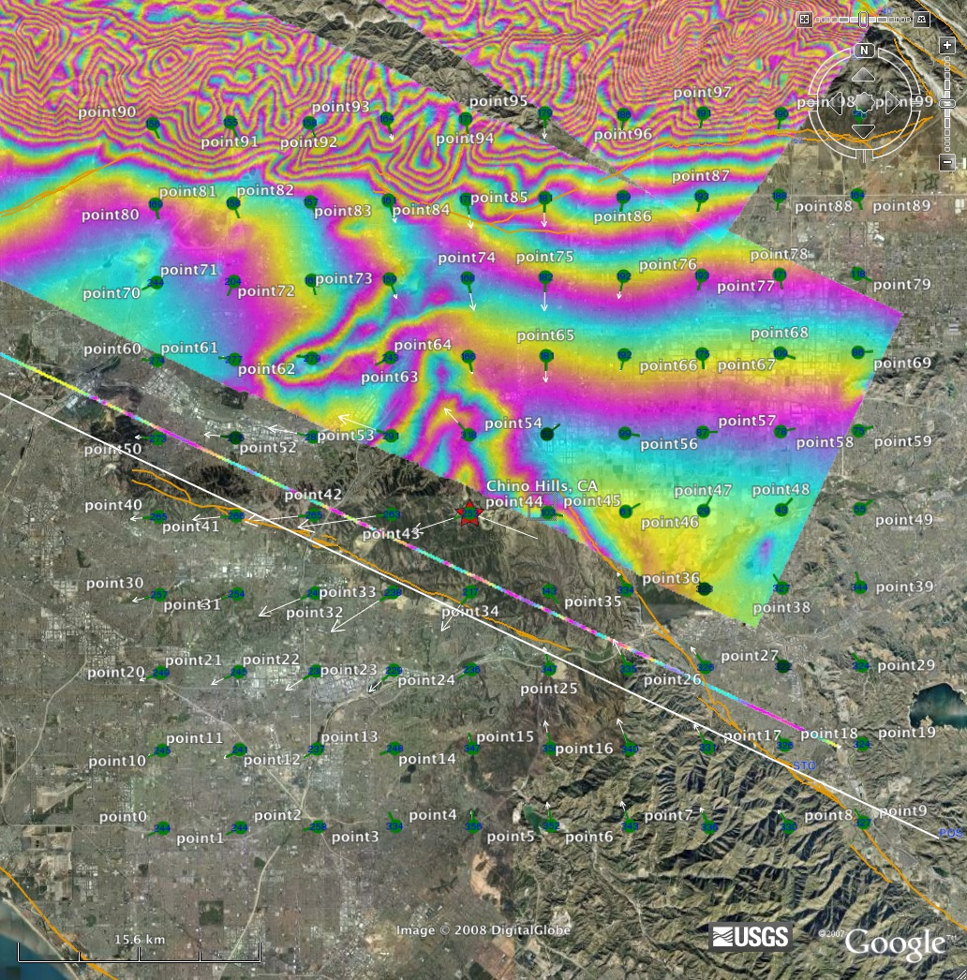
Integrating QuakeSim and UAVSAR
July 29, 2008 M 5.4 Chino Hills Earthquake
Used QuakeSim to model expected surface displacements from the event
Passed on KML file to UAVSAR program/project
Overlaid displacements with UAVSAR image
Will continue to merge projects using the Los Angeles ShakeOut in mid–November as a testbed

Slide 5
QuakeSpace
QuakeSim built using Web 2.0 and Cloud Technology
Applications, Sensors, Data Repositories as Services
Computing via Clouds
Portals as Gadgets
Metadata by tagging
Data sharing as in YouTube
Alerts by RSS
Virtual Organizations via Social Networking
Workflow by Mashups
Performance by multicore
Interfaces via iPhone, Android etc.

Slide 6
Enterprise Approach | Web 2.0 Approach
JSR 168 Portlets | Gadgets, Widgets
Server-side integration and processing | AJAX, client-side integration and processing, JavaScript
SOAP | RSS, Atom, JSON
WSDL | REST (GET, PUT, DELETE, POST)
Portlet Containers | Open Social Containers (Orkut, LinkedIn, Shindig); Facebook; StartPages
User Centric Gateways | Social Networking Portals
Workflow managers (Taverna, Kepler, etc) | Mash-ups
Grid computing: Globus, condor, etc | Cloud computing: Amazon WS Suite, Xen Virtualization

Slide 7
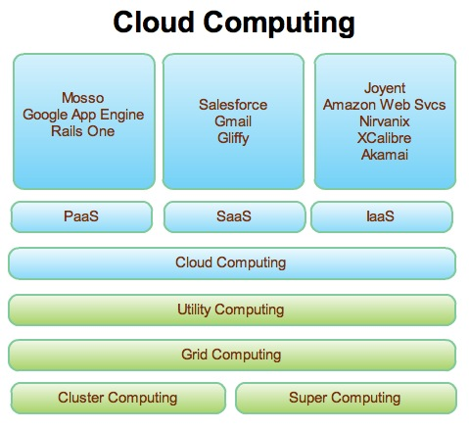
Web 2.0 and Clouds
Grids are less popular but most of what we did is reusable
Clouds are designed heterogeneous (for functionality) scalable distributed systems whereas Grids integrate a priori heterogeneous (for politics) systems
Clouds should be easier to use,
cheaper, faster and scale to larger
sizes than Grids
Grids assume you can’t design
system but rather must accept
results of N independent
supercomputer funding calls
SaaS: Software as a Service
IaaS: Infrastructure as a Service
or HaaS: Hardware as a Service
PaaS: Platform as a Service
delivers SaaS on IaaS

Slide 8

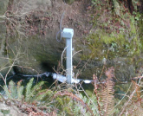
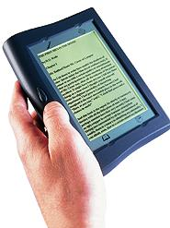
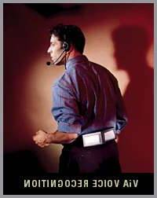




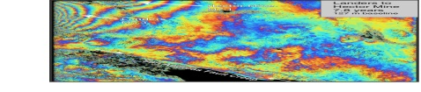
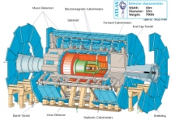
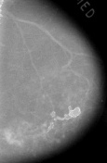

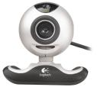

Information and Cyberinfrastructure
Raw Data → Data → Information → Knowledge → Wisdom → Decisions
Another
Grid
Another
Grid
SS
SS
SS
SS
SS
SS
fs
fs
Discovery
Cloud
Filter
Service
Portal
Filter
Cloud
fs
fs
SS
fs
fs
Filter
Cloud
Inter-Service Messages
Another
Service
fs
fs
SS
Filter
Cloud
fs
Filter
Service
fs
fs
fs
SS
fs
fs
fs
Filter
Service
fs
Discovery
Cloud
fs
fs
fs
fs
SS
Traditional Grid with exposed services
Filter
Cloud
fs
Filter
Service
fs
Filter
Cloud
Filter
Cloud
SS
fs
fs
Another
Grid
SS
SS
SS
SS
SS
SS
Sensor or Data
Interchange
Service
SS
SS
SS
SS
SS
SS
Compute
Cloud
Storage
Cloud
Database

Slide 9
Core (eScience) Cloud Architecture
Deploy VM
IAAS
PAAS
Build VO
Build Portal
Gadgets
Open Social
Ringside
Move Service
(from PC or internet
to Cloud)
Classic Compute File Database
on a cloud
Build Cloud Application
Ruby on Rails
Django(GAI)
Workflow
VM
VM
VM
VM
VM
VM
VM
VM
EC2, S3, SimpleDB
CloudDB
Bigtable
GFS (Hadoop)
? Lustre GPFS
(low level ||)
MPI CCR
Linux Clusters
? Windows Cluster
MapReduce
Taverna
BPEL
F#
DSS
Windows Workflow
DRYAD
Security
Model
VOMS
“UNIX”
Shib
OpenID
Libraries
Scripted Math
PAAS = Platform As A Service
R, SCALAPACK
Sho
Matlab
Mathematica
IAAS = Infrastructure As A Service
High level
Parallel
“HPF”, PGAS, OpenMP

Slide 10
Deploying eScience Cloud
INTERNET
Other clouds
Petaflop
Client PC
Cloud
extending Client
”simple compute”
Modestly Parallel
Portal Services
Web 2.0
Data access analysis
Capacity Clouds
(smallish clusters)
Mobile
Portal
Virtual
World
Archives
Satellites, Sensors,
LHC, Microarray,
Cell Phones
Display
“walls”
Specialized Machines
Grape
Road Runner
FPGA, GPU …
Legacy Systems
e.g. current TeraGrid
Other nifty
user interface

Slide 11
Sensors as a Service
Similar architecture for a Web/Net/Grid of
  Mobile Phones
  Video cams
  Surveillance devices
  Smart Cities/Homes
  Environmental/Polar/Earthquake sensors
  Military sensors
Similar System support for
  QuakeSim
  PolarGrid
  Command and Control
  Emergency Response
  Distance Education

Slide 12
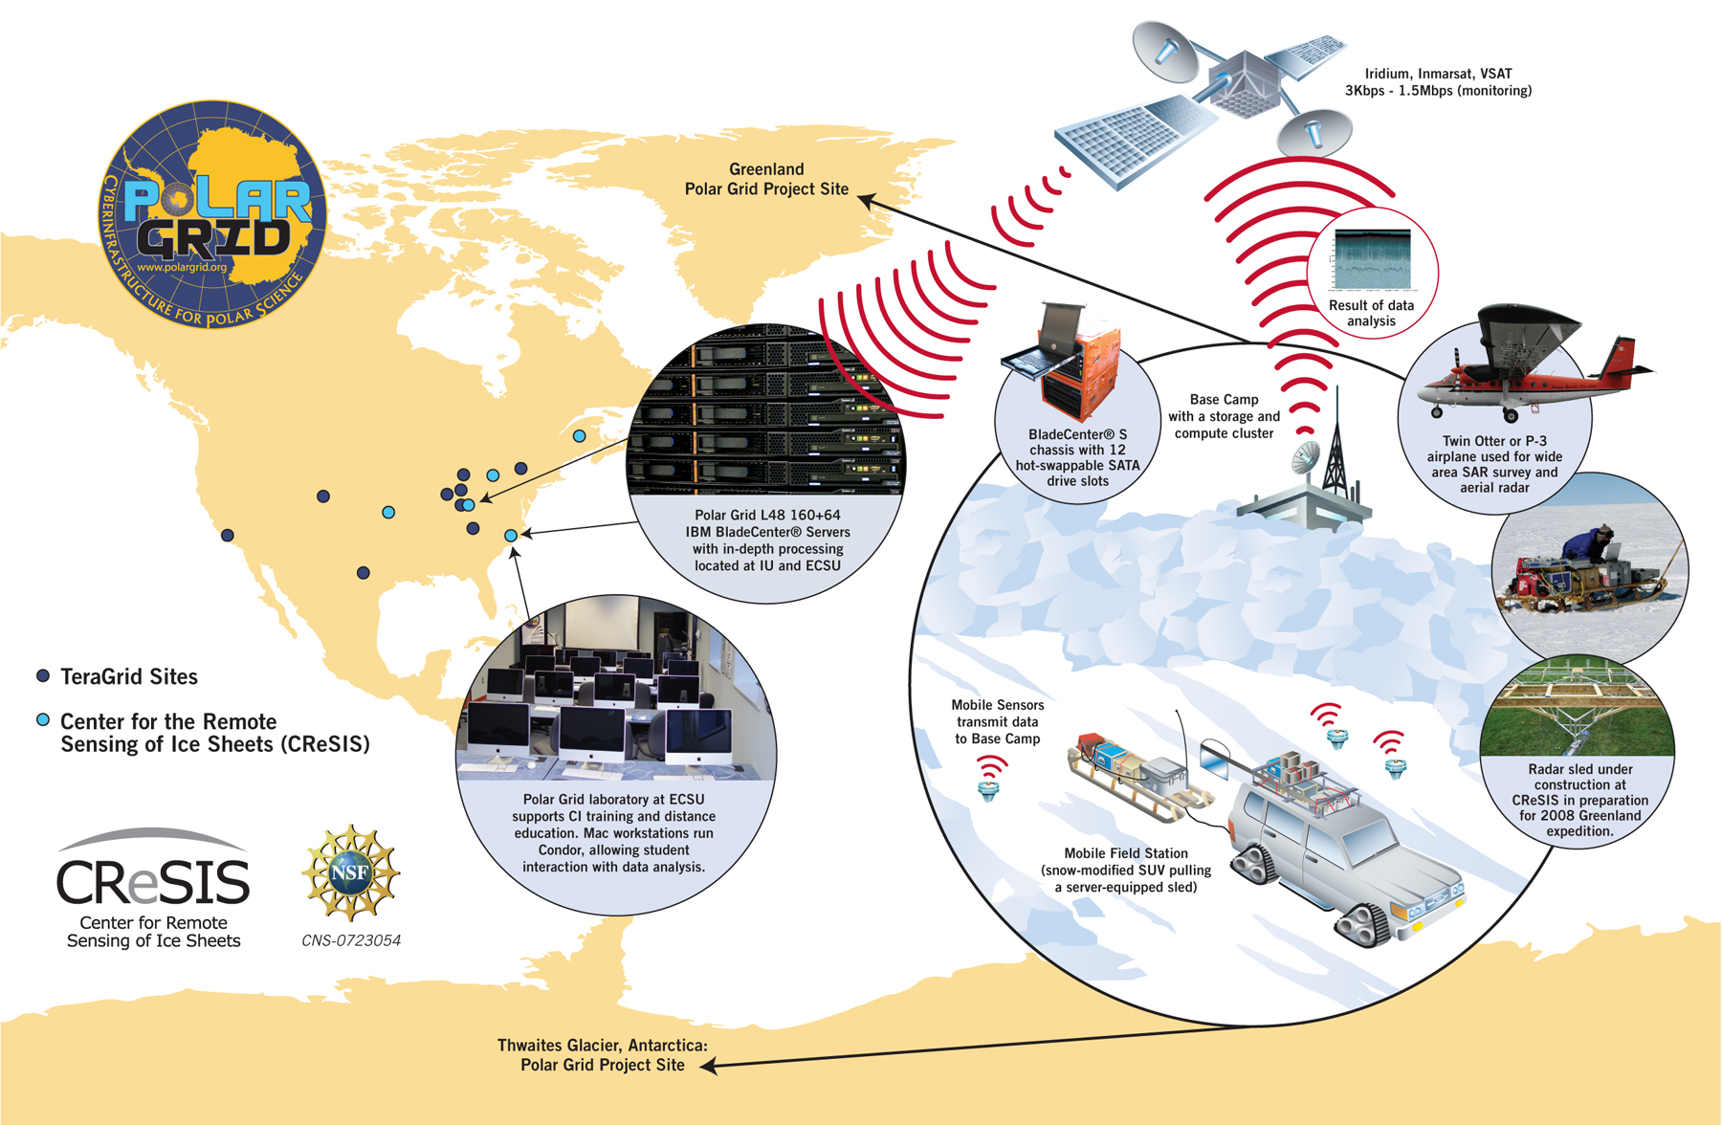
PolarGrid (collaboration ECSU and Indiana) has remote and TeraGrid components

Slide 13
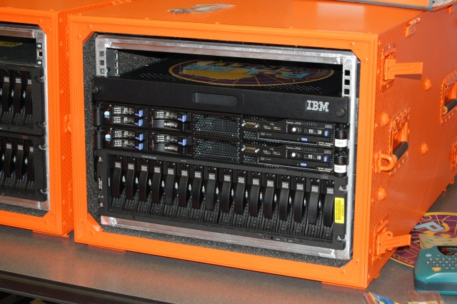
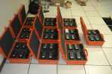
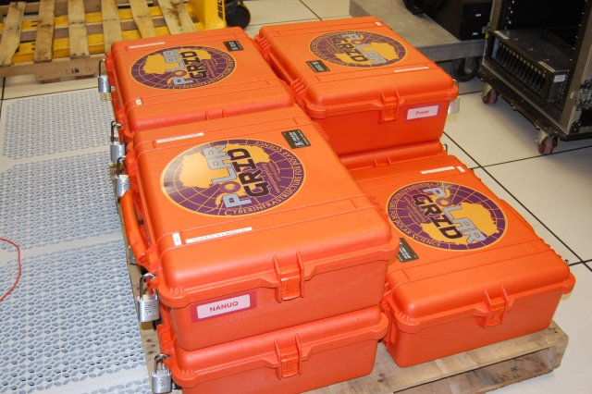
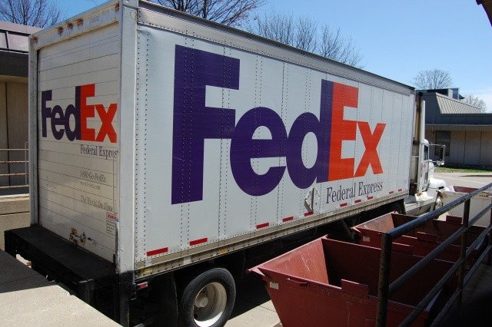
Polar Grid goes to Greenland
Leaving IU for Greenland
Field 8 core server and ruggedized laptops with USB Storage
Base camp 8-64 cores and 32 GB storage
Power: Solar, Hotel Room, Generator

Slide 14
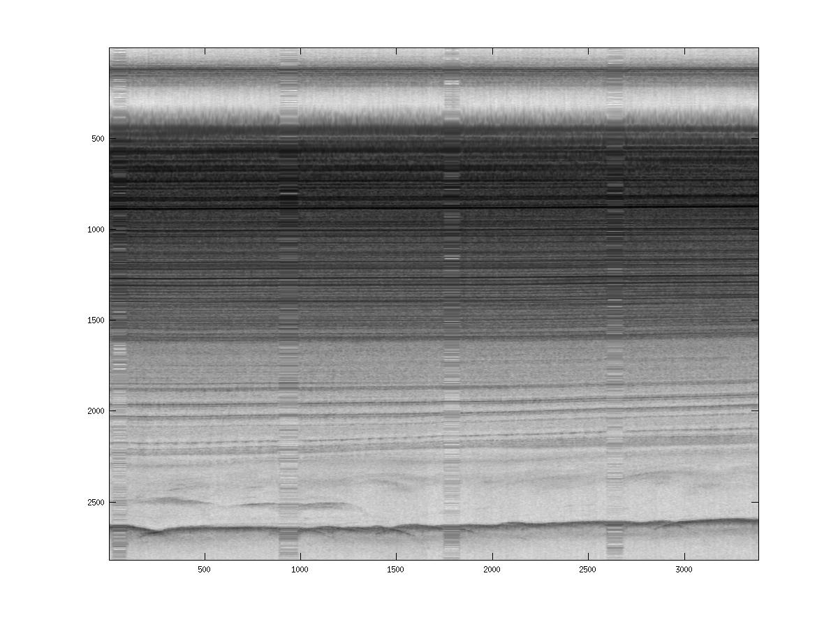
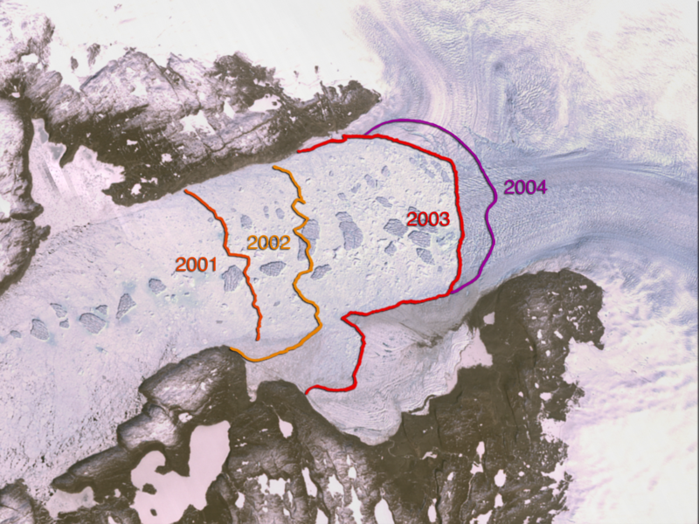
PolarGrid (collaboration ECSU and Indiana) has remote and TeraGrid components
Retreat of Jakobshavn Glacier
PolarGrid August 9 2008 looking at bed 2500metres deep; real time analysis removes noise

Slide 15
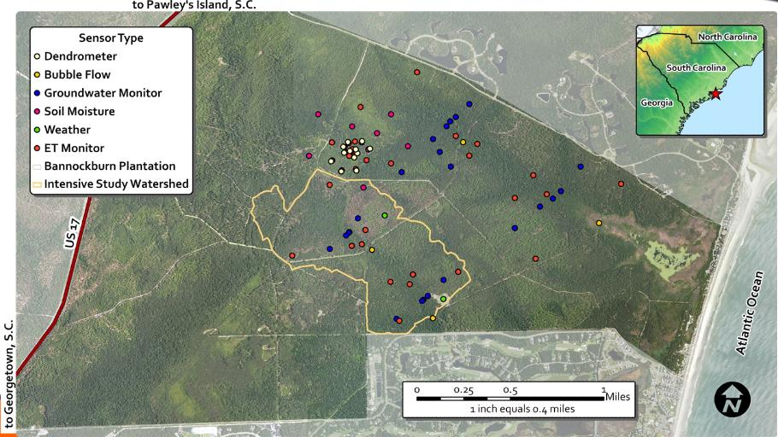
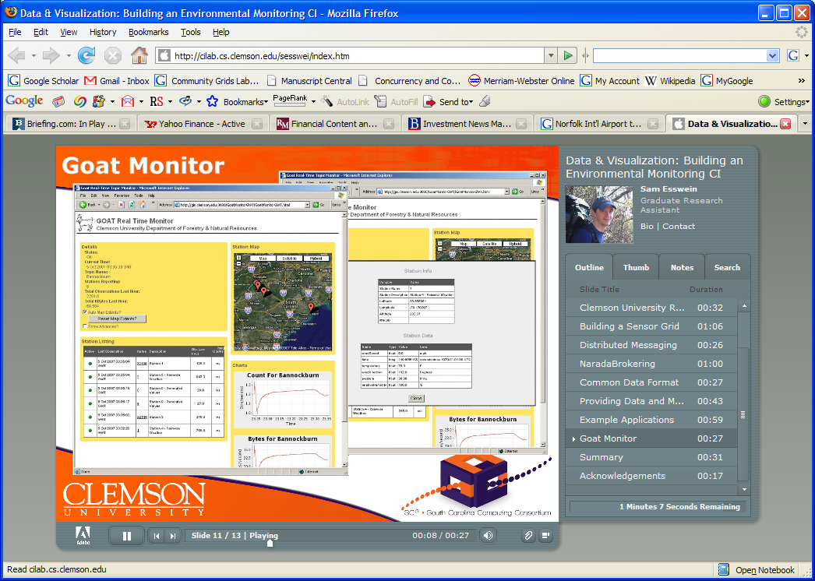
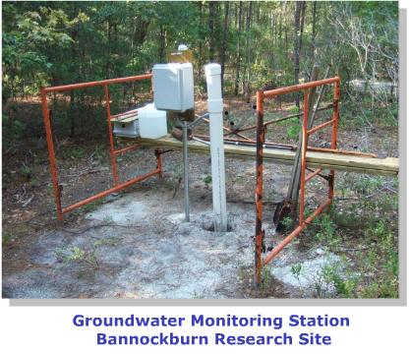
Environmental Monitoring Sensor Grid at Clemson

Slide 16
Heterogeneous Sensor Grids
Note sensors are any time dependent source of information and a fixed source of information is just a broken sensor
  SAR Satellites
  Environmental Monitors
  Nokia N800 pocket computers
  RFID tags and readers
  GPS Sensors
  Lego Robots including , accelerometer, gyroscope, compass, ultrasonic, temperature sensors
  RSS Feeds
  Wii remote sensor
  Audio/video: web-cams
  Presentation of teacher in distance education
  Text chats of students

Slide 17
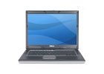
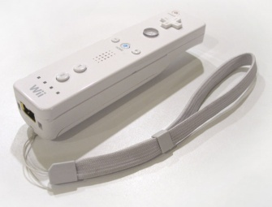
Components of the Sensor Grid
Laptop for PowerPoint
2 Robots used
Wii remote
Lego Robot GPS Nokia N800 RFID Tag RFID Reader

Slide 18
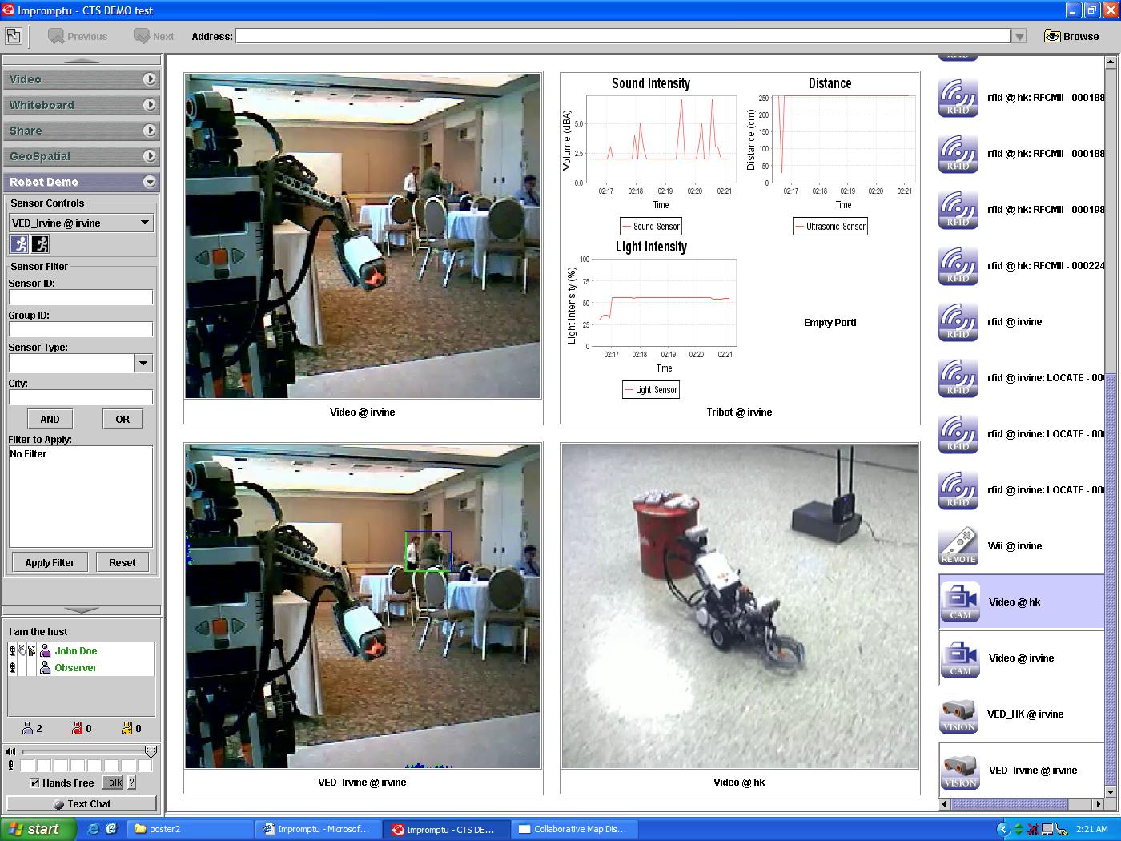
ANABAS

Slide 19
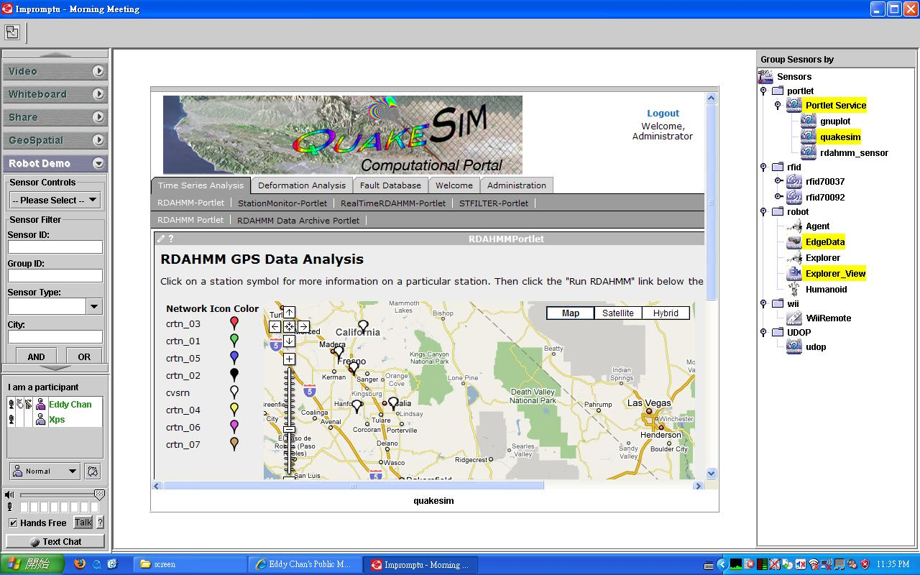
QuakeSim Grid of Grids with RDAHMM Filter (Compute) Grid

