Slide 1
Cloud Data mining and FutureGrid
SC10 New Orleans LA
AIST Booth
November 17 2010
Geoffrey Fox
gcf@indiana.edu
http://www.infomall.org http://www.futuregrid.org
Director, Digital Science Center, Pervasive Technology Institute
Associate Dean for Research and Graduate Studies, School of Informatics and Computing
Indiana University Bloomington

Slide 2
FutureGrid key Concepts I
FutureGrid is an international testbed modeled on Grid5000
Rather than loading images onto VM’s, FutureGrid supports Cloud, Grid and Parallel computing environments by dynamically provisioning software as needed onto “bare-metal” using Moab/xCAT
Image library for MPI, OpenMP, Hadoop, Dryad, gLite, Unicore, Globus, Xen, ScaleMP (distributed Shared Memory), Nimbus, Eucalyptus, OpenNebula, KVM, Windows …..
The FutureGrid testbed provides to its users:
A flexible development and testing platform for middleware and application users looking at interoperability, functionality and performance
Each use of FutureGrid is an experiment that is reproducible
A rich education and teaching platform for advanced cyberinfrastructure classes
Growth comes from users depositing novel images in library

Slide 3
Dynamic Provisioning Results
Number of nodes
Time elapsed between requesting a job and the jobs reported start time on the provisioned node. The numbers here are an average of 2 sets of experiments.

Slide 4
FutureGrid key Concepts II
Support Computer Science and Computational Science
Industry and Academia
Asia, Europe and Americas
Note most current use Education, Computer Science Systems and Biology
Very different from TeraGrid use
FutureGrid has ~5000 distributed cores with a dedicated network and a Spirent XGEM network fault and delay generator
Key early user oriented milestones:
June 2010 Initial users
November 1 2010 Increasing number of users allocated by FutureGrid
Apply now to use FutureGrid on web site www.futuregrid.org

Slide 5
FutureGrid Partners
Indiana University (Architecture, core software, Support)
Collaboration between research and infrastructure groups
Purdue University (HTC Hardware)
San Diego Supercomputer Center at University of California San Diego (INCA, Monitoring)
University of Chicago/Argonne National Labs (Nimbus)
University of Florida (ViNE, Education and Outreach)
University of Southern California Information Sciences (Pegasus to manage experiments)
University of Tennessee Knoxville (Benchmarking)
University of Texas at Austin/Texas Advanced Computing Center (Portal)
University of Virginia (OGF, Advisory Board and allocation)
Center for Information Services and GWT-TUD from Technische Universtität Dresden. (VAMPIR)
Red institutions have FutureGrid hardware

Slide 6
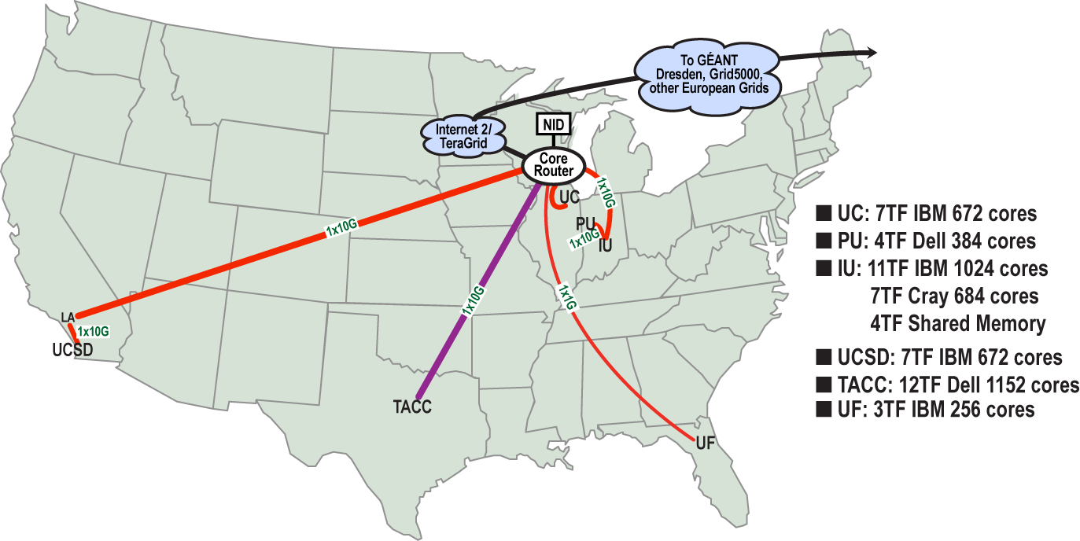
FutureGrid: a Grid/Cloud/HPC Testbed
Operational: IU Cray operational; IU , UCSD, UF & UC IBM iDataPlex operational
Network, NID operational
TACC Dell finished acceptance tests
INCA Node Operating Mode Statistics
NID: Network Impairment Device
Private Public
FG Network

Slide 7
Network & Internal Interconnects
FutureGrid has dedicated network (except to TACC) and a network fault and delay generator
Can isolate experiments on request; IU runs Network for NLR/Internet2
(Many) additional partner machines will run FutureGrid software and be supported (but allocated in specialized ways)
Machine | Name | Internal Network
IU Cray | xray | Cray 2D Torus SeaStar
IU iDataPlex | india | DDR IB, QLogic switch with Mellanox ConnectX adapters Blade Network Technologies & Force10 Ethernet switches
SDSC iDataPlex | sierra | DDR IB, Cisco switch with Mellanox ConnectX adapters Juniper Ethernet switches
UC iDataPlex | hotel | DDR IB, QLogic switch with Mellanox ConnectX adapters Blade Network Technologies & Juniper switches
UF iDataPlex | foxtrot | Gigabit Ethernet only (Blade Network Technologies; Force10 switches)
TACC Dell | alamo | QDR IB, Mellanox switches and adapters Dell Ethernet switches

Slide 8
Network Impairment Device
Spirent XGEM Network Impairments Simulator for jitter, errors, delay, etc
Full Bidirectional 10G w/64 byte packets
up to 15 seconds introduced delay (in 16ns increments)
0-100% introduced packet loss in .0001% increments
Packet manipulation in first 2000 bytes
up to 16k frame size
TCL for scripting, HTML for manual configuration

Slide 9
Some Current FutureGrid users I

Slide 10
Some Current FutureGrid users II

Slide 11
OGF’10 Demo
SDSC
Rennes
Grid’5000 firewall
UF
Lille
UC
Sophia
ViNe provided the necessary inter-cloud connectivity to deploy CloudBLAST across 5 Nimbus sites, with a mix of public and private subnets.

Slide 12
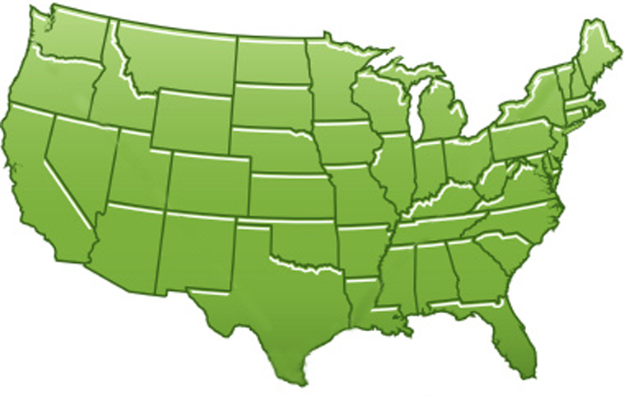
300+ Students learning about Twister & Hadoop
MapReduce technologies, supported by FutureGrid.
July 26-30, 2010 NCSA Summer School Workshop
http://salsahpc.indiana.edu/tutorial
Washington
University
University of
Minnesota
Michigan
State
Johns
Hopkins
Univ.Illinois
at Chicago
Iowa
State
Penn
State
IBM Almaden
Research Center
Notre
Dame
University of
California at
Los Angeles
Indiana
University
San Diego
Supercomputer
Center
University of
Texas at El Paso
University of
Arkansas
University
of Florida

Slide 13
Software Components
Portals including “Support” “use FutureGrid” “Outreach”
Monitoring – INCA, Power (GreenIT)
Experiment Manager: specify/workflow
Image Generation and Repository
Intercloud Networking ViNE
Virtual Clusters built with virtual networks
Performance library
Rain or Runtime Adaptable InsertioN Service: Schedule and Deploy images
Security (including use of isolated network), Authentication, Authorization,

Slide 14
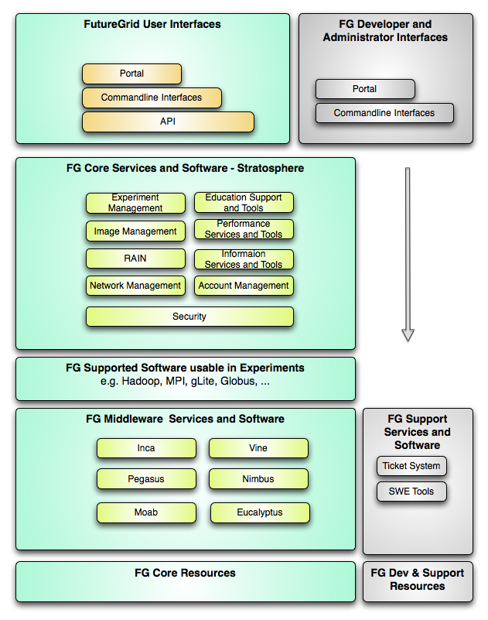
FutureGrid Layered Software Stack
User Supported Software usable in Experiments e.g. OpenNebula, Charm++, Other MPI, Bigtable

Slide 15
FutureGrid Interaction with Commercial Clouds
We support experiments that link Commercial Clouds and FutureGrid with one or more workflow environments and portal technology installed to link components across these platforms
We support environments on FutureGrid that are similar to Commercial Clouds and natural for performance and functionality comparisons
These can both be used to prepare for using Commercial Clouds and as the most likely starting point for porting to them
One example would be support of MapReduce-like environments on FutureGrid including Hadoop on Linux and Dryad on Windows HPCS which are already part of FutureGrid portfolio of supported software
We develop expertise and support porting to Commercial Clouds from other Windows or Linux environments
We support comparisons between and integration of multiple commercial Cloud environments – especially Amazon and Azure in the immediate future
We develop tutorials and expertise to help users move to Commercial Clouds from other environments

Slide 16
FutureGrid Viral Growth Model
Users apply for a project
Users improve/develop some software in project
This project leads to new images which are placed in FutureGrid repository
Project report and other web pages document use of new images
Images are used by other users
And so on ad infinitum ………

Slide 17
194 papers submitted to main track; 48 accepted; 4 days of tutorials

Slide 18
Philosophy of Clouds and Grids
Clouds are (by definition) commercially supported approach to large scale computing
So we should expect Clouds to replace Compute Grids
Current Grid technology involves “non-commercial” software solutions which are hard to evolve/sustain
Maybe Clouds ~4% IT expenditure 2008 growing to 14% in 2012 (IDC Estimate)
Public Clouds are broadly accessible resources like Amazon and Microsoft Azure – powerful but not easy to customize and perhaps data trust/privacy issues
Private Clouds run similar software and mechanisms but on “your own computers” (not clear if still elastic)
Platform features such as Queues, Tables, Databases currently limited
Services still are correct architecture with either REST (Web 2.0) or Web Services
Clusters are still critical concept for MPI or Cloud software

Slide 19
Grids MPI and Clouds
Grids are useful for managing distributed systems
Pioneered service model for Science
Developed importance of Workflow
Performance issues – communication latency – intrinsic to distributed systems
Can never run large differential equation based simulations or datamining
Clouds can execute any job class that was good for Grids plus
More attractive due to platform plus elastic on-demand model
MapReduce easier to use than MPI for appropriate parallel jobs
Currently have performance limitations due to poor affinity (locality) for compute-compute (MPI) and Compute-data
These limitations are not “inevitable” and should gradually improve as in July 13 Amazon Cluster announcement
Will probably never be best for most sophisticated parallel differential equation based simulations
Classic Supercomputers (MPI Engines) run communication demanding differential equation based simulations
MapReduce and Clouds replaces MPI for other problems
Much more data processed today by MapReduce than MPI (Industry Informational Retrieval ~50 Petabytes per day)

Slide 20
Cloud Computing: Infrastructure and Runtimes
Cloud infrastructure: outsourcing of servers, computing, data, file space, utility computing, etc.
Handled through Web services that control virtual machine lifecycles.
Cloud runtimes or Platform: tools (for using clouds) to do data-parallel (and other) computations.
Apache Hadoop, Google MapReduce, Microsoft Dryad, Bigtable, Chubby and others
MapReduce designed for information retrieval but is excellent for a wide range of science data analysis applications
Can also do much traditional parallel computing for data-mining if extended to support iterative operations
MapReduce not usually on Virtual Machines

Slide 21
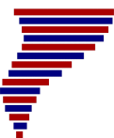
Application Classes
Old classification of Parallel software/hardware in terms of
5 (becoming 6) “Application architecture” Structures)
1 | Synchronous | Lockstep Operation as in SIMD architectures | SIMD
2 | Loosely Synchronous | Iterative Compute-Communication stages with independent compute (map) operations for each CPU. Heart of most MPI jobs | MPP
3 | Asynchronous | Computer Chess; Combinatorial Search often supported by dynamic threads | MPP
4 | Pleasingly Parallel | Each component independent – in 1988, Fox estimated at 20% of total number of applications | Grids
5 | Metaproblems | Coarse grain (asynchronous) combinations of classes 1)-4). The preserve of workflow. | Grids
6 | MapReduce++ | It describes file(database) to file(database) operations which has subcategories including. Pleasingly Parallel Map Only Map followed by reductions Iterative “Map followed by reductions” – Extension of Current Technologies that supports much linear algebra and datamining | Clouds Hadoop/ Dryad Twister
Notes:
CGL-MapReduce is an example of MapReduce++ -- supports MapReduce model with iteration (data stays in memory and communication via streams not files)

Slide 22
Applications & Different Interconnection Patterns
Map Only | Classic MapReduce | Iterative Reductions MapReduce++ | Loosely Synchronous
CAP3 Analysis Document conversion (PDF -> HTML) Brute force searches in cryptography Parametric sweeps | High Energy Physics (HEP) Histograms SWG gene alignment Distributed search Distributed sorting Information retrieval | Expectation maximization algorithms Clustering Linear Algebra | Many MPI scientific applications utilizing wide variety of communication constructs including local interactions
- CAP3 Gene Assembly - PolarGrid Matlab data analysis | - Information Retrieval - HEP Data Analysis - Calculation of Pairwise Distances for ALU Sequences | Kmeans Deterministic Annealing Clustering - Multidimensional Scaling MDS | - Solving Differential Equations and - particle dynamics with short range forces
Input
iterations
Input
Input
map
map
map
Pij
reduce
Output
reduce
Domain of MapReduce and Iterative Extensions
MPI

Slide 23
Fault Tolerance and MapReduce
MPI does “maps” followed by “communication” including “reduce” but does this iteratively
There must (for most communication patterns of interest) be a strict synchronization at end of each communication phase
Thus if a process fails then everything grinds to a halt
In MapReduce, all Map processes and all reduce processes are independent and stateless and read and write to disks
As 1 or 2 (reduce+map) iterations, no difficult synchronization issues
Thus failures can easily be recovered by rerunning process without other jobs hanging around waiting
Re-examine MPI fault tolerance in light of MapReduce
Twister (later) will interpolate between MPI and MapReduce

Slide 24
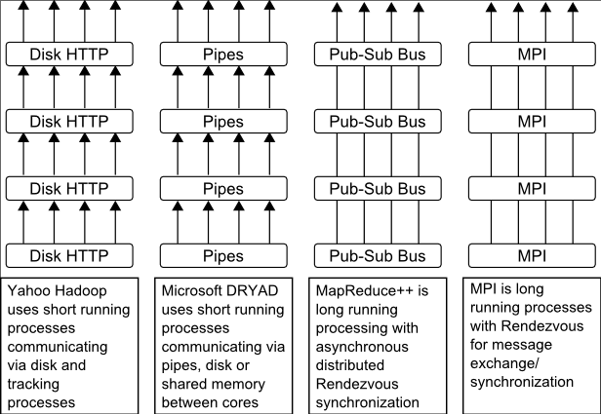
Twister
Pub/Sub Broker Network
Map Worker
M
Worker Nodes
R
Reduce Worker
Streaming based communication
Intermediate results are directly transferred from the map tasks to the reduce tasks – eliminates local files
Cacheable map/reduce tasks
Static data remains in memory
Combine phase to combine reductions
User Program is the composer of MapReduce computations
Extends the MapReduce model to iterative computations
D
D
MR
Driver
User
Program
M
M
M
M
D
MRDeamon
R
R
R
R
Data Read/Write
Communication
Data Split
File System
Iterate
Static
data
Configure()
User Program
Map(Key, Value)
δ flow
Reduce (Key, List<Value>)
Combine (Key, List<Value>)
Different synchronization and intercommunication mechanisms used by the parallel runtimes
Close()

Slide 25
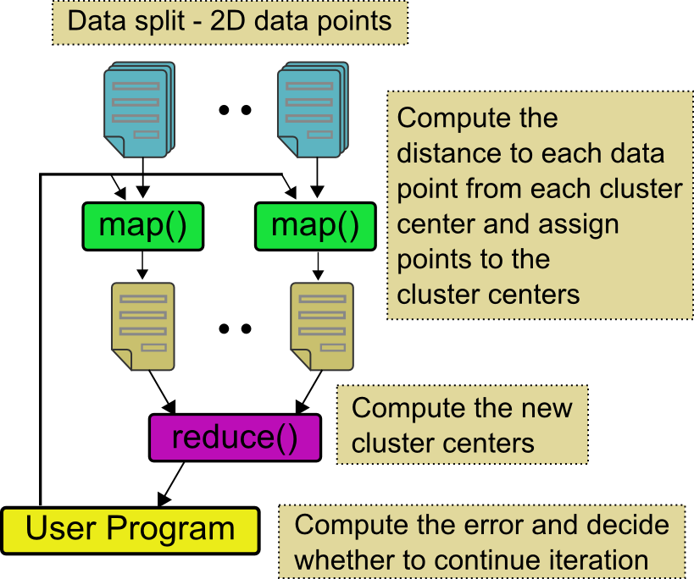
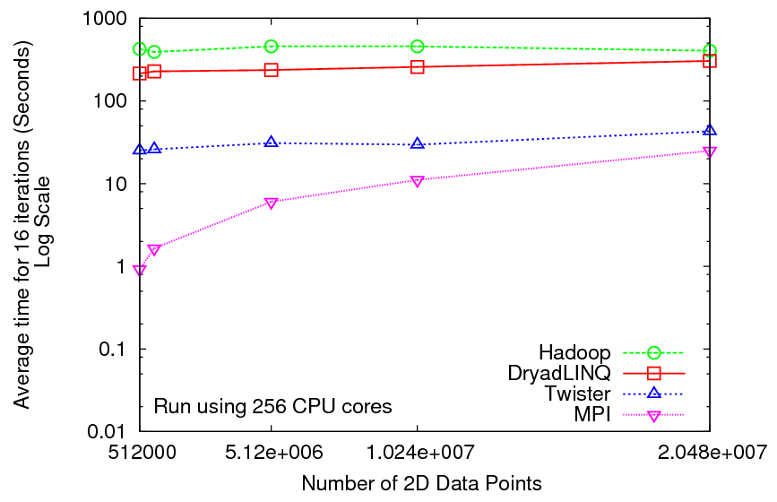
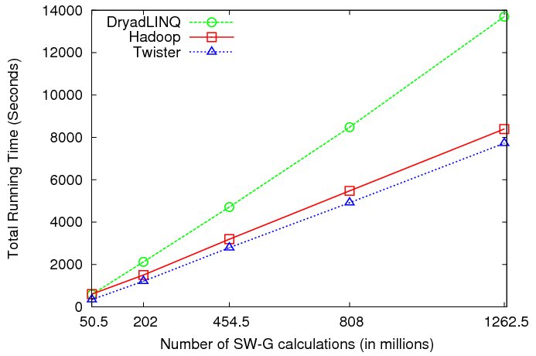
Iterative and non-Iterative Computations
K-means
Smith Waterman is a non iterative case and of course runs fine
Performance of K-Means

Slide 26
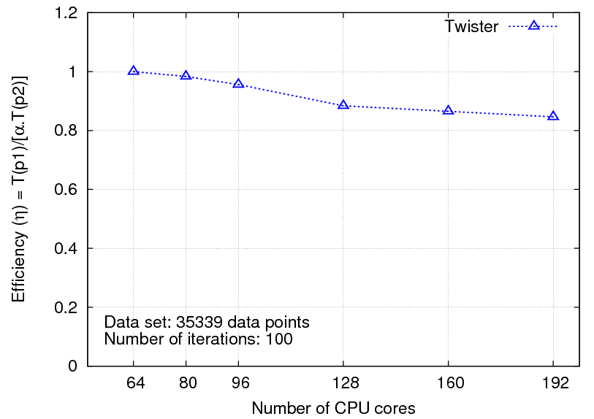
Multi-dimensional Scaling
While(condition)
{
<X> = [A] [B] <C>
C = CalcStress(<X>)
}
While(condition)
{
<T> = MapReduce1([B],<C>)
<X> = MapReduce2([A],<T>)
C = MapReduce3(<X>)
}
Iterative
Maps high dimensional data to lower dimensions (typically 2D or 3D)
SMACOF (Scaling by Majorizing of COmplicated Function)[1]
[1] J. de Leeuw, "Applications of convex analysis to multidimensional scaling," Recent Developments in Statistics, pp. 133-145, 1977.

Slide 27
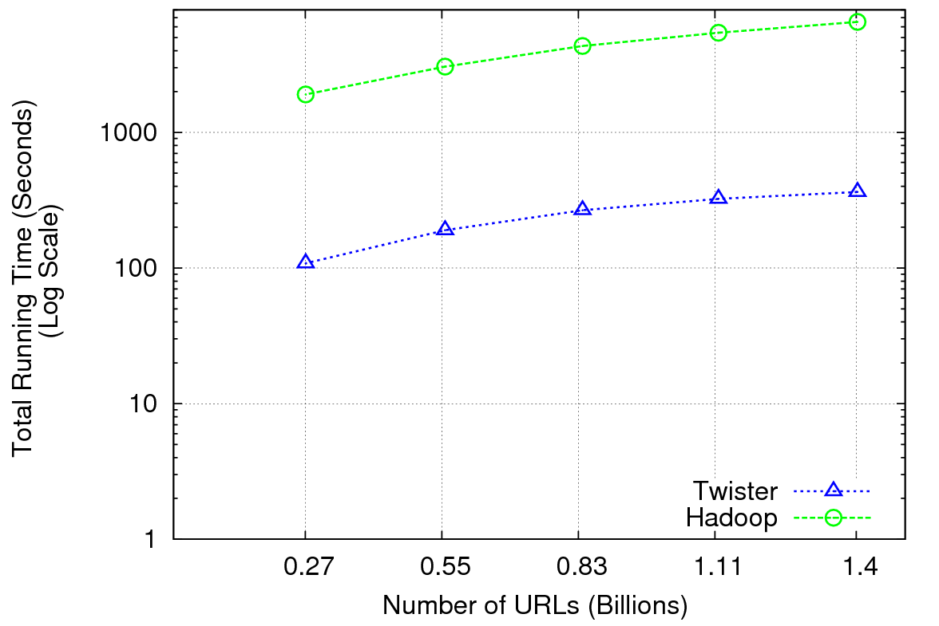
Performance of Pagerank using ClueWeb Data (Time for 20 iterations) using 32 nodes (256 CPU cores) of Crevasse

Slide 28
TwisterMPIReduce
PairwiseClustering MPI
Multi Dimensional Scaling MPI
Generative Topographic Mapping MPI
Other …
TwisterMPIReduce
Azure Twister (C# C++)
Java Twister
Microsoft Azure
FutureGrid
Local Cluster
Amazon EC2
Runtime package supporting subset of MPI mapped to Twister
Set-up, Barrier, Broadcast, Reduce

Slide 29
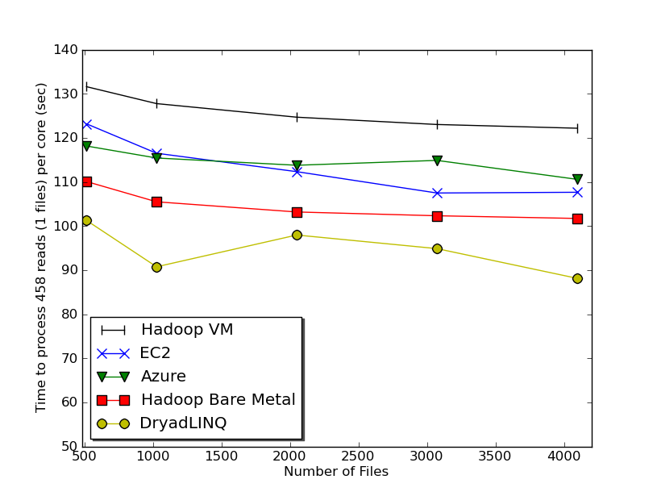
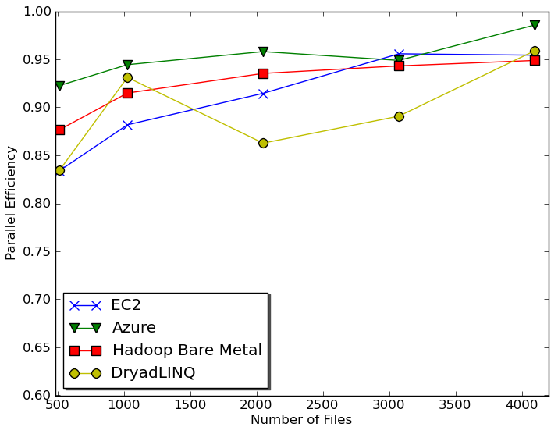
Sequence Assembly in the Clouds
Cap3 Parallel Efficiency
Cap3 – Time Per core per file (458 reads in each file) to process sequences

Slide 30
Early Results with Azure/Amazon MapReduce

Slide 31
SWG Cost
Notes:
This is just the cost for the compute instances. In addition to this, there will be minor charges for the data storage for EMR & AzureMR. Also there will be additional minor charges for the queue service and table service for AzureMR.
Cost presented here are amortized for the actual time (time/3600 * num_instances * instance_price_per_hour), assuming the remaining time of the instance hour have been put to useful work.
Note: EMR & Hadoop-EC2 requires one extra node to act as the master node (included in the cost calculation)

