Slide 1
Versatile HPC: Comet Virtual Clusters for the Long Tail of Science SC17 Denver Colorado
Comet Virtualization Team: Trevor Cooper, Dmitry Mishin, Christopher Irving, Gregor von Laszewski (IU) Fugang Wang (IU), Geoffrey C. Fox (IU), Phil Papadopoulos

Slide 2
Motivation for Virtual Clusters
OS and software requirements are diversifying. Growing number of user communities that can’t work in traditional HPC software environment.
Communities that have expertise and ability to utilize large clusters but need hardware.
Institutions that have bursty or intermittent need for computational resources.
Goal: Provide near bare metal HPC performance and management experience for groups that can manage their own clusters.

Slide 3
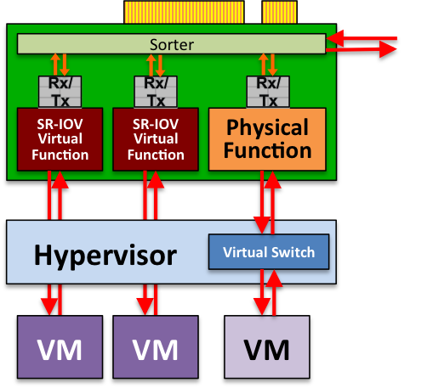
Key for Performance: Single Root I/O Virtualization (SR-IOV)
Problem: Virtualization generally has resulted in significant I/O performance degradation (e.g., excessive DMA interrupts)
Solution: SR-IOV and Mellanox ConnectX-3 InfiniBand host channel adapters
One physical function → multiple virtual functions, each light weight but with its own DMA streams, memory space, interrupts
Allows DMA to bypass hypervisor to VMs
SRIOV enables virtual HPC cluster w/ near-native InfiniBand latency/bandwidth and minimal overhead
Notes:
Virtualization → flexibility to run compute appliances:
run complex workflows with very specific application environments
tightly integrated, custom combinations of software: OS, libraries, and applications code/versions
Performance loss due to virtualized environments has been the major barrier
Virtualizing IO (DMAs) can cause excessive CPU interrupts
High-performance interconnect (InfiniBand) performance suffers
Solution: Single Root I/O Virtualization (SR-IOV) within Mellanox ConnectX-3 InfiniBand HCAs
provides technology for low-overhead DMA to virtual machines
non-proprietary industry standard: provides virtual functions for PCIe devices

Slide 4
User-Customized HPC 1:1 physical-to-virtual compute node
public network
physical
virtual
virtual
Virtual Frontend
Hosting
Frontend
Disk Image Vault
Virtual
Frontend
Virtual
Frontend
private
private
private
Compute
Compute
Compute
Virtual
Compute
Compute
Compute
Compute
Virtual
Compute
Virtual
Compute
Virtual
Compute
Compute
Compute
Compute
Virtual
Compute
Virtual
Compute

Slide 5
User Perspective User is a system administrator –we give them their own HPC cluster
Active virtual compute nodes
Scheduling
Storage management
Coordinating network changes
VM launch & shutdown
Attached and synchronized
Nucleus
Disk images
API
Request nodes
Console & power
Persistent virtual front end
Idle disk images

Slide 6
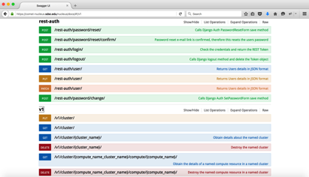
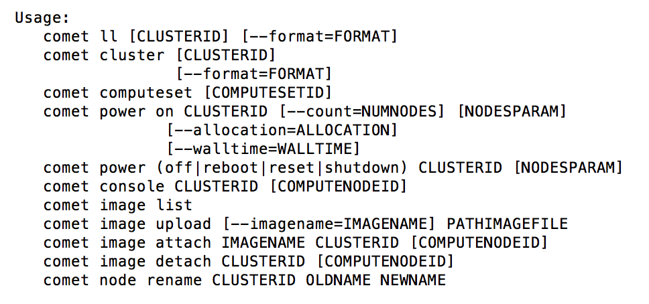
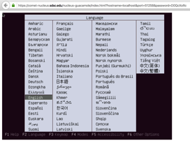
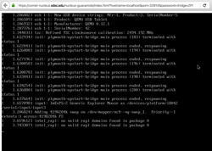
Accessing Virtual Cluster Capabilities
Reference: https://github.com/cloudmesh/client
https://github.com/cloudmesh/comet
hybrid clouds OpenStack, (EC2, AWS, Azure);
REST API
Command line interface
Command shell for scripting
Console Access
(Portal)
User does NOT see: Rocks, Slurm, etc.

Slide 7
Cloudmesh supports Continuous Improvement

Slide 8
Layered Architecture

Slide 9
Benefits
On same machine
MPI
Virtual Cluster
Containers
Allows reuse of technologies developed by local staff
Replicate your cluster on comet
Leverage local account management, e.g. if you have a large class you could use the existing account system simplifying access
Software stacks you developed

