Slide 1
Data Intensive Applications on Clouds
The Second International Workshop on
Data Intensive Computing in the Clouds (DataCloud-SC11)
at SC11
November 14 2011
Geoffrey Fox
gcf@indiana.edu
http://www.infomall.org http://www.salsahpc.org
Director, Digital Science Center, Pervasive Technology Institute
Associate Dean for Research and Graduate Studies, School of Informatics and Computing
Indiana University Bloomington
Work with Judy Qiu and several students

Slide 2
Some Trends
The Data Deluge is clear trend from Commercial (Amazon, transactions) , Community (Facebook, Search) and Scientific applications
Exascale initiatives will continue drive to high end with a simulation orientation
Clouds offer from different points of view
  NIST: On-demand service (elastic); Broad network access; Resource pooling; Flexible resource allocation; Measured service
  Economies of scale
  Powerful new software models

Slide 3
Some Data sizes
~40 10⁹ Web pages at ~300 kilobytes each = 10 Petabytes
Youtube 48 hours video uploaded per minute;
  in 2 months in 2010, uploaded more than total NBC ABC CBS
  ~2.5 petabytes per year uploaded?
LHC 15 petabytes per year
Radiology 69 petabytes per year
Square Kilometer Array Telescope will be 100 terabits/second
Earth Observation becoming ~4 petabytes per year
Earthquake Science – few terabytes total today
PolarGrid – 100’s terabytes/year
Exascale simulation data dumps – terabytes/second
Not very quantitative

Slide 4
Genomics in Personal Health
Suppose you measured everybody’s genome every 2 years
30 petabits of new gene data per day
  factor of 100 more for raw reads with coverage
Data surely distributed
1.5*10^8 to 1.5*10^10 continuously running present day cores to perform a simple Blast analysis on this data
  Amount depends on clever hashing and maybe Blast not good enough as field gets more sophisticated
Analysis requirements not well articulated in many fields – See http://www.delsall.org for life sciences
  LHC data analysis well understood – is it typical?
  LHC Pleasing parallel (PP) – some in Life Sciences like Blast also PP

Slide 5
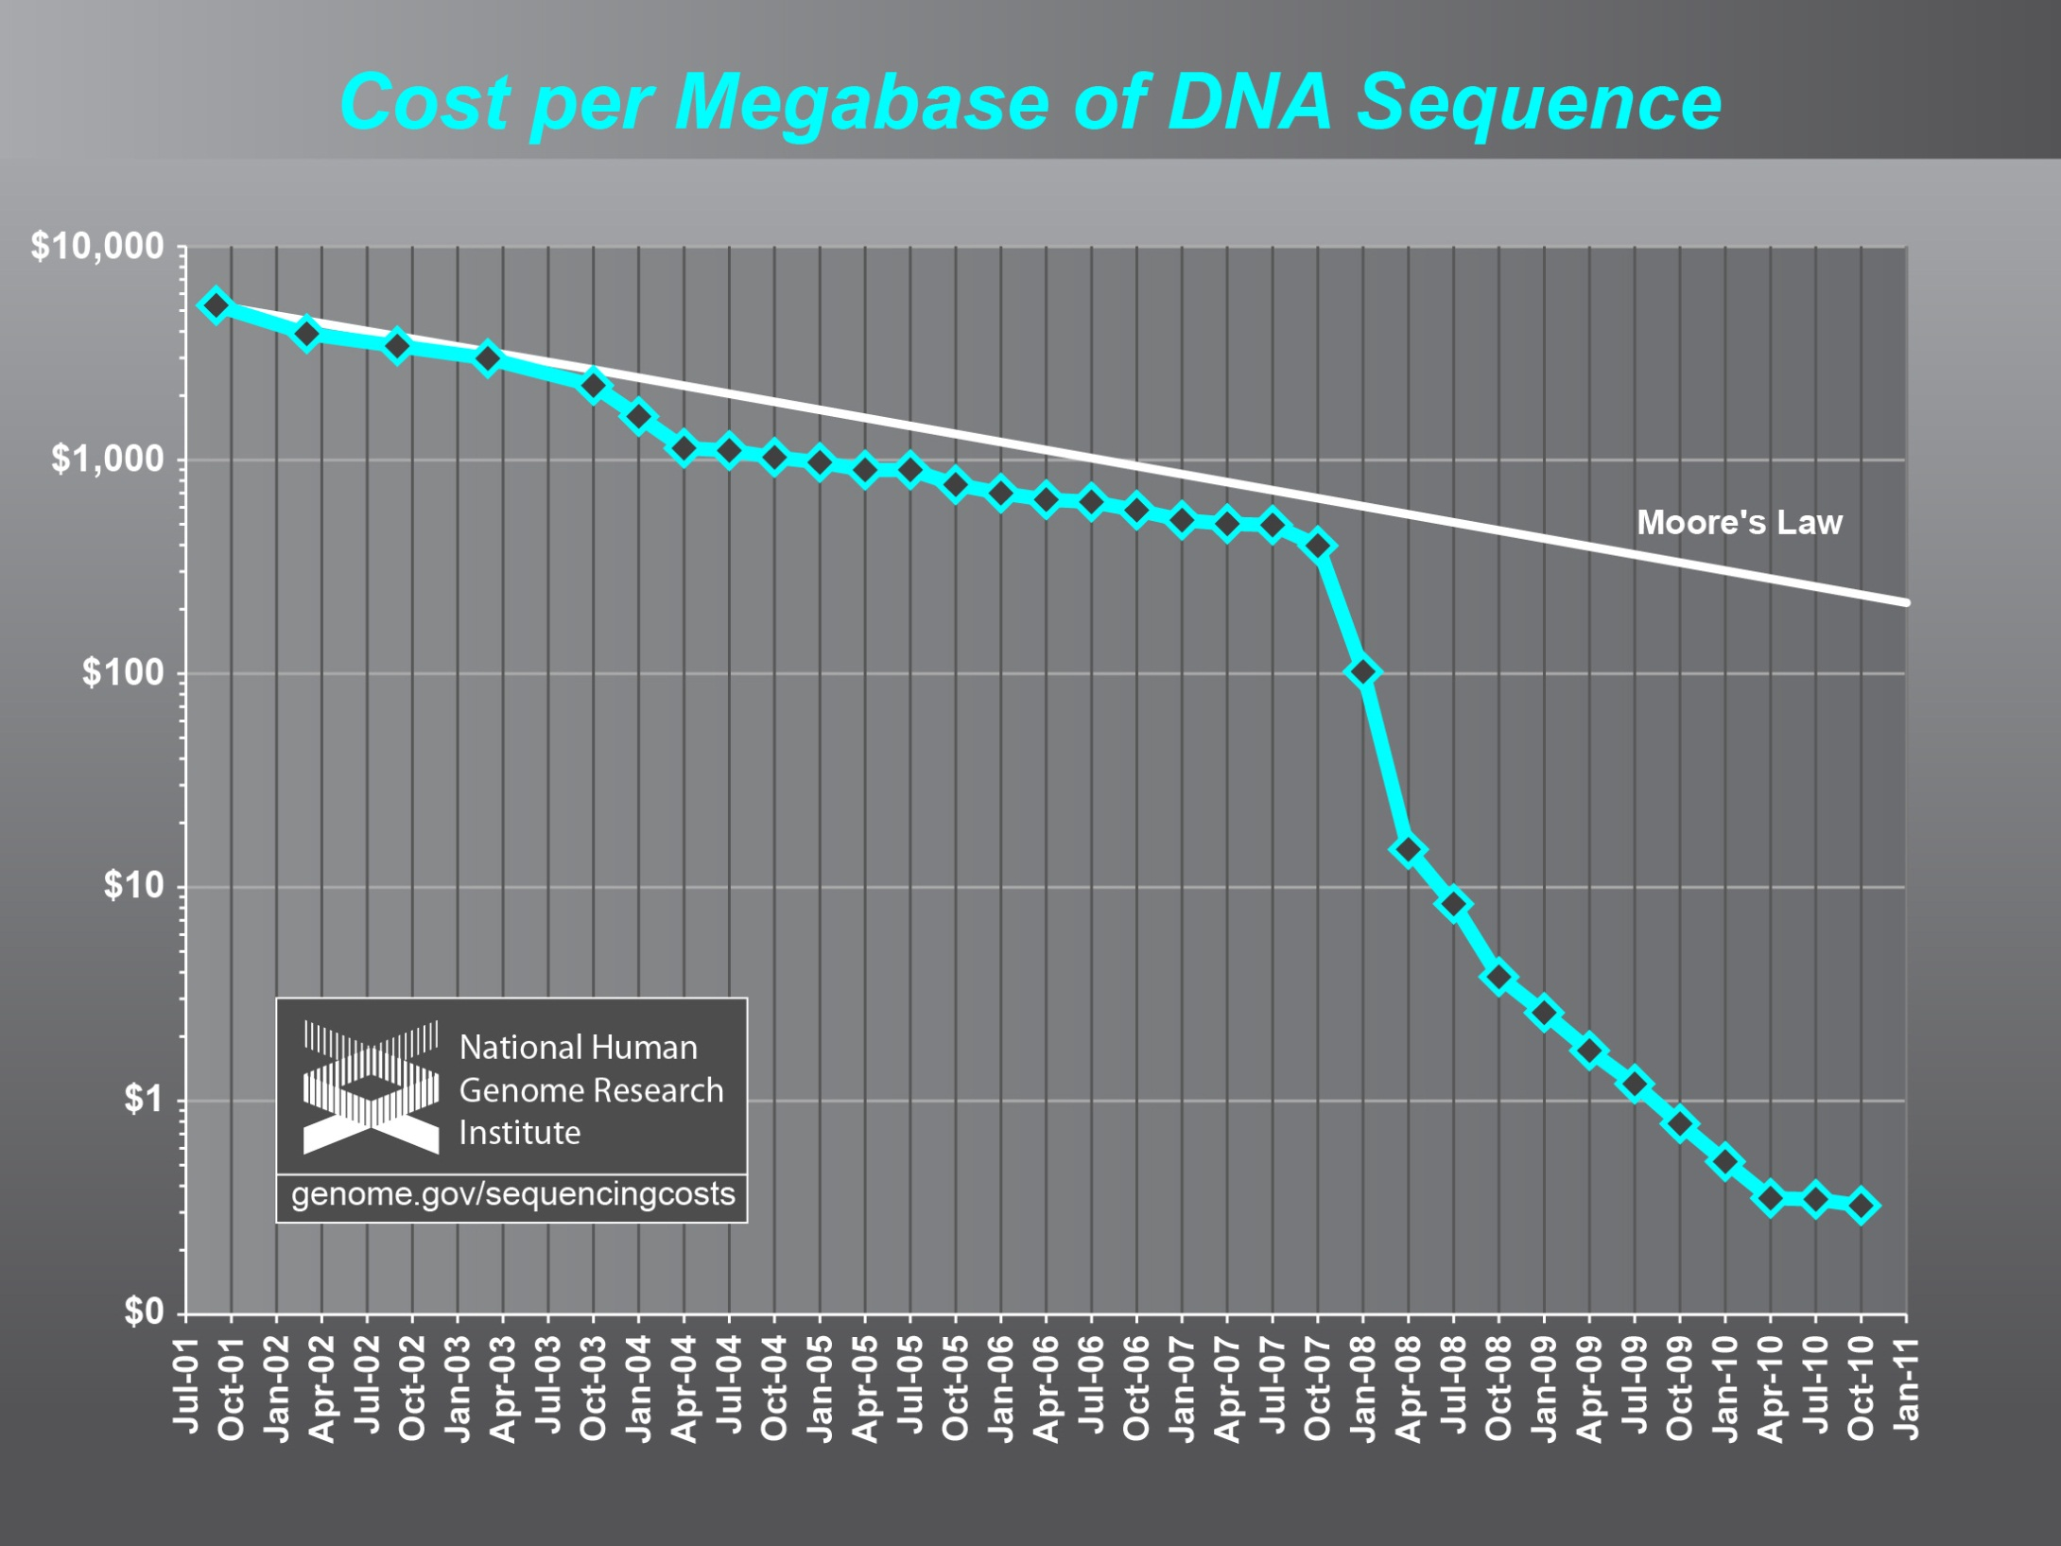
Why need cost effective
Computing!
(Note Public Clouds not allowed for human genomes)

Slide 6
Clouds and Grids/HPC
Synchronization/communication Performance
Grids > Clouds > HPC Systems
Clouds appear to execute effectively Grid workloads but are not easily used for closely coupled HPC applications
Service Oriented Architectures and workflow appear to work similarly in both grids and clouds
Assume for immediate future, science supported by a mixture of
  Clouds – data analysis (and pleasingly parallel)
  Grids/High Throughput Systems (moving to clouds as convenient)
  Supercomputers (“MPI Engines”) going to exascale

Slide 7
Clouds and Jobs
Clouds are a major industry thrust with a growing fraction of IT expenditure that IDC estimates will grow to $44.2 billion direct investment in 2013 while 15% of IT investment in 2011 will be related to cloud systems with a 30% growth in public sector.
Gartner also rates cloud computing high on list of critical emerging technologies with for example “Cloud Computing” and “Cloud Web Platforms” rated as transformational (their highest rating for impact) in the next 2-5 years.
Correspondingly there is and will continue to be major opportunities for new jobs in cloud computing with a recent European study estimating there will be 2.4 million new cloud computing jobs in Europe alone by 2015.
Cloud computing spans research and economy and so attractive component of curriculum for students that mix “going on to PhD” or “graduating and working in industry” (as at Indiana University where most CS Masters students go to industry)

Slide 8
2 Aspects of Cloud Computing:
Infrastructure and Runtimes
Cloud infrastructure: outsourcing of servers, computing, data, file space, utility computing, etc..
Cloud runtimes or Platform: tools to do data-parallel (and other) computations. Valid on Clouds and traditional clusters
  Apache Hadoop, Google MapReduce, Microsoft Dryad, Bigtable, Chubby and others
  MapReduce designed for information retrieval but is excellent for a wide range of science data analysis applications
  Can also do much traditional parallel computing for data-mining if extended to support iterative operations
  Data Parallel File system as in HDFS and Bigtable

Slide 9
Guiding Principles
Clouds may not be suitable for everything but they are suitable for majority of data intensive applications
  Solving partial differential equations on 100,000 cores probably needs classic MPI engines
Cost effectiveness, elasticity and quality programming model will drive use of clouds in many areas such as genomics
Need to solve issues of
  Security-privacy-trust for sensitive data
  How to store data – “data parallel file systems” (HDFS), Object Stores, or classic HPC approach with shared file systems with Lustre etc.
Programming model which is likely to be MapReduce based
  Look at high level languages
  Compare with databases (SciDB?)
  Must support iteration to do “real parallel computing”
  Need Cloud-HPC Cluster Interoperability

Slide 10






MapReduce “File/Data Repository” Parallelism
Map = (data parallel) computation reading and writing data
Reduce = Collective/Consolidation phase e.g. forming multiple global sums as in histogram
Instruments
MPI or Iterative MapReduce
Map Reduce Map Reduce Map
Communication
Reduce
Portals
/Users
Disks
Map₁
Map₂
Map₃

Slide 11
Application Classification
(a) Map Only
(b) Classic MapReduce
(c) Iterative MapReduce
(d) Loosely Synchronous
Input
Input
Iterations
Input
map
map
map
P_{ij}
reduce
reduce
Output
BLAST Analysis
Smith-Waterman Distances
Parametric sweeps
PolarGrid Matlab data analysis
High Energy Physics (HEP) Histograms
Distributed search
Distributed sorting
Information retrieval
Expectation maximization clustering e.g. Kmeans
Linear Algebra
Multimensional Scaling
Page Rank
Many MPI scientific applications such as solving differential equations and particle dynamics
Domain of MapReduce and Iterative Extensions
MPI

Slide 12
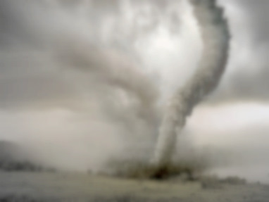
Twister v0.9
March 15, 2011
  New Interfaces for Iterative MapReduce Programming
  http://www.iterativemapreduce.org/
SALSA Group
Bingjing Zhang, Yang Ruan, Tak-Lon Wu, Judy Qiu, Adam Hughes, Geoffrey Fox, Applying Twister to Scientific Applications, Proceedings of IEEE CloudCom 2010 Conference, Indianapolis, November 30-December 3, 2010
Twister4Azure released May 2011
http://salsahpc.indiana.edu/twister4azure/
MapReduceRoles4Azure available for some time at
http://salsahpc.indiana.edu/mapreduceroles4azure/
Microsoft Daytona project July 2011 is Azure version

Slide 13

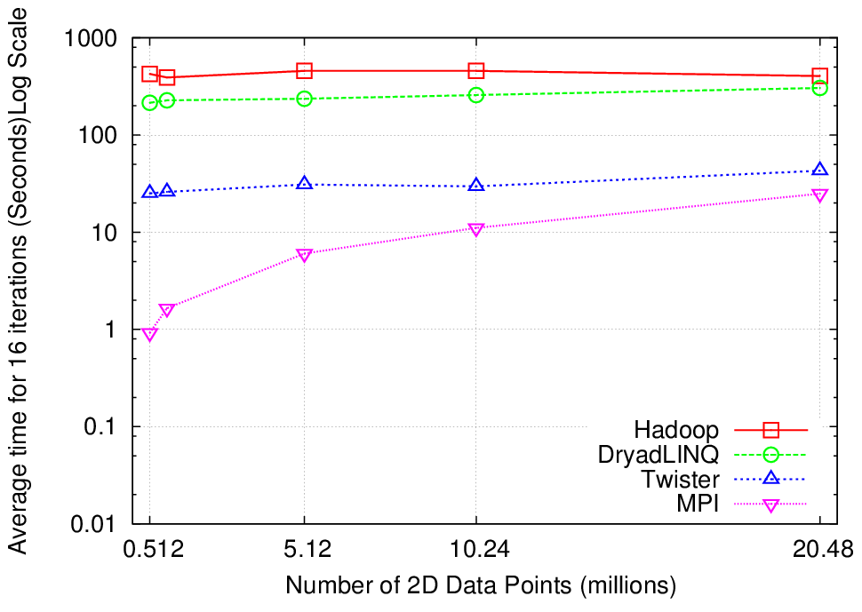
K-Means Clustering
Compute the distance to each data point from each cluster center and assign points to cluster centers
map
map
Time for 20 iterations
reduce
Compute new cluster
centers
User program
Compute new cluster centers
Iteratively refining operation
Typical MapReduce runtimes incur extremely high overheads
  New maps/reducers/vertices in every iteration
  File system based communication
Long running tasks and faster communication in Twister enables it to perform close to MPI

Slide 14


Twister
Pub/Sub Broker Network
Map Worker
M
Worker Nodes
R
Reduce Worker
Streaming based communication
Intermediate results are directly transferred from the map tasks to the reduce tasks – eliminates local files
Cacheable map/reduce tasks
  Static data remains in memory
Combine phase to combine reductions
User Program is the composer of MapReduce computations
Extends the MapReduce model to iterative computations
D
D
MR
Driver
User
Program
M
M
M
M
D
MRDeamon
R
R
R
R
Data Read/Write
Communication
Data Split
File System
Iterate
Static
data
Configure()
User Program
Map(Key, Value)
δ flow
Reduce (Key, List<Value>)
Combine (Key, List<Value>)
Different synchronization and intercommunication mechanisms used by the parallel runtimes
Close()

Slide 15
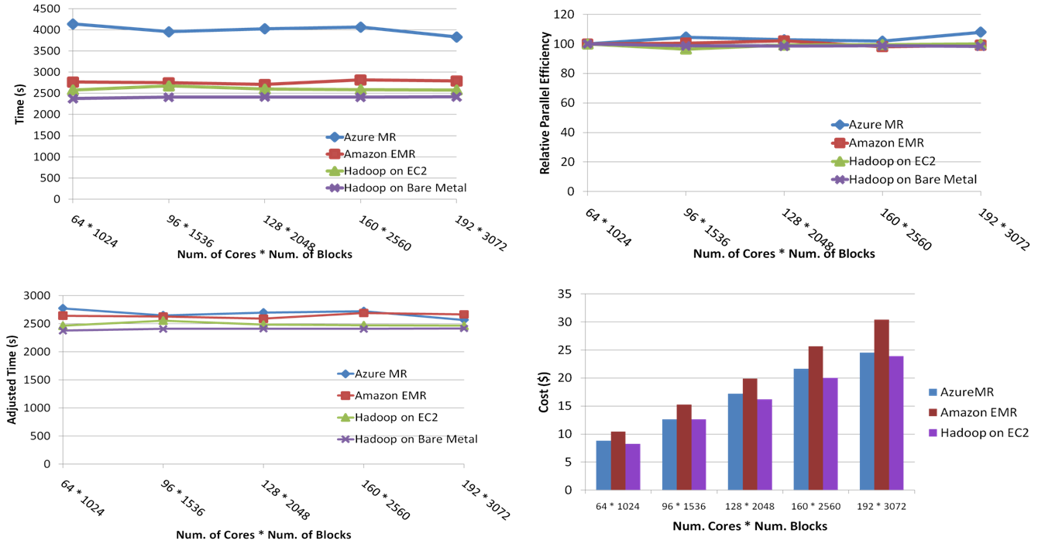
SWG Sequence Alignment Performance
Smith-Waterman-GOTOH to calculate all-pairs dissimilarity
Notes:
~123 million sequence alignments, for under 30$ with zero up front hardware cost,

Slide 16

Performance of Pagerank using
ClueWeb Data (Time for 20 iterations)
using 32 nodes (256 CPU cores) of Crevasse

Slide 17
Map Collective Model (Judy Qiu)
Combine MPI and MapReduce ideas
Implement collectives optimally on Infiniband, Azure, Amazon ……
Iterate
Input
map
Initial Collective Step
Network of Brokers
Generalized Reduce
Final Collective Step
Network of Brokers

Slide 18
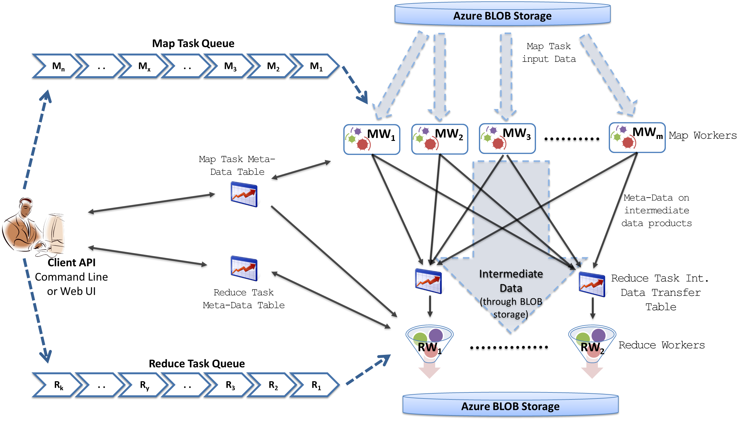
MapReduceRoles4Azure Architecture
Azure Queues for scheduling, Tables to store meta-data and monitoring data, Blobs for input/output/intermediate data storage.
Notes:
We use Azure Queues for scheduling, Tables to store meta-data and monitoring data, Blobs for input/output/intermediate data storage.

Slide 19
MapReduceRoles4Azure
Use distributed, highly scalable and highly available cloud services as the building blocks.
  Azure Queues for task scheduling.
  Azure Blob storage for input, output and intermediate data storage.
  Azure Tables for meta-data storage and monitoring
Utilize eventually-consistent , high-latency cloud services effectively to deliver performance comparable to traditional MapReduce runtimes.
Minimal management and maintenance overhead
Supports dynamically scaling up and down of the compute resources.
MapReduce fault tolerance
http://salsahpc.indiana.edu/mapreduceroles4azure/

Slide 20
High Level Flow Twister4Azure
Map
Combine
Job Start
Map
Reduce
Combine
Merge
Add Iteration?
Job Finish
Reduce
No
Map
Combine
Yes
Data Cache
Hybrid scheduling of the new iteration
Merge Step
In-Memory Caching of static data
Cache aware hybrid scheduling using Queues as well as using a bulletin board (special table)
Notes:
In our current work, we extend MR4Azure to support iterative mapreduce computations. We added an additional merge step to the programming model, where the computations decides whether to go for a new iteration or not. We also support in-memory caching of static data between iterations and we developed a hybrid scheduling strategy to perform cache aware scheduling.

Slide 21
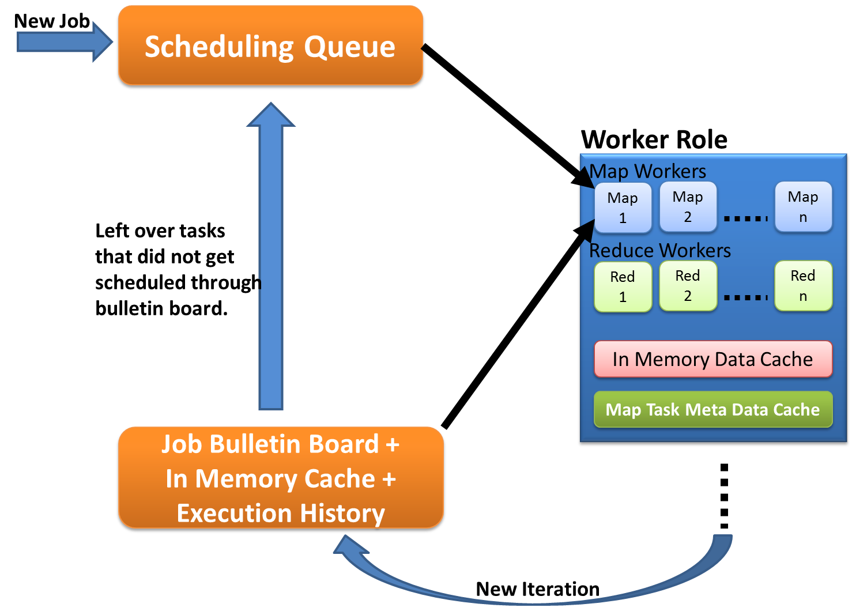
Cache aware scheduling
New Job (1st iteration)
  Through queues
New iteration
  Publish entry to Job Bulletin Board
  Workers pick tasks based on in-memory data cache and execution history (MapTask Meta-Data cache)
  Any tasks that do not get scheduled through the bulletin board will be added to the queue.

Slide 22
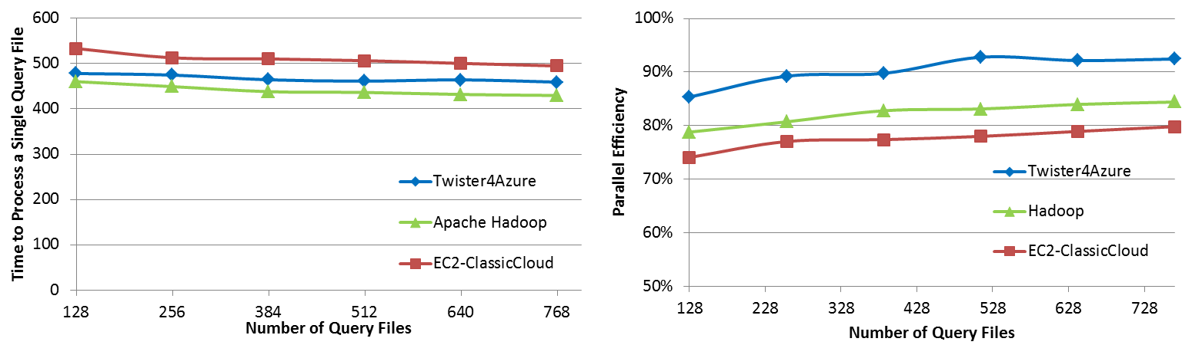

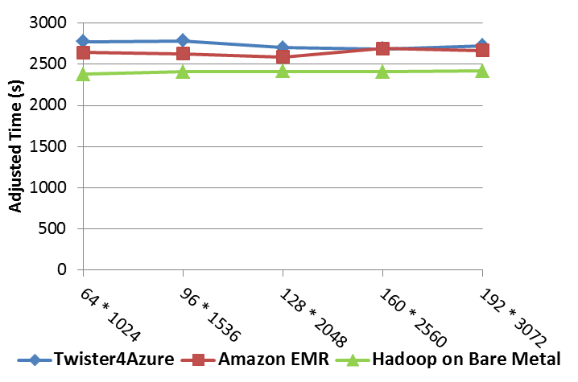
Performance Comparisons
BLAST Sequence Search
Smith Waterman Sequence Alignment
Cap3 Sequence Assembly

Slide 23

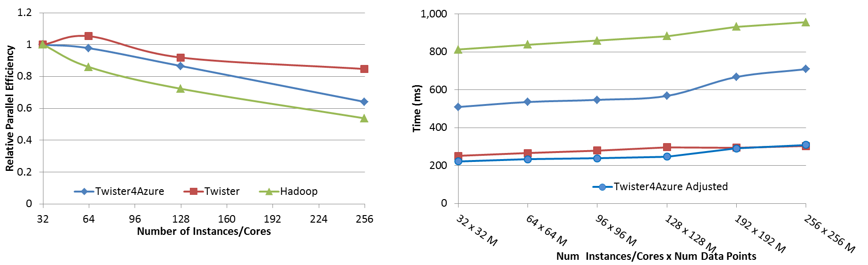




Performance – Kmeans Clustering
Task Execution Time Histogram
Number of Executing Map Task Histogram
Strong Scaling with 128M Data Points
Weak Scaling
Performance with/without
data caching
Speedup gained using data cache
Scaling speedup
Increasing number of iterations
Notes:
Right(c): Twister4Azure executing Map Task histogram for 128 million data points in 128 Azure small instances
Figure 5. KMeansClustering Scalability. Left(a): Relative parallel efficiency of strong scaling using 128 million data points.
Center(b): Weak scaling. Workload per core is kept constant (ideal is a straight horizontal line).

Slide 24
Kmeans Speedup from 32 cores

Slide 25
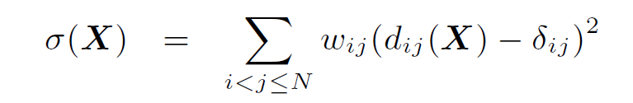
Look at one problem in detail
Visualizing Metagenomics where sequences are ~1000 dimensions
Map sequences to 3D so you can visualize
Minimize Stress
Improve with deterministic annealing (gives lower stress with less variation between random starts)
Need to iterate Expectation Maximization
N² dissimilarities (Smith Waterman, Needleman-Wunsch, Blast) δ_{i j}
Communicate N positions X between steps

Slide 26
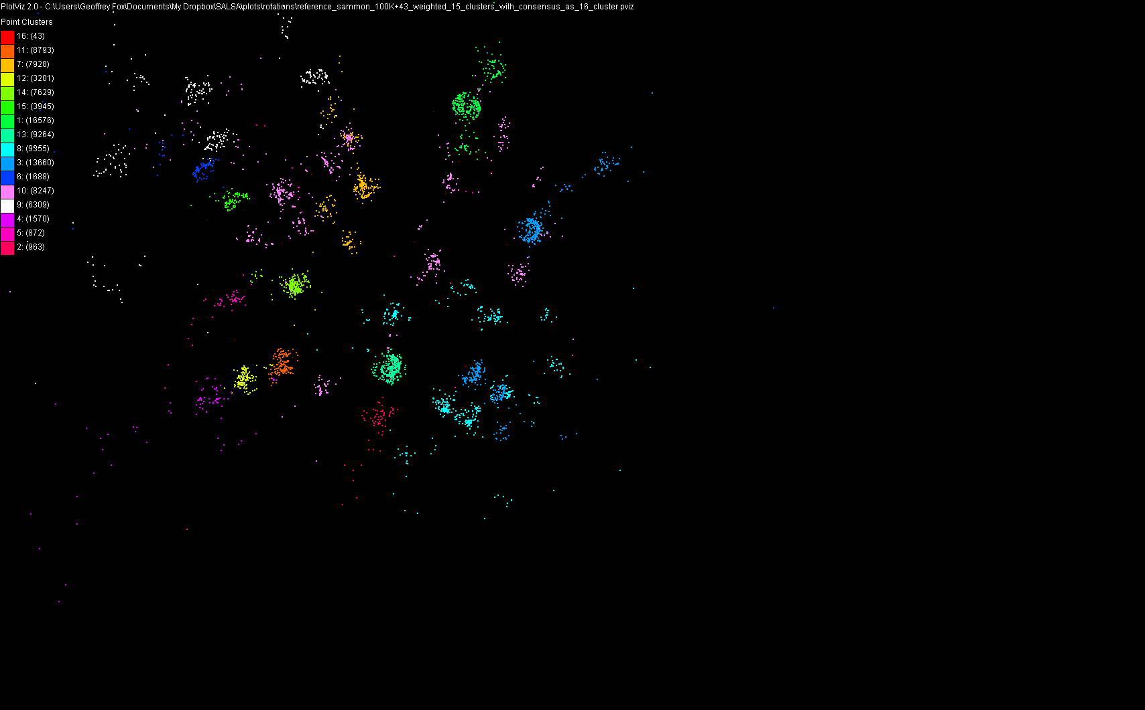
100,043 Metagenomics Sequences mapped to 3D

Slide 27
Its an O(N²) Problem
100,000 sequences takes a few days on 768 cores 32 nodes Windows Cluster Tempest
Could just run 680K on 6.8² larger machine but lets try to be “cleverer” and use hierarchical methods
Start with 100K sample run fully
Divide into “megaregions” using 3D projection
Interpolate full sample into megaregions and analyze latter separately
See http://salsahpc.org/millionseq/16SrRNA_index.html

Slide 28
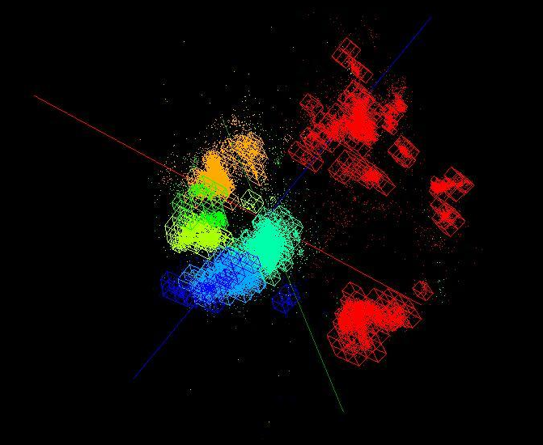
OctTree for 100K sample of Fungi
Use Barnes Hut OctTree originally developed to make O(N²) astrophysics O(NlogN)
We will use OctTree for logarithmic interpolation

Slide 29
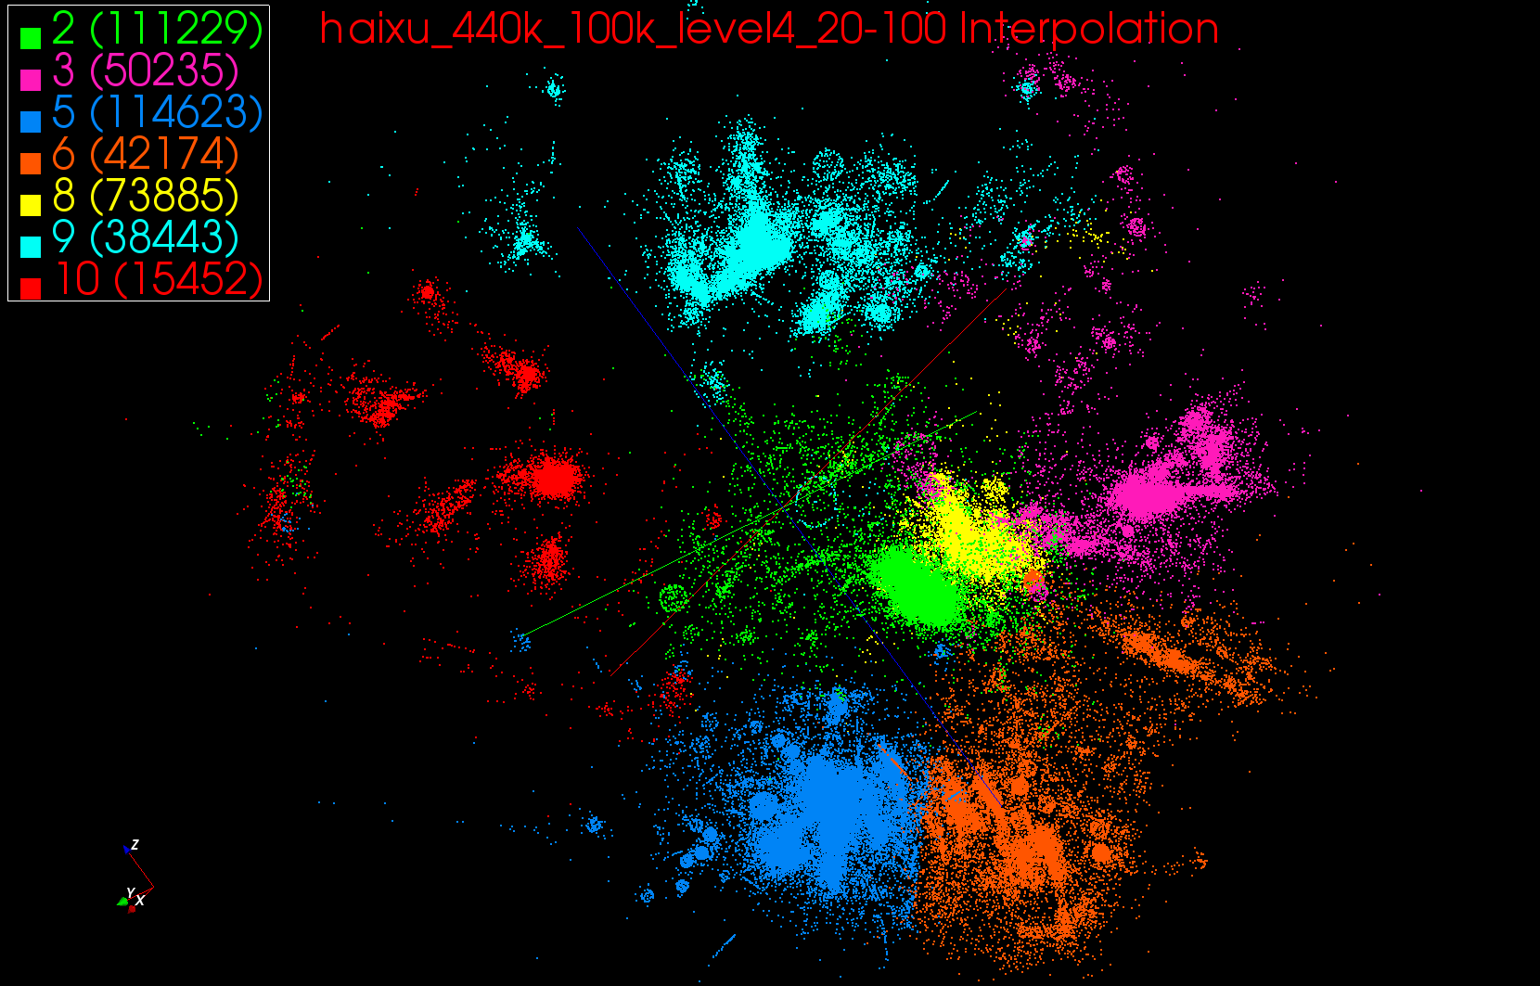
440K Interpolated

Slide 30
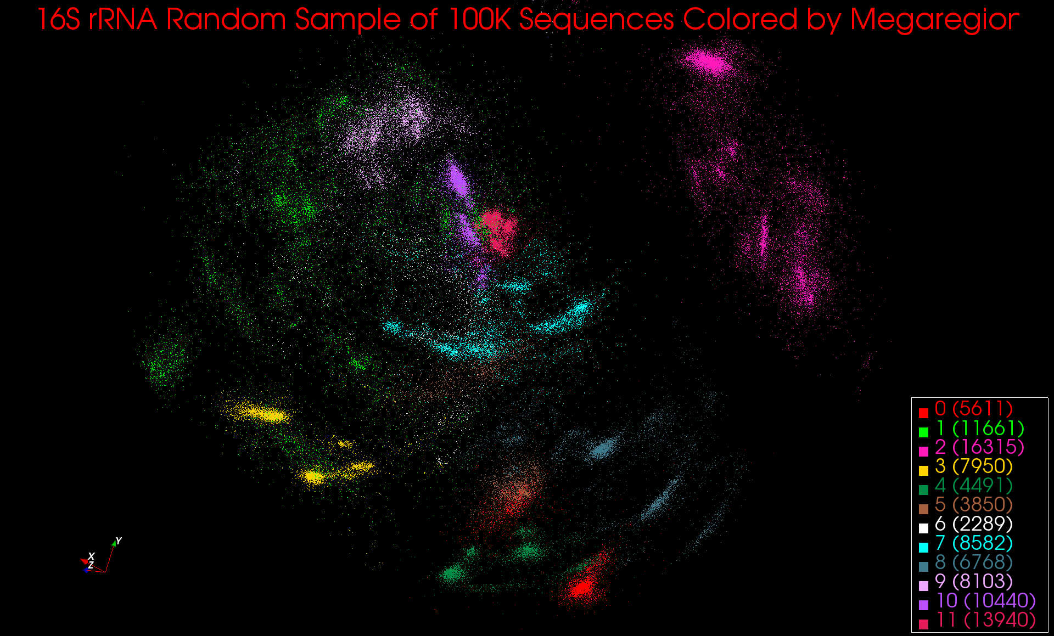
12 Megaregions defined from initial sample

Slide 31
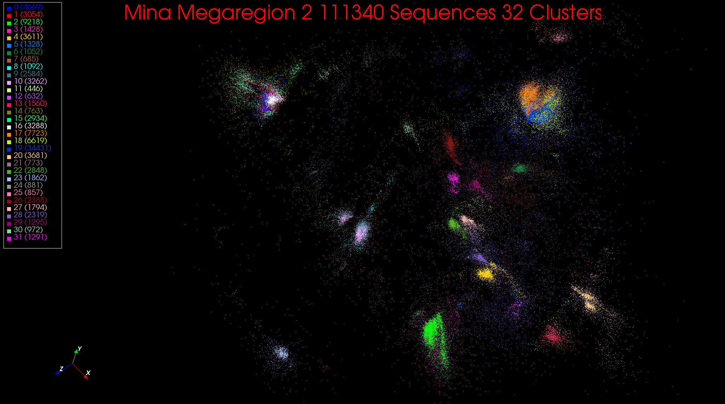
One Megaregion divided into many clusters

Slide 32
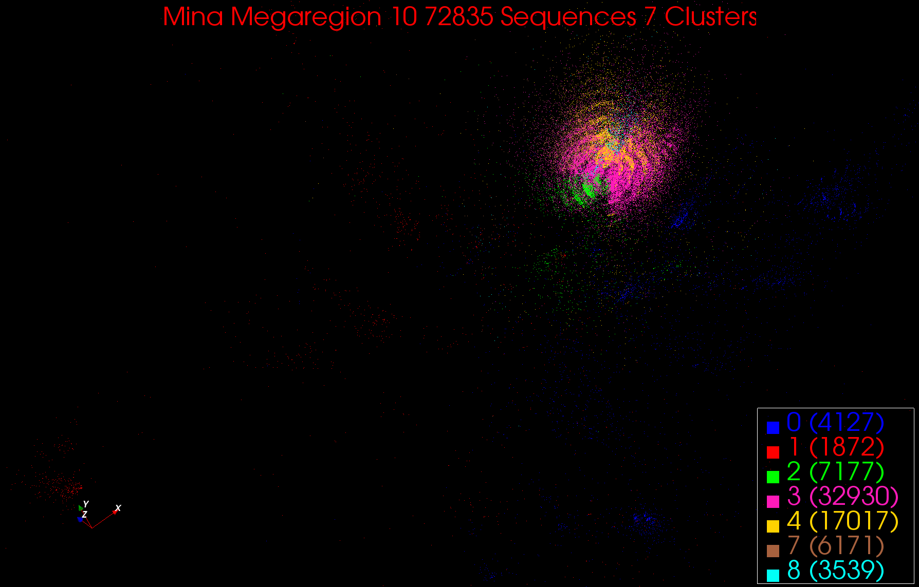
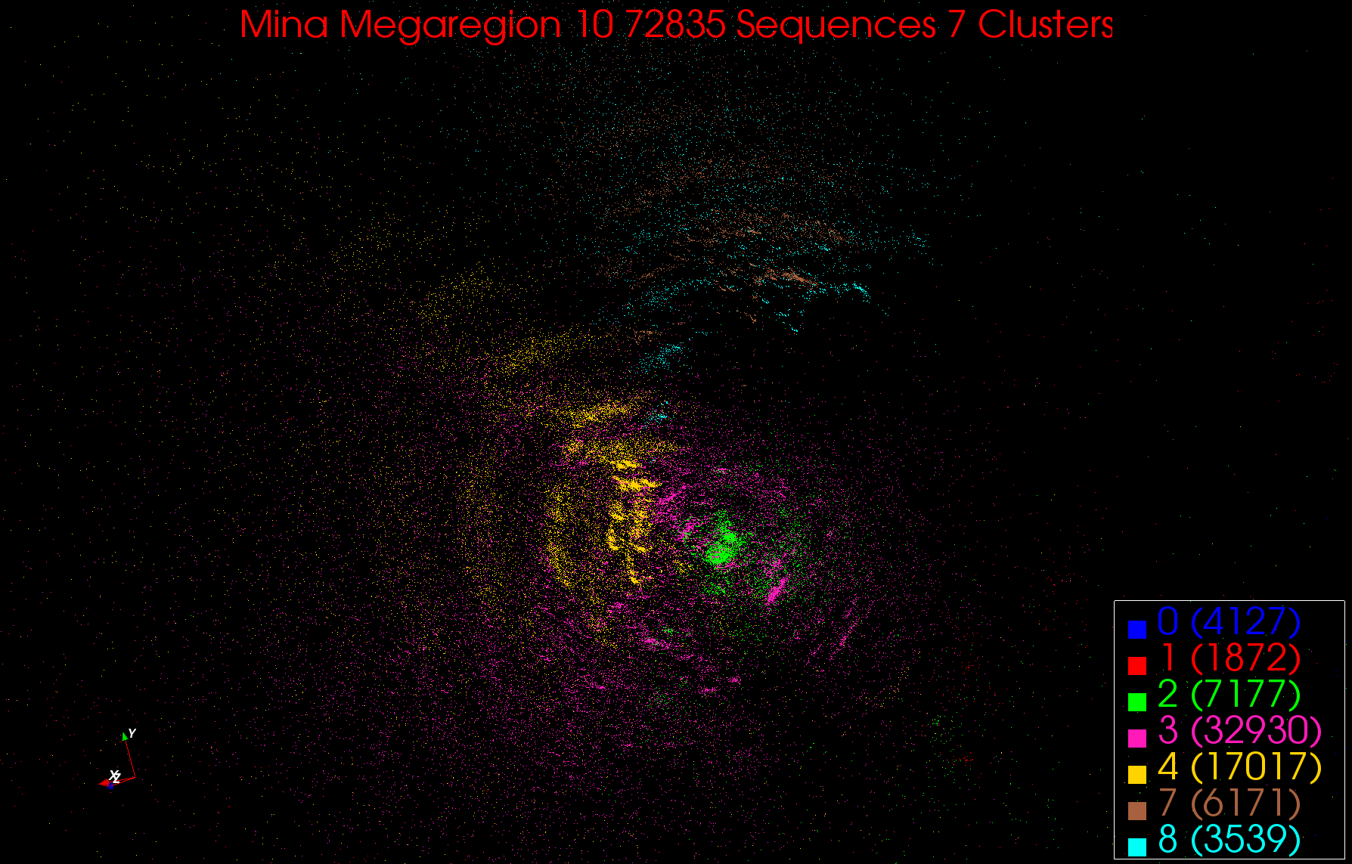
A more compact Megaregion

Slide 33
Multi-Dimensional-Scaling
Many iterations
Memory & Data intensive
3 Map Reduce jobs per iteration
X_{k} = invV * B(X_{(k-1)}) * X_{(k-1)}
2 matrix vector multiplications termed BC and X
BC: Calculate BX
X: Calculate invV (BX)
Calculate Stress
Map
Reduce
Merge
Map
Reduce
Merge
Map
Reduce
Merge
New Iteration

Slide 34
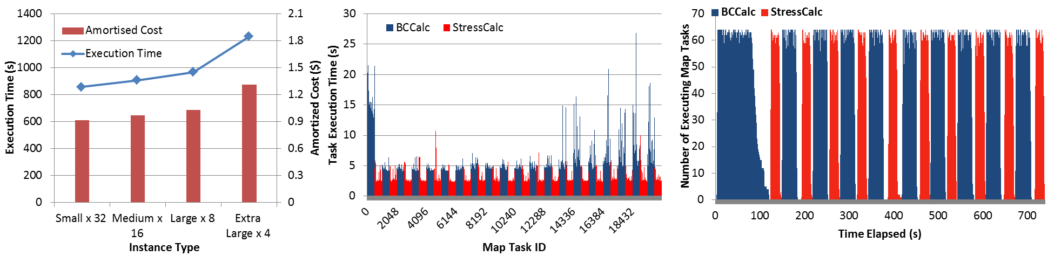
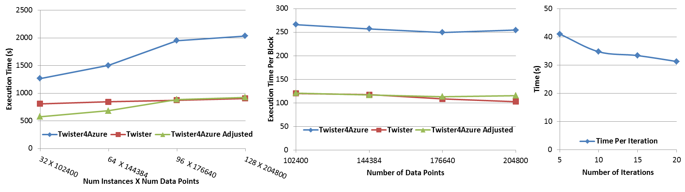
Performance – Multi Dimensional Scaling
Azure Instance Type Study
Task Execution Time Histogram
Number of Executing Map Task Histogram
Weak Scaling
Data Size Scaling
Increasing Number of Iterations
Performance with/without
data caching
Speedup gained using data cache
Scaling speedup
Increasing number of iterations
Notes:
Figure 6. Twister4Azure MDS performance Left: Instance type study using 76800 data points, 32 instances, 20 iterations. Center: Twister4Azure MDS individual task execution time histogram for 144384 x144384 distance matrix in 64 Azure small instances, 10 iterations Right: Twister4Azure executing Map Task histogram for 144384 x144384 distance matrix in 64 Azure small instances, 10 iterations
Figure 7. Left: Weak scaling where workload per core is ~constant. Ideal is a straight horizontal line. Center : Data size scaling with 128 Azure small instances/cores, 20 iterations. Right: Time per iteration with increasing number of iterations 30k x 30k distance matrix, 15 instances.

Slide 35
Twister4Azure Conclusions
Twister4Azure enables users to easily and efficiently perform large scale iterative data analysis and scientific computations on Azure cloud.
  Supports classic and iterative MapReduce
  Non pleasingly parallel use of Azure
Utilizes a hybrid scheduling mechanism to provide the caching of static data across iterations.
Should integrate with workflow systems
Plenty of testing and improvements needed!
Open source: Please use http://salsahpc.indiana.edu/twister4azure

Slide 36
What was/can be done where?
Dissimilarity Computation (largest time)
  Done using Twister on HPC
  Have running on Azure and Dryad
  Used Tempest with MPI as well (MPI.NET failed(!), Twister didn’t)
Full MDS
  Done using MPI on Tempest
  Have running well using Twister on HPC clusters and Azure
Pairwise Clustering
  Done using MPI on Tempest
  Probably need to change algorithm to get good efficiency on cloud
Interpolation (smallest time)
  Done using Twister on HPC
  Running on Azure

Slide 37
Expectation Maximization and Iterative MapReduce
Clustering and Multidimensional Scaling are both EM (expectation maximization) using deterministic annealing for improved performance
EM tends to be good for clouds and Iterative MapReduce
  Quite complicated computations (so compute largish compared to communicate)
  Communication is Reduction operations (global sums in our case)
  See also Latent Dirichlet Allocation and related Information Retrieval algorithms similar structure

Slide 38
DA-PWC EM Steps (E is red, M Black) k runs over clusters; i,j, α points
A(k) = - 0.5 ∑_{i=1}^{N} ∑_{j=1}^{N} δ(i, j) <M_{i}(k)> <M_{j}(k)> / <C(k)>²
B_{α}(k) = ∑_{i=1}^{N} δ(i, α) <M_{i}(k)> / <C(k)>
ε_{α}(k) = (B_{α}(k) + A(k))
<M_{i}(k)> = p(k) exp( -ε_{i}(k)/T )/
∑_{k’=1}^{K} p(k’) exp(-ε_{i}(k’)/T)
C(k) = ∑_{i=1}^{N} <M_{i}(k)>
p(k) = C(k) / N
Loop to converge variables; decrease T from ∞; split centers by halving p(k)
Steps 1 global sum (reduction)
Step 1, 2, 5 local sum if <M_{i}(k)> broadcast

Slide 39
May Need New Algorithms
DA-PWC (Deterministically Annealed Pairwise Clustering) splits clusters automatically as temperature lowers and reveals clusters of size O(√T)
Two approaches to splitting
  Look at correlation matrix and see when becomes singular which is a separate parallel step
  Formulate problem with multiple centers for each cluster and perturb ever so often spitting centers into 2 groups; unstable clusters separate
Current MPI code uses first method which will run on Twister as matrix singularity analysis is the usual “power eigenvalue method” (as is page rank)
  However not very good compute/communicate ratio
Experiment with second method which “just” EM with better compute/communicate ratio (simpler code as well)

Slide 40
What can we learn?
There are many pleasingly parallel data analysis algorithms which are super for clouds
  Remember SWG computation longer than other parts of analysis
There are interesting data mining algorithms needing iterative parallel run times
There are linear algebra algorithms with flaky compute/communication ratios
Expectation Maximization good for Iterative MapReduce

Slide 41
Research Issues for (Iterative) MapReduce
Quantify and Extend that Data analysis for Science seems to work well on Iterative MapReduce and clouds so far.
  Iterative MapReduce (Map Collective) spans all architectures as unifying idea
Performance and Fault Tolerance Trade-offs;
  Writing to disk each iteration (as in Hadoop) naturally lowers performance but increases fault-tolerance
  Integration of GPU’s
Security and Privacy technology and policy essential for use in many biomedical applications
Storage: multi-user data parallel file systems have scheduling and management
  NOSQL and SciDB on virtualized and HPC systems
Data parallel Data analysis languages: Sawzall and Pig Latin more successful than HPF?
Scheduling: How does research here fit into scheduling built into clouds and Iterative MapReduce (Hadoop)
  important load balancing issues for MapReduce for heterogeneous workloads

Slide 42
Authentication and Authorization: Provide single sign in to All system architectures
Workflow: Support workflows that link job components between Grids and Clouds.
Provenance: Continues to be critical to record all processing and data sources
Data Transport: Transport data between job components on Grids and Commercial Clouds respecting custom storage patterns like Lustre v HDFS
Program Library: Store Images and other Program material
Blob: Basic storage concept similar to Azure Blob or Amazon S3
DPFS Data Parallel File System: Support of file systems like Google (MapReduce), HDFS (Hadoop) or Cosmos (dryad) with compute-data affinity optimized for data processing
Table: Support of Table Data structures modeled on Apache Hbase/CouchDB or Amazon SimpleDB/Azure Table. There is “Big” and “Little” tables – generally NOSQL
SQL: Relational Database
Queues: Publish Subscribe based queuing system
Worker Role: This concept is implicitly used in both Amazon and TeraGrid but was (first) introduced as a high level construct by Azure. Naturally support Elastic Utility Computing
MapReduce: Support MapReduce Programming model including Hadoop on Linux, Dryad on Windows HPCS and Twister on Windows and Linux. Need Iteration for Datamining
Software as a Service: This concept is shared between Clouds and Grids
Web Role: This is used in Azure to describe user interface and can be supported by portals in Grid or HPC systems
Components of a Scientific Computing Platform

Slide 43
Architecture of Data Repositories?
Traditionally governments set up repositories for data associated with particular missions
  For example EOSDIS, GenBank, NSIDC, IPAC for Earth Observation , Gene, Polar Science and Infrared astronomy
  LHC/OSG computing grids for particle physics
This is complicated by volume of data deluge, distributed instruments as in gene sequencers (maybe centralize?) and need for complicated intense computing

Slide 44
Clouds as Support for Data Repositories?
The data deluge needs cost effective computing
  Clouds are by definition cheapest
Shared resources essential (to be cost effective and large)
  Can’t have every scientists downloading petabytes to personal cluster
Need to reconcile distributed (initial source of ) data with shared computing
  Can move data to (disciple specific) clouds
  How do you deal with multi-disciplinary studies

Slide 45
Traditional File System?
S
Data
C
C
C
C
S
C
C
C
C
Archive
Data
S
C
C
C
C
Data
C
C
C
C
S
Data
Compute Cluster
Storage Nodes
Typically a shared file system (Lustre, NFS …) used to support high performance computing
Big advantages in flexible computing on shared data but doesn’t “bring computing to data”
Object stores similar to this?

Slide 46
Data Parallel File System?
Block1
Replicate each block
File1
Block2
……
Breakup
BlockN
C
C
C
C
Data
Data
Data
Data
C
C
C
C
Data
Data
Data
Data
C
C
C
C
Data
Data
Data
Data
C
C
C
C
Data
Data
Data
Data
Block1
File1
Block2
……
Breakup
Replicate each block
BlockN
No archival storage and computing brought to data

Slide 47
FutureGrid key Concepts I
FutureGrid is an international testbed modeled on Grid5000
Supporting international Computer Science and Computational Science research in cloud, grid and parallel computing (HPC)
  Industry and Academia
  Note much of current use Education, Computer Science Systems and Biology/Bioinformatics
The FutureGrid testbed provides to its users:
  A flexible development and testing platform for middleware and application users looking at interoperability, functionality, performance or evaluation
  Each use of FutureGrid is an experiment that is reproducible
  A rich education and teaching platform for advanced cyberinfrastructure (computer science) classes

Slide 48

FutureGrid key Concepts II
Rather than loading images onto VM’s, FutureGrid supports Cloud, Grid and Parallel computing environments by dynamically provisioning software as needed onto “bare-metal” using Moab/xCAT
  Image library for MPI, OpenMP, Hadoop, Dryad, gLite, Unicore, Globus, Xen, ScaleMP (distributed Shared Memory), Nimbus, Eucalyptus, OpenNebula, KVM, Windows …..
Growth comes from users depositing novel images in library
FutureGrid has ~4000 (will grow to ~5000) distributed cores with a dedicated network and a Spirent XGEM network fault and delay generator
Image1
Image2
…
ImageN
Choose
Load
Run

Slide 49

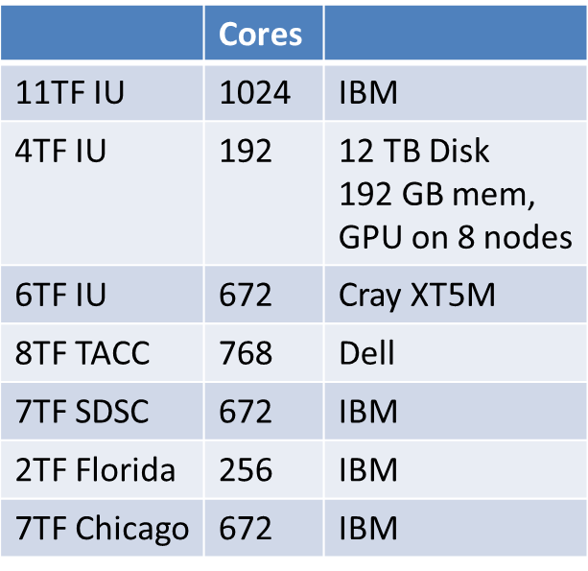
FutureGrid: a Grid/Cloud/HPC Testbed
 | Cores
11TF IU | 1024 | IBM
4TF IU | 192 | 12 TB Disk 192 GB mem, GPU on 8 nodes
6TF IU | 672 | Cray XT5M
8TF TACC | 768 | Dell
7TF SDSC | 672 | IBM
2TF Florida | 256 | IBM
7TF Chicago | 672 | IBM
NID: Network Impairment Device
Private
Public
FG Network

Slide 50
FutureGrid Partners
Indiana University (Architecture, core software, Support)
Purdue University (HTC Hardware)
San Diego Supercomputer Center at University of California San Diego (INCA, Monitoring)
University of Chicago/Argonne National Labs (Nimbus)
University of Florida (ViNE, Education and Outreach)
University of Southern California Information Sciences (Pegasus to manage experiments)
University of Tennessee Knoxville (Benchmarking)
University of Texas at Austin/Texas Advanced Computing Center (Portal)
University of Virginia (OGF, Advisory Board and allocation)
Center for Information Services and GWT-TUD from Technische Universtität Dresden. (VAMPIR)
Red institutions have FutureGrid hardware

Slide 51
5 Use Types for FutureGrid
~122 approved projects over last 10 months
Training Education and Outreach (11%)
  Semester and short events; promising for non research intensive universities
Interoperability test-beds (3%)
  Grids and Clouds; Standards; Open Grid Forum OGF really needs
Domain Science applications (34%)
  Life sciences highlighted (17%)
  Computer science (41%)
  Largest current category
Computer Systems Evaluation (29%)
  TeraGrid (TIS, TAS, XSEDE), OSG, EGI, Campuses
Clouds are meant to need less support than other models; FutureGrid needs more user support …….

Slide 52
Software Components
Portals including “Support” “use FutureGrid” “Outreach”
Monitoring – INCA, Power (GreenIT)
Experiment Manager: specify/workflow
Image Generation and Repository
Intercloud Networking ViNE
Virtual Clusters built with virtual networks
Performance library
Rain or Runtime Adaptable InsertioN Service for images
Security Authentication, Authorization,
“Research”
Above and below
Nimbus OpenStack Eucalyptus

