Slide 1
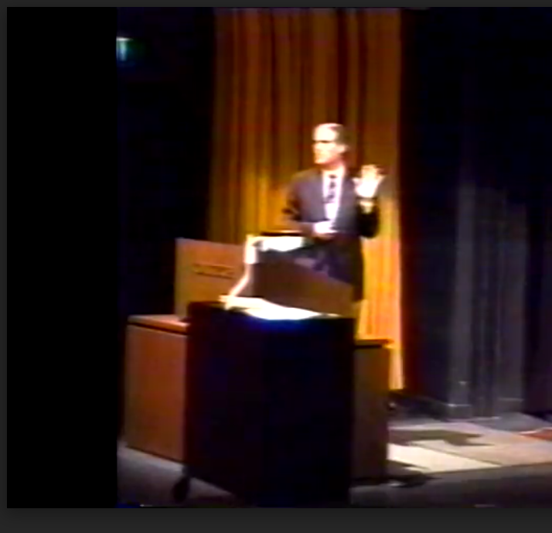
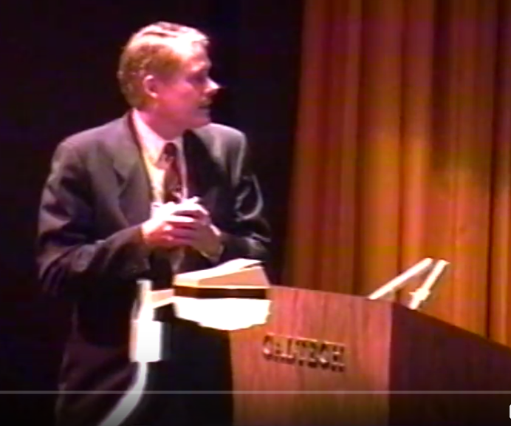
Parallel Computing: from Digital Twins to Grids to Deep Learning and Back
Geoffrey Fox,
November 20, 2019 SC19, Denver, Colorado, USA
gcf@indiana.edu,
http://www.infomall.org/

Slide 2
Starting with Big Data
In 1964 my PhD supervisor told me “Geoffrey, not many people look at data, why don’t you!”
For next 20 years I compared particle physics theory and experimental data with models (approximate Digital Twins and termed phenomenology)
Cambridge and indeed all of UK, had at the time modest computing facilities so I crossed the ocean
Note phenomenology was typically not respected but Feynman and Gell-Mann built theories on experiment and Feynman liked models
In ~1980 I taught first statistics class Ph229 at Caltech — quite respectable syllabus with Maximum Likelihood, Central Limit theorem, Bayes, Least Squares
At that time, Physics dominated data analysis field with Kolmogorov on theory and Feller on combinatorics
Then Carver Mead changed my career by explaining inevitability of parallel computing
I tried and failed to move forward with computational science education expressing importance of simulation on parallel computers

Slide 3
Early view of Data Science?
Phenomenology in Particle Physics, 1971, (C. B. Chiu, G. Fox and A. J. G. Hey) http://authors.library.caltech.edu/910/1/PHYS1971.pdf
What is phenomenology? Reach not for your dictionary; make no vain efforts to pronounce it; we will come clean and explain all.
Science is noted for a competitive and helpful interaction between theorists and experimentalists. Unfortunately in almost all developing sciences, the moving hand of time drives a widening wedge between theory and experiment. Thus theorists are fully occupied in the mathematical and philosophical intricacies of their latest ideas. Again, experimentalists must concentrate on the design of their apparatus to insure they will get the best possible results current technology will allow. Phenomenology seeks to close the between those once close friends, theory and experiment, and so restore the interaction which is both vital to and characteristic of science. Although a classical concept, phenomenology is best known in its second-quantized form.
Our first publication

Slide 4
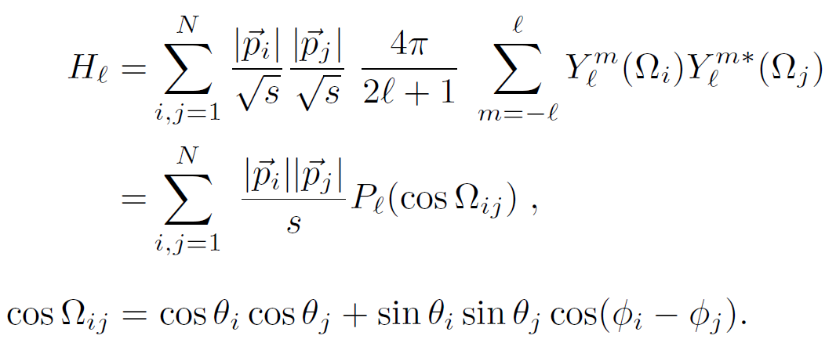
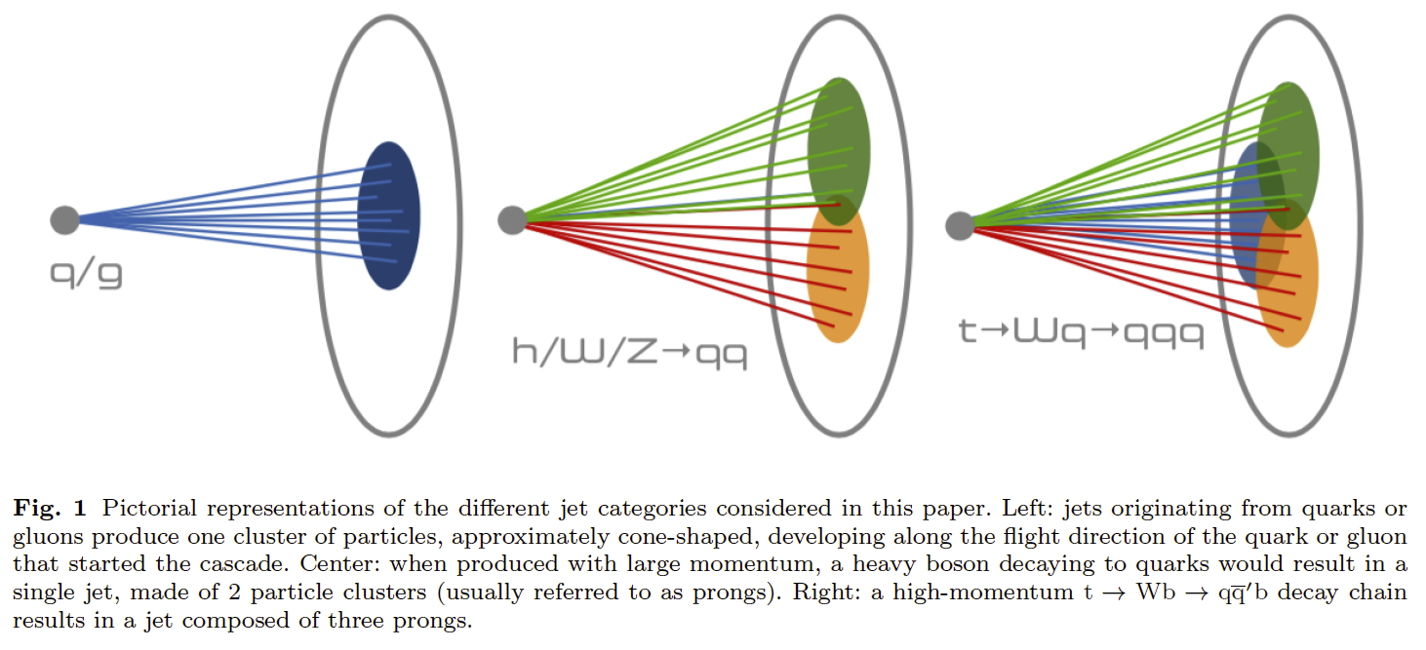
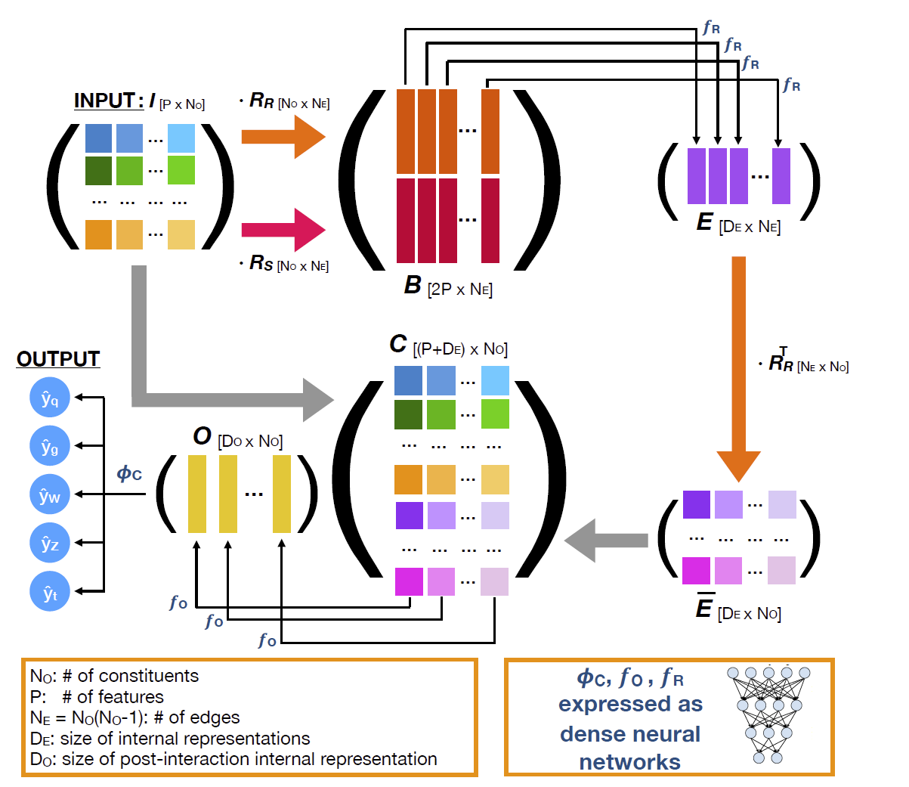
Fox-Wolfram Moments Replaced by Deep Learning
(Caltech) Observables for the analysis of event shapes in e+ e− annihilation and other processes, GC Fox, S Wolfram, Physical Review Letters 1978, 1648 citations (50 in 2019) introduced quantities to characterize shapes of collections of particles. They were invariant exactly to rotations and approximately to decays of hidden particles (quarks, gluons, Higgs, W/Z bosons) as involved sums over momenta preserved in decays
(Caltech, Fermilab, CERN) arXiv:1908.05318 from CMS introduces JEDI-NET with 3 DNN’s for this
This just one of many classic ideas replaced by deep learning; we will see more!
DNN’s recognize patterns
JEDI-NET
JEDI-NET

Slide 5
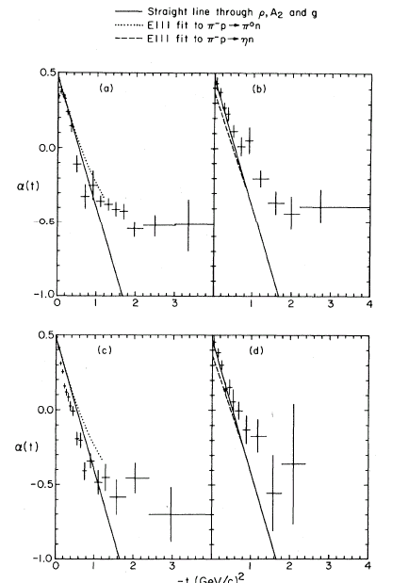
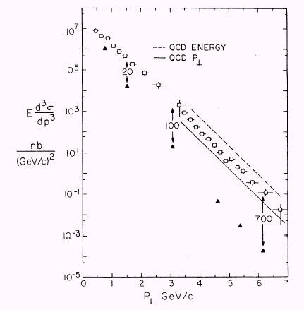
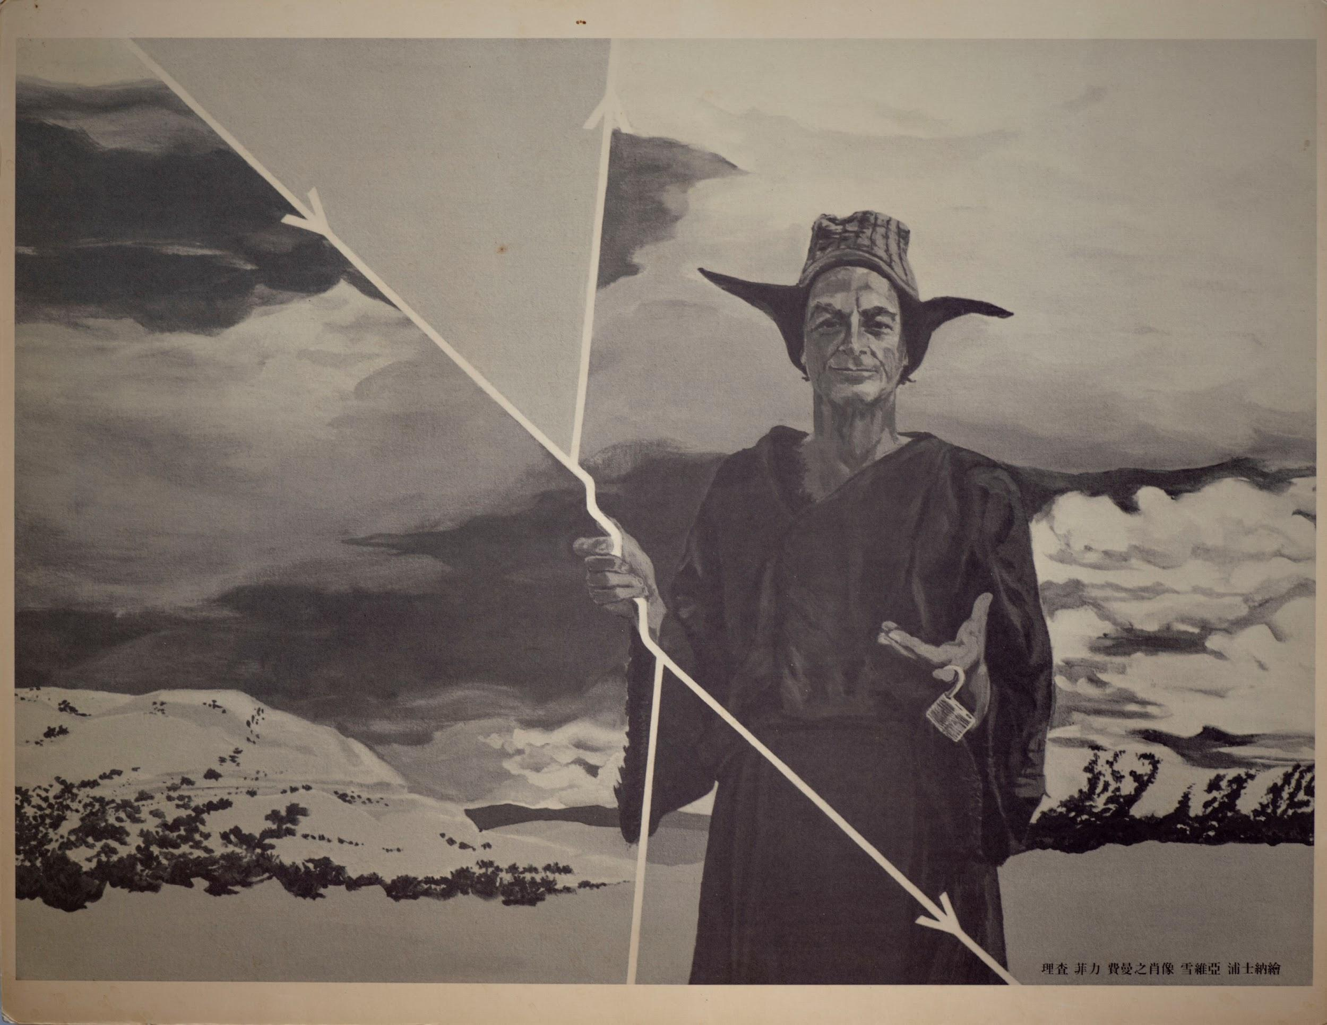
Initially Data Science for Physics
Experiments at Fermilab
E110, E260, E350
E350
π⁰X
η⁰X
Model Regge Theory
-t
Model Field - Feynman-Fox
η⁰X⁰
π⁰X⁰
E260
200 GeV

Slide 6
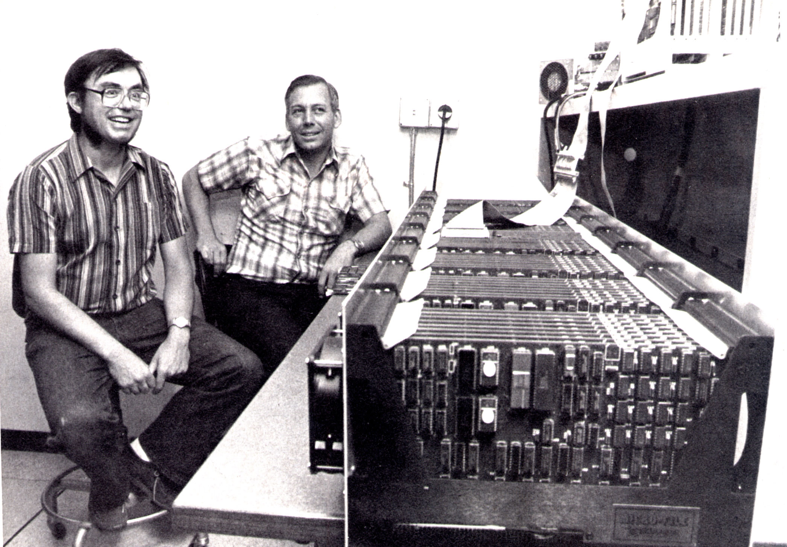
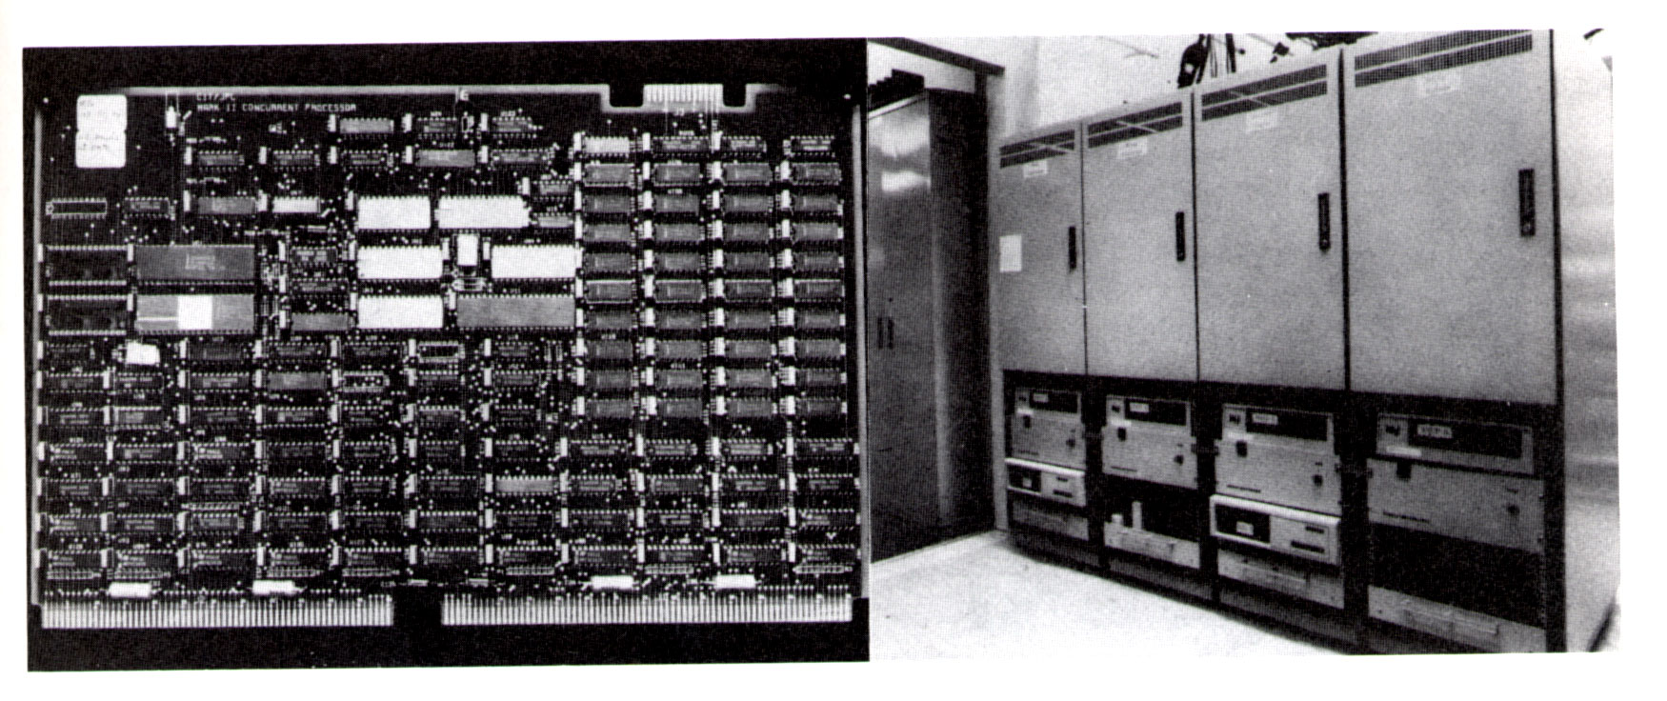
Caltech Hypercube 1983
With Chuck Seitz 1983
Motivated for me and Tony Hey by a Physics Colloquium by Carver Mead on VLSI and inevitable parallelism
Mapped into QCD and 9 other computations at Caltech
NASA JPL Mark II 1985 (used in Mars rover image analysis studies)

Slide 7
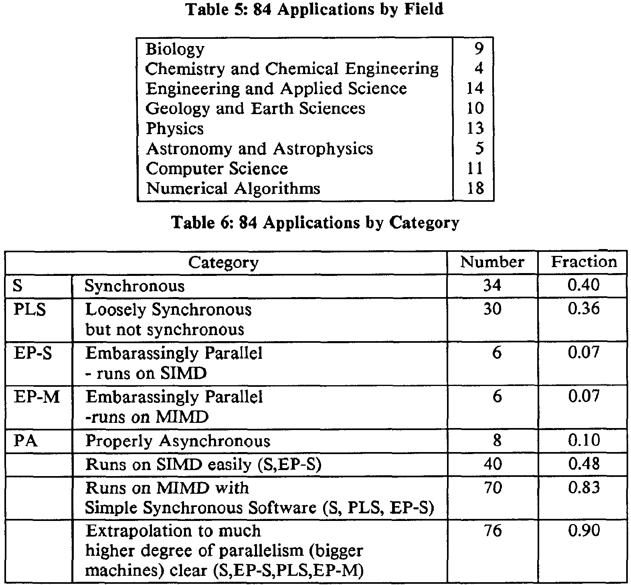
Parallel Application Summary at 3rd Hypercube Conference 1988
All implemented with message passing but some early compiler generated parallelism
14% Pleasingly Parallel
40% Synchronous (SIMD)
36% Bulk Synchronous Processing (BSP)
10% Difficult (e.g. event driven simulations, computer chess)

Slide 8
Center for Research on Parallel Computation CRPC 1989-2000
We were convinced that we could build parallel compilers to provide a high level interface for portable high performance codes
FortranD: Decompose arrays (tensors today) across nodes
Support with high performance libraries written by experts in message passing
Standardized as High Performance Fortran HPF
Use Fortran as limited syntax made efficient compilation easier
Tries to extend to Java with Java Grande but that didn’t catch on and was dealt a crushing blow by stock market crash in 2000 and its impact on Sun Microsystems
HPF could do a lot of problem classes but not the dynamic irregular cases such as complex adaptive meshes, Fast multipole methods etc., so it didn’t catch on
In retrospect, we gave up too soon!

Slide 9
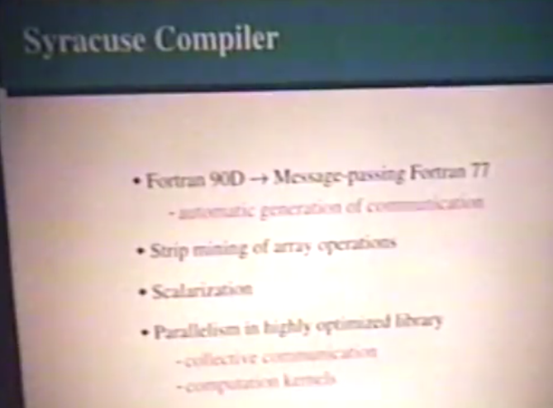
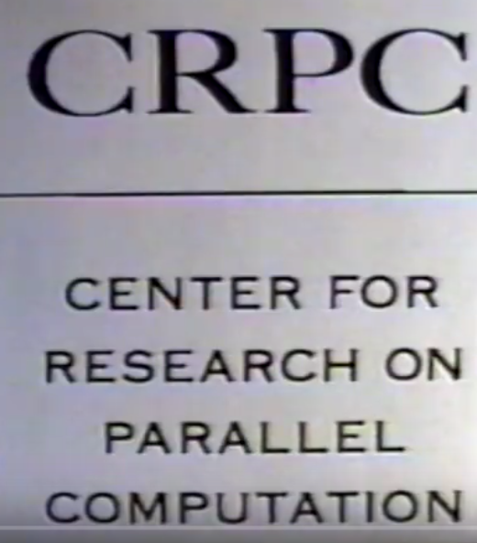
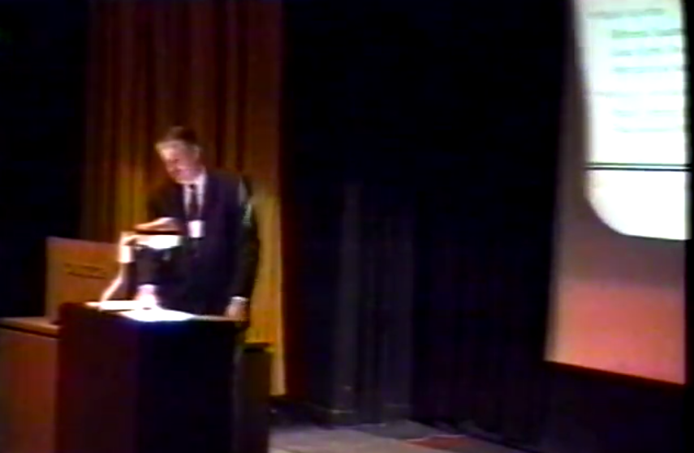
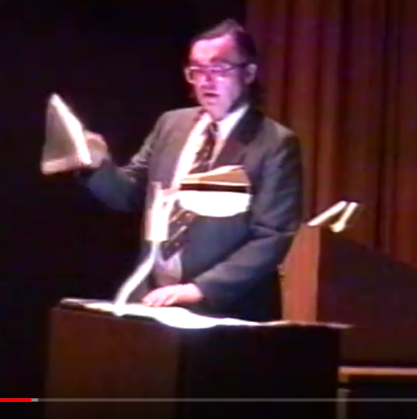
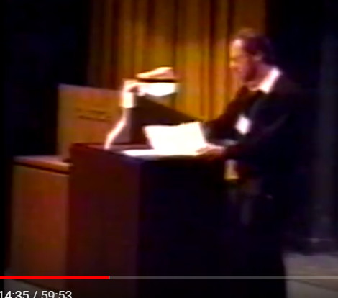
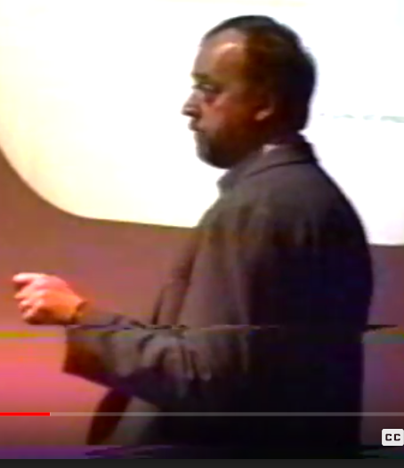
CRPC Short Course January Caltech 1994
https://drive.google.com/open?id=14VFmWWlCriFR7p2LMOjwcG9zNUbCBfkM

Slide 10
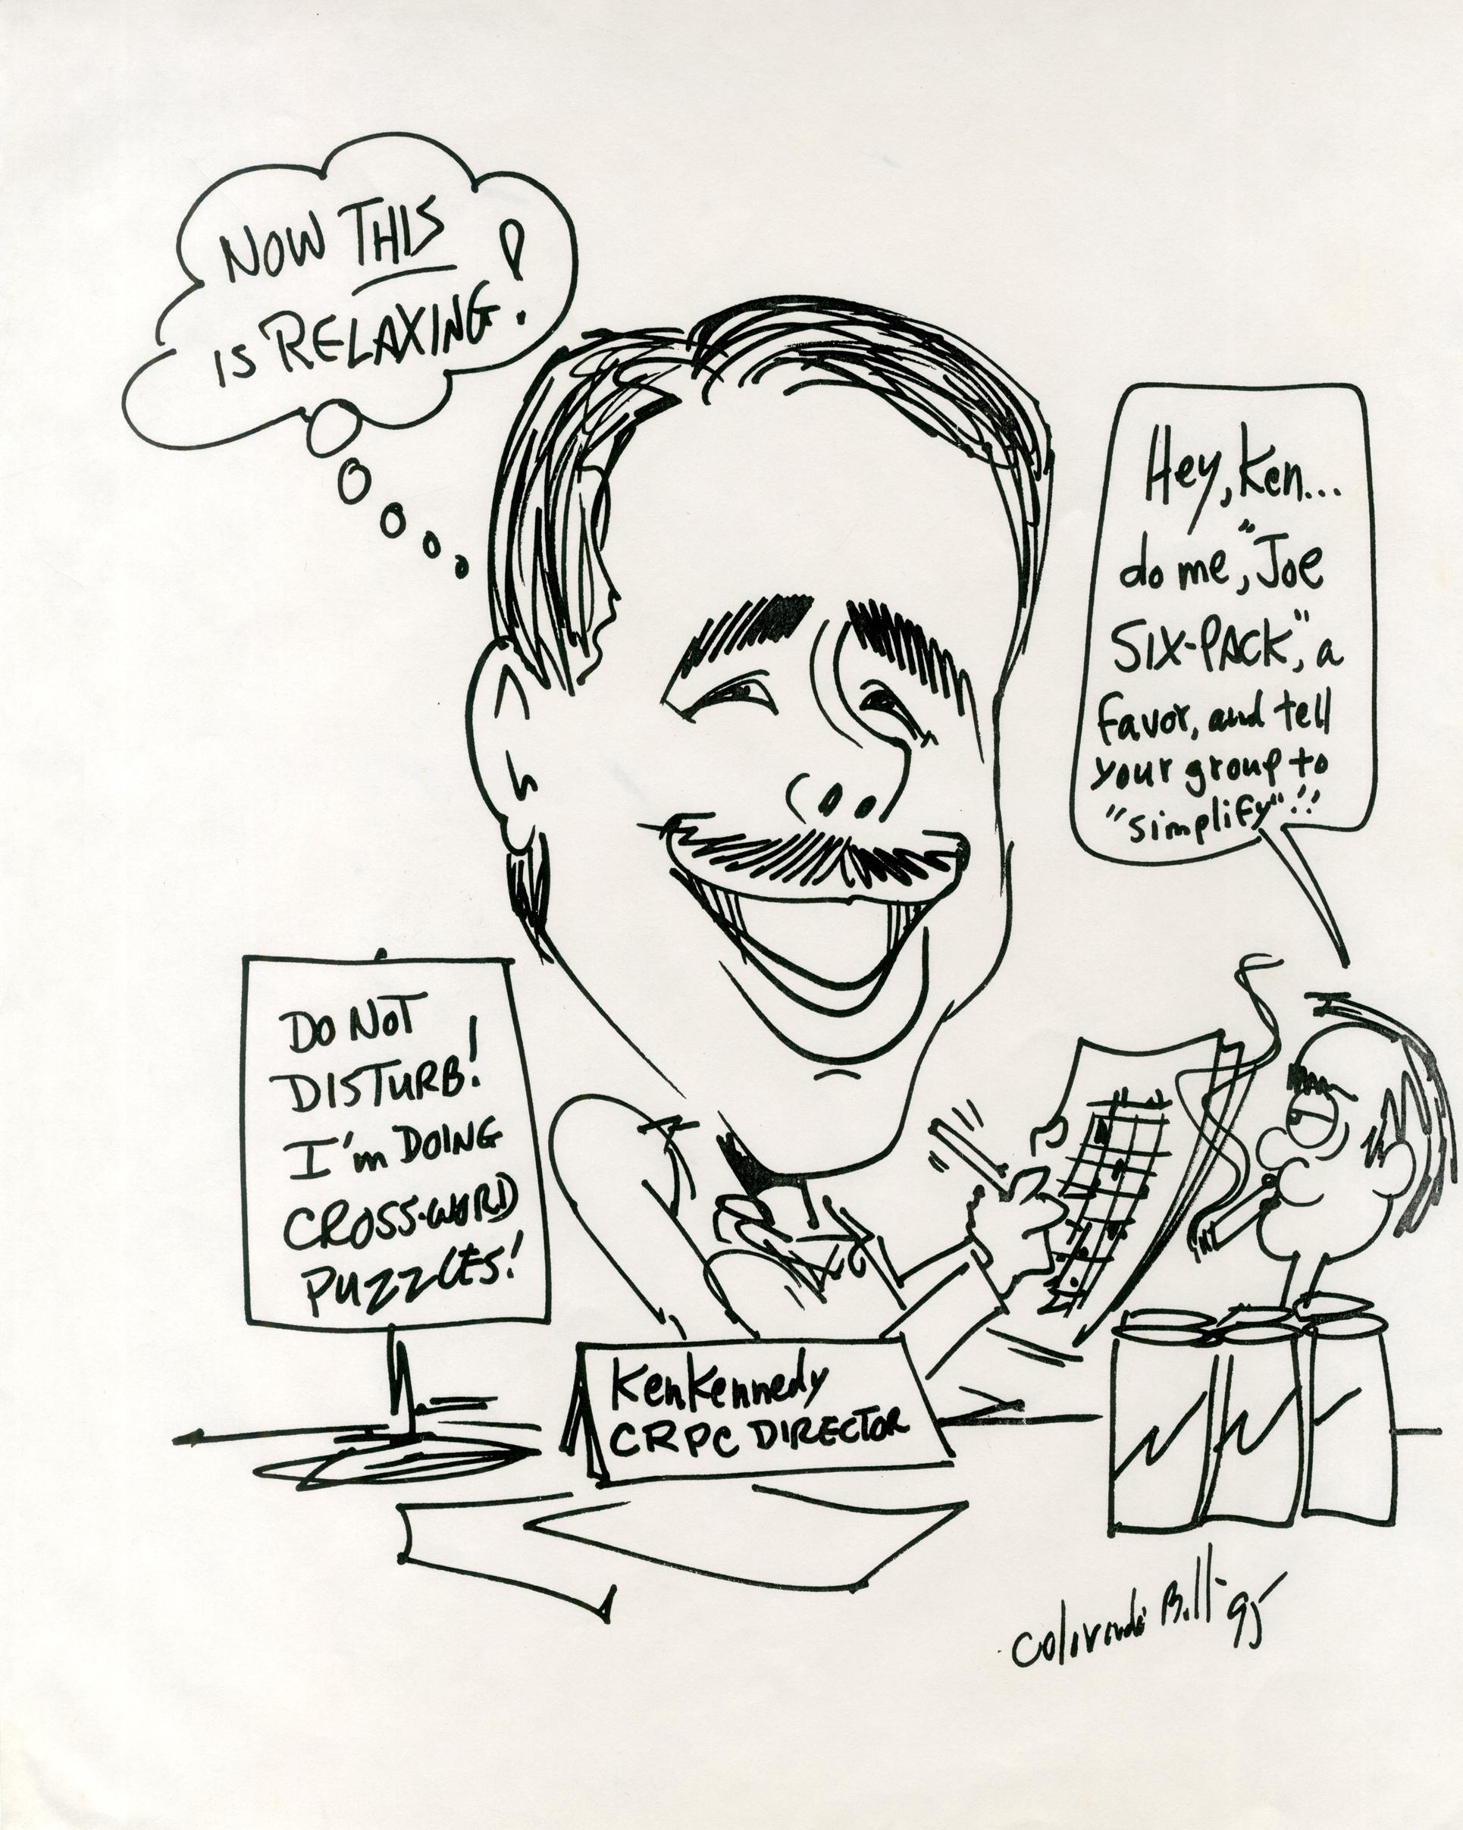
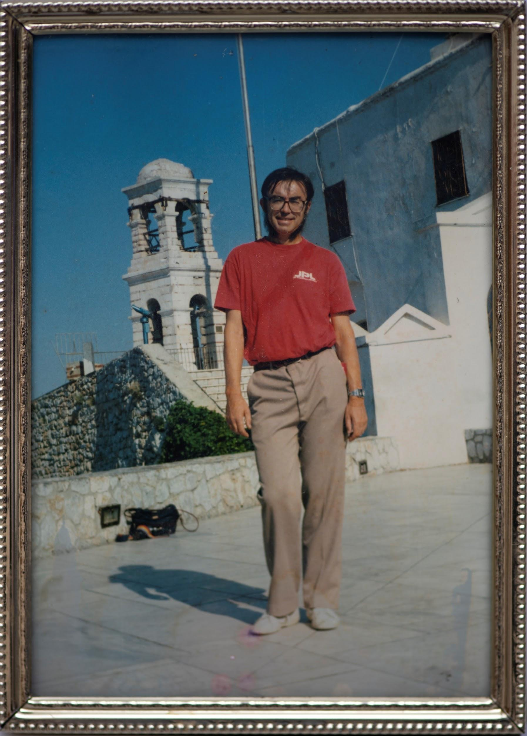
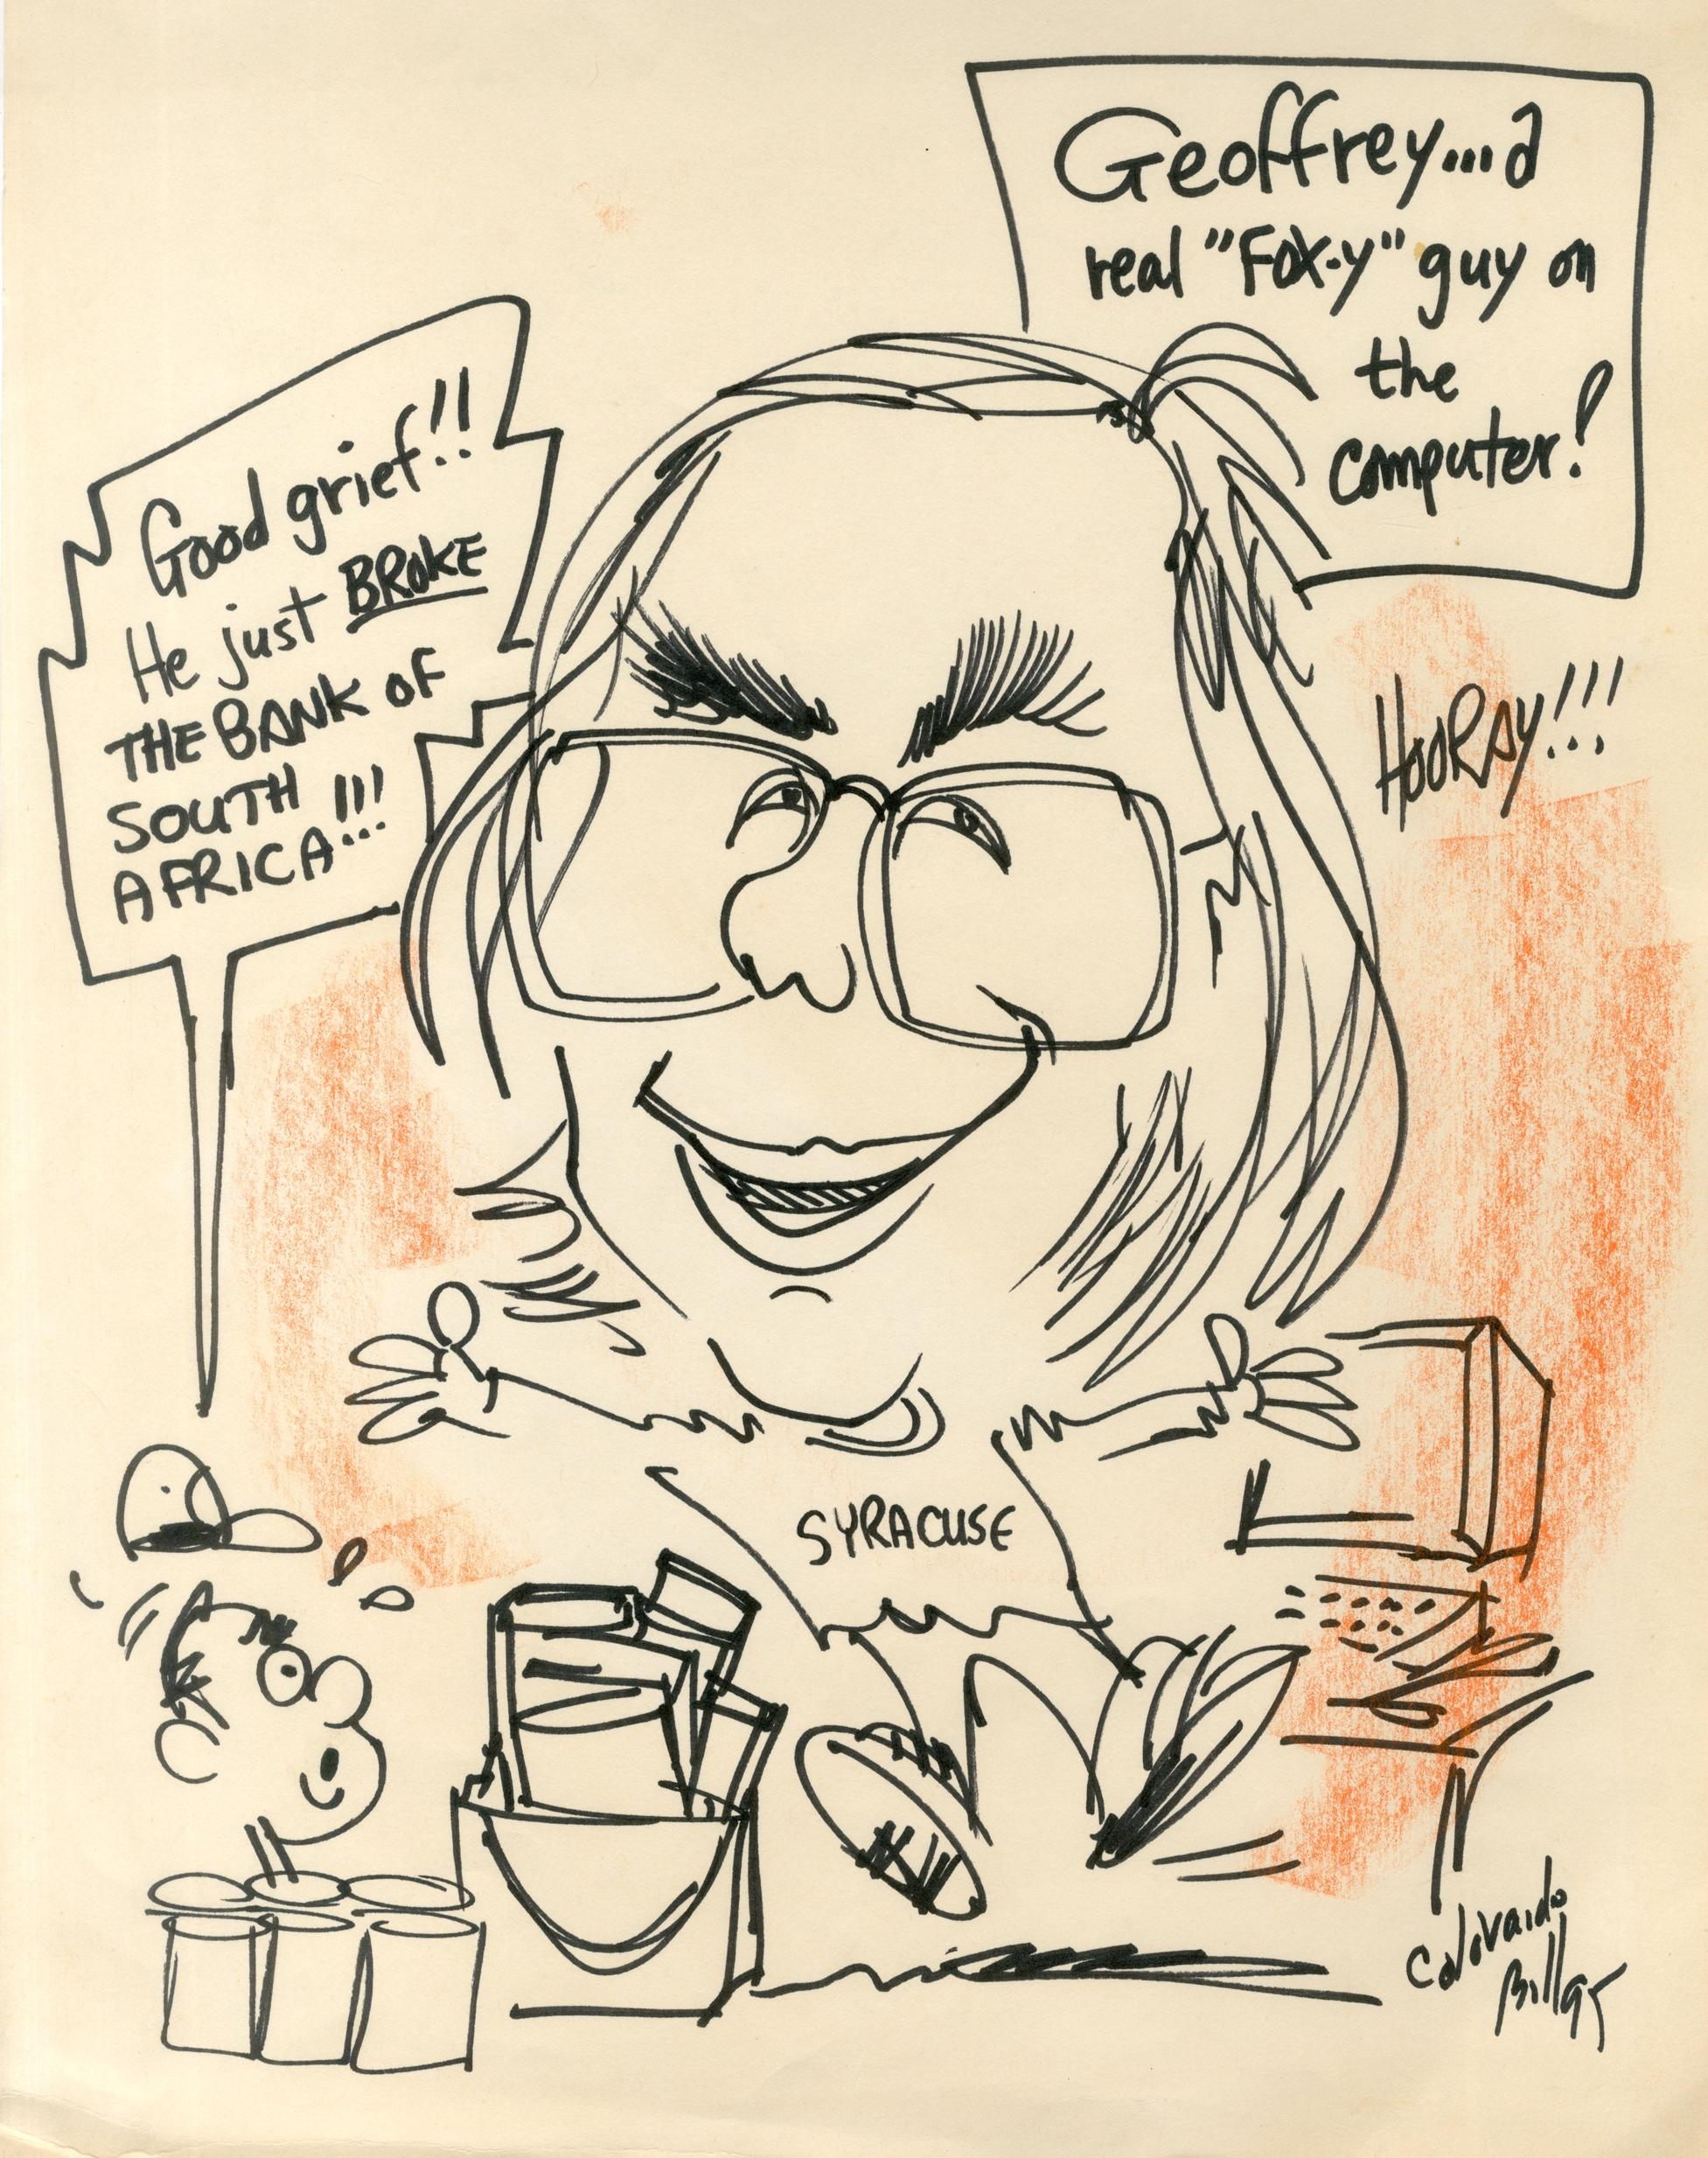
Center for Research on Parallel Computation CRPC
I met Ken Kennedy first at ICS87 Athens (on Olympic Airlines flight back)
Colorado Bill 1995

Slide 11
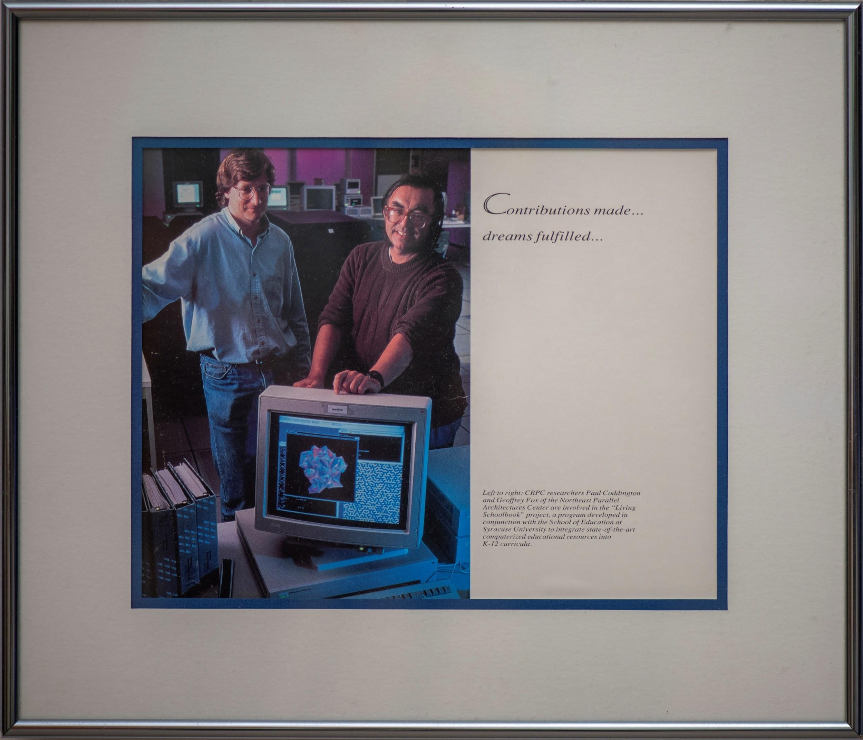
CRPC Education

Slide 12
Status and Future of HPF
HPF model was roughly
Decompose tensors across parallel tasks
Owner Computes Rule
Invoke MPI kernel libraries
OpenMP for the threads
This would solve parallel programming for applications as they stood at start of CRPC (1989)
However large scale simulations became extremely complex in many “Grand Challenges” of the 1990’s and one needs dynamic runtime not just compile time support
It takes a huge effort and a long time to develop parallel compilers
And they need to track rapid architectural change
Users need to trust that paradigm will have long term support
HPF style model for Java, C++, Go, Python, Julia, Fortran would address most Big Data and modest simulation problems
not the most sophisticated simulations but those are naturally developed by dedicated teams
ML surrogates could change problem in favor of HPF style

Slide 13
What did CRPC miss?
High Throughput Computing HTC and massively pleasingly parallel problems
Became the Grid and a dominant cloud pattern
Big Data problems and Machine Learning don’t have nearest neighbor connections and are
Either pleasingly parallel or fit HPF style?
Importance of Deep Learning whose training fits HPF style today
Will it be like simulation become more sophisticated?
We are in a 1989 moment for Big Data — just started
We were confused over distributed systems and tried to develop a model that spanned clusters and grids
A good problem but not the one CRPC was aimed at solving
Which should have kept the faith and delivered HPF Style
Note original compute Grid is now a data Grid and called Edge computing

Slide 14
Remarks on Convergence Big Data, Simulation, HPC
HPC integration with both Big Data and (Big) Simulation has one clear aspect as both areas need high performance reached by HPC technology
Clear in exascale initiative and underlied CRPC for Big Simulation.
Part of Systems for ML in Dean’s talk at NeurIPS 2017 for Big Data
We term HPCforML
We can also integrate Big Data technology (from Apache Software Stack to Containers) with simulations
Dean also discussed ML for Systems which becomes MLforHPC when system built on HPC technology
Detailed analysis with 100 papers divided into many subcategories given in https://arxiv.org/abs/1909.13340 and https://arxiv.org/abs/1909.02363 in work with Shantenu Jha

Slide 15
Big Data and Simulation Difficulties in Parallelism Complexity of Synchronization and Parallellization
Loosely Coupled
Regular Coupling
Complex Coupling
Big Data
HPC Clouds: Accelerators
High Performance Interconnect
HPC Clouds/Supercomputers
Memory access also critical
Commodity Clouds
MapReduce as in scalable databases
Global Machine Learning
e.g. parallel clustering
Graph Analytics e.g. subgraph mining
Deep Learning
LDA
Pleasingly Parallel
Often independent events
Regular simulations
Unstructured Adaptive Sparse
Parameter sweep simulations
Structured Adaptive Sparse
Current major Big Data category
Linear Algebra at core (often not sparse)
HPF Style Target
User Performed Parallelism
Simulations
Big Data (machine learning) and Simulations have similar (“converged”) Challenges

Slide 16
Five Major Application Structures
Global Machine Learning
Classic Cloud Workload
High Performance Big Data Workload
5 Application Classes cover both Applications and Simulations

Slide 17
MLaroundHPC and MLAutotuningHPC
Use Computation to represent Simulation or Big Data
Improving Computations with Configurations and Integration of Data
Autotuning of initial and running configuration; data assimilation
Learn Structure, Theory and Model for Computations
Learn potentials, support cross-scale integration; learn microscale structure; derive fundamental theories
Generate smart ensembles and collective coordinates
Learn Surrogates for Simulations
Can be input specifications mapped into output features
Can be combined with experimental observation over same input specifications
Or input field values mapped to output field values
ML gives speedup factors from 2 (static Autotuning) to 10^{N} (N=5-8 in examples) from surrogates with strong speedup (fixed problem speedup)

Slide 18
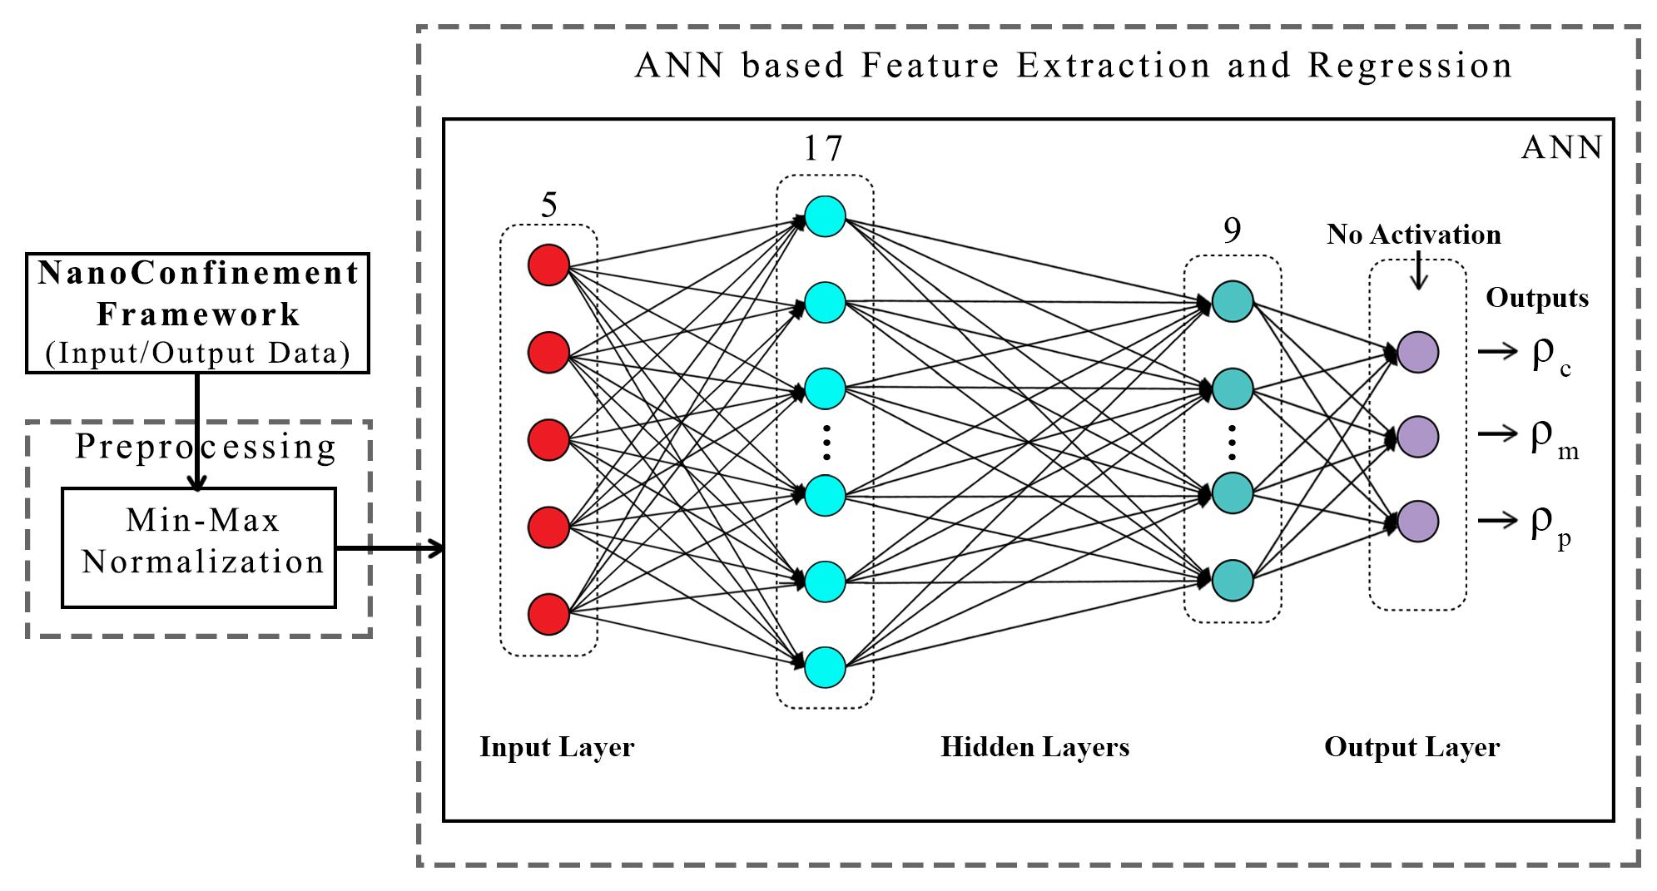
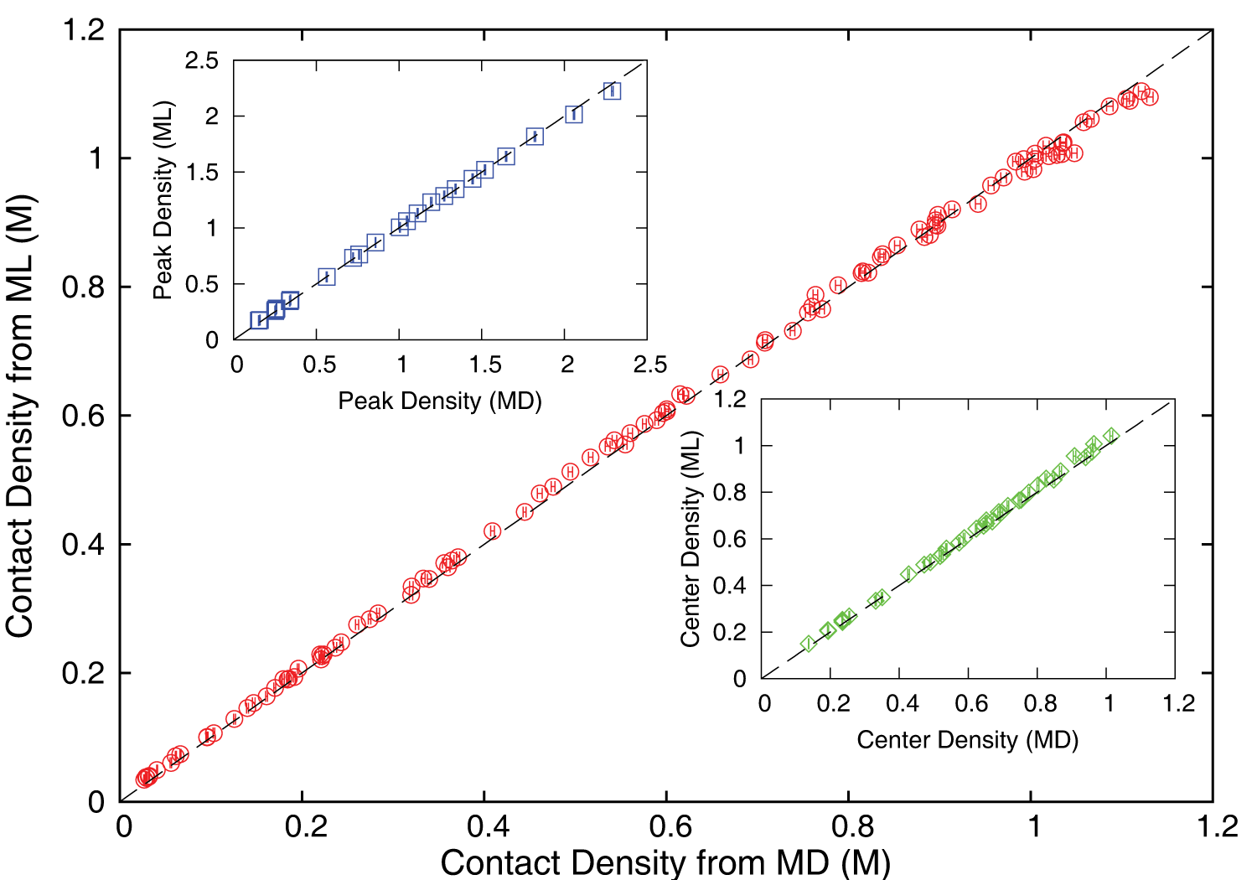
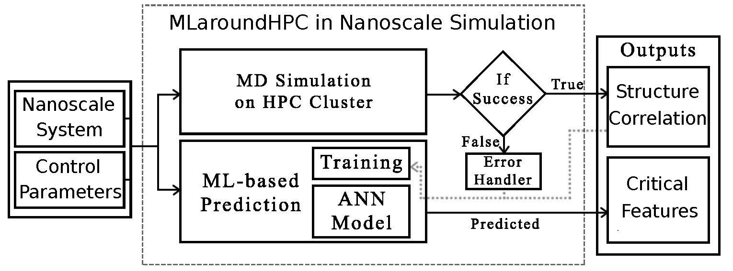
MLaroundHPC: Machine learning for performance enhancement with Surrogates of molecular dynamics simulations
Work with JCS Kadupitiya and Vikram Jadhao
Employed to extract the ionic structure in electrolyte solutions confined by planar and spherical surfaces.
Written with C++ and accelerated with hybrid MPI-OpenMP.
MLaroundHPC successfully learns desired features associated with the output ionic density that are in excellent agreement with the results from explicit molecular dynamics simulations.
Deployed on nanoHub where surrogates particularly useful in education
Speedup 10⁵
ML-Based Simulation Prediction ANN Model
Training
Inference

Slide 19
INSILICO MEDICINE USED CREATIVE AI TO DESIGN POTENTIAL DRUGS IN JUST 21 DAYS
September 4 2019 News Item
Map Drug (Material) Structure to Drug (Material) Properties
Hong Kong-based Insilico Medicine sent shockwaves through the pharma industry after publishing research in Nature Biotechnology that proves its AI-powered drug discovery system was capable of producing at least one potential treatment for fibrosis in less than a month's time.
The system uses a Deep Reinforcement Learning algorithm that can imagine potential protein structures based on existing research and certain preprogrammed design criteria.
Insilico's system initially produced 30,000 possible designs, which the research team whittled down to six that were synthesized in the lab, with one design eventually tested on mice to promising results.
Insilico's AI-powered research process could offer a massive push forward for the pharmaceutical industry, which faces increasingly high drug development costs. In just a handful of weeks and for approximately $150,000, Insilico delivered what typically takes pharmaceutical companies $2.6 billion over seven years.

Slide 20
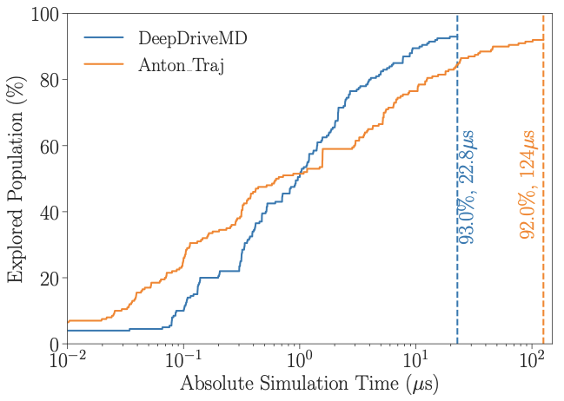
DeepDriveMD Smart Ensemble
O(10) improvement in sampling efficiency with DL model
O(1000) concurrent simulations on Summit supercomputer
Jha (BNL/Rutgers) and Ramanathan (ANL)
Notes:
Not a lucky

Slide 21
Putting it all Together Simulating Biological Organisms (with James Glazier @IU)
Learning Model (Agent) Behavior Replace components by learned surrogates (Reaction Kinetics Coupled ODE’s)
All steps use MLAutotuning
Smart Ensembles
Dynamic Data Assimilation

Slide 22
Operator Formulation of Deep Learning Inference
Suppose we are solving PDE’s or sets of coupled ODE’s
Typically we solve iteratively New Values = (Differential Operator) Previous Values
Classic applied math tells you nifty difference equations and spectral methods to represent Operator numerically
Deep Learning learns the operator from classic numerics or observational data or their combination
Inference is New Values = (DL Operator) Previous Values
This new nonlinear trained DL operator can allow much larger time steps, incorporate variations in parameters etc.
DL Operator is the new theory (Newton’s laws) of science
High order approximations are traditionally very sensitive to noise and one was taught to avoid but ANN are the opposite – both verbose and robust
See DL operator for Lennard Jones Potential in two LSTM layers with 100-100,000 parameters
Newton’s laws for this have 2-4 parameters

Slide 23
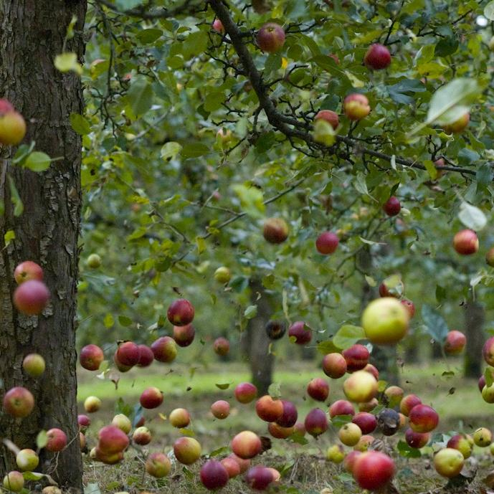
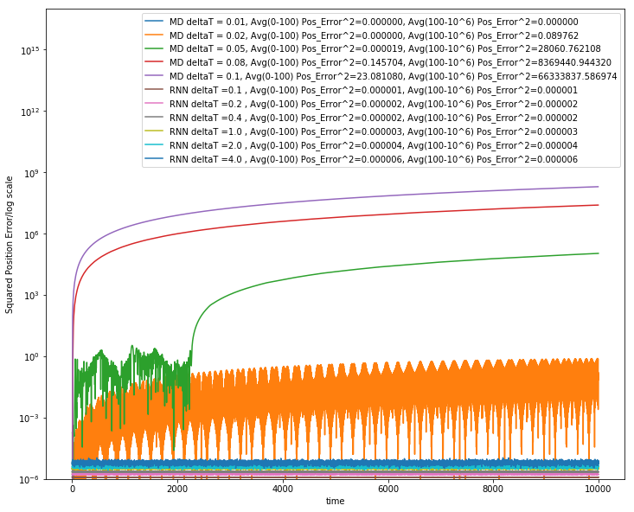
Learning how Apples Fall ?
Work with JCS Kadupitiya and Vikram Jadhao
We could use F=ma with 1D ODE solved by Verlet
Or use Recurrent Neural Network (LSTM) and Tensorflow (the new Newton) for particle in Lennard-Jones potential
Error Squared
MD dt > 0.01
12833 Trained Parameters
MD dt = 0.01, LSTM

Slide 24
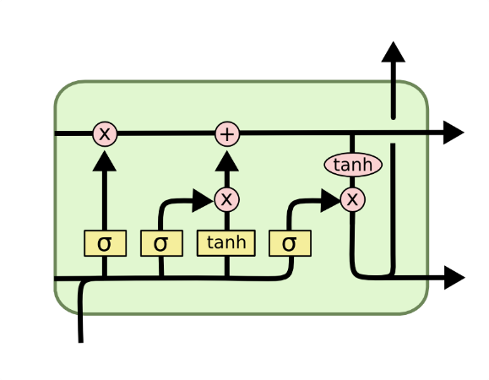
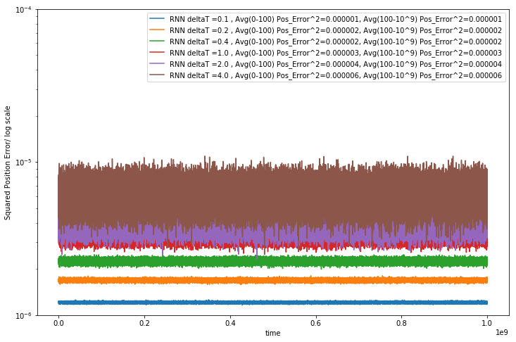
Extending to longer times
LSTM Cell
System trained up to t=100; network used up to t=10,000 or 10,000,000
Plots show error for MD and LSTM for different time steps. LSTM upto t=4
LSTM allows reliable large time steps; learns potential and differential operator
Compared to classic numerics has LOTS of parameters, statistical averaging (e.g. 32 initial LSTM’s only differing in randomized initial conditions) and nonlinear activation nodes
Looking at multiparticle systems learning O(N^2) potentia
Simple Harmonic Oscillator used upto 10⁹ dt
Error Squared
905 Trained Parameters
Timesteps

Slide 25
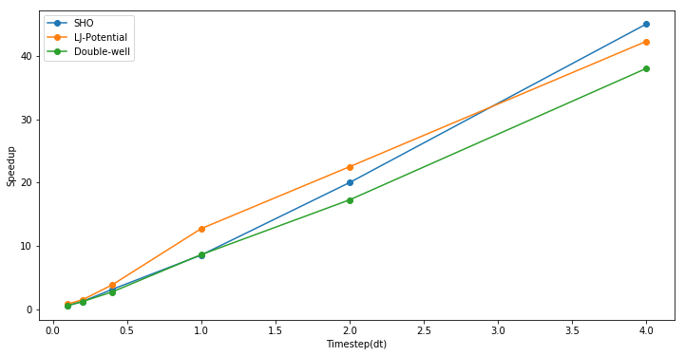
Speedup from use of LSTM compared to Velocity Verlet
Timings are integration from t=0 to 100 and MD velocity verlet used dt of 0.001 to get a accurate result
Speedup = (Time to do MD Simulation with dt=0.001) / (Time to do RNN (LSTM)-based simulation)
Can increase dt=4 and increase speedup

Slide 26
Status of MLaroundHPC
MLaroundHPC broadly applicable but current use is nonuniform across domains
we need to improve Cyberinfrastructure support to make MLforHPC more effective for more users
Use of modest DL network to map material/potential drug structure to properties (generalized QSAR) with simulation and observation: Advanced Progress
Learn surrogates for large scale simulations: initial small scale results
Use of MLforHPC in agent-based systems (learn agents): Very promising but few results
Macroscopic Structure as in learn complex multi-particle potentials scaling to N⁷: many great successes
Learn Collective coordinates and guide ensemble computations: dramatic progress with speedups up to 10⁸
Microscale; learn dynamics of small scale such as clouds, turbulence: Interesting results but much more to do
Use of Recurrent NN’s to represent dynamics (learn numerical differential operators): Promising but only studied in small problems

Slide 27
Issues and Summary
Parallel Computing has a renaissance with Big Data
HPF Style could be well suited to Big Data and MLforHPC
MLforHPC will lead to many remarkable discoveries in both computational and data science
1981-3 Moment for me with MLforHPC replacing parallelism; inspire users
What computations can be assisted by what ML in which of different scenarios
Not known how large training sets need to be.
What is performance of different DL (ML) choices in compute time and capability
Little or no study of either predicting errors or in fact of getting floating point numbers from deep learning.
What can we do with Yottascale computing? (10⁶ above Exascale)
Redesign all algorithms so they can be DL-assisted
Interesting load balancing issues if in parallel case some points learnt using surrogates and some points calculated from scratch
Also, complex difficult to load balance microscale replaced by uniform inference

