Slide 1
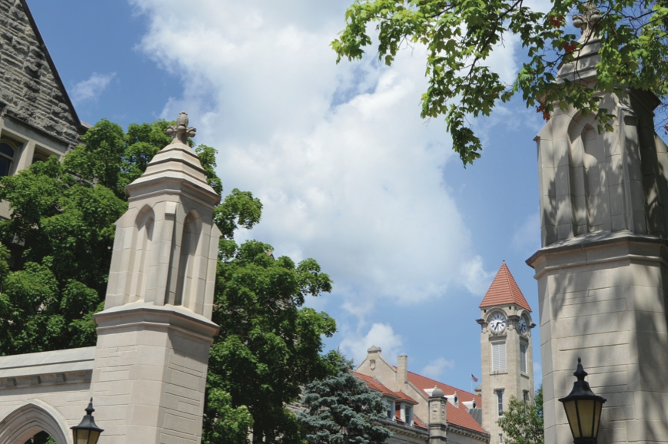
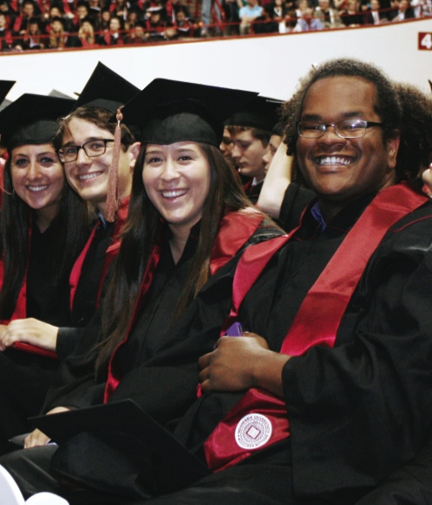
Intelligent Systems Engineering SICE Connect Day Saturday, February 17, 2018

Slide 2
Welcome
Introductions
Martin Swany, Director of Undergraduate Studies
Faculty and Staff
Background
Established in 2016
Last of the AAU
Builds on existing strengths at IU

Slide 3
What is Intelligent Systems Engineering?
The practice of system design and building with computing and artificial intelligence as key components:
Intelligent Systems – sense their environment, act accordingly—and use machine learning, artificial intelligence with edge (small devices), and cloud computing
Systems Engineering – design of systems that are the complex interrelation of many elements
Intelligent Systems is purpose-engineered systems—from the raw hardware and embedded systems; through data acquisition and signal processing; and to the transformation of data into decisions and/or knowledge.

Slide 4
What is ISE? (continued)
From the small to the large:
Edge Computing: Embedded Systems and Nanoscale Sensors – computing and sensing will be ubiquitous as we move toward smart homes, smart cities and smart transportation, with computing and intelligent systems helping us lead healthier lives
Cloud and High-Performance Computing – behind all of these edge devices are massive systems that analyze and manage the floods of data that are being produced; they also allow modelling and simulation of the engineered systems
All students have courses on edge, cloud, HPC systems, machine learning and modelling and simulation.

Slide 5
How is ISE Different?
Artificial Intelligence and Computing are at the core of our curriculum.
We built a modern curriculum that includes up-to-date content and methods.
We incorporated today’s technology and keep our pulse on what tomorrow will bring.
We looked at the field of engineering with fresh eyes without having to retrofit.

Slide 6
Sensors, Detectors, Mobile Devices, Internet of Things, Robotics, Intelligent Systems, Big Data, HPC, Modeling and Simulation, User Interface Design, Signal Processing, Control Theory, Information Theory
BIO
CE
CPS
NANO
Undergraduate
Engineering
Concentrations

Slide 7
Bioengineering
Bioengineering is for students who are interested in combining life sciences, computing, and engineering practices to solve problems spanning biology, medicine, environmental remediation, and more.
Bioengineering coursework:
includes

Slide 8
Computer Engineering
Computer Engineering is for students who are interested in building computing systems of various scales or an internet-of-things device.
CE coursework:
includes hardware and low-level software, e.g., drivers
allows students to mix and match courses to tailor the program toward their interests (e.g., big data, deep learning analysis systems, high-performance computing systems, specialized computing devices)

Slide 9
Cyber-Physical Systems
Cyber-Physical Systems is for students who on systems that interact with the physical work directly in some way.
CPS coursework:
addresses the entire system including high-level software;
usually emphasizes small devices; and
includes Robotics as well as sensor-rich environments like Smart Homes, Smart Cars and Smart Cities. In all of these cases, the Intelligence comes from computing devices.

Slide 10
Nanoengineering
Nanoengineering is for students who want to explore sensing technologies, energy devices, nanomedicine, and materials.
Nanoengineering coursework:
integrates electrical and materials engineering to prepare students to work with cyber-physical systems or other responsive intelligent systems;
includes modeling and simulation; and
contains experimental and computational aspects of nanoengineering.

Slide 11
Curriculum and Instruction
Our core philosophy is that students should learn, apply, and contextualize.
Courses are hands-on from the beginning to facilitate contextualization:
Science observes the world and derives principles; engineering applies those principles to create
Each concentration requires a fundamental understanding of computing:
Whether designing nanosensors or high-performance image processing pipelines, a solid understanding of how computers work is essential
Thus, we begin with computing early in the program.

Slide 12
Degree Structure
120 Credit Hours
69 credits in engineering
21 credits in university general education
30 credits in university math and science
6 credits in engineering electives

Slide 13
Student Opportunities
Academic year research
Outreach activities
Custom advising
Small class sizes
Faculty-Student ratio
A thoughtful, student-faculty support team committed to helping each student to and through college completion.

Slide 14
Funding Opportunities
Scholarship Information
IU/ISE
PLTW
First
Schnabel-Hatfield
Summer camp attendees
Other Funding Opportunities
Summer camps
Summer research
Lab support
Tutoring

Slide 15
Sensors, Detectors, Mobile Devices, Internet of Things, Robotics, Intelligent Systems, Big Data, HPC, Modeling and Simulation, User Interface Design, Signal Processing, Control Theory, Information Theory
BIO
ENVIRO
NANO
NEURO
CE
CPS
Master’s & Ph.D.
Engineering
Tracks

Slide 16
Master’s in ISE
30 Credit Hours (Traditional or Accelerated)
Accelerated Masters (4+1) shares 12 credits of graduate courses between both Bachelor’s and Master’s plans of study.
90 Credit Hours
Ph.D. in ISE

Slide 17
Accreditation
Accreditation Information
The curriculum has been designed to meet the ABET requirements.
SICE can apply for accreditation after the first graduating class, which means that the first cohort of graduates’ degrees will be accredited.
SICE will seek accreditation (retroactive).
The B.S. in Intelligent Systems Engineering is a degree from Indiana University; it is an accredited degree.
IU holds North Central Association accreditation.

Slide 18
Meet Our Faculty

Slide 19
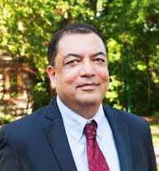
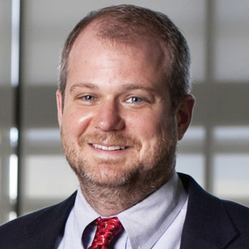
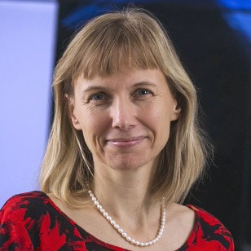
Raj Acharya, CE, Intelligent Systems: Dean of the School of Informatics and Computing, Rudy Professor of Engineering, Computer Science and Informatics
Geoffrey Fox; Chair, CPS, Intelligent Systems: IU distinguished professor, Data Analytics, Parallel computing, Physics.
Martin Swany; Associate Chair, CE, CPS: Network Systems, Embedded Systems, High-Performance Computing, Data Management
Katy Borner, Intelligent Systems: IU distinguished professor, data analysis and visualization, particularly in the areas of science and technology studies.

Slide 20
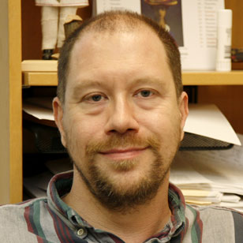
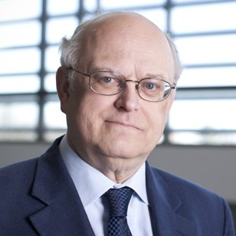
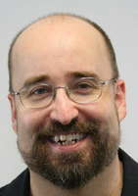
James Glazier; Bio-engineering: Biocomplexity, Virtual Tissue, toxicity.
Judy Qiu; CE, Intelligent Systems: Big Data, Cloud and Parallel Computing.
Thomas Sterling; CE, CPS: Electrical Engineering, Extreme Scale high performance hardware/software
Clint Whaley CE; HPC Software systems, Performance Engy; Assoc Tenured LSU, Asst. Prof UTSA, PhD CS FSU 2004; MS and Researcher CS UTK, BS Math Oklahoma.

Slide 21
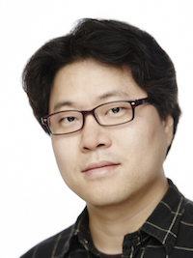
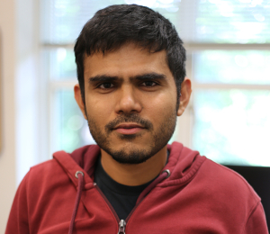
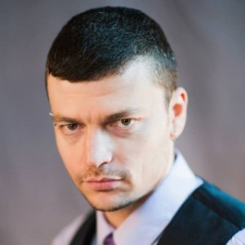
Lei Jiang, CE: HPC hardware studies: undergraduate Computer science, masters and PhD (Pittsburgh) in Computer Engineering; industry work with AMD as Senior Design Engineer.
Minje Kim, Intelligent Systems: signal processing & machine learning in multimedia area; Undergraduate and Masters in computer engineering; PhD (UIUC) in Computer Science.
Vikram Jadhao, Nanoengineering: using HPC simulation; Physics degrees (UIUC PhD); Postdocs in Department of Materials Science and Engineering at Northwestern, Physics at JHU
Alexander Gumennik, Nanoengineering; Intelligent fibers and 3D printing; Physics and Math Undergraduate, Applied Physics Masters and PhD (Hebrew University), Postdoc in MIT's Department of Materials Science and Engineering, Industry Process Engineer in 3D printing startup

Slide 22
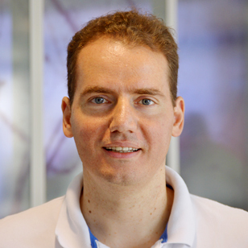
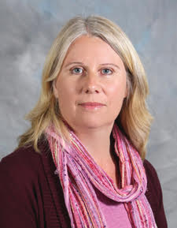
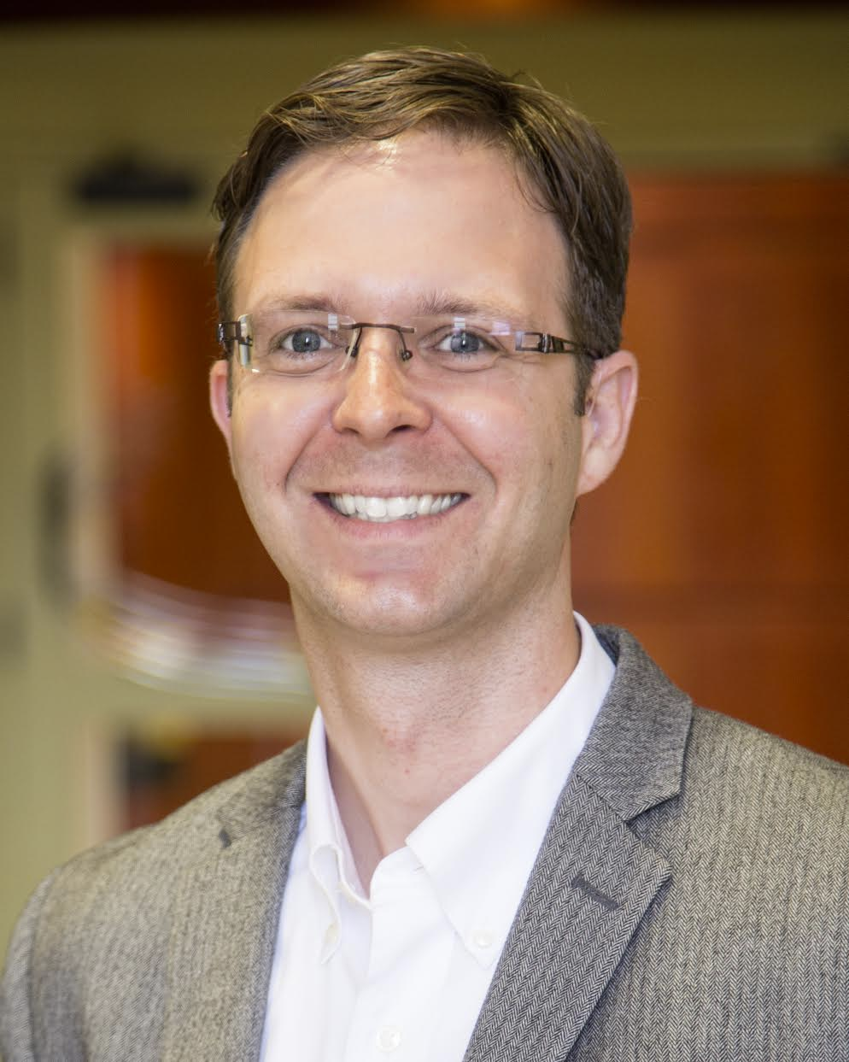
Eleftherios Garyfallidis, Neuroengineering: with software lab for MRI imaging; Undergraduate degree in Computer Science; Masters in Brain & Mind Sciences, PhD in Cognition and Brain Sciences (Neuroscience Cambridge)
Maria Bondesson-Bolin, Bioengineering: Systems biology and computational toxicology and experimental imaging analysis; Undergraduate degree in biology, PhD and research position in Department of Cell and Molecular Biology Karolinska Institutet, Sweden
Paul Macklin, Bioengineering: Modeling and data analysis for medical applications including cancer; Undergraduate degree in Mathematics, Graduate degrees in Industrial, Computational and Applied Mathematics (PhD, UC Irvine)

Slide 23
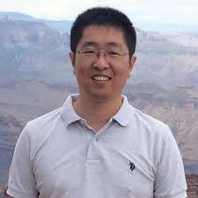
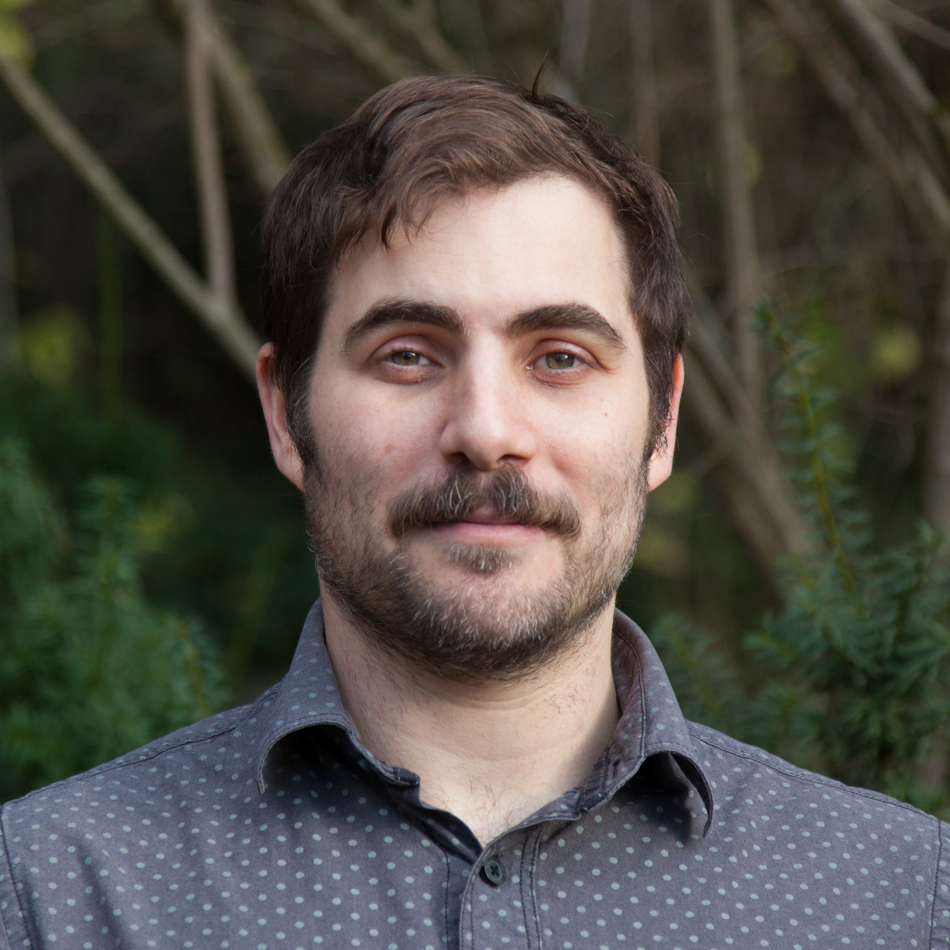
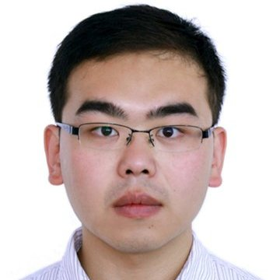
Lantao Liu; CPS, Env: Planning, decision-making, and machine learning methods for autonomous robots; Postdoc USC and CMU Robotics. PhD CS&Eng Texas A&M. BS Control China.
Eatai Roth; Neuro, CPS: Animal-robot flight analogies. reverse engineers intelligent (living) systems with a focus on cyber-physical interactions; Postdoc Seattle, PhD Mech Engy, BS Mech Engy Pitt, BS Fine Arts Wash U St. Louis 2001.
Greg Lewis; Bio, CPS: Wearables, work with Kinsey Institute; Asst. Prof. Psychiatry UNC-Chapel Hill, PhD University of Illinois Chicago, B.A., Psychology UNC-Chapel Hill.
Feng Guo; Bio, Nano: Acoustic tweezers. biomedical devices, and instruments for apps ranging from Single Cell Analysis and Prenatal Diagnostics to Virology and Neuroscience; Postdoc Stanford, Engineering Science and Mechanics Ph.D. PSU; B.S. Physics, Wuhan 2007. hindex 20.

Slide 24
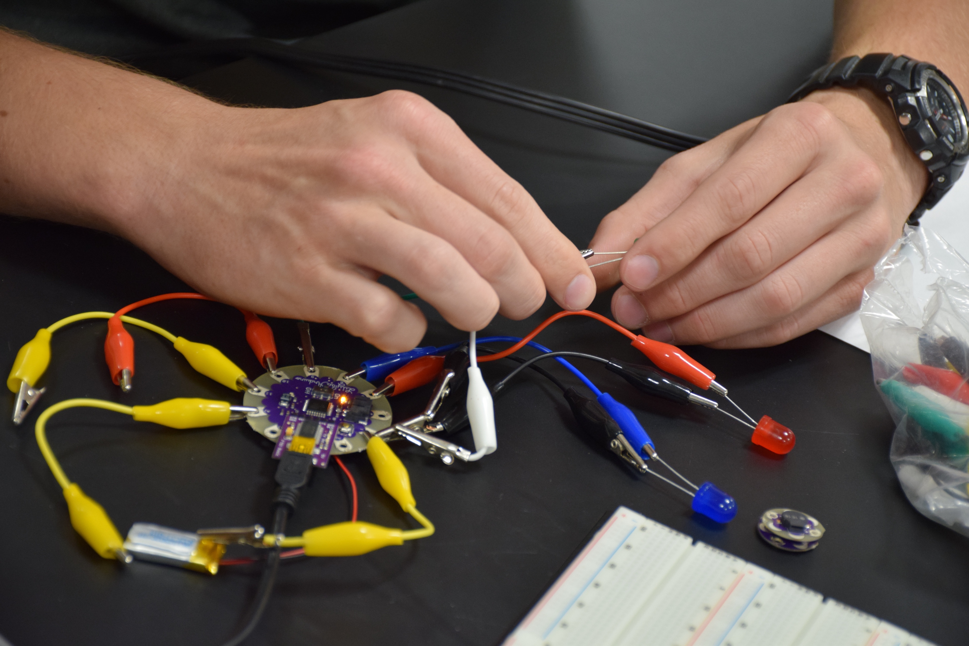
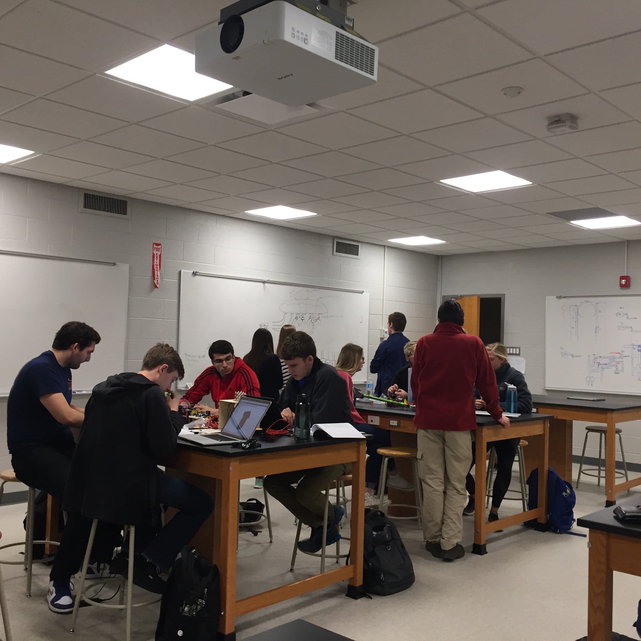
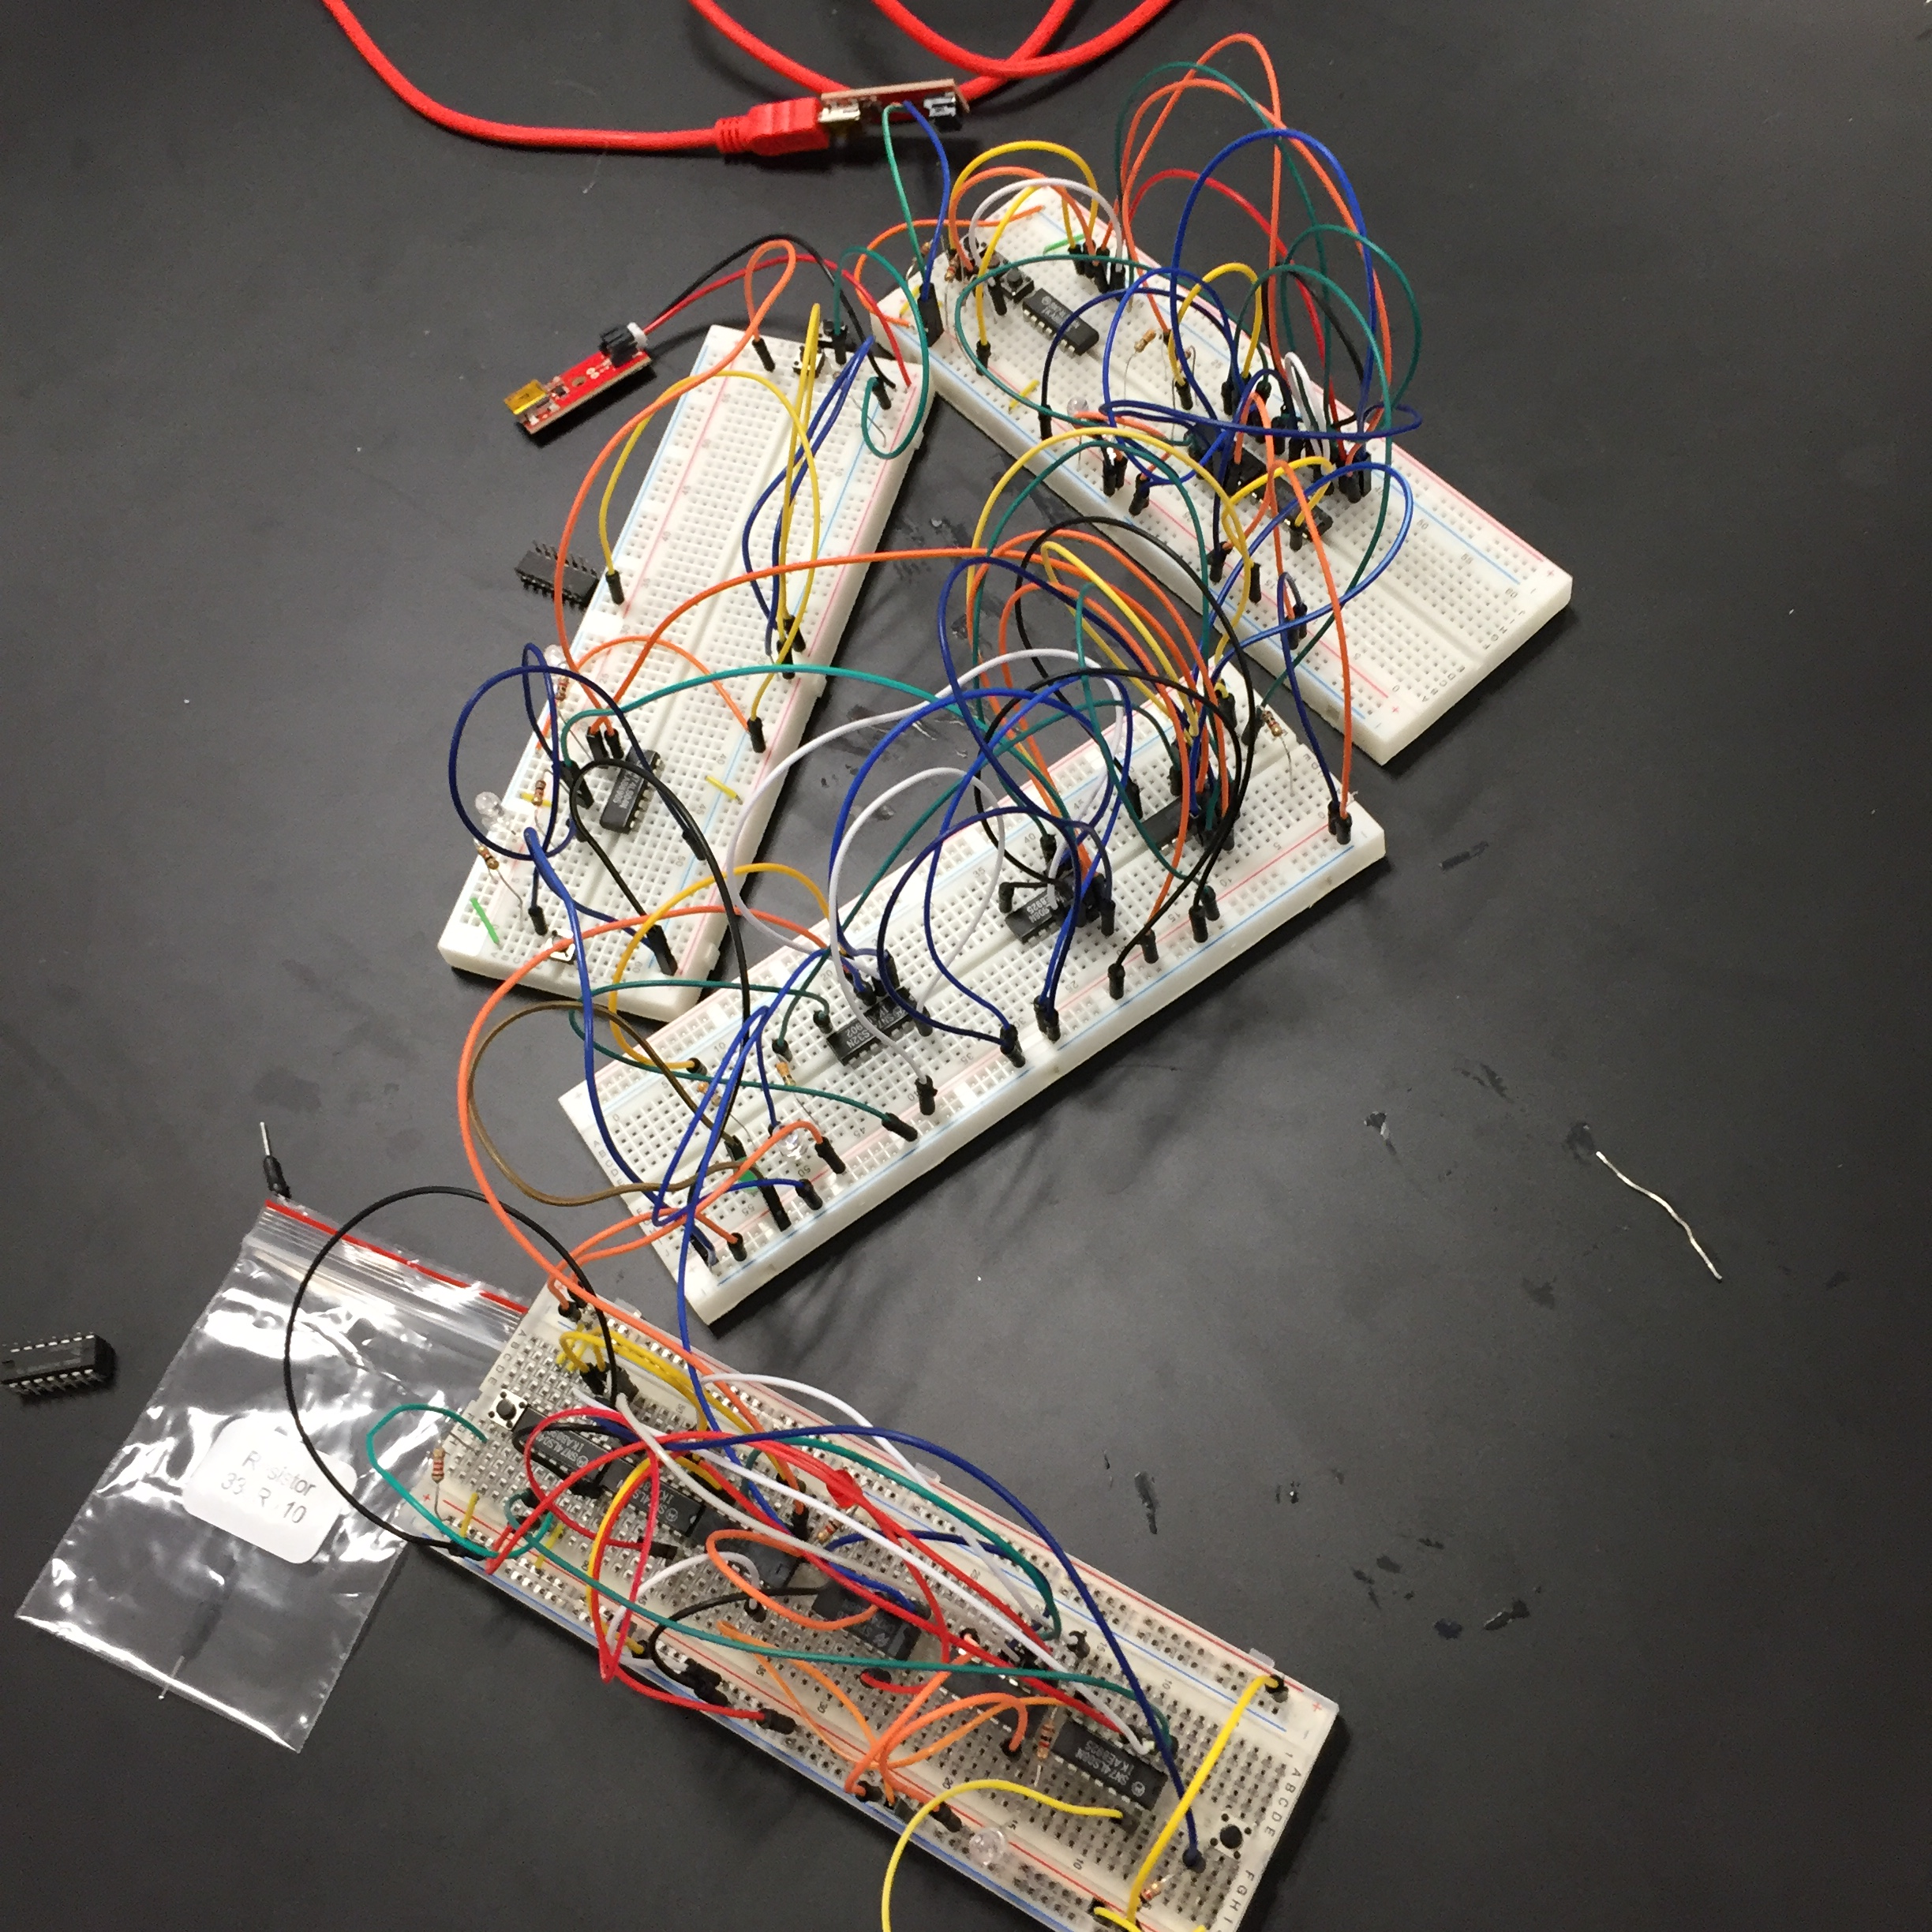
Questions?

