Slide 1

History of SICE
2000: School of Informatics established—first of its kind in the United States.
2005: Computer Science (established in 1971) becomes part of the school
2009: Becomes School of Informatics and Computing
2013: Library and Information Science (established in 1951) joins the school
2015: Data Science Program launched
2016: Intelligent Systems Engineering launches
2017: Becomes School of Informatics, Computing, and Engineering

Slide 2
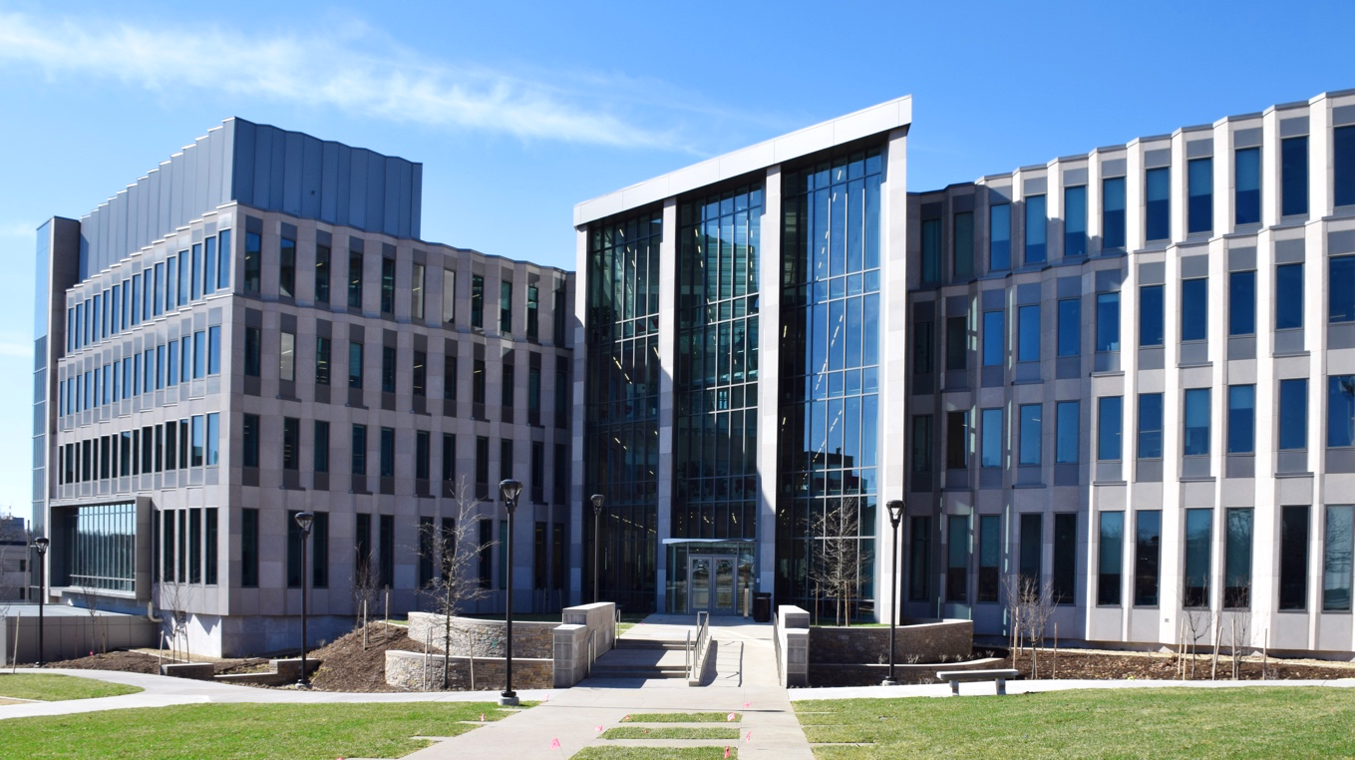



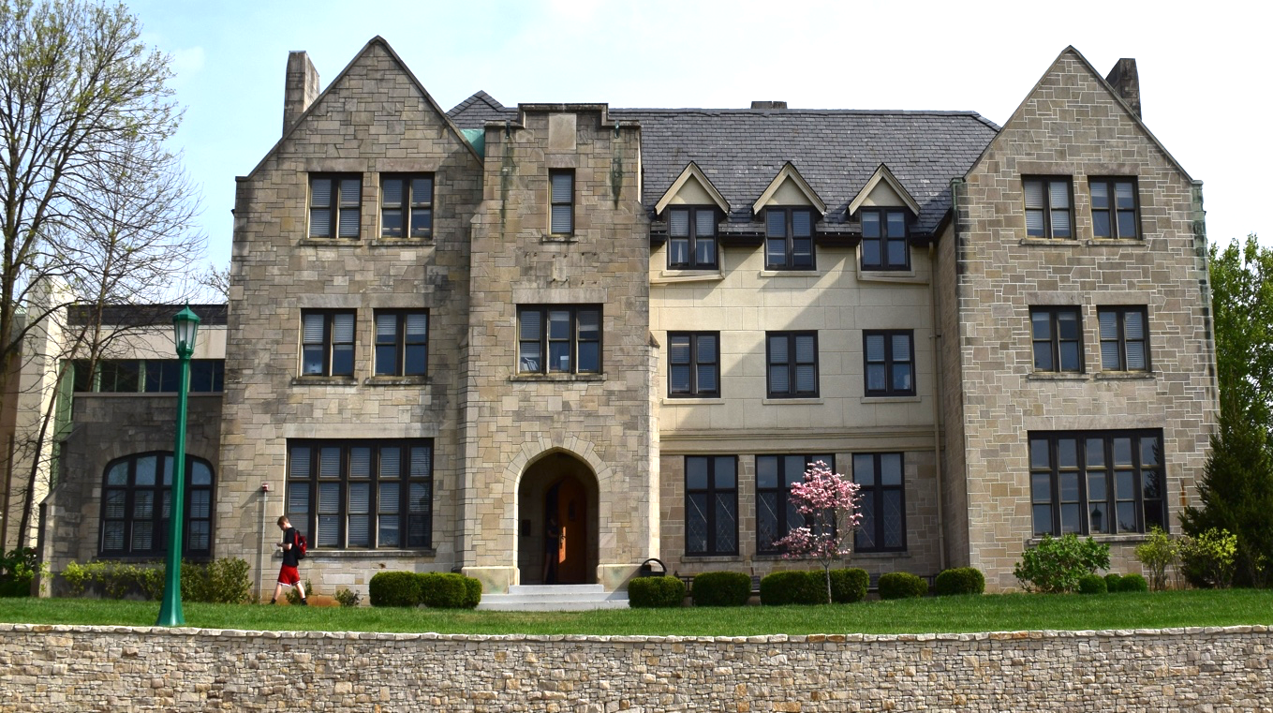
Size of School (2017-18)
Faculty
Students
Research Expenditures
129
(101 Tenure Track)
Undergraduate
1,904
Graduate Students
1,101
$13M
(2017-2018)

Slide 3
Undergraduate Degrees
Computer Science (B.S. and B.A.)
Informatics (B.S.)
Intelligent Systems Engineering (B.S.)
  CE, CPS, Nanoengineering, Bioengineering
Ph.D. Degrees
Computer Science
Informatics
Information Science
Intelligent Systems Engineering
  6 Tracks (4 UG tracks plus environmental and Neuroengineering)
Master’s Degrees
Bioinformatics
Computer Science
Data Science (online, in residence, or hybrid)
Human-Computer Interaction/Design
Informatics
Information Science
Intelligent Systems Engineering
  Same 6 tracks as Ph.D.
Library Science
Secure Computing

Slide 4
Major SICE Research Foci
Bioinformatics: Genomics, Genome privacy, Precision medicine, Structural bioinformatics, Mass spectrometry proteomics, Metagenomics
Computational Biology and Biocomplexity: virtual tissues
Complex Networks and Systems: Network Science
Cyberinfrastructure, e-Science and High Performance Computing
Cybersecurity, Security and Privacy
Data Science
Documentation and Information Science; Ontologies,
HCI Human Computer Interaction/Design
Health/Medical Engineering and Informatics; Wearables
Machine Learning, Data mining, Intelligent Systems
Programming Languages
Social Informatics; Computing Culture and Society

Slide 5
Other Important SICE Research Foci
Experimental Bioengineering
Computer Theory
Computer Vision including medical imaging
Databases
Digital Humanities: Curation, Preservation and Digital Libraries
Information Visualization
Music Informatics
Nano engineering simulation and experiment
Parallel and Distributed Systems
Quantum Computing and Sensing
Robotics
Virtual Heritage

Slide 6
Laboratories in Engineering
Deep Learning Laboratory (Minje Kim): Supported by the Cluster Romeo with Nvidia K80 and Volta GPU's; Tensorflow, Caffe, other software; and diverse large-scale datasets.
Cloud Computing Laboratory (Gregor von Laszewski) Multiple Docker and OpenStack Clusters
High-Performance Big Data Computing Laboratory (Judy Qiu) Haswell, Xeon Platinum and Knight’s Landing clusters. New NEC Vector machine for machine learning
Robotics and Internet of Things Laboratory (Lantao Liu): A smart network of a variety of small devices and robots. A large drone laboratory is being constructed for MESH.
Network Computing Laboratory (Martin Swany) focused on networked systems with embedded and reconfigurable computing elements for edge computing and the Internet of Things using a large cluster with FPGAs, network processors and software-defined network infrastructure. MESH and Luddy facilities
Visualization Laboratory (Katy Börner): Ultra-high resolution stereo display wall, HTC VIVE, and Microsoft HoloLens setups for data visualization, scientific visualization, and virtual/augmented/mixed reality R&D. Luddy facility
Medical Imaging Laboratory (Eleftherios Garyfallidis): Access to critical brain and other medical datasets. Provide software tools such as DIPY and NILEARN. Also training available for medical visualization and interactive tractography analysis. Major Open Source Software emphasis (also in HPBDC and nanoBIO)
Fibers & Additive Manufacturing Enabled Systems FAMES Laboratory (Alexander Gumennik) engineering of fibers and fabrics, embedding ensembles of nano-transducers and sensors. Major MESH Facility

Slide 7
Bio/Nano/Neuro Engineering Health
10 Faculty: Maria Bondesson, Eleftherios Garyfallidis, James A. Glazier, Alexander Gumennik, Feng Guo, Vikram Jadhao, Minje Kim, Gregory Lewis Paul Macklin, Eatai Roth. Also CE/IS for Big Data/Simulations
Current medical care is reactive and open-loop, with long delays between onset of problems, diagnosis, treatment specification, treatment and outcome evaluation
Integration of sensor technology, informatics, modeling and delivery
technologies will allow closed-loop continuous monitoring and
prediction of health states of individuals to maintain health and
respond more rapidly and effectively when problems do occur
Sensors and Background Data
Health State Inference
Prognosis/
Diagnosis
Treatment Evaluations
Intervention Delivery
Core skills include:
Wearable sensors
Image and data analysis
Predictive modeling of medical states
Design of therapeutic strategies
Hardware for intervention delivery
Biomedical workflow design
Social/legal/economic approaches to health delivery
Patient
Physician

Slide 8
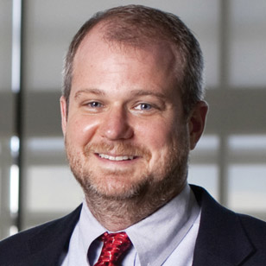

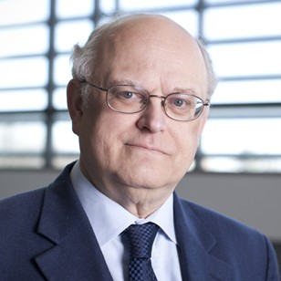




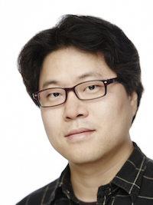
High Performance Computing and Cyberinfrastructure
Integration of HPC, Cloud, parallel, networking,
distributed and edge systems
Exascale machines:
  Next generation supercomputers
  New memory, CPU and software
Parallel big data systems:
  30 optimized ML libraries orders of
  magnitude faster than R, Spark, Flink
Embedded edge systems:
  FPGA, Pi
Martin Swany
Geoffrey Fox
Thomas Sterling
High-Performance Big Data Computing
Twister2 to subsume Hadoop, Kubernetes, Spark, MPI
Teach Cloud, HPC, Deep Learning, HP ML online
Run optimized Big Data systems for research and teaching
Judy Qiu
Lei Jiang
Gregor von Laszewski
Clint Whaley
Minje Kim
Notes:
In the ISE department, we have a world-class team of researchers investigating high performance computing and cyberinfrastructure. Basically they look at the hardware, middleware and software libraries needed to develop the next generation of supercomputers for scientific computing. They are truly foundational for doing big-data research in which you need efficient systems that can handle lots of throughput of data. While our faculty are pushing the frontier of research in this area, they are also committed to translating their research into practice with production systems available to scientists.
Geoffrey Fox and Martin Swany are here to represent his area.

Slide 9
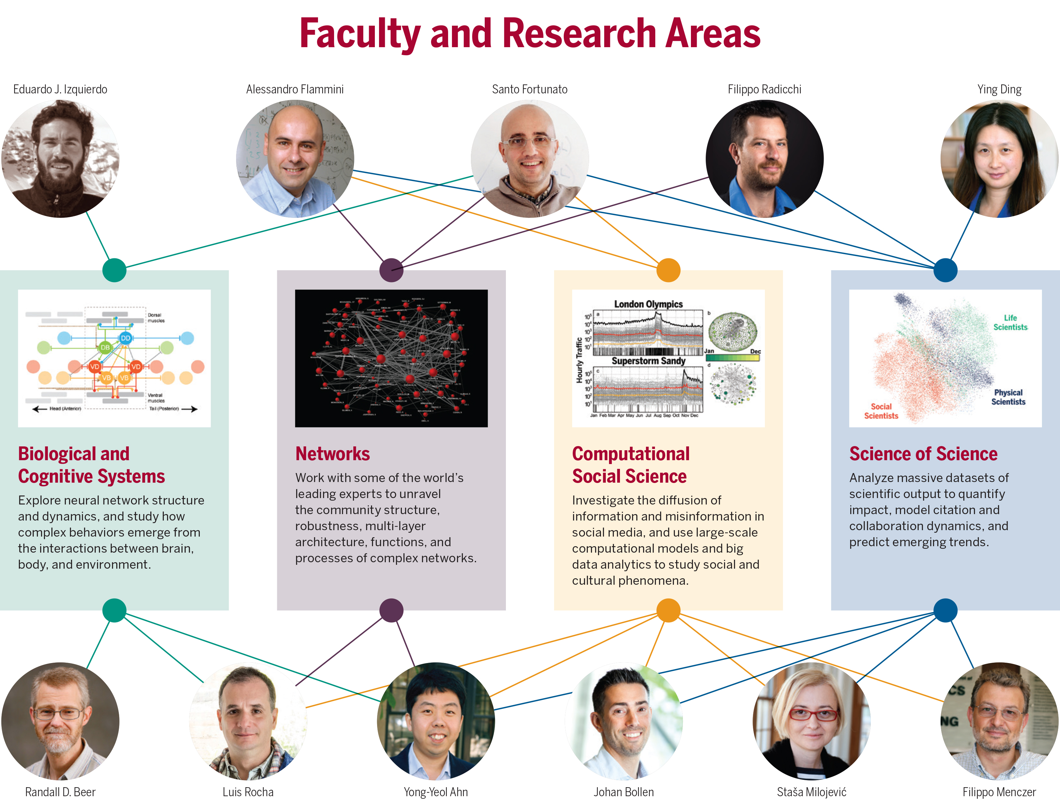
Complex Networks and Systems
draws on world-class faculty in a distinctly multi-disciplinary environment. Our researchers are experts in network science, data science, computation, computational biology, statistical physics, cognitive science, and information science; they study multi-scale networks that extend across social, informational, technological, infrastructural, and biological systems.
Notes:
And the final group I would like to introduce you to is the complex networks and systems group. Again, it is rare to have such an impressive collection of faculty around this topic of how we can use network science to better understand the world around us. They create new techniques and apply existing techniques to new data sets to understand very complicated systems that have complicated interactions, such as how information spreads in a social network, or how disease spreads in a community. They are at the forefront of using new, exciting data sets, such as twitter, to understand a variety of phenomena. Johan and Santo are here representing that group.

Slide 10

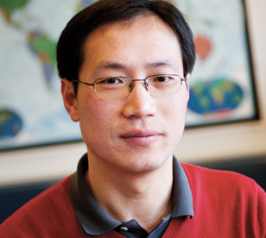


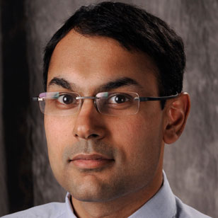
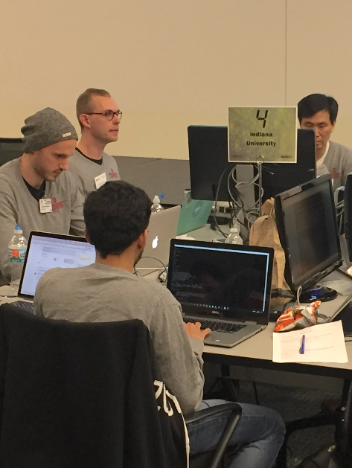
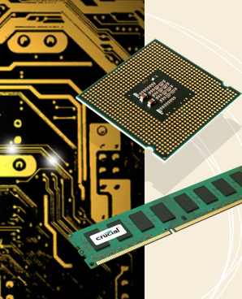
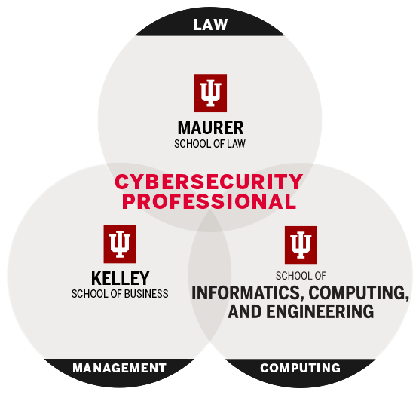
Security & Privacy in Informatics, and Computing
Ryan Henry
Xiaofeng Wang
IoT & Wearables
Crypto
Genomic
Privacy
Usable
Security
Secure
Systems
eCrime &
Malware
Building a more secure digital world for all users through research, multidisciplinary education, and outreach to industry, government, and academia.
Raquel Hill
Jean Camp
Yan Huang
Apu Kapadia
CTF & Cyber Course
Online Privacy
MS in Secure Computing
Joint Certificate
IU Joint Programs
Sameer Patil
Notes:
The next group is the security and privacy group, which has members from both computer science and informatics. This group is inherently interdisciplinary, because not only do you need to solve the very technical security problems, such as cryptography and how to secure systems, but humans are the weakest link in security, so we must understand policy, HCI and privacy concerns of real people in order to build a complete system. This group is also very active in educational initiatives, providing certificate and masters programs. Apu and Raquel are here representing this group.

