Slide 1
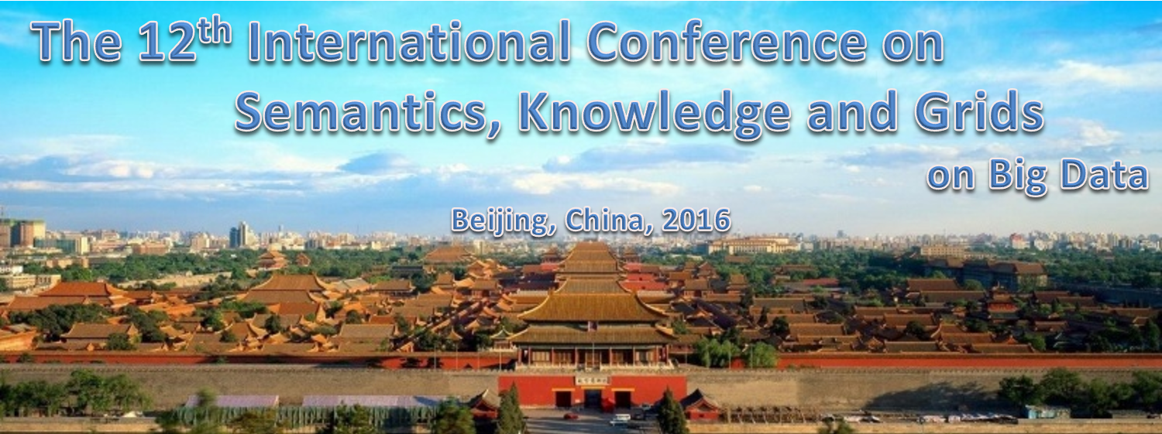
Designing and Building an Analytics Library with the Convergence of High Performance Computing and Big Data
http://www.knowledgegrid.net/skg2016/
Geoffrey Fox August 16, 2016
gcf@indiana.edu
http://www.dsc.soic.indiana.edu/, http://spidal.org/ http://hpc-abds.org/kaleidoscope/
Department of Intelligent Systems Engineering
School of Informatics and Computing, Digital Science Center
Indiana University Bloomington

Slide 2
Abstract
Two major trends in computing systems are the growth in high performance computing (HPC) with an international exascale initiative, and the big data phenomenon with an accompanying cloud infrastructure of well publicized dramatic and increasing size and sophistication.
We describe a classification of applications that considers separately "data" and "model" and allows one to get a unified picture of large scale data analytics and large scale simulations.
We introduce the High Performance Computing enhanced Apache Big Data software Stack HPC-ABDS and give several examples of advantageously linking HPC and ABDS.
In particular we discuss a Scalable Parallel Interoperable Data Analytics Library SPIDAL that is being developed to embody these ideas. SPIDAL covers some core machine learning, image processing, graph, simulation data analysis and network science kernels.
We use this to discuss the convergence of Big Data, Big Simulations, HPC and clouds.
We give examples of data analytics running on HPC systems including details on persuading Java to run fast.

Slide 3
Convergence Points for
HPC-Cloud-Big Data-Simulation
Nexus 1: Applications – Divide use cases into Data and Model and compare characteristics separately in these two components with 64 Convergence Diamonds (features)
Nexus 2: Software – High Performance Computing (HPC) Enhanced Big Data Stack HPC-ABDS. 21 Layers adding high performance runtime to Apache systems (Hadoop is fast!). Establish principles to get good performance from Java or C programming languages
Nexus 3: Hardware – Use Infrastructure as a Service IaaS and DevOps to automate deployment of software defined systems on hardware designed for functionality and performance e.g. appropriate disks, interconnect, memory

Slide 4
SPIDAL Project
Datanet: CIF21 DIBBs: Middleware and High Performance Analytics Libraries for Scalable Data Science
NSF14-43054 started October 1, 2014
Indiana University (Fox, Qiu, Crandall, von Laszewski)
Rutgers (Jha)
Virginia Tech (Marathe)
Kansas (Paden)
Stony Brook (Wang)
Arizona State (Beckstein)
Utah (Cheatham)
A co-design project: Software, algorithms, applications

Slide 5
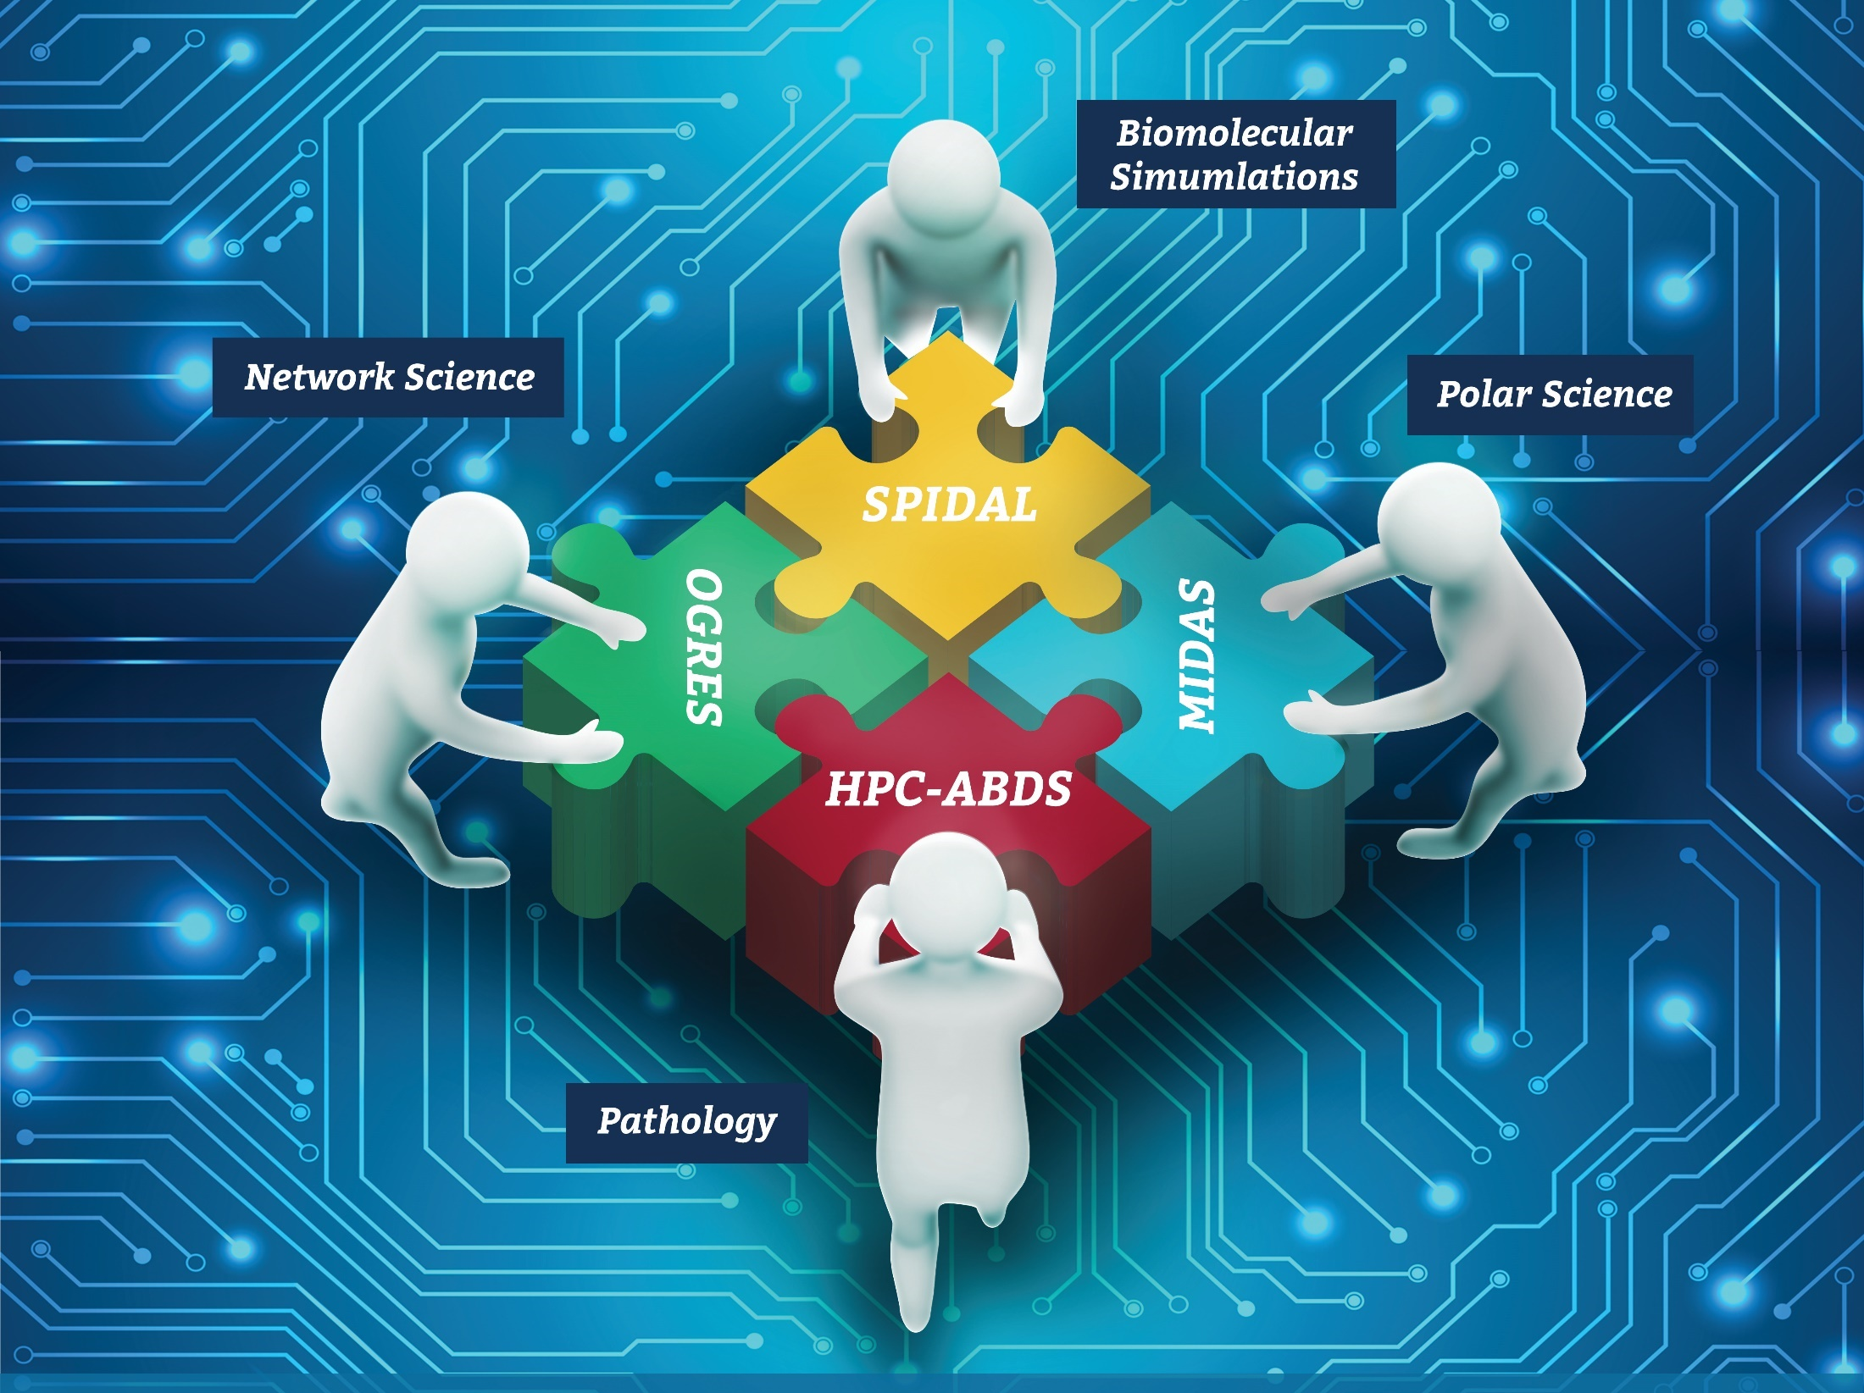




Co-designing Building Blocks Collaboratively
Software: MIDAS
HPC-ABDS

Slide 6
Main Components of SPIDAL Project
Design and Build Scalable High Performance Data Analytics Library
SPIDAL (Scalable Parallel Interoperable Data Analytics Library): Scalable Analytics for:
  Domain specific data analytics libraries – mainly from project.
  Add Core Machine learning libraries – mainly from community.
  Performance of Java and MIDAS Inter- and Intra-node.
NIST Big Data Application Analysis – features of data intensive Applications deriving 64 Convergence Diamonds. Application Nexus.
HPC-ABDS: Cloud-HPC interoperable software performance of HPC (High Performance Computing) and the rich functionality of the commodity Apache Big Data Stack. Software Nexus
MIDAS: Integrating Middleware – from project.
Applications: Biomolecular Simulations, Network and Computational Social Science, Epidemiology, Computer Vision, Geographical Information Systems, Remote Sensing for Polar Science and Pathology Informatics, Streaming for robotics, streaming stock analytics
Implementations: HPC as well as clouds (OpenStack, Docker) Convergence with common DevOps tool Hardware Nexus

Slide 7
Application Nexus
Use-case Data and Model
NIST Collection
Big Data Ogres
Convergence Diamonds

Slide 8
Data and Model in Big Data and Simulations
Need to discuss Data and Model as problems combine them, but we can get insight by separating which allows better understanding of Big Data - Big Simulation “convergence” (or differences!)
Big Data implies Data is large but Model varies
  e.g. LDA with many topics or deep learning has large model
  Clustering or Dimension reduction can be quite small in model size
Simulations can also be considered as Data and Model
  Model is solving particle dynamics or partial differential equations
  Data could be small when just boundary conditions
  Data large with data assimilation (weather forecasting) or when data visualizations are produced by simulation
Data often static between iterations (unless streaming); Model varies between iterations

Slide 9
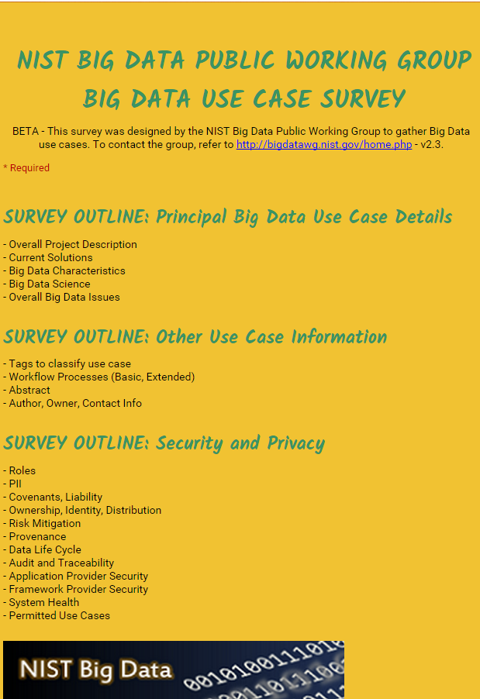
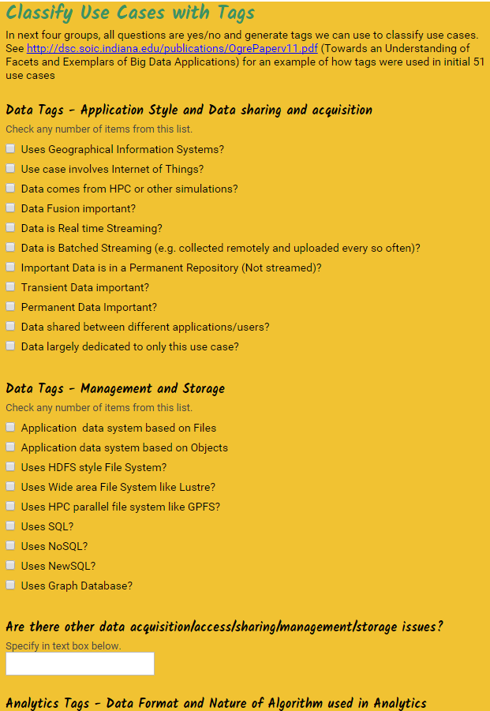
http://hpc-abds.org/kaleidoscope/survey/
Online Use Case Form

Slide 10
51 Detailed Use Cases: Contributed July-September 2013
Covers goals, data features such as 3 V’s, software, hardware
Government Operation(4): National Archives and Records Administration, Census Bureau
Commercial(8): Finance in Cloud, Cloud Backup, Mendeley (Citations), Netflix, Web Search, Digital Materials, Cargo shipping (as in UPS)
Defense(3): Sensors, Image surveillance, Situation Assessment
Healthcare and Life Sciences(10): Medical records, Graph and Probabilistic analysis, Pathology, Bioimaging, Genomics, Epidemiology, People Activity models, Biodiversity
Deep Learning and Social Media(6): Driving Car, Geolocate images/cameras, Twitter, Crowd Sourcing, Network Science, NIST benchmark datasets
The Ecosystem for Research(4): Metadata, Collaboration, Language Translation, Light source experiments
Astronomy and Physics(5): Sky Surveys including comparison to simulation, Large Hadron Collider at CERN, Belle Accelerator II in Japan
Earth, Environmental and Polar Science(10): Radar Scattering in Atmosphere, Earthquake, Ocean, Earth Observation, Ice sheet Radar scattering, Earth radar mapping, Climate simulation datasets, Atmospheric turbulence identification, Subsurface Biogeochemistry (microbes to watersheds), AmeriFlux and FLUXNET gas sensors
Energy(1): Smart grid
Published by NIST as http://nvlpubs.nist.gov/nistpubs/SpecialPublications/NIST.SP.1500-3.pdf
“Version 2” being prepared
26 Features for each use case Biased to science

Slide 11
Sample Features of 51 Use Cases I
PP (26) “All” Pleasingly Parallel or Map Only
MR (18) Classic MapReduce MR (add MRStat below for full count)
MRStat (7) Simple version of MR where key computations are simple reduction as found in statistical averages such as histograms and averages
MRIter (23) Iterative MapReduce or MPI (Flink, Spark, Twister)
Graph (9) Complex graph data structure needed in analysis
Fusion (11) Integrate diverse data to aid discovery/decision making; could involve sophisticated algorithms or could just be a portal
Streaming (41) Some data comes in incrementally and is processed this way
Classify (30) Classification: divide data into categories
S/Q (12) Index, Search and Query

Slide 12
Sample Features of 51 Use Cases II
CF (4) Collaborative Filtering for recommender engines
LML (36) Local Machine Learning (Independent for each parallel entity) – application could have GML as well
GML (23) Global Machine Learning: Deep Learning, Clustering, LDA, PLSI, MDS,
  Large Scale Optimizations as in Variational Bayes, MCMC, Lifted Belief Propagation, Stochastic Gradient Descent, L-BFGS, Levenberg-Marquardt . Can call EGO or Exascale Global Optimization with scalable parallel algorithm
Workflow (51) Universal
GIS (16) Geotagged data and often displayed in ESRI, Microsoft Virtual Earth, Google Earth, GeoServer etc.
HPC (5) Classic large-scale simulation of cosmos, materials, etc. generating (visualization) data
Agent (2) Simulations of models of data-defined macroscopic entities represented as agents

Slide 13
7 Computational Giants of
NRC Massive Data Analysis Report
http://www.nap.edu/catalog.php?record_id=18374 Big Data Models?
G1: Basic Statistics e.g. MRStat
G2: Generalized N-Body Problems
G3: Graph-Theoretic Computations
G4: Linear Algebraic Computations
G5: Optimizations e.g. Linear Programming
G6: Integration e.g. LDA and other GML
G7: Alignment Problems e.g. BLAST

Slide 14
HPC (Simulation) Benchmark Classics
Linpack or HPL: Parallel LU factorization
for solution of linear equations; HPCG
NPB version 1: Mainly classic HPC solver kernels
  MG: Multigrid
  CG: Conjugate Gradient
  FT: Fast Fourier Transform
  IS: Integer sort
  EP: Embarrassingly Parallel
  BT: Block Tridiagonal
  SP: Scalar Pentadiagonal
  LU: Lower-Upper symmetric Gauss Seidel
Simulation Models

Slide 15
13 Berkeley Dwarfs
Dense Linear Algebra
Sparse Linear Algebra
Spectral Methods
N-Body Methods
Structured Grids
Unstructured Grids
MapReduce
Combinational Logic
Graph Traversal
Dynamic Programming
Backtrack and
Branch-and-Bound
Graphical Models
Finite State Machines
Largely Models for Data or Simulation
First 6 of these correspond to Colella’s original. (Classic simulations)
Monte Carlo dropped.
N-body methods are a subset of Particle in Colella.
Note a little inconsistent in that MapReduce is a programming model and spectral method is a numerical method.
Need multiple facets to classify use cases!

Slide 16
Classifying Use cases

Slide 17
Classifying Use Cases
The Big Data Ogres built on a collection of 51 big data uses gathered by the NIST Public Working Group where 26 properties were gathered for each application.
This information was combined with other studies including the Berkeley dwarfs, the NAS parallel benchmarks and the Computational Giants of the NRC Massive Data Analysis Report.
The Ogre analysis led to a set of 50 features divided into four views that could be used to categorize and distinguish between applications.
The four views are Problem Architecture (Macro pattern); Execution Features (Micro patterns); Data Source and Style; and finally the Processing View or runtime features.
We generalized this approach to integrate Big Data and Simulation applications into a single classification looking separately at Data and Model with the total facets growing to 64 in number, called convergence diamonds, and split between the same 4 views.
A mapping of facets into work of the SPIDAL project has been given.

Slide 19
64 Features in 4 views for Unified Classification of Big Data and Simulation Applications
Both
Simulations
Analytics
(Model for Big Data)
(Nearly all Data)
(All Model)
(Mix of Data and Model)
(Nearly all Data+Model)

Slide 20
Local and Global Machine Learning
Many applications use LML or Local machine Learning where machine learning (often from R or Python or Matlab) is run separately on every data item such as on every image
But others are GML Global Machine Learning where machine learning is a basic algorithm run over all data items (over all nodes in computer)
  maximum likelihood or χ² with a sum over the N data items – documents, sequences, items to be sold, images etc. and often links (point-pairs).
  GML includes Graph analytics, clustering/community detection, mixture models, topic determination, Multidimensional scaling, (Deep) Learning Networks
Note Facebook may need lots of small graphs (one per person and ~LML) rather than one giant graph of connected people (GML)

Slide 21
Examples in Problem Architecture View PA
The facets in the Problem architecture view include 5 very common ones describing synchronization structure of a parallel job:
  MapOnly or Pleasingly Parallel (PA1): the processing of a collection of independent events;
  MapReduce (PA2): independent calculations (maps) followed by a final consolidation via MapReduce;
  MapCollective (PA3): parallel machine learning dominated by scatter, gather, reduce and broadcast;
  MapPoint-to-Point (PA4): simulations or graph processing with many local linkages in points (nodes) of studied system.
  MapStreaming (PA5): The fifth important problem architecture is seen in recent approaches to processing real-time data.
  We do not focus on pure shared memory architectures PA6 but look at hybrid architectures with clusters of multicore nodes and find important performances issues dependent on the node programming model.
Most of our codes are SPMD (PA-7) and BSP (PA-8).

Slide 22
6 Forms of MapReduce
Describes Architecture of
- Problem (Model reflecting data)
- Machine
- Software
2 important variants (software) of Iterative MapReduce and Map-Streaming a) “In-place” HPC b) Flow for model and data

Slide 23
Examples in Execution View EV
The Execution view is a mix of facets describing either data or model; PA was largely the overall Data+Model
EV-M14 is Complexity of model (O(N²) for N points) seen in the non-metric space models EV-M13 such as one gets with DNA sequences.
EV-M11 describes iterative structure distinguishing Spark, Flink, and Harp from the original Hadoop.
The facet EV-M8 describes the communication structure which is a focus of our research as much data analytics relies on collective communication which is in principle understood but we find that significant new work is needed compared to basic HPC releases which tend to address point to point communication.
The model size EV-M4 and data volume EV-D4 are important in describing the algorithm performance as just like in simulation problems, the grain size (the number of model parameters held in the unit – thread or process – of parallel computing) is a critical measure of performance.

Slide 24
Examples in Data View DV
We can highlight DV-5 streaming where there is a lot of recent progress;
DV-9 categorizes our Biomolecular simulation application with data produced by an HPC simulation
DV-10 is Geospatial Information Systems covered by our spatial algorithms.
DV-7 provenance, is an example of an important feature that we are not covering.
The data storage and access DV-3 and D-4 is covered in our pilot data work.
The Internet of Things DV-8 is not a focus of our project although our recent streaming work relates to this and our addition of HPC to Apache Heron and Storm is an example of the value of HPC-ABDS to IoT.

Slide 25
Examples in Processing View PV
The Processing view PV characterizes algorithms and is only Model (no Data features) but covers both Big data and Simulation use cases.
Graph PV-M13 and Visualization PV-M14 covered in SPIDAL.
PV-M15 directly describes SPIDAL which is a library of core and other analytics.
This project covers many aspects of PV-M4 to PV-M11 as these characterize the SPIDAL algorithms (such as optimization, learning, classification).
  We are of course NOT addressing PV-M16 to PV-M22 which are simulation algorithm characteristics and not applicable to data analytics.
Our work largely addresses Global Machine Learning PV-M3 although some of our image analytics are local machine learning PV-M2 with parallelism over images and not over the analytics.
Many of our SPIDAL algorithms have linear algebra PV-M12 at their core; one nice example is multi-dimensional scaling MDS which is based on matrix-matrix multiplication and conjugate gradient.

Slide 26
Comparison of Data Analytics with Simulation I
Simulations (models) produce big data as visualization of results – they are data source
  Or consume often smallish data to define a simulation problem
  HPC simulation in (weather) data assimilation is data + model
Pleasingly parallel often important in both
Both are often SPMD and BSP
  Non-iterative MapReduce is major big data paradigm
  not a common simulation paradigm except where “Reduce” summarizes pleasingly parallel execution as in some Monte Carlos
Big Data often has large collective communication
  Classic simulation has a lot of smallish point-to-point messages
  Motivates MapCollective model
Simulations characterized often by difference or differential operators leading to nearest neighbor sparsity
Some important data analytics can be sparse as in PageRank and “Bag of words” algorithms but many involve full matrix algorithm

Slide 27
Comparison of Data Analytics with Simulation II
There are similarities between some graph problems and particle simulations with a particular cutoff force.
  Both are MapPoint-to-Point problem architecture
Note many big data problems are “long range force” (as in gravitational simulations) as all points are linked.
  Easiest to parallelize. Often full matrix algorithms
  e.g. in DNA sequence studies, distance δ(i, j) defined by BLAST, Smith-Waterman, etc., between all sequences i, j.
  Opportunity for “fast multipole” ideas in big data. See NRC report
Current Ogres/Diamonds do not have facets to designate underlying hardware: GPU v. Many-core (Xeon Phi) v. Multi-core as these define how maps processed; they keep map-X structure fixed; maybe should change as ability to exploit vector or SIMD parallelism could be a model facet.
In image-based deep learning, neural network weights are block sparse (corresponding to links to pixel blocks) but can be formulated as full matrix operations on GPUs and MPI in blocks.
In HPC benchmarking, Linpack being challenged by a new sparse conjugate gradient benchmark HPCG, while I am diligently using non- sparse conjugate gradient solvers in clustering and Multi-dimensional scaling.

Slide 28
Software Nexus
Application Layer On
Big Data Software Components for Programming and Data Processing On
HPC for runtime On
IaaS and DevOps Hardware and Systems
HPC-ABDS
MIDAS
Java Grande

Slide 29
HPC-ABDS

Slide 30
Functionality of 21 HPC-ABDS Layers
Message Protocols:
Distributed Coordination:
Security & Privacy:
Monitoring:
IaaS Management from HPC to hypervisors:
DevOps:
Interoperability:
File systems:
Cluster Resource Management:
Data Transport:
A) File management
B) NoSQL
C) SQL
In-memory databases & caches / Object-relational mapping / Extraction Tools
Inter process communication Collectives, point-to-point, publish-subscribe, MPI:
A) Basic Programming model and runtime, SPMD, MapReduce:
B) Streaming:
A) High level Programming:
B) Frameworks
Application and Analytics:
Workflow-Orchestration:

Slide 31
HPC-ABDS SPIDAL Project Activities
Green is MIDAS
Black is SPIDAL
Level 17: Orchestration: Apache Beam (Google Cloud Dataflow) integrated with Heron/Flink and Cloudmesh on HPC cluster
Level 16: Applications: Datamining for molecular dynamics, Image processing for remote sensing and pathology, graphs, streaming, bioinformatics, social media, financial informatics, text mining
Level 16: Algorithms: Generic and custom for applications SPIDAL
Level 14: Programming: Storm, Heron (Twitter replaces Storm), Hadoop, Spark, Flink. Improve Inter- and Intra-node performance; science data structures
Level 13: Runtime Communication: Enhanced Storm and Hadoop (Spark, Flink, Giraph) using HPC runtime technologies, Harp
Level 12: In-memory Database: Redis + Spark used in Pilot-Data Memory
Level 11: Data management: Hbase and MongoDB integrated via use of Beam and other Apache tools; enhance Hbase
Level 9: Cluster Management: Integrate Pilot Jobs with Yarn, Mesos, Spark, Hadoop; integrate Storm and Heron with Slurm
Level 6: DevOps: Python Cloudmesh virtual Cluster Interoperability

Slide 32
Typical Big Data Pattern 2. Perform real time analytics on data source streams and notify users when specified events occur
Specify filter
Filter Identifying Events
Fetch streamed Data
Post Selected Events
Streaming Data
Posted Data
Identified Events
Streaming Data
Streaming Data
Archive
Repository
Storm (Heron), Kafka, Hbase, Zookeeper

Slide 33
Typical Big Data Pattern 5A. Perform interactive analytics on observational scientific data
Science Analysis Code, Mahout, R, SPIDAL
Grid or Many Task Software, Hadoop, Spark, Giraph, Pig …
Data Storage: HDFS, Hbase, File Collection
Direct Transfer
Transport batch of data to primary analysis data system
Streaming Twitter data for Social Networking
Local Accumulate and initial computing
NIST examples include LHC, Remote Sensing, Astronomy and Bioinformatics
Record Scientific Data in “field”

Slide 34
Java Grande
Revisited on 3 data analytics codes
Clustering
Multidimensional Scaling
Latent Dirichlet Allocation all sophisticated algorithms

Slide 35
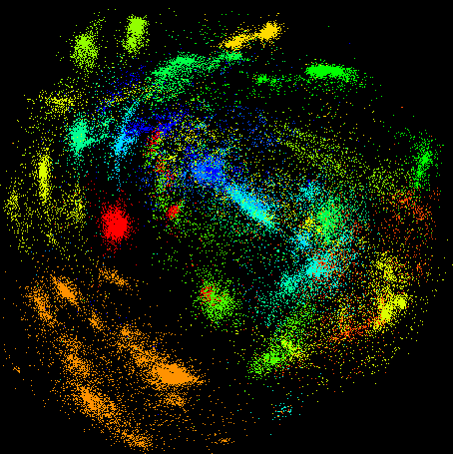
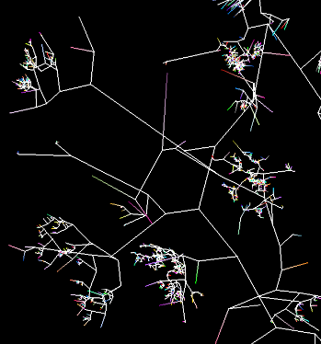
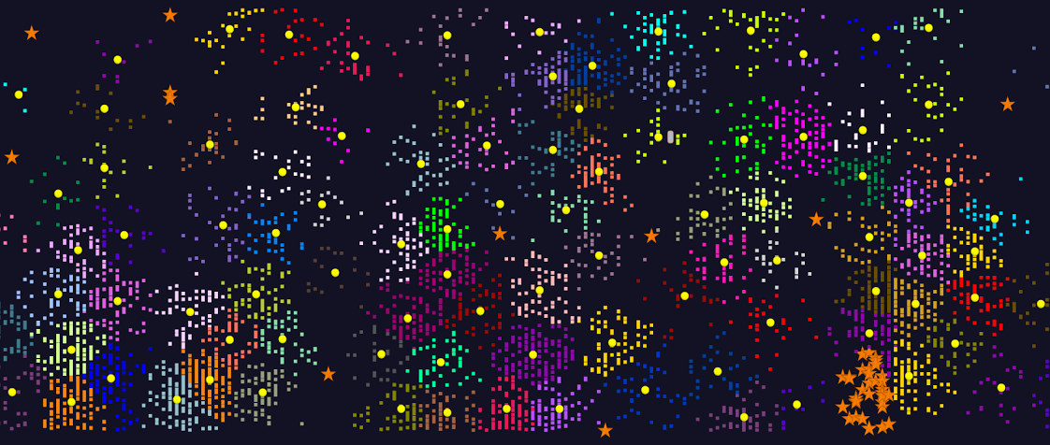
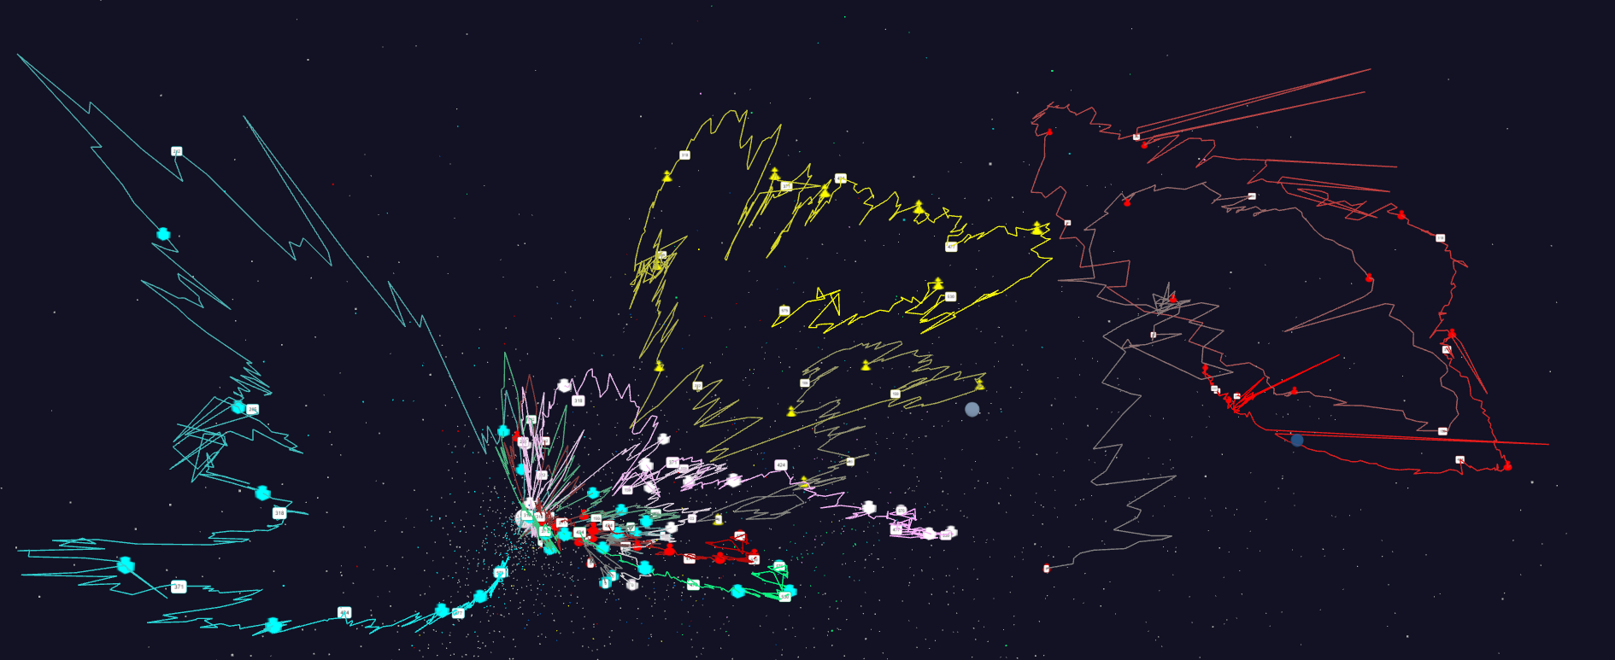
Some large scale analytics
100,000 fungi
Sequences
Eventually
120 clusters
3D phylogenetic tree
LCMS Mass Spectrometer Peak Clustering. Sample of 25 million points. 700 clusters
Jan 1 2004 → December 2015
Daily Stock Time Series in 3D

Slide 36
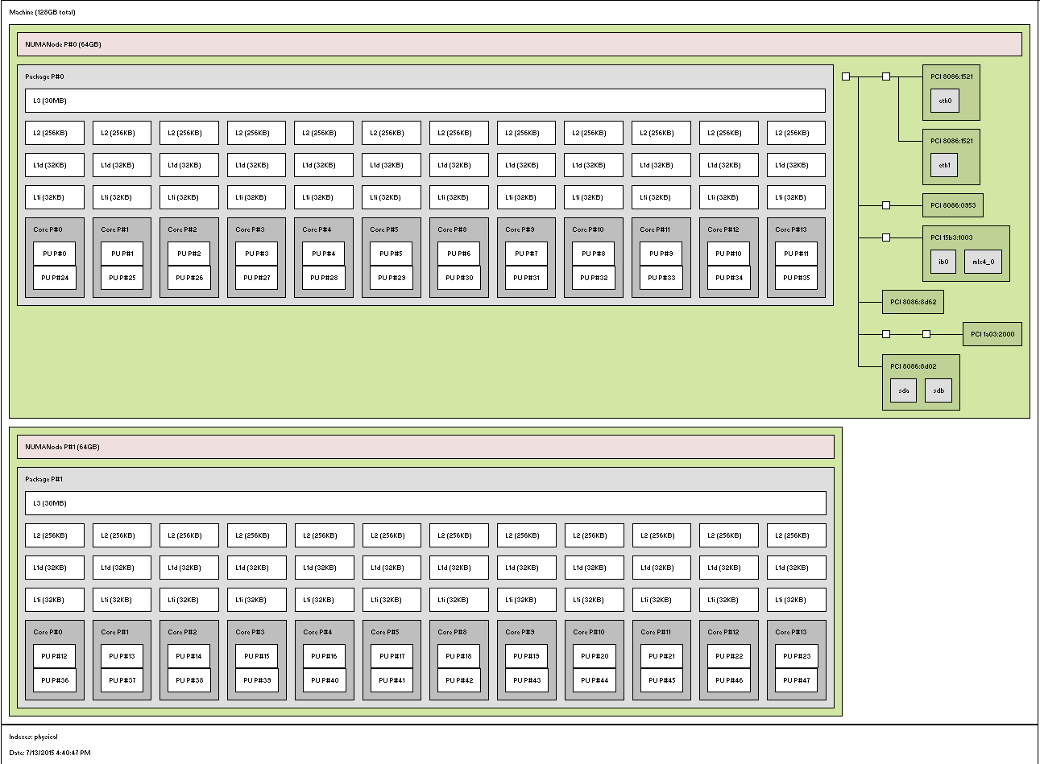
MPI, Fork-Join and Long Running Threads
Quite large number of cores per node in simple main stream clusters
  E.g. 1 Node in Juliet 128 node HPC cluster
    2 Sockets, 12 or 18 Cores each, 2 Hardware threads per core
    L1 and L2 per core, L3 shared per socket
Denote Configurations TxPxN for N nodes each with P processes and T threads per process
  Many choices in T and P
  Choices in Binding of processes and threads
  Choices in MPI where best seems to be SM “shared memory” with all messages for node combined in node shared memory
Socket 0
1 Core – 2 HTs
Socket 1

Slide 37
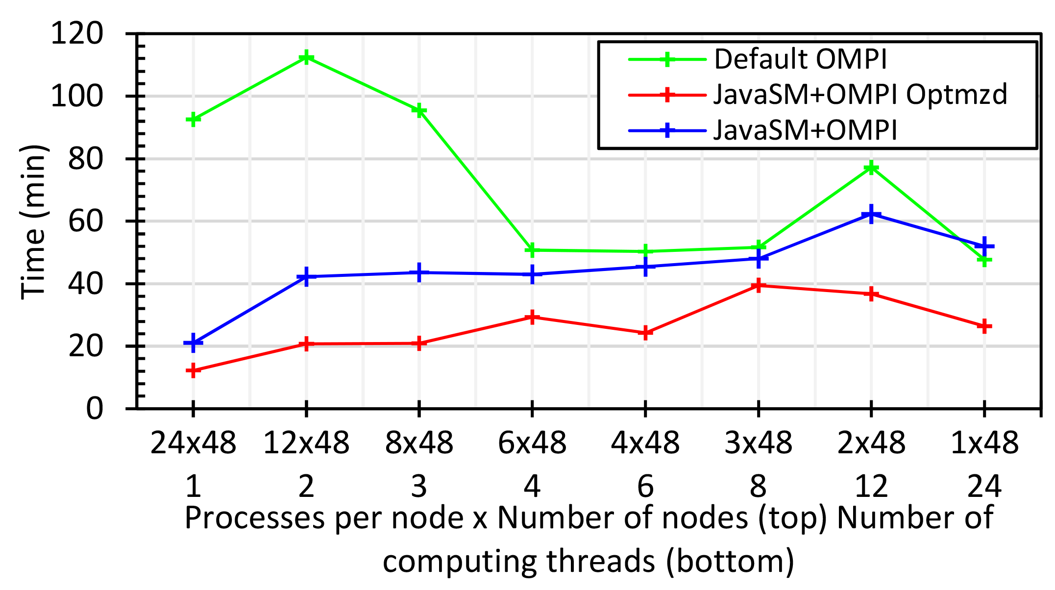
Java MPI performs better than FJ Threads I
48 24 core Haswell nodes 200K DA-MDS Dataset size
Default MPI much worse than threads
Optimized MPI using shared memory node-based messaging is much better than threads (default OMPI does not support SM for needed collectives)
All MPI
All Threads

Slide 38
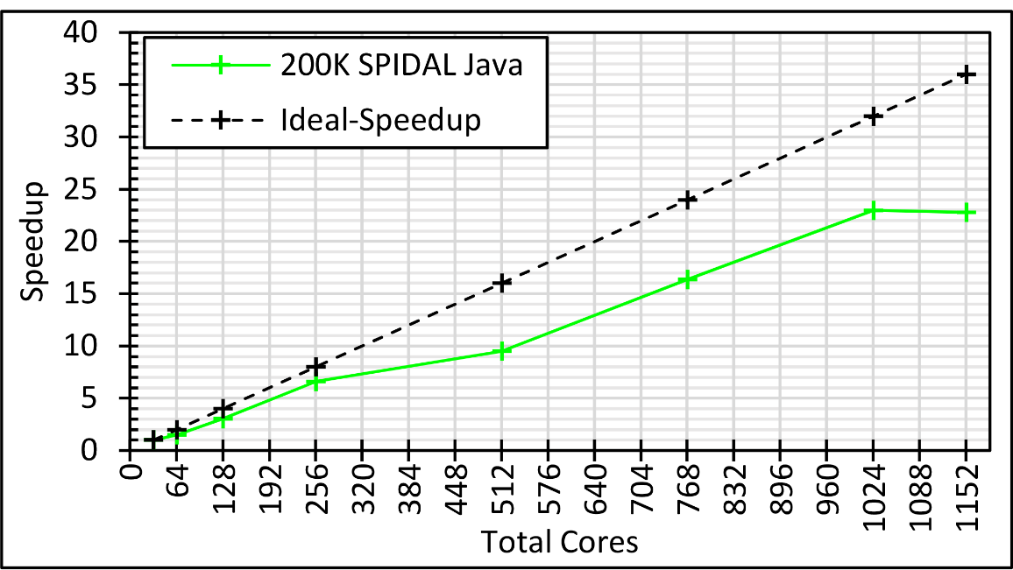
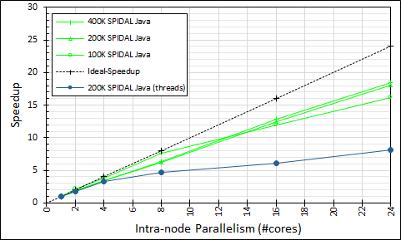
Intra-node Parallelism
All Processes: 32 nodes with 1-36 cores each; speedup compared to 32 nodes with 1 process; optimized Java
Processes (Green) and FJ Threads (Blue) on 48 nodes with 1-24 cores; speedup compared to 48 nodes with 1 process; optimized Java

Slide 39

Java MPI performs better than FJ Threads II
128 24 core Haswell nodes on SPIDAL DA-MDS Code
Speedup compared to 1 process per node on 48 nodes
Best MPI; inter and intra node
MPI; inter/intra node; Java not optimized
Best FJ Threads intra node; MPI inter node

Slide 40
Investigating Process and Thread Models
FJ Fork Join Threads lower performance than Long Running Threads LRT
Results
  Large effects for Java
  Best affinity is process and thread binding to cores - CE
  At best LRT mimics performance of “all processes”
6 Thread/Process Affinity Models

Slide 41
Java and C K-Means LRT-FJ and LRT-BSP with different affinity patterns over varying threads and processes.
10⁶ points and 50k, and 500k centers
performance on 16 nodes
10⁶ points and 1000 centers on 16 nodes
Java
C

Slide 42
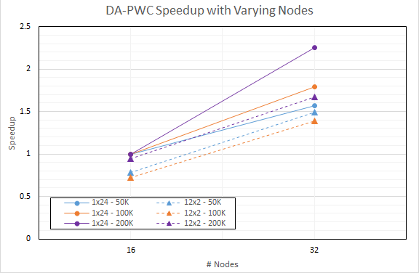
DA-PWC Non Vector Clustering
Speedup referenced to 1 Thread, 24 processes, 16 nodes
Increasing problem size
Circles 24 processes
Triangles: 12 threads, 2 processes on each node

Slide 43
Java versus C Performance
C and Java Comparable with Java doing better on larger problem sizes
All data from one million point dataset with varying number of centers on 16 nodes 24 core Haswell

Slide 44
HPC-ABDS
DataFlow and In-place Runtime

Slide 45
HPC-ABDS Parallel Computing I
Both simulations and data analytics use similar parallel computing ideas
Both do decomposition of both model and data
Both tend use SPMD and often use BSP Bulk Synchronous Processing
One has computing (called maps in big data terminology) and communication/reduction (more generally collective) phases
Big data thinks of problems as multiple linked queries even when queries are small and uses dataflow model
Simulation uses dataflow for multiple linked applications but small steps just as iterations are done in place
Reduction in HPC (MPIReduce) done as optimized tree or pipelined communication between same processes that did computing
Reduction in Hadoop or Flink done as separate map and reduce processes using dataflow
  This leads to 2 forms (In-Place and Flow) of Map-X mentioned earlier
Interesting Fault Tolerance issues highlighted by Hadoop-MPI comparisons – not discussed here!

Slide 46

Programming Model I
Programs are broken up into parts
  Functionally (coarse grain)
  Data/model parameter decomposition (fine grain)
Corse Grain Dataflow
HPC or ABDS

Slide 47
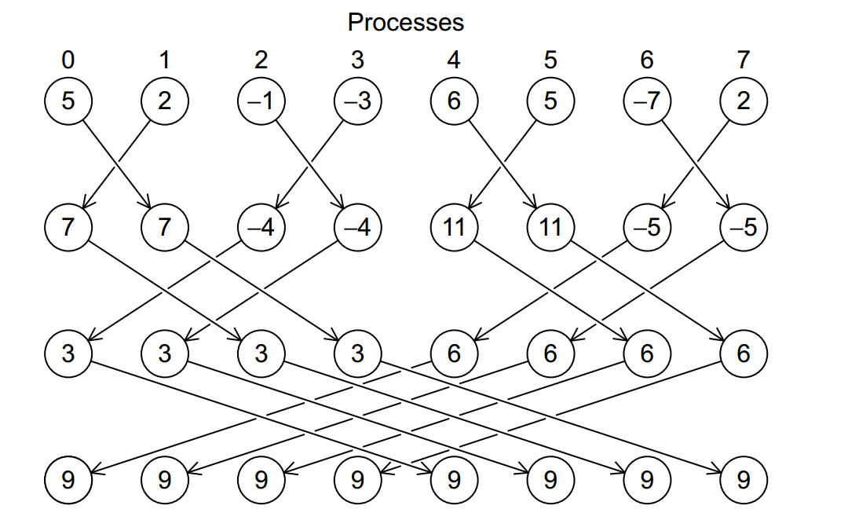
Illustration of In-Place AllReduce in MPI

Slide 48
HPC-ABDS Parallel Computing II
MPI designed for fine grain case and typical of parallel computing used in large scale simulations
  Only change in model parameters are transmitted
Dataflow typical of distributed or Grid computing paradigms
  Data sometimes and model parameters certainly transmitted
  Caching in iterative MapReduce avoids data communication and in fact systems like TensorFlow, Spark or Flink are called dataflow but usually implement “model-parameter” flow
Different Communication/Compute ratios seen in different cases with ratio (measuring overhead) larger when grain size smaller. Compare
  Intra-job reduction such as Kmeans clustering accumulation of center changes at end of each iteration and
  Inter-Job Reduction as at end of a query or word count operation

Slide 49
Kmeans Clustering Flink and MPI one million 2D points fixed; various # centers
24 cores on 16 nodes

Slide 50
HPC-ABDS Parallel Computing III
Need to distinguish
  Grain size and Communication/Compute ratio (characteristic of problem or component (iteration) of problem)
  DataFlow versus “Model-parameter” Flow (characteristic of algorithm)
  In-Place versus Flow Software implementations
Inefficient to use same mechanism independent of characteristics
Classic Dataflow is approach of Spark and Flink so need to add parallel in-place computing as done by Harp for Hadoop
  TensorFlow uses In-Place technology
Note parallel machine learning (GML not LML) can benefit from HPC style interconnects and architectures as seen in GPU-based deep learning
  So commodity clouds not necessarily best

Slide 51
Harp (Hadoop Plugin) brings HPC to ABDS
Basic Harp: Iterative HPC communication; scientific data abstractions
Careful support of distributed data AND distributed model
Avoids parameter server approach but distributes model over worker nodes and supports collective communication to bring global model to each node
Applied first to Latent Dirichlet Allocation LDA with large model and data
MapReduce Model
MapCollective Model
MapReduce Applications
MapCollective Applications
M
M
M
M
M
M
M
M
MapReduce V2
Harp
Shuffle
Collective Communication
R
R
YARN

Slide 52
Automatic parallelization
Database community looks at big data job as a dataflow of (SQL) queries and filters
Apache projects like Pig, MRQL and Flink aim at automatic query optimization by dynamic integration of queries and filters including iteration and different data analytics functions
Going back to ~1993, High Performance Fortran HPF compilers optimized set of array and loop operations for large scale parallel execution of optimized vector and matrix operations
HPF worked fine for initial simple regular applications but ran into trouble for cases where parallelism hard (irregular, dynamic)
Will same happen in Big Data world?
Straightforward to parallelize k-means clustering but sophisticated algorithms like Elkans method (use triangle inequality) and fuzzy clustering are much harder (but not used much NOW)
Will Big Data technology run into HPF-style trouble with growing use of sophisticated data analytics?

Slide 53
MIDAS
Continued
Harp earlier is part of MIDAS

Slide 54
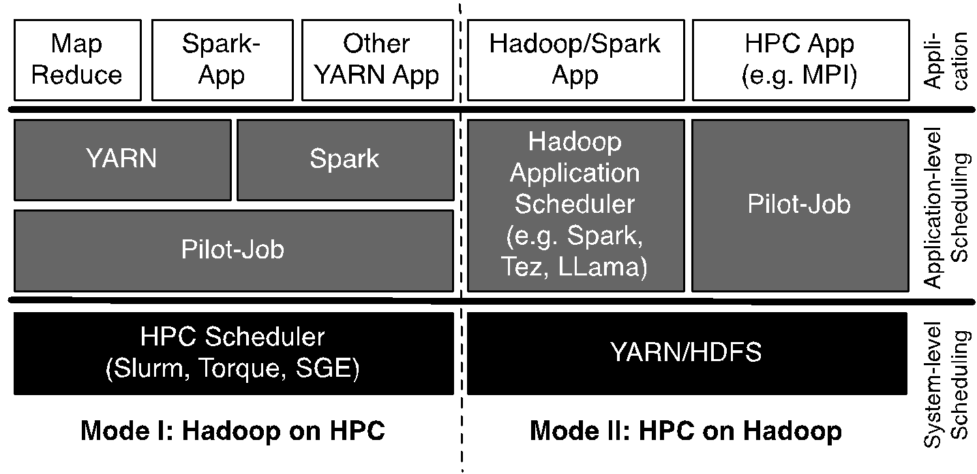
Pilot-Hadoop/Spark Architecture
HPC into Scheduling Layer
http://arxiv.org/abs/1602.00345

Slide 55
Workflow in HPC-ABDS
HPC familiar with Taverna, Pegasus, Kepler, Galaxy … but ABDS has many workflow systems with recently Crunch, NiFi and Beam (open source version of Google Cloud Dataflow)
  Use ABDS for sustainability reasons?
  ABDS approaches are better integrated than HPC approaches with ABDS data management like Hbase and are optimized for distributed data.
Heron, Spark and Flink provide distributed dataflow runtime
Beam prefers Flink as runtime and supports streaming and batch data
Use extensions of Harp as parallel computing interface and Beam as streaming/batch support of parallel workflows

Slide 56
Infrastructure Nexus
IaaS
DevOps
Cloudmesh

Slide 57
Constructing HPC-ABDS Exemplars
This is one of next steps in NIST Big Data Working Group
Jobs are defined hierarchically as a combination of Ansible (preferred over Chef or Puppet as Python) scripts
Scripts are invoked on Infrastructure (Cloudmesh Tool)
INFO 524 “Big Data Open Source Software Projects” IU Data Science class required final project to be defined in Ansible and decent grade required that script worked (On NSF Chameleon and FutureSystems)
  80 students gave 37 projects with ~15 pretty good such as
  “Machine Learning benchmarks on Hadoop with HiBench”, Hadoop/Yarn, Spark, Mahout, Hbase
  “Human and Face Detection from Video”, Hadoop (Yarn), Spark, OpenCV, Mahout, MLLib
Build up curated collection of Ansible scripts defining use cases for benchmarking, standards, education
https://docs.google.com/document/d/1INwwU4aUAD_bj-XpNzi2rz3qY8rBMPFRVlx95k0-xc4
Fall 2015 class INFO 523 introductory data science class was less constrained; students just had to run a data science application but catalog interesting
  140 students: 45 Projects (NOT required) with 91 technologies, 39 datasets

Slide 58
Cloudmesh Interoperability DevOps Tool
Model: Define software configuration with tools like Ansible (Chef, Puppet); instantiate on a virtual cluster
Save scripts not virtual machines and let script build applications
Cloudmesh is an easy-to-use command line program/shell and portal to interface with heterogeneous infrastructures taking script as input
  It first defines virtual cluster and then instantiates script on it
  It has several common Ansible defined software built in
Supports OpenStack, AWS, Azure, SDSC Comet, virtualbox, libcloud supported clouds as well as classic HPC and Docker infrastructures
  Has an abstraction layer that makes it possible to integrate other IaaS frameworks
Managing VMs across different IaaS providers is easier
Demonstrated interaction with various cloud providers:
  FutureSystems, Chameleon Cloud, Jetstream, CloudLab, Cybera, AWS, Azure, virtualbox
Status: AWS, and Azure, VirtualBox, Docker need improvements; we focus currently on SDSC Comet and NSF resources that use OpenStack
HPC Cloud Interoperability Layer

Slide 59
Cloudmesh Architecture
Software Engineering Process
We define a basic virtual cluster which is a set of instances with a common security context
We then add basic tools including languages Python Java etc.
Then add management tools such as Yarn, Mesos, Storm, Slurm etc …..
Then add roles for different HPC-ABDS PaaS subsystems such as Hbase, Spark
  There will be dependencies e.g. Storm role uses Zookeeper
Any one project picks some of HPC-ABDS PaaS Ansible roles and adds >=1 SaaS that are specific to their project and for example read project data and perform project analytics
E.g. there will be an OpenCV role used in Image processing applications

Slide 60
SPIDAL Algorithms
Core
Optimization
Graph
Domain Specific

Slide 61
SPIDAL Algorithms – Core I
Several parallel core machine learning algorithms; need to add SPIDAL Java optimizations to complete parallel codes except MPI MDS
  https://www.gitbook.com/book/esaliya/global-machine-learning-with-dsc-spidal/details
O(N²) distance matrices calculation with Hadoop parallelism and various options (storage MongoDB vs. distributed files), normalization, packing to save memory usage, exploiting symmetry
WDA-SMACOF: Multidimensional scaling MDS is optimal nonlinear dimension reduction enhanced by SMACOF, deterministic annealing and Conjugate gradient for non-uniform weights. Used in many applications
  MPI (shared memory) and MIDAS (Harp) versions
MDS Alignment to optimally align related point sets, as in MDS time series
WebPlotViz data management (MongoDB) and browser visualization for 3D point sets including time series. Available as source or SaaS
MDS as χ² using Manxcat. Alternative more general but less reliable solution of MDS. Latest version of WDA-SMACOF usually preferable
Other Dimension Reduction: SVD, PCA, GTM to do

Slide 62
SPIDAL Algorithms – Core II
Latent Dirichlet Allocation LDA for topic finding in text collections; new algorithm with MIDAS runtime outperforming current best practice
DA-PWC Deterministic Annealing Pairwise Clustering for case where points aren’t in a vector space; used extensively to cluster DNA and proteomic sequences; improved algorithm over other published. Parallelism good but needs SPIDAL Java
DAVS Deterministic Annealing Clustering for vectors; includes specification of errors and limit on cluster sizes. Gives very accurate answers for cases where distinct clustering exists. Being upgraded for new LC-MS proteomics data with one million clusters in 27 million size data set
K-means basic vector clustering: fast and adequate where clusters aren’t needed accurately
Elkan’s improved K-means vector clustering: for high dimensional spaces; uses triangle inequality to avoid expensive distance calcs
Future work – Classification: logistic regression, Random Forest, SVM, (deep learning); Collaborative Filtering, TF-IDF search and Spark MLlib algorithms
Harp-DaaL extends Intel DAAL’s local batch mode to multi-node distributed modes
  Leveraging Harp’s benefits of communication for iterative compute models

Slide 63
SPIDAL Algorithms – Optimization I
Manxcat: Levenberg Marquardt Algorithm for non-linear χ² optimization with sophisticated version of Newton’s method calculating value and derivatives of objective function. Parallelism in calculation of objective function and in parameters to be determined. Complete – needs SPIDAL Java optimization
Viterbi algorithm, for finding the maximum a posteriori (MAP) solution for a Hidden Markov Model (HMM). The running time is O(n*s²) where n is the number of variables and s is the number of possible states each variable can take. We will provide an "embarrassingly parallel" version that processes multiple problems (e.g. many images) independently; parallelizing within the same problem not needed in our application space. Needs Packaging in SPIDAL
Forward-backward algorithm, for computing marginal distributions over HMM variables. Similar characteristics as Viterbi above. Needs Packaging in SPIDAL

Slide 64
SPIDAL Algorithms – Optimization II
Loopy belief propagation (LBP) for approximately finding the maximum a posteriori (MAP) solution for a Markov Random Field (MRF). Here the running time is O(n²*s²*i) in the worst case where n is number of variables, s is number of states per variable, and i is number of iterations required (which is usually a function of n, e.g. log(n) or sqrt(n)). Here there are various parallelization strategies depending on values of s and n for any given problem.
  We will provide two parallel versions: embarrassingly parallel version for when s and n are relatively modest, and parallelizing each iteration of the same problem for common situation when s and n are quite large so that each iteration takes a long time.
  Needs Packaging in SPIDAL
Markov Chain Monte Carlo (MCMC) for approximately computing marking distributions and sampling over MRF variables. Similar to LBP with the same two parallelization strategies. Needs Packaging in SPIDAL

Slide 65
SPIDAL Graph Algorithms
Subgraph Mining: Finding patterns specified by a template in graphs
  Reworking existing parallel VT algorithm Sahad with MIDAS middleware giving HarpSahad which runs 5 (Google) to 9 (Miami) times faster than original Hadoop version
Triangle Counting: PATRIC improved memory use (factor of 25 lower) and good MPI scaling
Random Graph Generation: with particular degree distribution and clustering coefficients. new DG method with low memory and high performance, almost optimal load balancing and excellent scaling.
  Algorithms are about 3-4 times faster than the previous ones.
Last 2 need to be packaged for SPIDAL using MIDAS (currently MPI)
Community Detection: current work
Old version
SPIDAL
Harp
Pure Hadoop
Old New
VT

Slide 66
Applications
Network Science: start on graph algorithms earlier
General Discussion of Images
Remote Sensing in Polar regions: image processing
Pathology: image processing
Spatial search and GIS for Public Health
Biomolecular simulations
  Path Similarity Analysis
  Detect continuous lipid membrane leaflets in a MD simulation

Slide 67
Imaging Applications: Remote Sensing, Pathology, Spatial Systems
Both Pathology/Remote sensing working on 2D moving to 3D images
Each pathology image could have 10 billion pixels, and we may extract a million spatial objects per image and 100 million features (dozens to 100 features per object) per image. We often tile the image into 4K x 4K tiles for processing. We develop buffering-based tiling to handle boundary-crossing objects. For each typical study, we may have hundreds to thousands of images
Remote sensing aimed at radar images of ice and snow sheets; as data from aircraft flying in a line, we can stack radar 2D images to get 3D
2D problems need modest parallelism “intra-image” but often need parallelism over images
3D problems need parallelism for an individual image
Use many different Optimization algorithms to support applications (e.g. Markov Chain, Integer Programming, Bayesian Maximum a posteriori, variational level set, Euler-Lagrange Equation)
Classification (deep learning convolution neural network, SVM, random forest, etc.) will be important

Slide 68
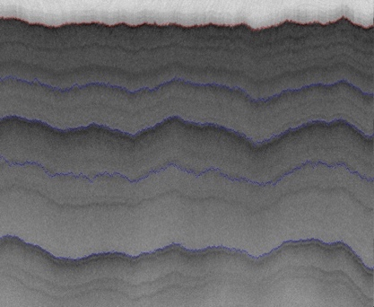
2D Radar Polar Remote Sensing
Need to estimate structure of earth (ice, snow, rock) from radar signals from plane in 2 or 3 dimensions.
Original 2D analysis (called [11]) used Hidden Markov Methods; better results using MCMC (our solution)
Extending to snow radar layers

Slide 69
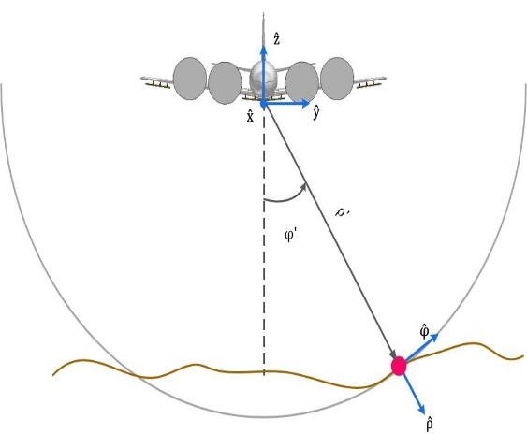
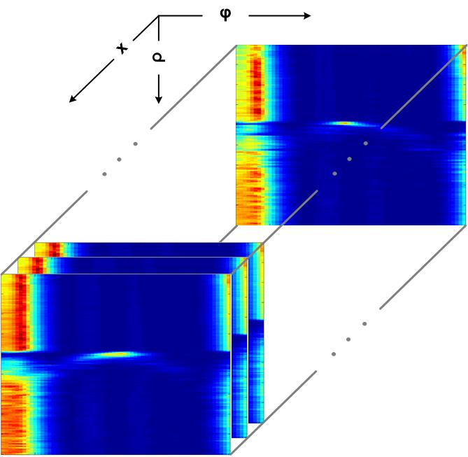
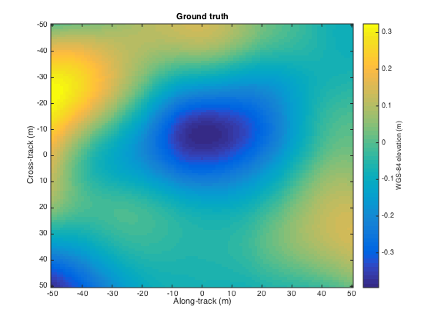
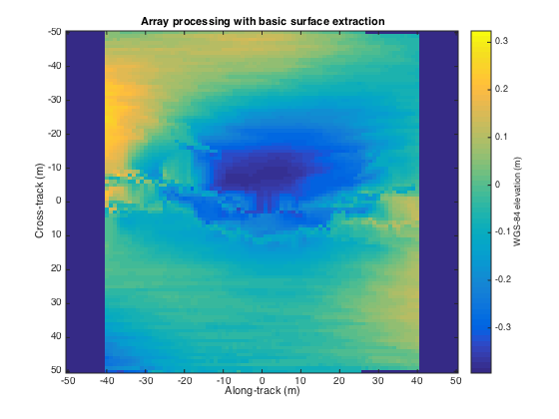
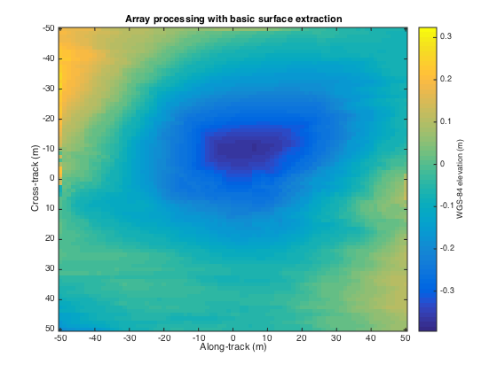
3D Radar Polar Remote Sensing
Uses Loopy belief propagation LBP to analyze 3D radar images
Radar gives a cross-section view, parameterized by angle and range, of the ice structure, which yields a set of 2-d tomographic slices (right) along the flight path.
Each image represents a 3d depth map, with along track and cross track dimensions on the x-axis and y-axis respectively, and depth coded as colors.
Reconstructing bedrock in 3D, for (left) ground truth, (center) existing algorithm based on maximum likelihood estimators, and (right) our technique based on a Markov Random Field formulation.

Slide 70
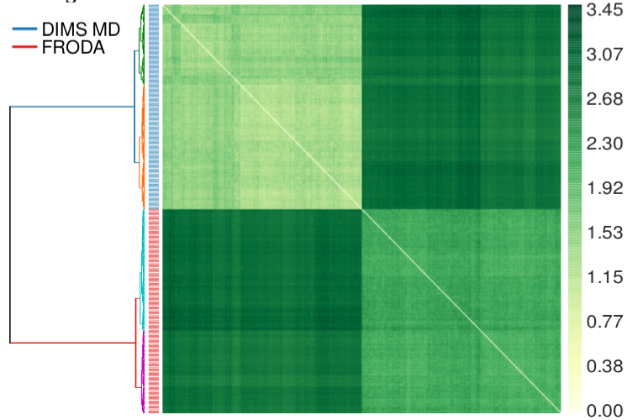
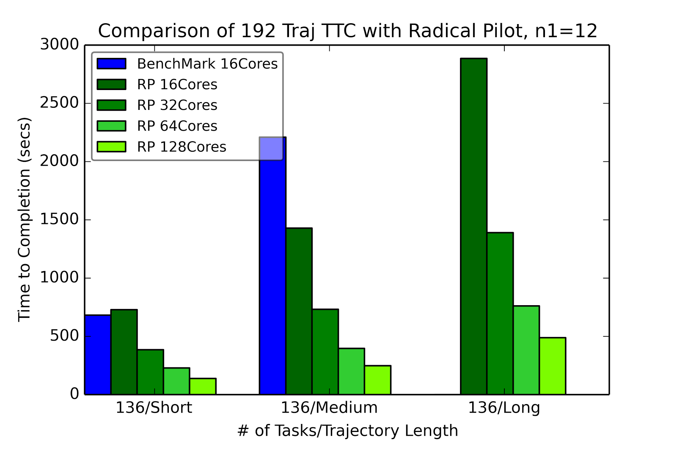
RADICAL-Pilot Hausdorff distance: all-pairs problem
Clustered distances for two methods for sampling macromolecular transitions (200 trajectories each) showing that both methods produce distinctly different pathways.
RADICAL Pilot benchmark run for three different test sets of trajectories, using 12x12 “blocks” per task.
Should use general SPIDAL library

Slide 71
Big Data - Big Simulation
Convergence?
HPC-Clouds convergence? (easier than converging higher levels in stack)
Can HPC continue to do it alone?
Convergence Diamonds
HPC-ABDS Software on differently optimized hardware infrastructure

Slide 72
General Aspects of Big Data HPC Convergence
Applications, Benchmarks and Libraries
  51 NIST Big Data Use Cases, 7 Computational Giants of the NRC Massive Data Analysis, 13 Berkeley dwarfs, 7 NAS parallel benchmarks
  Unified discussion by separately discussing data & model for each application;
  64 facets– Convergence Diamonds -- characterize applications
  Characterization identifies hardware and software features for each application across big data, simulation; “complete” set of benchmarks (NIST)
Software Architecture and its implementation
  HPC-ABDS: Cloud-HPC interoperable software: performance of HPC (High Performance Computing) and the rich functionality of the Apache Big Data Stack.
  Added HPC to Hadoop, Storm, Heron, Spark; could add to Beam and Flink
  Could work in Apache model contributing code
Run same HPC-ABDS across all platforms but “data management” nodes have different balance in I/O, Network and Compute from “model” nodes
  Optimize to data and model functions as specified by convergence diamonds
  Do not optimize for simulation and big data
Convergence Language: Make C++, Java, Scala, Python (R) … perform well
Training: Students prefer to learn Big Data rather than HPC
Sustainability: research/HPC communities cannot afford to develop everything (hardware and software) from scratch

Slide 73
Typical Convergence Architecture
Running same HPC-ABDS software across all platforms but data management machine has different balance in I/O, Network and Compute from “model” machine
Model has similar issues whether from Big Data or Big Simulation.
Data Management Model for Big Data
and Big Simulation

