Slide 1
Extracting Knowledge with Data Analytics
SKG 2014
Institute of Computing Technology, Chinese Academy of Sciences, Beijing, China
August 28 2014
Geoffrey Fox
gcf@indiana.edu
http://www.infomall.org
School of Informatics and Computing
Digital Science Center
Indiana University Bloomington

Slide 2
Analytics and the DIKW Pipeline
Data goes through a pipeline
Raw data → Data → Information → Knowledge → Wisdom → Decisions
Each link enabled by a filter which is “business logic” or “analytics”
We are interested in filters that involve “sophisticated analytics” which require non trivial parallel algorithms
  Improve state of art in both algorithm quality and (parallel) performance
Design and Build SPIDAL (Scalable Parallel Interoperable Data Analytics Library)
Data
Information
Analytics
Information
Knowledge
More Analytics

Slide 3

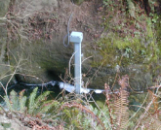
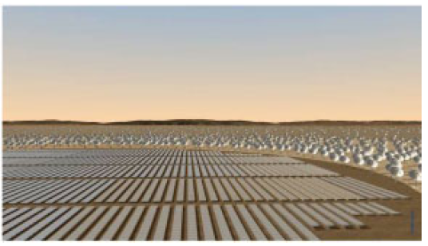
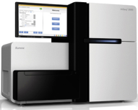
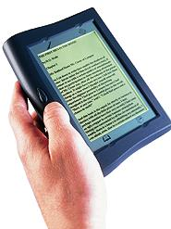





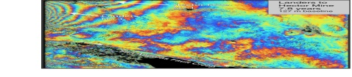
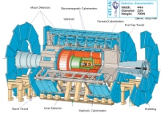
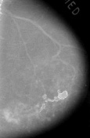

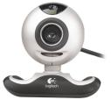

Raw Data → Data → Information → Knowledge → Wisdom → Decisions
Another
Grid
SS
SS
SS
SS
SS
SS
SS
Filter
Cloud
Discovery
Cloud
Portal
Filter
Cloud
Fusion for Discovery/Decisions
SS
Filter
Cloud
Another
Service
SS
Filter
Cloud
Filter
Cloud
Filter
Cloud
Discovery
Cloud
SS
SS: Sensor or Data
Interchange
Service
Workflow through multiple filter/discovery clouds or Services
SS
Filter
Cloud
Filter
Cloud
Filter
Cloud
Filter
Cloud
SS
Another
Cloud
SS
SS
SS
SS
SS
SS
SS
SS
SS
SS
SS
SS
SS
Compute
Cloud
Storage
Cloud
Distributed
Grid
Hadoop Cluster
Database

Slide 4
Strategy to Build SPIDAL
Analyze Big Data applications to identify analytics needed and generate benchmark applications
Analyze existing analytics libraries (in practice limit to some application domains) – catalog library members available and performance
  Mahout low performance, R largely sequential and missing key algorithms, MLlib just starting
Identify big data computer architectures
Identify software model to allow interoperability and performance
Design or identify new or existing algorithm including parallel implementation
Collaborate application scientists, computer systems and statistics/algorithms communities

Slide 5
NIST Big Data Initiative
Led by Chaitin Baru, Bob Marcus, Wo Chang

Slide 6
NBD-PWG (NIST Big Data Public Working Group) Subgroups & Co-Chairs
There were 5 Subgroups
Requirements and Use Cases Sub Group
  Geoffrey Fox, Indiana U.; Joe Paiva, VA; Tsegereda Beyene, Cisco
Definitions and Taxonomies SG
  Nancy Grady, SAIC; Natasha Balac, SDSC; Eugene Luster, R2AD
Reference Architecture Sub Group
  Orit Levin, Microsoft; James Ketner, AT&T; Don Krapohl, Augmented Intelligence
Security and Privacy Sub Group
  Arnab Roy, CSA/Fujitsu Nancy Landreville, U. MD Akhil Manchanda, GE
Technology Roadmap Sub Group
  Carl Buffington, Vistronix; Dan McClary, Oracle; David Boyd, Data Tactics
See http://bigdatawg.nist.gov/usecases.php
And http://bigdatawg.nist.gov/V1_output_docs.php

Slide 7
NIST Big Data Reference Architecture
INFORMATION VALUE CHAIN
System Orchestrator
Big Data Application Provider
Analytics
Data Provider
Curation
Visualization
Data Consumer
DATA
DATA
SW
Collection
Access
SW
DATA
SW
K E Y :
Big Data Framework Provider
Processing Frameworks (analytic tools, etc.)
IT VALUE CHAIN
Horizontally Scalable
Service Use
Vertically Scalable
Security & Privacy
DATA
Platforms (databases, etc.)
Management
Horizontally Scalable
Data Flow
Vertically Scalable
Infrastructures
SW
Horizontally Scalable (VM clusters)
Vertically Scalable
Analytics Tools Transfer
Physical and Virtual Resources (networking, computing, etc.)

Slide 8
NIST Big Data Use Cases

Slide 9

Use Case Template
26 fields completed for 51 areas
Government Operation: 4
Commercial: 8
Defense: 3
Healthcare and Life Sciences: 10
Deep Learning and Social Media: 6
The Ecosystem for Research: 4
Astronomy and Physics: 5
Earth, Environmental and Polar Science: 10
Energy: 1

Slide 10
51 Detailed Use Cases: Contributed July-September 2013
Covers goals, data features such as 3 V’s, software, hardware
26 Features for each use case
Biased to science
http://bigdatawg.nist.gov/usecases.php
https://bigdatacoursespring2014.appspot.com/course (Section 5)
Government Operation(4): National Archives and Records Administration, Census Bureau
Commercial(8): Finance in Cloud, Cloud Backup, Mendeley (Citations), Netflix, Web Search, Digital Materials, Cargo shipping (as in UPS)
Defense(3): Sensors, Image surveillance, Situation Assessment
Healthcare and Life Sciences(10): Medical records, Graph and Probabilistic analysis, Pathology, Bioimaging, Genomics, Epidemiology, People Activity models, Biodiversity
Deep Learning and Social Media(6): Driving Car, Geolocate images/cameras, Twitter, Crowd Sourcing, Network Science, NIST benchmark datasets
The Ecosystem for Research(4): Metadata, Collaboration, Language Translation, Light source experiments
Astronomy and Physics(5): Sky Surveys including comparison to simulation, Large Hadron Collider at CERN, Belle Accelerator II in Japan
Earth, Environmental and Polar Science(10): Radar Scattering in Atmosphere, Earthquake, Ocean, Earth Observation, Ice sheet Radar scattering, Earth radar mapping, Climate simulation datasets, Atmospheric turbulence identification, Subsurface Biogeochemistry (microbes to watersheds), AmeriFlux and FLUXNET gas sensors
Energy(1): Smart grid

Slide 11

Table 4: Characteristics of 6 Distributed Applications
Application Example | Execution Unit | Communication | Coordination | Execution Environment
Montage | Multiple sequential and parallel executable | Files | Dataflow (DAG) | Dynamic process creation, execution
NEKTAR | Multiple concurrent parallel executables | Stream based | Dataflow | Co-scheduling, data streaming, async. I/O
Replica-Exchange | Multiple seq. and parallel executables | Pub/sub | Dataflow and events | Decoupled coordination and messaging
Climate Prediction (generation) | Multiple seq. & parallel executables | Files and messages | Master-Worker, events | @Home (BOINC)
Climate Prediction (analysis) | Multiple seq. & parallel executables | Files and messages | Dataflow | Dynamics process creation, workflow execution
SCOOP | Multiple Executable | Files and messages | Dataflow | Preemptive scheduling, reservations
Coupled Fusion | Multiple executable | Stream-based | Dataflow | Co-scheduling, data streaming, async I/O
Part of Property Summary Table

Slide 12
Big Data Patterns – the Ogres

Slide 13
Would like to capture “essence of these use cases”
“small” kernels, mini-apps
Or Classify applications into patterns
Do it from HPC background not database viewpoint
e.g. focus on cases with detailed analytics
Section 5 of my class https://bigdatacoursespring2014.appspot.com/preview classifies 51 use cases with ogre facets

Slide 14
HPC Benchmark Classics
Linpack or HPL: Parallel LU factorization for solution of linear equations
NPB version 1: Mainly classic HPC solver kernels
  MG: Multigrid
  CG: Conjugate Gradient
  FT: Fast Fourier Transform
  IS: Integer sort
  EP: Embarrassingly Parallel
  BT: Block Tridiagonal
  SP: Scalar Pentadiagonal
  LU: Lower-Upper symmetric Gauss Seidel

Slide 15
13 Berkeley Dwarfs
Dense Linear Algebra
Sparse Linear Algebra
Spectral Methods
N-Body Methods
Structured Grids
Unstructured Grids
MapReduce
Combinational Logic
Graph Traversal
Dynamic Programming
Backtrack and Branch-and-Bound
Graphical Models
Finite State Machines
First 6 of these correspond to Colella’s original.
Monte Carlo dropped.
N-body methods are a subset of Particle in Colella.
Note a little inconsistent in that MapReduce is a programming model and spectral method is a numerical method.
Need multiple facets!

Slide 16
51 Use Cases: What is Parallelism Over?
People: either the users (but see below) or subjects of application and often both
Decision makers like researchers or doctors (users of application)
Items such as Images, EMR, Sequences below; observations or contents of online store
  Images or “Electronic Information nuggets”
  EMR: Electronic Medical Records (often similar to people parallelism)
  Protein or Gene Sequences;
  Material properties, Manufactured Object specifications, etc., in custom dataset
  Modelled entities like vehicles and people
Sensors – Internet of Things
Events such as detected anomalies in telescope or credit card data or atmosphere
(Complex) Nodes in RDF Graph
Simple nodes as in a learning network
Tweets, Blogs, Documents, Web Pages, etc.
  And characters/words in them
Files or data to be backed up, moved or assigned metadata
Particles/cells/mesh points as in parallel simulations

Slide 17
Features of 51 Use Cases I
PP (26) Pleasingly Parallel or Map Only
MR (18) Classic MapReduce MR (add MRStat below for full count)
MRStat (7) Simple version of MR where key computations are simple reduction as found in statistical averages such as histograms and averages
MRIter (23) Iterative MapReduce or MPI (Spark, Twister)
Graph (9) Complex graph data structure needed in analysis
Fusion (11) Integrate diverse data to aid discovery/decision making; could involve sophisticated algorithms or could just be a portal
Streaming (41) Some data comes in incrementally and is processed this way
Classify (30) Classification: divide data into categories
S/Q (12) Index, Search and Query

Slide 18
Features of 51 Use Cases II
CF (4) Collaborative Filtering for recommender engines
LML (36) Local Machine Learning (Independent for each parallel entity)
GML (23) Global Machine Learning: Deep Learning, Clustering, LDA, PLSI, MDS,
  Large Scale Optimizations as in Variational Bayes, MCMC, Lifted Belief Propagation, Stochastic Gradient Descent, L-BFGS, Levenberg-Marquardt . Can call EGO or Exascale Global Optimization with scalable parallel algorithm
Workflow (51) Universal
GIS (16) Geotagged data and often displayed in ESRI, Microsoft Virtual Earth, Google Earth, GeoServer etc.
HPC (5) Classic large-scale simulation of cosmos, materials, etc. generating (visualization) data
Agent (2) Simulations of models of data-defined macroscopic entities represented as agents

Slide 19
4 Forms of MapReduce
(1) Map Only
(2) Classic MapReduce
(3) Iterative Map Reduce or Map-Collective
(4) Point to Point or Map-Communication
Input
Input
Iterations
Input
map
map
map
Local
reduce
reduce
Output
Graph
PP | MR MRStat | MRIter | Graph, HPC
BLAST Analysis Local Machine Learning Pleasingly Parallel | High Energy Physics (HEP) Histograms Distributed search Recommender Engines | Expectation maximization Clustering e.g. K-means Linear Algebra, PageRank | Classic MPI PDE Solvers and Particle Dynamics Graph Problems
MapReduce and Iterative Extensions (Spark, Twister) |  |  | MPI, Giraph
Integrated Systems such as Hadoop + Harp with Compute and Communication model separated
Correspond to first 4 of Identified Architectures

Slide 20
Useful Set of Analytics Architectures
Pleasingly Parallel: including local machine learning as in parallel over images and apply image processing to each image
- Hadoop could be used but many other HTC, Many task tools
Classic MapReduce including search, collaborative filtering and motif finding implemented using Hadoop etc.
Map-Collective or Iterative MapReduce using Collective Communication (clustering) – Hadoop with Harp, Spark …..
Map-Communication or Iterative Giraph: (MapReduce) with point-to-point communication (most graph algorithms such as maximum clique, connected component, finding diameter, community detection)
  Vary in difficulty of finding partitioning (classic parallel load balancing)
Large and Shared memory: thread-based (event driven) graph algorithms (shortest path, Betweenness centrality) and Large memory applications
Ideas like workflow are “orthogonal” to this

Slide 21
Global Machine Learning aka EGO – Exascale Global Optimization
Typically maximum likelihood or χ² with a sum over the N data items – documents, sequences, items to be sold, images etc. and often links (point-pairs). Usually it’s a sum of positive numbers as in least squares
Covering clustering/community detection, mixture models, topic determination, Multidimensional scaling, (Deep) Learning Networks
PageRank is “just” parallel linear algebra
Note many Mahout algorithms are sequential – partly as MapReduce limited; partly because parallelism unclear
  MLLib (Spark based) better
SVM and Hidden Markov Models do not use large scale parallelization in practice?
Detailed papers on particular parallel graph algorithms
Name invented at Argonne-Chicago workshop

Slide 22
Data Gathering, Storage, Use

Slide 23
Data Source and Style Facet of Ogres I
(i) SQL or NoSQL: NoSQL includes Document, Column, Key-value, Graph, Triple store
(ii) Other Enterprise data systems: 10 examples from NIST integrate SQL/NoSQL
(iii) Set of Files: as managed in iRODS and extremely common in scientific research
(iv) File, Object, Block and Data-parallel (HDFS) raw storage: Separated from computing?
(v) Internet of Things: 24 to 50 Billion devices on Internet by 2020
(vi) Streaming: Incremental update of datasets with new algorithms to achieve real-time response (G7)
(vii) HPC simulations: generate major (visualization) output that often needs to be mined
(viii) Involve GIS: Geographical Information Systems provide attractive access to geospatial data
Notes:
Big dwarfs are Ogres
Implement Ogres in ABDS+

Slide 24
Data Source and Style Facet of Ogres II
Before data gets to compute system, there is often an initial data gathering phase which is characterized by a block size and timing. Block size varies from month (Remote Sensing, Seismic) to day (genomic) to seconds or lower (Real time control, streaming)
There are storage/compute system styles: Shared, Dedicated, Permanent, Transient
Other characteristics are needed for permanent auxiliary/comparison datasets and these could be interdisciplinary, implying nontrivial data movement/replication
10 Data Access/Use Styles from Bob Marcus at NIST
Notes:
Big dwarfs are Ogres
Implement Ogres in ABDS+

Slide 25
10 Generic Data Processing Styles
Multiple users performing interactive queries and updates on a database with basic availability and eventual consistency (BASE = (Basically Available, Soft state, Eventual consistency) as opposed to ACID = (Atomicity, Consistency, Isolation, Durability) )
Perform real time analytics on data source streams and notify users when specified events occur
Move data from external data sources into a highly horizontally scalable data store, transform it using highly horizontally scalable processing (e.g. Map-Reduce), and return it to the horizontally scalable data store (ELT Extract Load Transform)
Perform batch analytics on the data in a highly horizontally scalable data store using highly horizontally scalable processing (e.g MapReduce) with a user-friendly interface (e.g. SQL like)
Perform interactive analytics on data in analytics-optimized database
Visualize data extracted from horizontally scalable Big Data store
Move data from a highly horizontally scalable data store into a traditional Enterprise Data Warehouse (EDW)
Extract, process, and move data from data stores to archives
Combine data from Cloud databases and on premise data stores for analytics, data mining, and/or machine learning
Orchestrate multiple sequential and parallel data transformations and/or analytic processing using a workflow manager

Slide 26
2. Perform real time analytics on data source streams and notify users when specified events occur
Specify filter
Filter Identifying Events
Fetch streamed Data
Post Selected Events
Streaming Data
Posted Data
Identified Events
Streaming Data
Streaming Data
Archive
Repository
Storm, Kafka, Hbase, Zookeeper

Slide 27



5. Perform interactive analytics on data in analytics-optimized data system
Mahout, R
Hadoop, Spark, Giraph, Pig …
Data Storage: HDFS, Hbase
Data, Streaming, Batch …..

Slide 28
5A. Perform interactive analytics on observational scientific data
Science Analysis Code, Mahout, R
Grid or Many Task Software, Hadoop, Spark, Giraph, Pig …
Data Storage: HDFS, Hbase, File Collection (Lustre)
Direct Transfer
Transport batch of data to primary analysis data system
Streaming Twitter data for Social Networking
Local Accumulate and initial computing
NIST Examples include LHC, Remote Sensing (see later), Astronomy and Bioinformatics
Record Scientific Data in “field”

Slide 29
Examples: Especially Image based Applications

Slide 30
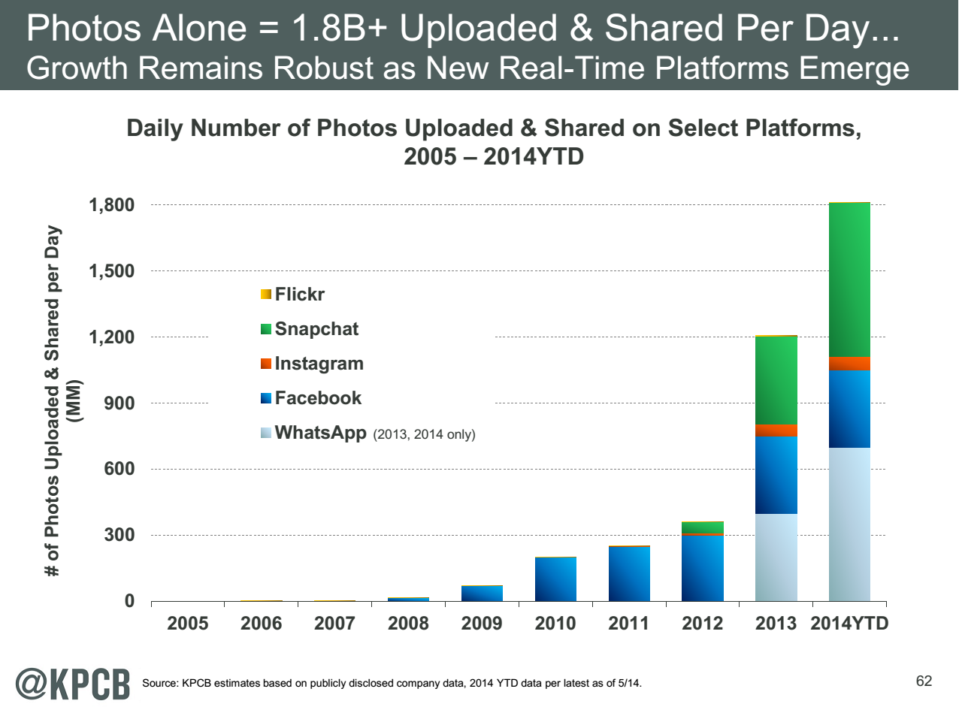
http://www.kpcb.com/internet-trends

Slide 31
13 Image-based Use Cases
13-15 Military Sensor Data Analysis/ Intelligence PP, LML, GIS, MR
7:Pathology Imaging/ Digital Pathology: PP, LML, MR for search becoming terabyte 3D images, Global Classification
18&35: Computational Bioimaging (Light Sources): PP, LML Also materials
26: Large-scale Deep Learning: GML Stanford ran 10 million images and 11 billion parameters on a 64 GPU HPC; vision (drive car), speech, and Natural Language Processing
27: Organizing large-scale, unstructured collections of photos: GML Fit position and camera direction to assemble 3D photo ensemble
36: Catalina Real-Time Transient Synoptic Sky Survey (CRTS): PP, LML followed by classification of events (GML)
43: Radar Data Analysis for CReSIS Remote Sensing of Ice Sheets: PP, LML to identify glacier beds; GML for full ice-sheet
44: UAVSAR Data Processing, Data Product Delivery, and Data Services: PP to find slippage from radar images
45, 46: Analysis of Simulation visualizations: PP LML ?GML find paths, classify orbits, classify patterns that signal earthquakes, instabilities, climate, turbulence

Slide 32
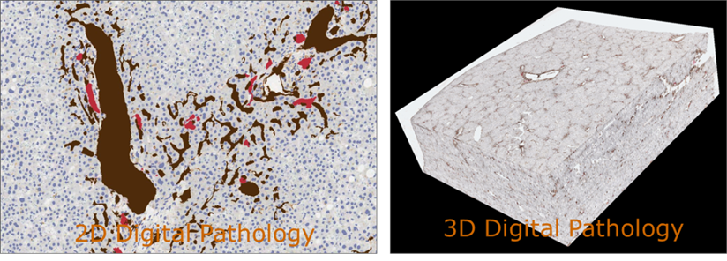
17:Pathology Imaging/ Digital Pathology I
Healthcare
Life Sciences
Application: Digital pathology imaging is an emerging field where examination of high resolution images of tissue specimens enables novel and more effective ways for disease diagnosis. Pathology image analysis segments massive (millions per image) spatial objects such as nuclei and blood vessels, represented with their boundaries, along with many extracted image features from these objects. The derived information is used for many complex queries and analytics to support biomedical research and clinical diagnosis.
MR, MRIter, PP, Classification
Streaming
Parallelism over Images

Slide 33
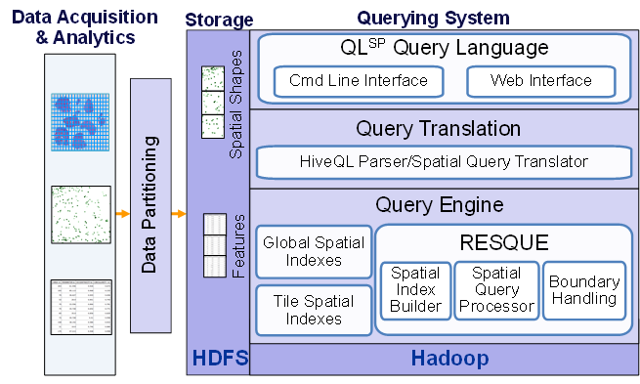
17:Pathology Imaging/ Digital Pathology II
Healthcare
Life Sciences
Current Approach: 1GB raw image data + 1.5GB analytical results per 2D image. MPI for image analysis; MapReduce + Hive with spatial extension on supercomputers and clouds. GPU’s used effectively. Figure below shows the architecture of Hadoop-GIS, a spatial data warehousing system over MapReduce to support spatial analytics for analytical pathology imaging.
Futures: Recently, 3D pathology imaging is made possible through 3D laser technologies or serially sectioning hundreds of tissue sections onto slides and scanning them into digital images. Segmenting 3D microanatomic objects from registered serial images could produce tens of millions of 3D objects from a single image. This provides a deep “map” of human tissues for next generation diagnosis. 1TB raw image data + 1TB analytical results per 3D image and 1PB data per moderated hospital per year.
Architecture of Hadoop-GIS, a spatial data warehousing system over MapReduce to support spatial analytics for analytical pathology imaging

Slide 34
26: Large-scale Deep Learning
Application: Large models (e.g., neural networks with more neurons and connections) combined with large datasets are increasingly the top performers in benchmark tasks for vision, speech, and Natural Language Processing. One needs to train a deep neural network from a large (>>1TB) corpus of data (typically imagery, video, audio, or text). Such training procedures often require customization of the neural network architecture, learning criteria, and dataset pre-processing. In addition to the computational expense demanded by the learning algorithms, the need for rapid prototyping and ease of development is extremely high.
Current Approach: The largest applications so far are to image recognition and scientific studies of unsupervised learning with 10 million images and up to 11 billion parameters on a 64 GPU HPC Infiniband cluster. Both supervised (using existing classified images) and unsupervised applications
Futures: Large datasets of 100TB or more may be necessary in order to exploit the representational power of the larger models. Training a self-driving car could take 100 million images at megapixel resolution. Deep Learning shares many characteristics with the broader field of machine learning. The paramount requirements are high computational throughput for mostly dense linear algebra operations, and extremely high productivity for researcher exploration. One needs integration of high performance libraries with high level (python) prototyping environments
Classified OUT
IN
Deep Learning, Social Networking
GML, EGO, MRIter, Classify

Slide 35
27: Organizing large-scale, unstructured collections of consumer photos I
Deep Learning
Social Networking
Application: Produce 3D reconstructions of scenes using collections of millions to billions of consumer images, where neither the scene structure nor the camera positions are known a priori. Use resulting 3d models to allow efficient browsing of large-scale photo collections by geographic position. Geolocate new images by matching to 3d models. Perform object recognition on each image. 3d reconstruction posed as a robust non-linear least squares optimization problem where observed relations between images are constraints and unknowns are 6-d camera pose of each image and 3-d position of each point in the scene.
Current Approach: Hadoop cluster with 480 cores processing data of initial applications. Note over 500 billion images on Facebook and over 5 billion on Flickr with over 500 million images added to social media sites each day.
EGO, GIS, MR, Classification
Parallelism over Photos

Slide 36
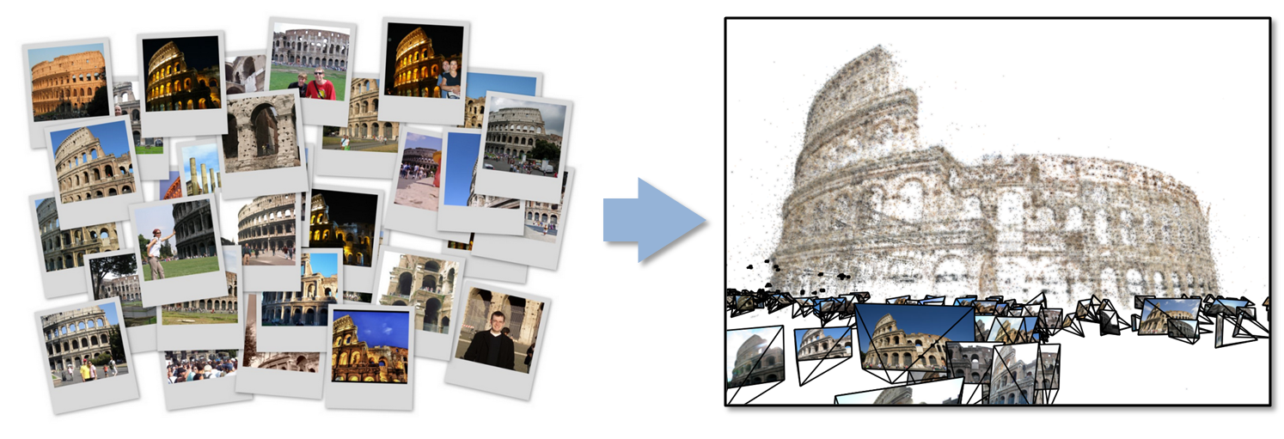
27: Organizing large-scale, unstructured collections of consumer photos II
Deep Learning
Social Networking
Futures: Need many analytics including feature extraction, feature matching, and large-scale probabilistic inference, which appear in many or most computer vision and image processing problems, including recognition, stereo resolution, and image denoising. Need to visualize large-scale 3-d reconstructions, and navigate large-scale collections of images that have been aligned to maps.

Slide 37
43: Radar Data Analysis for CReSIS Remote Sensing of Ice Sheets I
Application: This data feeds into intergovernmental Panel on Climate Change (IPCC) and uses custom radars to measures ice sheet bed depths and (annual) snow layers at the North and South poles and mountainous regions.
Current Approach: The initial analysis is currently Matlab signal processing that produces a set of radar images. These cannot be transported from field over Internet and are typically copied to removable few TB disks in the field and flown “home” for detailed analysis. Image understanding tools with some human oversight find the image features (layers) shown later, that are stored in a database front-ended by a Geographical Information System. The ice sheet bed depths are used in simulations of glacier flow. The data is taken in “field trips” that each currently gather 50-100 TB of data over a few week period.
Futures: An order of magnitude more data (petabyte per mission) is projected with improved instrumentation. Demands of processing increasing field data in an environment with more data but still constrained power budget, suggests low power/performance architectures such as GPU systems.
Earth, Environmental and Polar Science
PP, GIS
Streaming
Parallelism over Radar Images

Slide 38
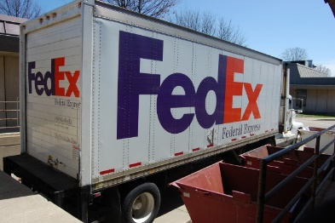
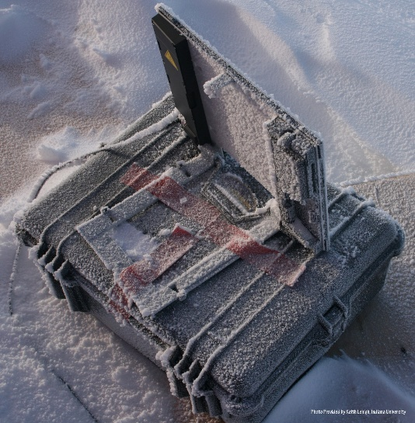

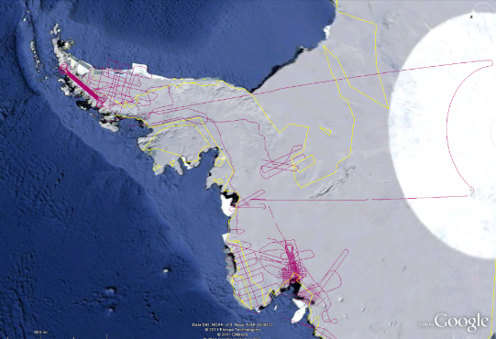
CReSIS Remote Sensing: Radar Surveys
Expeditions last 1-2 months and gather up to 100 TB data. Most is saved on removable disks and flown back to continental US at end. A sample is analyzed in field to check instrument

Slide 39
43: Radar Data Analysis for CReSIS Remote Sensing of Ice Sheets IV
Earth, Environmental and Polar Science
Typical CReSIS echogram with Detected Boundaries. The upper (green) boundary is between air and ice layer while the lower (red) boundary is between ice and terrain
PP, GIS
Streaming
Parallelism over Radar Images

Slide 40
Analytics Facet (kernels) of the Ogres

Slide 41
Machine Learning in Network Science, Imaging in Computer Vision, Pathology, Polar Science
Algorithm | Applications | Features | Status | Parallelism
Graph Analytics
Community detection | Social networks, webgraph | Graph . | P-DM | GML-GrC
Subgraph/motif finding | Webgraph, biological/social networks |  | P-DM | GML-GrB
Finding diameter | Social networks, webgraph |  | P-DM | GML-GrB
Clustering coefficient | Social networks |  | P-DM | GML-GrC
Page rank | Webgraph |  | P-DM | GML-GrC
Maximal cliques | Social networks, webgraph |  | P-DM | GML-GrB
Connected component | Social networks, webgraph |  | P-DM | GML-GrB
Betweenness centrality | Social networks | Graph, Non-metric, static | P-Shm | GML-GRA
Shortest path | Social networks, webgraph |  | P-Shm
Spatial Queries and Analytics
Spatial relationship based queries | GIS/social networks/pathology informatics | Geometric | P-DM | PP
Distance based queries |  |  | P-DM | PP
Spatial clustering |  |  | Seq | GML
Spatial modeling |  |  | Seq | PP
GML Global (parallel) ML
GrA Static GrB Runtime partitioning

Slide 42
Some specialized data analytics in SPIDAL
Algorithm | Applications | Features | Status | Parallelism
Core Image Processing
Image preprocessing | Computer vision/pathology informatics | Metric Space Point Sets, Neighborhood sets & Image features | P-DM | PP
Object detection & segmentation |  |  | P-DM | PP
Image/object feature computation |  |  | P-DM | PP
3D image registration |  |  | Seq | PP
Object matching |  | Geometric | Todo | PP
3D feature extraction |  |  | Todo | PP
Deep Learning
Learning Network, Stochastic Gradient Descent | Image Understanding, Language Translation, Voice Recognition, Car driving | Connections in artificial neural net | P-DM | GML
aa
PP Pleasingly Parallel (Local ML)
Seq Sequential Available
GRA Good distributed algorithm needed
Todo No prototype Available
P-DM Distributed memory Available
P-Shm Shared memory Available

Slide 43
Some Core Machine Learning Building Blocks
Algorithm | Applications | Features | Status | //ism
DA Vector Clustering | Accurate Clusters | Vectors | P-DM | GML
DA Non metric Clustering | Accurate Clusters, Biology, Web | Non metric, O(N²) | P-DM | GML
Kmeans; Basic, Fuzzy and Elkan | Fast Clustering | Vectors | P-DM | GML
Levenberg-Marquardt Optimization | Non-linear Gauss-Newton, use in MDS | Least Squares | P-DM | GML
SMACOF Dimension Reduction | DA- MDS with general weights | Least Squares, O(N²) | P-DM | GML
Vector Dimension Reduction | DA-GTM and Others | Vectors | P-DM | GML
TFIDF Search | Find nearest neighbors in document corpus | Bag of “words” (image features) | P-DM | PP
All-pairs similarity search | Find pairs of documents with TFIDF distance below a threshold
 |  |  | Todo | GML
Support Vector Machine SVM | Learn and Classify | Vectors | Seq | GML
Random Forest | Learn and Classify | Vectors | P-DM | PP
Gibbs sampling (MCMC) | Solve global inference problems | Graph | Todo | GML
Latent Dirichlet Allocation LDA with Gibbs sampling or Var. Bayes | Topic models (Latent factors) | Bag of “words” | P-DM | GML
Singular Value Decomposition SVD | Dimension Reduction and PCA | Vectors | Seq | GML
Hidden Markov Models (HMM) | Global inference on sequence models | Vectors | Seq | PP & GML

Slide 44
Remarks on Parallelism
All use parallelism over data points
  Entities to cluster or map to Euclidean space
Except deep learning which has parallelism over pixel plane in neurons not over items in training set
  as need to look at small numbers of data items at a time in Stochastic Gradient Descent
Maximum Likelihood or χ² both lead to structure like
Minimize sum ∑_{items=1}^{N} (Positive nonlinear function of unknown parameters for item i)
All solved iteratively with (clever) first or second order approximation to shift in objective function
  Sometimes steepest descent direction; sometimes Newton
  Have classic Expectation Maximization structure

Slide 45
Parameter “Server”
Note learning networks have huge number of parameters (11 billion in Stanford work) so that inconceivable to look at second derivative
Clustering and MDS have lots of parameters but can be practical to look at second derivative and use Newton’s method to minimize
Parameters are determined in distributed fashion but are typically needed globally
  MPI use broadcast and “AllCollectives”
  AI community: use parameter server and access as needed

Slide 46
Some Important Cases
Need to cover non vector semimetric and vector spaces for clustering and dimension reduction (N points in space)
Vector spaces have Euclidean distance and scalar products
  Algorithms can be O(N) and these are best for clustering but for MDS O(N) methods may not be best as obvious objective function O(N²)
MDS Minimizes Stress
σ(X) = Σ_{i<j=1}^{N} weight(i,j) (δ(i, j) - d(X_{i} , X_{j}))²
Semimetric spaces just have pairwise distances defined between points in space δ(i, j)
Note matrix solvers all use conjugate gradient – converges in 5-100 iterations – a big gain for matrix with a million rows. This removes factor of N in time complexity
Ratio of #clusters to #points important; new ideas if ratio >~ 0.1

Slide 47
SPIDAL Examples

Slide 48
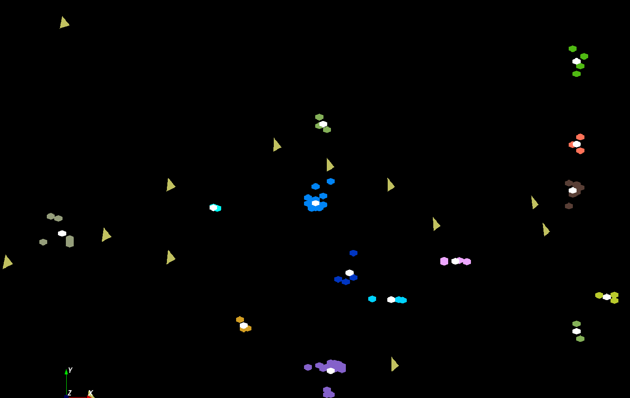
The brownish triangles are stray peaks outside any cluster.
The colored hexagons are peaks inside clusters with the white hexagons being determined cluster center
Fragment of 30,000 Clusters
241605 Points

Slide 49
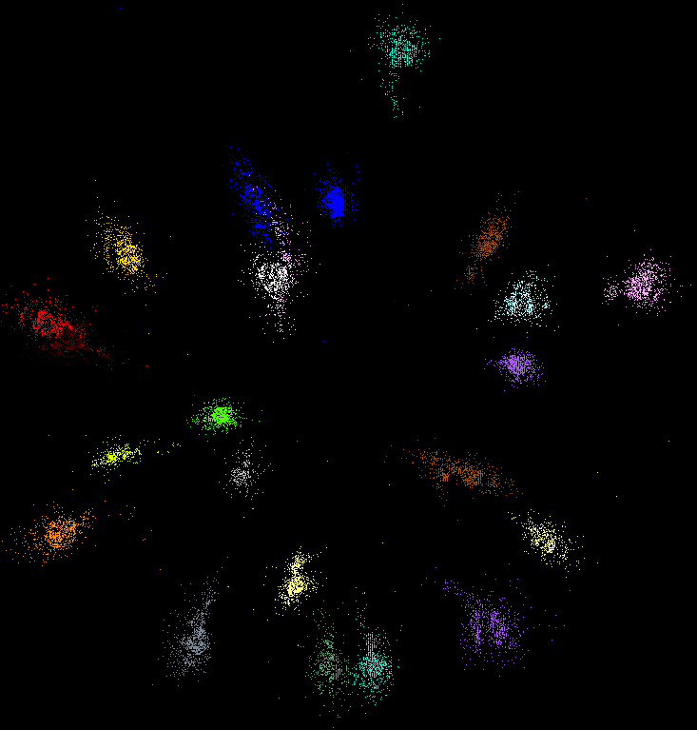
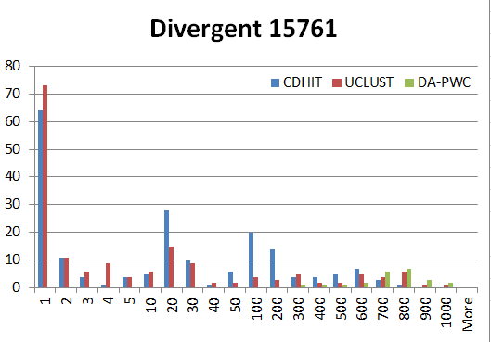
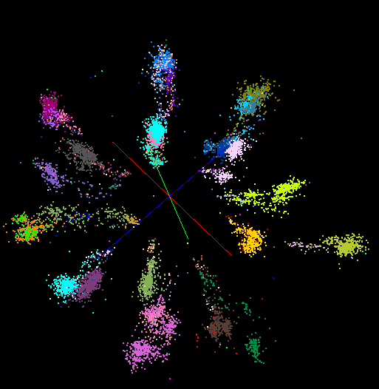
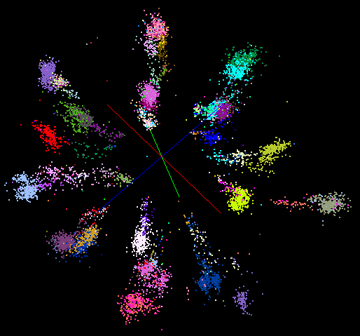
“Divergent” Data Sample
23 True Sequences
DA-PWC
UClust
CDhit
Divergent Data Set UClust (Cuts 0.65 to 0.95)
DAPWC 0.65 0.75 0.85 0.95
Total # of clusters 23 4 10 36 91
Total # of clusters uniquely identified 23 0 0 13 16
(i.e. one original cluster goes to 1 uclust cluster )
Total # of shared clusters with significant sharing 0 4 10 5 0
(one uclust cluster goes to > 1 real cluster)
Total # of uclust clusters that are just part of a real cluster 0 4 10 17(11) 72(62)
(numbers in brackets only have one member)
Total # of real clusters that are 1 uclust cluster 0 14 9 5 0
but uclust cluster is spread over multiple real clusters
Total # of real clusters that have 0 9 14 5 7
significant contribution from > 1 uclust cluster

Slide 50

Protein Universe Browser for COG Sequences with a few illustrative biologically identified clusters

Slide 51
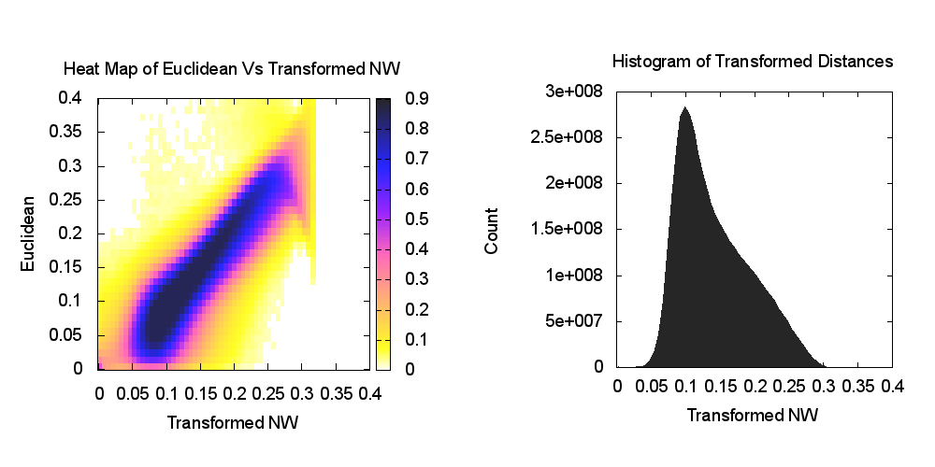
Heatmap of biology distance (Needleman-Wunsch) vs 3D Euclidean Distances
If d a distance, so is f(d) for any monotonic f. Optimize choice of f

Slide 52
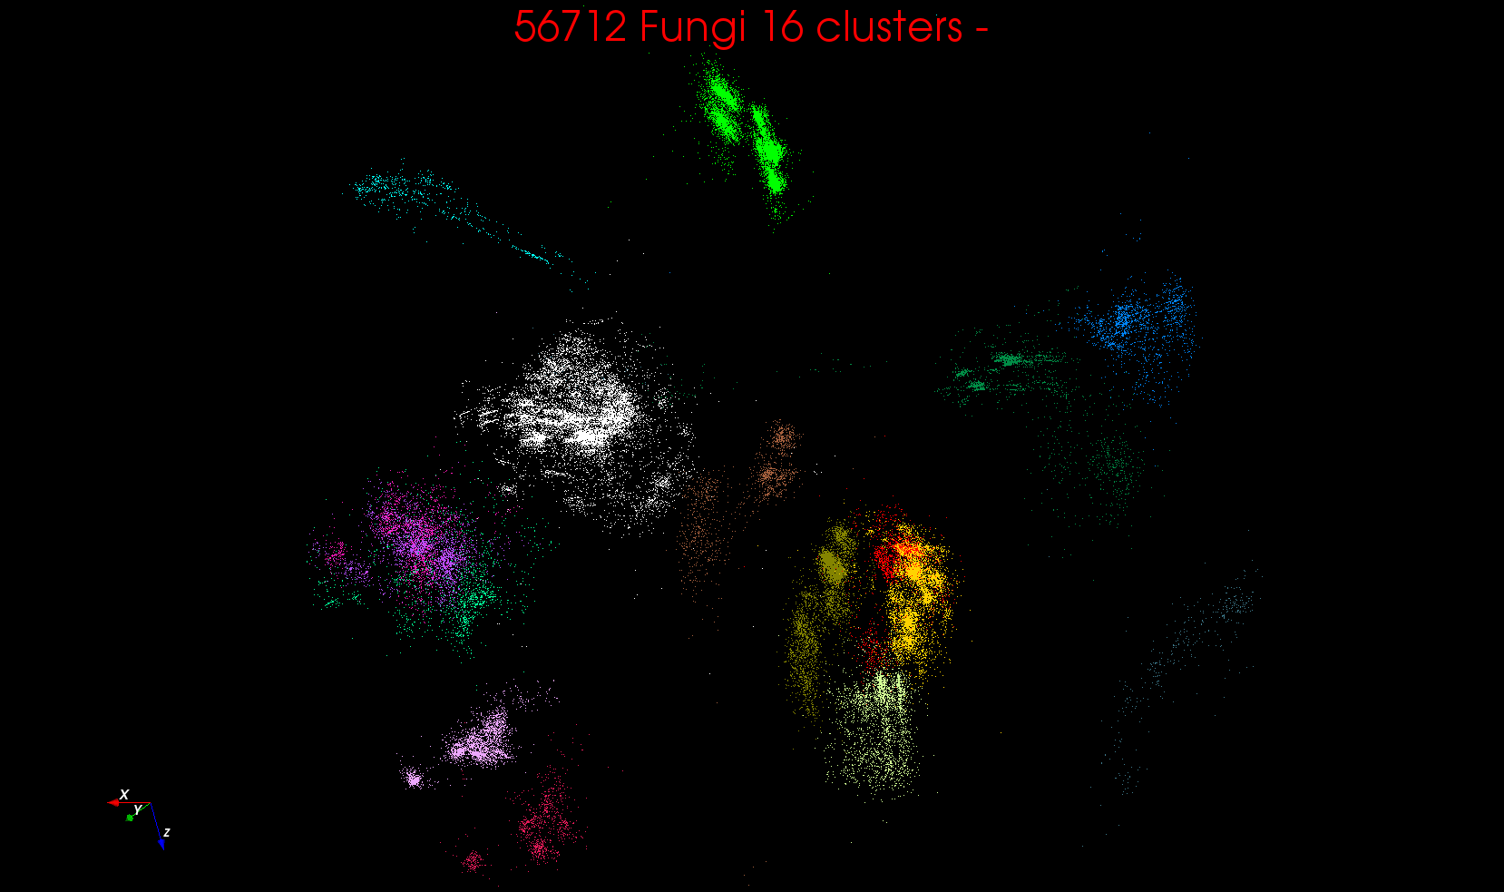

Slide 53
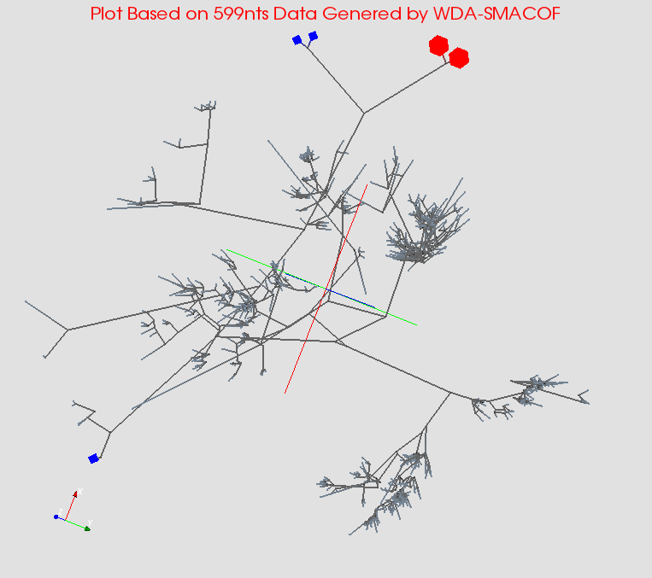
MDS gives classifying cluster centers and existing sequences for Fungi nice 3D Phylogenetic trees

Slide 54
HPC-ABDS
Integrating High Performance Computing with Apache Big Data Stack
Shantenu Jha, Judy Qiu, Andre Luckow

Slide 55
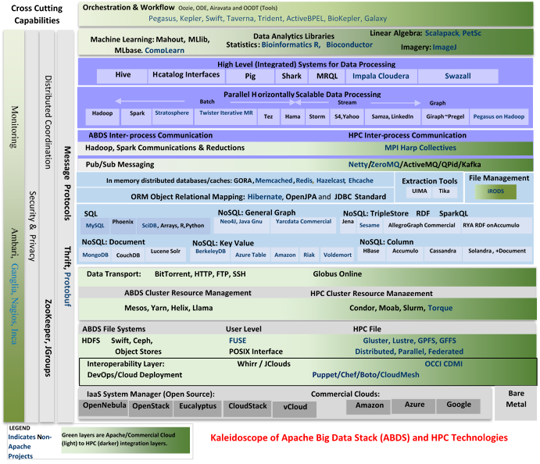

Slide 56
SPIDAL (Scalable Parallel Interoperable Data Analytics Library)
Getting High Performance on Data Analytics
Performance of HPC and Productivity/Sustainability of ABDS
On the systems side, we have two principles:
  The Apache Big Data Stack with ~140 projects has important broad functionality with a vital large support organization
  HPC including MPI has striking success in delivering high performance,
  however with a fragile sustainability model
There are key systems abstractions which are levels in HPC-ABDS software stack where Apache approach needs careful integration with HPC
  Resource management
  Storage
  Programming model -- horizontal scaling parallelism
  Collective and Point-to-Point communication
  Support of iteration
  Data interface (not just key-value)
In application areas, we define application abstractions to support:
  Graphs/network
  Geospatial
  Genes
  Images, etc.

Slide 57







HPC ABDS SYSTEM (Middleware)
120 Software Projects
System Abstraction/Standards
Data Format and Storage
HPC Yarn for Resource management
Horizontally scalable parallel
programming model
Collective and Point to Point Communication
Support for iteration (in memory processing)
HPC ABDS
Hourglass
Application Abstractions/Standards
Graphs, Networks, Images, Geospatial ..
Scalable Parallel Interoperable Data Analytics Library (SPIDAL)
High performance Mahout, R, Matlab …..
High Performance Applications

Slide 58
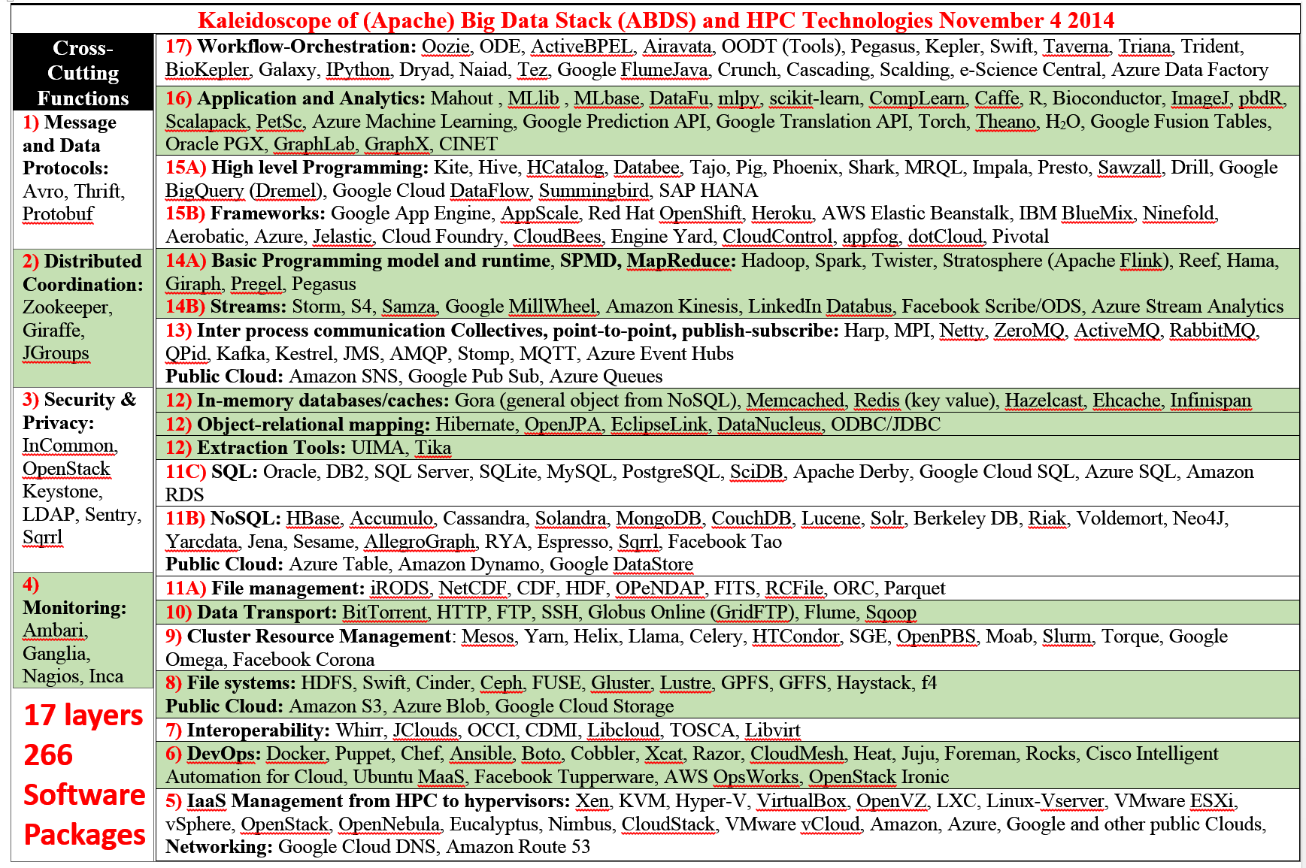
Big Data Software Model

Slide 59
Maybe a Big Data Initiative would include
We don’t need 266 software packages so can choose e.g.
Workflow: Python or Kepler
Data Analytics: Mahout, R, ImageJ, Scalapack
High level Programming: Hive, Pig
Parallel Programming model: Hadoop, Spark, Giraph (Twister4Azure, Harp), MPI; Storm, Kapfka or RabbitMQ (Sensors)
In-memory: Memcached
Data Management: Hbase, MongoDB, MySQL or Derby
Distributed Coordination: Zookeeper
Cluster Management: Yarn, Slurm
File Systems: HDFS, Lustre
DevOps: Cloudmesh, Chef, Puppet, Docker, Cobbler
IaaS: Amazon, Azure, OpenStack, Libcloud
Monitoring: Inca, Ganglia, Nagios

Slide 60
Applications SPIDAL MIDAS ABDS
Govt. Operations | Commercial Defense |  | Healthcare, Life Science |  |  | Deep Learning, Social Media |  | Research Ecosystems | Astronomy, Physics |  | Earth, Env., Polar Science |  | Energy
(Inter)disciplinary Workflow
Analytics Libraries
Native ABDS SQL-engines, Storm, Impala, Hive, Shark |  | Native HPC MPI |  | HPC-ABDS MapReduce
 |  |  |  | Map Only, PP Many Task |  |  | Classic MapReduce |  |  | Map Collective |  | Map – Point to Point, Graph
MIddleware for Data-Intensive Analytics and Science (MIDAS) API
Communication (MPI, RDMA, Hadoop Shuffle/Reduce, HARP Collectives, Giraph point-to-point) |  |  |  |  |  |  | Data Systems and Abstractions (In-Memory; HBase, Object Stores, other NoSQL stores, Spatial, SQL, Files)
Higher-Level Workload Management (Tez, Llama) |  |  |  |  | Workload Management (Pilots, Condor) |  |  |  |  | Framework specific Scheduling (e.g. YARN)
External Data Access (Virtual Filesystem, GridFTP, SRM, SSH) |  |  |  |  |  |  | Cluster Resource Manager (YARN, Mesos, SLURM, Torque, SGE)
Compute, Storage and Data Resources (Nodes, Cores, Lustre, HDFS)
Community & Examples
SPIDAL
Programming & Runtime Models
MIDAS
Resource Fabric

Slide 61
Iterative MapReduce
Implementing HPC-ABDS
Judy Qiu, Bingjing Zhang, Dennis Gannon, Thilina Gunarathne

Slide 62
Harp Design
Parallelism Model
Architecture
MapReduce Model
Map-Collective or Map-Communication Model
M
M
M
M
MapReduce Applications
Map-Collective
or Map-Communication Applications
M
M
M
M
Application
Shuffle
Harp
Optimal Communication
MapReduce V2
R
R
Framework
Resource Manager
YARN

Slide 63
Features of Harp Hadoop Plugin
Hadoop Plugin (on Hadoop 1.2.1 and Hadoop 2.2.0)
Hierarchical data abstraction on arrays, key-values and graphs for easy programming expressiveness.
Collective communication model to support various communication operations on the data abstractions (will extend to Point to Point)
Caching with buffer management for memory allocation required from computation and communication
BSP style parallelism
Fault tolerance with checkpointing

Slide 64
WDA SMACOF MDS (Multidimensional Scaling) using Harp on IU Big Red 2
Parallel Efficiency: on 100-300K sequences
Best available MDS (much better than that in R)
Java
Harp (Hadoop plugin)
Cores =32 #nodes
Conjugate Gradient (dominant time) and Matrix Multiplication

Slide 65
Increasing Communication
Identical Computation
Mahout and Hadoop MR – Slow due to MapReduce
Python slow as Scripting; MPI fastest
Spark Iterative MapReduce, non optimal communication
Harp Hadoop plug in with ~MPI collectives

Slide 66
Lessons / Insights
Proposed classification of Big Data applications with features and kernels for analytics
Integrate (don’t compete) HPC with “Commodity Big data” (Google to Amazon to Enterprise Data Analytics)
  i.e. improve Mahout; don’t compete with it
  Use Hadoop plug-ins rather than replacing Hadoop
Enhanced Apache Big Data Stack HPC-ABDS has ~140 members with HPC opportunities at Resource management, Data/File, Streaming, Programming, monitoring, workflow layers.
Data intensive algorithms do not have the well developed high performance libraries familiar from HPC
Global Machine Learning or (Exascale Global Optimization) particularly challenging
Develop SPIDAL (Scalable Parallel Interoperable Data Analytics Library)
  New algorithms and new high performance parallel implementations

