Slide 1
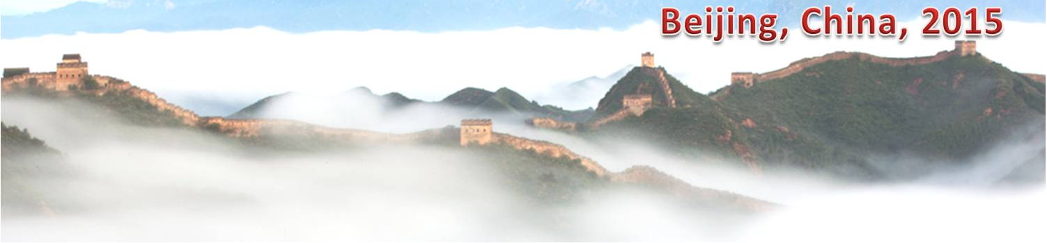
Classification of Big Data Applications and Convergence of HPC and Cloud Technology
11th International Conference on Semantics, Knowledge and Grids
SKG 2015, Aug 19 -21, 2015, Beijing, China,
See: http://hpc-abds.org/kaleidoscope/ for details
August 20 2015
Geoffrey Fox
gcf@indiana.edu
http://www.infomall.org, http://spidal.org/
School of Informatics and Computing, Digital Science Center
Indiana University Bloomington

Slide 2
Abstract
We discuss study of the nature and requirements of many big data applications in terms of Ogres that describe important general characteristics.
We develop ways of categorizing applications with features or facets that are useful in understanding suitable software and hardware approaches where 6 different broad paradigms are identified.
This allows study of benchmarks and to understand when high performance computing (HPC) is useful.
We propose adoption of DevOps motivated scripts to support hosting of applications on the many different infrastructures like OpenStack, Docker, OpenNebula, Commercial clouds and HPC supercomputers.

Slide 3
NIST Big Data Initiative
First reports under final review at NIST
Standards: ISO JTC1/WG9 ISO/IEC 20547-2
Information Technology — Big Data — Part 2: Use cases and derived requirements
Led by Chaitin Baru, Bob Marcus, Wo Chang

Slide 4
NBD-PWG (NIST Big Data Public Working Group) Subgroups & Co-Chairs
There were 5 Subgroups
  Note mainly industry
Requirements and Use Cases Sub Group
  Geoffrey Fox, Indiana U.; Joe Paiva, VA; Tsegereda Beyene, Cisco
Definitions and Taxonomies SG
  Nancy Grady, SAIC; Natasha Balac, SDSC; Eugene Luster, R2AD
Reference Architecture Sub Group
  Orit Levin, Microsoft; James Ketner, AT&T; Don Krapohl, Augmented Intelligence
Security and Privacy Sub Group
  Arnab Roy, CSA/Fujitsu Nancy Landreville, U. MD Akhil Manchanda, GE
Technology Roadmap Sub Group
  Carl Buffington, Vistronix; Dan McClary, Oracle; David Boyd, Data Tactics
See http://bigdatawg.nist.gov/V1_output_docs.php

Slide 5

Use Case Template
26 fields completed for 51 apps
Government Operation: 4
Commercial: 8
Defense: 3
Healthcare and Life Sciences: 10
Deep Learning and Social Media: 6
The Ecosystem for Research: 4
Astronomy and Physics: 5
Earth, Environmental and Polar Science: 10
Energy: 1
Now an online form

Slide 6
51 Detailed Use Cases: Contributed July-September 2013
Covers goals, data features such as 3 V’s, software, hardware
26 Features for each use case
Biased to science
http://bigdatawg.nist.gov/usecases.php
https://bigdatacoursespring2014.appspot.com/course (Section 5)
Government Operation(4): National Archives and Records Administration, Census Bureau
Commercial(8): Finance in Cloud, Cloud Backup, Mendeley (Citations), Netflix, Web Search, Digital Materials, Cargo shipping (as in UPS)
Defense(3): Sensors, Image surveillance, Situation Assessment
Healthcare and Life Sciences(10): Medical records, Graph and Probabilistic analysis, Pathology, Bioimaging, Genomics, Epidemiology, People Activity models, Biodiversity
Deep Learning and Social Media(6): Driving Car, Geolocate images/cameras, Twitter, Crowd Sourcing, Network Science, NIST benchmark datasets
The Ecosystem for Research(4): Metadata, Collaboration, Language Translation, Light source experiments
Astronomy and Physics(5): Sky Surveys including comparison to simulation, Large Hadron Collider at CERN, Belle Accelerator II in Japan
Earth, Environmental and Polar Science(10): Radar Scattering in Atmosphere, Earthquake, Ocean, Earth Observation, Ice sheet Radar scattering, Earth radar mapping, Climate simulation datasets, Atmospheric turbulence identification, Subsurface Biogeochemistry (microbes to watersheds), AmeriFlux and FLUXNET gas sensors
Energy(1): Smart grid

Slide 7

Table 4: Characteristics of 6 Distributed Applications
Application Example | Execution Unit | Communication | Coordination | Execution Environment
Montage | Multiple sequential and parallel executable | Files | Dataflow (DAG) | Dynamic process creation, execution
NEKTAR | Multiple concurrent parallel executables | Stream based | Dataflow | Co-scheduling, data streaming, async. I/O
Replica-Exchange | Multiple seq. and parallel executables | Pub/sub | Dataflow and events | Decoupled coordination and messaging
Climate Prediction (generation) | Multiple seq. & parallel executables | Files and messages | Master-Worker, events | @Home (BOINC)
Climate Prediction (analysis) | Multiple seq. & parallel executables | Files and messages | Dataflow | Dynamics process creation, workflow execution
SCOOP | Multiple Executable | Files and messages | Dataflow | Preemptive scheduling, reservations
Coupled Fusion | Multiple executable | Stream-based | Dataflow | Co-scheduling, data streaming, async I/O
Part of Property Summary Table

Slide 8
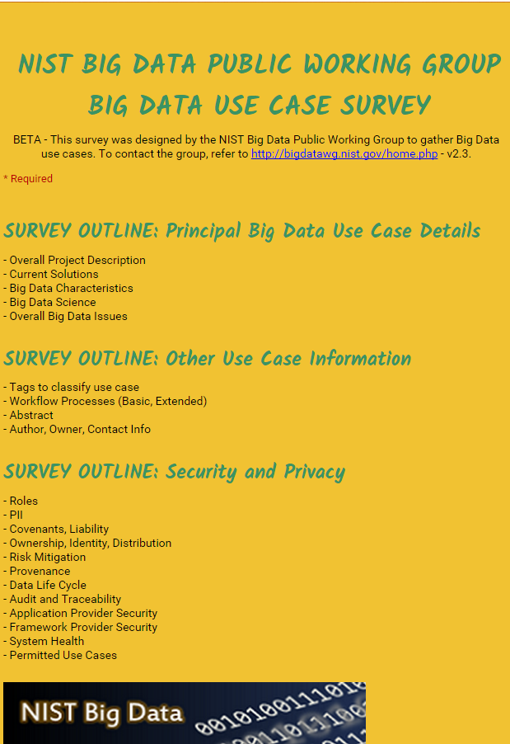
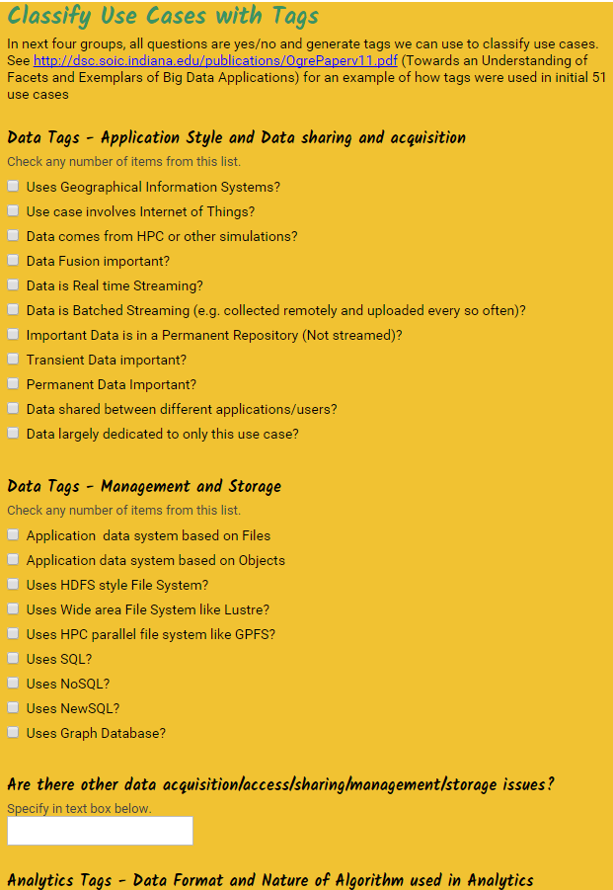
http://hpc-abds.org/kaleidoscope/survey/
Online Use Case Form

Slide 9
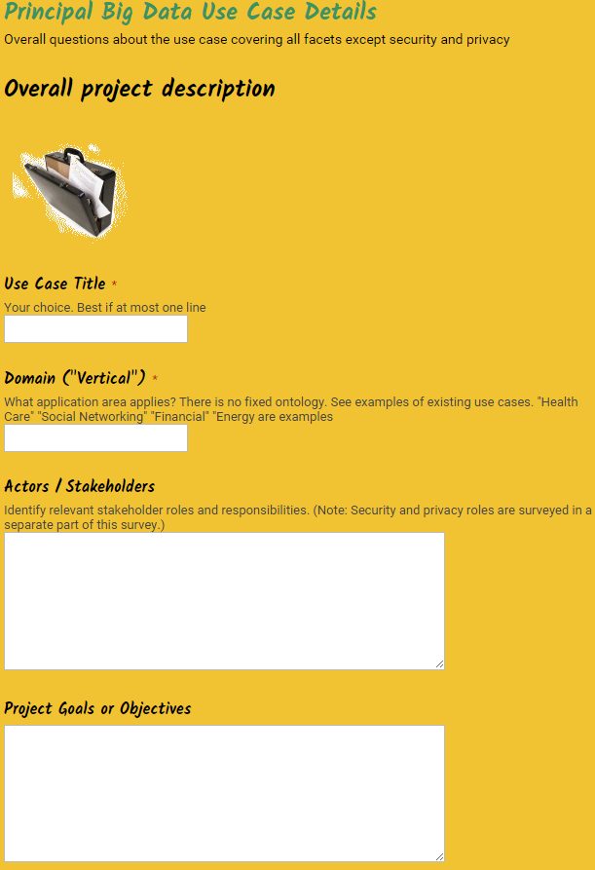
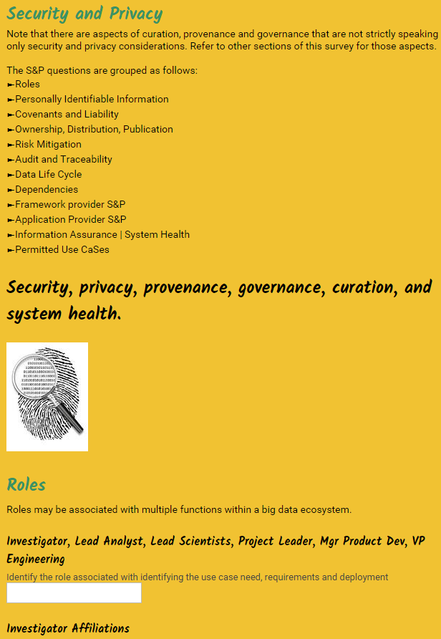
http://hpc-abds.org/kaleidoscope/survey/

Slide 10
Features and Examples

Slide 11
Features of 51 Use Cases I
PP (26) “All” Pleasingly Parallel or Map Only
MR (18) Classic MapReduce MR (add MRStat below for full count)
MRStat (7) Simple version of MR where key computations are simple reduction as found in statistical averages such as histograms and averages
MRIter (23) Iterative MapReduce or MPI (Spark, Twister)
Graph (9) Complex graph data structure needed in analysis
Fusion (11) Integrate diverse data to aid discovery/decision making; could involve sophisticated algorithms or could just be a portal
Streaming (41) Some data comes in incrementally and is processed this way
Classify (30) Classification: divide data into categories
S/Q (12) Index, Search and Query

Slide 12
Features of 51 Use Cases II
CF (4) Collaborative Filtering for recommender engines
LML (36) Local Machine Learning (Independent for each parallel entity) – application could have GML as well
GML (23) Global Machine Learning: Deep Learning, Clustering, LDA, PLSI, MDS,
  Large Scale Optimizations as in Variational Bayes, MCMC, Lifted Belief Propagation, Stochastic Gradient Descent, L-BFGS, Levenberg-Marquardt . Can call EGO or Exascale Global Optimization with scalable parallel algorithm
Workflow (51) Universal
GIS (16) Geotagged data and often displayed in ESRI, Microsoft Virtual Earth, Google Earth, GeoServer etc.
HPC (5) Classic large-scale simulation of cosmos, materials, etc. generating (visualization) data
Agent (2) Simulations of models of data-defined macroscopic entities represented as agents

Slide 13
Local and Global Machine Learning
Many applications use LML or Local machine Learning where machine learning (often from R) is run separately on every data item such as on every image
But others are GML Global Machine Learning where machine learning is a single algorithm run over all data items (over all nodes in computer)
  maximum likelihood or χ² with a sum over the N data items – documents, sequences, items to be sold, images etc. and often links (point-pairs).
  Graph analytics is typically GML
Covering clustering/community detection, mixture models, topic determination, Multidimensional scaling, (Deep) Learning Networks
PageRank is “just” parallel linear algebra
Note many Mahout algorithms are sequential – partly as MapReduce limited; partly because parallelism unclear
  MLLib (Spark based) better
SVM and Hidden Markov Models do not use large scale parallelization in practice?

Slide 14
13 Image-based Use Cases
13-15 Military Sensor Data Analysis/ Intelligence PP, LML, GIS, MR
7:Pathology Imaging/ Digital Pathology: PP, LML, MR for search becoming terabyte 3D images, Global Classification
18&35: Computational Bioimaging (Light Sources): PP, LML Also materials
26: Large-scale Deep Learning: GML Stanford ran 10 million images and 11 billion parameters on a 64 GPU HPC; vision (drive car), speech, and Natural Language Processing
27: Organizing large-scale, unstructured collections of photos: GML Fit position and camera direction to assemble 3D photo ensemble
36: Catalina Real-Time Transient Synoptic Sky Survey (CRTS): PP, LML followed by classification of events (GML)
43: Radar Data Analysis for CReSIS Remote Sensing of Ice Sheets: PP, LML to identify glacier beds; GML for full ice-sheet
44: UAVSAR Data Processing, Data Product Delivery, and Data Services: PP to find slippage from radar images
45, 46: Analysis of Simulation visualizations: PP LML ?GML find paths, classify orbits, classify patterns that signal earthquakes, instabilities, climate, turbulence

Slide 15
Internet of Things and Streaming Apps
It is projected that there will be 24 (Mobile Industry Group) to 50 (Cisco) billion devices on the Internet by 2020.
The cloud natural controller of and resource provider for the Internet of Things.
Smart phones/watches, Wearable devices (Smart People), “Intelligent River” “Smart Homes and Grid” and “Ubiquitous Cities”, Robotics.
Majority of use cases are streaming – experimental science gathers data in a stream – sometimes batched as in a field trip. Below is sample
10: Cargo Shipping Tracking as in UPS, Fedex PP GIS LML
13: Large Scale Geospatial Analysis and Visualization PP GIS LML
28: Truthy: Information diffusion research from Twitter Data PP MR for Search, GML for community determination
39: Particle Physics: Analysis of LHC Large Hadron Collider Data: Discovery of Higgs particle PP for event Processing, Global statistics
50: DOE-BER AmeriFlux and FLUXNET Networks PP GIS LML
51: Consumption forecasting in Smart Grids PP GIS LML

Slide 16
Big Data Patterns – the Ogres
Benchmarking

Slide 17
Classifying Applications and Benchmarks
“Benchmarks” “kernels” “algorithm” “mini-apps” can serve multiple purposes
Motivate hardware and software features
  e.g. collaborative filtering algorithm parallelizes well with MapReduce and suggests using Hadoop on a cloud
  e.g. deep learning on images dominated by matrix operations; needs CUDA&MPI and suggests HPC cluster
Benchmark sets designed cover key features of systems in terms of features and sizes of “important” applications
Take 51 uses cases → derive specific features; each use case has multiple features
Generalize and systematize as Ogres with features termed “facets”
50 Facets divided into 4 sets or views where each view has “similar” facets

Slide 18
7 Computational Giants of
NRC Massive Data Analysis Report
http://www.nap.edu/catalog.php?record_id=18374
G1: Basic Statistics e.g. MRStat
G2: Generalized N-Body Problems
G3: Graph-Theoretic Computations
G4: Linear Algebraic Computations
G5: Optimizations e.g. Linear Programming
G6: Integration e.g. LDA and other GML
G7: Alignment Problems e.g. BLAST

Slide 19
HPC Benchmark Classics
Linpack or HPL: Parallel LU factorization
for solution of linear equations
NPB version 1: Mainly classic HPC solver kernels
  MG: Multigrid
  CG: Conjugate Gradient
  FT: Fast Fourier Transform
  IS: Integer sort
  EP: Embarrassingly Parallel
  BT: Block Tridiagonal
  SP: Scalar Pentadiagonal
  LU: Lower-Upper symmetric Gauss Seidel

Slide 20
13 Berkeley Dwarfs
Dense Linear Algebra
Sparse Linear Algebra
Spectral Methods
N-Body Methods
Structured Grids
Unstructured Grids
MapReduce
Combinational Logic
Graph Traversal
Dynamic Programming
Backtrack and
Branch-and-Bound
Graphical Models
Finite State Machines
First 6 of these correspond to Colella’s original.
Monte Carlo dropped.
N-body methods are a subset of Particle in Colella.
Note a little inconsistent in that MapReduce is a programming model and spectral method is a numerical method.
Need multiple facets!

Slide 21
Facets of the Ogres

Slide 22
Introducing Big Data Ogres and their Facets I
Big Data Ogres provide a systematic approach to understanding applications, and as such they have facets which represent key characteristics defined both from our experience and from a bottom-up study of features from several individual applications.
The facets capture common characteristics (shared by several problems)which are inevitably multi-dimensional and often overlapping.
Ogres characteristics are cataloged in four distinct dimensions or views.
Each view consists of facets; when multiple facets are linked together, they describe classes of big data problems represented as an Ogre.
Instances of Ogres are particular big data problems
A set of Ogre instances that cover a rich set of facets could form a benchmark set
Ogres and their instances can be atomic or composite

Slide 23
Introducing Big Data Ogres and their Facets II
Ogres characteristics are cataloged in four distinct dimensions or views.
Each view consists of facets; when multiple facets are linked together, they describe classes of big data problems represented as an Ogre.
One view of an Ogre is the overall problem architecture which is naturally related to the machine architecture needed to support data intensive application while still being different.
Then there is the execution (computational) features view, describing issues such as I/O versus compute rates, iterative nature of computation and the classic V’s of Big Data: defining problem size, rate of change, etc.
The data source & style view includes facets specifying how the data is collected, stored and accessed.
The final processing view has facets which describe classes of processing steps including algorithms and kernels. Ogres are specified by the particular value of a set of facets linked from the different views.

Slide 24

Geospatial Information System
Shared / Dedicated / Transient / Permanent
HPC Simulations
Internet of Things
Metadata/Provenance
Archived/Batched/Streaming
Data Source and Style View
10
9
8
HDFS/Lustre/GPFS
7
6
Enterprise Data Model
5
Files/Objects
SQL/NoSQL/NewSQL
4
Search / Query / Index
Local Analytics
Graph Algorithms
Micro-benchmarks
Alignment
Optimization Methodology
Learning
Classification
Streaming
Global Analytics
Linear Algebra Kernels
Recommendations
Visualization
Base Statistics
3
2
1
4 Ogre Views and 50 Facets
Execution View
Pleasingly Parallel
1
2
3
4
5
6
7
8
9
10
11
12
13
14
14
13
12
11
10
9
8
7
6
Classic MapReduce
Map-Collective
5
4
3
2
1
Map Point-to-Point
Single Program Multiple Data
Map Streaming
1
Processing View
Shared Memory
Bulk Synchronous Parallel
2
3
Performance Metrics
4
Volume
Dynamic = D / Static = S
$O\left(N^{2}\right)$ = NN / $O(N)$ = N
Velocity
Variety
Veracity
Communication Structure
Regular = R / Irregular = I
Data Abstraction
Iterative / Simple
5
Metric = M / Non-Metric = N
Flops per Byte; Memory I/O
Execution Environment; Core libraries
6
7
Fusion
Dataflow
8
Problem
Architecture
View
9
Agents
10
Workflow
11
12

Slide 25
Facets of the Ogres
Problem Architecture
Meta or Macro Aspects of Ogres

Slide 26
Problem Architecture View of Ogres (Meta or MacroPatterns)
Pleasingly Parallel – as in BLAST, Protein docking, some (bio-)imagery including Local Analytics or Machine Learning – ML or filtering pleasingly parallel, as in bio-imagery, radar images (pleasingly parallel but sophisticated local analytics)
Classic MapReduce: Search, Index and Query and Classification algorithms like collaborative filtering (G1 for MRStat in Features, G7)
Map-Collective: Iterative maps + communication dominated by “collective” operations as in reduction, broadcast, gather, scatter. Common datamining pattern
Map-Point to Point: Iterative maps + communication dominated by many small point to point messages as in graph algorithms
Map-Streaming: Describes streaming, steering and assimilation problems
Shared Memory: Some problems are asynchronous and are easier to parallelize on shared rather than distributed memory – see some graph algorithms
SPMD: Single Program Multiple Data, common parallel programming feature
BSP or Bulk Synchronous Processing: well-defined compute-communication phases
Fusion: Knowledge discovery often involves fusion of multiple methods.
Dataflow: Important application features often occurring in composite Ogres
Use Agents: as in epidemiology (swarm approaches)
Workflow: All applications often involve orchestration (workflow) of multiple components
Notes:
Big dwarfs are Ogres
Implement Ogres in ABDS+

Slide 27
Relation of Problem and Machine Architecture
In my old papers (especially book Parallel Computing Works!), I discussed computing as multiple complex systems mapped into each other
Problem → Numerical formulation → Software → Hardware
Each of these 4 systems has an architecture that can be described in similar language
One gets an easy programming model if architecture of problem matches that of Software
One gets good performance if architecture of hardware matches that of software and problem
So “MapReduce” can be used as architecture of software (programming model) or “Numerical formulation of problem”

Slide 28
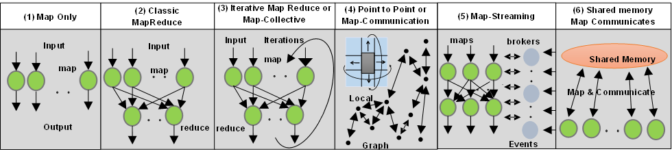
6 Forms of MapReduce cover “all” circumstances
Also an interesting software (architecture) discussion

Slide 29
8 Data Analysis Problem Architectures
1) Pleasingly Parallel PP or “map-only” in MapReduce
  BLAST Analysis; Local Machine Learning
2A) Classic MapReduce MR, Map followed by reduction
  High Energy Physics (HEP) Histograms; Web search; Recommender Engines
2B) Simple version of classic MapReduce MRStat
  Final reduction is just simple statistics
3) Iterative MapReduce MRIter
  Expectation maximization Clustering Linear Algebra, PageRank
4A) Map Point to Point Communication
  Classic MPI; PDE Solvers and Particle Dynamics; Graph processing Graph
4B) GPU (Accelerator) enhanced 4A) – especially for deep learning
5) Map + Streaming + Communication
  Images from Synchrotron sources; Telescopes; Internet of Things IoT
  6) Shared memory allowing parallel threads which are tricky to program but lower latency
  Difficult to parallelize asynchronous parallel Graph Algorithms

Slide 30
Ogre Facets
Execution Features View

Slide 31
One View of Ogres has Facets that are micropatterns or Execution Features
Performance Metrics; property found by benchmarking Ogre
Flops per byte; memory or I/O
Execution Environment; Core libraries needed: matrix-matrix/vector algebra, conjugate gradient, reduction, broadcast; Cloud, HPC etc.
Volume: property of an Ogre instance
Velocity: qualitative property of Ogre with value associated with instance
Variety: important property especially of composite Ogres
Veracity: important property of “mini-applications” but not kernels
Communication Structure; Interconnect requirements; Is communication BSP, Asynchronous, Pub-Sub, Collective, Point to Point?
Is application (graph) static or dynamic?
Most applications consist of a set of interconnected entities; is this regular as a set of pixels or is it a complicated irregular graph?
Are algorithms Iterative or not?
Data Abstraction: key-value, pixel, graph(G3), vector, bags of words or items
Are data points in metric or non-metric spaces?
Is algorithm O(N²) or O(N) (up to logs) for N points per iteration (G2)

Slide 32
Facets of the Ogres
Data Source and Style Aspects

Slide 33
Data Source and Style View of Ogres I
SQL NewSQL or NoSQL: NoSQL includes Document,
Column, Key-value, Graph, Triple store; NewSQL is SQL redone to exploit NoSQL performance
Other Enterprise data systems: 10 examples from NIST integrate SQL/NoSQL
Set of Files or Objects: as managed in iRODS and extremely common in scientific research
File systems, Object, Blob and Data-parallel (HDFS) raw storage: Separated from computing or colocated? HDFS v Lustre v. Openstack Swift v. GPFS
Archive/Batched/Streaming: Streaming is incremental update of datasets with new algorithms to achieve real-time response (G7); Before data gets to compute system, there is often an initial data gathering phase which is characterized by a block size and timing. Block size varies from month (Remote Sensing, Seismic) to day (genomic) to seconds or lower (Real time control, streaming)
Notes:
Big dwarfs are Ogres
Implement Ogres in ABDS+

Slide 34
Data Source and Style View of Ogres II
Shared/Dedicated/Transient/Permanent: qualitative property of data; Other characteristics are needed for permanent auxiliary/comparison datasets and these could be interdisciplinary, implying nontrivial data movement/replication
Metadata/Provenance: Clear qualitative property but not for kernels as important aspect of data collection process
Internet of Things: 24 to 50 Billion devices on Internet by 2020
HPC simulations: generate major (visualization) output that often needs to be mined
Using GIS: Geographical Information Systems provide attractive access to geospatial data
Note 10 Bob Marcus (led NIST effort) Use cases
Notes:
Big dwarfs are Ogres
Implement Ogres in ABDS+

Slide 35
2. Perform real time analytics on data source streams and notify users when specified events occur
Specify filter
Filter Identifying Events
Fetch streamed Data
Post Selected Events
Streaming Data
Posted Data
Identified Events
Streaming Data
Streaming Data
Archive
Repository
Storm, Kafka, Hbase, Zookeeper

Slide 36



5. Perform interactive analytics on data in analytics-optimized database
Mahout, R
Hadoop, Spark, Giraph, Pig …
Data Storage: HDFS, Hbase
Data, Streaming, Batch …..

Slide 37
5A. Perform interactive analytics on observational scientific data
Science Analysis Code, Mahout, R
Grid or Many Task Software, Hadoop, Spark, Giraph, Pig …
Data Storage: HDFS, Hbase, File Collection
Direct Transfer
Transport batch of data to primary analysis data system
Streaming Twitter data for Social Networking
Local Accumulate and initial computing
NIST examples include LHC, Remote Sensing, Astronomy and Bioinformatics
Record Scientific Data in “field”

Slide 38
Facets of the Ogres
Processing View

Slide 39
Facets in Processing (runtime) View of Ogres I
Micro-benchmarks ogres that exercise simple features of hardware such as communication, disk I/O, CPU, memory performance
Local Analytics executed on a single core or perhaps node
Global Analytics requiring iterative programming models (G5,G6) across multiple nodes of a parallel system
Optimization Methodology: overlapping categories
  Nonlinear Optimization (G6)
  Machine Learning
  Maximum Likelihood or χ² minimizations
  Expectation Maximization (often Steepest descent)
  Combinatorial Optimization
  Linear/Quadratic Programming (G5)
  Dynamic Programming
Visualization is key application capability with algorithms like MDS useful but it itself part of “mini-app” or composite Ogre
Alignment (G7) as in BLAST compares samples with repository
Notes:
Big dwarfs are Ogres
Implement Ogres in ABDS+

Slide 40
Facets in Processing (run time) View of Ogres II
Streaming divided into 5 categories depending on event size and synchronization and integration
  Set of independent events where precise time sequencing unimportant.
  Time series of connected small events where time ordering important.
  Set of independent large events where each event needs parallel processing with time sequencing not critical
  Set of connected large events where each event needs parallel processing with time sequencing critical.
  Stream of connected small or large events to be integrated in a complex way.
Basic Statistics (G1): MRStat in NIST problem features
Search/Query/Index: Classic database which is well studied (Baru, Rabl tutorial)
Recommender Engine: core to many e-commerce, media businesses; collaborative filtering key technology
Classification: assigning items to categories based on many methods
  MapReduce good in Alignment, Basic statistics, S/Q/I, Recommender, Calssification
Deep Learning of growing importance due to success in speech recognition etc.
Problem set up as a graph (G3) as opposed to vector, grid, bag of words etc.
Using Linear Algebra Kernels: much machine learning uses linear algebra kernels
Notes:
Big dwarfs are Ogres
Implement Ogres in ABDS+

Slide 41
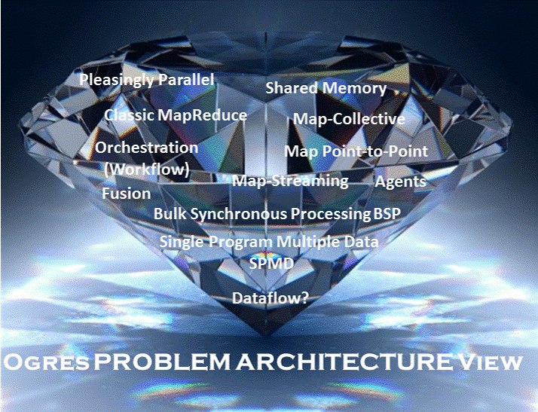

Slide 42
Benchmarks and Ogres

Slide 43
Benchmarks/Mini-apps spanning Facets
Look at NSF SPIDAL Project, NIST 51 use cases, Baru-Rabl review
Catalog facets of benchmarks and choose entries to cover “all facets”
Micro Benchmarks: SPEC, EnhancedDFSIO (HDFS), Terasort, Wordcount, Grep, MPI, Basic Pub-Sub ….
SQL and NoSQL Data systems, Search, Recommenders: TPC (-C to x–HS for Hadoop), BigBench, Yahoo Cloud Serving, Berkeley Big Data, HiBench, BigDataBench, Cloudsuite, Linkbench
  includes MapReduce cases Search, Bayes, Random Forests, Collaborative Filtering
Spatial Query: select from image or earth data
Alignment: Biology as in BLAST
Streaming: Online classifiers, Cluster tweets, Robotics, Industrial Internet of Things, Astronomy; BGBenchmark; choose to cover all 5 subclasses
Pleasingly parallel (Local Analytics): as in initial steps of LHC, Pathology, Bioimaging (differ in type of data analysis)
Global Analytics: Outlier, Clustering, LDA, SVM, Deep Learning, MDS, PageRank, Levenberg-Marquardt, Graph 500 entries
Workflow and Composite (analytics on xSQL) linking above

Slide 44
Big Data Software

Slide 45
Green implies HPC
Integration

Slide 47
Software for a Big Data Initiative
Functionality of ABDS and Performance of HPC
Workflow: Apache Crunch, Python or Kepler
Data Analytics: Mahout, R, ImageJ, Scalapack
High level Programming: Hive, Pig
Programming model:
  Batch Parallel: Hadoop, Spark, Giraph, Harp, MPI;
  Streaming: Storm, Kafka or RabbitMQ
In-memory: Memcached
Data Management: Hbase, MongoDB, MySQL
Distributed Coordination: Zookeeper
Cluster Management: Yarn, Mesos, Slurm
File Systems: HDFS, Object store (Swift),Lustre
DevOps: Cloudmesh, Chef, Ansible, Docker, Cobbler
IaaS: Amazon, Azure, OpenStack, Docker, SR-IOV
Monitoring: Inca, Ganglia, Nagios
Red implies layers of most interest to user

Slide 48
Software Defined Distributed Systems

Slide 49
Software Defined Distributed Systems
Management Environments
IaaS: OpenStack
DevOps Tools: Docker and tools (Swarm, Kubernetes, Centurion, Shutit), Chef, Ansible, Cobbler, OpenStack Ironic, Heat, Sahara; AWS OpsWorks,
DevOps Standards: OpenTOSCA; Winery
Monitoring: Hashicorp Consul, (Ganglia, Nagios)
Cluster Control: Rocks, Marathon/Mesos, Docker Shipyard/citadel, CoreOS Fleet
Orchestration Standards: BPEL
Orchestration Tools: Pegasus, Kepler, Crunch, Docker Compose, Spotify Helios
Data Integration and Management: Jitterbit, Talend
Platform As A Service: Heroku, Jelastic, Stackato, AWS Elastic Beanstalk, Dokku, dotCloud, OpenShift (Origin)

Slide 50
Cloudmesh and SDDSaaS Stack for HPC-ABDS
Just examples from 350 components
IPython, Pegasus, Kepler, FlumeJava, Tez, Cascading
Orchestration
HPC-ABDS at 4 levels
Mahout, MLlib, R
SaaS
PaaS
Hadoop, Giraph, Storm
IaaS
Docker, OpenStack,
Bare metal
NaaS
OpenFlow
BMaaS
Cobbler
Abstract Interfaces removes tool dependency

Slide 51
Functionality of Management/Configuration Systems
Planning job -- identifying nodes/cores to use
Preparing image
Booting machines
Deploying images on cores
Supporting parallel deployment
Execution including Scheduling inside and across nodes
Monitoring
Data Management
Replication/failover/Elasticity/Bursting/Shifting
Orchestration/Workflow
Discovery
Security
Language to express systems of computers and software
Available Ontologies
Available Scripts (thousands?)

Slide 52
CloudMesh SDDSaaS Architecture
Cloudmesh is a open source http://cloudmesh.github.io toolkit:
  A software-defined distributed system encompassing virtualized and bare-metal infrastructure, networks, application, systems and platform software with a unifying goal of providing Computing as a Service.
  The creation of a tightly integrated mesh of services targeting multiple IaaS frameworks
  The ability to federate a number of resources from academia and industry. This includes existing FutureSystems infrastructure, Amazon Web Services, Azure, HP Cloud, Karlsruhe using several IaaS frameworks
  The creation of an environment in which it becomes easier to experiment with platforms and software services while assisting with their deployment and execution.
  The exposure of information to guide the efficient utilization of resources. (Monitoring)
  Support reproducible computing environments
  IPython-based workflow as an interoperable onramp
Cloudmesh exposes both hypervisor-based and bare-metal provisioning to users and administrators
Access through command line, API, and Web interfaces.

Slide 53
Conclusions
Collected 51 use cases; useful although certainly incomplete and biased (to research and against energy for example)
Improved (especially in security and privacy) and available as online form
Identified 50 features called facets divided into 4 sets (views) used to classify applications
Used to derive set of hardware architectures
  Could discuss software (se papers)
Surveyed some benchmarks
Could be used to identify missing benchmarks
  Noted streaming a dominant feature of use cases but not common in benchmarks
Suggested integration of DevOps, Cluster Control, PaaS and workflow to generate software defined systems

