Slide 1

High-Performance Big Data Computing
Geoffrey Fox, September 13, 2018
SKG 2018 The 14th International Conference on Semantics, Knowledge and Grids
On Big Data, AI and Future Interconnection Environment
Guangzhou, China, 12-14 Sept 2018
Digital Science Center
Department of Intelligent Systems Engineering
gcf@indiana.edu, http://www.dsc.soic.indiana.edu/, http://spidal.org/

Slide 2
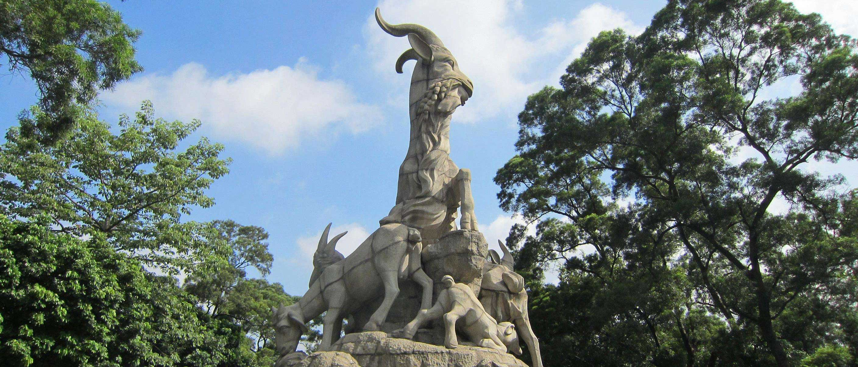
What are we doing?
Solving AI-Driven Science and Engineering
with the Global AI and Modeling Supercomputer GAIMSC

Slide 3
Let’s learn from Microsoft Research what they think are hot areas
Industry’s role in research much larger today than 20-40 years ago
Microsoft Research has about 1000 researchers and has 800 interns per year
  One of the largest computer science research organizations (INRIA larger)
They just held a faculty summit August 2018 largely focused on systems for AI
https://www.microsoft.com/en-us/research/event/faculty-summit-2018/
With an interesting overview at the end positioning their work as building designing and using the "Global AI Supercomputer" concept linking the Intelligent Cloud to the Intelligent Edge https://www.youtube.com/watch?v=jsv7EWhCqIQ&feature=youtu.be

Slide 4
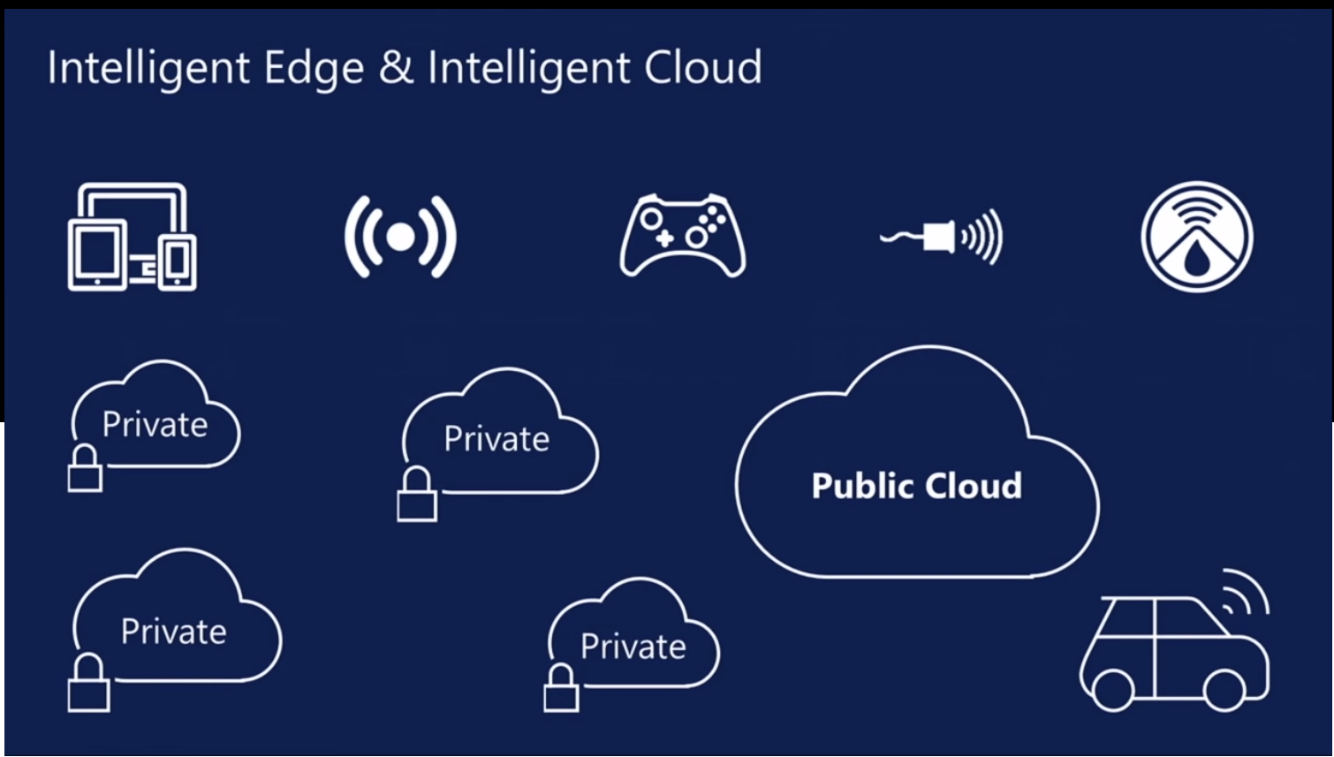
aa
aa

Slide 5
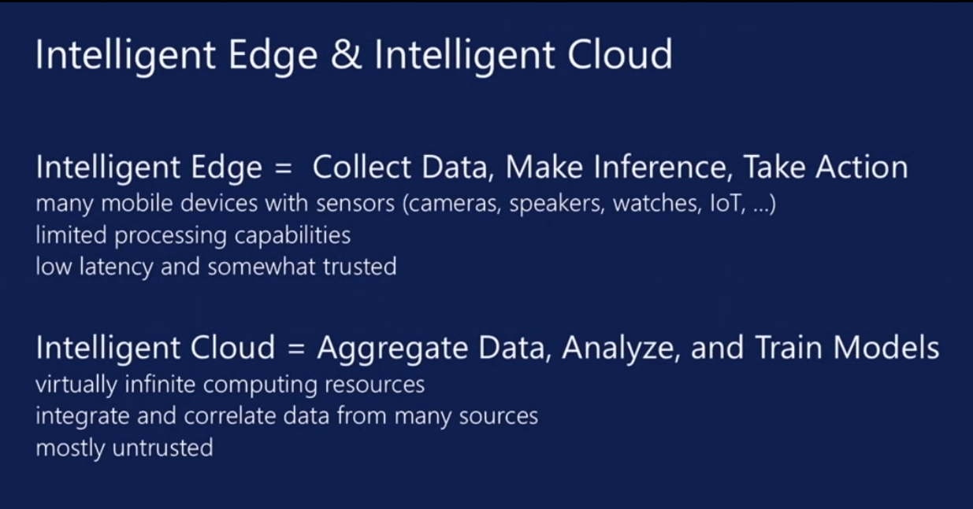
aa
aa

Slide 6
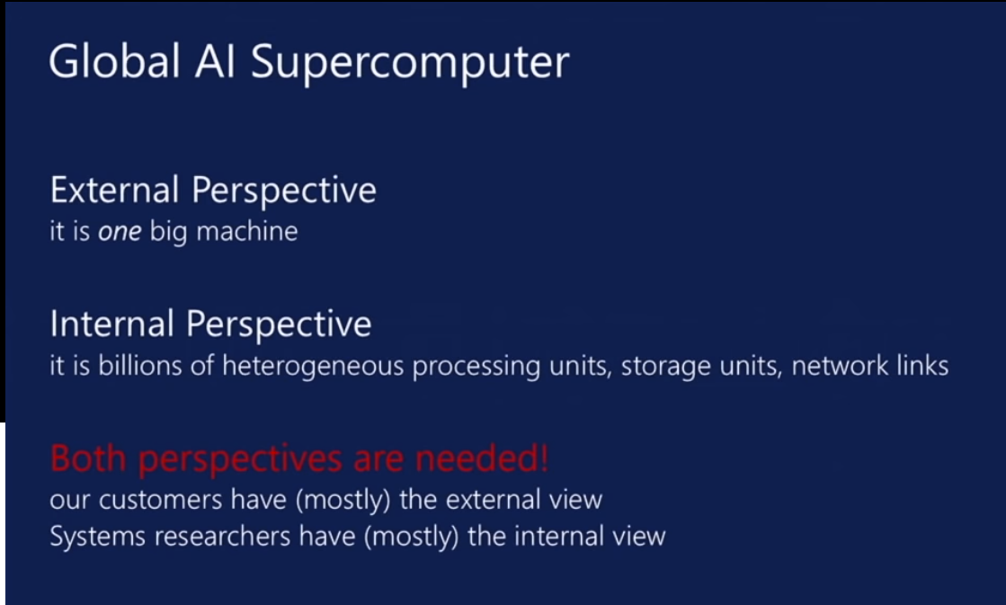
aa
aa

Slide 7
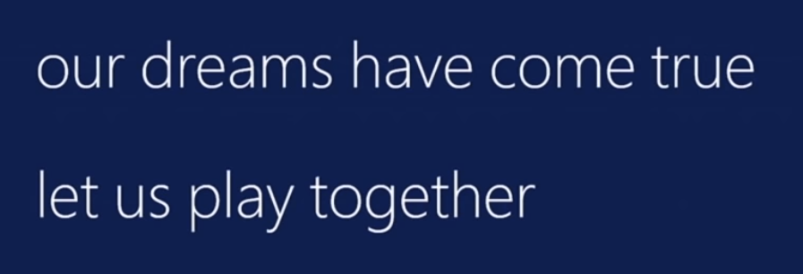
Adding Modeling?
Microsoft is very optimistic and excited
I added “Modeling” to get the
Global AI and Modeling Supercomputer GAIMSC
Modeling was meant to
  Include classic simulation oriented supercomputers
  Even just in Big Data, one needs to build a model for the machine learning to use
Note many talks discussed autotuning i.e. using GAIMSC to optimize GAIMSC

Slide 8
Possible Slogans for Research in
Global AI and Modeling Supercomputer arena
AI First Science and Engineering
Global AI and Modeling Supercomputer (Grid)
Linking Intelligent Cloud to Intelligent Edge
Linking Digital Twins to Deep Learning
High-Performance Big-Data Computing (HPBDC)
Big Data and Extreme-scale Computing (BDEC)
Common Digital Continuum Platform for Big Data and Extreme Scale Computing (BDEC2)
Using High Performance Computing ideas/technologies to give higher functionality and performance “cloud” and “edge” systems
Software 2.0 – replace Python by Training Data
Industry 4.0 – Software defined machines or Industrial Internet of Things

Slide 9

Big Data and Extreme-scale Computing http://www.exascale.org/bdec/
BDEC Pathways to Convergence Report
New series BDEC2 “Common Digital Continuum Platform for Big Data and Extreme Scale Computing” with first meeting November 28-30, 2018 Bloomington Indiana USA.
  First day is evening reception with meeting focus “Defining application requirements for a Common Digital Continuum Platform for Big Data and Extreme Scale Computing”
Next meetings: February 19-21 Kobe, Japan (National infrastructure visions) followed by two in Europe, one in USA and one in China.
http://www.exascale.org/bdec/sites/www.exascale.org.bdec/files/whitepapers/bdec2017pathways.pdf

Slide 10
AI First Research for AI-Driven Science and Engineering
Artificial Intelligence is a dominant disruptive technology affecting all our activities including business, education, research, and society.
Further, several companies have proposed AI first strategies.
  They used to be mobile first
The AI disruption in cyberinfrastructure is typically associated with big data coming from edge, repositories or sophisticated scientific instruments such as telescopes, light sources and gene sequencers.
AI First requires mammoth computing resources such as clouds, supercomputers, hyperscale systems and their distributed integration.
AI First strategy is using the Global AI and Modeling Supercomputer GAIMSC
Indiana University is examining a Masters in AI-Driven Engineering

Slide 11
AI First Publicity: 2017 Headlines
The Race For AI: Google, Twitter, Intel, Apple In A Rush To Grab Artificial Intelligence Startups
Google, Facebook, And Microsoft Are Remaking Themselves Around AI
Google: The Full Stack AI Company
Bezos Says Artificial Intelligence to Fuel Amazon's Success
Microsoft CEO says artificial intelligence is the 'ultimate breakthrough'
Tesla’s New AI Guru Could Help Its Cars Teach Themselves
Netflix Is Using AI to Conquer the World... and Bandwidth Issues
How Google Is Remaking Itself As A “Machine Learning First” Company
If You Love Machine Learning, You Should Check Out General Electric
Notes:
until ISE came along

Slide 12
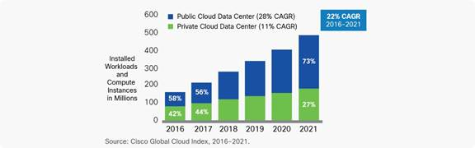
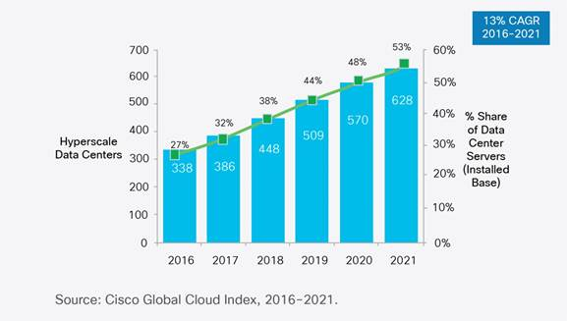
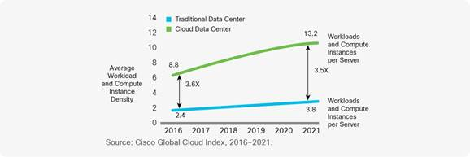
Remembering Grid Computing: IoT and Distributed Center I
Hyperscale data centers will grow from 338 in number at the end of 2016 to 628 by 2021. They will represent 53 percent of all installed data center servers by 2021.
  They form a distributed Compute (on data) grid with some 50 million servers
94 percent of workloads and compute instances will be processed by cloud data centers by 2021-- only six percent will be processed by traditional data centers.
Analysis from CISCO https://www.cisco.com/c/en/us/solutions/collateral/service-provider/global-cloud-index-gci/white-paper-c11-738085.html
Number of Public or Private Cloud Data Center Instances
Number of Cloud Data Centers
Number of instances per server

Slide 13
Remembering Grid Computing: IoT and Distributed Center II
By 2021, Cisco expects IoT connections to reach 13.7 billion, up from 5.8 billion in 2016, according to its Global Cloud Index.
Globally, the data stored in data centers will nearly quintuple by 2021 to reach 1.3ZB by 2021, up 4.6-fold (a CAGR of 36 percent) from 286 exabytes (EB) in 2016.
Big data will reach 403 EB by 2021, up almost eight-fold from 25EB in 2016. Big data will represent 30 percent of data stored in data centers by 2021, up from 18 percent in 2016.
The amount of data stored on devices will be 4.5-times higher than data stored in data centers, at 5.9ZB by 2021.
Driven largely by IoT, the total amount of data created (and not necessarily stored) by any device will reach 847ZB per year by 2021, up from 218ZB per year in 2016.
The Intelligent Edge or IoT is a distributed Data Grid

Slide 14
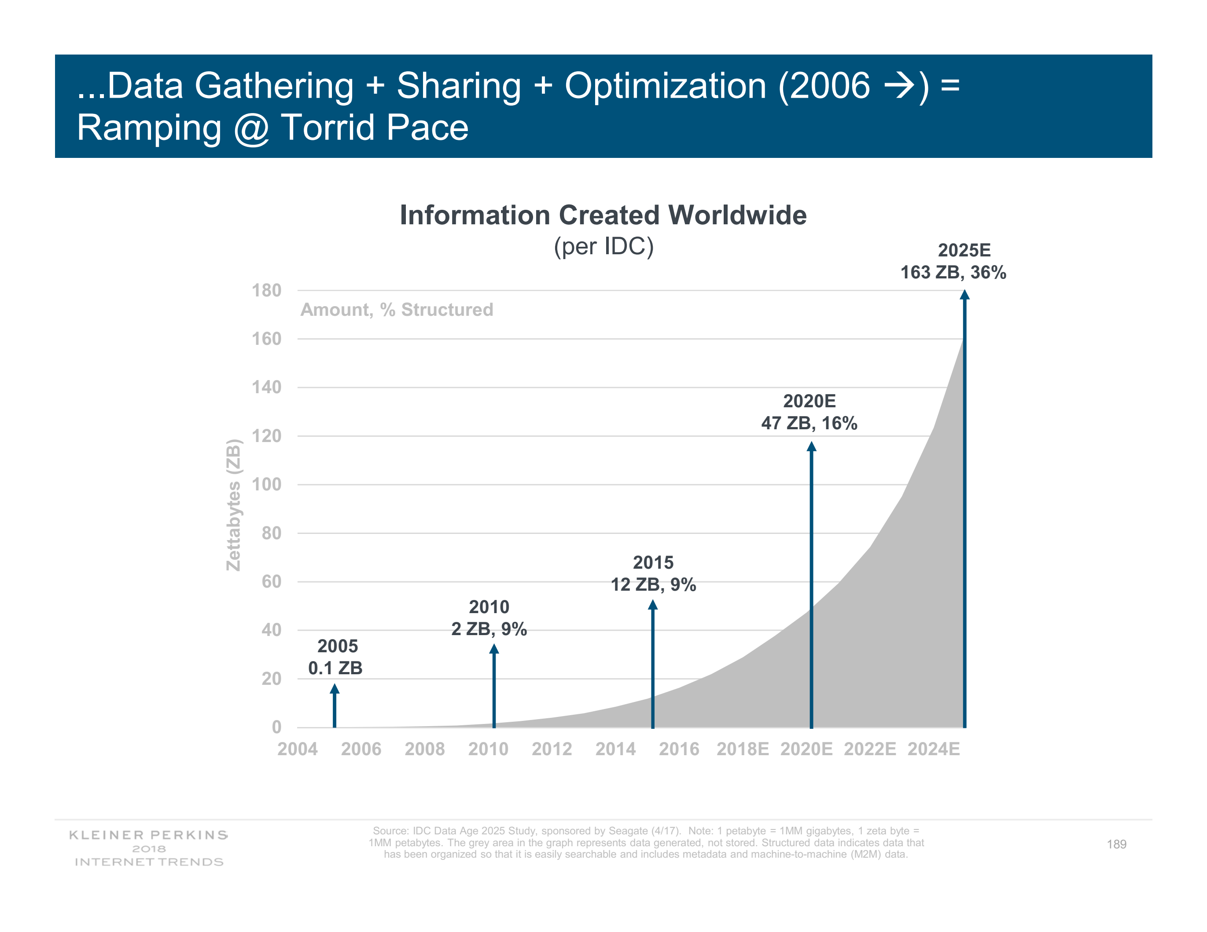
Mary Meeker identifies even more digital data

Slide 15
Overall Global AI and Modeling Supercomputer GAIMSC Architecture
There is only a cloud at the logical center but it’s physically distributed and owned by a few major players
There is a very distributed set of devices surrounded by local Fog computing; this forms the logically and physically distribute edge
The edge is structured and largely data
  These are two differences from the Grid of the past
  e.g. self driving car will have its own fog and will not share fog with truck that it is about to collide with
The cloud and edge will both be very heterogeneous with varying accelerators, memory size and disk structure.

Slide 16
Collaborating on the
Global AI and Modeling Supercomputer GAIMSC
Microsoft says:
We can only “play together” and link functionalities from Google, Amazon, Facebook, Microsoft, Academia if we have open API’s and open code to customize
  We must collaborate
Open source Apache software
Academia needs to use and define their own Apache projects
We want to use AI and modeling supercomputer for AI-Driven science studying the early universe and the Higgs boson and not just producing annoying advertisements (goal of most elite CS researchers)

Slide 17
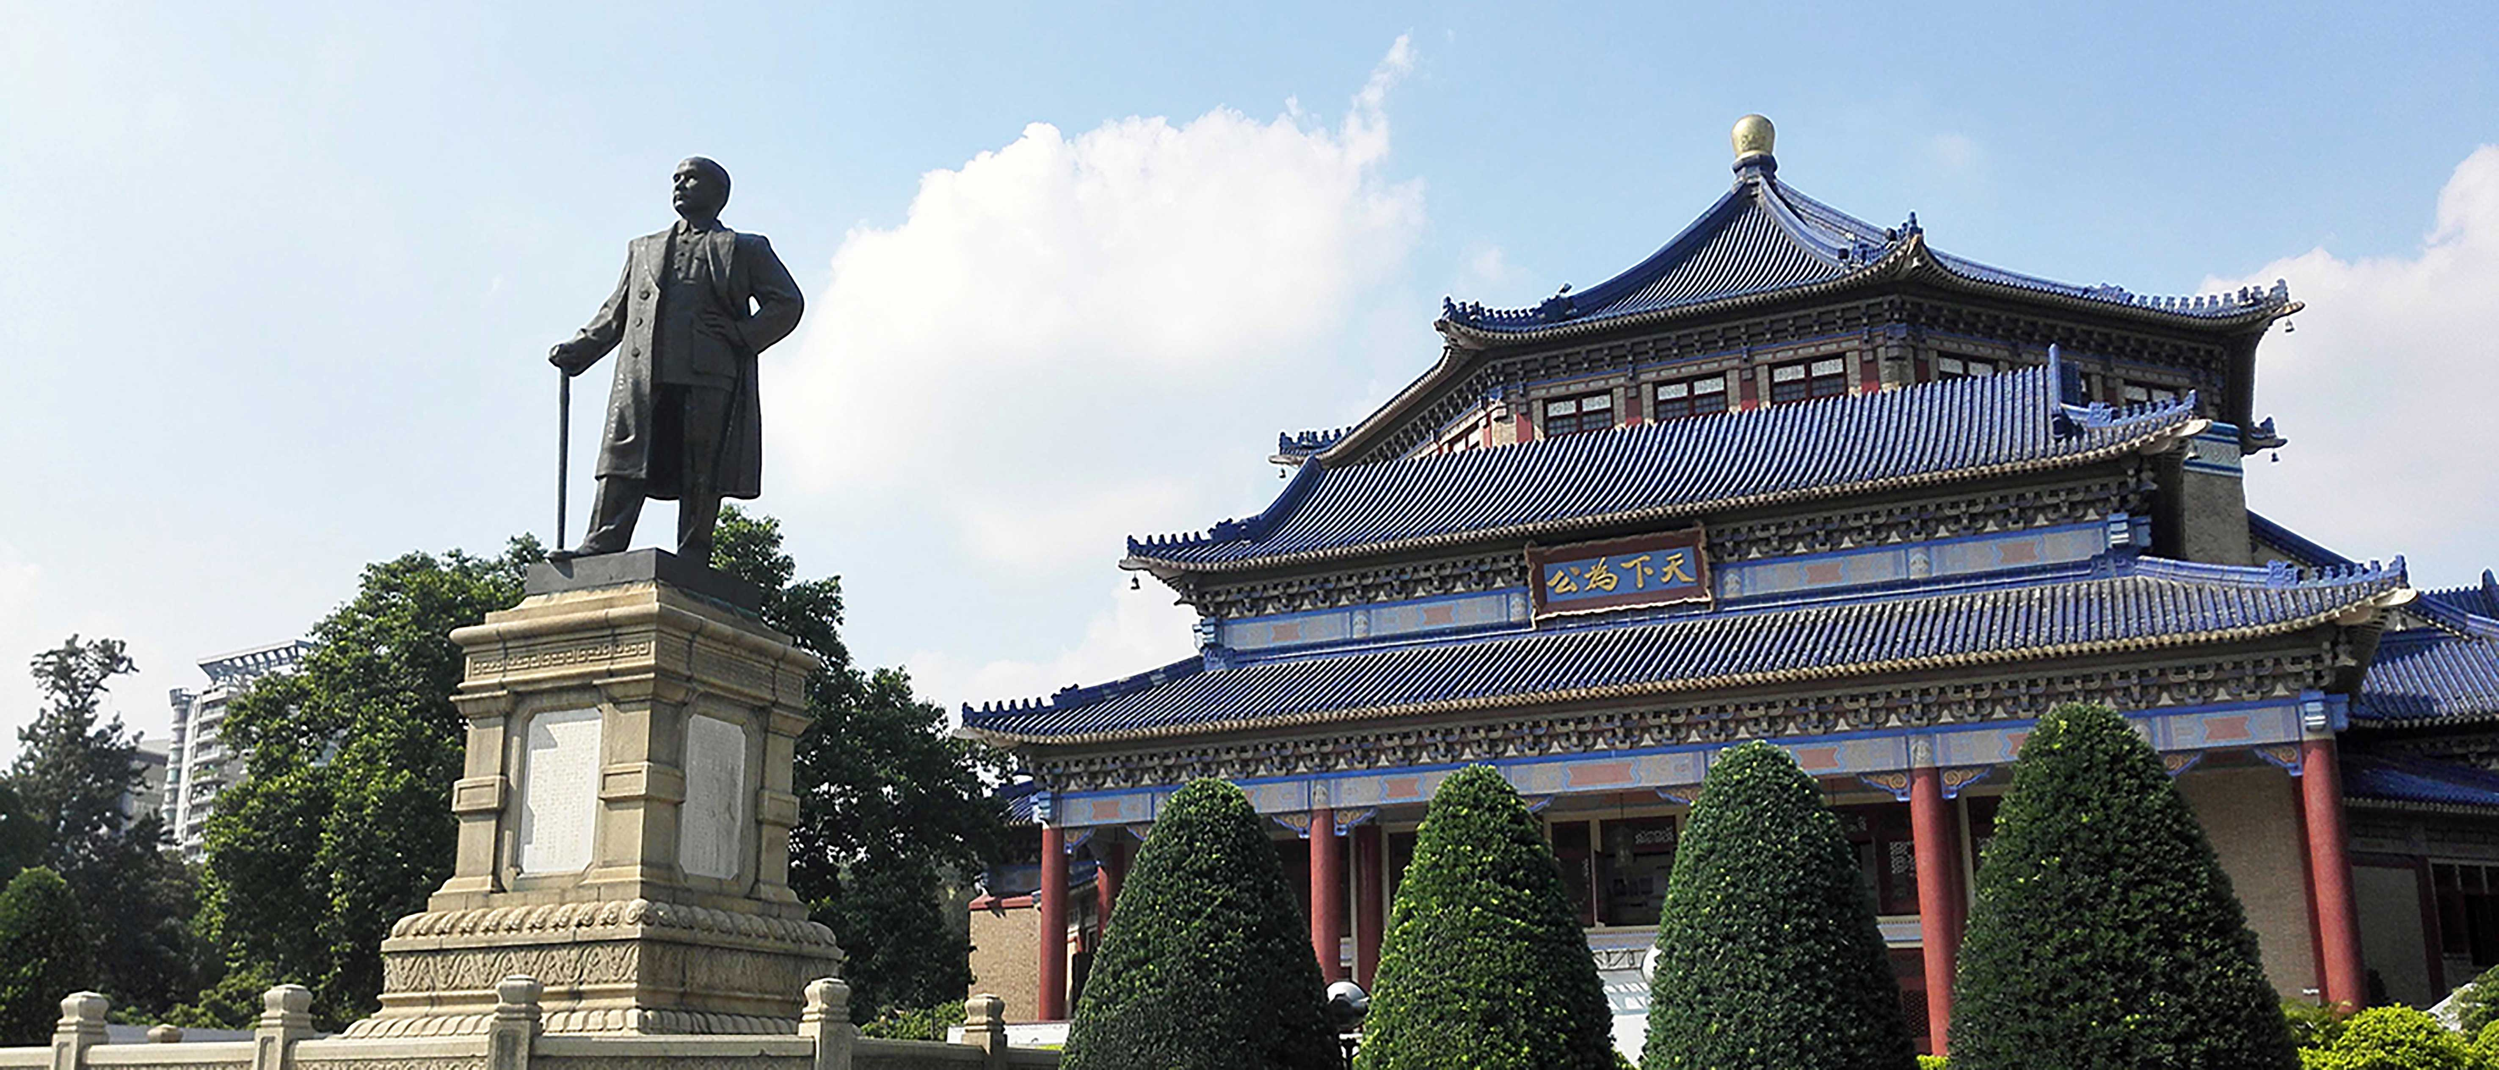
What is Microsoft telling us to do?
with the Global AI and Modeling Supercomputer GAIMSC

Slide 18
What are GAIMSC Researchers looking at?
Topics in Microsoft Faculty Summit I
Systems Research | Fueling Future Disruptions Overall Vision
Welcome: https://youtu.be/_IF9esNec3E
Introduction: https://youtu.be/RnzjxXOqovc
Summary: Global AI Supercomputer: Intelligent Cloud and Intelligent Edge: https://youtu.be/jsv7EWhCqIQ
Entrepreneurship and Systems Research https://youtu.be/vszcATWtr2U
Azure and Intelligent Cloud
Inside Microsoft Azure Datacenter Architecture:
The Art of Building a Reliable Cloud Network https://youtu.be/Iiwb7ysxyck
Fundamentals of Artificial Intelligence AI and Intelligent Systems
Free Inference and Instant Training: Breakthroughs and Implications https://youtu.be/Tkl6ERLWAbA. 3 slidesets
Knowledge Systems and AI
AI Infrastructure and Tools. 1 slideset

Slide 19
Topics in Microsoft Faculty Summit II
AI to Control (AI) Systems. GAIMSC is autotuned by itself
Database and Data Analytic Systems https://youtu.be/nxEIfluXQ_A 3 slidesets
AI for AI Systems https://youtu.be/MqBOuoLflpU. 2 slidesets
The Good, the Bad, and the Ugly of ML for Networked Systems. 3 slidesets
Edge Computing
Intelligent Edge. 4 slidesets
Security and Privacy
Verification and Secure Systems https://youtu.be/J9977DaNAlc 2 slidesets
Confidential Computing. 4 slidesets
CPU & DRAM Bugs: Attacks & Defenses. 3 slidesets
Current Trends in Blockchain Technology https://youtu.be/QcRQRUlk5Xs. 3 slidesets

Slide 20
Topics in Microsoft Faculty Summit III
Physical Systems
Hardware-accelerated Networked Systems. 2 slidesets
Programmable Hardware for Distributed Systems. 1 slideset
Future of Cloud Storage Systems. 2 slidesets
Quantum Computers: Software and Hardware Architecture. 2 slidesets
Software Engineering
Continuous Deployment: Current and Future Challenges. 2 slidesets

Slide 21
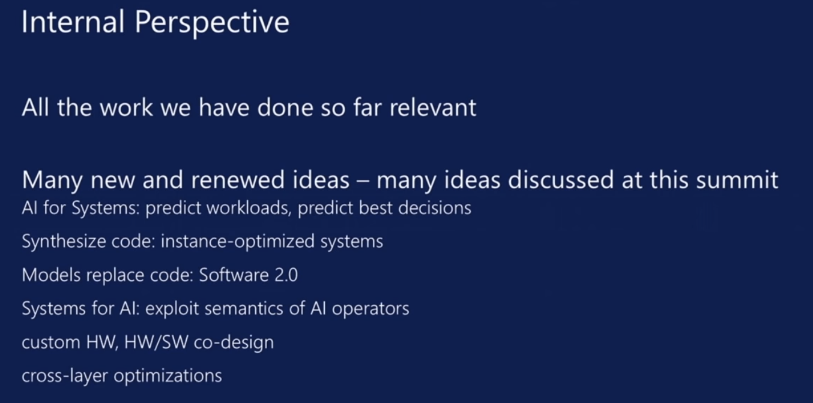
aa
aa

Slide 22
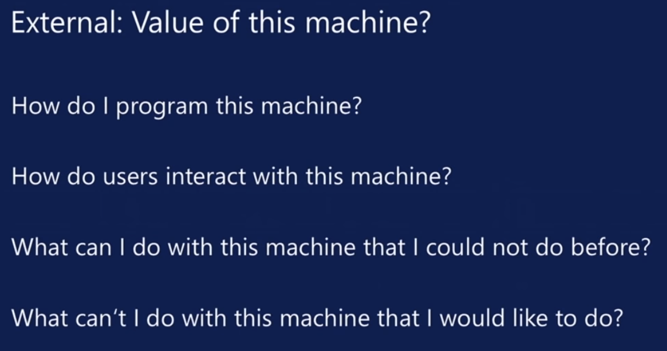
aa
aa

Slide 23
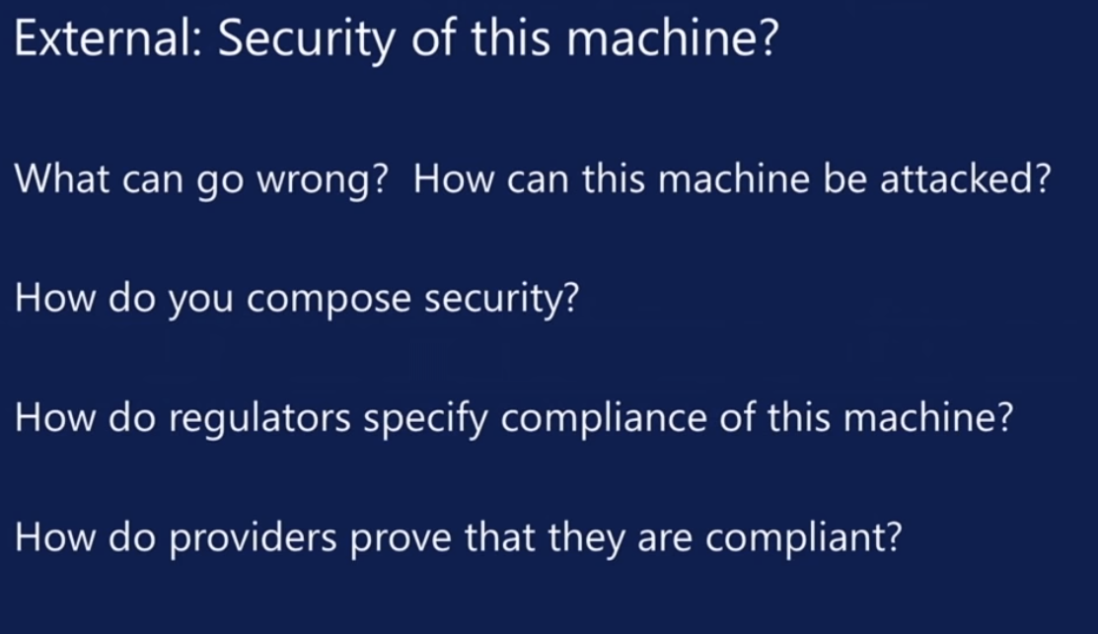
aa
aa

Slide 24
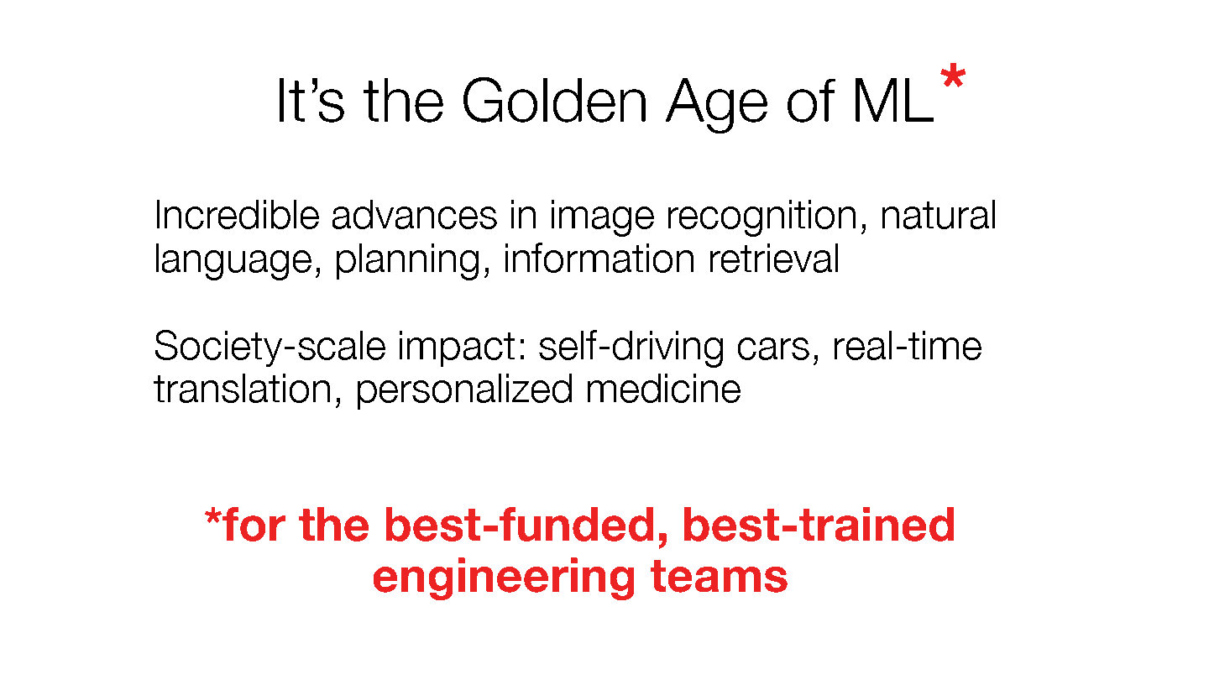
Its is challenging these days to compete with Berkeley, Stanford, Google, Facebook, Amazon, Microsoft, IBM.
Zaharia from Stanford (earlier Berkeley and Spark)

Slide 25
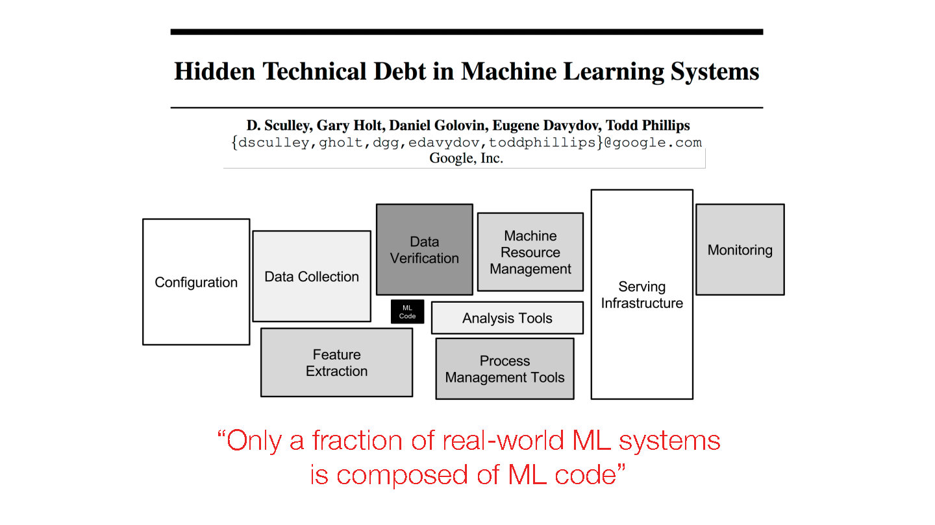
Should we train data scientists or data engineers?
Gartner says that 3 times as many jobs for data engineers as data scientists.
There is more to life (jobs) than Machine Learning!
ML Code
NIPS 2015 http://papers.nips.cc/paper/5656-hidden-technical-debt-in-machine-learning-systems.pdf

Slide 26
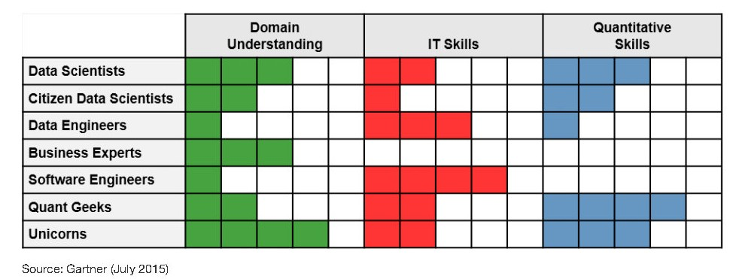
Gartner on Data Engineering
Gartner says that job numbers in data science teams are
10% - Data Scientists
20% - Citizen Data Scientists ("decision makers")
30% - Data Engineers
20% - Business experts
15% - Software engineers
5% - Quant geeks
~0% - Unicorns
(very few exist!)

Slide 27
Working with Industry?
Many academic areas today have been turned upside down by the increased role of industry as there is so much overlap between major University research issues and problems where the large technology companies are battling it out for commercial leadership.
Correspondingly we have seen -- especially with top-ranked departments --- increasing numbers and styles of industry-university collaboration. Probably most departments must join this trend and increase their Industry links if they are to thrive.
  Sometimes faculty are 20% University and 80% Industry
These links can have the student internship opportunity needed for ABET and traditional in the field.
  However, this is a double-edged sword as the increased access to internships for our best Ph.D. students is one reason for the decrease in University research contribution.
  We should try to make such internships part of joint University-Industry research and not just an Industry only activity
Relationship can be jointly run centers such as NSF I/UCRC and Industry oriented University centers such as Intel parallel Computing centers

Slide 28
GAIMSC Global AI & Modeling Supercomputer Questions
What do gain from the concept? e.g. Ability to work with Big Data community
What do we lose from the concept? e.g. everything runs as slow as Spark
Is GAIMSC useful for BDEC2 initiative? For NSF? For DoE?
For Universities? For Industry? For users?
Does adding modeling to concept add value?
What are the research issues for GAIMSC? e.g. how to program?
What can we do with GAIMSC that we couldn’t do with classic Big Data technologies?
What can we do with GAIMSC that we couldn’t do with classic HPC technologies?
Are there deep or important issues associated with the “Global” in GAIMSC?
Is the concept of an auto-tuned Global AI and Modeling Supercomputer scary?

Slide 29
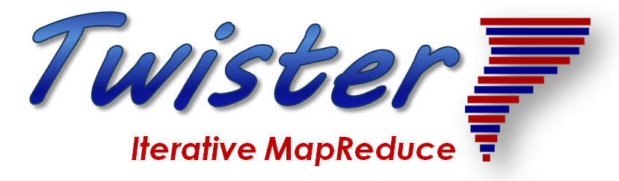
Application Structure
2
http://www.iterativemapreduce.org/

Slide 30
Requirements for Global AI (and Modeling) Supercomputer
Application Requirements: The structure of application clearly impacts needed hardware and software
  Pleasingly parallel
  Workflow
  Global Machine Learning
Data model: SQL, NoSQL; File Systems, Object store; Lustre, HDFS
Distributed data from distributed sensors and instruments (Internet of Things) requires Edge computing model
  Device – Fog – Cloud model and streaming data software and algorithms
Hardware: node (accelerators such as GPU or KNL for deep learning) and multi-node architecture configured as AI First HPC Cloud;
  Disks speed and location
Software requirements: Programming model for GAIMSC
Analytics
Data management
Streaming or Repository access or both

Slide 31
Distinctive Features of Applications
Ratio of data to model sizes: vertical axis on next slide
Importance of Synchronization – ratio of inter-node communication to node computing: horizontal axis on next slide
Sparsity of Data or Model; impacts value of GPU’s or vector computing
Irregularity of Data or Model
Geographic distribution of Data as in edge computing; use of streaming (dynamic data) versus batch paradigms
Dynamic model structure as in some iterative algorithms

Slide 32
Big Data and Simulation Difficulty in Parallelism
Size of Synchronization constraints
Loosely Coupled
Tightly Coupled
HPC Clouds: Accelerators
High Performance Interconnect
HPC Clouds/Supercomputers
Memory access also critical
Commodity Clouds
Size of Disk I/O
MapReduce as in scalable databases
Global Machine Learning
e.g. parallel clustering
Deep Learning
Graph Analytics e.g. subgraph mining
LDA
Pleasingly Parallel
Often independent events
Unstructured Adaptive Sparse
Current major Big Data category
Linear Algebra at core (often not sparse)
Structured Adaptive Sparse
Parameter sweep simulations
Largest scale simulations
Just two problem characteristics
There is also data/compute distribution seen in grid/edge computing
Exascale Supercomputers

Slide 33
Comparing Spark, Flink and MPI
2
http://www.iterativemapreduce.org/

Slide 34
Machine Learning with MPI, Spark and Flink
Three algorithms implemented in three runtimes
  Multidimensional Scaling (MDS)
  Terasort
  K-Means (drop as no time and looked at later)
Implementation in Java
  MDS is the most complex algorithm - three nested parallel loops
  K-Means - one parallel loop
  Terasort - no iterations
With care, Java performance ~ C performance
Without care, Java performance << C performance (details omitted)

Slide 35



Multidimensional Scaling: 3 Nested Parallel Sections
Kmeans also bad
Flink
Spark
MPI
MPI Factor of 20-200 Faster than Spark/Flink
MDS execution time with 32000 points on varying number of nodes. Each node runs 20 parallel tasks
Spark, Flink No Speedup
MDS execution time on 16 nodes with 20 processes in each node with varying number of points

Slide 36


Terasort
Sorting 1TB of data records
Terasort execution time in 64 and 32 nodes. Only MPI shows the sorting time and communication time as other two frameworks doesn't provide a clear method to accurately measure them. Sorting time includes data save time.
MPI-IB - MPI with Infiniband
Partition the data using a sample and regroup

Slide 37
Programming Environment for Global AI and Modeling Supercomputer GAIMSC
2
http://www.iterativemapreduce.org/

Slide 38
Five Major Application Structures
Global Machine Learning
Always Classic Cloud Workload
Add High Performance Big Data Workload
Note Problem and System Architecture ae similar as efficient execution says they must match

Slide 39
Ways of adding High Performance to
Global AI (and Modeling) Supercomputer
Fix performance issues in Spark, Heron, Hadoop, Flink etc.
  Messy as some features of these big data systems intrinsically slow in some (not all) cases
  All these systems are “monolithic” and difficult to deal with individual components
Execute HPBDC from classic big data system with custom communication environment – approach of Harp for the relatively simple Hadoop environment
Provide a native Mesos/Yarn/Kubernetes/HDFS high performance execution environment with all capabilities of Spark, Hadoop and Heron – goal of Twister2
Execute with MPI in classic (Slurm, Lustre) HPC environment
Add modules to existing frameworks like Scikit-Learn or Tensorflow either as new capability or as a higher performance version of existing module.

Slide 40
Features of High Performance Big Data Processing Systems
Application Requirements: The structure of application clearly impacts needed hardware and software
  Pleasingly parallel
  Workflow
  Global Machine Learning
Data model: SQL, NoSQL; File Systems, Object store; Lustre, HDFS
Distributed data from distributed sensors and instruments (Internet of Things) requires Edge computing model
  Device – Fog – Cloud model and streaming data software and algorithms
Hardware: node (accelerators such as GPU or KNL for deep learning) and multi-node architecture configured as AI First HPC Cloud;
  Disks speed and location
This implies software requirements
Analytics
Data management
Streaming or Repository access or both

Slide 41
GAIMSC Programming Environment Components I
Area | Component | Implementation | Comments: User API
Architecture Specification | Coordination Points | State and Configuration Management; Program, Data and Message Level | Change execution mode; save and reset state
 | Execution Semantics | Mapping of Resources to Bolts/Maps in Containers, Processes, Threads | Different systems make different choices - why?
 | Parallel Computing | Spark Flink Hadoop Pregel MPI modes | Owner Computes Rule
Job Submission | (Dynamic/Static) Resource Allocation | Plugins for Slurm, Yarn, Mesos, Marathon, Aurora | Client API (e.g. Python) for Job Management
Task System | Task migration | Monitoring of tasks and migrating tasks for better resource utilization | Task-based programming with Dynamic or Static Graph API; FaaS API; Support accelerators (CUDA,FPGA, KNL)
 | Elasticity | OpenWhisk
 | Streaming and FaaS Events | Heron, OpenWhisk, Kafka/RabbitMQ
 | Task Execution | Process, Threads, Queues
 | Task Scheduling | Dynamic Scheduling, Static Scheduling, Pluggable Scheduling Algorithms
 | Task Graph | Static Graph, Dynamic Graph Generation

Slide 42
GAIMSC Programming Environment Components II
Area | Component | Implementation | Comments
Communication API | Messages | Heron | This is user level and could map to multiple communication systems
 | Dataflow Communication | Fine-Grain Twister2 Dataflow communications: MPI,TCP and RMA Coarse grain Dataflow from NiFi, Kepler? | Streaming, ETL data pipelines; Define new Dataflow communication API and library
 | BSP Communication Map-Collective | Conventional MPI, Harp | MPI Point to Point and Collective API
Data Access | Static (Batch) Data | File Systems, NoSQL, SQL | Data API
 | Streaming Data | Message Brokers, Spouts
Data Management | Distributed Data Set | Relaxed Distributed Shared Memory(immutable data), Mutable Distributed Data | Data Transformation API; Spark RDD, Heron Streamlet
Fault Tolerance | Check Pointing | Upstream (streaming) backup; Lightweight; Coordination Points; Spark/Flink, MPI and Heron models | Streaming and batch cases distinct; Crosses all components
Security | Storage, Messaging, execution | Research needed | Crosses all Components

Slide 43
Our approach
SPIDAL, Twister2 and Harp
2
http://www.iterativemapreduce.org/

Slide 44
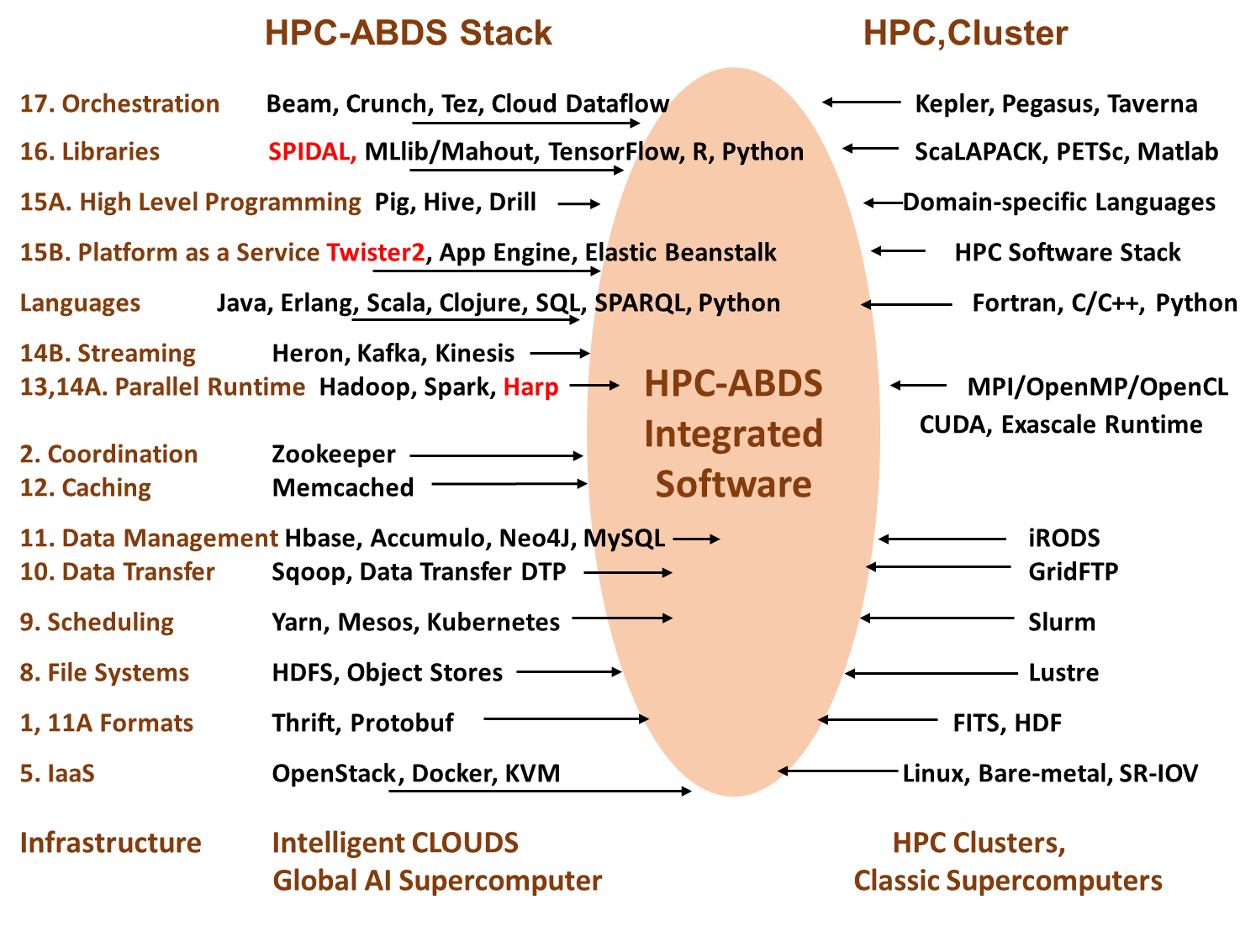
Different choices in software systems for Global AI and Modeling Supercomputer compared to that for conventional simulation supercomputers

Slide 45
Integrating HPC and Apache Programming Environments
Harp-DAAL with a kernel Machine Learning library exploiting the Intel node library DAAL and HPC communication collectives within the Hadoop ecosystem.
  Harp-DAAL supports all 5 classes of data-intensive AI first computation, from pleasingly parallel to machine learning and simulations.
Twister2 is a toolkit of components that can be packaged in different ways
  Integrated batch or streaming data capabilities familiar from Apache Hadoop, Spark, Heron and Flink but with high performance.
  Separate bulk synchronous and data flow communication;
  Task management as in Mesos, Yarn and Kubernetes
  Dataflow graph execution models
  Launching of the Harp-DAAL library with native Mesos/Kubernetes/HDFS environment
  Streaming and repository data access interfaces,
  In-memory databases and fault tolerance at dataflow nodes. (use RDD to do classic checkpoint-restart)

Slide 46
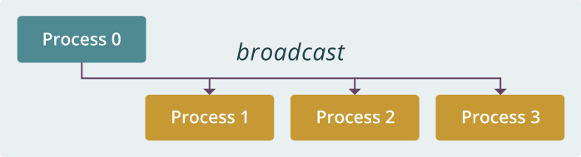
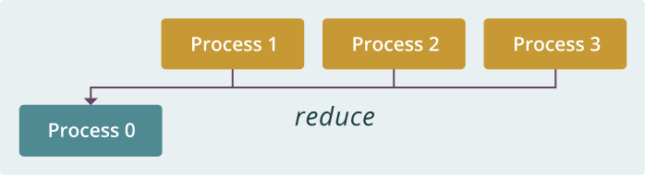
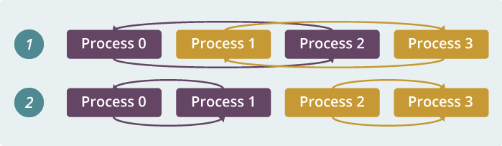
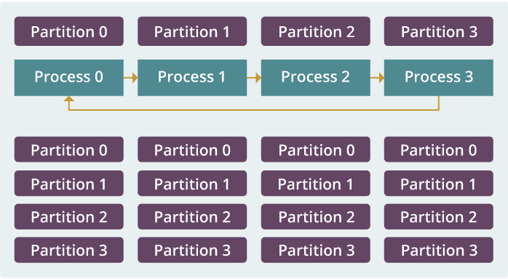
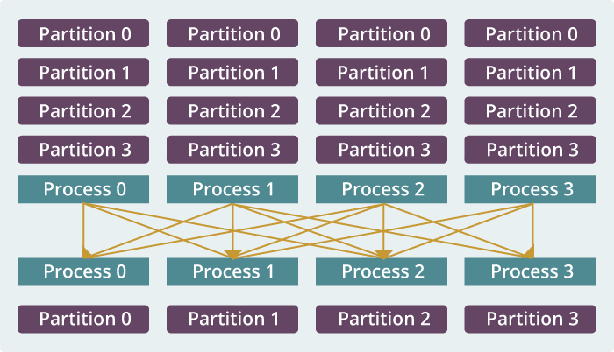
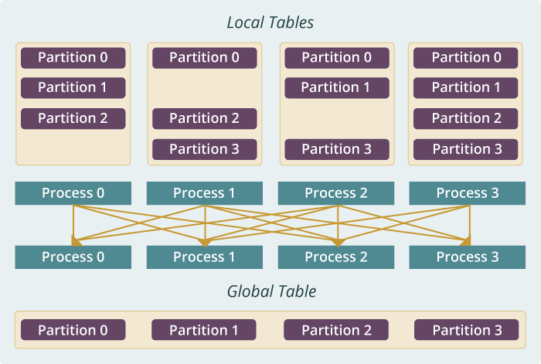
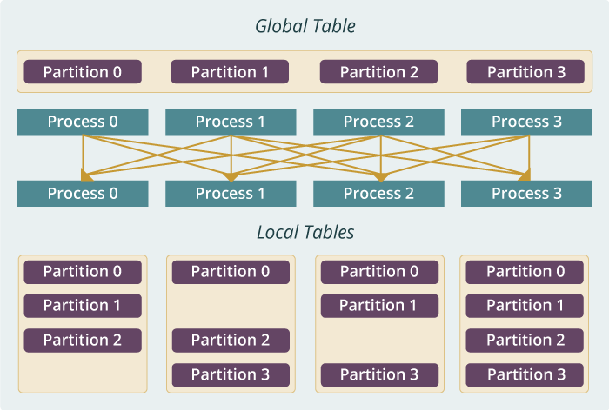
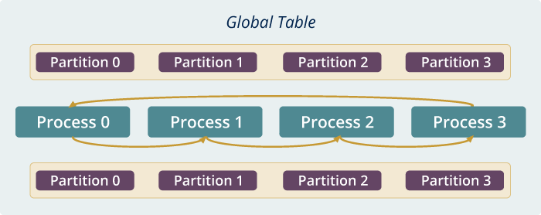
Run time software for Harp
broadcast
reduce
allreduce
allgather
regroup
push & pull
rotate
Map Collective Run time merges MapReduce and HPC

Slide 47
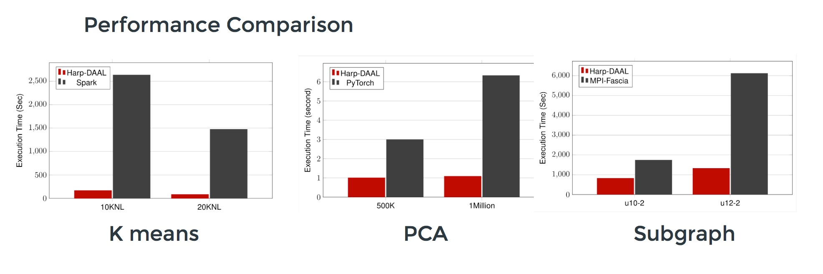
Harp v. Spark Harp v. Torch Harp v. MPI
Datasets: 5 million points, 10 thousand centroids, 10 feature dimensions
10 to 20 nodes of Intel KNL7250 processors
Harp-DAAL has 15x speedups over Spark MLlib
Datasets: 500K or 1 million data points of feature dimension 300
Running on single KNL 7250 (Harp-DAAL) vs. single K80 GPU (PyTorch)
Harp-DAAL achieves 3x to 6x speedups
Datasets: Twitter with 44 million vertices, 2 billion edges, subgraph templates of 10 to 12 vertices
25 nodes of Intel Xeon E5 2670
Harp-DAAL has 2x to 5x speedups over state-of-the-art MPI-Fascia solution

Slide 48
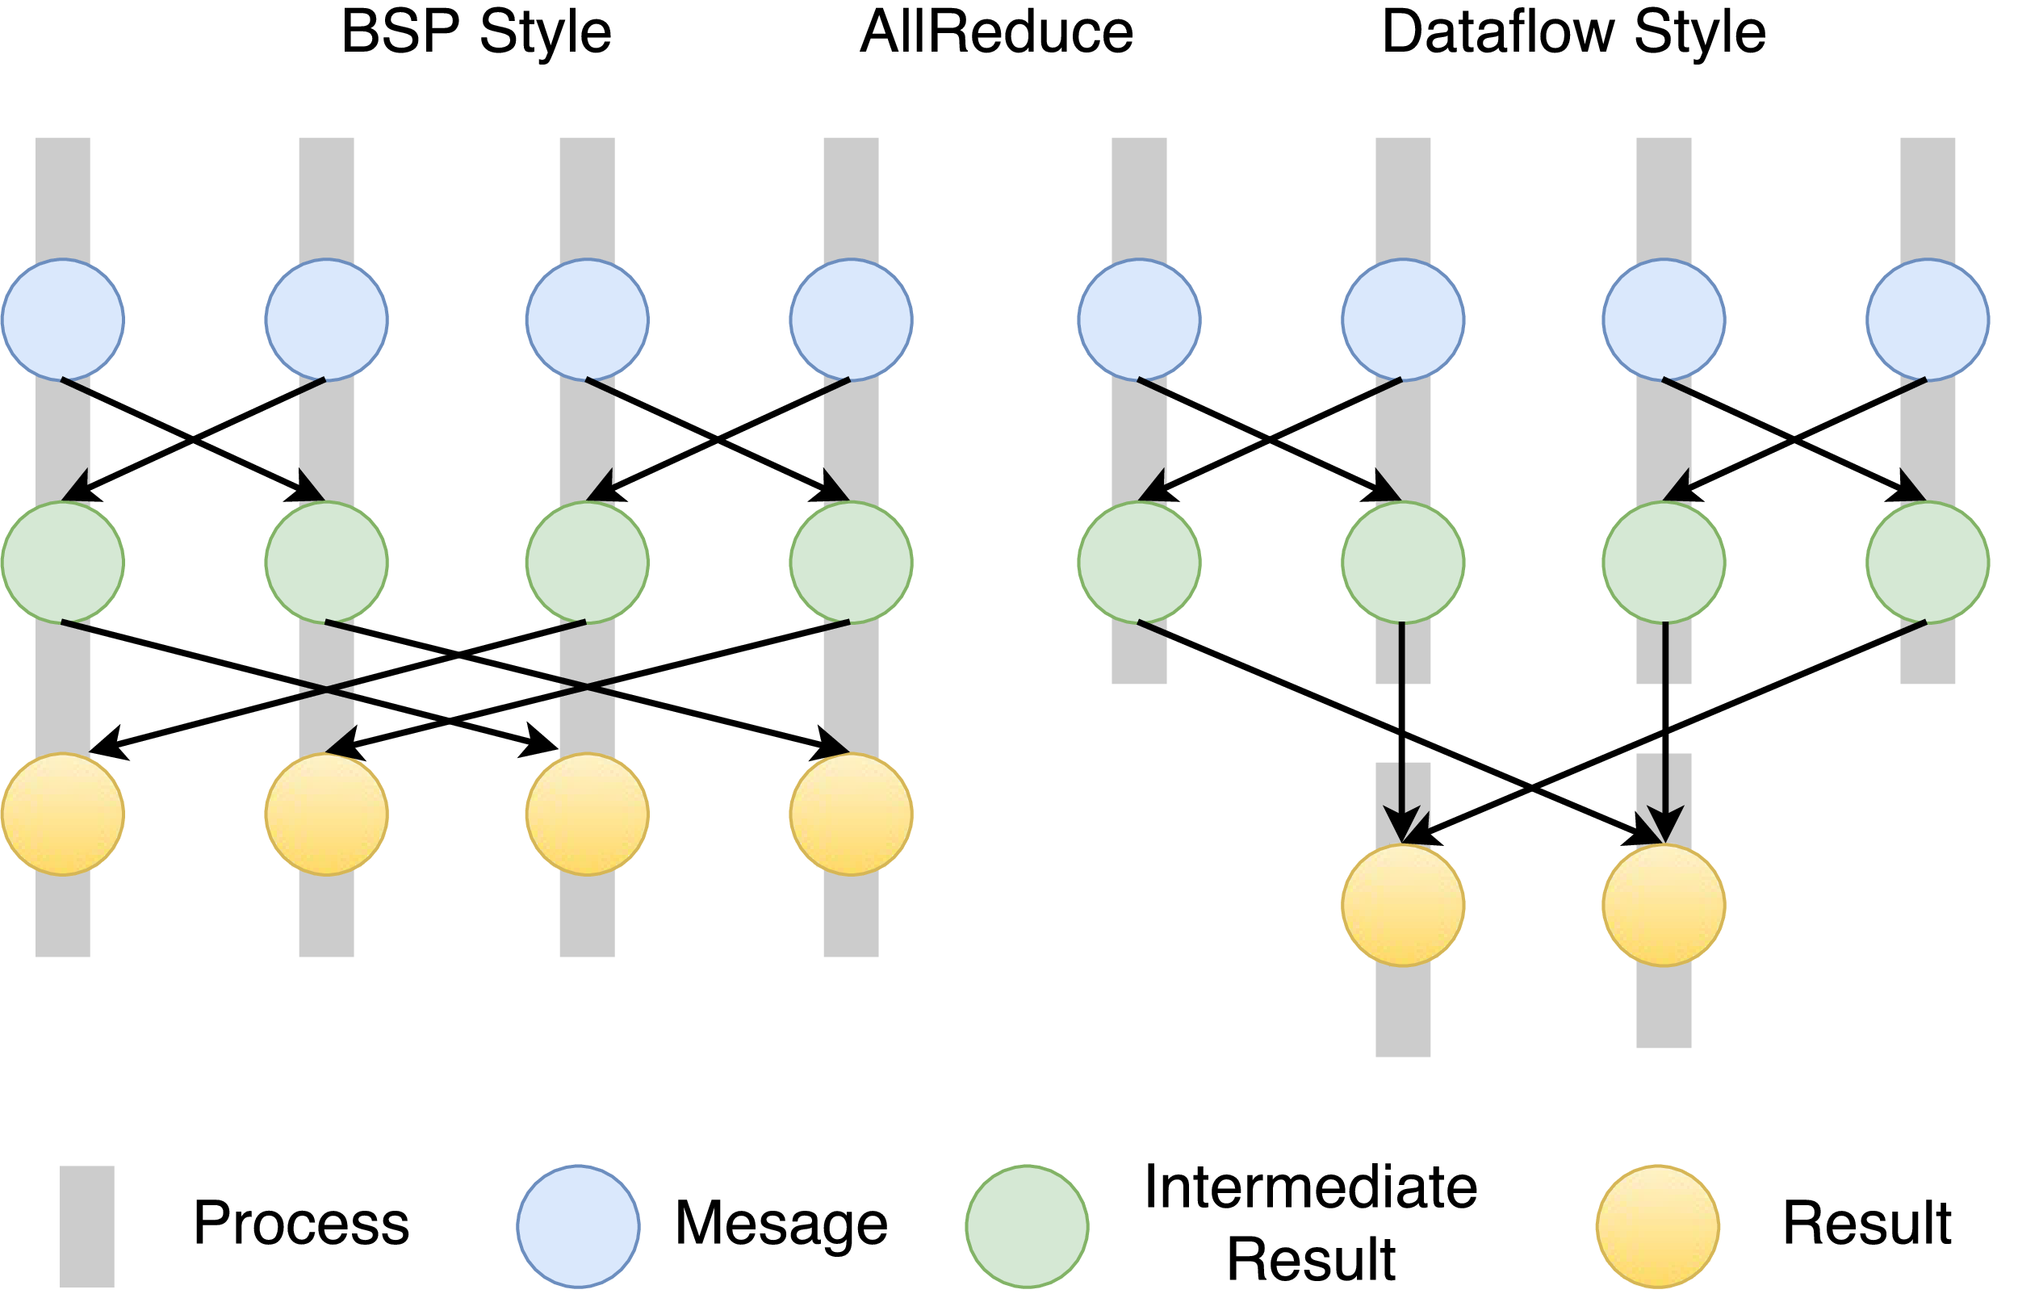
Twister2 Dataflow Communications
Twister:Net offers two communication models
BSP (Bulk Synchronous Processing) message-level communication using TCP or MPI separated from its task management plus extra Harp collectives
DFW a new Dataflow library built using MPI software but at data movement not message level
  Non-blocking
  Dynamic data sizes
  Streaming model
    Batch case is modeled as a finite stream
  The communications are between a set of
  tasks in an arbitrary task graph
  Key based communications
  Data-level Communications spilling to disks
  Target tasks can be different from source tasks

Slide 49
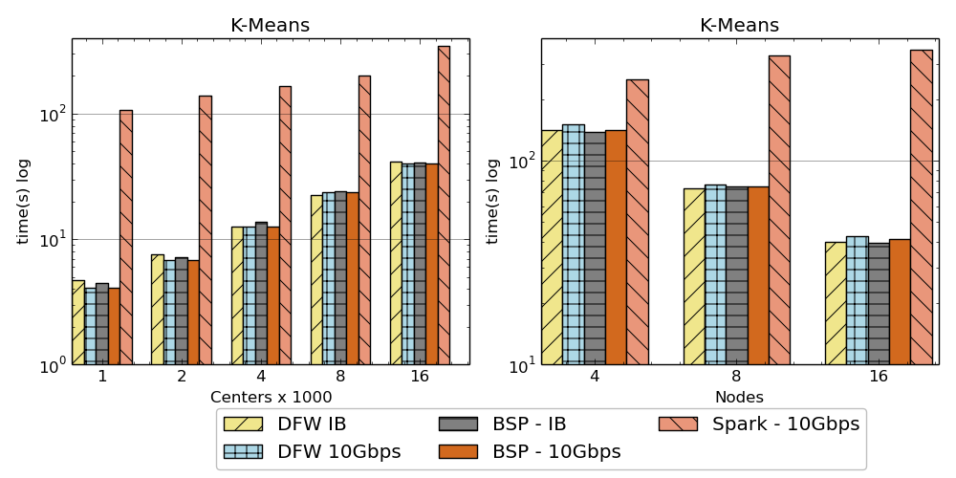
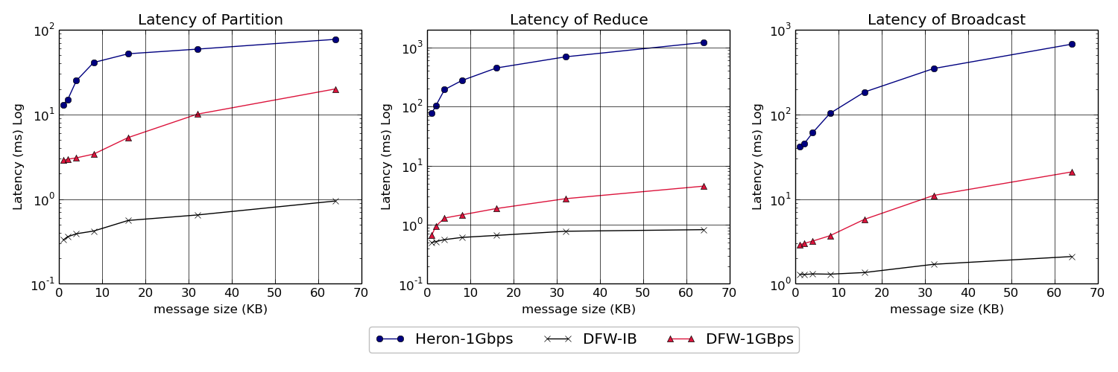
Twister:Net and Apache Heron and Spark
Left: K-means job execution time on 16 nodes with varying centers, 2 million points with 320-way parallelism. Right: K-Means wth 4,8 and 16 nodes where each node having 20 tasks. 2 million points with 16000 centers used.
Latency of Apache Heron and Twister:Net DFW (Dataflow) for Reduce, Broadcast and Partition operations in 16 nodes with 256-way parallelism

Slide 50

Dataflow at Different Grain sizes
Coarse Grain Dataflows links jobs in such a pipeline
Visualization
Dimension
Reduction
Data preparation
Clustering
But internally to each job you can also elegantly express algorithm as dataflow but with more stringent performance constraints
Corresponding to classic Spark K-means Dataflow
P = loadPoints()
C = loadInitCenters()
for (int i = 0; i < 10; i++) {
T = P.map().withBroadcast(C)
C = T.reduce() }
Internal Execution
Dataflow Nodes
Reduce
Iterate
HPC
Communication
Maps
Iterate

Slide 51
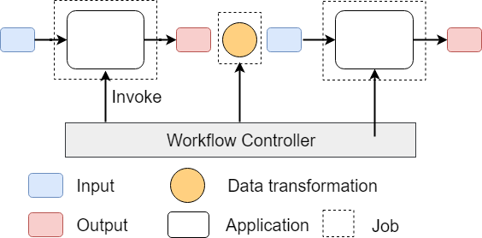
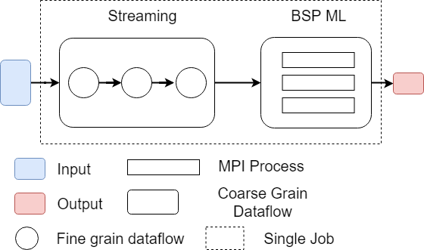
Workflow vs Dataflow: Different grain sizes and different performance trade-offs
The fine-grain dataflow can expand from Edge to Cloud
Coarse-grain Dataflow
Workflow Controlled by Workflow Engine or a Script
Fine-grain dataflow application running as a single job

Slide 52
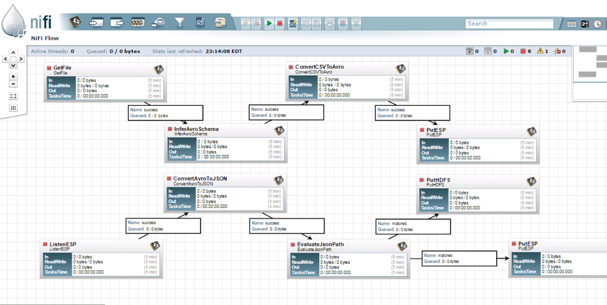
NiFi Coarse-grain Workflow

Slide 53
Fault Tolerance and State
Similar form of check-pointing mechanism is used already in HPC and Big Data
  although HPC informal as doesn’t typically specify as a dataflow graph
  Flink and Spark do better than MPI due to use of database technologies; MPI is a bit harder due to richer state but there is an obvious integrated model using RDD type snapshots of MPI style jobs
Checkpoint after each stage of the dataflow graph (at location of intelligent dataflow nodes)
  Natural synchronization point
  Let’s allows user to choose when to checkpoint (not every stage)
  Save state as user specifies; Spark just saves Model state which is insufficient for complex algorithms

Slide 54
Futures
Implementing Twister2 for Global AI and Modeling Supercomputer
2
http://www.iterativemapreduce.org/

Slide 55
Twister2 Timeline: End of September 2018
Twister:Net Dataflow Communication API
  Dataflow communications with MPI or TCP
Data access
  Local File Systems
  HDFS Integration
Task Graph
  Streaming Batch analytics – Iterative jobs
  Data pipelines
Deployments on Docker, Kubernetes, Mesos (Aurora), Slurm

Slide 56
Twister2 Timeline: Middle of December 2018
Harp for Machine Learning (Custom BSP Communications)
  Rich collectives
  Around 30 ML algorithms
Naiad model based Task system for Machine Learning
Link to Pilot Jobs
Fault tolerance as in Heron and Spark
  Streaming
  Batch
Storm API for Streaming
RDD API for Spark batch

Slide 57
Twister2 Timeline: After December 2018
Native MPI integration to Mesos, Yarn
Dynamic task migrations
RDMA and other communication enhancements
Integrate parts of Twister2 components as big data systems enhancements (i.e. run current Big Data software invoking Twister2 components)
  Heron (easiest), Spark, Flink, Hadoop (like Harp today)
Support different APIs (i.e. run Twister2 looking like current Big Data Software)
  Hadoop
  Spark (Flink)
  Storm
Refinements like Marathon with Mesos etc.
Function as a Service and Serverless
Support higher level abstractions
  Twister:SQL (major Spark use case)

Slide 58
Qiu/Fox Core SPIDAL Parallel HPC Library with Collective Used
DA-MDS Rotate, AllReduce, Broadcast
Directed Force Dimension Reduction AllGather, Allreduce
Irregular DAVS Clustering Partial Rotate, AllReduce, Broadcast
DA Semimetric Clustering (Deterministic Annealing) Rotate, AllReduce, Broadcast
K-means AllReduce, Broadcast, AllGather DAAL
SVM AllReduce, AllGather
SubGraph Mining AllGather, AllReduce
Latent Dirichlet Allocation Rotate, AllReduce
Matrix Factorization (SGD) Rotate DAAL
Recommender System (ALS) Rotate DAAL
Singular Value Decomposition (SVD) AllGather DAAL
QR Decomposition (QR) Reduce, Broadcast DAAL
Neural Network AllReduce DAAL
Covariance AllReduce DAAL
Low Order Moments Reduce DAAL
Naive Bayes Reduce DAAL
Linear Regression Reduce DAAL
Ridge Regression Reduce DAAL
Multi-class Logistic Regression Regroup, Rotate, AllGather
Random Forest AllReduce
Principal Component Analysis (PCA) AllReduce DAAL
DAAL implies integrated on node with Intel DAAL Optimized Data Analytics Library (Runs on KNL!)

Slide 59
Summary of High-Performance Big Data Computing Environment Research in Digital Science Center
Participating in the designing, building and using the Global AI and Modeling Supercomputer
  Cloudmesh build interoperable Cloud systems (von Laszewski)
  Harp is parallel high performance machine learning (Qiu)
  Twister2 can offer the major Spark Hadoop Heron capabilities with clean high performance
  nanoBIO Node build Bio and Nano simulations (Jadhao, Macklin, Glazier)
  Polar Grid building radar image processing algorithms
  Other applications – Pathology, Precision Health, Network Science, Physics, Analysis of simulation visualizations
Try to keep our system infrastructure up to date and optimized for data-intensive problems (fast disks on nodes)

