Slide 1
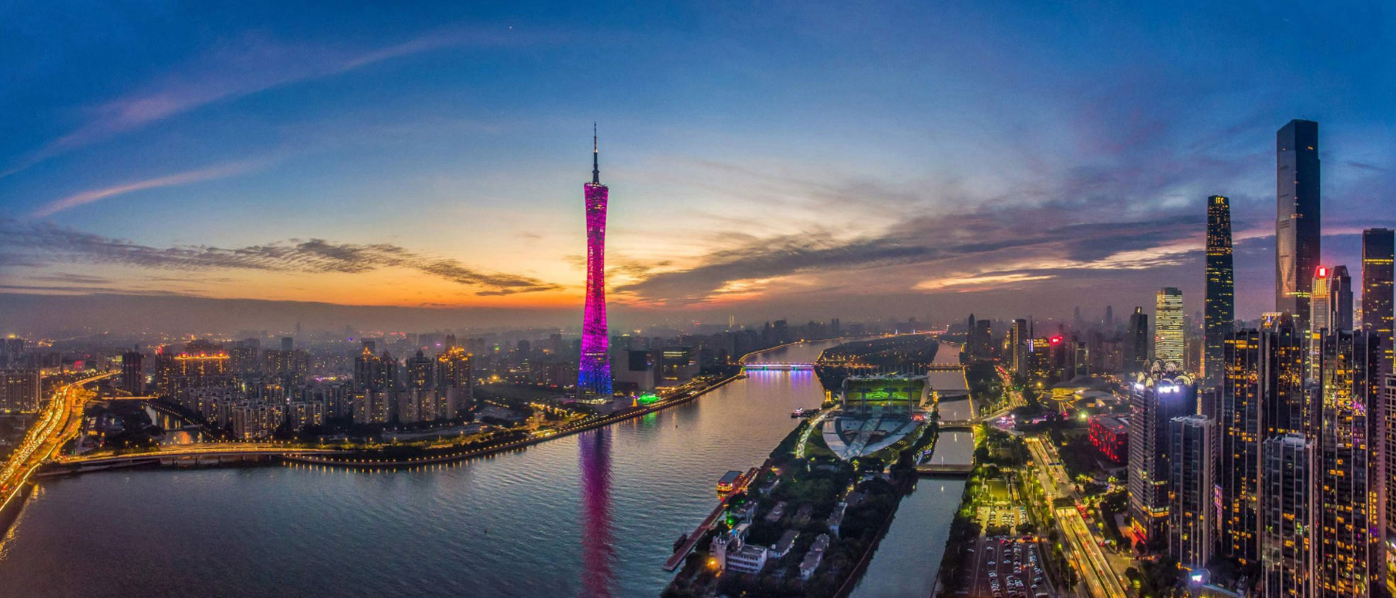
Learning Everywhere: Machine (actually Deep) Learning Delivers HPC
Geoffrey Fox, September 17, 2019
SKG 2019 The 15th International Conference on Semantics, Knowledge and Grids
On Big Data, AI and Future Interconnection Environment
Guangzhou, China, 17-18 Sept 2019
Digital Science Center
Indiana University
gcf@indiana.edu, http://www.dsc.soic.indiana.edu/, http://spidal.org/

Slide 2
Evolution of Interests, Technologies and Communities
AI/ML
Systems
HPC
Cloud
Big Data
Edge
Data Science v. AI First

Slide 3
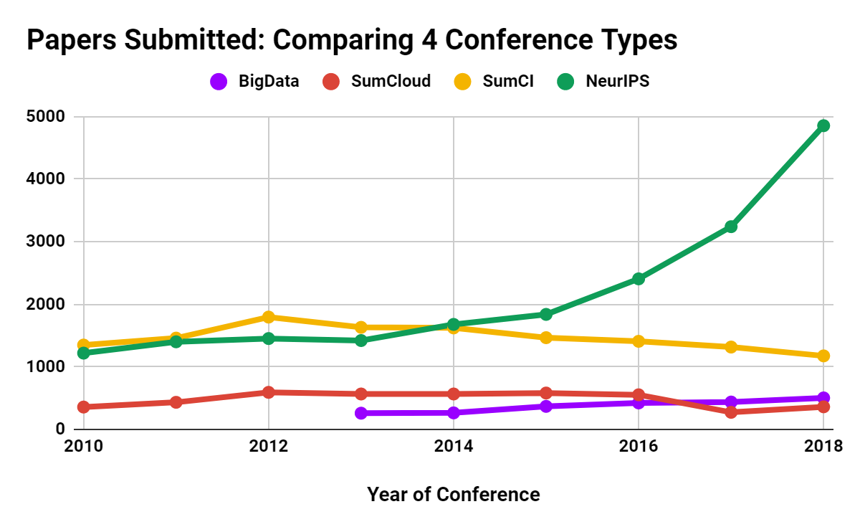
Papers Submitted: Comparing 4 Conference Types
SumCI: SC, eScience, CCGrid, IPDPS
SumCloud: IEEE Cloud, Cloudcom
Notes:
Summary

Slide 4
Trends in AI, Big Data, Clouds, Edge, HPC over last 5 years
Artificial Intelligence
Amazon Web Services (Proxy for cloud computing)
Internet of Things
Big Data
High Performance Computing (1%)

Slide 5
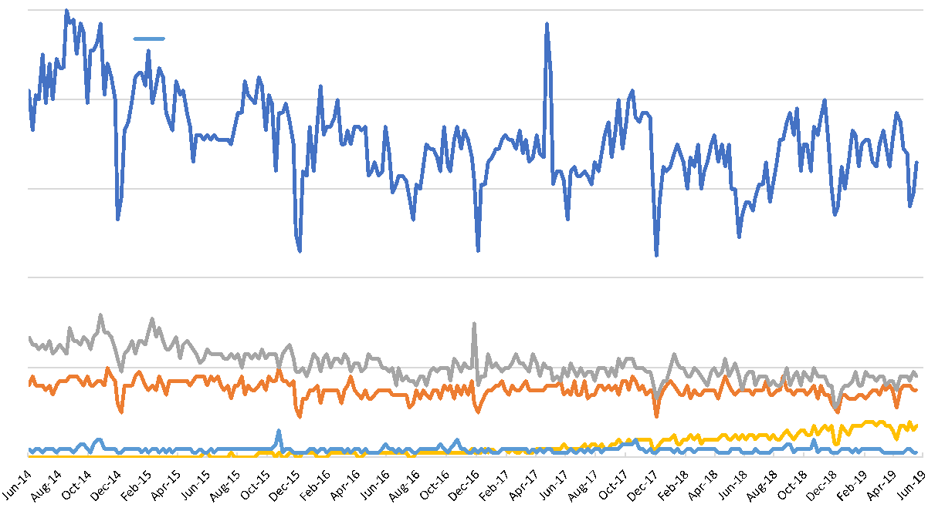
Some smaller areas: Google Trends last 5 years (Topics unless stated)
Cloud Computing (Search Term)
Grid Computing
HPC
Edge Computing
SuperComputing (Search Term)

Slide 6
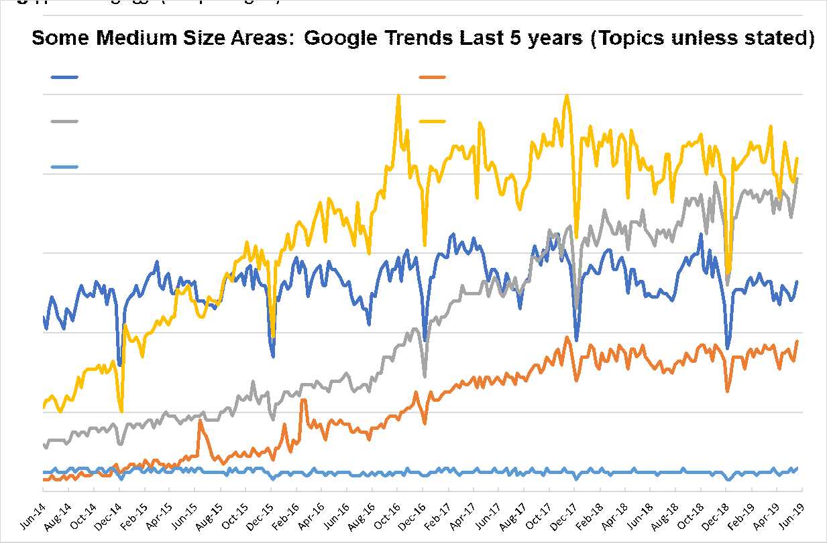
Some medium size areas: Google Trends last 5 years (Topics unless otherwise stated)
AI IS 10X BIG DATA, CYBERINFRASTRUCTURE, EXASCALE SMALL
Internet of Things
Machine Learning
(Search Term)
Big Data
Deep Learning
High Performance Computing (HPC)
Notes:
●IoT ML DL growing
●Big Data HPC flattish with HPC < Big Data

Slide 7
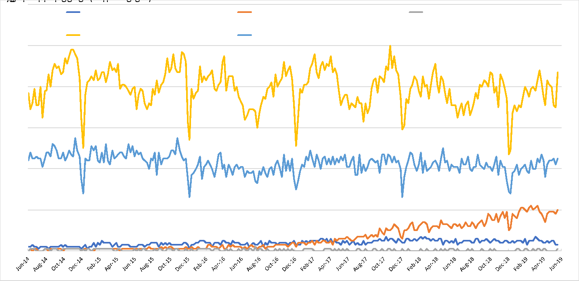
Some smaller areas: Google Trends last 5 years (Topics unless otherwise stated)
Parallel Computing (Programming Paradigm)
HPC
Edge Computing
Fog Computing
Cyberinfrastructure
Notes:
●Some small fields. Edge growing but pretty small

Slide 8
H5-index Conferences: AI, Big Data, Cloud, Systems, Other 2018 (2019 Brown)
H5 is h index for papers over 5 years for conferences and journals
158 (188) CVPR: Conference on Computer Vision and Pattern Recognition
101 (134) NeurIPS: Neural Information Processing Systems
98 (104) ECCV: European Conference on Computer Vision
91 (113) ICML: International Conference on Machine Learning
89 (124) ICCV: International Conference on Computer Vision
85 (86) CHI: Computer Human Interaction
80 (76) INFOCOM: Joint Conference of the Computer and Communications Societies
77 (76) WWW: International World Wide Web Conferences
73 (74) VLDB: International Conference on Very Large Databases
73 (77) SIGKDD: International Conference on Knowledge discovery and data mining
71 (75) ICRA: International Conference on Robotics and Automation
56 (69) AAAI: Assoc. Adv. AI Conference on Artificial Intelligence
54 (58) ISCA: International Symposium on Computer Architecture
50 (54) IROS: International Conference on Intelligent Robots and Systems
50 (51) ASPLOS: International Conference on Architectural Support for Programming Languages and Operating Systems
47 (42) SC: International Conference on High Performance Computing, Networking, Storage and Analysis
46 (51) HPCA: International Symposium on High Performance Computer Architecture
45 (61) IJCAI: International Joint Conference on Artificial Intelligence
43 (42) BMVC: British Machine Vision Conference
43 (46) IPDPS: International Symposium on Parallel & Distributed Processing
41 (41) MICRO: International Symposium on Microarchitecture
39 (31) CLOUD: International Conference on Cloud Computing
39 (?) OSDI: Symposium on Operating Systems Design and Implementation
37 (33) OOPSLA: SIGPLAN International Conference on Object-Oriented Programming, Systems, Languages, and Applications
37 (32) PPOPP: SIGPLAN Symposium on Principles & Practice of Parallel Programming
37 (33) CCGrid: International Symposium on Cluster Computing and the Grid
34 (41) ICIP: International Conference on Image Processing
34 (28) ICPR: International Conference on Pattern Recognition
30 (35) SoCC: Symposium on Cloud Computing
29 (22) ECAI: European Conference on Artificial Intelligence
29 (28) HPDC: International Symposium on High Performance Distributed Computing
28 (25) CloudCom: International Conference on Cloud Computing Technology and Science
26 (25) ICS: International Conference on Supercomputing
25 (33) Big Data: International Conference on Big Data
21 (20) CLUSTER: International Conference on Cluster Computing
21 (22) SPAA: Symposium on Parallelism in Algorithms and Architectures
20 (20) ICPP: International Conference on Parallel Processing
18 (20) ICCSA: International Conference on Computational Science and Its Applications
15 (12) SBAC-PAD: International Symposium on Computer Architecture and High Performance Computing
14 (11) DS-RT: International Symposium on Distributed Simulation and Real-Time Applications
Some didn’t make h5-index cut of >=12
Notes:
Escience below cut
H5 shows dominance of AI

Slide 9
Importance of HPC, Cloud, Edge and Big Data Community
HPC Community not growing in terms of obvious metrics such as new faculty advertisements, student interest, papers published
Cloud Community quite strong in Industry; relatively small academically as Industry has some advantages (infrastructure and data)
Big data and Edge communities strong in Academia and Industry
  Big Data definition unclear but it is growing although still quite small in terms of dedicated activities
At IEEE services federation in Milan just completed; Cloud Edge IoT and Big Data conferences had significant overlap – not surprising as most IoT/Edge systems connect to Cloud and essentially all Big Data computing uses cloud.
All these academic fields need to align with mainstream (Industry) systems
Microsoft described the AI Supercomputer linking Intelligent Cloud to Intelligent Edge

Slide 10
Importance of AI and Data Science
AI (and several forms of ML which is becoming DL) will dominate the next 10 years and it has distinctive impact on applications whereas HPC, Clouds and Big Data are important and essential enablers
AI First popular with Industry with 2017 Headlines
  The Race For AI: Google, Twitter, Intel, Apple In A Rush To Grab Artificial Intelligence Startups
  Google, Facebook, And Microsoft Are Remaking Themselves Around AI
  Google: The Full Stack AI Company
  Bezos Says Artificial Intelligence to Fuel Amazon's Success
  Microsoft CEO says artificial intelligence is the 'ultimate breakthrough'
  Tesla’s New AI Guru Could Help Its Cars Teach Themselves
  Netflix Is Using AI to Conquer the World... and Bandwidth Issues
  How Google Is Remaking Itself As A “Machine Learning First” Company
  If You Love Machine Learning, You Should Check Out General Electric
Could refine emphasis on data science as AI First X
  where X runs over areas where AI can help
  e.g. AI First Engineering; AI First Cyberinfrastructure; AI First Social Science etc.

Slide 11
ML/AI needs Systems and HPC
HPC is part of Systems Community and includes parallel computing
Recently most technical progress from ML/AI and Big Data Systems
At IU, Data Science students emphasize ML over systems
Applications are Cloud, Fog, Edge systems
Any real Big Data or Edge application needs High Performance Big Data computing with systems and ML/AI expertise
  Distributed big data management (not AI) maybe doesn’t need HPC
  HPC and Cyberinfrastructure are critical technologies for analytics/AI but mature so innovation and h-index not so high

Slide 12
Overall Environment
Cloud Computing domination; it is all data center computing
  Including HPC offered by Public Clouds
MLPerf
Apache Big Data Stack
5 Computation Paradigms
Global AI Supercomputer
Intelligent Cloud and Intelligent Edge
Clouds & Deep Learning Lead
Follow and make use of technologies and architectures developed in Industry but exploit for science

Slide 13
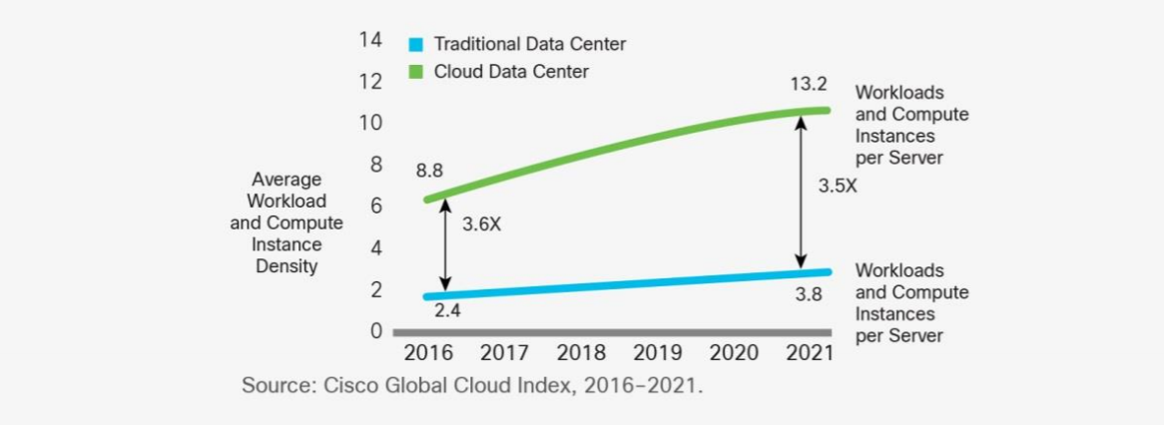
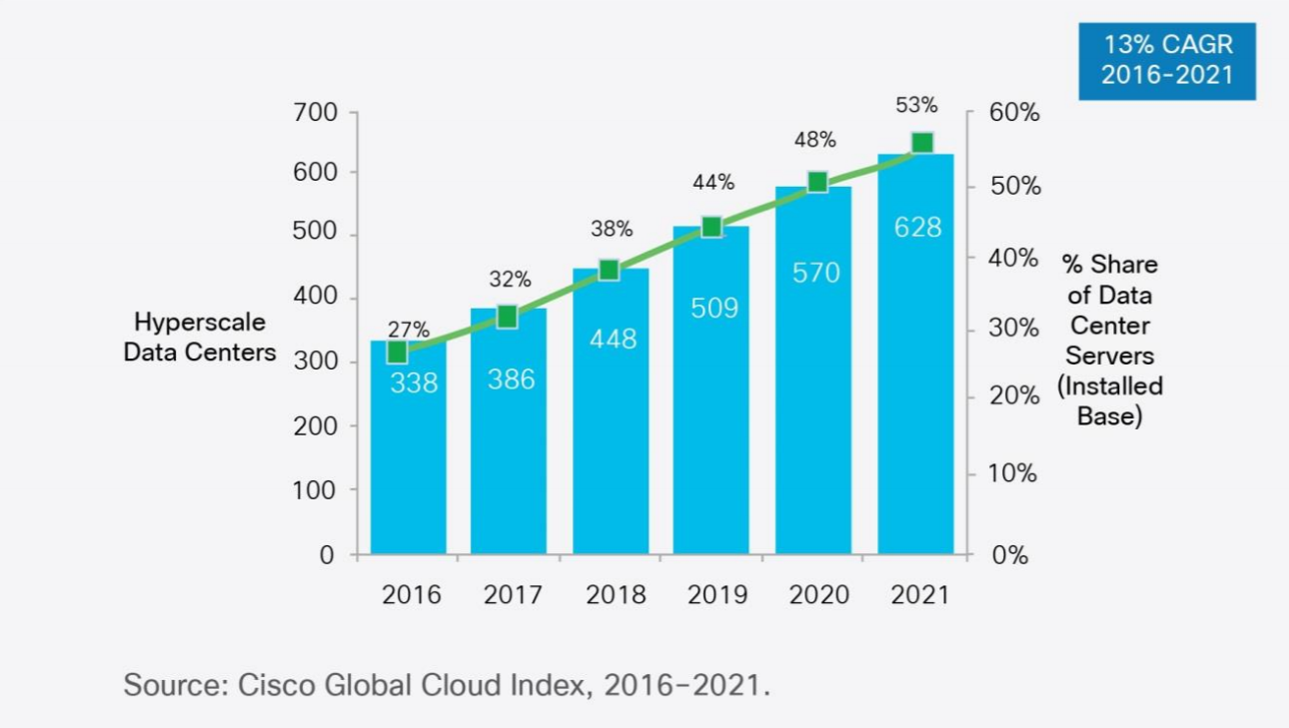
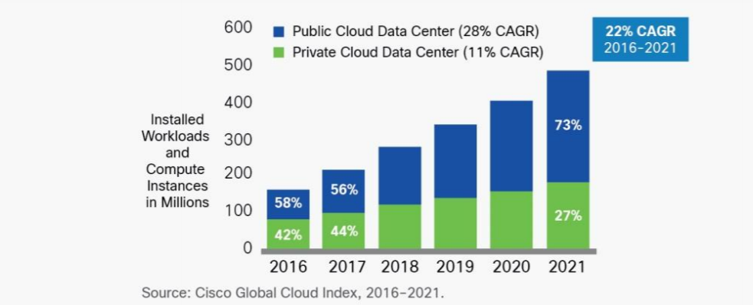
Dominance of Cloud Computing
Number of instances per server
94 percent of workloads and compute instances will be processed by cloud data centers (22% CAGR) by 2021-- only six percent will be processed by traditional data centers (-5% CAGR).
Hyperscale data centers will grow from 338 in number at the end of 2016 to 628 by 2021. They will represent 53 percent of all installed data center servers by 2021. They form a distributed Compute (on data) grid with some 50 million servers
Analysis from CISCO https://www.cisco.com/c/en/us/solutions/collateral/service-provider/global-cloud-index-gci/white-paper-c11-738085.html updated November 2018
Number of Cloud Data Centers
Number of Public or Private Cloud Data Center Instances

Slide 14
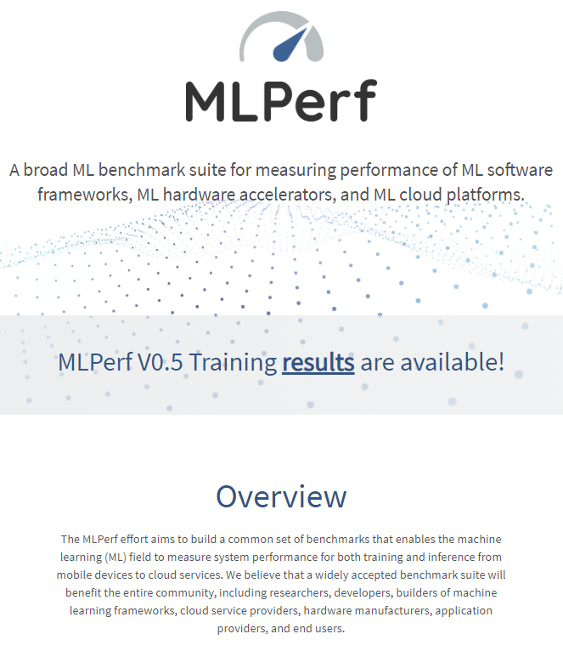
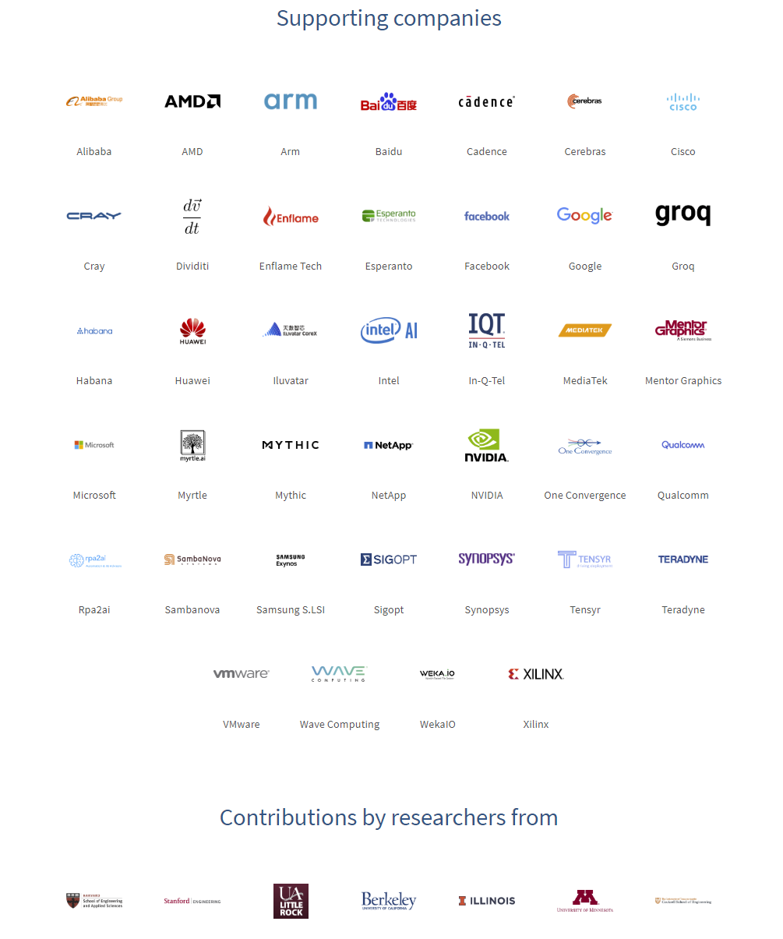
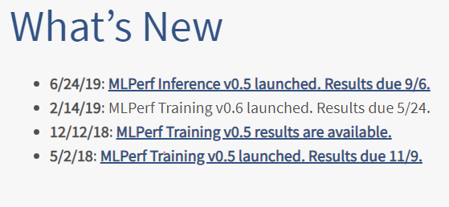
MLPerf's mission is to build fair and useful benchmarks for measuring training and inference performance of ML hardware, software, and services. MLPerf was founded in February, 2018 as a collaboration of companies and researchers from educational institutions. MLPerf is presently led by volunteer working group chairs. MLPerf could not exist without open source code and publically available datasets others have generously contributed to the community.
Get Involved
Join the forum
Join working groups
Attend community meetings
Make your organization an official supporter of MLPerf
Ask questions, or raise issues
Note Industry Dominance

Slide 15
ABDS
Apache Big Data Stack
HPC-ABDS is an integrated wide range of HPC and Big Data technologies.
I gave up updating list in January 2016!
21 layers

Slide 16
Architecture of five Big Data and Big Simulation Computation Paradigms
Dataflow and “in-place”
Classic Cloud Workload
These 3 are focus of Twister2 but we need to preserve capability on first 2 paradigms
Note Problem, Software and System all have an Architecture and efficient execution says they must match

Slide 17
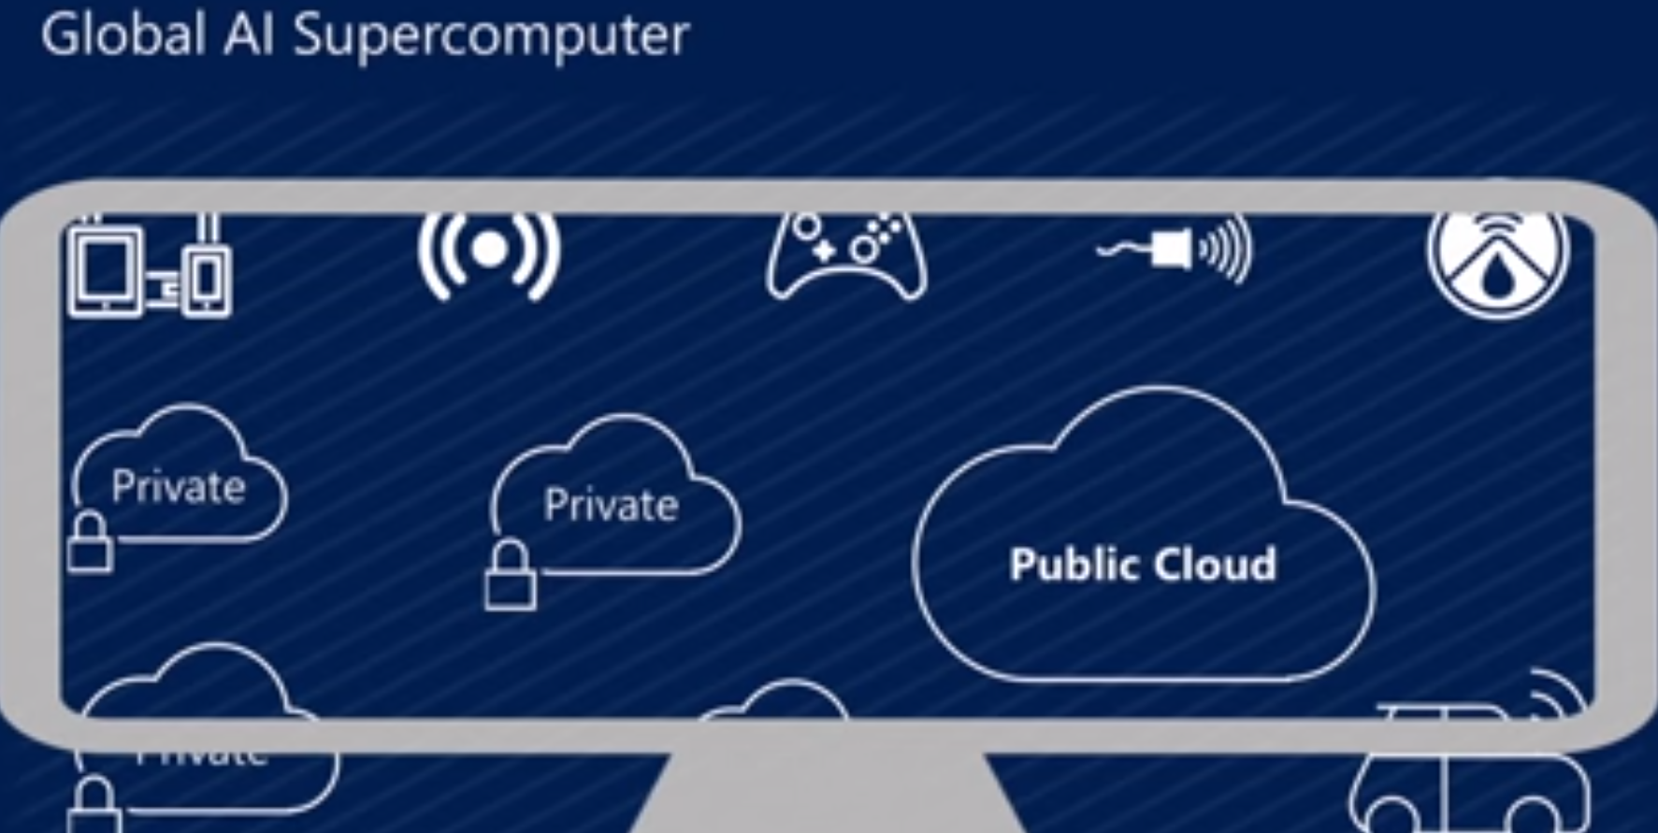
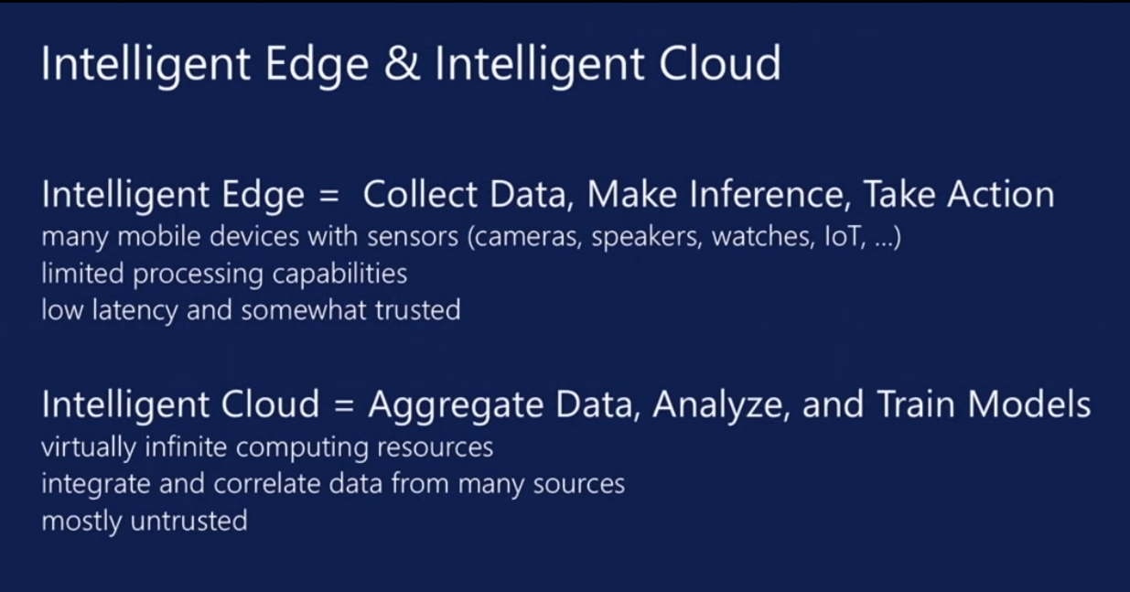
Microsoft Summer 2018: Global AI Supercomputer
By Donald Kossmann

Slide 18
Overall Global AI and Modeling Supercomputer GAIMSC Architecture
Global says we are all involved –
I added “Modeling” to get the Global AI and Modeling Supercomputer GAIMSC
There is only a cloud at the logical center but it’s physically distributed and domated by a few major players
Modeling was meant to include classic simulation oriented supercomputers
Even in Big Data, one needs to build a model for the machine learning to use
GAIMSC will use classic HPC for data analytics which has similarities to big simulations (HPCforML)
GAIMSC must also support I/O centric data management with Hadoop etc.
Nature of I/O subsystem controversial for such HPC clouds
  Lustre v. HDFS; importance of SSD and NVMe;
HPC Clouds would suggest that MPI runs well on Mesos and Kubernetes and with Java and Python

Slide 19
HPCforML and
MLforHPC
Technical aspects of converging HPC and Machine Learning
HPCforML
  Parallel high performance ML algorithms
  High Performance Spark, Hadoop, Storm
8 scenarios for MLforHPC
  Illustrate 4 scenarios
  Illustration of transforming Computational Biology
  Research Issues

Slide 20
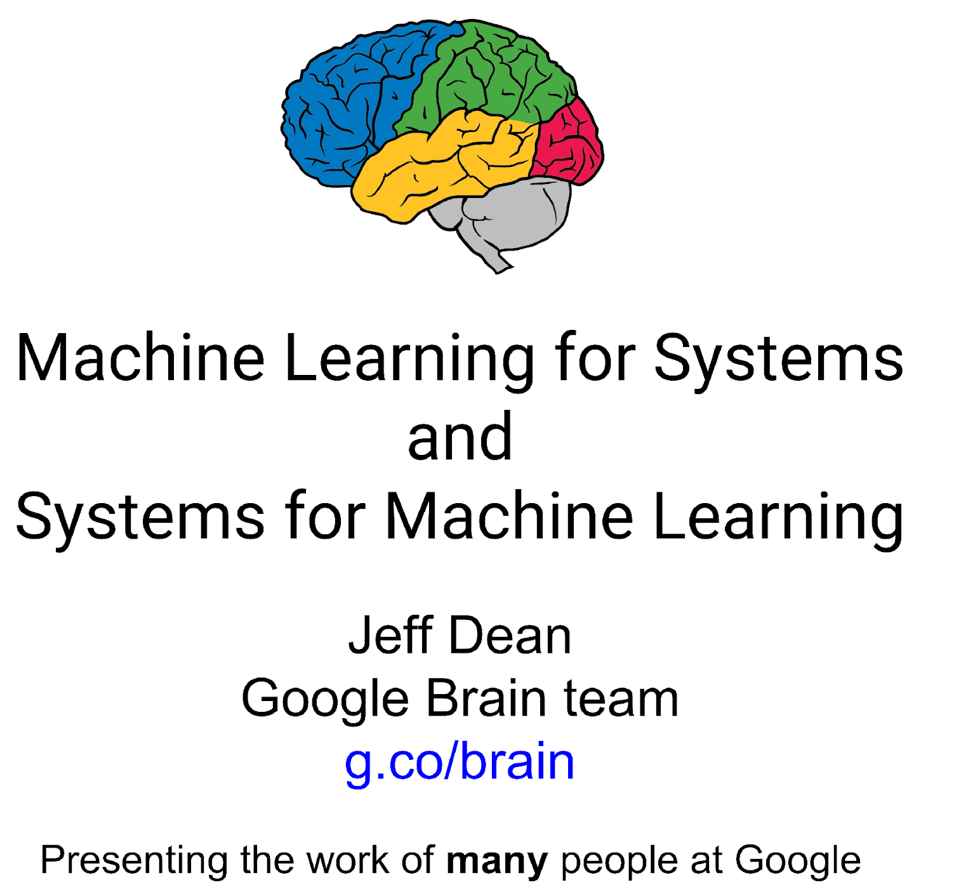
Dean at NeurIPS
DECEMBER 2017
ML for optimizing parallel computing (load balancing)
Learned Index Structure
ML for Data-center Efficiency
ML to replace heuristics and user choices (Autotuning)

Slide 21
Implications of Machine Learning for Systems and Systems for Machine Learning
We could replace “Systems” by “Cyberinfrastructure” or by “HPC”
I use HPC as we are aiming at systems that support big data or big simulations and almost by (my) definition could naturally involve HPC.
So we get ML for HPC and HPC for ML
HPC for ML is very important but has been quite well studied and understood
  It makes data analytics run much faster
ML for HPC is transformative both as a technology and for application progress enabled
  If it is ML for HPC running ML, then we have the creepy situation of the AI supercomputer improving itself
  Microsoft 2018 faculty summit discussed ML to improve Big Data systems e.g. configure database system.

Slide 22

MLaroundHPC
MLAutotuning

Slide 23
MLforHPC (ML for Systems) in detail
MLforHPC can be further subdivided into several categories:
  MLafterHPC: ML analyzing results of HPC as in trajectory analysis and structure identification in biomolecular simulations. Well established and successful
  MLControl: Using simulations (with HPC) and ML in control of experiments and in objective driven computational campaigns. Here simulation surrogates are very valuable to allow real-time predictions.
  MLAutotuning: Using ML to configure (autotune) ML or HPC simulations.
  MLaroundHPC: Using ML to learn from simulations and produce learned surrogates for the simulations or parts of simulations. The same ML wrapper can also learn configurations as well as results. Most Important.

Slide 24
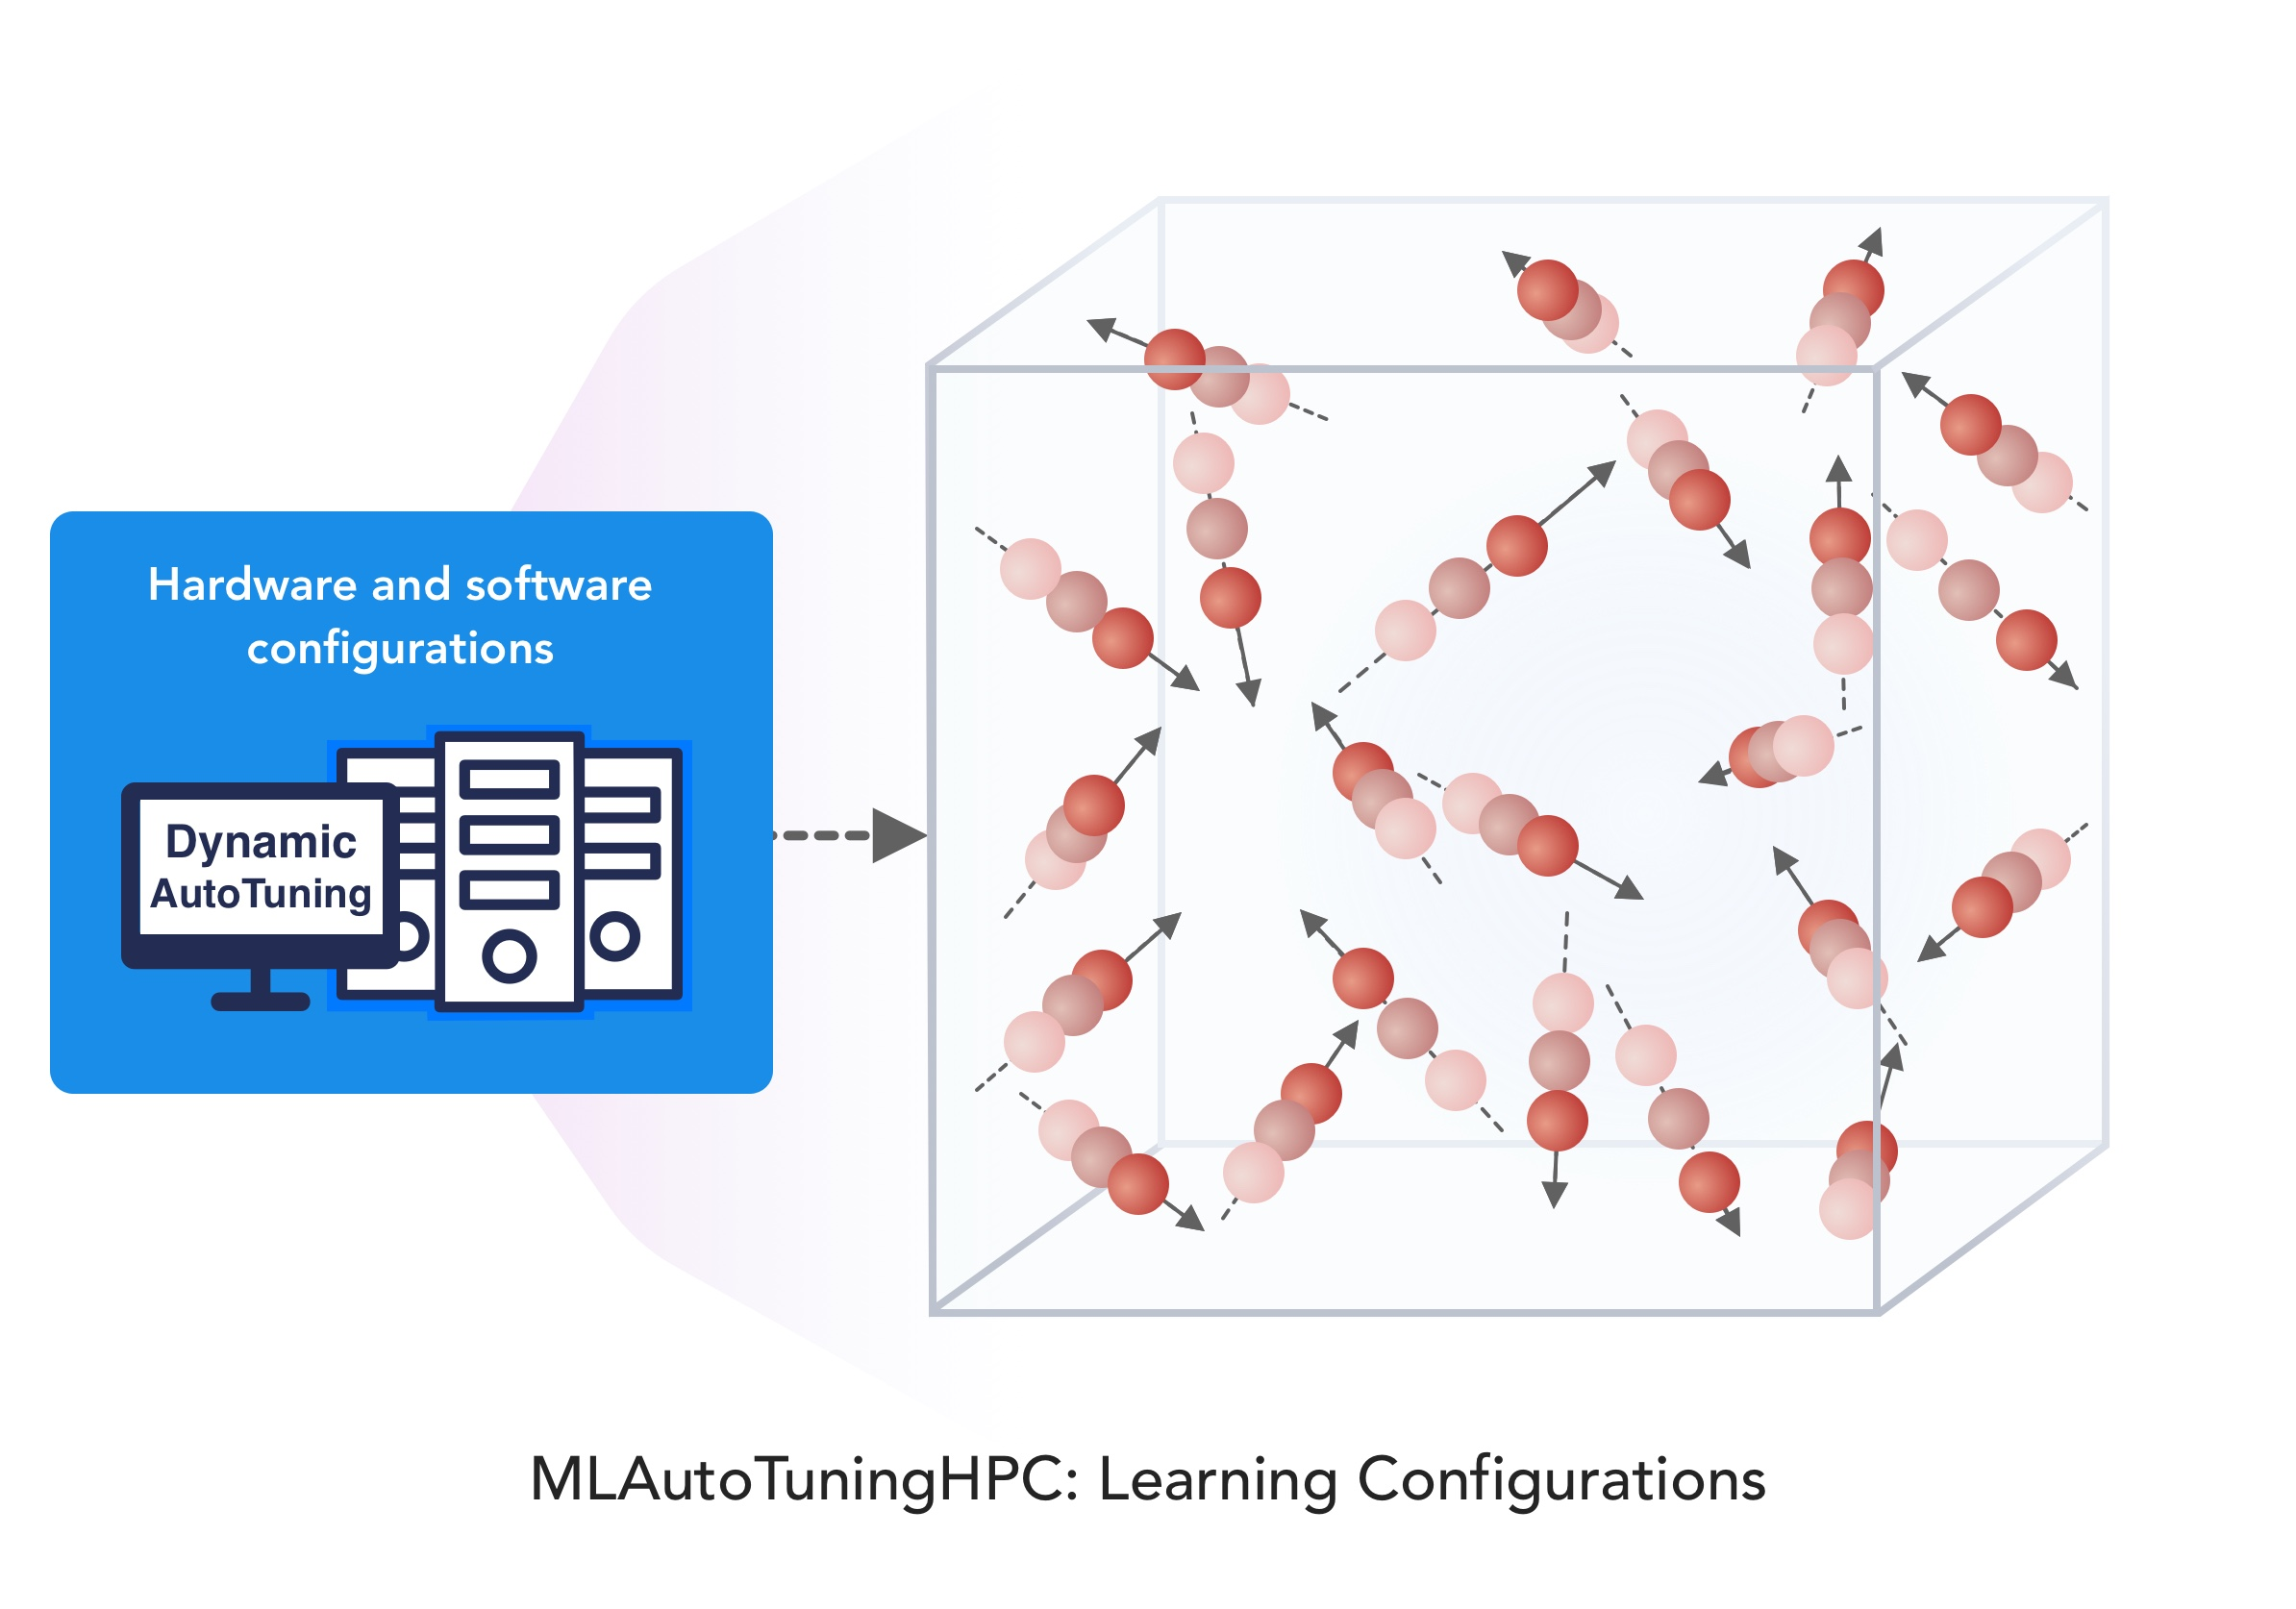
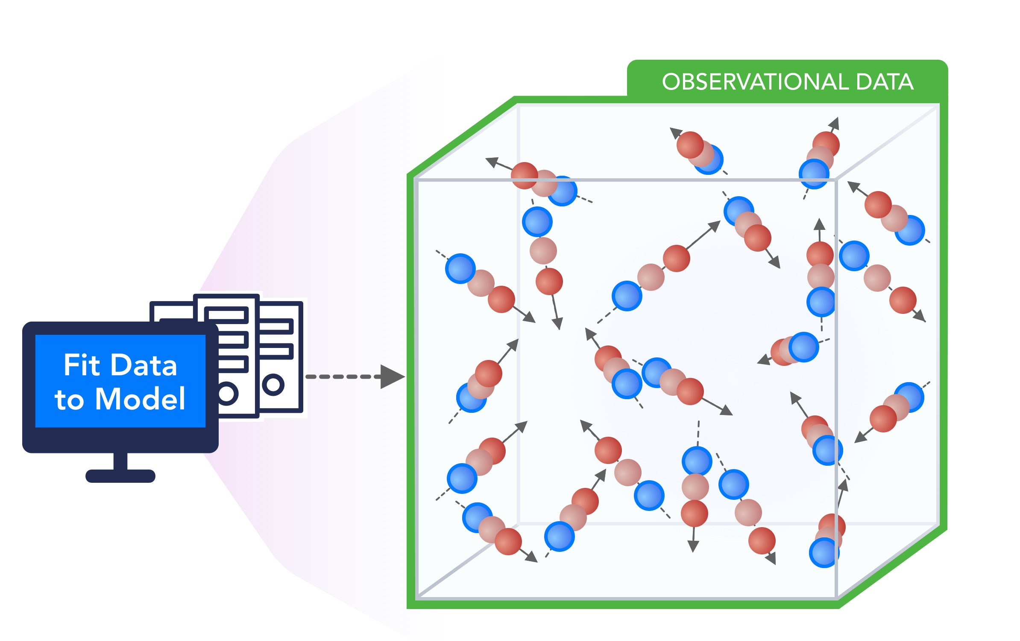
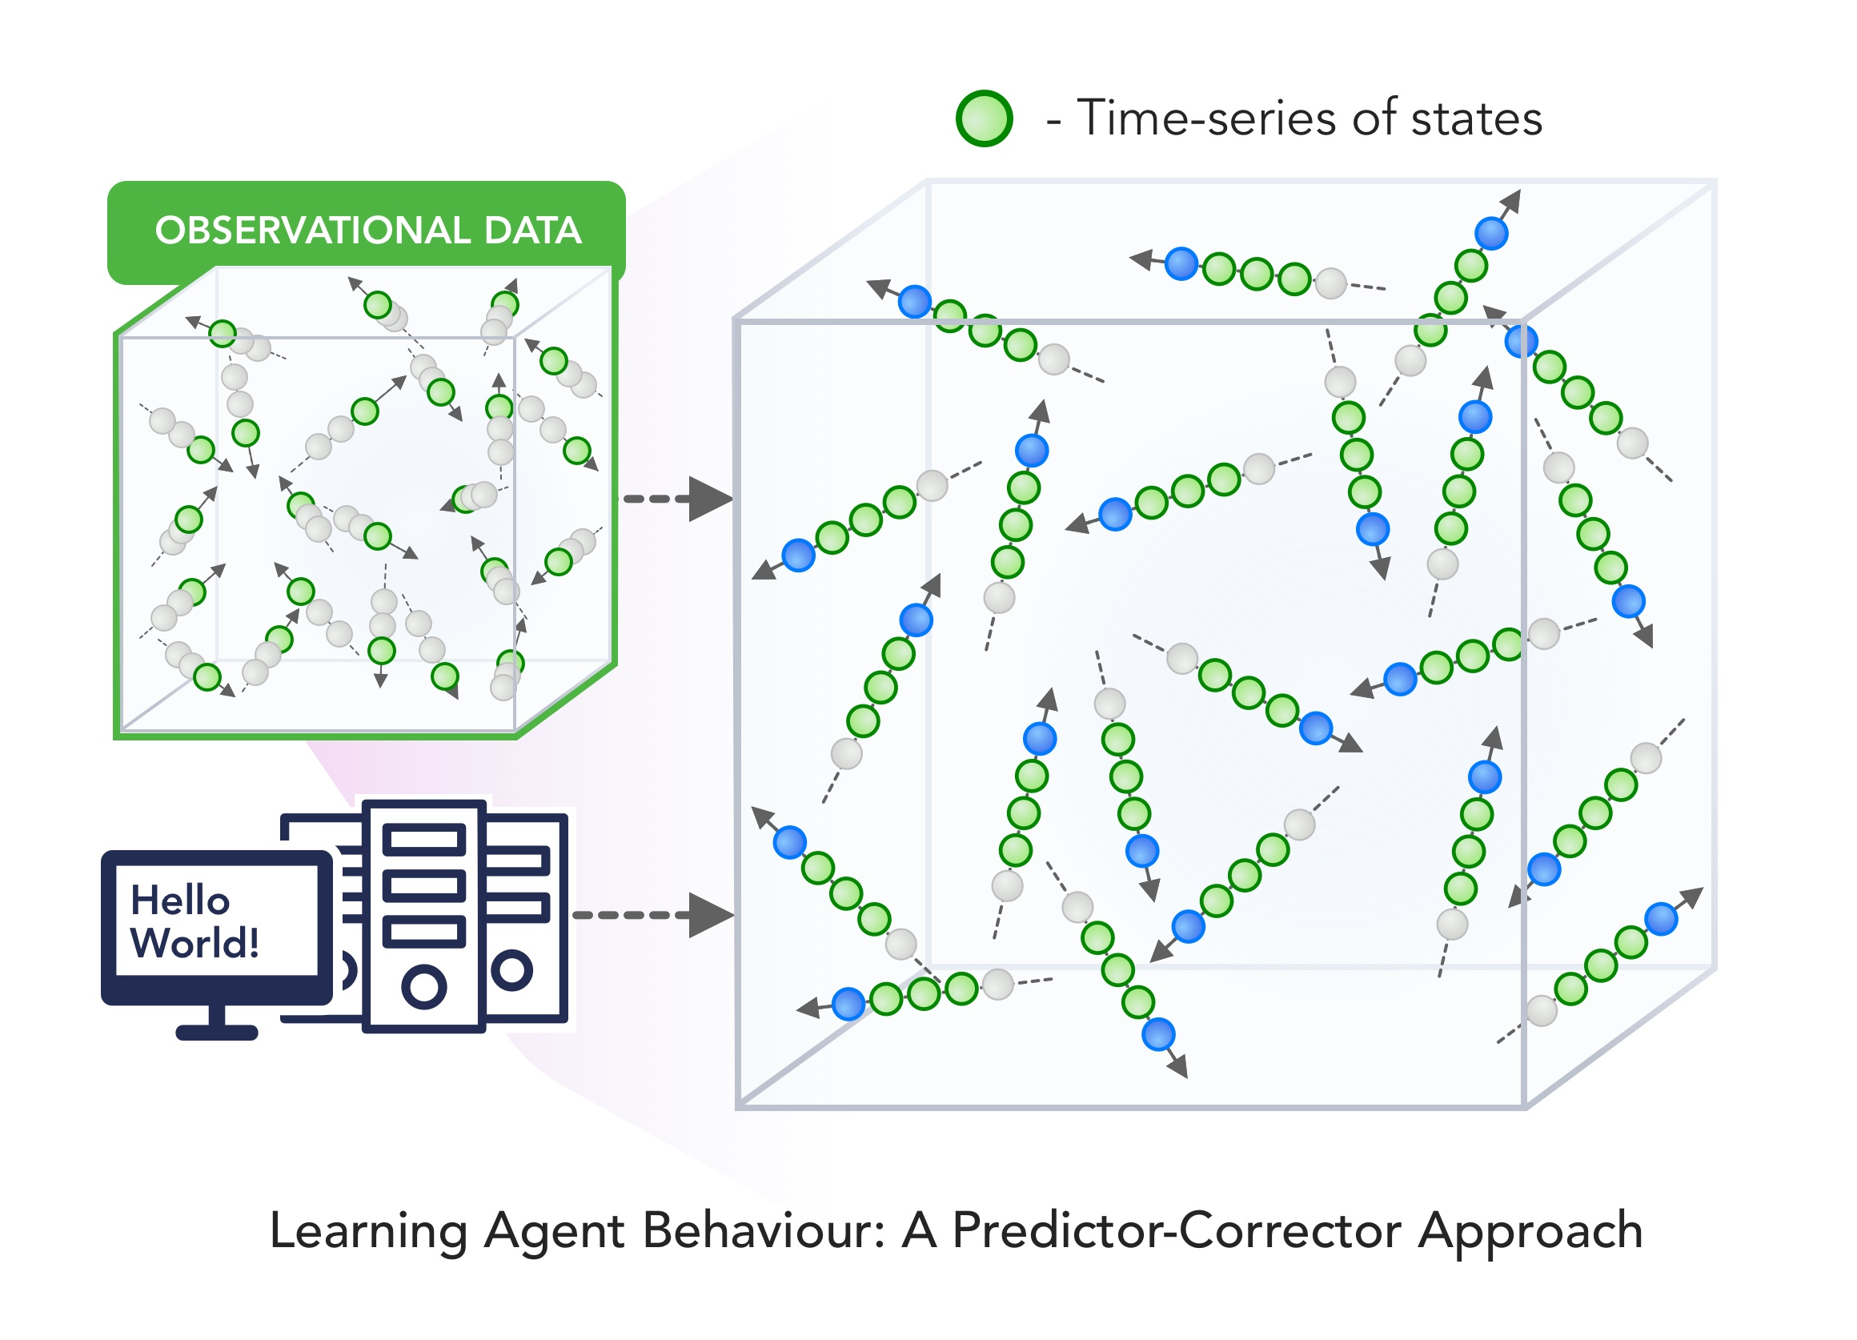
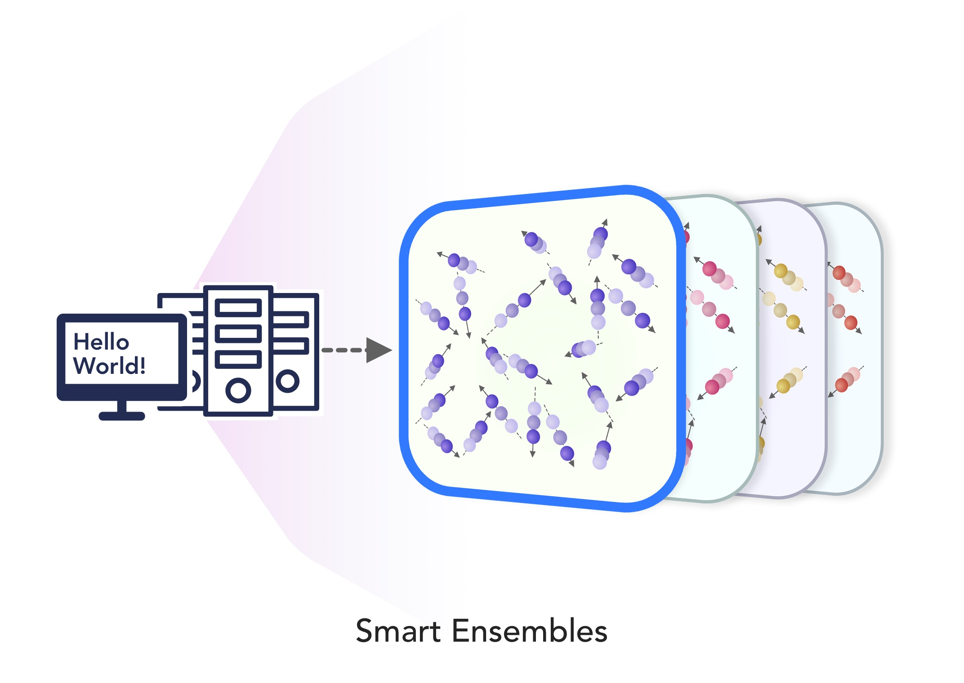
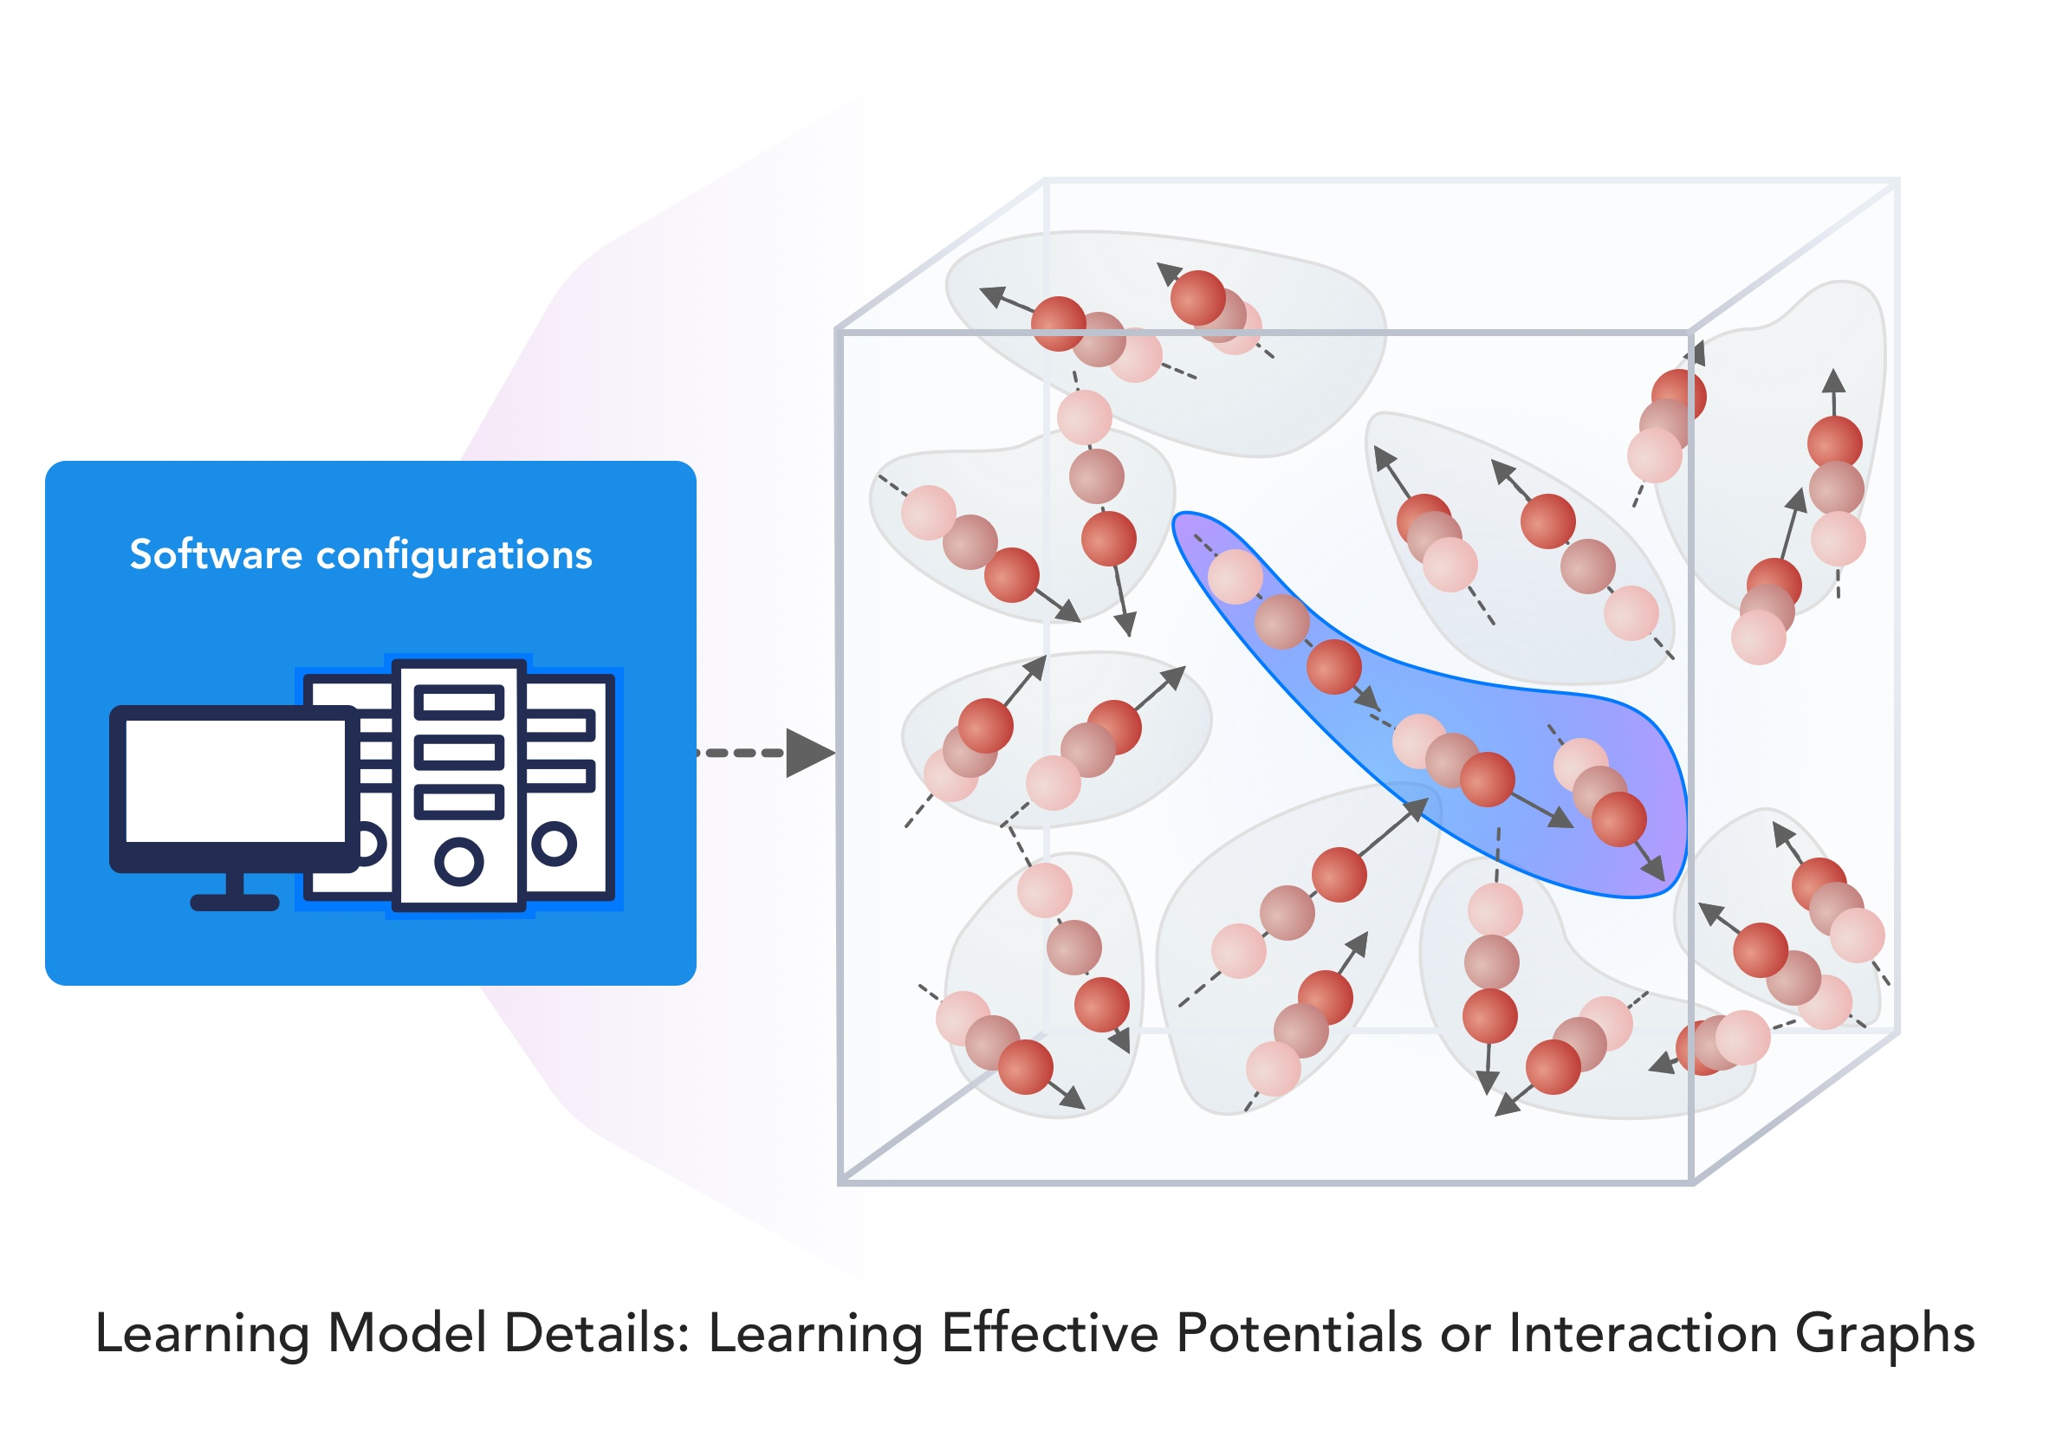
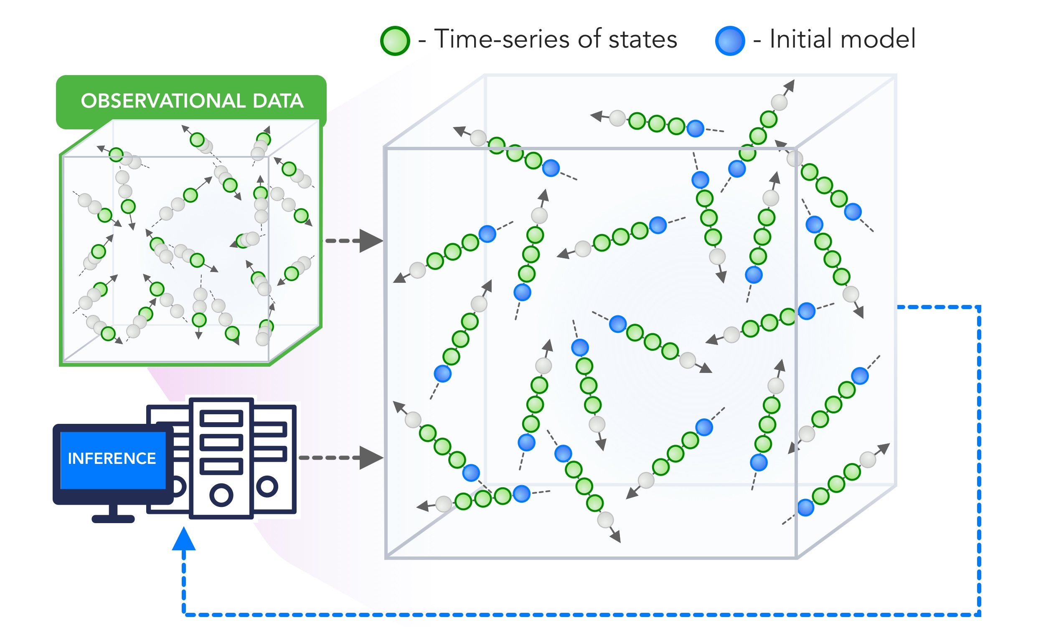
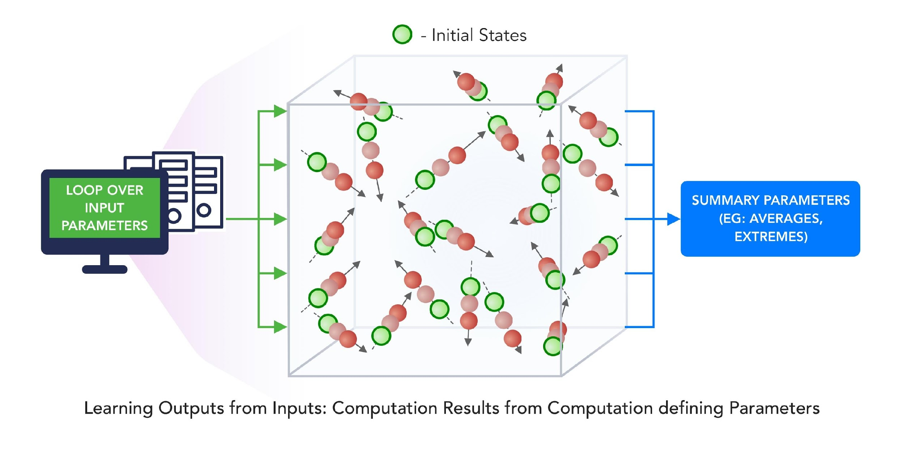
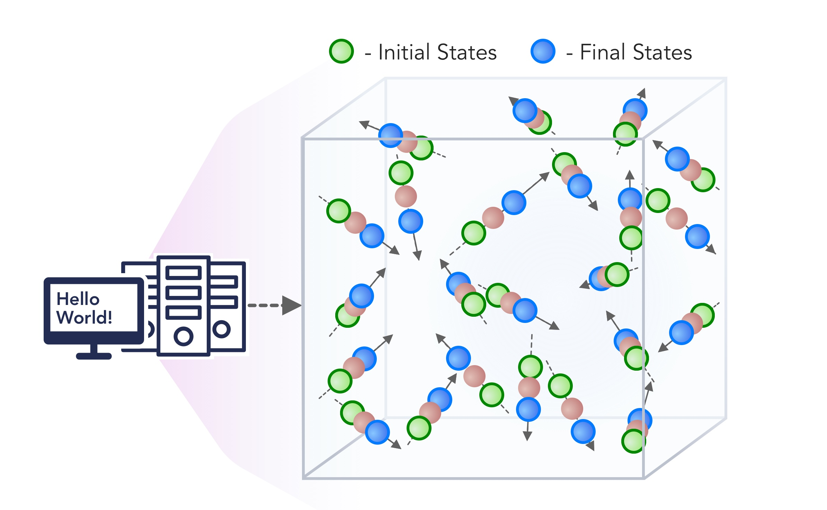
1. Improving Simulation with Configurations and Integration of Data
1.1 MLAutotuningHPC – Learn configurations
1.2 MLAutotuningHPC – Learn models from data
1.3 MLaroundHPC: Learning Model Details (ML based data assimilation)
2. Learn Structure, Theory and Model for Simulation
2.1 MLAutotuningHPC – Smart ensembles
2.2 MLaroundHPC: Learning Model Details (coarse graining, effective potentials)
2.3 MLaroundHPC: Improve Model or Theory
3. Learn Surrogates for Simulation
3.1 MLaroundHPC: Learning Outputs from Inputs (parameters)
3.2 MLaroundHPC: Learning Outputs from Inputs (fields)
INPUT
OUTPUT

Slide 25
3. MLforHPC Learn Surrogates for Simulation
3.1 MLaroundHPC: Learning Outputs from Inputs:
a) Computation Results from Computation defining Parameters
Here one just feeds in a modest number of meta-parameters that the define the problem and learn a modest number of calculated answers.
This presumably requires fewer training samples than “fields from fields” and is main use so far
Operationally same as SimulationTrainedML but with a different goal: In SimulationTrainedML the simulations are performed to directly train an AI system rather than the AI system being added to learn a simulation.

Slide 26
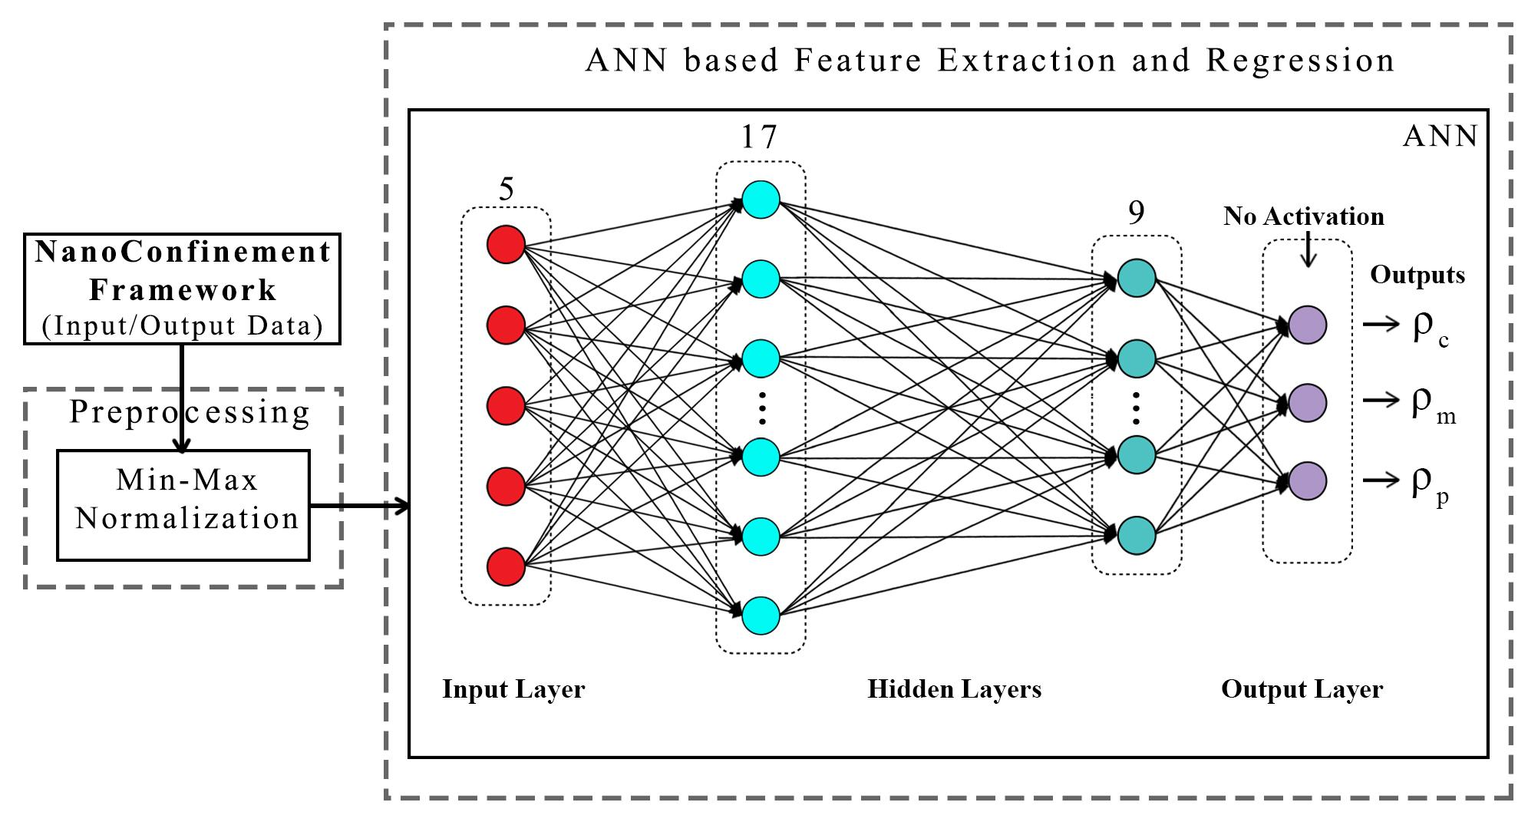
ANN for Regression
Dataset having 6,864 simulation configurations was created for training and testing (0.7:0.3) the ML model.
Note learning network quite small
ANN was trained to predict three continuous variables; Contact density ρ_{c} , mid-point (center of the slit) density ρ_{m} , and peak density ρ_{p}
TensorFlow, Keras and Sklearn libraries were used in the implementation
Adam optimizer, xavier normal distribution, mean square loss function, dropout regularization.
JCS Kadupitiya,
Geoffrey Fox,
Vikram Jadhao

Slide 27
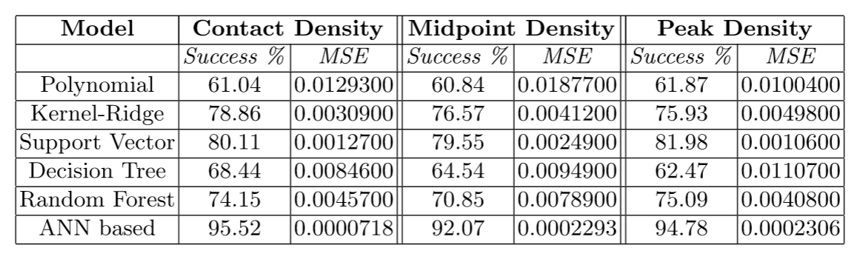
Parameter Prediction in Nanosimulation
ANN based regression model predicted Contact density ρ_{c} , mid-point (center of the slit) density ρ_{m} , and peak density ρ_{p} accurately with a success rate of 95:52% (MSE ~ 0:0000718), 92:07% (MSE ~ 0:0002293), and 94:78% (MSE ~ 0:0002306) respectively, easily outperforming other non-linear regression models
Success means within error bars (2 sigma) of Molecular Dynamics Simulations

Slide 28
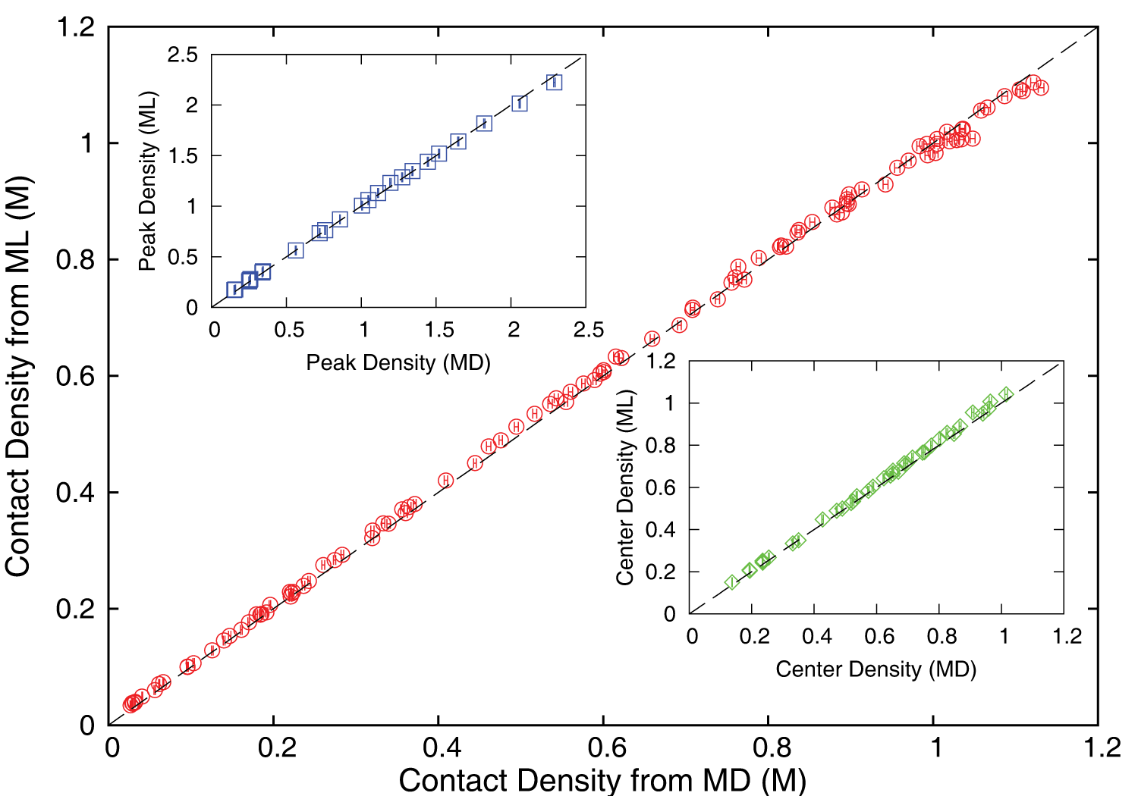
Accuracy comparison between ML predictions and MD simulation results
ρ_{c ,} ρ_{m} and ρ_{p} predicted by the ML model were found to be in excellent agreement with those calculated using the MD method; correlated data from both approaches fall on the dashed lines which indicate perfect correlation.

Slide 29
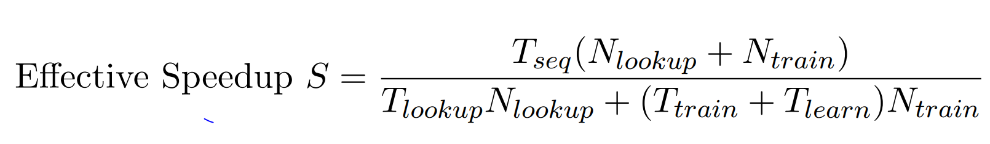
Speedup of MLaroundHPC
T_{seq} is sequential time
T_{train} time for a (parallel) simulation used in training ML
T_{learn} is time per point to run machine learning
T_{lookup} is time to run inference per instance
N_{train} number of training samples
N_{lookup} number of results looked up
Becomes T_{seq}/T_{train} if ML not used
Becomes T_{seq}/T_{lookup} (10⁵ in our case) if inference dominates (will overcome end of Moore’s law and win the race to zettascale)
Another factor as inferences uses one core; parallel simulation 128 cores
Speedup is strong (not weak with problem size increasing to improve performance) scaling as size fixed
N_{train} is 7K to 16K in our work

Slide 30
INSILICO MEDICINE USED CREATIVE AI TO DESIGN POTENTIAL DRUGS IN JUST 21 DAYS
September 4 2019 News Item
Map Drug (Material) Structure to Drug (Material) Properties
Hong Kong-based Insilico Medicine sent shockwaves through the pharma industry after publishing research in Nature Biotechnology that proves its AI-powered drug discovery system was capable of producing at least one potential treatment for fibrosis in less than a month's time.
The system bucks the standard brute-force approach for AI drug development, which involves screening millions of potential molecular structures looking for a viable fit, in favor of a Deep Reinforcement Learning algorithm that can imagine potential protein structures based on existing research and certain preprogrammed design criteria.
Insilico's system initially produced 30,000 possible designs, which the research team whittled down to six that were synthesized in the lab, with one design eventually tested on mice to promising results.
Insilico's AI-powered research process could offer a massive push forward for the pharmaceutical industry, which faces increasingly high drug development costs. In just a handful of weeks and for approximately $150,000, Insilico delivered what typically takes pharmaceutical companies $2.6 billion over seven years.

Slide 31
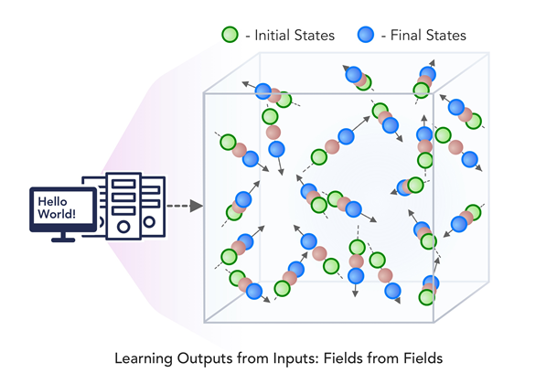
3. MLforHPC Learn Surrogates for Simulation
3.2 MLaroundHPC: Learning Outputs from Inputs:
b) Fields from Fields
Here one feeds in initial conditions and the neural network learns the result where initial and final results are fields
In simple cases, it is shown that you can learn Newton’s laws and their numerical approximation
Unclear how far but probably generalizes

Slide 32
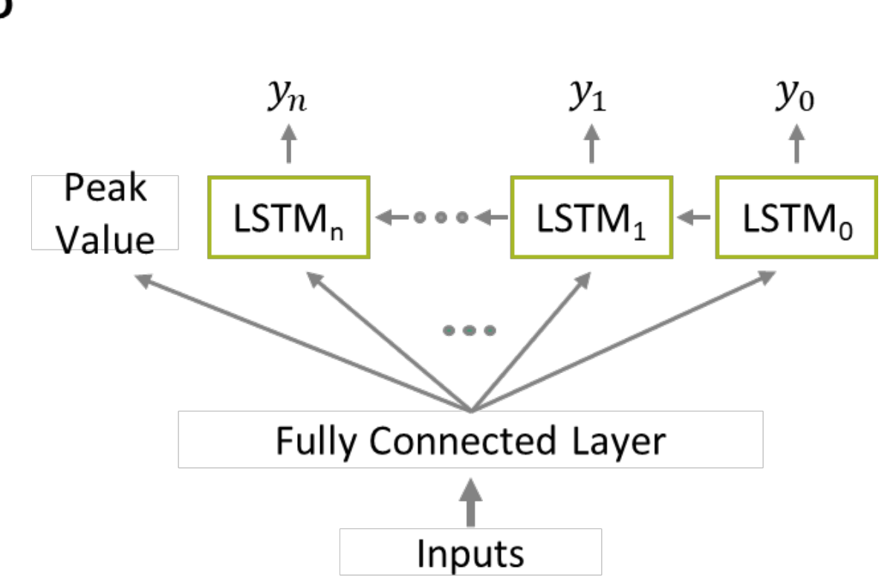
Example from a hybrid case? Fields from Parameters
If you are learning particular output features (as in Computation Results from Computation defining Parameters), then a simple (not necessarily deep) neural net suffices
If you want to learn the output fields (from either input fields or input Computation defining Parameters), then a more sophisticated approach is appropriate
Recent paper “Massive computational acceleration by using neural networks to emulate mechanism based biological models” uses 501 LSTM units to represent a one-dimensional grid of values which is output of a two-dimensional gene circuit simulation which only depends on radius.
Note LSTM models sequences and one gets
Sequences in either time (usual LSTM application) or space
The ML representation allowed a much richer parameter sweep showing features not in training set
Performance improved by factor 30,000

Slide 33
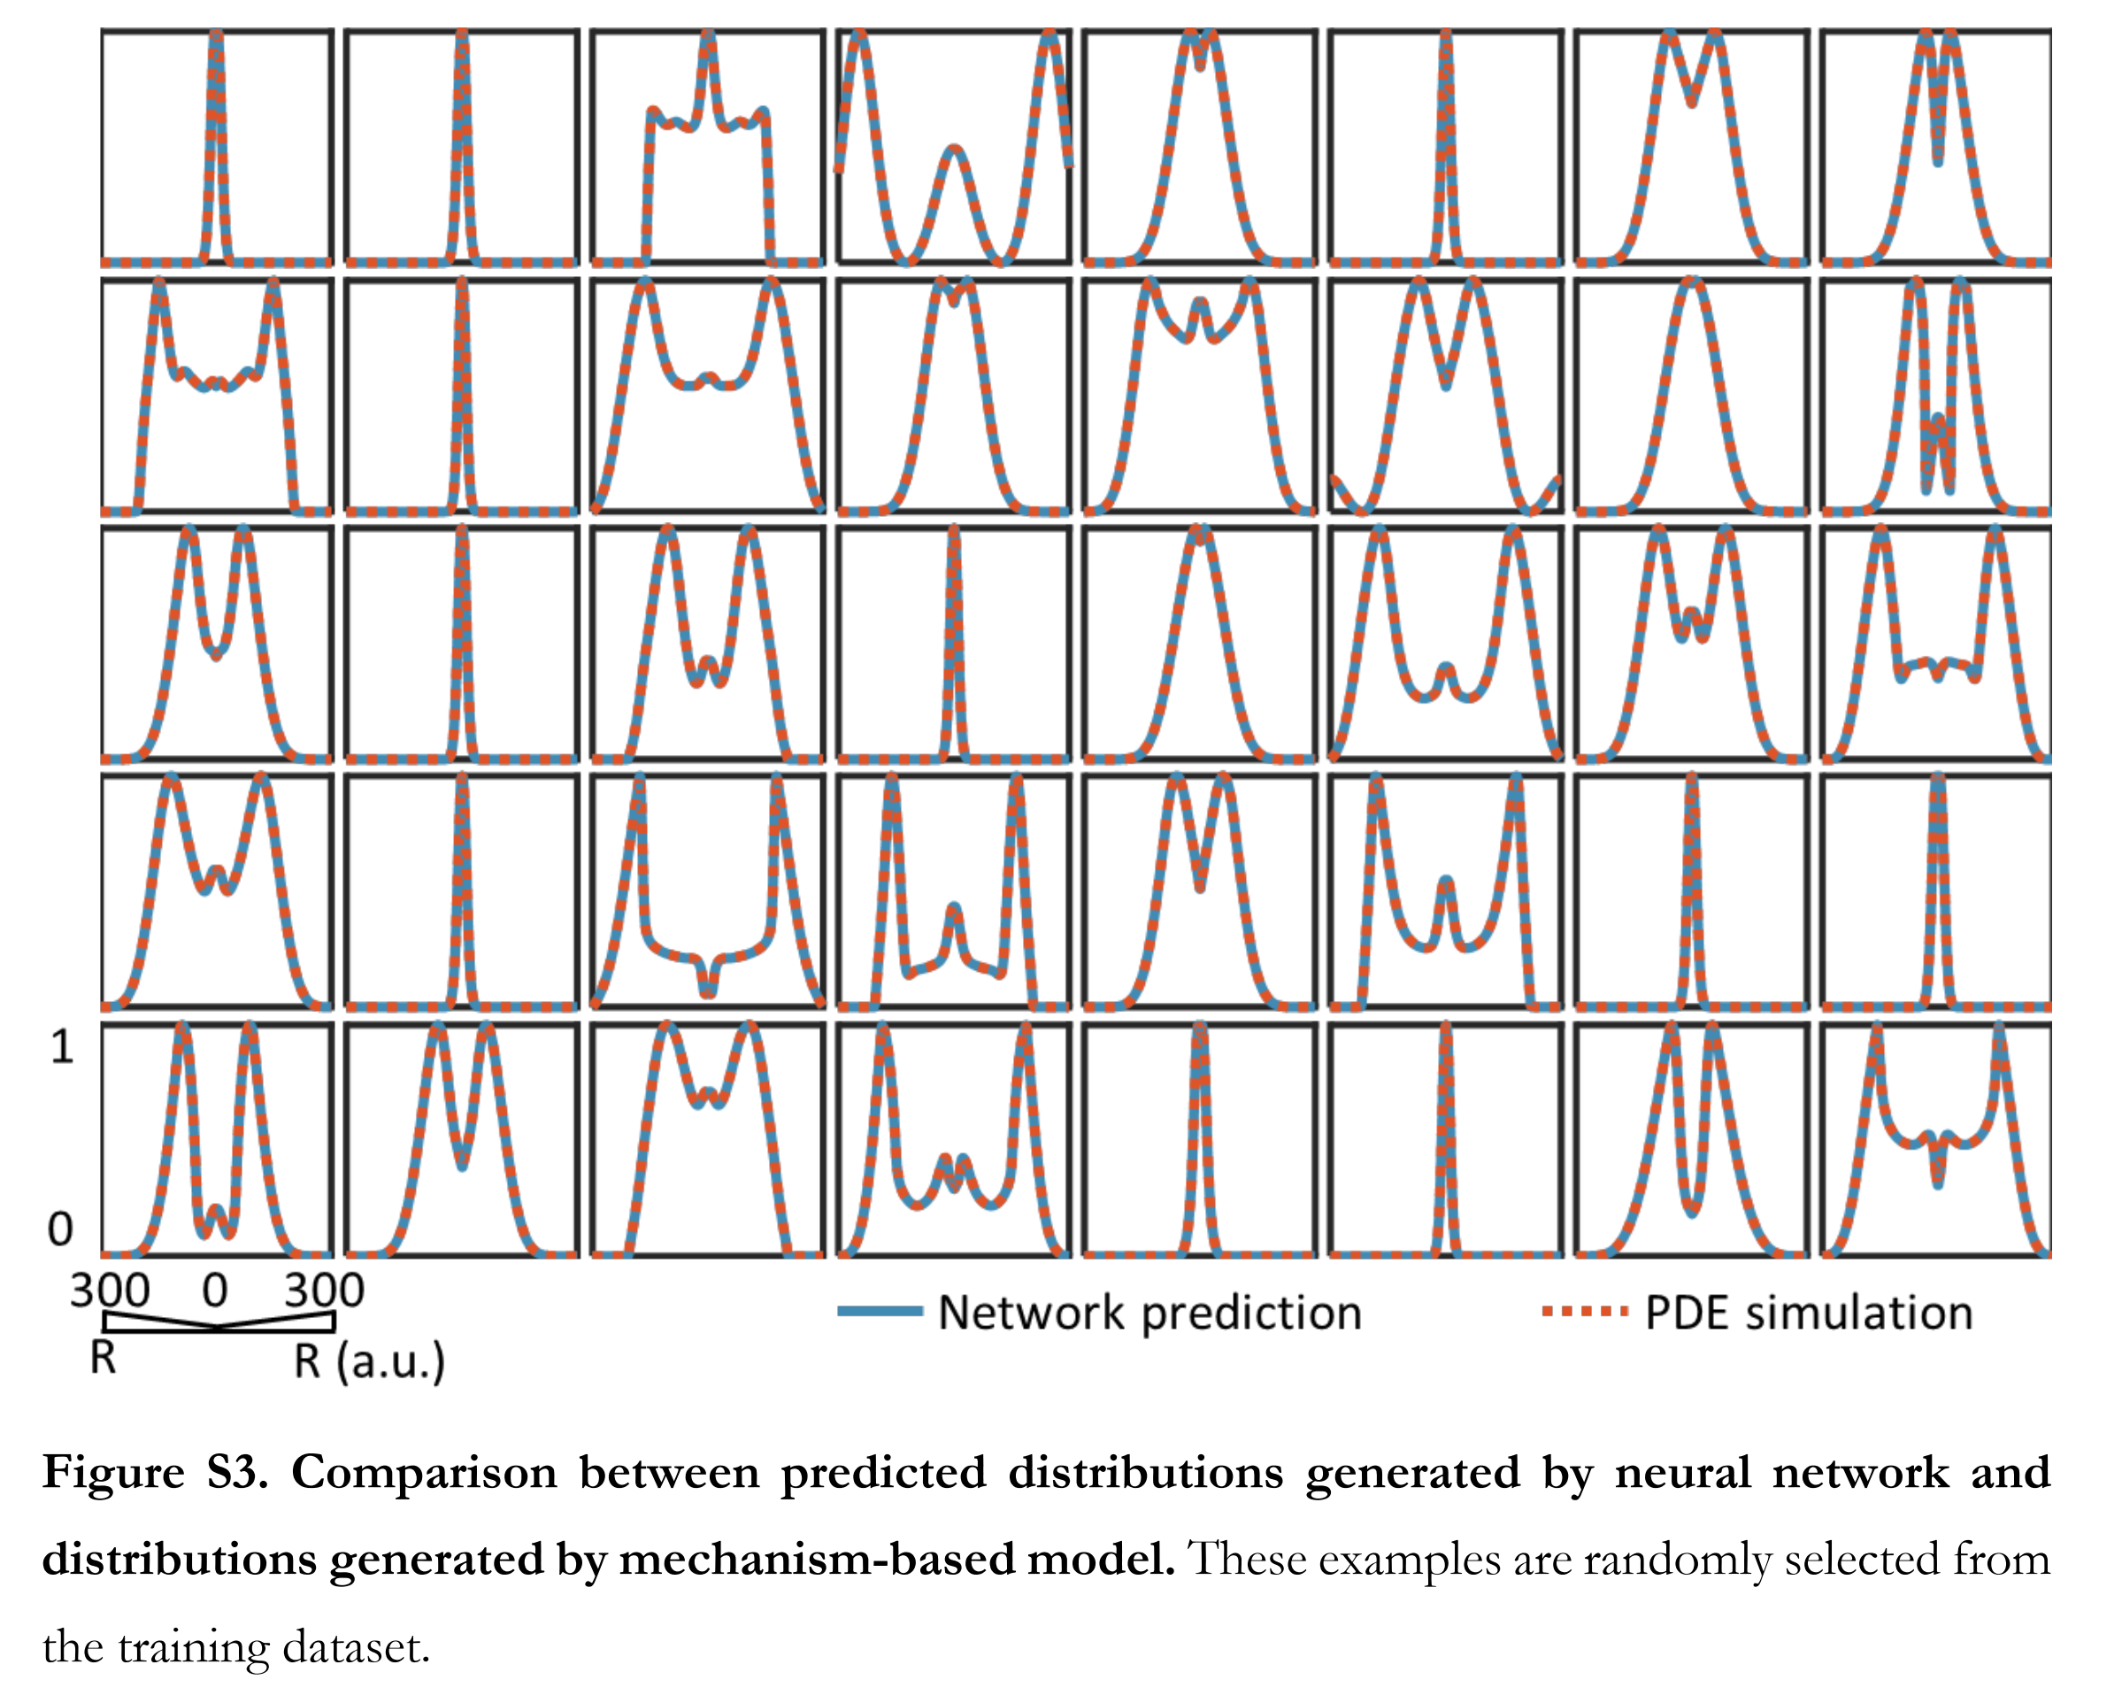
Massive computational acceleration by using neural networks to emulate mechanism based biological models

Slide 34
1. Improving Simulation with Configurations and Integration of Data
1.1 MLAutoTuningHPC: Learning Configurations
This is classic Autotuning and one optimizes some mix of performance and quality of results with the learning network inputting the configuration parameters of the computation.
This includes initial values and also dynamic choices such as block sizes for cache use, variable step sizes in space and time.
It can also include discrete choices as to the type of solver to be used.

Slide 35
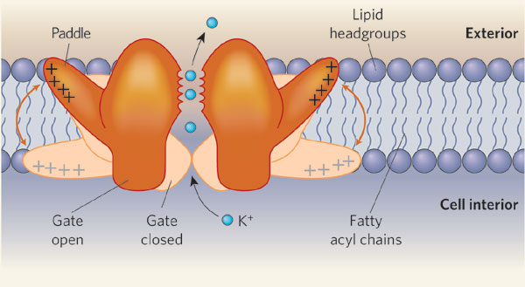
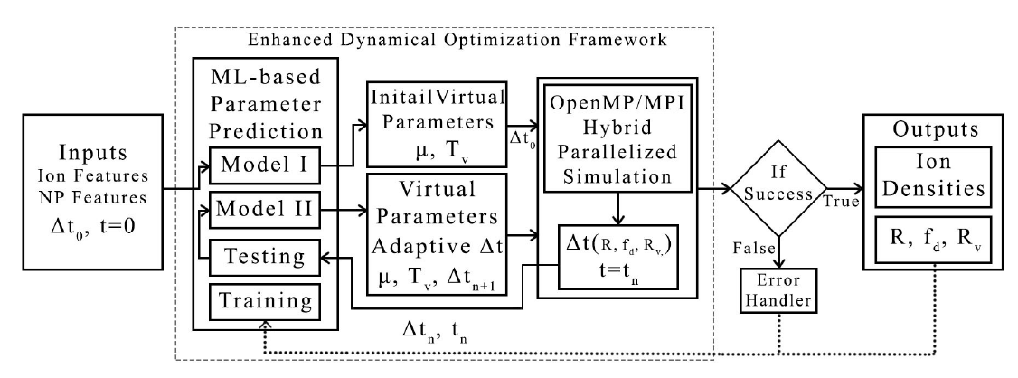
MLAutoTuningHPC: Learning Configurations by Parameter Auto-tuning in Molecular Dynamics Simulations: Efficient Dynamics of Ions near Polarizable Nanoparticles (NPs)
Integration of machine learning (ML) methods for parameter prediction for MD simulations by demonstrating how they were realized in MD simulations of ions near polarizable NPs.
Note ML used at start and end of simulation blocks
JCS Kadupitiya,
Geoffrey Fox,
Vikram Jadhao
ML-Based Simulation Configuration
Inference I
Inference I
Inference II
Inference II
Testing
Testing
Training
Training

Slide 36
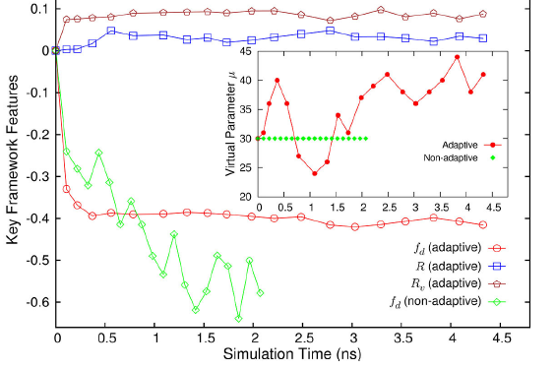
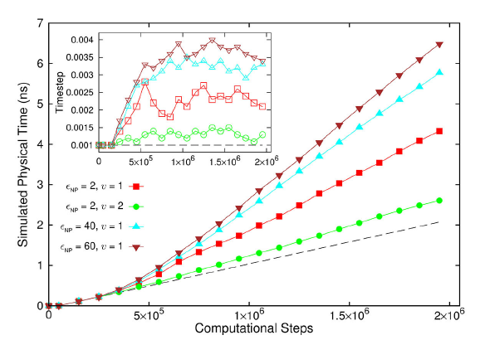
Results for Nanosimulation MLAutotuning
Key characteristics of simulated system showing greater stability for ML enabled adaptive approach.
Auto-tuning of parameters generated accurate dynamics of ions for 10 million steps while improving the stability.
Integrated with ML-enhanced framework with hybrid OpenMP/MPI
Maximum speedup of 3 from MLAutoTuning and a maximum speedup of 600 from the combination of ML and parallel computing.
Quality of simulation measured by time simulated per step with increasing use of ML enhancements. (Larger is better).
Inset is timestep used

Slide 37
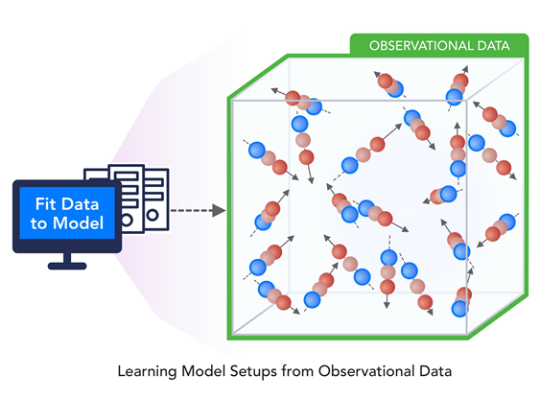
1. Improving Simulation with Configurations and Integration of Data
1.2 MLAutoTuningHPC: Learning Model Setups from Observational Data
One can use observational data to set up simulations in optimized fashion
Particularly effective in agent-based models where tuning agent (model) parameters to optimize their predictions versus available empirical data presents one of the greatest challenges in model construction

Slide 38
1. Improving Simulation with Configurations and Integration of Data
1.3 MLaroundHPC: Learning Model Details (ML for Data Assimilation)
a) Learning Agent Behavior One has a a set of cells as agents modeling a virtual tissue and use ML to learn both parameters and dynamics of cells replacing detailed computations by ML surrogates. As there can be millions to billions of such agents the performance gain can be huge as each agent uses same learned model.
b) Predictor-Corrector approach Take the case where data is a video or high dimensional (spatial extent) time series. Now one time steps models and at each step optimize the parameters to minimize divergence between simulation and ground truth data. E.g. produce a generic model organism such as an embryo. Take this generic model as a template and learn the different adjustments for particular individual organisms.
Current state of the art expresses spatial structure as a convolutional neural net and time dependence as recurrent neural net (LSTM)

Slide 39
2. Learn Structure, Theory and Model for Simulation
2.1 MLAutoTuningHPC: Smart Ensembles
Here we choose the best set of collective coordinates to achieve some computation goal
Such as exploring special states – proteins are folding
Or providing the most efficient training set with defining parameters spread well over the relevant phase space.
Deep Learning (e.g. autoencoders) replacing other machine learning approaches to find collective coordinates

Slide 40
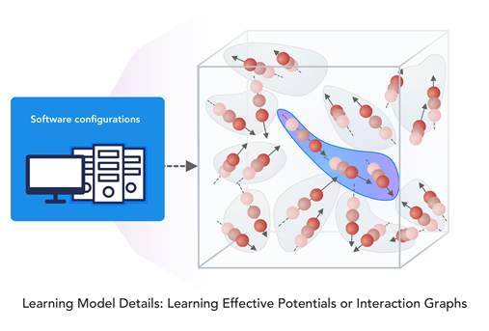
2. Learn Structure, Theory and Model for Simulation
2.2 MLaroundHPC: Learning Model Details (effective potentials and coarse graining)
An effective potential is an analytic, quasi-empirical or quasi-phenomenological potential that combines multiple, perhaps opposing, effects into a single potential.
This is classic coarse graining

Slide 41
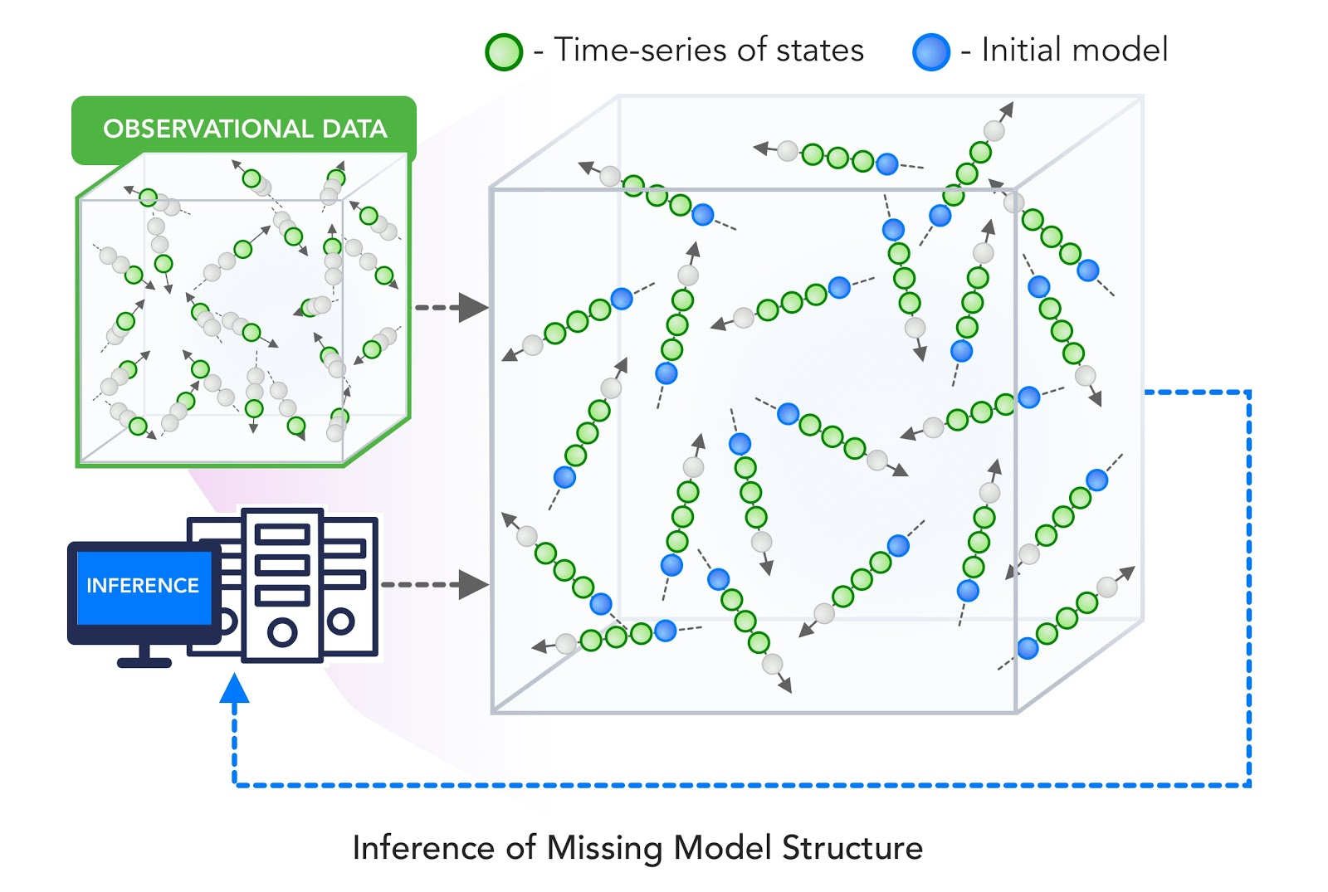
2. Learn Structure, Theory and Model for Simulation
2.3 MLaroundHPC: Learning Model Details - Inference of Missing Model Structure
This imagines a future where AI will essentially be able to derive theories from data, or more practically a mix of data and models.
This is especially promising in agent based models which often contain phenomenological approaches such as the predictor-corrector method of 1.3. We expect that will take the results of such assimilation and effective potentials and interactions and use them as the master model or theory for future research.

Slide 42
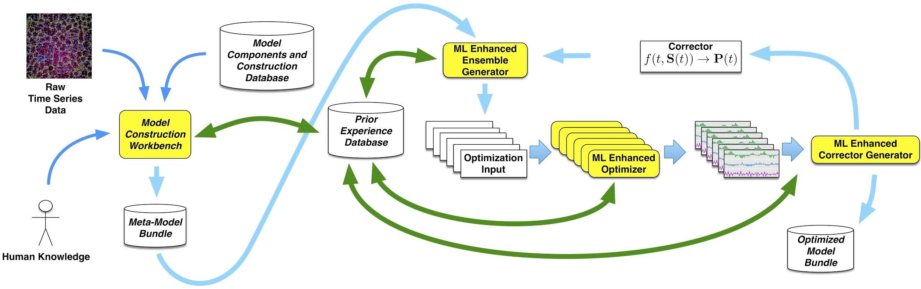
Putting it all Together
Simulating Biological Organisms (with James Glazier @IU)
Learning Model (Agent) Behavior
Replace components by learned surrogates
(Reaction Kinetics Coupled ODE’s)
All steps use MLAutotuning
Smart Ensembles
Predictor-Corrector

Slide 43
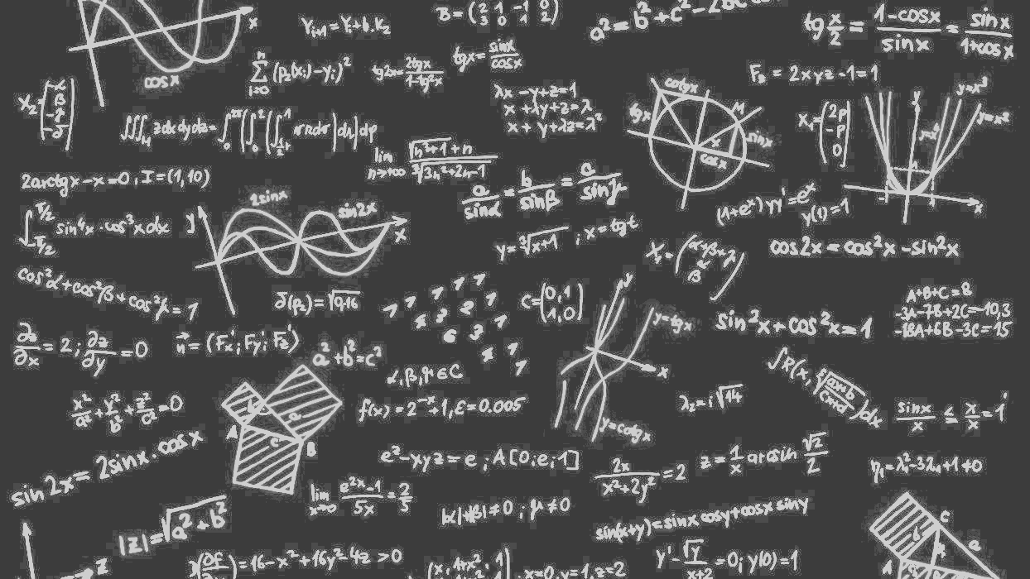
Complete Systems
HPCforML
Parallel Big Data Analytics in some ways like parallel Big Simulation
Twister2 Implements HPCforML as HPC-ABDS and supports MLforHPC

Slide 44
Next Generation of Cyberinfrastructure: Overarching Principles
We want to discover a very small number of classes of Hardware-Software systems that together will support all major Cyberinfrastructure (CI) needs for researchers in the next 5 years. It is unlikely to be a single class but a small number of shared major system classes will be attractive as it
  Implies not many distinct software stacks and hardware types to support
  The size of resources in any area goes like Fixed Total Budget/Number of distinct types and so will be larger if we just have a few key types.
Note projects like BDEC2 are aiming at new systems and possibly constraints from continuity to the past may be less important than for production systems deployed today.
Almost by definition, any big data computing must involve HPC technologies but not necessarily classic HPC systems.
The growing demand from Big Data and from the use of ML with simulations (MLAutotuning, MLaroundHPC) implies new demands for new algorithms and new ideas for hardware/software of the supporting cyberinfrastructure CI. This note is a start to address this.
The AI for science initiative from DoE will certainly need new CI as discussed here
We will term the systems as HPC which are linked to HPC edge such as Google edge TPU. Both Cloud and Edge are Intelligent

Slide 45
Next Generation of Cyberinfrastructure:
Application Requirements
Four clear classes of applications are
  Classic simulations which are addressed excellently by DoE exascale program and although our focus is Big Data, one should consider this application area as we need to integrate simulations with data analytics and ML (Machine Learning) -- item d) below
  Classic Big Data Analytics as in the analysis of LHC data, SKA, Light sources, health, and environmental data.
  Cloud-Edge applications which certainly overlap with b) as data in many fields comes from the edge
  Integration of ML and Data analytics with simulations. “learning everywhere”,

Slide 46
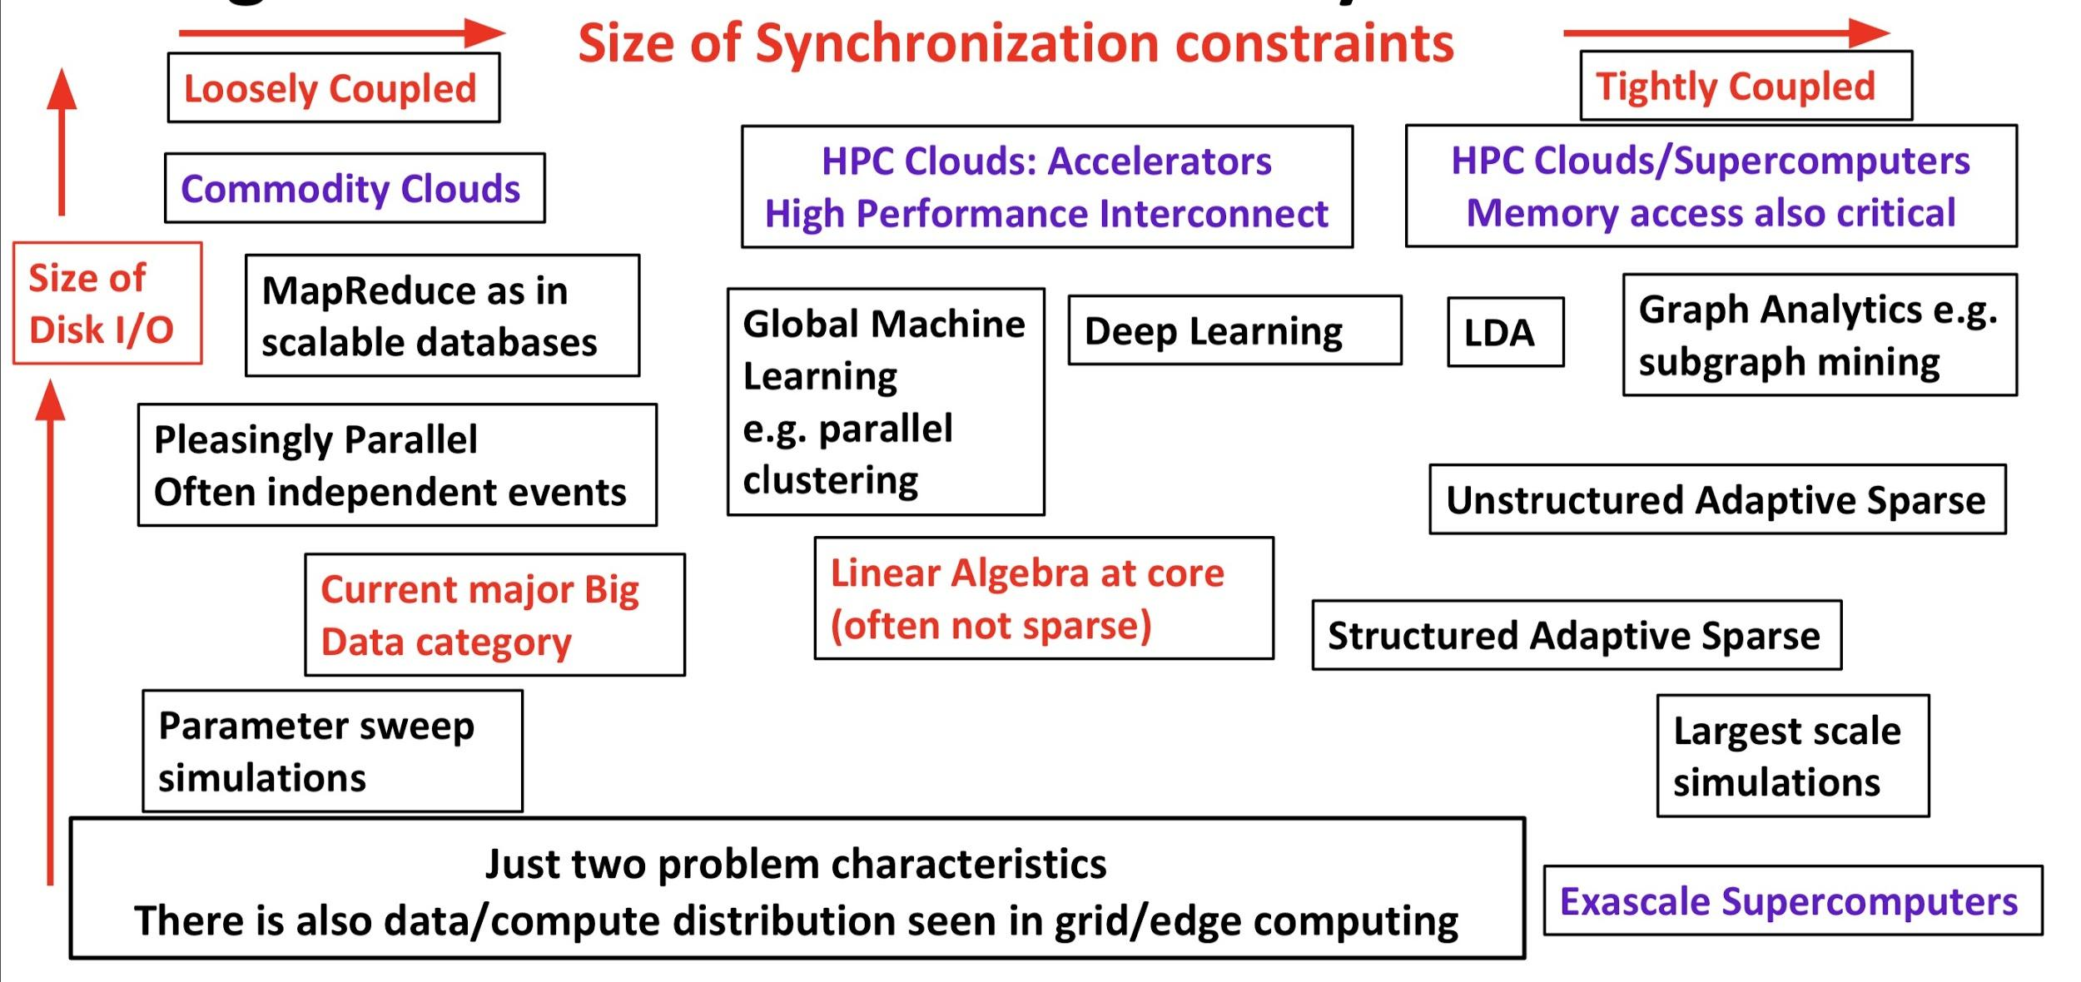
Big Data and Simulation Comparison of Difficulty in Parallelism
Parallel Big Data Algorithms many issues in common with Parallel Simulations

Slide 47
Next Generation of Cyberinfrastructure: Remarks on Deep Learning
We expect growing use of deep learning (DL) replacing older machine learning methods and DL will appear in many different forms such as Perceptrons, Convolutional NN's, Recurrent NN's, Graph Representational NN's, Autoencoders, Variational Autoencoder, Transformers, Generative Adversarial Networks, and Deep Reinforcement Learning.
For industry, growth in reinforcement learning is increasing the computational requirements of systems. However, it is hard to predict the computational complexity, parallelizability, and algorithm structure for DL even just 3 years out.
Note we always have the training and inference phases for DL and these have very different system needs.
  Training will give large often parallel jobs; Inference will need a lot of small tasks.
Note in parallel DL, one MUST change both batch size and # training epochs as one scales to larger systems (in fixed problem size case) and this is implicit in MLPerf results; this may change with more model parallelism

Slide 48
Next Generation of Cyberinfrastructure: Compute and Data patterns
The application classes a) to d) will all have needs in the four capabilities
  Parallel simulations;
  Data Management;
  Data analytics;
  Streaming
but the proportion of these will differ in the four classes and d) is particularly hard as it intermixes all of them in a dynamic heterogeneous fashion.
  A system for class d) will be able to run the other classes as it will have “everything” but a “d” system may not be the most cost-effective for a pure class a) or b) application.
  The growing complexity of work implies that dynamic heterogeneity will characterize all major problems of each class.
  In the absence of consensus application requirements and software systems to support ML driven HPC, it is unclear whether scaled up machines should be the same design but larger or have a radically different design and performance point.
Classic Simulations
Classic Big Data
Cloud-Edge
HPCforML. MLforHPC

Slide 49
Next Generation of Cyberinfrastructure: Cloud-Edge Computing
Classic Simulations
Classic Big Data
Cloud-Edge
HPCforML. MLforHPC
This is application class c)
Here the fog concept suggests that the Cloud model extends to compute resources near the edge as in AWS Greengrass but doesn’t affect the “central” HPC Cloud much except to insist that cloud support streaming systems such as the Apache Storm/Kafka model.
This does not seem difficult to support as a modest upgrade to any design aimed at classes a), b), d).
Real-time machine learning is important and needs special discussion

Slide 50
Common Practices Relevant to HPC Cloud I
Low level structure
Industry important leader
Docker/Openshift/Singularity containers
Kubernetes container orchestration/management with Slurm supporting high performance
Build everything as services OpenAPI REST standard
DevOps
Possibly Bare metal or hypervisor-based nodes (but always containers)
Use MLAutotuning or Jeffrey Dean’s Systems for ML

Slide 51
Common Practices Relevant to HPC Cloud II
Middleware
“XSEDE” or Exascale Simulation stack
Service Mesh to link services e.g.Openshift offers Docker Kubernetes Service mesh
HDFS based on node storage with growing use of high speed storage (NVMe, Intel Optane)
Variety of databases as a service
Data Management: Hadoop, Spark, Flink.
  Twister2 offers high performance version

Slide 52
Common Practices Relevant to HPC Cloud III:
Edge-Cloud Link
Storm/Heron-Kafka style streaming -- dataflow compute engine plus buffered edge messages.
  Twister2 offers High performance
Fog (cloudlets) implies environment should run on on small systems near the edge.
  See AWS Greengrass. Industry must solve this anyway
Real-time machine learning is an important part of many edge problems and here one either needs just real-time inference but sometimes real-time inference and training.
  Supporting real-time ML is more dependent on algorithm used and edge systems than on the HPC Cloud.
Edge-Cloud forms a Data Grid

Slide 53
Common Practices Relevant to HPC Cloud IV
Languages
Different Languages inevitable and Industry needs to alleviate as not specific to science
Python as either frontend (~universal) or main tool (several important libraries); MDAnalysis and Keras as examples
C or C++ Best performance for computing; links to Python better than Java
Java -- most data management

Slide 54
Common Practices Relevant to HPC Cloud V:
Big Simulations
Classic Simulations
Classic Big Data
Cloud-Edge
HPCforML. MLforHPC
Application class a)
Parallelism very important
has important but largely well understood issues
MPI
Science is probably lead stakeholder
Exascale Initiative will produce high quality hardware and software

Slide 55
Common Practices Relevant to HPC Cloud VI: Data Analytics
Parallelism is of growing importance especially in deep learning
Great importance to industry and of course science is smaller than industry but data analytics is of central importance to science
Keras, Tensorflow, MXNET, PyTorch for deep learning DL
Graph databases and graph analytics key in some important areas and are perhaps the hardest parallel algorithms
Decreasing but nontrivial interest in general Machine learning such as SVM, Clustering
Note the different communication needs of different classes.
  DL is dominantly AllReduce and Broadcast.
  Graph analytics is Scatter and Gather.
  The local communication structure of most simulations is not seen in data analytics. I don’t think there is a lot of study of this but could affect optimal interconnect and messaging software.
See MLPerf and results from SPIDAL on HPCforML
Real time and online algorithms and systems are critical in some applications such as speech recognition on edge, autonomous driving, etc.
Link to simulation with MLaroundHPC and MLafterHPC

Slide 56
Common Practices Relevant to HPC Cloud VII: Scheduling
In Slurm, the unit is a node but in Mesos or Kubernetes it is a container. This needs to be resolved.
  Large scale data analytics will need to be allocated at the node level as for example parallel deep learning will use classic synchronizing algorithms.
HPC tends to emphasize single job performance whereas industry focus is throughput i.e. total system performance
Need Resource management for dynamic heterogeneity,
Rutgers Radical Pilot addresses some of these issues

Slide 57
Common Practices Relevant to HPC Cloud VIII: Workflow
There is little overlap between approaches to orchestration and workflow in simulation and big data fields.
  This is perhaps historical as the requirements are not very different. Probably one could support either the HPC or the Big Data approaches to workflow on most system designs.
In more detail, Big data systems like Spark or Flink support a dataflow computing model that is at a finer grain size than that supported by HPC systems such as Pegasus or Kepler.
Developments such as Function as a Service and event-driven computing also suggest a finer grain size (microservices) computing model.

Slide 58
Common Practices Relevant to HPC Cloud IX: Issues from high performance
Accelerators: here commonality (true now for GPU) across simulation and ML makes it much easier to deploy a system good at four classes.
  This could be true for GPUs and TPU’s as accelerators
  but the more exotic ANN accelerators may not be at all useful in simulations.
  In fact, some accelerators may not be good at all variants of DL/ML.
    e.g. in some cases, RNN and CNN behave differently in performance studies
High speed interconnect will always be necessary
Minimize data transfer; bring compute to data

Slide 59
Common Practices Relevant to HPC Cloud X: Futures
Not necessary now but could be important for HPC Cloud -- need to watch Industry
  Serverless
  Microservices
  Event-based computing
  Cloud-native for fault tolerance and microservices

Slide 60
Summary Requirements for a Global AI Supercomputer
Support HPC simulation stack – MPI, Kepler (workflow), Slurm
  Fast network and nodes
  Modest I/O constrains – shared backend Lustre
  Uses Shifter, Singularity but probably can change
Support Apache Big Data stack – such as Spark, Storm, Hadoop, Flink, Docker, Kubernetes, Mesos or equivalent
  Runs on hypervisors on shared systems; can support bare metal and use when machines but not individual nodes shared
  Does workflow as dataflow in Spark
  Several non optimized implementations
  Large I/O; data from Computer, Repositories, Edge (streaming), Local disks
Support Machine Learning – Tensorflow, PyTorch
  GPU, TPU, Fast Networks
  Python front ends
All 3 must be integrated

Slide 61
Twister2 Highlights I
“Big Data Programming Environment” such as Hadoop, Spark, Flink, Storm, Heron but uses HPC wherever appropriate and outperforms Apache systems – often by large factors
Runs preferably under Kubernetes Mesos Nomad but Slurm supported
Highlight is high performance dataflow supporting iteration, fine-grain, coarse grain, dynamic, synchronized, asynchronous, batch and streaming
Three distinct communication environments
  DFW Dataflow with distinct source and target tasks; data not message level; Data-level Communications spilling to disks as needed
  BSP for parallel programming; MPI is default. Inappropriate for dataflow
  Storm API for streaming events with pub-sub such as Kafka
Rich state model (API) for objects supporting in-place, distributed, cached, RDD (Spark) style persistence with Tsets (see Pcollections in Beam, Datasets in Flink, Streamlets in Storm, Heron)

Slide 62
Twister2 Highlights II
Can be a pure batch engine
  Not built on top of a streaming engine
Can be a pure streaming engine supporting Storm/Heron API
  Not built on on top of a batch engine
Fault tolerance (June 2019) as in Spark or MPI today; dataflow nodes define natural synchronization points
Many API’s: Data, Communication, Task
  High level hiding communication and decomposition (as in Spark) and low level (as in MPI)
DFW supports MPI and MapReduce primitives: (All)Reduce, Broadcast, (All)Gather, Partition, Join with and without keys
Component based architecture -- it is a toolkit
  Defines the important layers of a distributed processing engine
  Implements these layers cleanly aiming at high performance data analytics

Slide 63
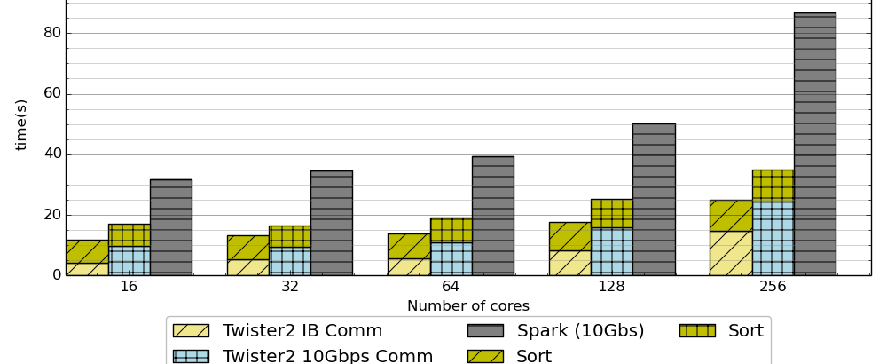
Terasort in Spark and Twister2
Times
Spark 10 Gbs > Twister2 10 Gbs > Twister2 IB
1 Gigabyte per core; all jobs run on 16 nodes; varying core count
Running on 16 nodes of Intel with 2 24-core Intel(R) Xeon(R) Platinum 8160 Skylake 2.10GHz processors, 256GB of memory, 8TB of local disk storage, 400GB of NVMe storage, and a Mellanox ConnectX-3 InfiniBand (IB) FDR 56GT/s adapter

Slide 64
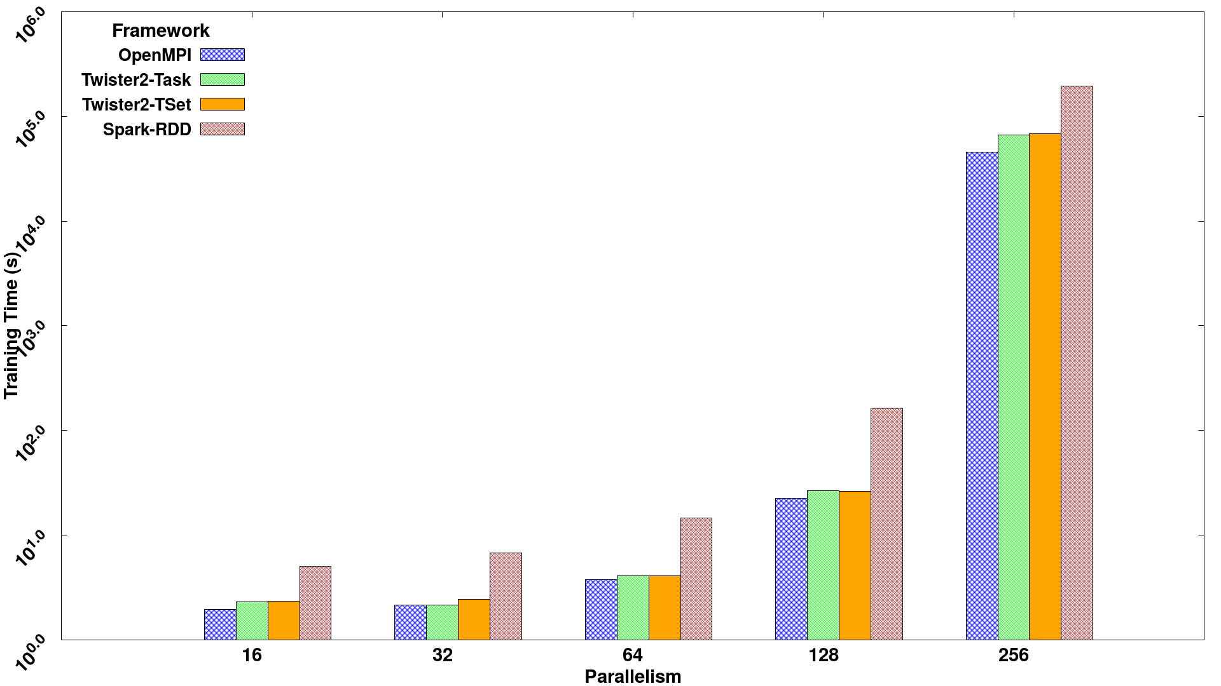
Parallel SVM using SGD execution time for 320K data points with 2000 features and 500 iterations, on 16 nodes with varying parallelism
Times
Spark RDD > Twister2 Tset > Twister2 Task > MPI

Slide 65
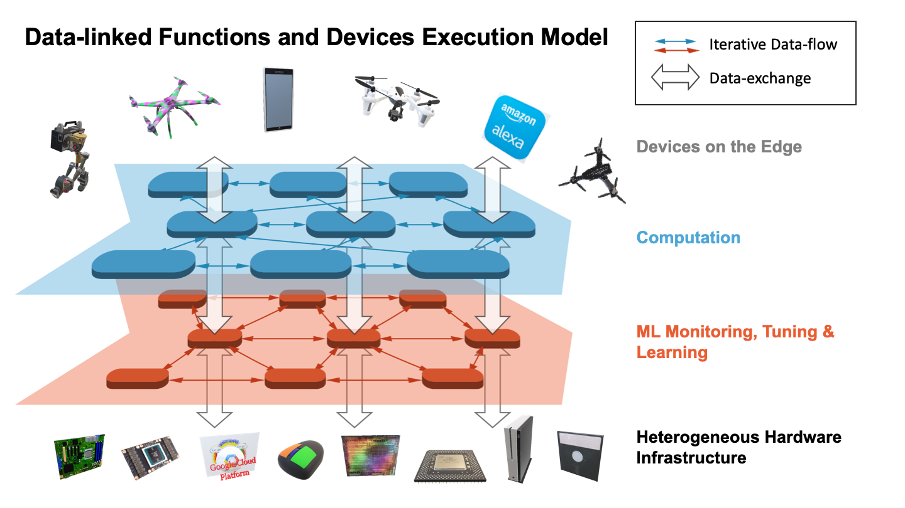
Suitable for MLforHPC?
Continually interacting in the Intelligent Aether with
Software model supported by Twister2

Slide 66
Challenges and Opportunities
Computer Science Issues

Slide 67
Computer Science Issues I
Hundreds of Ph. D. theses!
What computations can be assisted by what ML in which of 9 scenarios
  What is performance of different DL (ML) choices in compute time and capability
  What can we do with zettascale computing?
Redesign all algorithms so they can be ML-assisted
Dynamic interplay (of data and control) between simulations and ML seems likely but not clear at present
There ought to be important analogies between time series and this area (as simulations are 4D time series?)
  Exploit MLPerf examples?

Slide 68
Computer Science Issues II
Little study of best ANN structure especially for hardest cases such as “predict fields from fields” and ML assisted data assimilation
  Not known how large training set needs to be.
  Most published data has quite small training sets
I am surprised that there is not a rush to get effective performances on simulations of exascale and zettascale on current machines
Interesting load balancing issues if in parallel case some points learnt using surrogates and some points calculated from scratch
Little or no study of either predicting errors or in fact of getting floating point numbers from deep learning.

Slide 69

Conclusions

Slide 70
Conclusions
HPC is essential (HPCforML) although innovation in classic areas limited
Everybody needs systems
Need to align communities to ensure HPC importance (although innovation limited) recognized
1
HPC is essential for the future of the world
  Everybody needs systems
  Need to align communities
2
Good to work closely with industry
Student Internships, Collaborations such as Contributions to MLPerf
Global AI and Modeling Supercomputer GAIMSC good framework with HPC Cloud linked to HPC Edge
Training on cloud; Inference and some training on the edge
3
HPCforML well established but MLforHPC even more promising where we could aim at
First Zettascale effective performance in next 2 years
Hardware/Software aimed at general ML assisted speedup of computation
Your health can be engineered with ML-assisted personalized nanodevices designed based on the ML-assisted digital twin of disease in your tissues
4

