Slide 1
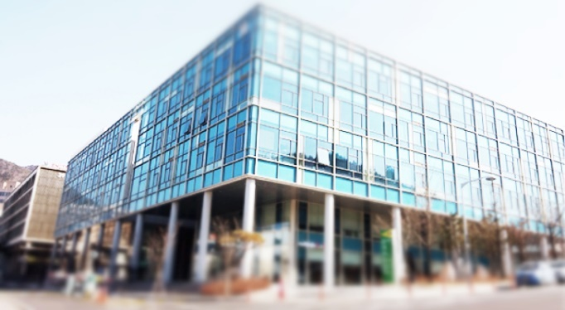
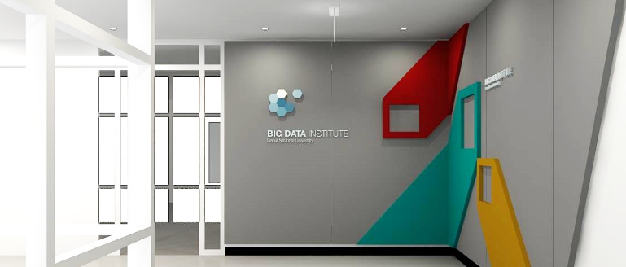
High Performance Computing and Big Data
Big Data Institute,
Seoul National University, Korea
Geoffrey Fox August 22, 2016
gcf@indiana.edu
http://www.dsc.soic.indiana.edu/, http://spidal.org/ http://hpc-abds.org/kaleidoscope/
Department of Intelligent Systems Engineering
School of Informatics and Computing, Digital Science Center
Indiana University Bloomington

Slide 2
Abstract
We propose a hybrid software stack with Large scale data systems for both research and commercial applications running on the commodity (Apache) Big Data Stack (ABDS) using High Performance Computing (HPC) enhancements typically to improve performance. We give several examples taken from bio and financial informatics.
We look in detail at parallel and distributed run-times including MPI from HPC and Apache Storm, Heron, Spark and Flink from ABDS stressing that one needs to distinguish the different needs of parallel (tightly coupled) and distributed (loosely coupled) systems.
We also study "Java Grande" or the principles to use to allow Java codes to perform as fast as those written in more traditional HPC languages. We also note the differences between capacity (individual jobs using many nodes) and capability (lots of independent jobs) computing.
We discuss how this HPC-ABDS concept allows one to discuss convergence of Big Data, Big Simulation, Cloud and HPC Systems. See http://hpc-abds.org/kaleidoscope/

Slide 3
Why Connect (“Converge”) Big Data and HPC
Two major trends in computing systems are
  Growth in high performance computing (HPC) with an international exascale initiative (China in the lead)
  Big data phenomenon with an accompanying cloud infrastructure of well publicized dramatic and increasing size and sophistication.
Note “Big Data” largely an industry initiative although software used is often open source
  So HPC labels overlaps with “research” e.g. HPC community largely responsible for Astronomy and Accelerator (LHC, Belle, BEPC ..) data analysis
Merge HPC and Big Data to get
  More efficient sharing of large scale resources running simulations and data analytics
  Higher performance Big Data algorithms
  Richer software environment for research community building on many big data tools
  Easier sustainability model for HPC – HPC does not have resources to build and maintain a full software stack

Slide 4
Convergence Points (Nexus) for
HPC-Cloud-Big Data-Simulation
Nexus 1: Applications – Divide use cases into Data and Model and compare characteristics separately in these two components with 64 Convergence Diamonds (features)
Nexus 2: Software – High Performance Computing (HPC) Enhanced Big Data Stack HPC-ABDS. 21 Layers adding high performance runtime to Apache systems (Hadoop is fast!). Establish principles to get good performance from Java or C programming languages
Nexus 3: Hardware – Use Infrastructure as a Service IaaS and DevOps to automate deployment of software defined systems on hardware designed for functionality and performance e.g. appropriate disks, interconnect, memory

Slide 5
SPIDAL Project
Datanet: CIF21 DIBBs: Middleware and High Performance Analytics Libraries for Scalable Data Science
NSF14-43054 started October 1, 2014
Indiana University (Fox, Qiu, Crandall, von Laszewski)
Rutgers (Jha)
Virginia Tech (Marathe)
Kansas (Paden)
Stony Brook (Wang)
Arizona State (Beckstein)
Utah (Cheatham)
A co-design project: Software, algorithms, applications

Slide 6





Co-designing Building Blocks Collaboratively
Software: MIDAS
HPC-ABDS

Slide 7
Main Components of SPIDAL Project
Design and Build Scalable High Performance Data Analytics Library
SPIDAL (Scalable Parallel Interoperable Data Analytics Library): Scalable Analytics for:
  Domain specific data analytics libraries – mainly from project.
  Add Core Machine learning libraries – mainly from community.
  Performance of Java and MIDAS Inter- and Intra-node.
NIST Big Data Application Analysis – features of data intensive Applications deriving 64 Convergence Diamonds. Application Nexus.
HPC-ABDS: Cloud-HPC interoperable software performance of HPC (High Performance Computing) and the rich functionality of the commodity Apache Big Data Stack. Software Nexus
MIDAS: Integrating Middleware – from project.
Applications: Biomolecular Simulations, Network and Computational Social Science, Epidemiology, Computer Vision, Geographical Information Systems, Remote Sensing for Polar Science and Pathology Informatics, Streaming for robotics, streaming stock analytics
Implementations: HPC as well as clouds (OpenStack, Docker) Convergence with common DevOps tool Hardware Nexus

Slide 8
Application Nexus
Use-case Data and Model
NIST Collection
Big Data Ogres
Convergence Diamonds

Slide 9
Data and Model in Big Data and Simulations I
Need to discuss Data and Model as problems have both intermingled, but we can get insight by separating which allows better understanding of Big Data - Big Simulation “convergence” (or differences!)
The Model is a user construction and it has a “concept”, parameters and gives results determined by the computation. We use term “model” in a general fashion to cover all of these.
Big Data problems can be broken up into Data and Model
  For clustering, the model parameters are cluster centers while the data is set of points to be clustered
  For queries, the model is structure of database and results of this query while the data is whole database queried and SQL query
  For deep learning with ImageNet, the model is chosen network with model parameters as the network link weights. The data is set of images used for training or classification

Slide 10
Data and Model in Big Data and Simulations II
Simulations can also be considered as Data plus Model
  Model can be formulation with particle dynamics or partial differential equations defined by parameters such as particle positions and discretized velocity, pressure, density values
  Data could be small when just boundary conditions
  Data large with data assimilation (weather forecasting) or when data visualizations are produced by simulation
Big Data implies Data is large but Model varies in size
  e.g. LDA with many topics or deep learning has a large model
  Clustering or Dimension reduction can be quite small in model size
Data often static between iterations (unless streaming); Model parameters vary between iterations

Slide 11
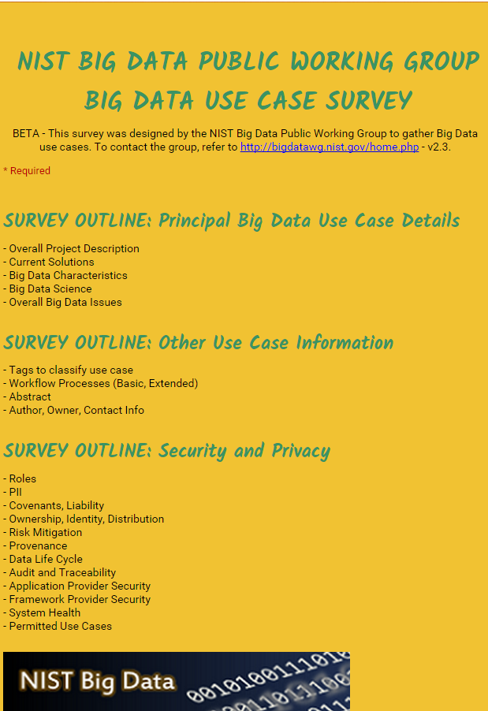
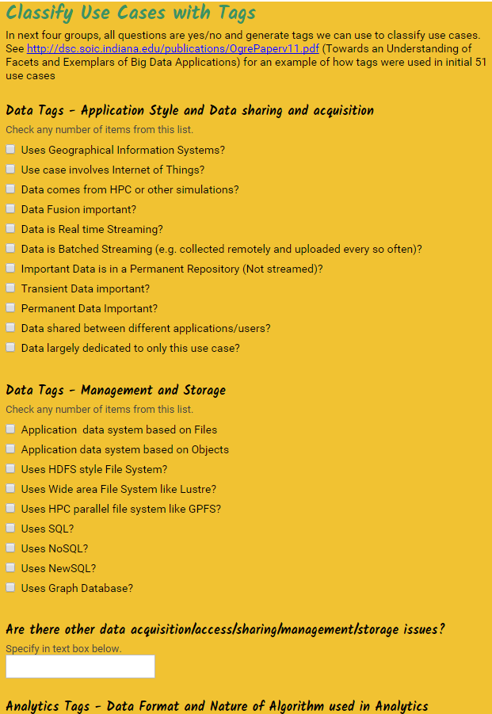
http://hpc-abds.org/kaleidoscope/survey/
Online Use Case Form

Slide 12
51 Detailed Use Cases: Contributed July-September 2013
Covers goals, data features such as 3 V’s, software, hardware
Government Operation(4): National Archives and Records Administration, Census Bureau
Commercial(8): Finance in Cloud, Cloud Backup, Mendeley (Citations), Netflix, Web Search, Digital Materials, Cargo shipping (as in UPS)
Defense(3): Sensors, Image surveillance, Situation Assessment
Healthcare and Life Sciences(10): Medical records, Graph and Probabilistic analysis, Pathology, Bioimaging, Genomics, Epidemiology, People Activity models, Biodiversity
Deep Learning and Social Media(6): Driving Car, Geolocate images/cameras, Twitter, Crowd Sourcing, Network Science, NIST benchmark datasets
The Ecosystem for Research(4): Metadata, Collaboration, Language Translation, Light source experiments
Astronomy and Physics(5): Sky Surveys including comparison to simulation, Large Hadron Collider at CERN, Belle Accelerator II in Japan
Earth, Environmental and Polar Science(10): Radar Scattering in Atmosphere, Earthquake, Ocean, Earth Observation, Ice sheet Radar scattering, Earth radar mapping, Climate simulation datasets, Atmospheric turbulence identification, Subsurface Biogeochemistry (microbes to watersheds), AmeriFlux and FLUXNET gas sensors
Energy(1): Smart grid
Published by NIST as http://nvlpubs.nist.gov/nistpubs/SpecialPublications/NIST.SP.1500-3.pdf with common set of 26 features recorded for each use-case; “Version 2” being prepared
26 Features for each use case Biased to science

Slide 13
Sample Features of 51 Use Cases I
PP (26) “All” Pleasingly Parallel or Map Only
MR (18) Classic MapReduce MR (add MRStat below for full count)
MRStat (7) Simple version of MR where key computations are simple reduction as found in statistical averages such as histograms and averages
MRIter (23) Iterative MapReduce or MPI (Flink, Spark, Twister)
Graph (9) Complex graph data structure needed in analysis
Fusion (11) Integrate diverse data to aid discovery/decision making; could involve sophisticated algorithms or could just be a portal
Streaming (41) Some data comes in incrementally and is processed this way
Classify (30) Classification: divide data into categories
S/Q (12) Index, Search and Query

Slide 14
Sample Features of 51 Use Cases II
CF (4) Collaborative Filtering for recommender engines
LML (36) Local Machine Learning (Independent for each parallel entity) – application could have GML as well
GML (23) Global Machine Learning: Deep Learning, Clustering, LDA, PLSI, MDS,
  Large Scale Optimizations as in Variational Bayes, MCMC, Lifted Belief Propagation, Stochastic Gradient Descent, L-BFGS, Levenberg-Marquardt . Can call EGO or Exascale Global Optimization with scalable parallel algorithm
Workflow (51) Universal
GIS (16) Geotagged data and often displayed in ESRI, Microsoft Virtual Earth, Google Earth, GeoServer etc.
HPC (5) Classic large-scale simulation of cosmos, materials, etc. generating (visualization) data
Agent (2) Simulations of models of data-defined macroscopic entities represented as agents

Slide 15
7 Computational Giants of
NRC Massive Data Analysis Report
http://www.nap.edu/catalog.php?record_id=18374 Big Data Models?
G1: Basic Statistics e.g. MRStat
G2: Generalized N-Body Problems
G3: Graph-Theoretic Computations
G4: Linear Algebraic Computations
G5: Optimizations e.g. Linear Programming
G6: Integration e.g. LDA and other GML
G7: Alignment Problems e.g. BLAST

Slide 16
HPC (Simulation) Benchmark Classics
Linpack or HPL: Parallel LU factorization
for solution of linear equations; HPCG
NPB version 1: Mainly classic HPC solver kernels
  MG: Multigrid
  CG: Conjugate Gradient
  FT: Fast Fourier Transform
  IS: Integer sort
  EP: Embarrassingly Parallel
  BT: Block Tridiagonal
  SP: Scalar Pentadiagonal
  LU: Lower-Upper symmetric Gauss Seidel
Simulation Models

Slide 17
13 Berkeley Dwarfs
Dense Linear Algebra
Sparse Linear Algebra
Spectral Methods
N-Body Methods
Structured Grids
Unstructured Grids
MapReduce
Combinational Logic
Graph Traversal
Dynamic Programming
Backtrack and
Branch-and-Bound
Graphical Models
Finite State Machines
Largely Models for Data or Simulation
First 6 of these correspond to Colella’s original. (Classic simulations)
Monte Carlo dropped.
N-body methods are a subset of Particle in Colella.
Note a little inconsistent in that MapReduce is a programming model and spectral method is a numerical method.
Need multiple facets to classify use cases!

Slide 18
Classifying Use cases

Slide 19
Classifying Use Cases
The Big Data Ogres built on a collection of 51 big data uses gathered by the NIST Public Working Group where 26 properties were gathered for each application.
This information was combined with other studies including the Berkeley dwarfs, the NAS parallel benchmarks and the Computational Giants of the NRC Massive Data Analysis Report.
The Ogre analysis led to a set of 50 features divided into four views that could be used to categorize and distinguish between applications.
The four views are Problem Architecture (Macro pattern); Execution Features (Micro patterns); Data Source and Style; and finally the Processing View or runtime features.
We generalized this approach to integrate Big Data and Simulation applications into a single classification looking separately at Data and Model with the total facets growing to 64 in number, called convergence diamonds, and split between the same 4 views.
A mapping of facets into work of the SPIDAL project has been given.

Slide 21
64 Features in 4 views for Unified Classification of Big Data and Simulation Applications
Both
Simulations
Analytics
(Model for Big Data)
(Nearly all Data)
(All Model)
(Mix of Data and Model)
(Nearly all Data+Model)

Slide 22
Examples in Problem Architecture View PA
The facets in the Problem architecture view include 5 very common ones describing synchronization structure of a parallel job:
  MapOnly or Pleasingly Parallel (PA1): the processing of a collection of independent events;
  MapReduce (PA2): independent calculations (maps) followed by a final consolidation via MapReduce;
  MapCollective (PA3): parallel machine learning dominated by scatter, gather, reduce and broadcast;
  MapPoint-to-Point (PA4): simulations or graph processing with many local linkages in points (nodes) of studied system.
  MapStreaming (PA5): The fifth important problem architecture is seen in recent approaches to processing real-time data.
  We do not focus on pure shared memory architectures PA6 but look at hybrid architectures with clusters of multicore nodes and find important performances issues dependent on the node programming model.
Most of our codes are SPMD (PA-7) and BSP (PA-8).

Slide 23
6 Forms of MapReduce
Describes Architecture of
- Problem (Model reflecting data)
- Machine
- Software
2 important variants (software) of Iterative MapReduce and Map-Streaming a) “In-place” HPC b) Flow for model and data

Slide 24
Examples in Execution View EV
The Execution view is a mix of facets describing either data or model; PA was largely the overall Data+Model
EV-M14 is Complexity of model (O(N²) for N points) seen in the non-metric space models EV-M13 such as one gets with DNA sequences.
EV-M11 describes iterative structure distinguishing Spark, Flink, and Harp from the original Hadoop.
The facet EV-M8 describes the communication structure which is a focus of our research as much data analytics relies on collective communication which is in principle understood but we find that significant new work is needed compared to basic HPC releases which tend to address point to point communication.
The model size EV-M4 and data volume EV-D4 are important in describing the algorithm performance as just like in simulation problems, the grain size (the number of model parameters held in the unit – thread or process – of parallel computing) is a critical measure of performance.

Slide 25
Examples in Data View DV
We can highlight DV-5 streaming where there is a lot of recent progress;
DV-9 categorizes our Biomolecular simulation application with data produced by an HPC simulation
DV-10 is Geospatial Information Systems covered by our spatial algorithms.
DV-7 provenance, is an example of an important feature that we are not covering.
The data storage and access DV-3 and D-4 is covered in our pilot data work.
The Internet of Things DV-8 is not a focus of our project although our recent streaming work relates to this and our addition of HPC to Apache Heron and Storm is an example of the value of HPC-ABDS to IoT.

Slide 26
Examples in Processing View PV
The Processing view PV characterizes algorithms and is only Model (no Data features) but covers both Big data and Simulation use cases.
Graph PV-M13 and Visualization PV-M14 covered in SPIDAL.
PV-M15 directly describes SPIDAL which is a library of core and other analytics.
This project covers many aspects of PV-M4 to PV-M11 as these characterize the SPIDAL algorithms (such as optimization, learning, classification).
  We are of course NOT addressing PV-M16 to PV-M22 which are simulation algorithm characteristics and not applicable to data analytics.
Our work largely addresses Global Machine Learning PV-M3 although some of our image analytics are local machine learning PV-M2 with parallelism over images and not over the analytics.
Many of our SPIDAL algorithms have linear algebra PV-M12 at their core; one nice example is multi-dimensional scaling MDS which is based on matrix-matrix multiplication and conjugate gradient.

Slide 27
Comparison of Data Analytics with Simulation I
Simulations (models) produce big data as visualization of results – they are data source
  Or consume often smallish data to define a simulation problem
  HPC simulation in (weather) data assimilation is data + model
Pleasingly parallel often important in both
Both are often SPMD and BSP
  Non-iterative MapReduce is major big data paradigm
  not a common simulation paradigm except where “Reduce” summarizes pleasingly parallel execution as in some Monte Carlos
Big Data often has large collective communication
  Classic simulation has a lot of smallish point-to-point messages
  Motivates MapCollective model
Simulations characterized often by difference or differential operators leading to nearest neighbor sparsity
Some important data analytics can be sparse as in PageRank and “Bag of words” algorithms but many involve full matrix algorithm

Slide 28
Comparison of Data Analytics with Simulation II
There are similarities between some graph problems and particle simulations with a particular cutoff force.
  Both are MapPoint-to-Point problem architecture
Note many big data problems are “long range force” (as in gravitational simulations) as all points are linked.
  Easiest to parallelize. Often full matrix algorithms
  e.g. in DNA sequence studies, distance δ(i, j) defined by BLAST, Smith-Waterman, etc., between all sequences i, j.
  Opportunity for “fast multipole” ideas in big data. See NRC report
Current Ogres/Diamonds do not have facets to designate underlying hardware: GPU v. Many-core (Xeon Phi) v. Multi-core as these define how maps processed; they keep map-X structure fixed; maybe should change as ability to exploit vector or SIMD parallelism could be a model facet.

Slide 29
Comparison of Data Analytics with Simulation III
In image-based deep learning, neural network weights are block sparse (corresponding to links to pixel blocks) but can be formulated as full matrix operations on GPUs and MPI in blocks.
In HPC benchmarking, Linpack being challenged by a new sparse conjugate gradient benchmark HPCG, while I am diligently using non- sparse conjugate gradient solvers in clustering and Multi-dimensional scaling.
Simulations tend to need high precision and very accurate results – partly because of differential operators
Big Data problems often don’t need high accuracy as seen in trend to low precision (16 or 32 bit) deep learning networks
  There are no derivatives and the data has inevitable errors
Note parallel machine learning (GML not LML) can benefit from HPC style interconnects and architectures as seen in GPU-based deep learning
  So commodity clouds not necessarily best

Slide 30
Some use of Analytics

Slide 31
Clustering
The SPIDAL Library includes several clustering algorithms with sophisticated features
  Deterministic Annealing
  Radius cutoff in cluster membership
  Elkans algorithm using triangle inequality
They also cover two important cases
  Points are vectors – algorithm O(N) for N points
  Points not vectors – all we know is distance δ(i, j) between each pair of points i and j. algorithm O(N²) for N points
We find visualization important to judge quality of clustering
As data typically not 2D or 3D, we use dimension reduction to project data so we can then view it
Have a browser viewer WebPlotViz that replaces an older Windows system

Slide 32
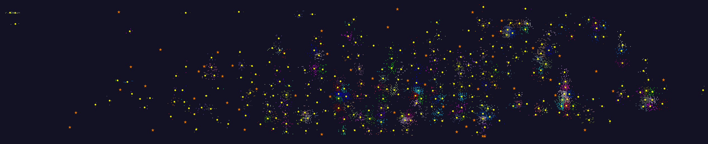
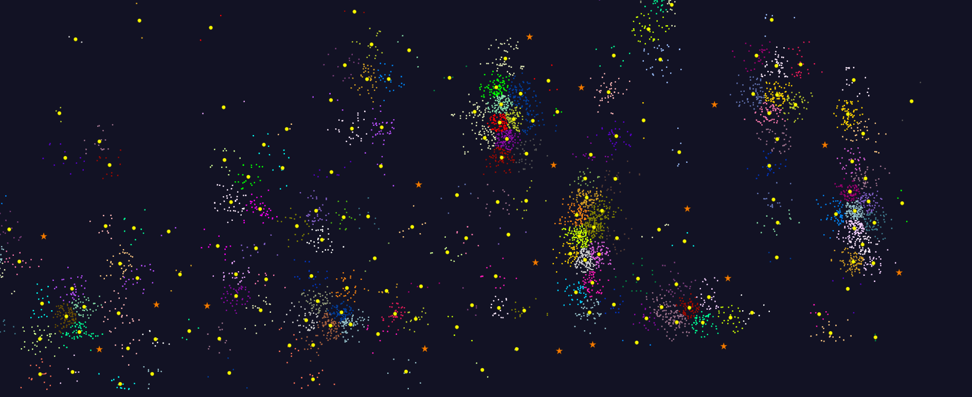
2D Vector Clustering with cutoff at 3 σ
Orange Star – outside all clusters; yellow circle cluster centers
LCMS Mass Spectrometer Peak Clustering. Charge 2 Sample with 10.9 million points and 420,000 clusters visualized in WebPlotViz

Slide 33
Dimension Reduction
Principal Component Analysis (linear mapping) and Multidimensional Scaling MDS (nonlinear and applicable to non-Euclidean spaces) are methods to map abstract spaces to three dimensions for visualization
    Both run well in parallel and give great results
Semimetric spaces have pairwise distances defined between points in space δ(i, j)
But data is typically in a high dimensional or non vector space so use dimension reduction. Associate each point i with a vector X_{i} in a Euclidean space of dimension K so that δ(i, j) ≈ d(X_{i} , X_{j}) where d(X_{i} , X_{j}) is Euclidean distance between mapped points i and j in K dimensional space.
    K = 3 natural for visualization but other values interesting
Principal Component analysis is best known dimension reduction approach but a) linear b) requires original points in a vector space
There are many other nonlinear vector space methods such as GTM Generative Topographic Mapping

Slide 34
WDA-SMACOF “Best” MDS
MDS Minimizes Stress σ(X) with pairwise distances δ(i, j)
σ(X) = Σ_{i<j=1}^{N} weight(i,j) (δ(i, j) - d(X_{i} , X_{j}))²
SMACOF clever Expectation Maximization method choses good steepest descent
Improved by Deterministic Annealing gradually reducing Temperature ≈ distance scale; DA does not impact compute time much and gives DA-SMACOF
  Deterministic Annealing like Simulated Annealing but no Monte Carlo
Classic SMACOF is O(N²) for uniform weight and O(N³) for non trivial weights but get nonuniform weight from
  The preferred Sammon method weight(i,j) = 1/δ(i, j) or
  Missing distances put in as weight(i,j) = 0
Use conjugate gradient – converges in 5-100 iterations – a big gain for matrix with a million rows. This removes factor of N in time complexity and gives WDA-SMACOF

Slide 35
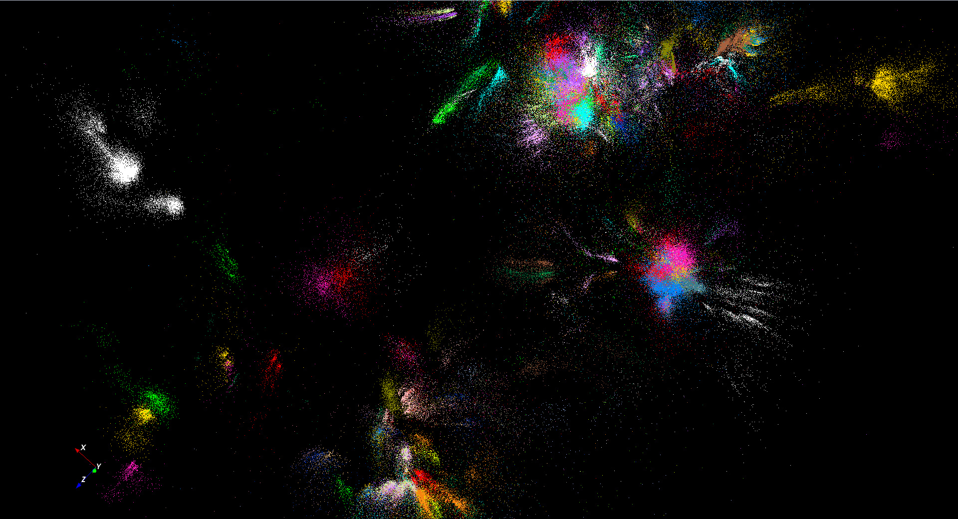
446K sequences
~100 clusters
Note distorted shapes probably due to imperfect distance measures e.g. position correlated with sequence length

Slide 36
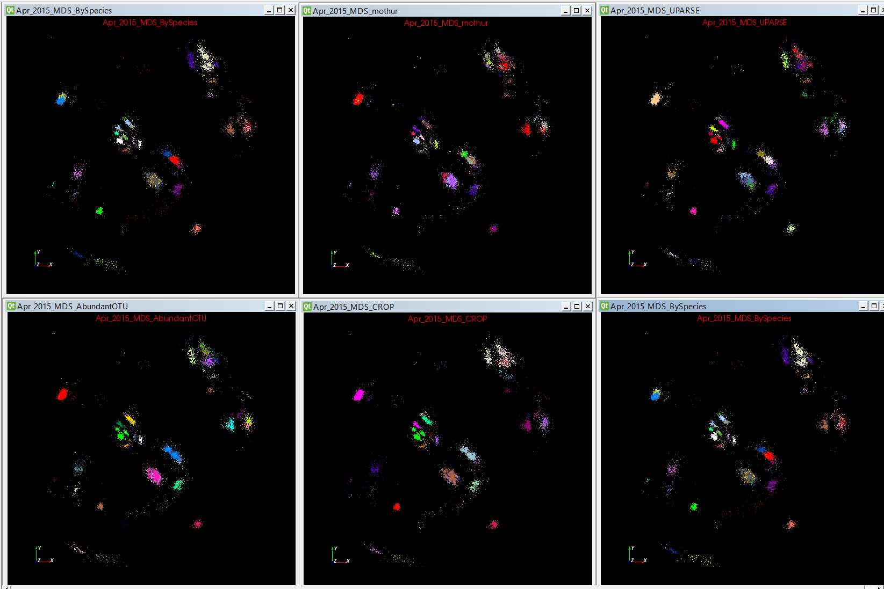
Fungi -- 4 Classic Clustering Methods plus Species Coloring

Slide 37
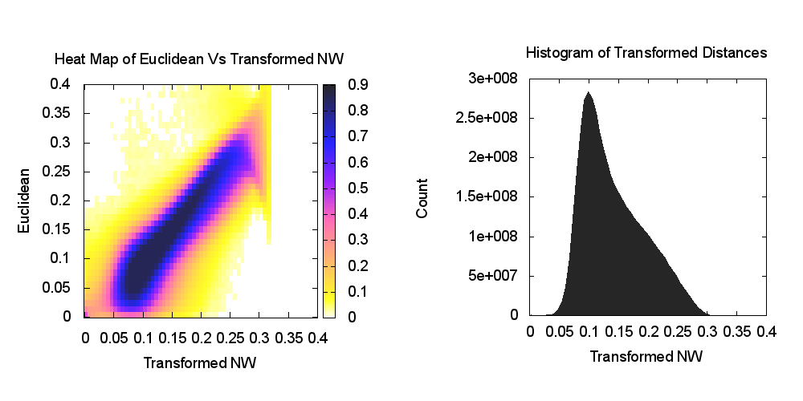
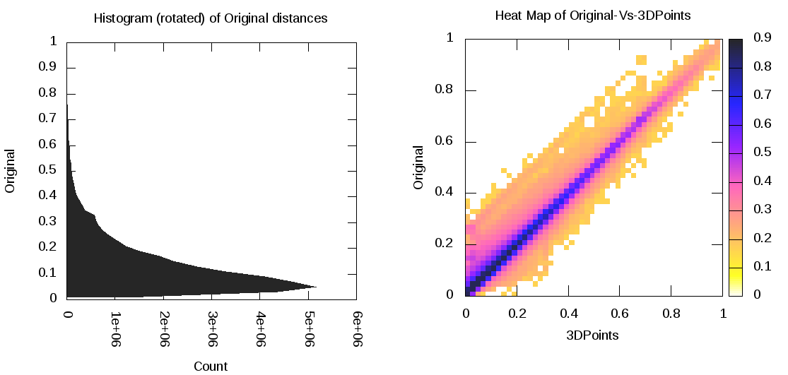
Heatmap of original distance vs 3D Euclidean Distances for Sequences and Stocks
One can visualize quality of dimension by comparing as a scatterplot or heatmap, the distances δ(i, j) before and after mapping to 3D.
Perfection is a diagonal straight line and results seem good in general
Proteomics Example
Stock Market Example

Slide 38
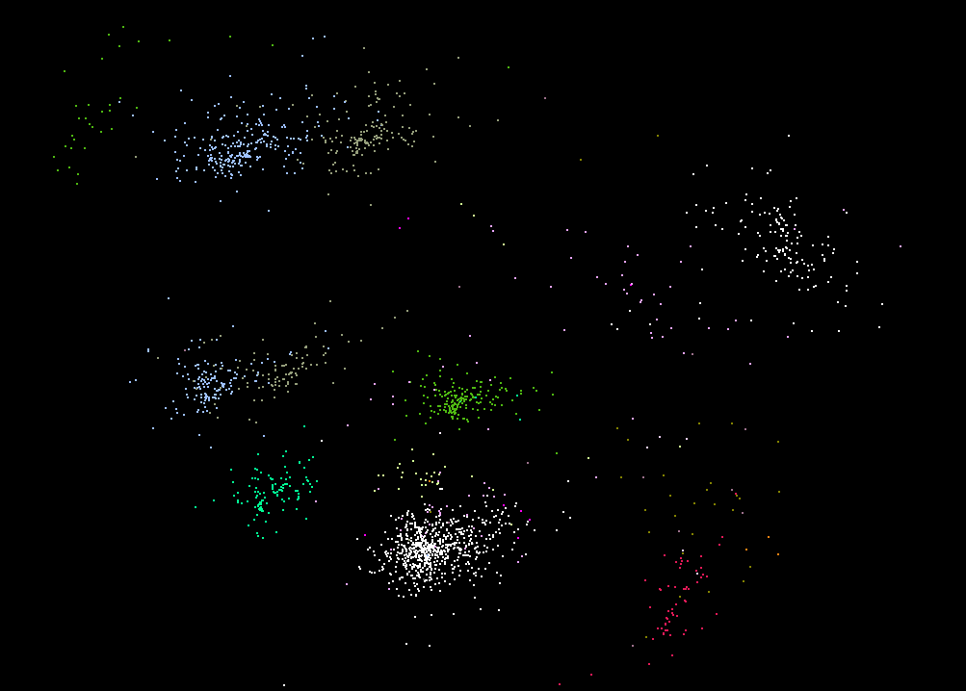
Labelled by Species MDS: Same Species Two groupings

Slide 39
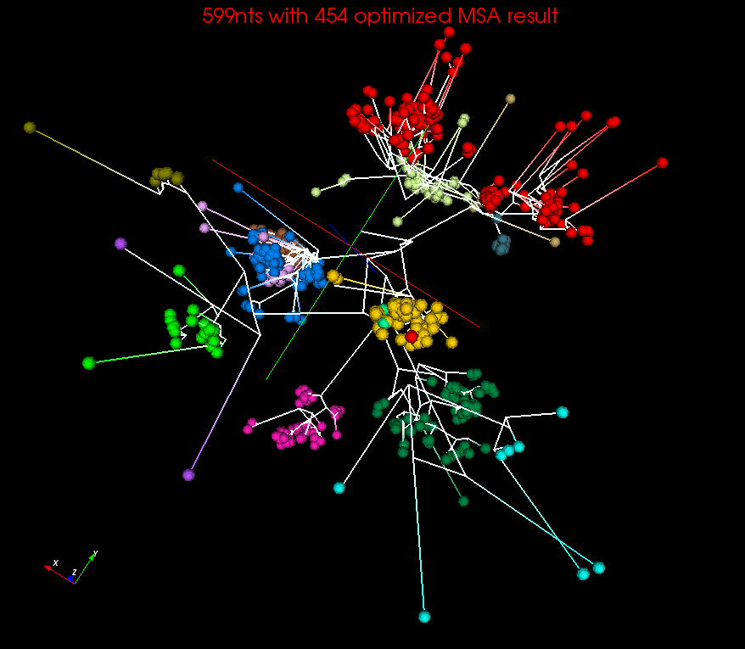
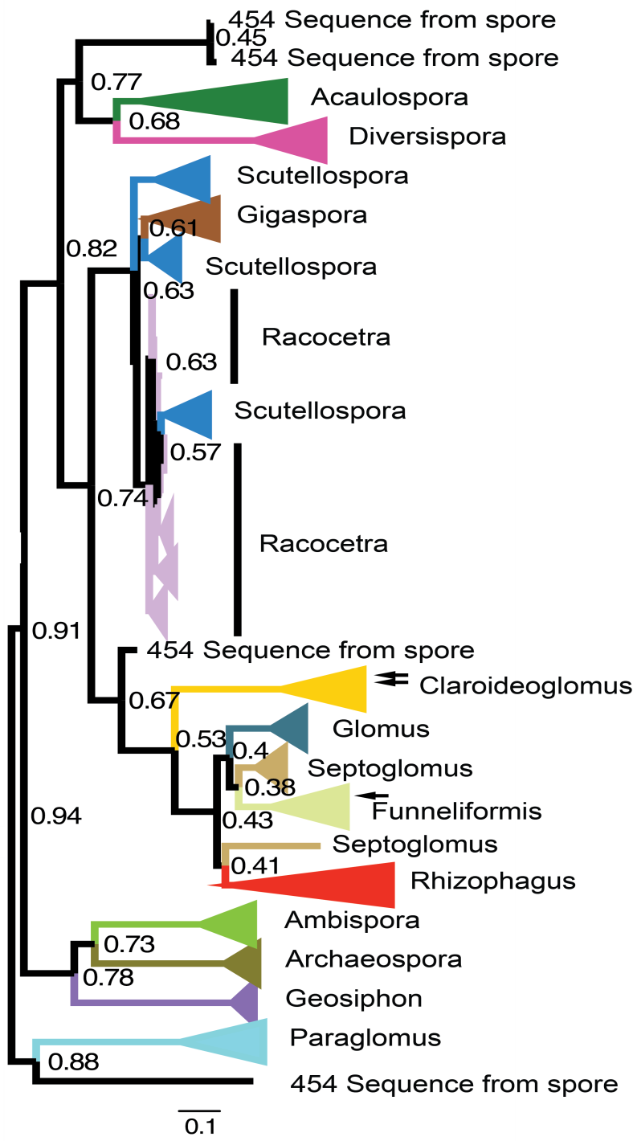
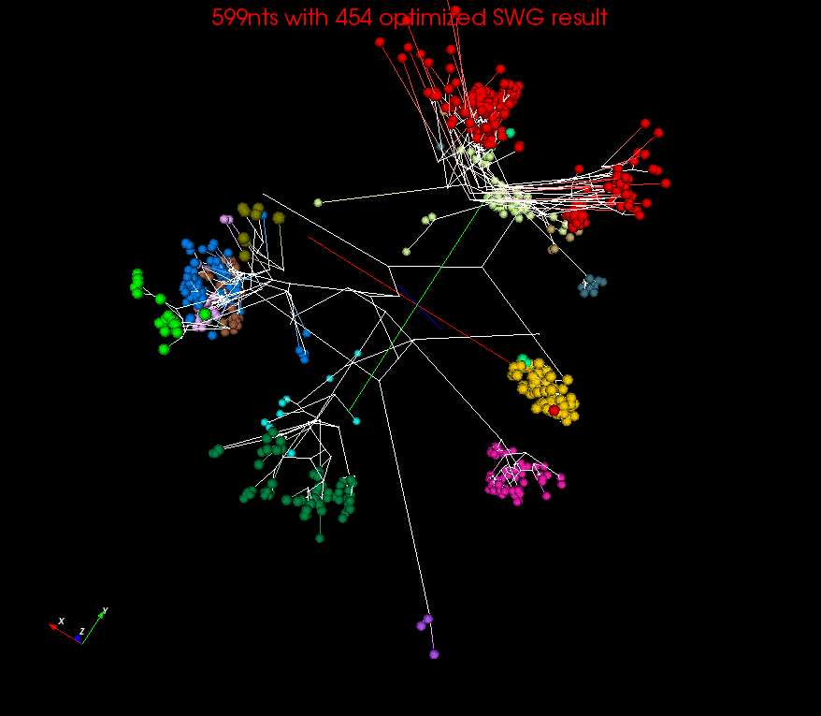
Spherical Phylograms
MSA or SWG distances
MSA
RAxML result visualized in FigTree.
SWG

Slide 40
Quality of 3D Phylogenetic Tree
3 different MDS implementations and 3 different distance measures
EM-SMACOF is basic SMACOF for MDS
LMA was previous best method using Levenberg-Marquardt nonlinear χ² solver
WDA-SMACOF finds best result
Sum of branch lengths of the Spherical Phylogram generated in 3D space on two datasets

Slide 41
HTML5 web viewer WebPlotViz
Supports visualization of 3D point sets (typically derived by mapping from abstract spaces) for streaming and non-streaming case
  Simple data management layer
  3D web visualizer with various capabilities such as defining color schemes, point sizes, glyphs, labels
Core Technologies
  MongoDB management
  Play Server side framework
  Three.js
  WebGL
  JSON data objects
  Bootstrap Javascript web pages
Open Source
http://spidal-gw.dsc.soic.indiana.edu/
~10,000 lines of extra code
Front end view (Browser)
Plot visualization & time series animation (Three.js)
Upload
Request Plots
JSON Format Plots
Web Request Controllers (Play Framework)
Server
Upload format to JSON Converter
Data Layer
(MongoDB)
MongoDB

Slide 42
Stock Daily Data Streaming Example
Example is collection of around 7000 distinct stocks with daily values available at ~2750 distinct times
  Clustering as provided by Wall Street – Dow Jones set of 30 stocks, S&P 500, various ETF’s etc.
The Center for Research in Security Prices (CSRP) database through the Wharton Research Data Services (wrds) web interface
Available for free to the Indiana University students for research
2004 Jan 01 to 2015 Dec 31 have daily Stock prices in the form of a CSV file
We use the information
  ID, Date, Symbol, Factor to Adjust Volume, Factor to Adjust Price, Price, Outstanding Stocks

Slide 43
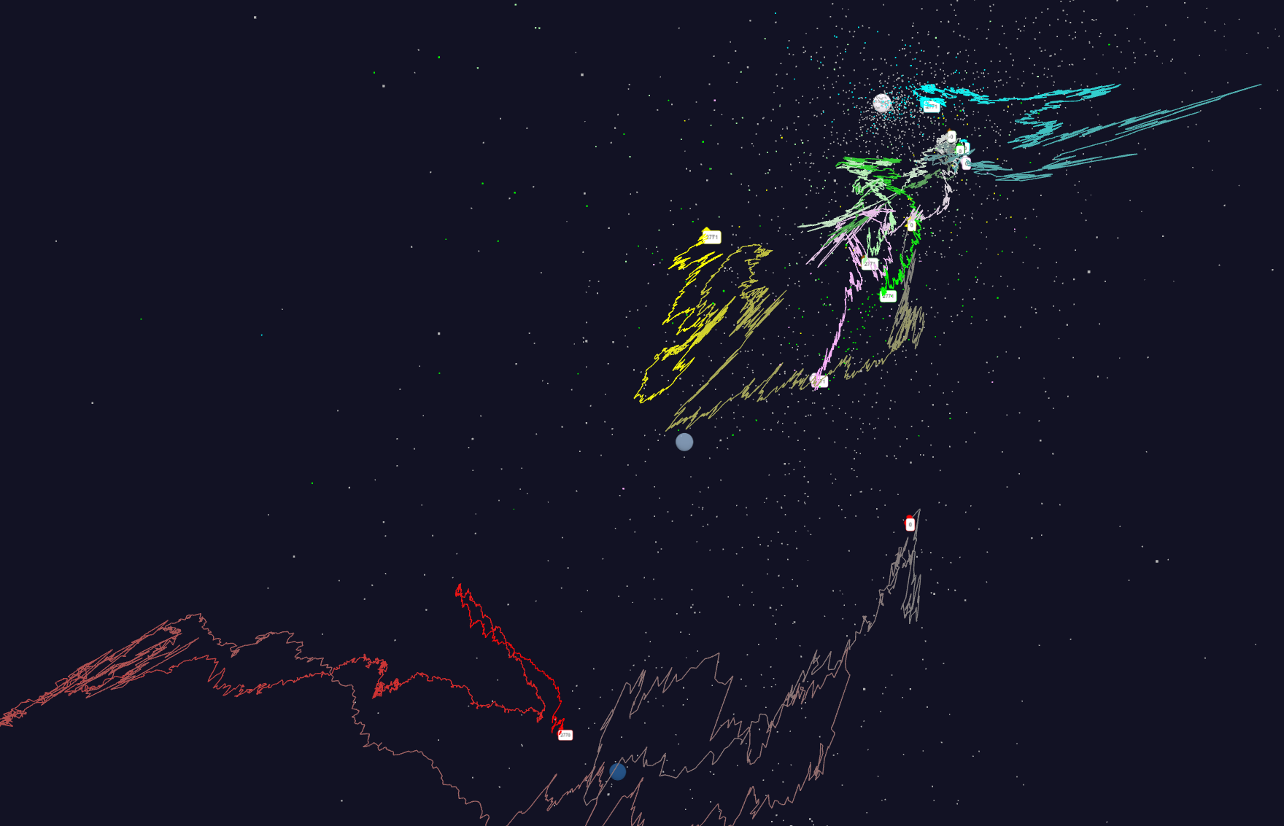
Relative Changes in Stock Values using one day values measured from January 2004 and starting after one year January 2005
Filled circles are final values
Origin
0% change
Finance
Energy
Dow Jones
S&P
Mid Cap
+10%
Apple
+20%

Slide 44
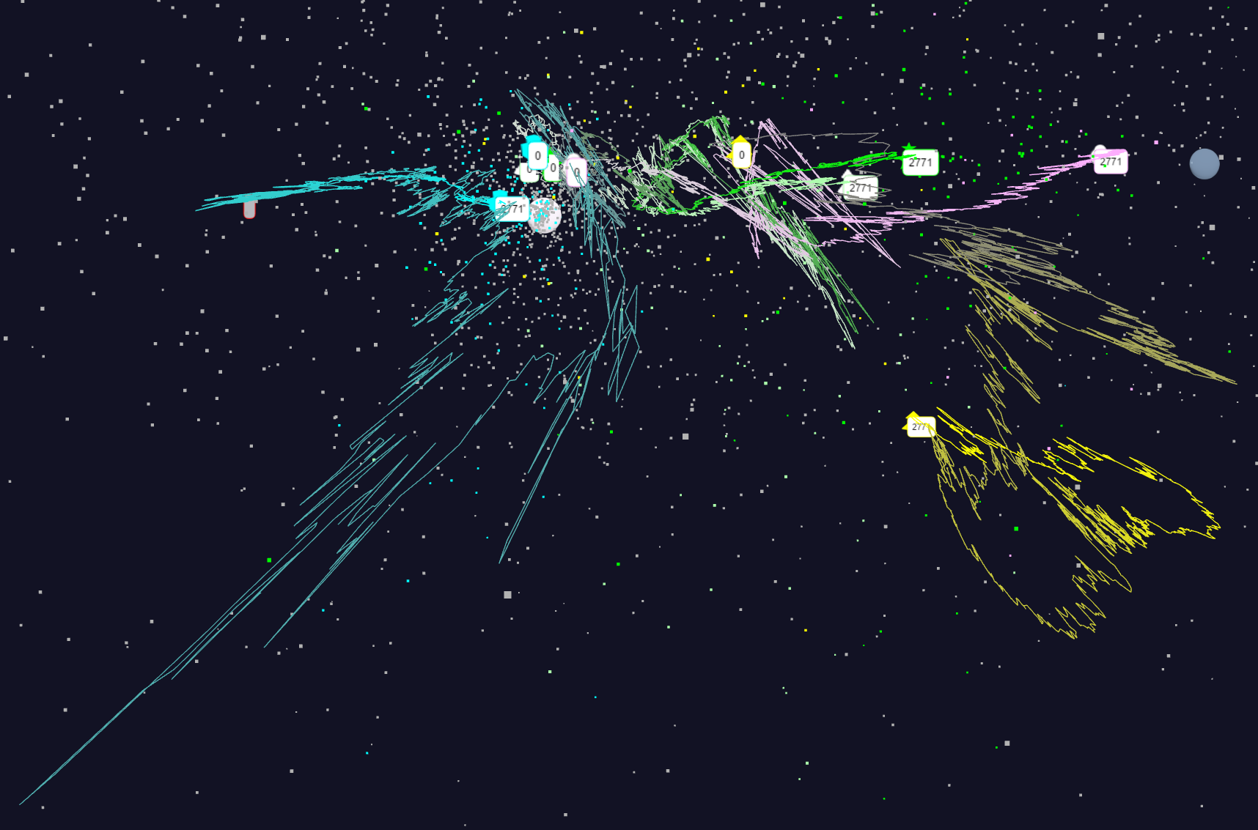
Relative Changes in Stock Values using one day values
Expansion of previous data
S&P
Mid Cap
S&P
Mid Cap
Dow Jones
Dow Jones
+10%
Finance
Finance
Origin
0% change
Energy
Energy
9/15/2016
44

Slide 45
Algorithm Challenge
The NRC Massive Data Analysis report stresses importance of finding O(N) or O(NlogN) algorithms for O(N²) problems
  N is number of points
This is well understood for O(N²) simulation problems where there is a long range force as in gravitational (cosmology) simulations for N stars or galaxies
Simulations are governed by equations that allow a systematic ”multipole expansion” with O(N) as first term with corrections
  Has been used successfully in parallel for 25 years
O(N²) big data problems don’t have a systematic practical approach even though there is a qualitative argument shown in next slide.
The work w_{i,j} is labelled by two indices i and j each running from 1 to N.
If points i and j are near each other, need to perform accurate calculations
If far apart, can use approximations and for example, replace points in a far away cluster of M particles by their cluster center weighted by M

Slide 46
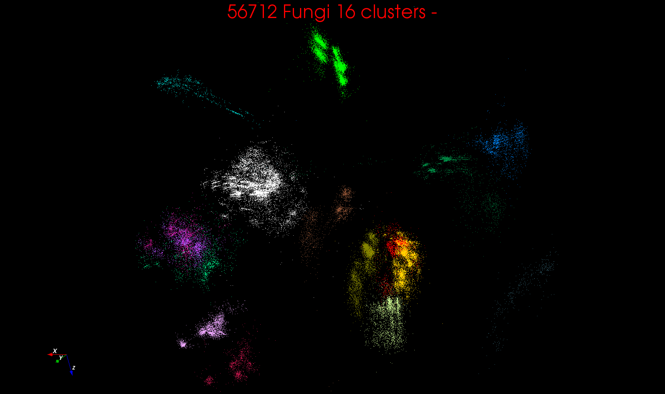
“clean” sample of 446K
O(N²) green-green and purple-purple interactions have value but green-purple are “wasted”
O(N²) reduced to O(N) times cluster size
O(N²) interactions between green and purple clusters should be able to represent by centroids as in Barnes-Hut.
Hard as no Gauss theorem; no multipole expansion and points really in 1000 dimension space as clustered before 3D projection

Slide 47
Software Nexus
Application Layer On
Big Data Software Components for Programming and Data Processing On
HPC for runtime On
IaaS and DevOps Hardware and Systems
HPC-ABDS
MIDAS
Java Grande

Slide 48
HPC-ABDS

Slide 49
Functionality of 21 HPC-ABDS Layers
Message Protocols:
Distributed Coordination:
Security & Privacy:
Monitoring:
IaaS Management from HPC to hypervisors:
DevOps:
Interoperability:
File systems:
Cluster Resource Management:
Data Transport:
A) File management
B) NoSQL
C) SQL
In-memory databases & caches / Object-relational mapping / Extraction Tools
Inter process communication Collectives, point-to-point, publish-subscribe, MPI:
A) Basic Programming model and runtime, SPMD, MapReduce:
B) Streaming:
A) High level Programming:
B) Frameworks
Application and Analytics:
Workflow-Orchestration:
Lesson of large number (350). This is a rich software environment that HPC cannot “compete” with. Need to use and not regenerate
Note level 13 Inter process communication added

Slide 50
HPC-ABDS SPIDAL Project Activities
Green is MIDAS
Black is SPIDAL
Level 17: Orchestration: Apache Beam (Google Cloud Dataflow) integrated with Heron/Flink and Cloudmesh on HPC cluster
Level 16: Applications: Datamining for molecular dynamics, Image processing for remote sensing and pathology, graphs, streaming, bioinformatics, social media, financial informatics, text mining
Level 16: Algorithms: Generic and custom for applications SPIDAL
Level 14: Programming: Storm, Heron (Twitter replaces Storm), Hadoop, Spark, Flink. Improve Inter- and Intra-node performance; science data structures
Level 13: Runtime Communication: Enhanced Storm and Hadoop (Spark, Flink, Giraph) using HPC runtime technologies, Harp
Level 12: In-memory Database: Redis + Spark used in Pilot-Data Memory
Level 11: Data management: Hbase and MongoDB integrated via use of Beam and other Apache tools; enhance Hbase
Level 9: Cluster Management: Integrate Pilot Jobs with Yarn, Mesos, Spark, Hadoop; integrate Storm and Heron with Slurm
Level 6: DevOps: Python Cloudmesh virtual Cluster Interoperability

Slide 51
Java Grande
Revisited on 3 data analytics codes
Clustering
Multidimensional Scaling
Latent Dirichlet Allocation all sophisticated algorithms

Slide 52

Java MPI performs better than FJ Threads
128 24 core Haswell nodes on SPIDAL 200K DA-MDS Code
Speedup compared to 1 process per node on 48 nodes
Best MPI; inter and intra node
MPI; inter/intra node; Java not optimized
Best FJ Threads intra node; MPI inter node

Slide 53
Investigating Process and Thread Models
FJ Fork Join Threads lower performance than Long Running Threads LRT
Results
  Large effects for Java
  Best affinity is process and thread binding to cores - CE
  At best LRT mimics performance of “all processes”
6 Thread/Process Affinity Models

Slide 54
Java and C K-Means LRT-FJ and LRT-BSP with different affinity patterns over varying threads and processes.
10⁶ points and 50k, and 500k centers
performance on 16 nodes
10⁶ points and 1000 centers on 16 nodes
Java
C

Slide 55
Java versus C Performance
C and Java Comparable with Java doing better on larger problem sizes
All data from one million point dataset with varying number of centers on 16 nodes 24 core Haswell

Slide 56
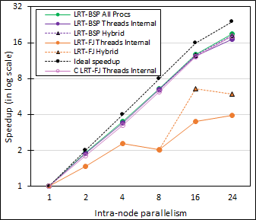
Performance Dependence on Number of Cores inside node (16 nodes total)
Long-Running Theads LRT Java
  All Processes
  All Threads internal to node
  Hybrid – Use one process per chip
Fork Join Java
  All Threads
  Hybrid – Use one process per chip
Fork Join C
  All Threads
All MPI internode

Slide 57
HPC-ABDS
DataFlow and In-place Runtime

Slide 58
HPC-ABDS Parallel Computing
Both simulations and data analytics use similar parallel computing ideas
Both do decomposition of both model and data
Both tend use SPMD and often use BSP Bulk Synchronous Processing
One has computing (called maps in big data terminology) and communication/reduction (more generally collective) phases
Big data thinks of problems as multiple linked queries even when queries are small and uses dataflow model
Simulation uses dataflow for multiple linked applications but small steps such as iterations are done in place
Reduction in HPC (MPIReduce) done as optimized tree or pipelined communication between same processes that did computing
Reduction in Hadoop or Flink done as separate map and reduce processes using dataflow
  This leads to 2 forms (In-Place and Flow) of Map-X mentioned earlier
Interesting Fault Tolerance issues highlighted by Hadoop-MPI comparisons – not discussed here!

Slide 59
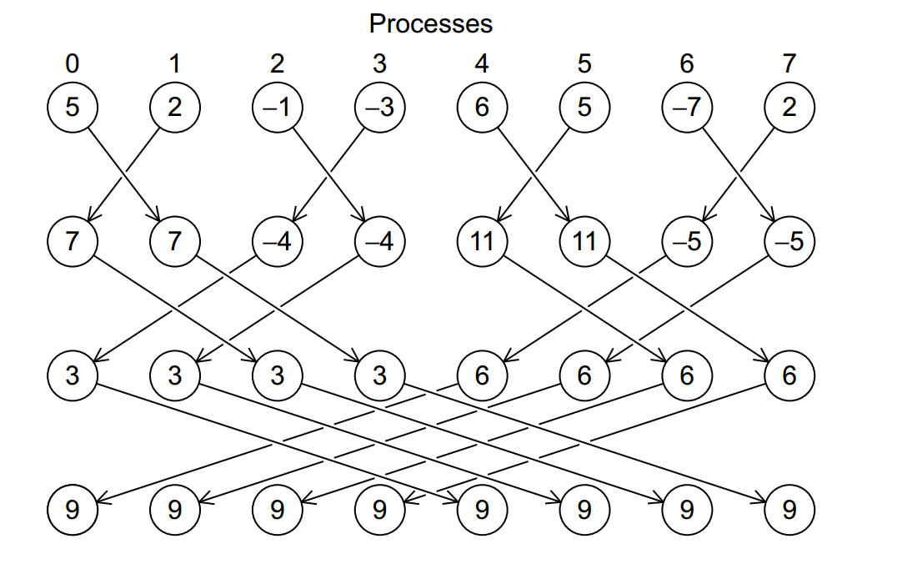
Illustration of In-Place AllReduce in MPI

Slide 60

Breaking Programs into Parts
Fine Grain Parallel Computing Data/model parameter decomposition
Coarse Grain Dataflow
HPC or ABDS

Slide 61
Kmeans Clustering Flink and MPI one million 2D points fixed; various # centers
24 cores on 16 nodes

Slide 62
HPC-ABDS Parallel Computing I
MPI designed for fine grain case and typical of parallel computing used in large scale simulations
  Only change in model parameters are transmitted
  In-place implementation
  Synchronization important as parallel computing
Dataflow typical of distributed or Grid computing workflow paradigms
  Data sometimes and model parameters certainly transmitted
  If used in workflow, large amount of computing and no synchronization constraints
  Caching in iterative MapReduce avoids data communication and in fact systems like TensorFlow, Spark or Flink are called dataflow but usually implement “model-parameter” flow

Slide 63
HPC-ABDS Parallel Computing II
Overheads are given by similar formulae for big data analytics and simulations
Overhead f = (1/Model parameter Size in each map)^{n} x (Typical Hardware communication cost/Typical computing cost)
Index n>0 depends on communication structure
  n=0.5 for matrix problems; n=1 for O(N²) problems
Intra-job reduction such as Kmeans clustering has center changes at end of each iteration and can have small f if use high performance networks
Inter-Job overheads can be small as computing load high e.g. as summed over overheads, even if cost ratio high
Increasing grain size = Model parameter Size in each map, decreases overhead as n>0

Slide 64
HPC-ABDS Parallel Computing III
For a given application, need to understand:
  Ratio of amount of computing to amount of communication
  Requirements of hardware compute/communication ratio
Inefficient to use same runtime mechanism independent of characteristics
  Use In-Place implementations for parallel computing with high overhead and Flow for flexible low overhead cases
Classic Dataflow is approach of Spark and Flink so need to add parallel in-place computing as done by Harp for Hadoop
HPC-ABDS plan is to keep current user interfaces (say to Spark Flink Hadoop Storm Heron) and transparently use HPC to improve performance exploiting added level 13 in HPC-ABDS
We have done this to Hadoop (next Slide), Spark, Storm, Heron
  Working on further HPC integration with ABDS

Slide 65
Harp (Hadoop Plugin) brings HPC to ABDS
Basic Harp: Iterative HPC communication; scientific data abstractions
Careful support of distributed data AND distributed model
Avoids parameter server approach but distributes model over worker nodes and supports collective communication to bring global model to each node
Applied first to Latent Dirichlet Allocation LDA with large model and data
MapReduce Model
MapCollective Model
MapReduce Applications
MapCollective Applications
M
M
M
M
M
M
M
M
MapReduce V2
Harp
Shuffle
Collective Communication
R
R
YARN

Slide 66
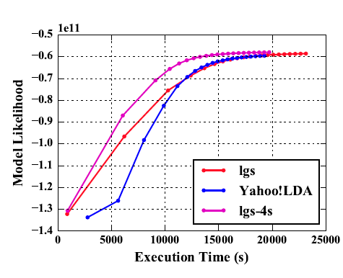
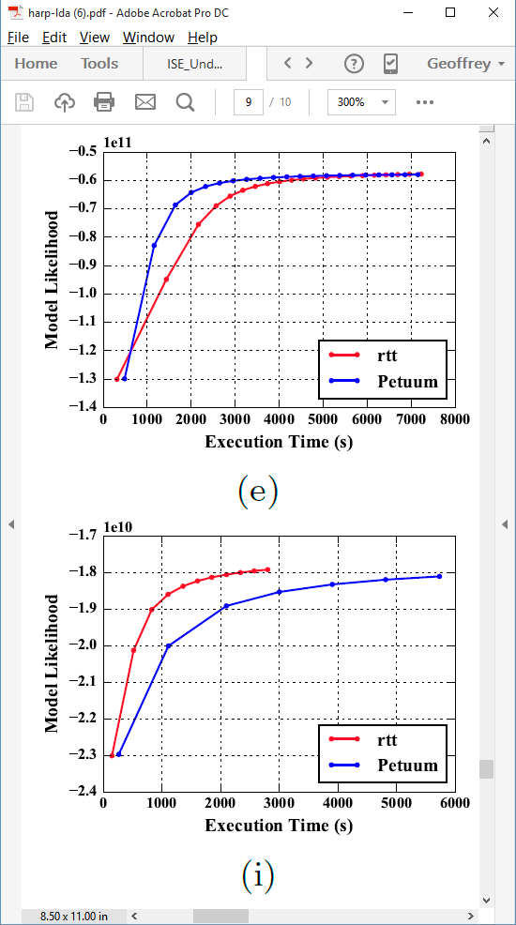
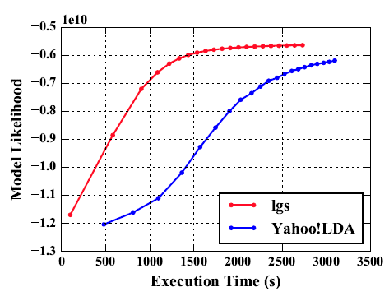
Latent Dirichlet Allocation on 100 Haswell nodes: red is Harp (lgs and rtt)
Clueweb
Clueweb
enwiki
Bi-gram

Slide 67
Harp LDA on Big Red II Supercomputer (Cray)
Harp LDA Scaling Tests
Harp LDA on Juliet (Intel Haswell)
  Big Red II: tested on 25, 50, 75, 100 and 125 nodes; each node uses 32 parallel threads; Gemini interconnect
  Juliet: tested on 10, 15, 20, 25, 30 nodes; each node uses 64 parallel threads on 36 core Intel Haswell nodes (each with 2 chips); Infiniband interconnect
Corpus: 3,775,554 Wikipedia documents, Vocabulary: 1 million words;
Topics: 10k topics; alpha: 0.01; beta: 0.01; iteration: 200

Slide 68
Streaming Applications and Technology

Slide 69
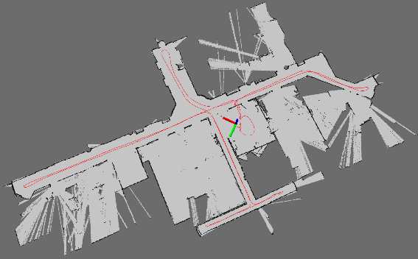
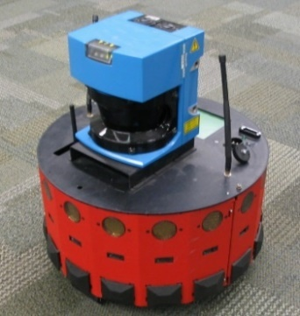
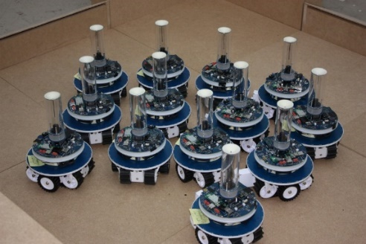
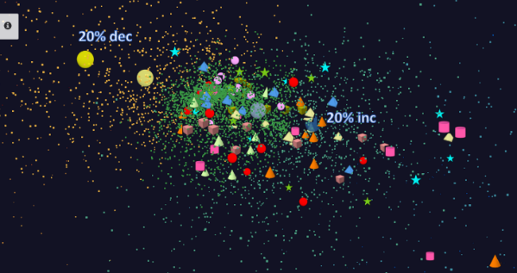
Adding HPC to Storm & Heron for Streaming
Robotics Applications
Time series data visualization in real time
Simultaneous Localization and Mapping
N-Body Collision
Avoidance
Map Built from
Robot data
Robot with a Laser Range Finder
Robots need to avoid collisions when they move
Map High dimensional data to 3D visualizer
Apply to Stock market data tracking 6000 stocks

Slide 70
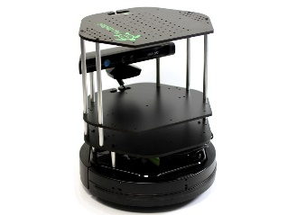
Data Pipeline
Sending to
pub-sub
Sending to
Persisting
storage
Multiple
streaming
workflows
Streaming
workflow
A stream application with some tasks running in parallel
Gateway
Message Brokers
RabbitMQ, Kafka
Streaming Workflows
Apache Heron and Storm
End to end delays without any processing is less than 10ms
Storm does not support “real parallel processing” within bolts – add optimized inter-bolt communication
Hosted on HPC and OpenStack cloud

Slide 71
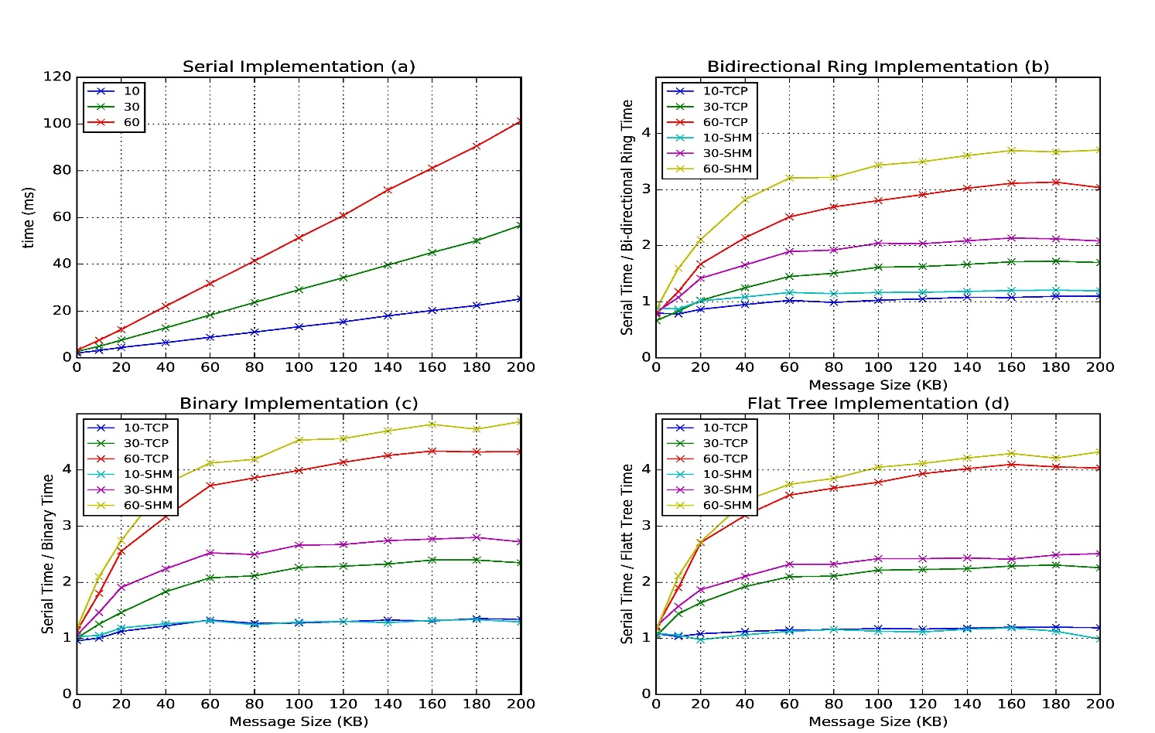
Improvement of Storm (Heron) using HPC communication algorithms
Latency of binary tree, flat tree and bi-directional ring implementations compared to serial implementation. Different lines show varying # of parallel tasks with either TCP communications and shared memory communications(SHM).
Original Time
Speedup Ring
Speedup Binary
Speedup Tree

Slide 72
End of Software Discussion

Slide 73
Workflow in HPC-ABDS
HPC familiar with Taverna, Pegasus, Kepler, Galaxy etc. and
ABDS has many workflow systems with recent Apache systems being Crunch, NiFi and Beam (open source version of Google Cloud Dataflow)
  Use ABDS for sustainability reasons?
  ABDS approaches are better integrated than HPC approaches with ABDS data management like Hbase and are optimized for distributed data.
Heron, Spark and Flink provide distributed dataflow runtime which is needed for workflow
Beam uses Spark or Flink as runtime and supports streaming and batch data
Needs more study

Slide 74
Automatic parallelization
Database community looks at big data job as a dataflow of (SQL) queries and filters
Apache projects like Pig, MRQL and Flink aim at automatic query optimization by dynamic integration of queries and filters including iteration and different data analytics functions
Going back to ~1993, High Performance Fortran HPF compilers optimized set of array and loop operations for large scale parallel execution of optimized vector and matrix operations
HPF worked fine for initial simple regular applications but ran into trouble for cases where parallelism hard (irregular, dynamic)
Will same happen in Big Data world?
Straightforward to parallelize k-means clustering but sophisticated algorithms like Elkans method (use triangle inequality) and fuzzy clustering are much harder (but not used much NOW)
Will Big Data technology run into HPF-style trouble with growing use of sophisticated data analytics?

Slide 75
Infrastructure Nexus
IaaS
DevOps
Cloudmesh

Slide 76
Constructing HPC-ABDS Exemplars
This is one of next steps in NIST Big Data Working Group
Jobs are defined hierarchically as a combination of Ansible (preferred over Chef or Puppet as Python) scripts
Scripts are invoked on Infrastructure (Cloudmesh Tool)
INFO 524 “Big Data Open Source Software Projects” IU Data Science class required final project to be defined in Ansible and decent grade required that script worked (On NSF Chameleon and FutureSystems)
  80 students gave 37 projects with ~15 pretty good such as
  “Machine Learning benchmarks on Hadoop with HiBench”, Hadoop/Yarn, Spark, Mahout, Hbase
  “Human and Face Detection from Video”, Hadoop (Yarn), Spark, OpenCV, Mahout, MLLib
Build up curated collection of Ansible scripts defining use cases for benchmarking, standards, education
https://docs.google.com/document/d/1INwwU4aUAD_bj-XpNzi2rz3qY8rBMPFRVlx95k0-xc4
Fall 2015 class INFO 523 introductory data science class was less constrained; students just had to run a data science application but catalog interesting
  140 students: 45 Projects (NOT required) with 91 technologies, 39 datasets

Slide 77
Cloudmesh Interoperability DevOps Tool
Model: Define software configuration with tools like Ansible (Chef, Puppet); instantiate on a virtual cluster
Save scripts not virtual machines and let script build applications
Cloudmesh is an easy-to-use command line program/shell and portal to interface with heterogeneous infrastructures taking script as input
  It first defines virtual cluster and then instantiates script on it
  It has several common Ansible defined software built in
Supports OpenStack, AWS, Azure, SDSC Comet, virtualbox, libcloud supported clouds as well as classic HPC and Docker infrastructures
  Has an abstraction layer that makes it possible to integrate other IaaS frameworks
Managing VMs across different IaaS providers is easier
Demonstrated interaction with various cloud providers:
  FutureSystems, Chameleon Cloud, Jetstream, CloudLab, Cybera, AWS, Azure, virtualbox
Status: AWS, and Azure, VirtualBox, Docker need improvements; we focus currently on SDSC Comet and NSF resources that use OpenStack
HPC Cloud Interoperability Layer

Slide 78
Cloudmesh Architecture
Software Engineering Process
We define a basic virtual cluster which is a set of instances with a common security context
We then add basic tools including languages Python Java etc.
Then add management tools such as Yarn, Mesos, Storm, Slurm etc …..
Then add roles for different HPC-ABDS PaaS subsystems such as Hbase, Spark
  There will be dependencies e.g. Storm role uses Zookeeper
Any one project picks some of HPC-ABDS PaaS Ansible roles and adds >=1 SaaS that are specific to their project and for example read project data and perform project analytics
E.g. there will be an OpenCV role used in Image processing applications

Slide 79
Summary of Big Data - Big Simulation
Convergence?
HPC-Clouds convergence? (easier than converging higher levels in stack)
Can HPC continue to do it alone?
Convergence Diamonds
HPC-ABDS Software on differently optimized hardware infrastructure

Slide 80
General Aspects of Big Data HPC Convergence
Applications, Benchmarks and Libraries
  51 NIST Big Data Use Cases, 7 Computational Giants of the NRC Massive Data Analysis, 13 Berkeley dwarfs, 7 NAS parallel benchmarks
  Unified discussion by separately discussing data & model for each application;
  64 facets– Convergence Diamonds -- characterize applications
  Characterization identifies hardware and software features for each application across big data, simulation; “complete” set of benchmarks (NIST)
Software Architecture and its implementation
  HPC-ABDS: Cloud-HPC interoperable software: performance of HPC (High Performance Computing) and the rich functionality of the Apache Big Data Stack.
  Added HPC to Hadoop, Storm, Heron, Spark; could add to Beam and Flink
  Could work in Apache model contributing code
Run same HPC-ABDS across all platforms but “data management” nodes have different balance in I/O, Network and Compute from “model” nodes
  Optimize to data and model functions as specified by convergence diamonds
  Do not optimize for simulation and big data
Convergence Language: Make C++, Java, Scala, Python (R) … perform well
Training: Students prefer to learn Big Data rather than HPC
Sustainability: research/HPC communities cannot afford to develop everything (hardware and software) from scratch

Slide 81
Typical Convergence Architecture
Running same HPC-ABDS software across all platforms but data management machine has different balance in I/O, Network and Compute from “model” machine
  Note data storage approach: HDFS v. Object Store v. Lustre style file systems is still rather unclear
The Model behaves similarly whether from Big Data or Big Simulation.
Data Management Model for Big Data
and Big Simulation

