Slide 1
FutureGrid
SOIC Lightning Talk
February 18 2011
Geoffrey Fox
gcf@indiana.edu
http://www.infomall.org http://www.futuregrid.org
Director, Digital Science Center, Pervasive Technology Institute
Associate Dean for Research and Graduate Studies, School of Informatics and Computing
Indiana University Bloomington

Slide 2
US Cyberinfrastructure Context
There are a rich set of facilities
  Production TeraGrid facilities with distributed and shared memory
  Experimental “Track 2D” Awards
    FutureGrid: Distributed Systems experiments cf. Grid5000
    Keeneland: Powerful GPU Cluster
    Gordon: Large (distributed) Shared memory system with SSD aimed at data analysis/visualization
  Open Science Grid aimed at High Throughput computing and strong campus bridging

Slide 3
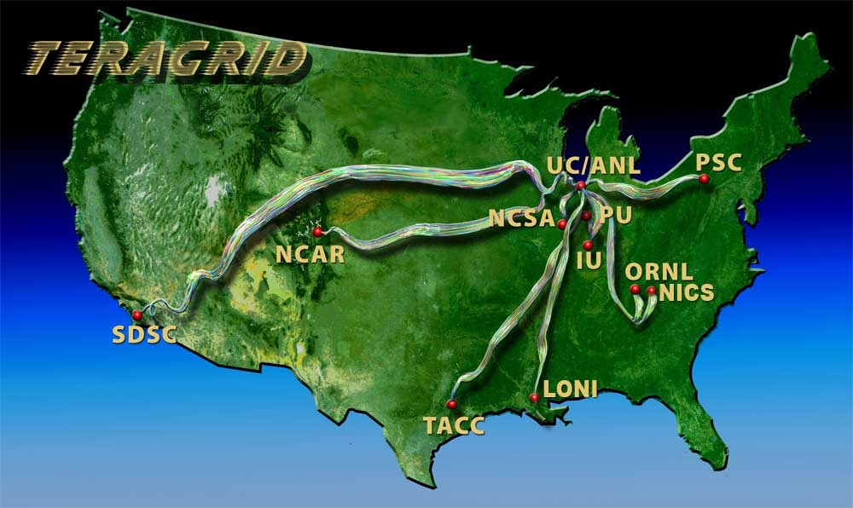
TeraGrid
~2 Petaflops; over 20 PetaBytes of storage (disk and tape), over 100 scientific data collections
UW
Grid Infrastructure Group (UChicago)
UC/ANL
PSC
NCAR
PU
NCSA
Caltech
IU
UNC/RENCI
ORNL
USC/ISI
NICS
SDSC
LONI
TACC
Resource Provider (RP)
Software Integration Partner
Network Hub

Slide 4
FutureGrid key Concepts I
FutureGrid is a 4 year $15M project with 7 clusters at 5 sites across country with 8 funded partners
FutureGrid is a flexible testbed supporting Computer Science and Computational Science experiments in
  Innovation and scientific understanding of distributed computing (cloud, grid) and parallel computing paradigms
  The engineering science of middleware that enables these paradigms
  The use and drivers of these paradigms by important applications
  The education of a new generation of students and workforce on the use of these paradigms and their applications
  interoperability, functionality, performance or evaluation

Slide 5

FutureGrid key Concepts II
Rather than loading images onto VM’s, FutureGrid supports Cloud, Grid and Parallel computing environments by dynamically provisioning software as needed onto “bare-metal”
  Image library for MPI, OpenMP, Hadoop, Dryad, gLite, Unicore, Globus, Xen, ScaleMP (distributed Shared Memory), Nimbus, Eucalyptus, OpenNebula, KVM, Windows …..
Growth comes from users depositing novel images in library
Each use of FutureGrid is an experiment that is reproducible
Developing novel software to support these goals which build on Grid5000 in France
Image1
Image2
…
ImageN
Choose
Load
Run

Slide 6
FutureGrid Partners
Indiana University (Architecture, core software, Support)
Purdue University (HTC Hardware)
San Diego Supercomputer Center at University of California San Diego (INCA, Monitoring)
University of Chicago/Argonne National Labs (Nimbus)
University of Florida (ViNE, Education and Outreach)
University of Southern California Information Sciences (Pegasus to manage experiments)
University of Tennessee Knoxville (Benchmarking)
University of Texas at Austin/Texas Advanced Computing Center (Portal)
University of Virginia (OGF, Advisory Board and allocation)
Center for Information Services and GWT-TUD from Technische Universtität Dresden. (VAMPIR)
Red institutions have FutureGrid hardware

Slide 7

FutureGrid: a Grid/Cloud/HPC Testbed
NID: Network Impairment Device
Private
Public
FG Network

Slide 8
5 Use Types for FutureGrid
Training Education and Outreach
  Semester and short events; promising for outreach
Interoperability test-beds
  Grids and Clouds; OGF really needed this
Domain Science applications
  Life science highlighted
Computer science
  Largest current category
Computer Systems Evaluation
  TeraGrid (TIS, TAS, XSEDE), OSG, EGI

Slide 9
Some Current FutureGrid projects I
Project | Institution | Details
Educational Projects
VSCSE Big Data | IU PTI, Michigan, NCSA and 10 sites | Over 200 students in week Long Virtual School of Computational Science and Engineering on Data Intensive Applications & Technologies
LSU Distributed Scientific Computing Class | LSU | 13 students use Eucalyptus and SAGA enhanced version of MapReduce
Topics on Systems: Cloud Computing CS Class | IU SOIC | 27 students in class using virtual machines, Twister, Hadoop and Dryad
Interoperability Projects
OGF Standards | Virginia, LSU, Poznan | Interoperability experiments between OGF standard Endpoints
Sky Computing | University of Rennes 1 | Over 1000 cores in 6 clusters across Grid’5000 & FutureGrid using ViNe and Nimbus to support Hadoop and BLAST demonstrated at OGF 29 June 2010

Slide 10
Some Current FutureGrid projects II
Domain Science Application Projects
Combustion | Cummins | Performance Analysis of codes aimed at engine efficiency and pollution
Cloud Technologies for Bioinformatics Applications | IU PTI | Performance analysis of pleasingly parallel/MapReduce applications on Linux, Windows, Hadoop, Dryad, Amazon, Azure with and without virtual machines
Computer Science Projects
Cumulus | Univ. of Chicago | Open Source Storage Cloud for Science based on Nimbus
Differentiated Leases for IaaS | University of Colorado | Deployment of always-on preemptible VMs to allow support of Condor based on demand volunteer computing
Application Energy Modeling | UCSD/SDSC | Fine-grained DC power measurements on HPC resources and power benchmark system
Evaluation and TeraGrid/OSG Support Projects
Use of VM’s in OSG | OSG, Chicago, Indiana | Develop virtual machines to run the services required for the operation of the OSG and deployment of VM based applications in OSG environments.
TeraGrid QA Test & Debugging | SDSC | Support TeraGrid software Quality Assurance working group
TeraGrid TAS/TIS | Buffalo/Texas | Support of XD Auditing and Insertion functions

Slide 11
Education & Outreach on FutureGrid
Build up tutorials on supported software
Support development of curricula requiring privileges and systems destruction capabilities that are hard on conventional TeraGrid
Offer suite of appliances (customized VM based images) supporting online laboratories
Supporting several workshops including Virtual Summer School on “Big Data” July 26-30 2010; TeraGrid ‘10 “Cloud technologies, data-intensive science and the TG” August 2010; CloudCom conference tutorials Nov 30-Dec 3 2010
Experimental class use at Indiana, Florida and LSU
Planning ADMI Summer 2011 School on Clouds and REU program for Minority Serving Institutions
Will expand with new hire

Slide 12
Software Components
Important as Software is Infrastructure …
Portals including “Support” “use FutureGrid” “Outreach”
Monitoring – INCA, Power (GreenIT)
Experiment Manager: specify/workflow
Image Generation and Repository
Intercloud Networking ViNE
  Virtual Clusters built with virtual networks
Performance library (current tools don’t work on VM’s)
Rain or Runtime Adaptable InsertioN Service for images
Security Authentication, Authorization (need to vet images)
Expect major open sources software releases this summer of RAIN (underneath VM’s) and appliance platform (above images)

Slide 13
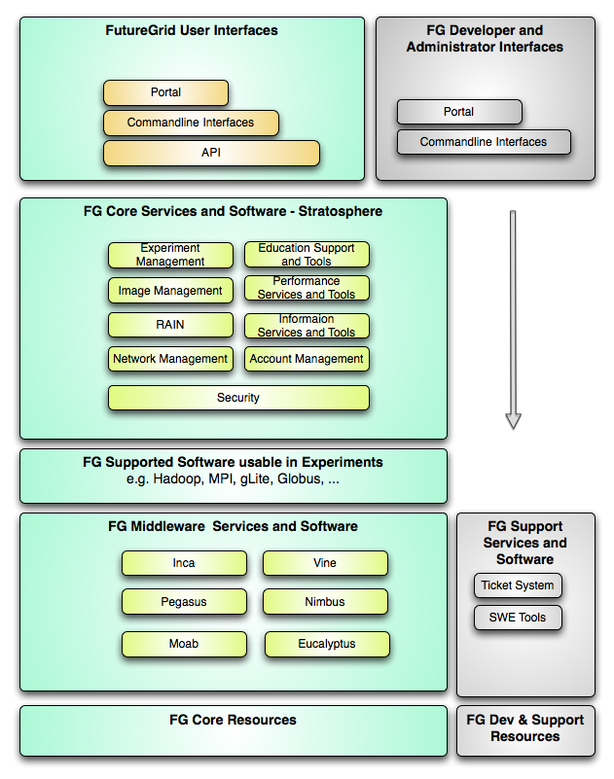
FutureGrid
Layered Software Stack
User Supported Software usable in Experiments e.g. OpenNebula, Kepler, Other MPI, Bigtable
Note on Authentication and Authorization
We have different environments and requirements from TeraGrid
Non trivial to integrate/align security model with TeraGrid

Slide 14
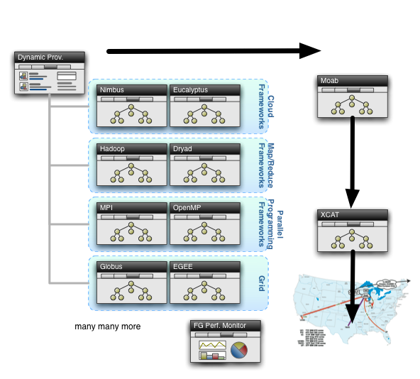
Rain in FutureGrid

Slide 15
FutureGrid SWOT
Difference from TeraGrid/XD/DEISA/EGI implies need to develop processes and software from scratch
Newness implies need to explain why its useful!
High “user support” load
Software is Infrastructure and must be approached as this
Rich skill base from distributed team
Lots of new education and outreach opportunities
5 interesting use categories: TEO, Interoperability, Domain applications, CS Middleware, System Evaluation
Tremendous student interest in all parts of FutureGrid can be tapped to help support & software development

Slide 16
Level of Effort
$15M over 4 years
8 funded partners filing reports every 2 weeks
IU effort
  GCF 40% effort (and growing!)
  Project Manager 65% EFFORT
  Systems Admin 2 FTE
  UITS Network support 1.13 FTE
  UITS RT 1 FTE
  User Support 2.2 FTE (currently 0.2)
  Software 3.3 FTE + 1 postdoc
  Portal Content 0.3 FTE
  6 PhD students (software and architecture innovative)

