Slide 1





NSF 1443054: CIF21 DIBBs: Middleware and High Performance Analytics Libraries for Scalable Data Science
Software: MIDAS
HPC-ABDS
DA Algorithms
Analytics
February 2017

Slide 2
Deterministic Annealing
Algorithms

Slide 3

Some Motivation
Big Data requires high performance – achieve with parallel computing
Big Data sometimes requires robust algorithms as more opportunity to make mistakes
Deterministic annealing (DA) is one of better approaches to robust optimization and broadly applicable
  Started as “Elastic Net” by Durbin for Travelling Salesman Problem TSP
  Tends to remove local optima
  Addresses overfitting
  Much Faster than simulated annealing
Physics systems find true lowest energy state if you anneal i.e. you equilibrate at each temperature as you cool
Uses mean field approximation, which is also used in “Variational Bayes” and “Variational inference”

Slide 4
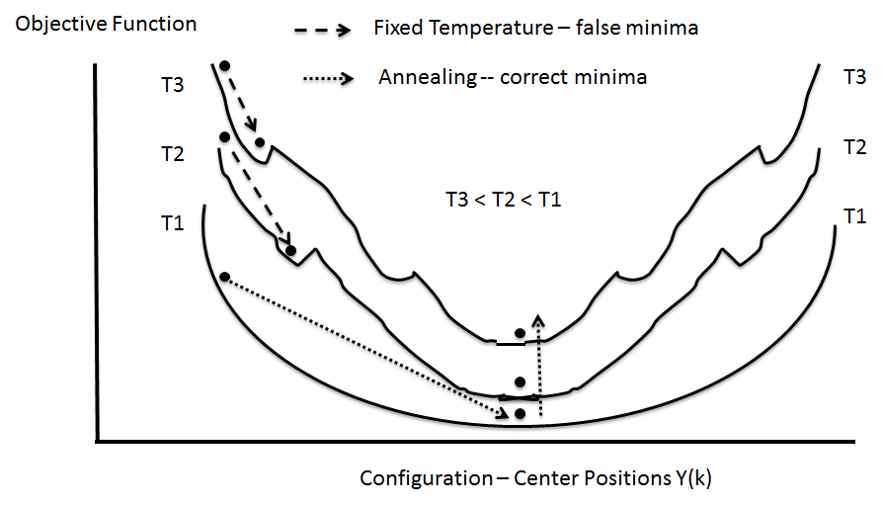
(Deterministic) Annealing
Find minimum at high temperature when trivial
Small change avoiding local minima as lower temperature
Typically gets better answers than standard libraries- R and Mahout
And can be parallelized and put on GPU’s etc.

Slide 5
General Features of DA
In many problems, decreasing temperature is classic multiscale – finer resolution (√T is “just” distance scale)
In clustering √T is distance in space of points (and centroids), for MDS scale in mapped Euclidean space
T = ∞, all points are in same place – the center of universe
For MDS all Euclidean points are at center and distances are zero. For clustering, there is one cluster
As Temperature lowered there are phase transitions in clustering cases where clusters split
  Algorithm determines whether split needed as second derivative matrix singular
Note DA has similar features to hierarchical methods and you do not have to specify a number of clusters; you need to specify a final distance scale

Slide 6
Math of Deterministic Annealing
H(χ) is objective function to be minimized as a function of parameters χ (as in Stress formula given earlier for MDS)
Gibbs Distribution at Temperature T
P(χ) = exp( - H(χ)/T) / ∫ dχ exp( - H(χ)/T)
Or P(χ) = exp( - H(χ)/T + F/T )
Use the Free Energy combining Objective Function and Entropy
F = < H - T S(P) > = ∫ dχ {P(χ)H + T P(χ) lnP(χ)}
Simulated annealing performs these integrals by Monte Carlo
Deterministic annealing corresponds to doing integrals analytically (by mean field approximation) and is much much faster
Need to introduce a modified Hamiltonian for some cases so that integrals are tractable. Introduce extra parameters to be varied so that modified Hamiltonian matches original
In each case temperature is lowered slowly – say by a factor 0.95 to 0.9999 at each iteration

Slide 7
Some Uses of Deterministic Annealing DA
Clustering improved K-means
  Vectors: Rose (Gurewitz and Fox 1990 – 486 citations encouraged me to revisit)
  Clusters with fixed sizes and no tails (Proteomics team at Broad)
  No Vectors: Hofmann and Buhmann (Just use pairwise distances)
Dimension Reduction for visualization and analysis
  Vectors: GTM Generative Topographic Mapping
  No vectors SMACOF: Multidimensional Scaling) MDS (Just use pairwise distances)
Can apply to HMM & general mixture models (less study)
  Gaussian Mixture Models
  Probabilistic Latent Semantic Analysis with Deterministic Annealing DA-PLSA as alternative to Latent Dirichlet Allocation for finding “hidden factors”
Have scalable parallel versions of much of above – mainly Java
Many clustering methods – not clear what is best although DA pretty good and improves K-means at increased computing cost which is not always useful
DA clearly improves MDS which is most reliable dimension reduction?

Slide 8
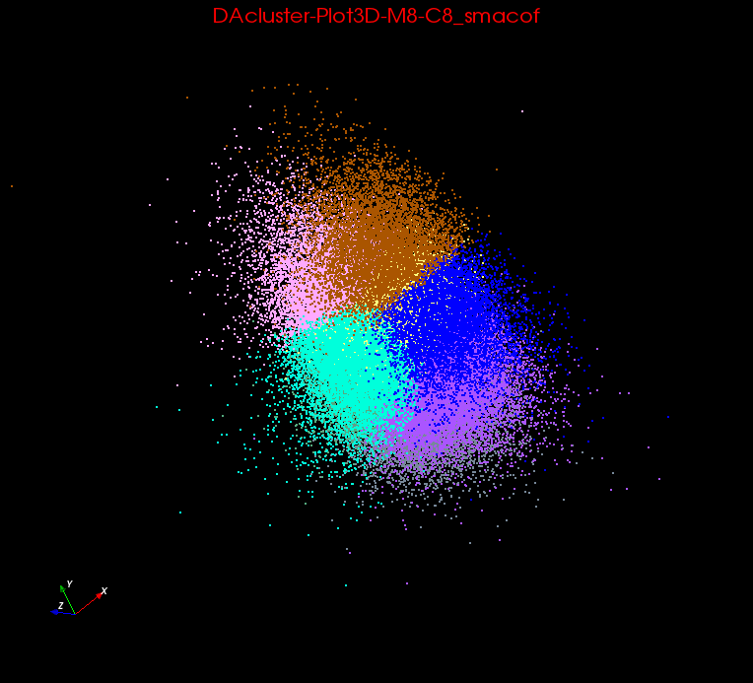
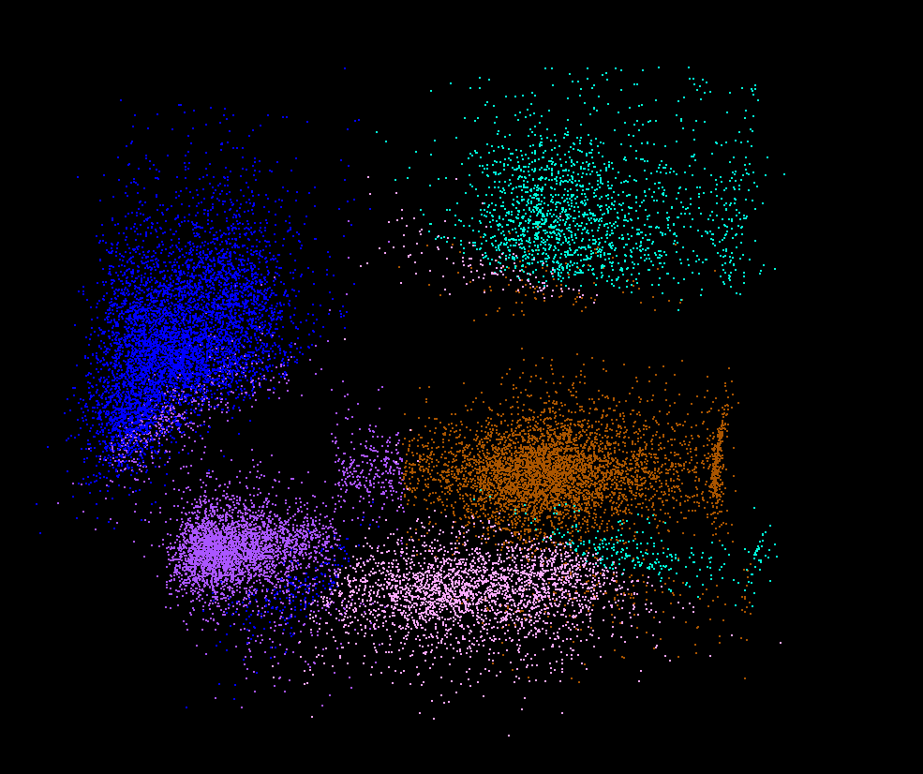
Clusters v. Regions
Lymphocytes 4D
Pathology 54D
In Lymphocytes clusters are distinct; DA useful
In Pathology, clusters divide space into regions and sophisticated methods like deterministic annealing are probably unnecessary

Slide 9
Some Problems we are working on
Analysis of Mass Spectrometry data to find peptides by clustering peaks (Broad Institute/Hyderabad)
  ~0.5 million points in 2 dimensions (one collection) -- ~ 50,000 clusters summed over charges
Metagenomics – 0.5 million (increasing rapidly) points NOT in a vector space – hundreds of clusters per sample
  Apply MDS to Phylogenetic trees
Pathology Images >50 Dimensions
Social image analysis is in a highish dimension vector space
  10-50 million images; 1000 features per image; million clusters
Finding communities from network graphs coming from Social media contacts etc.

Slide 10
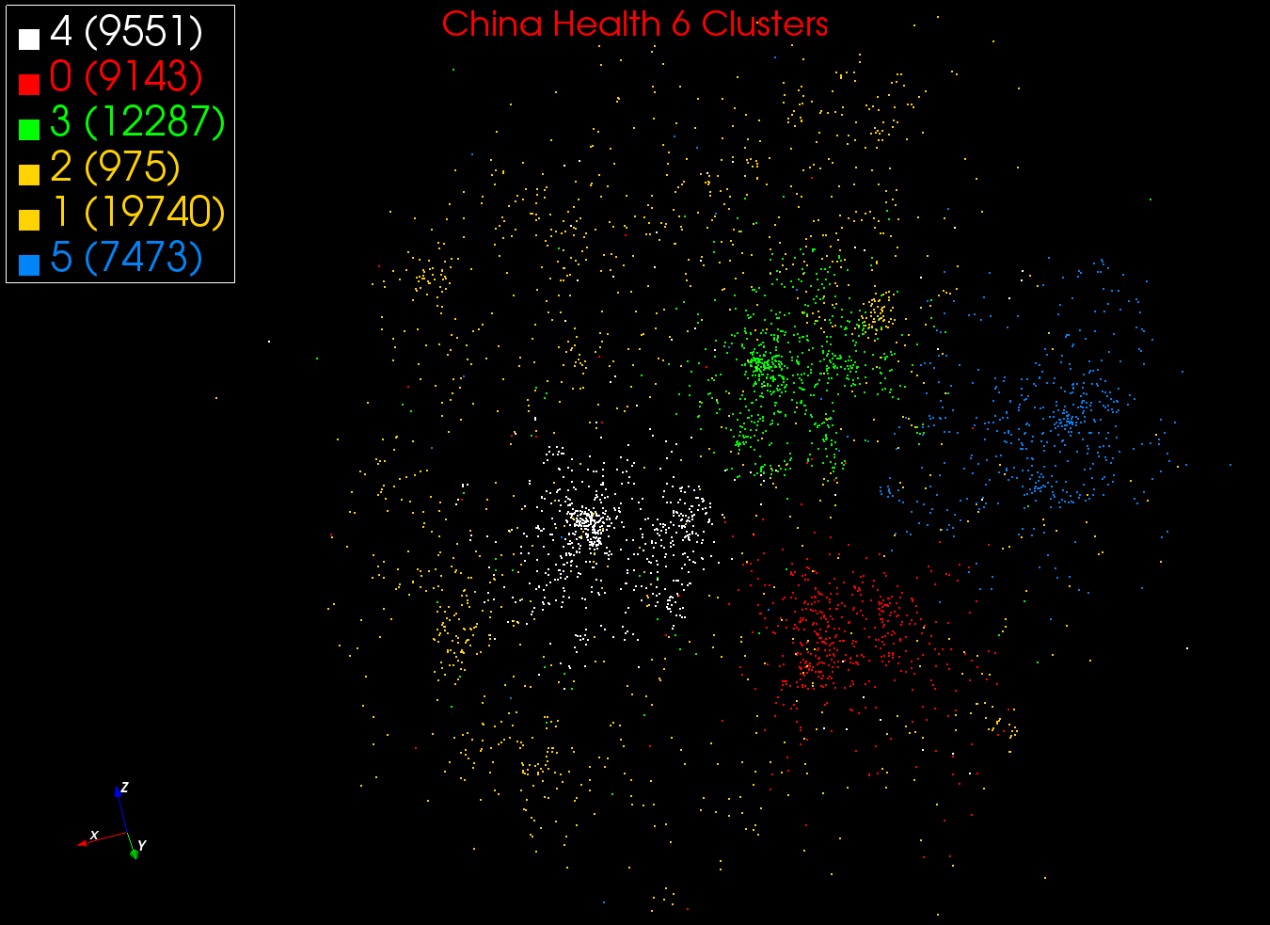
MDS and Clustering on ~60K EMR

Slide 11
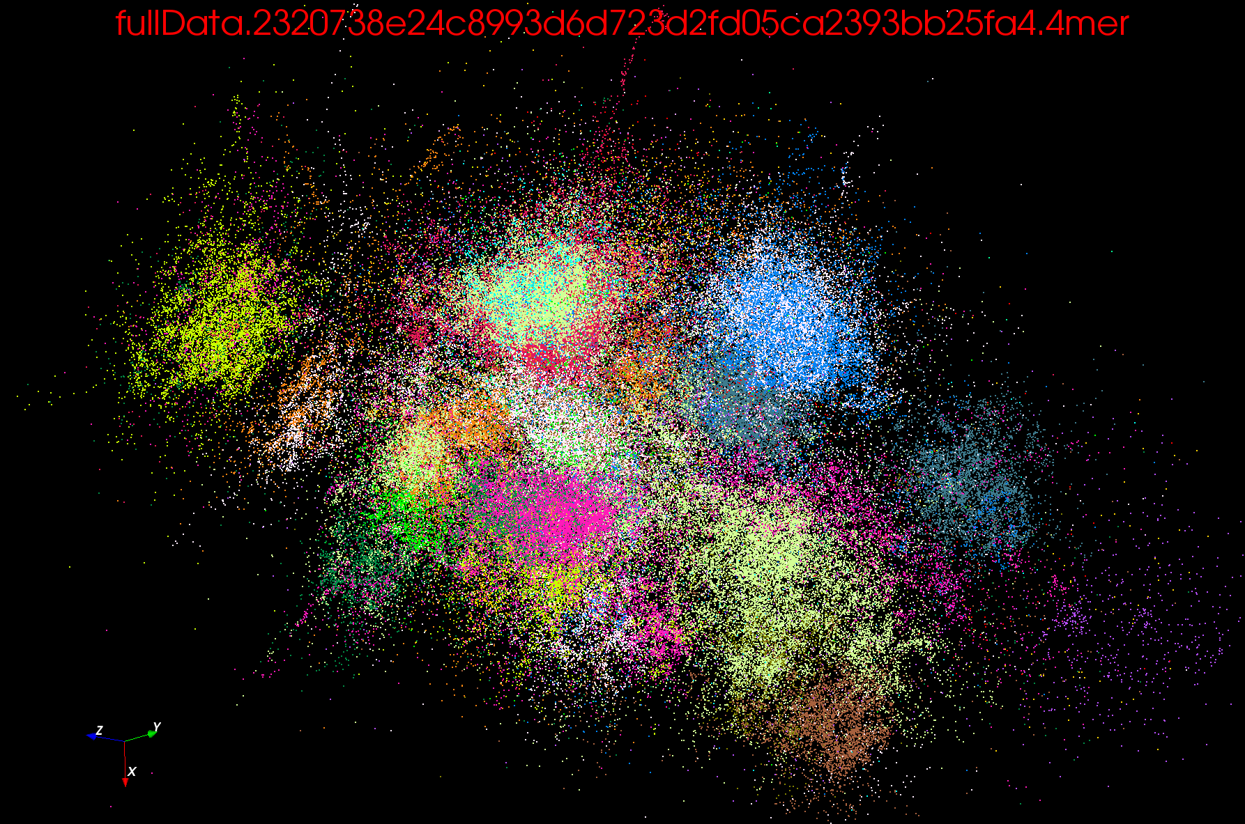
Colored by Sample – not clustered. Distances from vectors in word space. This 128 4mers for ~200K sequences

Slide 12
Examples of current DA algorithms: LCMS

Slide 13
Background on LC-MS
Remarks of collaborators – Broad Institute/Hyderabad
Abundance of peaks in “label-free” LC-MS enables large-scale comparison of peptides among groups of samples.
In fact when a group of samples in a cohort is analyzed together, not only is it possible to “align” robustly or cluster the corresponding peaks across samples, but it is also possible to search for patterns or fingerprints of disease states which may not be detectable in individual samples.
This property of the data lends itself naturally to big data analytics for biomarker discovery and is especially useful for population-level studies with large cohorts, as in the case of infectious diseases and epidemics.
With increasingly large-scale studies, the need for fast yet precise cohort-wide clustering of large numbers of peaks assumes technical importance.
In particular, a scalable parallel implementation of a cohort-wide peak clustering algorithm for LC-MS-based proteomic data can prove to be a critically important tool in clinical pipelines for responding to global epidemics of infectious diseases like tuberculosis, influenza, etc.

Slide 14
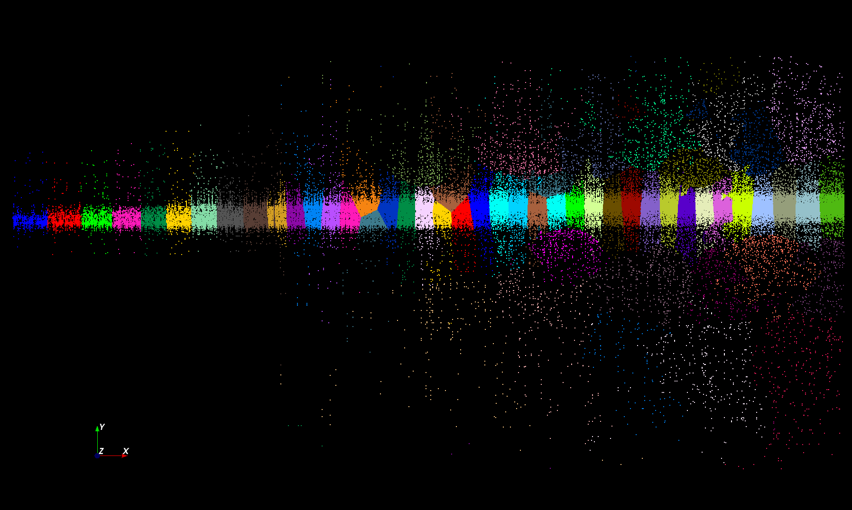
Proteomics 2D DA Clustering T= 25000 with 60 Clusters (will be 30,000 at T=0.025)

Slide 15
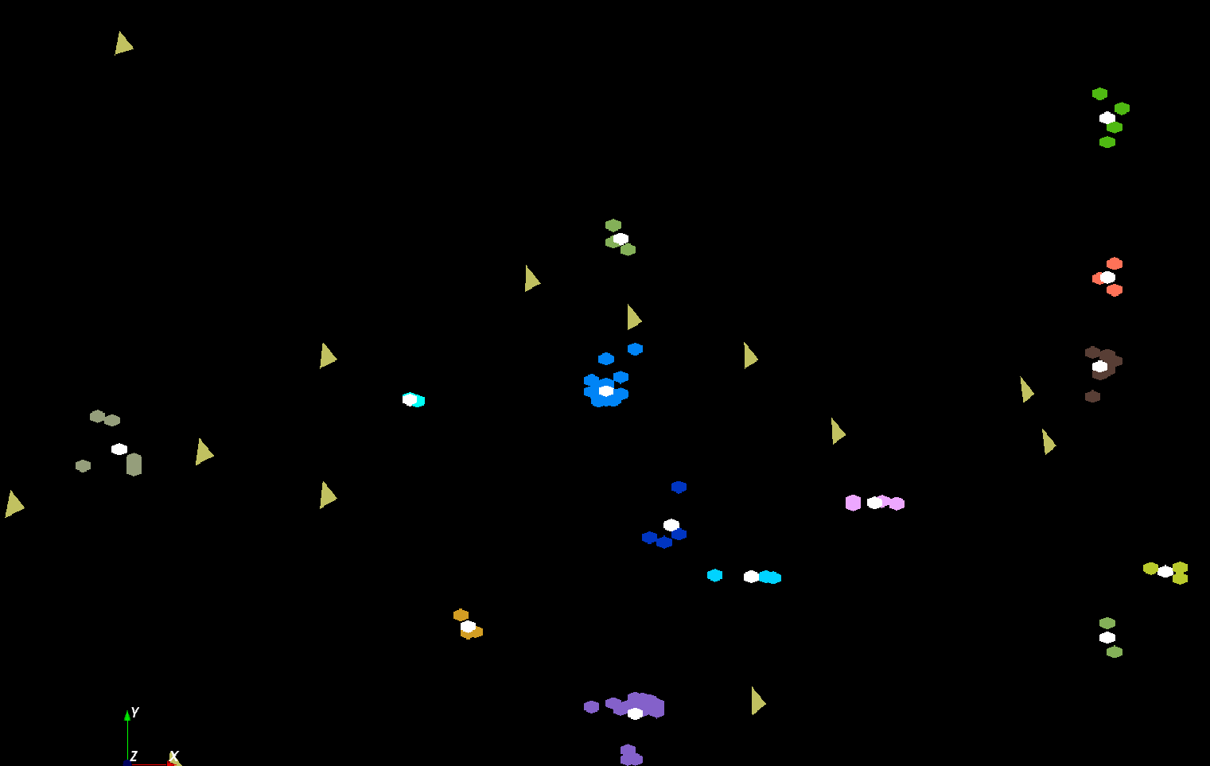
The brownish triangles are “sponge” (soaks up trash) peaks outside any cluster.
The colored hexagons are peaks inside clusters with the white hexagons being determined cluster center
Fragment of 30,000 Clusters
241605 Points

Slide 16
Continuous Clustering
This is a very useful subtlety introduced by Ken Rose but not widely known although it greatly improves algorithm
Take a cluster k to be split into 2 with centers Y(k)_{A} and Y(k)_{B} with initial values Y(k)_{A} = Y(k)_{B} at original center Y(k)
Then typically if you make this change
and perturb the Y(k)_{A} and Y(k)_{B}, they will
return to starting position
as F at stable minimum (positive eigenvalue)
But instability (the negative eigenvalue) can develop and one finds
Implement by adding arbitrary number p(k) of centers for each cluster
Z_{i} = ∑_{k=1}^{K} p(k) exp(-ε_{i}(k)/T) and M step gives p(k) = C(k)/N
Halve p(k) at splits; can’t split easily in standard case p(k) = 1
Show weighting in sums like Z_{i} now equipoint not equicluster as p(k)is proportional to points C(k) in cluster
Free Energy F
Y(k)_{A} and Y(k)_{B}
Free Energy F
Free Energy F
Y(k)_{A} + Y(k)_{B}
Y(k)_{A} - Y(k)_{B}

Slide 17
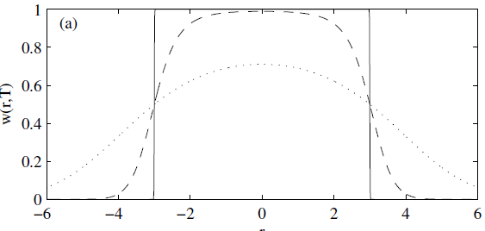
Trimmed Clustering
Clustering with position-specific constraints on variance: Applying redescending M-estimators to label-free LC-MS data analysis (Rudolf Frühwirth , D R Mani and Saumyadipta Pyne) BMC Bioinformatics 2011, 12:358
H_{TCC} = ∑_{k=0}^{K} ∑_{i=1}^{N} M_{i}(k) f(i,k)
  f(i,k) = (X(i) - Y(k))²/2σ(k)² k > 0
  f(i,0) = c² / 2 k = 0
The 0’th cluster captures (at zero temperature) all points outside clusters (background)
Clusters are trimmed
(X(i) - Y(k))²/2σ(k)² < c² / 2
Relevant when well
defined errors
T = 1
T ~ 0
T = 5
Distance from cluster center

Slide 18
Cluster Count v. Temperature for 2 Runs
All start with one cluster at far left
T=1 special as measurement errors divided out
DA2D counts clusters with 1 member as clusters. DAVS(2) does not

Slide 19
Simple Parallelism as in k-means
Decompose points i over processors
Equations either pleasingly parallel “maps” over i
Or “All-Reductions” summing over i for each cluster
Parallel Algorithm:
  Each process holds all clusters and calculates contributions to clusters from points in node
  e.g. Y(k) = ∑_{i=1}^{N} <M_{i}(k)> X_{i} / C(k)
Runs well in MPI or MapReduce
See discussion in other parts of tutorial

Slide 20
Better Parallelism
The previous model is correct at start but each point does not really contribute to each cluster as damped exponentially by exp( - (X_{i}- Y(k))² /T )
For Proteomics problem, on average only 6.45 clusters needed per point if require (X_{i}- Y(k))² /T ≤ ~40 (as exp(-40) small)
So only need to keep nearby clusters for each point
As average number of Clusters ~ 20,000, this gives a factor of ~3000 improvement
Further communication is no longer all global; it has nearest neighbor components and calculated by parallelism over clusters which can be done in parallel if separated

Slide 21
Speedups for several runs on Tempest from 8-way through 384 way MPI parallelism with one thread per process. We look at different choices for MPI processes which are either inside nodes or on separate nodes

Slide 22
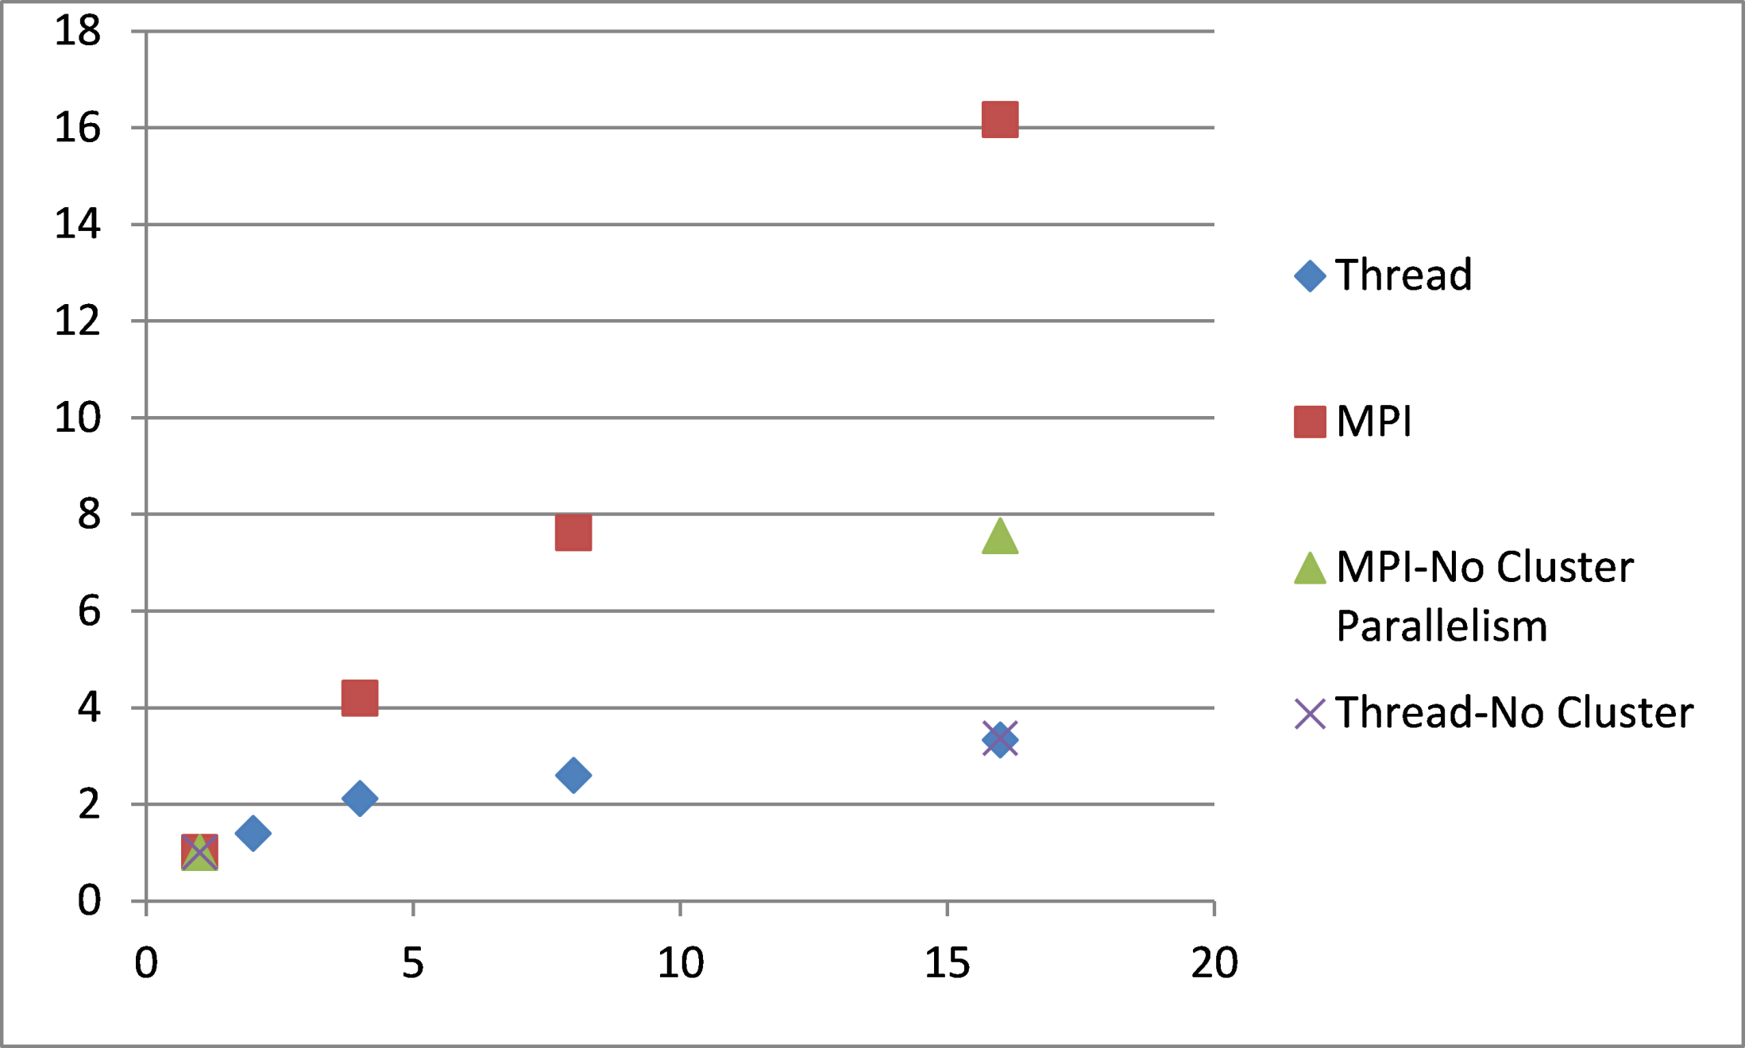
Parallelism within a Single Node of Madrid Cluster. A set of runs on 241605 peak data with a single node with 16 cores with either threads or MPI giving parallelism. Parallelism is either number of threads or number of MPI processes.
Parallelism (#threads or #processes)

Slide 23
Metagenomics -- Sequence clustering
Non-metric Spaces
O(N²) Algorithms – Illustrate Phase Transitions

Slide 24
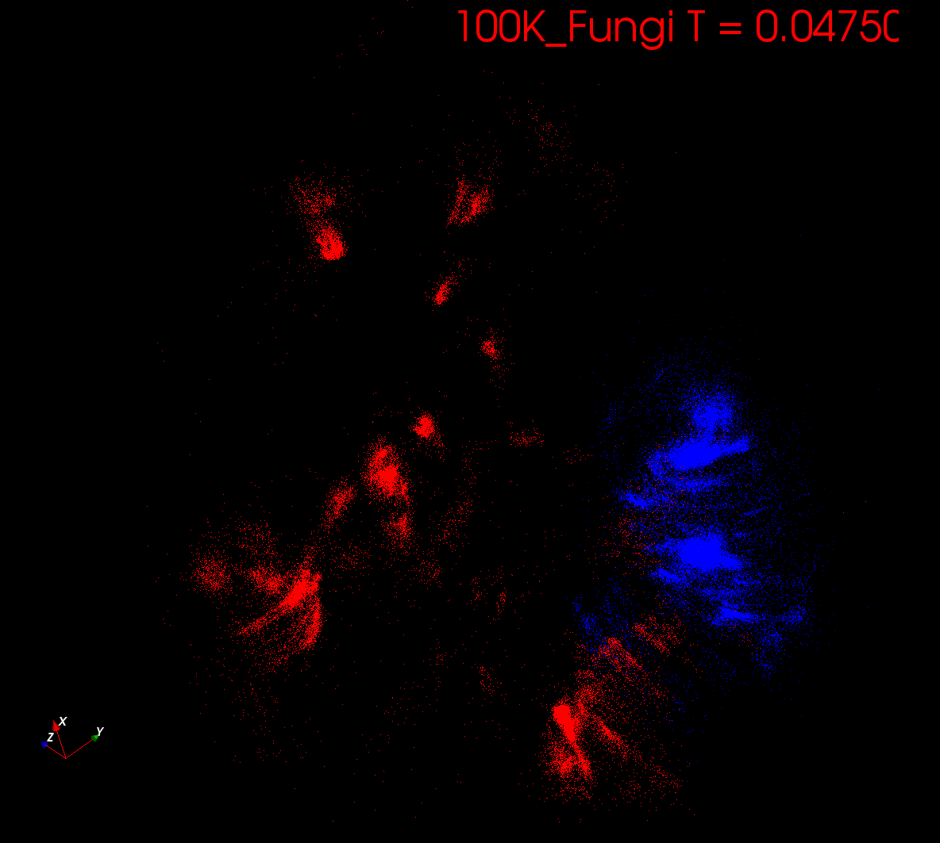
Start at T= “∞” with 1 Cluster
Decrease T, Clusters emerge at instabilities

Slide 25
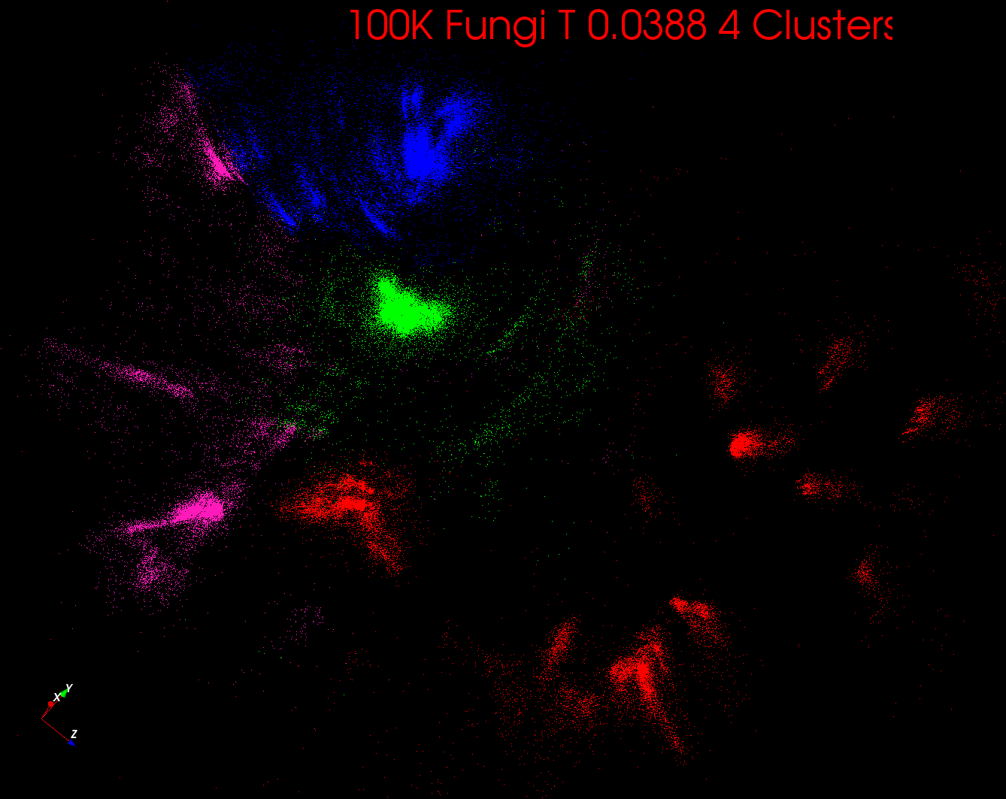

Slide 26
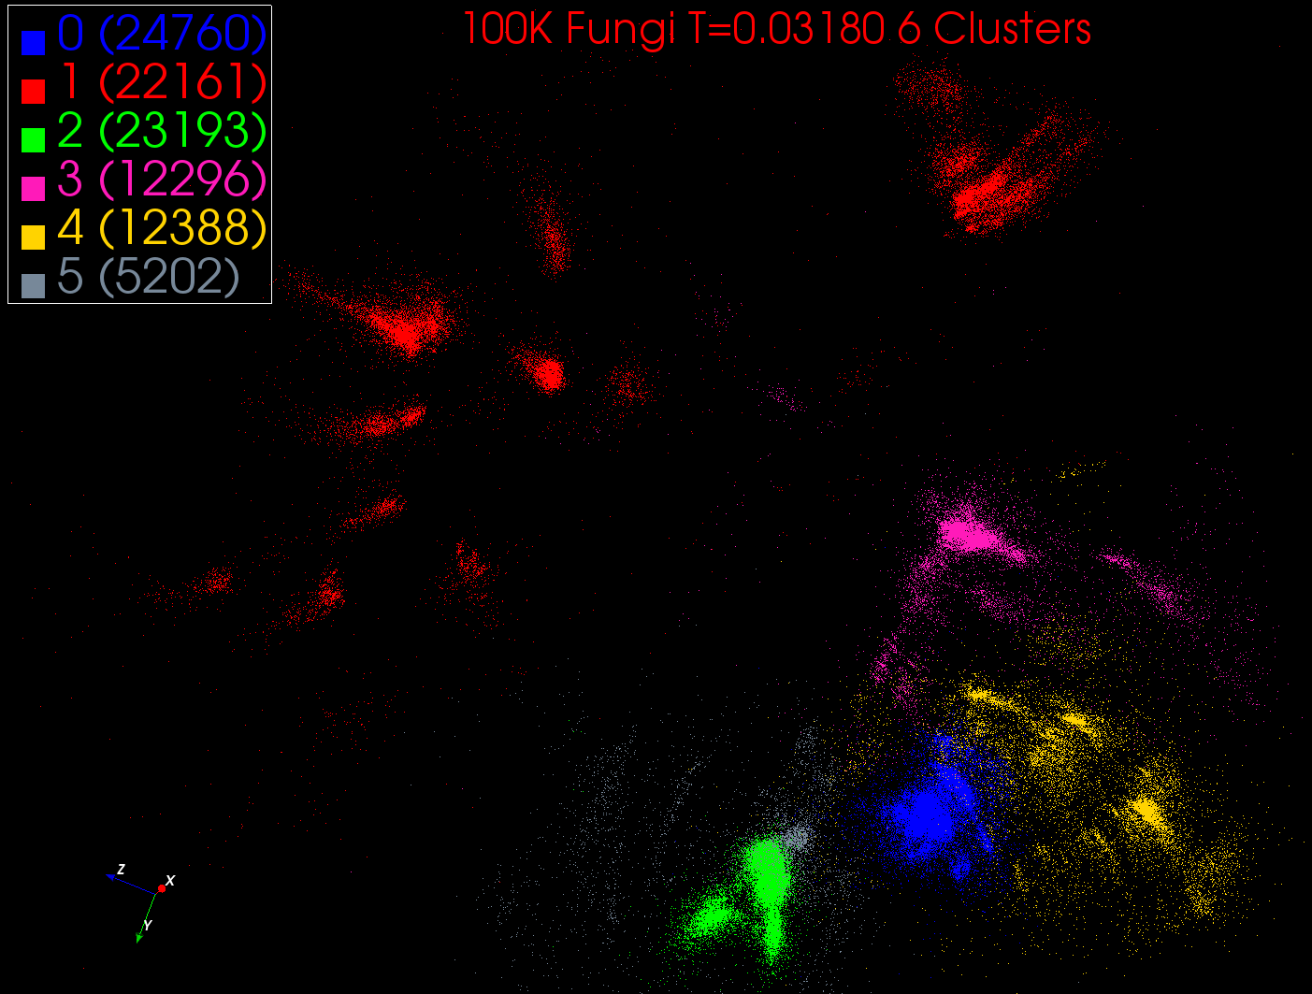

Slide 27
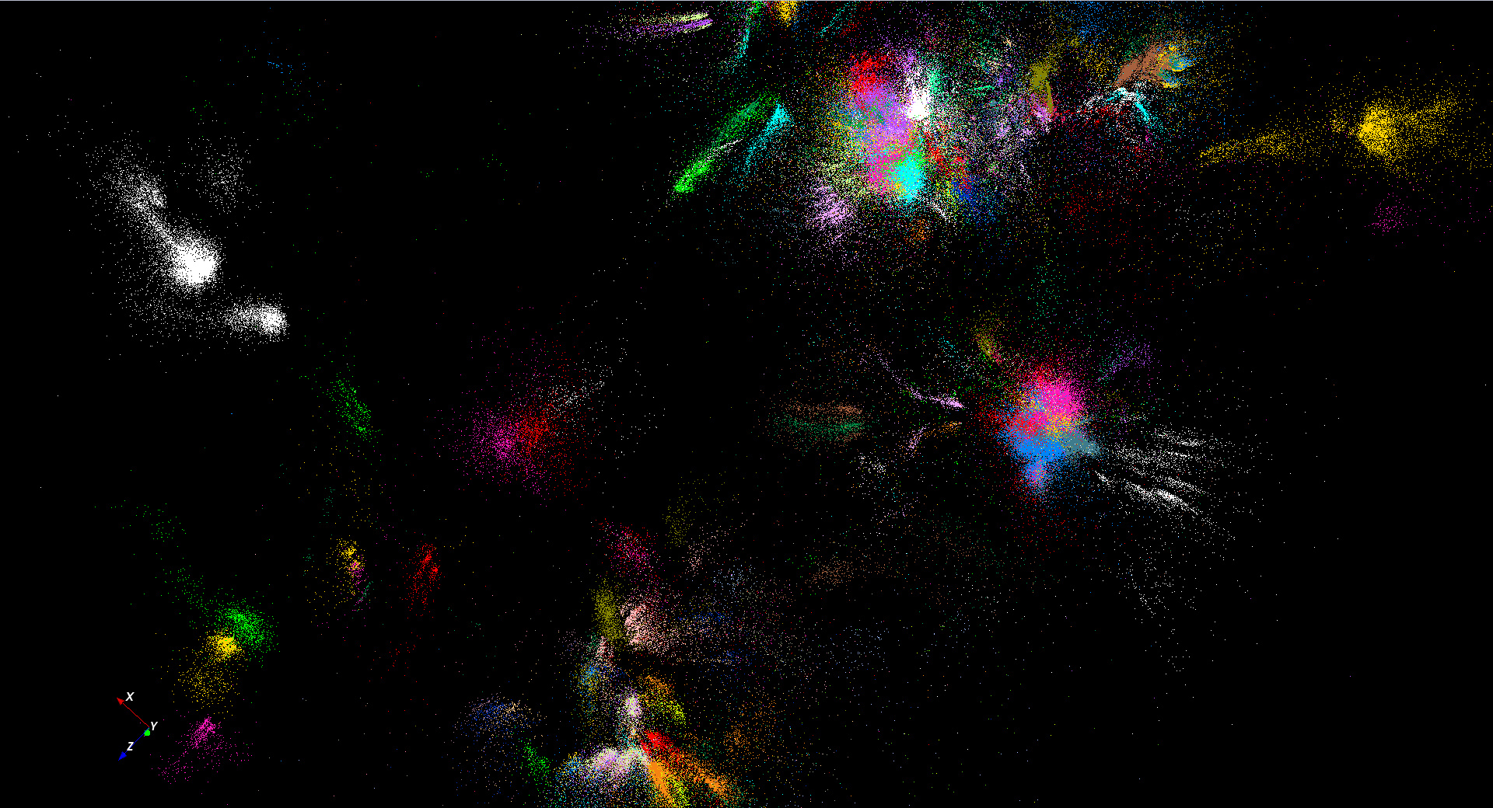
446K sequences
~100 clusters

Slide 28
Metagenomics -- Sequence clustering
Non-metric Spaces
O(N²) Algorithms – Compare Other Methods

Slide 29
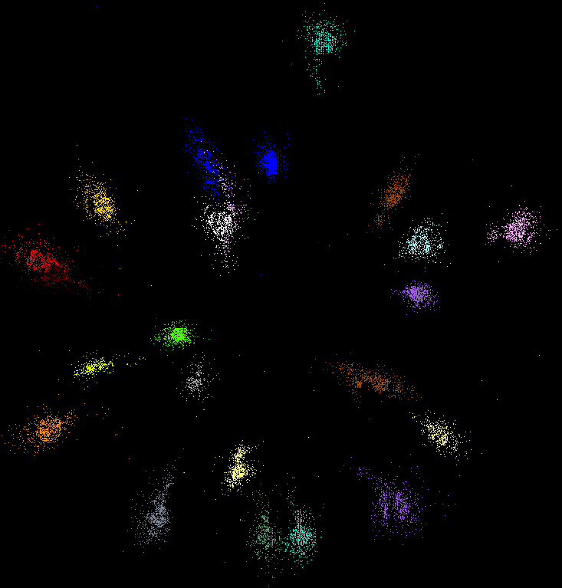
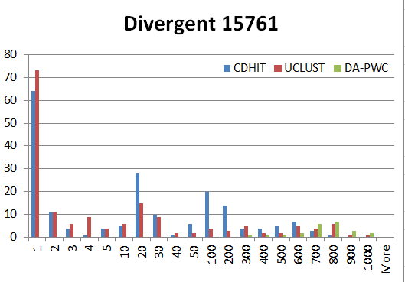
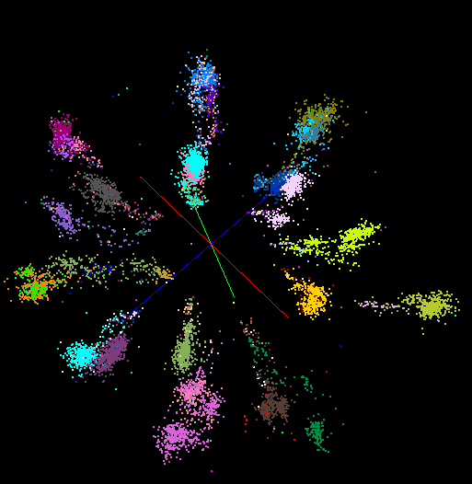
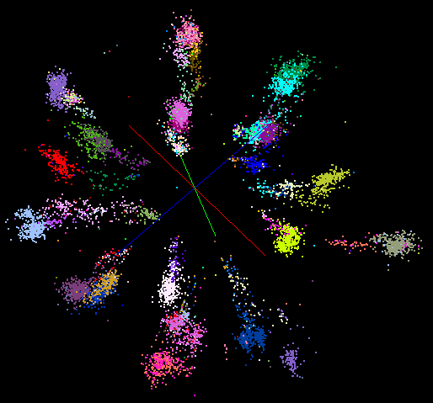
“Divergent” Data Sample
23 True Clusters
DA-PWC
UClust
CDhit
Divergent Data Set UClust (Cuts 0.65 to 0.95)
DAPWC 0.65 0.75 0.85 0.95
Total # of clusters 23 4 10 36 91
Total # of clusters uniquely identified 23 0 0 13 16
(i.e. one original cluster goes to 1 uclust cluster )
Total # of shared clusters with significant sharing 0 4 10 5 0
(one uclust cluster goes to > 1 real cluster)
Total # of uclust clusters that are just part of a real cluster 0 4 10 17(11) 72(62)
(numbers in brackets only have one member)
Total # of real clusters that are 1 uclust cluster 0 14 9 5 0
but uclust cluster is spread over multiple real clusters
Total # of real clusters that have 0 9 14 5 7
significant contribution from > 1 uclust cluster

Slide 30
Proteomics
No clear clusters

Slide 31

Protein Universe Browser for COG Sequences with a few illustrative biologically identified clusters

Slide 32
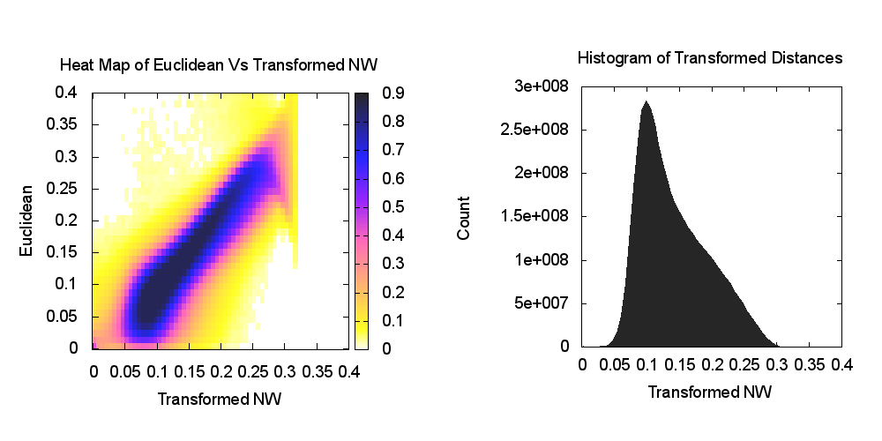
Heatmap of biology distance (Needleman-Wunsch) vs 3D Euclidean Distances
If d a distance, so is f(d) for any monotonic f. Optimize choice of f

Slide 33
O(N²) Algorithms?

Slide 34
Algorithm Challenges
See NRC Massive Data Analysis report
O(N) algorithms for O(N²) problems
Parallelizing Stochastic Gradient Descent
Streaming data algorithms – balance and interplay between batch methods (most time consuming) and interpolative streaming methods
Graph algorithms – need shared memory?
Machine Learning Community uses parameter servers; Parallel Computing (MPI) would not recommend this?
  Is classic distributed model for “parameter service” better?
Apply best of parallel computing – communication and load balancing – to Giraph/Hadoop/Spark
Are data analytics sparse?; many cases are full matrices
BTW Need Java Grande – Some C++ but Java most popular in ABDS, with Python, Erlang, Go, Scala (compiles to JVM) …..

Slide 35
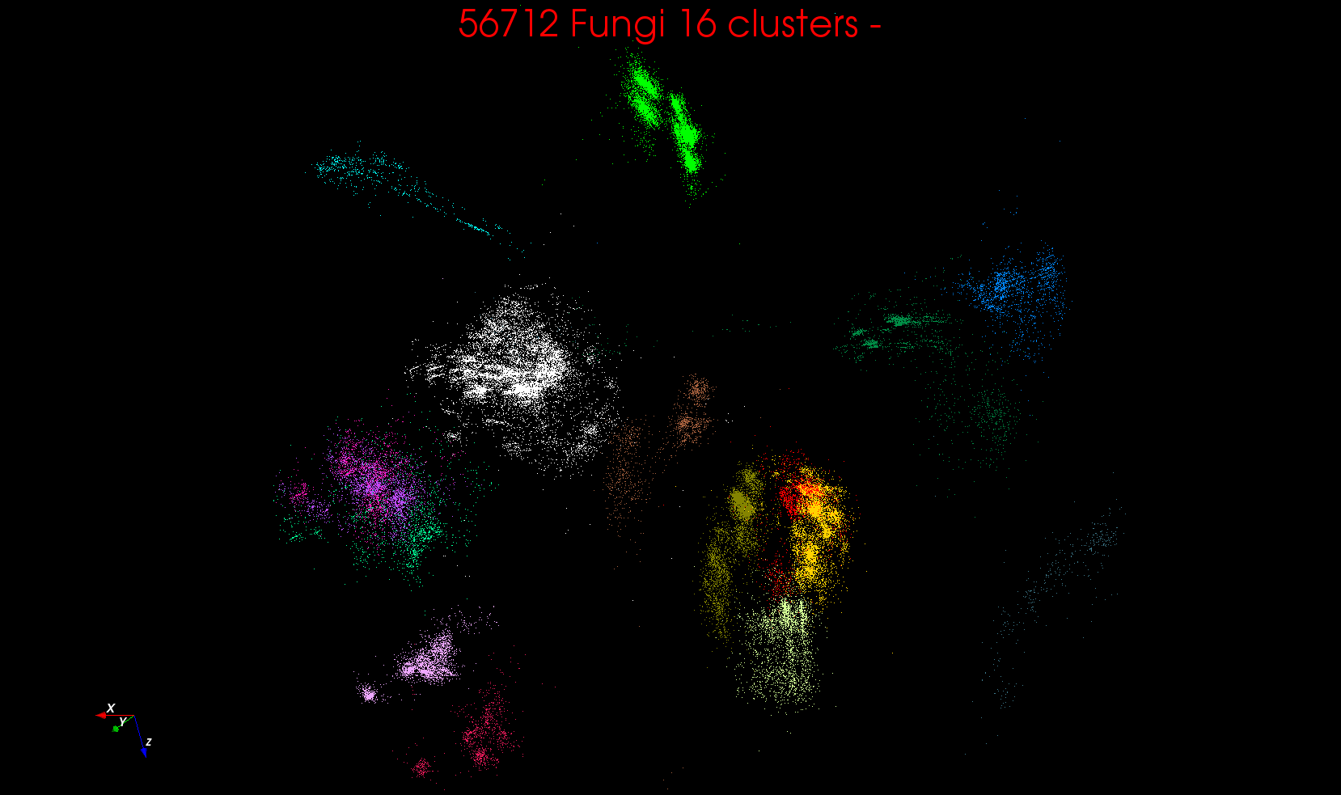
“clean” sample of 446K
O(N²) green-green and purple-purple interactions have value but green-purple are “wasted”
O(N²) interactions between green and purple clusters should be able to represent by centroids as in Barnes-Hut.
Hard as no Gauss theorem; no multipole expansion and points really in 1000 dimension space as clustered before 3D projection

Slide 36
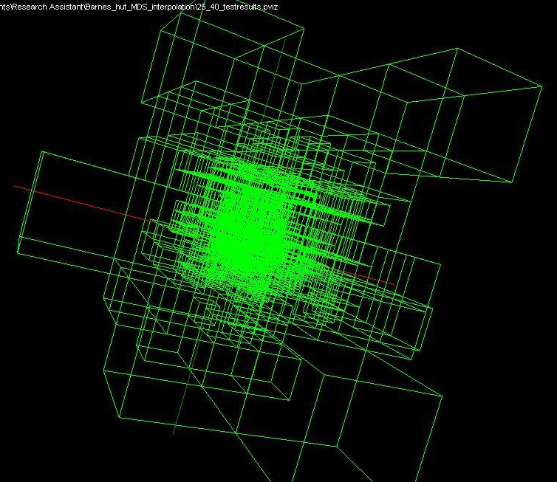
Use Barnes Hut OctTree, originally developed to make O(N²) astrophysics O(NlogN), to give similar speedups in machine learning

Slide 37
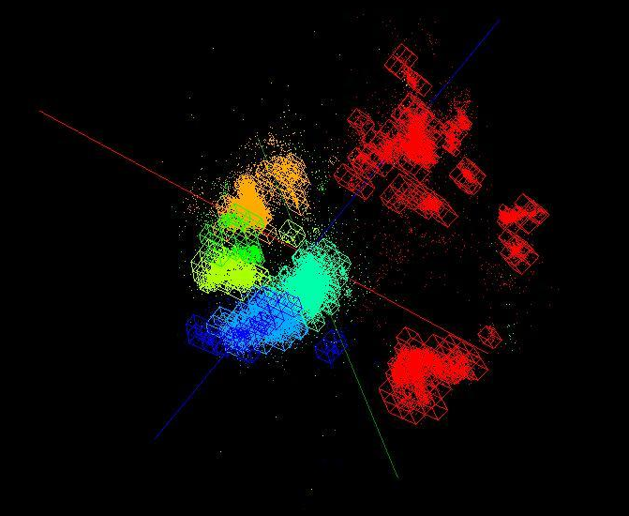
OctTree for 100K sample of Fungi
We use OctTree for logarithmic interpolation (streaming data)

Slide 38
Fungi Analysis

Slide 39
Fungi Analysis
Multiple Species from multiple places
Several sources of sequences starting with 446K and eventually boiled down to ~10K curated sequences with 61 species
Original sample – clustering and MDS
Final sample – MDS and other clustering methods
Note MSA and SWG gives similar results
Some species are clearly split
Some species are diffuse; others compact making a fixed distance cut unreliable
  Easy for humans!
MDS very clear on structure and clustering artifacts
Why not do “high-value” clustering as interactive iteration driven by MDS?

Slide 40
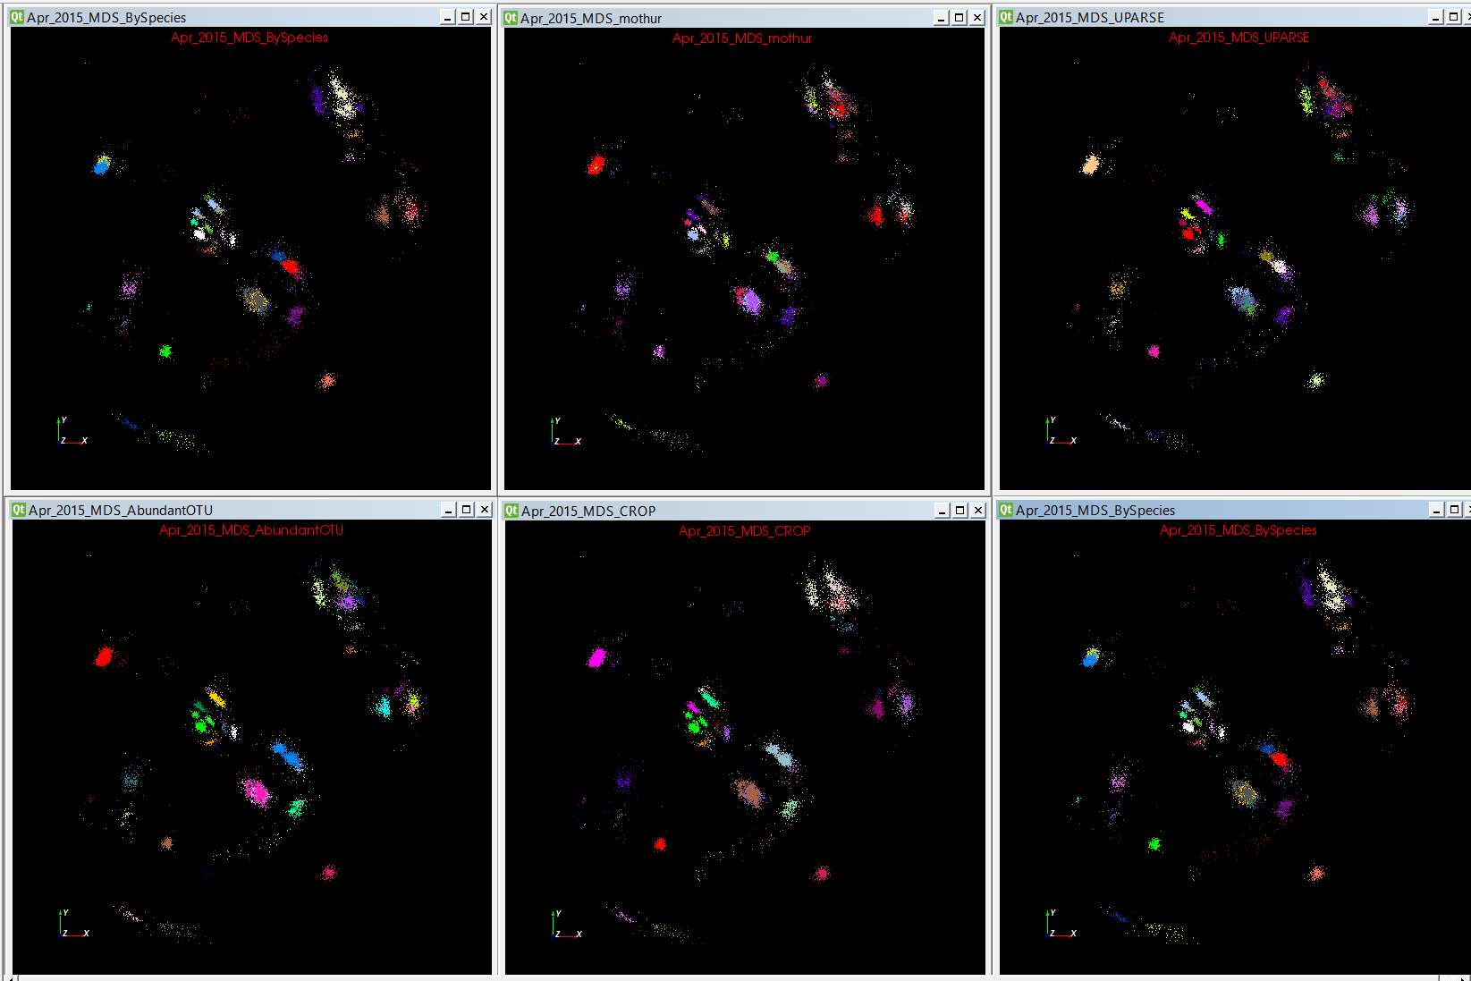
Fungi -- 4 Classic Clustering Methods

Slide 41
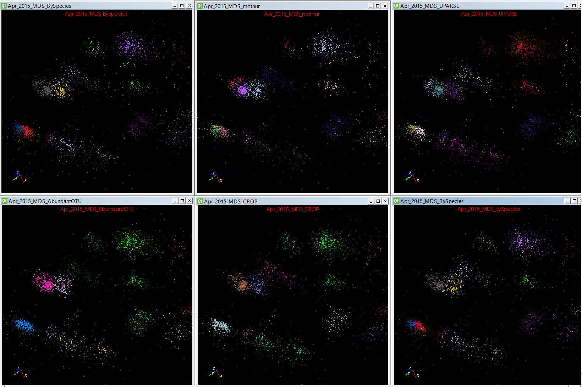

Slide 42
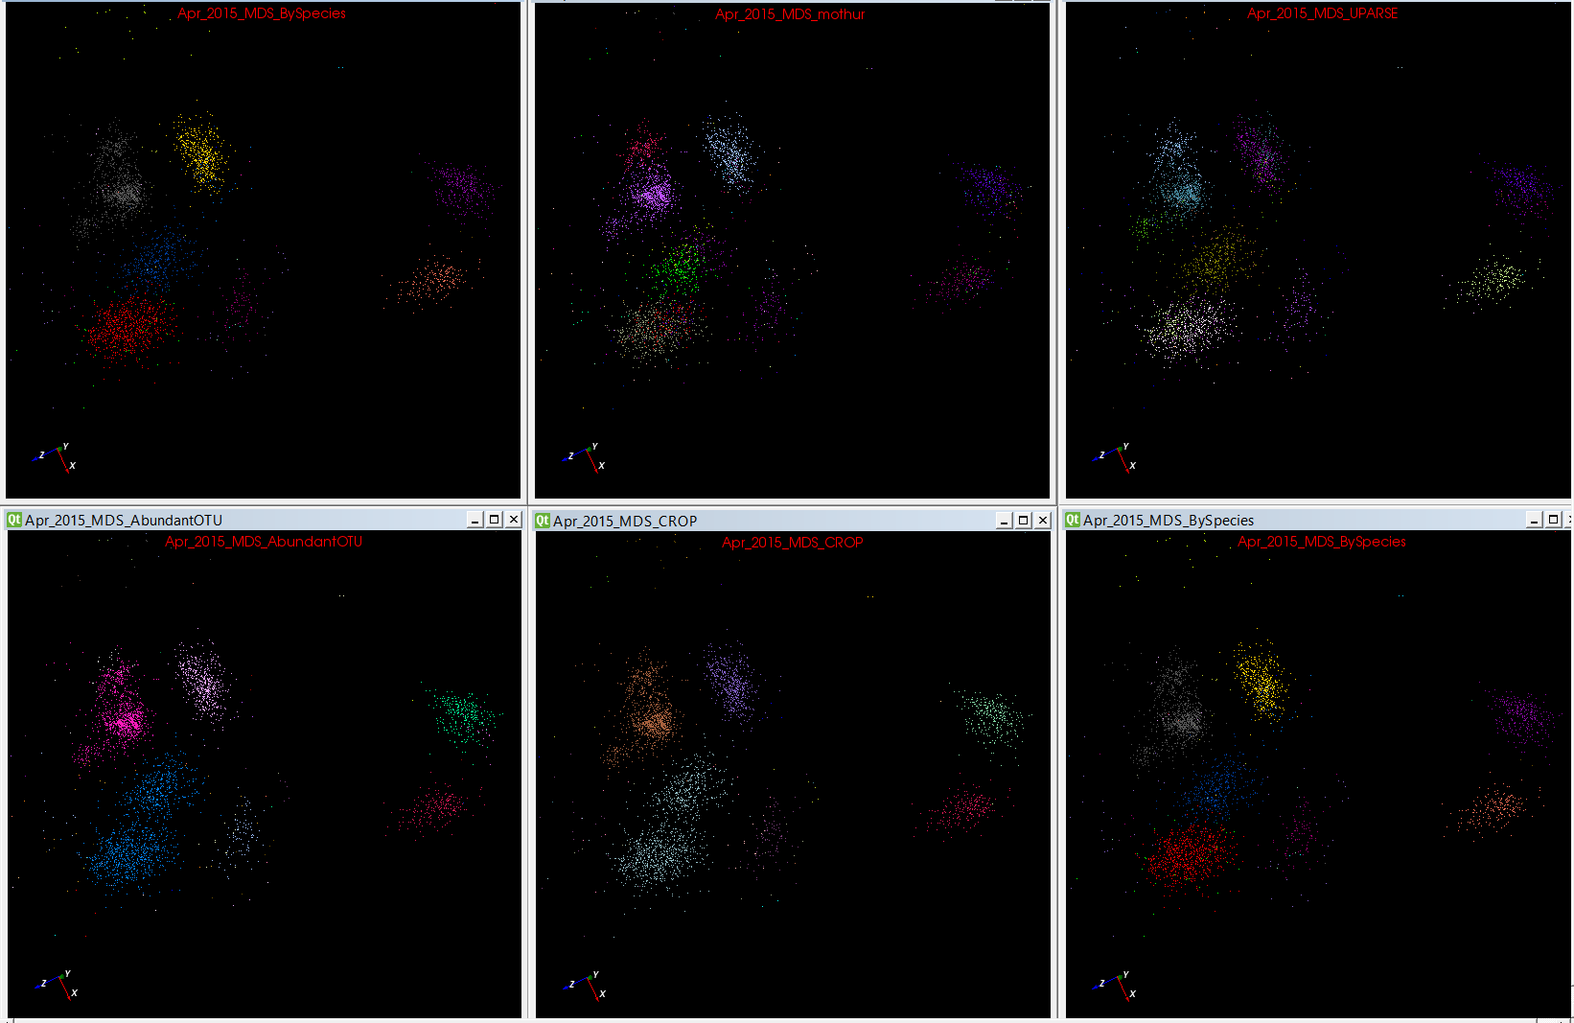

Slide 43
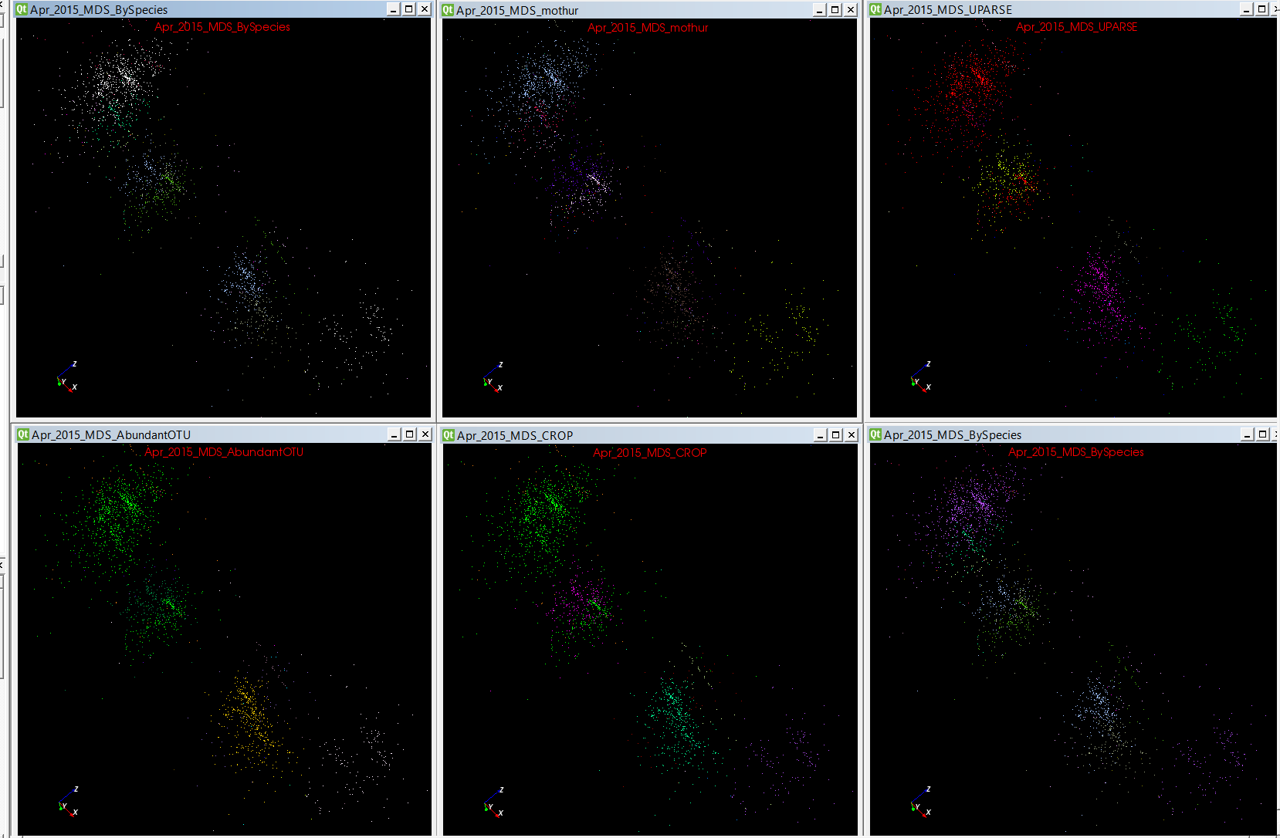
Same Species

Slide 44
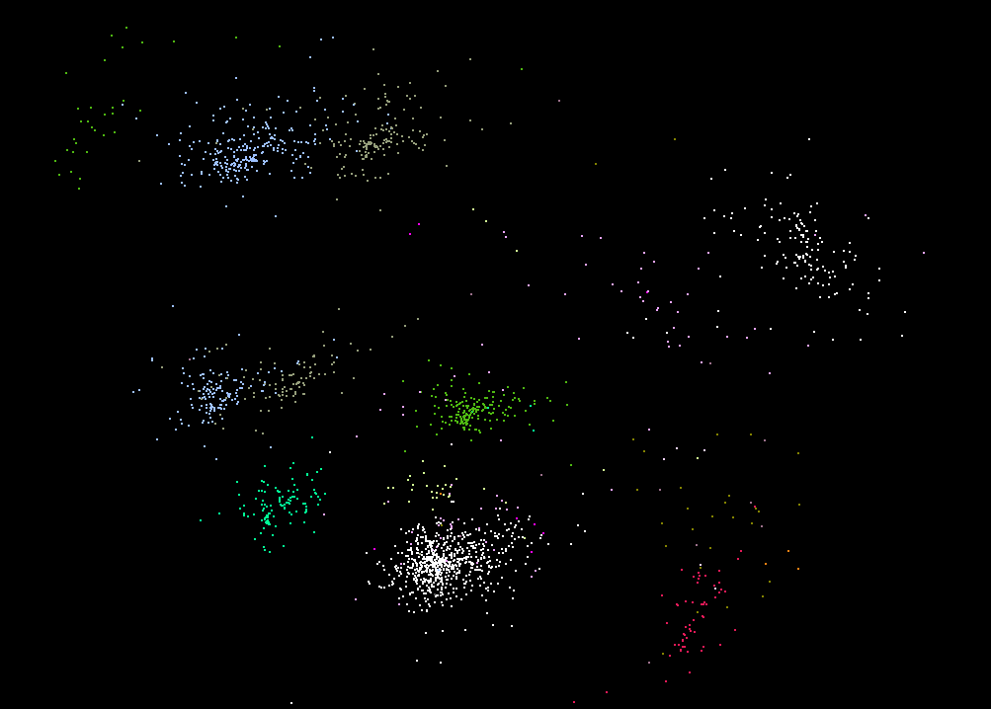
Same Species Different Locations

Slide 45
Parallel Data Mining

Slide 46
Parallel Data Analytics
Streaming algorithms have interesting differences but
“Batch” Data analytics is “just classic parallel computing” with usual features such as SPMD and BSP
Expect similar systematics to simulations where
Static Regular problems are straightforward but
Dynamic Irregular Problems are technically hard and high level approaches fail (see High Performance Fortran HPF)
  Regular meshes worked well but
  Adaptive dynamic meshes did not although “real people with MPI” could parallelize
However using libraries is successful at either
  Lowest: communication level
  Higher: “core analytics” level
Data analytics does not yet have “good regular parallel libraries”
  Graph analytics has most attention

Slide 47
Remarks on Parallelism I
Maximum Likelihood or χ² both lead to objective functions like
Minimize sum ∑_{items=1}^{N} (Positive nonlinear function of unknown parameters for item i)
Typically decompose items i and parallelize over both i and parameters to be determined
Solve iteratively with (clever) first or second order approximation to shift in objective function
  Sometimes steepest descent direction; sometimes Newton
  Have classic Expectation Maximization structure
  Steepest descent shift is sum over shift calculated from each point
  Classic method – take all (millions) of items in data set and move full distance
  Stochastic Gradient Descent SGD – take randomly a few hundred of items in data set and calculate shifts over these and move a tiny distance
  SGD cannot parallelize over items

Slide 48
Remarks on Parallelism II
Need to cover non vector semimetric and vector spaces for clustering and dimension reduction (N points in space)
Semimetric spaces just have pairwise distances defined between points in space δ(i, j)
MDS Minimizes Stress and illustrates this
σ(X) = Σ_{i<j=1}^{N} weight(i,j) (δ(i, j) - d(X_{i} , X_{j}))²
Vector spaces have Euclidean distance and scalar products
  Algorithms can be O(N) and these are best for clustering but for MDS O(N) methods may not be best as obvious objective function O(N²)
  Important new algorithms needed to define O(N) versions of current O(N²) – “must” work intuitively and shown in principle
Note matrix solvers often use conjugate gradient – converges in 5-100 iterations – a big gain for matrix with a million rows. This removes factor of N in time complexity
Ratio of #clusters to #points important; new clustering ideas if ratio >~ 0.1

Slide 49
MDS in more detail

Slide 50
WDA-SMACOF “Best” MDS
Semimetric spaces just have pairwise distances defined between points in space δ(i, j)
MDS Minimizes Stress with pairwise distances δ(i, j)
σ(X) = Σ_{i<j=1}^{N} weight(i,j) (δ(i, j) - d(X_{i} , X_{j}))²
SMACOF clever Expectation Maximization method choses good steepest descent
Improved by Deterministic Annealing reducing distance scale; DA does not impact compute time much and gives DA-SMACOF
Classic SMACOF is O(N²) for uniform weight and O(N³) for non trivial weights but get nonuniform weight from
  The preferred Sammon method weight(i,j) = 1/δ(i, j) or
  Missing distances put in as weight(i,j) = 0
Use conjugate gradient – converges in 5-100 iterations – a big gain for matrix with a million rows. This removes factor of N in time complexity and gives WDA-SMACOF

Slide 51
Original Timing Tests on WDA SMACOF now called DA-MDS
20k to 100k AM Fungal sequences on 600 cores
Time Cost Comparison between WDA-SMACOF with Equal Weights and Sammon's Mapping

Slide 52
WDA-SMACOF (DA-MDS) Timing
Input Data: 100k to 400k AM Fungal sequences
Environment: 32 nodes (1024 cores) to 128 nodes (4096 cores) on BigRed2.
Using first version of Harp plug in for Hadoop (MPI Performance)
Notes:
Add 250 cores, 500 cores, 750 cores

Slide 53
Spherical Phylogram
Take a set of sequences mapped to nD with MDS (WDA-SMACOF) (n=3 or ~20)
  N=20 captures ~all features of dataset?
Consider a phylogenetic tree and use neighbor joining formulae to calculate distances of nodes to sequences (or later other nodes) starting at bottom of tree
Do a new MDS fixing mapping of sequences noting that sequences + nodes have defined distances
Use RAxML or Neighbor Joining (N=20?) to find tree
Random note: do not need Multiple Sequence Alignment; pairwise tools are easier to use and give reliably good results

Slide 54
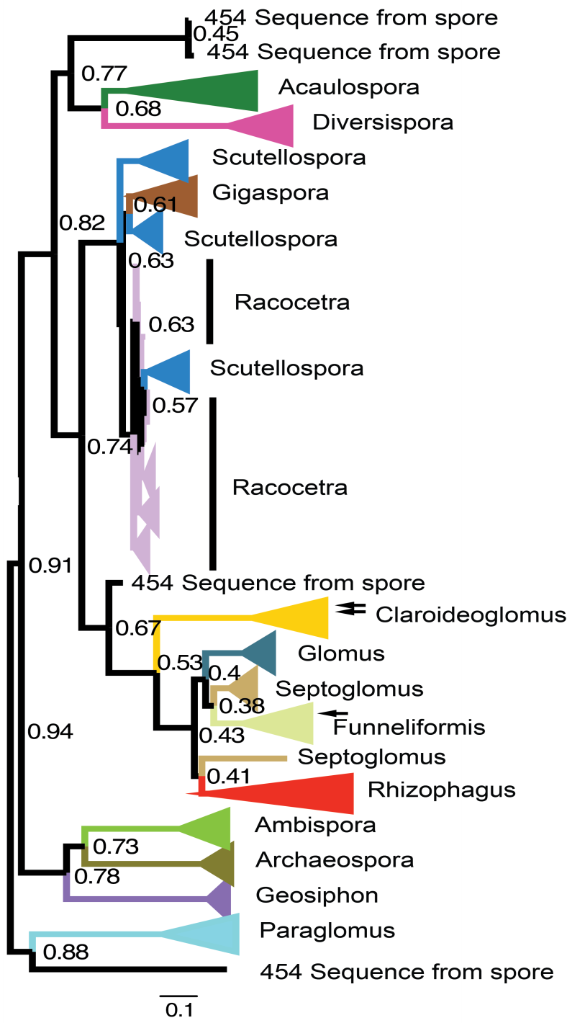
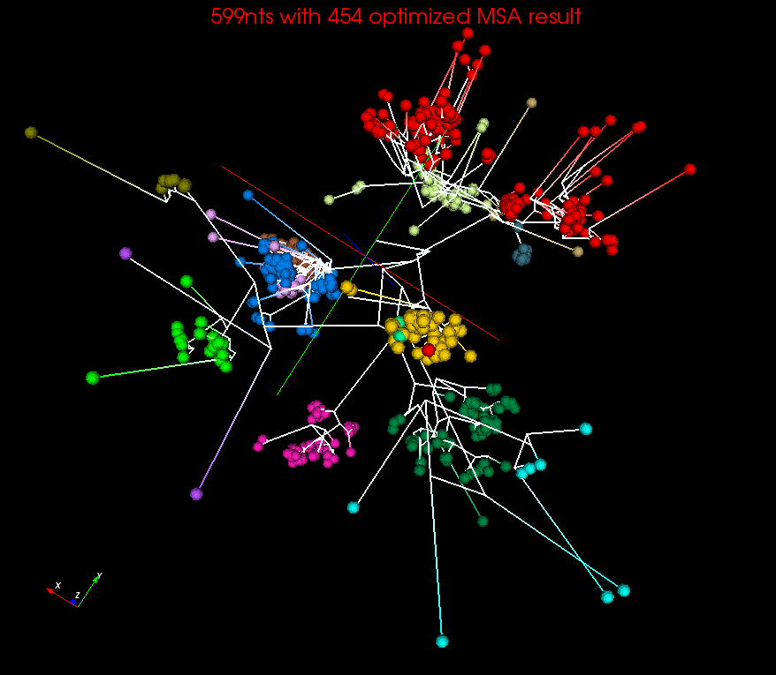
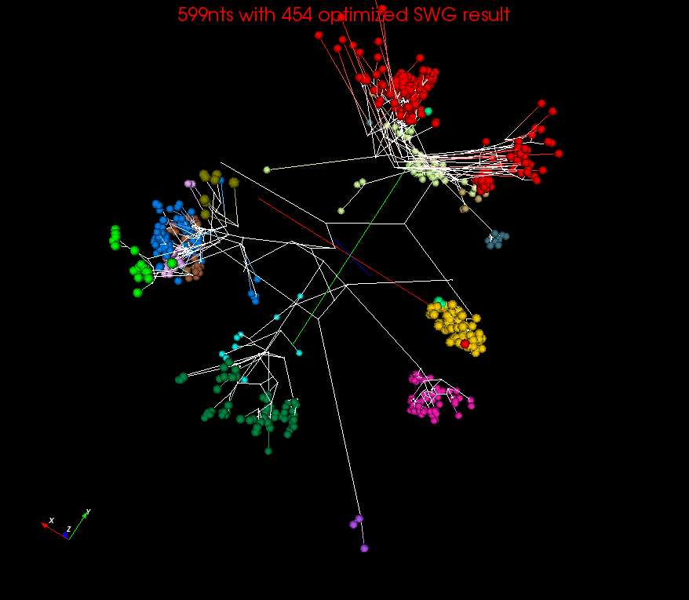
Spherical Phylograms
MSA
SWG
Spherical Phylogram visualized in PlotViz for MSA or SWG distances
RAxML result.
visualized in FigTree

Slide 55
Quality of 3D Phylogenetic Tree
EM-SMACOF is basic SMACOF
LMA was previous best method using Levenberg-Marquardt nonlinear χ² solver
WDA-SMACOF (DA-MDS) finds best result
3 different distance measures
Sum of branch lengths of the Spherical Phylogram generated in 3D space on two datasets

Slide 56
Summary
Always run MDS. Gives insight into data and performance of machine learning
  Leads to a data browser as GIS gives for spatial data
  3D better than 2D
  ~20D better than MSA?
Clustering Observations
  Do you care about quality or are you just cutting up space into parts
  Deterministic Clustering always makes more robust
  Continuous clustering enables hierarchy
  Trimmed Clustering cuts off tails
  Distinct O(N) and O(N²) algorithms
Use Conjugate Gradient

