Slide 1
Cookbook on Clustering, Dimension Reduction and Point Cloud Visualization
SPIDAL Presentation
December 4 2015
Geoffrey Fox, Judy Qiu, Saliya Ekanayake, Supun Kamburugamuve, Pulasthi Wickramasinghe
gcf@indiana.edu
http://www.infomall.org
School of Informatics and Computing
Digital Science Center
Indiana University Bloomington

Slide 2
The goals, methods and features

Slide 3
Problem to be solved
We have N data records
We want to classify them and look at their structure
Sometimes data points are vectors such as
  Each point is a row in a database
Or sometimes just an abstract quantity
  DNA sequence which is collection of unaligned sequences
  Or it could be thought about as a row in a database but some or many entries in row are undefined (not same as being zero) e.g. row is book in Amazon and columns are user rankings
There is always a space of points and a distance δ(i,j) between points i and j
If points vectors then there is a scalar product and distance is Euclidean
Vector algorithms are typically O(N), non-vector algorithms O(N²)
Typically need parallel algorithms – especially for O(N²) problems that are computationally intense for N >= 10⁵

Slide 4
Dimension Reduction
So you have done a classification in some fashion – such as clustering – how do decide it’s any good?
  Obvious statistical measures but better
  Use the human eye – visualize the labelling
Semimetric spaces have pairwise distances defined between points in space δ(i, j)
But data is typically in a high dimensional or non vector space so use dimension reduction. Associate each point i with a vector X_{i} in a Euclidean space of dimension K so that δ(i, j) ≈ d(X_{i} , X_{j}) where d(X_{i} , X_{j}) is Euclidean distance between mapped points i and j in K dimensional space.
  K = 3 natural for visualization but other values interesting
Principal Component analysis is best known dimension reduction approach but a) linear b) requires original points in a vector space
There are many other nonlinear vector space methods such as GTM Generative Topographic Mapping
Non vector space method MDS Minimizes Stress σ
σ(X) = Σ_{i<j=1}^{N} weight(i,j) (δ(i, j) - d(X_{i} , X_{j}))²

Slide 5
WDA-SMACOF “Best” MDS
MDS Minimizes Stress with pairwise distances δ(i, j)
σ(X) = Σ_{i<j=1}^{N} weight(i,j) (δ(i, j) - d(X_{i} , X_{j}))²
SMACOF clever Expectation Maximization method choses good steepest descent
Improved by Deterministic Annealing gradually reducing Temperature ≈ distance scale; DA does not impact compute time much and gives DA-SMACOF
  Deterministic Annealing like Simulated Annealing but no Monte Carlo
Classic SMACOF is O(N²) for uniform weight and O(N³) for non trivial weights but get nonuniform weight from
  The preferred Sammon method weight(i,j) = 1/δ(i, j) or
  Missing distances put in as weight(i,j) = 0
Use conjugate gradient – converges in 5-100 iterations – a big gain for matrix with a million rows. This removes factor of N in time complexity and gives WDA-SMACOF

Slide 6
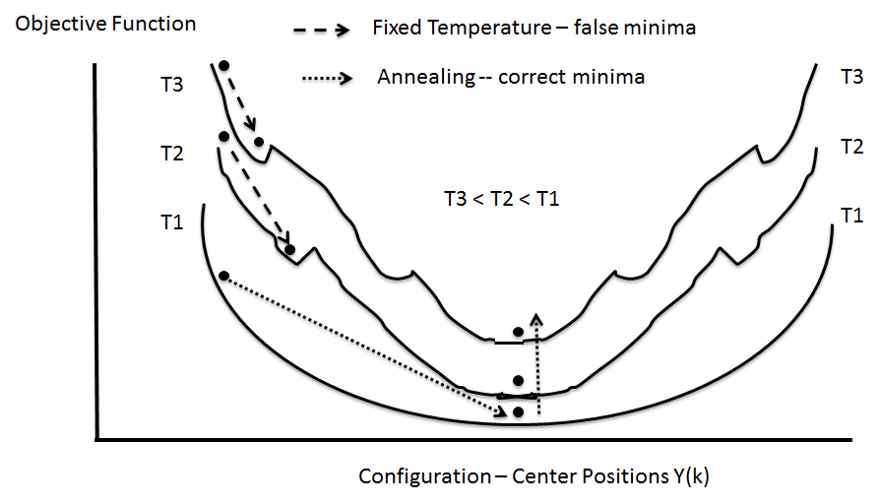
(Deterministic) Annealing
Find minimum at high temperature when trivial
Small change avoiding local minima as lower temperature
Typically gets better answers than standard libraries- R and Mahout
And can be parallelized and put on GPU’s etc.

Slide 7
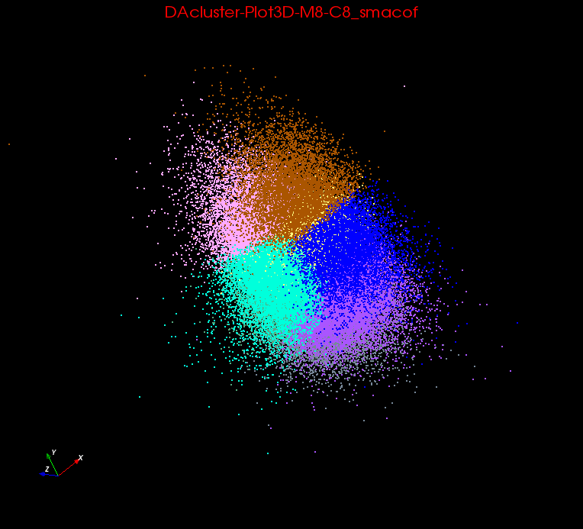
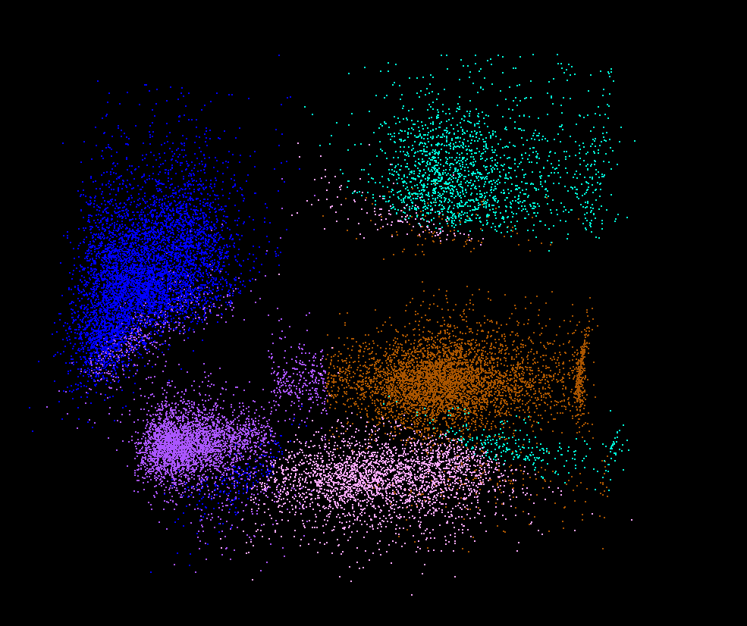
Clusters v. Regions
Lymphocytes 4D
Pathology 54D
In Lymphocytes clusters are distinct; DA useful
In Pathology, clusters divide space into regions and sophisticated methods like deterministic annealing are probably unnecessary

Slide 8
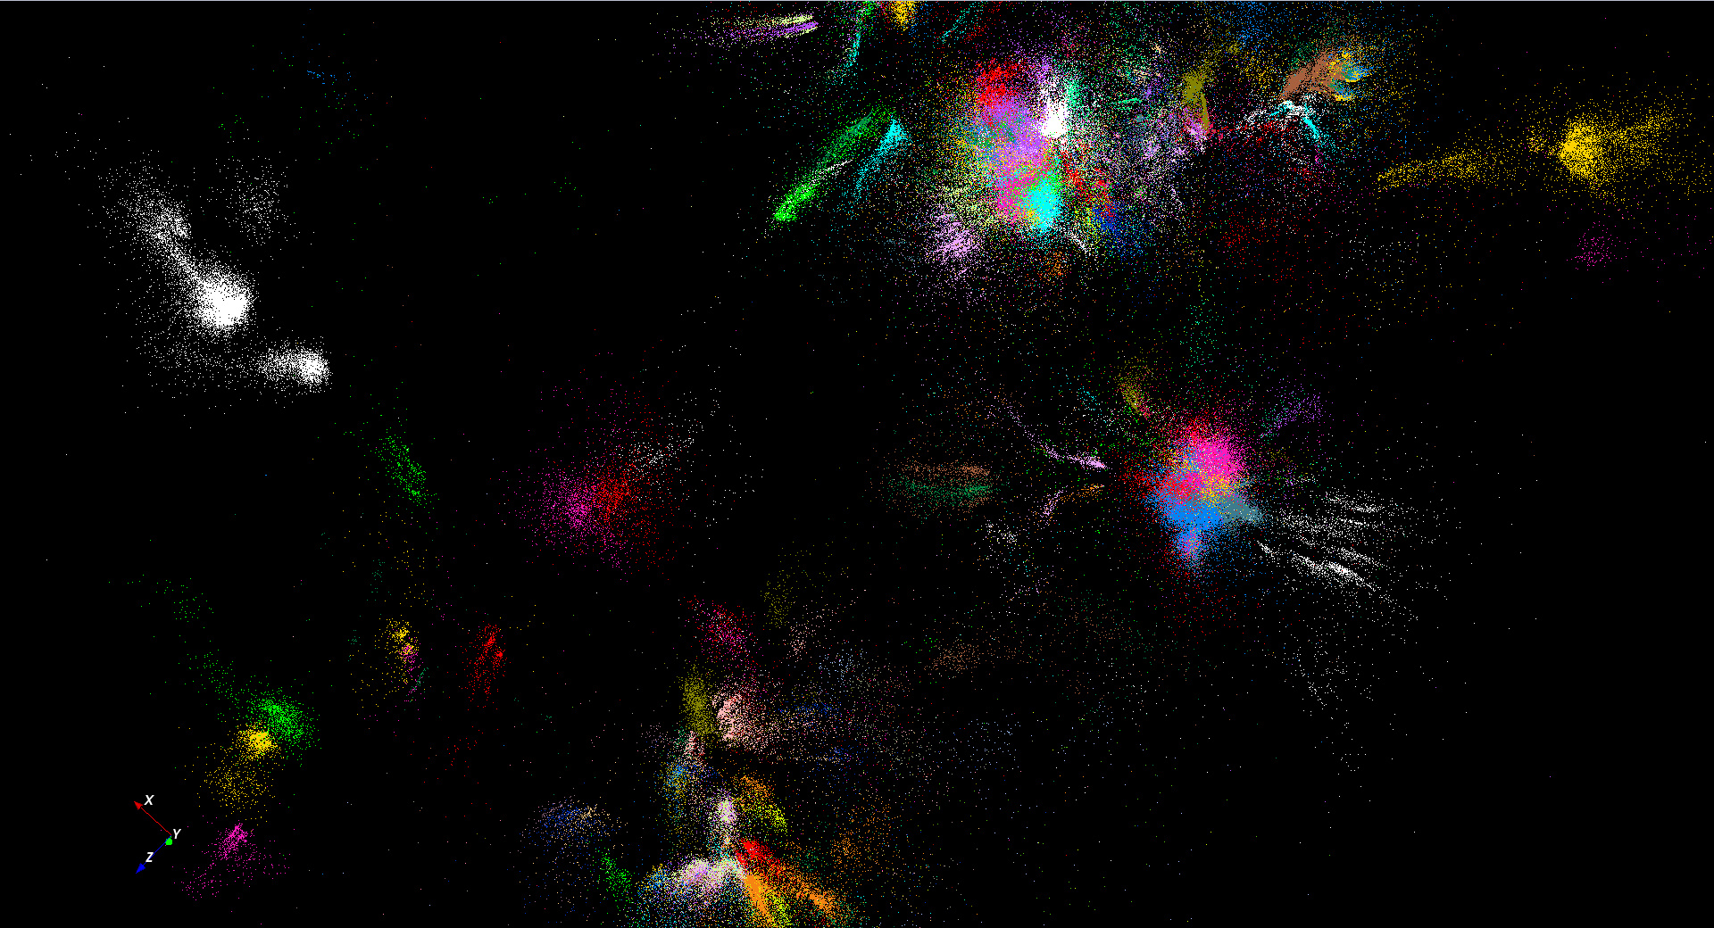
446K sequences
~100 clusters

Slide 9
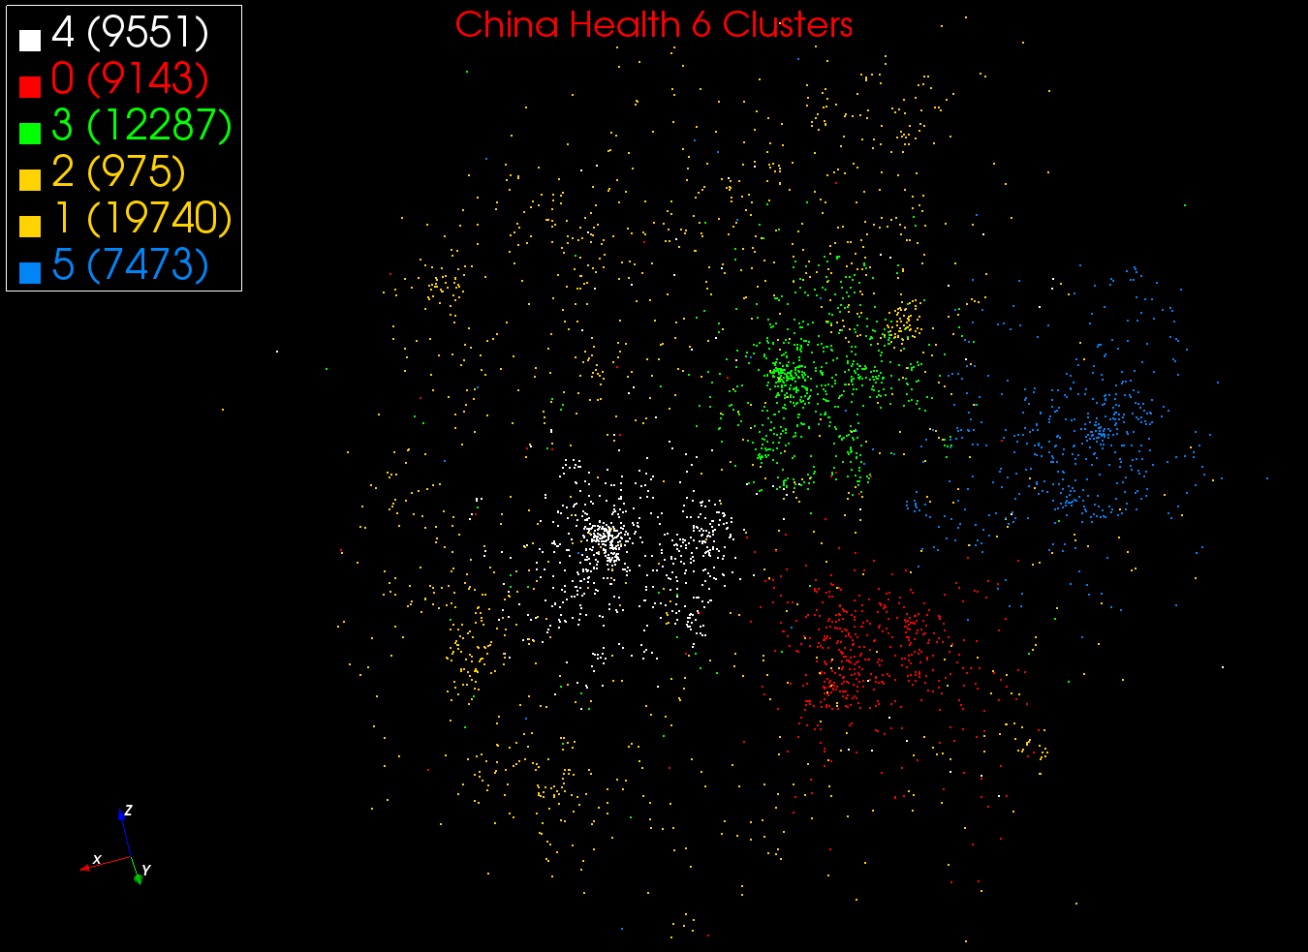
MDS and Clustering on ~60K EMR

Slide 10
Examples of current DA algorithms: LCMS

Slide 11
Background on LC-MS
Remarks of collaborators – Broad Institute/Hyderabad
Abundance of peaks in “label-free” LC-MS enables large-scale comparison of peptides among groups of samples.
In fact when a group of samples in a cohort is analyzed together, not only is it possible to “align” robustly or cluster the corresponding peaks across samples, but it is also possible to search for patterns or fingerprints of disease states which may not be detectable in individual samples.
This property of the data lends itself naturally to big data analytics for biomarker discovery and is especially useful for population-level studies with large cohorts, as in the case of infectious diseases and epidemics.
With increasingly large-scale studies, the need for fast yet precise cohort-wide clustering of large numbers of peaks assumes technical importance.
In particular, a scalable parallel implementation of a cohort-wide peak clustering algorithm for LC-MS-based proteomic data can prove to be a critically important tool in clinical pipelines for responding to global epidemics of infectious diseases like tuberculosis, influenza, etc.

Slide 12
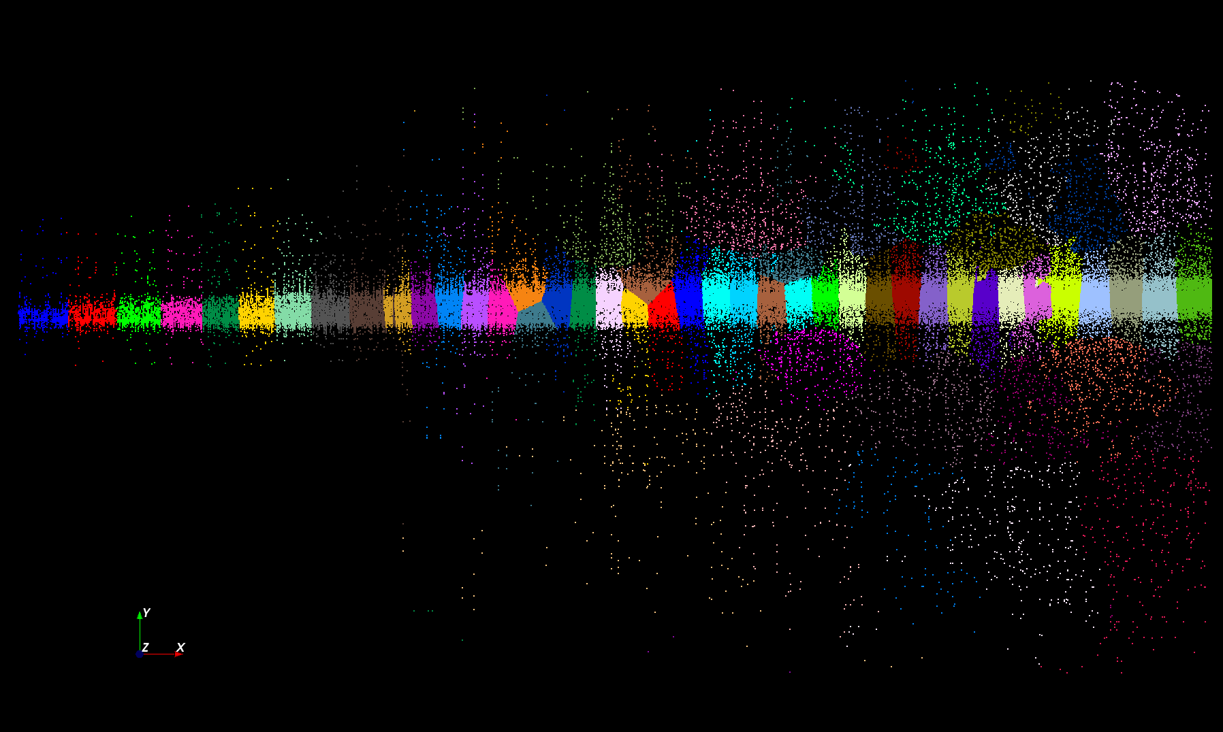
Proteomics 2D DA Clustering T= 25000 with 60 Clusters (will be 30,000 at T=0.025)

Slide 13
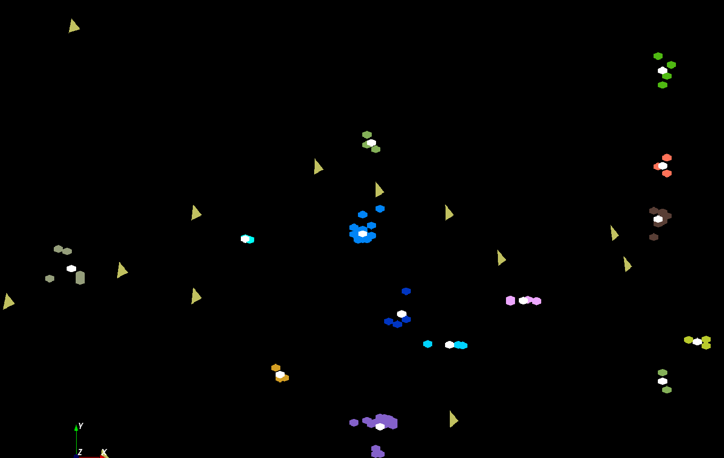
The brownish triangles are “sponge” (soaks up trash) peaks outside any cluster.
The colored hexagons are peaks inside clusters with the white hexagons being determined cluster center
Fragment of 30,000 Clusters
241605 Points

Slide 14
Cluster Count v. Temperature for 2 Runs
All start with one cluster at far left
T=1 special as measurement errors divided out
DA2D counts clusters with 1 member as clusters. DAVS(2) does not

Slide 15
Simple Parallelism as in k-means
Decompose points i over processors
Equations either pleasingly parallel “maps” over i
Or “All-Reductions” summing over i for each cluster
Parallel Algorithm:
  Each process holds all clusters and calculates contributions to clusters from points in node
  e.g. Y(k) = ∑_{i=1}^{N} <M_{i}(k)> X_{i} / C(k)
Runs well in MPI or MapReduce
  See all the MapReduce k-means papers

Slide 16
Better Parallelism
The previous model is correct at start but each point does not really contribute to each cluster as damped exponentially by exp( - (X_{i}- Y(k))² /T )
For Proteomics problem, on average only 6.45 clusters needed per point if require (X_{i}- Y(k))² /T ≤ ~40 (as exp(-40) small)
So only need to keep nearby clusters for each point
As average number of Clusters ~ 20,000, this gives a factor of ~3000 improvement
Further communication is no longer all global; it has nearest neighbor components and calculated by parallelism over clusters which can be done in parallel if separated

Slide 17
Metagenomics -- Sequence clustering
Non-metric Spaces
O(N²) Algorithms – Illustrate Phase Transitions

Slide 18
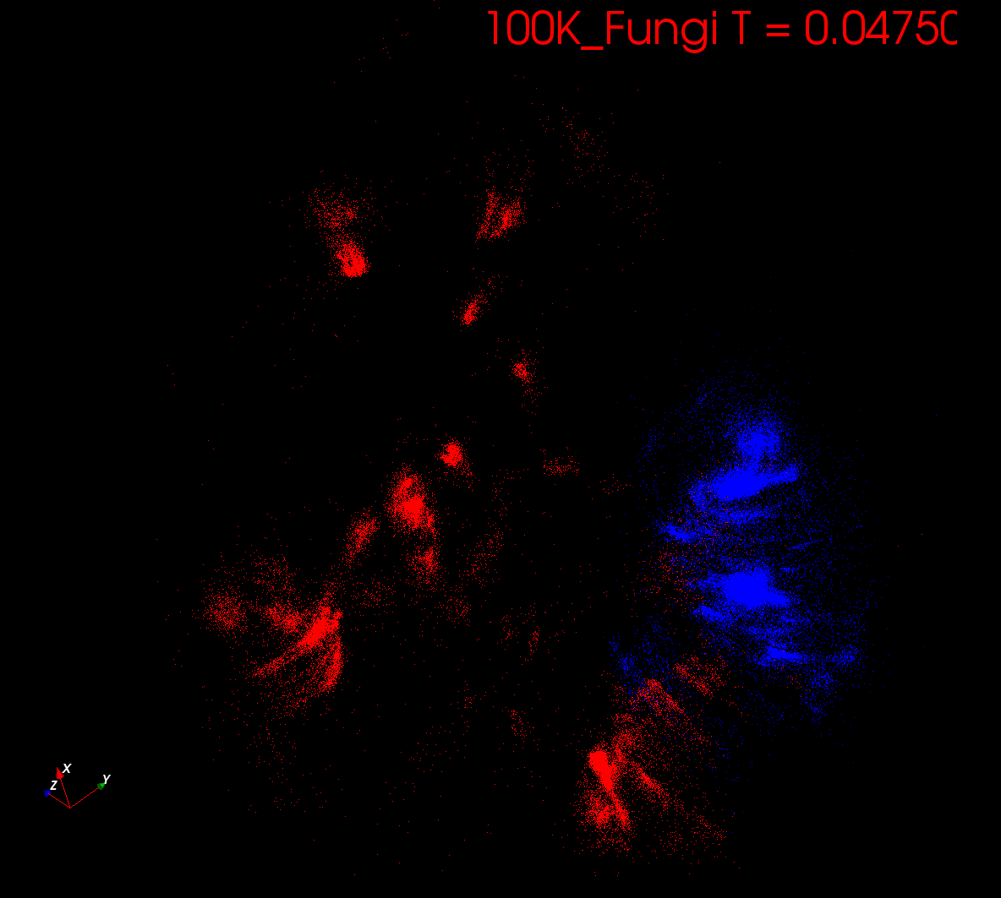
Start at T= “∞” with 1 Cluster
Decrease T, Clusters emerge at instabilities

Slide 19
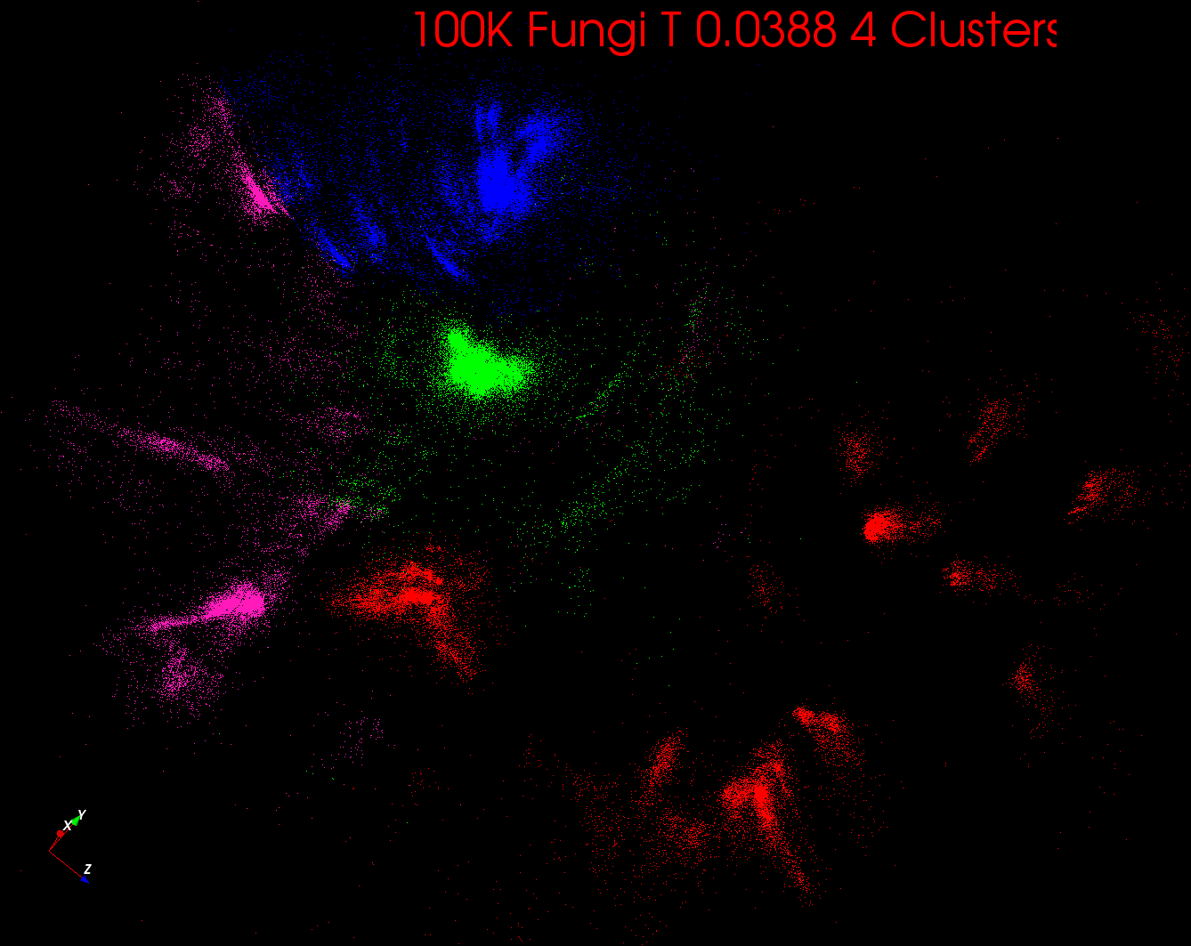

Slide 20
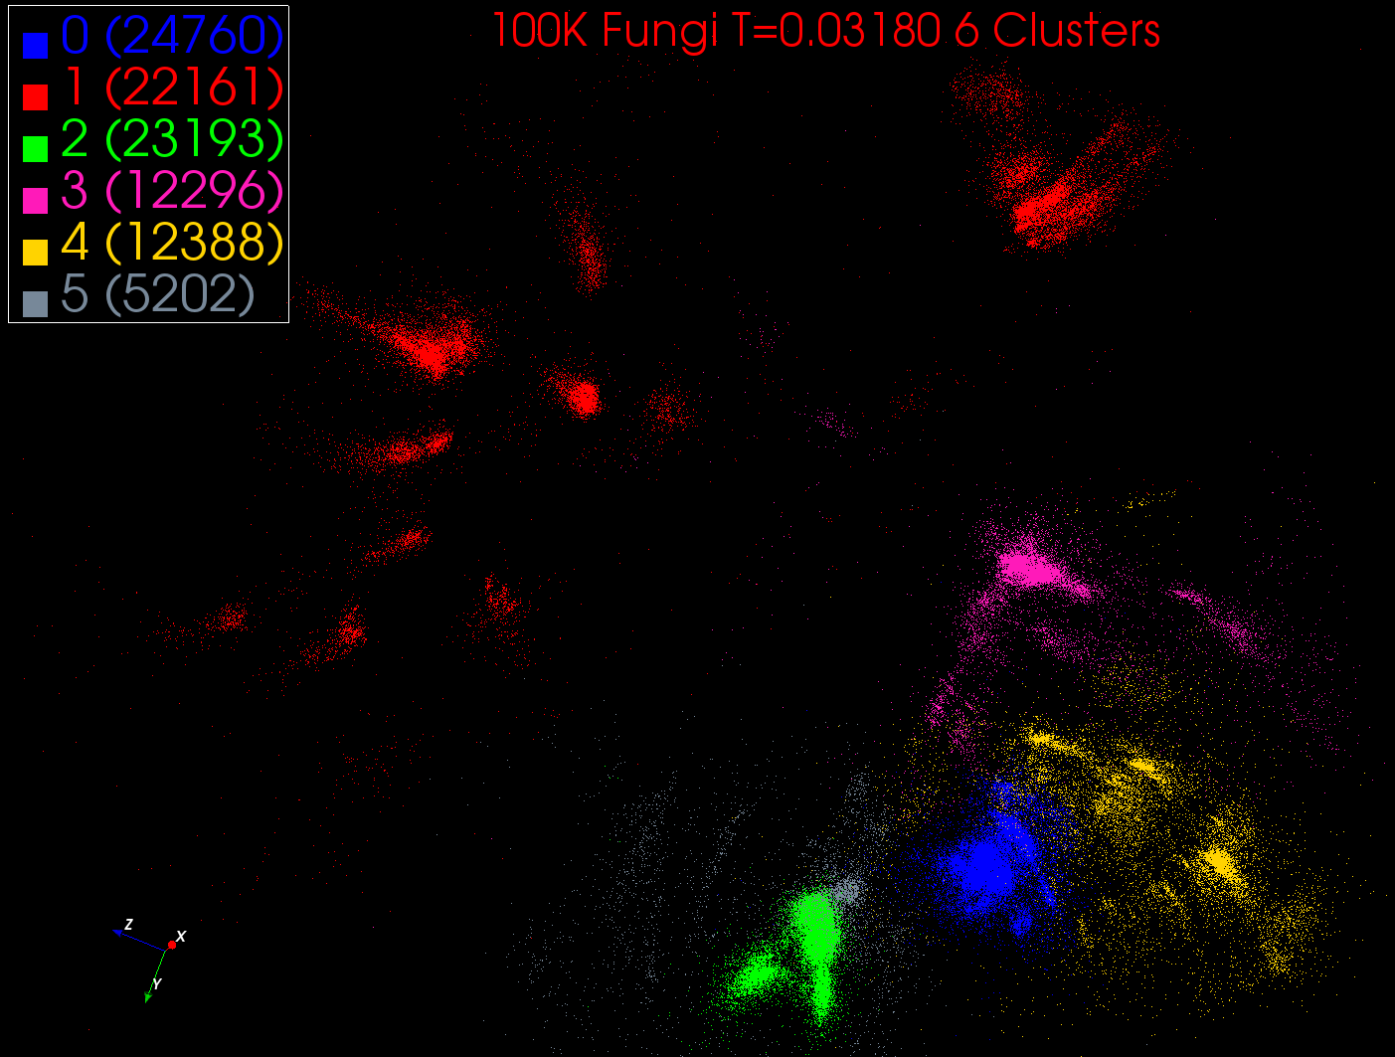

Slide 21
Metagenomics -- Sequence clustering
Non-metric Spaces
O(N²) Algorithms – Compare Other Methods

Slide 22
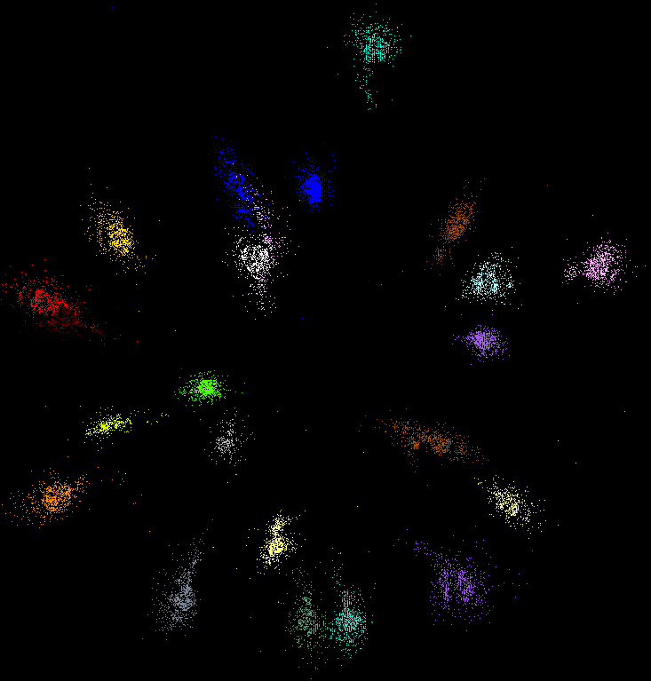
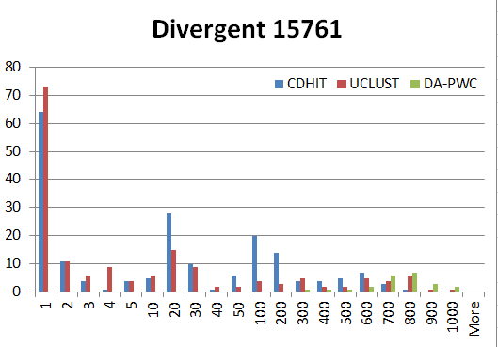
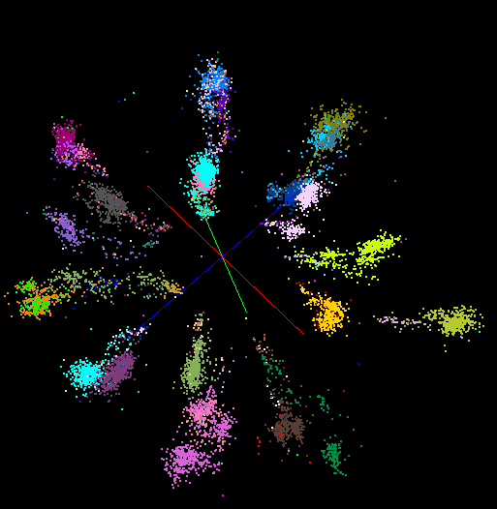
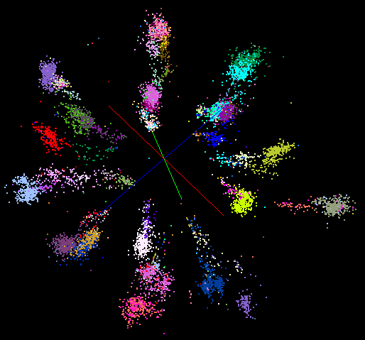
“Divergent” Data Sample
23 True Clusters
DA-PWC
UClust
CDhit
Divergent Data Set UClust (Cuts 0.65 to 0.95)
DAPWC 0.65 0.75 0.85 0.95
Total # of clusters 23 4 10 36 91
Total # of clusters uniquely identified 23 0 0 13 16
(i.e. one original cluster goes to 1 uclust cluster )
Total # of shared clusters with significant sharing 0 4 10 5 0
(one uclust cluster goes to > 1 real cluster)
Total # of uclust clusters that are just part of a real cluster 0 4 10 17(11) 72(62)
(numbers in brackets only have one member)
Total # of real clusters that are 1 uclust cluster 0 14 9 5 0
but uclust cluster is spread over multiple real clusters
Total # of real clusters that have 0 9 14 5 7
significant contribution from > 1 uclust cluster

Slide 23
Proteomics
No clear clusters

Slide 24

Protein Universe Browser for COG Sequences with a few illustrative biologically identified clusters

Slide 25
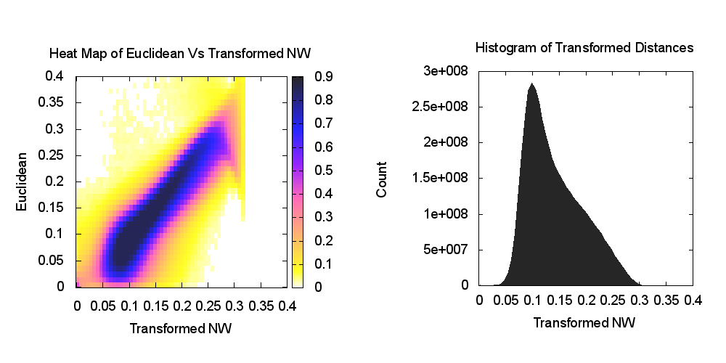
Heatmap of biology distance (Needleman-Wunsch) vs 3D Euclidean Distances
If d a distance, so is f(d) for any monotonic f. Optimize choice of f

Slide 26
O(N²) Algorithms?

Slide 27
Algorithm Challenges
See NRC Massive Data Analysis report
O(N) algorithms for O(N²) problems
Parallelizing Stochastic Gradient Descent
Streaming data algorithms – balance and interplay between batch methods (most time consuming) and interpolative streaming methods
Graph algorithms – need shared memory?
Machine Learning Community uses parameter servers; Parallel Computing (MPI) would not recommend this?
  Is classic distributed model for “parameter service” better?
Apply best of parallel computing – communication and load balancing – to Giraph/Hadoop/Spark
Are data analytics sparse?; many cases are full matrices
BTW Need Java Grande – Some C++ but Java most popular in ABDS, with Python, Erlang, Go, Scala (compiles to JVM) …..

Slide 28
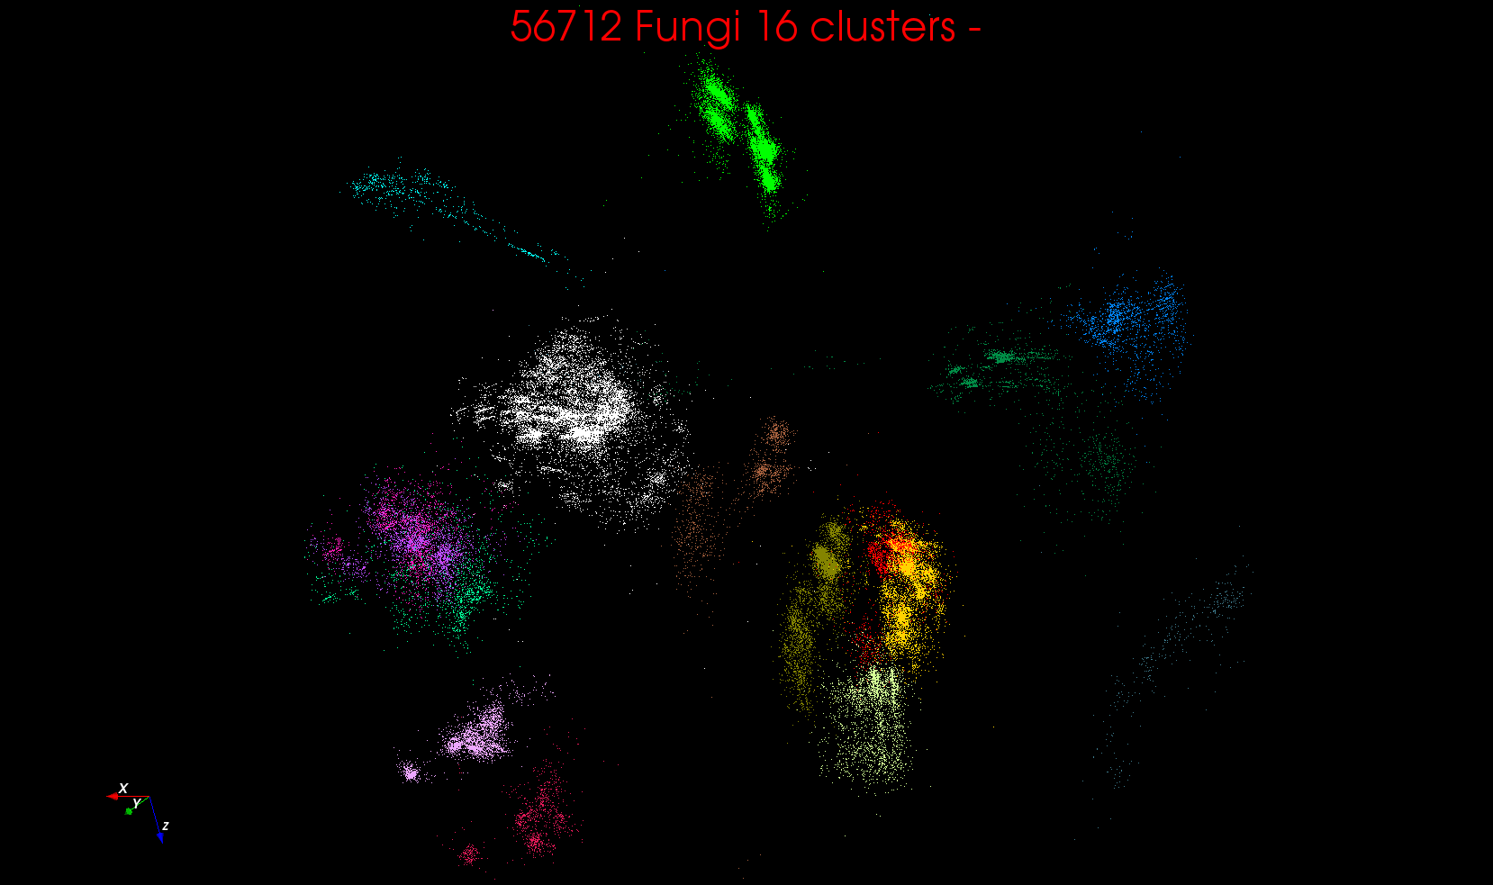
“clean” sample of 446K
O(N²) green-green and purple-purple interactions have value but green-purple are “wasted”
O(N²) interactions between green and purple clusters should be able to represent by centroids as in Barnes-Hut.
Hard as no Gauss theorem; no multipole expansion and points really in 1000 dimension space as clustered before 3D projection

Slide 29
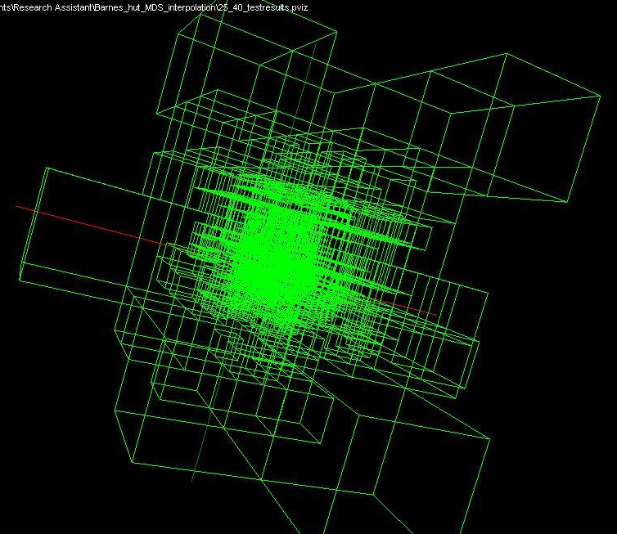
Use Barnes Hut OctTree, originally developed to make O(N²) astrophysics O(NlogN), to give similar speedups in machine learning

Slide 30
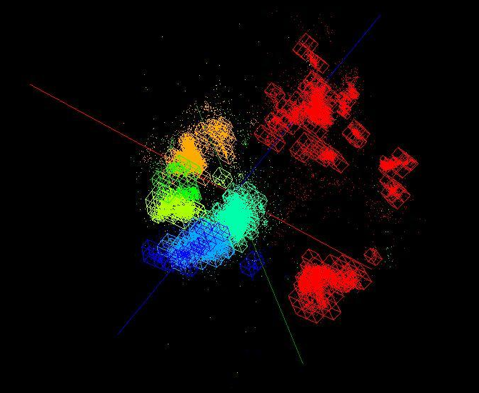
OctTree for 100K sample of Fungi
We use OctTree for logarithmic interpolation (streaming data)

Slide 31
Fungi Analysis

Slide 32
Fungi Analysis
Multiple Species from multiple places
Several sources of sequences starting with 446K and eventually boiled down to ~10K curated sequences with 61 species
Original sample – clustering and MDS
Final sample – MDS and other clustering methods
Note MSA and SWG gives similar results
Some species are clearly split
Some species are diffuse; others compact making a fixed distance cut unreliable
  Easy for humans!
MDS very clear on structure and clustering artifacts
Why not do “high-value” clustering as interactive iteration driven by MDS?

Slide 33
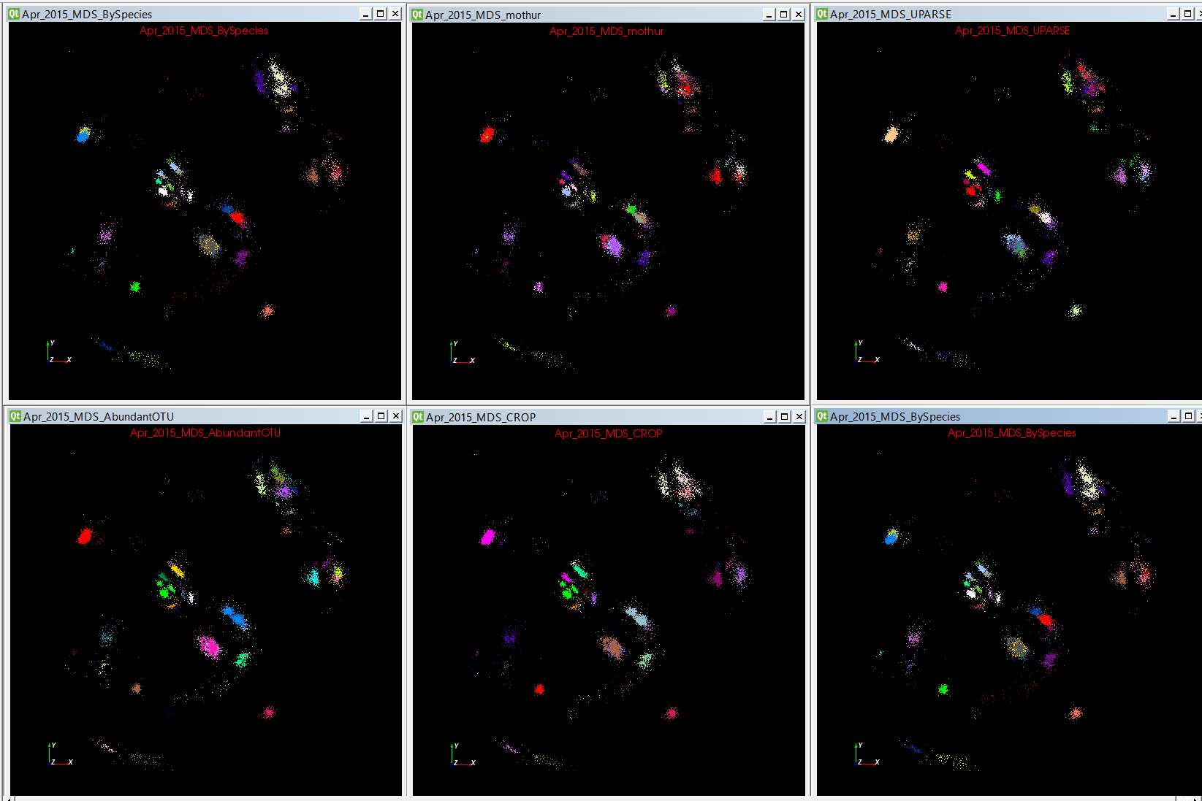
Fungi -- 4 Classic Clustering Methods

Slide 34
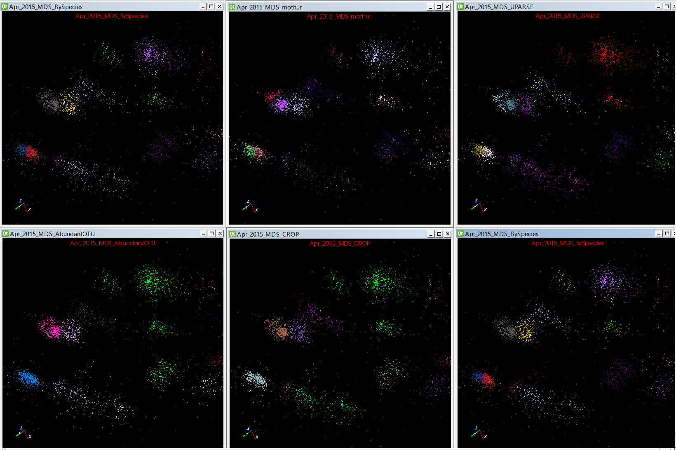

Slide 35
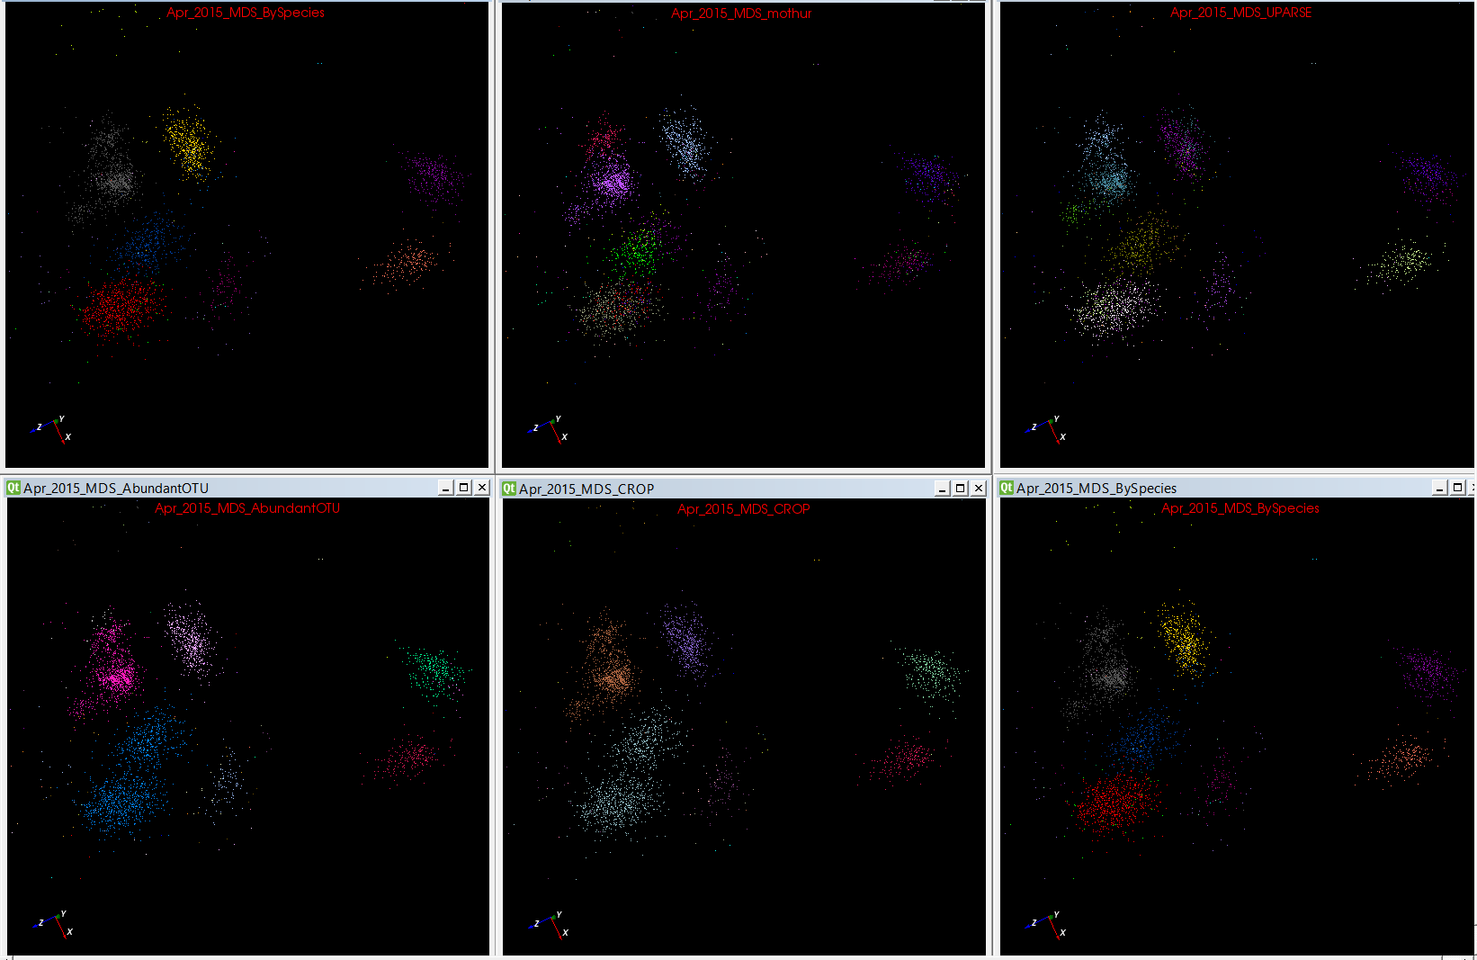

Slide 36
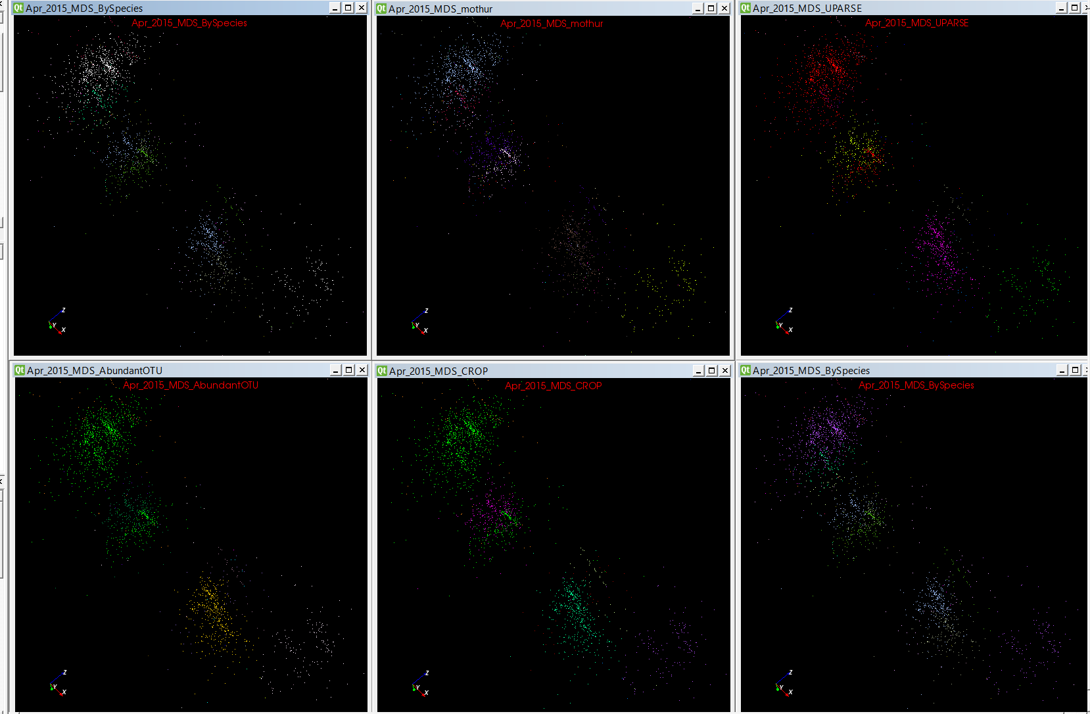
Same Species

Slide 37
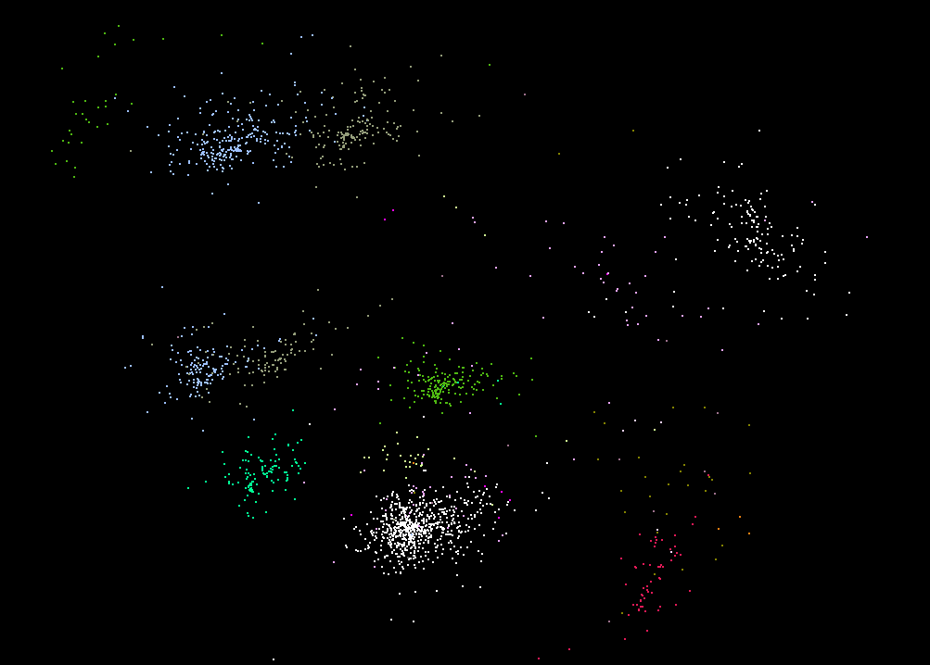
Same Species Different Locations

Slide 38
Parallel Data Mining

Slide 39
Parallel Data Analytics
Streaming algorithms have interesting differences but
“Batch” Data analytics is “just classic parallel computing” with usual features such as SPMD and BSP
Expect similar systematics to simulations where
Static Regular problems are straightforward but
Dynamic Irregular Problems are technically hard and high level approaches fail (see High Performance Fortran HPF)
  Regular meshes worked well but
  Adaptive dynamic meshes did not although “real people with MPI” could parallelize
However using libraries is successful at either
  Lowest: communication level
  Higher: “core analytics” level
Data analytics does not yet have “good regular parallel libraries”
  Graph analytics has most attention

Slide 40
Remarks on Parallelism I
Maximum Likelihood or χ² both lead to objective functions like
Minimize sum ∑_{items=1}^{N} (Positive nonlinear function of unknown parameters for item i)
Typically decompose items i and parallelize over both i and parameters to be determined
Solve iteratively with (clever) first or second order approximation to shift in objective function
  Sometimes steepest descent direction; sometimes Newton
  Have classic Expectation Maximization structure
  Steepest descent shift is sum over shift calculated from each point
  Classic method – take all (millions) of items in data set and move full distance
  Stochastic Gradient Descent SGD – take randomly a few hundred of items in data set and calculate shifts over these and move a tiny distance
  SGD cannot parallelize over items

Slide 41
Remarks on Parallelism II
Need to cover non vector semimetric and vector spaces for clustering and dimension reduction (N points in space)
Semimetric spaces just have pairwise distances defined between points in space δ(i, j)
MDS Minimizes Stress and illustrates this
σ(X) = Σ_{i<j=1}^{N} weight(i,j) (δ(i, j) - d(X_{i} , X_{j}))²
Vector spaces have Euclidean distance and scalar products
  Algorithms can be O(N) and these are best for clustering but for MDS O(N) methods may not be best as obvious objective function O(N²)
  Important new algorithms needed to define O(N) versions of current O(N²) – “must” work intuitively and shown in principle
Note matrix solvers often use conjugate gradient – converges in 5-100 iterations – a big gain for matrix with a million rows. This removes factor of N in time complexity
Ratio of #clusters to #points important; new clustering ideas if ratio >~ 0.1

Slide 42
Problem Structure
Note learning networks have huge number of parameters (11 billion in Stanford work) so that inconceivable to look at second derivative
Clustering and MDS have lots of parameters but can be practical to look at second derivative and use Newton’s method to minimize
Parameters are determined in distributed fashion but are typically needed globally
  MPI use broadcast and “AllCollectives” implying Map-Collective is a useful programming model
  AI community: use parameter server and access as needed. Non-optimal?

Slide 43
MDS in more detail

Slide 44
Timing of WDA SMACOF
20k to 100k AM Fungal sequences on 600 cores

Slide 45
WDA-SMACOF Timing
Input Data: 100k to 400k AM Fungal sequences
Environment: 32 nodes (1024 cores) to 128 nodes (4096 cores) on BigRed2.
Using Harp plug in for Hadoop (MPI Performance)
Notes:
Add 250 cores, 500 cores, 750 cores

Slide 46
Spherical Phylogram
Take a set of sequences mapped to nD with MDS (WDA-SMACOF) (n=3 or ~20)
  N=20 captures ~all features of dataset?
Consider a phylogenetic tree and use neighbor joining formulae to calculate distances of nodes to sequences (or later other nodes) starting at bottom of tree
Do a new MDS fixing mapping of sequences noting that sequences + nodes have defined distances
Use RAxML or Neighbor Joining (N=20?) to find tree
Random note: do not need Multiple Sequence Alignment; pairwise tools are easier to use and give reliably good results

Slide 47
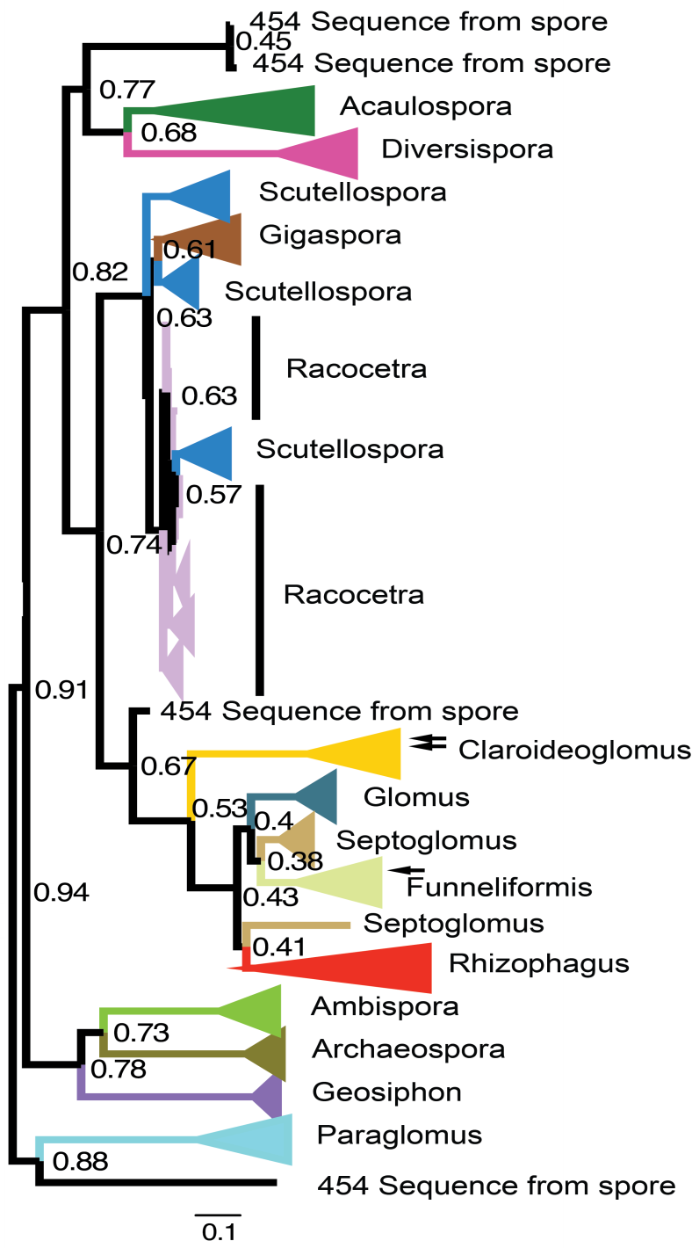
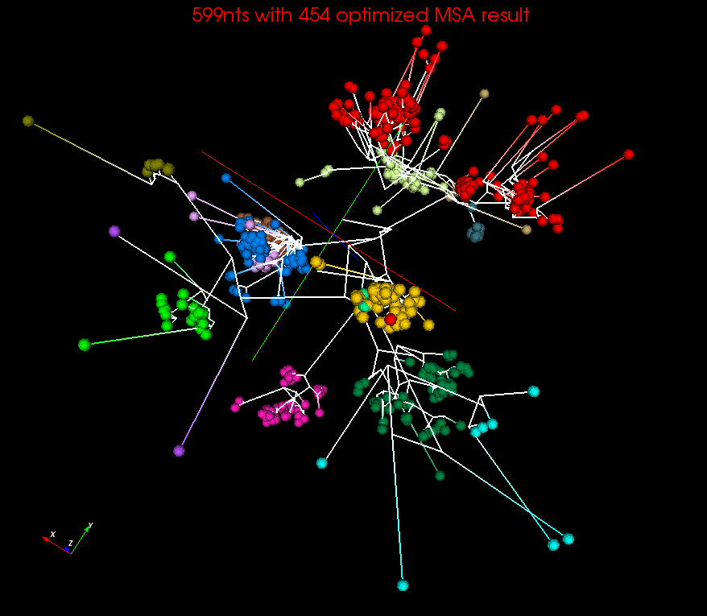
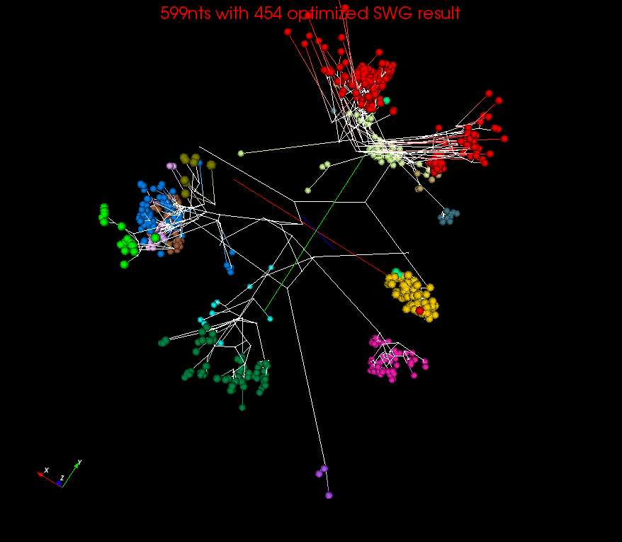
Spherical Phylograms
MSA
SWG
Spherical Phylogram visualized in PlotViz for MSA or SWG distances
RAxML result visualized in FigTree.

Slide 48
Quality of 3D Phylogenetic Tree
EM-SMACOF is basic SMACOF
LMA was previous best method using Levenberg-Marquardt nonlinear χ² solver
WDA-SMACOF finds best result
3 different distance measures
Sum of branch lengths of the Spherical Phylogram generated in 3D space on two datasets

Slide 49
Summary
Always run MDS. Gives insight into data and performance of machine learning
  Leads to a data browser as GIS gives for spatial data
  3D better than 2D
  ~20D better than MSA?
Clustering Observations
  Do you care about quality or are you just cutting up space into parts
  Deterministic Clustering always makes more robust
  Continuous clustering enables hierarchy
  Trimmed Clustering cuts off tails
  Distinct O(N) and O(N²) algorithms
Use Conjugate Gradient

Slide 50
Java Grande

Slide 51
Java Grande
We once tried to encourage use of Java in HPC with Java Grande Forum but Fortran, C and C++ remain central HPC languages.
  Not helped by .com and Sun collapse in 2000-2005
The pure Java CartaBlanca, a 2005 R&D100 award-winning project, was an early successful example of HPC use of Java in a simulation tool for non-linear physics on unstructured grids.
Of course Java is a major language in ABDS and as data analysis and simulation are naturally linked, should consider broader use of Java
Using Habanero Java (from Rice University) for Threads and mpiJava or FastMPJ for MPI, gathering collection of high performance parallel Java analytics
  Converted from C# and sequential Java faster than sequential C#
So will have either Hadoop+Harp or classic Threads/MPI versions in Java Grande version of Mahout

Slide 52
Performance of MPI Kernel Operations
Pure Java as in FastMPJ slower than Java interfacing to C version of MPI

Slide 53
Java Grande and C# on 40K point DAPWC Clustering
Very sensitive to threads v MPI
C# Hardware 0.7 performance Java Hardware
C#
Java
64 Way parallel
128 Way parallel
256 Way
parallel
TXP
Nodes
Total

Slide 54
Java and C# on 12.6K point DAPWC Clustering
Time hours
Java
C#
#Threads x #Processes per node
# Nodes
Total Parallelism
C# Hardware 0.7 performance Java Hardware
#Threads x #Processes per node
1x1
1x2
2x1
1x4
2x2
4x1
1x8
2x4
4x2
8x1

Slide 55
Data Analytics in SPIDAL

Slide 56
Analytics and the DIKW Pipeline
Data goes through a pipeline
Raw data → Data → Information → Knowledge → Wisdom → Decisions
Each link enabled by a filter which is “business logic” or “analytics”
We are interested in filters that involve “sophisticated analytics” which require non trivial parallel algorithms
  Improve state of art in both algorithm quality and (parallel) performance
Design and Build SPIDAL (Scalable Parallel Interoperable Data Analytics Library)
Data
Information
Analytics
Information
Knowledge
More Analytics

Slide 57
Strategy to Build SPIDAL
Analyze Big Data applications to identify analytics needed and generate benchmark applications
Analyze existing analytics libraries (in practice limit to some application domains) – catalog library members available and performance
  Mahout low performance, R largely sequential and missing key algorithms, MLlib just starting
Identify big data computer architectures
Identify software model to allow interoperability and performance
Design or identify new or existing algorithm including parallel implementation
Collaborate application scientists, computer systems and statistics/algorithms communities

Slide 58
Machine Learning in Network Science, Imaging in Computer Vision, Pathology, Polar Science, Biomolecular Simulations
Algorithm | Applications | Features | Status | Parallelism
Graph Analytics
Community detection | Social networks, webgraph | Graph . | P-DM | GML-GrC
Subgraph/motif finding | Webgraph, biological/social networks |  | P-DM | GML-GrB
Finding diameter | Social networks, webgraph |  | P-DM | GML-GrB
Clustering coefficient | Social networks |  | P-DM | GML-GrC
Page rank | Webgraph |  | P-DM | GML-GrC
Maximal cliques | Social networks, webgraph |  | P-DM | GML-GrB
Connected component | Social networks, webgraph |  | P-DM | GML-GrB
Betweenness centrality | Social networks | Graph, Non-metric, static | P-Shm | GML-GRA
Shortest path | Social networks, webgraph |  | P-Shm
Spatial Queries and Analytics
Spatial relationship based queries | GIS/social networks/pathology informatics | Geometric | P-DM | PP
Distance based queries |  |  | P-DM | PP
Spatial clustering |  |  | Seq | GML
Spatial modeling |  |  | Seq | PP
GML Global (parallel) ML
GrA Static GrB Runtime partitioning

Slide 59
Some specialized data analytics in SPIDAL
Algorithm | Applications | Features | Status | Parallelism
Core Image Processing
Image preprocessing | Computer vision/pathology informatics | Metric Space Point Sets, Neighborhood sets & Image features | P-DM | PP
Object detection & segmentation |  |  | P-DM | PP
Image/object feature computation |  |  | P-DM | PP
3D image registration |  |  | Seq | PP
Object matching |  | Geometric | Todo | PP
3D feature extraction |  |  | Todo | PP
Deep Learning
Learning Network, Stochastic Gradient Descent | Image Understanding, Language Translation, Voice Recognition, Car driving | Connections in artificial neural net | P-DM | GML
aa
PP Pleasingly Parallel (Local ML)
Seq Sequential Available
GRA Good distributed algorithm needed
Todo No prototype Available
P-DM Distributed memory Available
P-Shm Shared memory Available

Slide 60
Some Core Machine Learning Building Blocks
Algorithm | Applications | Features | Status | //ism
DA Vector Clustering | Accurate Clusters | Vectors | P-DM | GML
DA Non metric Clustering | Accurate Clusters, Biology, Web | Non metric, O(N²) | P-DM | GML
Kmeans; Basic, Fuzzy and Elkan | Fast Clustering | Vectors | P-DM | GML
Levenberg-Marquardt Optimization | Non-linear Gauss-Newton, use in MDS | Least Squares | P-DM | GML
SMACOF Dimension Reduction | DA- MDS with general weights | Least Squares, O(N²) | P-DM | GML
Vector Dimension Reduction | DA-GTM and Others | Vectors | P-DM | GML
TFIDF Search | Find nearest neighbors in document corpus | Bag of “words” (image features) | P-DM | PP
All-pairs similarity search | Find pairs of documents with TFIDF distance below a threshold
 |  |  | Todo | GML
Support Vector Machine SVM | Learn and Classify | Vectors | Seq | GML
Random Forest | Learn and Classify | Vectors | P-DM | PP
Gibbs sampling (MCMC) | Solve global inference problems | Graph | Todo | GML
Latent Dirichlet Allocation LDA with Gibbs sampling or Var. Bayes | Topic models (Latent factors) | Bag of “words” | P-DM | GML
Singular Value Decomposition SVD | Dimension Reduction and PCA | Vectors | Seq | GML
Hidden Markov Models (HMM) | Global inference on sequence models | Vectors | Seq | PP & GML

Slide 61
Some Futures
Always run MDS. Gives insight into data
  Leads to a data browser as GIS gives for spatial data
Claim is algorithm change gave as much performance increase as hardware change in simulations. Will this happen in analytics?
  Today is like parallel computing 30 years ago with regular meshs. We will learn how to adapt methods automatically to give “multigrid” and “fast multipole” like algorithms
Need to start developing the libraries that support Big Data
  Understand architectures issues
  Have coupled batch and streaming versions
  Develop much better algorithms
Please join SPIDAL (Scalable Parallel Interoperable Data Analytics Library) community

