Slide 1





NSF 1443054: CIF21 DIBBs: Middleware and High Performance Analytics Libraries for Scalable Data Science
Software: MIDAS
HPC-ABDS
Harp HPC for Big Data
February 2017

Slide 2
Harp (Hadoop Plugin) Implementations
Basic Harp: Iterative HPC communication; scientific data abstractions
Careful support of distributed data AND distributed model
Avoids parameter server approach but distributes model over worker nodes and supports collective communication to bring global model to each node
Applied first to Latent Dirichlet Allocation LDA with large model and data
HPC into Programming/communication Layer

Slide 3
Harp (Hadoop Plugin) brings HPC to ABDS
Judy Qiu: Iterative HPC communication; scientific data abstractions
Careful support of distributed data AND distributed model
Avoids parameter server approach but distributes model over worker nodes and supports collective communication to bring global model to each node
Have also added HPC to Apache Storm and Heron; working on adding Parallel Computing Runtime to Distributed computing model built into Apache Spark, Flink, Beam
MapReduce Model
MapCollective Model
MapReduce Applications
MapCollective Applications
M
M
M
M
M
M
M
M
MapReduce V2
Harp
Shuffle
Collective Communication
R
R
YARN

Slide 4
Model-Centric Data Analytics

Slide 5
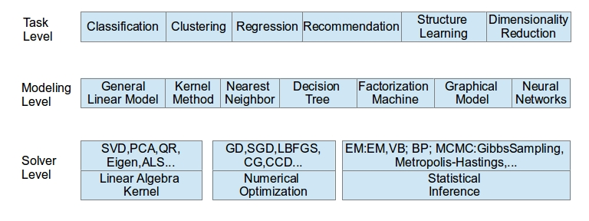
Taxonomy of Machine Learning Algorithms
Task level: describe functionality of the algorithm
Modeling level: the form and structure of model
Solver level: the computation pattern of training

Slide 6
Candidate Algorithms
Selection Criterion
  importance
  diversity in model structure and computation pattern
Selection List (all included in Harp Tutorial except the green ones)
  1. MB_KMeans: minibatch K-Means
  2. LR: Logistic Regression
  3. Lasso: linear regression with L1 regularizer
  4. SVM: support vector machine
  5. FM: Factorization Machine
  6. CRFs: conditional random fields
  7. NN: neural networks
  8. ID3/C4.5, RF: decision tree, random forest
  9. LDA: latent dirichlet allocation
  10. KNN: K-nearest neighbor

Slide 7
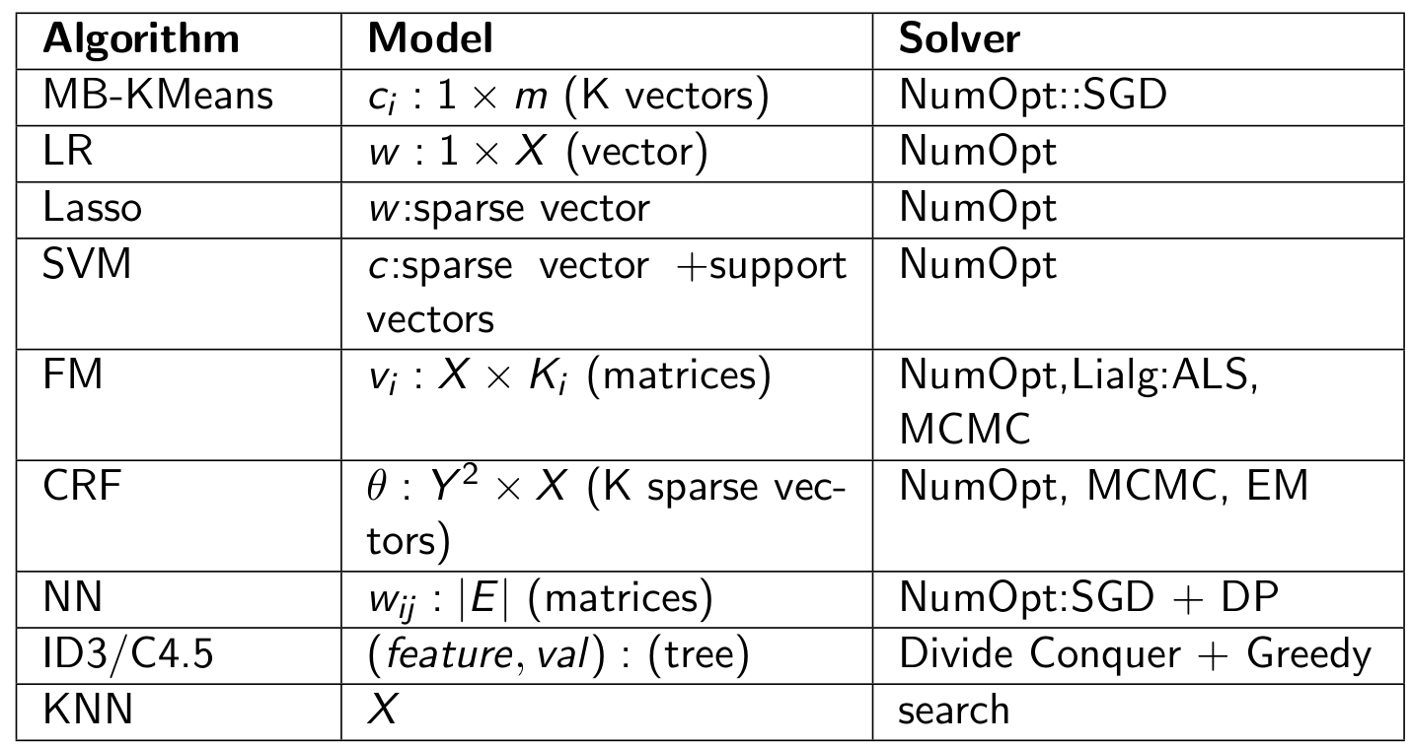
Summary of the Algorithm Candidates
We investigated different computation and communication patterns of important machine learning algorithms

Slide 8
Harp

Slide 9
Outline
Harp Overview
Collective Computation Operations
Computation Models
Programming Paradigm
Machine Learning Parallelization
Model Rotation Framework
Schedulers
Architecture
Data Interfaces

Slide 10
Harp Programming Paradigm
MapReduce
MapCollective
Input Splits
Input Splits
M
M
M
M
M
M
M
M
K-V
K-V
K-V
K-V
Partitioned Distributed Dataset
Shuffle
P
K-V
K-V
P
P
R
R
P
Collective Communication
Notes:
This slide shows the change of programming paradigm from MapReduce to MapCollective.
MapReduce uses key-value pairs and shuffling.
MapCollective uses partitioned distributed dataset and collective communication operation.

Slide 11
Harp Architecture
MapReduce Applications
MapCollective Applications
Application
Harp
MapReduce V2
Framework
YARN
Resource Manager
Notes:
Harp architecture in the Hadoop cluster

Slide 12
Execute MapCollective Jobs through Harp on Hadoop Cluster
YARN Resource Manager
I. Launch AppMaster
II. Launch
Tasks
Client
MapCollective
AppMaster
CollectiveMapper
2. Read key-value pairs
MapCollective
Container
Allocator
setup
MapCollective Runner
mapCollective
3. Invoke collective communication APIs
MapCollective
Container
Launcher
cleanup
4. Write output to HDFS
1. Record Map task locations from original MapReduce AppMaster
Notes:
How MapCollective jobs run with Harp on Hadoop

Slide 13
Harp Features
Abstraction
Distributed computing
Management
Data
Computation
Collective
Dynamic scheduler
Arrays & Objects
Pool-based
Event-driven
Multi-threading
Partitions & Tables
Static scheduler
Schedulers
Notes:
This slide is an overview of Harp features.
For data, it uses array/object + partition/table hierarchical abstractions, and pool based management for data allocation.
For distributed computation, it uses collective communication operations and event driven (not focused in the slides) APIs for data exchange.
For multithreading computation within one node, two schedulers are equipped.

Slide 14
Data Interfaces
Arrays & Objects
Primitive Arrays
ByteArray, ShortArray, IntArray, FloatArray, LongArray, DoubleArray
Serializable Objects
Writable
Partitions & Tables
Partition
An array/object with partition ID
Table (local partition container)
Key-Value Table: key-based automatic partitioning
Partitions with the same IDs are combined
Notes:
Hierarchical data abstraction

Slide 15
An Example of Partition & Table
Process 0
Table<DoubleArray> table = new Table<>(0, new DoubleArrPlus());
for (int i = 0; i < numPartitions; i++) {
DoubleArray array = DoubleArray.create(size, false);
table.addPartition(new Partition<>(i, array));
}
Table
Partition 0
Partition 1
public class DoubleArrPlus extends PartitionCombiner<DoubleArray> {
public PartitionStatus combine(DoubleArray curPar, DoubleArray newPar) {
double[] doubles1 = curPar.get(); int size1 = curPar.size();
double[] doubles2 = newPar.get(); int size2 = newPar.size();
if (size1 != size2) {
return PartitionStatus.COMBINE_FAILED;
}
for (int i = 0; i < size2; i++) {
doubles1[i] = doubles1[i] + doubles2[i];
}
return PartitionStatus.COMBINED;
}
}
Partition 2
Partition 3
Notes:
This slide shows an example of using partitions and tables.
User can create a table and add partitions into it.
Each partition has an ID and an array/object.

Slide 16
Computation Interfaces
Collective
broadcast
Event Driven
reduce
allgather
allreduce
regroup
pull & push
rotate
getEvent
waitEvent
sendEvent
Scheduler
DynamicScheduler
StaticScheduler
Notes:
Collective/event-driven operations and scheduler components used for computation

Slide 17
Collective Communication Operations
Collective Communication Operations | Description
broadcast | The master worker broadcasts the partitions to the tables on other workers.
reduce | The partitions from all the workers are reduced to the table on the master worker.
allreduce | The partitions from all the workers are reduced in tables of all the workers.
allgather | Partitions from all the workers are gathered in the tables of all the workers.
regroup | Regroup partitions on all the workers based on the partition ID.
push & pull | Partitions are pushed from local tables to the global table or pulled from the global table to local tables.
rotate | Build a virtual ring topology, and rotate partitions from a worker to a neighbor worker.
Notes:
Explanation of collective communication operations

Slide 18
Multi-Threading Schedulers
(A) Dynamic Scheduler
(B) Static Scheduler
I
I
I
I
I
I
Thread
Thread
Thread
Thread
Thread
Thread
I
I
I
I
O
O
O
O
O
O
Notes:
The difference between dynamic schedulers and static schedulers.
The details are explained in the next slides.

Slide 19
Multi-Threading Schedulers cont’d
(A) Dynamic Scheduler
All the inputs are submitted to one queue.
Threads dynamically fetch inputs from the queue.
Outputs are retrieved from the output queue.
(B) Static Scheduler
Each thread has its own input queue and output queue.
Each thread can submit inputs to another thread.
Outputs are retrieved from each task’s output queue.

Slide 20
Parallelization of Machine Learning Applications
Machine Learning Application
Machine Learning Algorithm
Programming Interface
Computation Model
Implementation
Notes:
Basic steps in parallelizing machine learning applications

Slide 21
Computation Models
Computation Models are used to describe the parallelization patterns of the parallel machine learning applications.
A computation model can be used to describe the synchronization patterns between processes in a distributed environment or threads in a multi-threading environment.
Computation model composition is allowed when parallelizing machine learning algorithms with one computation model in the multi-process parallelization and another computation model in the multi-thread parallelization.
Notes:
A key step when parallelizing machine learning applications is to choose computation models.
Computation models describe the synchronization patterns of parallel model updates.

Slide 22
Inter/Intra-node Computation Models
(A)
(B)
Model
Model1
Model2
Model3
Process/Thread
Process/Thread
Process/Thread
Process/Thread
Process/Thread
Process/Thread
Synchronized algorithm
The latest model
Synchronized algorithm
The latest model
(C)
(D)
Model
Model
Process/Thread
Process/Thread
Process/Thread
Process/Thread
Process/Thread
Process/Thread
Synchronized algorithm
The stale model
Asynchronous algorithm
The stale model
Notes:
Illustrations of four computation models
Detailed explanations are seen in the next slide.

Slide 23
Computation Model Description
Computation Model A
Once a process/thread trains a data item, it locks the related model parameters and prevents other processes from accessing them. When the related model parameters are updated, the process/thread unlocks the parameters. Thus the model parameters used in local computation is always the latest.
Computation Model B
Each process/thread first takes a part of the shared model and performs training. Afterwards, the model is shifted. Through model rotation, each model parameters are updated by one process/thread at a time so that the model is consistent.
Computation Model C
Each process/thread first fetches all the model parameters required by local computation. When the local computation is completed, modifications of the local model from all processes/threads are gathered to update the model.
Computation Model D
Each process/thread independently fetches related model parameters, performs local computation, and returns model modifications. Unlike A, processes/threads are allowed to fetch or update the same model parameters in parallel. In contrast to B and C, there is no synchronization barrier.

Slide 24
Model Rotation Framework
Higher level programming interfaces based on model rotation computation model are designed.
Several algorithms are benefitted from Computation Model B.
  Algorithms
    Collapsed Gibbs Sampling for Latent Dirichlet Allocation
    Stochastic Gradient Descent for Matrix Factorization
    Cyclic Coordinate Descent for Matrix Factorization
  The latest model update result in most effective model update
  The communication routine in model rotation can be easily optimized to reduce the synchronization overhead
Notes:
From the concepts of computation models, a model rotation framework is introduced
which provides higher level programming interfaces
to program machine learning applications with model rotation.

Slide 25
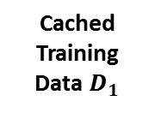
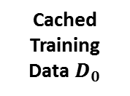



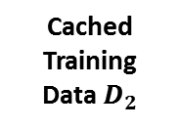
Model Rotation Execution Flow
3
Iteration Control
2
Rotate Model
Worker 0
Worker 1
Worker 2
Model $A_{0}^{t_{i}}$
Model $A_{1}^{t_{i}}$
Model $A_{2}^{t_{i}}$
Cached Training Data $D_{0}$
Cached Training Data $D_{1}$
Cached Training Data${ D}_{2}$
1
Local Compute
Load & Initialize
Training Data $D$ on HDFS
Notes:
Execution flow chart of model rotation

Slide 26
Pipelining and Dynamic Rotation Control
Pipelined model rotation
  Overlap the time spent in the computation and the communication to reduce the synchronization overhead.
  Works on CGS for LDA, SGD for MF and CCD for MF
Dynamic Rotation Control
  The time point of model rotation in some algorithms can be adjusted by the timer
    Balance the computation load on each machine
    Prioritize important model parameter update
  Works on CGS for LDA and SGD for MF
Notes:
Pipelined model rotation and dynamic rotation control are two mechanisms introduced in the model rotation framework.

Slide 27


























Pipelined Model Rotation
Model $A_{∗a}$
Model $A_{∗b}$
Worker 0
Compute
Worker 1
Compute
Worker 2
Compute
Model $A_{0a}$
Model $A_{1a}$
Model $A_{2a}$
Time
Model $A_{0b}$
Model $A_{1b}$
Model $A_{2b}$
Model $A_{2a}$
Model $A_{0a}$
Model $A_{1a}$
Model $A_{2b}$
Model $A_{0b}$
Model $A_{1b}$
Model $A_{1a}$
Model $A_{2a}$
Model $A_{0a}$
Model $A_{1b}$
Model $A_{2b}$
Model $A_{0b}$
Model $A_{0a}$
Model $A_{1a}$
Model $A_{2a}$
Model $A_{0b}$
Model $A_{1b}$
Model $A_{2b}$
Shift
Shift
Shift
Notes:
The execution flow of pipelined model rotation

Slide 28
Local Parameter Update Scheduling and Timer based Rotation Control
Model Parameters
From Rotation
Model Related Training Data
Computes with multi-threading until the time arrives, then starts model rotation
Other Model Parameters
From Caching
Notes:
In multi-threading, model rotation is also chosen to perform model computation.
This figure shows how the computation is scheduled.
Each time a set of training data and model parameters are scheduled to a thread without model update conflict.

Slide 29
Training Dataset
LDA Dataset | Documents | Words | Tokens | CGS Parameters
clueweb1 | 76,163,963 | 999,933 | 29,911,407,874 | K = 10000 α = 0.01 β = 0.01
MF Dataset | Rows | Columns | Non-Zero Elements | SGD Parameters | CCD Parameters
clueweb2 | 76,163,963 | 999,933 | 15,997,649,665 | K = 2000 λ = 0.01 ε = 0.001 | K = 120 λ = 0.1
Notes:
The training dataset used in the experiments to show the performance of the model rotation framework.

Slide 30
Test Plan
Dataset | Node Type
 | Xeon E5 2699 v3 (each uses 30 Threads) | Xeon E5 2670 v3 (each uses 20 Threads)
clueweb1 | Harp CGS vs. Petuum (30 nodes) | Harp CGS vs. Petuum (60 nodes)
clueweb2 | Harp SGD vs. NOMAD (30 nodes) Harp CCD vs. CCD++ (30 nodes) | Harp SGD vs. NOMAD (60 nodes) Harp CCD vs. CCD++ (60 nodes)
Existing leading Implementation in the Field | References
Petuum LDA from CMU | https://github.com/petuum/strads/tree/master/apps/lda_release
NOMAD from Purdue and UT Austin | http://bikestra.github.io/
CCD++ from UT Austin | http://www.cs.utexas.edu/~rofuyu/libpmf/
Notes:
Test plan (Juliet Intel Haswell cluster) and the related implementations compared

Slide 31
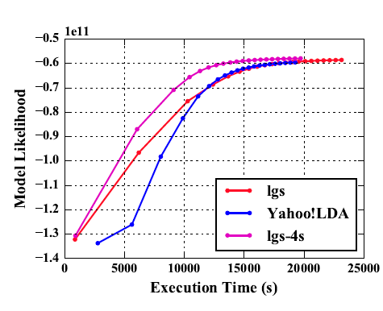
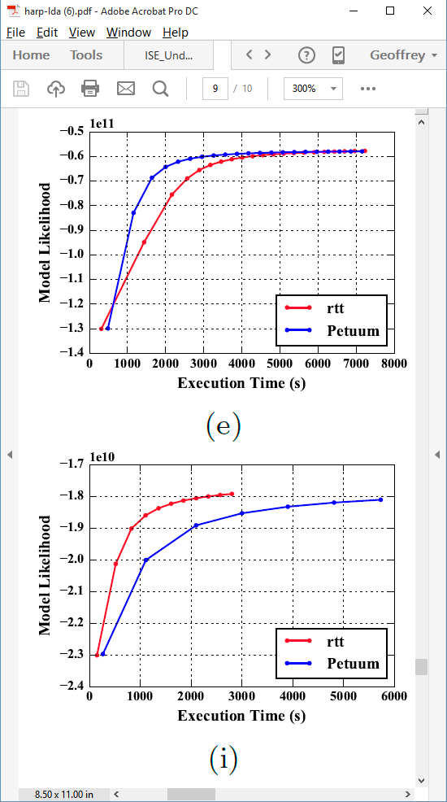
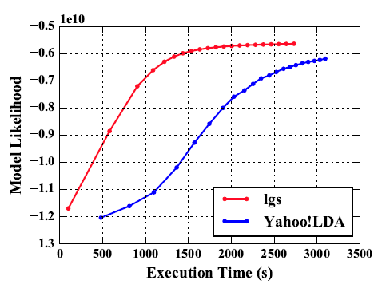
Latent Dirichlet Allocation on 100 Haswell nodes: red is Harp (lgs and rtt)
Clueweb
Clueweb
enwiki
Bi-gram

Slide 32
Collapsed Gibbs Sampling for Latent Dirichlet Allocation
45% faster
18% faster
Notes:
The execution time comparison between Harp and Petuum when the model is converged

Slide 33
Stochastic Gradient Descent for Matrix Factorization
58% faster
93% faster
Notes:
The execution time comparison between Harp and NOMAD when the model is converged

Slide 34
Cyclic Coordinate Descent for Matrix Factorization
53% faster
101% faster
Notes:
The execution time comparison between Harp and CCD++ when the model is converged

Slide 35
Harp-DAAL

Slide 36
Harp-DAAL: A Fast Machine Learning Framework
Harp
1. Java API
2. Local computation: Java threads
3. Communication: Collective MapReduce
DAAL
1. Java & C++ API
2. Local computation: MKL, TBB
3. Communication: MPI & Hadoop & Spark
Harp-DAAL
1. Java API
2. Local Computation: DAAL
3. Communication: Collective MapReduce

Slide 37
Harp-DAAL in the complete HPCCloud Stack
Harp-DAAL is at the intersection of
HPC and Big Data stacks, which requires:
Interface: User friendly, consistent with other Java written Data analytics Apps.
Low level Kernels: highly optimized for HPC platforms such as many-core arch
Models: inherit Harp’s computation models for different ML algorithms

Slide 38
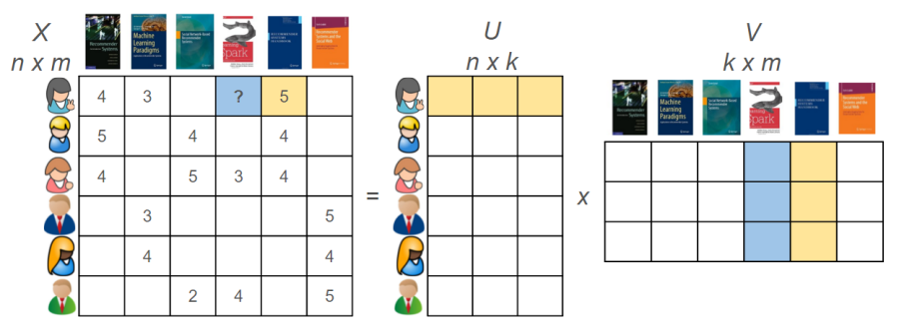
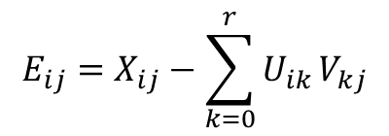



Matrix-Factorization Based on SGD (MF-SGD)
X$=UV$
Decompose a large matrix into two model matrices, used in Recommender systems
$$E_{ij}=X_{ij}−\sum_{k=0}^{r}{U_{ik}}V_{kj}$$
$$\left.U_{i∗}^{t}=U_{i∗}^{t−1}−η(E_{ij}^{t−1}⋅V_{∗j}^{t−1}−λ⋅U_{i∗}^{t−1}\right)$$
Large Training Data: Tens of millions of points
Large Model Data: m, n could be millions
Random Memory Access Pattern in Training
$$\left.V_{∗j}^{t}=V_{∗j}^{t−1}−η(E_{ij}^{t−1}⋅U_{i∗}^{t−1}−λ⋅V_{∗j}^{t−1}\right)$$

Slide 39
Intra-node Performance: DAAL-MF-SGD vs. LIBMF
LIBMF: a start-of-art open source MF-SGD package
Only single node mode
Highly optimized for memory usage
We compare our DAAL-MF-SGD kernel with LIBMF on a single KNL node, using Yahoomusic dataset
DAAL-MF-SGD delivers a comparable training time for each Iteration with that of LIBMF
DAAL-MF-SGD has a better convergence speed than LIBMF, using less iterations to achieve the same convergence.

Slide 40
Intra-node Performance: Haswell Xeon vs. KNL Xeon Phi
KNL has
3x speedup from vectorization
1.5x – 4x speedup compared to Haswell
DAAL-MF-SGD has a better performance on KNL than on Haswell CPU, because it benefits from
KNL’s AVX512 vectorization
High Memory Bandwidth

Slide 41
Inter-node Performance: Harp-DAAL-SGD vs. Harp-SGD
Inter-node test is done on two Haswell E5-2670 v3 2.3GHz nodes. We uses two datasets
MovieLens, a small set with 9301274 points
Yahoomusic a large set with 252800275 points
For both datasets, we have around 5% to 15% speedup by using DAAL-SGD within Harp.
There is still some overhead of interfacing DAAL and Harp, which requires future investigation

Slide 42
Interface Overhead between DAAL and Harp
We decompose the training time into different phases.
There are two overhead of interface
Harp-DAAL Interface
  Conversion between data structures
JNI interface
  Data movement from Java heap to out-of-heap buffer for C++ native kernels in DAAL
The two overheads could take up to 25% of the total training time, which must be optimized in the future work.
Rewrite some Harp codes to create shared memory space between DAAL and Harp
Add more Harp compatible data structures to DAAL

Slide 43
Harp Tutorial

Slide 44
Harp Tutorial: K-means Clustering
MapCollective Steps
1. Read point data from point files
2. Load/Generate centroids
3. Find the nearest centroids
4. Update the centroids
Load points
M
M
M
M
Initialize K centroids
Calculate local point assignment
Generate new centroids

Slide 45
Choose Collective Communication Operation
If each mapper has an copy of the centroids…
1. Use “allreduce” operation
  allreduce("main", "allreduce_" + iter, cenTable);
2. Use “broadcast & reduce” operation
  reduce("main", "reduce_"+iter, cenTable, getMasterID());
  if (isMaster()) {calculateCentroids(cenTable);}
  broadcast("main", "bcast_"+iter, cenTable, getMasterID(), false);
3. Use “regroup & allgather” operation
  regroup("main", "regroup_" + iter, cenTable, null);
  calculateCentroids(cenTable);
  allgather("main", "allgather_" + iter, cenTable);
4. Use “push & pull” operation
  push("main", "push_"+iter, cenTable, globalTable, new Partitioner(getNumWorkers()));
  calculateCentroids(globalTable);
  pull("main", "pull_"+iter, cenTable, globalTable, true);

Slide 46
Choose Collective Communication Operation cont’d
If the centroids are distributed across mappers…
1. Use “rotate” operation
for (int i = 0; i < numIterations; i++) {
// Expectation
for (int j = 0; j < getNumWorkers(); j++) {
// Retrieve a part of centroids and update the nearest centroids
// assignment
expectationCompute(cenTable);
rotate("kmeans", "exp-rotate-" + i + "-" + j, cenTable, null);
}
// Maximization
for (int j = 0; j < getNumWorkers(); j++) {
// Update point summation on each new centroids
maximizationCompute(cenTable);
rotate("kmeans", "max-rotate-" + i + "-" + j, cenTable, null);
}
calculateCentroids(cenTable);
}

Slide 47
Tutorial Links
K-means
  https://dsc-spidal.github.io/Harp/docs/examples/kmeans/
  Allreduce
  https://dsc-spidal.github.io/Harp/docs/examples/allreducekmeans/
  Broadcast & Reduce
  https://dsc-spidal.github.io/Harp/docs/examples/bcastreducekmeans/
  Regroup & Allgather
  https://dsc-spidal.github.io/Harp/docs/examples/regroupallgatherkmeans/
  Push & Pull
  https://dsc-spidal.github.io/Harp/docs/examples/pushpullkmeans/

Slide 48
Tutorial Links cont’d
Latent Dirichlet Allocation
  https://dsc-spidal.github.io/Harp/docs/examples/latentdirichletallocation/
Multiclass Logistic Regression
  https://dsc-spidal.github.io/Harp/docs/examples/mlrsgd/
Support Vector Machine
  https://dsc-spidal.github.io/Harp/docs/examples/svm/

